Slide 1
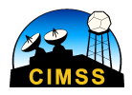
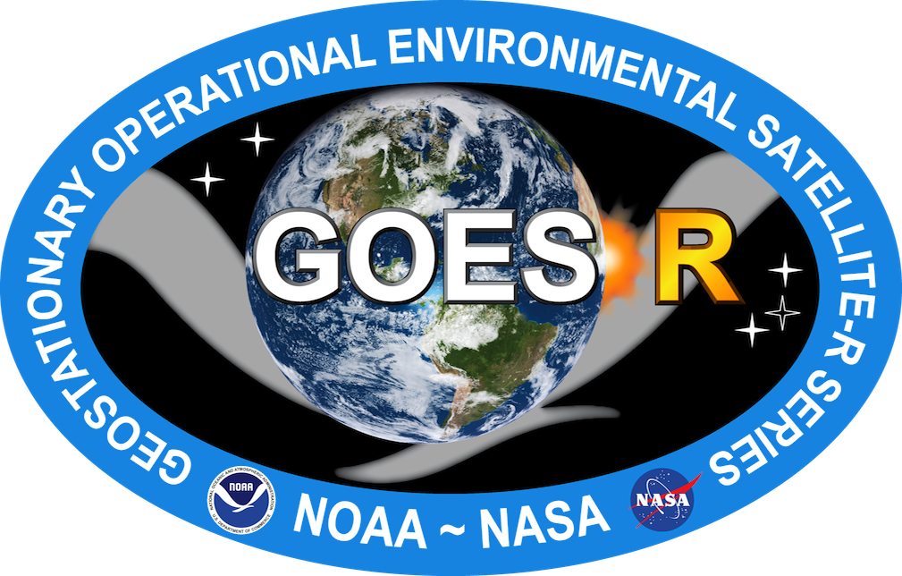
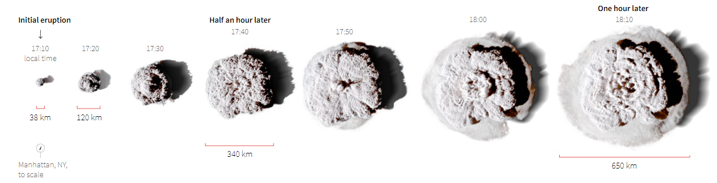
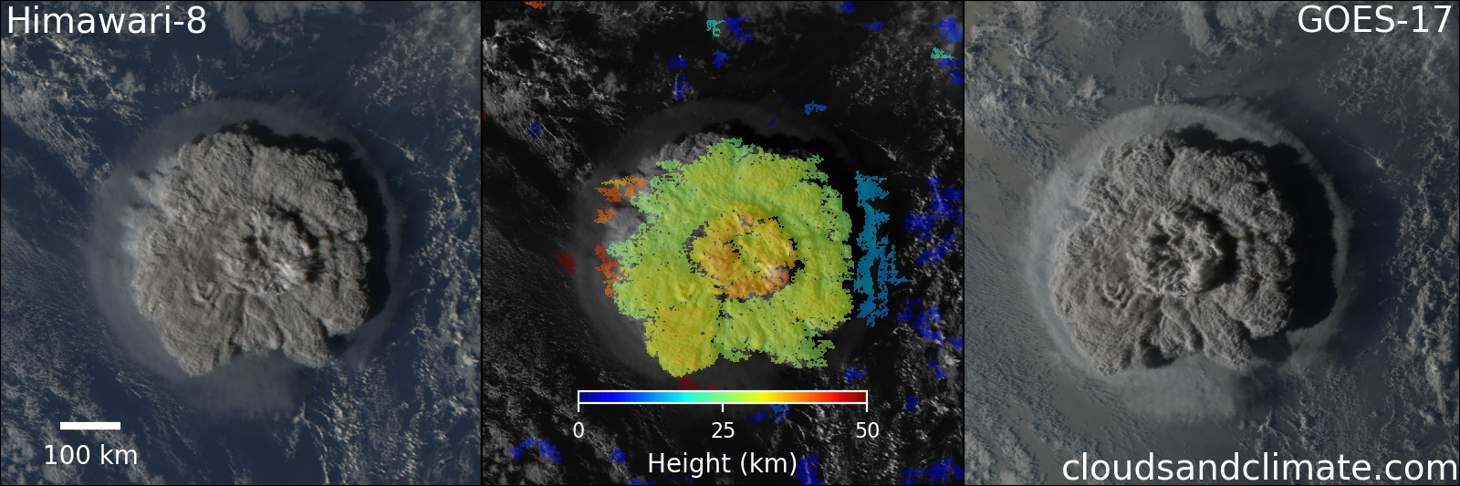
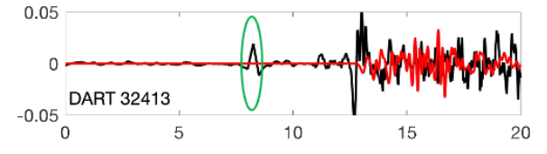
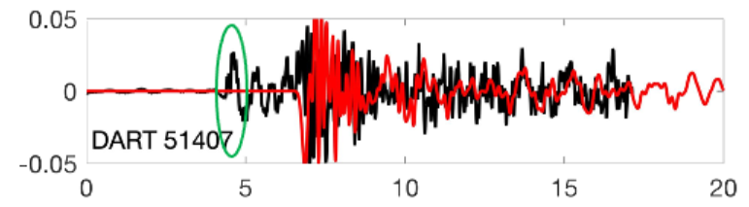
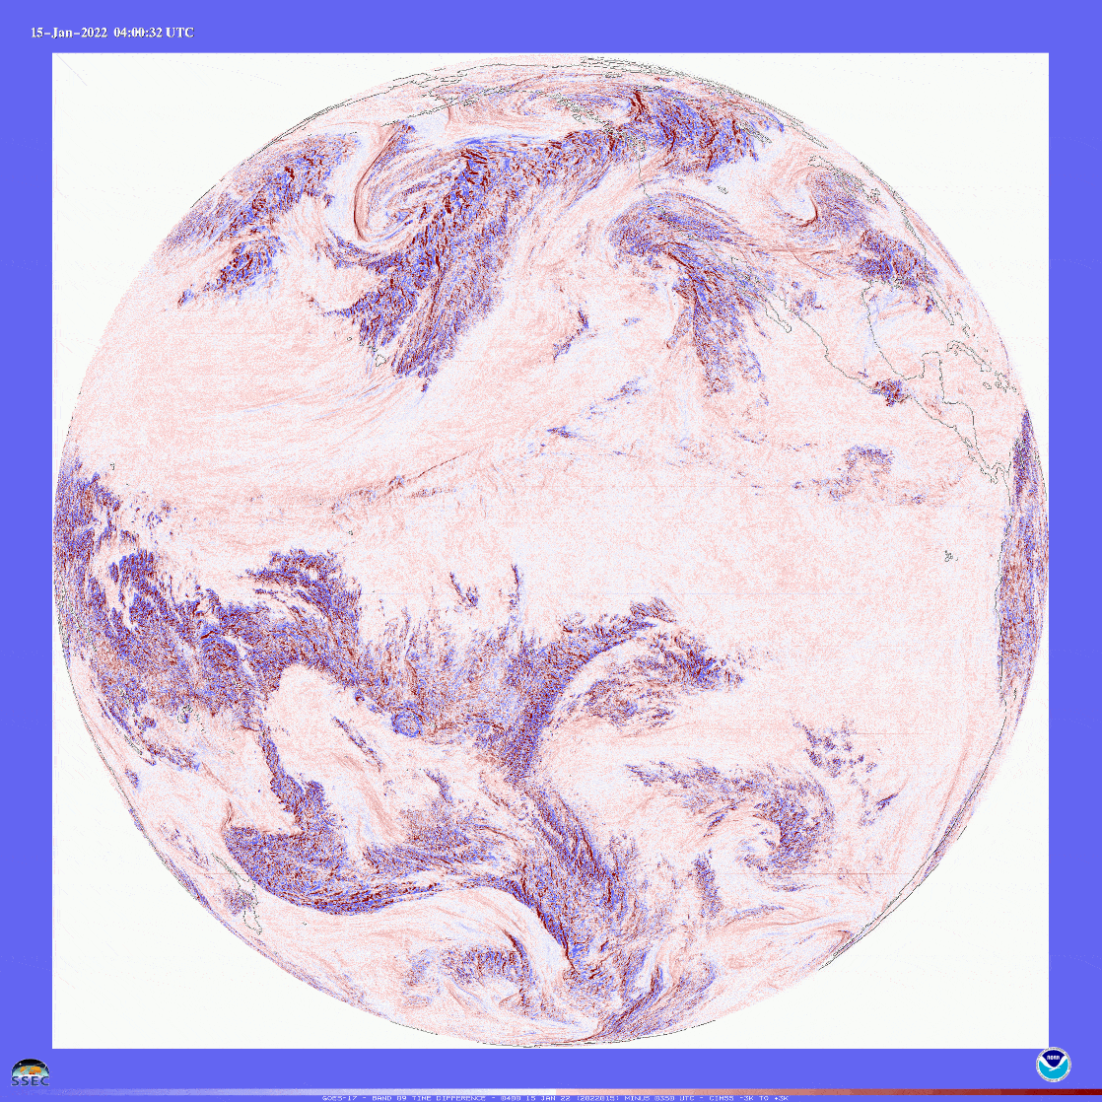
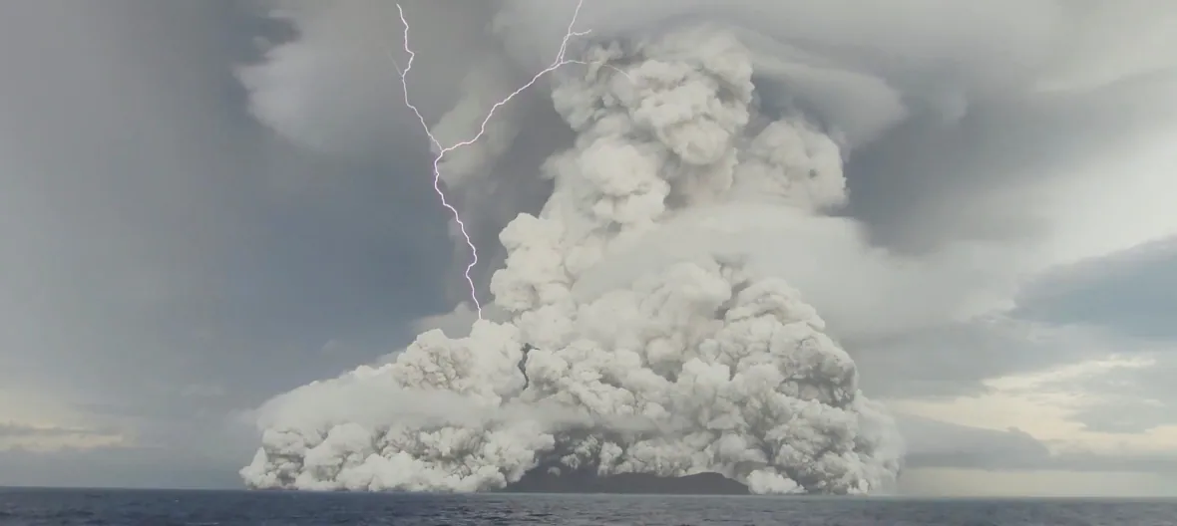
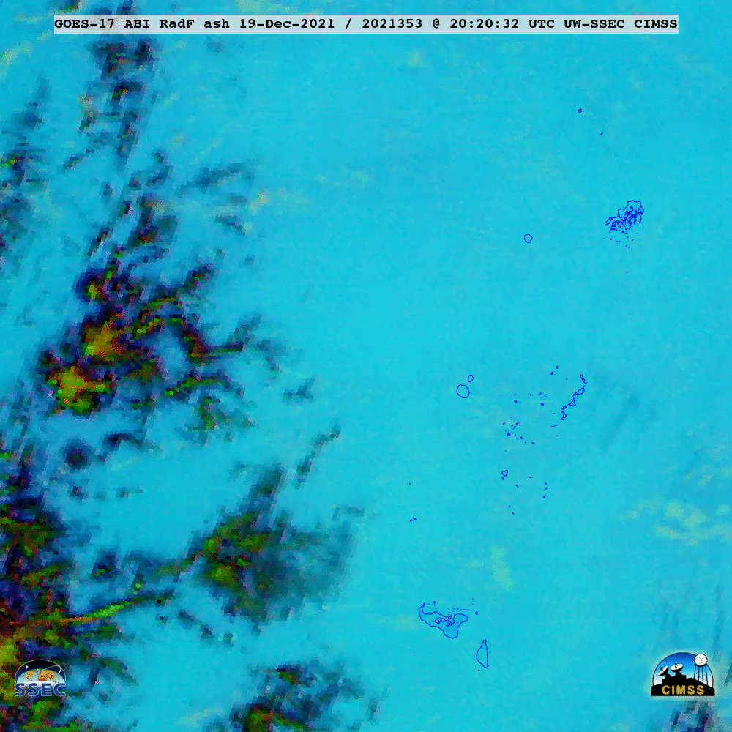
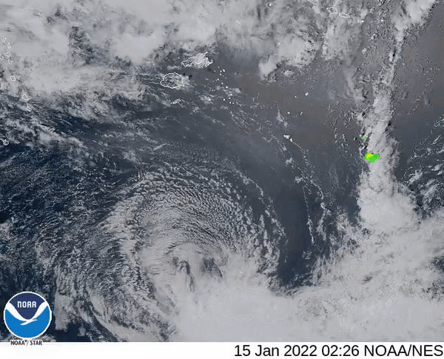
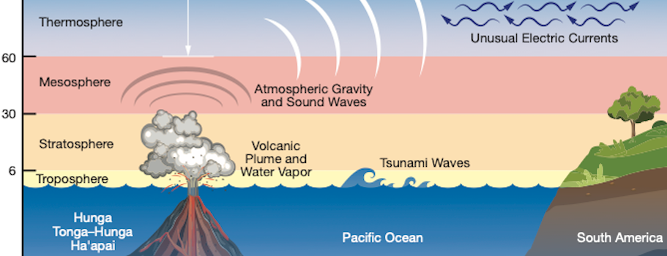
Hunga-Tonga: Studying the Hazards Posed by Volcanic Eruptions with GOES-17
Timothy Cai
Centennial High School, Ellicott City, MD
ABSTRACT
RESEARCH with Satellite Images, ABI Bands, and GLM
RESULTS and CONCLUSIONS
From December 2021 to January 2022, the Hunga Tonga–Hunga Ha’apai volcano erupted three times. The last eruption propelled its plume of ash, tephra, and gases into the mesosphere 58 km above the Earth’s surface, caused thousands of lightning strikes, and sent two different types of tsunamis around the globe. I used GOES-17’s ABI and GLM to gather crucial information about multiple hazards generated by the December 20 and January 15 eruptions. My research will determine the capacity of ABI and GLM in the GOES-R series to rapidly detect and monitor volcanic eruptions and the hazards that they produce.
A
The expansion of the volcanic umbrella cloud
Results:
ABI’s “Red” visual band (0.64 µm) provided an accurate measurement of the volcanic cloud’s size and height as time progressed, which was made possible by its high spatial and temporal resolution
The 6.9 µm water vapor band recorded the atmospheric shockwave that spread worldwide from the center of the eruption, which caused a classical tsunami and fast meteotsunami, as detected by the DART data:
Unfortunately, GLM was unable to detect most of the lightning because of heavy ash and smoke cover
AshRGB images were able to measure SO₂ and volcanic ash emitted in the plume during the December eruption
Conclusions:
When combined with its high observation frequency, GOES-17’s varied toolkit was capable of delivering excellent insight into a volcanic eruption as it happened. Multiple ABI bands worked independently and collaboratively to collect information about the volcanic cloud, shockwave, ash, and SO₂ emissions.
B
Stereoscopic 3D model of umbrella cloud
https://graphics.reuters.com/TONGA-VOLCANO/lgpdwjyqbvo/
Peru
Hawaii
https://www.cloudsandclimate.com/blog/hunga_tonga_eruption/
C
Shockwaves
(A-B) Umbrella cloud diameter measured by GOES-17 ABI alone (A); height estimated with GOES-17 ABI and Himawari-8 AHI (B); 0.64 µm visible band used for its high spatial resolution (500 m)
(C) Volcanic shockwaves observed with 6.9 µm mid-level tropospheric water vapor band because of its higher sensitivity than the upper- and lower-level water vapor bands (6.2 and 7.3 µm)
(D) Volcanic ash and sulfur dioxide emissions visualized with AshRGB;
ash plumes indicated by red (band difference between 12.3 and 10.3 µm); sulfur dioxide indicated by green (band difference between 11.2 and 8.4 µm)
(E) Lightning activity observed with Geostationary Lightning Mapper (GLM)
Jan 15 eruption (Tonga Geological Services)
RESEARCH QUESTION
https://commons.wikimedia.org/wiki/File:Shockwave_from_Hunga_Tonga_GOES_17.gif
References
How can GOES-17 be used to study the hazards posed by volcanic eruptions?
Graphical Abstract:
https://www.nasa.gov/feature/goddard/2022/sun/nasa-mission-finds-tonga-volcanic-eruption-effects-reached-space
GOES ABI Band Information:
https://www.goes-r.gov/mission/ABI-bands-quick-info.html
GOES AshRGB Quick Guide: https://rammb.cira.colostate.edu/training/visit/quick_guides/GOES_Ash_RGB.pdf
DART data: https://nctr.pmel.noaa.gov/tonga20220115/
CIMSS Satellite Blog.: https://cimss.ssec.wisc.edu/satellite-blog/
Andrews, R. (2022, January 25). Tonga shock wave created tsunamis in two different oceans. Science. https://www.science.org/content/article/tonga-shock-wave-created-tsunamis-two-different-oceans
D
Ash and sulfur dioxide
E
Lightning activity
Miles
https://cimss.ssec.wisc.edu/satellite-blog/archives/43894
https://twitter.com/goesglm/status/1482374849070784512
Notes:
‹#›

