Slide 1

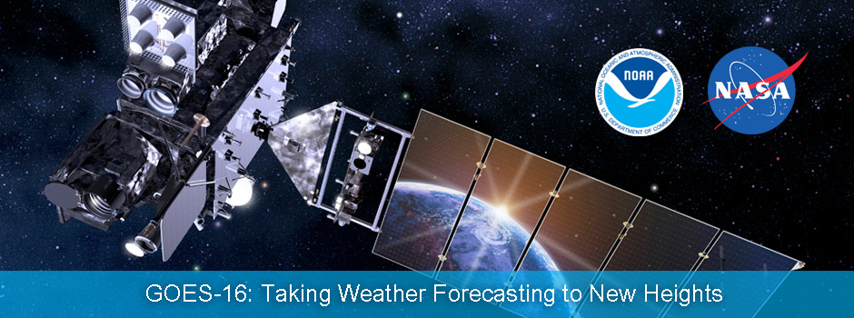
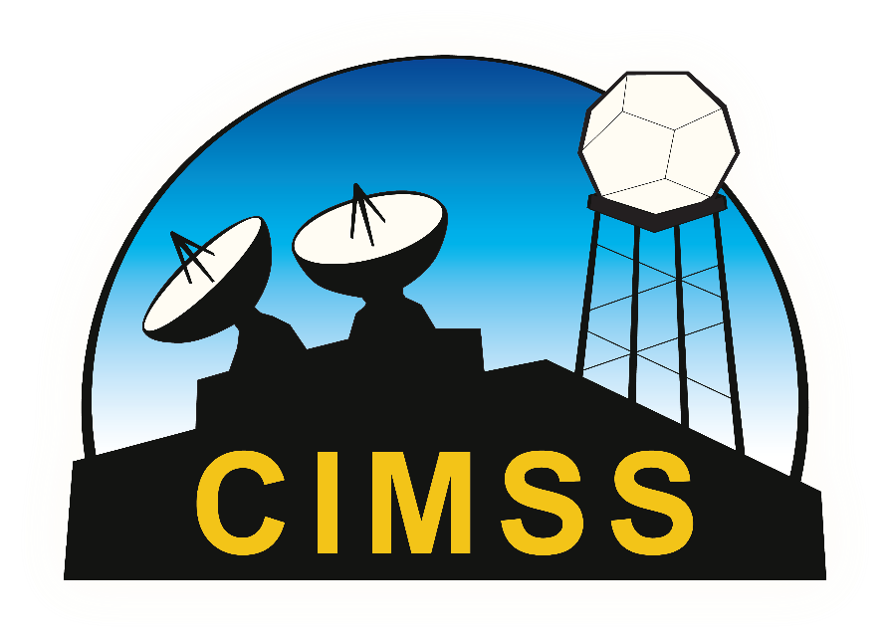
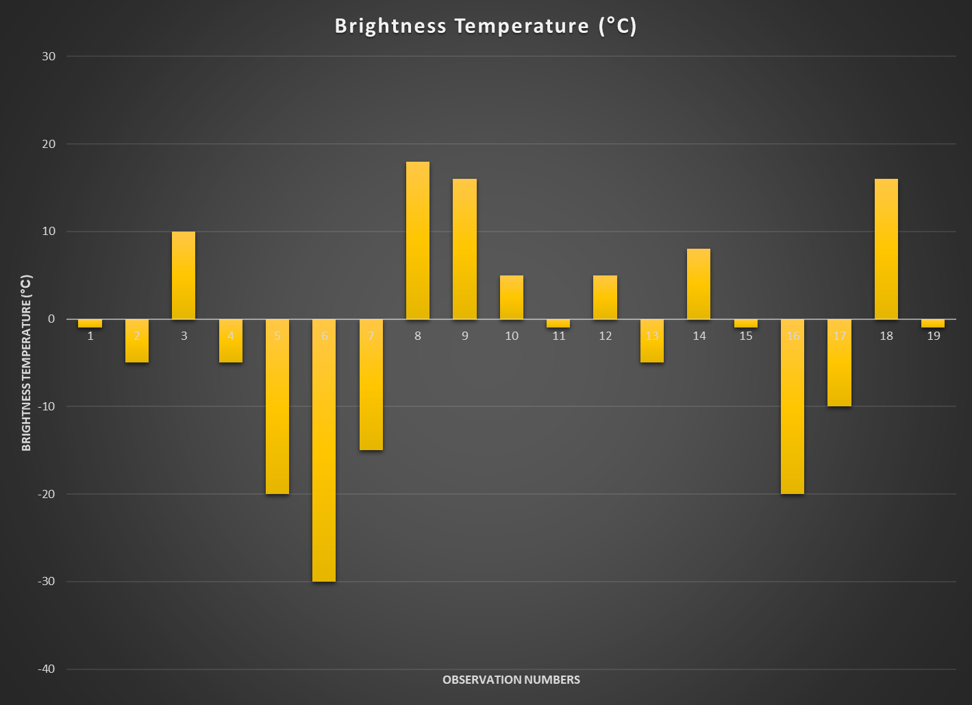
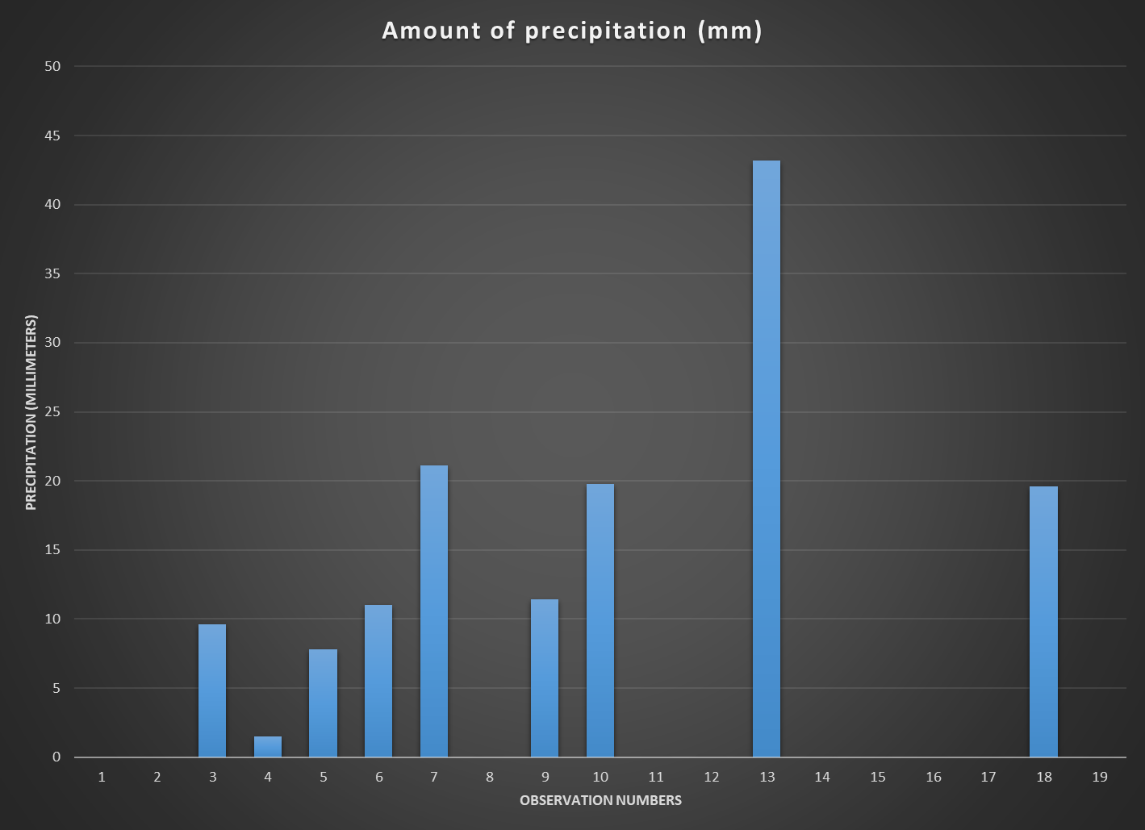
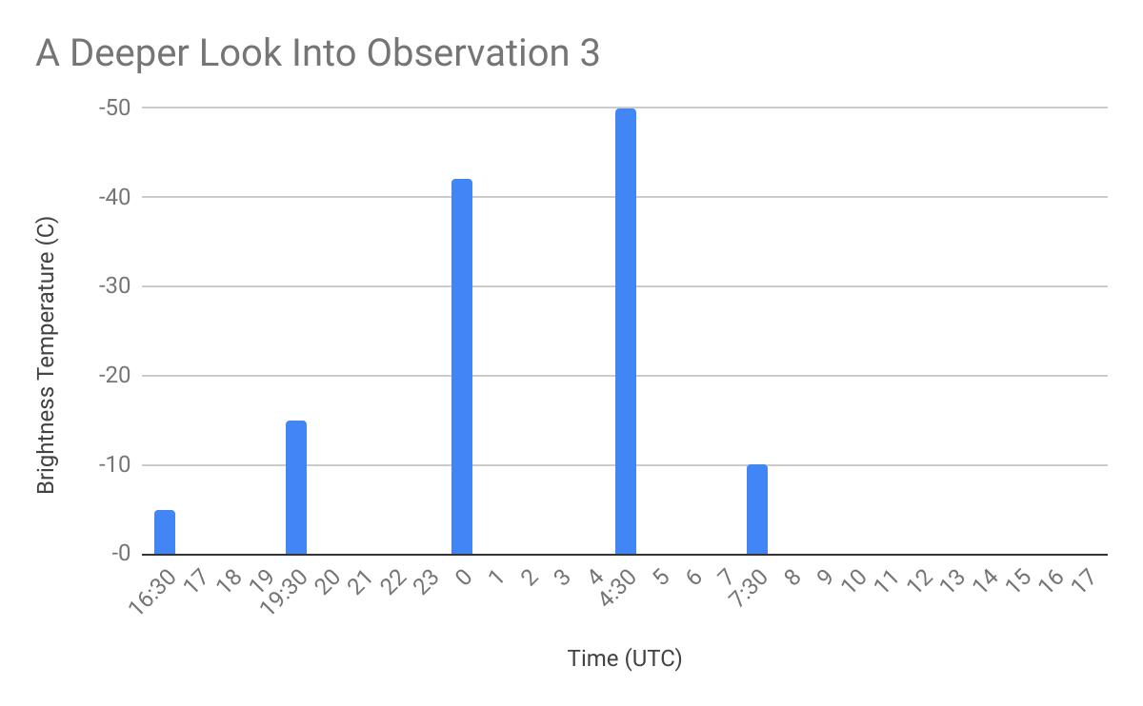
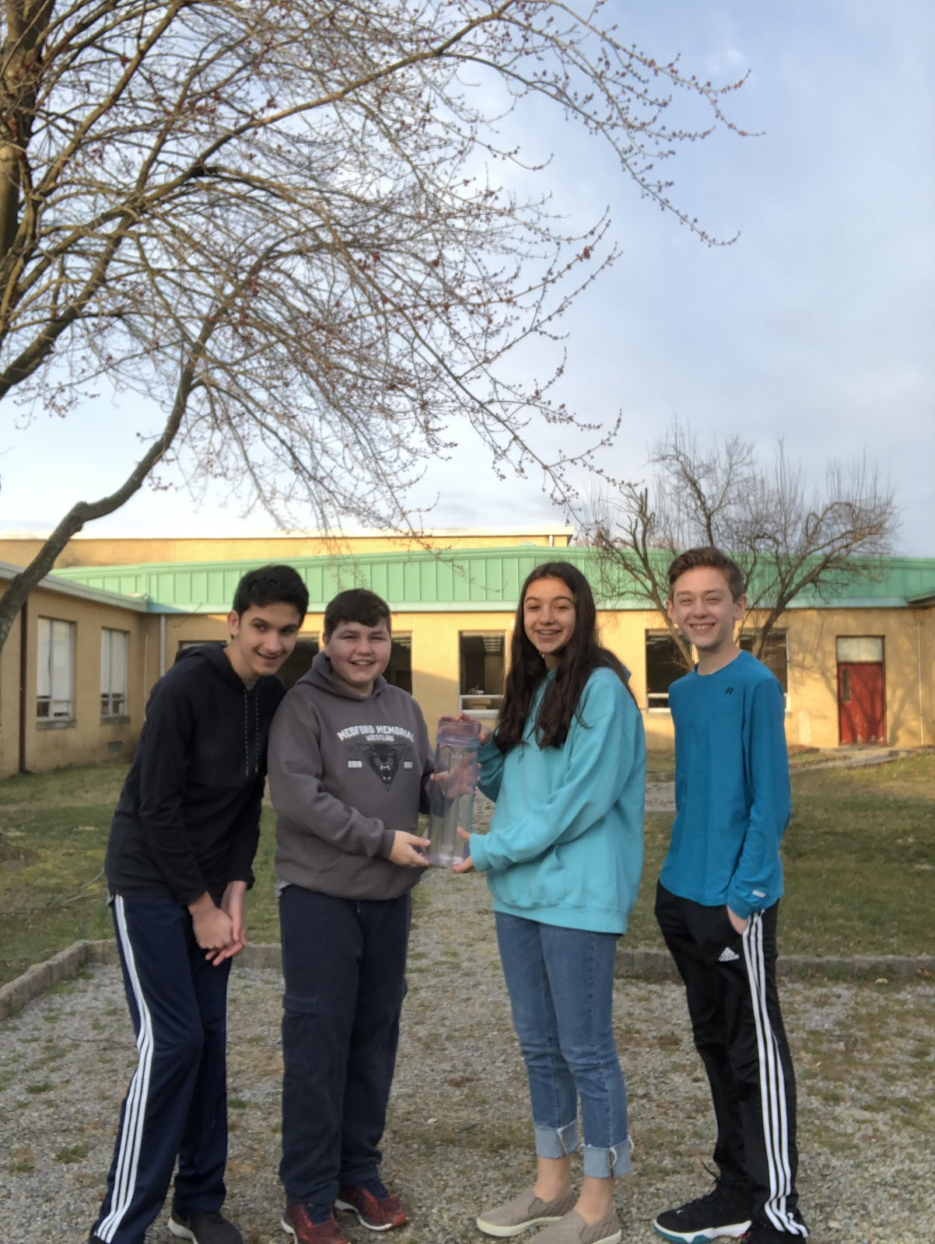
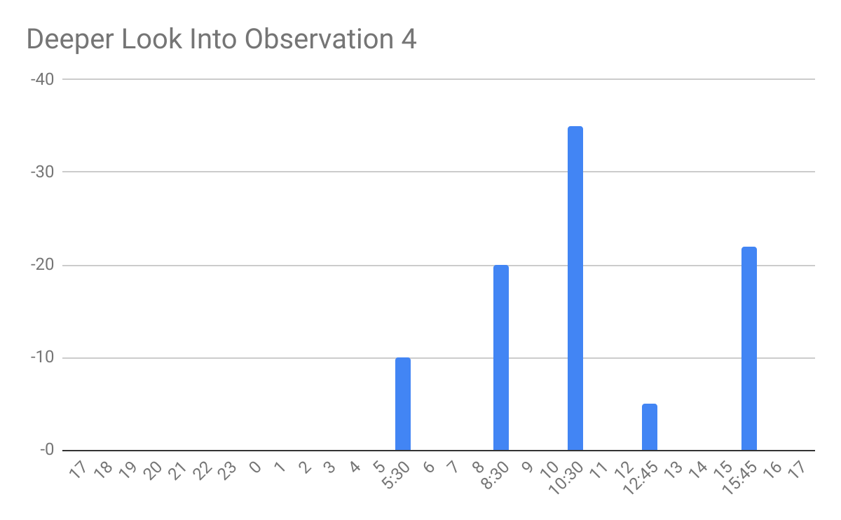
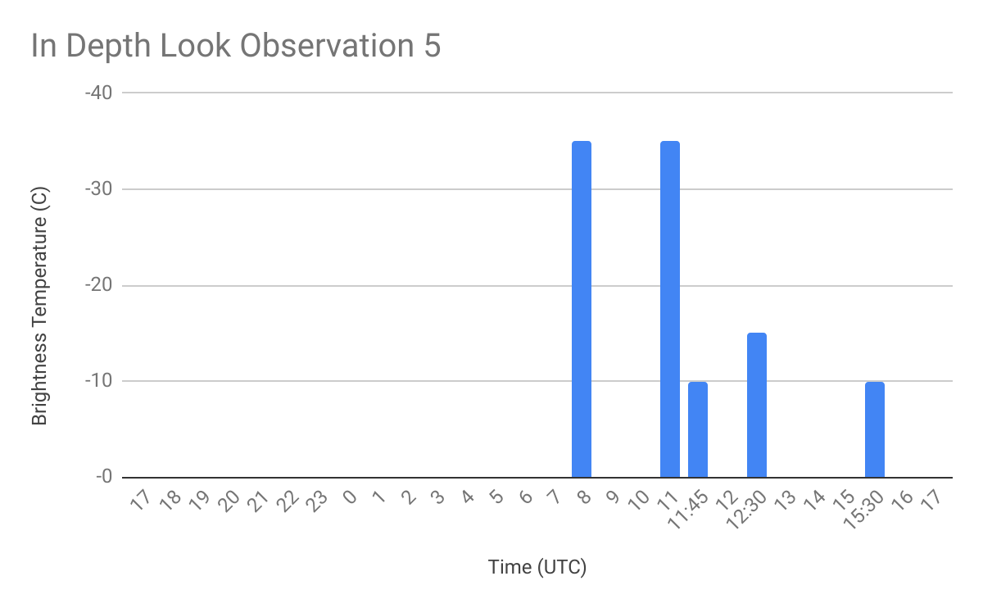
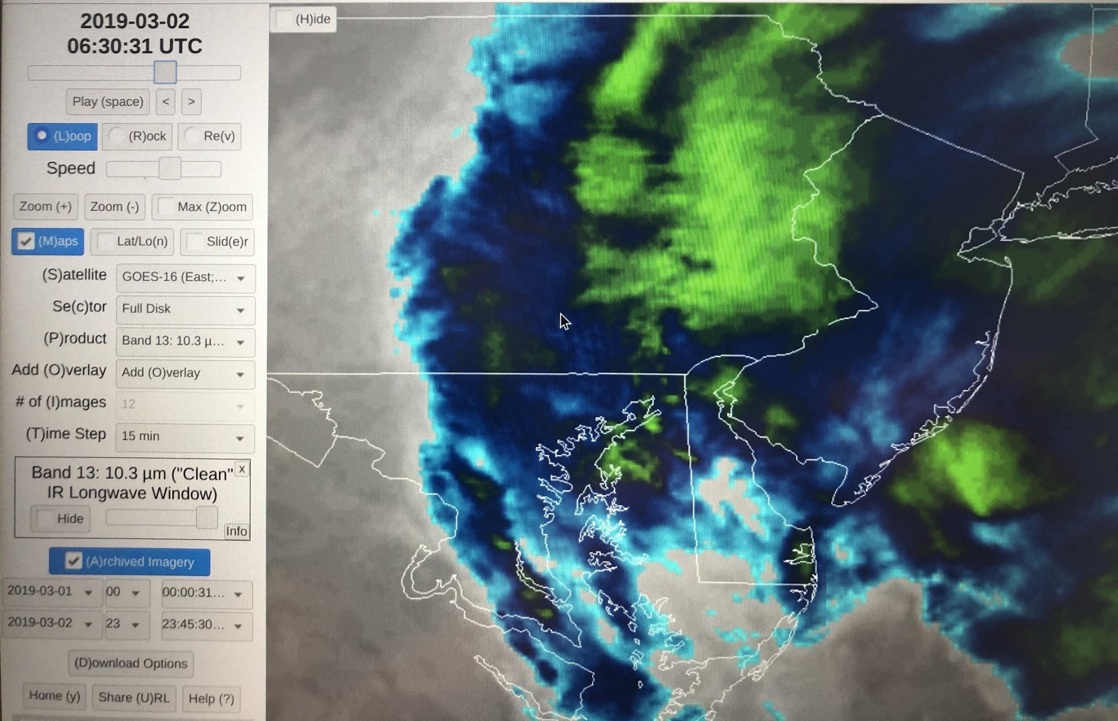
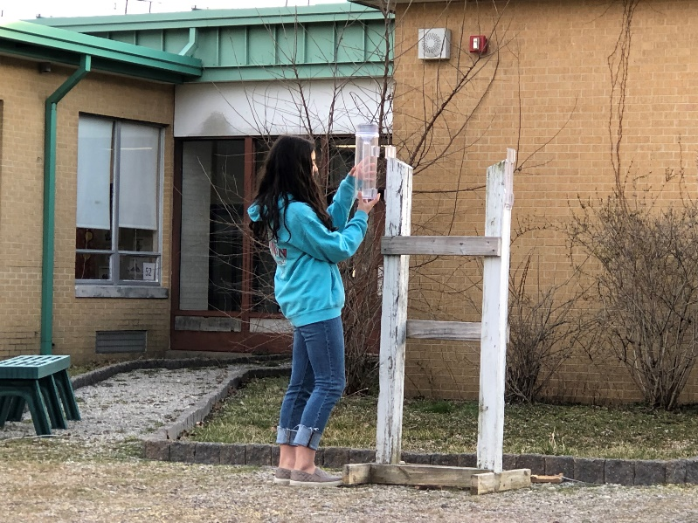
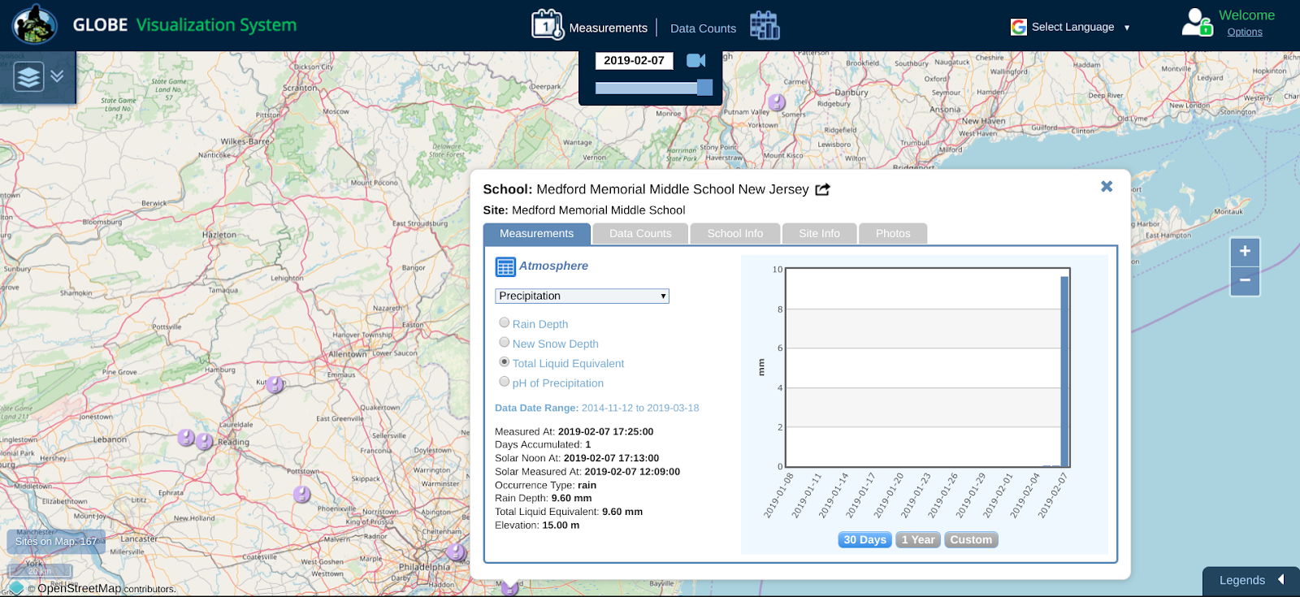
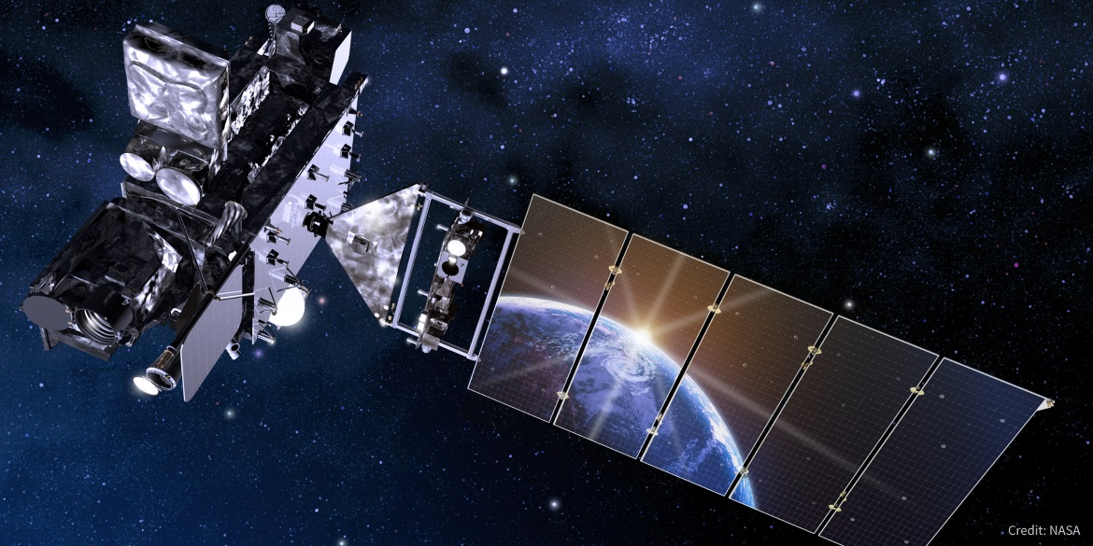

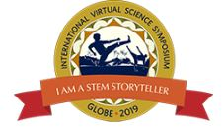
No Correlation Between Precipitation Amounts (Rain Gauge)
and Brightness Temperature (GOES-16 ABI, Band 13)
Elena Garistina, Mason Doshi, Andrew Fricke, Logan Michaels
Citizen Science Education Program, Medford Memorial Middle School, Medford, NJ, USA
ABSTRACT
RESEARCH METHODS
RESULTS
The Advanced Baseline Imager (ABI) is the main instrument on GOES-16. It represents a historic improvement over past GOES instruments. The previous generation of GOES gathered information using five spectral bands. The ABI uses 16. The research in this project used Band 13 data. Band 13 measures energy at 10.3 microns. The energy at this wavelength can give information about cloud top temperature (Brightness Temperature - BT) and cloud particle size. Clouds have a correlation to precipitation, so the research team decided to check Band 13 data against amounts of precipitation.
Over a span of 30 days, 21 precipitation measurements were taken using a metric rain gauge, positioned in the school courtyard. The GLOBE program precipitation protocol was followed. ABI Band 13 data was retrieved from the RAMMB Slider, Colorado State University. The team reached out to two scientists. Dr. Tim Schmit, CIMSS, NOAA and Dr. Dan Lindsey, NOAA were the best mentors.
About 3⁄4 of the way through the research window, the team realized there was a flaw in the experimental design. The rain gauge was emptied around solar noon every day and on a Monday after the weekend. Brightness Temperature was recorded at the same time. But, the actual rain event might have happened anytime within the 24- or 72-hour period. The team turned to Dr. Lindsey and it was suggested that instead of looking at amounts of precipitation, it would better to check BT as the rain was occurring.
Precipitation was collected at approximately the same time every day using a metric rain gauge. An exception was over weekends and holidays when there were multiple days’ worth of accumulation recorded. Brightness Temperature images from GOES-16 were copied and saved, using the Regional and Mesoscale Meteorology Branch (RAMMB) slider, on the Colorado State University website. Images were recorded multiple times during the day.
The metric rain gauge was set in one of the courtyards of Medford Memorial Middle School. In the courtyard, there is a rain gauge stand, which is on top of a pathway. The pathway is gravel, and grass outlines it. In the grass, there are several trees scattered throughout the area. Each day (except on weekends or holidays), at solar noon, the rain gauge was emptied and millimeter measurements were taken. If the water inside the rain gauge was frozen, a new gauge was put on the stand and the frozen water was brought inside to thaw. The GLOBE Precipitation Protocol was followed and all data was entered into the GLOBE data base. There were 21 entries of data on GLOBE.gov over a span of 30 days.
Two scientists who mentored the research team were Dr. Tim Schmit, NOAA, CIMSS and Dr. Dan Lindsey, NOAA. Dr. Lindsey recommended the team use Band 13 as that is the band that measure clouds. Dr. Lindsey also provided brightness temperature images for February 5th to February 19th because access to images on those days was limited on the RAMMB slider. Both Dr. Schmit and Dr. Lindsey were very instrumental when it came to helping the research team.
When the original research plan was constructed, it was decided to measure Brightness Temperature when the rain gauge was emptied. When it was realized there might never be a correlation between amount of precipitation and BT, using the original experimental design, the research team decided to look at a new research question. This question looked at BT while it was actually raining. This new question meant going back into archived data on www.wunderground.com to see when it was raining in Medford, not how much it was raining. The data was put into several bar graphs. To double check that the precipitation observations actually made it into the GLOBE program database, the GLOBE Visualization Page was checked.
Not enough time was left in the original research window to gather enough data to make a reasonable conclusion. However, the small amount of data was graphed and looked interesting. This new research project will be recommended to future CSEPers, so they might pick up on the new research and continue with it.
Figure 3.
These graphs represent the data used to identify the flaw in the experimental design first used to answer the original research question.
Figures 4, 5, and 6.
These figures represent three different precipitation events. BT was recorded three hours before the event, during the event, at the end of the event, and three hours after the event. In total, the team collected data for nine separate precipitation events. The results provided enough proof of concept for future CSEPers to run a complete research project using the new research question.
4
This required the team to go back and use NWS archived precipitation data for Medford to get the approximate times when rain occurred. This information was then checked against Band 13 data. There seemed to be a correlation. A recommendation to future CSEPers is to redo the research by checking BT as the rain is occurring.
5
6
Figure 2 (below).
This is the GLOBE Visualization page for Medford Memorial Middle School, Medford, NJ. It was checked to ensure precipitation data, entered by the research team, was being stored by the GLOBE databank.
Image 1. Future NASA and NOAA employees, starting from the left, Mason, Andrew, Elena, and Logan.
Image 2. Elena replacing the rain gauge.
CONCLUSIONS
Research Question
The experiment based off of the original research question was flawed. Instead of measuring precipitation amounts, Band 13 data should be viewed as precipitation is falling. Analyzing Brightness Temperature during an actual rain event could be a future project for other junior scientists. Possible things to look for are when the cloud top temperature is lower, the cloud is higher in the sky. If it is raining, this could mean there is a tall, cumulonimbus cloud causing a storm. Or if the rain is a steady, light rain, the BT will be warmer, because maybe a warm front is coming through and the warm air mass is sliding above the cold air. Also, when students choose a research question, they should always consider if the data they need is available and understandable at their level. However, students should not be afraid to try things that are difficult. Also, students should not be afraid of making a mistake or failing at proving their hypothesis. Scientists fail all of the time. Doing research like a professional is an excellent experience. Satellites are really interesting and GOES-16 is really cool. We understand how many of the jobs that have to do with satellites and weather will be the types of jobs we will do in the future.
“What is the correlation between GOES-16 ABI Band 13 data and the amount of precipitation collected using a metric rain gauge?”
Image 3.
This is an artist’s image of GOES-16. One of the primary instruments on GOES-16 is the Advanced Baseline Imager (ABI). It collects data using 16 different spectral bands. The GOES-16 CSEP group used the ABI Band 13 during research.
Figure 1 (above).
This is the RAMMB slider used to find Brightness Temperature. On the bottom is the legend which shows which colors correspond to the temperature of the cloud tops in °C. On the left is a menu that changes the satellite, band and also shows the start/end dates/times.
STEM OPPORTUNITIES
The obvious STEM careers for “Satellites and Precipitation” include meteorologist, climatologist, hydrologist and mechanical engineer. However, there are many other careers that could be connected to satellites and precipitation.
Aerospace Engineer Environmental Scientist Satellite Engineer
Reporter Atmospheric Scientist Educator
REFERENCES
“ABI Bands Quick Information Guides.” GOES, www.goes-r.gov/education/ABI-bands-quick-info.html.
“CIMSS GOES Index.” Index of /Goes/OCLOFactSheetPDFs, cimss.ssec.wisc.edu/goes/OCLOFactSheetPDFs.
Dunbar, Brian. “Earth's Inconstant Magnetic Field.” NASA, NASA, www.nasa.gov/vision/earth/lookingatearth/29dec_magneticfield.html.
Dunbar, Brian. “Electromagnetic Spectrum.” NASA, NASA, 22 May 2015, www.nasa.gov/directorates/heo/scan/spectrum/txt_electromagnetic_spectrum.html.
“Geostationary Operational Environmental Satellite - R Series A Collaborative NOAA &amp; NASA Program.” Geostationary Operational Environmental Satellites - R Series
NOAA/NASA, www.goes-r.gov/.
“GOES-R Education Proving Ground CIMSS.” CIMSS GOES-R Education Proving Ground -- SSEC, UW-Madison, cimss.ssec.wisc.edu/education/goesr/ms.
“GOES-R Series Frequently Asked Questions (FAQs).” FAQs │ GOES-R Series, www.goes-r.gov/resources/faqs.html.
“GOES-R Series.” NOAA National Environmental Satellite, Data, and Information Service (NESDIS), NOAA, www.nesdis.noaa.gov/GOES-R-Series-Satellites.
“Instruments: Advanced Baseline Imager (ABI).” ABI │ GOES-R Series, www.goes- r.gov/spacesegment/abi.html.
Jenner, Lynn. “GOES-R.” NASA, NASA, 4 Mar. 2015, www.nasa.gov/content/goes- r/index.html
“The Future of Solar Forecasting with the New GOES-16 Satellite.” Clean Power Research, 20 Mar. 2019 www.cleanpower.com/2018/new-goes-16-satellite-improves-solar-forecasting/.
The GLOBE program International Virtual Science Symposium Badges for this project.

