Slide 1
GEO-XO Introduction
Pam Sullivanª, Frank Gallagherª, Sid Boukabaraª, Dan Lindseyª, Ed Grigsby^{b}
ªNOAA/NESDIS, ^{b}NASA/GSFC
Special International Technical Interchange Meeting
NOAA, ABoM, and JMA April 6 (for some) and 7 (for others), 2020

Slide 2
The Next Decade of GEO
2019 | 2020 | 2021 | 2022 | 2023 | 2024 | 2025 | 2026 | 2027 | 2028 | 2029 | 2030 | 2031 | 2032
NOAA System Launches
Partner/Other EO and SpWx System Launches
NOAA/NESDIS GEO Programs GOES-R SWFO GEO-XO
GOES-T
GOES-U
1st L1
1st GEO
SWFO
FY-4B
FY-4C
FY-4E
FY-4F
EUMETSAT
CMA
JMA
KMA
NASA
FY-4D
MTG-I1
MTG-S1
MTG-I2
MTG-I3
MTG-S2
MTG-I4
GK2B
Himawari-10
TEMPO
GeoCarb
IMAP
GLIMR
Published Date
Notional Date
Cloud
Ingest
Cloud
PG/PD
GS Tech
Refresh
Final
Launch
Implementation
Launch
Implementation
M/S1
SRR
SDR
PDR
CDR
1st L1 Launch
1st GEO Launch
Formulation
Implementation
ALL DATES SUBJECT TO APPROVAL BY FUNDING AUTHORITIES; PARTNER DATES ARE FROM INTERNET SOURCES AND MAY NOT BE CURRENT

Slide 3
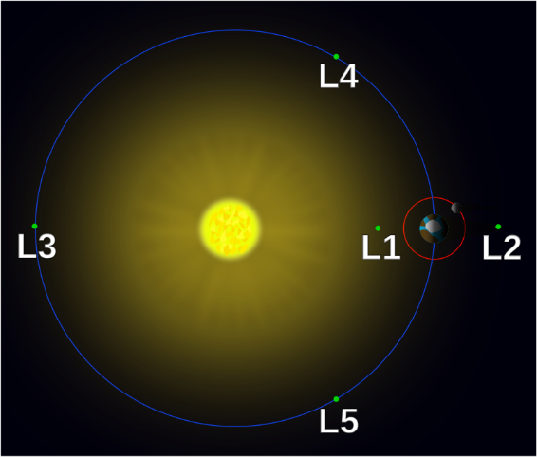
GEO-XO Introduction
GEO-XO = Geostationary and Extended Orbits
The initiative planning the missions to follow GOES-R
Will provide continuity for observations from geostationary orbit and the Sun-Earth L1 point
Considering expanding capabilities to include observations from “Tundra” Highly Elliptical Orbit and Sun-Earth L5
Includes:
All NOAA assets deployed above LEO:
Government spacecraft
Instruments or payloads hosted on commercial and/or partner spacecraft
Potential use of commercial services for:
Communication relays
Observational data
Planned for operation in the 2030-2050 timeframe
Program scope & structure to be defined in formulation phase

Slide 4
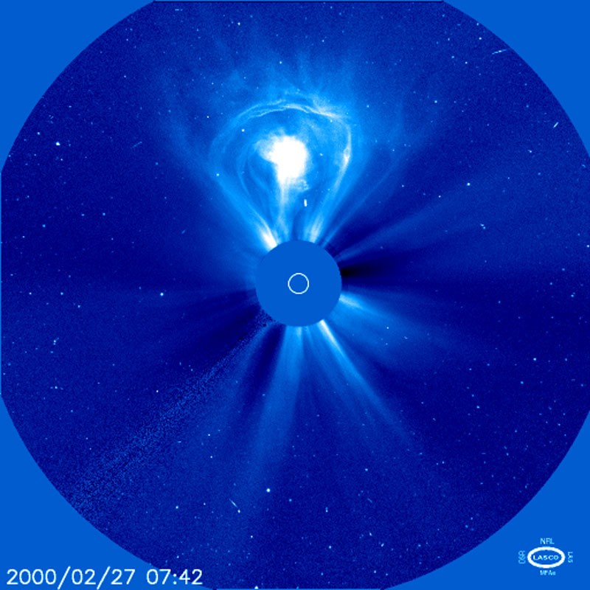
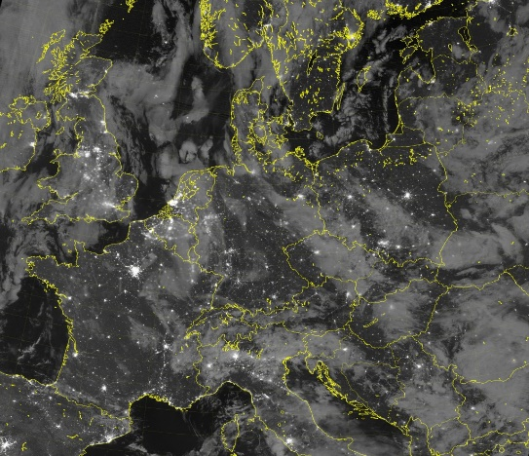
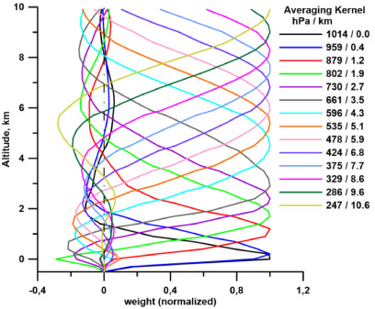
GEO-XO Observations
Both GOES-R/SWFO continuity as well as new observations are in consideration for GEO-XO
Magnetometer, Solar Wind / Particle Sensors, Solar Irradiance Monitor, plus those shown below
Visible & Near-IR Imagery
Lightning Mapping
CME Detection
Solar UV Imaging
Day/Night Imagery
Sounding
Solar Magnetogram
Auroral Imaging

Slide 5
GEO-XO Builds on Conclusions from NSOSA Study
NOAA Satellite Observing Systems Architecture (NSOSA) study concluded GEO-XO should include a dedicated in-situ space weather satellite at L1
Ability to issue an accurate and high reliability warning of geomagnetic storm events requiring real-time mitigation actions on earth is dependent on physical presence at L1
NSOSA concluded GEO-XO should consider structured trades for the terrestrial and solar observation instruments. Options of interest are:
GEO/Tundra agile system able to contain a comprehensive set of both terrestrial and solar observation capabilities
Comprehensive GEO-only system
Disaggregated terrestrial and space weather system with option for hosted payloads
NSOSA recommended that current GOES-R communications functions (GRB, DCS, HRIT, EMWIN) be transitioned to commercial services

Slide 6
GEO-XO Current Activities
Milestone Zero, 1st gate of DOC program life cycle, was completed in Dec 2019
Confirmed mission need for replacement systems in GEO and L1 ~2030
Initiated a formal concept study phase
Budget Activities
FY20 budget includes funding for GEO-XO pre-formulation activities
Anticipate increasing funds in FY21+, intended to fund GEO-XO formulation & implementation
Pre-formulation activities underway
GEO-XO Concept Exploration Broad Agency Announcement (BAA)
Industry responses received and under evaluation
Expect to award contracts for ~6mo studies starting in 2nd Quarter FY20
Sensor Assessment Team assisting with observation decisions
GEO Hyperspectral Sounder OSSE studies
Communications relay alternative concept study
√
GEO-XO
DOC Project
Life Cycle

Slide 7
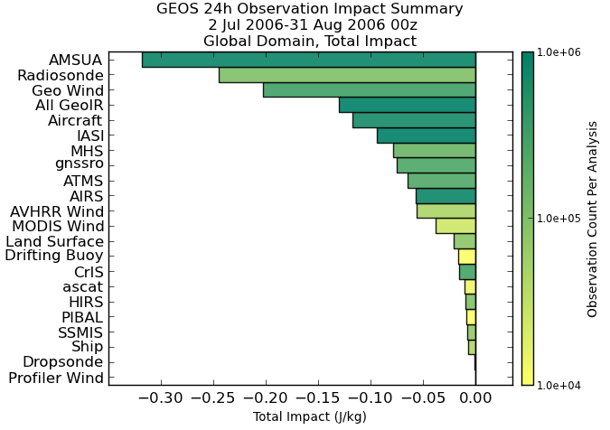
Hyperspectral Sounder OSSEs – Preliminary Results
Observing System Simulation Experiment (OSSE):
Experimentation performed using 5.17 version of the Goddard Earth Observing System (GEOS) Atmospheric Data Assimilation System (ADAS)
Goddard Earth Observing System (GEOS) atmospheric data assimilation system (ADAS)
1/4° (C360) model grid spacing
4D-EnVar
Simulations based on 7 km GEOS-5 Nature Run (G5NR)
Observations simulated from 7 km GEOS-5 Nature Run (G5NR)
GeoIR ring ranked 4th overall via FSOI metric
*Results from Dr. Will McCarty: NASA GSFC GMAO

Slide 8
Road Map Decisions Mapped to Program Phases
 | Pre-Phase A (FY20) | Phase A (FY21-23) | Phase B (FY24-25)
Major Decisions | A: Decide which observations to study in formulation - Specify performance requirements and ranges | B: Decide comm relay services to be included and method C: Define role of hosting D: Confirm and specify instruments - Baseline L1 Reqts and OpsCon - Finalize program scope & partner roles | E: Confirm space segments for implementation - Update L1 Reqts and OpsCon - Program schedule & launch dates - Program Life Cycle Cost (LCC)
Work to be Performed | - BAA Industry Studies - User engagement to define requirements - Observation OSSEs or other quantitative value assessments | - Instrument Industry Studies - Risk Reduction/Tech Dev to TRL7 - Host Industry Studies - Space Segment Industry Studies (start) - Comm relay demos (start) - OSSEs/other quant. value assessments - User engagement to baseline requirements and use cases/ops con | - Instrument Implementation (start) - SC Implementation (start) - Comm relay specification and/or implementation start - User Engagement to refine requirements and use cases/ops con
Reviews | Mission Concept Review | SRR, SDR | PDR
Concluding Milestone | DOC MS1 (NASA Equivalent: KDP-A*) | DOC MS2 (NASA Equivalent: KDP-B*) | DOC MS3 (NASA Equivalent: KDP-C*)
*NASA Equivalent milestones are letters or Roman numbers depending on program type (ie tightly coupled, uncoupled, etc). Letters are used here as they are most familiar to this audience.
Dates are notional and contingent on funding and program approvals.

Slide 9
Anticipated Characteristics of Mission Solution
System In GEO
“GOES-R-class” Imager
Provides continuity of real-time, high-refresh-rate vis/IR imagery
Imager manifested on a customized, high performance NOAA GEO spacecraft
Imager mission requires high reliability, availability, & pointing accuracy
Spacecraft designed for compatibility with GEO and HEO orbits
Preserves option to provide arctic coverage
Spacecraft provides capacity for additional payloads
New operational, experimental, and/or partner instruments ‘on ramped’ when ready
Additional instruments under consideration include a lightning mapper, a hyperspectral sounder, and others
Space Weather
Solar instruments hosted in GEO on commercial or government bus
Small, latitude-agnostic instruments have more host opportunities
In Situ instruments on small “ESPA-class” satellites at L1 and GEO
Small spacecraft have more ride-share opportunities
Partnership adds Space Weather capabilities at L5

Slide 10
User Engagement Plan Elements
GEO-XO User Requirements Working Group
Engages user community to inform GEO-XO capabilities
Conducts/directs OSSE or other quantitative value assessments
Conducts future scenario assessments to inform needs
Recommends Systems Performance Requirements & Ops Con
Targeted User Outreach
NCEP Centers, OFCM, DoD, Emergency Managers, and others
Inputs solicited regularly, and in preparation for key decisions
GEO-XO Workshops throughout formulation phase
Present GEO-XO status and plans to US/international user community and partners
Solicit community input on implementation decisions
Potentially in conjunction with NOAA Satellite Conference
Annual conferences – AMS, NWA, AGU, EUMETSAT, Space Symposium, etc
GEO-XO status and plans
Satellite Liaisons, Proving Ground, TOWR-S (NWS embed)
Prepare users in advance of operations for new system/data/products
NOAA Social Media and News Releases
Future scenario assessments will
be used in GEO-XO formulation

Slide 11
GEO-XO Next Steps
Pre-Formulation Activities (thru ~2020)
Complete initial observational requirements
Complete GEO BAA industry studies and analyze results
Hold GEO-XO Mission Concept Review
Complete DoC Milestone 1 (MS1), Program Initiation Approval
Formulation activities to be accomplished in ~2020 to prepare for MS1
Develop Formulation Agreements (FAD)
Establish GEO-XO Program Office and draft Program Plans
Prepare requirements & documentation for instrument Phase A studies
Approximate program schedule:
Mission Concept Review & Formulation Start, FY21
System Requirements Review, FY22
Preliminary Design Review & Program Baseline, FY25
1st Sun-Earth L1 Launch FY29
1st GEO Launch FY31
Dates are notional and contingent on funding and program approvals

Slide 12
Summary
GEO-XO builds on the NSOSA study results to define NOAA’s next generation satellite systems
Within the next year:
Continue user engagement activities
Industry studies will begin
Plan for formulation will be defined
We look forward to working with the community to develop GEO-XO
GEO-XO will maintain and
advance NOAA’s observational
capabilities through 2050

