Slide 1
Training Resources for GOES-R:
The Nation’s Next-Generation Geostationary Weather Satellites
Mat Gunshor matg@ssec.wisc.edu
CIMSS / UW-Madison
American Meteorological Society 99th Annual Meeting
Phoenix, AZ • January 6-10, 2019

Slide 2
The Advanced Baseline Imager:
 | ABI | Current Imager
Spectral Coverage | 16 bands | 5 bands
Spatial Resolution
0.64 mm Visible | 0.5 km | Approx. 1 km
Other Visible/near-IR | 1.0 km | n/a
Bands (>2 um) | 2 km | Approx. 4 km
Spatial Coverage
Full Disk | 4 per hour | Scheduled (3 hourly)
CONUS | 12 per hour | Approx. 4 per hour
Mesoscale | 2 every 1-minute | n/a
Notes:
The ABI allows more bands, finer spatial resolution, faster refresh rates and on-orbit calibration of all bands!

Slide 3
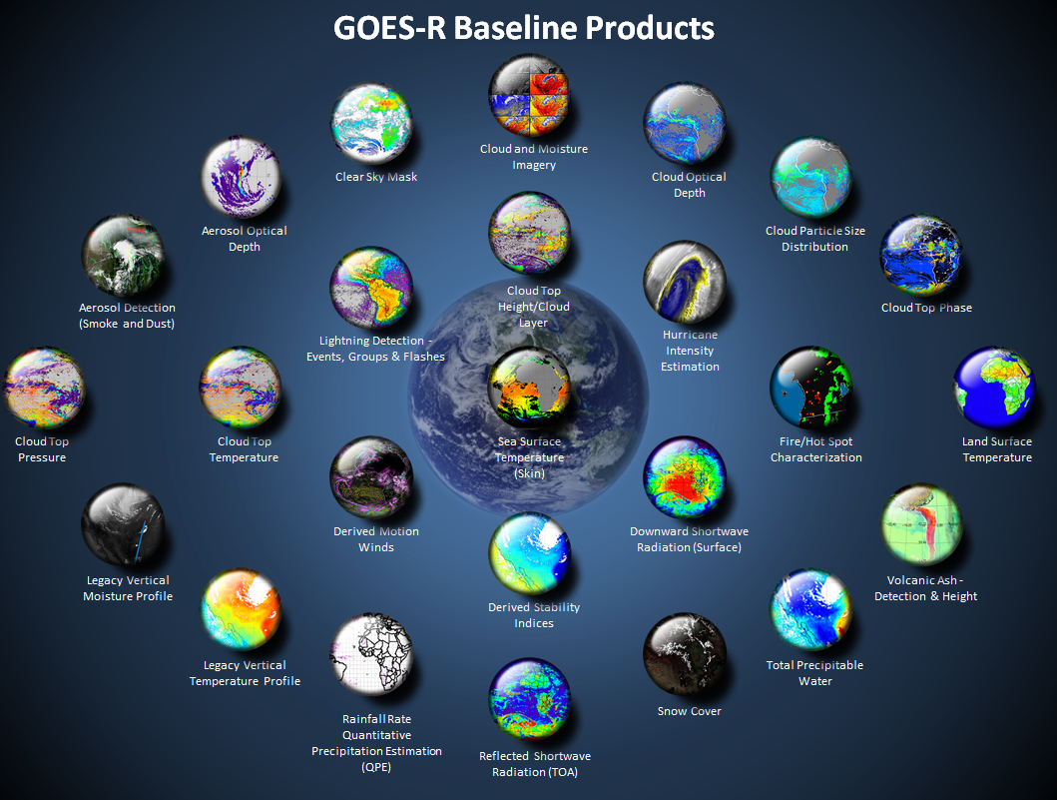
Many critical derived quantities
http://www.goes-r.gov

Slide 4
GOES-16 Products
ABI L1b Product
Radiances
ABI L2+ Products (con’t)
Downward S/W Radiation: Surface
Fire/Hot Spot Characterization
Hurricane Intensity Estimation
Land Surface Temperature
Legacy Vertical Moisture Profile
Legacy Vertical Temperature Profile
Rainfall Rate/QPE
Reflected S/W Radiation: TOA
Sea Surface Temperature
Snow Cover
Total Perceptible Water
Volcanic Ash: Detection and Height
GLM L2 Product
Lightning: Events, Groups, Flashes
SEISS L1b Products
Energetic Heavy Ions
Magnetospheric e⁻/p⁺: Low Energy
Magnetospheric e⁻/p⁺: High Energy
Solar & Galactic Protons
EXIS L1b Product
Solar Flux: EUV
Solar Flux: X-ray Irradiance
SUVI L1b Product
Solar EUV Imagery
MAG L1b Product
Geomagnetic Field
ABI L2+ Products
Cloud and Moisture Imagery (KPP)
Aerosol Detection (Smoke & Dust)
Aerosol Optical Depth (AOD)
Clear Sky Mask
Cloud Particle Size Distribution
Cloud Top Height
Cloud Top Phase
Cloud Top Pressure
Cloud Top Temperature
Derived Motion Winds
Derived Stability Indices
Plus from the ABI (Pathfinders)
Aerosol Particle Size Cloud Layers/Heights Ice Thickness Low Cloud and Fog Ice: Concentration Ice: Motion

Slide 5
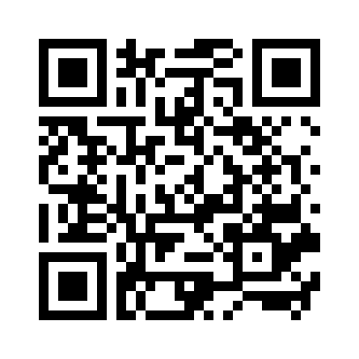
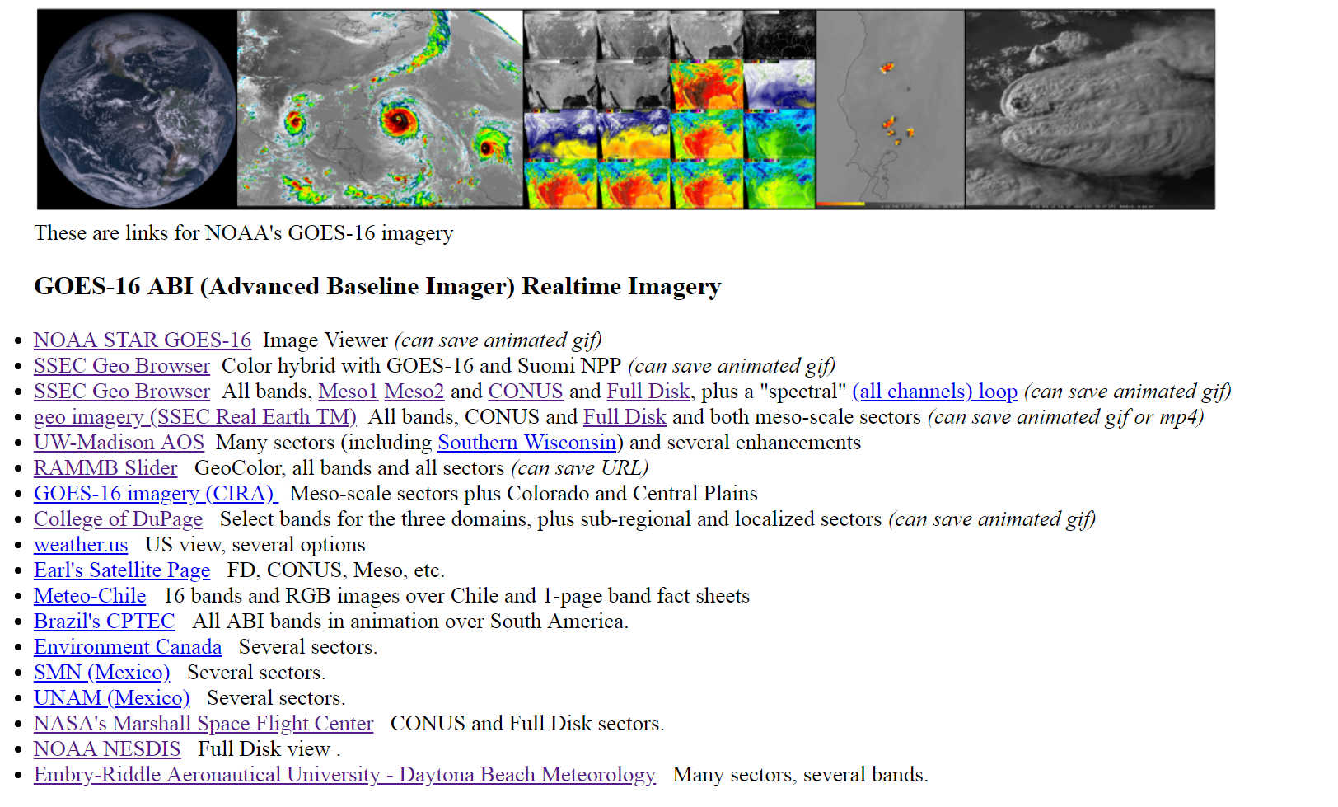
GOES-R Series web sites
http://cimss.ssec.wisc.edu/goes/goesdata.html
GLM (Geostationary Lightning Mapper)
Calibration
GOES-16 ABI Data
(Free) Software
(Free) Phone apps
GOES-R/16 ABI Training / Education
GOES-R/16 ABI Info
Level 2 -- Derived Products, etc.
Notes:
animation

Slide 6
  CIMSS Has developed ‘webapps’ that allow you to explore the different spectral bands on ABI
  Coded in HTML5 so you can play with them on your SmartPhone.
  http://cimss.ssec.wisc.edu/goes/webapps/bandapp/overview_goes_16.html
  http://cimss.ssec.wisc.edu/goes/webapps/satrgb/overview_abi_goes16.html

Slide 7
GOES-16 Training Modules
GOES-16 Training Modules
Satellite Foundational Course for GOES-R
Created in 2016, ready pre-launch for all NWS Forecasters
Currently being revised to swap in GOES-16 examples (vs. Himawari-8/Suomi-NPP/Legacy GOES data were used initially)
Initial version:
http://rammb.cira.colostate.edu/training/shymet/satfc-g_intro.asp
Revised version will be at COMET MetEd.

Slide 8
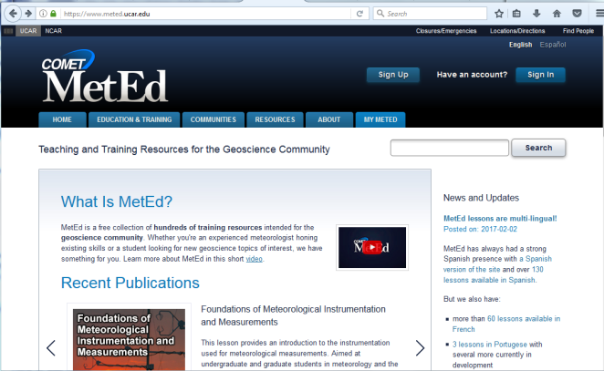
GOES-16 Training Sources
http://www.meted.ucar.edu
GOES-16

Slide 9
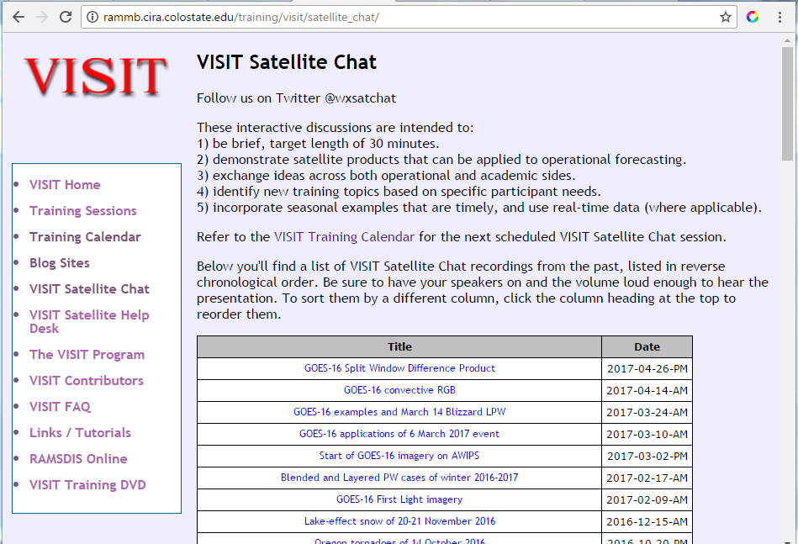
GOES-16 Training Sources
FDTD GOES-16 Applications Webinars
Semi-regular short discussion by NWS SOOs (and others) on how GOES-16 data were used.
Grew out of VISIT “Satellite Chat” sessions
http://rammb.cira.colostate.edu/training/visit/satellite_chat/
Recordings and Q/A are included
Sample Topics:
GOES-16 Water Vapor bands orographic applications
GOES-16 views Hail swaths
GOES-16 Split Window Difference
GOES-16 Convective RGB

Slide 10
GOES-16 Training Sources
Blogs!
Satellite Liaison Blog
CIMSS Satellite Blog on GOES-16
VISIT Blog at CIRA
Notes:
What should people be able to do after this particular topic….remember to start with action verbs

Slide 11
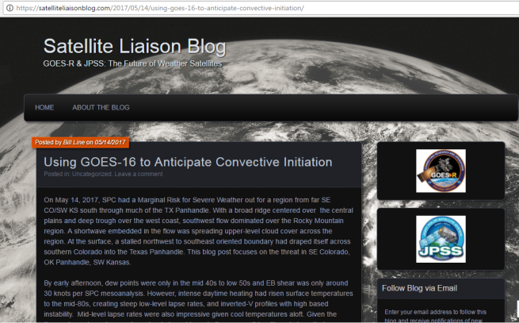
GOES-16 Training Sources
Specific examples of how GOES-16 can help with forecast problems

Slide 12
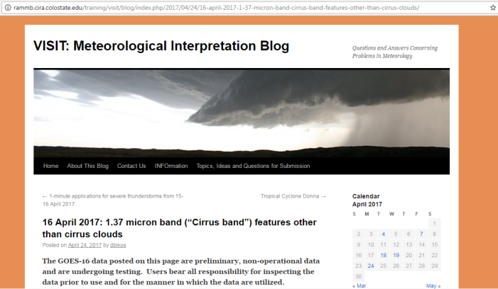
GOES-16 Training Sources
Questions and Answers concerning problems in Meteorology

Slide 13
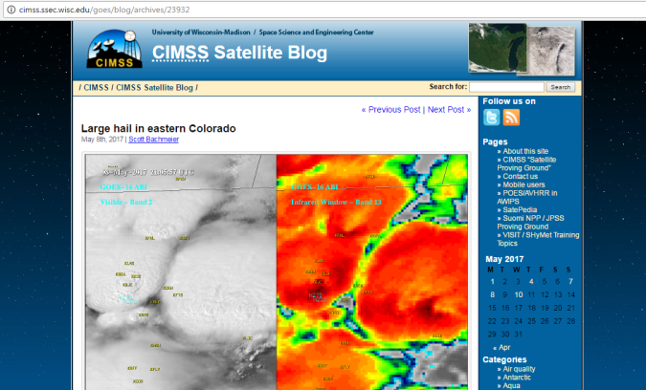
GOES-16 Training Sources
Since 1996, showing how to interpret Satellite Imagery to understand weather events

Slide 14
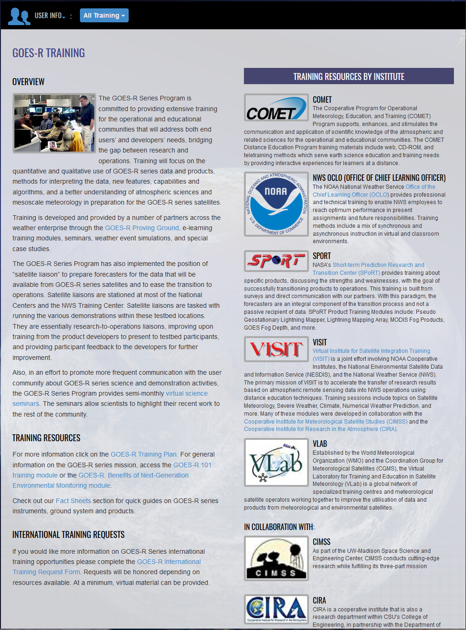
Other Resources Online
www.goes-r.gov
  http://www.goes-r.gov/users/training.html

Slide 15
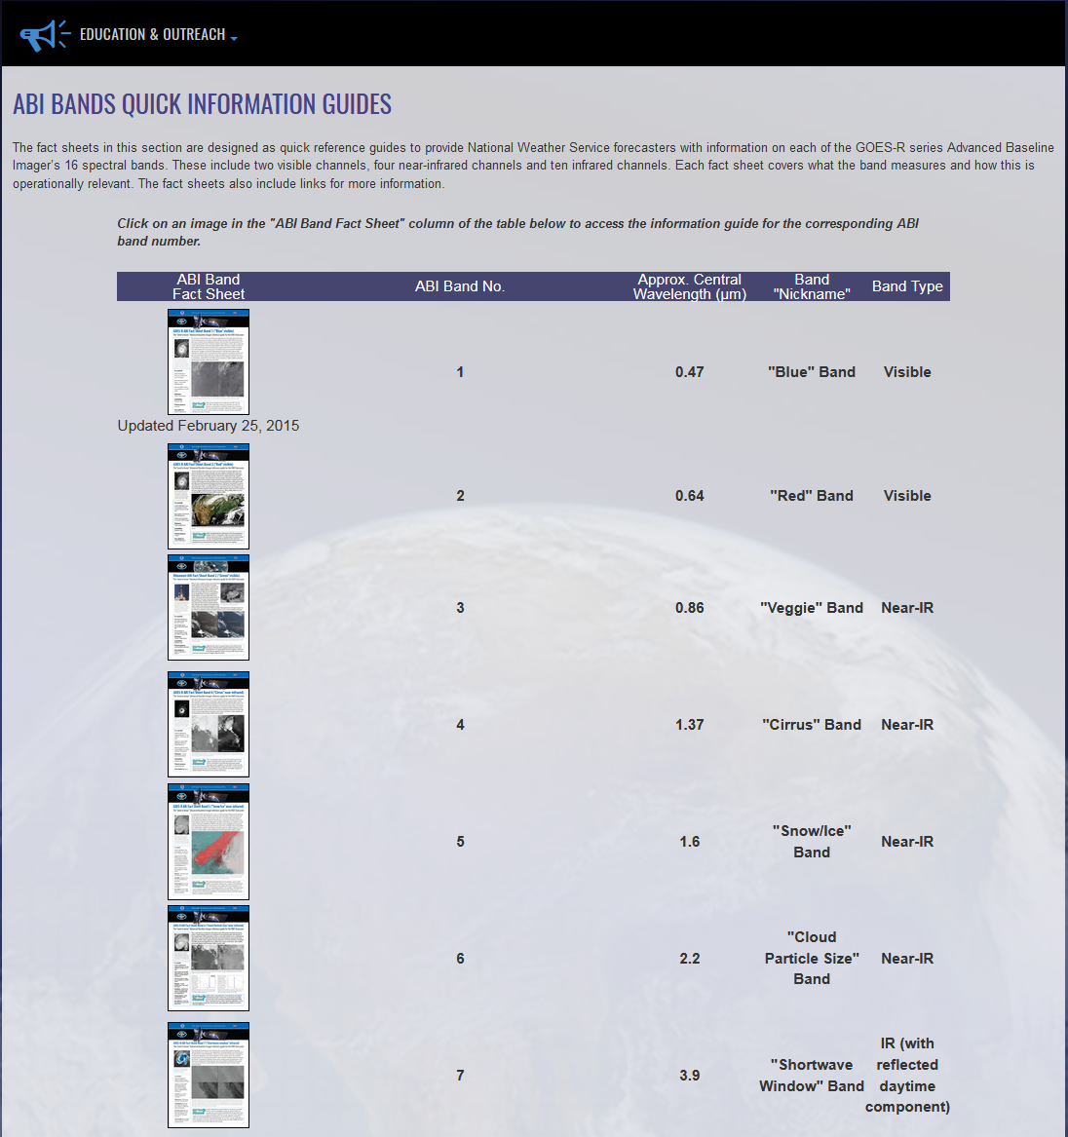
GOES-R Band Fact Sheets
http://www.goes-r.gov/education/ABI-bands-quick-info.html

Slide 16
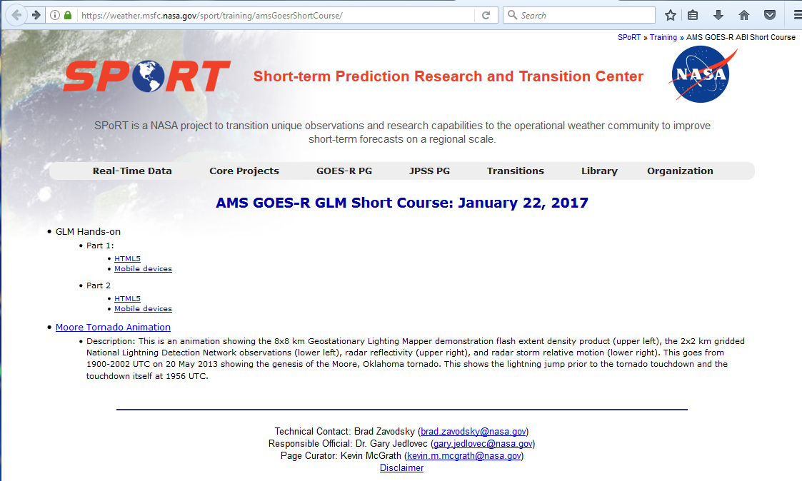
GOES-16 Training Sources
https://weather.msfc.nasa.gov/sport/training/amsGoesrShortCourse/
GOES-16 also includes the Geostationary Lightning Mapper (GLM)
This website includes Real-Time Data (when available) and training resources
https://weather.msfc.nasa.gov/sport/training/amsGoesrShortCourse/

Slide 17

GOES-16 Training Sources
Summary:
Website with links for today’s short course: http://cimss.ssec.wisc.edu/goes/shortcourse/ams2019.html
Any Questions? Scott.Lindstrom@NOAA.GOV
Notes:
1st slide should be AGENDA slide – an overview of what is planned during the
Throughout - First layer of text should be Arial 22 font size, in black.
Topic bullets should be Arial 20 font size
Agenda should list all topics that will be covered in training, written short and to the point

Slide 18
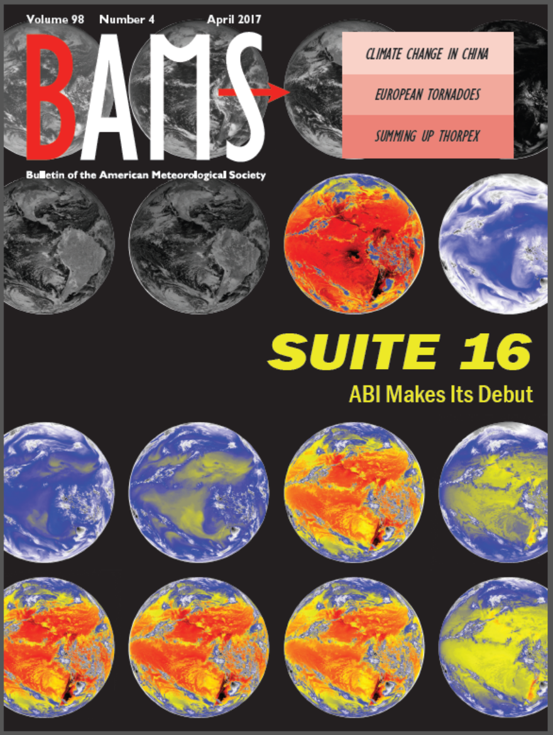
A Closer Look at the ABI
http://journals.ametsoc.org/doi/abs/10.1175/BAMS-D-15-00230.1
April 2017 BAMS issue
Schmit, T.J., P. Griffith, M. M. Gunshor, J. M. Daniels, S. J. Goodman, and W. J. Lebair, 2017: A closer look at the ABI on the GOES-R series. Bull. Amer. Meteor. Soc., 98, 681–698, doi:10.1175/BAMS-D-15-00230.1.

Slide 19
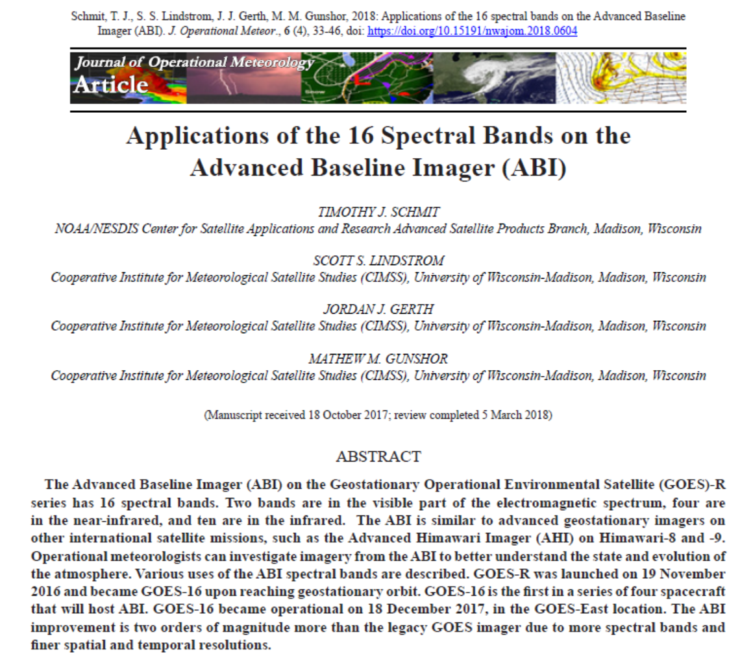
Questions? Comments?
http://nwafiles.nwas.org/jom/articles/2018/2018-JOM4/2018-JOM4.pdf
2018 Journal of Operational Meteorology (NWA)
Schmit, T. J., S. S. Lindstrom, J. J. Gerth, M. M. Gunshor, 2018: Applications of the 16 spectral bands on the Advanced Baseline Imager (ABI). J. Operational Meteor., 6 (4), 33-46, doi: https://doi.org/10.15191/nwajom.2018.0604
Feel free to contact: Tim.J.Schmit@noaa.gov
Notes:
Thank you for your attention!

Slide 20
Question
Do you know where to gather needed resources regarding the ABI?
a) Very doubtful
b) Cannot predict now
c) Most likely
d) Yes
e) Without a doubt

Slide 21

Thank you
For more information visit www.goes-r.gov
www.facebook.com/GOESRsatellite
www.youtube.com/user/NOAASatellites
twitter.com/NOAASatellites
www.flickr.com/photos/noaasatellites

