Slide 1
Imagery Sources Online Scott Lindstrom
Where can you find Satellite Imagery presented as imagery
This is not data you can use, necessarily, for science imagery, but you can use it to view the weather, or to decide where you want to gather data
This is not an exhaustive list!
This is a list of places that I know about

Slide 2
Bookkeeping
Slido.com : #SatMOCTraining-1
Put Questions in Sli.do under Q&A
That will be monitored more obsessively than the Zoom Chat!
This is recorded! A recording will be made available to all
For now: We’ll start with the 1st 3 poll questions at Slido
If you have a Question: Note the Q&A capability in Slido.
Request: Do you have a source for imagery that you use and that you think is superb? Put it in there!

Slide 3
Your instructor: Scott Lindstrom
Pennsylvania native
BS in Meteorology and BS in Computer Science from Penn State
MS and PhD in Meteorology from UW-Madison
Special Thrills: Extreme Weather or Unusual Weather
Special Skills: Remembering songs and lyrics
Special Ills: Always a song playing in my head
Special Drills: Writing a Blog post about satellite meteorology in 15 minutes
I make training material for various institutions, especially the US National Weather Service; I write Blog posts for two sites: CIMSS Satellite Blog (https://cimss.ssec.wisc.edu/satellite-blog and CIMSS Fog Blog https://fusedfog.ssec.wisc.edu)
I’ve also written a lot of software for McIDAS-X
P.S.: That headshot on the AMS site is terrible! I regret giving it to them ☺

Slide 4
Data from Suomi-NPP / VIIRS
List of VIIRS Channels
https://rammb.cira.colostate.edu/projects/npp/VIIRS_bands_and_bandwidths.pdf
“M” Bands: Moderate Resolution
“I” Bands: Imager resolution

Slide 5
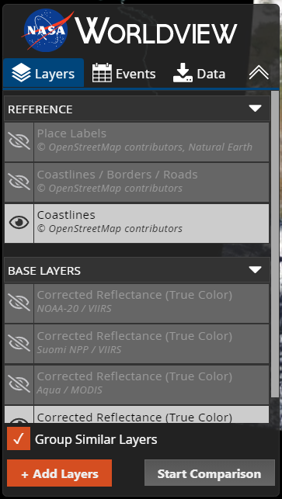
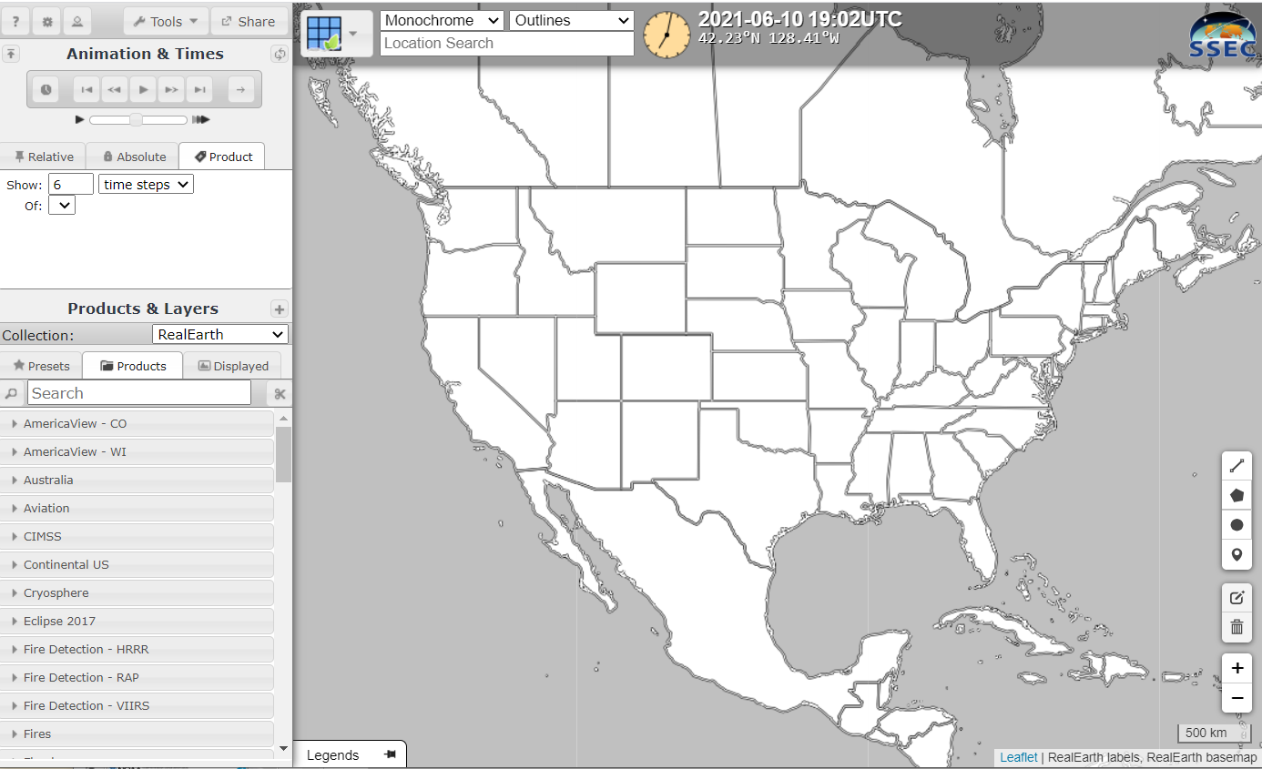
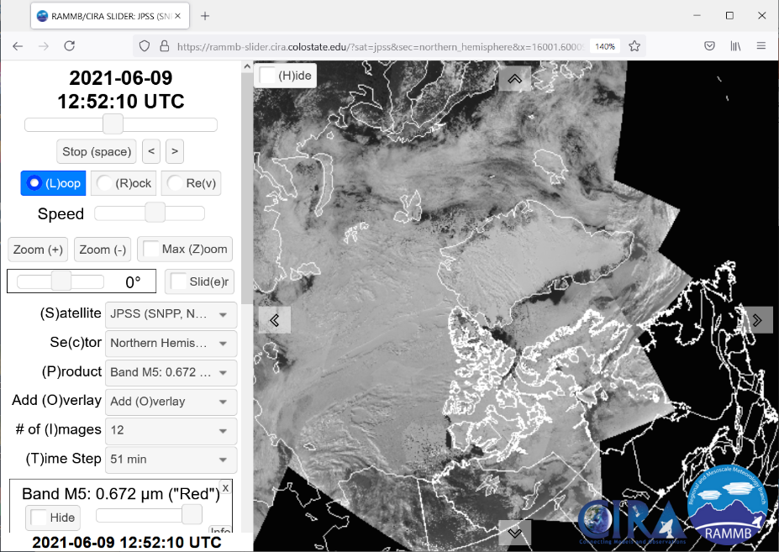
Where can you find VIIRS Imagery online?
(also includes GCOM, TROPOMI and JPSS Products and VIIRS Granules)
JSTAR Mapper
VIIRS Today
RealEarth
NASA Worldview
ftp-like servers at Direct Broadcast sites
CIRA Slider

Slide 6
JSTAR Mapper
Includes imagery from Suomi-NPP, NOAA-20, GCOM-W2, Sentinel
Some of these are very hard to find elsewhere

Slide 7
JSTAR Mapper
Includes imagery from Suomi-NPP, NOAA-20, GCOM-W2, Sentinel
Some of these are very hard to find elsewhere

Slide 8
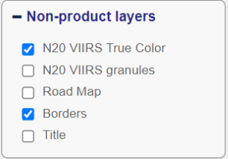
Some things that you can find

Slide 9
TROPOMI Imagery: CO

Slide 10
TROPOMI Imagery: Aerosol Index
This could be dust or smoke?
Nice capture of a SAL event

Slide 11
VIIRS Today
This is data from Direct Broadcast sites over CONUS, and it only shows VIIRS.
True Color imagery (Red/Green/Blue imagery with Red/Green/Blue bands)
‘False Color’ imagery (Combines visible and near-infrared imagery)
Day Night Band imagery
Also links to orbits!

Slide 12
VIIRS Today Website
Note: S-NPP and VIIRS
True Color
False Color
Day Night Band
Coastline toggle
State Borders toggle
Sector Borders
Today’s NOAA-20 Passes
Today’s Moon Phase
MODIS Today
Click on a sector!

Slide 13
VIIRS Sectors – there are 8 of them
2000 m, 1000 m and 250 m resolutions

Slide 14
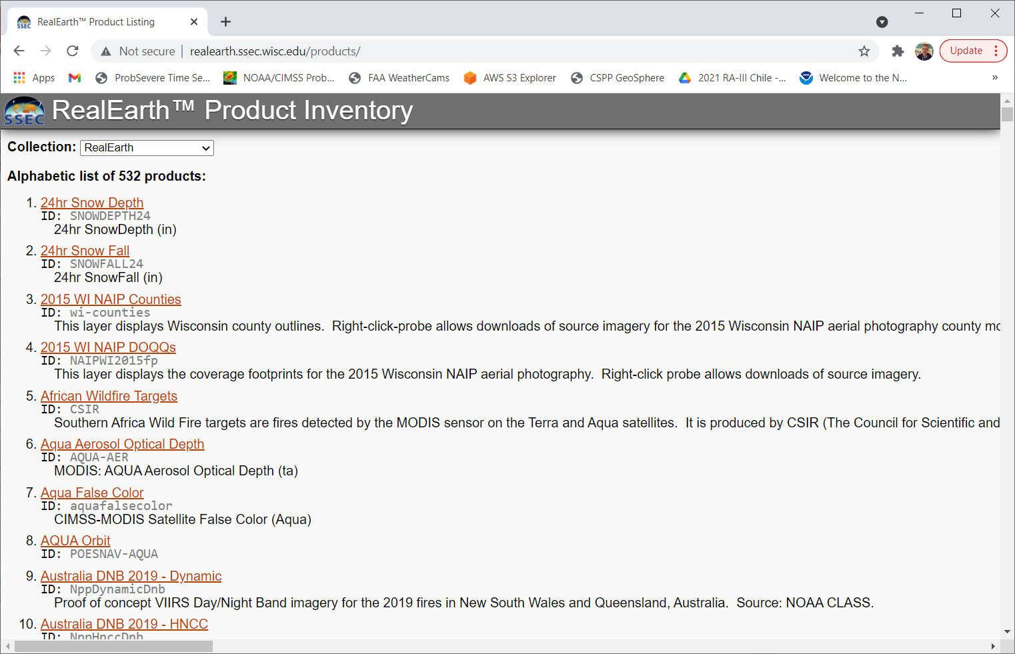
RealEarth: an Aggregator!
Gathers imagery from many places and puts then in a common environment.
http://realearth.ssec.wisc.edu/products/
Alphabetic list of products in RealEarth
Note: 500+ of them!
Alternatively, enter RealEarth and use the Search

Slide 15
RealEarth Front Page: Use the Search Tool
Some products in RealEarth – like CMORPH – are very very hard to find elsewhere
There are many ‘Presets’ and ‘Products’ that you can look through. The labels are mostly self-explanatory.
Enter something like ‘CMORPH’

Slide 16
NASA Worldview
Note that you can slide back in time – and you can change that ‘DAY’ to ‘YEAR’ to slide through more quickly
As with RealEarth – many different products (all from polar orbiters) – use the Search tools after you + Add Layers

Slide 17
NASA Worldview
It keeps track of what you’ve selected in the past, and there are different categories
If you know what you want, just enter that “Ozone” or “Day Night Band”
(Note I’ve scrolled all the way back to 2008!

Slide 18
When you type in something – search looks for all the matches

Slide 19
CIRA Slider (Polar version)
Change Satellite from default (GOES-16) to JPSS

Slide 20
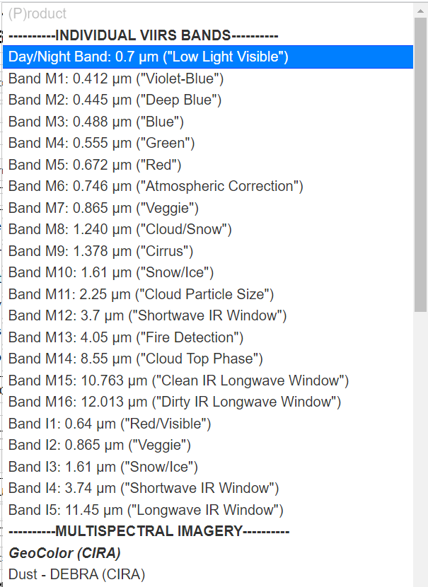
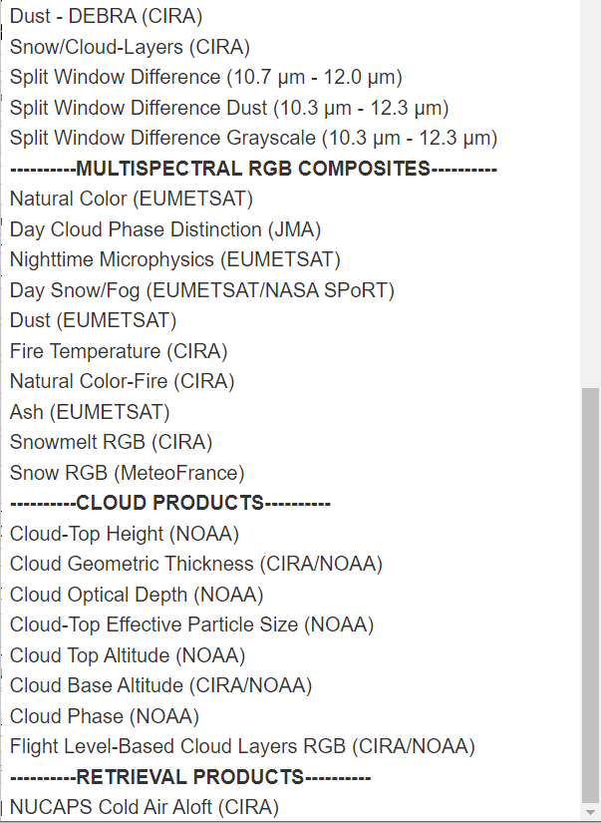
Different Channels and Products
JPSS – related, so derived from VIIRS

Slide 21
Direct Broadcast sites
UW-Madison: ftp://ftp.ssec.wisc.edu/pub/eosdb/ (NOAA-20, NPP, MODIS) (Oops: https://ftp.ssec.wisc.edu/pub/eosdb )
Contains imagery – and also output from CSPP that (1) mimics what you will find in NOAA CLASS and (2) can be fed into Polar2Grid to create imagery
Alaska-Fairbanks (GINA): http://hippy.gina.alaska.edu/distro/nrt/
Miami (Imagery only): https://dbps.aoml.noaa.gov/browser/
Excellent for Tropical information
Hawaii: http://soest-hcc1.hcc.hawaii.edu/browser/
Blog posts on Polar2Grid: https://cimss.ssec.wisc.edu/satellite-blog/?s=Polar2Grid

Slide 22
Slido break
Rest of the Polling questions
If there are questions in Slido right now, I’ll address them (Vote for your favorite questions!)

Slide 23
Geostationary Imagery

Slide 24
Where can you find Geo Imagery online?
Himawari-8
FY-4A
GeoKompsat2A
Meteosat-11
Meteosat-IODC
EWS – G1
GOES-16
GOES-17
Japan
China
South Korea
EUMETSAT
EUMETSAT
US Space Force
USA NOAA/NESDIS
USA NOAA/NESDIS

Slide 25
My assumption for this talk
You are familiar with the various bands on the different satellites – or you know where to find that information
For example, GOES-16 band information is available on Fact Sheets here in English, here in Spanish (Click on Imágenes Satelitales, and then on the individual Canale; you can also find Tutorials on RGBs at that site) and here in French!

Slide 26
Himawari data are from JMA (Japan Meteorological Agency) MSC (Meteorological Satellite Center)
https://www.data.jma.go.jp/mscweb/data/himawari/sat_img.php?area=fd
You can choose some imagery, and a lot of different RGBs
Many different areas scattered through the Pacific Region, shown here: https://www.data.jma.go.jp/mscweb/data/himawari/index.html
Also can view data from USA sources
https://www.ssd.noaa.gov/imagery/jma.html
https://rammb-slider.cira.colostate.edu/?sat=himawari

Slide 27
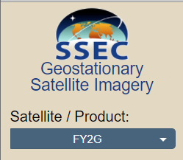
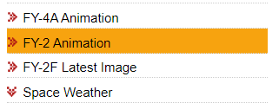
FY-4A from CMA
FY-4A is CMA (China Meteorological Administration) Geostationary. It is experimental. The operational satellite, FY-4B, was launched in early June 2021, look for data from that in early 2022
FY-2G is an older satellite, but giving imagery over China
You can register at the site to acquire data in near-real time via ftp
https://www.ssec.wisc.edu/data/geo/#/animation?satellite=fy2g
http://www.nsmc.org.cn/en/NSMC/Channels/Animation.html?reg=LAN-pas=VIS-col=GRA-t=24#tabs-1
More FY information from CMA is here: http://www.virtuallab.bom.gov.au/files/9316/2339/2765/RFG_meeting_8th_June_2021_PART_1.mp4

Slide 28
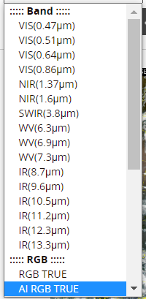
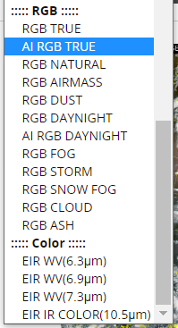
GK2A – From South Korea Meteorological Administration
The AMI, ABI and AHI imagers are all close cousins. Slight differences in channel selection. AHI doesn’t have 1.38 ; ABI doesn’t have 0.51 ; AMI doesn’t have 2.24
Imagery is here https://nmsc.kma.go.kr/enhome/html/satellite/viewer/selectGk2aSatViewer.do?view=basic
Products (many!) are here https://nmsc.kma.go.kr/enhome/html/satellite/viewer/selectGk2aSatViewer.do?view=product#
Archived imagery as well

Slide 29
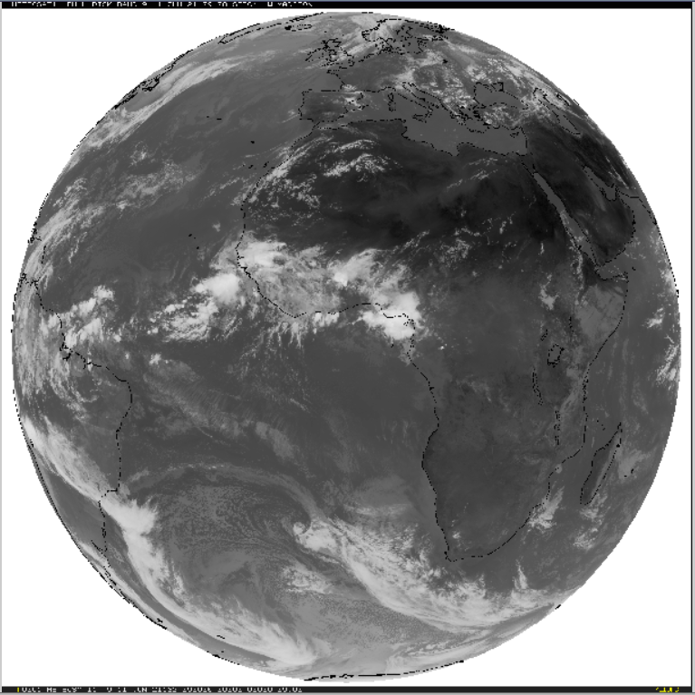
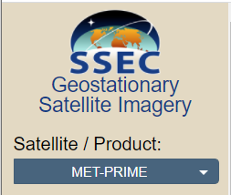
Meteosat-11 – primary satellite over Europe
11 Channels
Some imagery is free, some is not
Coverage over Africa, Europe, eastern Atlantic
EUMETVIEW: https://view.eumetsat.int/productviewer?v=default (basic imagery)
https://pics.eumetsat.int/viewer/index.html
https://www.ssec.wisc.edu/data/geo/#/animation?satellite=met-prime (11 bands)
Also on CIRA Slider: https://rammb-slider.cira.colostate.edu/?sat=meteosat-11 (all bands, and some RGBs)

Slide 30
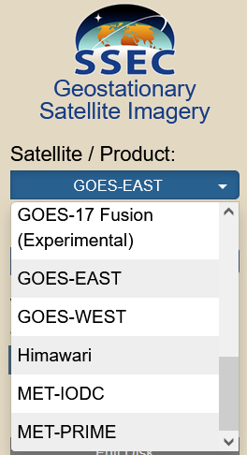
Meteosat-IODC (Indian Ocean Data Coverage)
This is a Meteosat (-8) satellite viewing the Indian Ocean and eastern Africa.
https://rammb-slider.cira.colostate.edu/?sat=meteosat-8 (CIRA Slider, all bands, and some RGBs)
https://www.ssec.wisc.edu/data/geo/#/animation (4 bands)

Slide 31
EWS-G1 – the former GOES-13
Electro-optical Infrared Weather System Geostationary – GOES-13 ‘adopted’ and repurposed by the US Space Force. Sits over the Indian Ocean
1st satellite owned by the US Department of Defense
https://www.ssec.wisc.edu/data/geo/#/animation?satellite=ews-g1
All 5 GOES Channels – remember those?
0.64, 3.9, 6.5, 10.7, 12.3

Slide 32
GOES-16 and GOES-17
Many many sites have current data. (I’ve sent around a list). Common to have ~24 hours online
Many many sites have RGB products.
Fewer sites have Level2 Products in real time. (RealEarth does)
Some sites have archived data
CIRA Slider goes back ~9 days
CSPP GeoSphere goes back ~2 weeks.
RealEarth goes back about a week

Slide 33
Global Composites
RealEarth has these https://realearth.ssec.wisc.edu

Slide 34
Are there any Sli.do questions to answer?

Slide 35
Many websites have imagery. Few websites have archived imagery
How do you get data to make archived imagery?
Like with so many data sources (from the USA) – they are in NOAA CLASS. Both radiances and Level 2 Products
Ways to display the data that you download are varied
McIDAS-V
Geo2Grid
SIFT

Slide 36
After logging in: Choose what you’re looking for
It can be kind of hard to see the drop-down menu

Slide 37
After logging in: Choose what you’re looking for
It can be kind of hard to see this drop-down menu
Click on the down arrow

Slide 38
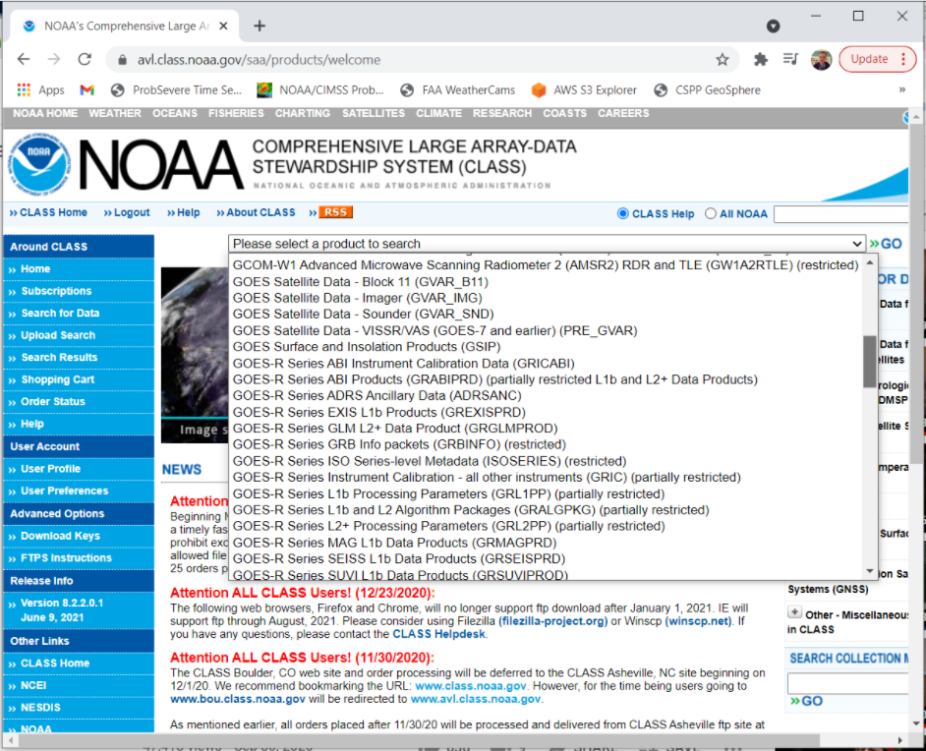
Notice how many there are!
You can scroll to see many products
Choose GRABIPRD (what does partially restricted mean?)

Slide 39
Click on Partially Restricted L1b and L2+ Data Products
Select the Start/End Date and Time
G16 and G17
Full Disk/CONUS/Meso1/Meso2
Channels
Product Types

Slide 40
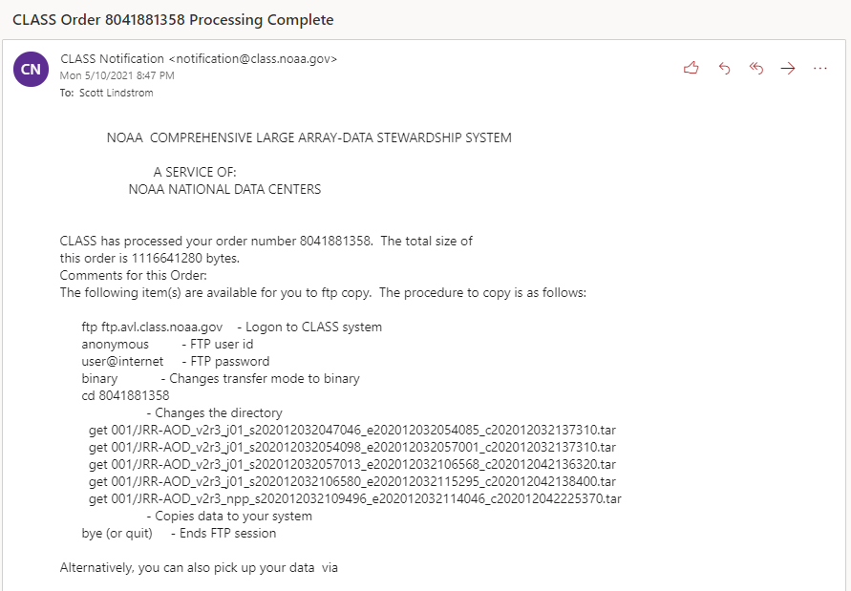
CLASS Sends an email when the data are ready
(This is an example of VIIRS data)

Slide 41
Once you have the data – how do you display it?
Geo2Grid can do this (based on Satpy)
SIFT can do this
McIDAS-V can do this

Slide 42
Geo2Grid
You’ll need a linux box for this
Download it : http://download.ssec.wisc.edu/files/csppgeo/ Documentation: https://www.ssec.wisc.edu/software/geo2grid/
You’ll get a gzipped tar-ball: put it in a unique directory, say /home/name/Geo2Grid
export $GEO2GRID_HOME=/home/name/Geo2Grid
There are shell scripts in $GEO2GRID_HOME/bin

Slide 43
Geo2Grid works well with AHI, AMI and AHI
../p2g_grid_helper.sh mapname -99.0 52.0 500 -500 960 720 > $GEO2GRID_HOME/mapfile.conf
-99.0 W (Longitude) 52.0 (Latitude) 500/-500 (resolution, meters) 960x720: size of domain
../geo2grid.sh -r abi_l1b -w geotiff -p firergb -g FIRERGB --grid-configs $GEO2GRID_HOME/FIRERGB.conf --method nearest -f /arcdata/goes_restricted/grb/goes16/2021/2021_05_18_138/abi/L1b/RadF/*s2021138190*.nc
-r reader: abi_l1b (also ahi_hsd ; ami_l1b); -w writer (geotiff); -p (product, do –list-products to see possibilities); -g gridded map name; --grid-configs – where is the map defined? ; --method nearest (how to interpolate?); -f where are the raw data sitting?
../add_coastlines.sh --add-borders --borders-outline='blue' --borders-resolution=f --add-grid --grid-text-size 20 --grid-d 5.0 5.0 --grid-D 5.0 5.0 GOES-16_ABI_RadF_firergb_20210518_190019_FIRERGB.tif
Documentation here: https://www.ssec.wisc.edu/software/geo2grid/utilscripts.html or in Polar2Grid

Slide 44
SIFT: Satellite Information Familiarization Tool
This is a tool that can be used in Linux / MacOS / Windows environments
Download it from here: https://sift.ssec.wisc.edu
Download the data to some place accessible

Slide 45
SIFT Window

Slide 46
SIFT Window
The first thing you’ll want to do: Load Data. Ctrl-o opens the File Wizard

Slide 47
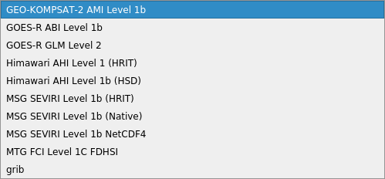
The File Wizard steps you through opening data

Slide 48
SIFT is useful for developing RGBs
This is possible in Geo2Grid as well, by adding definitions to abi.yaml (or ahi.yaml) in $GEO2GRID_HOME/etc/satpy/composites/ and $GEO2GRID_HOME/etc/satpy/enhancements/ but in SIFT things change on the fly, allowing you to quickly iterate to a solution.

Slide 49
Different windows that can pop out of the main SIFT window – Layers that are loaded, and RGB bounds (which you can see when you create a Composite)
Under RGB Bounds, you see drop-down menus that allow you to choose any Layer that is listed – either the single bands or, if you create them, algebraics.
As you change values, you’ll see instantaneous changes in the window behind.
Layers show what is loaded. Then I typed ‘C’ (alternatively, under the ‘Layer’ tab, see Create Composite; ‘Create Algebraic’ under that same tab can be used to create a difference field)

Slide 50
Altered RGB

Slide 51
Other accumulators/aggregators of imagery
erddap! https://coastwatch.pfeg.noaa.gov/erddap/index.html
Aerosol Watch: https://www.star.nesdis.noaa.gov/smcd/spb/aq/AerosolWatch/
Have any been put in the Q&A in Slido?

Slide 52
ERDDAP: https://youtu.be/6DSa0qh7wNQ
The Front Page is shown at left. ERDDAP is a former acronym – kind of like ‘COMET*’ – that has outgrown its original meaning (Environmental Research Division’s Data Access Program)
Think of ERDDAP as a gateway to many types of data. This presentation focuses on oceanographic data
There is a helpful Search function – do you see it?
*Cooperative Program for Operational Meteorology, Education and Training

Slide 53
Useful resources for ERDDAP
The amount of data in ERDDAP can overwhelm in a “where do I start” kind of way.
Here’s a short YouTube video on getting one type of data: https://www.youtube.com/watch?v=18xZoXu1USM
The “Search” utility (upper right part of the main window) can help winnow down to what you actually need to view
Search on “SSTs” yields a long list:
Notice the “Make a Graph” column!

Slide 54
Aerosol Watch: https://www.star.nesdis.noaa.gov/smcd/spb/aq/AerosolWatch/
Very long archive

Slide 55
Do you have any questions?
scott.lindstrom@ssec.wisc.edu or you can call me
Thanks for your attention, and enjoy using Satellite Data

