Slide 1
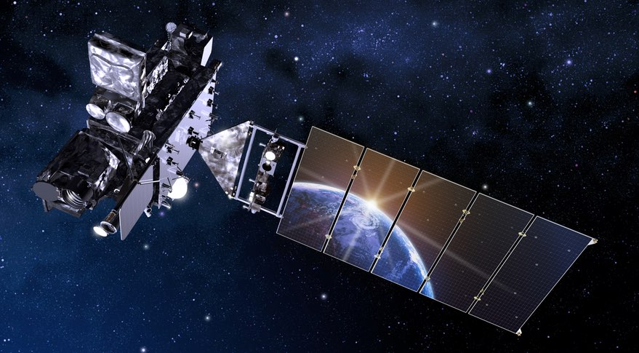

Satellite Training at CIMSS that is relevant to the Pacific Rim
Scott Lindstrom , Tim Schmit ¹, Mat Gunshor, Scott Bachmeier, Jordan Gerth ², Dave Hoese
University of Wisconsin-Madison
Cooperative Institute for Meteorological Satellite Studies
¹ NOAA/NESDIS/STAR
² NOAA/OBS
AOMSUC-10 Melbourne Australia 2019

Slide 2
Thank You!
Kathy Strabala, Liam Gumley, Mike Pavolonis, Andy Heidinger, Dan Lindsey, Janel Thomas-Fry, Chris Schmidt, Jim Nelson, Jeff Key, Dan Bikos, Ed Szoke, Bernie Connell,….

Slide 3
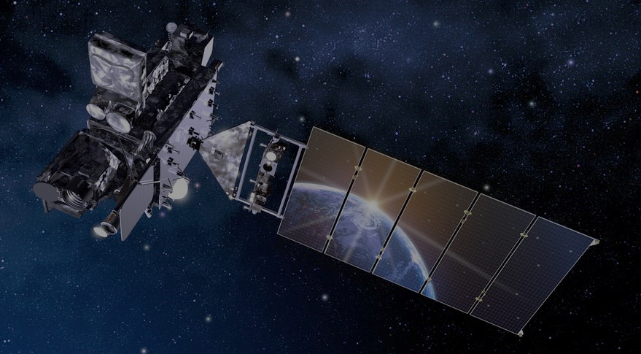
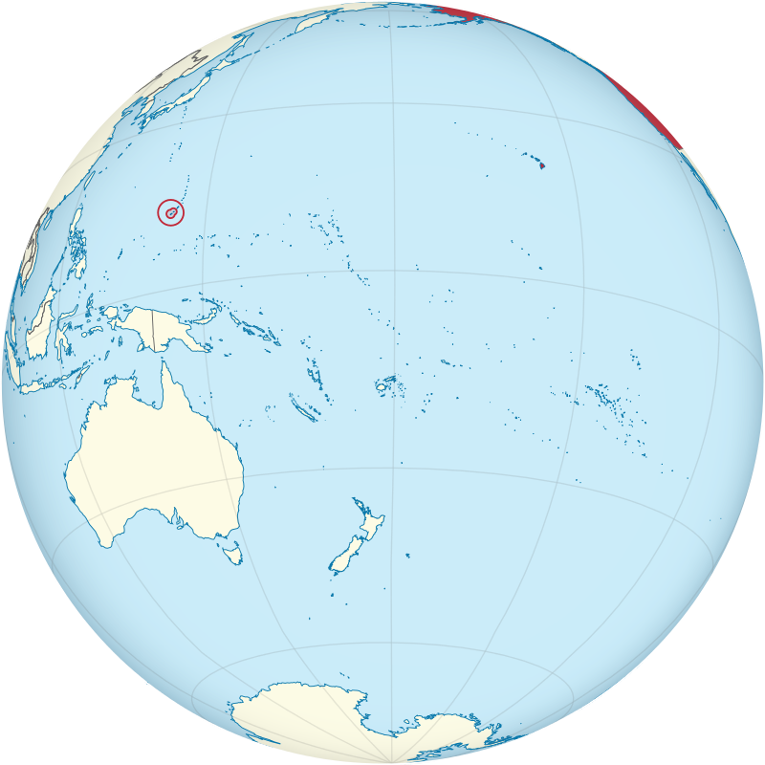
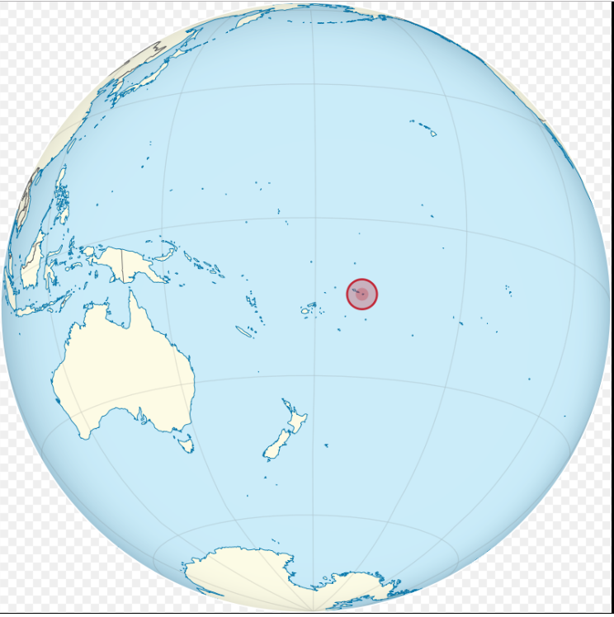
Why does the USA create training material for the Pacific?
NWS WFO Honolulu
NWS WFO Guam
NWS WSO Pago Pago

Slide 4
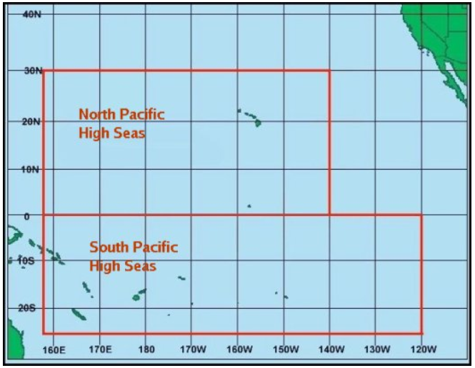
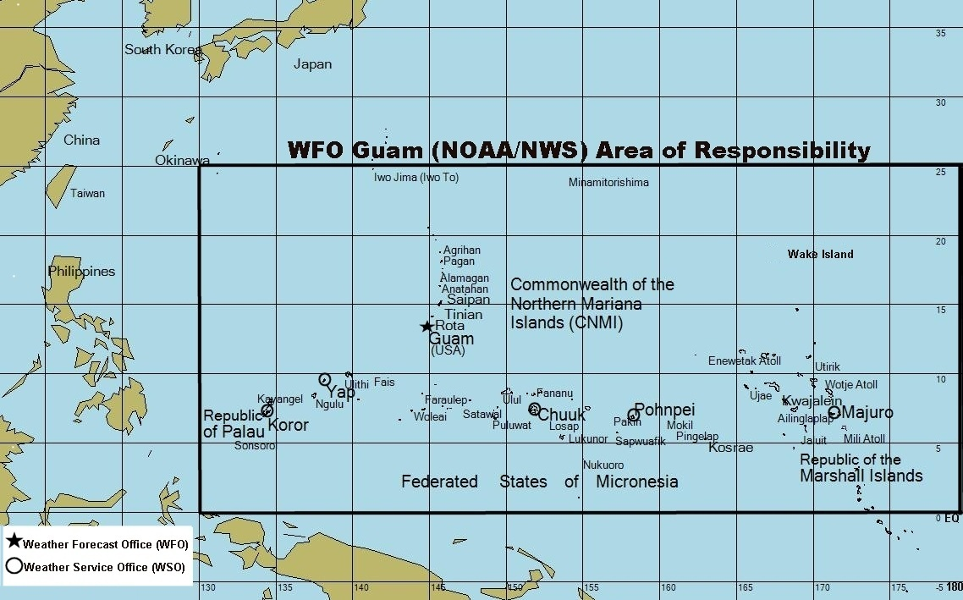
Why does the USA create training material for the Pacific?

Slide 5
Satellites
Himawari-8 (140 E)
  Advanced Himawari Imager (AHI) ; Operational since July 2015
GOES-17 (137 W)
  Advanced Baseline Imager (ABI) ; Launched March 2018 ; Feb 12 2019
GEOKOMPSAT-2 – operational since July 2019 (128 E)
Suomi-NPP / NOAA-20
  Visible Infrared Imaging Radiometer Suite (VIIRS)
  Launched October 28 2011 (S-NPP), November 28 2017 (NOAA-20)
Other Polar Orbiters
  GCOM, Metop-A/B/C, Terra/Aqua

Slide 6
How do you know where MESOs were?
GOES-R and Himawari-8 have meso sectors. If you’re working on a past event: How do you find the location of the meso sector easily?
https://www.ssec.wisc.edu/~rickk/goes16-meso-2019.html

Slide 7
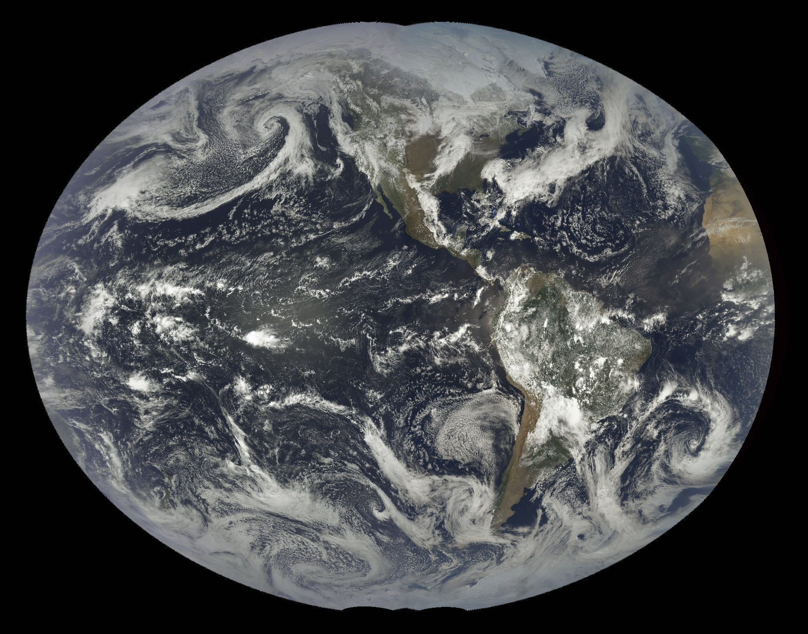
GOES-R Series: From New Zealand to Africa
But how do you display the data

Slide 8
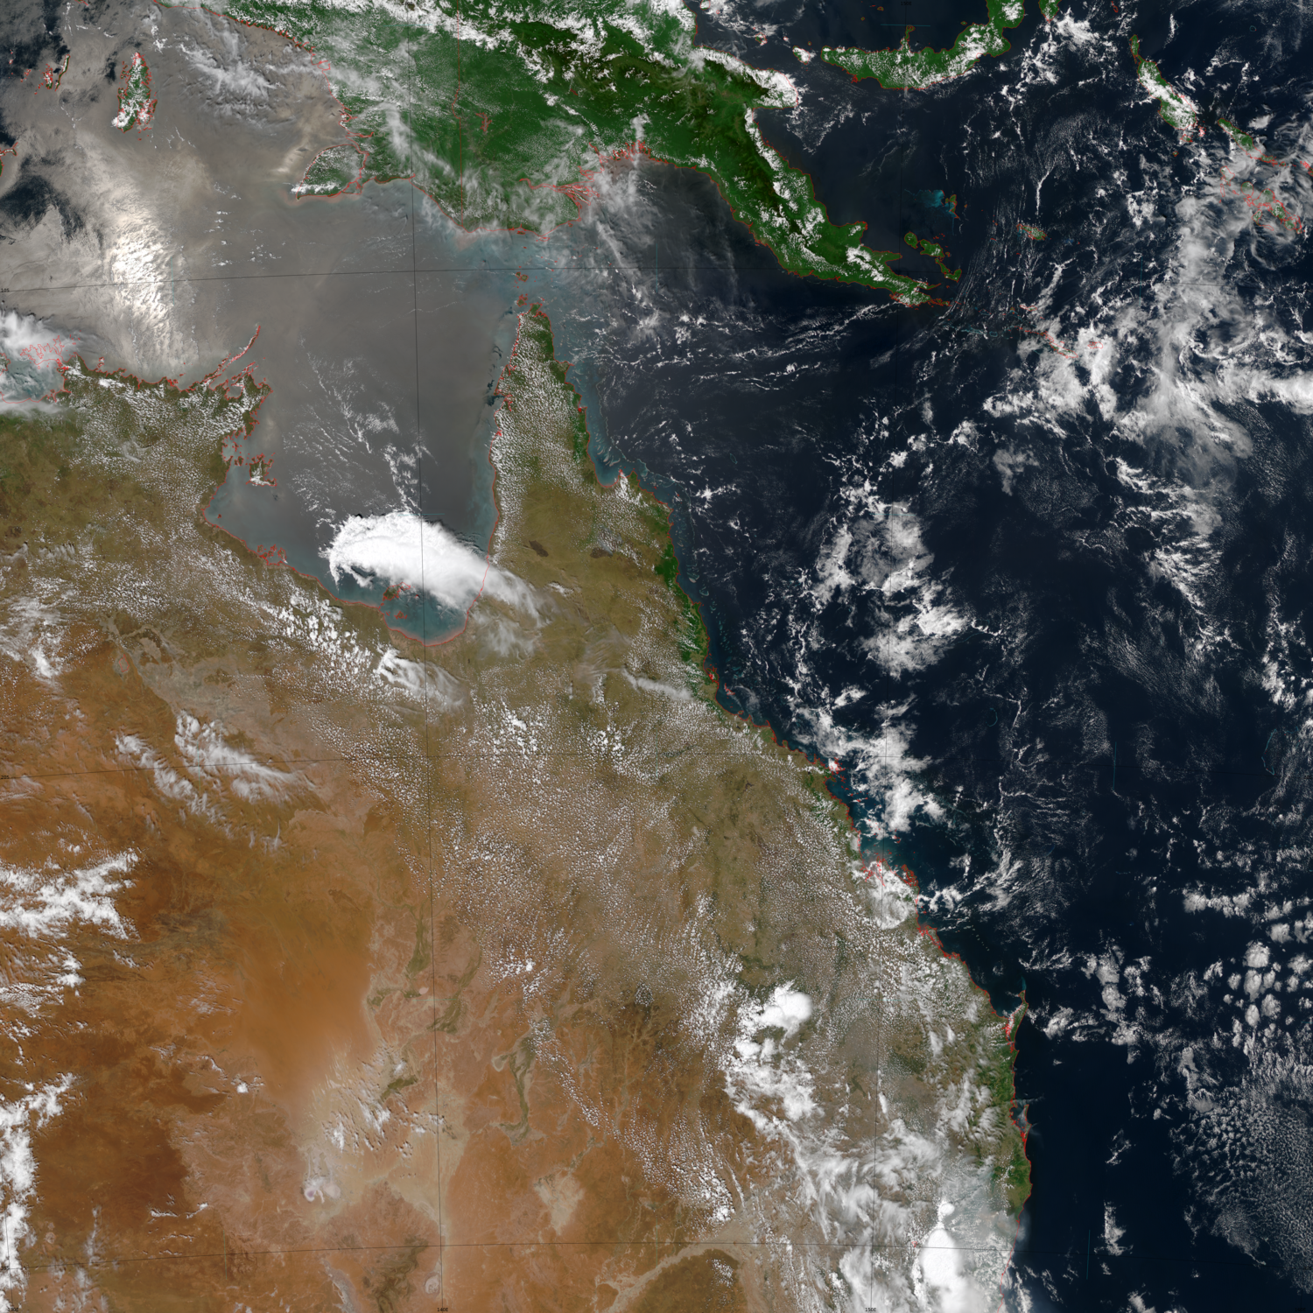
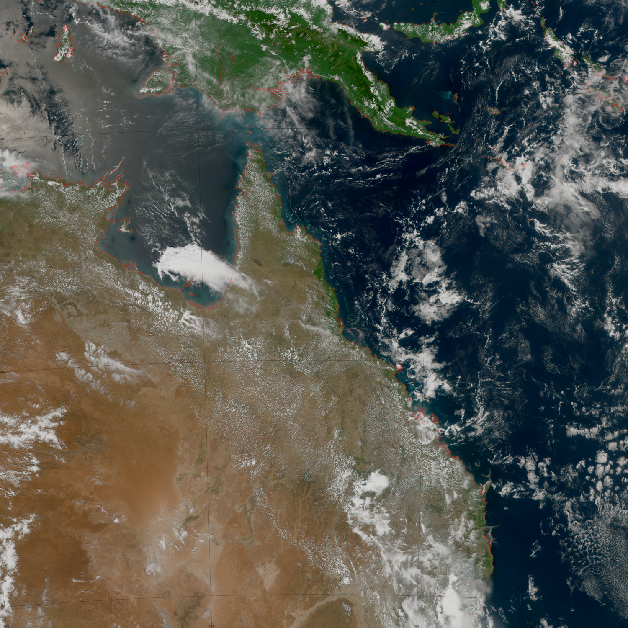
Satpy
Python-based satellite library (a global open source library with contributors at CIMSS) can be used to view Himawari-8 and GEOKOMPSAT-2 imagery.
Converts netCDF files (GEOKOMPSAT-2/GOES-R) or HSD files (Himawari-8) to imagery
Himawari-8
GEOKOMPSAT-2

Slide 9
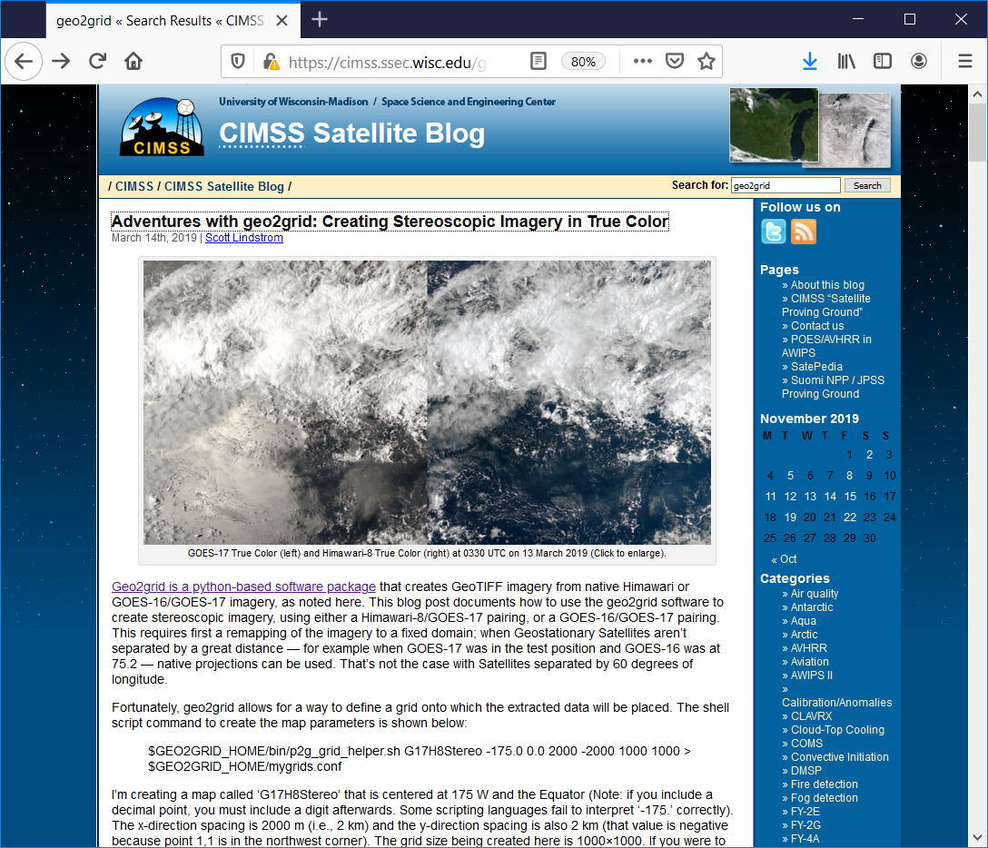
Satpy
Instructions are online at the CIMSS Blog
How do you access the data?
Himawari-8
GEOKOMPSAT-2

Slide 10
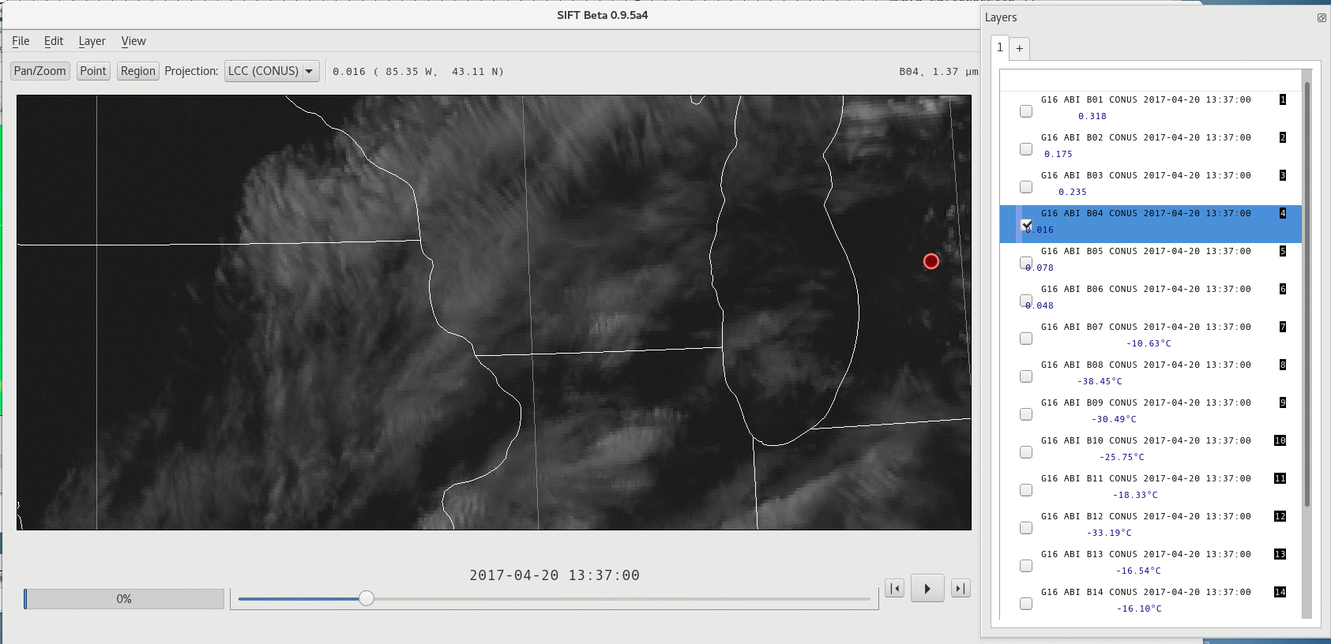
SIFT: Satellite Information Familiarization Tool
https://sift.ssec.wisc.edu
Includes Laboratory Exercises!

Slide 11
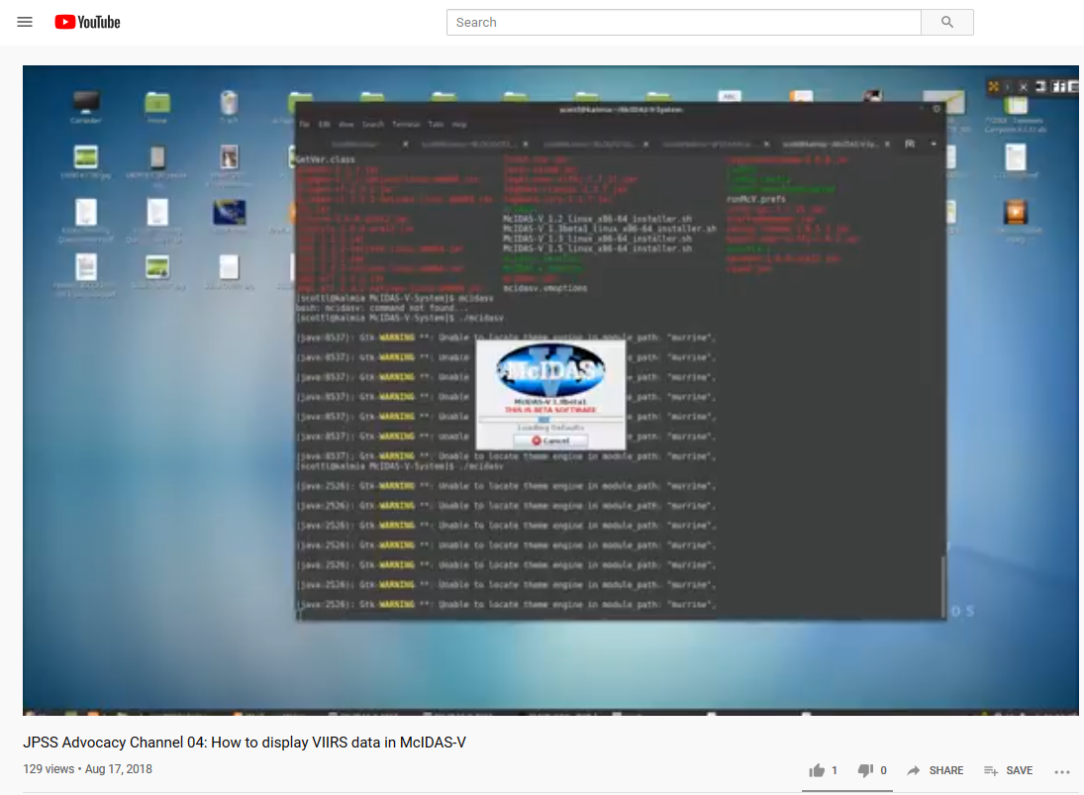
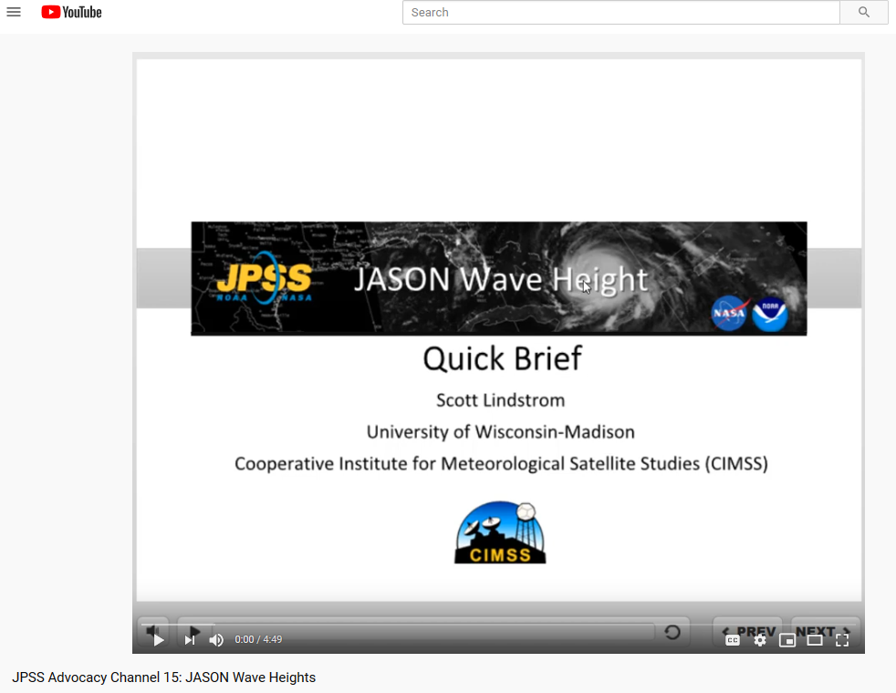
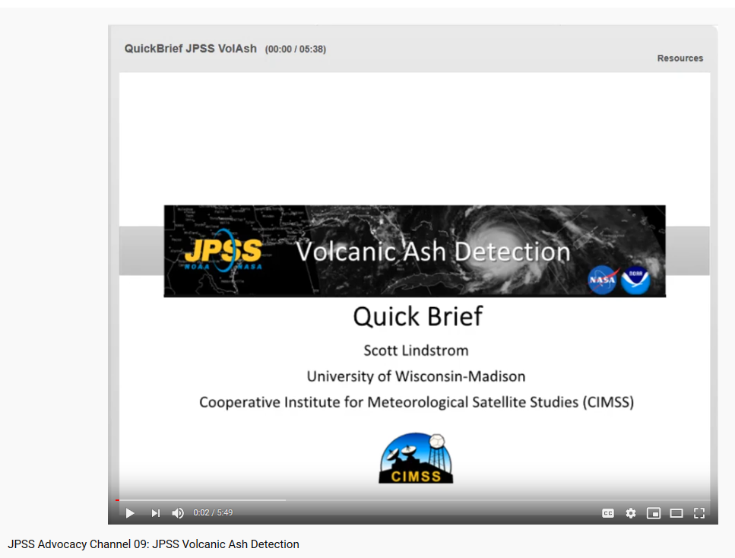
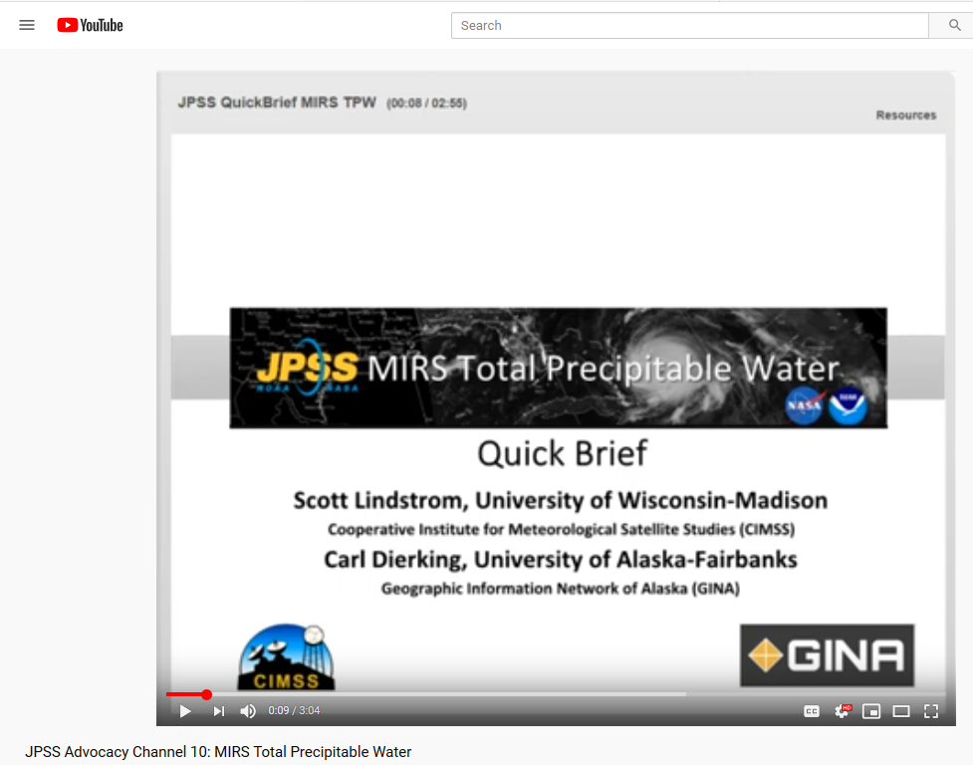
Videos with JPSS Information
JPSS Advocacy Channel on YouTube
  Short Training videos on a variety of topics related to Polar Orbiters: How to display the data, How to interpret the products, etc.

Slide 12
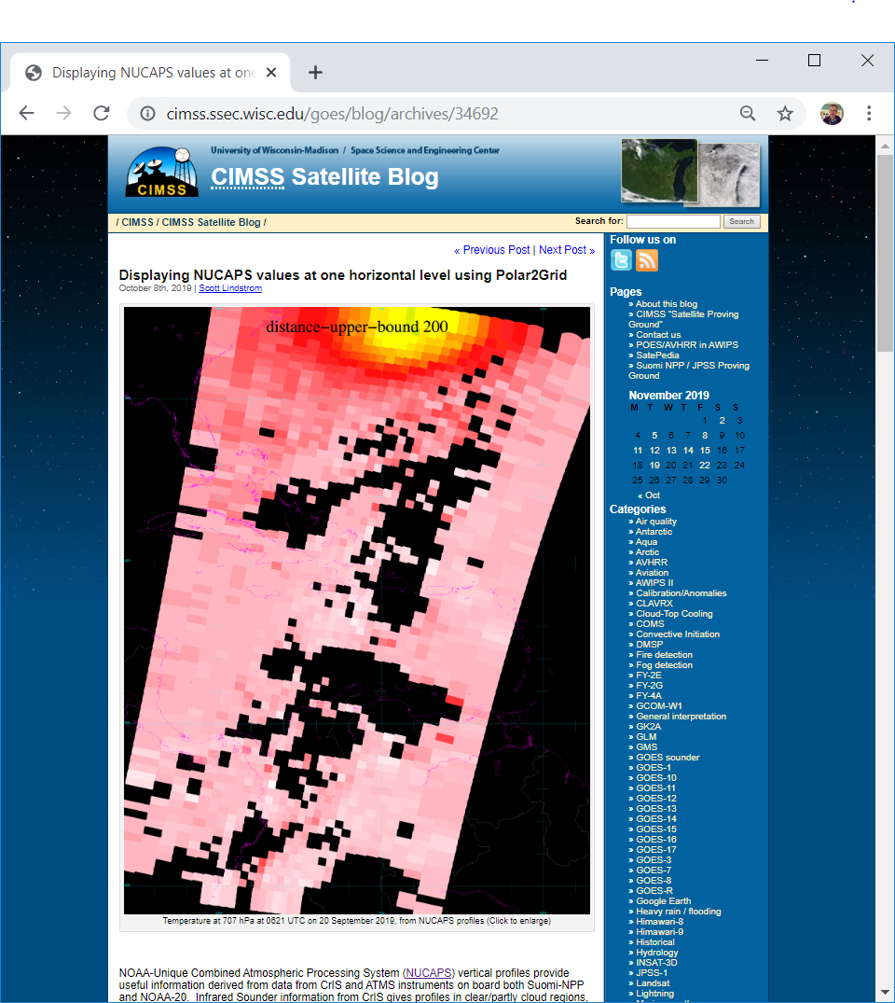
JPSS Information
You can find this on the CIMSS Blog.
  How to Display JPSS data? (Polar2Grid)
  Searchable by satellite
  https://cimss.ssec.wisc.edu/goes/blog/archives/34692
You can also display data using Satpy and other python libraries
Direct Broadcast Antenna Labs:
  https://cimss.ssec.wisc.edu/dbs/

Slide 13
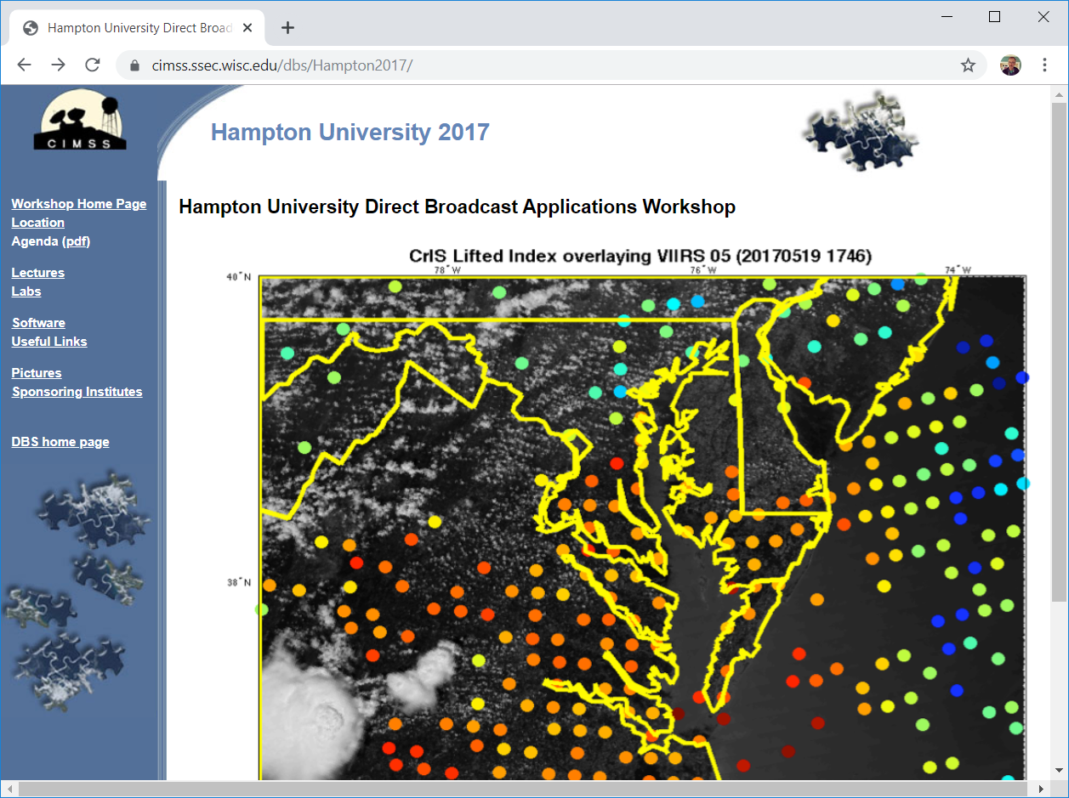
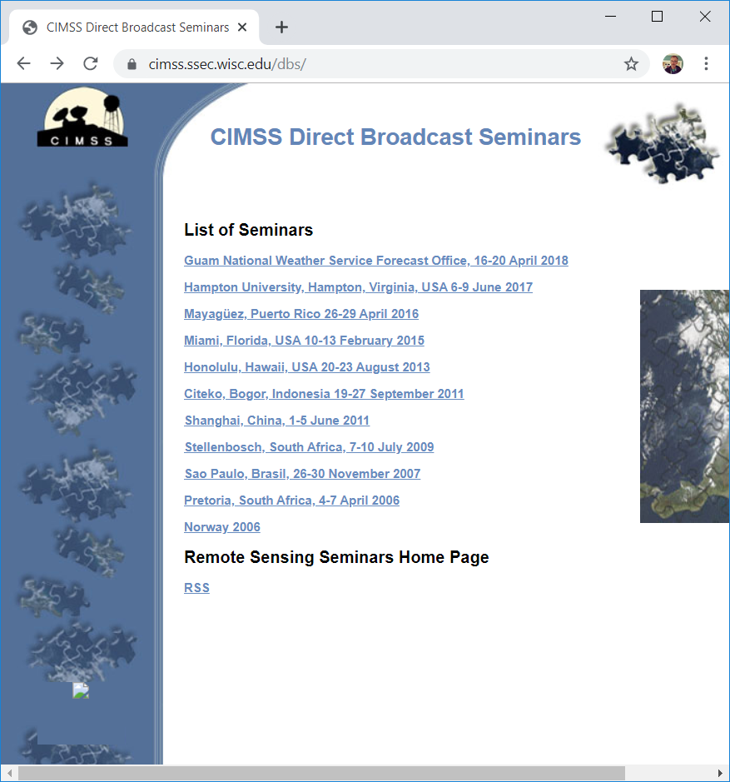
JPSS Seminars

Slide 14
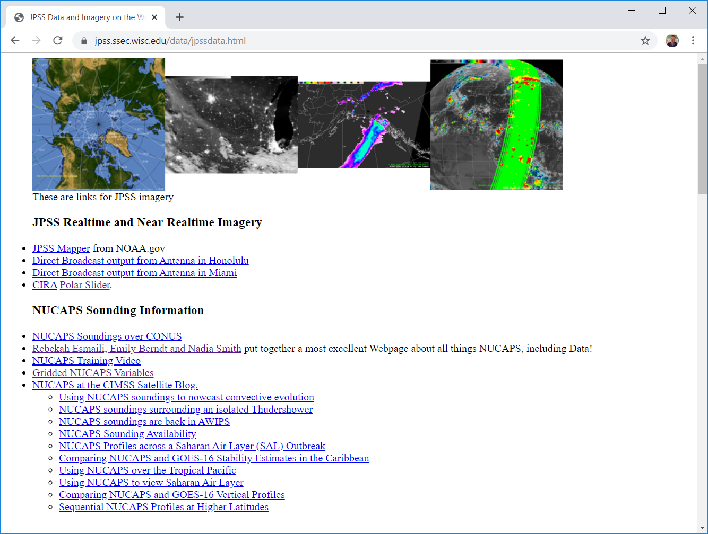
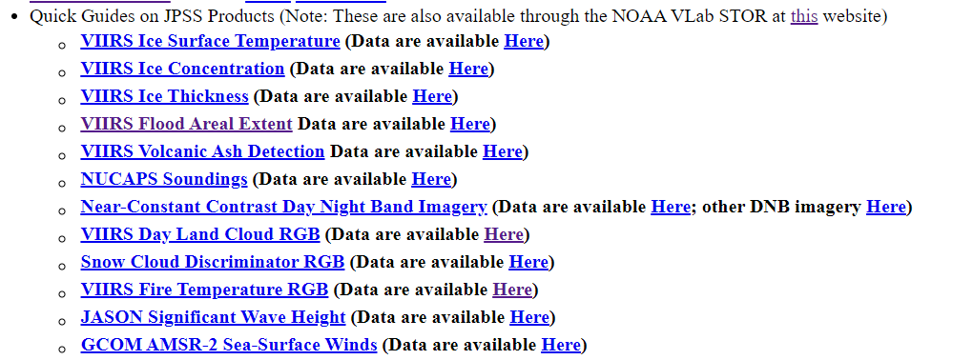
Collection of JPSS Information
https://jpss.ssec.wisc.edu/data/jpssdata.html

Slide 15
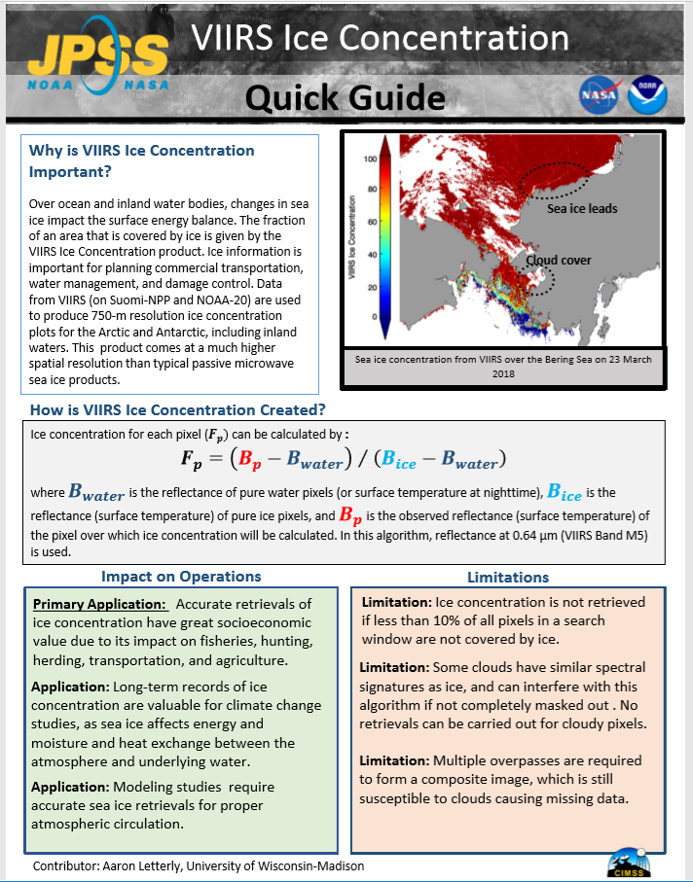
Quick Guides
One or Two-Page Tutorials that give you information about the product
JPSS and GOES-R
Created with funding from NOAA NWS OCLO and FDTD
Available for all 16 Bands on ABI (+ AHI/AMI Green Band) and many Level 2 (GOES-R) Products and JPSS Products and for RGBs
Sometimes link to information (like ATBDs for L2 products)
Available online: (LINK) -- find them by searching on ‘CIRA Quick Guides’

Slide 16
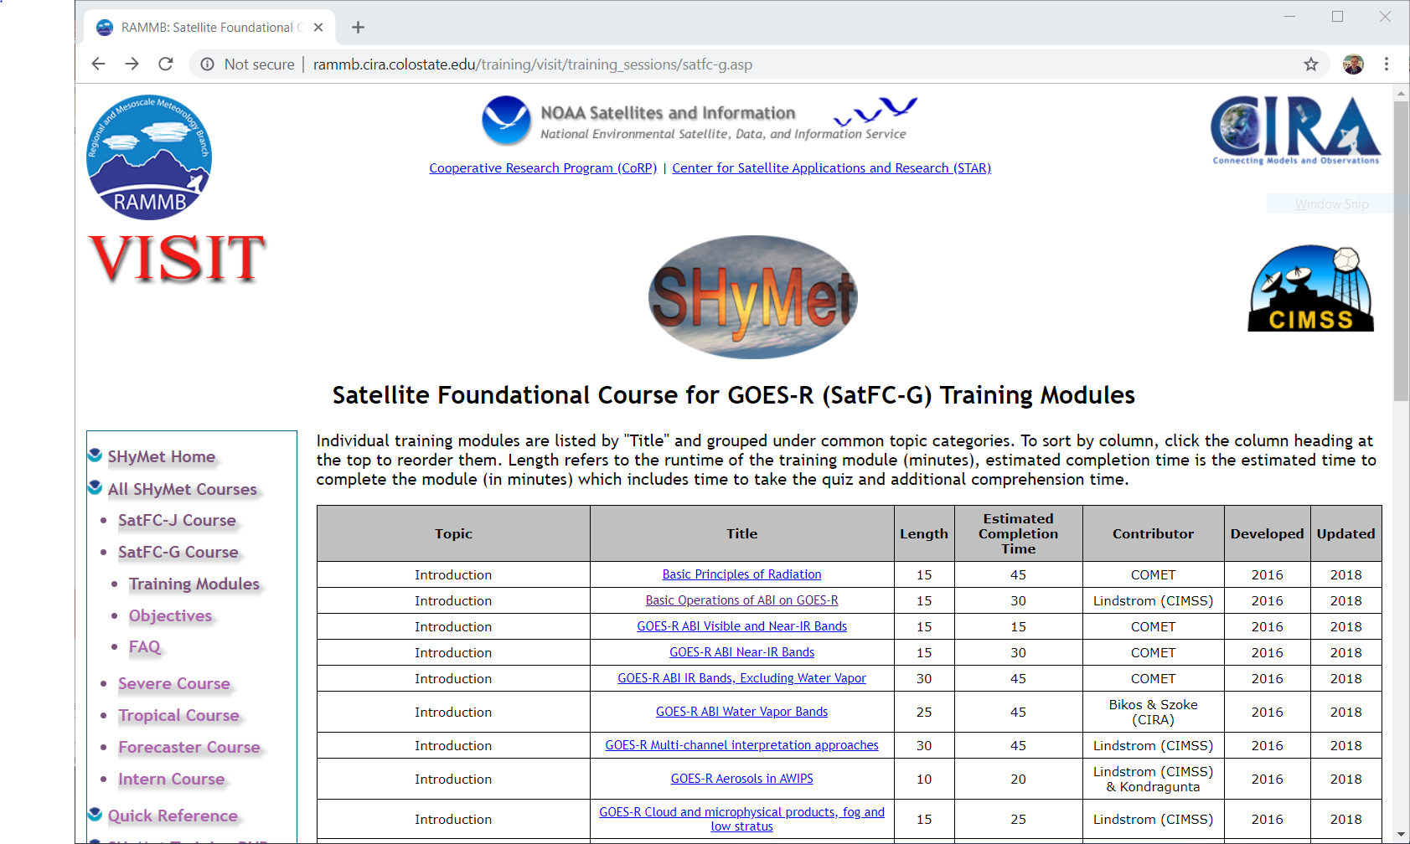
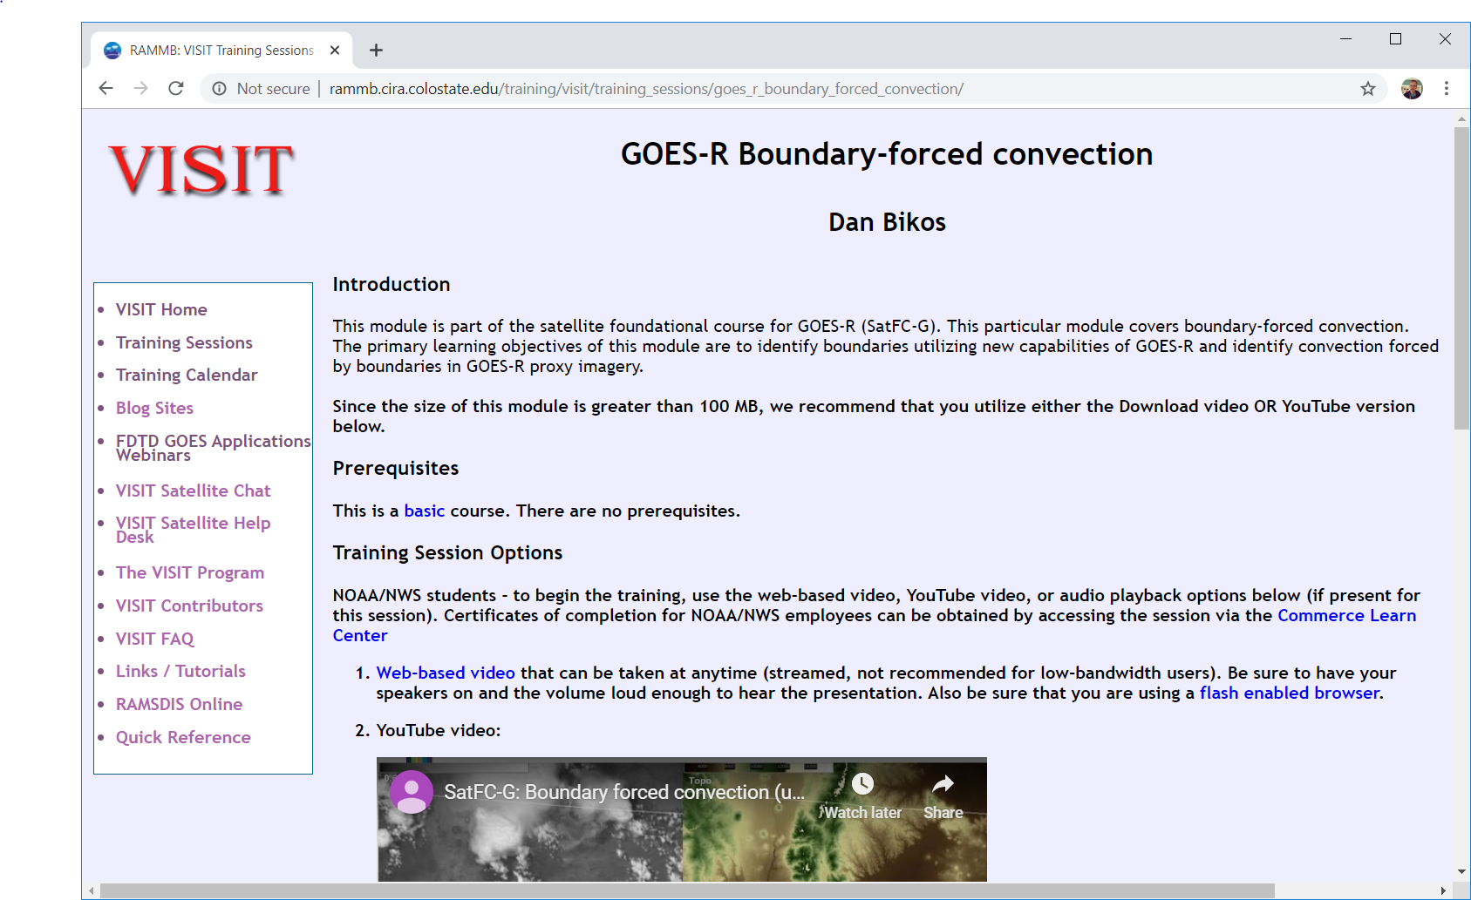
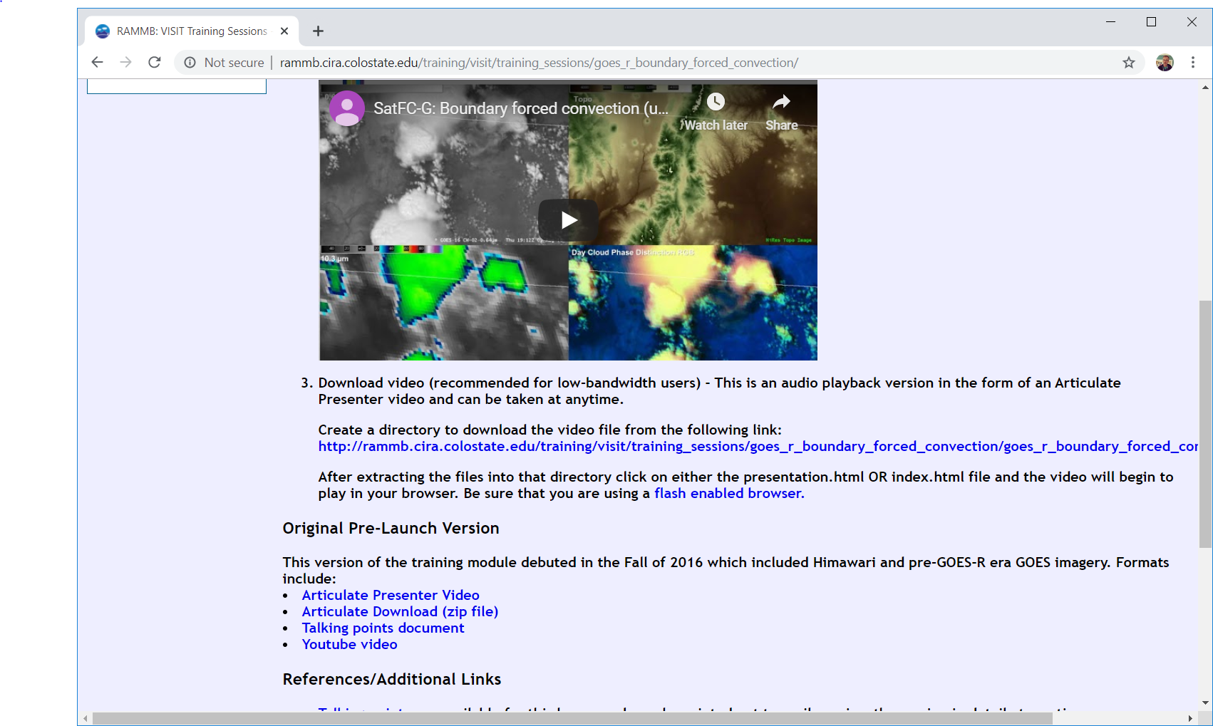
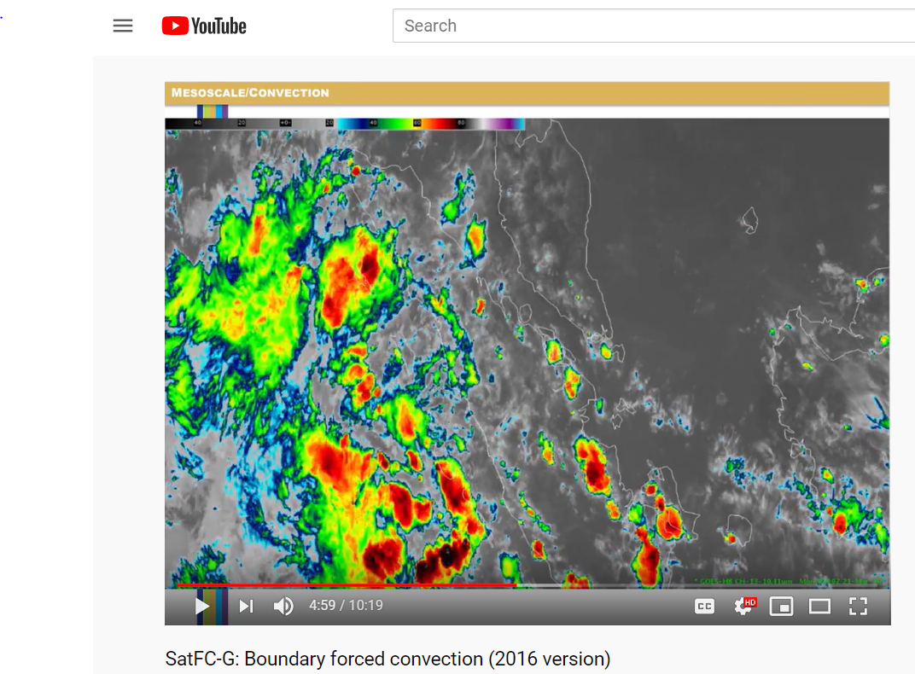
How about Himawari-based training?
Satellite Foundation Course for GOES-R – originally was created with Himawari-8 imagery. All of the training is available. (Look in YouTube and search for ‘SatFC_G 2016’

Slide 17
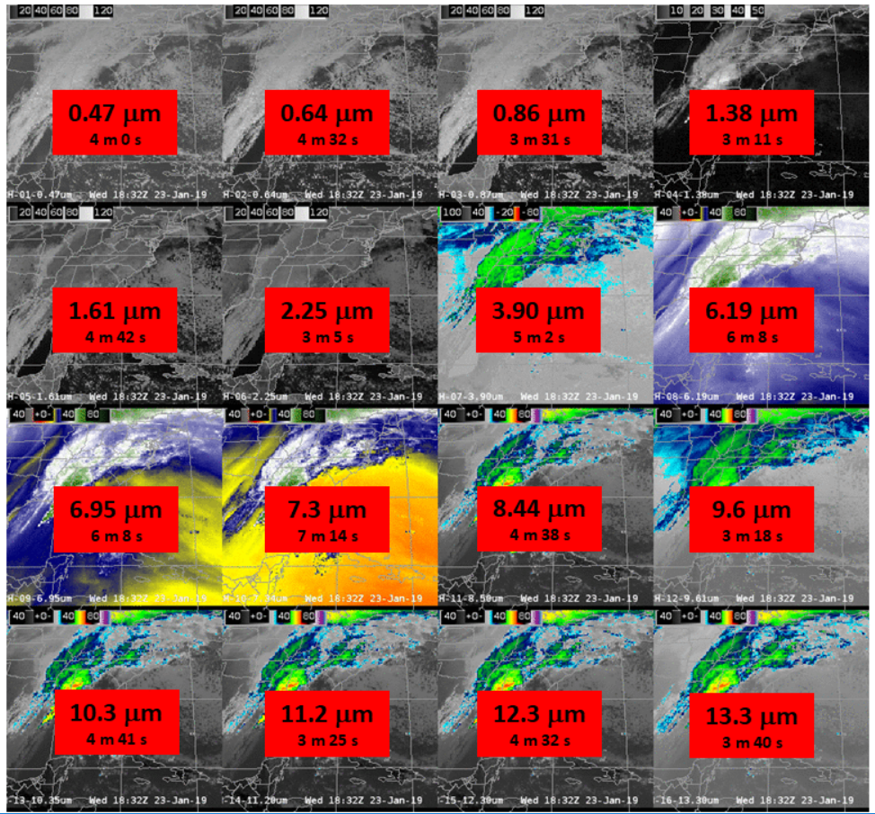
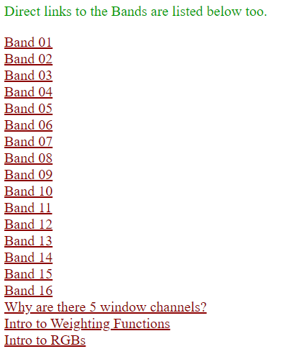
SHyMet Training
Not Applications-based (those are in the process of being made
Website:
http://www.ssec.wisc.edu/~scottl/SHyMet/

Slide 18
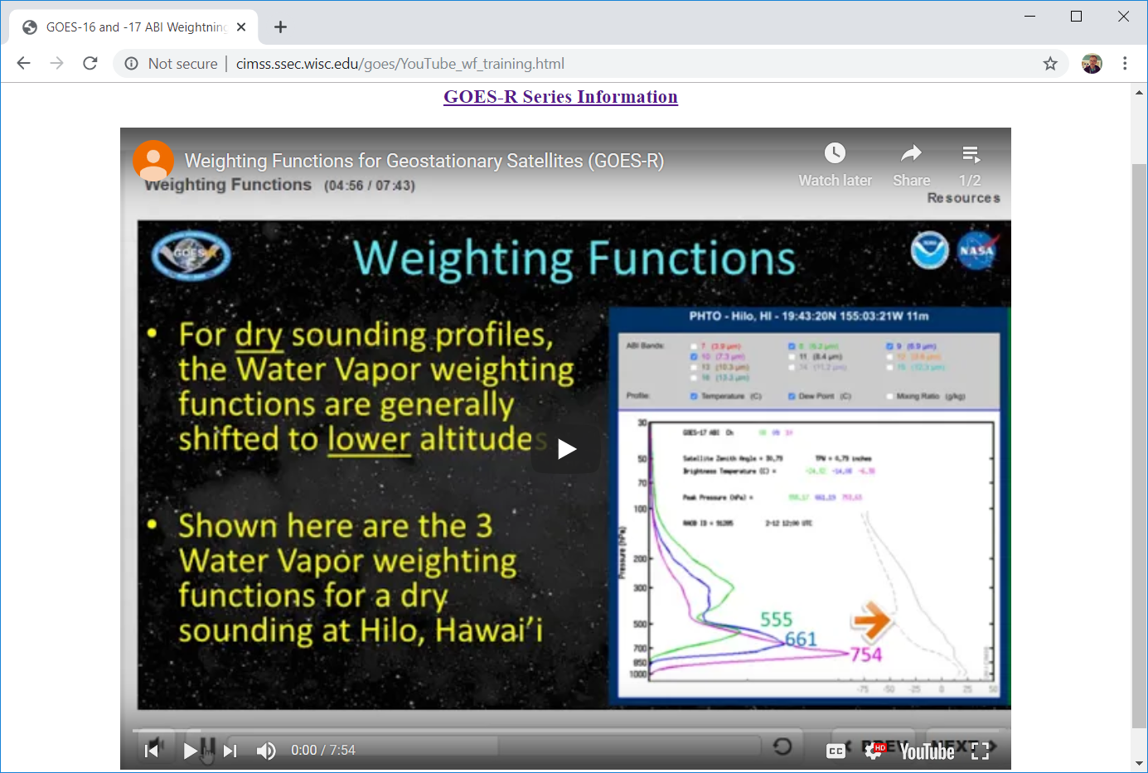
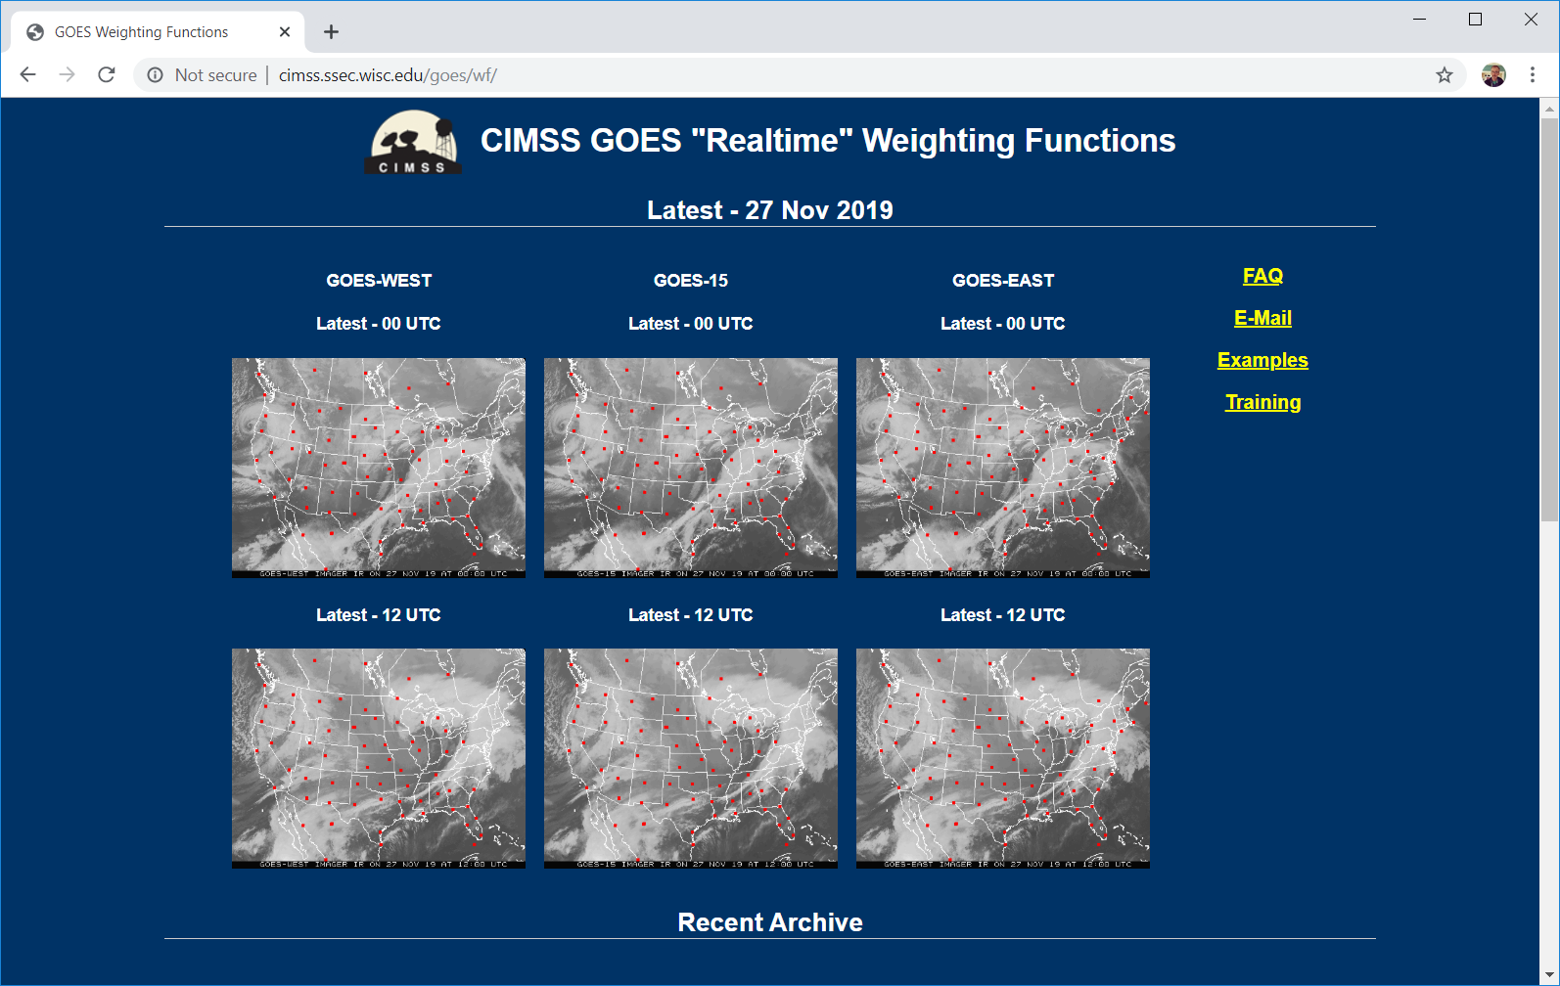
Weighting Functions for Water Vapor Channels
http://cimss.ssec.wisc.edu/goes/YouTube_wf_training.html

Slide 19
CIMSS Training
Gives useful information on Satellite Scanning, Bands, etc.
Tells you how to find / access / display data
Provides lab exercises for both Geostationary and Polar Orbiting satellites
Available as documents and/or videos
Help users understand the science behind the observations and also the uses of the data in the Decision Support Process

Slide 20
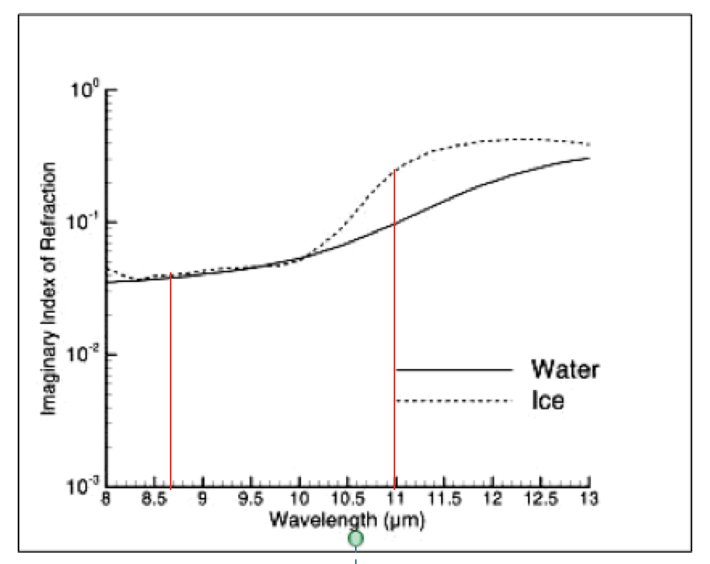
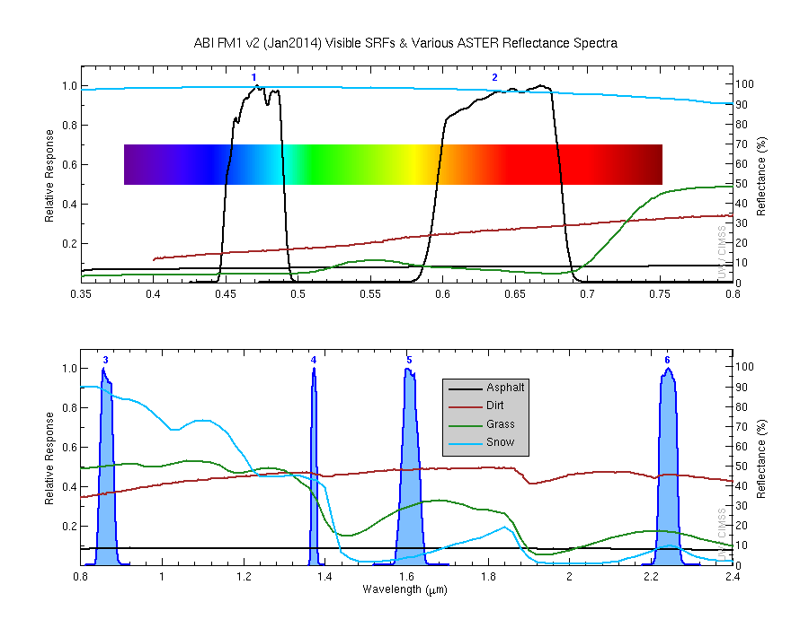
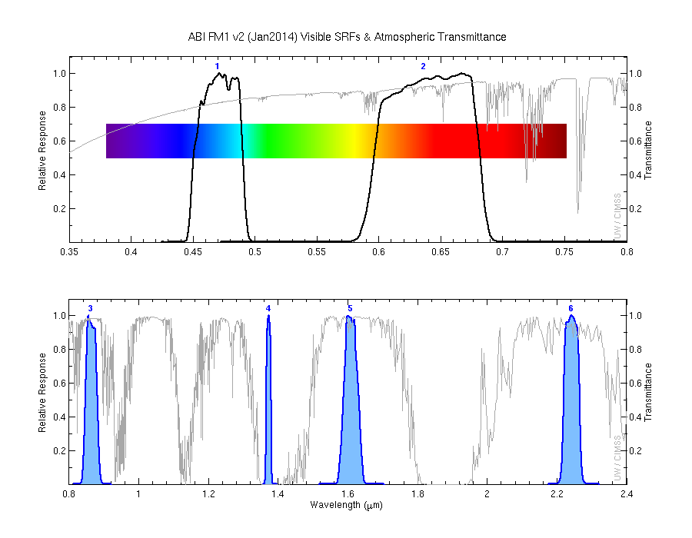
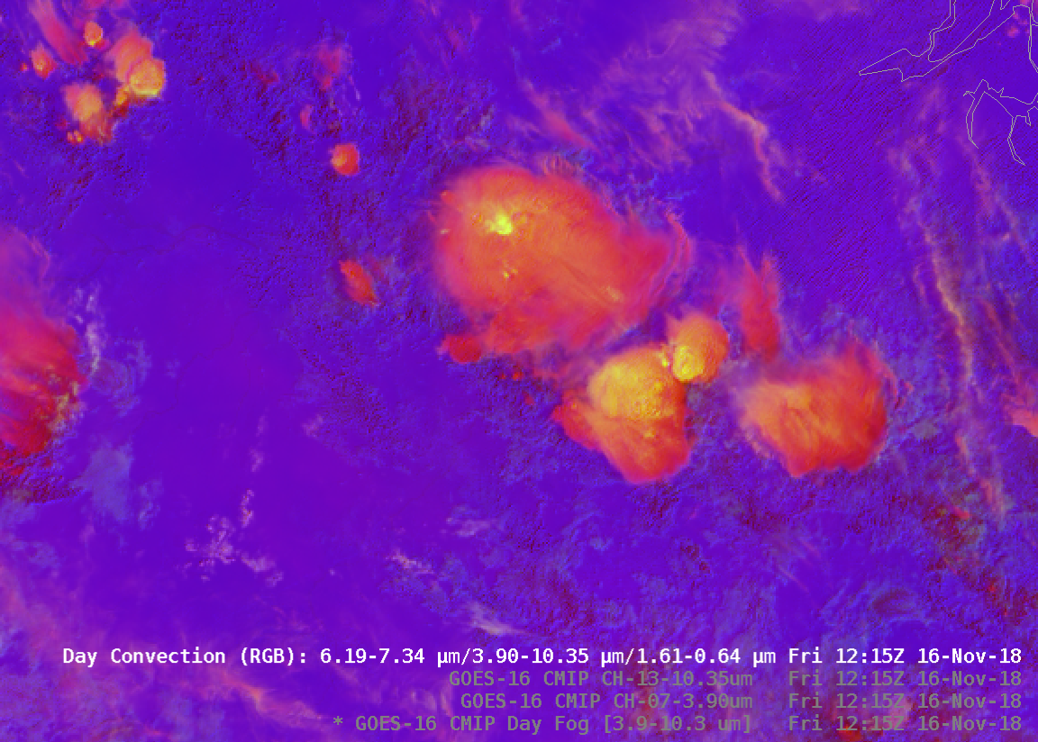
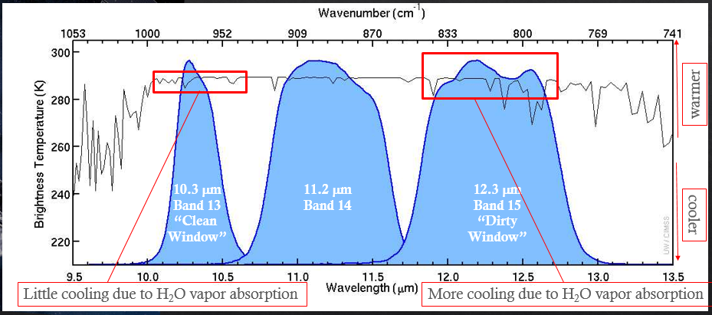
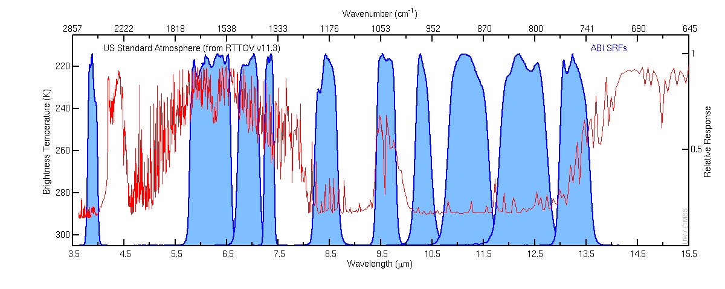

Slide 21
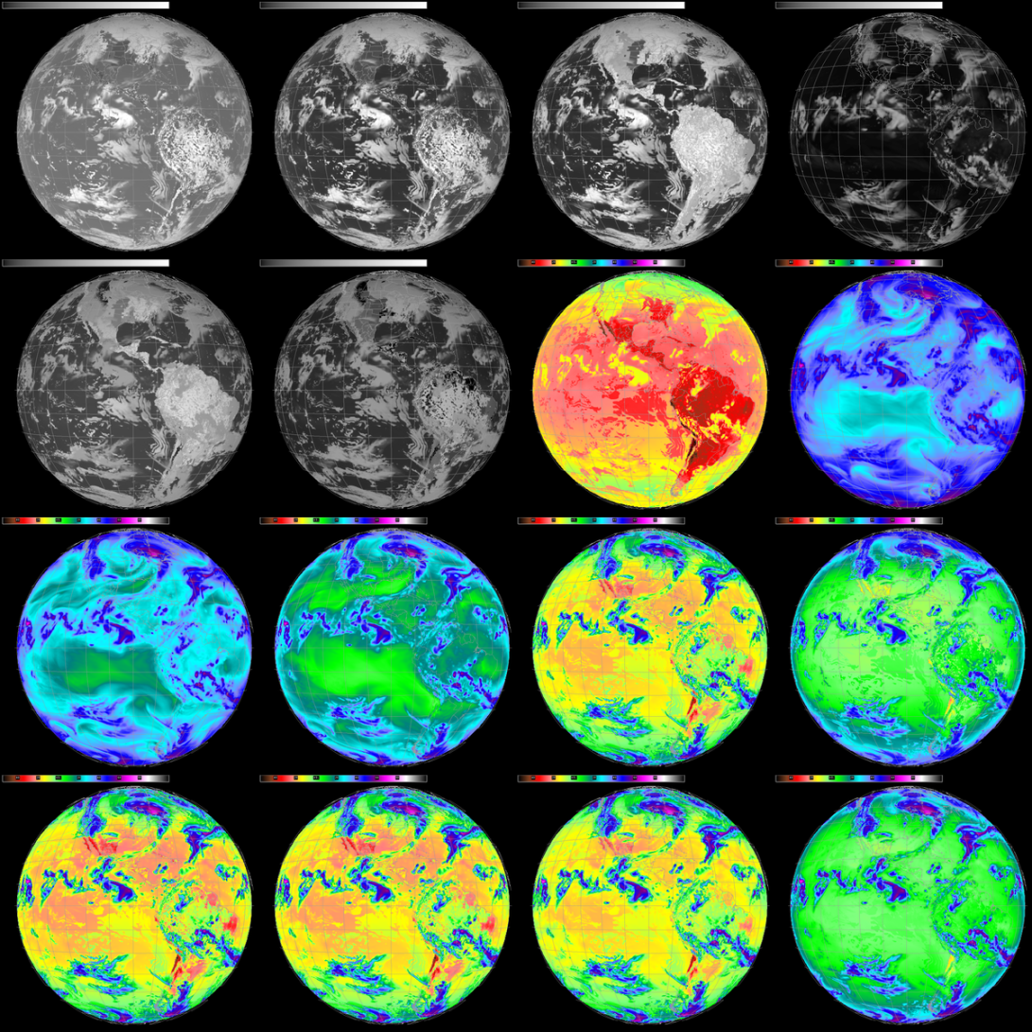
0.47 μm
0.64 μm
0.86 μm
1.37 μm
Thank You
Scott Lindstrom
Scott.Lindstrom@noaa.gov
608 263 4425
https://cimss.ssec.wisc.edu/training
1.6 μm
2.2 μm
3.9 μm
6.2 μm
6.9 μm
7.3 μm
8.4 μm
9.6 μm
10.3 μm
11.2 μm
12.3 μm
13.3 μm
Future GOES – 16 Channels, 2 VIS, 4 Near-IR, 10 IR
Notes:
Here's a graphical image of future GOES channels, centered at 89.5 W. In summary: A lot more data is set to flow from GOES-R!

