Slide 1
Training on Polar Hyperspectral Soundings and Microwave Data and ABI modeling output
Bill Smith, Sr., Anthony DiNorscia
Scott Lindstrom, Lee Cronce
Hazardous Weather Testbed May/June 2024

Slide 2
PHS
PHS: Polar Hyperspectral Soundings
The Quickest explanation
With each Polar Orbit, associations between JPSS sounder data (infrared and Microwave) and ABI observations are established
Those associations are stepped forward in time with each ABI scan, and used to initialize a numerical model every hour
This method takes advantage of the excellent spectral resolution on LEO satellites, and the excellent spatial/temporal resolution on ABI
The generated profiles include infrared and microwave vertical profile, and ABI horizontal and temporal, resolution information

Slide 3
Dual Regression Retrievals
Single field-of-view (FOV), all-sky condition, retrievals provide atmospheric profiles and surface and cloud parameters from hyperspectral sounders
Hyperspectral data alone cannot tell you a value at a specific level – which is what you need for a numerical model (because the top-of-atmosphere observations from the sounding instruments could come from a variety of temperature/moisture distributions) within a deep (~ 150-hPa) atmospheric layer
Retrievals give the most likely distribution of temperature/moisture subject to the constraints of the model used in the retrieval
The final regression retrieval uses a model-based first guess field, in place of a single global average sounding, to sharpen the vertical resolution in the original global regression retrievals.
How does ABI data acquire better spectral resolution from Polar data?
How does Polar data acquire better spatial and temporal resolution from ABI?

Slide 4
Flowchart that describes how ABI data acquires better spectral resolution
Start with ABI retrievals
All the ABI retrievals within the polar footprint
are averaged to match the horizontal resolution of the polar footprint. The results are Lores ABI retrievals.
Find the N=10 Lores ABI retrievals that most closely match (in space, time, and in profile T and RH values) the Hires (full horizontal resolution) ABI retrievals
Average the 10 PHS profiles corresponding to the 10 closest Lores profiles, weighted according to their sequence number (i.e., the closest profile getting the highest weight in the profile average)
HiresPHS(p)= HiresABI(p)+(PHSavg*– LoresABIAvg*)
* 150 hPa vertical average centered at level p
*
* PHS fusion errors corrected using known ABI Lores2Hires differences

Slide 5
How far into the future do these computed associations hold?
They don’t have to hold very long, because there are 4 Polar Orbiters being used.
IASI from Metop (-B and –C) samples over CONUS ca. 01-04 and 14-17 UTC
CrIS from NOAA-20/NOAA-21 samples over CONUS ca. 06-11 and 17-22 UTC
In practice, only the most current Polar data within 9 hours of latest ABI data is used.

Slide 6
What’s the most important information?
Moisture
Sounder information from CrIS (NOAA-20/NOAA-21) and IASI (MetOps) leads to a more accurate definition of the moisture distribution than might be occurring in the numerical model
Temperature
Usually, temperature is well-forecast, so the additional temperature information from the polar orbiters is not quite so impactful as the moisture

Slide 7
The moisture also changes the wind fields during the assimilation
Hourly ABI fused PHS data are assimilated during a 3-h run of the model to adjust the winds forcing the dynamic fields to be consistent with the observed thermodynamic variations being assimilated
Then the 4-km model is initialized and stepped forward in time
At HWT 2022/2023: PHS model output was used most often for nearcasting
Identify regions where convective initiation is either most likely to start (or most likely to be suppressed)

Slide 8
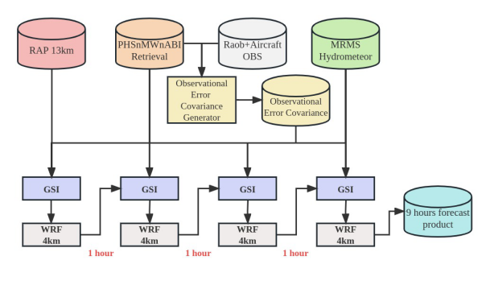
System Workflow in 2022 HWT
Prototypical demonstration that infrared sounding information can improve hazardous weather prediction
System Workflow in 2023 HWT
2023 Updates (maintained for 2024)
Passive microwave sounding retrieval added
Routinely updated observational error covariance
Hydrometeor fields update in analysis cycles

Slide 9
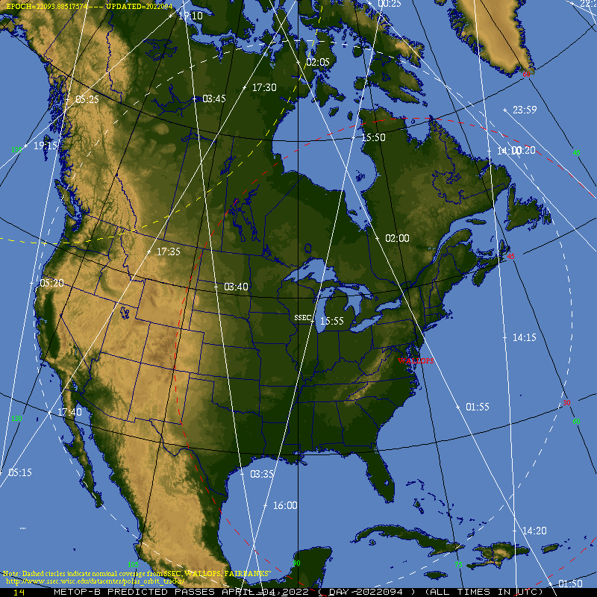
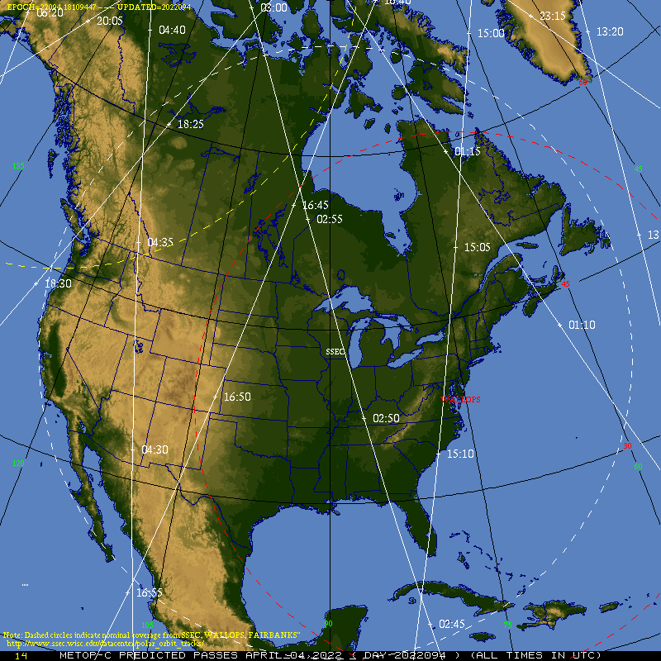
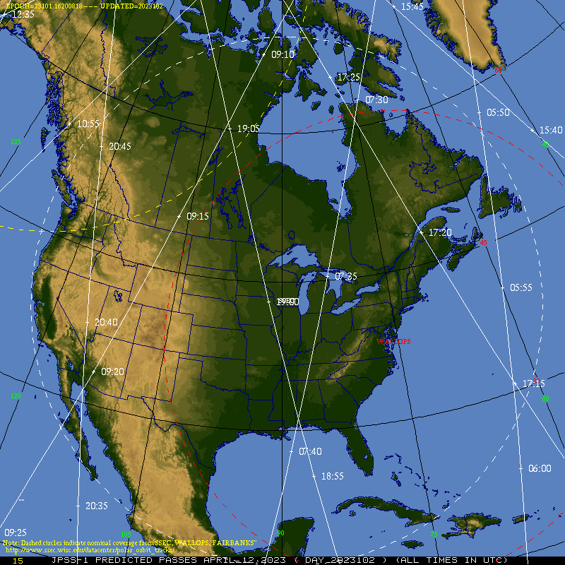
Which Satellites / When do they overfly?
NOAA-21/NOAA-20 and Metop-B/Metop-C
What’s the maximum time between Polar overpasses: about 4-5 hours
0345
1730
1930
1550
0300
0755
0615
0910
1725
0200
1745
0730
0550
1735
1925
1905
0340
2045
1645
1555
1415
0255
0800
1505
0915
1720
1740
0620
0155
0735
0555
1920
1900
0335
1650
2040
1600
0250
0805
0920
Metop-B
1510
NOAA-21
1715
0625
1735
0740
0600
1855
Metop-C
0245
NOAA20
Metop-B/Metop-C are paired
(one is in between the other)
NOAA-20/NOAA-21 are paired
(one is in between the other)
1500-1700 UTC
1700-2000 UTC

Slide 10
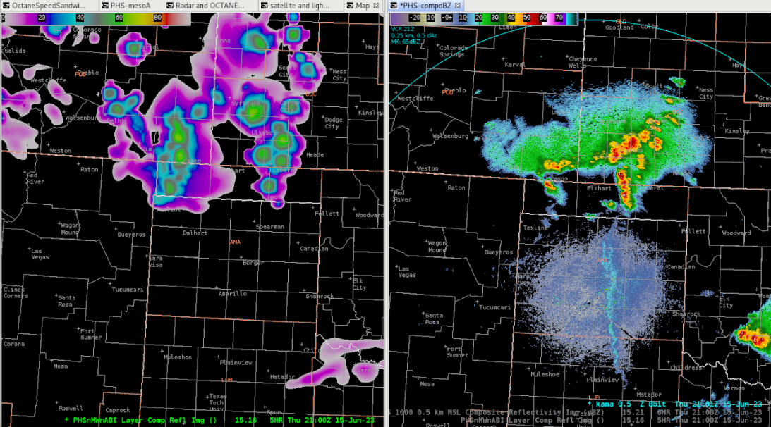
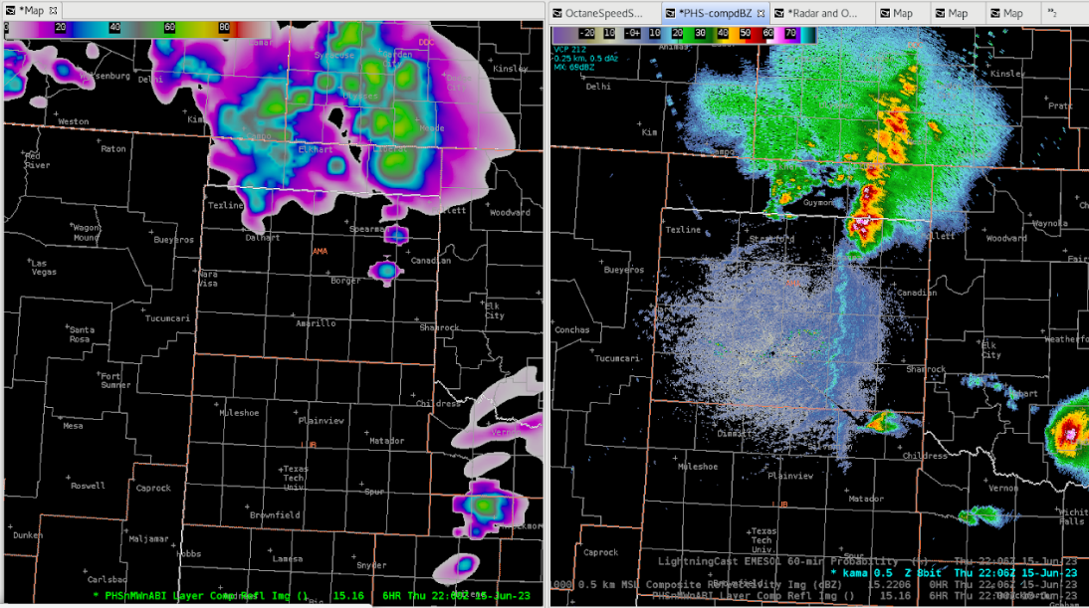
PHS MUCAPE showing a tongue of instability into the Texas Panhandle (from HWT 2023)
5-h forecast valid 2100 UTC
5-h forecast valid 2100 UTC
6-h forecast valid 2200 UTC

Slide 11
PHS with Visible and LightningCast and ProbSevere
ProbSevere contours
Example from HWT 2022
LightningCast contours
Forecaster Comment: After overlaying Prob Severe with the PHS CAPE and Visible Satellite imagery, you can see your strongest storms along the PHS CAPE gradient which tracks well. (source)

Slide 12
PHS with Decision Support
PHS CAPE gradient shown to highlight where threat is large
Example from HWT 2022
(source)
(forecaster comment: ) For this, the PHS Sfc CAPE field was used to display the potential thunderstorm strengths. This would likely not be used in an actual DSS event, given the lack of understanding the intended audience would have of surface based CAPE and instability. But it does highlight the potential use if communicated properly.

Slide 13
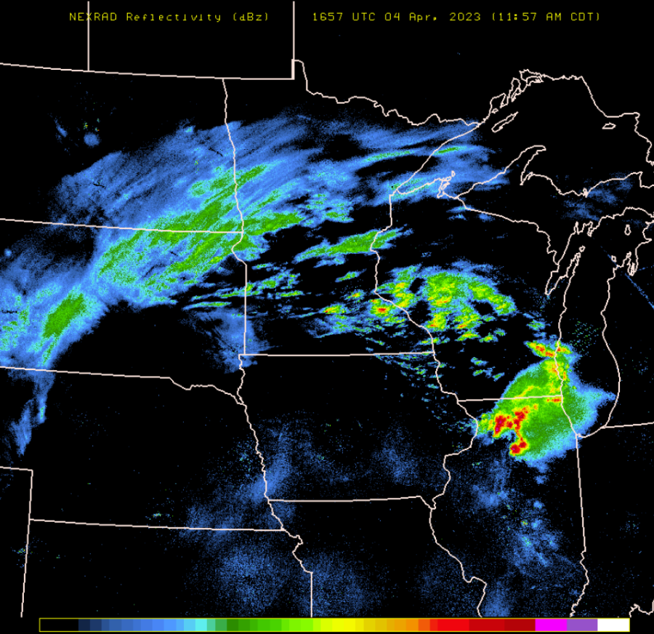
Forecast Radar, 1700 UTC on 4 April 2023
The WRF with PHS had more convective development (compared to the HRRR without that input) over north-central IL where strong convection was observed

Slide 14
Average STP parameters
WRF w/ PHS STP
HRRR STP
This is the average of 9 forecasts in the region

Slide 15
Average STP parameters
WRFw/ PHS STP
HRRR STP
This is the average of 9 forecasts in the region

Slide 16
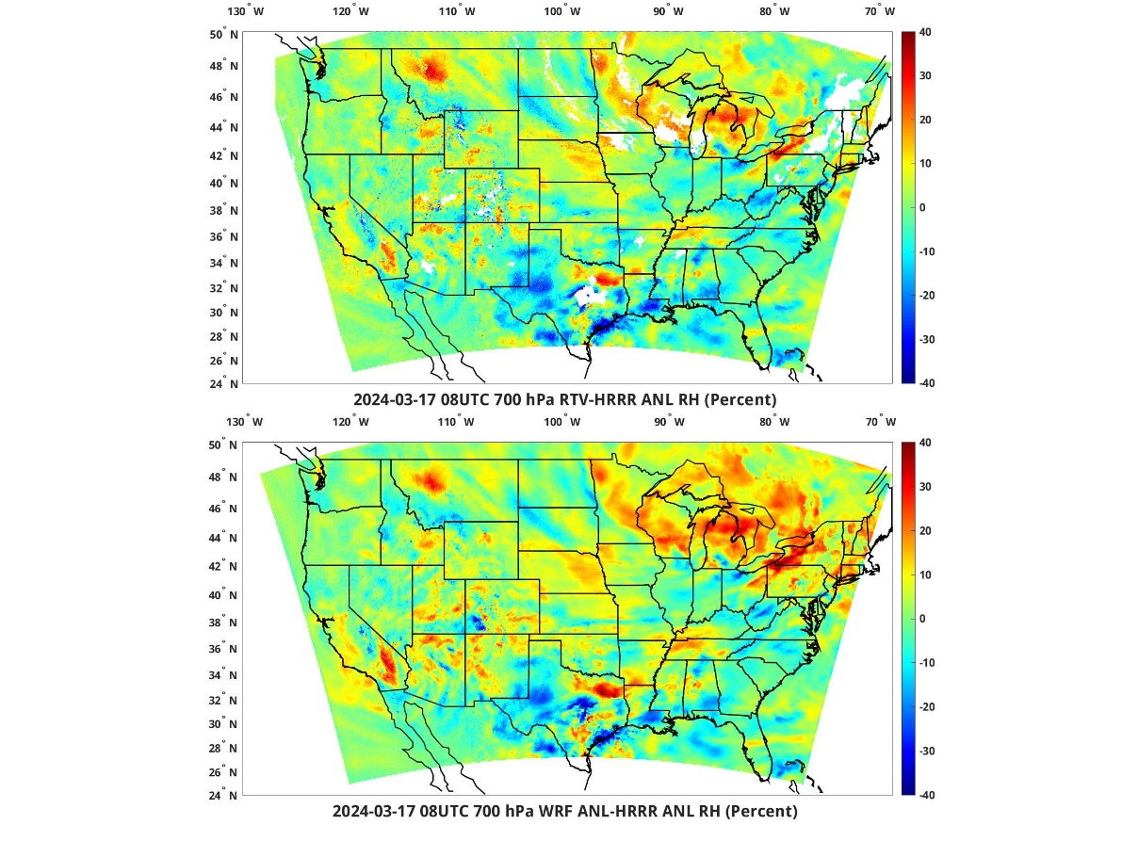
HWT on-line has useful graphics that we’ll show you changes in Potential Instability
These will answer the question: How has the initialization changed the moisture distribution?
Good for convection: More moisture at low levels, less moisture at upper levels
Not so good for convection: Less moisture at low levels, more moisture aloft
Website: https://www.ssec.wisc.edu/hufusion/
This figure shows the last input data that goes into the WRF assimilation. (700 mb). This tells you how far apart the two start
PHS 08 UTC Analysis minus HRRR 08 UTC Analysis. What’s the difference between the 00h PHS and the 00h WRF? The two fields are usually in close agreement.

Slide 17
Questions?
scott.lindstrom@noaa.gov
Use your time at HWT to become familiar with this product, and think about (and recommend) ways it might be improved or made more useful

