Slide 1
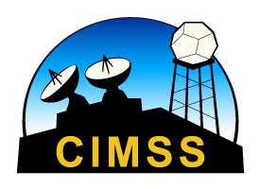
Training on Polar Hyperspectral Soundings and Microwave Data and ABI modeling output
Bill Smith, Sr., Qi Zhang, Anthony diNorscia
Hampton University
Scott Lindstrom
University of Wisconsin/Madison CIMSS
Hazardous Weather Testbed May/June 2022

Slide 2
PHSnMWnABI: That’s a mouthful!
I just call it PHS: Polar Hyperspectral Soundings
The Quickest explanation
With each Polar Orbit, associations between JPSS data (infrared and Microwave) and ABI retrievals are established
Those associations are stepped forward in time with each ABI scan, and used to initialize a numerical model each hour
This method takes advantage of the excellent spectral resolution on LEO satellites, and the excellent spatial/temporal resolution on ABI

Slide 3
Dual Regression Retrievals
Single field-of-view (FOV), all-sky condition, retrievals provide atmospheric soundings and surface and cloud parameters from hyperspectral sounders
Hyperspectral data alone cannot tell you a value at a specific level – which is what you need for a numerical model
Regression uses a model-based first guess field to sharpen the vertical resolution in the retrievals.
How does ABI data acquire better spectral resolution from Polar data?
How does Polar data acquire better spatial and temporal resolution from ABI?

Slide 4
Flowchart that describes how ABI data acquires better spectral resolution
Start with ABI retrievals
Where do the ABI retrievals sit within the Polar footprint
Average all the ABI retrievals in the Polar Footprint
Find the 5 HiRes ABI retrievals that most closely match (in space and in profile T and RH!) the Low-Res (averaged) ABI retrievals
Average those 5 profiles together, note their location
The *Polar* Soundings for those 5 locations are also known.
PHSnABI is : HiResABI + (PHSavg – LowResABIAvg)

Slide 5
How far into the future do these computed associations hold?
They don’t have to hold very long, because there are 4 Polar Orbiters being used.
IASI from Metop (-B and –C) samples over CONUS ca. 01-04 and 14-17 UTC
CrIS from Suomi-NPP/NOAA-20 samples over CONUS ca. 06-09 and 17-20 UTC
In practice, Polar data more than 7 hours old is not used.

Slide 6
What’s the most important information?
Moisture
Sounder information from CrIS (Suomi-NPP/NOAA-20) and IASI (MetOps) leads to a more accurate definition of the moisture distribution than might be occurring in the numerical model
Temperature
Usually, temperature is well-forecast, so the additional temperature information from the polar orbiters is not quite so impactful as the moisture

Slide 7
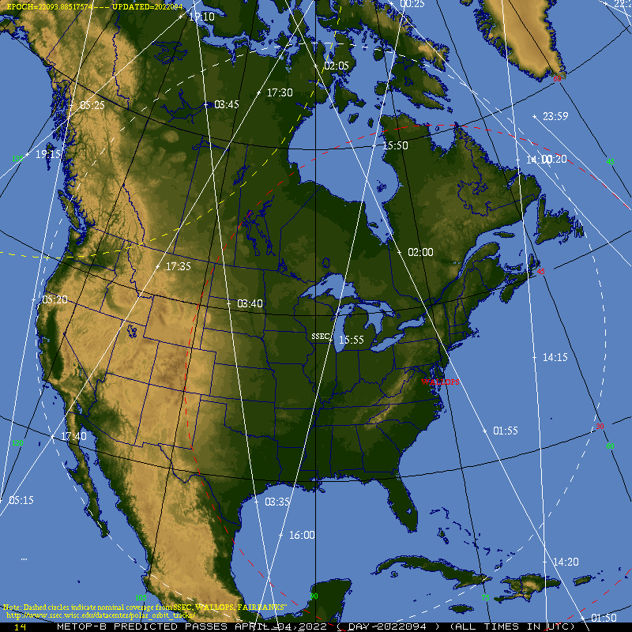
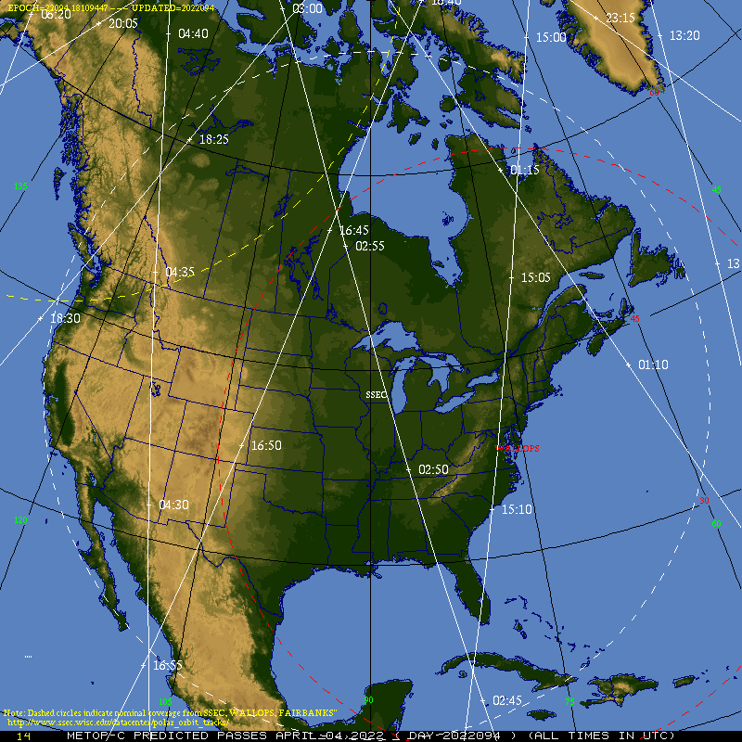
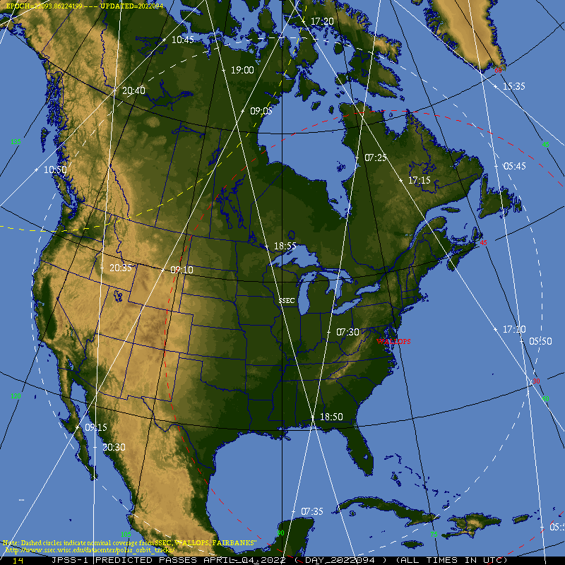
Which Satellites / When do they overfly?
Suomi NPP/NOAA-20 and Metop-B/Metop-C
What’s the maximum time between Polar overpasses: about 4-5 hours
0345
1730
1950
1550
0300
0815
0635
0200
1805
2040
0905
1735
1945
0340
1645
0725
0545
1555
1415
0255
0820
1715
1505
0640
1855
0155
1800
2035
0910
0335
1650
1940
0730
1710
1600
0250
0550
1510
0825
Metop-B
S-NPP
0645
1755
1850
0915
Metop-C
NOAA20
0735
0555
0245
Metop-B/Metop-C are paired
(one is in between the other)
Suomi-NPP/NOAA-20 are paired
(one is in between the other)

Slide 8
Example over Florida: GOES-16 Vis/CAPE

Slide 9
Example over Florida: GOES-16 Vis/PHS CAPE

