Slide 1
How NUCAPS and Gridded NUCAPS can Help You
Scott Lindstrom
Cooperative Institute for Meteorological Satellite Studies (CIMSS)
NWS Columbia SC
26 March 2020

Slide 2
NUCAPS
NOAA-Unique Combined Atmospheric Processing System
(First known as NOAA-Unique CrIS-ATMS Processing System; then Metop with IASI and AMSU/MHS data were included)
SBN NUCAPS data are from NOAA-20
You can get Suomi-NPP NUCAPS from an LDM feed
Two satellites: Twice as much data, and a nice time separation (45-50 minutes)
Suomi-NPP, then ~50 minutes later, NOAA-20

Slide 3
Where do you find orbit paths
https://www.ssec.wisc.edu/datacenter/orbit_tracks.html

Slide 4
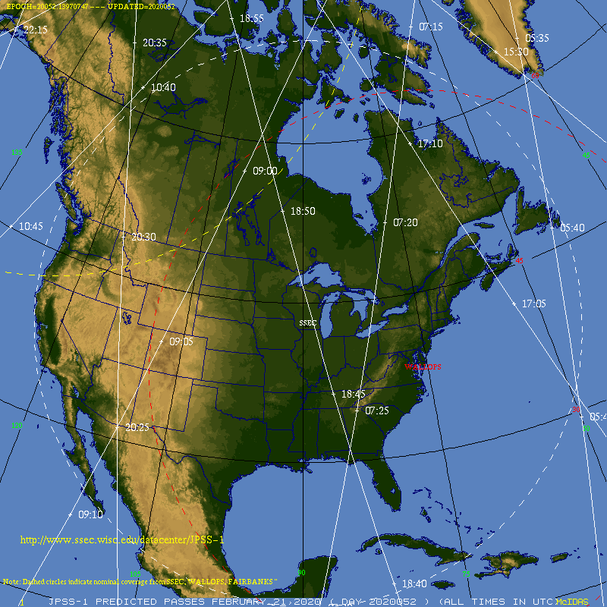
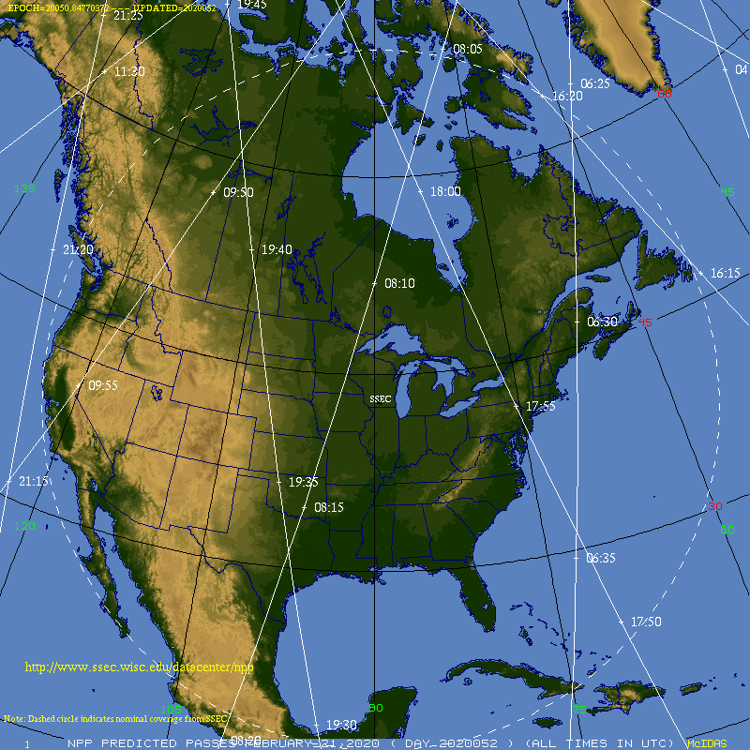
Where do you find orbit paths?
For NOAA-20
https://www.ssec.wisc.edu/datacenter/NOAA20/
For Suomi-NPP
https://www.ssec.wisc.edu/datacenter/npp/
18:50
Feb 21 2020
18:00
07:20
06:30
17:55
18:45
07:25
06:35
17:50
18:40
NOAA-20
S-NPP

Slide 5
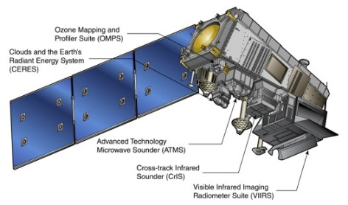
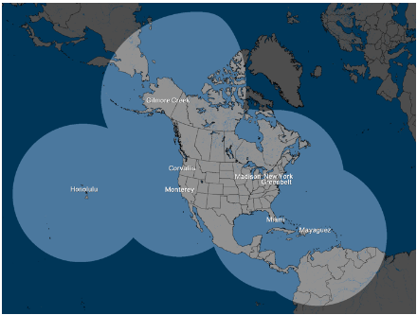
NUCAPS
NOAA-Unique Combined Atmospheric Processing System
What is Combined?
NOAA-20/Suomi-NPP
CrIS: Cross-track Infrared Sounder (1305 channels)
ATMS: Advanced Technology Microwave Sounder (22 channels)
Overpass Times:
Suomi NPP/NOAA-20: ~0130 AM/1330 PM
(separated by half an orbit)
Svalbard
Downlink
NSOF
(NDE)
NWS
Gateway
Local Antenna Downlink
SBN Data Flow
60 minutes
SBN
Antenna Data Flow
CSPP 30 minutes
WFO
HWT
HWT
Notes:
NUCAPS is the NOAA Unique CrIS ATMS Combined Atmospheric Processing System, combining information from an infrared sounder (CrIS on Suomi NPP and NOAA-20; IASI on Metop) and a microwave sounder (ATMS on Suomi NPP and NOAA-20 ; AMSU/MHS on Metop.
Equatorial crossing times for the different polar orbiters are shown. NPP and NOAA-20 data are halfway between synoptic radiosonde times over CONUS - and about 2-3 hours after MetOp.
At the WFO, Data appears in AWIPS after it is downlinked at Svalbard and then proceeds through computers that process it - and that process can take more than 90 minutes. Data arrives much more quickly through a direct broadcast link. NOAA-20 also arrives more quickly.
At HWT, NUCAPS Soundings from NOAA-20 will get to AWIPS quickly: typically around 30 minutes!

Slide 6
When are Data Available?
About half-way between 0000 and 1200 UTC Soundings.
Afternoon sounding is just when convective heating is starting to mean business
Morning sounding middle of the night
Data shows up about 60 minutes after it is observed (This is for NOAA-20; This is a big improvement on Suomi-NPP data which has slower throughput to AWIPS)

Slide 7
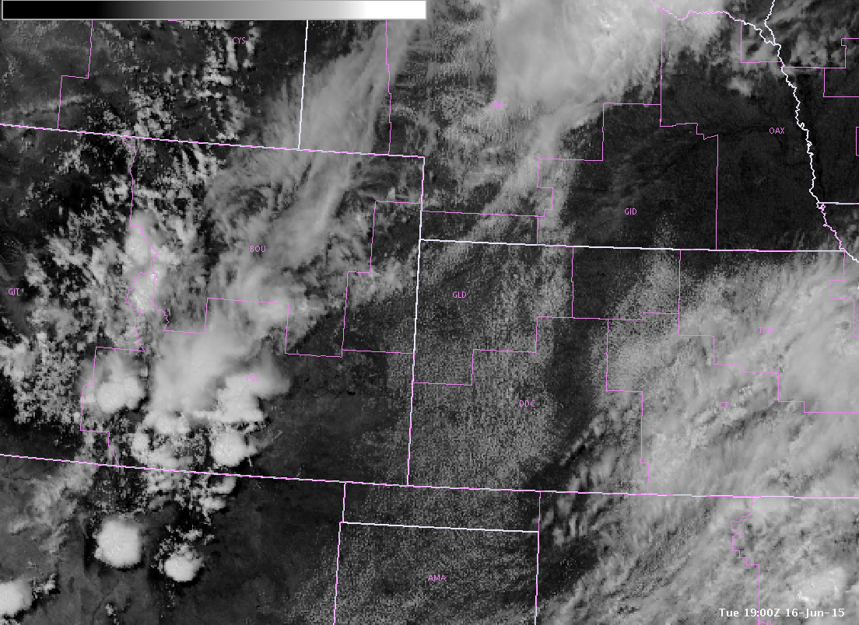
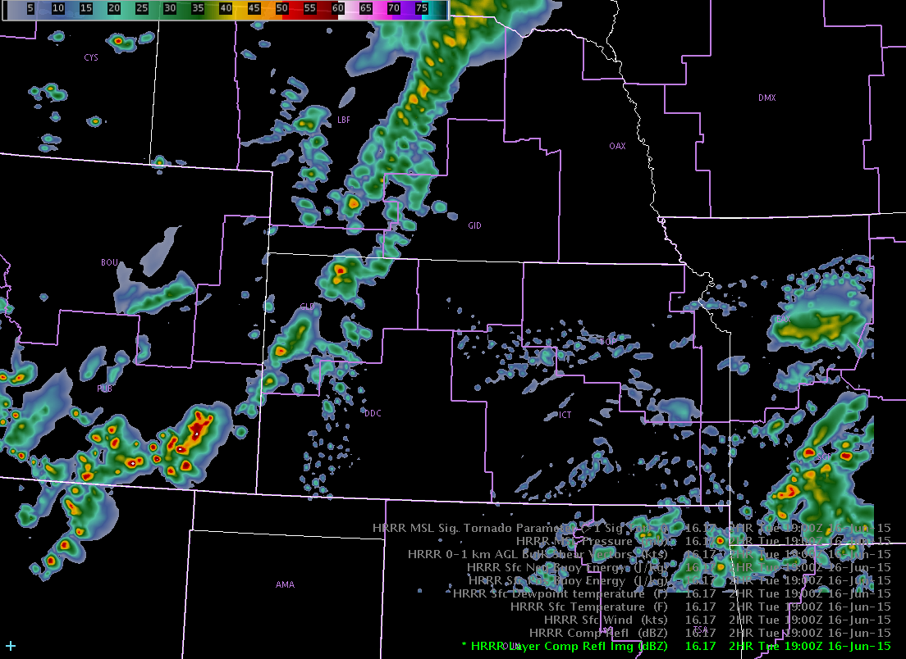
Real vs. Modeled
Observed GOES Visible
HRRR 2-hr forecast
2 hr fcst
from 17Z run
1900 UTC June 16, 2015
Atmosphere with clear, blue sky
1900 UTC June 16, 2015
Atmosphere with deep convection
Notes:
Timing issues in models sometimes cause problems. Wouldn’t it be better to use a NUCAPS sounding in SE Colorado on this day vs. the sounding from the model?

Slide 8
How are Vertical Profiles Produced
Regression uses static coefficients (derived from ECMWF output for four focus days [2014: 6/18, 9/15, 12/20; 2015: 3/21]) to create a first guess/cloud-clearing field.
Regression uses all Sounder and Microwave channels
Retrieval minimizes Observation-Calculation value
First Guess: NCEP-based Climatology + GFS Surface Pressure
If this doesn’t converge to a solution, sounding is still produced, but flagged
Retrieval uses a subset of channels
Shape-preserving; adjusts regression to the solution
Microwave-only Retrieval fails in regions of precipitation
Final Sounding is computed on 100 standard levels for a Radiative Transfer Model
More levels than warranted by Sounder resolution
You see these 100 levels in AWIPS 2
Notes:
Vertical profiles in NUCAPS spring out of a Regression that uses static coefficients and all Sounder/Microwave data followed by a retrieval that uses a subset of the infrared channels (but still all the microwave channels).
The Regression step relies on coefficients trained from cases that used all sounder and microwave data and ECMWF model output on four select days in the past such that the best statistical relationship between the satellite data and the profiles of Temperature and moisture were created (“Best” being subject to the constraints of the weather on the test days, of course). Regressions with daily data use those static coefficients and *all channels*, so they capture more vertical structure than in the final physical retrievals that use a subset of sounder channels (that is, CrIS - for NPP/NOAA-20 - or IASI - for MetOp).
Regression output are used to do cloud-clearing. A physical retrieval follows that uses 399 of more than 1300 CrIS channels (a different subset is used for IASI on Metop, of course). In the physical retrieval, the algorithm sequentially solves for temperature, moisture, ozone and other gases. The first guess for this is climatology: If the environment really deviates from normal (the first guess is climatology), the retrieval has to do a lot of work to converge to a solution, but that will usually happen. If that convergence to a solution doesn't happen – something that usually can be blamed on clouds - the sounding is still produced, but flagged.
What is OBS-CALC? The OBS Vector is a cloud-cleared radiance spectrum that uses a subset of Sounder radiances -- that is, not all channels. The CALCulation vector is from a radiative transfer model that uses the regression solution - trained with the ECMWF - and climatology.
The final output is mapped to 100 levels that are standard for a radiative transfer model. You'll notice the 100 levels in AWIPS are always the same pressure surfaces. It's really more levels than are resolved.

Slide 9
Effective vertical resolution
‘Interfering Parameters’ are things that reduce precision of a temperature or water vapor measurement from NUCAPS
Variable
d.o.f. (Degrees Of Freedom) is something like the number of layers that are resolved by NUCAPS data within the troposphere
Notes:
NUCAPS resolves about 5 vertical levels of water vapor, and about 6-10 layers of temperature in troposphere. Vertical profiles are much smoother than a radiosonde!

Slide 10
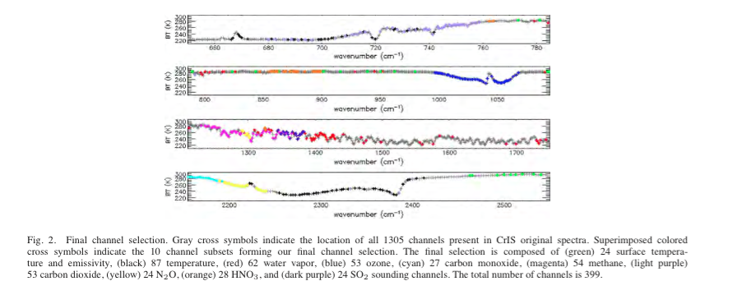
For Suomi-NPP/NOAA-20 Satellites
Which CrIS channels are used for physical retrieval step? 399 of them
24 for surface temperature
87 for atmospheric temperature
62 for water vapor
Channels chosen most sensitive to one gas and least sensitive to other gases
All ATMS channels (22 of them) are used in NUCAPS for SNPP
(There is a similar type of channels selection for Metop-A/B/C instruments)
Notes:
There are 24 channels (highlighted in green) from which surface temperature is retrieved, 62 (in red) from which water vapor is retrieved, etc. These channels selected are most sensitive to one gas while being less sensitive to other gases. That is, they have high (but not perfect) spectral purity.
In contrast to the subset of Sounder channels shown above, All Microwave channels are used in NUCAPS. The ATMS retrieval is the solution if either the cloud clearing fails or if the Physical infrared retrieval fails.

Slide 11
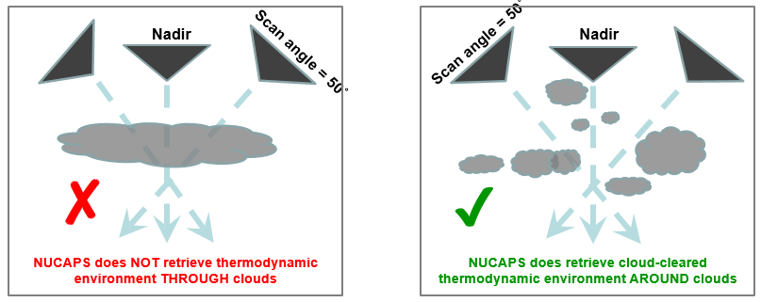
Cloud Clearing
Clouds can cause problems with Satellite-based soundings
Biggest problem: Uniform clouds!
Each NUCAPS Footprint contains 9 CrIS or 4 IASI Fields-of-view. If there is spatial variability to the clouds among the FOVs, NUCAPS might nevertheless produce a good product
If there are uniform clouds across the 50-km scene/9 FOVs, it’s more likely to be rejected, even if there aren’t a lot of clouds!
Cloud Clearing uses Regression based on all Infrared and Microwave data and the coefficients from an ECMWF-based training
Notes:
Cloud-clearing is an important part of the NUCAPS algorithm. From the algorithm perspective, uniform clouds are the biggest problem. Each NUCAPS footprint contains 9 CrIS fields or view (for SuomiNPP or NOAA-20) or 4 IASI (for MetOp) Fields-of-view; if there is spatial variability to the clouds among those Fields-of-view, NUCAPS will nevertheless produce a good product. If there are uniform clouds across the 50-km scene, then it's more likely to be rejected.

Slide 12
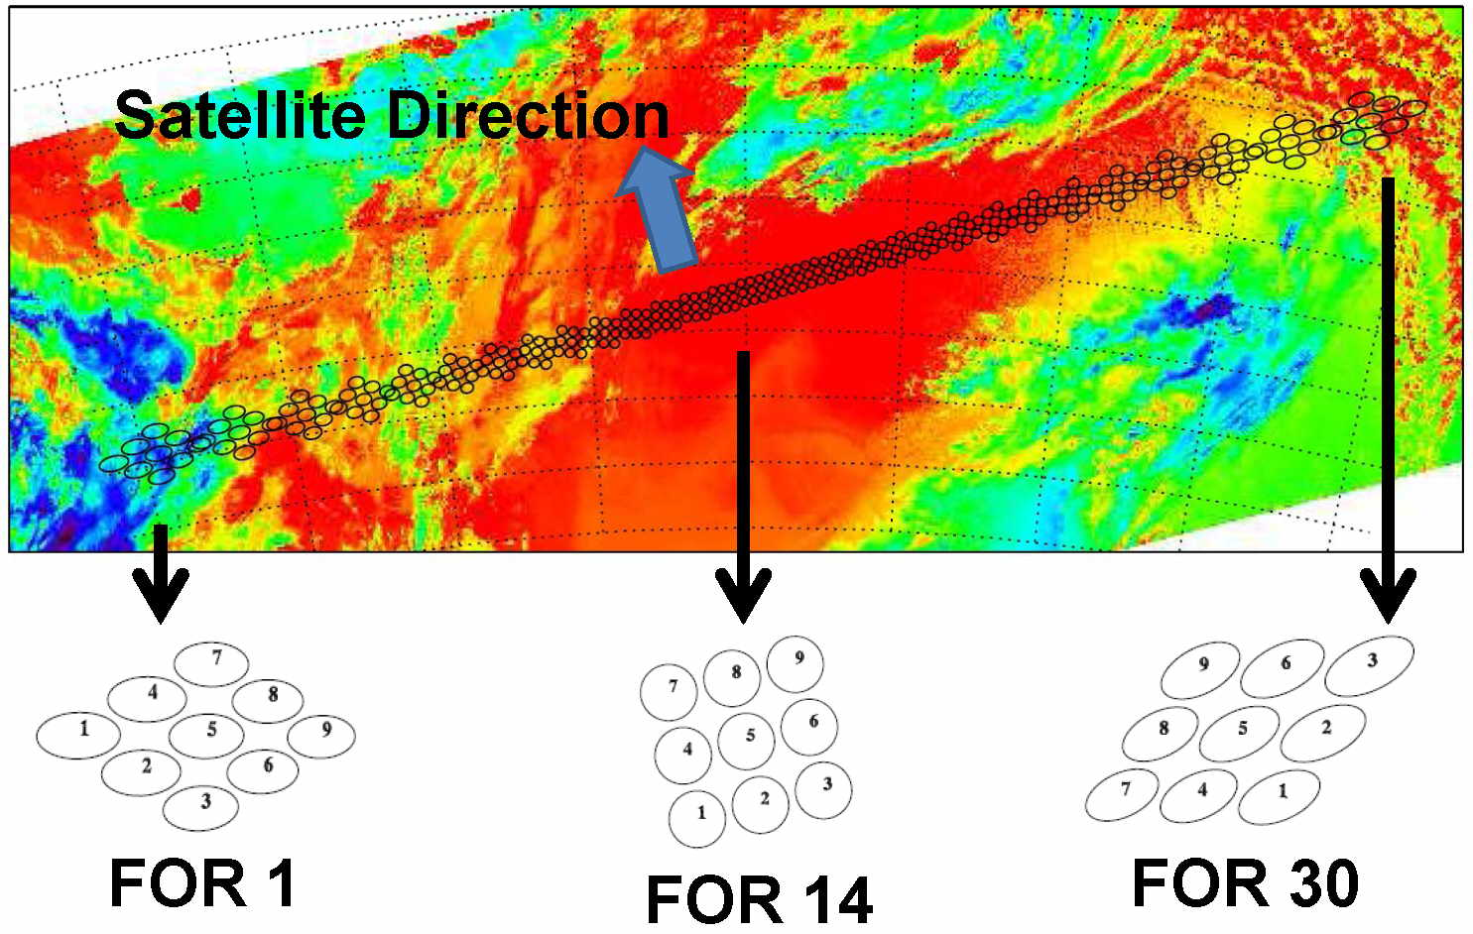
Each of the green dots in the NUCAPS display includes information
from up to 9 Fields of Regard from the CrIS (or up to 4 from IASI). Dot #5 is
the location of the green dot in the NUCAPS AWIPS Display
It takes 8 seconds to scan these 30 Fields of Regard
Notes:
This shows the 9 Fields of Regard in CrIS for each NUCAPS sounding. At nadir, they're closely spaced, and towards the limb they are more widely spaced. It's not uncommon for sky conditions to vary across the Fields of Regard.
Note that the Sounder Fields of Regard do not extend to the edge of the swath

Slide 13
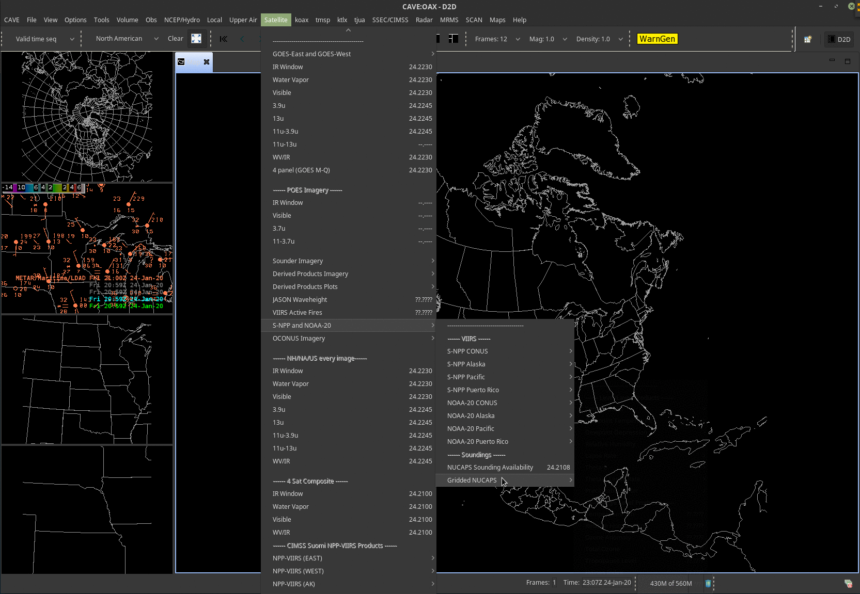
In the WFO AWIPS,
NUCAPS soundings are under
Satellite > S-NPP and NOAA-20 > NUCAPS Sounding Availability
(right above ‘GriddedNUCAPS’
Notes:
NUCAPS soundings at that WFO are accessed under the Satellite Tab. As of early 2019, only Suomi NPP NUCAPS soundings are available at WFOs. NOAA-20 NUCAPS will flow later this year, perhaps as soon at April.

Slide 14
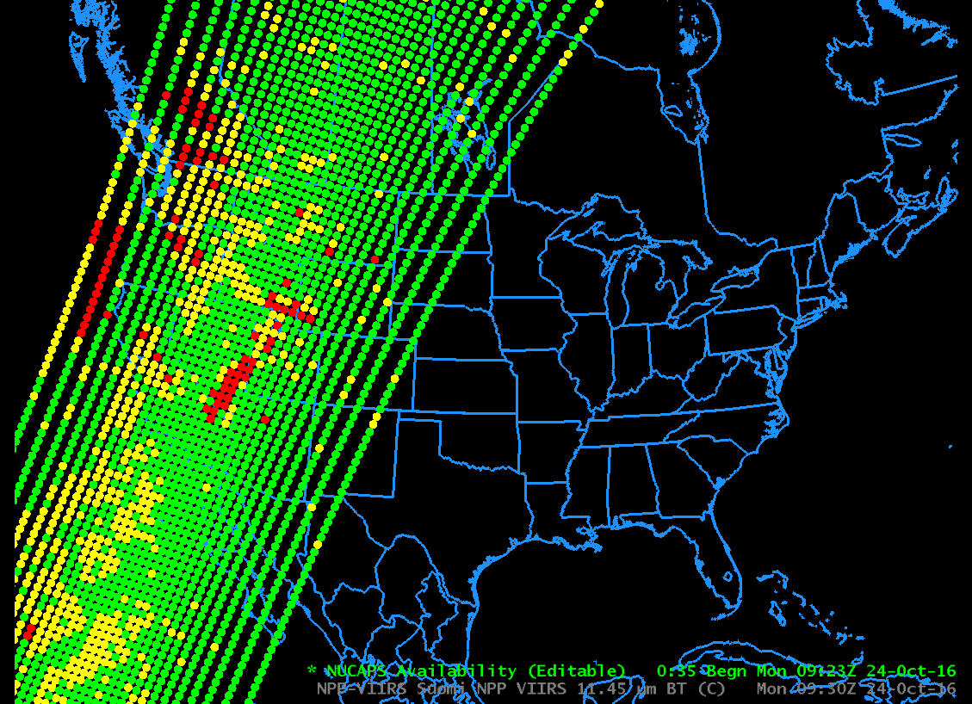
Green Dots: Retrievals Completed Successfully
Yellow Dots: IR Retrieval Failed
Red Dots: IR and Microwave Retrievals failed
Notes:
Clicking on 'Sounding Availability' yeilds a plot of the latest NUCAPS sounding points that are denoted by color-coded circles. Soundings are available at each of these points.

Slide 15
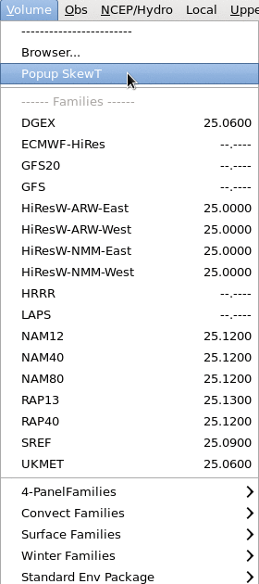
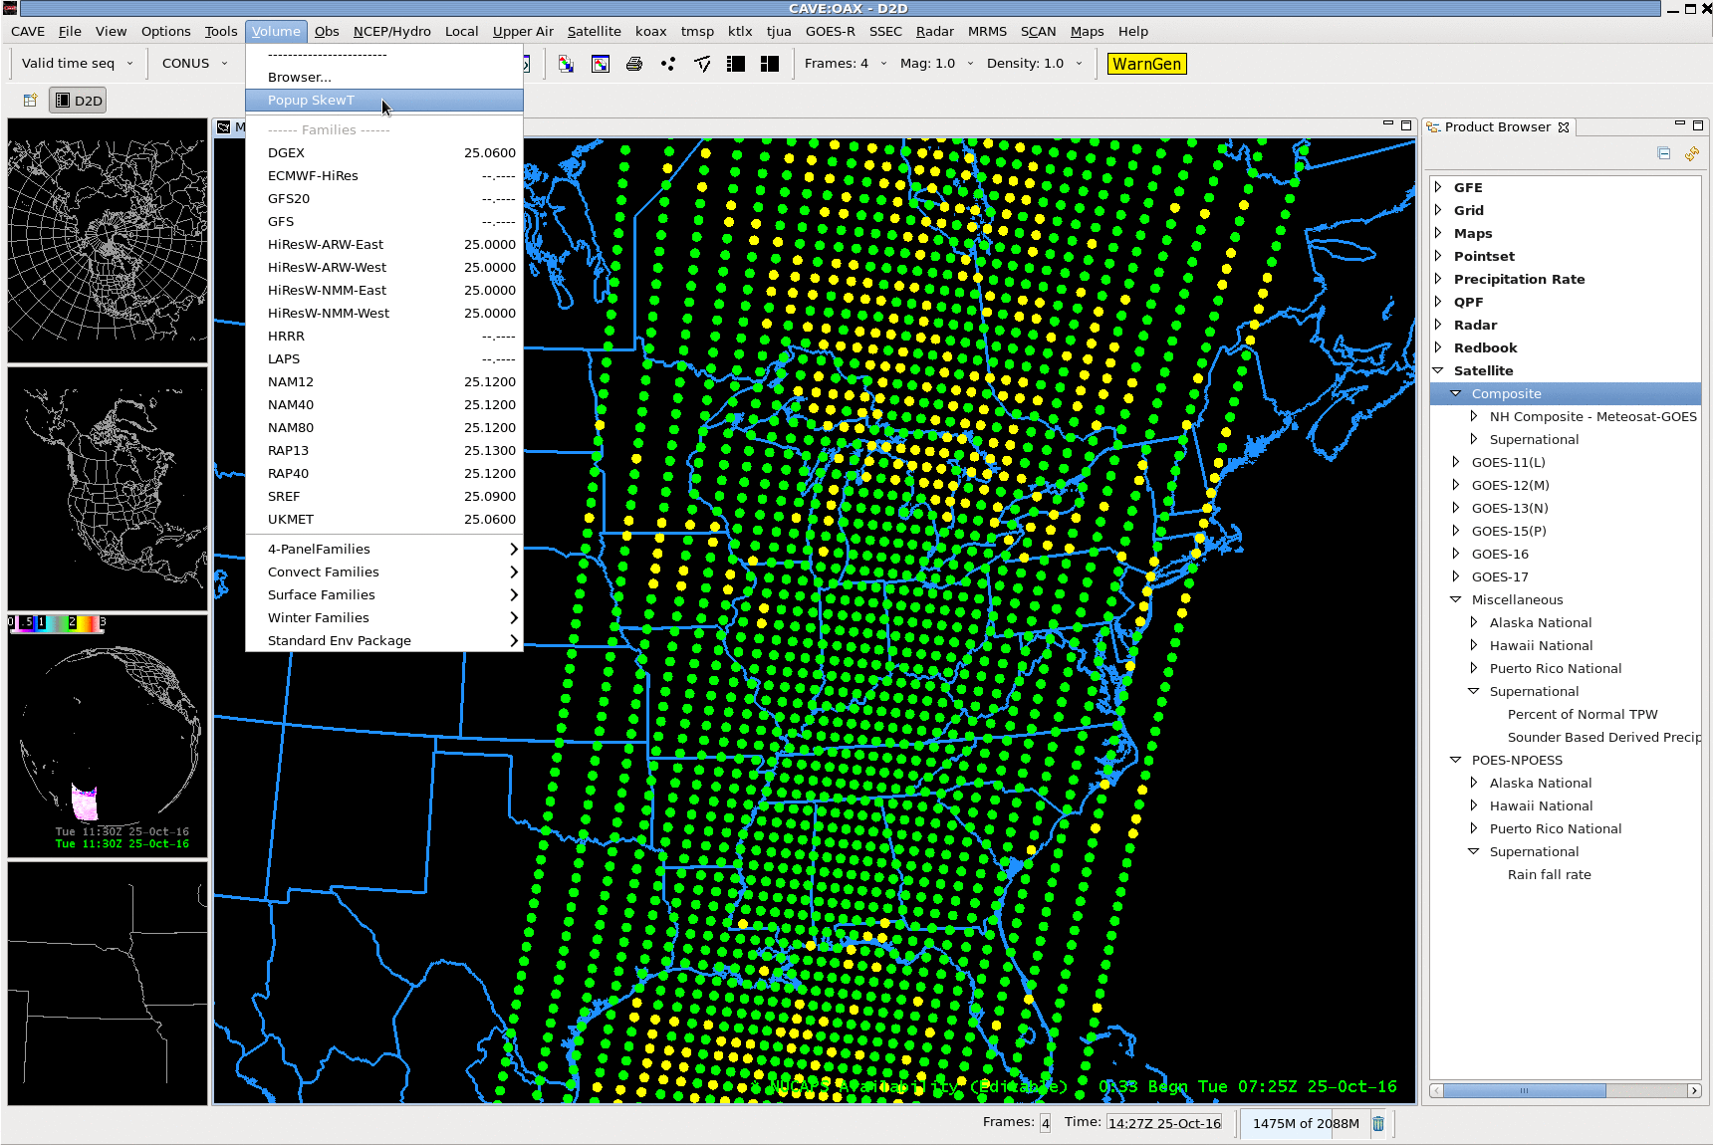
Back to AWIPS: Popup SkewTs
After you load the Soundings, enable Popup SkewT in Volume Browser so you can browse quickly through many Skew-Ts
Notes:
The *amount* of data can overwhelm, and pop-up SkewTs are helpful in that regard to quickly assess how soundings vary over a region. These next slides describe how to enable them. After loading the soundings, go to the Volume Browser

Slide 16
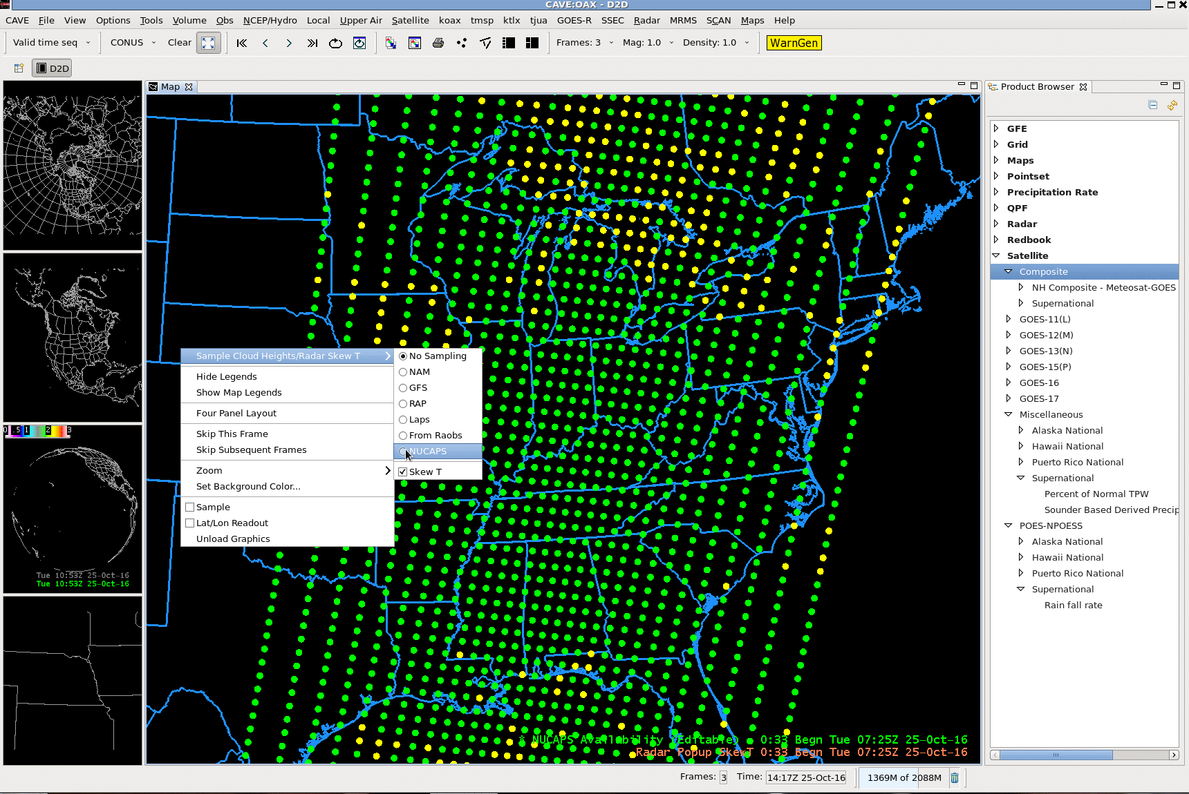
Popup SkewTs
Right-click anywhere in image
Also: TURN ON
Sampling!
Notes:
Turn sampling on, and right click in the image, clicking on 'NUCAPS' in the menu that pops open.

Slide 17
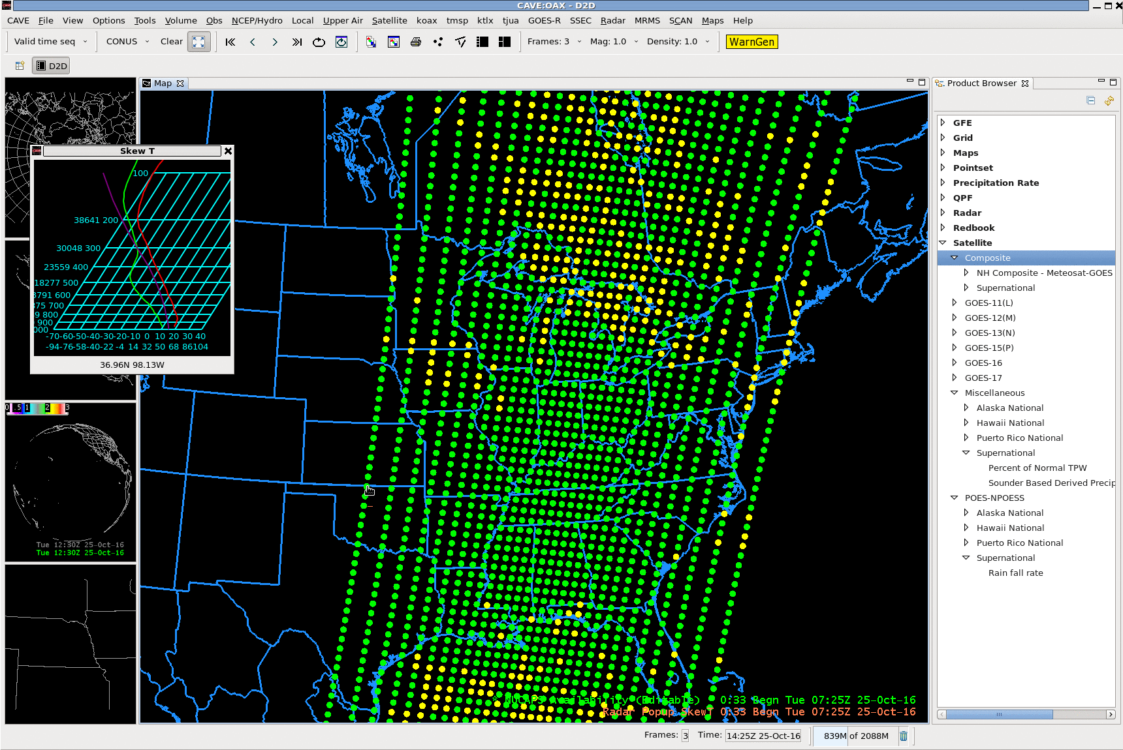
Popup SkewTs
Notes:
Then move the mouse around over the soundings to see how they change in the horizontal.

Slide 18
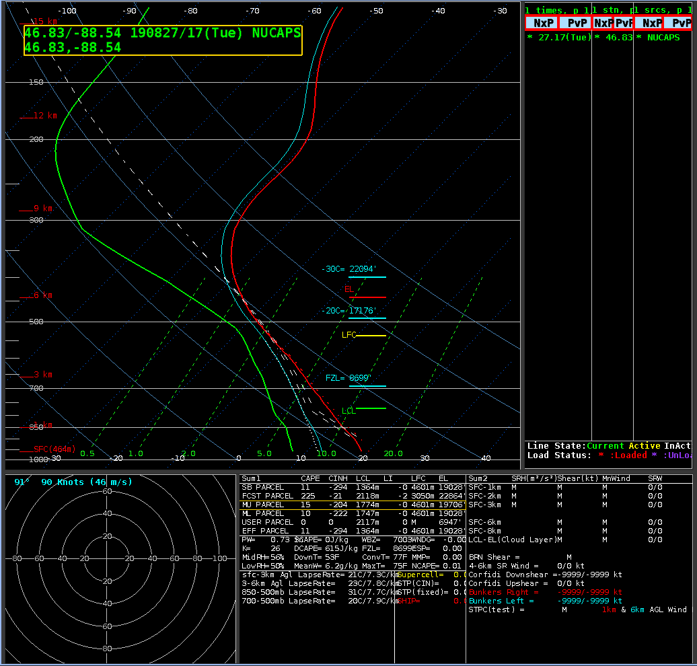
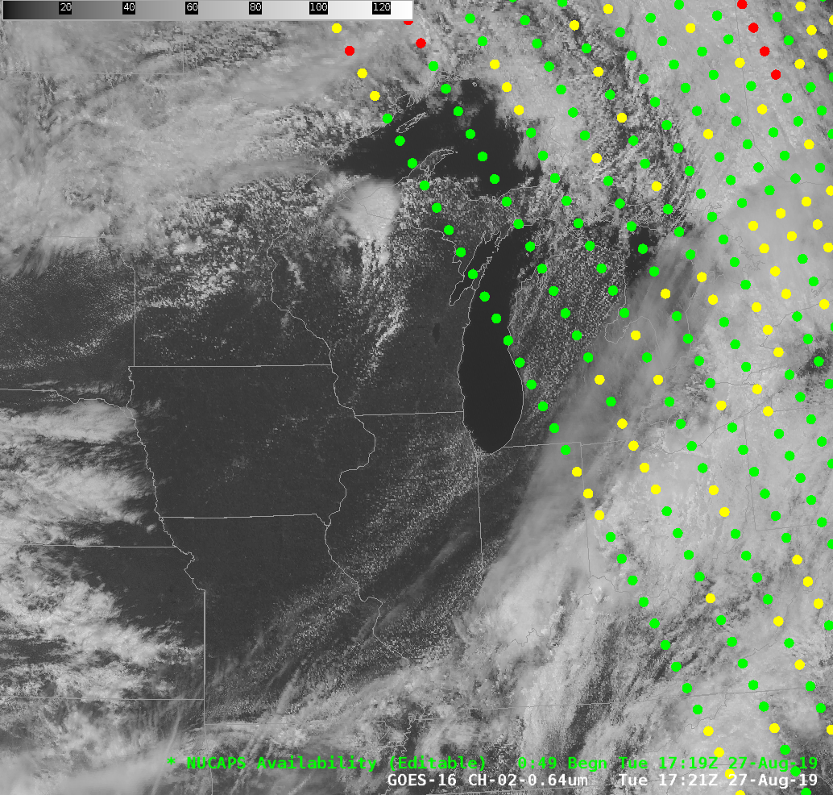
NUCAPS Profiles are Useful in the afternoon, as daytime heating is helping convection initiate

Slide 19
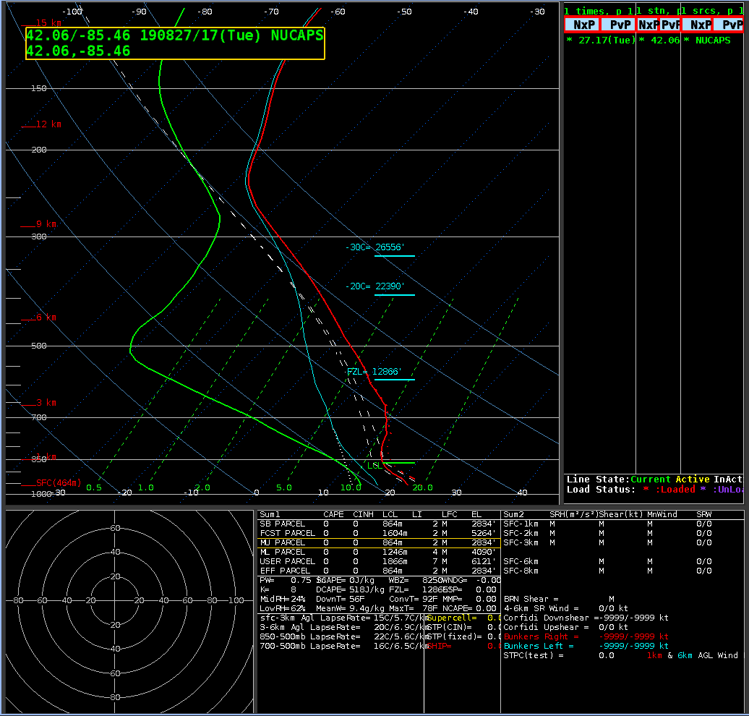
NUCAPS Profiles are Useful in the afternoon, as daytime heating is helping convection initiate

Slide 20
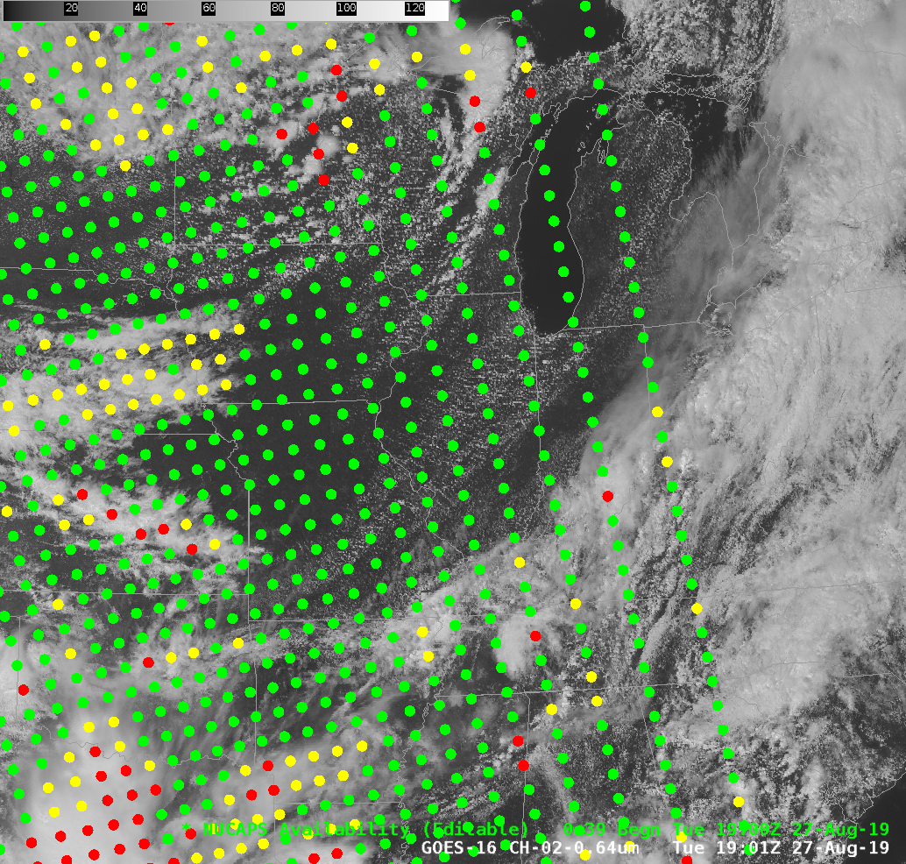
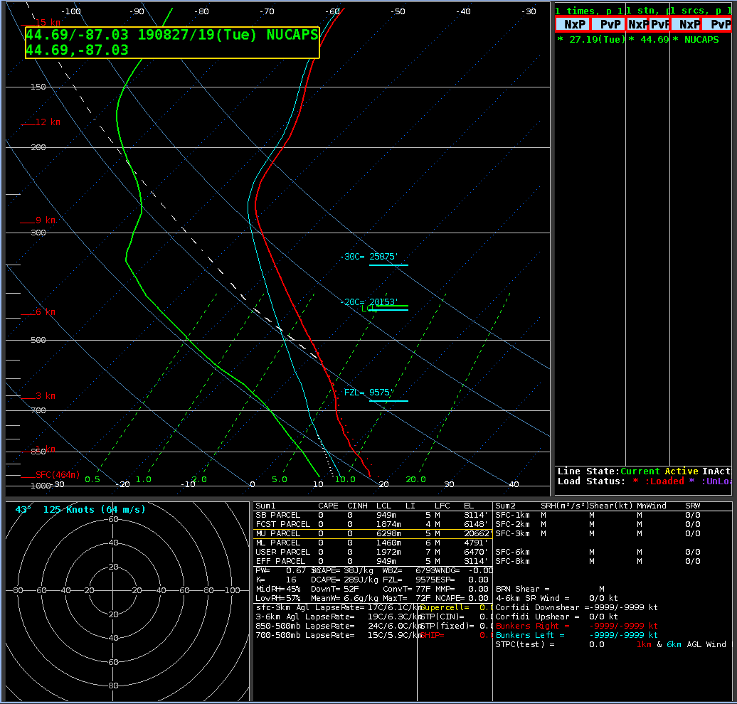
Bonus up north: Consecutive passes

Slide 21
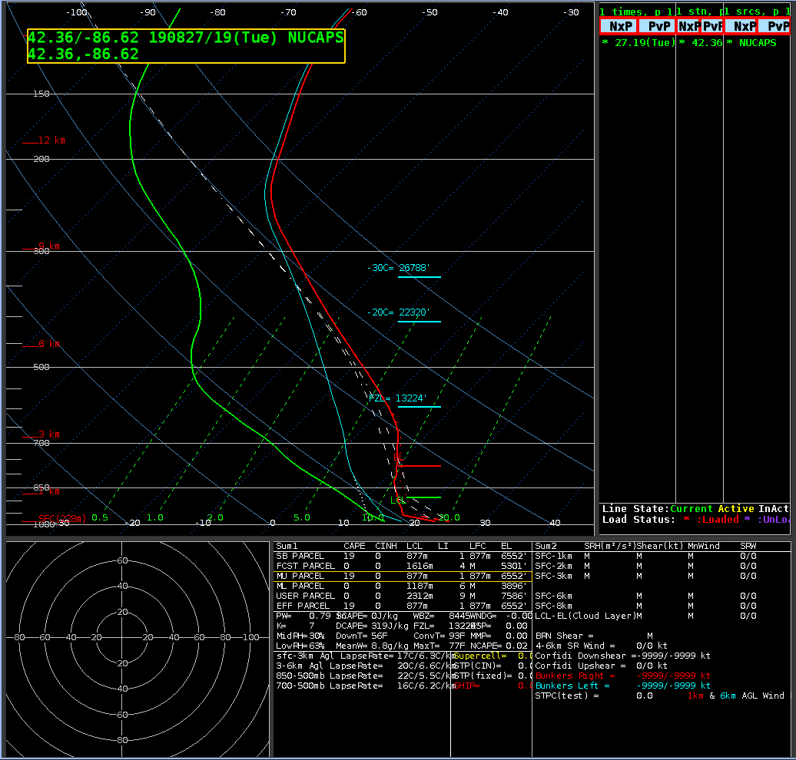
Bonus up north: Consecutive Passes!

Slide 22
Again: What do Consecutive Soundings Get you?
Western-most scan at ~1700 UTC
Eastern-most scan at ~1830 UTC
Two samplings of a destabilizing atmosphere
90 minutes apart. Note: IF NOAA-20 data were available, you’d have a 3rd Sounding!
Notes:
You can sometimes get two sequential soundings in the right spot to monitor developing convection. Look for this to happen!

Slide 23
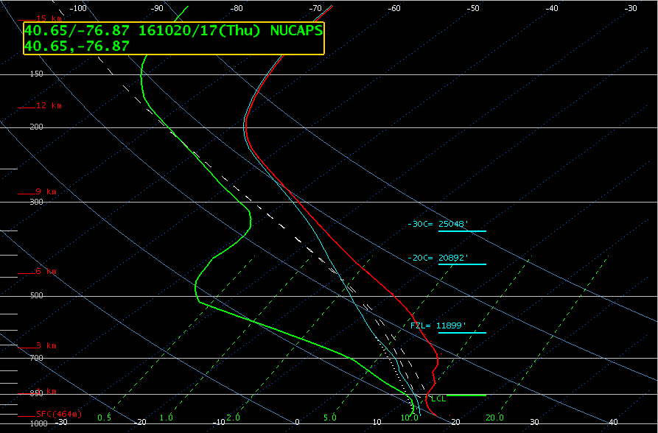
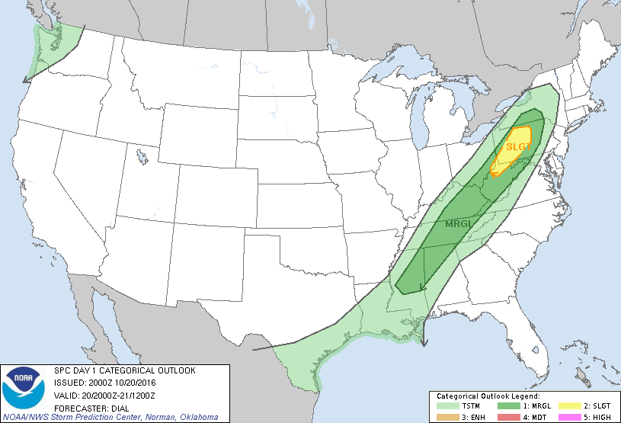
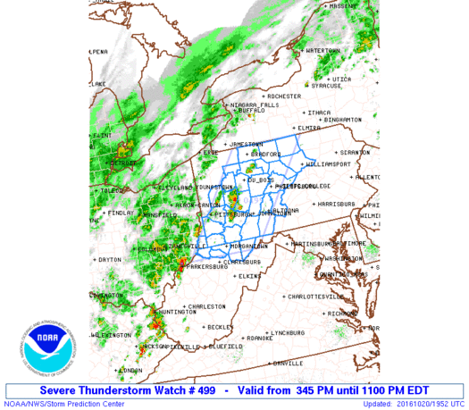
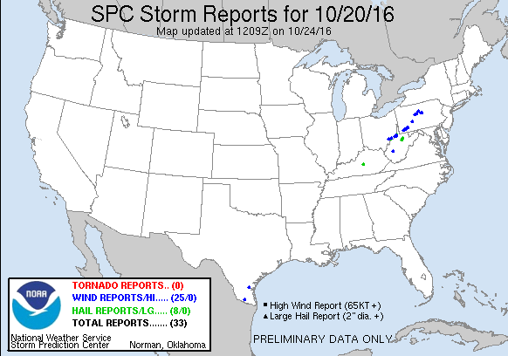
1700 UTC
Notes:
SO the first pass showed a moderately unstable profile in a region of slight risk.

Slide 24
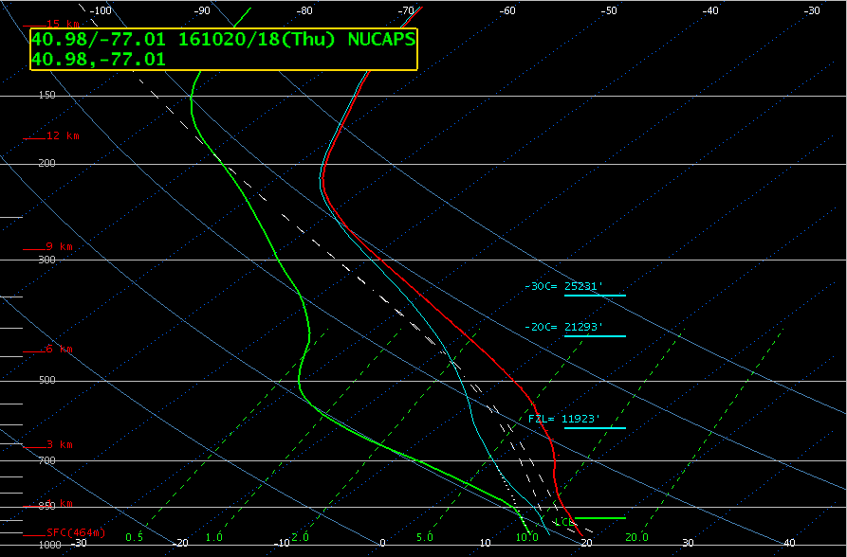
1830 UTC
Notes:
90 minutes later, destabilitization is ongoing. This should help in your situational awareness.

Slide 25
You won’t get sequential passes from one satellite in South Carolina
NOAA-20 is what is in AWIPS
Suomi NPP data is offset by 50 minutes
Work underway to allow you to get Suomi NPP NUCAPS via LDM feed.

Slide 26
You can get two passes with two satellites
17:10
18:50
17:05
17:55
18:45
17:50
NOAA-20
via SBN
Suomi NPP

Slide 27
Note how smooth these profiles are!
1700 UTC
1830 UTC
Keep the smooth nature in mind: Don’t expect to see thin layers or to see sharp gradients in the vertical

Slide 28
Feedback from HWT 2018
SBCAPE: NUCAPS Modified Sounding- 1430 j/kg NUCAPS Sounding- 1022 j/kg SPC Mesoanalysis - about 1500 j/kg PWAT: NUCAPS Modified Sounding - 0.74 inches NUCAPS Sounding - 0.74 inches SPC Mesoanalysis - about 0.80 inches SBLCL Height: NUCAPS Modified Sounding - 928m NUCAPS Sounding- 841m SPC Mesoanalysis - about 1200m Sfc LI: NUCAPS Modified Sounding - -4 NUCAPS Sounding- -3 SPC Mesoanalysis - about -3.5
Forecaster compared NUCAPS (with/without modification) with SPC
Overall, very impressed by the NUCAPS soundings in an environment that likely would not have had actual RAOBs to look at.
(Link)
Notes:
These numbers are from an HWT blog post that compared NUCAPS convective indices -- with and without automatic modification to match RTMA analyses -- with SPC values. THe forecaster appreciated the data.

Slide 29
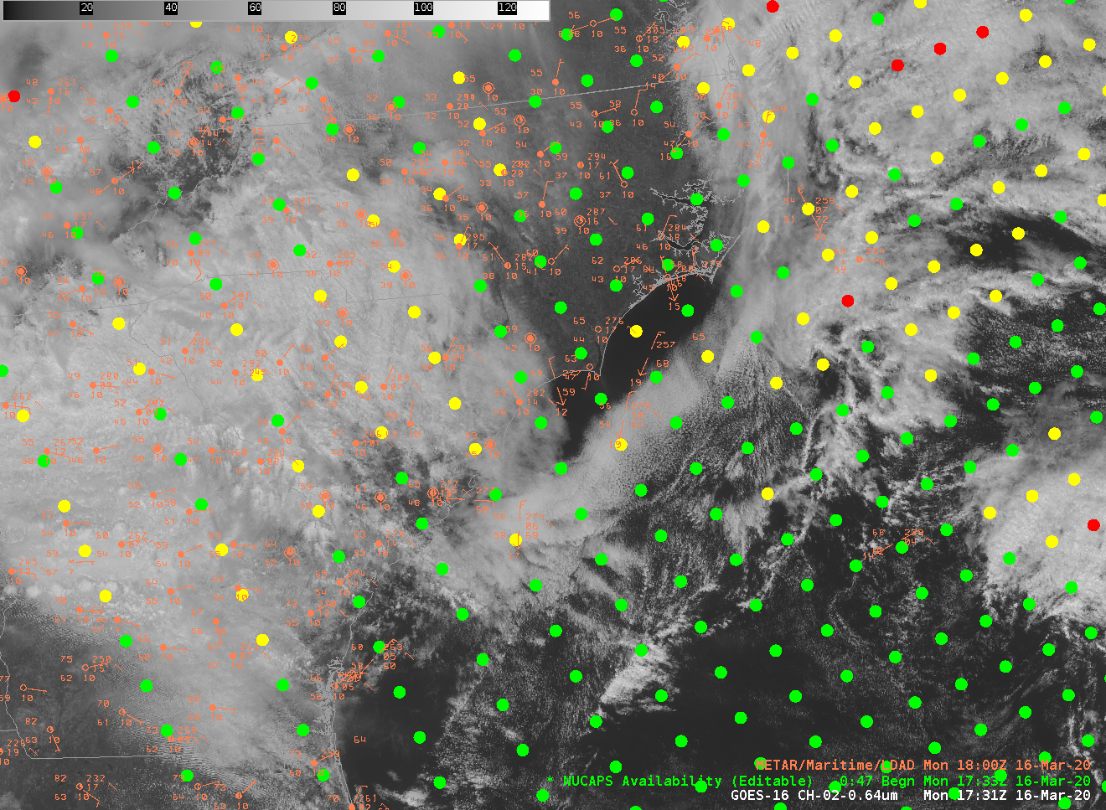
Editing
Notes:
You can also change soundings using the graphical editor in AWIPS. When you click on the sounding, note the nearby temperature/dewpoint values.

Slide 30
Editing
It’s common for the lowest part of the sounding to be at odds with nearby observations. This example just south of Jacksonville is for a sounding where the observed T/Td 73/60. Modify NUCAPS Soundings in AWIPS to match observations.
Notes:
You can also change soundings using the graphical editor in AWIPS. When you click on the sounding, note the nearby temperature/dewpoint values.

Slide 31
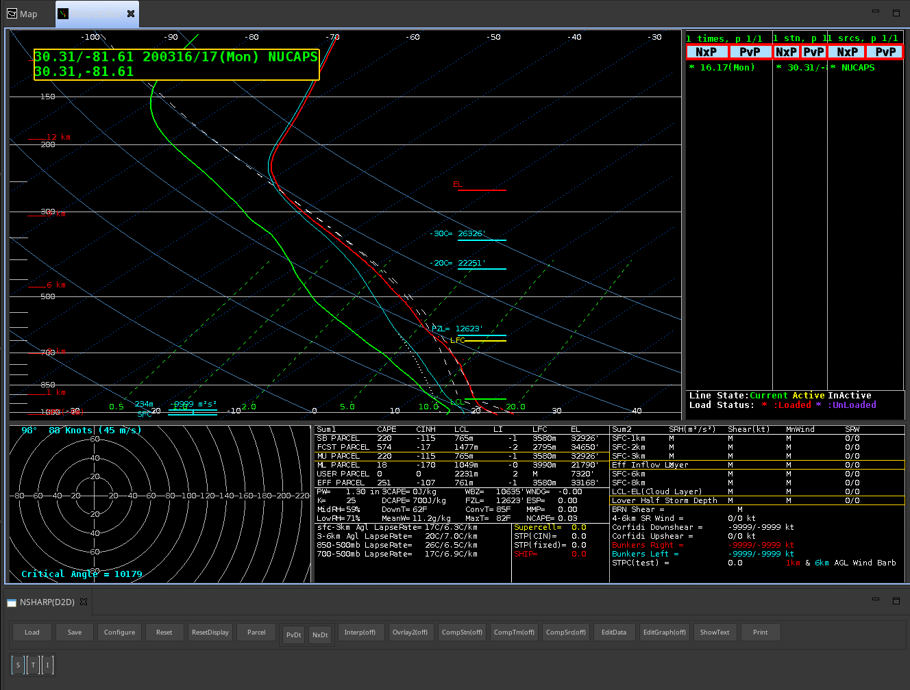
Do surface values match observations in the METAR plot?
Notes:
Here's the sounding near Philadelphia from the previous slide. To edit, toggle 'Edit Graph' to 'On' (Note that you can also click on 'Edit Data' to edit the data in a table)

Slide 32
Do surface values match observations in the METAR plot?
Notes:
Here's the sounding near Philadelphia from the previous slide. To edit, toggle 'Edit Graph' to 'On' (Note that you can also click on 'Edit Data' to edit the data in a table)

Slide 33
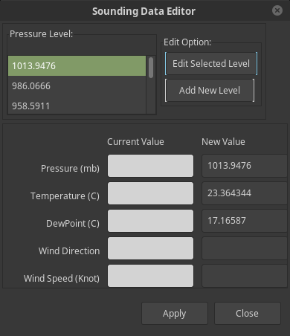
Do surface values match observations in the METAR plot?
Notes:
Here's the sounding near Philadelphia from the previous slide. To edit, toggle 'Edit Graph' to 'On' (Note that you can also click on 'Edit Data' to edit the data in a table)

Slide 34
Do surface values match observations in the METAR plot?
22.7
15.6
Notes:
Here's the sounding near Philadelphia from the previous slide. To edit, toggle 'Edit Graph' to 'On' (Note that you can also click on 'Edit Data' to edit the data in a table)

Slide 35
Do surface values match observations in the METAR plot?
Toggle from ‘Off’ to ‘On’
Notes:
Here's the sounding near Philadelphia from the previous slide. To edit, toggle 'Edit Graph' to 'On' (Note that you can also click on 'Edit Data' to edit the data in a table)

Slide 36
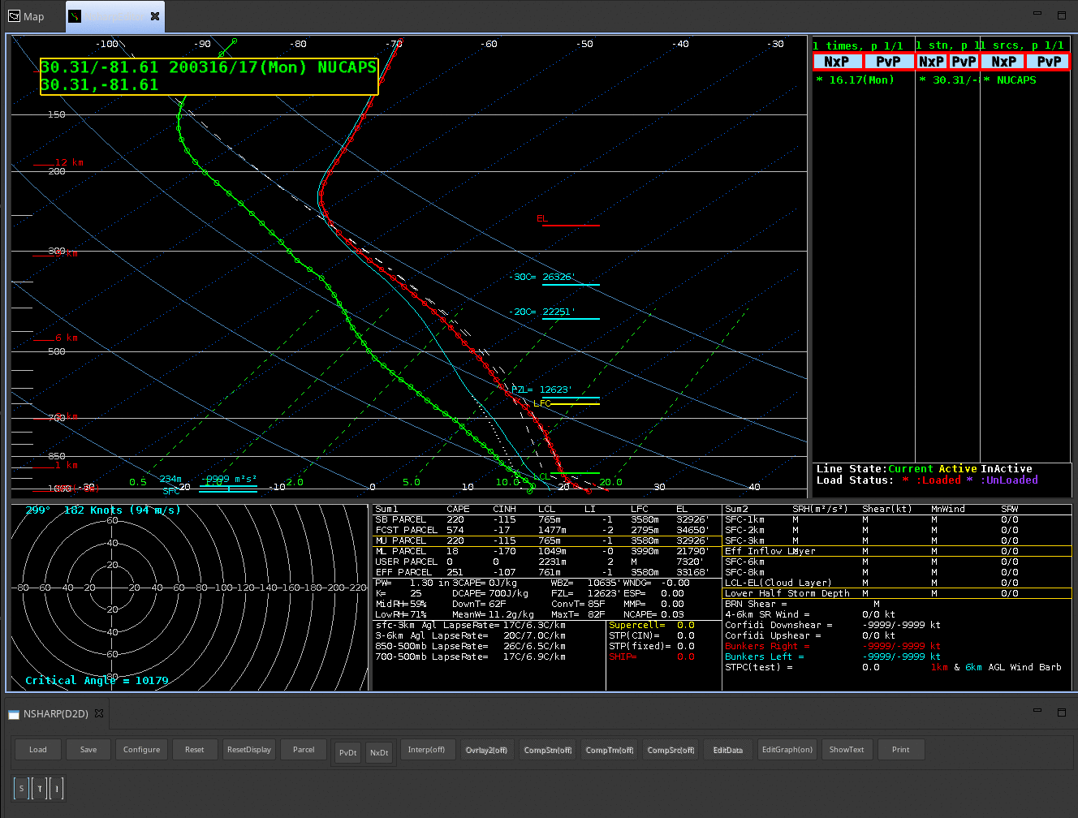
Draggable Points appear on T and Td lines. Move those points to values you think appropriate

Slide 37
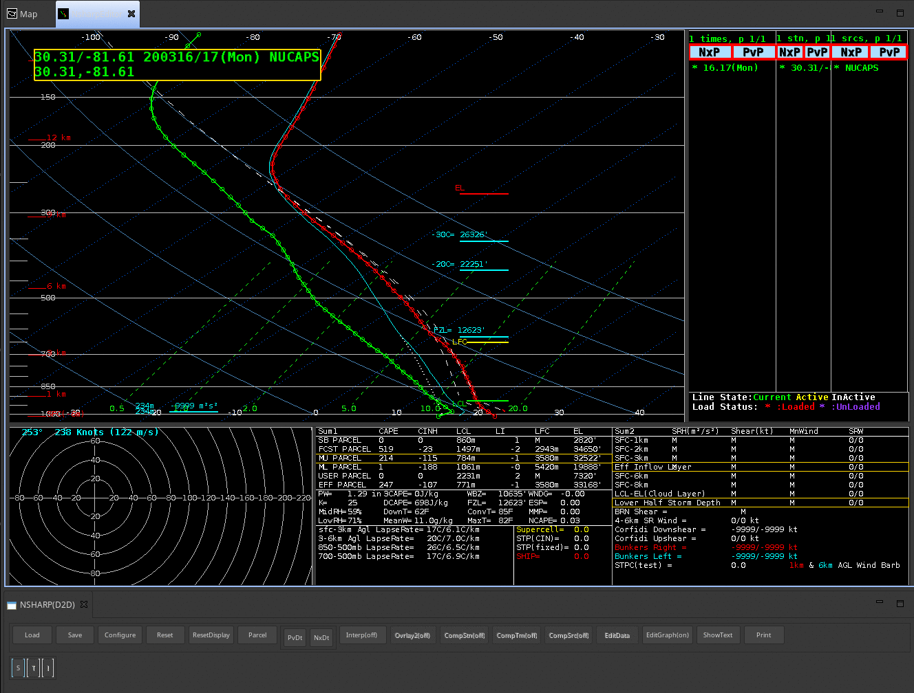

Slide 38
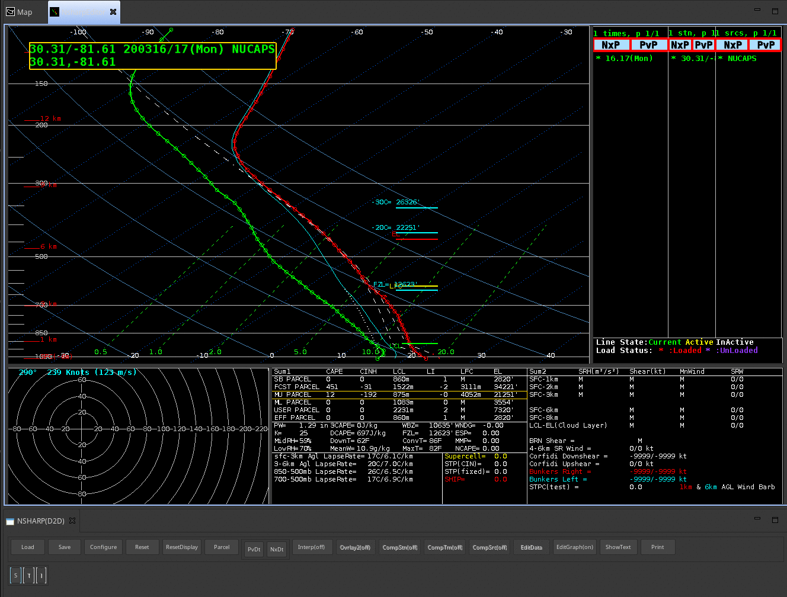

Slide 39
Toggle from ‘On’ to ‘Off’

Slide 40
Modified
Original
How have convective parameters changed? CAPE? LCL? EL?
All that was changed was T/Td at a few of the lower levels

Slide 41
The first, classic example, of how to use NUCAPS
Convective Afternoon in the central Plains
Timing of NUCAPS soundings is such that you get a profile during the peak in convective heating over the Plains
Use the data (maybe including sounding modification) to make a better-informed decision

Slide 42
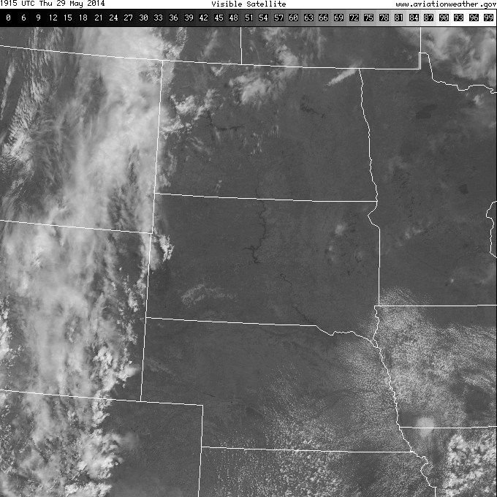
Forecast Problem: 29 May 2014 Will there be Afternoon/Evening Convection ?
GFS 9 hour fcst
From 12UTC 29 May
Valid 21 UTC 29 May
1915 UTC
Visible
Will the Cumulus Field develop further? (As suggested by the GFS)
Notes:
This is a more forecast-specific use of the soundings. Will that broken cumulus field on the border of Iowa/Nebraska develop? The GFS is predicting QPF later in the day.

Slide 43
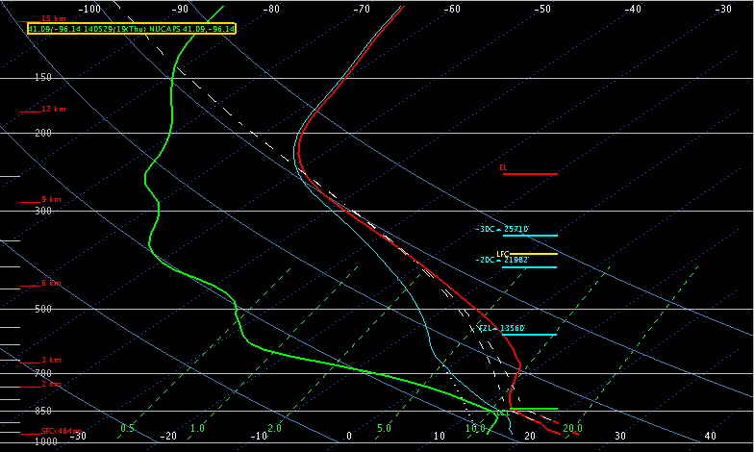
NUCAPS Sounding 1842 UTC 29 May 2014 Would you expect convective development?
T = 79F (METAR = 80F)
Td = 60F (METAR = 63F)
CAPE ~ 50 J/KG
Notes:
This sounding has a surface temperature and dewpoint close to observations (so we needn't edit the sounding to bring it into accord with observations). CAPE is small. Would you expect convective development?

Slide 44
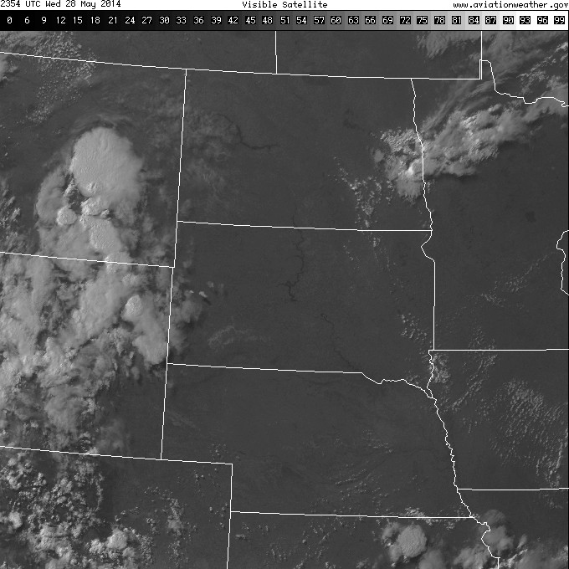
2354 UTC
Visible
Notes:
Late afternoon visible imagery shows that the cumulus field has dissipated.

Slide 45
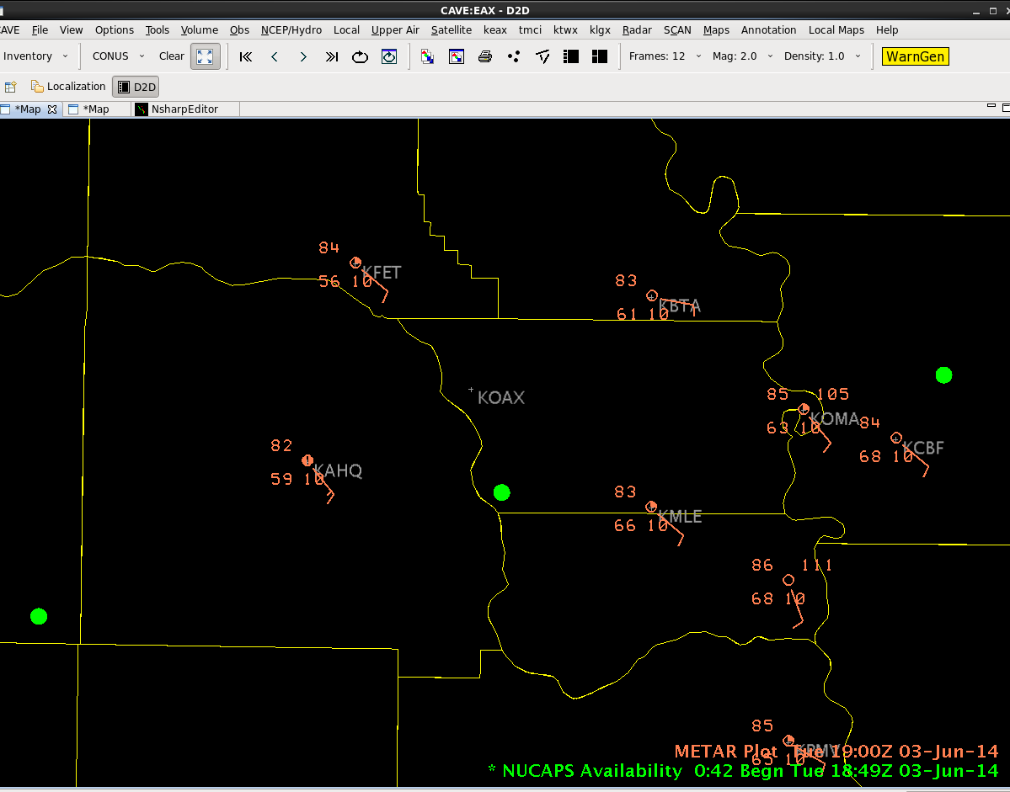
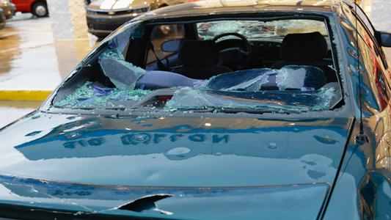
June 3, 2014 High Risk Severe Weather Event in Omaha
Notes:
A couple days later, Omaha experienced severe weather. This image shows the storm reports, damage, and two NUCAPS sounding sites from 1849 UTC on 3 June. Note also the gradient in dewpoint in the plotted METARs.
The next page shows the NUCAPS sounding for the site just south of the Omaha WFO -- the one in the Green Box.

Slide 46
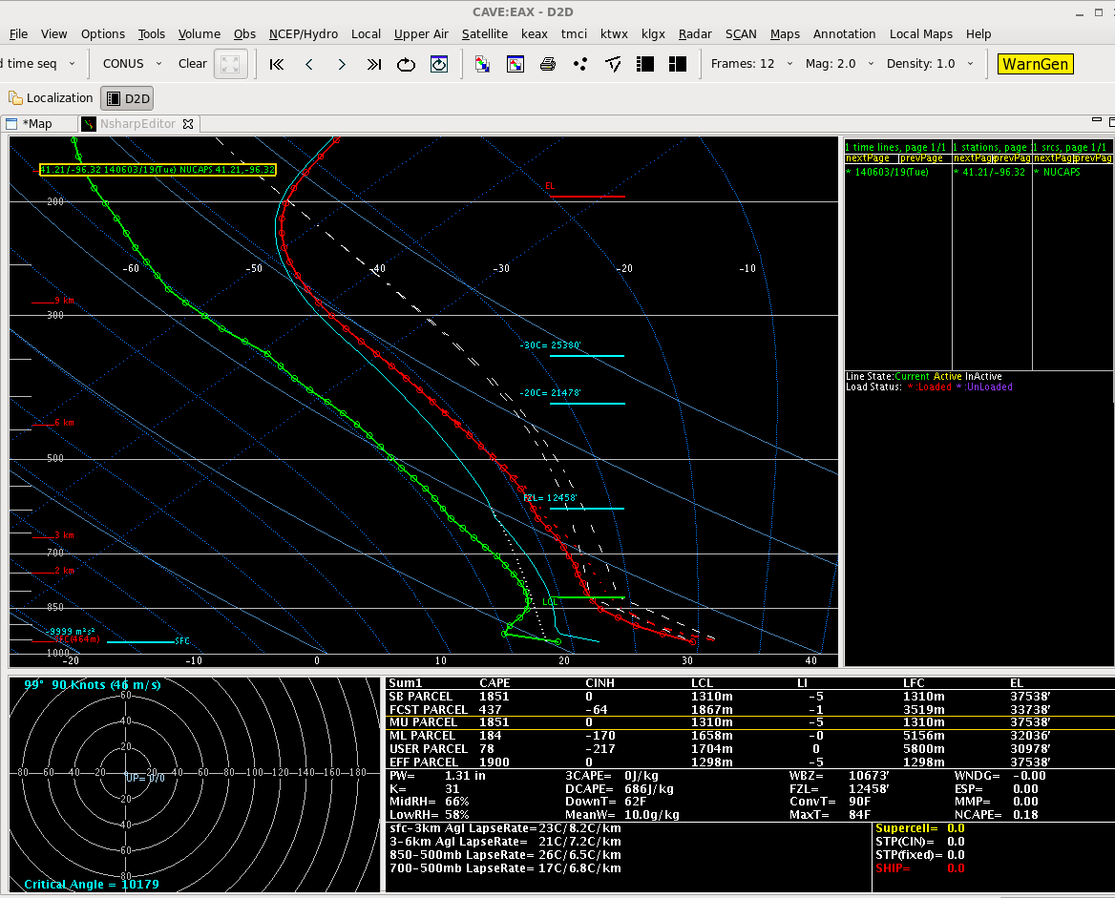
June 3, 2014 High Risk Severe Weather Event in Omaha
NUCAPS ~10 KM south of OAX
1849Z June 3, 2014 – cloudy
scene, but still gives info!
Modified to match METAR
Ob of T=83, Td=63
SB CAPE = 1851
Notes:
The NUCAPS sounding from the site in the green box on the previous page -- a cloudy region (but not dense clouds), but the sounding still gives information because not all of the CrIS points were in overcast regions. This sounding has been modified so the surface METARs match the sounding values. Surface-based CAPE is 1851.

Slide 47
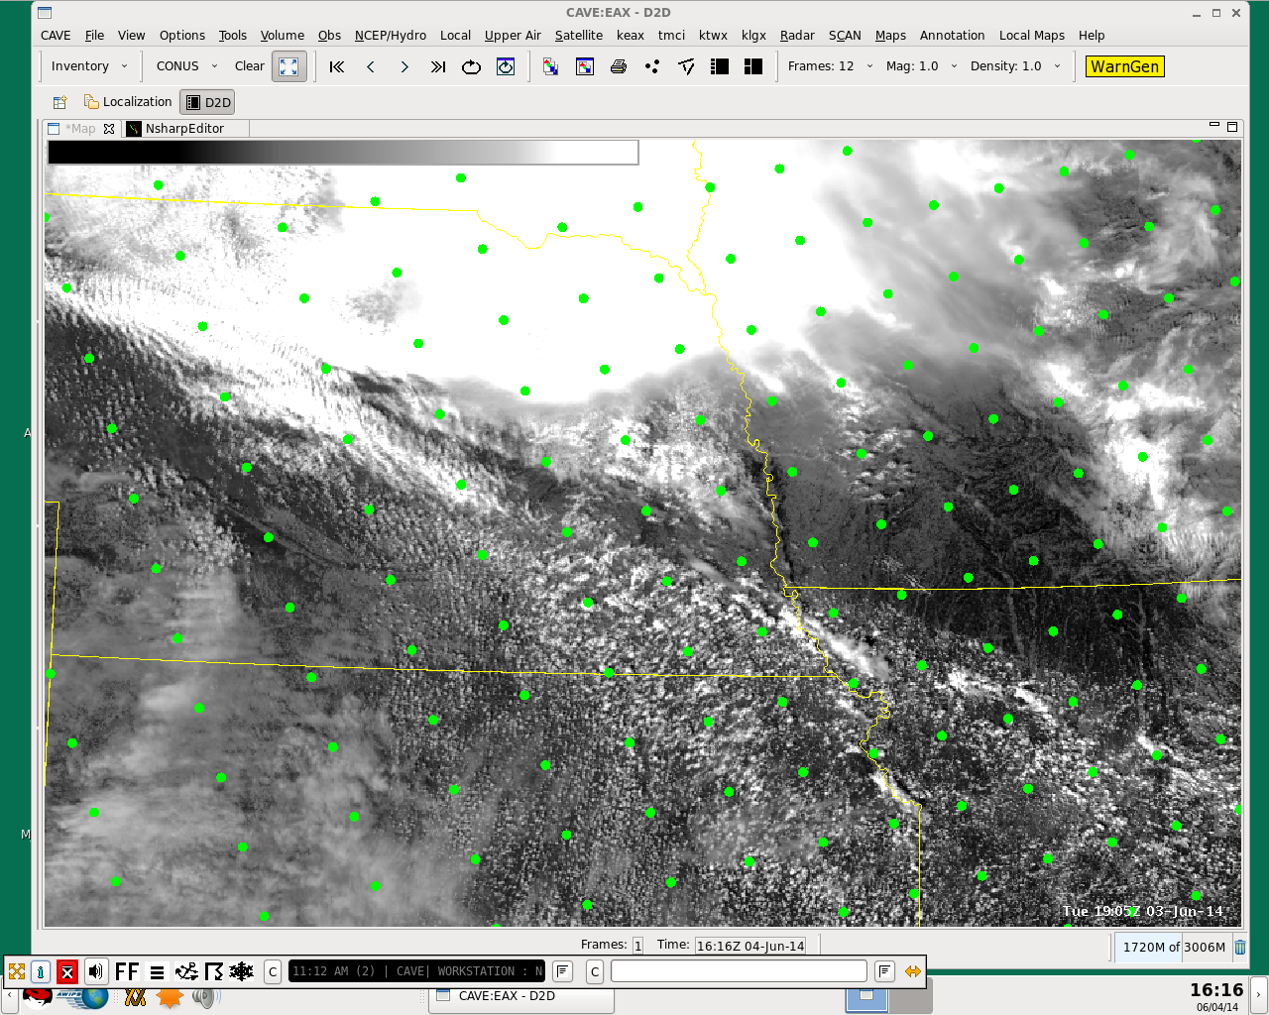
June 3, 2014 High Risk Severe Weather Event in Omaha
NUCAPS sounding locations
overlain on VIIRS 0.64
1905Z June 3, 2014
Notes:
The boxed site is the one we just looked at. Imagine 9 points centered on this boxed green point – some of those points are in relatively clear skies. Note that an even-more clear Sounding is just south -- and recall that there is a strong dewpoint gradient in the region.

Slide 48
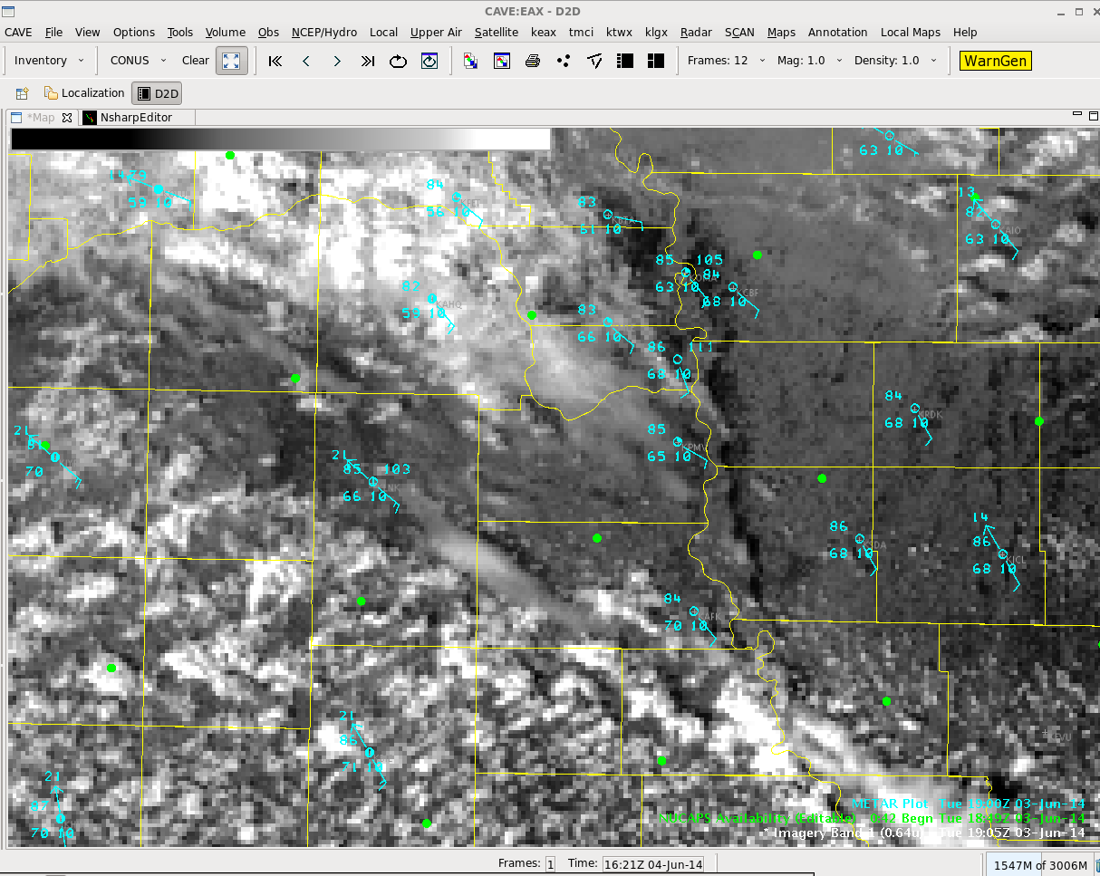
June 3, 2014 High Risk Severe Weather Event in Omaha
NUCAPS sounding locations
Overlaid with VIIRS 0.64
1905Z June 3, 2014
Location of OAX in yellow
Northern dot is within a few
KM of KOAX, but under
cloud cover
Southern dot is in a nearly
Cloud-free location, and is
warmer and more humid
OAX
Notes:
Zooming in again, we see the sounding from the cloudy region -- boxed in green, and also a second sounding to the south where skies are clearer. (And dewpoints are warmer there too)

Slide 49
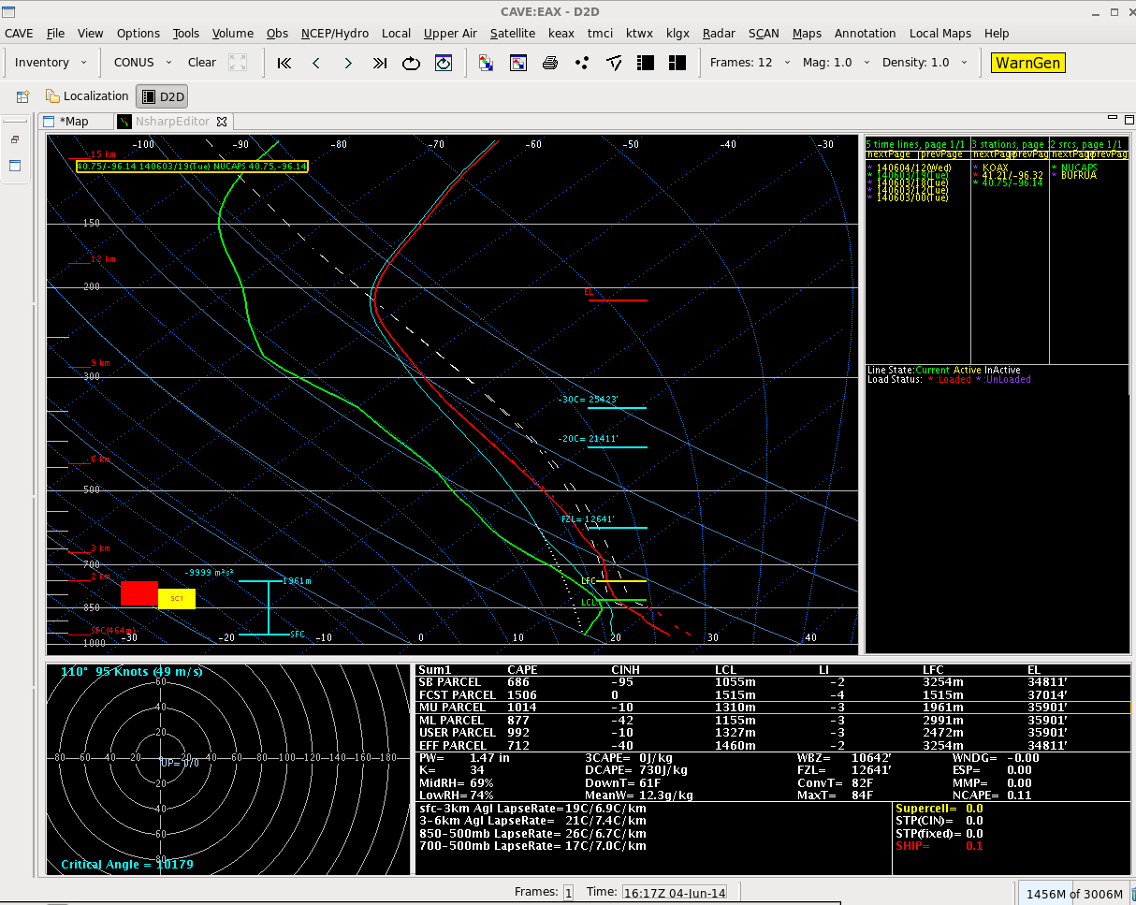
June 3, 2014 High Risk Severe Weather Event in Omaha
NUCAPS sounding
40 km south of OAX
1849Z June 3, 2014
Unmodified
SB CAPE = 686
Notes:
Here is the unmodified NUCAPS sounding at that southern site. Surface-based CAPE is around 700 -- but the surface temperature/dewpoint in the sounding do not match the METARs. This is a good sounding to edit.

Slide 50
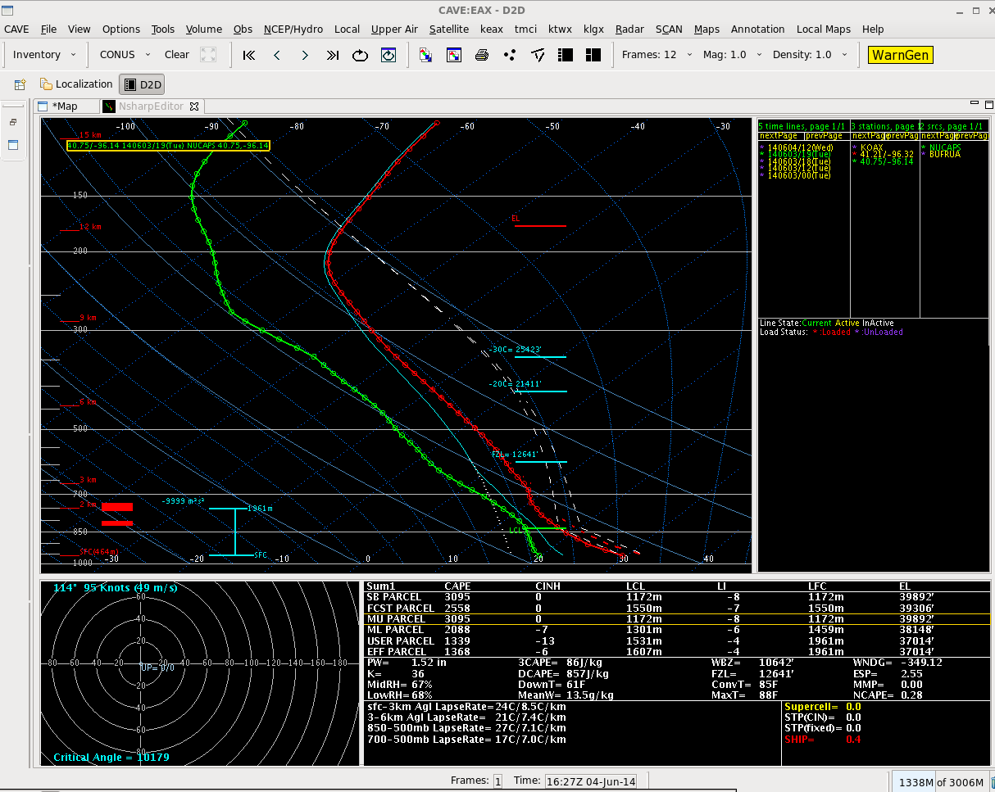
June 3, 2014 High Risk Severe Weather Event in Omaha
NUCAPS sounding
40 km south of OAX
1849Z June 3, 2014
Modified to match METAR
Ob of T=85, Td=68
SB CAPE = 3095
Notes:
Once the sounding is edited so that its lowest temperature/dewpoint match the METAR, surface based CAPE exceeds 3000! This kind of information should influence your interpretation of present conditions.

Slide 51
New* in 2019/2020
Data from vertical profiles are converted into horizontal fields.
No need to click through many points to find information
Many (many) different thermodynamic fields are available
AWIPS presentation requires some ITO input to make sure you retain all the fields.
Only AWIPS (as of now) has the multitude of fields and lapse rates pre-derived
* Not new for Alaska! Gridded Values have been available since 2018 from the DB Antenna
Notes:
What does the Point mean in the NUCAPS sounding field?
A NUCAPS sounding comprises data from 9 CrIS Fields of Regard; the point as plotted in AWIPS is the centroid of the 9 points, so information from the sounder is coming from the region surrounding the point. Rather than a point, you should consider the NUCAPS sounding volumetric -- that is, it's telling you something a cylinder of air in the atmosphere.

Slide 52
Look in the Product Browser!

Slide 53
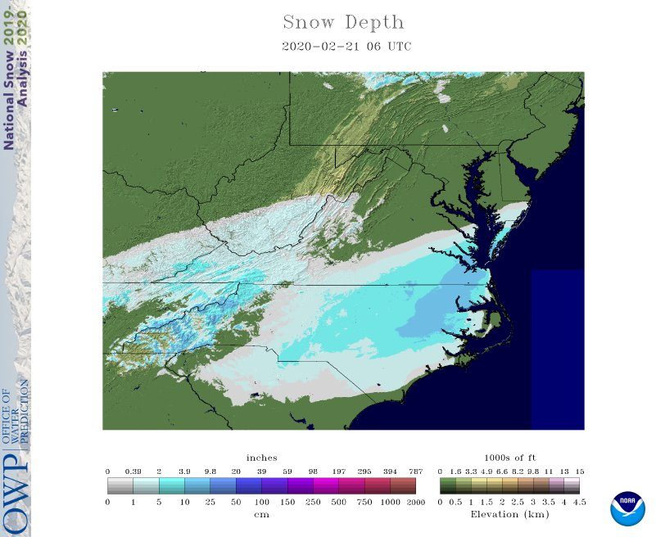
Gridded Temperature Fields
Snowfall on 2/20 – 2/21
Binary Probability of T < 0 at 950 mb

Slide 54
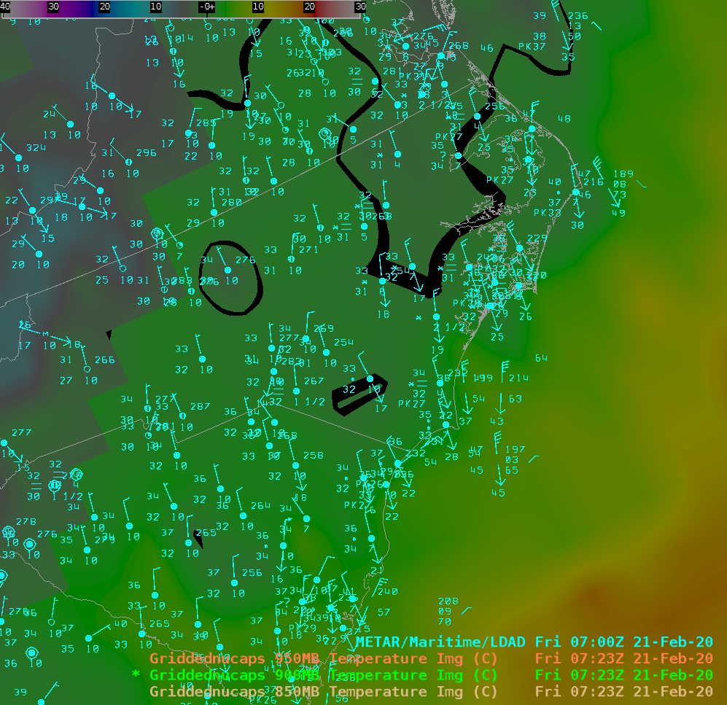
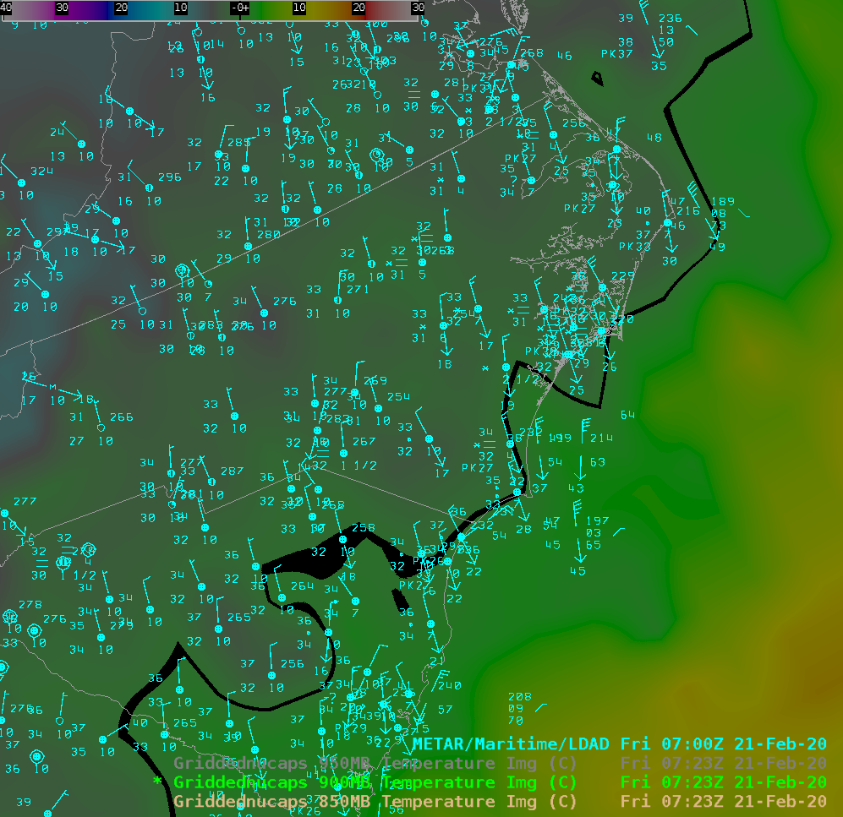
Temperature fields, 0720 UTC 2-21-2020
T @ 950
T @ 850
Enhancement changed so that 0 C is black
(Put this in a procedure)
T @ 900

Slide 55
Temperature fields: Do they come from a sounding you would trust?
Keep in mind that gridded soundings use all points: green, yellow and red …it’s up to you the forecaster to apply QC

Slide 56
Compare to Model fields: Which is correct?
Tight Gradient

Slide 57
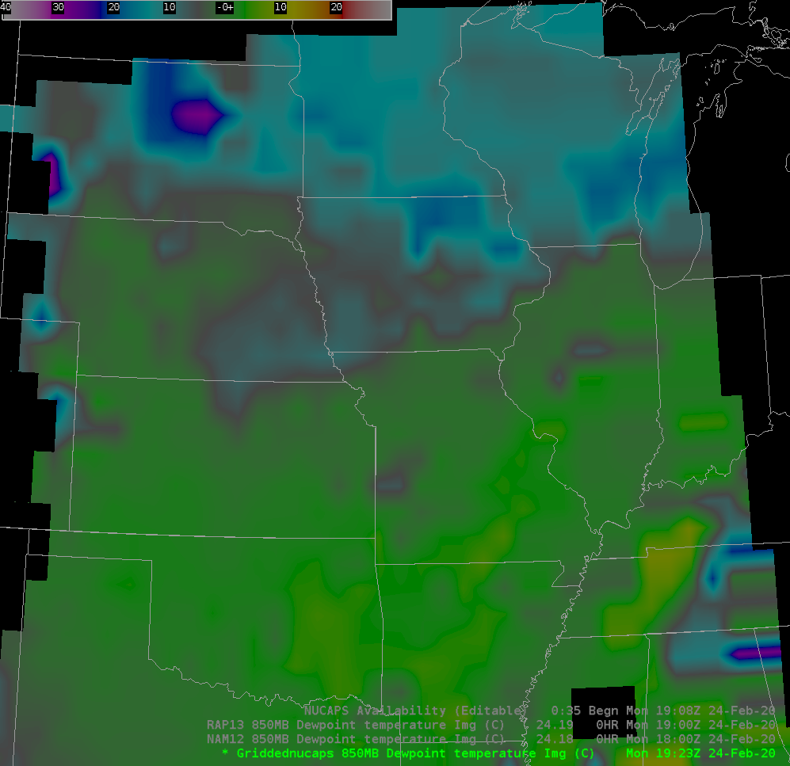
Compare to Model fields: Which is correct?
RAP and NAM are much drier than NUCAPS

Slide 58
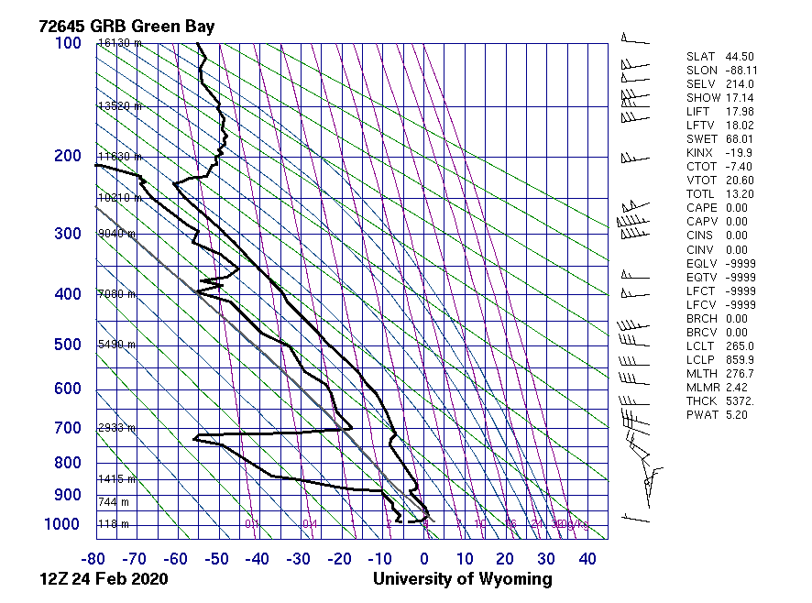
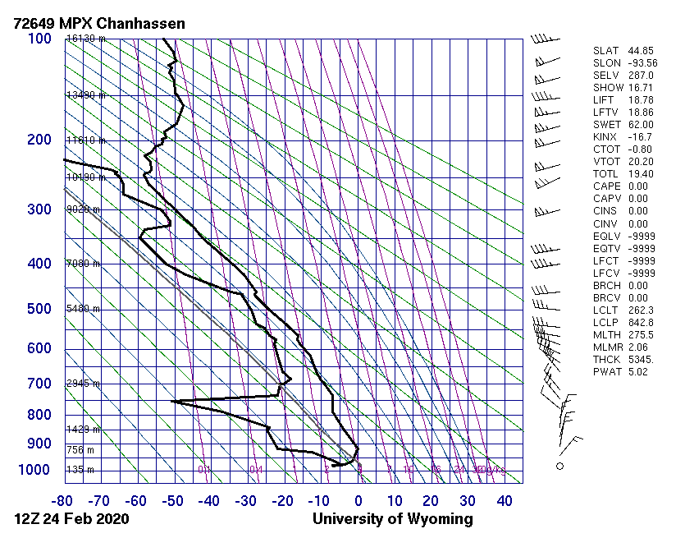
12z Soundings

Slide 59
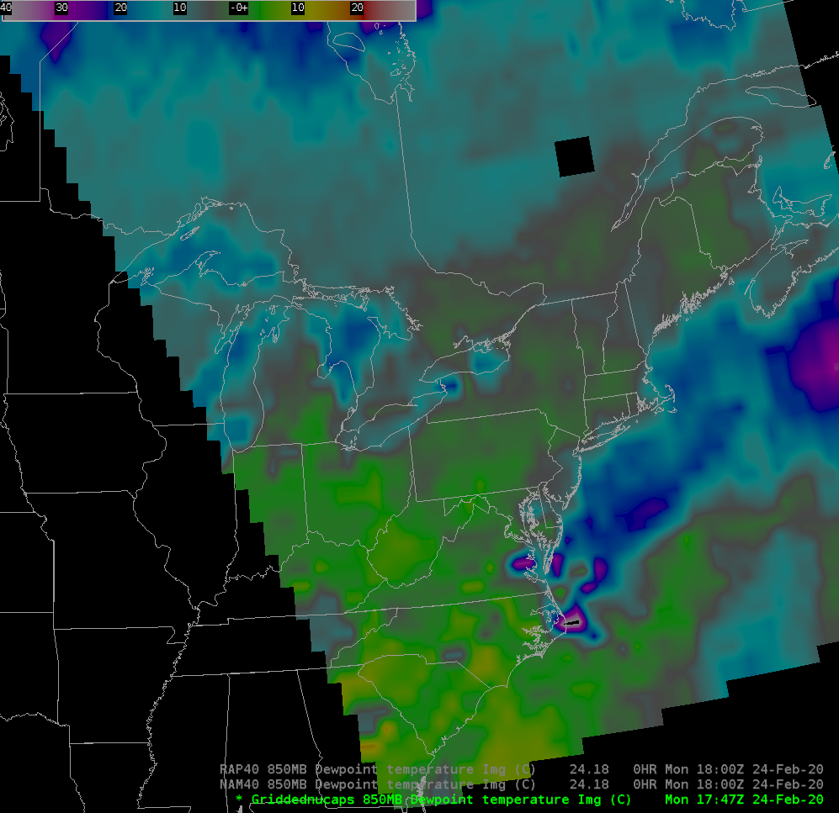
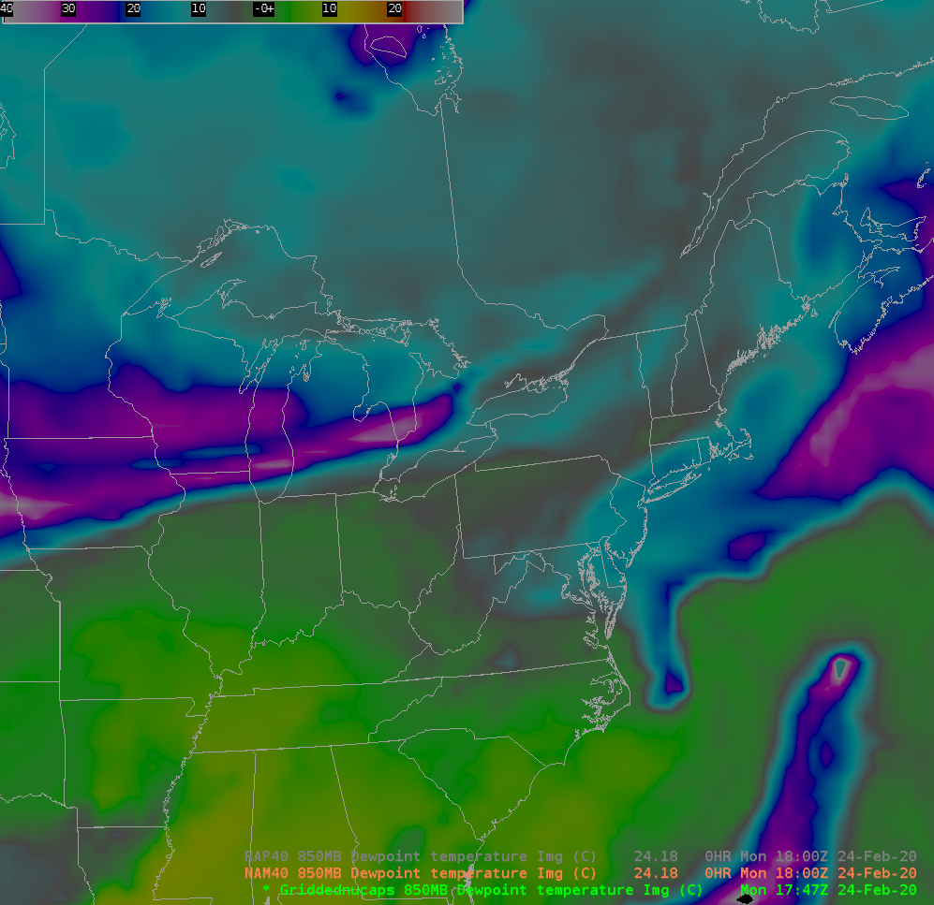
Southeast Coast

Slide 60
Gridded NUCAPS with convection
Total Totals values >50 south and west of convection moving through Nashville (after the storm). NUCAPS at 0717 UTC, tornado on ground 0640 UTC
Nicely captures the instability feeding into the convective system

Slide 61
Gridded NUCAPS over the Pacific Ocean
Note the region with small 900-700 mb lapse rates!

Slide 62
Night Fog Brightness Temperature Difference
Note the region with small 900-700 mb lapse rates!
Use this (maybe) to diagnose inversion strength; it might take longer for the Sun to burn off fog there!

Slide 63
What might you use NUCAPS for?
Diagnose Stability in the atmosphere before convection forms
Understand the thermal structure in borderline precipitation type events
Map out the extent of trace gases – CO, SO₂, etc. – after fires and volcanic events
Check the distribution of O₃ in a region of cyclogenesis
Find areas of very cold temperatures aloft for aircraft routing
Determine moist/dry regions by examining precipitable water fields
Lapse rate information to help diagnose lake effect
What forecast problem is the satellite data going to help?

Slide 64
Useful Links
Gridded NUCAPS Vlab page
https://vlab.ncep.noaa.gov/web/nasa-sport/gridded-nucaps
NUCAPS Landing Page for information
https://weather.msfc.nasa.gov/nucaps/
List of Links, including to Blog Posts that show how NUCAPS can be used
https://jpss.ssec.wisc.edu/data/jpssdata.html
Polar2Grid software package
https://cimss.ssec.wisc.edu/cspp/npp_polar2grid_v2.1.shtml
OSPO website
https://www.ospo.noaa.gov/Products/atmosphere/soundings/nucaps/pskewt/WORLD.html
Gridded NUCAPS Site (from Rebekah)
http://sigma.umd.edu/resmaili/nucaps.html

Slide 65
Summary
A mix of infrared and microwave information. Infrared Regression can fail, but a microwave-only sounding will still be produced.
At most 10 temperature layers and about five moisture layers are resolved in the troposphere.
NOAA-20 NUCAPS soundings will arrive within about 60 minutes! This is better latency than Suomi-NPP
Learn how to modify the soundings if the lowest layers don’t agree with nearby METARs or the RTMA
Modified Soundings have been modified to match RTMA Thermodynamics: Is the boundary layer that is inserted correct? (The modified NUCAPS product can be LDM-delivered)
Notes:
To summarize: NUCAPS soundings can give a timely update to 1200 UTC soundings; use them to diagnose how the atmosphere has changed.
NOAA-20 soundings are being provided and should be available within 30 minutes of the overpass. Metop A and Metop B soundings arrive via the SBN and will have a slower arrival -- and they typically do not supply early afternoon data.
You may have to modify the sounding to reflect surface conditions, but modified NUCAPS NOAA-20 afternoon soundings have done that automatically for you. The mixed layer that is inserted in these depends on Skin and Air temperature differences observed before the overpass.
Note that there is additional training available on the horizontal fields of information that can be extracted from the field of NUCAPS Soundings.
This concludes the training on NUCAPS Vertical Profiles at HWT.

