Slide 1
NUCAPS Sounding Moisture 25 February 2020
Scott Lindstrom

Slide 2
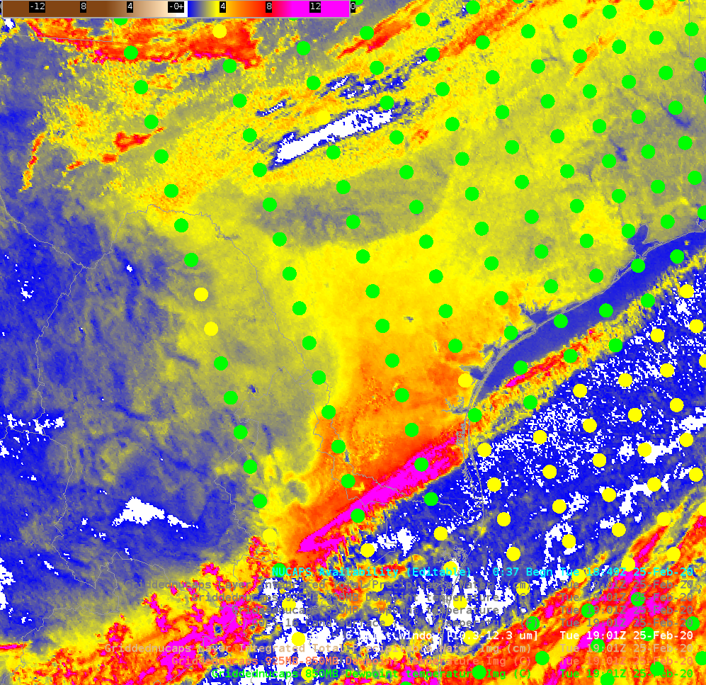
Split Window Difference shows a dry spot (qualitative!)

Slide 3
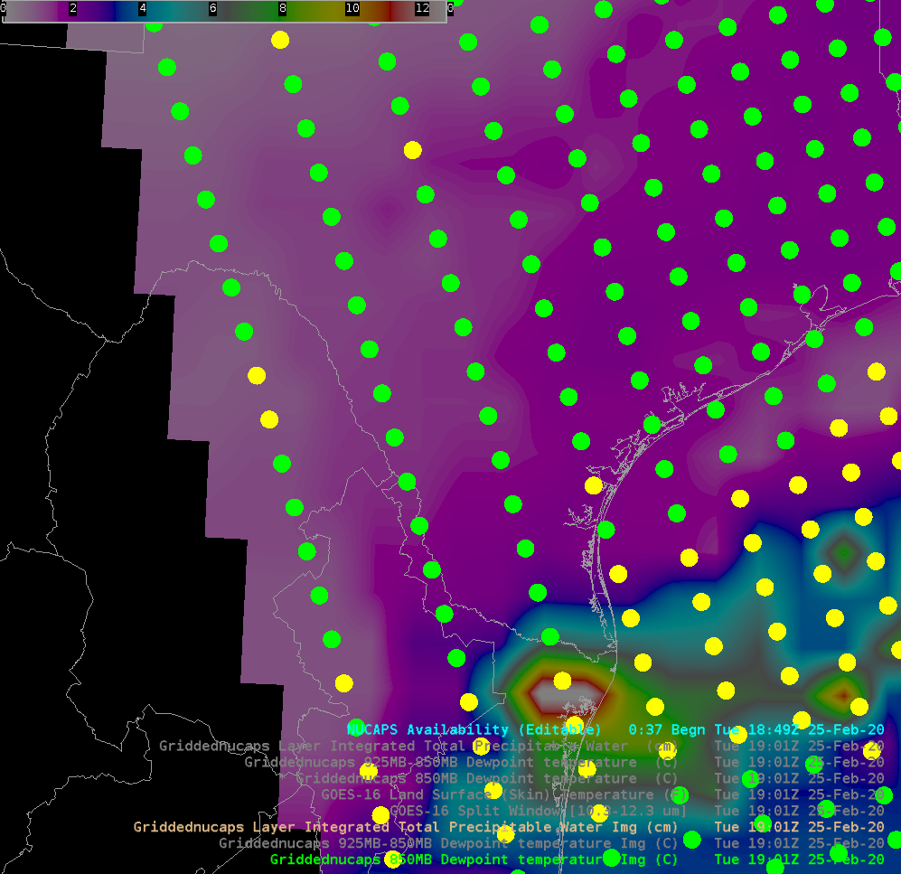
NUCAPS TPW shows a dry spot (quantitative!)
(subtle!)

Slide 4
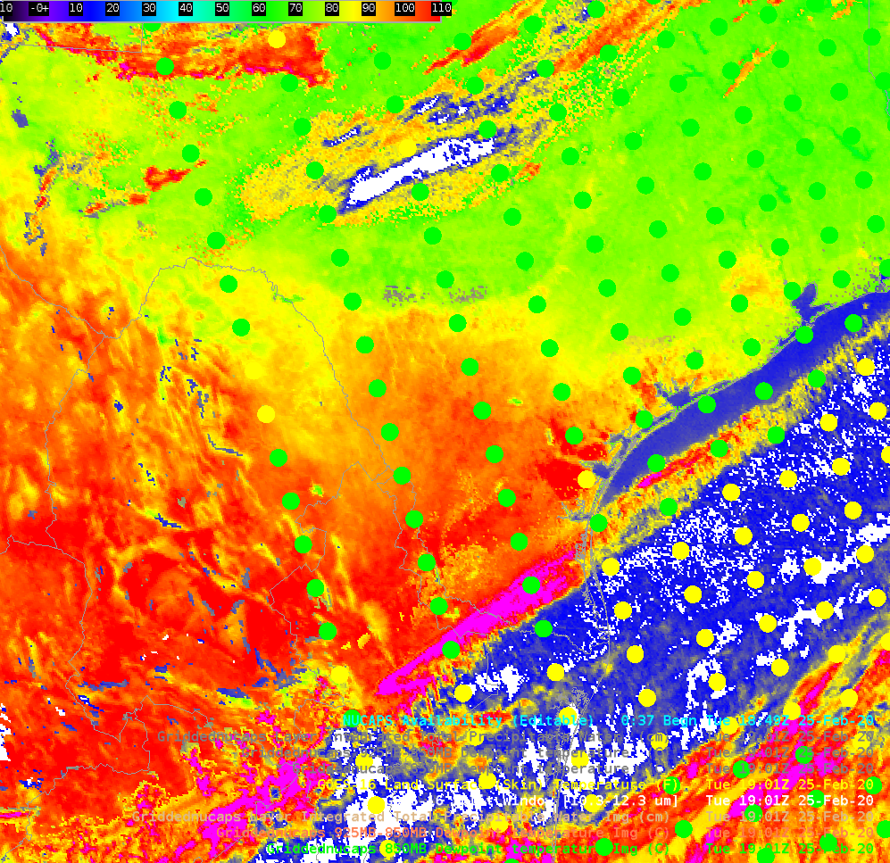
Split Window Difference is sensitive to skin temperature, and it’s cold there too

Slide 5
Split Window Difference shows a dry spot (qualitative!)

Slide 6
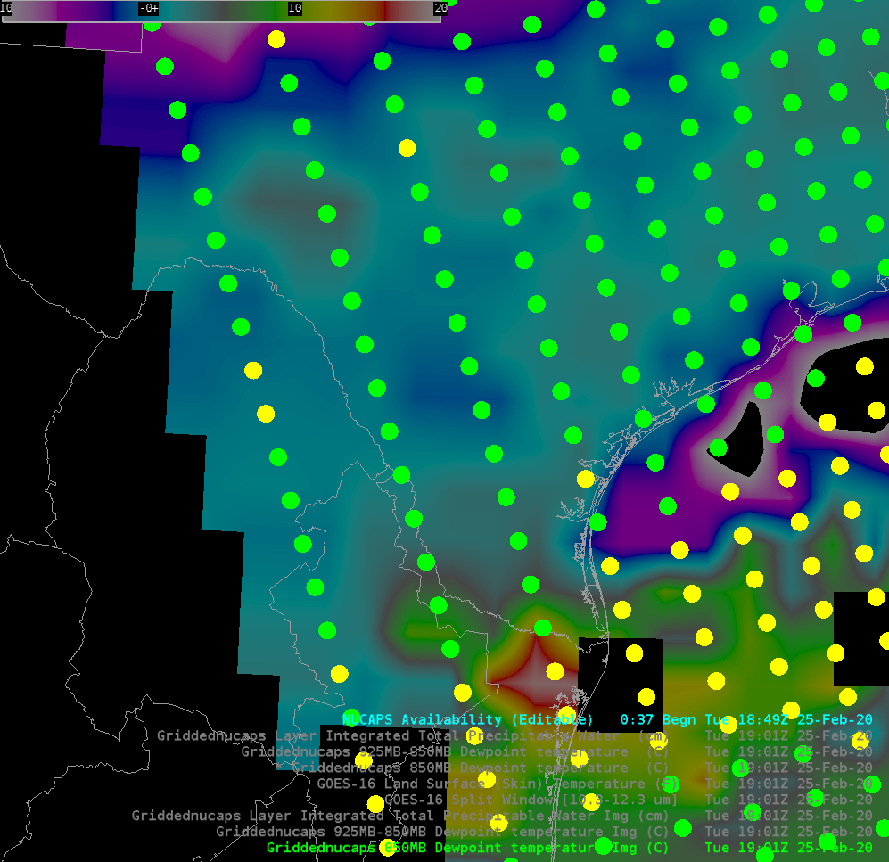
850-mb Td shows a dry spot (quantitative!)

Slide 7
Split Window Difference shows a dry spot (qualitative!)

Slide 8
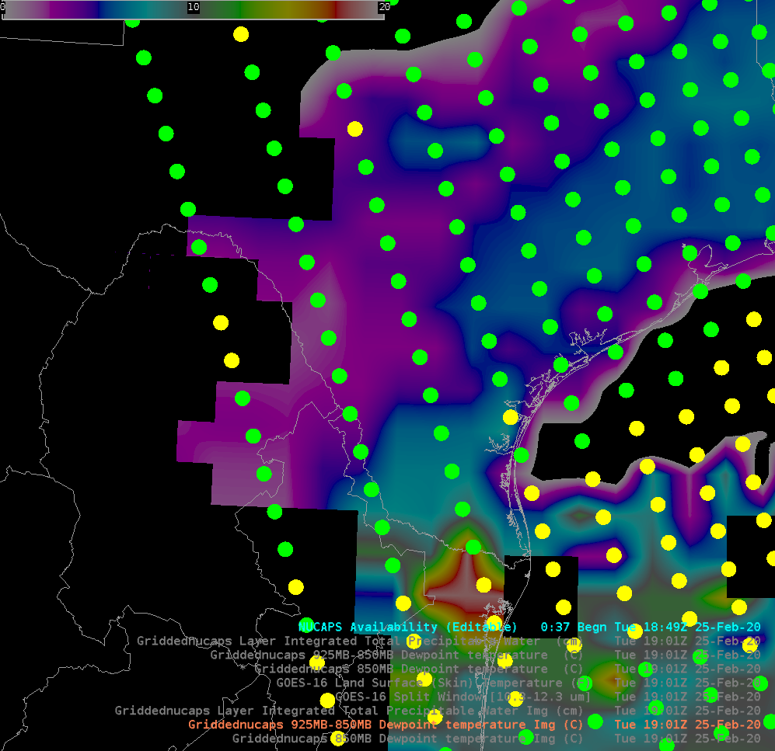
925-850 mb Td shows a dry spot (quantitative!)

Slide 9
Split Window Difference shows a dry spot (qualitative!)

Slide 10
NUCAPS Soundings
Show relatively dryer air in region where SWD shows dryness
TPW printed in box (in inches, with a cm conversion) is taken from NSharp PW readout in AWIPS (taken after you click on the NUCAPS Sounding Availability dot)
Values plotted on top of the dot are readouts from AWIPS – NUCAPS Total Precipitable Water

Slide 11
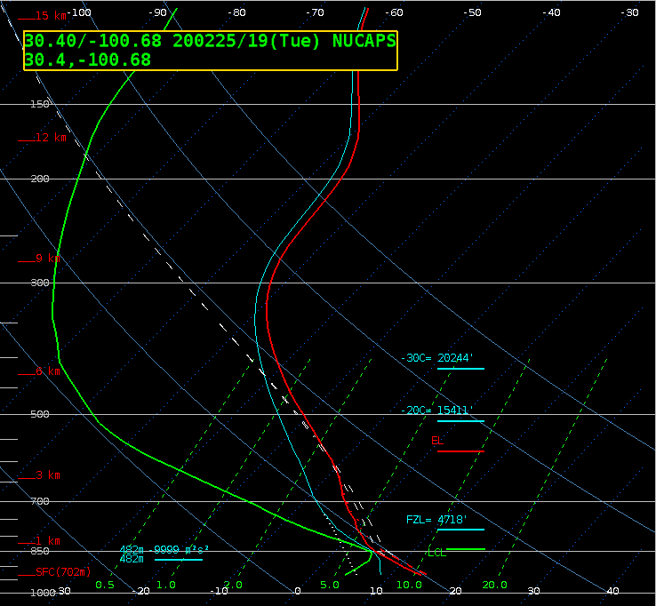
1.57
1.38
1.57
1.24
1.57
1.42
1.25
1.74
1.21
1.52
1.32
1.83
1.21
1.65
.44” / 1.12 cm
1.29
1.37

Slide 12
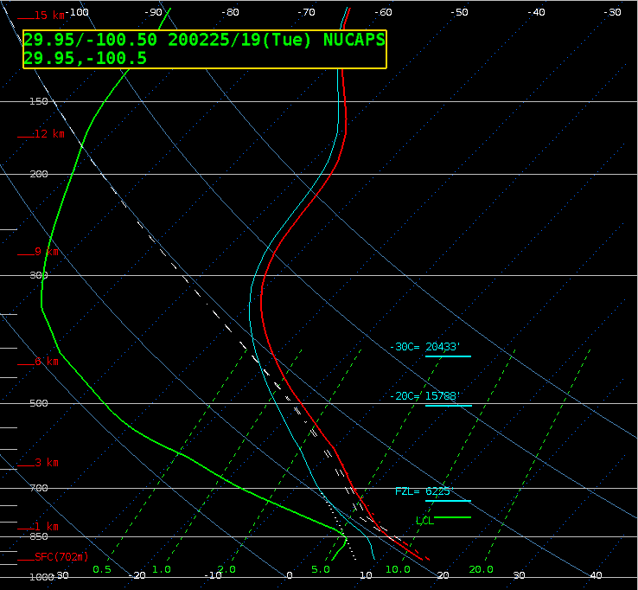
1.57
1.38
1.57
1.24
1.57
1.42
1.25
1.74
1.21
1.52
1.32
1.83
1.21
1.65
.42” / 1.07 cm
1.29
1.37

Slide 13
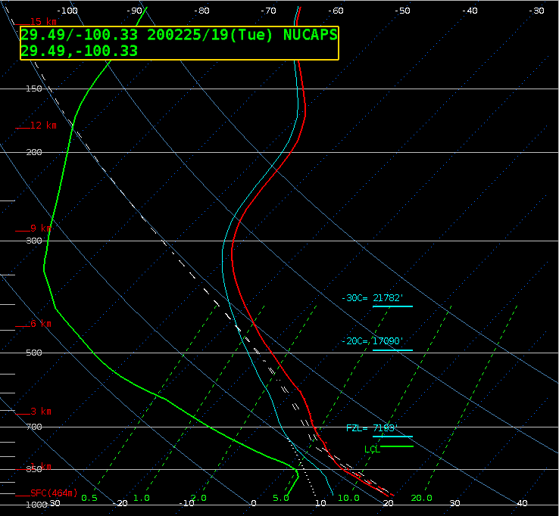
1.57
1.38
1.57
1.24
1.57
1.42
1.25
1.74
1.21
1.52
1.32
1.83
1.21
1.65
.45” / 1.14 cm
1.29
1.37

Slide 14
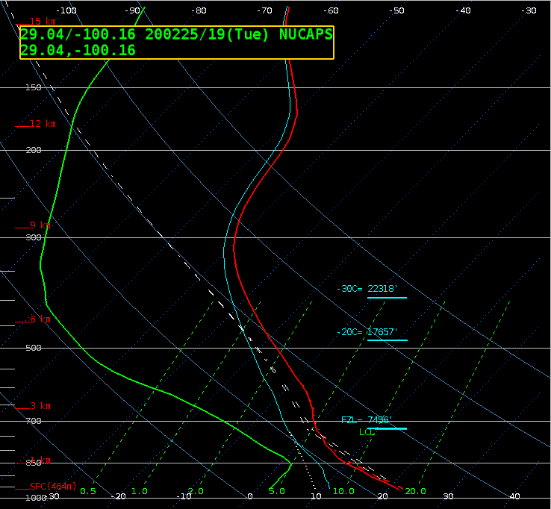
1.57
1.38
1.57
1.24
1.57
1.42
1.25
1.74
1.21
1.52
1.32
1.83
1.21
1.65
.46” / 1.17 cm
1.29
1.37

Slide 15
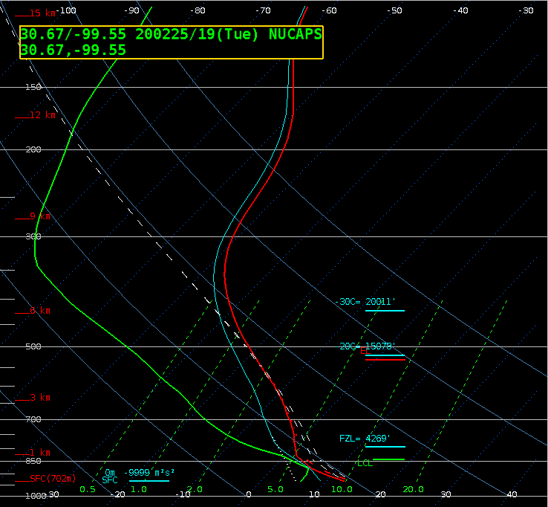
1.57
1.38
1.57
1.24
1.57
1.42
1.25
1.74
1.21
1.52
1.32
1.83
1.21
1.65
.43” / 1.09 cm
1.29
1.37

Slide 16
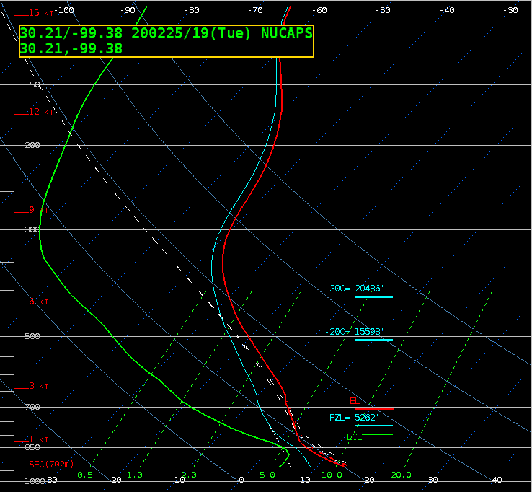
1.57
1.38
1.57
1.24
1.57
1.42
1.25
1.74
1.21
1.52
1.32
1.83
1.21
1.65
.40” / 1.02 cm
1.29
1.37

Slide 17
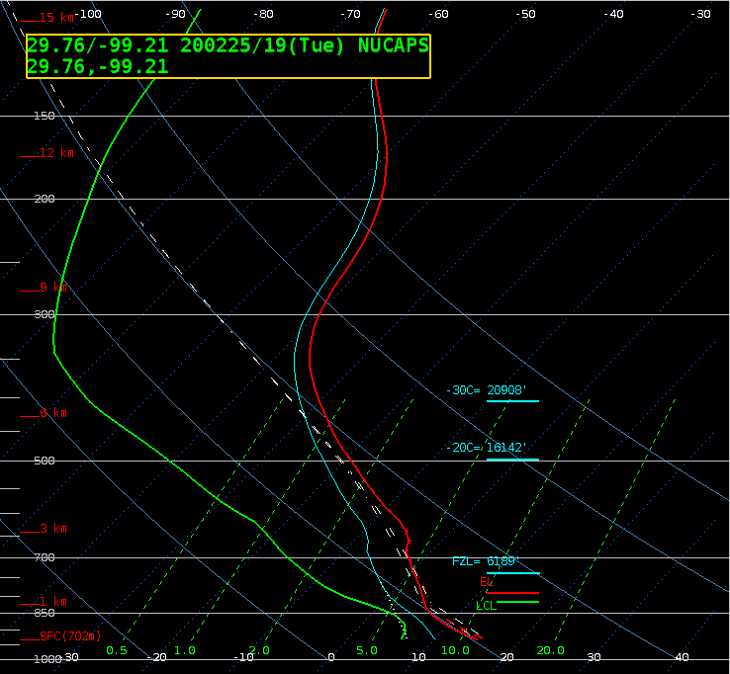
1.57
1.38
1.57
1.24
1.57
1.42
1.25
1.74
1.21
1.52
1.32
1.83
1.21
1.65
.44” / 1.12 cm
1.29
1.37

Slide 18
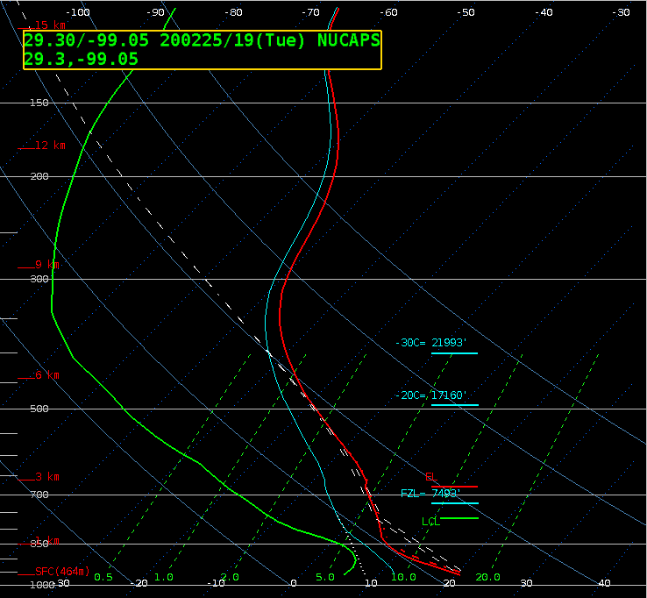
1.57
1.38
1.57
1.24
1.57
1.42
1.25
1.74
1.21
1.52
1.32
1.83
1.21
1.65
.47” / 1.19 cm
1.29
1.37

Slide 19
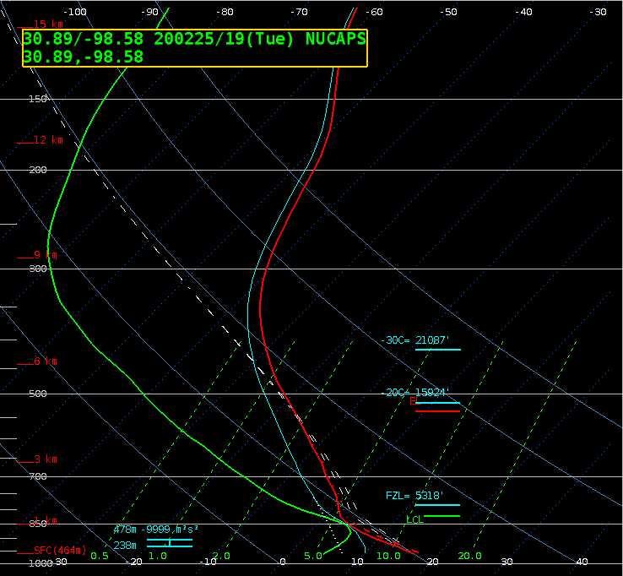
1.57
1.38
1.57
1.24
1.57
1.42
1.25
1.74
1.21
1.52
1.32
1.83
1.21
1.65
.57” / 1.45 cm
1.29
1.37

Slide 20
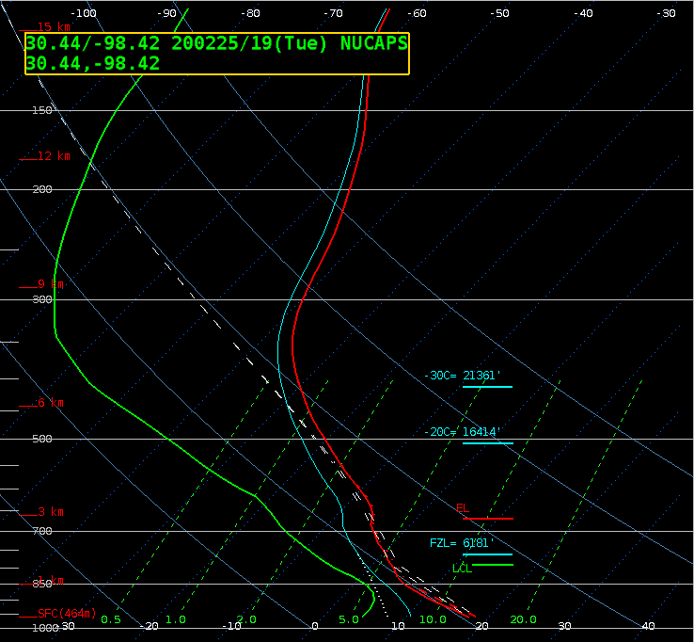
1.57
1.38
1.57
1.24
1.57
1.42
1.25
1.74
1.21
1.52
1.32
1.83
1.21
1.65
.51” / 1.30 cm
1.29
1.37

Slide 21
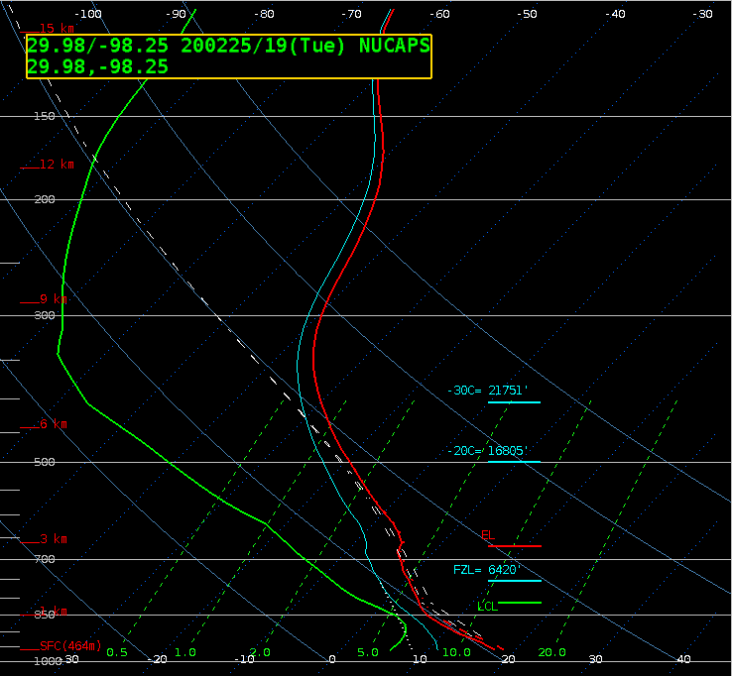
1.57
1.38
1.57
1.24
1.57
1.42
1.25
1.74
1.21
1.52
1.32
1.83
1.21
1.65
.53” / 1.37 cm
1.29
1.37

Slide 22
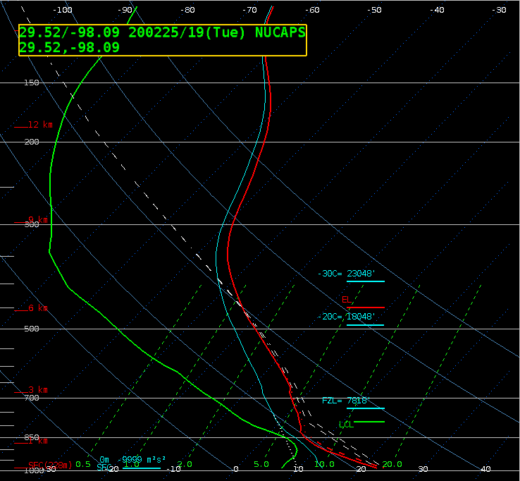
1.57
1.38
1.57
1.24
1.57
1.42
1.25
1.74
1.21
1.52
1.32
1.83
1.21
1.65
.62” / 1.57 cm
1.29
1.37

Slide 23
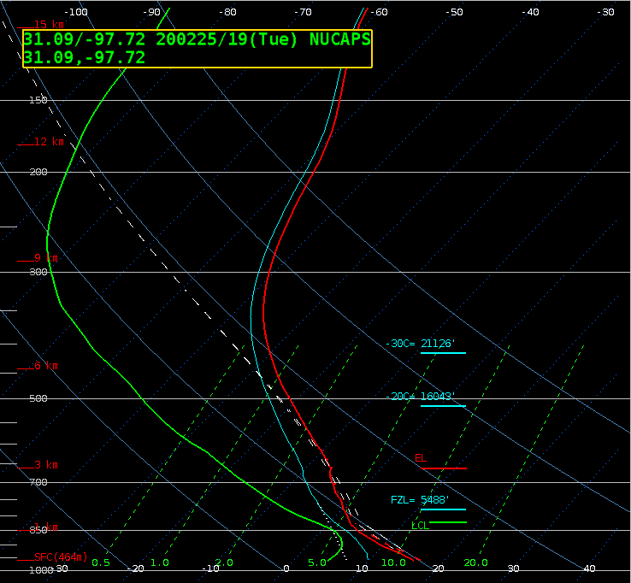
1.57
1.38
1.57
1.24
1.57
1.42
1.25
1.74
1.21
1.52
1.32
1.83
1.21
1.65
.48” / 1.22 cm
1.29
1.37

Slide 24
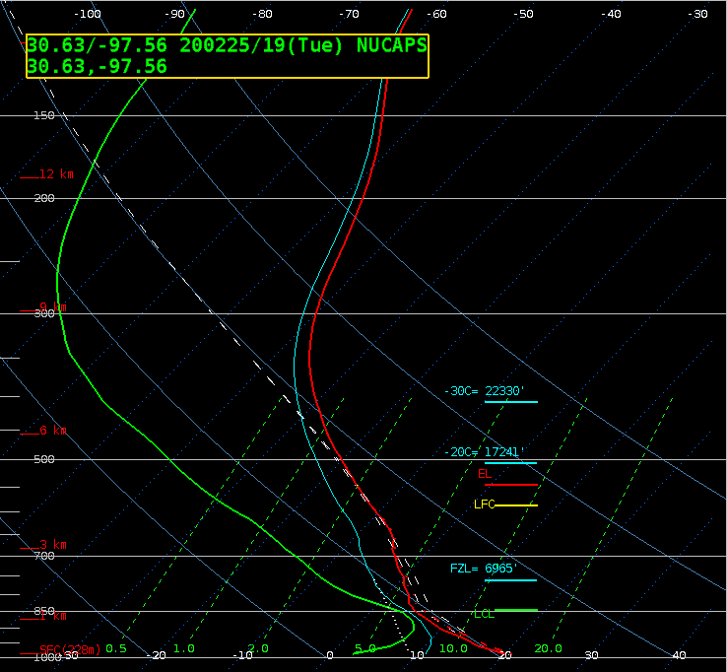
1.57
1.38
1.57
1.24
1.57
1.42
1.25
1.74
1.21
1.52
1.32
1.83
1.21
1.65
.60” / 1.52 cm
1.29
1.37

Slide 25
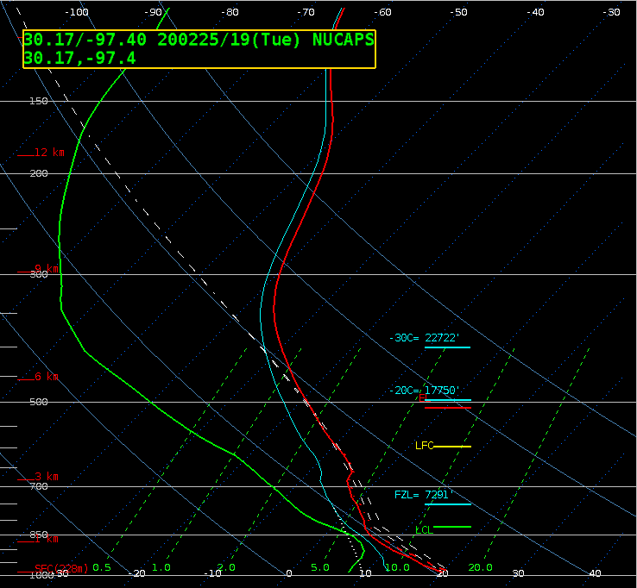
1.57
1.38
1.57
1.24
1.57
1.42
1.25
1.74
1.21
1.52
1.32
1.83
1.21
1.65
.65” / 1.65 cm
1.29
1.37

Slide 26
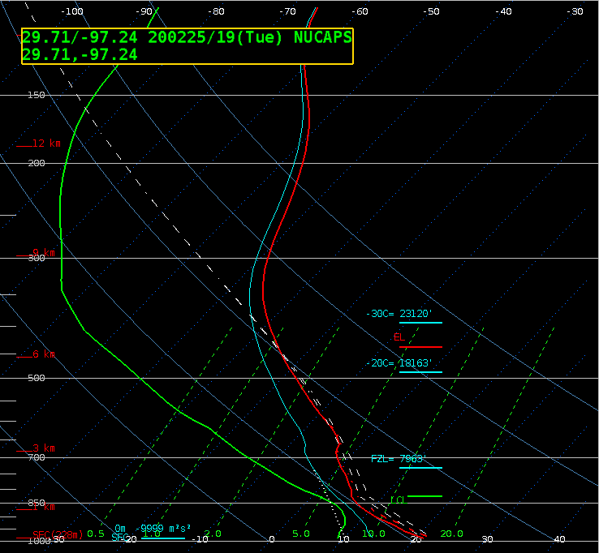
1.57
1.38
1.57
1.24
1.57
1.42
1.25
1.74
1.21
1.52
1.32
1.83
1.21
1.65
.66” / 1.68 cm
1.29
1.37

