Slide 1
Satellite-detected Aircraft Turbulence
Scott Lindstrom, Tony Wimmers
Cooperative Institute for Meteorological Satellite Studies (CIMSS)
April 2020

Slide 2
Turbulence
Subject Matter Expert: Tony Wimmers
ABI and AHI have sufficient spatial and temporal resolution to detect many turbulent episodes
  Some features in clear sky, some in clouds (technically over clouds)
Deep Learning is used to relate satellite observations to the likelihood of Moderate or Greater (MOG) turbulence
  Thousands of turbulent and non-turbulent cases are used to create the predictive model.
    Infrared Window Channel (10.3 μm) and (upper-level) Water Vapor imagery (6.2 μm)
    Aircraft-based observations of turbulence (at 30000 – 40000 feet) are used to train and validate the model

Slide 3
Turbulence
The turbulence product is probabilistic (percentage). This is meant to be interpreted as the probability of MOG…
  At any level within typical cruising altitude (30,000-40,000 ft)
  For large aircraft (eg. commercial passenger)
  At least once during a 10-minute period

Slide 4
Which Channels Are Used?
Water Vapor imagery is preferable, but a window channel-only option is available for times when the GOES-17 Loop Heat Pipe is not cooling the ABI enough
For Window Channel only
  Predictions of Turbulence are about 1/3rd LESS precise
  Regions of predicted turbulence are larger and more smoothed out

Slide 5
It matters what is producing the turbulence
Better Detection
Poorer Detection
Strong gravity waves that perturb clouds
Developing convection
Subtle gravity waves that emerge near convection or jet-stream shearing
This is especially true when only Band 13 (10.3 μm) is available

Slide 6
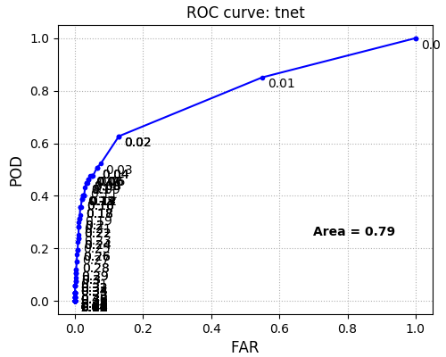
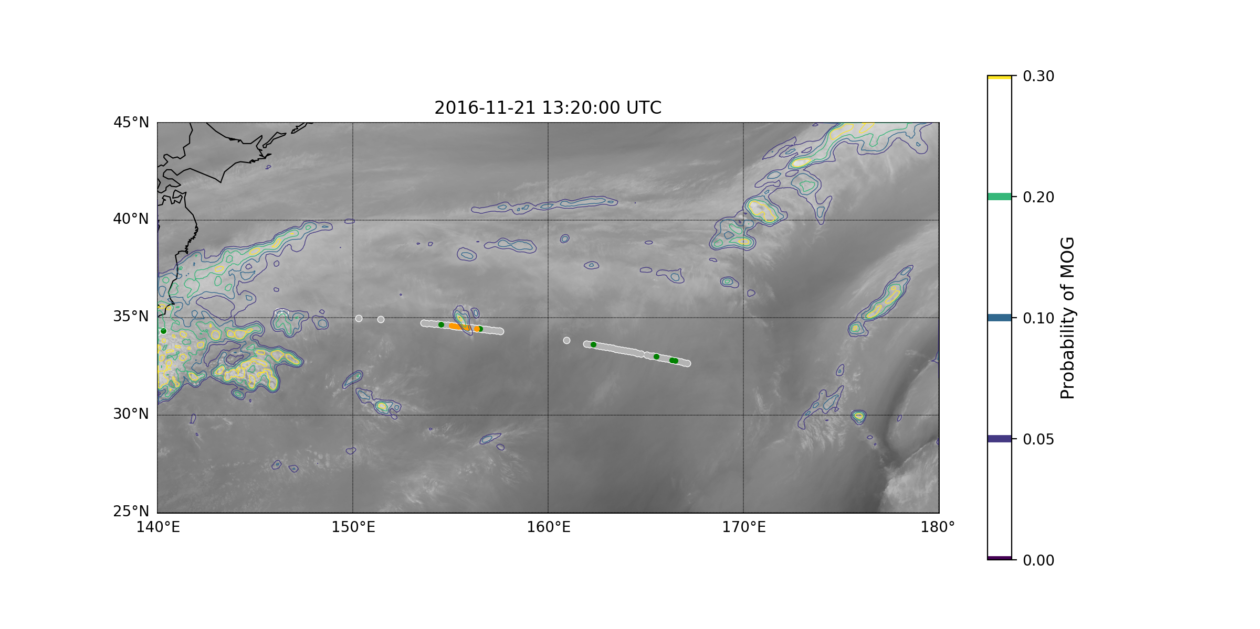
Performance
Detects ~45% of turbulence at cruising altitude with very low false alarm rate
Precise estimation of turbulent regions confirmed by observations (orange = MOG observation)

Slide 7
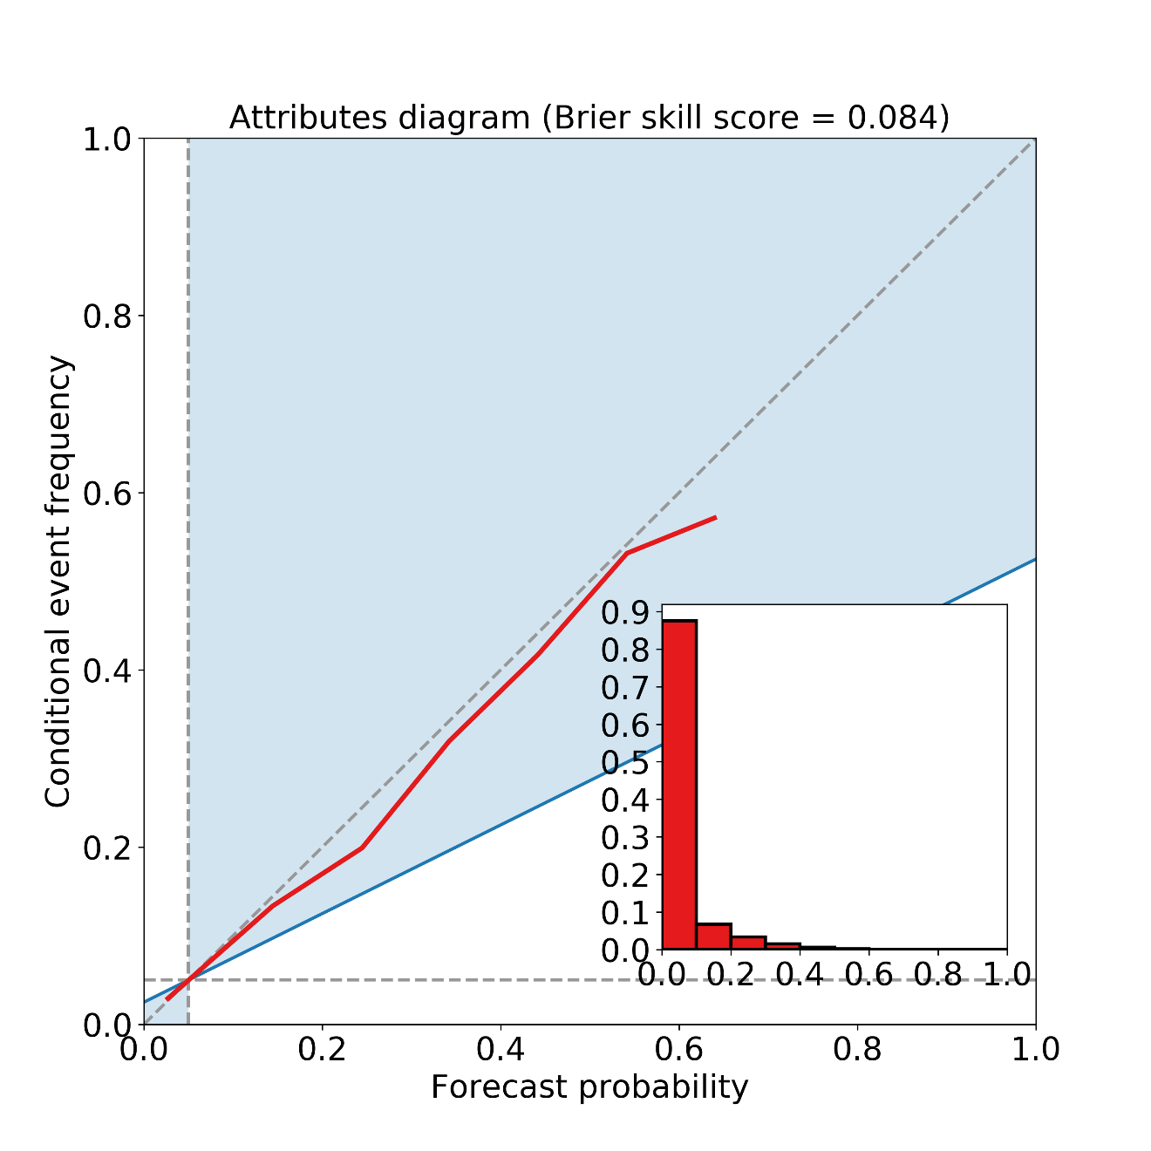
Performance
The probabilistic model is tuned to have very low bias. The 10% probability zones experience a ~10% frequency of MOG turbulence. The 40% probability zones experience a ~40% frequency of MOG, etc.

Slide 8
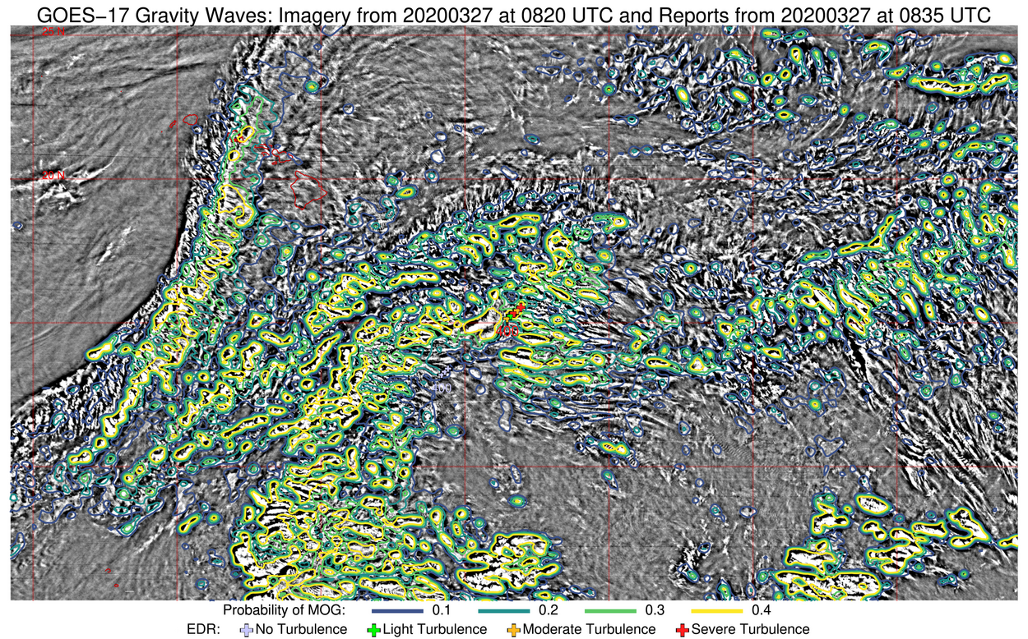
Examples
Large areas of convection
Automated aircraft obs
Turbulence product shown in contours over high-pass imagery

Slide 9
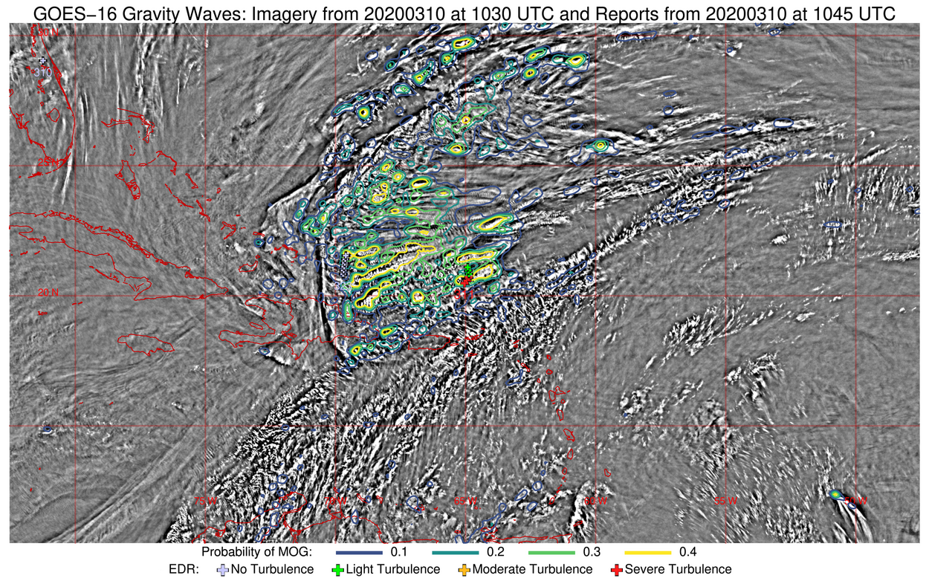
Examples
It usually flags areas of intense gravity waves (above), but does not flag weaker gravity waves of any kind.
Turbulence product shown in contours over high-pass imagery

Slide 10
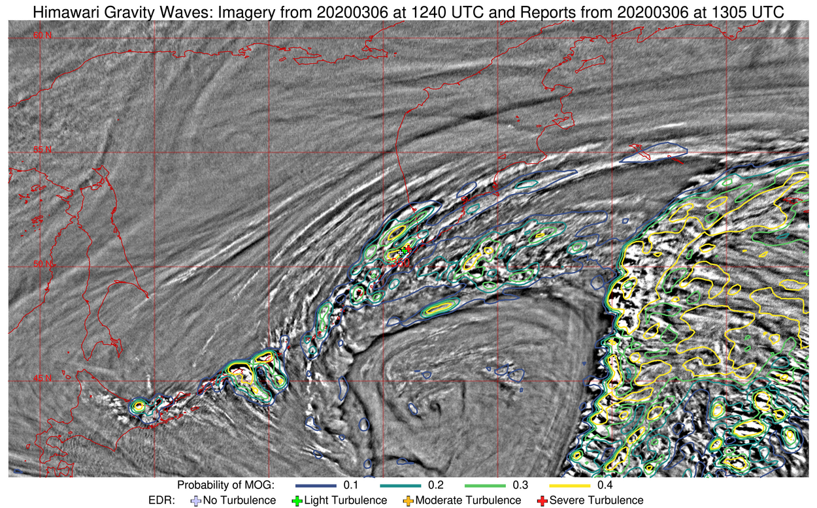
Examples
It can sometimes identify structures formed from active vertical shear, such as this.
Turbulence product shown in contours over high-pass imagery

Slide 11
Example: Rapid convection
Air Canada Incident, 11 July 2019
Severe turbulence event for a Boeing 777 at 34,000 ft on 1413 UTC 11 July 2019
  >= 25 injuries
No turbulent reports from aircraft in the area before or after the event.

Slide 12
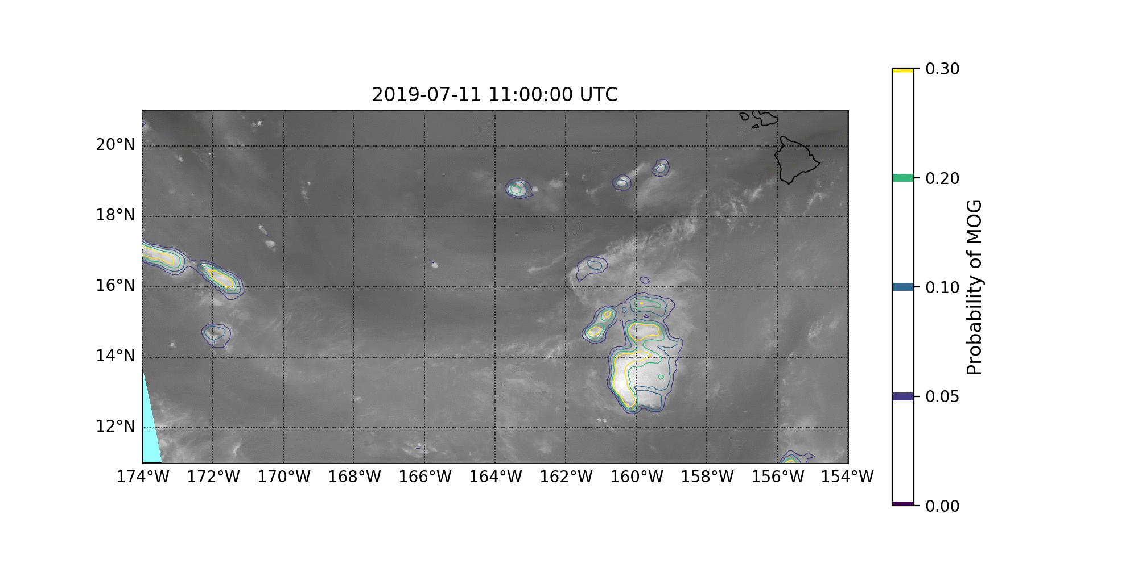
Contours show estimated probability of MOG over a 10-minute period based on GOES-17 Bands 8 and 13
Base image is GOES-17 Upper level water vapor (Band 8)
Event occurs inside the red circle at ~1410 UTC, at the emergence of a small convective cell

Slide 13
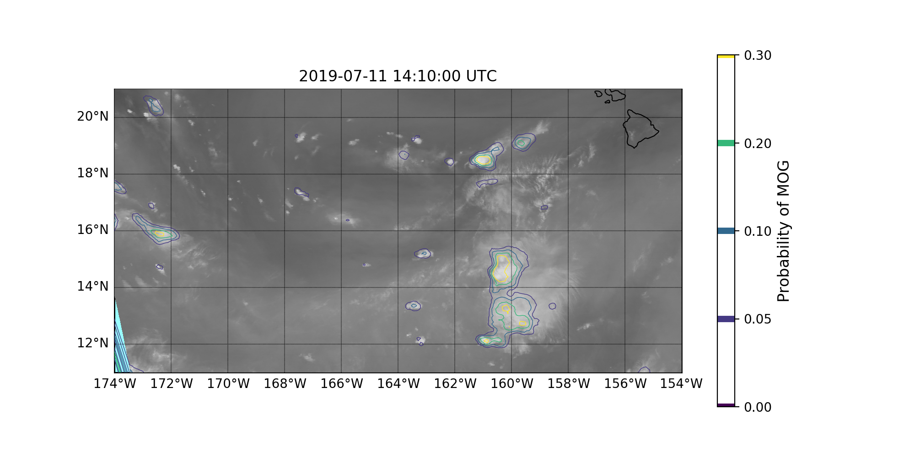
Convective cell is ~6 pixels wide north/south (~12 km), and grew rapidly

Slide 14
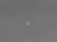
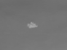
Convective cell @1350-1410 UTC
1350 UTC
1400 UTC
1410 UTC
First emergence of the cell is at 1350 UTC, but very hard to distinguish.
Shape is coherent at 1400 UTC. It may have been possible to identify a hazard at this time.
Algorithm finds a significant pattern at 1410 UTC (but only 5% probability).
In other words, these events are detectable, but at 5%, these are quite prone to false alarms

Slide 15
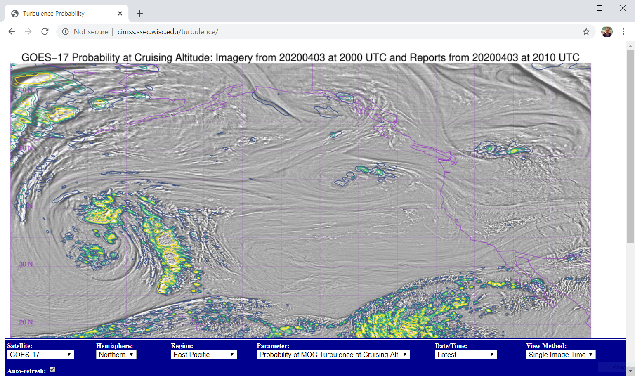
Turbulence predictions can be found online
LINK
Choices
Notes:
To summarize: NUCAPS soundings can give a timely update to 1200 UTC soundings; use them to diagnose how the atmosphere has changed.
NOAA-20 soundings are being provided and should be available within 30 minutes of the overpass. Metop A and Metop B soundings arrive via the SBN and will have a slower arrival -- and they typically do not supply early afternoon data.
You may have to modify the sounding to reflect surface conditions, but modified NUCAPS NOAA-20 afternoon soundings have done that automatically for you. The mixed layer that is inserted in these depends on Skin and Air temperature differences observed before the overpass.
Note that there is additional training available on the horizontal fields of information that can be extracted from the field of NUCAPS Soundings.
This concludes the training on NUCAPS Vertical Profiles at HWT.

Slide 16
Known quirks
At SSEC we have observed the product in real-time since late February.
We notice that often turbulence occurs on the edge of a predicted feature, not in the center. This indicates that an aircraft that skirts just around a known feature is not “in the clear”.
We are still researching improvements and looking for feedback on the product.

Slide 17
Summary
Deep Learning algorithm that uses Upper-Level water vapor (best) or window channel (good)
Probability of Moderate or Greater (MOG) Turbulence
Trained on flight-level turbulence (30-40K feet)
Model bias is very low, but estimated probability of MOG typically remains under 40%

