Slide 1
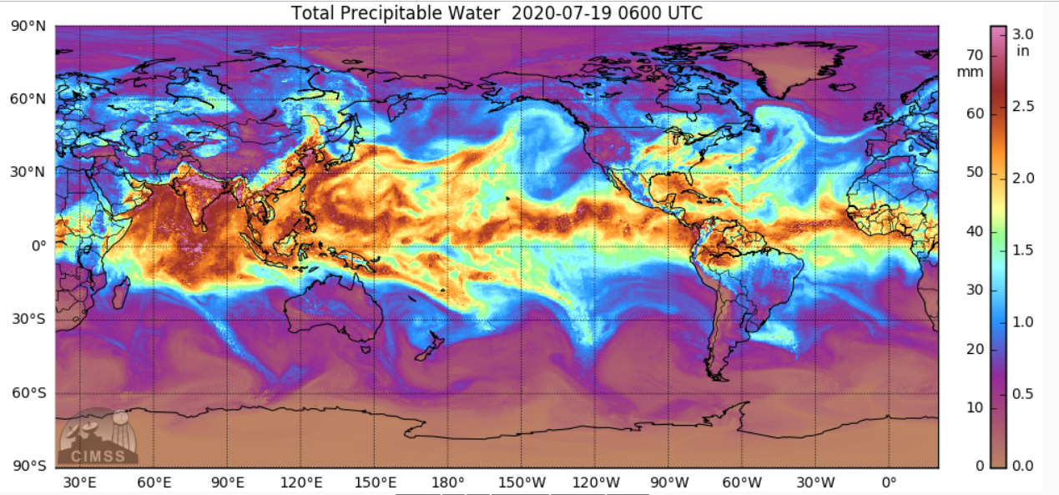


MIMIC-TPW
Anthony Wimmers, Chris Velden
Cooperative Institute for Meteorological Satellite Studies (CIMSS)
Scott Lindstrom, CIMSS, Trainer

Slide 2
‘MIMIC-TPW’
Real-time, hourly total precipitable water imagery over land and oceans from advective blending of polar-orbiting microwave satellite retrievals
‘MIMIC’: Morphed Integrated Microwave Imagery at CIMSS
TPW: Total Precipitable Water vapor
Blended data uses NOAA-19, Metop A, Metop B, Suomi NPP, DMSP F18
Advected with model winds
Computed using MIRS (Operational Microwave Integrated Retrieval System) algorithms that give information over land and water
Emphasis on fidelity to data, resolution, timeliness, seamless blending
Why does this work?
  Microwave Instruments sense energy at wavelengths sensitive to water vapor and at wavelengths that aren’t sensitive to water vapor. The difference between sensed energy is a function of water vapor
  Total Precipitable Water is quasi-conserved in the atmosphere: it changes slowly.
Notes:
You would think that fidelity to data and seamless blending are in conflict, but when the data is integrated properly, they are in harmony.

Slide 3
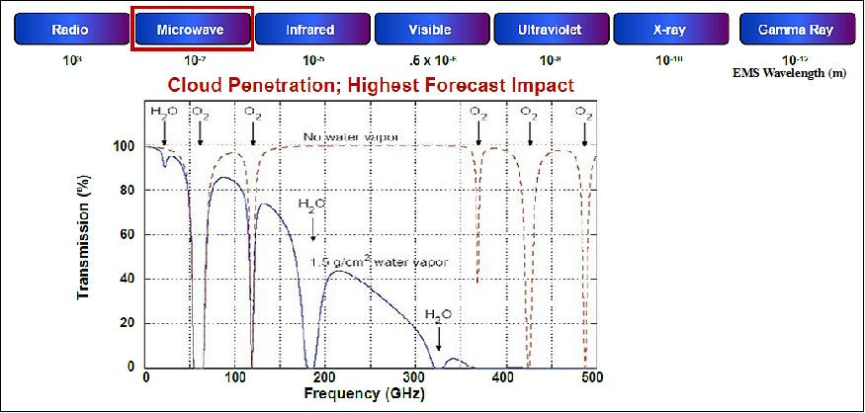
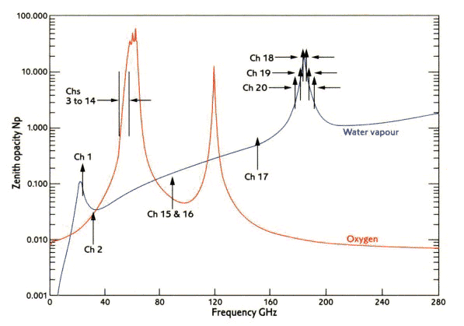
MIMIC-TPW: Why does this work?
v
v
Channel 1 and 2 (23.8, 31.4 GHz) on AMSU are in regions of different water vapor absorption. Both channels are also on ATMS

Slide 4
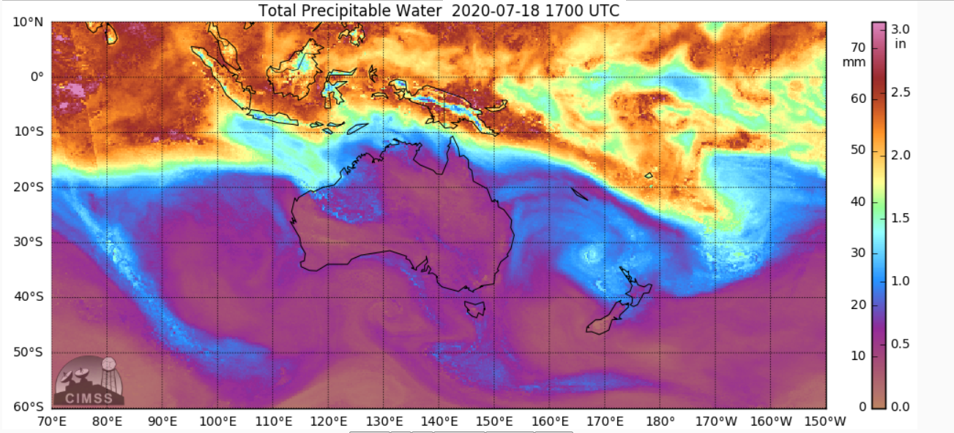
“What am I looking at?”
Blended polar-orbiting swaths, taken from observations nearest in time
Data are advected with (GFS) model winds to improve accuracy and continuity
Essentially the same information as single polar overpasses, but this is packaged for nowcasting
Notes:
The most common question we get is…

Slide 5
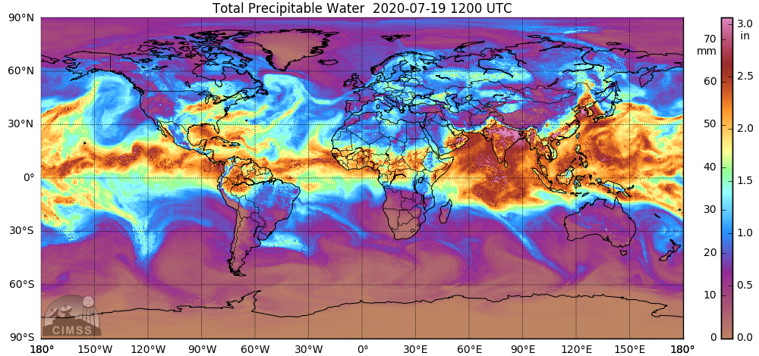
Applications
Analyzing the environment for tropical cyclone development
Tracking the Saharan Aerosol Layer and other regions of dry air
Tracking plumes of rich moisture (i.e., Atmospheric Rivers)
Notes:
The most common question we get is…

Slide 6
Applications
Analyzing the environment for tropical cyclone development
Tracking the Saharan Aerosol Layer and other regions of dry air
Tracking plumes of rich moisture (i.e., Atmospheric Rivers)
Notes:
The most common question we get is…

Slide 7

Applications
Analyzing the environment for tropical cyclone development
Tracking the Saharan Aerosol Layer and other regions of dry air
Tracking plumes of rich moisture (i.e., Atmospheric Rivers)
Notes:
The most common question we get is…

Slide 8
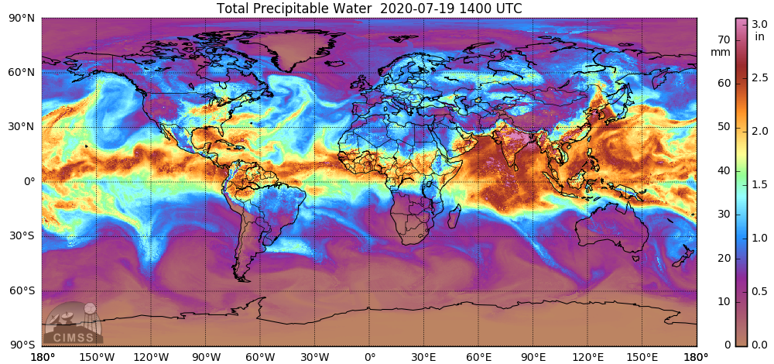
Applications
Analyzing the environment for tropical cyclone development
Tracking the Saharan Aerosol Layer and other regions of dry air
Tracking plumes of rich moisture (i.e., Atmospheric Rivers)
Notes:
The most common question we get is…

Slide 9

Applications
Analyzing the environment for tropical cyclone development
Tracking the Saharan Aerosol Layer and other regions of dry air
Tracking plumes of rich moisture (i.e., Atmospheric Rivers)
Notes:
The most common question we get is…

Slide 10

Applications
Analyzing the environment for tropical cyclone development
Tracking the Saharan Aerosol Layer and other regions of dry air
Tracking plumes of rich moisture (i.e., Atmospheric Rivers)
Notes:
The most common question we get is…

Slide 11
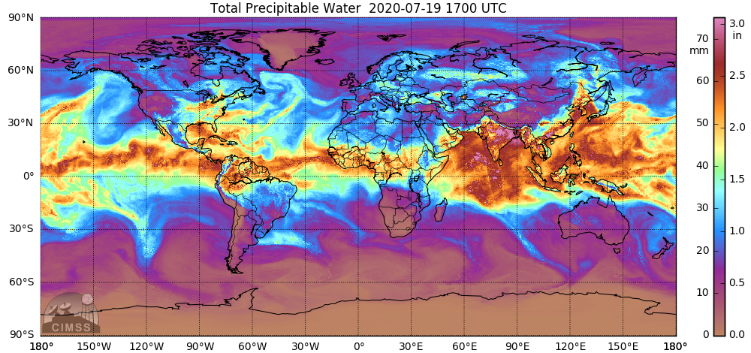
Applications
Analyzing the environment for tropical cyclone development
Tracking the Saharan Aerosol Layer and other regions of dry air
Tracking plumes of rich moisture (i.e., Atmospheric Rivers)
Notes:
The most common question we get is…

Slide 12
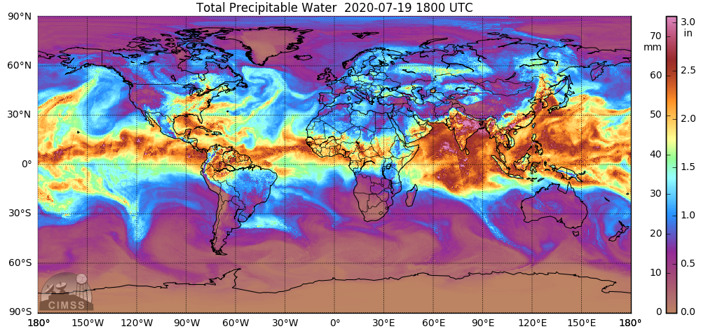
Applications
Analyzing the environment for tropical cyclone development
Tracking the Saharan Aerosol Layer and other regions of dry air
Tracking plumes of rich moisture (i.e., Atmospheric Rivers)
Notes:
The most common question we get is…

Slide 13
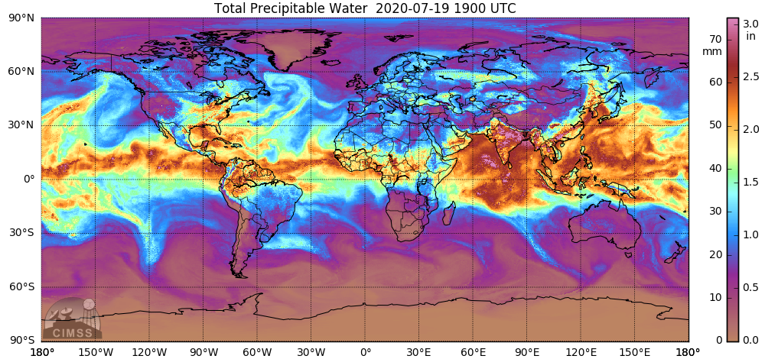
Applications
Analyzing the environment for tropical cyclone development
Tracking the Saharan Aerosol Layer and other regions of dry air
Tracking plumes of rich moisture (i.e., Atmospheric Rivers)
Notes:
The most common question we get is…

Slide 14
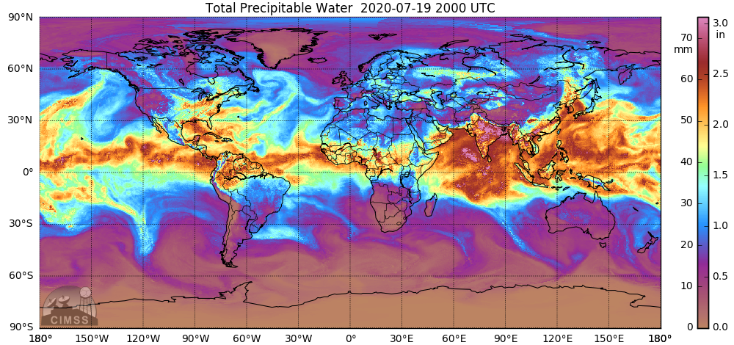
Applications
Analyzing the environment for tropical cyclone development
Tracking the Saharan Aerosol Layer and other regions of dry air
Tracking plumes of rich moisture (i.e., Atmospheric Rivers)
Notes:
The most common question we get is…

Slide 15
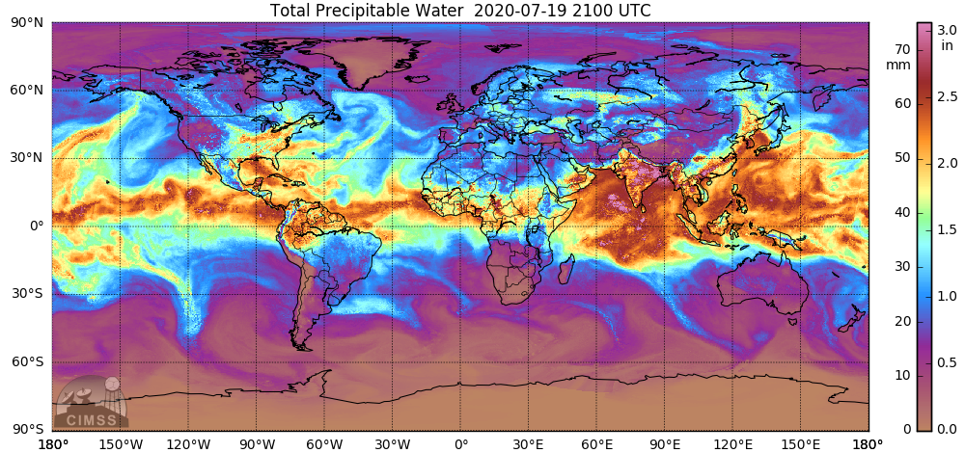
Applications
Analyzing the environment for tropical cyclone development
Tracking the Saharan Aerosol Layer and other regions of dry air
Tracking plumes of rich moisture (i.e., Atmospheric Rivers)
Notes:
The most common question we get is…

Slide 16

Applications
Analyzing the environment for tropical cyclone development
Tracking the Saharan Aerosol Layer and other regions of dry air
Tracking plumes of rich moisture (i.e., Atmospheric Rivers)
Notes:
The most common question we get is…

Slide 17

Applications
Analyzing the environment for tropical cyclone development
Tracking the Saharan Aerosol Layer and other regions of dry air
Tracking plumes of rich moisture (i.e., Atmospheric Rivers)
Notes:
The most common question we get is…

Slide 18
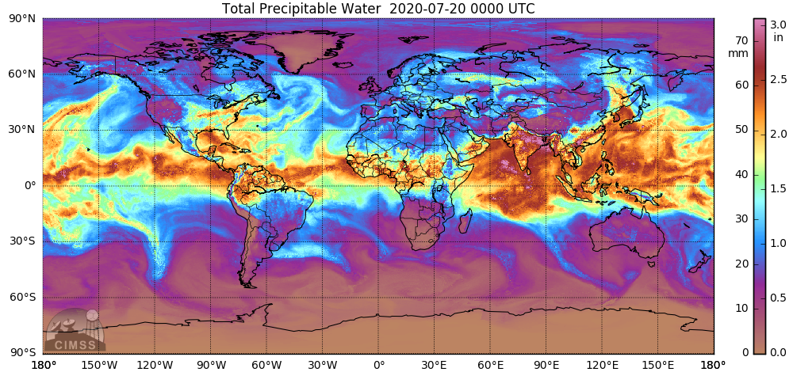
Applications
Analyzing the environment for tropical cyclone development
Tracking the Saharan Aerosol Layer and other regions of dry air
Tracking plumes of rich moisture (i.e., Atmospheric Rivers)
Notes:
The most common question we get is…

Slide 19

Applications
Analyzing the environment for tropical cyclone development
Tracking the Saharan Aerosol Layer and other regions of dry air
Tracking plumes of rich moisture (i.e., Atmospheric Rivers)
Notes:
The most common question we get is…

Slide 20
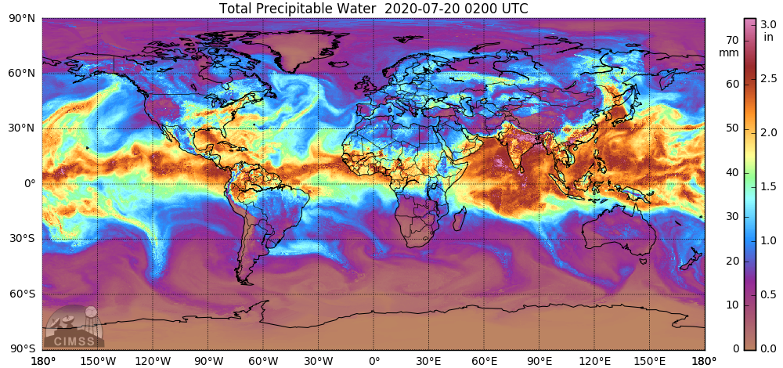
Applications
Analyzing the environment for tropical cyclone development
Tracking the Saharan Aerosol Layer and other regions of dry air
Tracking plumes of rich moisture (i.e., Atmospheric Rivers)
Notes:
The most common question we get is…

Slide 21

Applications
Analyzing the environment for tropical cyclone development
Tracking the Saharan Aerosol Layer and other regions of dry air
Tracking plumes of rich moisture (i.e., Atmospheric Rivers)
Notes:
The most common question we get is…

Slide 22

Applications
Analyzing the environment for tropical cyclone development
Tracking the Saharan Aerosol Layer and other regions of dry air
Tracking plumes of rich moisture (i.e., Atmospheric Rivers)
Notes:
The most common question we get is…

Slide 23

Applications
Analyzing the environment for tropical cyclone development
Tracking the Saharan Aerosol Layer and other regions of dry air
Tracking plumes of rich moisture (i.e., Atmospheric Rivers)
Notes:
The most common question we get is…

Slide 24

Applications
Analyzing the environment for tropical cyclone development
Tracking the Saharan Aerosol Layer and other regions of dry air
Tracking plumes of rich moisture (i.e., Atmospheric Rivers)
Notes:
The most common question we get is…

Slide 25

Applications
Analyzing the environment for tropical cyclone development
Tracking the Saharan Aerosol Layer and other regions of dry air
Tracking plumes of rich moisture (i.e., Atmospheric Rivers)
Notes:
The most common question we get is…

Slide 26

Applications
Analyzing the environment for tropical cyclone development
Tracking the Saharan Aerosol Layer and other regions of dry air
Tracking plumes of rich moisture (i.e., Atmospheric Rivers)
Notes:
The most common question we get is…

Slide 27
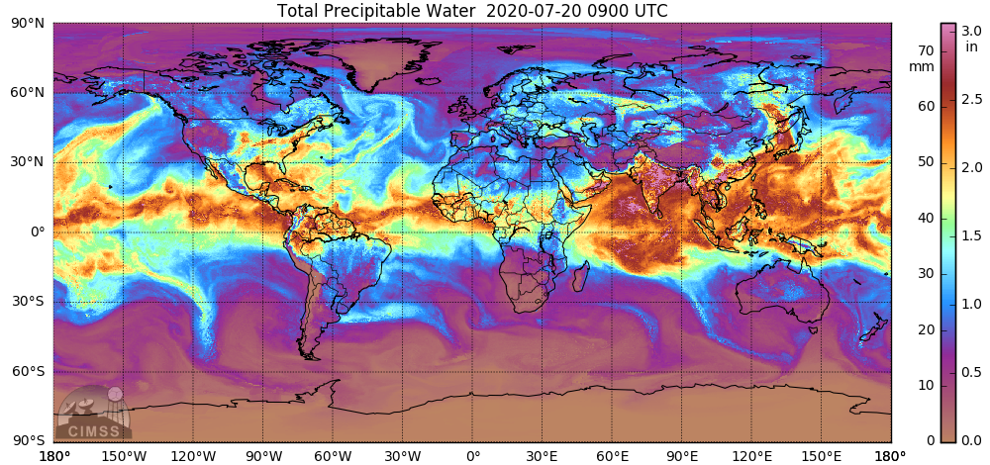
Applications
Analyzing the environment for tropical cyclone development
Tracking the Saharan Aerosol Layer and other regions of dry air
Tracking plumes of rich moisture (i.e., Atmospheric Rivers)
Notes:
The most common question we get is…

Slide 28

Applications
Analyzing the environment for tropical cyclone development
Tracking the Saharan Aerosol Layer and other regions of dry air
Tracking plumes of rich moisture (i.e., Atmospheric Rivers)
Notes:
The most common question we get is…

Slide 29

Applications
Analyzing the environment for tropical cyclone development
Tracking the Saharan Aerosol Layer and other regions of dry air
Tracking plumes of rich moisture (i.e., Atmospheric Rivers)
Notes:
The most common question we get is…

Slide 30

Applications
Analyzing the environment for tropical cyclone development
Tracking the Saharan Aerosol Layer and other regions of dry air
Tracking plumes of rich moisture (i.e., Atmospheric Rivers)
Notes:
The most common question we get is…

Slide 31
Outline
Method: Swath advection
Method: Compositing
Validation
Conclusions

Slide 32
A) Swath advection
Individual swaths of polar orbiter total precipitable water (TPW) are transported by Numerical Model Winds.
This relies on the quasi-conserved nature of TPW in the atmosphere

Slide 33
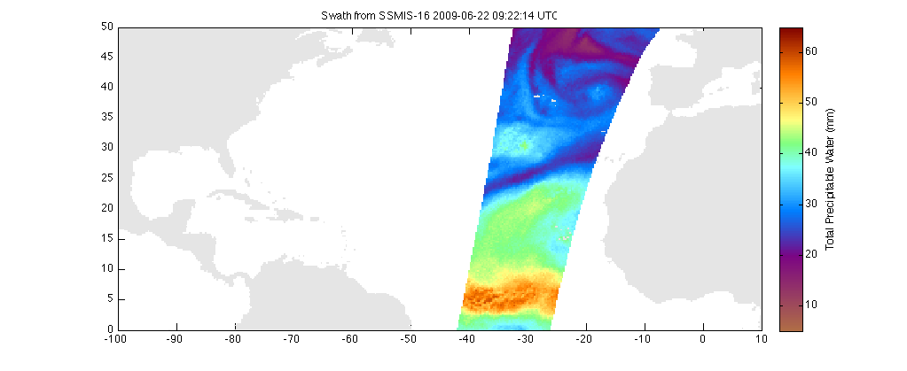
Data advected from 09:22 UTC
2009 / 06 / 22
18 · · 21 · · 00 · · 03 · · 06 · · 09 · · 12 · · 15 · · 18 · · 21
Now let’s add winds to move the moisture around

Slide 34
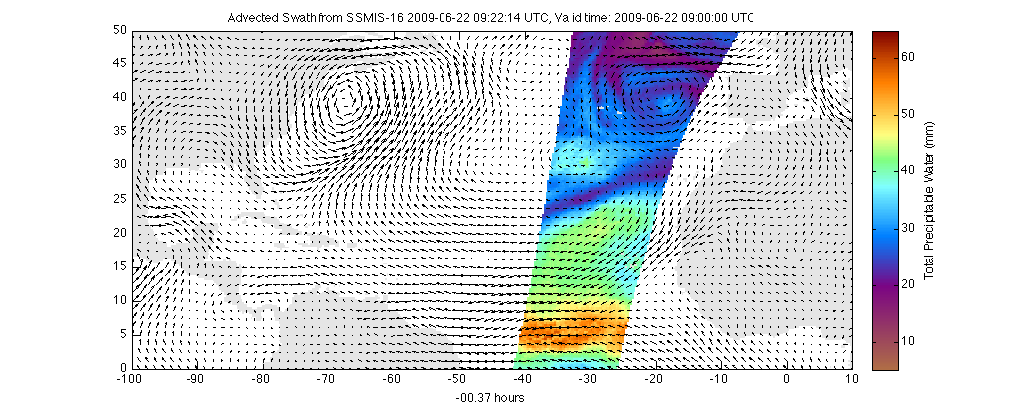
Data advected from 09:22 UTC
2009 / 06 / 22
18 · · 21 · · 00 · · 03 · · 06 · · 09 · · 12 · · 15 · · 18 · · 21
Field is deformed by winds; values don’t really change

Slide 35
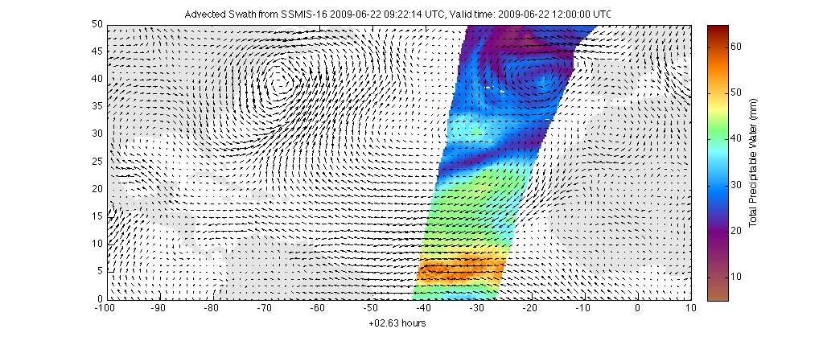
Data advected from 09:22 UTC
2009 / 06 / 22
18 · · 21 · · 00 · · 03 · · 06 · · 09 · · 12 · · 15 · · 18 · · 21
Field is deformed by winds; values don’t really change

Slide 36
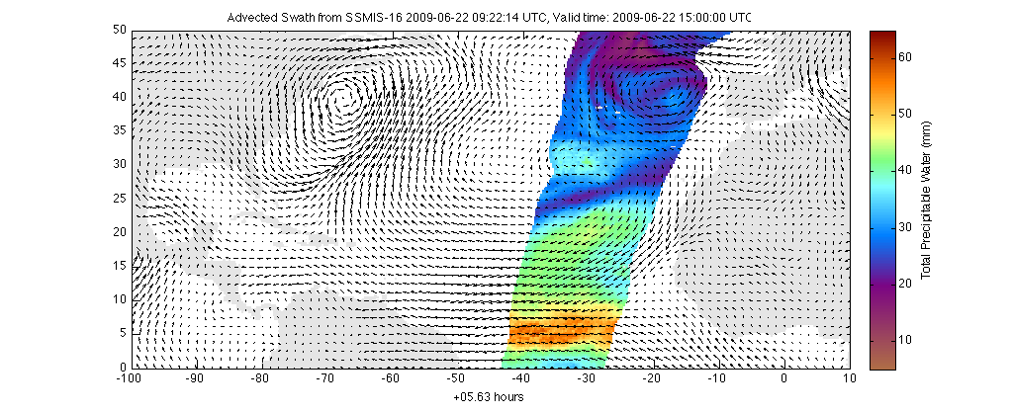
Data advected from 09:22 UTC
2009 / 06 / 22
18 · · 21 · · 00 · · 03 · · 06 · · 09 · · 12 · · 15 · · 18 · · 21
Field is deformed by winds; values don’t really change

Slide 37

Data advected from 09:22 UTC
2009 / 06 / 22
18 · · 21 · · 00 · · 03 · · 06 · · 09 · · 12 · · 15 · · 18 · · 21
Field is deformed by winds; values don’t really change

Slide 38

Data advected from 09:22 UTC
2009 / 06 / 22
18 · · 21 · · 00 · · 03 · · 06 · · 09 · · 12 · · 15 · · 18 · · 21
Field is deformed by winds; values don’t really change
Notes:
As you know, we are not allowed to do this. This is physically unsound! You cannot advect integrated total column tracers.
Well, we do it anyway. Now maybe this can build some suspense before I show the validation (I bet you’ve never heard that sentence in your life before.)

Slide 39
Data advected from 09:22 UTC
2009 / 06 / 22
18 · · 21 · · 00 · · 03 · · 06 · · 09 · · 12 · · 15 · · 18 · · 21
You can advect backwards in time too!

Slide 40

Data advected from 09:22 UTC
2009 / 06 / 22
18 · · 21 · · 00 · · 03 · · 06 · · 09 · · 12 · · 15 · · 18 · · 21
You can advect backwards in time too!

Slide 41

Data advected from 09:22 UTC
2009 / 06 / 22
18 · · 21 · · 00 · · 03 · · 06 · · 09 · · 12 · · 15 · · 18 · · 21
You can advect backwards in time too!

Slide 42
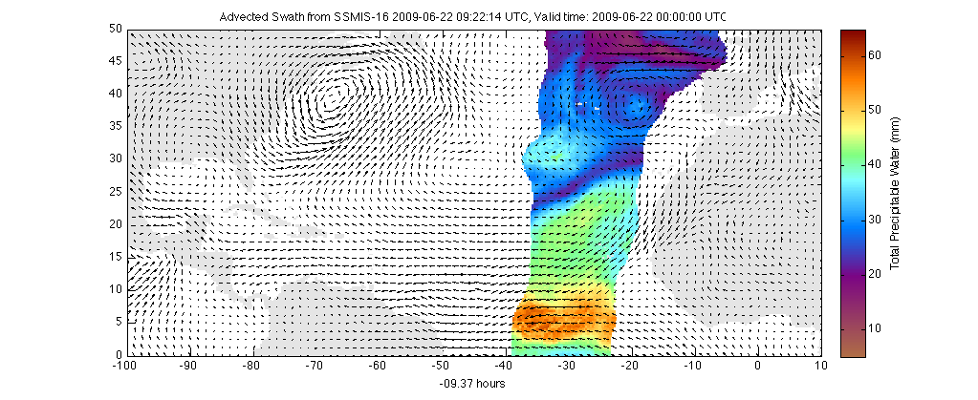
Data advected from 09:22 UTC
2009 / 06 / 22
18 · · 21 · · 00 · · 03 · · 06 · · 09 · · 12 · · 15 · · 18 · · 21
You can advect backwards in time too!

Slide 43
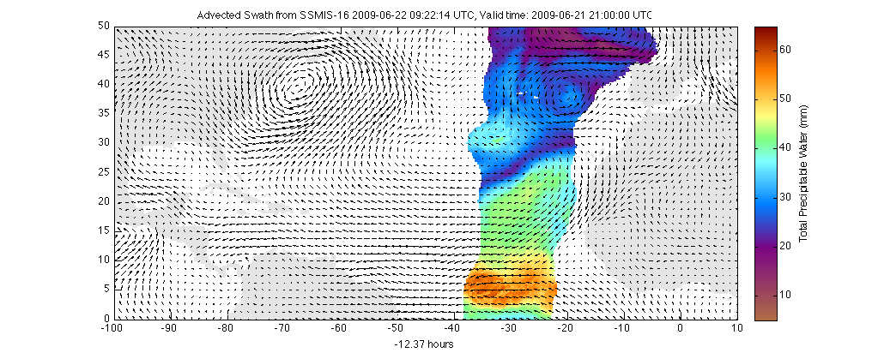
Data advected from 09:22 UTC
2009 / 06 / 22
18 · · 21 · · 00 · · 03 · · 06 · · 09 · · 12 · · 15 · · 18 · · 21
You can advect backwards in time too!

Slide 44
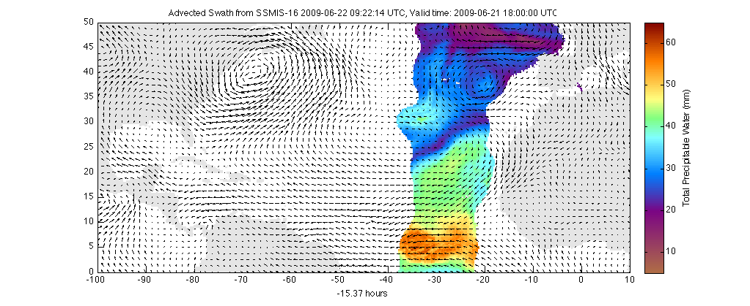
Data advected from 09:22 UTC
2009 / 06 / 22
18 · · 21 · · 00 · · 03 · · 06 · · 09 · · 12 · · 15 · · 18 · · 21
You can advect backwards in time too!

Slide 45
Data advected from 09:22 UTC
2009 / 06 / 22
This is done hourly, not every 3 hours as shown here
18 · · 21 · · 00 · · 03 · · 06 · · 09 · · 12 · · 15 · · 18 · · 21
You can advect backwards in time too!

Slide 46
Individual Swaths
There are (advected) swaths that represent the observations from a Polar Pass at different times before and after the observation time!
Combine all the swaths from all the different satellites into 1-hour observations.

Slide 47
What wind does the advecting?
GFS output is interpolated to hourly data
In the tropics (Equatorward of 25º):
  56% 1000 mb; 28% 850 mb; 16% 700 mb
Near the Poles (Poleward of 50º)
  51.7% 1000 mb; 34.5% 850 mb; 13.8% 700 mb

Slide 48
B) Compositing
- Every swath observed within ~16 hours of the hourly display time has an advected counterpart at the display time – this is what will be composited!

Slide 49
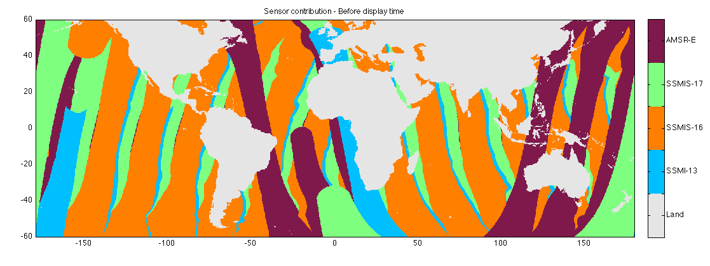
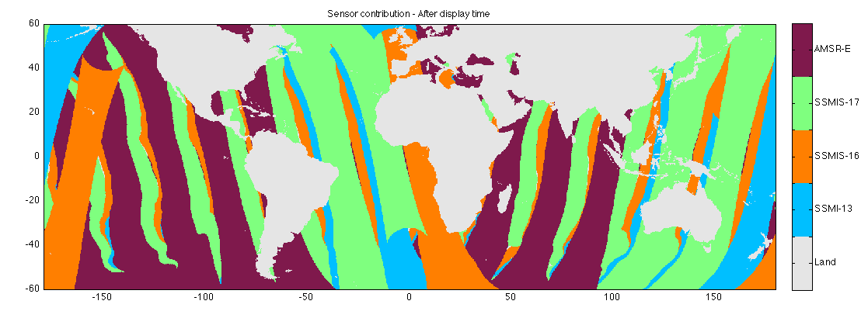
1) Identify sensor with closest time before/after display time (for every hour)
(before)
Data were observed before the display time
(after)
Data were observed after the display time
Valid time: 2009/06/22 1800 UTC

Slide 50
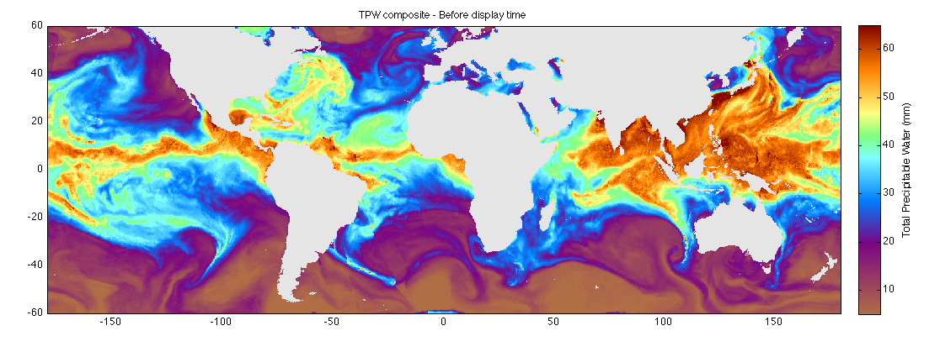

2) Construct TPW composite before/after display time (for every hour)
TPW
(made using only data from before the valid time)
TPW
(made using only data from after the valid time)
Valid time: 2009/06/22 1800 UTC

Slide 51
2) Construct TPW composite before/after display time (for every hour)
TPW
(made using only data from before the valid time)
The delta-t between observation and valid time helps determine which value to use! Assumption: Less error if delta-t is smaller
TPW
(made using only data from after the valid time)
Valid time: 2009/06/22 1800 UTC

Slide 52
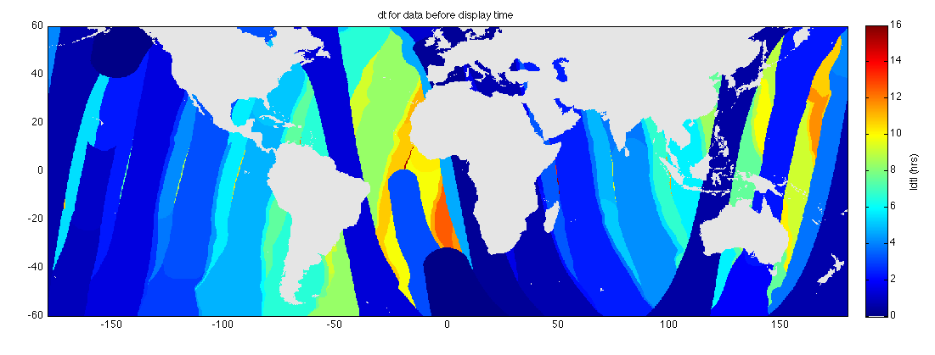
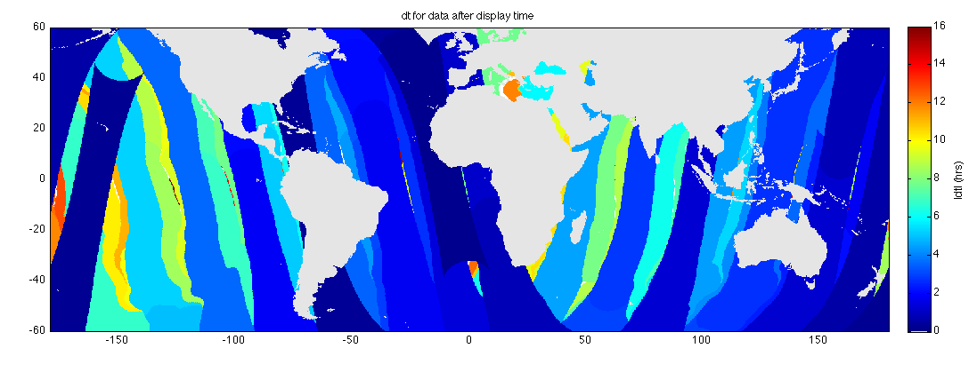
3) Compute corresponding dt before/after display time
dt(before)
dt(after)
Valid time: 2009/06/22 1800 UTC

Slide 53
3) Compute corresponding dt before/after display time
‘before data here is older than ‘after’ data
dt(before)
‘after’ data should influence better the final composite here!
dt(after)
Valid time: 2009/06/22 1800 UTC

Slide 54
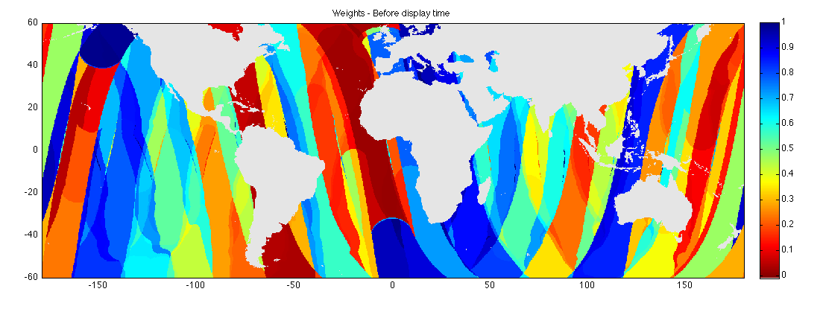
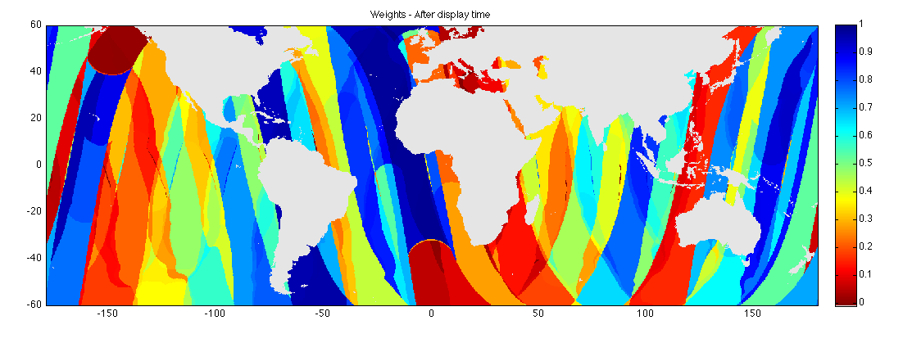
4) Compute before/after weights proportional to dt: w(before) = dt(after) / [dt(before)+dt(after)]
‘before’ weight: small
w(before)
‘after’ weight: large
w(after)
Valid time: 2009/06/22 1800 UTC

Slide 55

5) MIMIC-TPW is a time-weighted average of the before and after composites
MIMIC-TPW = w(before)*TPW(before) + w(after)*TPW(after)
Valid time: 2009/06/22 1800 UTC
Notes:
- This is all more important for the flow than it is for the still image.

Slide 56
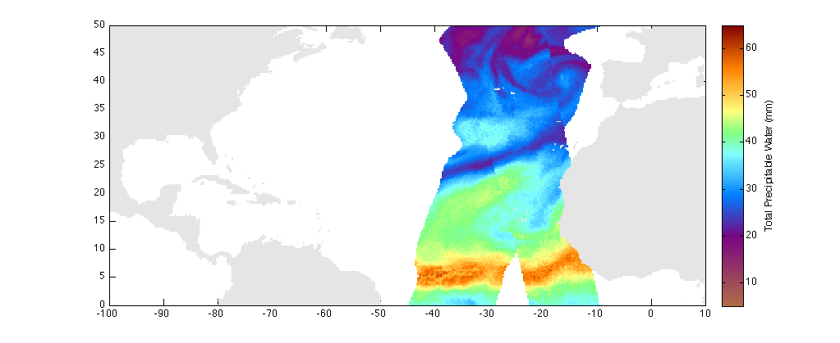
C) Validation
Valid 2009/06/22 1900 UTC

Slide 57
C) Validation
Valid 2009/06/22 1900 UTC

Slide 58
C) Validation
Test: SSMI-16 from 0922 UTC, advected to 1900 UTC
(dt = 10.37 hours)
Valid 2009/06/22 1900 UTC

Slide 59
C) Validation
Test: SSMI-16 from 0922 UTC, advected to 1900 UTC
(dt = 10.37 hours)
Truth: SSMI-13 from 1906 UTC, advected to 1900 UTC
Valid 2009/06/22 1900 UTC

Slide 60
C) Validation
Test: SSMI-16 from 0922 UTC, advected to 1900 UTC
(dt = 10.37 hours)
Truth: SSMI-13 from 1906 UTC, advected to 1900 UTC
Valid 2009/06/22 1900 UTC

Slide 61
C) Validation
Analyze the difference in TPW in the area of overlap (tagged with dt = 10.37 hrs)
Test: SSMI-16 from 0922 UTC, advected to 1900 UTC
(dt = 10.37 hours)
Truth: SSMI-13 from 1906 UTC, advected to 1900 UTC
Valid 2009/06/22 1900 UTC

Slide 62
C) Validation
Analyze the difference in TPW in the area of overlap (tagged with dt = 10.37 hrs)
Test: SSMI-16 from 0922 UTC, advected to 1900 UTC
(dt = 10.37 hours)
Truth: SSMI-13 from 1906 UTC, advected to 1900 UTC
Valid 2009/06/22 1900 UTC

Slide 63
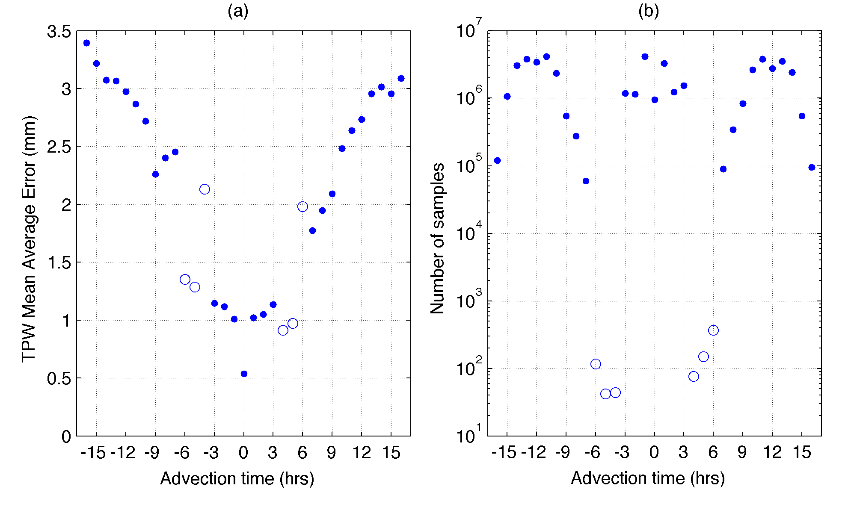
Error stats binned by advection time
Note how small the error is: Less than 2 mm as long as the Advection Time is less than about 6 or 7 hours

Slide 64
Error stats binned by advection time
Note how small the error is: Less than 2 mm as long as the Advection Time is less than about 6 or 7 hours
Error is small and manageable ( 2 mm = 0.08”)
Error increases linearly with advection time

Slide 65
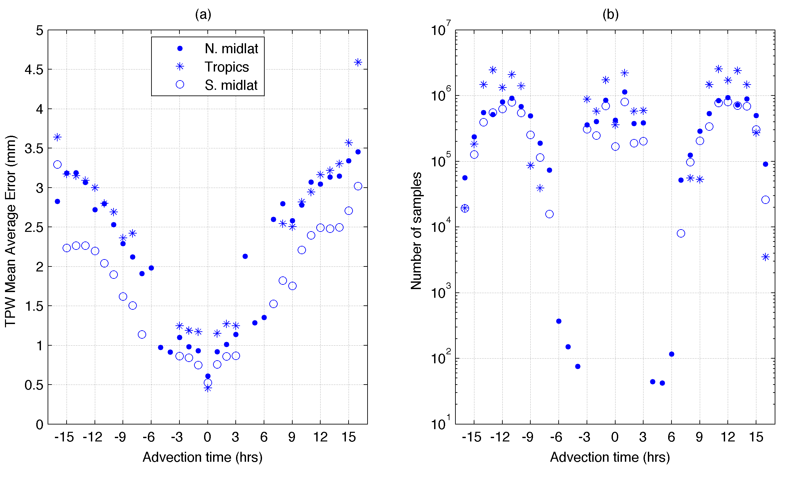
Error stats: By zone
There is a geographic dependence to the error.
But in all regions, the error is a small value, about 2 mm as long as the advection time is small. How do you minimize the advection time? By increasing the number of polar satellites observing TPW with their microwave sensors.
Error is naturally larger in the boreal summer
Notes:
Errors lower in the SH because there’s less extrapolation at the coasts

Slide 66
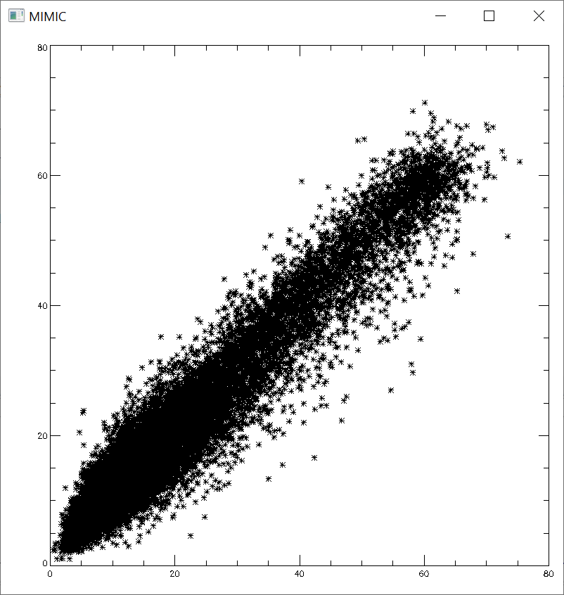
MIMIC values of TPW
Radiosonde values of TPW

Slide 67
Backward advection helps reduce error
At any particular last time in the MIMIC fields, there will be locations that haven’t seen an overpass for some time. Data from any overpass shortly after that time will be advected backward and reduce the dt (and any error)

Slide 68
D) Conclusions
Anchored directly to observations not model output!
  Treated these as observations
Not oversmoothed
Global (over land and ocean)
Available at one hour resolution
One hour latency
Available online and in AWIPS
  Archived back to mid-2007 at MIMIC website!

Slide 69
Questions?
scott.lindstrom@noaa.gov

