Slide 1
Synthetic Aperture RADAR (SAR) case studies over the Pacific* area
Scott Lindstrom, UW-Madison
Cooperative Institute for Meteorological Satellite Studies
( )
Many thanks to Christoper Jackon and Tyler Ruff, SOCD/SMCD for answering many questions
*Broadly Defined ☺

Slide 2
SAR Basics
SAR: Synthetic Aperture Radar
RCM and RADARSAT observations are here:
https://www.star.nesdis.noaa.gov/socd/mecb/sar/AKDEMO_products/APL_winds/wind_images_nic/sarwinds_calendar_now.html
Sentinel-1A SAR observations are here:
https://www.star.nesdis.noaa.gov/socd/mecb/sar/AKDEMO_products/APL_winds/wind_images2/sarwinds_daily_rcs.html
SAR detects: Ice. Floods. Winds. Deformation. Oil Spills

Slide 3
SAR is explained on the following slides
I received these slides from Cara Wilson, NOAA Coastwatch
Christopher Jackson created them with input from Cara, Melanie Abe and Dale Robinson (and others)
I’m grateful to all of these people!

Slide 4
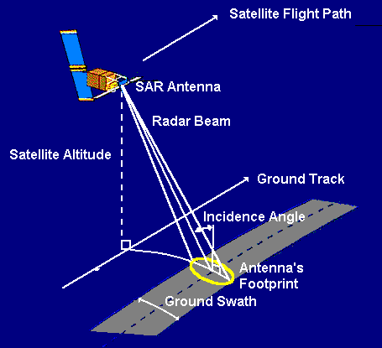
RADAR : a transmitter, a receiver, an antenna, and an electronic system
The transmitter generates at regular intervals microwave pulses that are focused by the antenna into a beam.
The beam illuminates the surface of Earth.
The antenna receives that part of the transmitted signal that is reflected, or backscattered, from the Earth's surface.
The antenna length is called the aperture.
The electronic system processes and records the data.
https://appliedsciences.nasa.gov/join-mission/training/english/arset-introduction-synthetic-aperture-radar

Slide 5
RADAR measures the portion of the transmitter radar energy that is backscattered to the antenna
With a smooth surfaces, most of the radar energy scatters away from the radar: less is backscattered to the SAR antenna.
SAR images in this case appear black.
A rough surfaces backscatter more radar energy back to the SAR antenna.
These SAR images appear brighter
Normalized Radar Cross Section (NRCS) measures the radar backscatter
Images from https://appliedsciences.nasa.gov/join-mission/training/english/arset-introduction-synthetic-aperture-radar

Slide 6
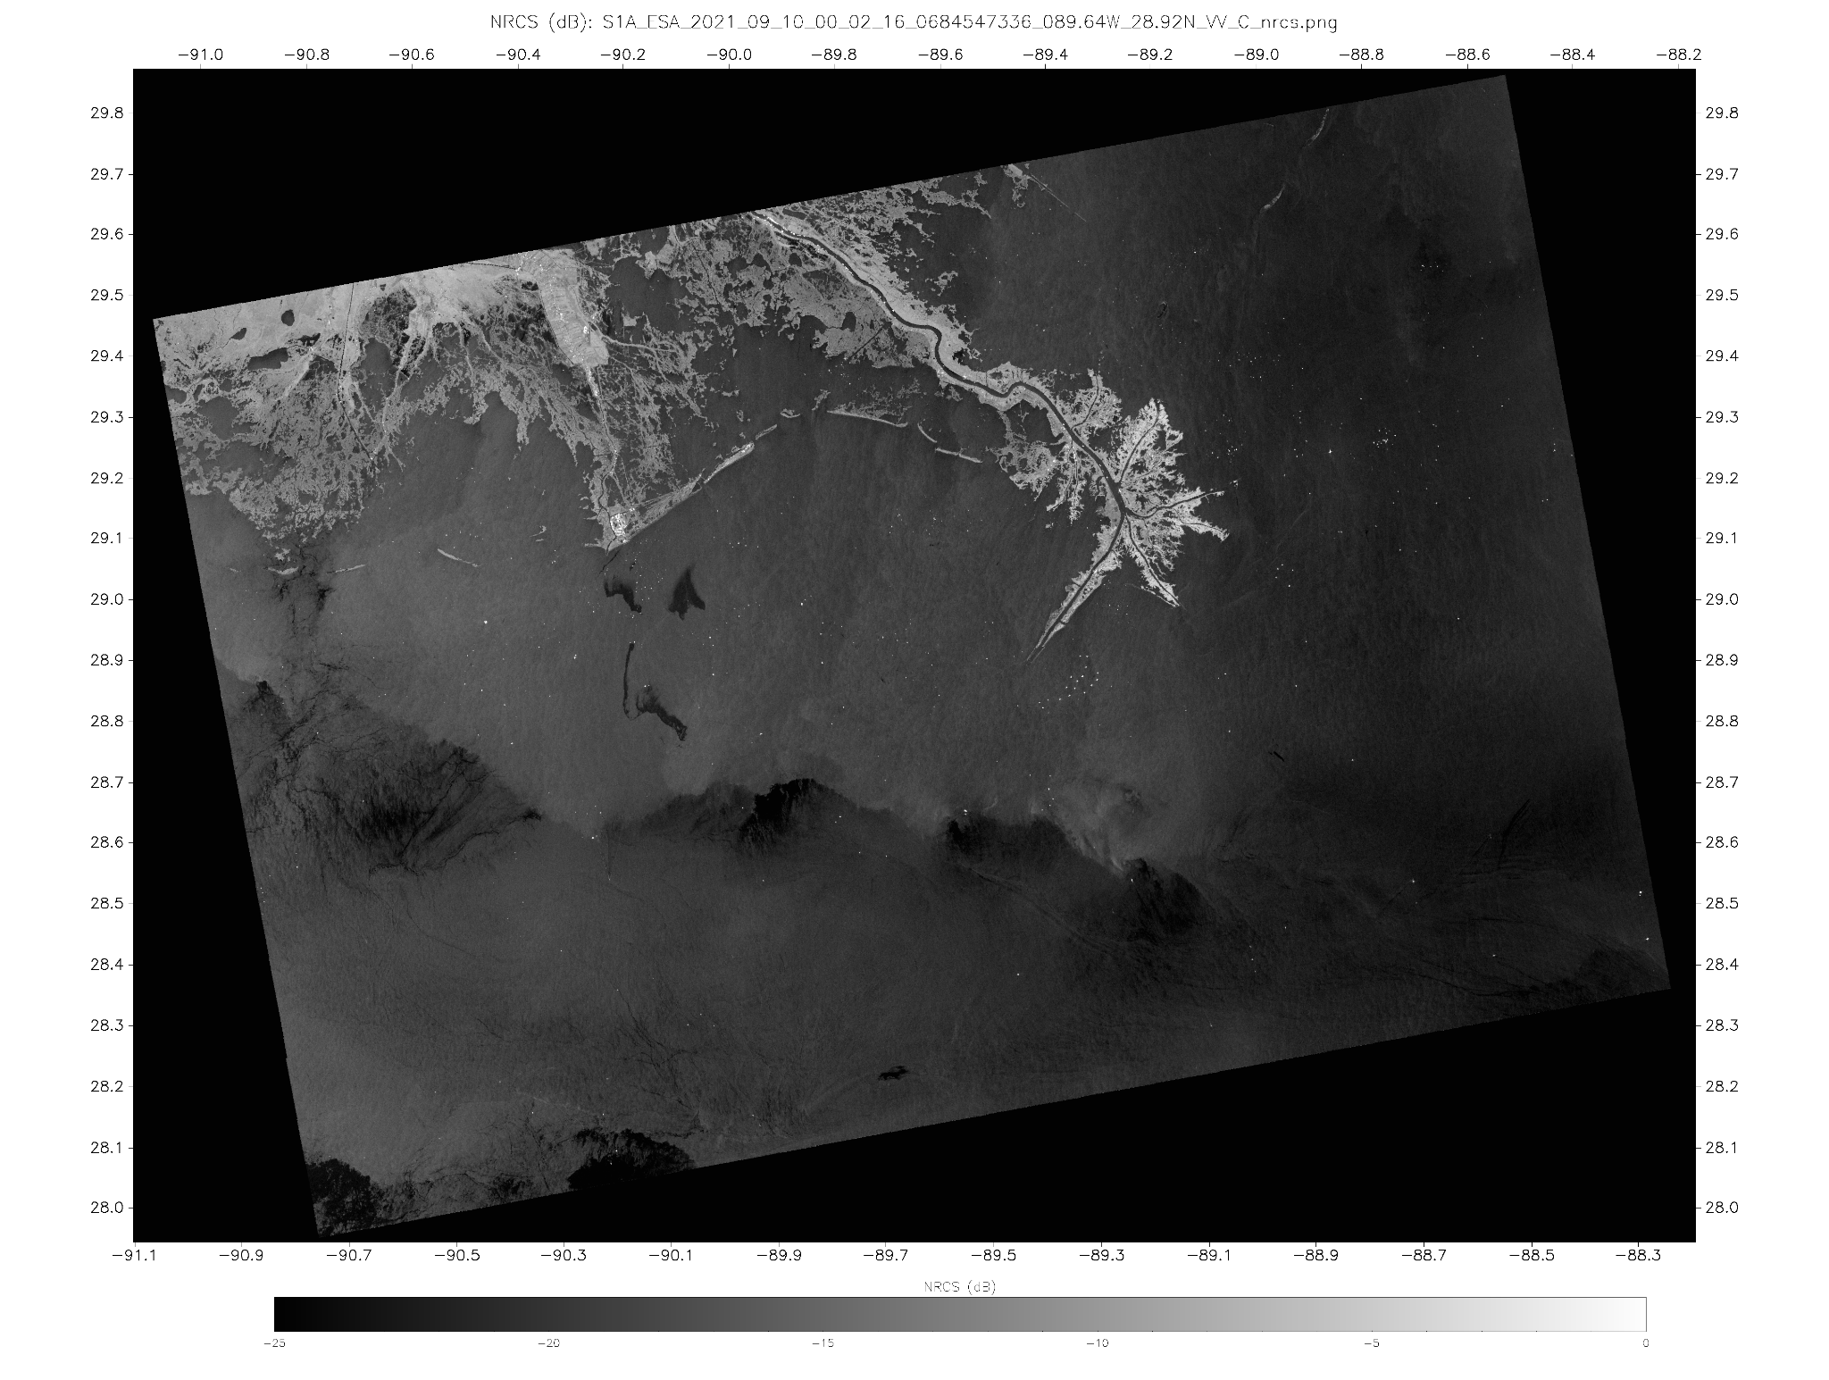
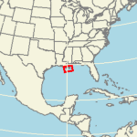
SAR image over the Gulf of Mexico
High backscatter (bright)
Land, Oil Platforms
Low backscatter (dark)
Ocean surface with oil or low winds
Moderate backscatter (gray)
Ocean surface with moderate wind speeds (5-8 m/s)
Oil Spills
Higher Wind Area (behind front)
Oil Platforms
Atmospheric Front Boundary
Biogenic Slicks
Lower Wind Area (ahead of front)
Sentinel-1 VV SAR Image,
10 September 2021 00:02 UTC,
Bird’s Foot Delta - Gulf of Mexico
From this website

Slide 7
Ocean surface roughness contributes to backscatter
Wind-generated short waves (Capillary to short gravity waves) have wavelengths from a few to tens of centimeters and periods < 1 sec
Radar wavelengths of a few centimeters (Recall: c-band antennas have 5-cm wavelengths) are needed to observe ocean surface roughness and obtain a measure of wind speed.
Longer gravity waves, currents, oil slicks, and other phenomena can be identified by the ways they affect the pattern of the wind-generated short waves.

Slide 8
Antenna size and pulse bandwidth determine spatial resolution
Azimuth direction (along-track)
Spatial resolution depends on the beam width
Beam width is inversely proportional to the antenna length.
A longer antenna (aperture) produces a narrower beam and a finer resolution
Range direction (normal to along-track)
Spatial resolution depends on the bandwidth of the signal pulse
Signal pulse length can be controlled for specific applications
Satellite flight
vector
=
Azimuth
Range
Satellite Track
SAR systems are side-looking
Image modified from https://earth.esa.int/eogateway/missions/ers/radar-courses/radar-course-1

Slide 9
High-resolution radar imagery from space would require a very large antenna
For a “real” aperture radar
Range resolution is on the order of meters
a 100 MHz bandwidth pulse produces a resolution of ~ 1.5 meters
Azimuth resolution is on the order of kilometers
a 12 meter antenna operating at 5 GHz gives a beam width of ~ ¼ degree
At 700 km altitude this is ~3.5km on the ground
An antenna a few kilometers long would be needed to produce an azimuth resolution of 30 meters!
It is not feasible to have that long a (physical) antenna in space.
“Synthetic” aperture radar (SAR) signal processing combines many individual radar pulses to “synthesize” a larger antenna.

Slide 10
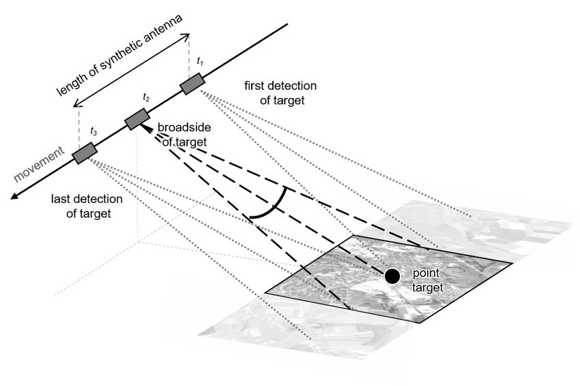
How is a synthetic aperture created?
Signals are transmitted to and received from the same object from successive sensor positions along the orbital path (t1, t2, t3 on the figure).
Signals from successive sensor positions are coherently combined. (amplitude and phase are preserved)
The length of the orbit path where the object is observed is the synthetic aperture (length of the synthetic antenna).
length of synthetic antenna
t₁
t₂
t₃
https://up42.com/blog/tech/sar-data-complementary-optical

Slide 11
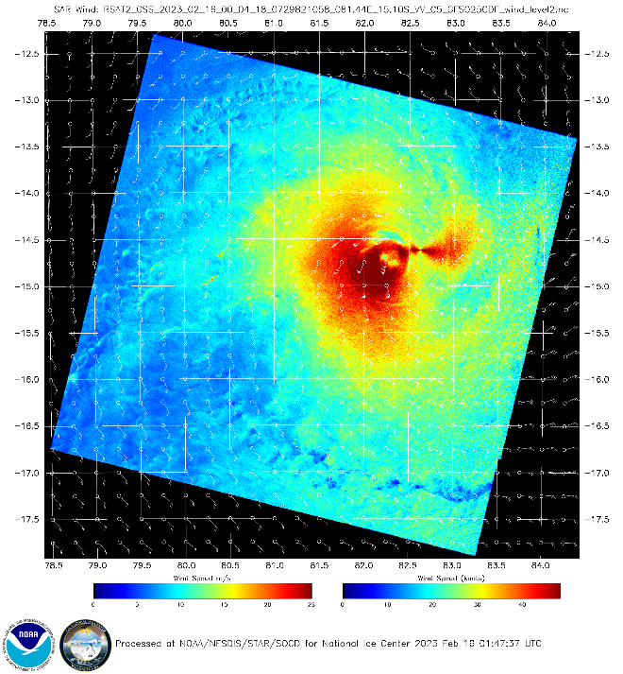
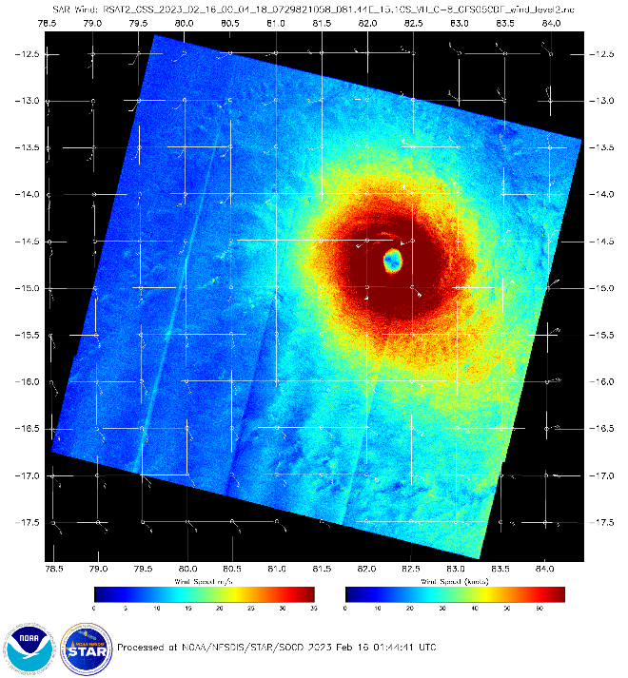
NRCS is the observation: How do you create a wind field?
>1 wind distributions that could have spawned this NRCS field
Start with a close first guess field, and use that to retrieve the winds.
Errors – especially in wind direction – in the first guess will appear in the derived wind field

Slide 12
SAR Observations over Guam, Hawai’i, American Samoa
NWS Office of Observations makes requests to the people who control the SAR instruments.
Then data acquisition from the satellite is turned on when it is moving over the region of interest

Slide 13
Guam
Look how far downwind the effect of the island extends!

Slide 14
Guam
Look how far downwind the effect of the island extends!

Slide 15
What traps the energy?

Slide 16
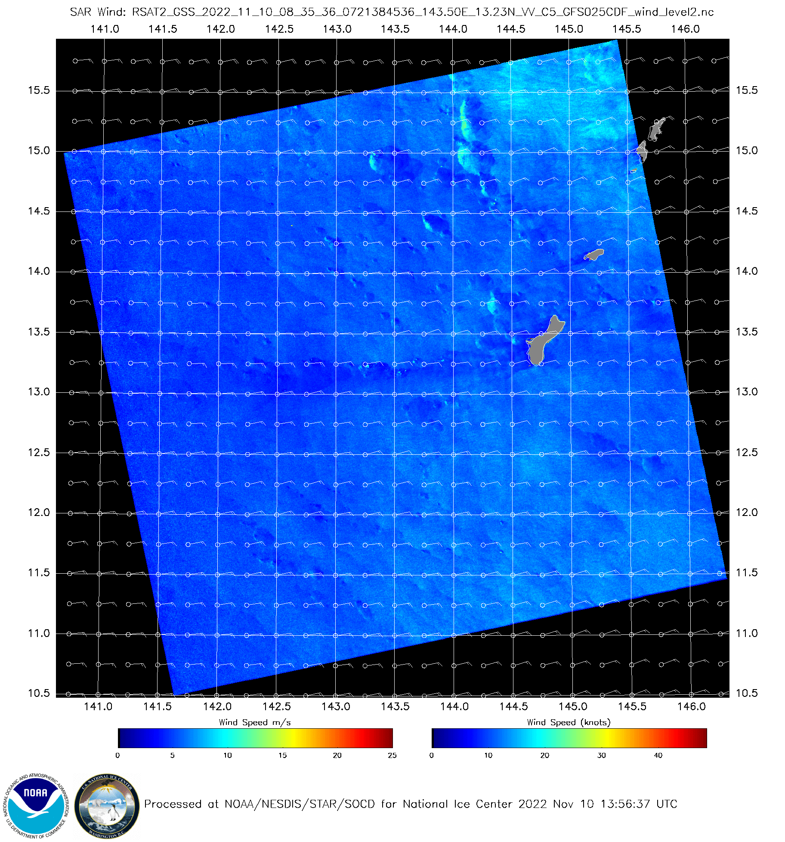
Guam
NRCS – Normalized Radar Cross Section is converted to wind

Slide 17
Ships near Saipan
Saipan
Tinian

Slide 18
Hawai’i

Slide 19
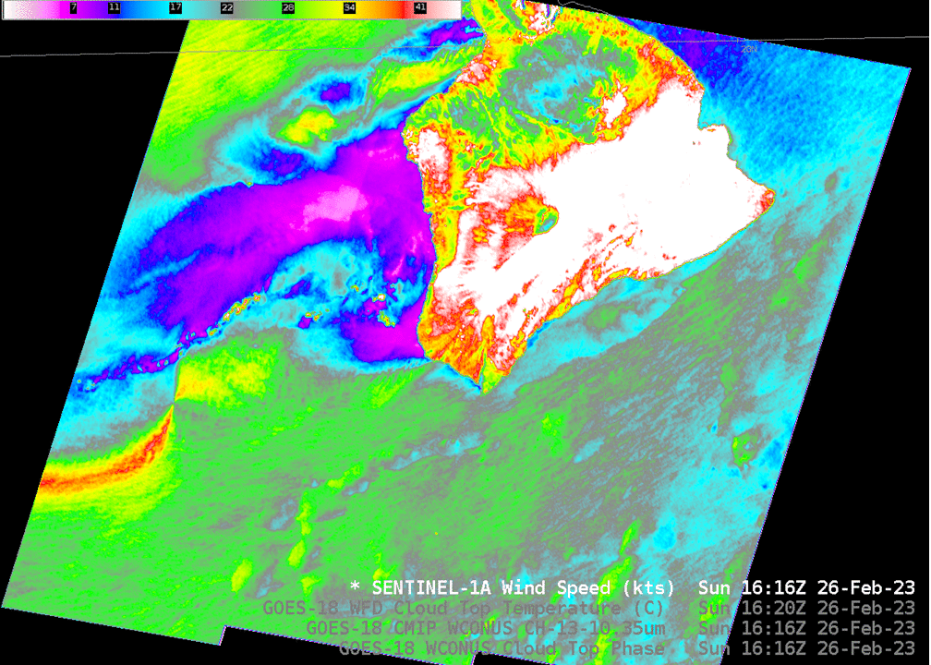
Hawai’i
Reflection off of ice in clouds can create false large wind estimates
Hourglass artifact because initial windfield is wrong

Slide 20
SAR winds over Samoan islands

Slide 21
SAR and Band 13 GOES-18

Slide 22
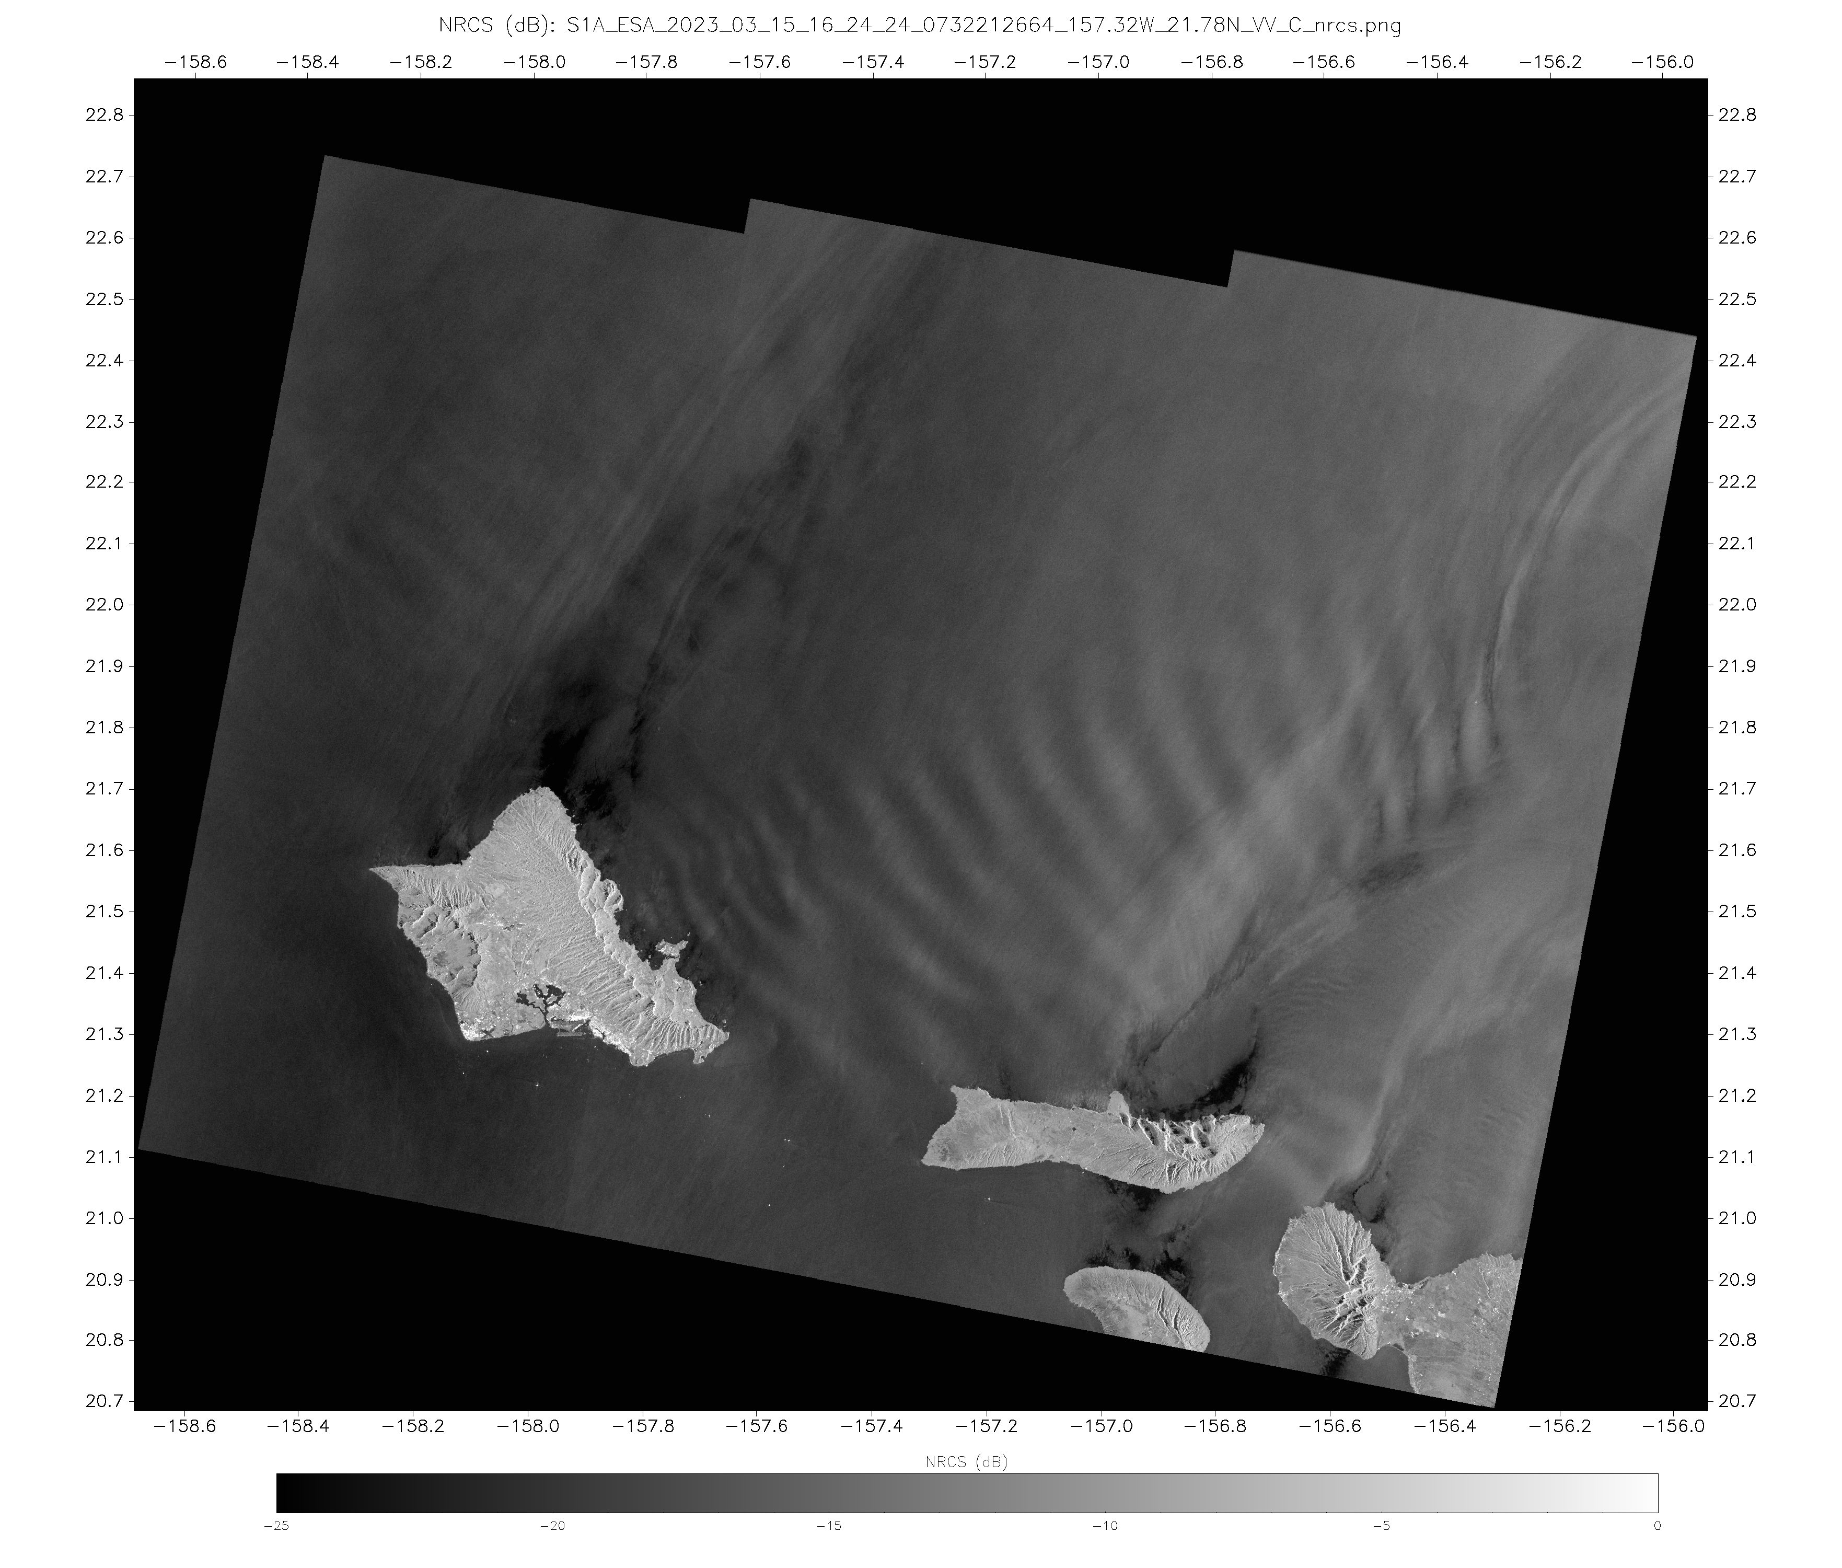
When something at the surface extends all the way up through the troposphere

Slide 23
SAR Websites

Slide 24
Tropical Cyclones
https://www.star.nesdis.noaa.gov/socd/mecb/sar/AKDEMO_products/APL_winds/tropical/index.html
url

Slide 25
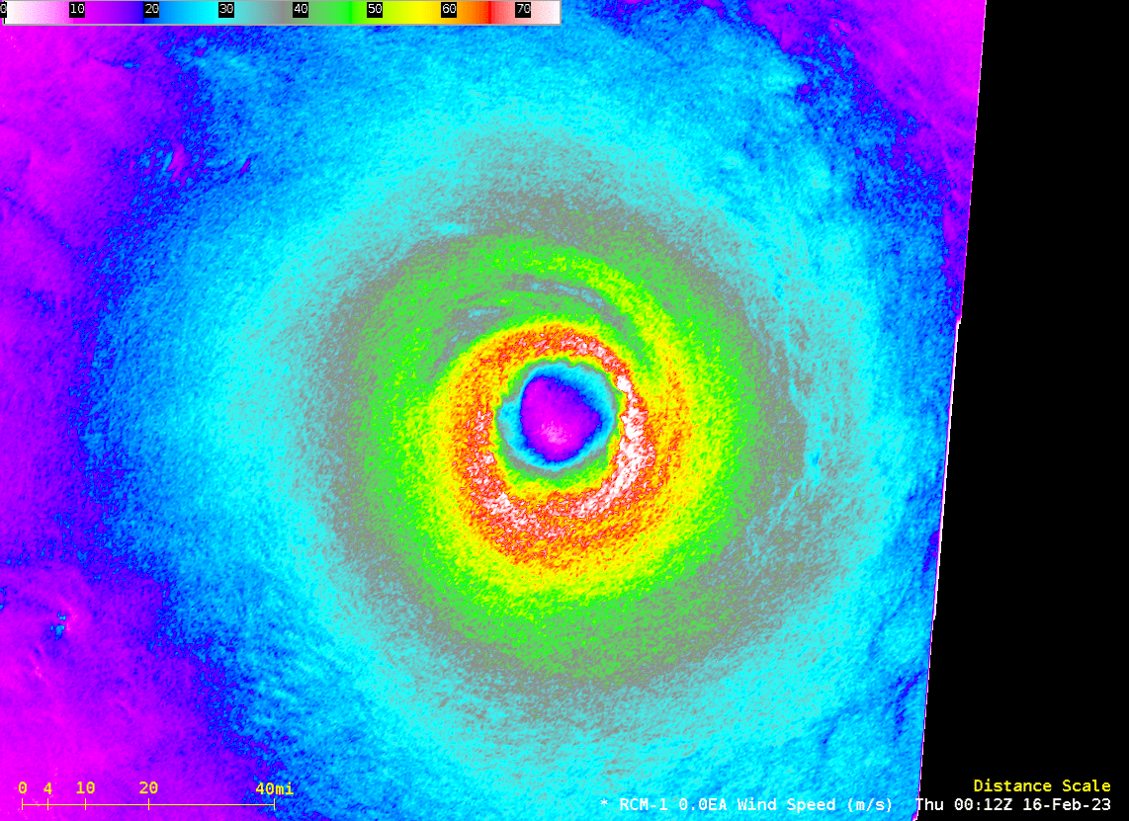
SAR Footprints over the Indian Ocean, 8-20 February 2023
From this CIMSS Satellite Blog Post

Slide 26
Parallax
SAR is seeing the surface! Remember that if you’re comparing things to satellite imagery. (source)

Slide 27
Thanks for your attention
SAR examples on the CIMSS Satellite Blog
https://cimss.ssec.wisc.edu/satellite-blog/archives/category/sar (52 and counting)
https://www.star.nesdis.noaa.gov/socd/mecb/sar/AKDEMO_products/APL_winds/wind_images_nic/sarwinds_calendar_now.html (RADARSAT / RCM)
https://www.star.nesdis.noaa.gov/socd/mecb/sar/AKDEMO_products/APL_winds/wind_images2/sarwinds_daily_rcs.html (Sentinel 1A)
scott.lindstrom@ssec.wisc.edu / scott.lindstrom@noaa.gov

