Slide 1
Training Forecasters to use Satellite data Worldwide
Scott S Lindstrom
UW-Madison
Cooperative Institute for Meteorological Satellite Studies
( )

Slide 2
Contact Information
scott.lindstrom@noaa.gov ; scott.lindstrom@ssec.wisc.edu
608 263 4425 (work)
Thank you to many people whom I work with – they give me lots of information cheerfully. I ask a lot of questions

Slide 3
Topics
Training Venues
Training Philosophy
Training Examples
Websites, etc., that show Global Data

Slide 4
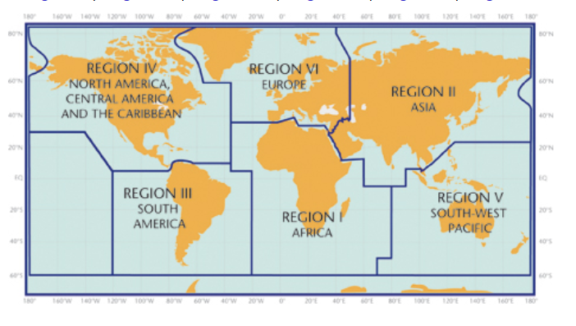
Activities
Funding from GOES-R and JPSS to create training material [Thank you!!]
Training is in the form of short documents (Quick Guides), short examples (blog posts), videos, in-person training, followup webinars and emails
2022 in-person training at (Region V)
Guam
American Samoa
Kuala Lumpur (at the request of Pacific Region HQ)
Participation in planning for (and participation in) WMO Training for RA III/IV
6
4
2
3
1
5

Slide 5
Activities
Funding from GOES-R and JPSS to create training material [Thank you!!]
Training is in the form of short documents (Quick Guides), short examples (blog posts), videos, in-person training, follow-up webinars and emails
2022 in-person training at (Region V)
Guam
American Samoa
Kuala Lumpur (at the request of Pacific Region HQ) (Region V)
Participation in planning for (and participation in) WMO Training for RA III/IV (this was mostly imagery creation)
Also have presented training for Myanmar Department of Meteorology/Hydrology (Region V)

Slide 6
Follow-up is important!
One and done training leads to information loss
Learning something requires repeated exposure, and that’s what followup emails or supplementary blog posts achieve: repeated exposure

Slide 7
Training Venues
In-person, as requested by various people
Pacific International Training Desk
https://www.facebook.com/PacificDesk/
http://pacificdesk.org/
Virtual Alaska Weather Seminars
https://vimeo.com/channels/vaws
https://uaf-accap.org/events/about-accap-webinars/
ACCAP: Alaska Center for Climate Assessment & Policy
Australian Vlab Centre of Excellence Regional Focus Group
http://www.virtuallab.bom.gov.au/
http://www.virtuallab.bom.gov.au/archive/regional-focus-group-recordings/
Blogs

Slide 8
What kind of information needs to be given?
You can talk about important events in the (recent? distant?) past
Do you want to talk about things that the forecaster/scientists remember as just having happened, or do you want to talk about the most impactful events?
You can talk about simple things that happen every day
Make a choice between the unusual – high impact – and the very common – things that happen all the time
A forecaster might find discussions about everyday events more useful
Or you can talk about both!
If you just talk about the weather today, that means relying that the weather will cooperate. Also, say you’re training people in a monsoonal climate, and it’s the dry monsoon. How do you give information about the wet months?
(i.e., something like Cyclone Nargis?)

Slide 9
The good thing about prepping beforehand
Much less likely to fall victim to technical snafus
Imagery creation requires iteration sometimes between the creator and the trainer.
Not all color enhancements highlight every feature of interest
Always give the people being trained information on how to create the imagery, including how to acquire the data being used to create the imagery

Slide 10
Are you training in English?
Is English the first language of the people you are training?
If not: this is a very large roadblock to a transfer of knowledge
Students will be receiving information and having to translate it simultaneously
You can supply all your lectures beforehand (which clamps down on the flexibility of your training! That is, if something interesting comes up that you want to talk about….)
Students will have difficulty formulating a question

Slide 11
What is the culture of the people being trained?
This must be understood well, and training should be adapted to it
For example, some cultures frown on questioning an expert or an elder. This makes it hard to gauge understanding (especially in a remote framework!)
How do you get around this natural reticence that inhibits give-and-take during a training
Anonymous ‘clickers’ – this is worthwhile if you are in the room with them and want to know what knowledge they’ve acquired
Very much more difficult to do with Remote Training

Slide 12
How do you force interaction in remote sessions?
Put up with long uncomfortable silences when you ask a question
Sometimes students will email/chat you an answer or question (I’ve ended up encouraging that)
Ask (“require”) students to summarize what they’ve learned on a particular day
Put these into a google doc so all students can see/edit the summaries

Slide 13
Training should always be viewing the future! For example: JPSS data as a prelude to GeoXO
Polar Hyperspectral Soundings and ABI
Relate Polar Hyperspectral information to ABI data
Exploits the great spectral resolution of Polar Hyperspectral soundings (IASI, CrIS)
Exploits the great Spatial resolution of ABI/AHI, etc
Exploits the excellent temporal resolution of Geostationary satellites
GXS is planned for GeoXO
This was demonstrated last year at NOAA’s Hazardous Weather Testbed
Note that this activity can also be used to inform GXS decisions

Slide 14
Short term forecast of CAPE from PHS model, along with cumulus initiating along a sea-breeze front
Axis of predicted instability

Slide 15
An important aspect of any training
No product is a silver bullet
It’s important to tell forecasters that a product is just one more product in their arsenal,
Make sure that forecasters understand when one product should be used rather than other products
Make sure forecasters know when one product will greatly enhance another product

Slide 16
What do you need for Satellite Training?
One good image
A good image tells a compelling story
Just seeing a good image should make a person want to learn more about that image!

Slide 17
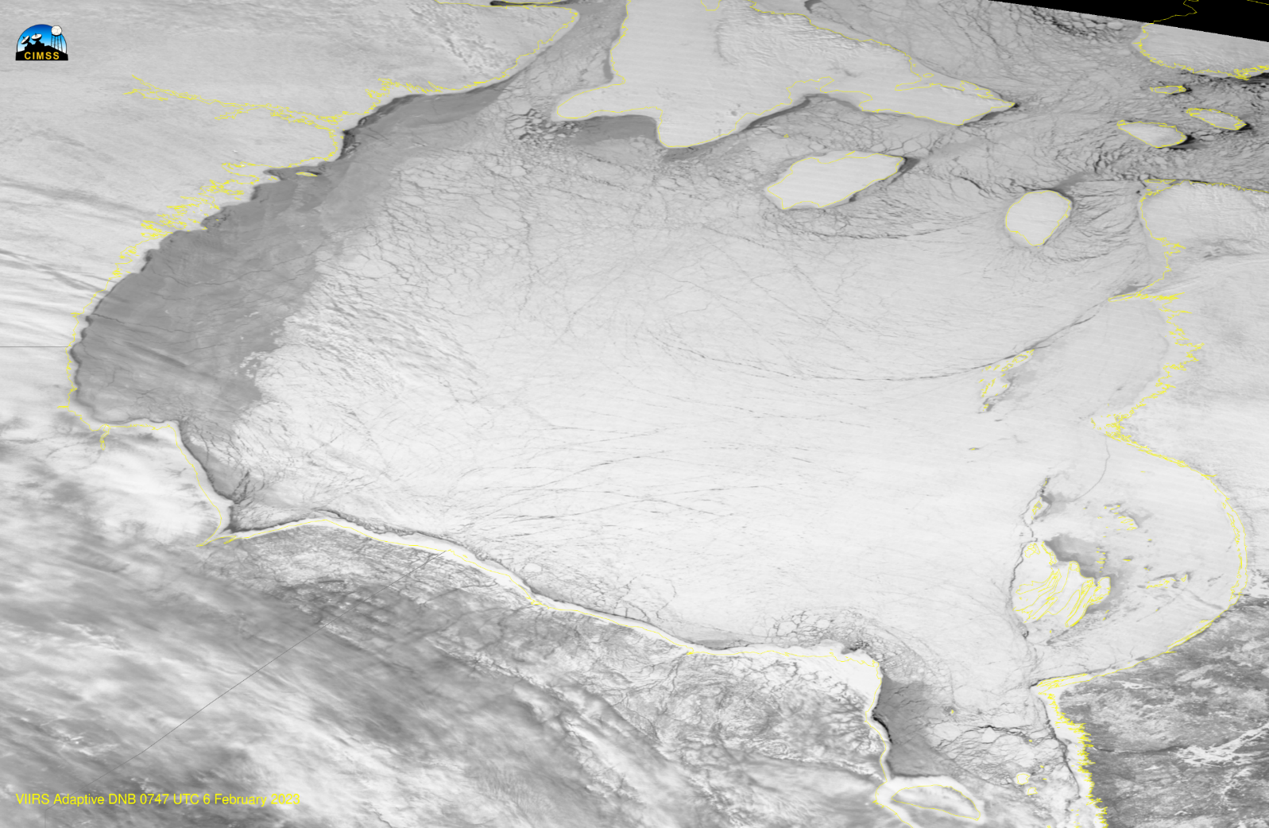
Training is always teaching me something
For example: I can write a Blog Post about an interesting feature I see (a good Blog post tells a good story)
And I speculate (wildly!) about why the difference in Day Night Band reflectance exists!
Why is the ice over western Hudson Bay dark?
Note: daytime VIIRS also showed a difference, in both VIS and 1.6!

Slide 18
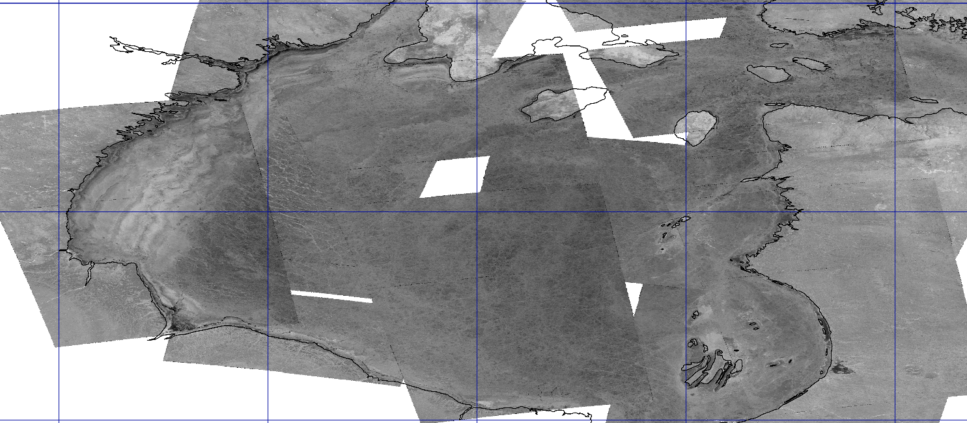
Email Received
I forecast for Canada’s Eastern Arctic and your post about the differences in brightness over western Hudson Bay caught my eye. Regarding some of your hypotheses, I don’t think it has to do with snow age (no reason for such a narrow strip to be older) or some other form of precipitation (been <-30ºC there for weeks). Instead, I think it’s largely due to the persistence of NW winds once the Polar Vortex becomes established. We see this feature most years, and I’ve always assumed that it’s a combination of (a) snow pack being scoured in blizzards and deposited further east in the lighter winds, and (b) the compaction of the ice field eastwards, leading to thinner/newer ice over western Hudson Bay compared to areas further east.
Then I receive a composite image from the SAR ice people at NOAA/STAR – that whiter region over western Hudson Bay is rougher ice (would that change the reflectance?)

Slide 19
More figures arrive (via NOAA Cryosphere team)
VIIRS Level 2 Products show thin ice, and young ice
SMOS data shows thinner ice

Slide 20
The important conclusion to all of this
No one product gives you the entire story
Always look for other satellite products (or, if you must, model and radar!) to tell the story, or to confirm what you find
Establish connections with scientists creating products so you can ask them for information, or so they can supply you with information
Scientists: Do you have a good working relationship with a trainer who can advocate for your product(s)?

Slide 21
Establish Connections
You cannot train on products without the trust of developers – whom you have to ask if (when!!) you have questions (Connections with the scientist are important)
Connections with the student are important
When you find an interesting training-worthy event, after the training, and you forward the example to your students, they are more likely to recognize your name and take the sent email seriously
You also have to know your meteorology so you can quickly understand and interpret a scene

Slide 22
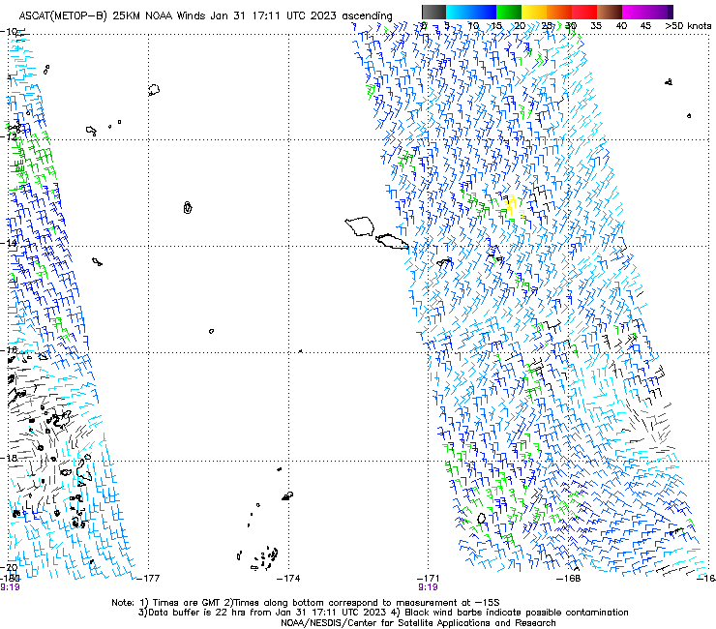
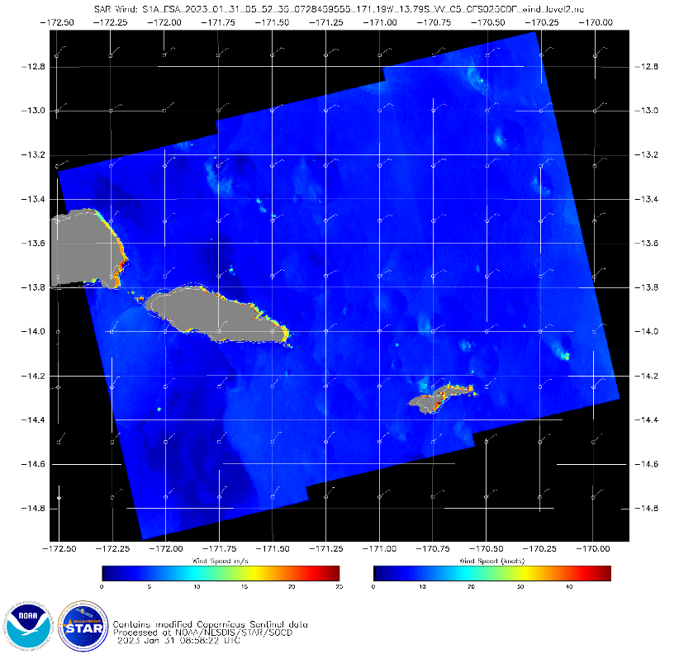
A Trainer must talk about scale – what is the scale of the feature you are trying to identify
Advanced Scatterometry (ASCAT) information
25-km resolution
Global coverage
Synthethic Aperture Radar
500-m resolution
But: Very small region!

Slide 23
Scale
Talking about scale will also show your students that different products are available to reveal different aspects about a feature

Slide 24
SAR Winds and islands
I saw this wind distribution around Tutuila
Blogged about it https://cimss.ssec.wisc.edu/satellite-blog/archives/50428
Learned later that there was a big wind event over the western part of Tutuila!
But ASCAT winds can’t show this detail

Slide 25
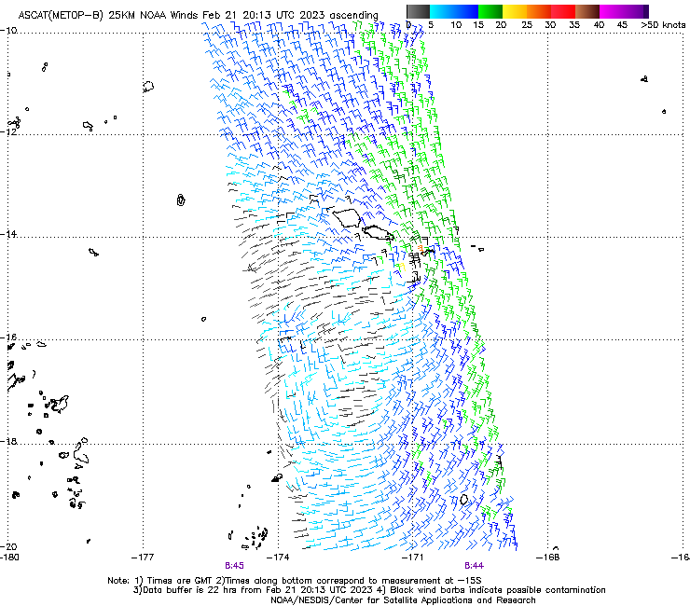
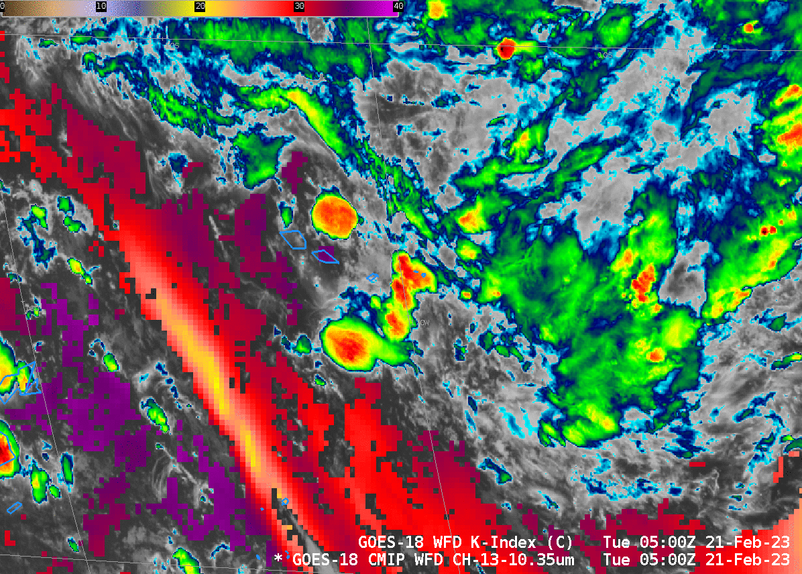
Show examples that might not work (last slide) and that do work (this slide)
SAR data are infrequent in the tropics.
ASCAT can give you useful information
Convergence

Slide 26
Challenges
If you are training in Asia (for example): where can you find data?
Imagery can be found – but what if you want to look at actual raw satellite data?
Where can you find AMI data, for example?
Once you get (for example) AGRI data, how do you display it?
A trainer will become very familiar with data aggregating sites
Real Earth, NASA Worldview, Aerosol Watch, SLIDER, JSTAR Mapper, GsMAP,
A trainer will become familiar with various software packages to create imagery
SatPY (or something like geo2grid)
McIDAS-V

Slide 27
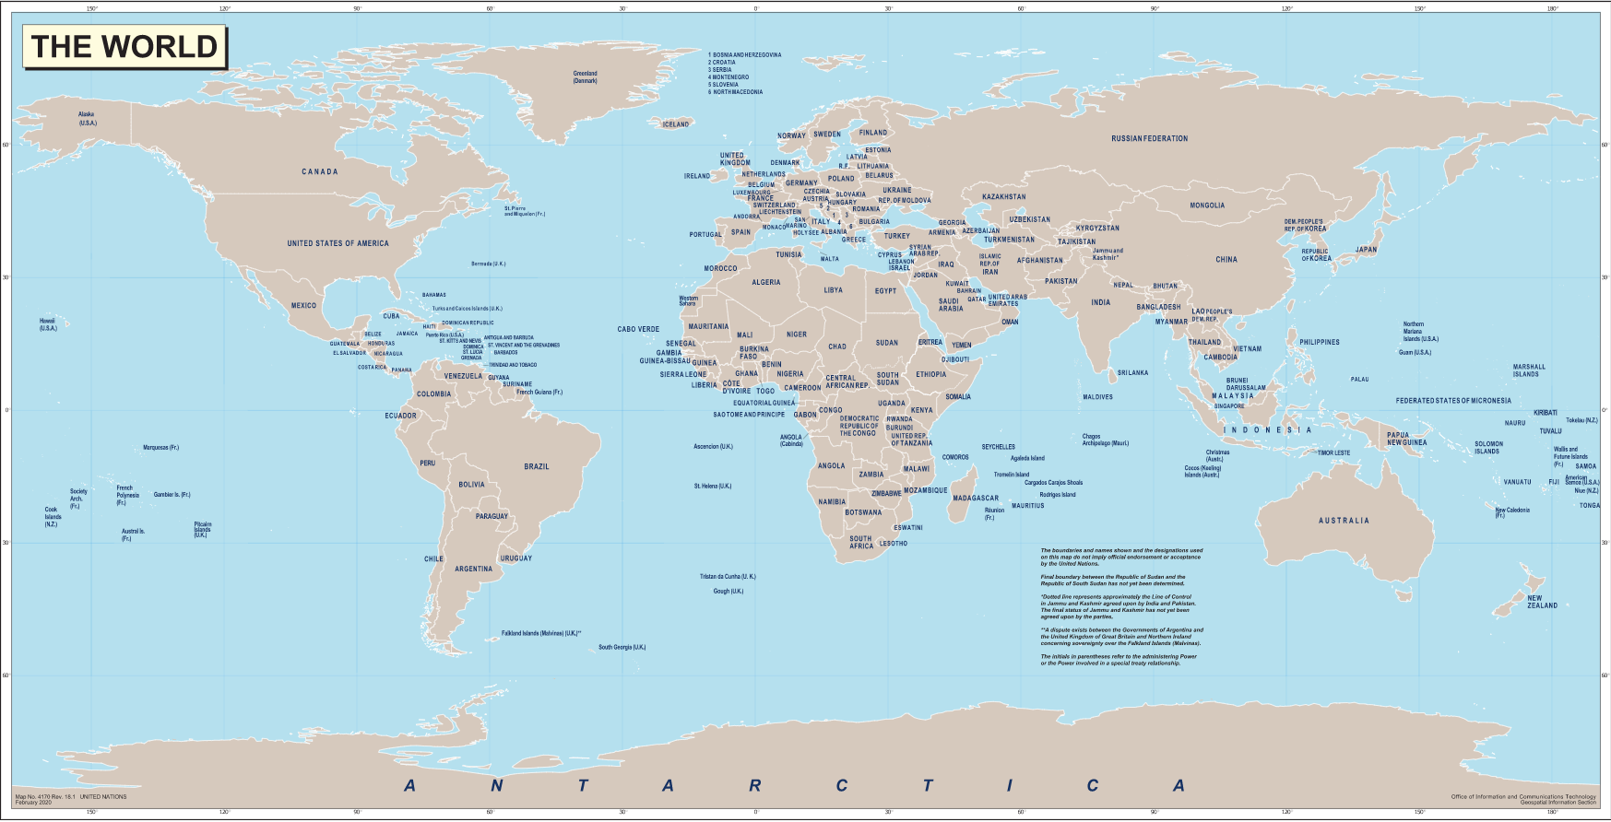
Much of where I’ve trained: in the Tropics
What topic is on most interest in the tropics?
Tropical Cyclones!

Slide 28
Resources
There are many global (or nearly!) datasets that can be used for training
SSEC Tropical Website, with analyses in different domains
MIMIC Total Precipitable Water
MiRS products
NUCAPS/HEAP profiles/NASA SPoRT website
SAR/ASCAT/SMAP/AMSR-2 wind datasets
This is a lot of information to become conversant in

Slide 29
Front Page: Top
The map includes currently active storms or invests. There are many links on this front page, especially the links under the map. These go to specific websites for products that may be useful
https://tropic.ssec.wisc.edu

Slide 30
Front Page: Choices
ADT: Advanced Dvorak Technique: Satellite-based intensity estimates
OPEN-AIIR: Ordered Pattern ENcoding AI InfraRed TC intensity estimator (OPEN-AIIR)
MIMIC-TC: Morphed Integrated Microwave Imagery at CIMSS
MIMIC-TPW: Morphed Integrated Microwave Imagery : Total PW
AiDT: AI-enhanced Dvorak Technique
SATCON: Satellite estimates of wind speed/MSLP
AI-RI: Artificial Intelligence Rapid Intensification
SAL: Saharan Air Layer analyses (Atlantic Basin only)
ARCHER: Automated Rotational Center Hurricane Eye Retrieval: Center-fixing the eye, ERC
TC Diurnal Cycle: Observations of night-time changes
AMSU: Advanced Microwave Sounder Unit: Microwave imagery of storms
MPERC: Microwave-based Probability of an Eyewall Replacement Cycle (ERC)
Also have links to RSMCs that have basin responsibilities
(Regional Specialized Meteorological Center)
DeepMultiNet: AI Microwave and infrared TC intensity estimator

Slide 31
The challenge for that website
New Products keep showing up (in the last years: A lot of products rooted in Machine Learning)
Shout-out to Derrick Herndon and Sarah Griffin for answering countless questions I have!
(This also is a good example of why Scientists and Trainers should be in reasonably close proximity – because that’s more immediate than emails!)
And thanks to the people supplying funds to SSEC/CIMSS for this kind of work that is used World-wide.

Slide 32
The bottom half of the SSEC Tropical Website: Domain Analyses
When you’re training on Tropical Cyclogenesis, you need to talk about shear.
Tropical Website includes wind analyses : low-level convergence, upper-level divergence, wind shear
It’s a beautiful resource for talking about things in real time, as in: Does the impulse we see on satellite imagery have a chance of developing?

Slide 33
Front Page: Bottom
https://tropic.ssec.wisc.edu
The top part of the CIMSS page shows active storms.
The bottom half shows basins, and you can explore information in basins to determine if conditions favorable for tropical cyclogenesis are present

Slide 34
Front Page: Bottom
https://tropic.ssec.wisc.edu
Different basins have different colors; mouse over them to view data over that particular region
Mouse over a location

Slide 35
‘Winds and Analyses’
Here’s what you see after clicking on the basin. Satellite-derived winds at upper levels (100-250, 250-350 and 350-500 mb)
There are other products available, and you can also change the time of the imagery
NOT CURRENT DATA

Slide 36
‘Winds and Analyses’
You can click on different tabs to view different products. Here is Wind Shear, color-coded.
Wind shear is a difference between the average of the 150, 200, 250 and 300 mb winds (upper winds) and the average of the 700, 775, 850 and 925 mb winds (lower winds).
Contours are color-coded. Green: Favorable; Red: Unfavorable; Yellow: Neither
NOT CURRENT DATA

Slide 37
‘Winds and Analyses’
Note the Product Info Tabs! Click on those to view information about the product you’re looking at (if you’ve forgotten)
NOT CURRENT DATA

Slide 38
Other things to discuss: Winds!
Scatterometry gives vital information over water about wind speed and direction
https://manati.star.nesdis.noaa.gov/ (“manati”)
https://scatterometer.knmi.nl/tile_prod/ (“osisaf” multi-platform viewer)
SAR data is another great source of information about tropical cyclones
Needed when talking about this: training on microwave data: how are these data created?

Slide 39
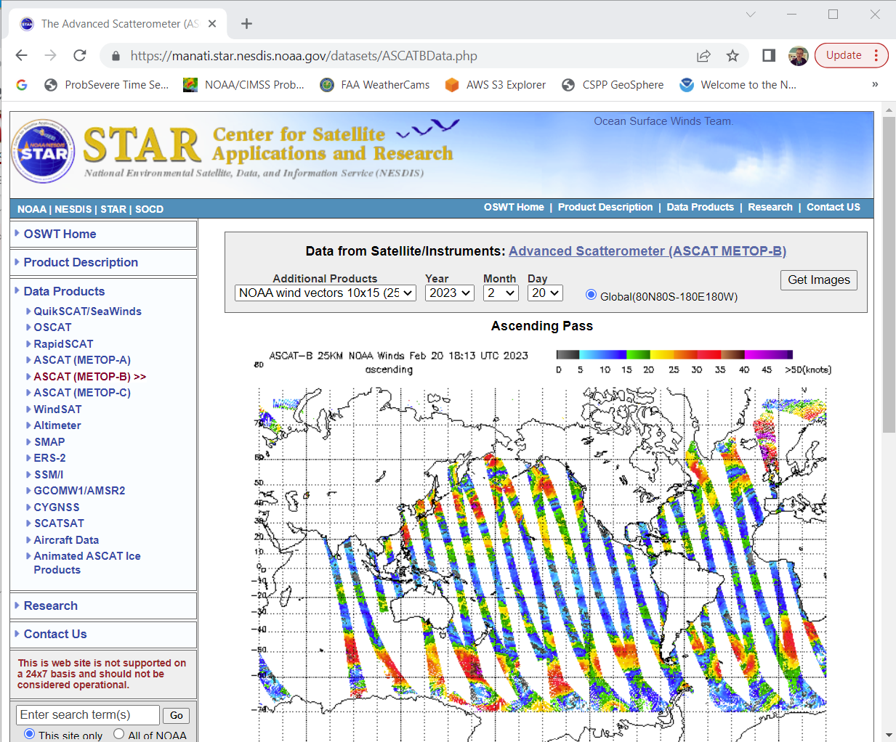
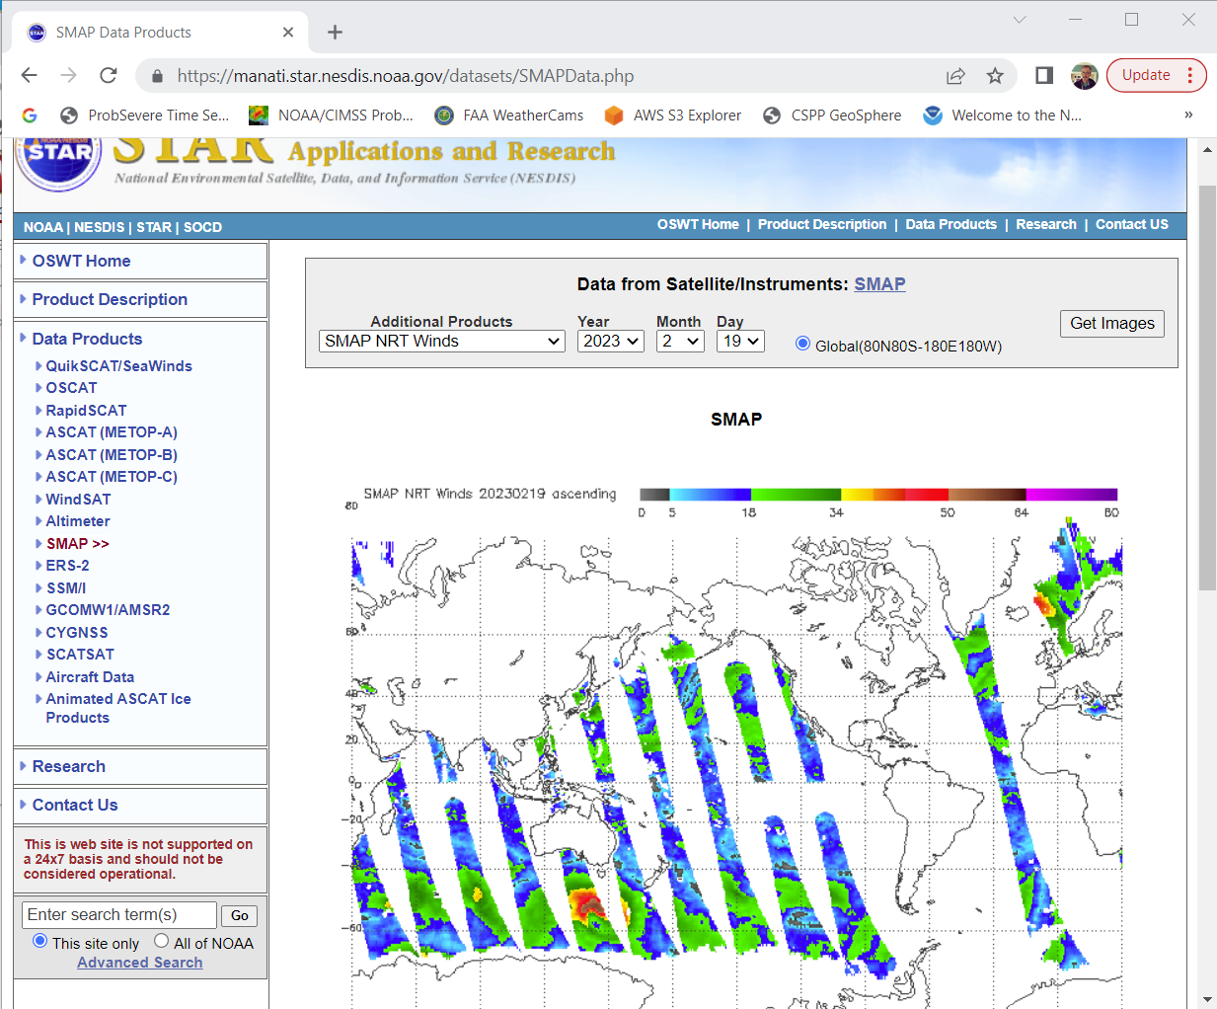
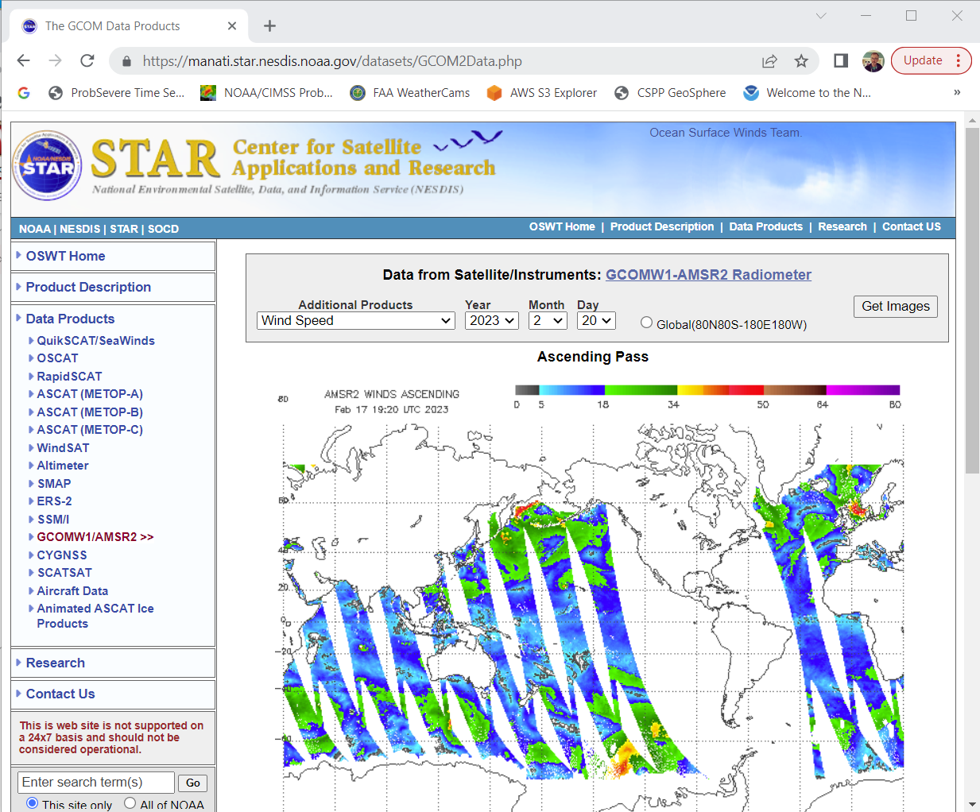
Wind observations
SMAP
ASCAT
AMSR-2

Slide 40
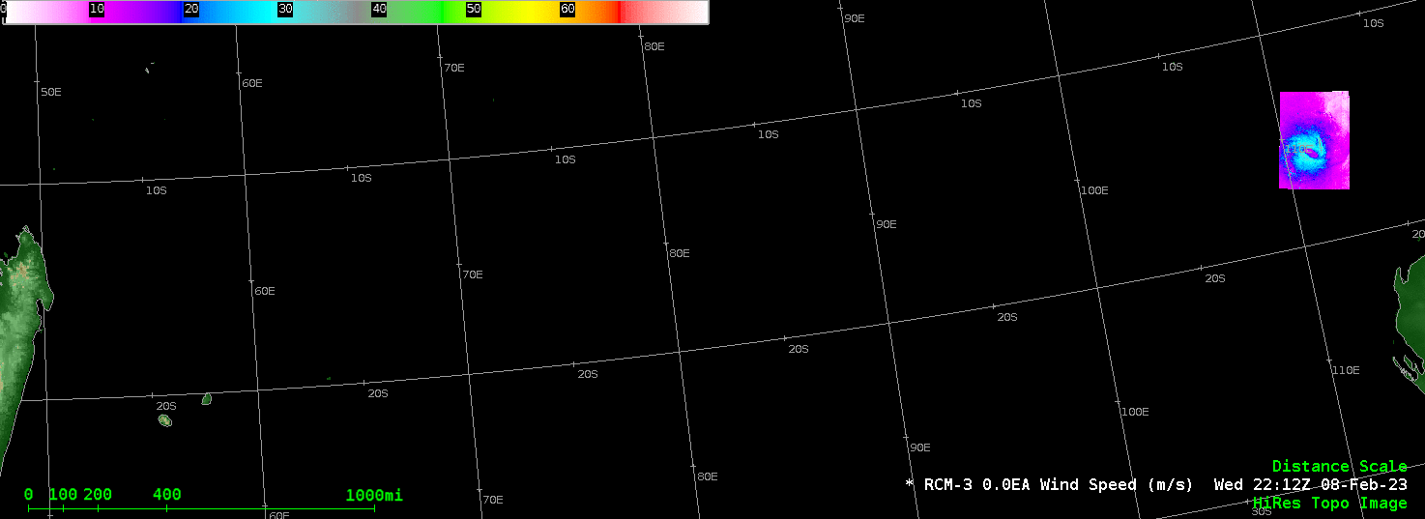
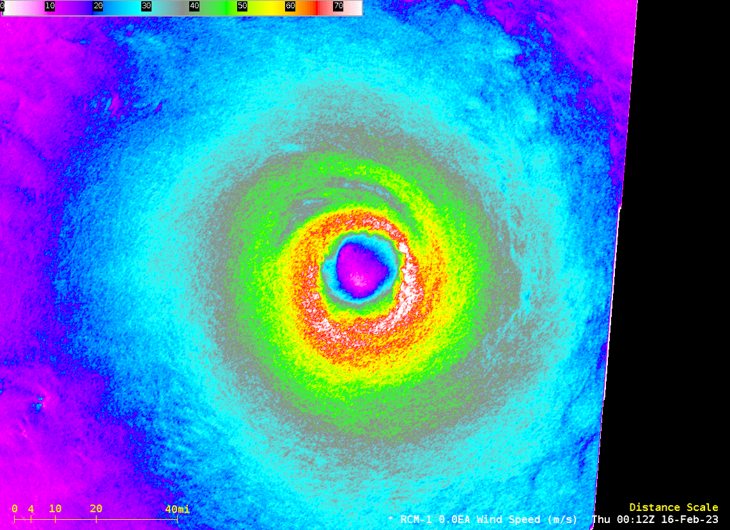
SAR Data

Slide 41
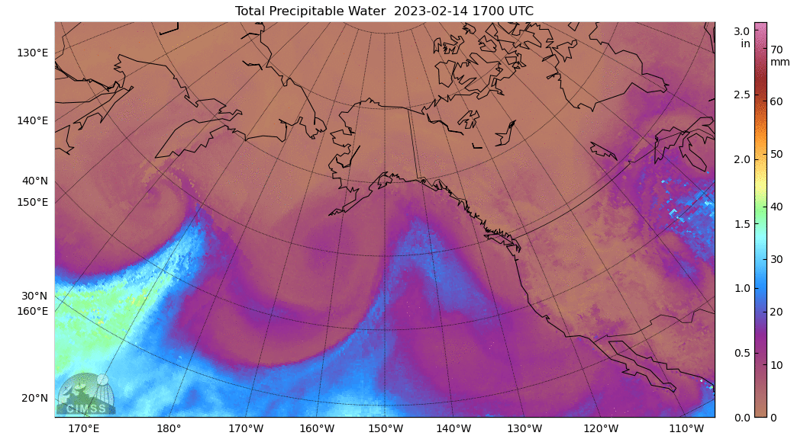
More Microwave Data: also show students the MiRS website
More training on microwave capabilities
Training on Atmospheric River-like structures

Slide 42
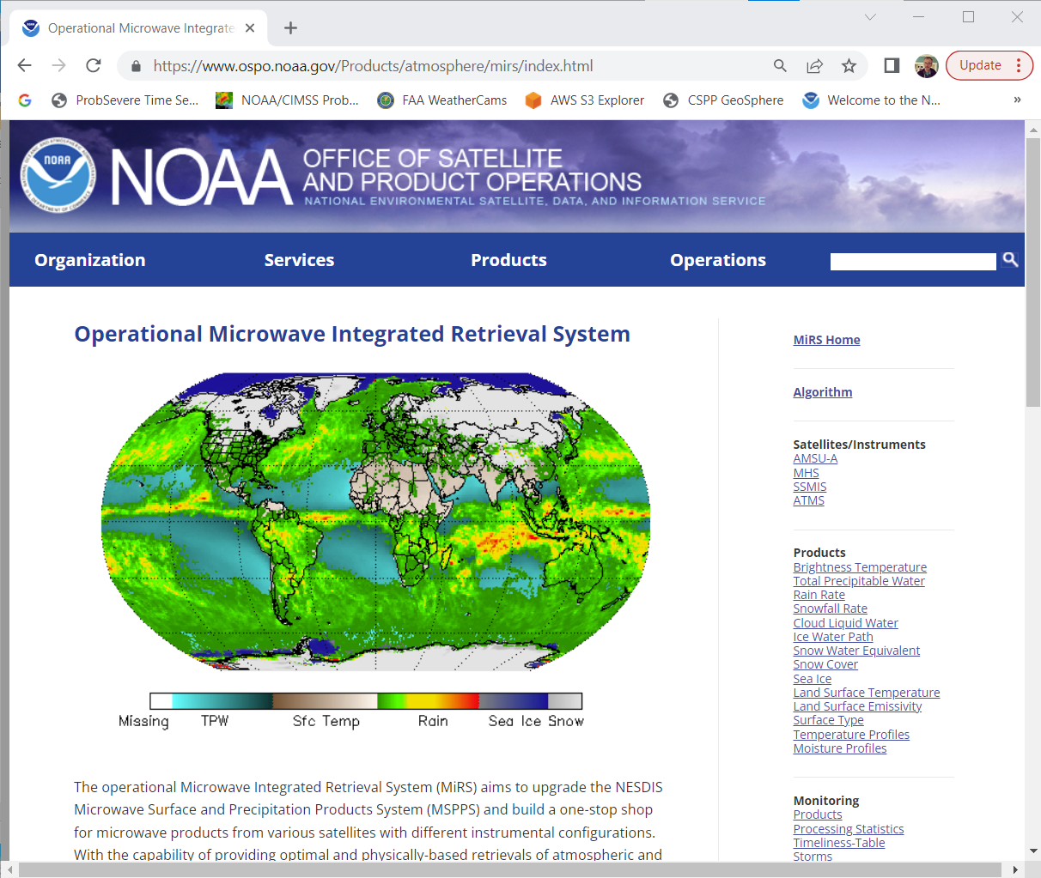
https://www.ospo.noaa.gov/Products/atmosphere/mirs/index.html
Look at all these products derived from Microwave data! Very useful for moisture and the cryosphere

Slide 43
NUCAPS – NOAA-Unique Combined Atmospheric Processing System Thermodynamic Profiles
Excellent source of data over the oceans
Can tell you the freezing level
Can tell you where instability gradients sit
Can tell you where moisture gradients sit
Can tell you where dry air sits
This is another dataset that can be linked to GeoXO – hyperspectral soundings are similar to the GXS, after all.

Slide 44
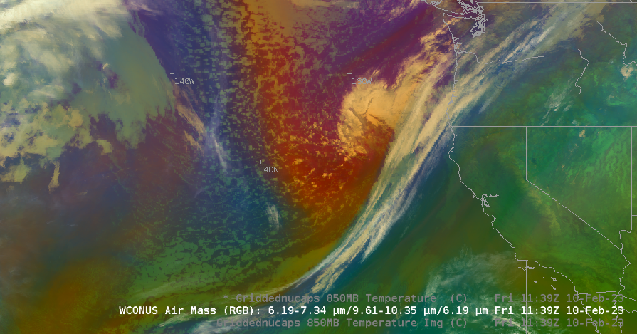
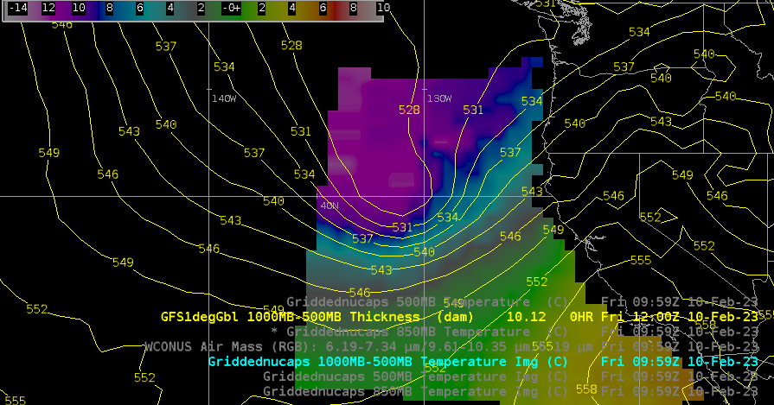
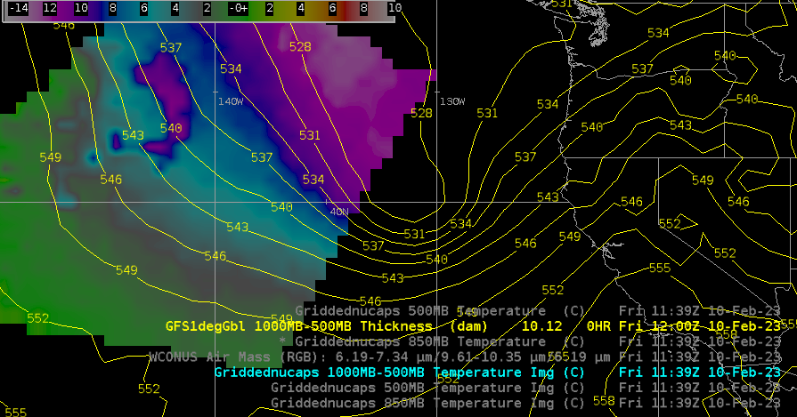
NUCAPS can be used to add information
How cold is the airmass behind the storm?

Slide 45
More information
NUCAPS: https://cimss.ssec.wisc.edu/satellite-blog/archives/category/nucaps [134 Blog Posts]
SAR: https://cimss.ssec.wisc.edu/satellite-blog/archives/category/sar [45 Blog Posts]
Microwave imagery: https://cimss.ssec.wisc.edu/satellite-blog/archives/category/microwave [121 Blog Posts]
Many other categories for your searching and reading pleasure

Slide 46
Thank you for your attention
I’m always like to see satellite views of interesting weather events!
Send me an email when you see something: scott.lindstrom@noaa.gov
If you have a training need, contact me and I can help put you in touch with what or who can help you
I create short blogs on weather events at the CIMSS Satellite blog (https://cimss.ssec.wisc.edu/satellite-blog)

