Slide 1
ProbSevere LightningCast
John Cintineo (NOAA/OAR/NSSL)
Mike Pavolonis (NOAA/NESDIS/STAR)
Justin Sieglaff (UW-CIMSS)
Scott Lindstrom (UW-CIMSS, training)
With support from GOES-R Science Program

Slide 2
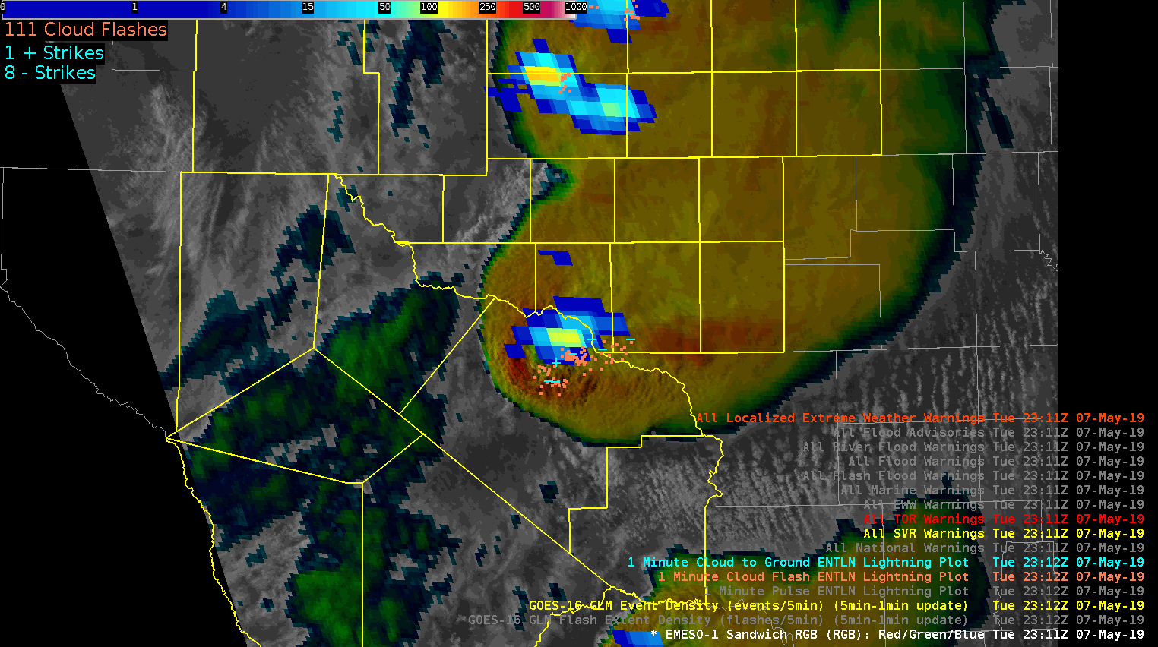
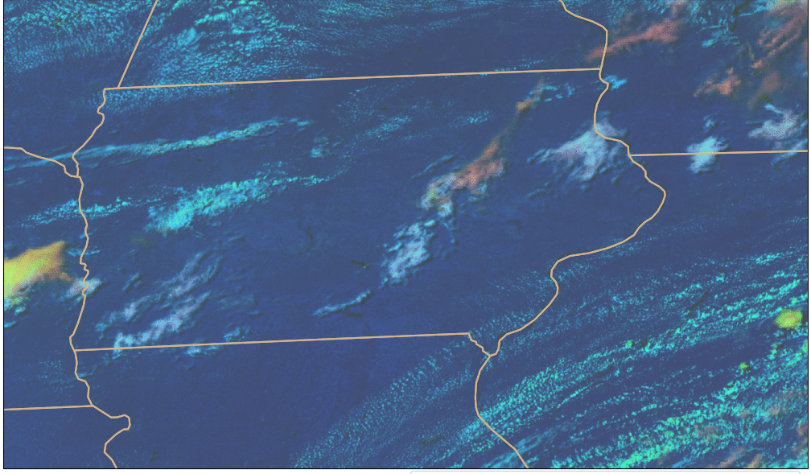
What is ProbSevere LightningCast?
GLM: where lightning is currently present
ABI: multi-spectral images of convective clouds
Day Cloud Phase Distinction is discussed in depth in Elsenheimer and Gravelle 2019
ProbSevere LightningCast is an ABI-based machine-learning model that predicts where the (gridded) GLM will observe lightning up to 60 minutes in the future – based on the evolution of ABI cloud imagery. Human eyes/brains already do this – the model attempts to mimic this capability objectively.
Notes:
-GLM observes lightning
-Human interpretation of ABI imagery has been shown to be important for nowcasting lightning, especially lightning initiation
-In short, we used a portion of the historical ABI and GLM data record (2019) to train a machine learning algorithm to analyze multispectral ABI imagery with the goal of nowcasting lightning as observed by GLM

Slide 3
Lightning Probability: How?
Take image observations of the ABI Bands, including those used operationally in Convective situations (Day Cloud Phase Distinction, for example, during daytime)
Take future image observations of lightning from GLM
Use both of these to train a model based on ABI data on when lightning will occur
A request for this product came from OPC/WPC – for predictive information over the ocean

Slide 4
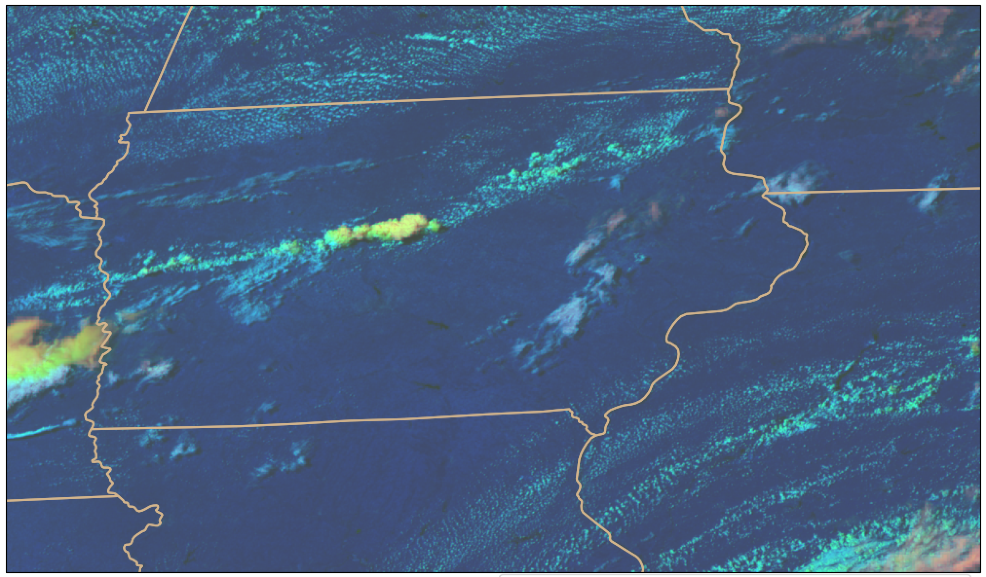
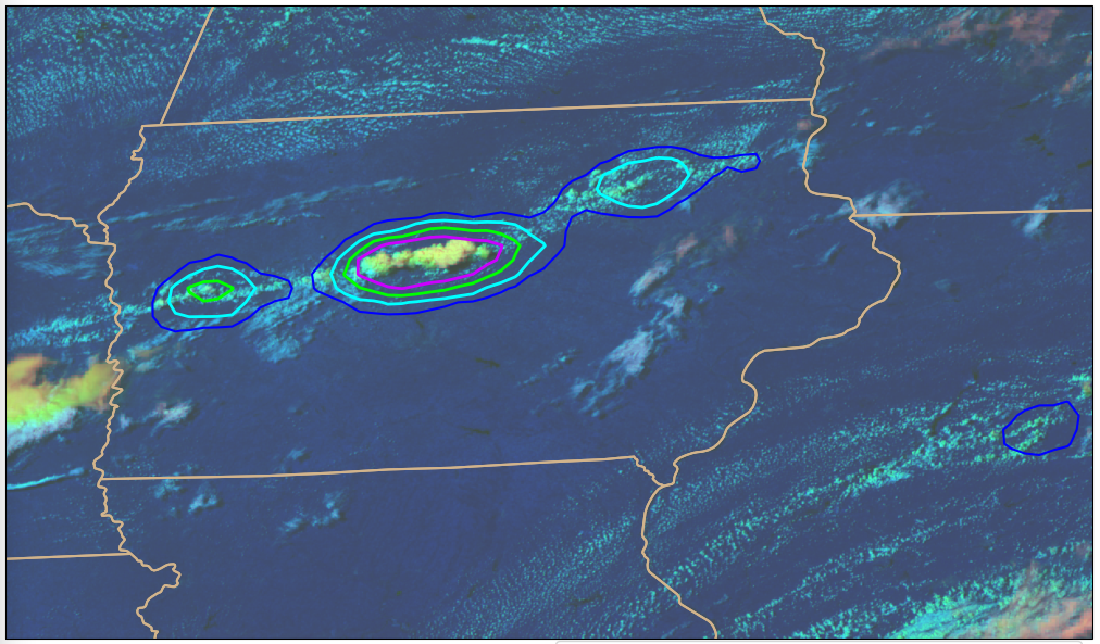
How does LightningCast work?
Input:
0.64 µm reflectance (band 2)
1.6 µm reflectance (band 5)
10.3 µm brightness temperature (band 13)
12.3 µm brightness temperature (band 15)
Output:
probability that GLM will observe lightning in the next 60 minutes
Natively 2-km res. on the ABI grid
Remapped to ~10-km res. on equal lat-lon grid
Works day and night; Applicable to any scan domain (meso, CONUS, or FD); Applicable to GOES-East (GOES-16) and GOES-West (GOES-18)
Notes:
-Same family of computer vision machine learning that is used in self driving cars
-Learns the relationship between ABI image patterns (spatial and spectral) and the location of where GLM observed any lightning in the 60 minutes that follow the ABI image time – millions of ABI images with GLM derived labels were used
-Unlike with PSv2 and PSv3, there is no feature detection or tracking; it is a pure computer vision approach (mimics how a human interprets imagery)
-Input: All channel input is at 0.5 km via oversampling
-The contribution from the reflective bands gracefully ramps down to zero at night, with no noticeable discontinuity
-Output: A 0.5 km map of probabilities is the result. The probability map is subsequently subsampled and converted into probability contours.

Slide 5
How is LightningCast used?
Impact-based Decision Support Services (IDSS) for outdoor events
Maritime nowcasting
Airport and air traffic operations
Wildfire incident response
General convective initiation/maintenance guidance
Personal decision making

Slide 6
5 (75%) – 25 (25%) minutes of lead-time prior to first GLM flash
15 (75%) – 25 (25%) minutes of lead-time prior to first GLM flash
15 (75%) – 30 (25%) minutes of lead-time prior to first GLM flash
30 (75%) – 70 (25%) minutes of lead-time prior to first GLM flash
Notes:
-Clean example with variable lead-time in the midwest
-The lead-time is a function of how rapidly the storm develops

Slide 7
Note : LightningCast is frequently shown on animations; however, time tendency (how ABI Band information is changing) is not used in the algorithm.

Slide 8
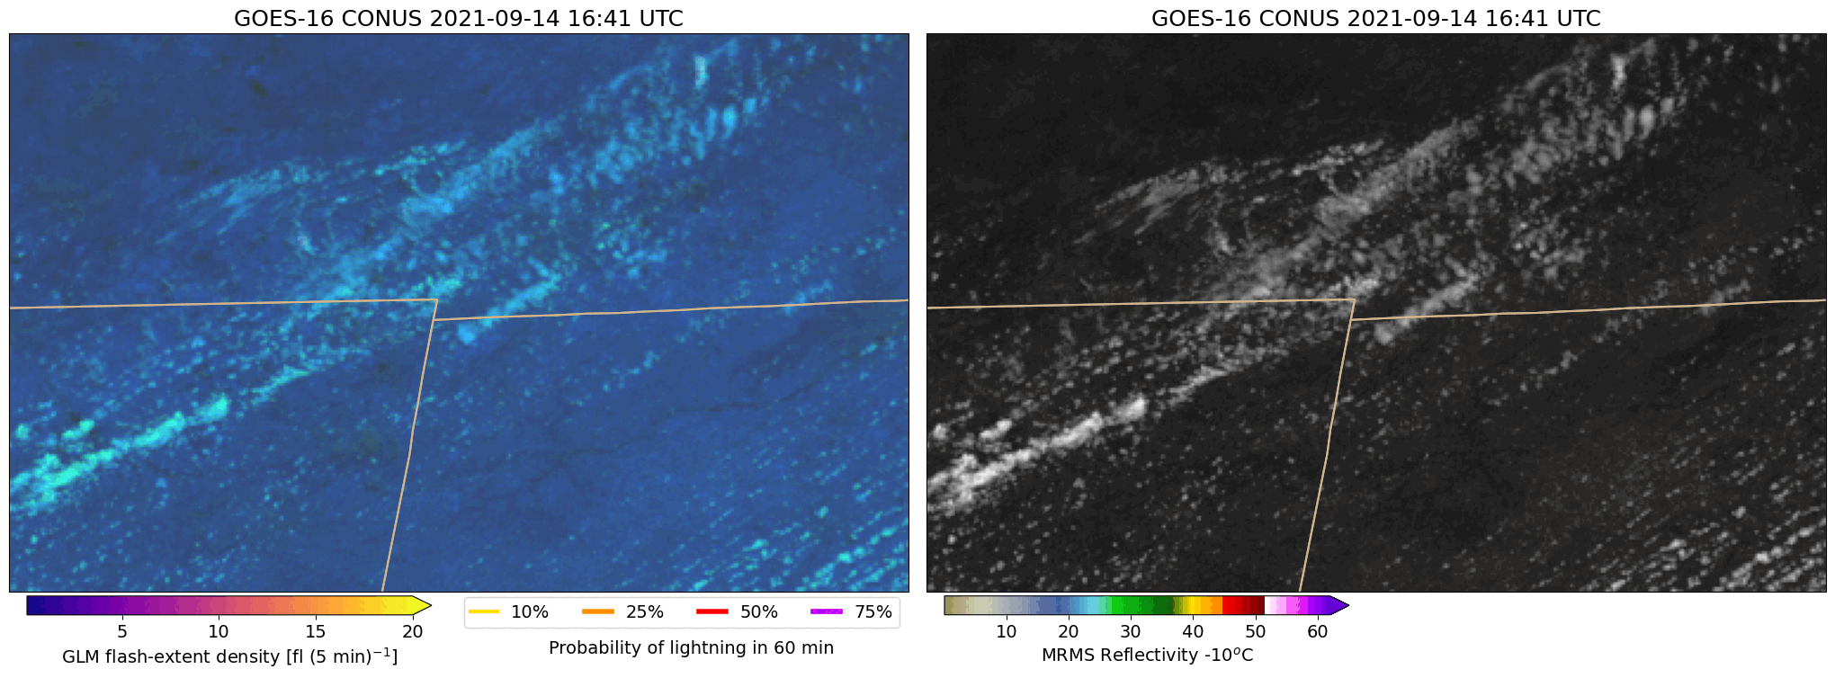
Comparison to NEXRAD radar
Michigan
Michigan
Ohio
Ohio
Day-cloud-phase distinction RGB + LightningCast contours
Visible imagery + Refl. @ -10ºC
Spatially coherent LightningCast signals often precede early radar indicators of convective and lightning initiation
Notes:
-Storms in N. Indiana with composite reflectivity
-Not an extreme example

Slide 9
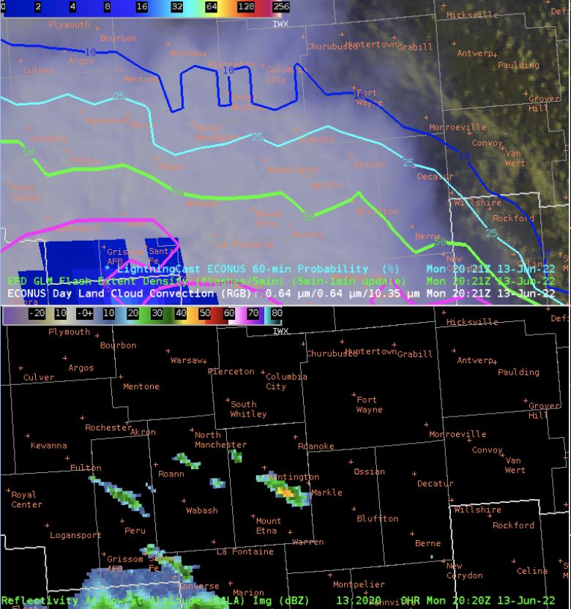
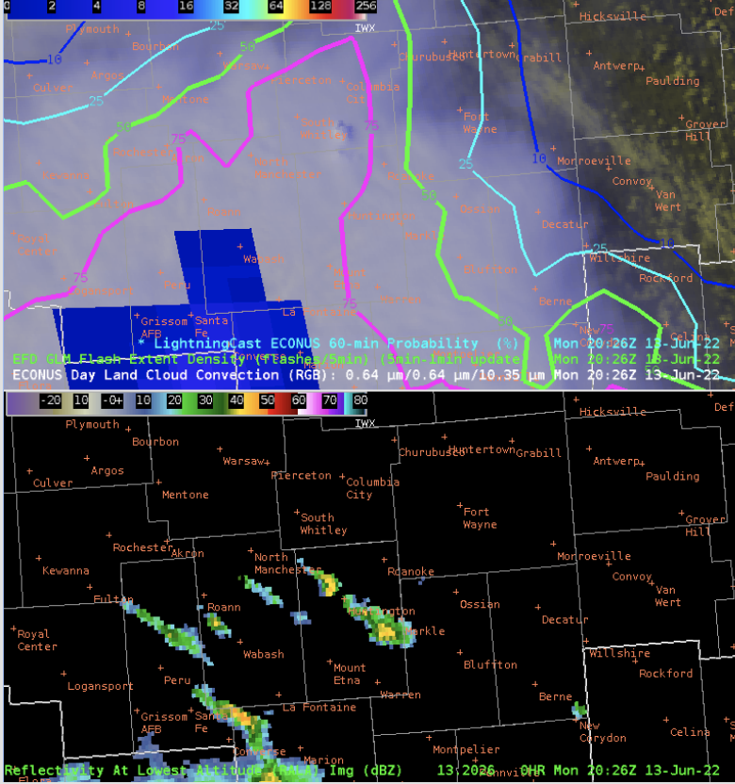
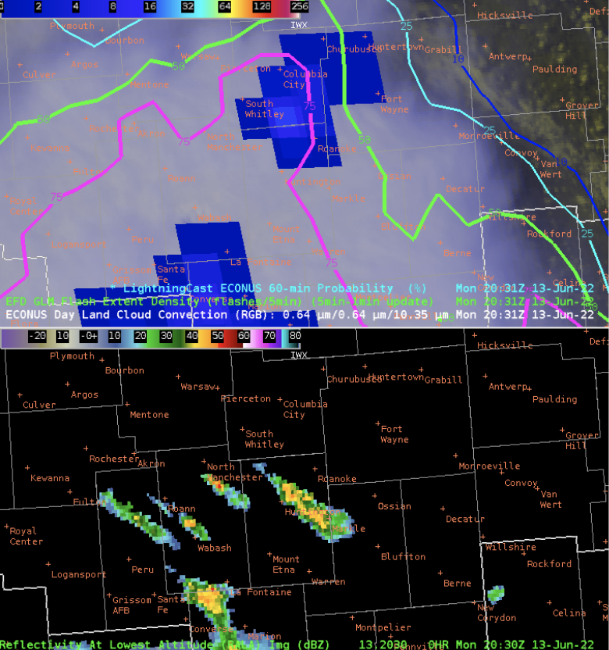
LightningCast and developing convection under thick cirrus
https://goesrhwt.blogspot.com/2022/06/where-is-new-convection-going-up.html
20:21 UTC
20:26 UTC
20:31 UTC
Notes:
This message is here is that thick cirrus can obscure growing convection. LightningCast picks up on the convection late, once it emerges from cirrus deck at 20:26Z.

Slide 10
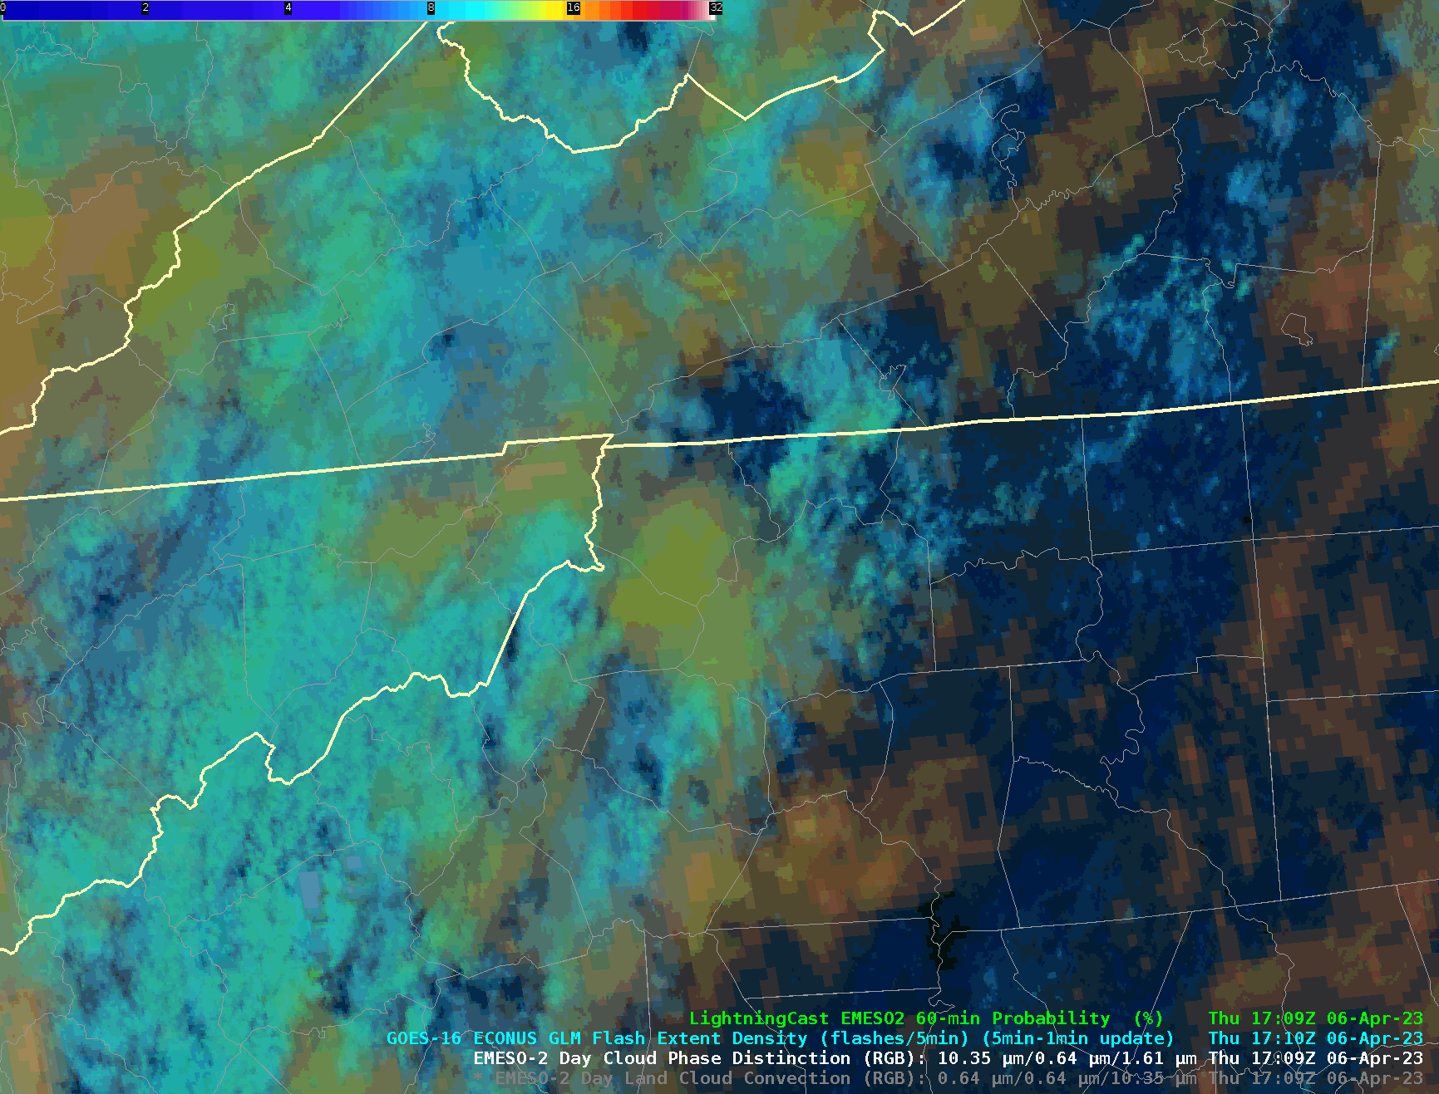
New features at 2024 HWT
Web-based lightning dashboards
Including on-demand location request
GOES-East model trained with 2 years of data
Higher skill
Better calibration
Probability thresholds for desired lead time may be lower than you are used to
A new product for GOES-East:
P(≥ 10 flashes in 60 min)
GOES-West model trained with GOES-18 data
Was previously using model trained with GOES-16 data
Easier AWIPS customization of probability contours

Slide 11
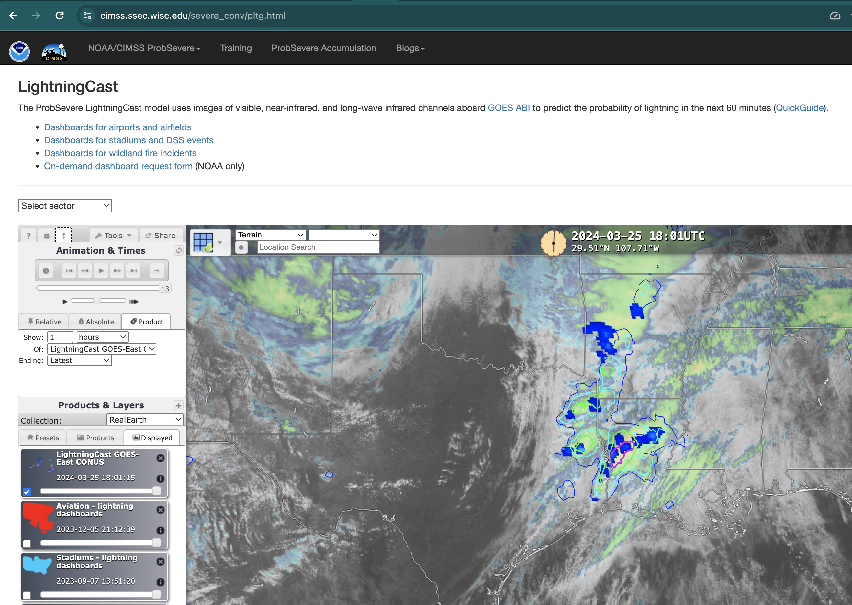
Navigate to webpage:
cimss.ssec.wisc.edu/severe_conv/pltg.html

Slide 12
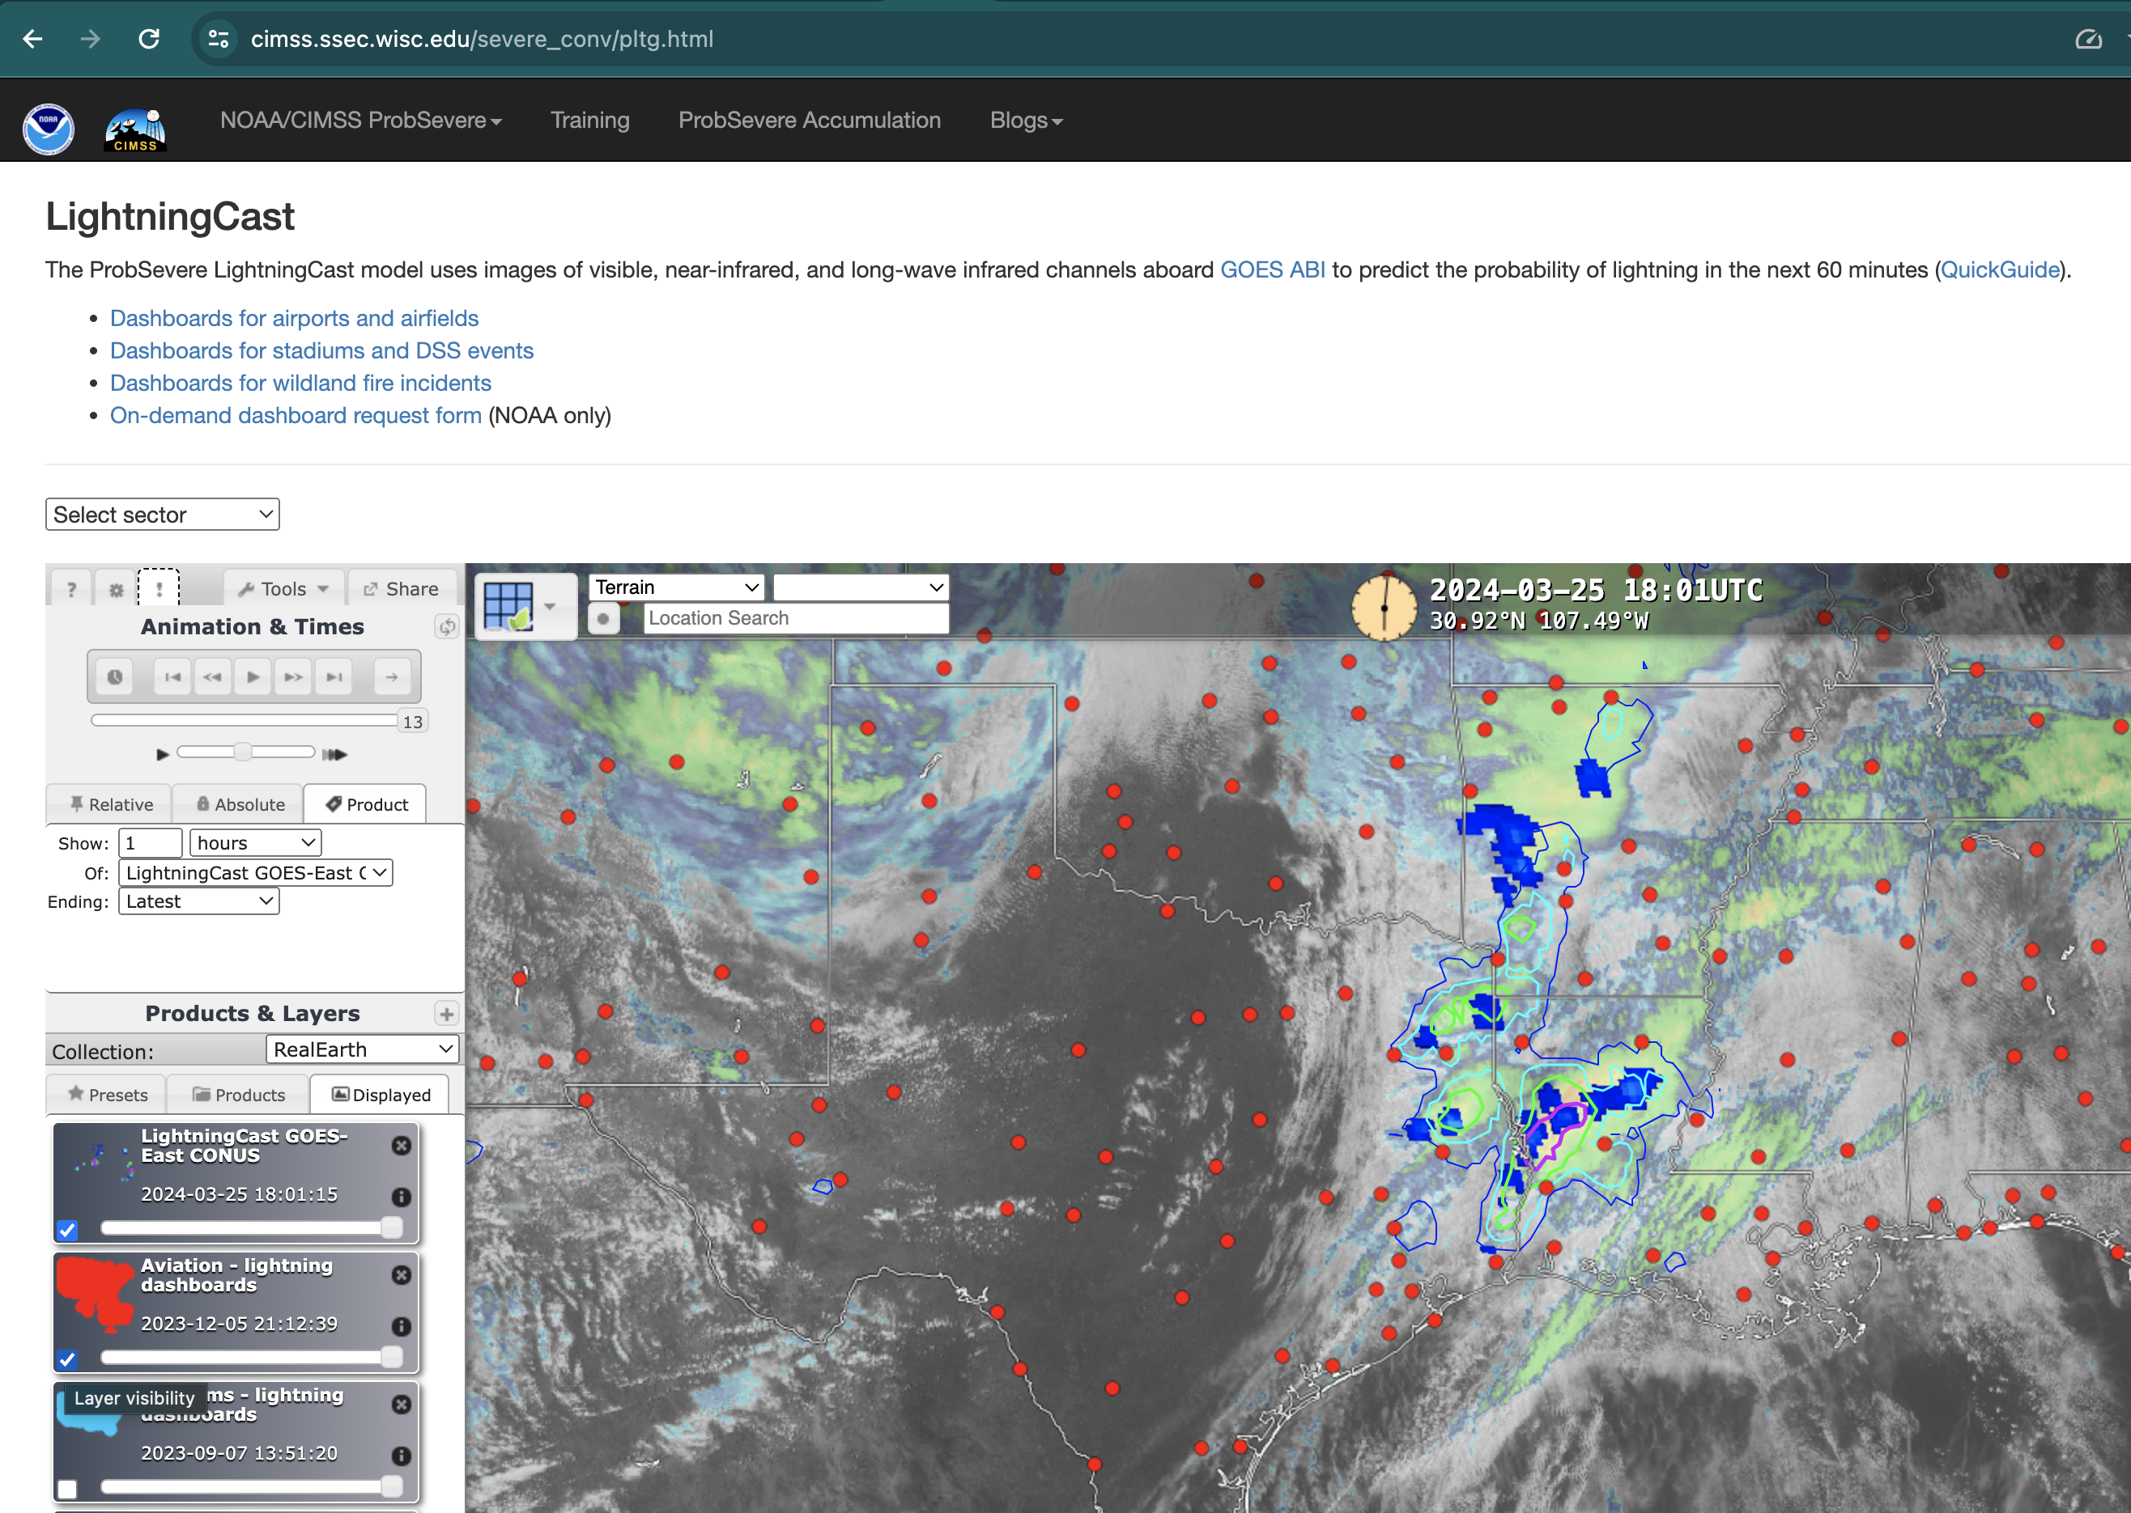
Toggle on dashboard layer

Slide 13
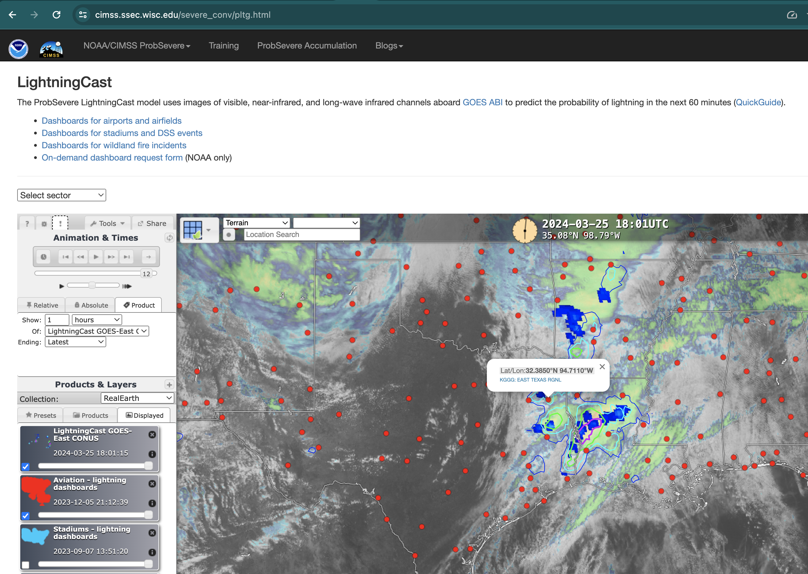
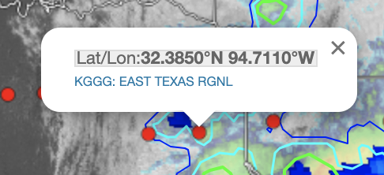
Click on airport (or stadium)
Click link

Slide 14
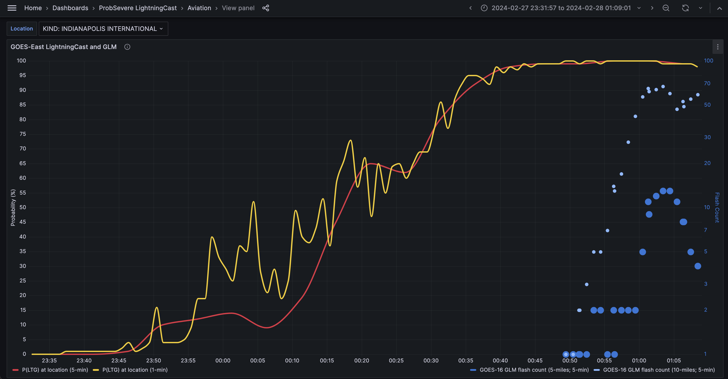
Dashboards open in new browser window
Change airport (or stadium)
Change time frame and time zone
GLM flash centroids w/in 10 miles and 5 min before
Meso. LightningCast probs
(1 min, when applicable)
GLM flash centroids w/in 5 miles and 5 min before
CONUS LightningCast probs (5 min)
Toggle on/off meteograms

Slide 15
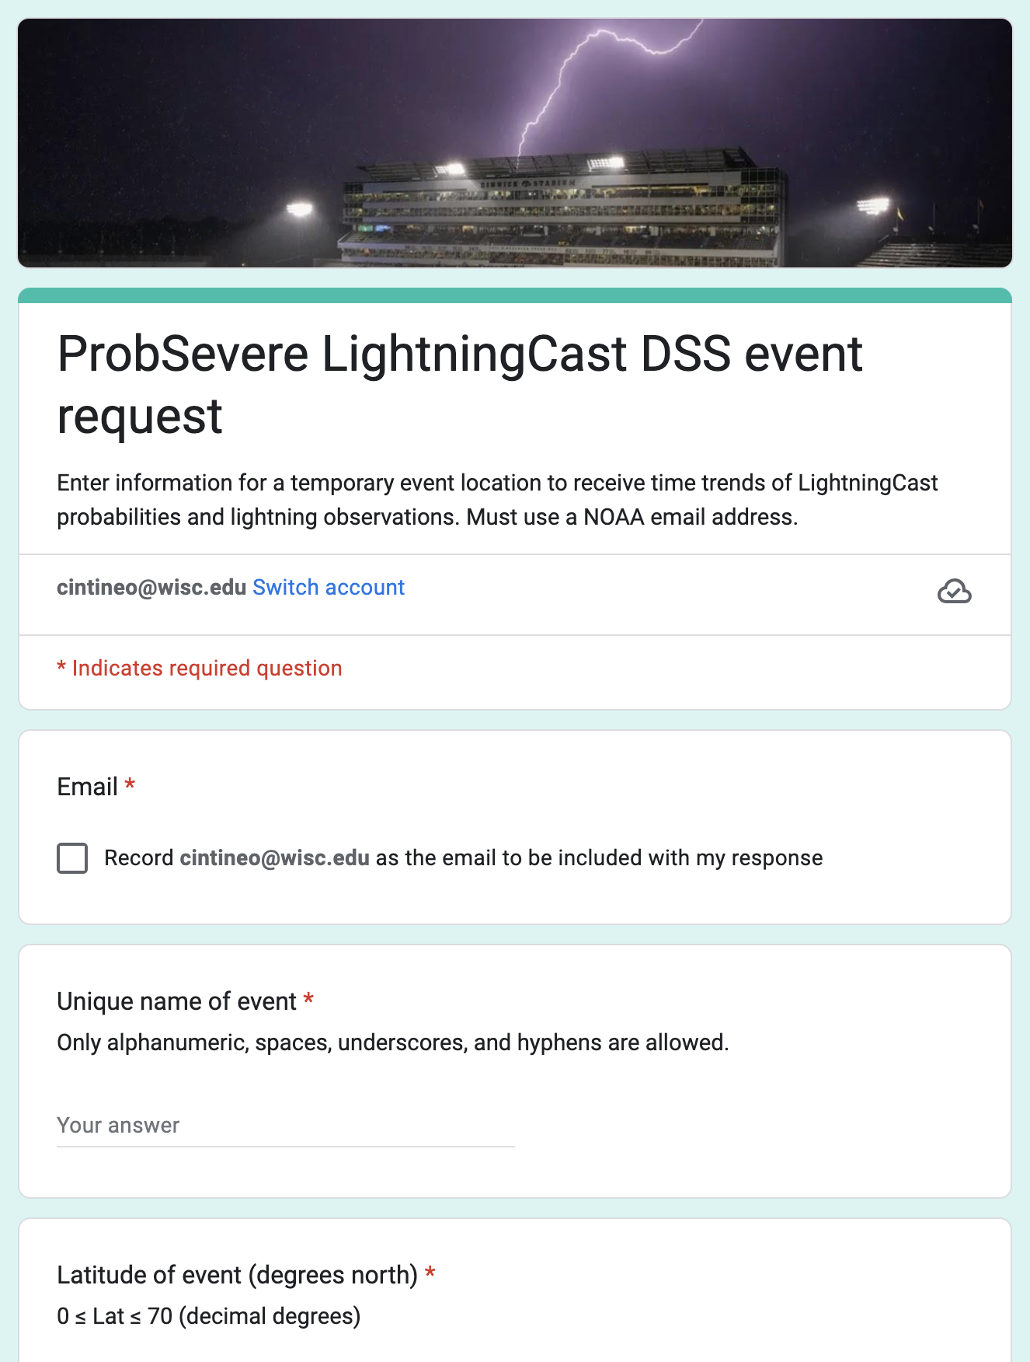
New features at 2024 HWT
On-demand location request for DSS
Simple google form: https://go.wisc.edu/x16m56
Email address
Name of event
Location (lat / lon)
Start and end time of event
Email sent with link to dashboard
valid during event
Try it out for DSS events this week!
Your feedback on the static and on-demand dashboards is crucial for if and how these features get transitioned to operations!

Slide 16
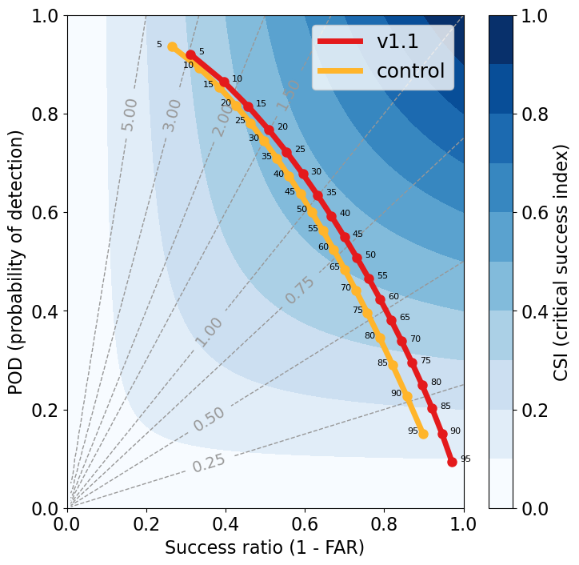
P(≥ 1 fl in 60 min)
2024
2022-23
GOES-16 model has higher CSI as a result of training on 2 years of data
Test set = one year (2021)
Best thresholds for maximizing CSI 25-50%, compared to 35-65%
Good thresholds for balancing CSI and lead time to first flash: 25-35%, compared to 40-50% previously
Point labels are probability thresholds

Slide 17
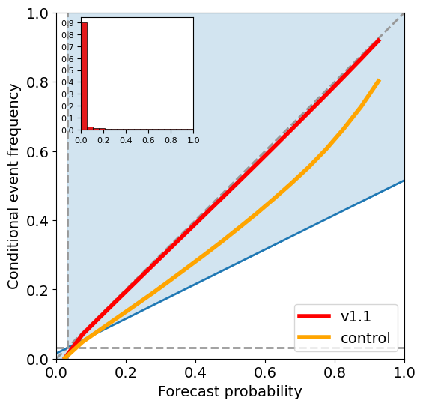
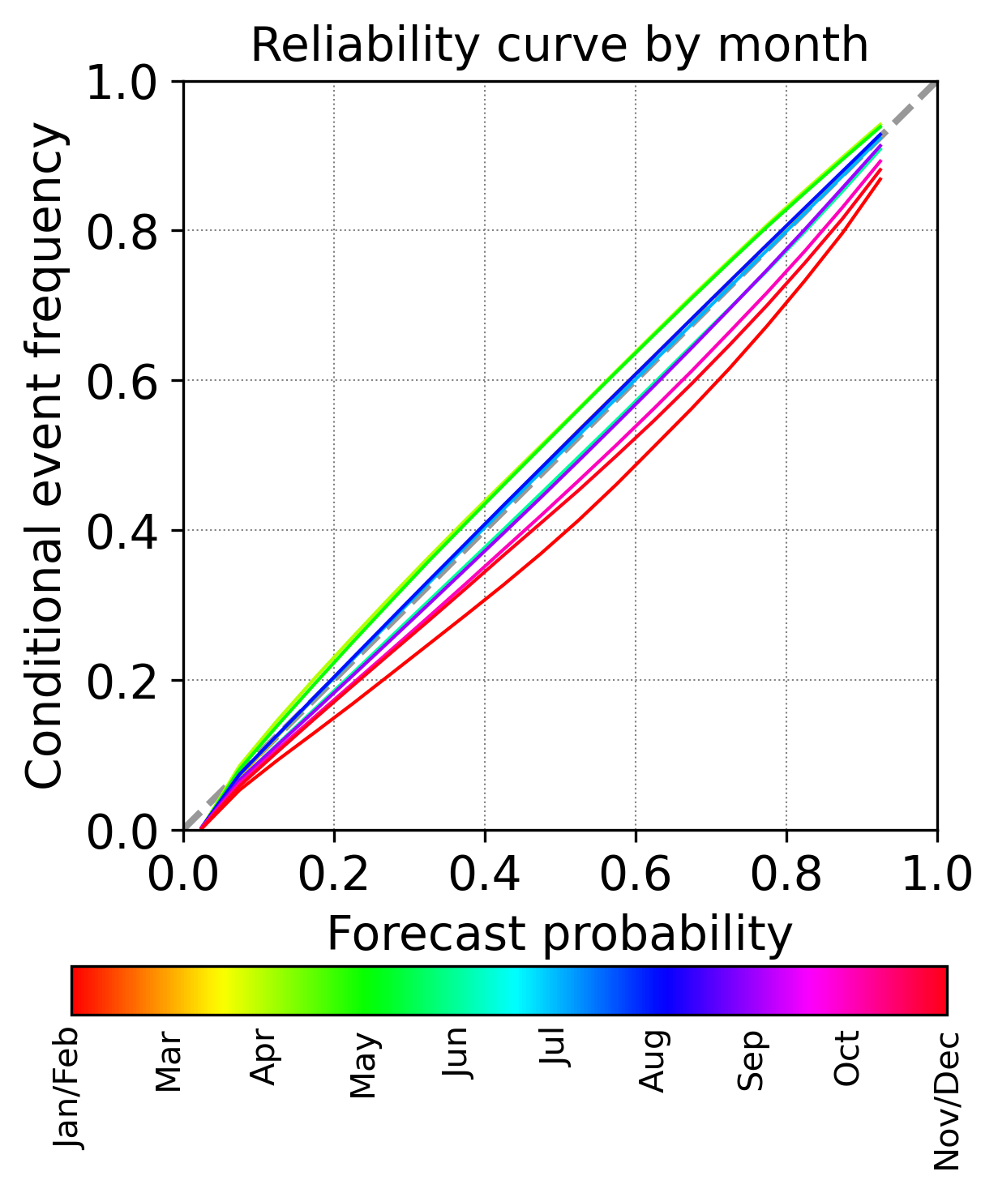
Better probability calibration
P(≥ 1 fl in 60 min)
2024
2022-23
v1.1 by month
Notes:
Very good calibration. This is for ALL predictions (lightning initiation and persistence/advection)

Slide 18
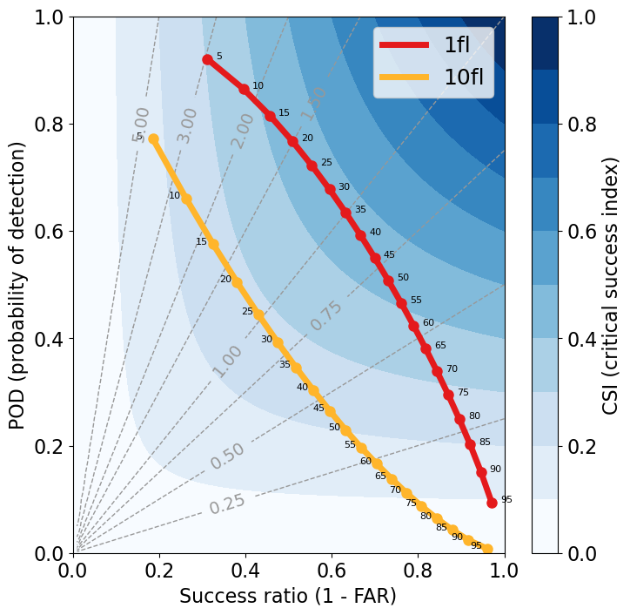
New features at 2024 HWT
New product: P( ≥ 10 flashes in next 60 min)
Currently, GOES-East only
P(≥ 10 flashes) much more difficult to predict than P(≥ 1 flash) from only ABI
Can be used to capture storm intensification or weakening ahead of GLM trends
Lead time to first “10 flashes” observation often on the order of 5-10 min
Point labels are probability thresholds

Slide 19
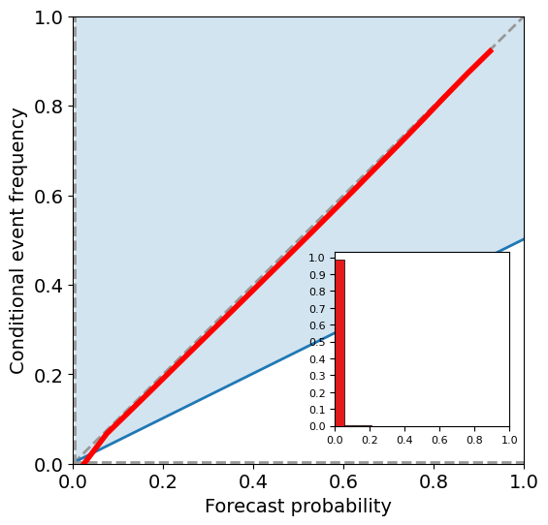
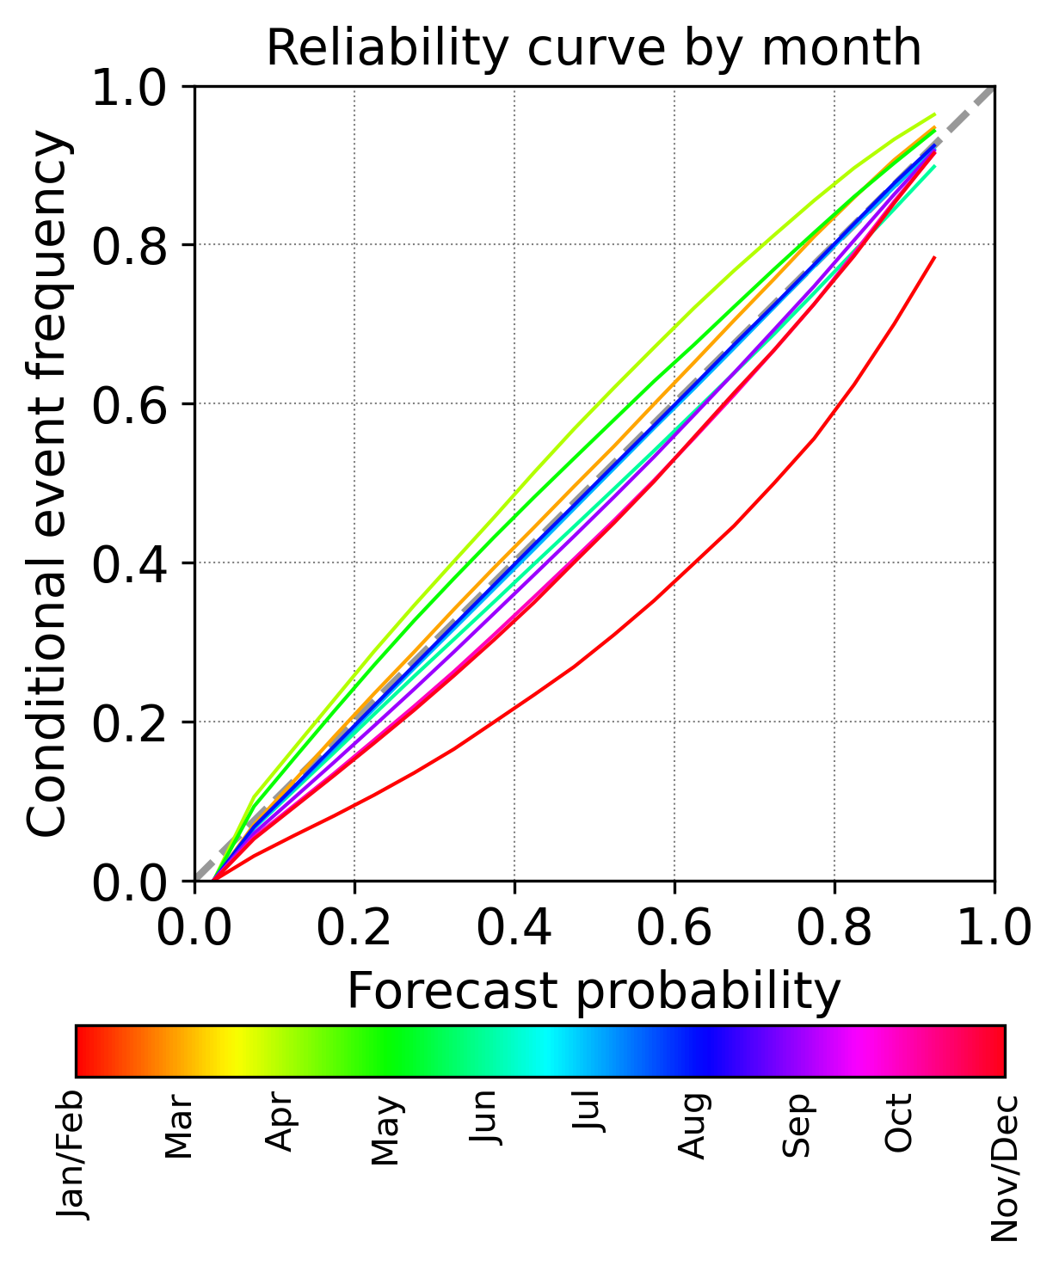
New features at 2024 HWT
P(≥ 10 fl in 60 min)
Notes:
Still very good calibration. This is for ALL predictions (“initiation” and persistence/advection)

Slide 20
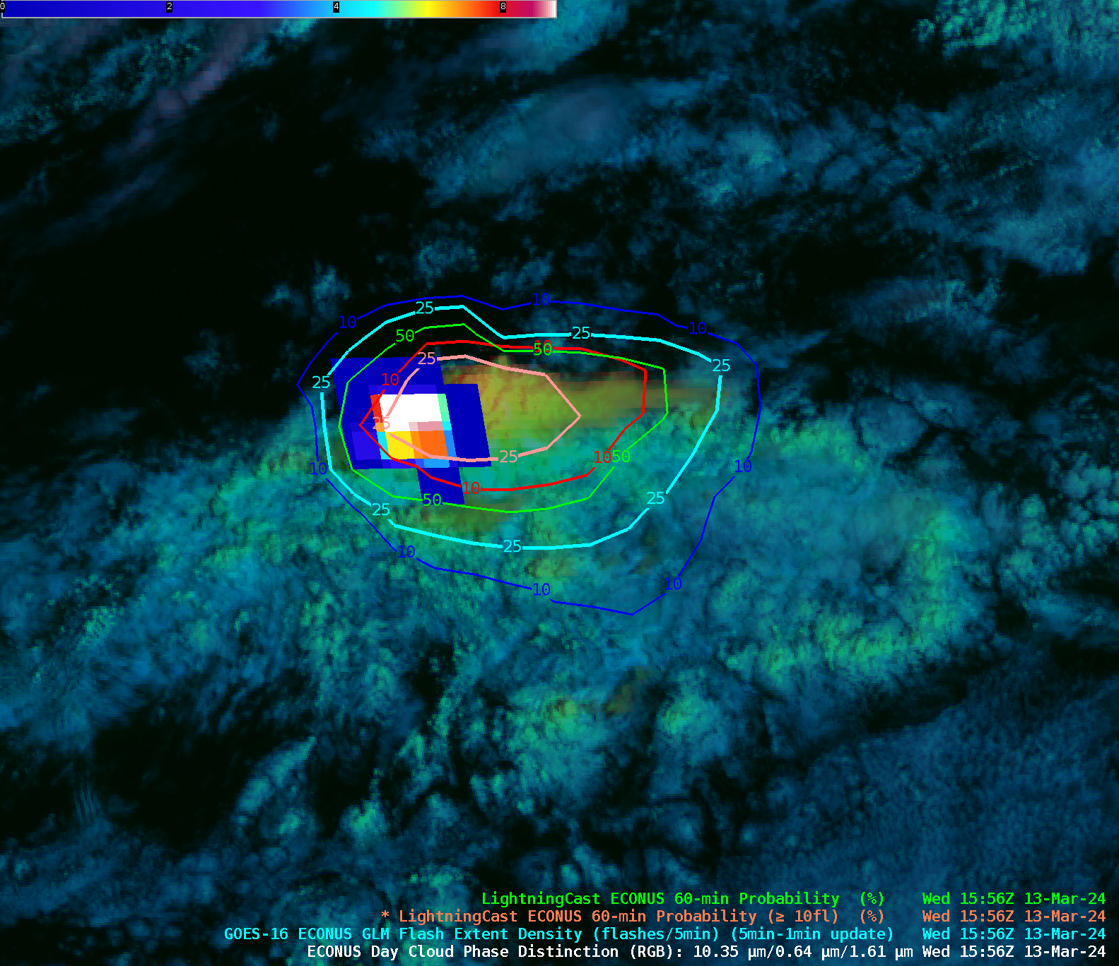
GLM Flash-extent density
4
10
Default contour colormaps
P(≥ 1 flash)
P(≥ 10 flashes)
10%
25%
50%
10%
25%

Slide 21
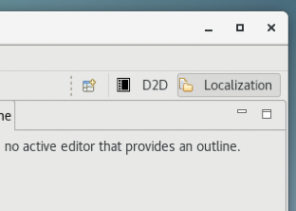
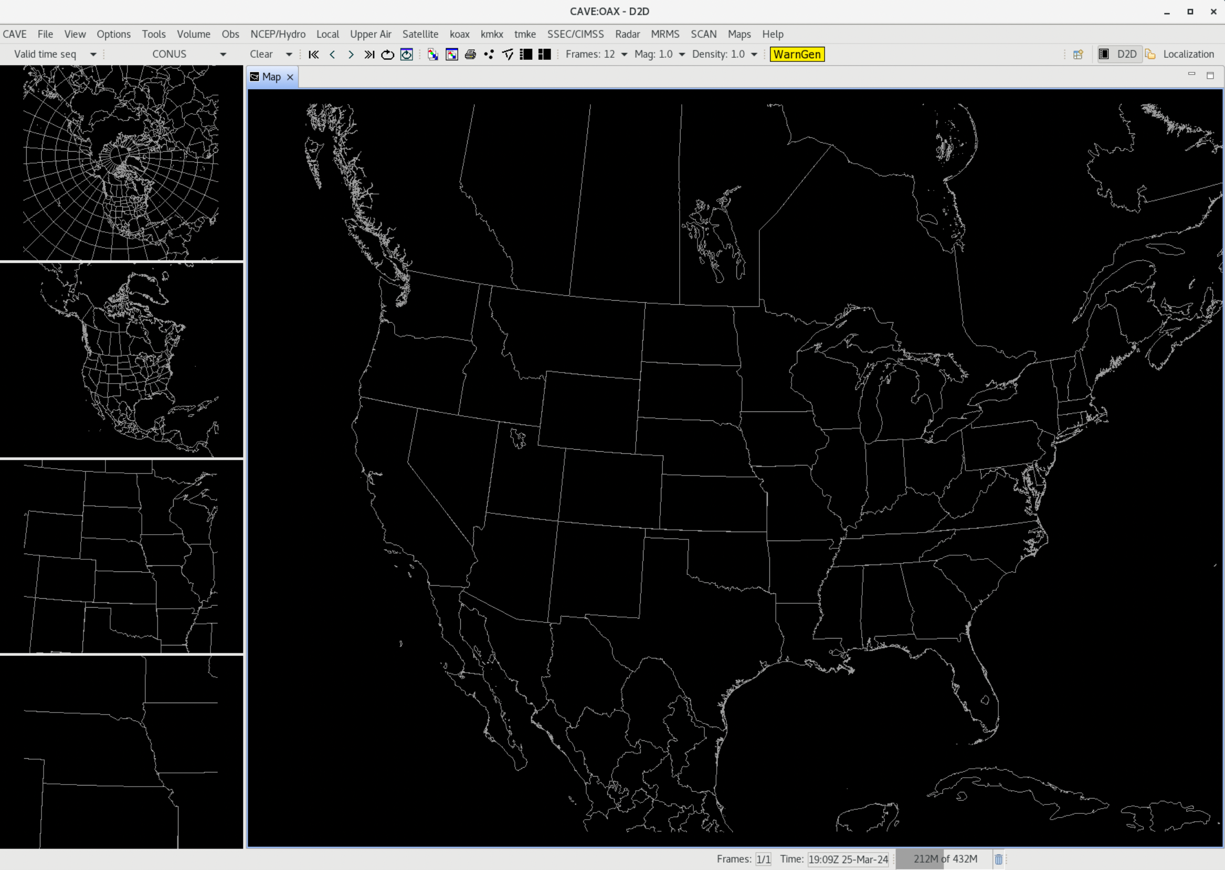
LightningCast contours are easily configurable…
Click on “Localization” pane
This info also available at:: https://tinyurl.com/lightningcast-in-awips

Slide 22
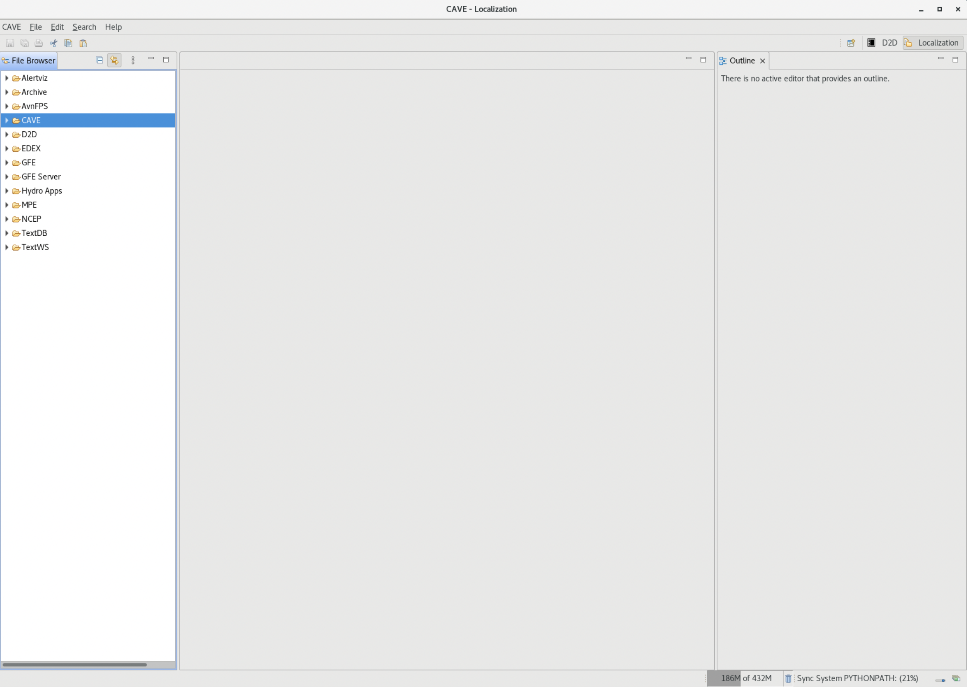
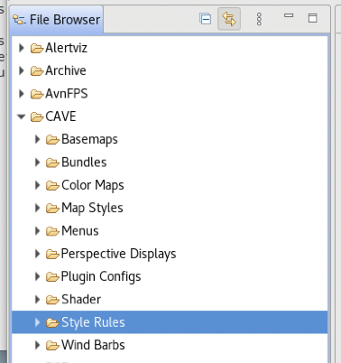
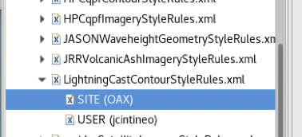
LightningCast contours are easily configurable…
Expand this menu, then find and open the LightningCastContourStyleRules.xml menu. Select the USER file. If it doesn’t exist, right click on the SITE file and select “Copy To → User”. Then open the USER file.
Navigate to CAVE → Style Rules
This info also available at:: https://tinyurl.com/lightningcast-in-awips

Slide 23
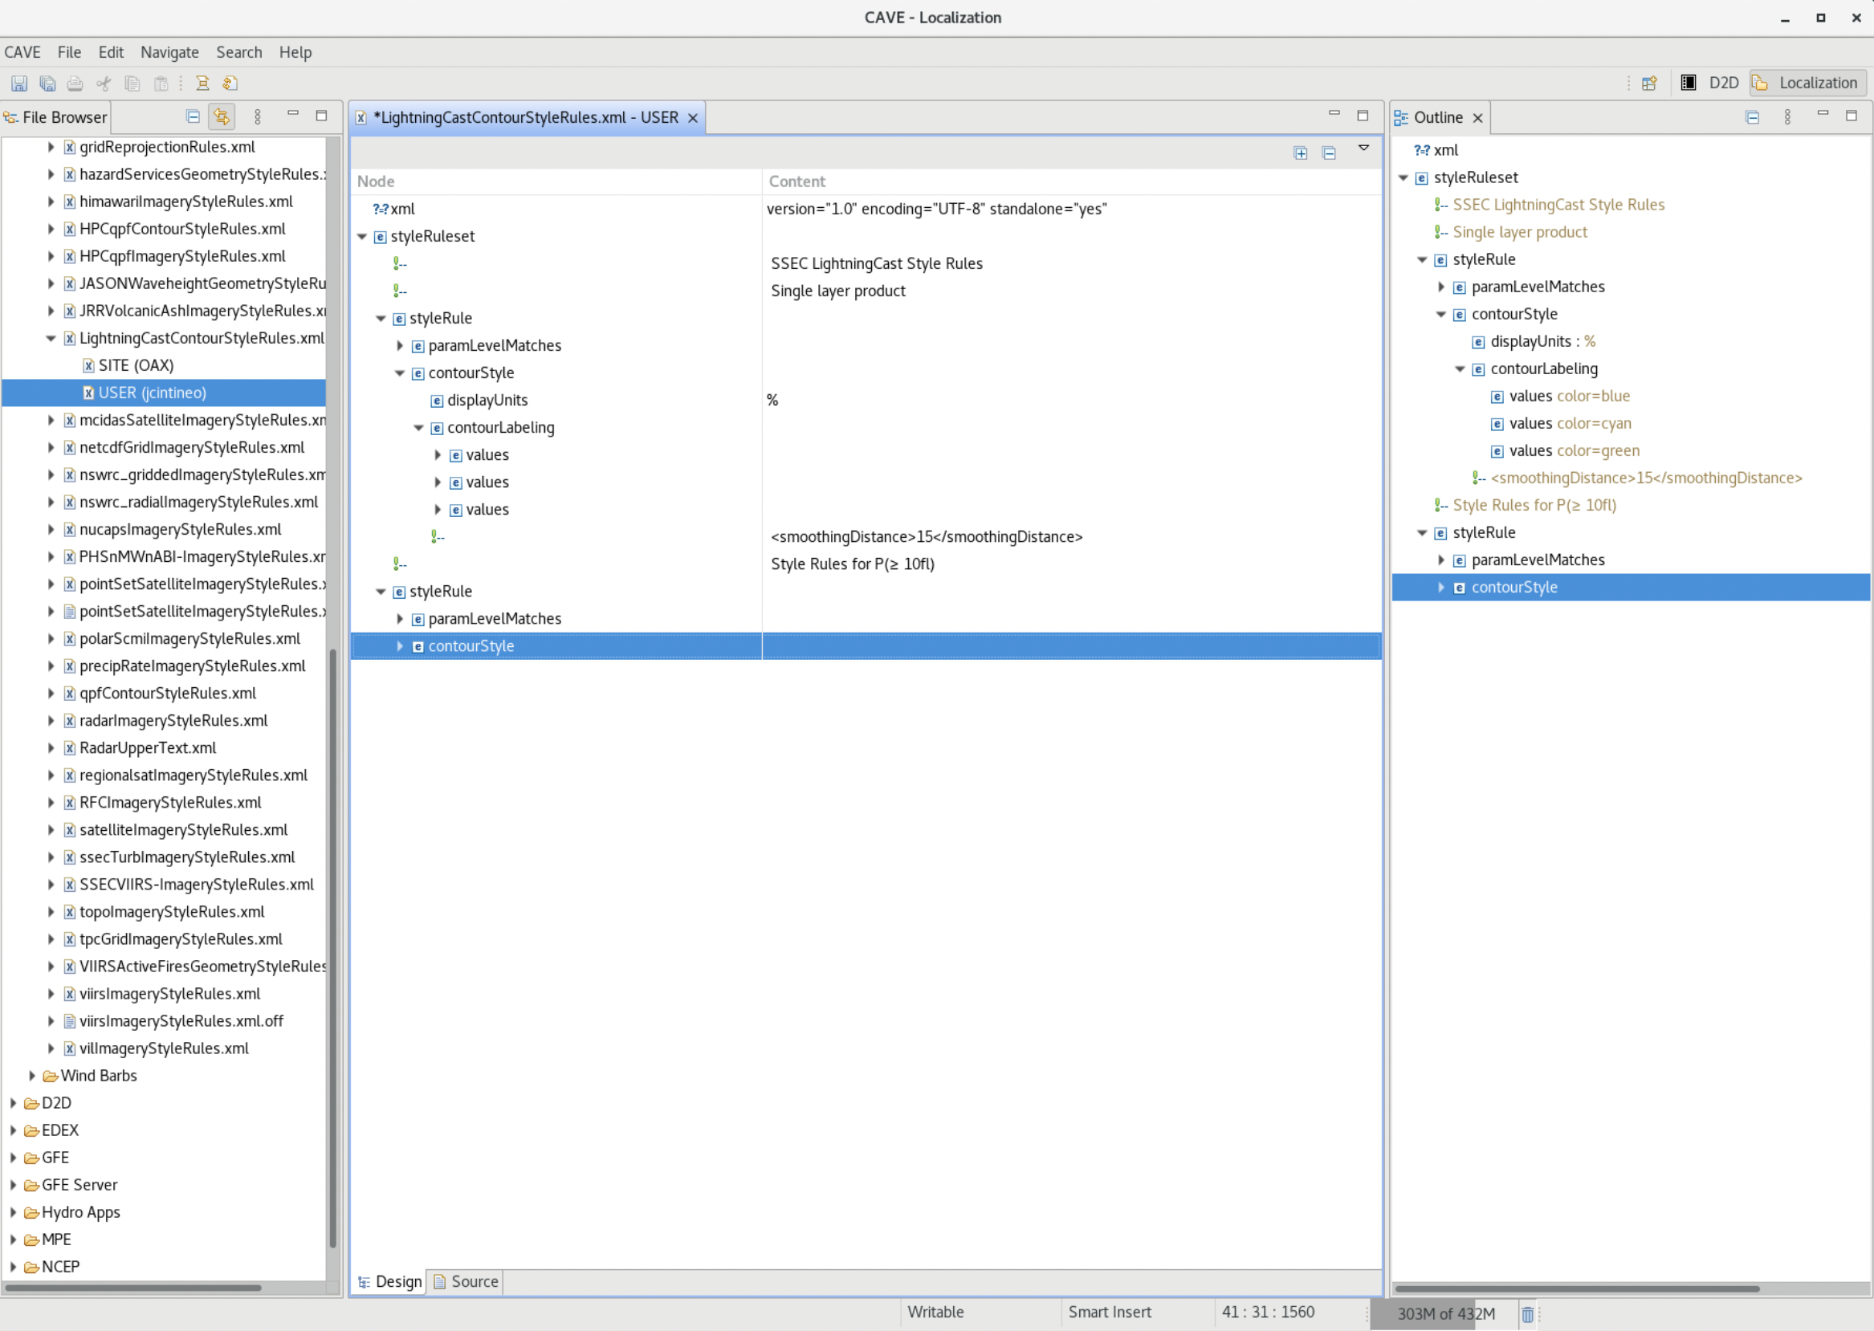
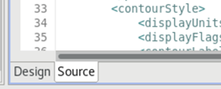
If not already selected, switch views to the Source tab located on the bottom of the window.

Slide 24
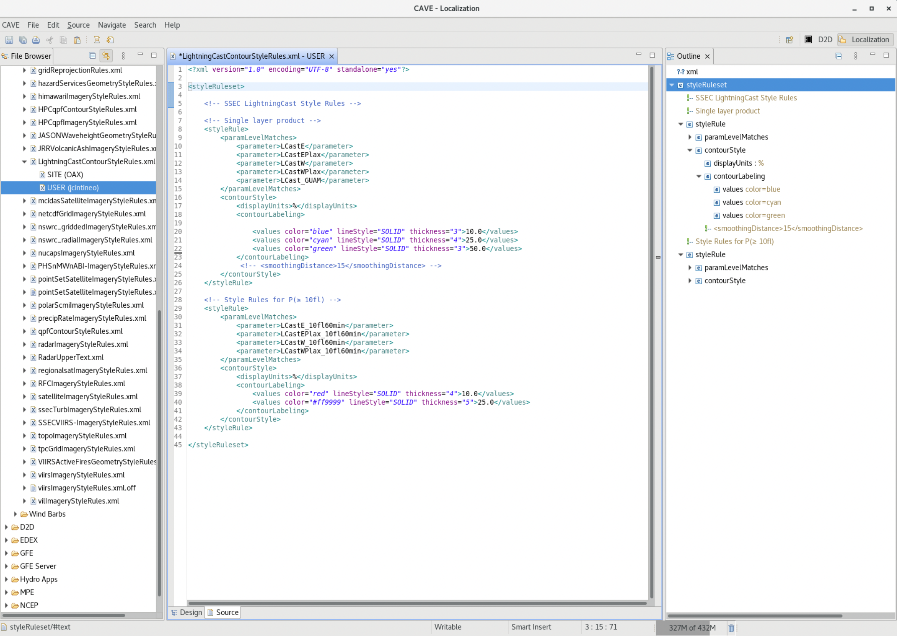
Top block is for P( ≥ 1 flash) product
Bottom block is for P( ≥ 10 flashes) product
This info also available at:: https://tinyurl.com/lightningcast-in-awips

Slide 25
You can change contour….
Color
Style
Thickness
Probability level
Make changes, save the file, then reload the LightningCast product(s) for changes to take effect.
This info also available at:: https://tinyurl.com/lightningcast-in-awips

Slide 26
ProbSevere LightningCast: Summary/Next Steps
Unique quantitative exploitation of GOES-R data: ~20-30 minutes of lead-time relative to first occurrence of GLM-detected lightning.
AI tools are not a replacement for human expert analysis, but they enable consistent, efficient, and timely decision-making.
LightningCast v1 is scheduled to be transitioned-to-operations at NESDIS by October 2024.
We want to hear ideas from the field regarding how to prioritize R+D and improve LightningCast products.
We’re interested in forecaster utility of the LightningCast dashboards
Notes:
-Unique exploitation of GOES-R that provides 10-50 minutes of lead-time ahead of the first occurrence of lightning (~20-30 minutes is a typical lead-time); systematic and objective
-Does not replace human expert analysis for IDSS, but it may improve efficiency, lead-time, and enable a great focus on hazard communication (uniquely human)
-Now that a sufficiently mature and proven model has been deployed, user feedback will dictate further development of the model, user interfaces, and dissemination mechanisms

Slide 27
Questions?
john.cintineo@noaa.gov
michael.pavolonis@noaa.gov
justin.sieglaff@ssec.wisc.edu
scott.lindstrom@noaa.gov

