Slide 1
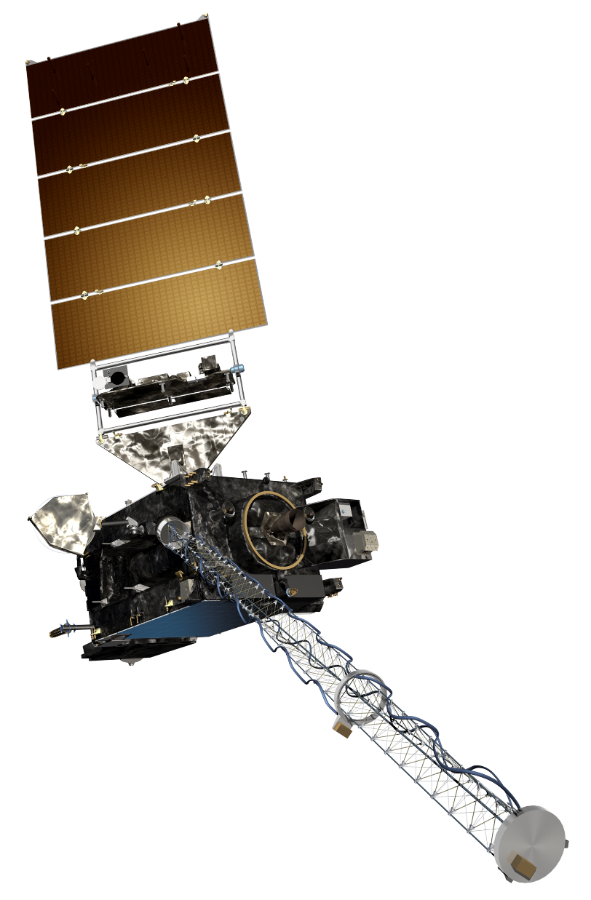
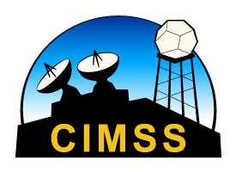
GOES-R Short Course
RGBs – Composite Imagery with Red, Blue and Green Components
Scott Lindstrom
CIMSS/SSEC/UW-Madison
CMOS/IUGG, Montreal Canada
8 July 2019

Slide 2
Thanks!
Thanks are due to:
Tim Schmit
Jordan Gerth

Slide 3
Omnibus suggestion:
If you want satellite data or products for your broadcasts or research or other offerings, if it could improve your forecasting or your presentation of knowledge about the atmosphere to the public, or even if you just think it could be helpful but aren’t quite sure how just yet, please:
Ask for it!
Ask the NWS, your vendors, your university for it. Much satellite data sits on hard drives in data centers providing lovely opportunities for students to do case studies years after the events have unfolded. Additionally, unless people ask for them, the next series of satellites won’t have new capabilities. Such was the case with true color imaging for GOES-R…

Slide 4
Difficulty in Interpreting RGB: Your Eyes and your Brain!
Are these Easter Eggs the same color?
Are these Easter Eggs the same color?
Are these Easter Eggs the same color?
Are these Easter Eggs the same color?
Source

Slide 5
Difficulty in Interpreting RGB: Your Eyes and your Brain!
These spheres are also the same color!
Source

Slide 6
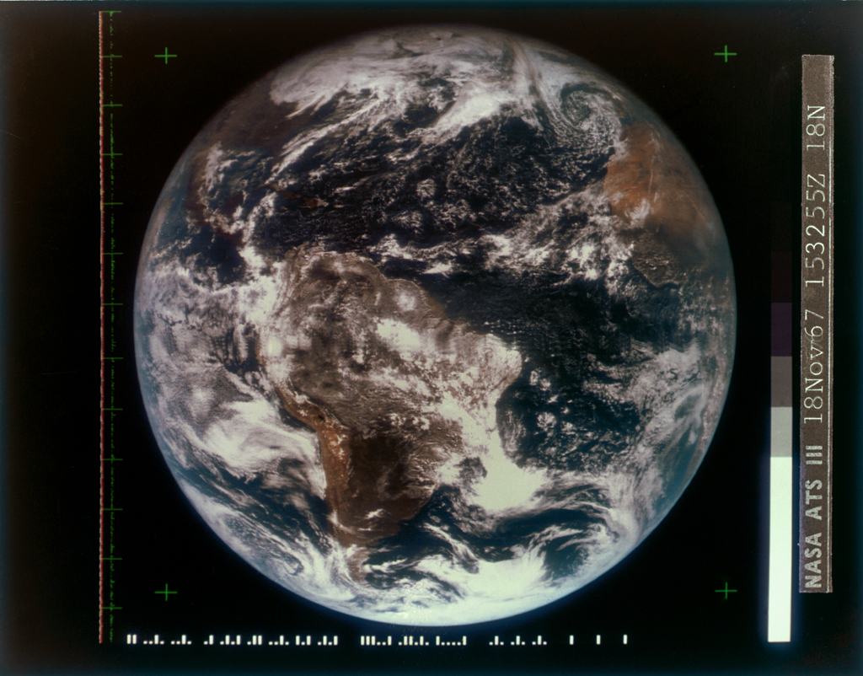
More than just a pretty picture
Some RGBs are useful: they are intuitive and require little training at all –
like True color imagery. This is an ATS-III image from 18 Nov 1967.

Slide 7
RGB Requirements
You need to know how colors are combined on a computer in order to interpret the RGB images that you see on the screen.
Base Colors: Red, Green, Blue
How is Yellow Made?
How is Orange Made? Subtract off Green from yellow
How is Brown Made? Subtract Green from orange, subtract some red, add blue
How is Cyan Made?
How is Magenta Made?
subtle changes in colors are hard to see!
1, 0.3, 0.8
1, 0.3, 1
1, 0, 1

Slide 8
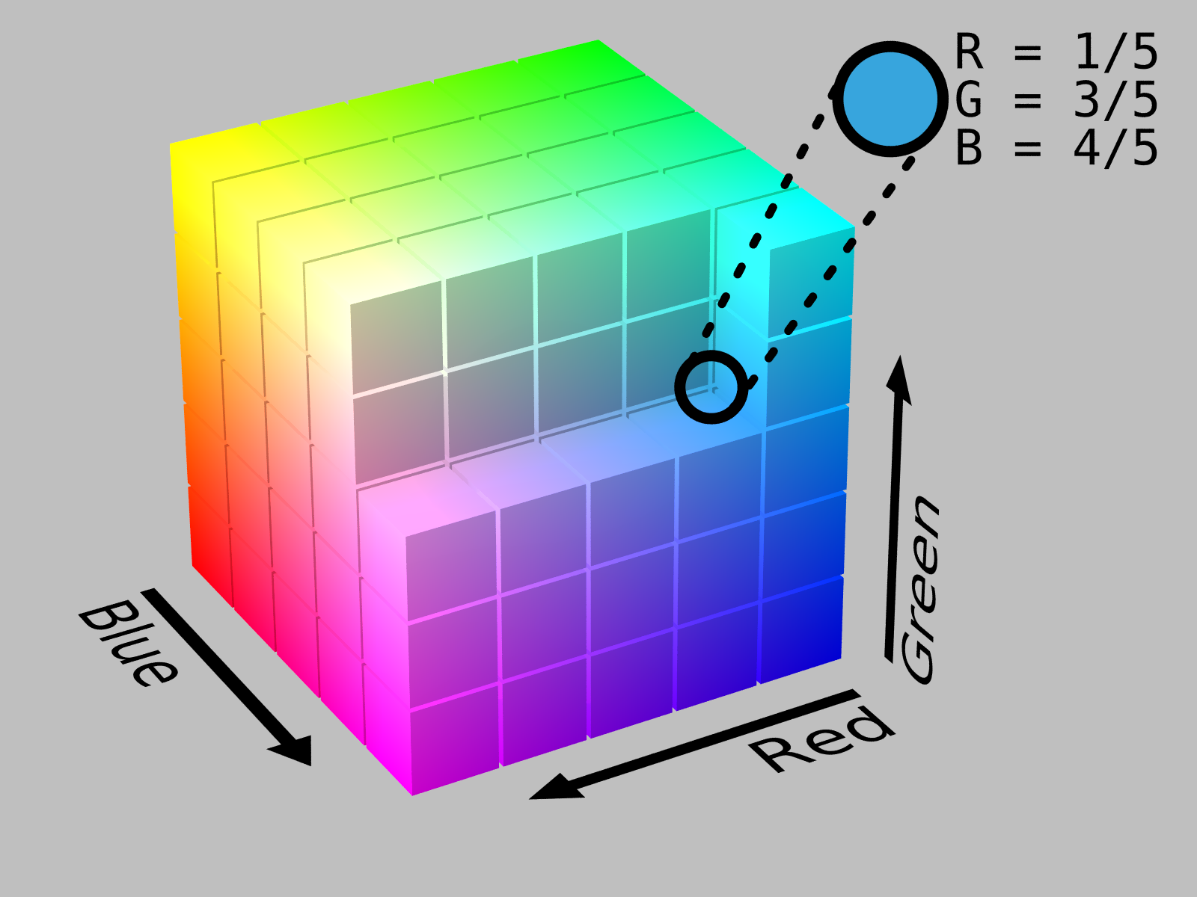
Color Cubes
http://www.data.jma.go.jp/mscweb/en/VRL/VLab_RGB/RGBimage.html
This is the JMA RGB Training Link (Himawari-heavy)

Slide 9
RGBs have well-known definitions
Day Cloud Phase Distinction
Red: 10.3 μm; Green: 0.64 μm; Blue: 1.61 μm
Day Land Cloud RGB (formerly known in the USA as Natural Color)
Red: 1.6 μm ; Green: 0.86 μm ; Blue: 0.64 μm
These are daytime only – they include visible imagery
US National Weather Service RGB Definitions here

Slide 10
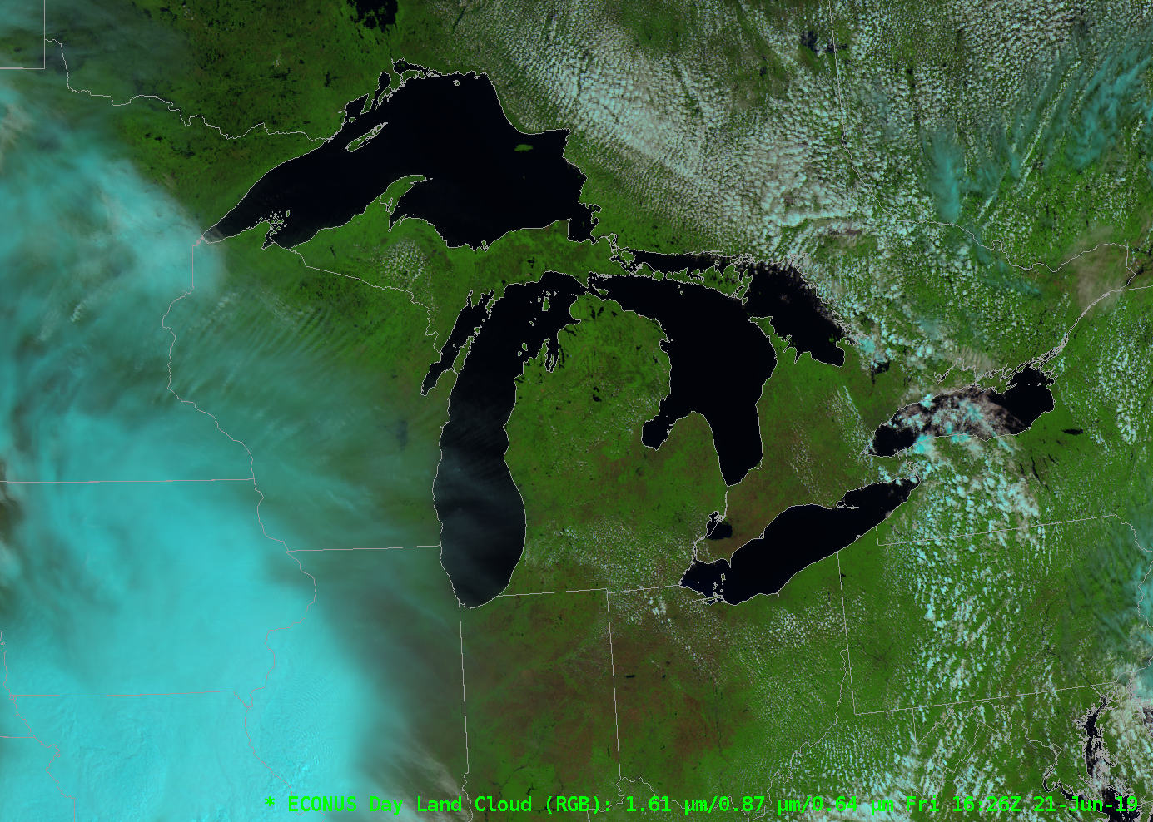
RGBs have well-known looks
Day Cloud Phase Distinction
Day Land Cloud

Slide 11
You can make RGBs online
Link with near real-time data
http://cimss.ssec.wisc.edu/goes/webapps/satrgb/overview_near_realtime.html

Slide 12
Choose a domain
Choose the Red, Green and Blue Components, with scale, gamma, and inversion if you want.
Note: No Channel Differences!

Slide 13
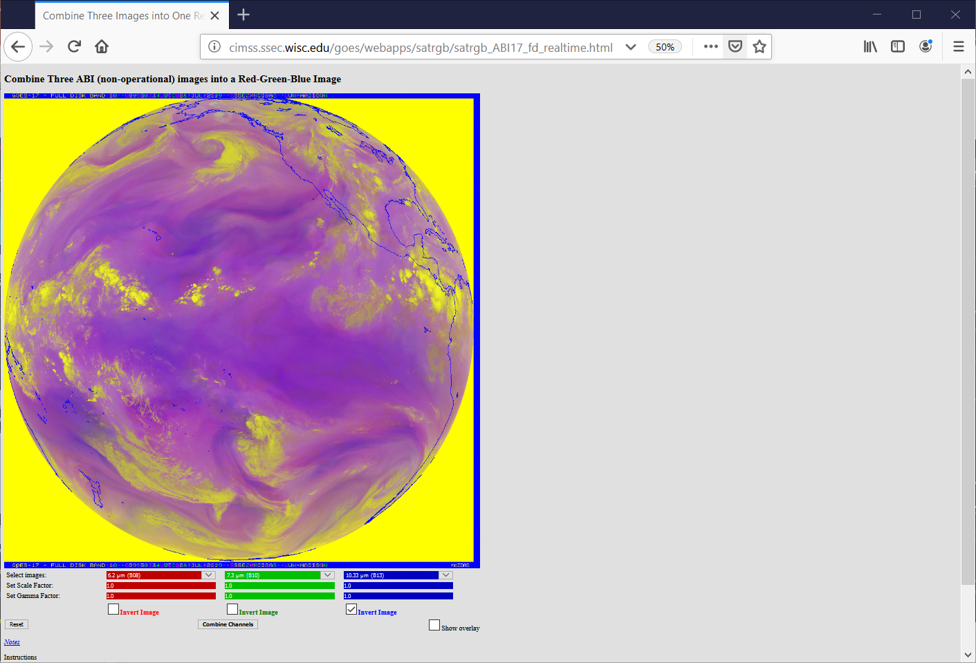
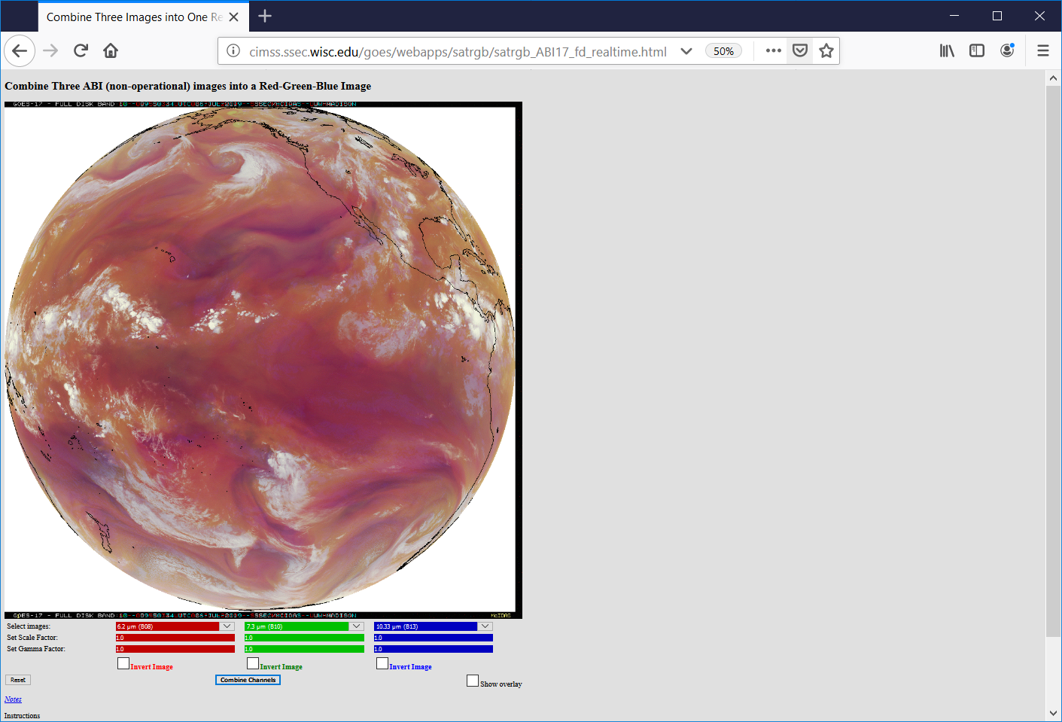
Choose Bands, hit ‘Combine Channels’

Slide 14
Are there platforms that let you experiment with RGBs?
Yes! SIFT – the Satellite Information Familiarization Tool has an RGB creation feature that is great fun to play with!
AND: It supports Channel Differences!
http://sift.ssec.wisc.edu

Slide 15
SIFT Front Page

Slide 16
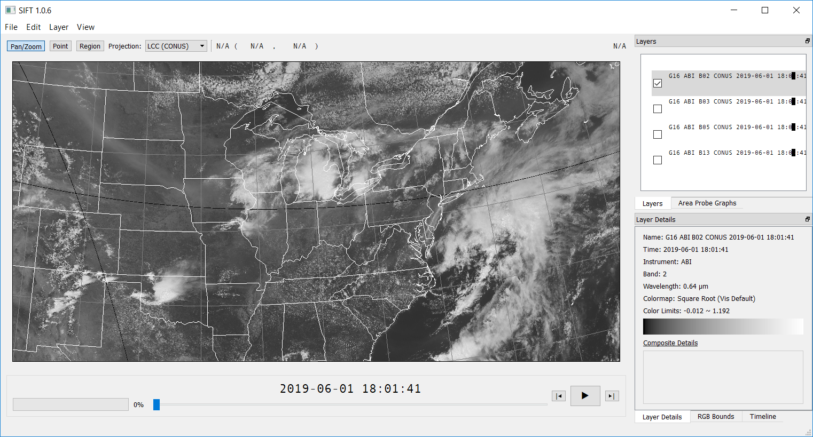
Load up imagery from NOAA CLASS

Slide 17
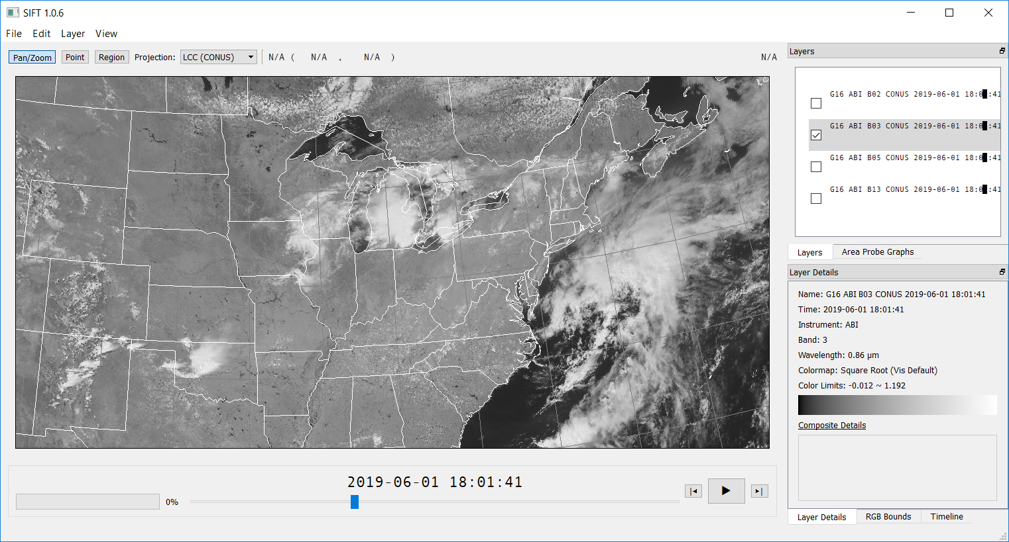
Load up imagery from NOAA CLASS

Slide 18
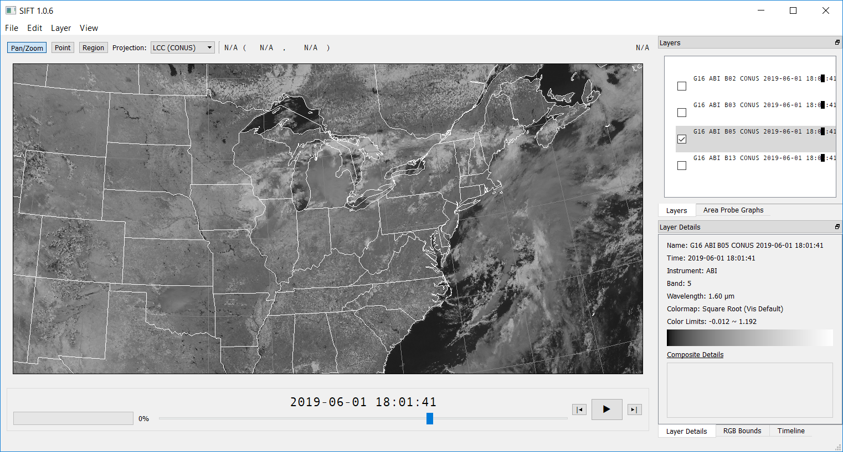
Load up imagery from NOAA CLASS

Slide 19
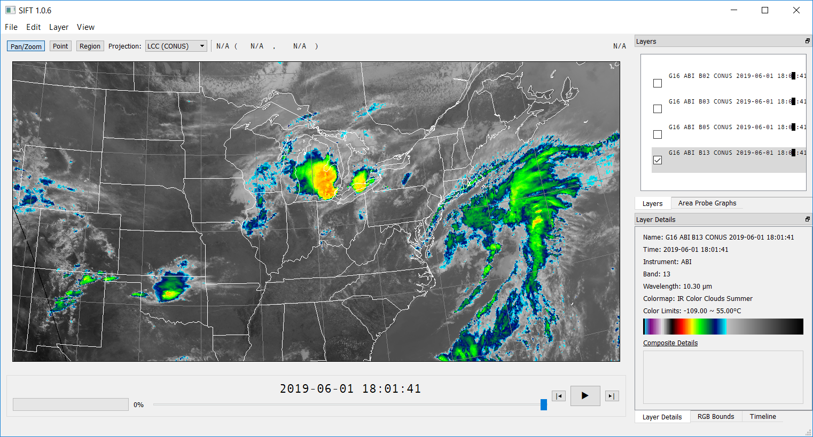
Load up imagery from NOAA CLASS

Slide 20
Start making an RGB

Slide 21
Start making an RGB

Slide 22
Start making an RGB

Slide 23
Start making an RGB
Using the NWS definition for Day Cloud Phase Distinction RGB

Slide 24
Start making an RGB
Using the NWS definition for Day Land Cloud RGB

Slide 25
What is Gamma in an RGB?
Gamma influences which part of the range is emphasized.
Gamma=1, then all parts of the range are emphasized equally.
Gamma < 1, then the lower part of the range is emphasized
Gamma > 1, then the higher part of the range is emphasized

Slide 26
What is Gamma in an RGB?
1
Much of the display range is used by the smaller values. Gamma < 1
Display Range
Gamma = 1
Much of the display range is used by the larger values. Gamma > 1
0
Low Value
High Value
Input Range

Slide 27
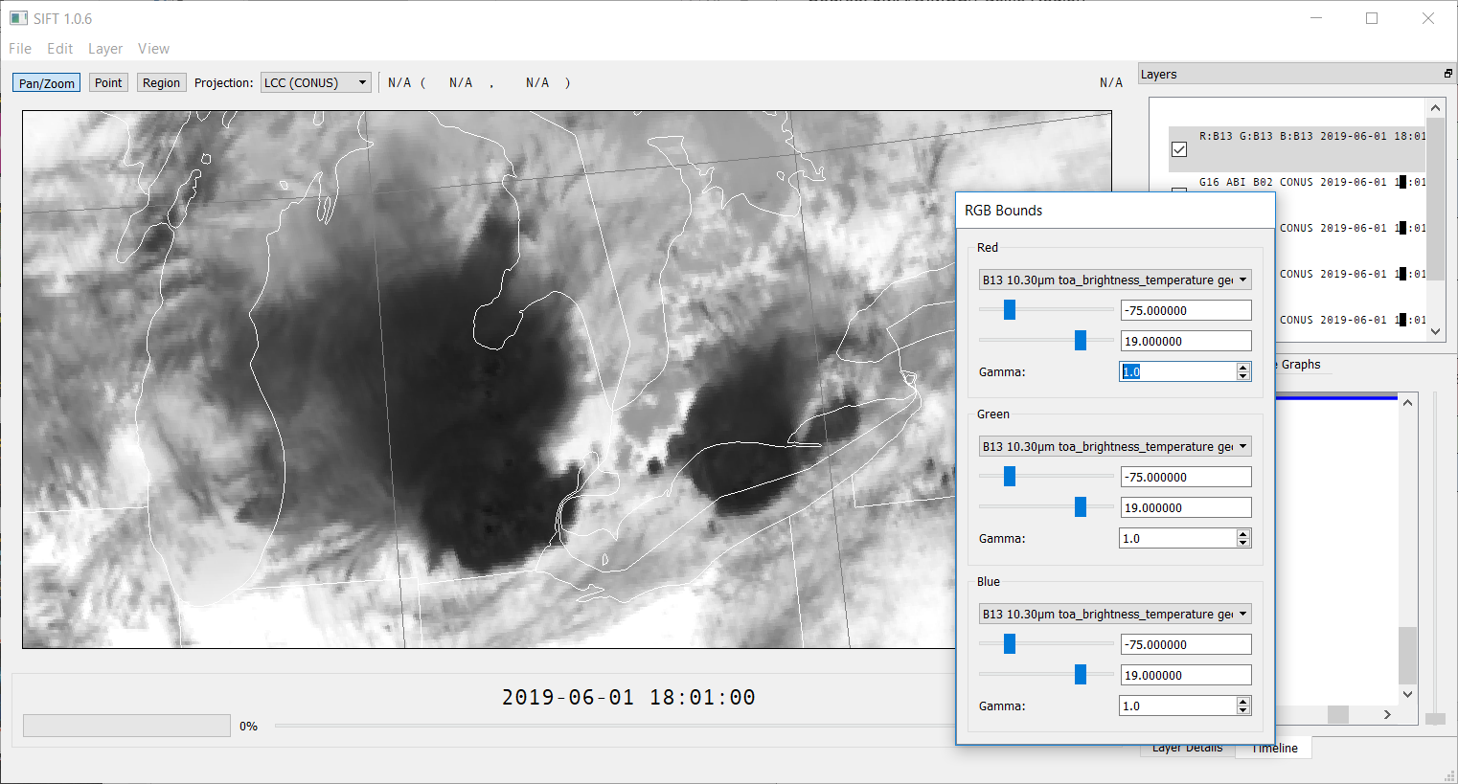
Gamma = 1

Slide 28
Gamma Examples

Slide 29
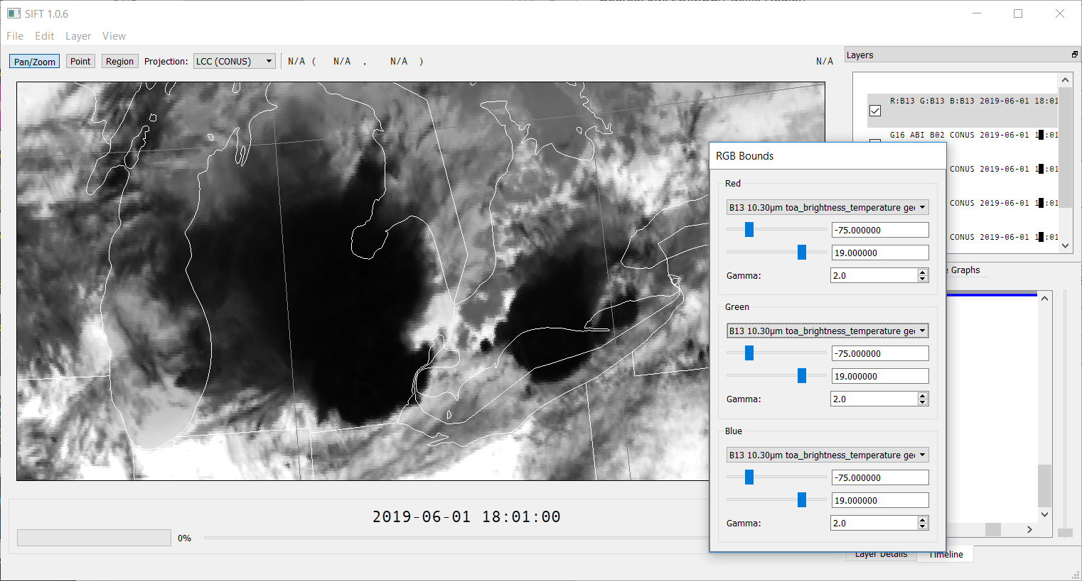
Gamma =2

Slide 30
If you want to make your own RGB…
Consider what you’re trying to highlight, and what you know about radiation and how it behaves in the atmosphere (The table below is incomplete!)
1.6 μm helps highlight snow and ice | 10.3 – 3.9 views highlights stratus at night
1.38 highlights cirrus clouds | 10.3 – 12.3 highlights moisture and/or dust and/or contrails
Veggie Band highlights land/water contrasts | 11.2 – 8.4 highlights dust and clouds
.47 is most sensitive to aerosols and scattering | 13.3 emphasizes upper tropospheric features
.86 and 1.61 mean highly reflective surfaces | Water Vapor Channels don’t show surface features
3.9, 2.2, 1.6 describe fires | Water Vapor Difference fields indicate the depth of features
Change the range of window channels to view upper level or low-level features | 7.3 and 8.4 have SO2 absorption
What allows you to view smoke? | 10.3 – 3.9 will indicate ice crystal size (daytime)
Training on what the different window channels allow

Slide 31
Create an RGB that’s great for cirrus detection
Daytime
There is a Cirrus Channel (1.38 ) on GOES-R. Use it!
The Snow/Ice Channel (1.61) discriminates between ice clouds and clouds made of water droplets
Visible Imagery shows all clouds.
Split Window Difference highlights contrails and other cirrus forms.
Here is my recipe for that RGB r = refl_1_38um_nom g = refl_0_65um_nom b = refl_1_60um_nom flip_r = 0 flip_g = 0 flip_b = 0 gamma_fac_r = 1.5 gamma_fac_g = 1.0 gamma_fac_b = 1.0 r_range = [0,10.0] g_range = [0,100.0] b_range = [0,60.0] I can make an example for any image if you want to verify thanks and hope all is well, Andy

Slide 32
Create an RGB that’s great for cirrus detection
Red : 1.38 reflectance ( 0 to 0.10), Gamma 1.5
Green : 1.61 reflectance ( 0 to 1.00), Gamma 1.0
Blue: 0.64 reflectance ( 0 to 0.60) , Gamma 1.0

Slide 33
Load up the bands into SIFT and find the best combination
Here’s an example of what one forecaster is doing in Duluth to track smoke at night:
Look at True Color imagery at sunset
Find IR RGBs that match smoke patterns, see how the RGBs evolve at night
Compare RGB to smoke pattern at sunrise
(Link to recorded presentation)

Slide 34
GOES-16 Derived Products
ABI Baseline Products
Aerosol Detection (Including Smoke and Dust) Aerosol Optical Depth (AOD) Clear Sky Masks Cloud and Moisture Imagery Cloud Optical Depth Cloud Particle Size Distribution Cloud Top Height Cloud Top Phase Cloud Top Pressure Cloud Top Temperature Derived Motion Winds Derived Stability Indices Downward Shortwave Radiation: Surface Fire/Hot Spot Characterization Hurricane Intensity Estimation Land Surface Temperature (Skin) Legacy Vertical Moisture Profile Legacy Vertical Temperature Profile Radiances Rainfall Rate/QPE Reflected Shortwave Radiation: TOA Sea Surface Temperature (Skin) Snow Cover Total Precipitable Water Volcanic Ash: Detection and Height
ABI Future Capability Products
Absorbed Shortwave Radiation: Surface Aerosol Particle Size Aircraft Icing Threat Cloud Ice Water Path Cloud Layers/Heights Cloud Liquid Water Cloud Type Convective Initiation Currents Currents: Offshore Downward Longwave Radiation: Surface Enhanced "V" / Overshooting Top Detection Flood/Standing Water Ice Cover Low Cloud and Fog Ozone Total Probability of Rainfall Rainfall Potential Sea and Lake Ice: Age, Concentration, and Motion Snow Depth (Over Plains) SO2 Detection Surface Albedo Surface Emissivity Tropopause Folding Turbulence Prediction Upward Longwave Radiation: Surface and TOA Vegetation Fraction: Green Vegetation Index Visibility
Why not include Level 2 products – or model data – in your RGB?
Notes:
Products in red are featured

Slide 35
KISS
Keep RGB simple (ish)
You want to be able to understand why a particular feature is the color it shows
That’s harder and harder to do if you have multiple channel differences in the definition

Slide 36
Thank You!
My Contact Information
Scott.Lindstrom@ssec.wisc.edu
Scott.Lindstrom@noaa.gov
608 263 4425

