Slide 1
Training Activities at the Cooperative Institute for Meteorological Satellite Studies (CIMSS)
Scott S. Lindstrom, A. S. Bachmeier, W. Straka III, M. Gunshor, J. Nelson, C. C. Schmidt, L. Cronce, T. Schmit, M. Mooney, and K. Strabala

Slide 2
CIMSS-based information that needs training
There are products, and imagery
Tropical Website Products
MIMIC TPW, MIMIC-TC, ARCHER, . . .
IFR Probability, NOAA/CIMSS ProbSevere, VOLCAT. . .
Satellite Imagery from different sources
GEO, LEO, GRB, Direct Broadcast
There are ways to display products, and imagery
Geo2Grid, McIDAS-V, RealEarth, Polar2Grid
There are different groups needing training
National Weather Service forecasters
Students, Teachers, Professionals

Slide 3
VISIT Training
VISIT (Virtual Institute for Satellite Integration Training) Modules have been created/updated in the past year to meet COVID Work From Home demands.
A lot more individual training sessions
CIMSS Modules that have been created/updated in the past 18 months:
GOES-R Satellite Detection of Blowing Snow | Above-Anvil Cirrus Plumes
GOES-R Fog/Low Stratus detection IFR Probability | NOAA/CIMSS ProbSevere
Mesoscale Convective Vortices | NUCAPS Soundings
TROWAL Formation | GOES-17 Loop Heat Pipe and Predictive Calibration
For more information on VISIT (and SHyMet), please see presentation Friday 9:50 – 9:55
Link by Lindstrom, Bachmeier, Bikos, Szoke and Torres

Slide 4
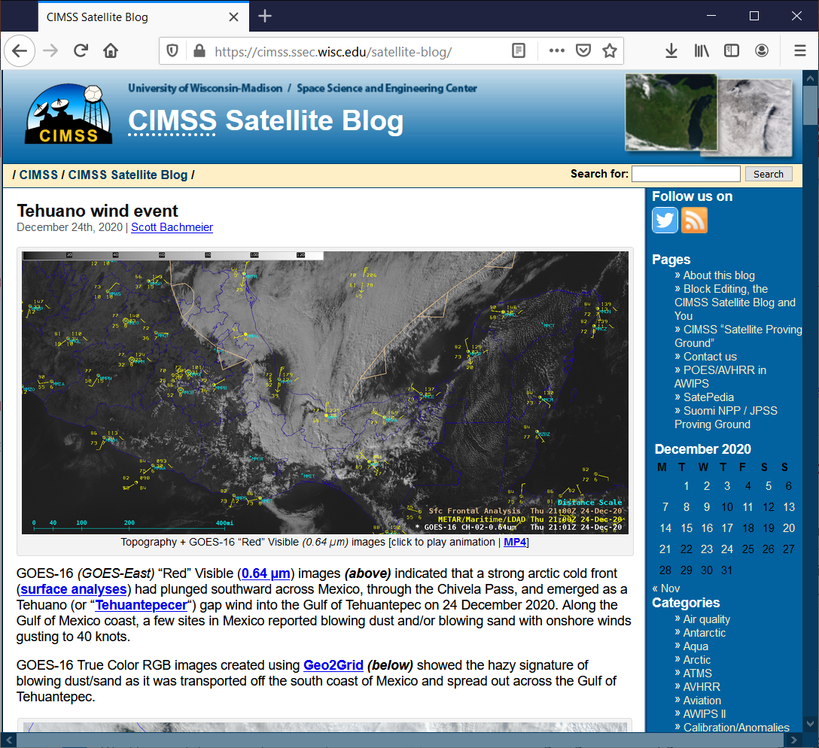
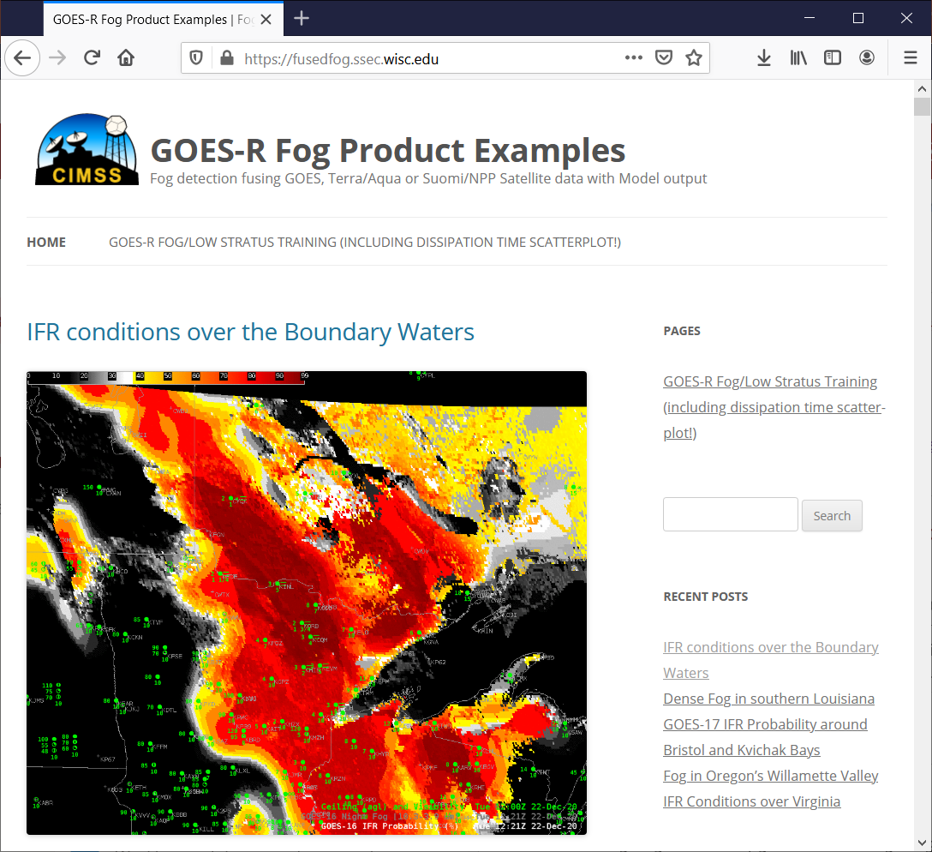
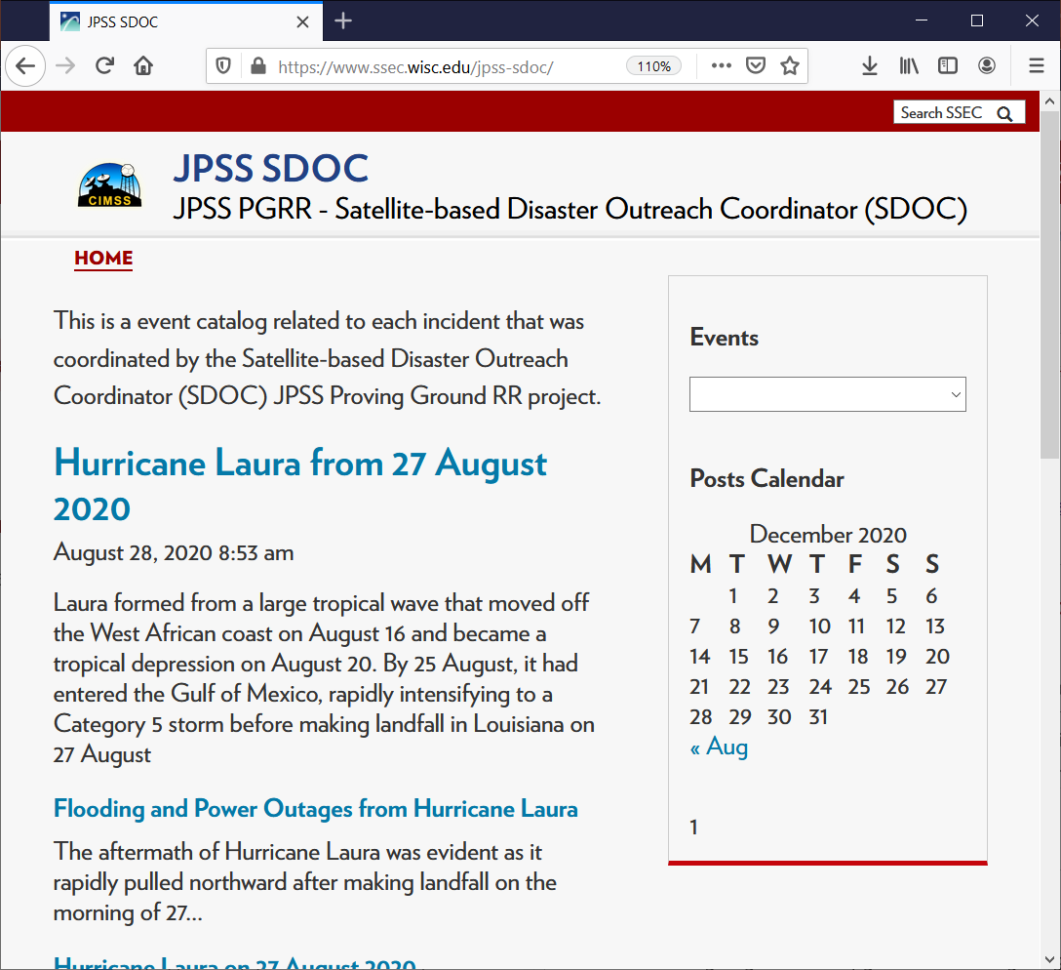
Blogs at CIMSS
CIMSS has many blogs
https://cimss.ssec.wisc.edu/satellite-blog
https://fusedfog.ssec.wisc.edu
https://www.ssec.wisc.edu/jpss-sdoc

Slide 5
In-Person training!
This was back in January, pre-COVID, but CIMSS scientists will travel to nearby WFOs to give satellite primers to new hires!

Slide 6
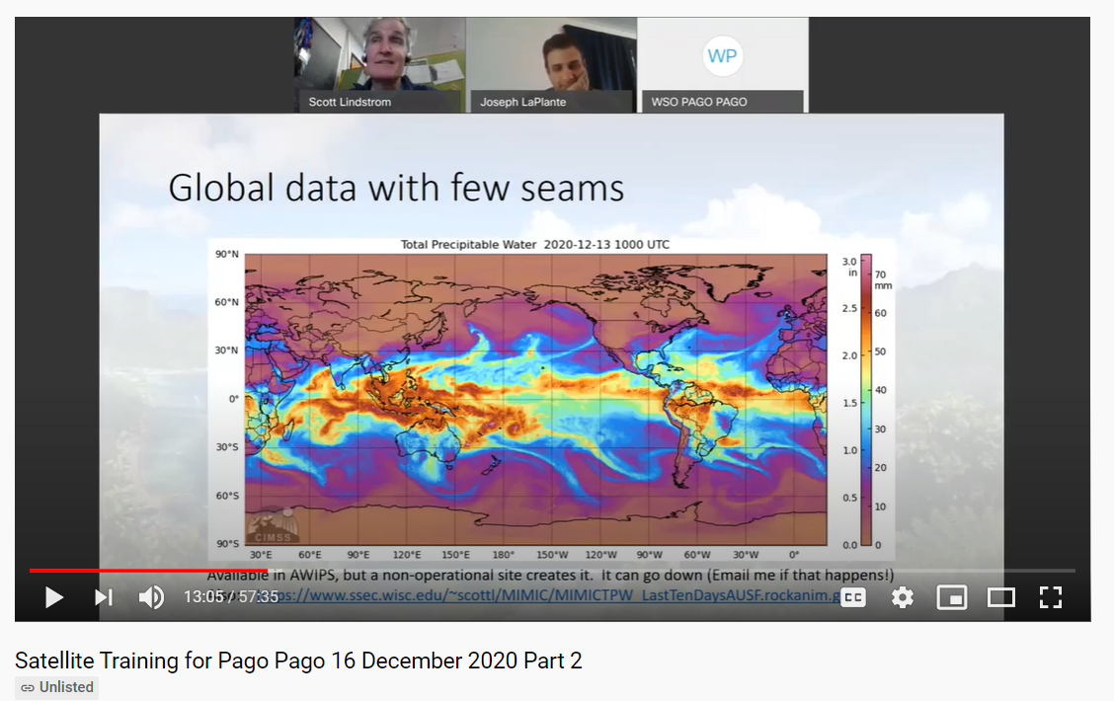
Remote Training
Set up for individual offices, recorded so midnight shift-ers can view
At left: Training to WSO Pago Pago (one forecaster at home) on MIMIC TPW product
How to make information stick?

Slide 7
Blog Post on MIMIC TPW
Send a link to this Blog Post on MIMIC
The Blog Post includes a link to a training video

Slide 8
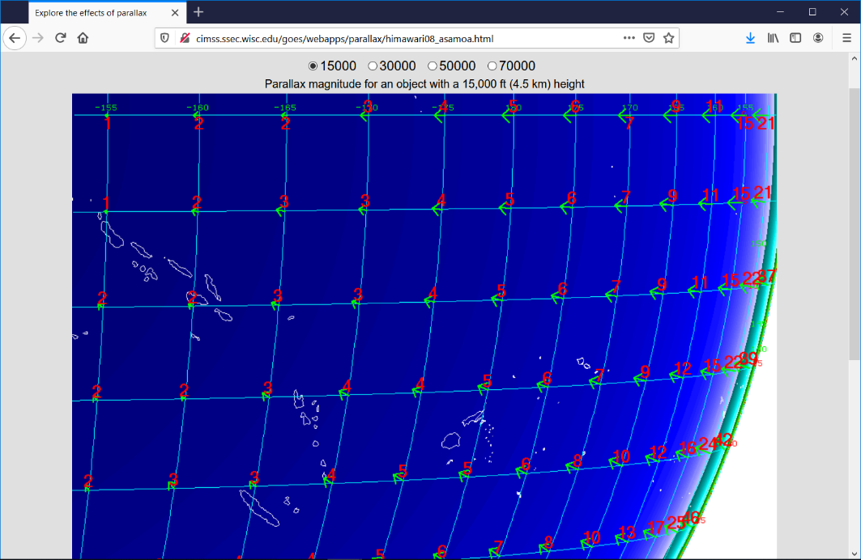
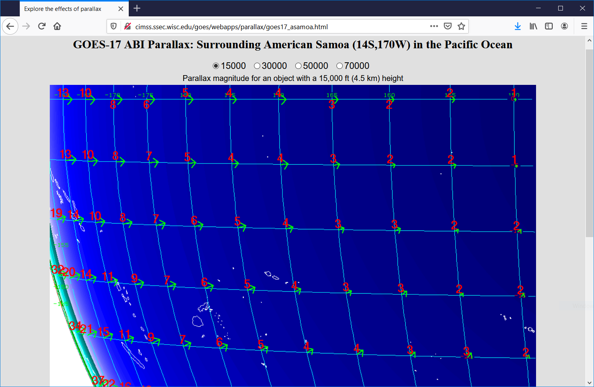
Also included in the training: Parallax Web Sites! http://cimss.ssec.wisc.edu/goes/webapps/parallax/himawari08_asamoa.html http://cimss.ssec.wisc.edu/goes/webapps/parallax/goes17_asamoa.html

Slide 9
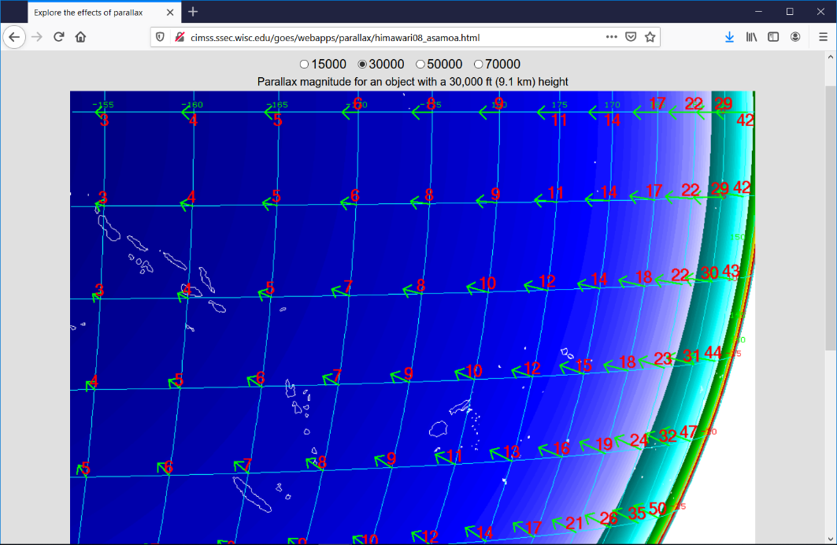
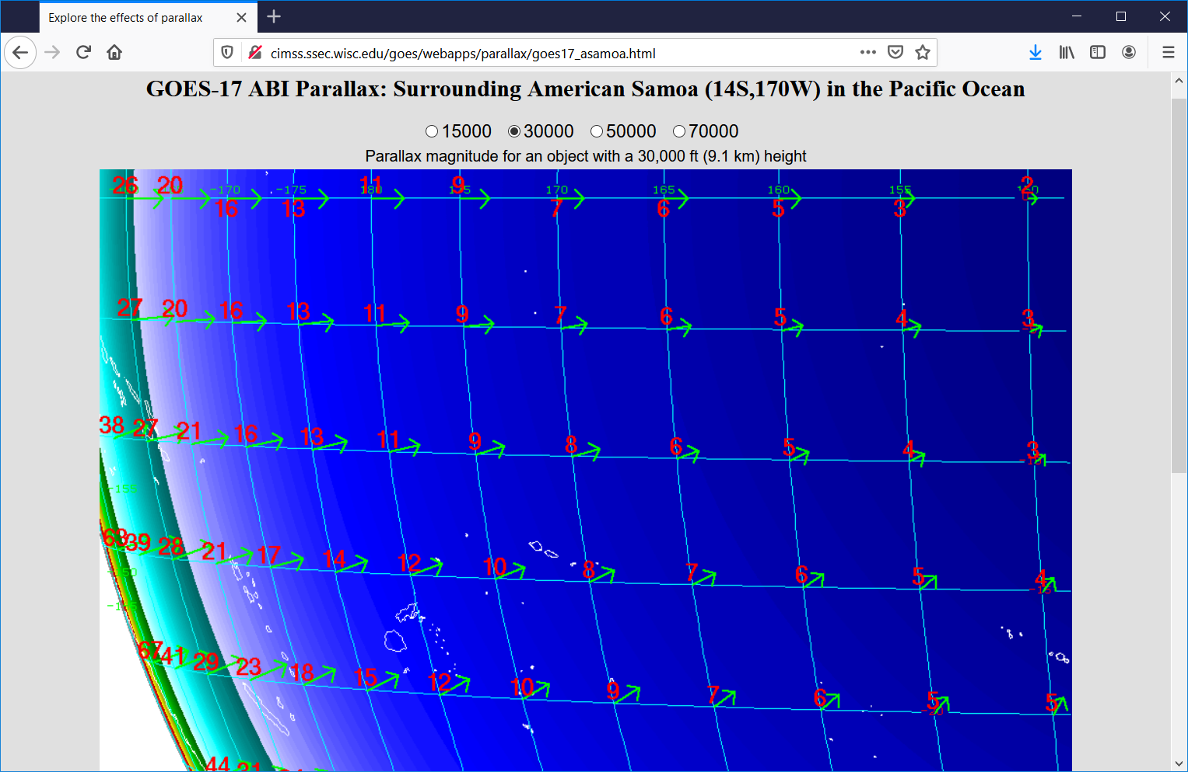
Also included in the training: Parallax Web Sites! http://cimss.ssec.wisc.edu/goes/webapps/parallax/himawari08_asamoa.html http://cimss.ssec.wisc.edu/goes/webapps/parallax/goes17_asamoa.html

Slide 10
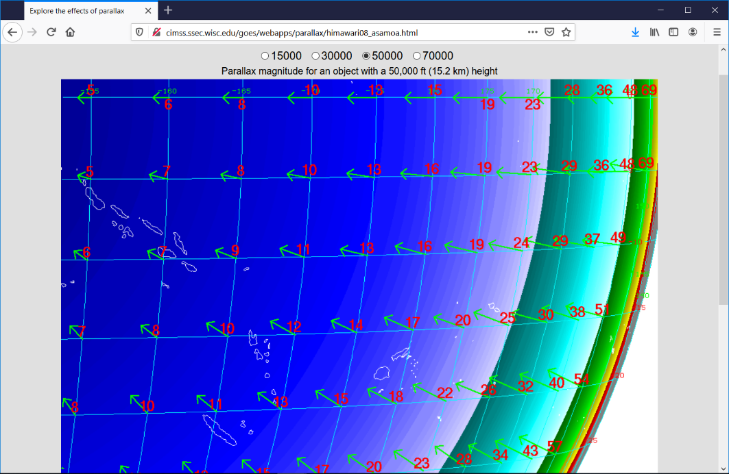
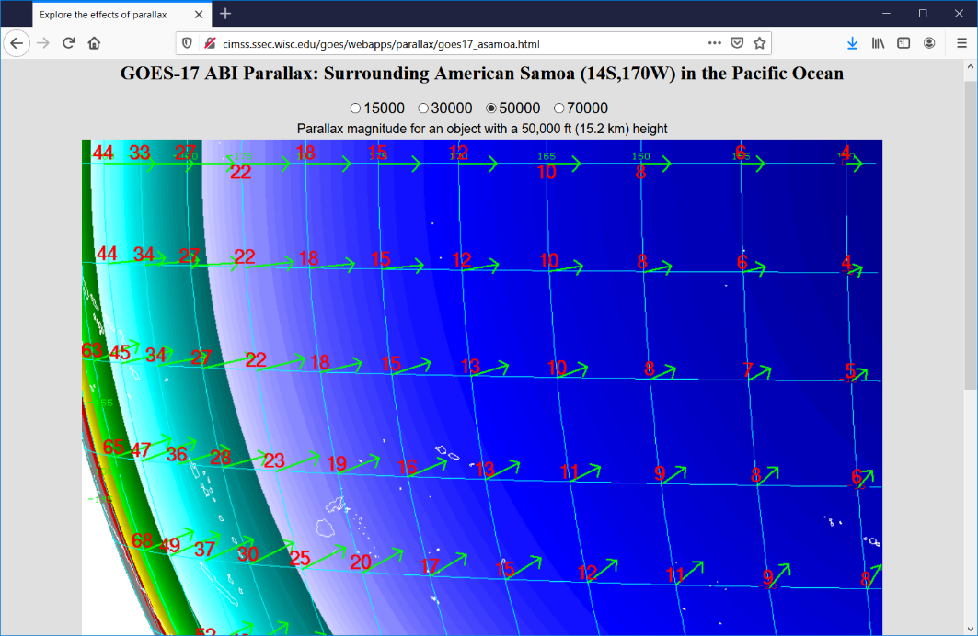
Also included in the training: Parallax Web Sites! http://cimss.ssec.wisc.edu/goes/webapps/parallax/himawari08_asamoa.html http://cimss.ssec.wisc.edu/goes/webapps/parallax/goes17_asamoa.html

Slide 11
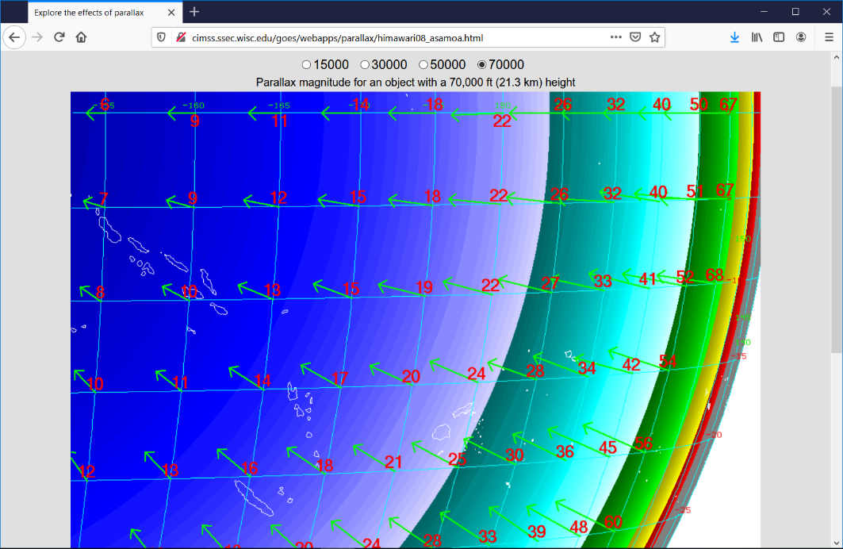
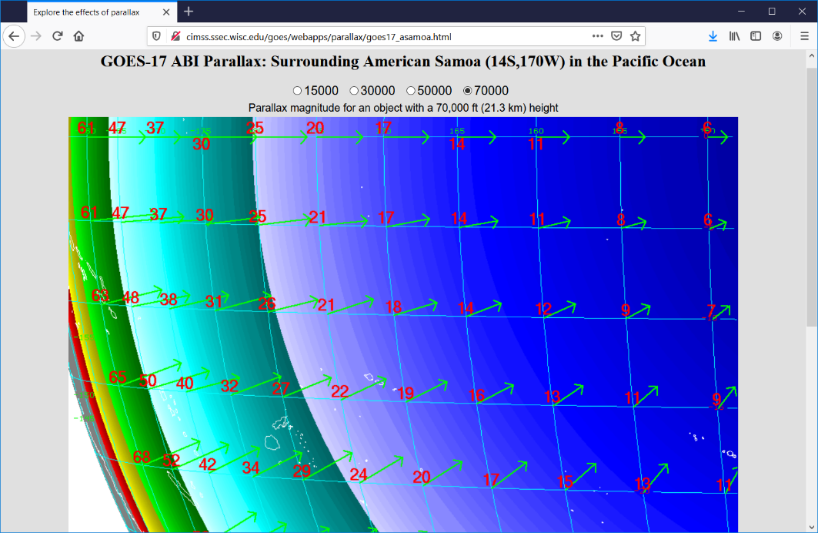
Also included in the training: Parallax Web Sites! http://cimss.ssec.wisc.edu/goes/webapps/parallax/himawari08_asamoa.html http://cimss.ssec.wisc.edu/goes/webapps/parallax/goes17_asamoa.html

Slide 12
Geo2Grid used to create imagery for RA-III/RA-IV training
Geo2Grid is a python-based SatPy-dependent series of shell scripts that access data, georeference it, color-enhance it (if necessary) and combine it (into RGBs, if requested)
CIMSS Blog Posts on how to use Geo2Grid (or Polar2Grid)
https://cimss.ssec.wisc.edu/satellite-blog/archives/37391 (How to apply enhancements)
This software was used to create single channel imagery and also custom RGBs as requested by trainers

Slide 13
Training is incorporated into some CIMSS websites
https://cimss.ssec.wisc.edu/goes/wf

Slide 14
Training is incorporated into some CIMSS websites
https://cimss.ssec.wisc.edu/goes/wf

Slide 15
Training is incorporated into some CIMSS websites
https://cimss.ssec.wisc.edu/goes/wf
Click for audio training

Slide 16
Training is incorporated into some CIMSS websites
https://cimss.ssec.wisc.edu/goes/wf
Click for audio training
Upgraded version coming in 2021!

Slide 17
ProbSevere
Fact sheet that includes links to training videos

Slide 18
VOLCAT
https://volcano.ssec.wisc.edu/
Includes training

Slide 19
Training on New Products

Slide 20
Training on New Products
Part of the GOES-R/JPSS
Short Course at AMS 2020

Slide 21
Training on New Products
Part of the GOES-R/JPSS
Short Course at AMS 2020

Slide 22
Training on New Products
Part of the GOES-R/JPSS
Short Course at AMS 2020
https://www.ssec.wisc.edu/flood-map-demo/flood-products/

Slide 23
Product website, with training information
https://www.ssec.wisc.edu/flood-map-demo/flood-products/

Slide 24
Product website, with training information
https://www.ssec.wisc.edu/flood-map-demo/flood-products/

Slide 25
Direct Broadcast Workshops
`
CIMSS has a Direct Broadcast satellite dish
CIMSS manages other satellite dishes (Guam, Puerto Rico, …
CIMSS has Direct Broadcast expertise
There are periodic Direct Broadcast Workshops, including one in February 2020 in Mexico City
(List of previous DB Seminars, 2006 – 2018)

Slide 26
DB Packages that need to be trained on!
CSPP Software Package Name | CSPP LEO Product Description
VIIRS ASCI | VIIRS imager aerosol optical depth, cloud properties, sea ice, and volcanic ash (NOAA algorithm).
VIIRS Active Fires | VIIRS imager active fires detection (NOAA algorithm).
VIIRS Flood Detection | VIIRS imager flood detection (NOAA algorithm).
CLAVR-x | Multispectral imager retrievals of cloud properties; aerosol optical depth; surface properties; ocean properties (NOAA algorithm).
ACSPO | Multispectral imager retrievals of sea surface temperature (NOAA algorithm).
Polar2grid | Reprojected imagery (single and multi-band) in GeoTIFF and AWIPS formats.
Hydra | Interactive visualization and interrogation of multispectral imagery and hyper spectral soundings.
Sounder Quicklook | Projected 2D maps of temperature and water vapor retrievals, and Skew-T profiles for individual atmospheric profiles.
`

Slide 27
Training for K-14
http://cimss.ssec.wisc.edu/education/goesr/vsf.html
Virtual Science Fair. Prize: GOES-T Launch Pass!

Slide 28
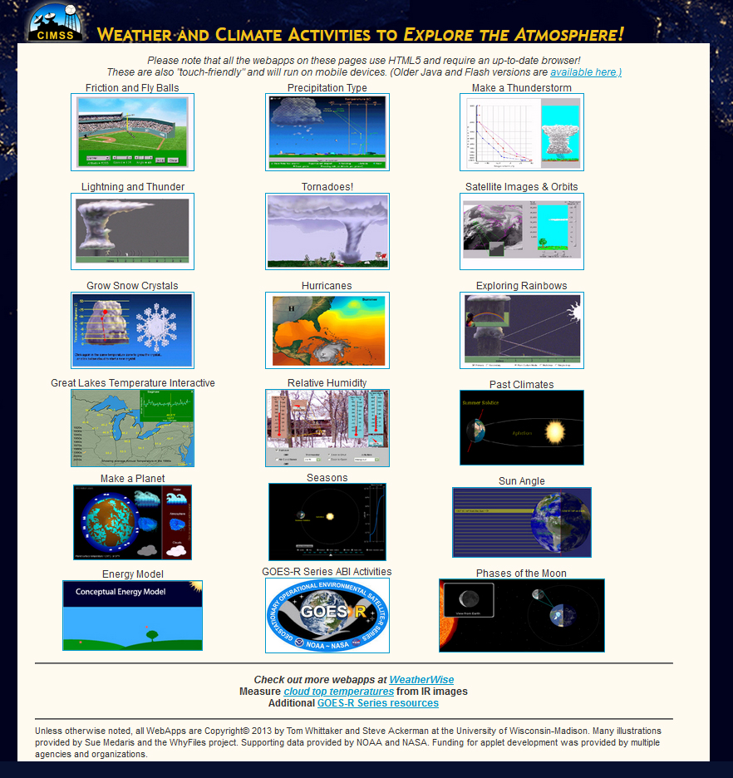
More K-14 Links
https://cimss.ssec.wisc.edu/wxfest/
https://cimss.ssec.wisc.edu/wxcamp
http://cimss.ssec.wisc.edu/education/goesr/intro.html

Slide 29
Contact Information
First Guess: firstname.lastname@ssec.wisc.edu
scott.lindstrom@ssec.wisc.edu (general training)
kathy.strabala@ssec.wisc.edu (Direct Broadcast)
margaret.mooney@ssec.wisc.edu (K-14, GOES-R for teachers)
chris.schmidt@ssec.wisc.edu (Fires)
william.straka@ssec.wisc.edu (JPSS and events)
tim.j.schmit@noaa.gov (All things GOES-R)
608 263 4425

