Slide 1
Using Polar2Grid to assist Training on Low Earth Orbit Satellites
Scott Lindstrom
University of Wisconsin-Madison (USA) Cooperative Institute for Meteorological Satellite Studies

Slide 2
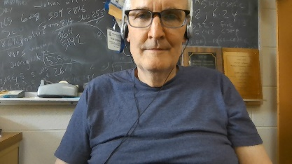
Your speaker
Scott Lindstrom
B.S. Meteorology (Penn State University)
B.S. Computer Science (Penn State University)
M.S. Meteorology (Univ. of Wisconsin-Madison)
PhD. Meteorology (Univ. of Wisconsin-Madison)
Traveled to Korea, Myanmar, Oman, Malaysia, American Samoa, Guam, all over the USA to talk about how Satellite Data can be used to aid forecasting.
Write about Satellite Meteorology at the CIMSS Satellite Blog
https://cimss.ssec.wisc.edu/satellite-blog/archives/author/scottl

Slide 3
Upcoming Meeting!!!
CSPP Users’ Meeting
1-3 April 2025
Hyatt Regency Hotel on Guam
Meeting Website
https://www.ssec.wisc.edu/meetings/cspp/2025-meeting/
Local usage and applications of CSPP LEO and CSPP Geo software such as
Fire detection; Monitoring and predicting severe weather events; Climate change research and analysis; Oceanography and marine ecosystem studies; Land surface and vegetation monitoring; Air quality and pollution tracking; NWP assimilation; Education and training; National security;
CSPP software overview and updates;
CSPP software technical topics, including related software packages (e.g., AAPP);
Status of current and future environmental satellite missions and sensors;
Technical innovations in algorithms, processing and distribution, including cloud processing, artificial intelligence, machine learning, containerization and very low latency solutions;
Feedback and guidance to the CSPP LEO/Geo development teams on current products and future priorities;
Satellite data analysis and visualization applications;
LEO and GEO ground stations and hardware;
General issues affecting the direct broadcast community.
Presentations related to other satellite missions are also welcome.

Slide 4
Low Earth Orbit Satellites offer infrared and microwave data to help a forecaster assess the atmosphere
Data are available online, from the ‘cloud’ – something like Amazon Web Services (USA Satellites)
https://noaa-nesdis-snpp-pds.s3.amazonaws.com/index.html
https://noaa-nesdis-n20-pds.s3.amazonaws.com/index.html
https://noaa-nesdis-n21-pds.s3.amazonaws.com/index.html
JAXA supplies data from their website (GCOM-W1)
Currently under maintenance until March
Both JAXA and NOAA data can be used to create imagery with accessible software

Slide 5
Training Requires Imagery!
That imagery might have to be created if you don’t gather it in real time
Many sources of Low-Earth-Orbit (LEO) satellite data products are transitory – they won’t be around for more than a week or two
Original data files are available for a long time after the face – so you need some kind of way to take hdf/netCDF files and make an image

Slide 6
Polar2Grid: How to get it
Start with a Google Search

Slide 7
Polar2Grid: How to get it
Polar2Grid is CSPP Software, so search on that!

Slide 8
Polar2Grid: How to get it
Search Results are shown and you want to click that first link!
Click this link

Slide 9
Polar2Grid: How to get it
CSPP Front Page
Scroll around – look at all the software!

Slide 10
Polar2Grid: How to get it
CSPP Front Page
Click this link for Polar2Grid

Slide 11
Polar2Grid: You’re asked for an email
Either enter your email if you’ve done this before
Or, fill out more information if you’ve not done this before

Slide 12
Polar2Grid: How to get it
Scroll Down

Slide 13
Polar2Grid: How to get it
Scrolled Down

Slide 14
Polar2Grid: How to get it
This takes you to the CSPP Download page

Slide 15
Polar2Grid: How to get it
Scroll Down

Slide 16
Polar2Grid: How to get it
Scrolled Down

Slide 17
Polar2Grid: How to get it
Download this gzipped tar file to a clean directory in your linux machine

Slide 18
Polar2Grid: How to get it
This is on-line documentation
Open it up, and bookmark it!

Slide 19
Polar2Grid: How to get it

Slide 20
Polar2Grid: What it can read
VIIRS SDR reader for all VIIRS channels
MIRS reader for ATMS channels
NUCAPS reader for JPSS Profiles
AMSR2 L1B reader for MW imagery
ACSPO SST readers
Once you have the data, point to it and invoke the –list-products-all ; this will tell you the possibilities

Slide 21
You have downloaded the software to read Polar Orbiting Data – where do you find the data?
Some Direct Broadcast sites will have files that you can use – but these will be geographically constrained
You can find data online – global data!
Polar2Grid will read Microwave Data, Infrared Data, and Microwave Products

Slide 22
JPSS data
https://noaa-nesdis-n20-pds.s3.amazonaws.com/index.html
Data you can find in the cloud
MIRS
ATMS
VIIRS
NUCAPS

Slide 23
Portal to NOAA-20 Data online
https://noaa-nesdis-n20-pds.s3.amazonaws.com/index.html
Scroll Down
Many data sources!!

Slide 24
Portal to NOAA-20 Data online
https://noaa-nesdis-n20-pds.s3.amazonaws.com/index.html
Many data sources!!
Scroll Down

Slide 25
Portal to NOAA-20 Data online
https://noaa-nesdis-n20-pds.s3.amazonaws.com/index.html
Scrolled Down
Another Page!!

Slide 26
Portal to NOAA-20 Data online
https://noaa-nesdis-n20-pds.s3.amazonaws.com/index.html
Many data sources!!
Scrolled Down

Slide 27
Portal to NOAA-20 Data online
https://noaa-nesdis-n20-pds.s3.amazonaws.com/index.html
Back to Top of 1st page

Slide 28
Portal to NOAA-20 Data online
https://noaa-nesdis-n20-pds.s3.amazonaws.com/index.html
If you Click on NPR_MIRS_IMG
-- or on other data sources – you’ll see years, then months, then days to click through to the day you want

Slide 29
Portal to NOAA-20 Data online
https://noaa-nesdis-n20-pds.s3.amazonaws.com/index.html
Data from 12 November 2024

Slide 30
Data are saved in granule files that don’t cover very much real estate at all
NPR-MIRS-IMG_v11r9_n20_s202411120000216_e202411120000533_c202411120036520.nc
What do all the fields mean in the file name?
MIRS: Microwave Integrated Retrieval System
n20: Satellite
s202411120000216 : Start time of data
e202411120000533: End time of data
c202411120036520: Creation time of data file

Slide 31
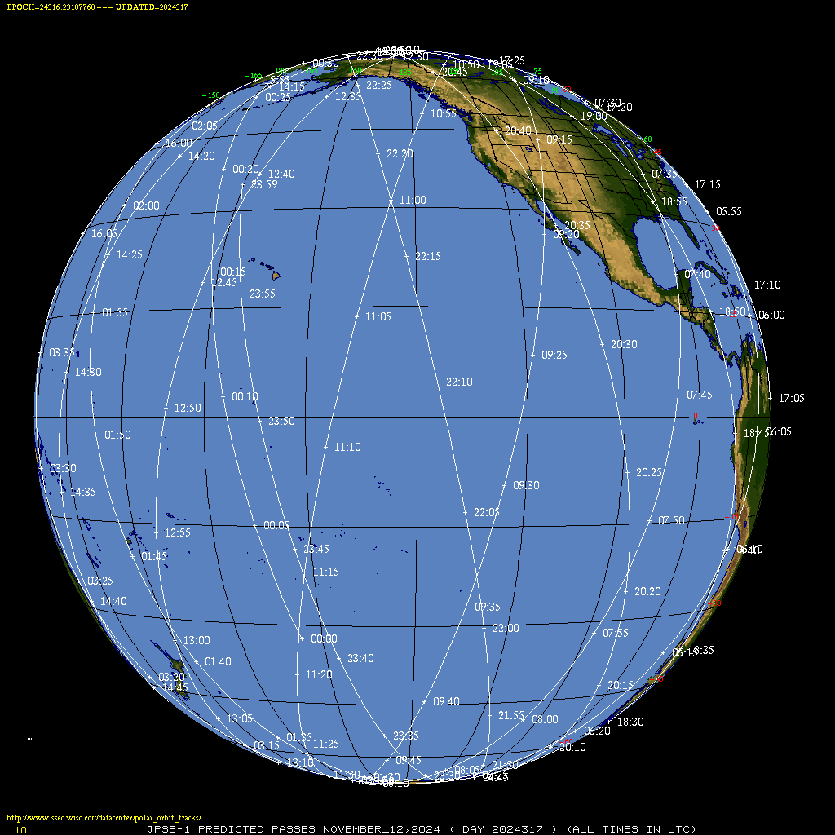
How do you know where the satellite was at 0000 UTC on 12 November?
NOAA-20 is usually ascending somewhere over the Pacific Ocean at 0000 UTC
0005 UTC
0000 UTC
https://www.ssec.wisc.edu/datacenter/polar_orbit_tracks/

Slide 32
What if I want data over Asia on 12 Nov?
0705 UTC
0700 UTC

Slide 33
What was going on weather-wise?
MIMIC TPW over Indian Ocean

Slide 34
Back to the AWS portal, find MIRS data between 0700 and 0705
Data in this file starts at 0700030
Download these 10 files
Data in this file ends at 0705226

Slide 35
Files downloaded
(I downloaded 11 files)
Something that would be useful to develop: A script that given times, fetches the data you want from the cloud (I was just doing a lot of right-click saving on the website)

Slide 36
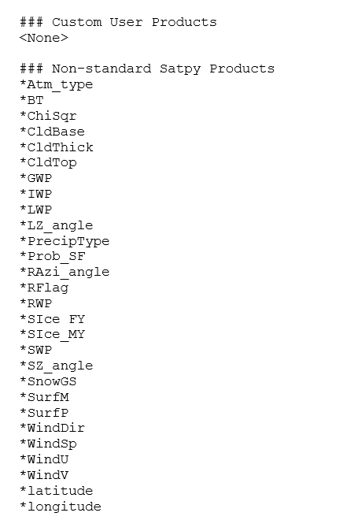
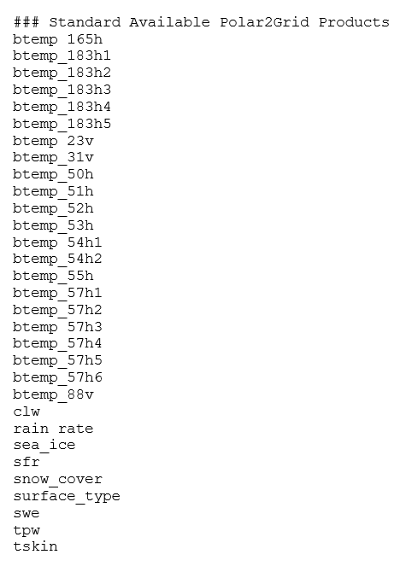
What kind of Products can be displayed?
Polar2Grid will tell you!
../polar2grid.sh -r mirs -w geotiff –list-products-all -f ./path_to_downloadedfiles/*

Slide 37
Change directories to where the Polar2Grid distribution ended
cd polar2grid_v_3_1/
export POLAR2GRID_HOME=$PWD
cd bin; mkdir Nov12; cd Nov12
../p2g_grid_helper.sh Bangladesh 90.0 27.0 4000 -4000 1080 960 > Bang.yaml
../polar2grid.sh -r mirs -w geotiff -p tpw -g Bangladesh --grid-configs ./Bang.yaml -f ../../../data/N20MIRS/12Nov/*
../add_colormap.sh ../../colormaps/p2g_sst_palette.txt noaa20_atms_tpw_20241112_070003_Bangladesh.tif
../add_coastlines.sh --add-coastlines --add-grid --grid-D 10.0 10.0 --grid-d 10.0 10.0 --grid-text-size 14 --add-colorbar --colorbar-tick-marks 255 --colorbar-minor-tick-marks 255 --colorbar-text-size 1 noaa20_atms_tpw_20241112_070003_Bangladesh.tif

Slide 38
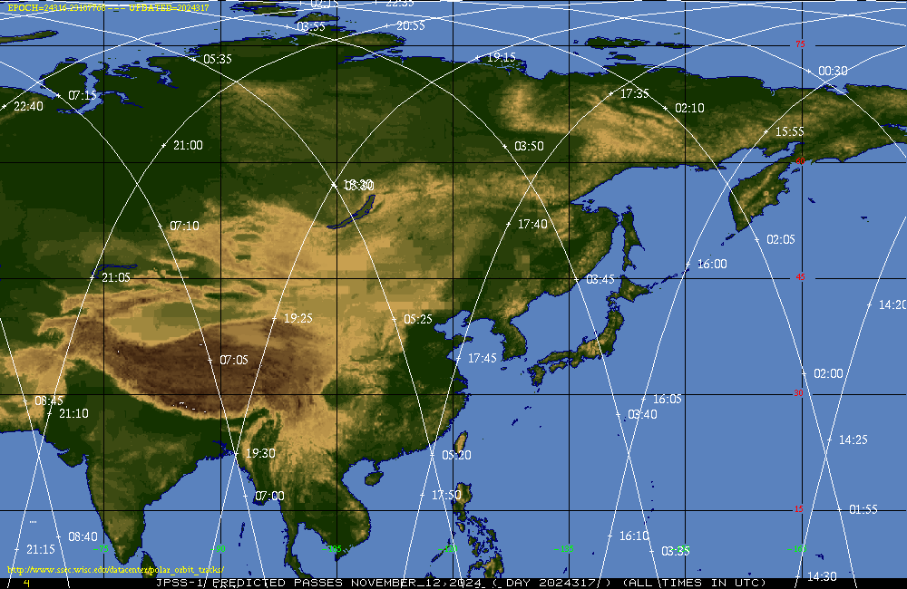
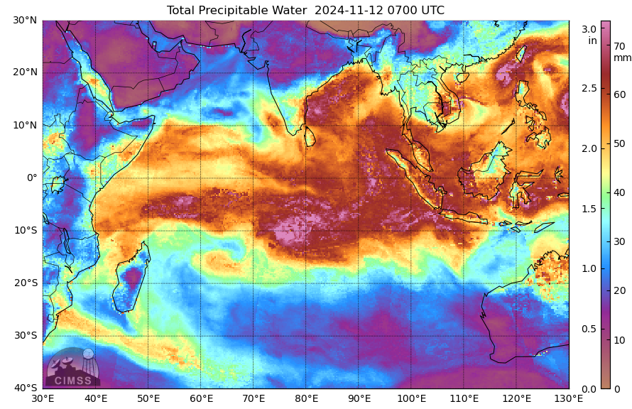
Total Precipitable Water from MIRS algorithm

Slide 39
NUCAPS from NOAA-20 over American Samoa
12:35 UTC
Link

Slide 40
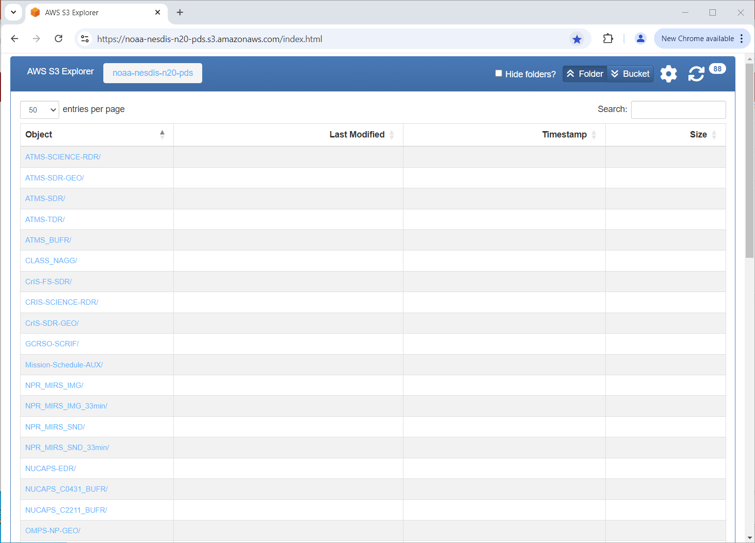
NUCAPS profiles can be displayed

Slide 41
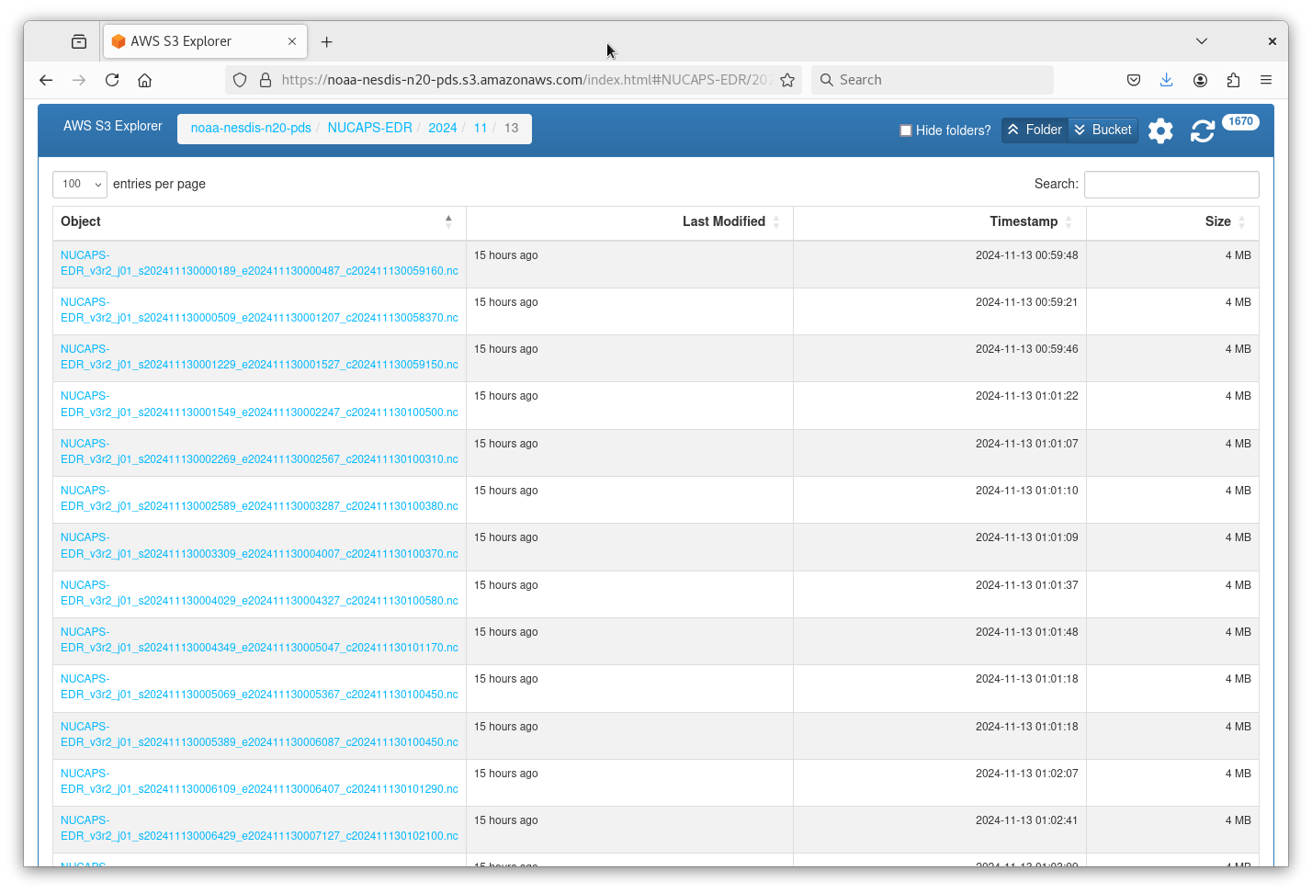
NUCAPS granules – there are many per day

Slide 42
Here are the files bracketing Samoa

Slide 43
Polar2Grid has a NUCAPS reader
../polar2grid.sh –r nucaps –w geotiff –list-products-all –f ./pathToNUCAPSFiles/*.nc
(This creates a listing that’s a lot longer than for the MIRS data – because NUCAPS profiles have 100 layers!)

Slide 44
Polar2Grid commands to create imagery
../p2g_grid_helper.sh Samoa -172.0 -13.0 4000 -4000 960 720 > Samoa.yaml
../polar2grid.sh -r nucaps -w geotiff -p Temperature_802mb Temperature_596mb –f ../../../data/13NovNUCAPS/*
../add_colormap.sh ../../colormaps/gridded_data.cmap j01_atms_cris_Temperature_???mb_20241113_123314*.tif
../add_coastlines.sh –add-coastlines –add-grid –grid-D 5.0 5.0 –grid-d 5.0 5.0 –grid-test-size 12 –add-colorbar –colorbar-height 24 –colorbar-tick-marks 255 –colorbar-minor-tick-marks 255 –colorbar-text-size 1 j01_atms-cris_Temperture_???mb_20241113_123314_*.tif
Did you notice – with this and with MIRS – that georeferencing is within the file? We didn’t have to supply information on where the data sits, it’s within the files downloaded already!

Slide 45
Temperature at 596 mb

Slide 46
Temperature at 802 mb

Slide 47
Issues with previous 2 slides
For this case, I didn’t specify the temperature bounds
Colorbar is not labeled
All of these things are possible to do with Polar2Grid
Also: Do not know the Quality Flag
Did the infrared retrieval converge?
Did only the microwave retrieval converge?
Did neither converge?

Slide 48
You can also view individual VIIRS bands
Use knowledge elsewhere that defines the central wavelength of the VIIRS bands
Must download a separate file that includes georeferencing
This website contains VIIRS Band Imagery information, for both I-bands, M-bands, and Day Night Band.

Slide 49
Table at the CIRA VIIRS Site
True-Color imagery use M3, M4, M5
‘M-Bands: Moderate Resolution
‘I-Bands: Imagery Resolution

Slide 50
VIIRS Data are available online
VIIRS instrument is on NOAA-20, NOAA-21 and Suomi-NPP.
Global Coverage
Excellent Resolution
Polar2Grid has a viirs_sdr reader – so find the SDR records!
Data are available on-line ‘in the cloud’ – like at an Amazon Web Services site.

Slide 51
Where do I want data?
10:15
Back to This Website
Then look at ‘Africa’ projection, and NOAA-20
I’m interested in data along the path from 10:05 to 10:15 UTC on 18 November, i.e., crossing the Horn of Africa, Arabia, and ending west of Iraq
10:05

Slide 52
List of Imager Files available in the cloud
Day Night Band Sensor Data Records
I1 Sensor Data Records
I2 Sensor Data Records
I3 Sensor Data Records
I4 Sensor Data Records
I5 Sensor Data Records
Imager Band Geo Data

Slide 53
List of Mod Resolution Files available in the cloud
M3 Sensor Data Records
M4 Sensor Data Records
M5 Sensor Data Records
Moderate Resolution Band Geo Data

Slide 54
This AWS shows I01 data (0.64 μm)
1005 UTC start here
1015 UTC end here

Slide 55
This AWS shows I02 data (0.86 μm)
1005 UTC start here
1015 UTC end here

Slide 56
This AWS shows I03 data (1.61 μm)
1005 UTC start here
1015 UTC end here

Slide 57
Other files needed by Polar2Grid
Polar2Grid needs the GIMGO files that supply information on where the data occurs. IMG for the I01/I02/I03/I04/I05 files

Slide 58
List of Image Files downloaded
Note that the t/e times are all the same

Slide 59
VIIRS data files do not contain Georeferencing data…you need to download a separate file for that!
I put all the IMG files into a directory, shown above.
polar2grid.sh with a –list-products-all will tell you what Polar2Grid can create
You can create re-projected displays of natural color – the RGB – as well as individual 0.64 μm, 0.86 μm and 1.61 μm images

Slide 60
This AWS shows M04 data (0.55 μm)
1005 UTC start here
1015 UTC end here

Slide 61
This AWS shows M05 data (0.64 μm)
1005 UTC start here
1015 UTC end here

Slide 62
Other files needed by Polar2Grid
Polar2Grid needs the GMODO files that supply information on where the data occurs. MOD for Moderate-resolution files

Slide 63
Then I added moderate-resolution files to the directory
Again, the t/e times are all the same

Slide 64
The addition of channels means more possibilities in image creation
polar2grid.sh with a –list-products-all tells you what Polar2Grid can create
Because M03/M04/M05 are 0.48 μm, 0.55 μm, 0.67μm – you can create true-color imagery

Slide 65
How to create imagery?
Polar2grid reads in the imagery and georeferencing data, and creates a tif image
./polar2grid.sh –r viirs_sdr –w geotiff –p true_color –f /home/scottl/AOMSUC14/TrueColorImages/Data/
Then add in coastlines – could also include lat/lon lines (with labels)
./add_coastlines.sh –add-coastlines noaa20_viirs_true_color_20241118_100521_wgs84_fit.tif

Slide 66
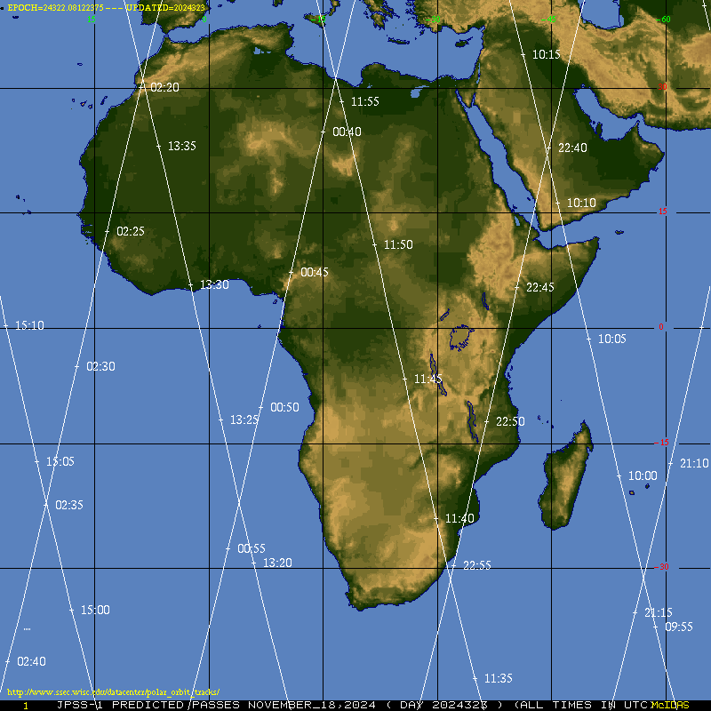
Here’s the result. This has very high resolution, much better than I can show in this PowerPoint
Full-Res link

Slide 67
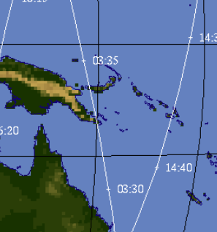
You can also do single bands, let’s try it with M15
What do you need to do for that?
Choose a location, find the times: 3:30-3:35 on 20 November, NOAA-21
Get the data
Get the georeferencing data

Slide 68
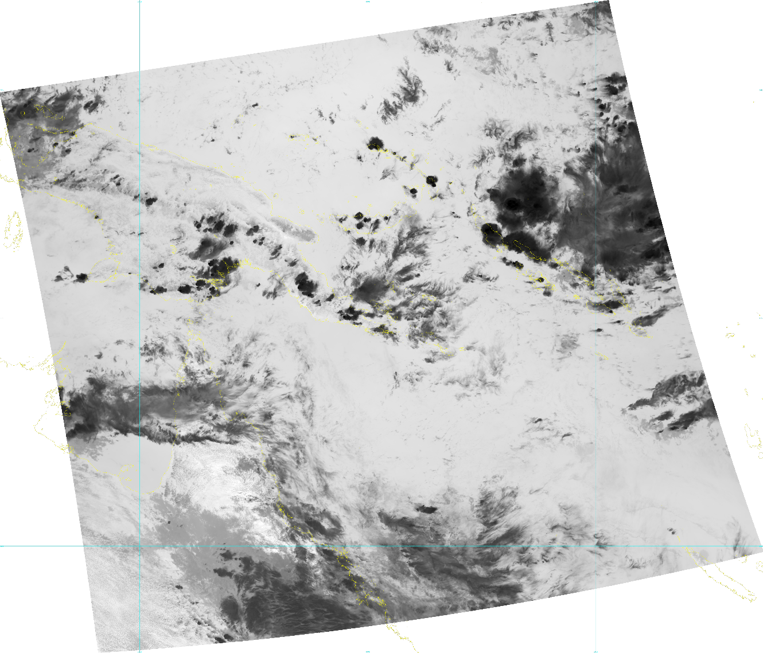
Now make the images
../geo2grid.sh –r viirs_sdr –w geotiff –p M15 –f /path/toM15_GEOfiles/*
../add_coastlines.sh –add-coastlines –add-grid –grid-D 10.0 10.0 –grid-d 10.0 10.0 –grid-text-size 12
This creates a grey-scaled image, georeferenced, of M15 data (10.8μm)
We also could created a grid and put the data on a grid – this one is in Satellite coordinates.

Slide 69
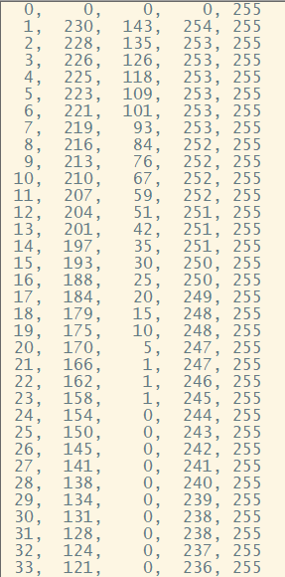
What if you want a color enhancement?
Polar2grid color enhancements are text files that have 256 entries – each entry has a grey-scale value and r/g/b and alpha values
Software will interpolate if there are missing values
There are some built-in values with Polar2Grid (and with Geo2Grid)

Slide 70
What if you want a color enhancement?
Three Commands
Create the image of M15 data
../polar2grid.sh -r viirs_sdr -w geotiff -p m15 -f /home/scottl/AOMSUC14/M15/*
Add a colormap to the tif file that is created.
../add_colormap.sh ../../colormaps/p2g_sst_palette.txt noaa21_viirs_m15_20241120_032903_wgs84_fit.tif
Create a png file that has a color bar, coastlines and lat/lon lines
../add_coastlines.sh --add-coastlines --add-grid --grid-D 10.0 10.0 --grid-d 10.0 10.0 --grid-text-size 12 --add-colorbar --colorbar-height 42 noaa21_viirs_m15_20241120_032903_wgs84_fit.tif

Slide 71
Note that the colorbar values go from 0-255: The greyscale values that are in the file
If you want a color to associate with a temperature, you need to tell Polar2Grid how that happens

Slide 72
How do you create a colorbar that knows about temperatures
cd $POLAR2GRID_HOME/etc/polar2grid/enhancements/
Edit viirs.yaml
Add these lines – I put them at the bottom:
Then, redo the geo2grid/add_colormap/add_coastlines

Slide 73
Note that the colorbar values go from 170-330K!
Maybe you think the range of colors is too broad – you can change that – change the 170 and 330 values to 190 and 310 (for example), and re-run the scripts

Slide 74
Result: maybe this is better?

Slide 75
Other things Polar2Grid can do
Create Brightness Temperature Difference files
Create RGB products (including products in which one of the colors is a brightness temperature/reflectance difference)

Slide 76
Let’s make a Split Window Difference
M15: 10.8 μm ; M16: 12.0 μm ; Split Window Difference : 10.8 – 12.0
I downloaded the M16 data into the same directory that holds the M15/Geo data
Add information (to viirs.yaml) in two spots:
$POLAR2GRID_HOME/etc/polar2grid/composites
$POLAR2GRID_HOME/etc/polar2grid/enhancements

Slide 77
So now – when you do a –list-products-all and point to the directory with those data….
…and now use –p m15m16dif in the polar2grid.sh call

Slide 78
Same data, but I subsected it to center on New Guinea: p2g_grid_helper.sh

Slide 79
How do you create RGBs?
As you might expect (now), you have to add information in the viirs.yaml file within both the enhancements and composites directories under $POLAR2GRID_HOME/etc/polar2grid

Slide 80
enhancements directory
Here’s an example of the ABI Dust RGB
composites directory

Slide 81
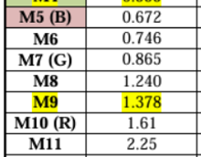
Let’s replicate the GOES definition of the Day Land Cloud Fire RGB – but with the higher-resolution VIIRS imagery
We have to add this information as definitions in the viirs.yaml files

Slide 82
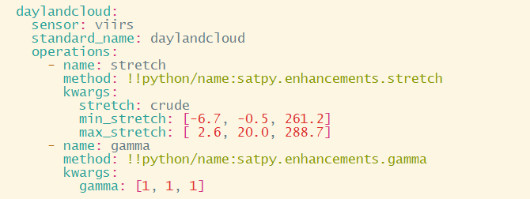
enhancements directory
Here’s what I created for the VIIRS Day Land Cloud Fire RGB
composites directory

Slide 83
Let’s look at data from 1710 to 1715 UTC on 22 November 2024
(These data were in the cloud at 1750 UTC)

Slide 84
You’ve made changes – what does –list-products-all show you?
When I’ve added the M05/M07 .h5 files from the cloud

Slide 85
You’ve made changes – what does –list-products-all show you?
Why isn’t the RGB there?
When I’ve added the M05/M07/M12 .h5 files from the cloud

Slide 86
You’ve made changes – what does –list-products-all show you?
The RGB shows up in the output!
When I’ve added the M05/M07/M11 .h5 files from the cloud

Slide 87
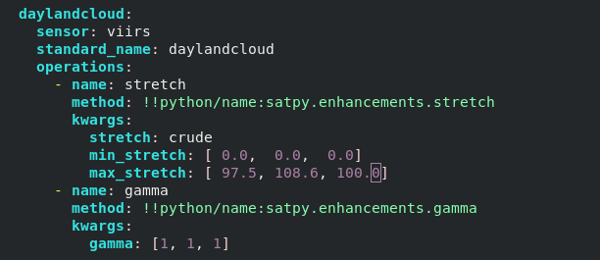
Create the imagery – this doesn’t look right!
viirs.yaml in enhancements directory is WRONG!

Slide 88
Fire Regions should have extra red in them – can you see the pixel of two?

Slide 89
A further benefit of Polar2Grid
Polar2grid uses the same gridding capability as Geo2Grid: so you can reproject LEO data onto the same grid as geostationary data
This has great utility when you want to compare polar orbiting data and geostationary data.
Compare LEO Microwave imagery and infrared geostationary data, for example

Slide 90
GOES-16 True-Color Imagery and AMSR-2 89-GHz
See Also: This website

Slide 94
Upcoming Meeting!!!
CSPP Users’ Meeting
1-3 April 2025
Hyatt Regency Hotel on Guam
Meeting Website
https://www.ssec.wisc.edu/meetings/cspp/2025-meeting/
Local usage and applications of CSPP LEO and CSPP Geo software such as
Fire detection; Monitoring and predicting severe weather events; Climate change research and analysis; Oceanography and marine ecosystem studies; Land surface and vegetation monitoring; Air quality and pollution tracking; NWP assimilation; Education and training; National security;
CSPP software overview and updates;
CSPP software technical topics, including related software packages (e.g., AAPP);
Status of current and future environmental satellite missions and sensors;
Technical innovations in algorithms, processing and distribution, including cloud processing, artificial intelligence, machine learning, containerization and very low latency solutions;
Feedback and guidance to the CSPP LEO/Geo development teams on current products and future priorities;
Satellite data analysis and visualization applications;
LEO and GEO ground stations and hardware;
General issues affecting the direct broadcast community.
Presentations related to other satellite missions are also welcome.

Slide 95
Examples/Tutorials online
Using Polar2Grid to create MIRS imagery
Creating customized brightness temperature ranges in Polar2Grid
Using NODD and Polar2Grid to create Day Night Band imagery anywhere
Displaying JPSS data from the NODD using Polar2Grid
How fast can you create JPSS imagery from data on the Amazon Cloud using Polar2Grid?
How to make Brightness Temperature Difference fields with Geo2grid
Using CSPP’s polar2grid to create mappings of sea-surface temperature
Creating a Tropical Air Mass RGB in Geo2grid
Instructions for geo2grid and polar2grid should be the same!

Slide 96
Happy to take questions now, or later this week
Scott.Lindstrom@ssec.wisc.edu
Scott.Lindstrom@noaa.gov

