Slide 1
Satellite Training with CIMSS Software and Cloud-based data
Scott S. Lindstrom
Univ. of Wisconsin-Madison
Cooperative Institute for Meteorological Satellite Studies

Slide 2
Weather Satellites in the 21st Century
Satellite Resources are billion-dollar investments
How do you maximize a government’s return on investment?
Forecasters need training
Show compelling images that tell a good story
Persuade forecasters to do the same
Relate the satellite imagery to the ability to provide support for decision-makers (This makes satellite interpretation a vital part of a forecaster’s job)

Slide 3
Advertisement: Upcoming Meeting!!!
CSPP Users’ Meeting
1-3 April 2025
Hyatt Regency Hotel on Guam
Meeting Website
https://www.ssec.wisc.edu/meetings/cspp/2025-meeting/
Local usage and applications of CSPP LEO and CSPP Geo software such as
Fire detection; Monitoring and predicting severe weather events; Climate change research and analysis; Oceanography and marine ecosystem studies; Land surface and vegetation monitoring; Air quality and pollution tracking; NWP assimilation; Education and training; National security;
CSPP software overview and updates;
CSPP software technical topics, including related software packages (e.g., AAPP);
Status of current and future environmental satellite missions and sensors;
Technical innovations in algorithms, processing and distribution, including cloud processing, artificial intelligence, machine learning, containerization and very low latency solutions;
Feedback and guidance to the CSPP LEO/Geo development teams on current products and future priorities;
Satellite data analysis and visualization applications;
LEO and GEO ground stations and hardware;
General issues affecting the direct broadcast community.
Presentations related to other satellite missions are also welcome.

Slide 4
CIMSS Scientists create useful imagery – training helps forecasters take advantage of the information
Future Fergal
(This product shows Microwave estimates of TPW hourly last week)
Training Video
Data available in real time here

Slide 5
CIMSS Scientists create useful imagery – training helps forecasters take advantage of the information
(This product shows Probability of Moderate or Greater Turbulence)
Data available in real time here

Slide 6
What I flew through en route to Delhi
Didn’t feel anything – but Captain said sit down and put on seat belts

Slide 7
Satellite Imagery
To train forecasters on satellite imagery, you have to access satellite imagery
In real-time, imagery is not hard to find
In real-time, products are not hard to find
For past cases, imagery and products can be a challenge to find
Exceptions!
NASA Worldview allows you to scroll back in time
CIRA SLIDER has a limited archive for GOES-R
Shout-out to the National Meteorological Agencies that have easy-to-access data

Slide 8
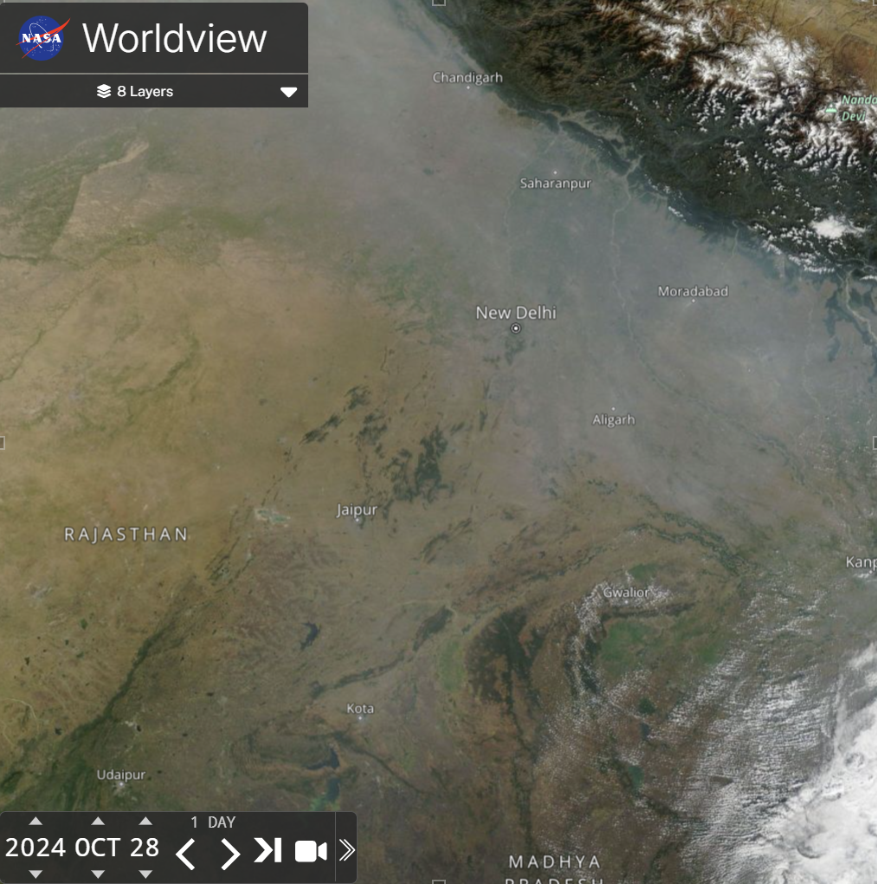
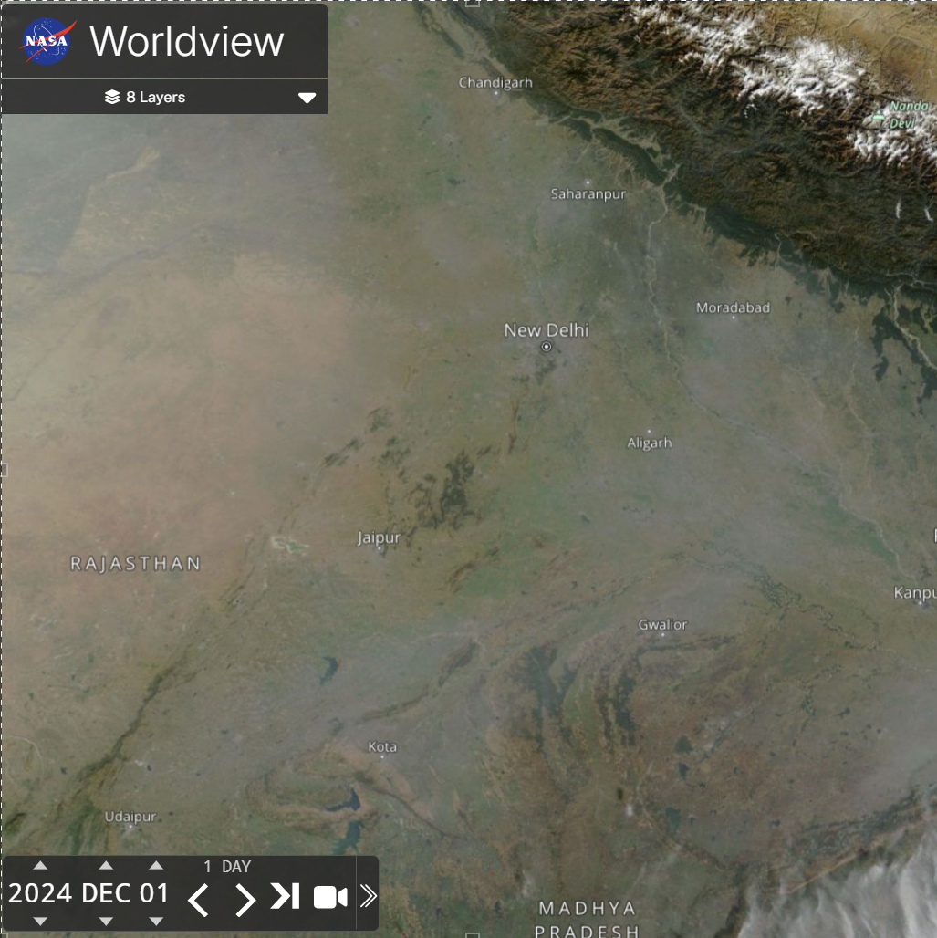
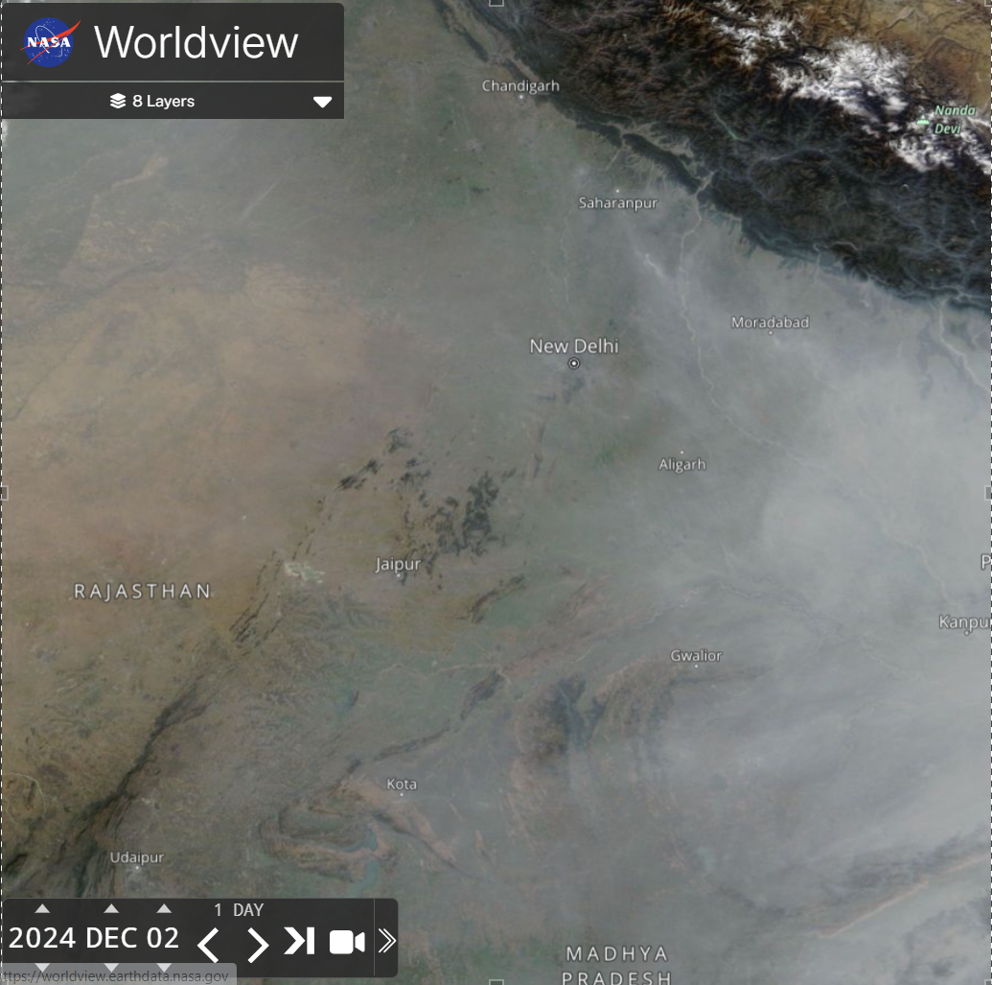
So when you read a news snippet (and naturally ask yourself “What did the satellite imagery show?”)

Slide 9
Where to find the data?
The data sit in the cloud (NOAA’s NODD)
Amazon, Google, Microsoft data repositories
JPSS Data, GOES-R Data, GK2A, Himawari data
I am most familiar with Amazon Web Services
https://noaa-gk2a-pds.s3.amazonaws.com/index.html
gk2a_ami_le1b_ir105_fd020ge_202411242310.nc
https://noaa-himawari9.s3.amazonaws.com/index.html
HS_H09_20241129_0410_B02_FLDK_R10_S0610.DAT.bz2
https://noaa-nesdis-n20-pds.s3.amazonaws.com/index.html
VIIRS / ATMS / MIRS data, for example
https://noaa-jpss.s3.amazonaws.com/index.html
NUCAPS data
https://noaa-goes18.s3.amazonaws.com/index.html
https://noaa-goes16.s3.amazonaws.com/index.html

Slide 10
Direct Broadcast Data
Designed to have the same format as the data in the cloud
Software that works at direct broadcast sites works with data downloaded from the cloud
Imagery created from both sources is identical

Slide 11
Software to create imagery
CSPP Software (polar2grid and geo2grid) can create imagery – and products
Readers for many different satellite products – but you need access to (usually) netCDF/hdf5 files.
Readers do not exist for all satellites – but a clever programmer can create the reader
(That is, the format needed in SatPy is known)

Slide 12
What kind of Geostationary Data Readers exist now?
Geostationary Data Readers
ABI Level 1b, Level 2 NetCDF Reader
GLM Level 2 Reader
AGRI (-4A/-4B) Reader
AHI HSD/HRIT Reader
AMI L1B Reader
FCI Level-1C Reader
Python Code / SatPy
These (combined) Satellites cover much of the Globe – polar region coverage is sketchy

Slide 13
What kind of Polar Data Readers exist right now?
VIIRS SDR / VIIRS Level1B
(MODIS Level 1B)
AVHRR
AMSR-2 Level 1B reader
NUCAPS
MIRS
MERSI-2 / MERSI-LL L1B Reader
These Satellites cover all of the Globe

Slide 14
Why does CIMSS create software for Polar Orbiters
GINA
CIMSS manages a variety of Direct Broadcast sites – and imagery is created for National Weather Service Offices nearby. Data are also funneled via DBNet to NWP centers worldwide

Slide 15
Software for the 2 different Satellite types
Geostationary Satellites
Geo2grid software
Python based, uses Satpy libraries (among others)
Extensive documentation
Examples of how to use the software are on the CIMSS Satellite Blog
Low-Earth-Orbit Satellites
Polar2grid software
Python based, uses Satpy libraries (among others)
Extensive documentation
Examples of how to use the software are on the CIMSS Satellite Blog
Do a web search on ‘CSPP geo2grid’ / ‘CSPP polar2grid’

Slide 16
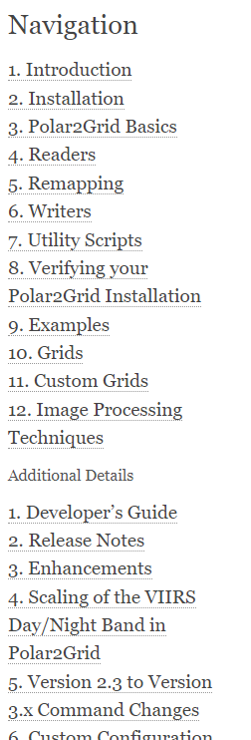
Documentation looks similar!
https://cimss.ssec.wisc.edu/software/geo2grid
https://cimss.ssec.wisc.edu/software/polar2grid

Slide 17
Those similarities are powerful when you combine the two different data sources
ABI Band 13 (10.3 μm) June 2024

Slide 18
Those similarities are powerful when you combine the two different data sources
ABI Band 13 (10.3 μm) June 2024
GCOM AMSR-2 36.5 GHz

Slide 19
Those similarities are powerful when you combine the two different data sources
ABI Band 13 (10.3 μm) June 2024
GCOM AMSR-2 89 GHz

Slide 20
Help forecasters understand imagery such as this
A low-level swirl is centered near 16ºN Latitude, 154ºE Longitude, note the curved bands to the west and north (darker blue in the enhancement) and deep convection (yellow/red/brown in the enhancement) to the southeast of the low-level swirl. Derived wind speeds show values exceeding 40 knots underneath the strongest convection.
These data were used in real time by the forecast office on Guam to give Decision Support to the Marianas
Imagery courtesy William Aydlett, SOO, WFO Guam

Slide 21
Examples/Tutorials online on CIMSS Satellite Blog
Using Polar2Grid to create MIRS imagery
Creating customized brightness temperature ranges in Polar2Grid
Using NODD and Polar2Grid to create Day Night Band imagery anywhere
Displaying JPSS data from the NODD using Polar2Grid
How fast can you create JPSS imagery from data on the Amazon Cloud using Polar2Grid?
How to make Brightness Temperature Difference fields with Geo2grid
Using CSPP’s polar2grid to create mappings of sea-surface temperature
Creating a Tropical Air Mass RGB in Geo2grid
There are also many many examples of how to use satellite data, or just showing satellite imagery during interesting events
https://cimss.ssec.wisc.edu/satellite-blog
These are examples of how
to use polar2grid/geo2grid

Slide 22
Advertisement: Upcoming Meeting!!!
CSPP Users’ Meeting
1-3 April 2025
Hyatt Regency Hotel on Guam
Meeting Website
https://www.ssec.wisc.edu/meetings/cspp/2025-meeting/
Local usage and applications of CSPP LEO and CSPP Geo software such as
Fire detection; Monitoring and predicting severe weather events; Climate change research and analysis; Oceanography and marine ecosystem studies; Land surface and vegetation monitoring; Air quality and pollution tracking; NWP assimilation; Education and training; National security;
CSPP software overview and updates;
CSPP software technical topics, including related software packages (e.g., AAPP);
Status of current and future environmental satellite missions and sensors;
Technical innovations in algorithms, processing and distribution, including cloud processing, artificial intelligence, machine learning, containerization and very low latency solutions;
Feedback and guidance to the CSPP LEO/Geo development teams on current products and future priorities;
Satellite data analysis and visualization applications;
LEO and GEO ground stations and hardware;
General issues affecting the direct broadcast community.
Presentations related to other satellite missions are also welcome.

Slide 23
Summary
CIMSS manages CSPP software that can be used to read data that are found online
CSPP software is free
Images created (from geo2grid and polar2grid) can help tell the story that highlights the importance of satellite imagery in decision support services to protect lives and property
Multiple examples are available online – at the CIMSS Satellite Blog, for example
I am happy to answer questions!
scott.lindstrom@ssec.wisc.edu
scott.lindstrom@noaa.gov

