Slide 1
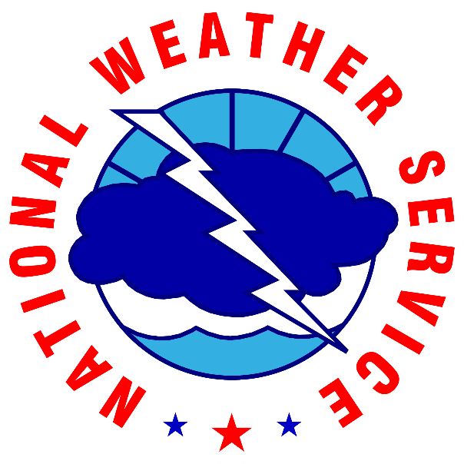
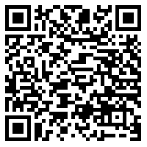
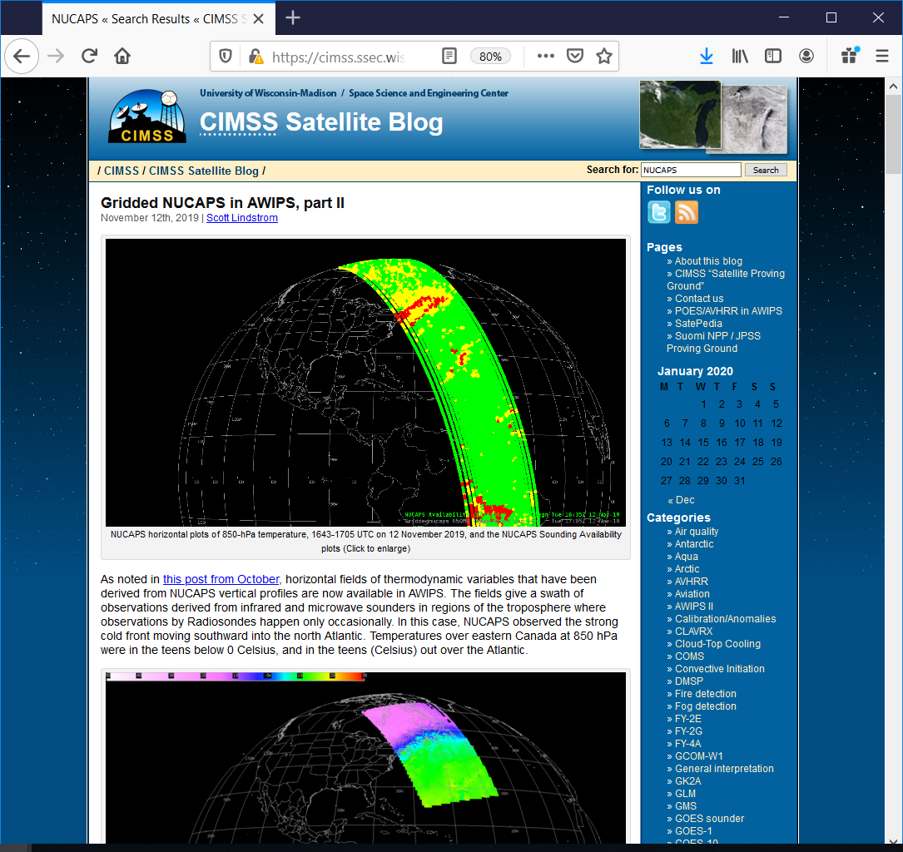
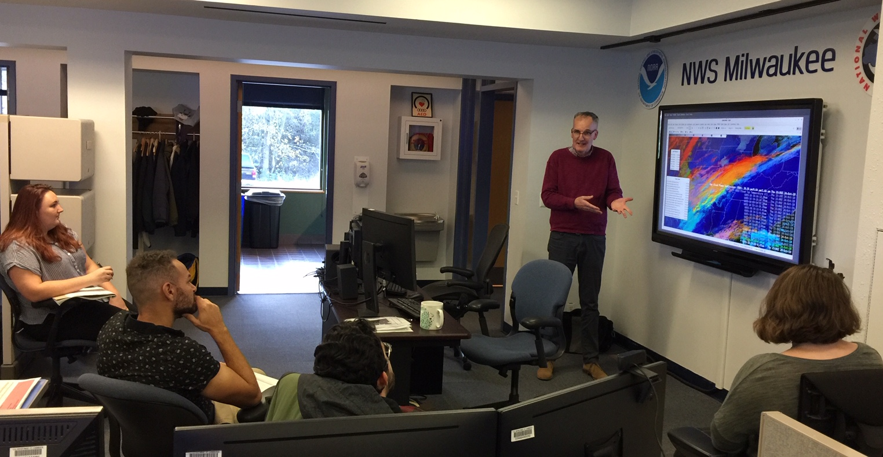
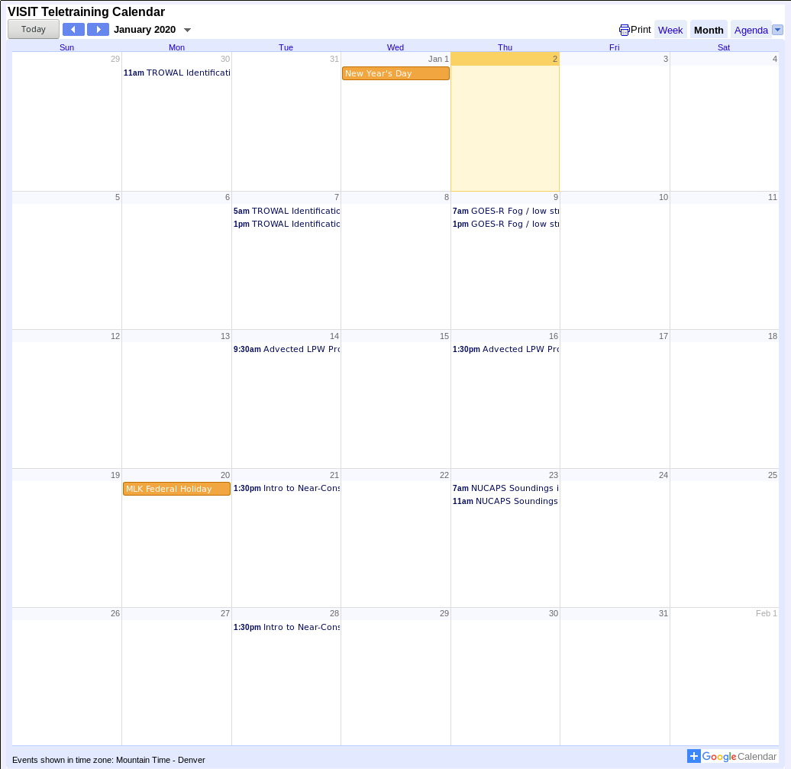
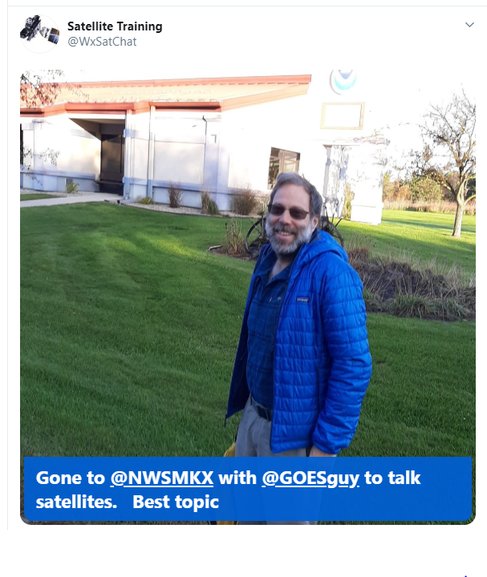
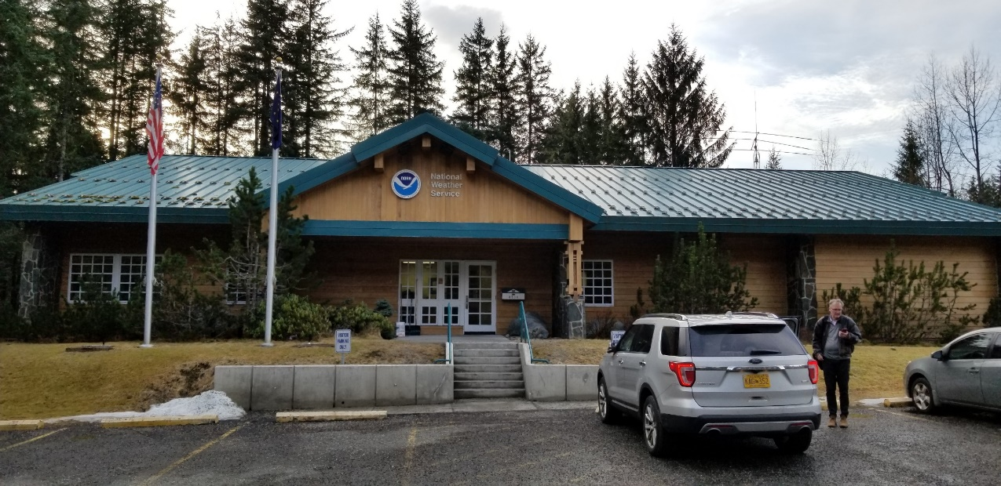
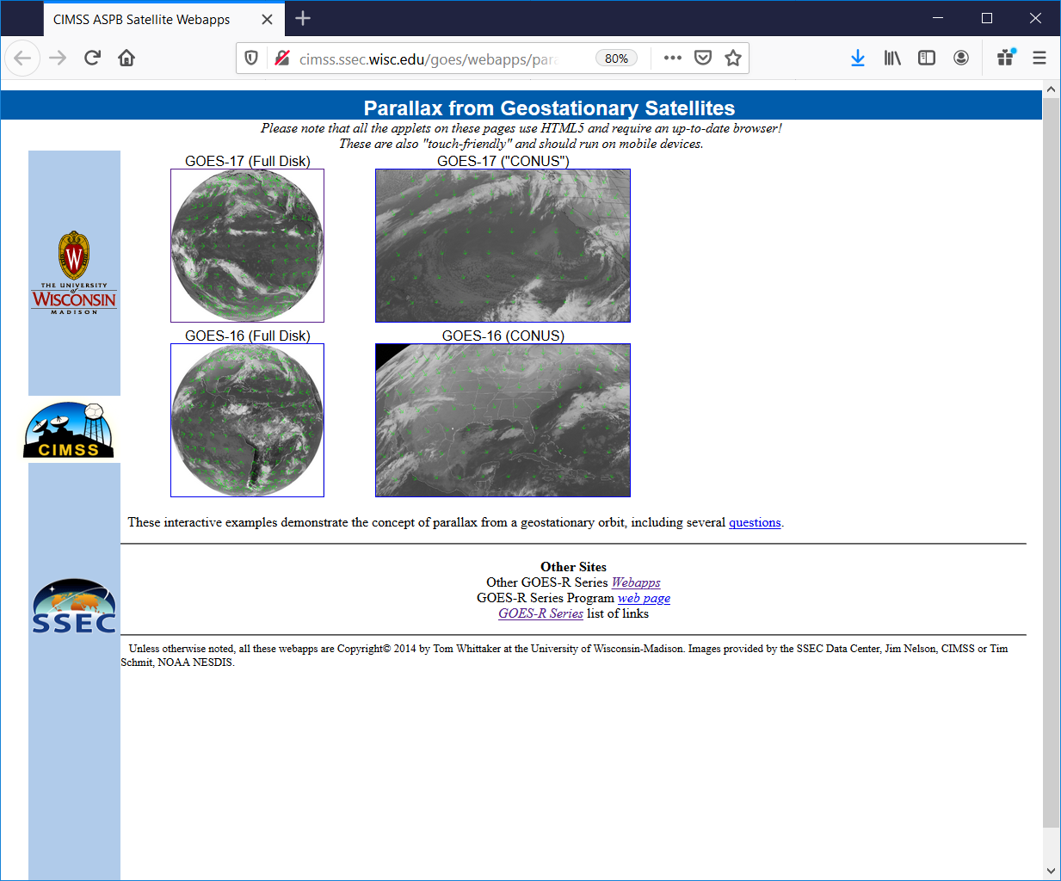
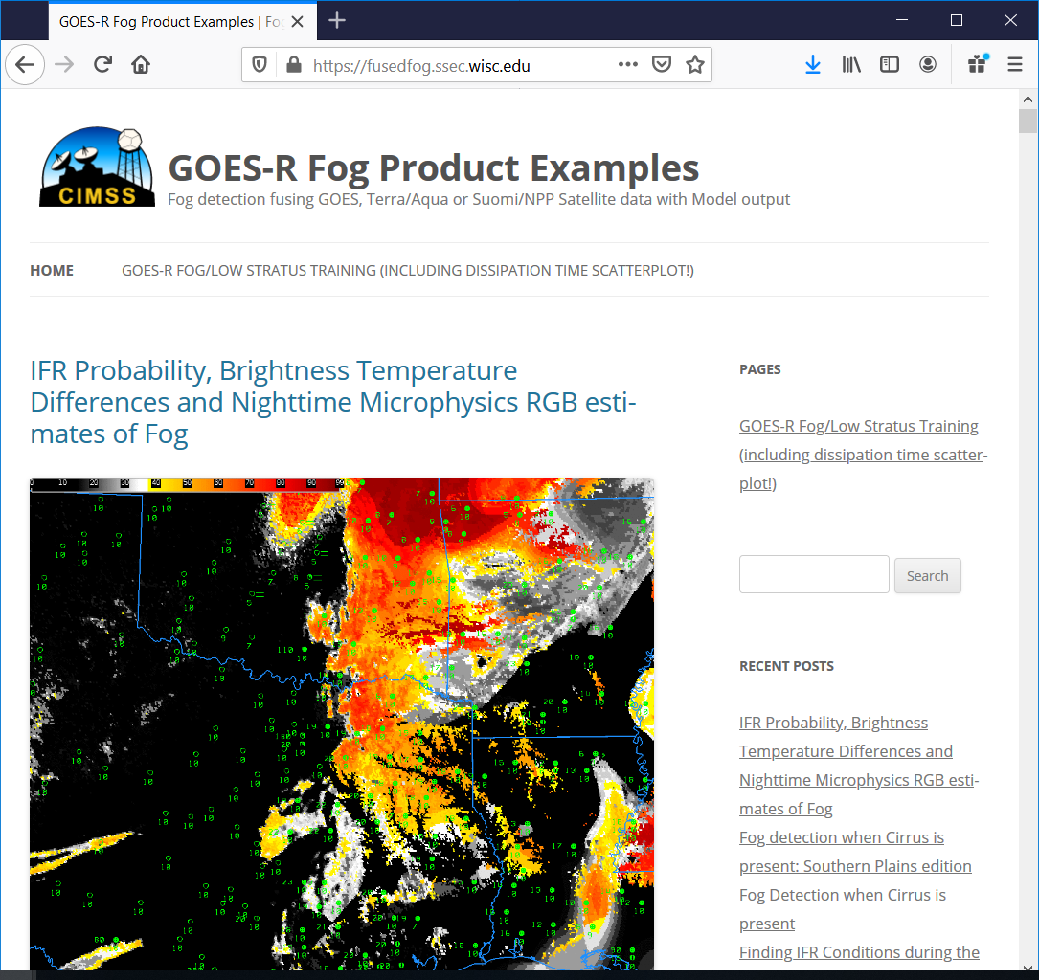
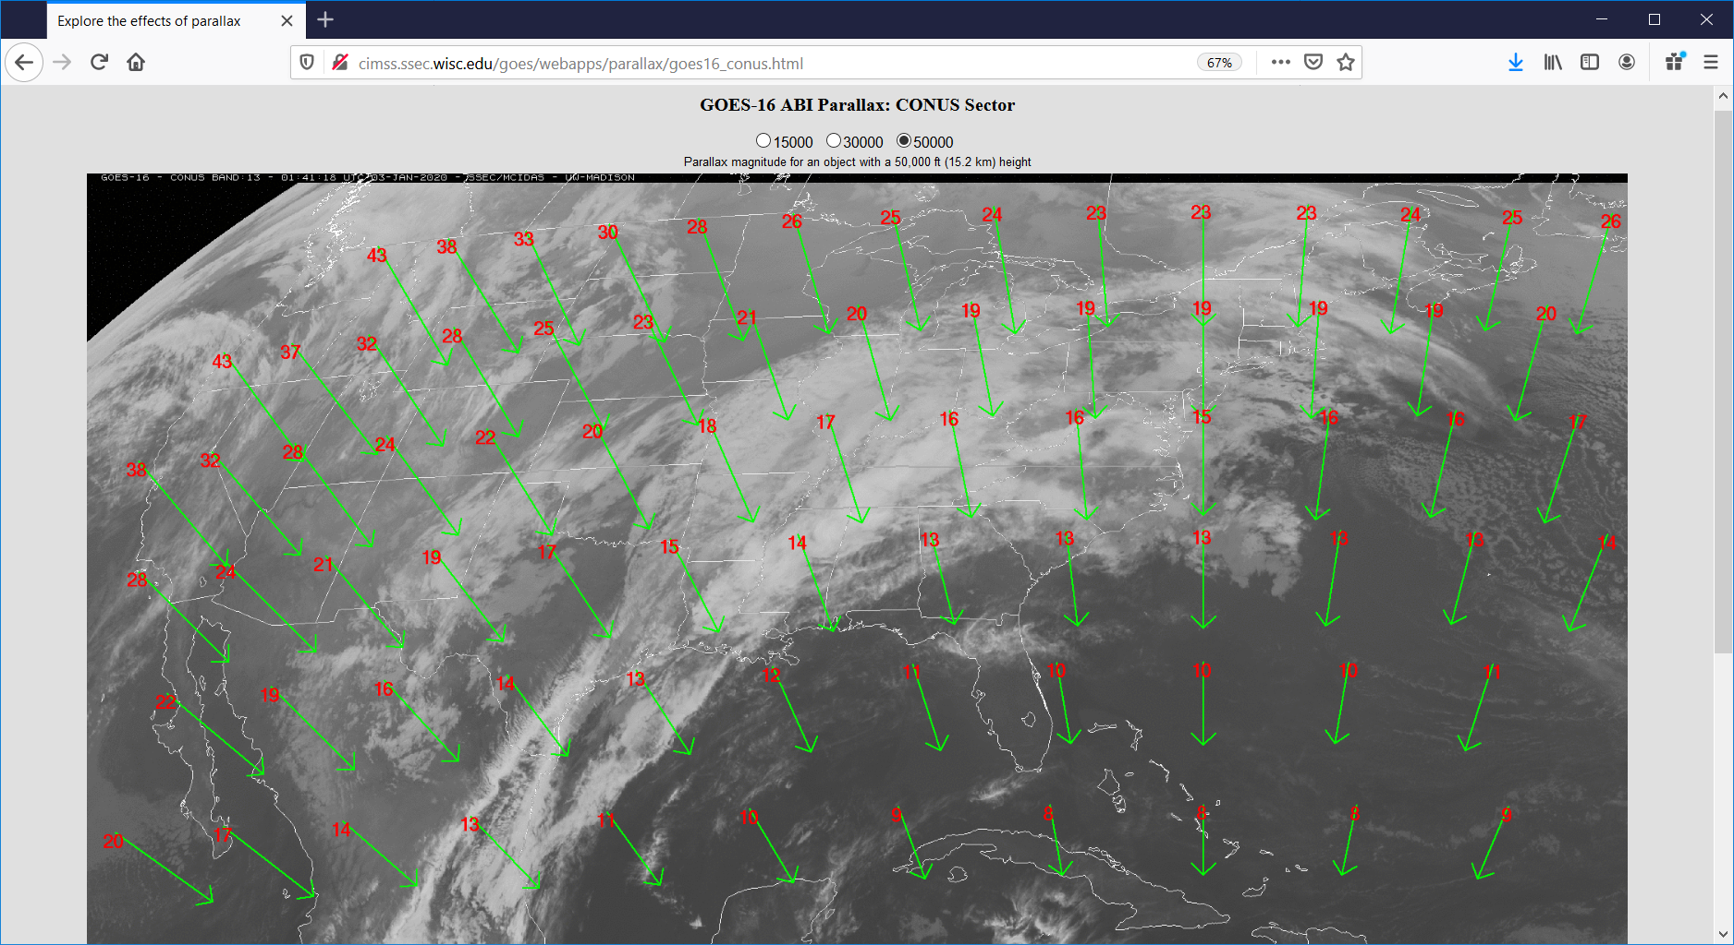
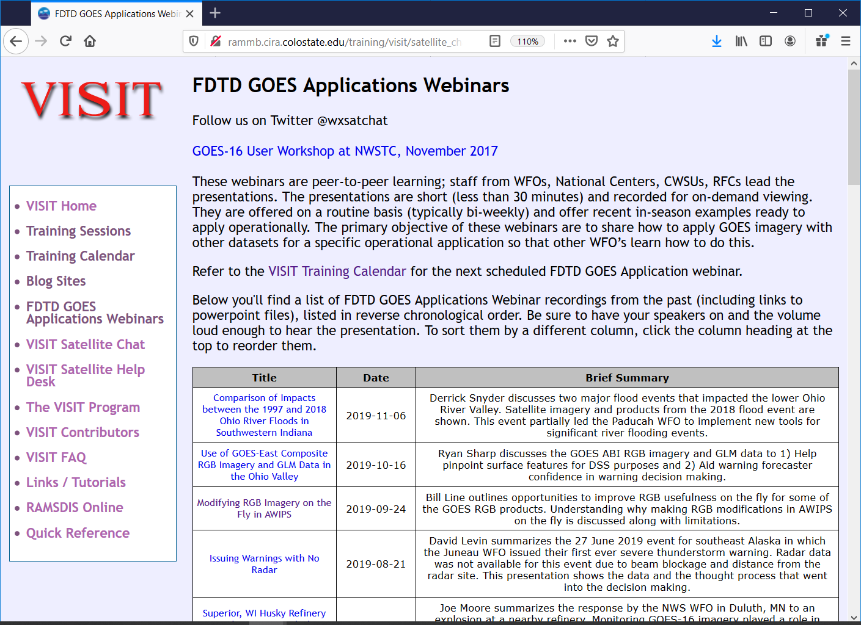
1368
National Weather Service Training Activities at the UW-Madison Cooperative Institute for Meteorological Satellite Studies
Scott S. Lindstrom¹, A. S. Bachmeier¹, C. C. Schmidt¹, M. M. Gunshor¹, J. J. Gerth², T. J. Schmit³
¹ Cooperative Institute for Meteorological Satellite Studies, University of Wisconsin-Madison ²NOAA/OBS ³NOAA/ASPB
Blogs and Videos!
Virtual Institute for Satellite Integration Training
In-person visits
https://cimss.ssec.wisc.edu/satellite-blog
WFOs visited
ANC: March 2019
AJK: March 2019
AFG: March 2019
GRB: April 2019
BUF: Oct 2019
MKX: Oct 2019
MEM: Nov 2019
Scott Lindstrom training forecasters at MKX (photo credit: T. Schmit)
These are live teletraining sessions, some given by CIMSS, some by CIRA, that use VISITview software
url: http://rammb.cira.colostate.edu/training/visit/calendar.asp (or search on ‘VISIT Teletraining Calendar’)
http://cimss.ssec.wisc.edu/goes/webapps/parallax/overview.html
Scott Lindstrom outside WFO AJK (photo credit: J. Gerth)
Web Applications
https://fusedfog.ssec.wisc.edu
CIMSS-developed modules: TROWAL ; MCVs ; NUCAPS Soundings, GOES-R IFR Probability, NOAA/CIMSS ProbSevere
FDTD GOES Applications Webinars
http://rammb.cira.colostate.edu/training/visit/satellite_chat/
YouTube Channels: JPSS Advocacy, VISIT/SHyMet
(The VISIT YouTube Channel, from CIRA, also has great training material!)
GOES Training Links JPSS Training Links
One of many YouTube videos – this one is on Weighting Functions
These are peer-to-peer webinars organized by CIRA and CIMSS and (mostly) led by NWS Forecasters

