Slide 1
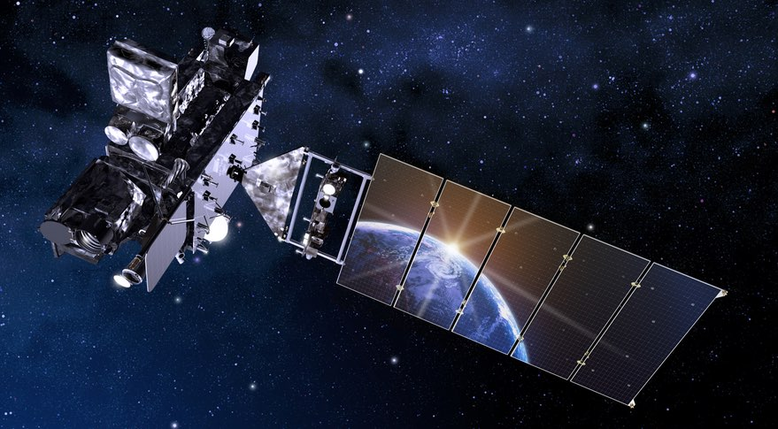
FDTD Satellite Applications Webinars: Peer-to-peer training for the National Weather Service
Dan Bikos¹
Scott Lindstrom²
Brian Motta³
Kevin Scharfenberg³
¹ Colorado State University Cooperative Institute for Research in the Atmosphere
² University of Wisconsin-Madison Cooperative Institute for Meteorological Satellite Studies
³ NOAA/NWS/OCLO/FDTD

Slide 2
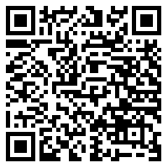
For people who have to leave
All webinars are recorded and available at http://rammb.cira.colostate.edu/training/visit/satellite_chat/

Slide 3
What kind of training is done in Satellite Webinars?
Peer-to-Peer Training: This has been shown to be very effective : you learn from your cohort who knows what you face daily in the trenches
Experts talk about their research: Forecasters learn straight from the researcher!

Slide 4
How is this done?
Dan or Scott (or others) become aware of something
At a Conference
Via Social Media

Slide 5
How is this done?
Dan or Scott (or others) become aware of something
At a Conference
Via Social Media

Slide 6
GLOMW Agenda
Great Lakes Operational Meteorology Workshop, May 2019 in Duluth
(Link to Agenda: https://www.weather.gov/dlh/GLOMW-2019 )

Slide 7
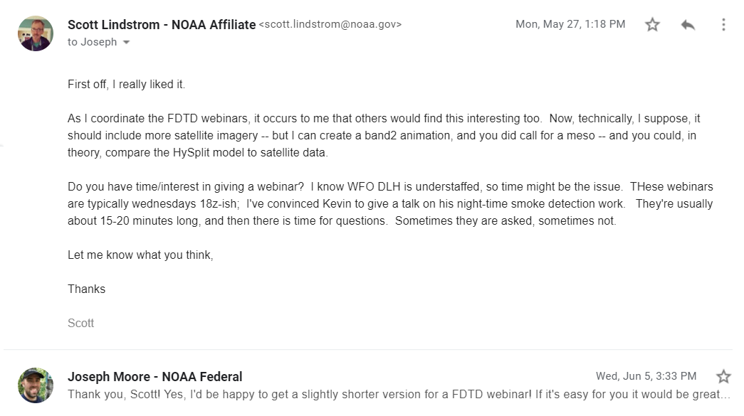
GLOMW Agenda
Presenter gets an email!

Slide 8
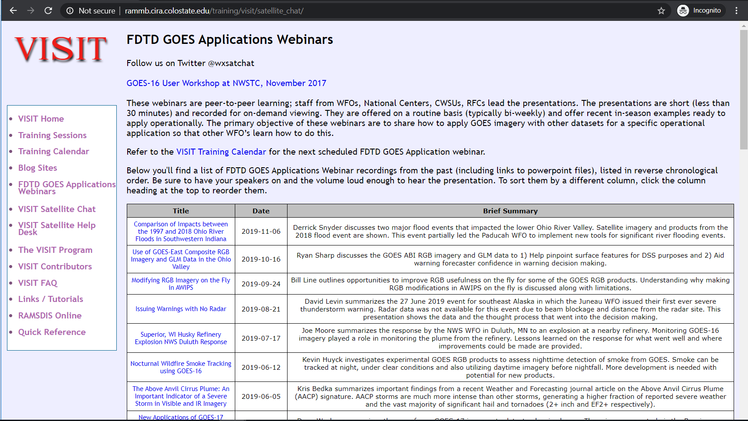
After seeing something on Twitter…
/

Slide 9
NWA Meeting (or any meeting)
For posters, I (or Dan) can just walk up and say how nice it would be if the material were reformatted into a short webinar
We help the presenter with the process of converting poster to talk

Slide 10
NWA Meeting
National Weather Association Meeting in Huntsville AL, 7 – 12 September 2019

Slide 11
After seeing something on Twitter…
/

Slide 12
How is this done?
Dan or Scott (or others) become aware of something
At a Conference
Via Social Media

Slide 13
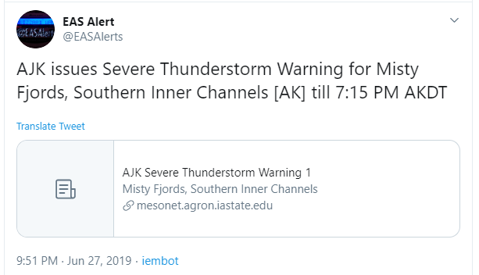
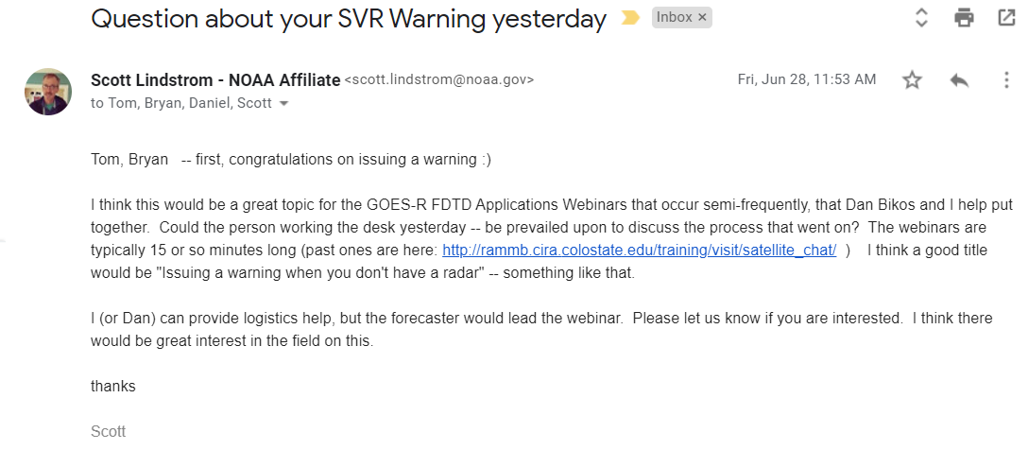
After seeing something on Twitter…
/

Slide 14
After seeing something on Twitter…
/

Slide 15
After seeing something on Twitter…
You can see this talk here at AMS too!
/

Slide 16
Bottom Line: Multiple ways for forecasters to advocate for the use of Satellite Data to their peers
Something Happens
Conference Presentation
FDTD Webinar
Multiple ways to learn
FDTD Webinar
Conference Presentation

Slide 17
Bottom Line: Multiple ways for forecasters to advocate for the use of Satellite Data to their peers
These are all links to PowerPoints and Recordings!

Slide 18
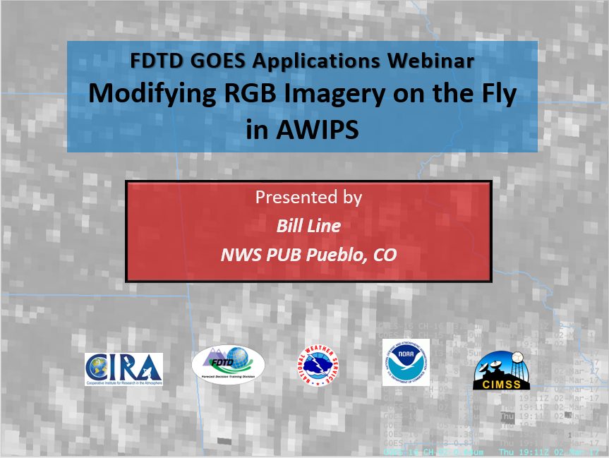
Bottom Line: Multiple ways for forecasters to advocate for the use of Satellite Data to their peers
Clickable Video
Link to YouTube
PowerPoint slides

Slide 19
Recent Metrics
Date | Title | Presenter | # of WFOs listening
10-16-2019 | Use of GOES-East Composite RGB Imagery and GLM Data in the Ohio Valley | Ryan Sharp, WFO LMK | 7
9-24-1019 | Modifying RGB imagery on the fly in AWIPS | Bill Line, WFO PUB | 22
8-21-2019 | Issuing Warnings with no radar | David Levin, WFO JNU | 15
7-17-2019 | Superior, WI Husky refinery explosion NWS Duluth response | Joseph Moore, WFO DLH | 6
6-12-2019 | Nocturnal detection of smoke with GOES-16 | Kevin Huyck, WFO DLH | 13
6-5-2019 | The Above-Anvil Cirrus Plume | Kris Bedka, NASA Langley | 15

Slide 20
We are always looking for topics – if you have one, email us!
scott.lindstrom@noaa.gov
608 263 4425 / @WxSatChat
dan.bikos@noaa.gov
970 491 3777

Slide 21
Thank You!
All webinars are recorded and made available at http://rammb.cira.colostate.edu/training/visit/satellite_chat/

