Slide 1

Why Sounder Data can help you
(and a peek into the future, to pique your interest)
Scott Lindstrom, UW-Madison
Cooperative Institute for Meteorological Satellite Studies
( )

Slide 2

We are using slido.com!
#AOMSUC13
https://www.slido.com/

Slide 3
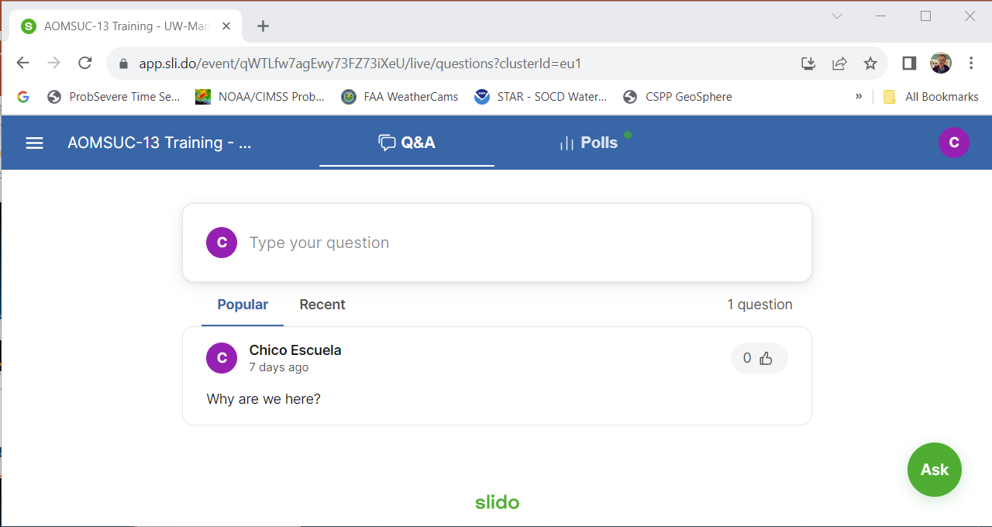
You can do different things at slido
If you hear something unclear, or something needs to be
repeated, or raises a question in your mind, type that in here
The Q&A Tab: You are asking US questions, and if you see one you, like, well, click on the thumbs up icon!

Slide 4
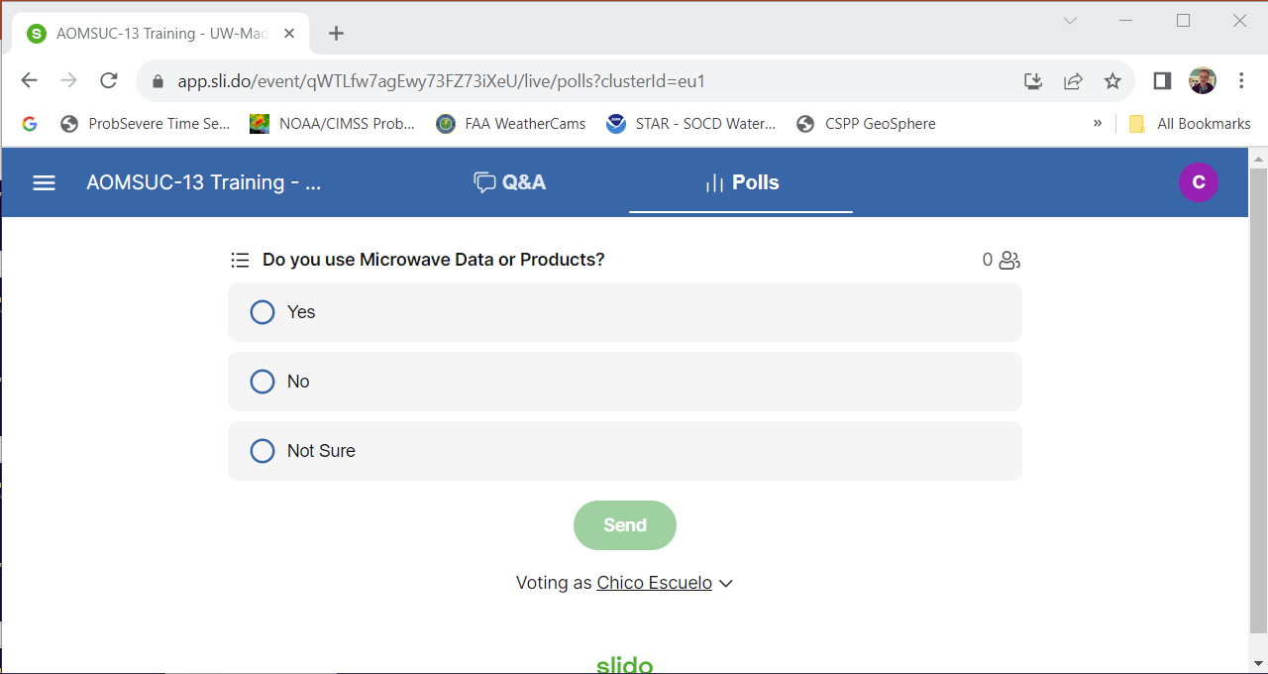
You can do different things at slido
The Polls Tab: We are asking You questions (questions can have different formats; answer them then press ‘Send’)

Slide 5
Imagers v. Sounders
Maybe you’re familiar with Imagers: AHI, AMI, AGRI, ABI, GHI
  Advanced Himawari Imager (16 bands)
  Advanced Meteorological Imager (16 bands)
  Advanced Geostationary Radiation Imager (16 bands)
  Advanced Baseline Imager (16 bands)
  Geostationary High-speed Image (7 bands)
Radiometers: AVHRR, VIIRS, VIRR
  Advanced Very High Resolution Radiometer (5-6 bands)
  Visible/Infrared Imager Radiometer Suite (22 bands)
  Visible and Infrared Radiometer (10 bands)
Other LEO Imagers: MERSI-1, MERSI-2, MERSI-LL
  Medium Resolution Spectral Imager (up to 25 bands)

Slide 6
Slido Question #1
Go to Slido.com and answer the questions, and we’ll discuss!
Question 1: What satellite data do you currently use?
Question 2: How do you get that data?

Slide 7
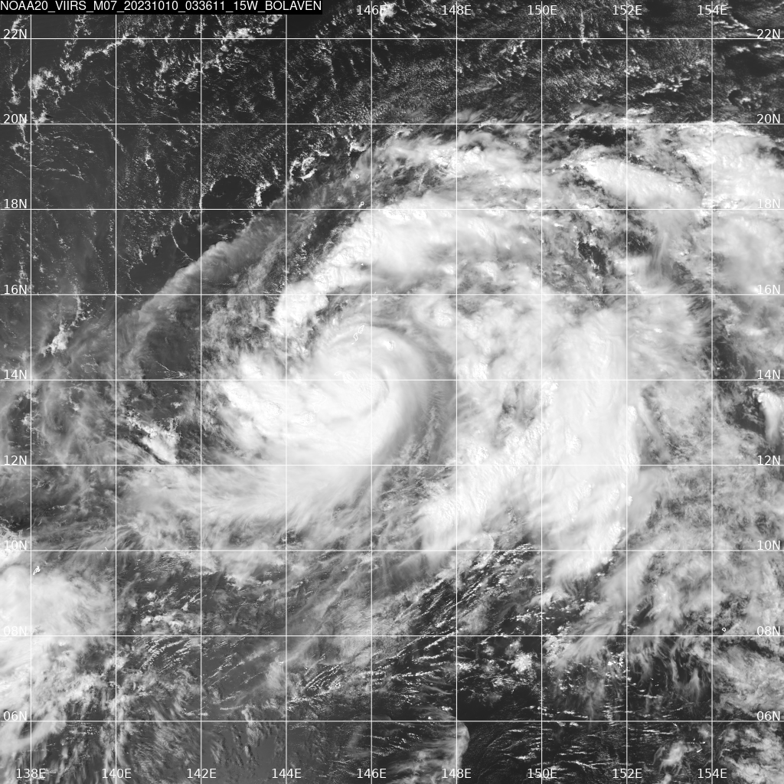
Imagers give a view of a surface
You can use Imager data to derive products. Sometimes that derivation requires information from Numerical Models
(For example, I might have added a Sea Surface Temperature analysis under the image of Bolaven)
M07 from NOAA-20 VIIRS
10 October 2023
0336 UTC (0.86 μm)
Typhoon Bolaven, east of Guam

Slide 8
Imagers give information from one level
Sounders give volumetric information
CrIS, IASI, HIRAS-2
  Cross-Track Infrared Sounder (1305 bands)
    3.92 – 4.64 μm; 5.71 – 8.26 μm; 9.13 – 15.4 μm
    2155 – 2550 ; 1210 – 1750 ; 650 – 1095
  Infrared Atmospheric Sounding Interferometer (8461 bands)
    3.62 – 15.5 μm ; 645 – 2760
  Hyperspectral Infrared Atmospheric Sounding-2 (3000+ bands)
    3.92 – 4.64 μm ; 5.71 – 8.26 μm ; 8.8 – 15.38 μm
    2155 – 2550 ; 1210 – 1750 ; 650 – 1136
GIIRS, GIIRS-2
  Geostationary Interferometric Infrared Sounder (1188 detectors on FY-4B)

Slide 9
What can sounding data give you: Vertical Profiles of temperature and moisture
The >1000 observations of radiances you get from a sounder could represent the emissions from more than one atmosphere
The challenge is to find the most likely combination of temperature and moisture profiles that yield the observations
  This is a tricky mathematical problem
  For 40+ years this has been achieved using Radiative Transfer Models (RTMs) – that are computationally slow
  How to become famous: Devise a speedy way to transform the observations to the most likely atmosphere

Slide 10
Slido Question #3
In clear skies, from where does the information that a ‘water vapor’ infrared channel (for example, Band 8 on AMI at 6.24 μm) detects originate?
  A: From the Earth’s Surface
  B: From around 900 mb
  C: From around 550 mb
  D: From around 350 mb
  E: I need more information!

Slide 11
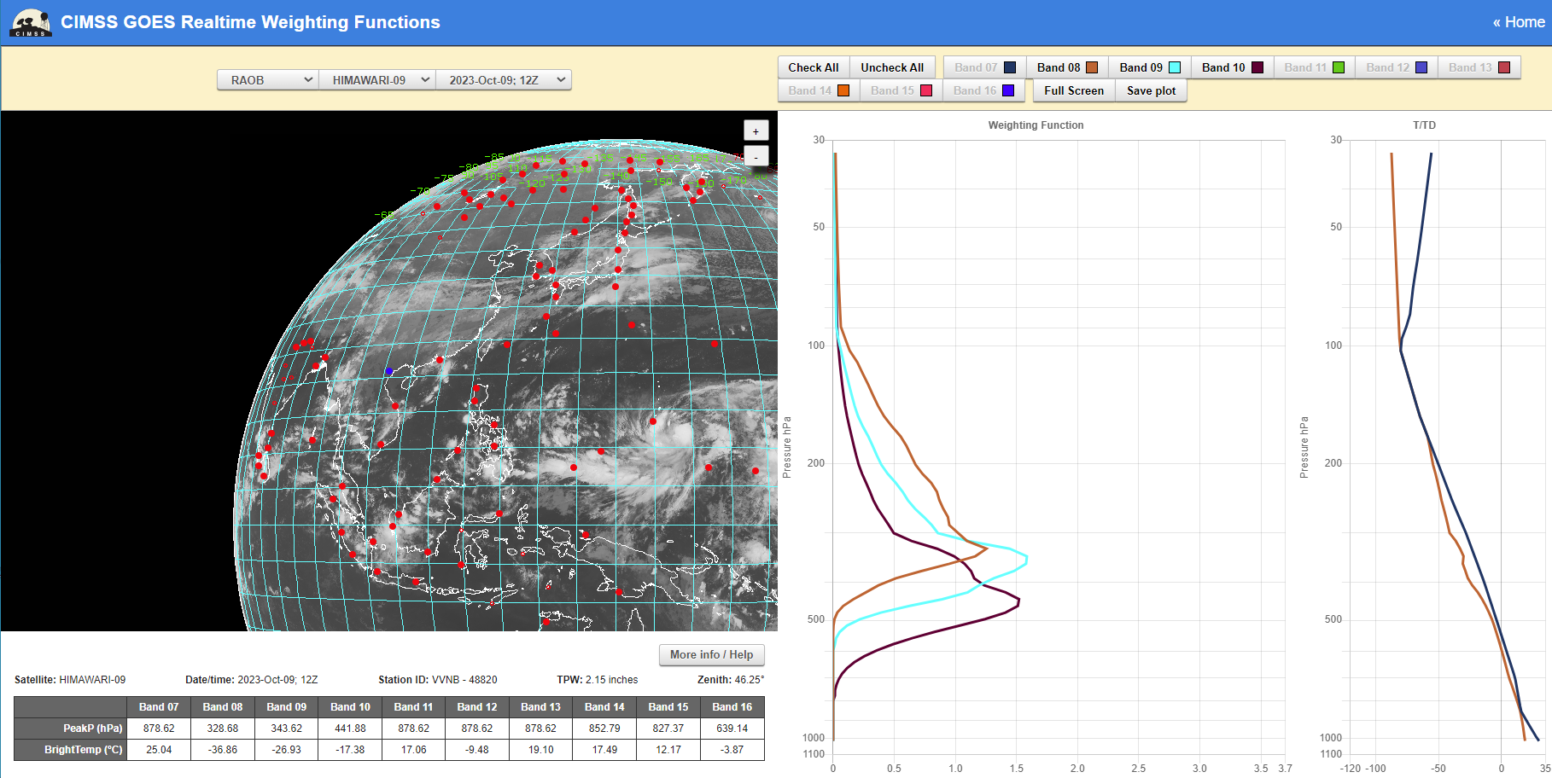
Weighting Function
326 mb
344 mb
441 mb
AHI has 3 bands in the part of the spectrum that is sensitive to water vapor absorption
Where does the information sensed by those three channels originate in the vertical?
This is a function of water vapor in the column

Slide 12
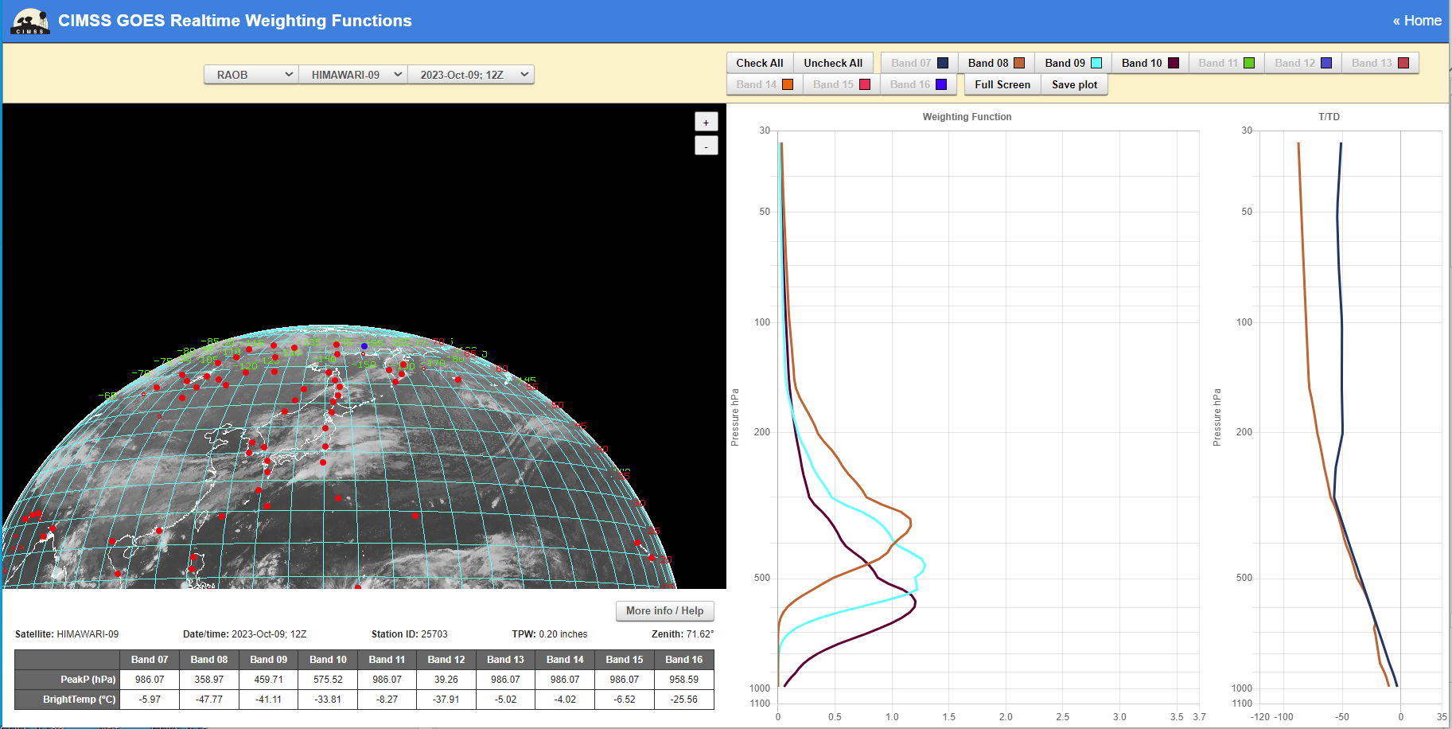
Weighting Function
358 mb
460 mb
576 mb
AHI has 3 bands in the part of the spectrum that is sensitive to water vapor absorption
Where does the information sensed by those three channels originate in the vertical?
This is a function of water vapor in the column

Slide 13
The complication of water vapor
“Water Vapor” bands on a satellite are sensing emissions at different wavelengths (6.21, 6.94, 7.33 μm on AMI)
  The ability of water molecules to absorb energy at those wavelengths varies as a function of wavelength
    A thin region of water vapor might absorb most of the energy at 6.21 μm, but a lot of the 7.33 μm energy will move through it.
    What is the temperature of the water vapor. That also affects the absorption.
    Are there big gradients in temperature that can be sensed through the water vapor?

Slide 14
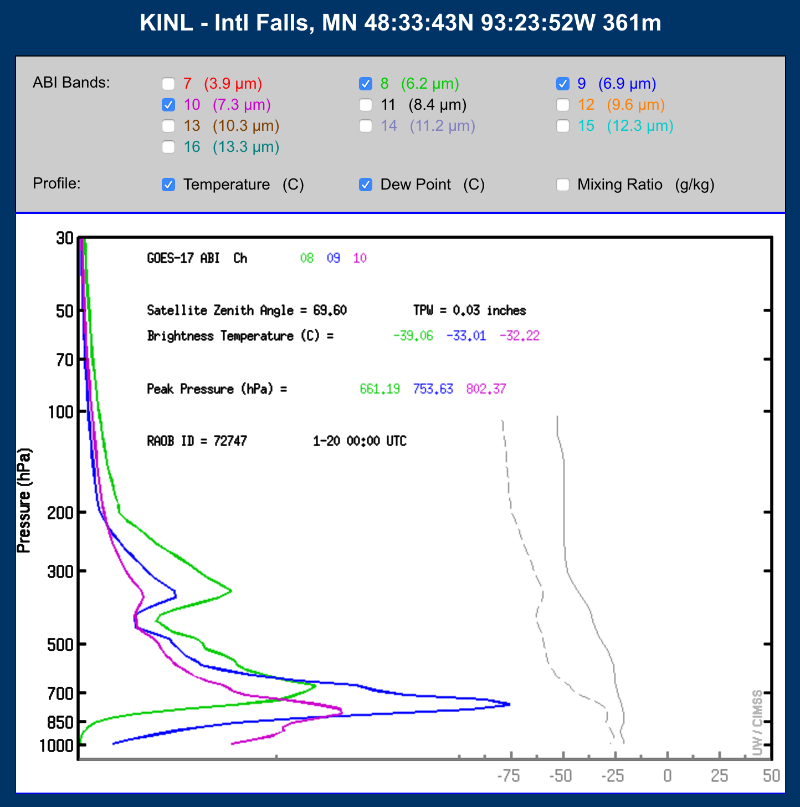
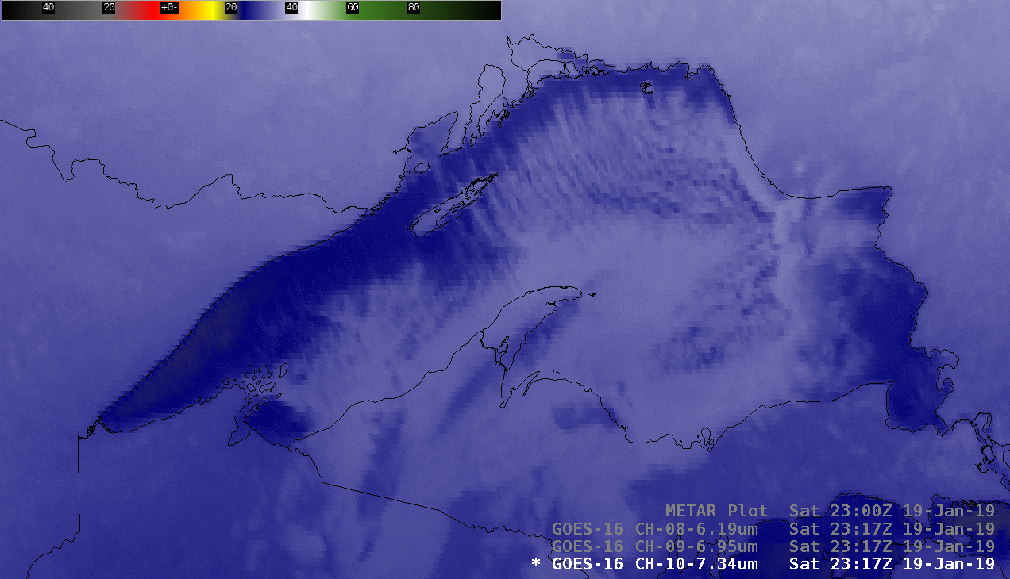
When the air is very very dry (usually it’s cold too) you can see the surface in water vapor imagery

Slide 15
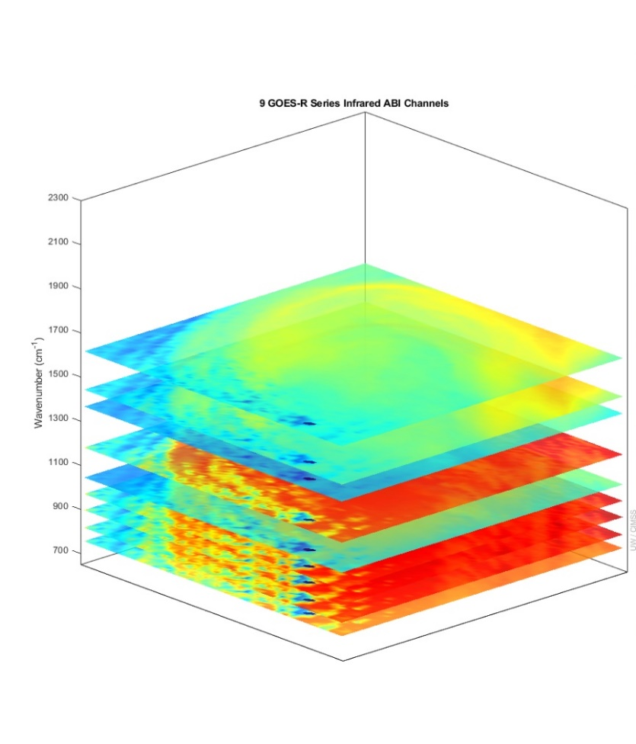
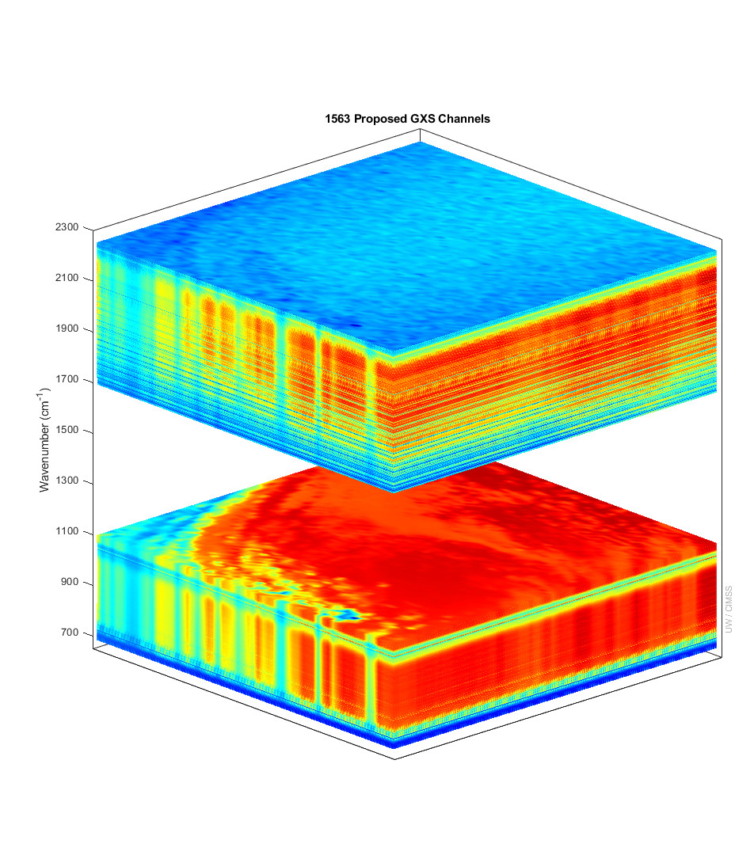
More spectral bands means more temperature/moisture information in the vertical
ABI GXS
9 ABI IR Bands
1000s of GXS Bands
There are more than six times (temperature) and four times (moisture) of number of independent pieces of vertical information in this proposed sounder compared to the ABI.
(And up to 20 times more for thin clouds.)
The weighting functions mean that 3 (overlapping) moisture layers are resolved (in clear skies)
Number of Independent Pieces of Vertical Information
 | GXS | ABI
Temperature | 13 | 2
Moisture | 11 | 2.5
GXS is the sounder on GeoXO
Notes:
Y axis is wavenumber. ABI and GOES Sounder bands within the GXS range are shown. Credit: UW/CIMSS
Vertical pieces recently calculated by Z. Li, UW/CIMSS.

Slide 16
Slido Question 4:
What could you use Sounder information for?

Slide 17
Sounder data is in three dimensions
You can show vertical profiles of information
You can show horizontal fields of information

Slide 18
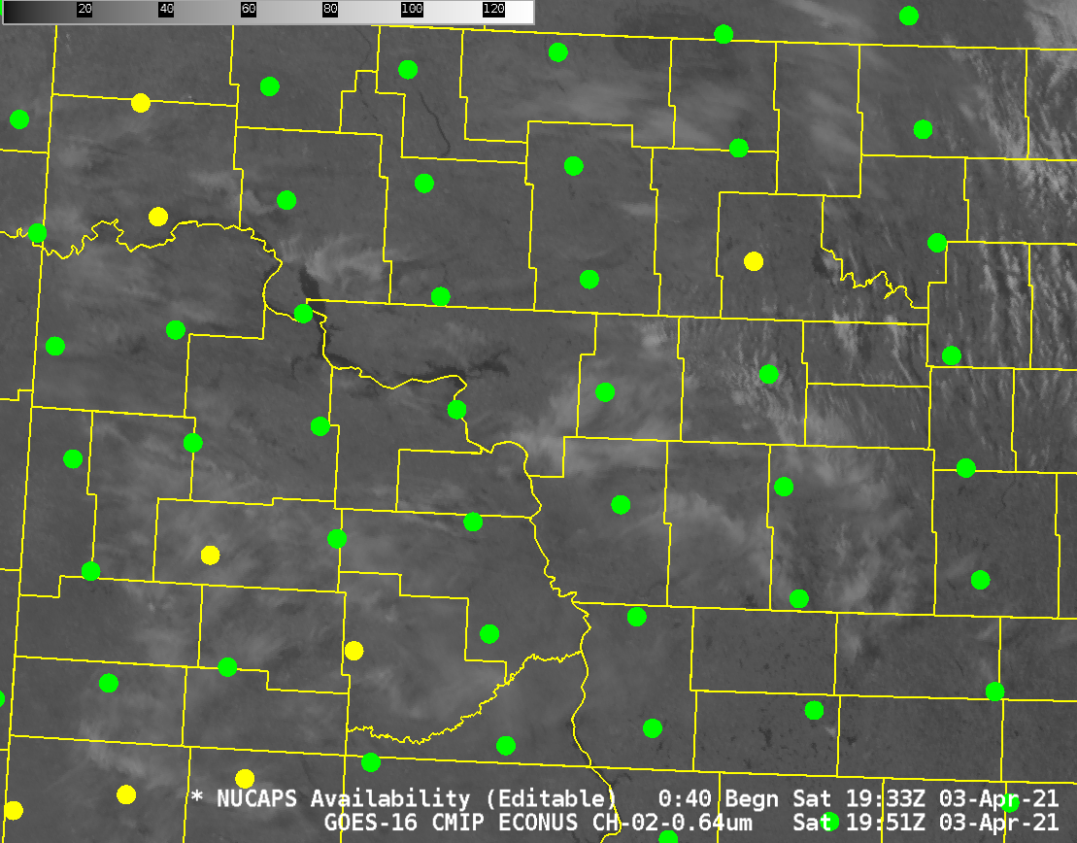
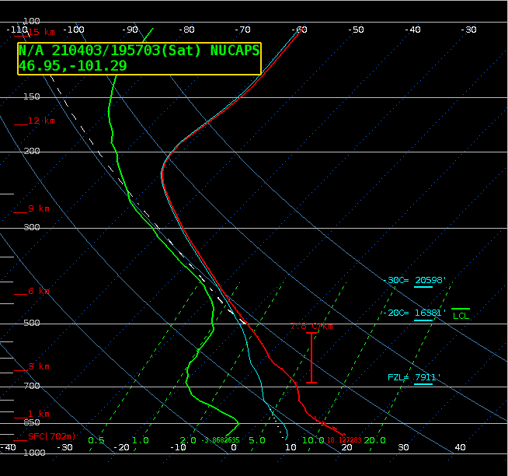
Example of using temperature/moisture data to determine environment
Retrieved Soundings from near a fire location ( )

Slide 19
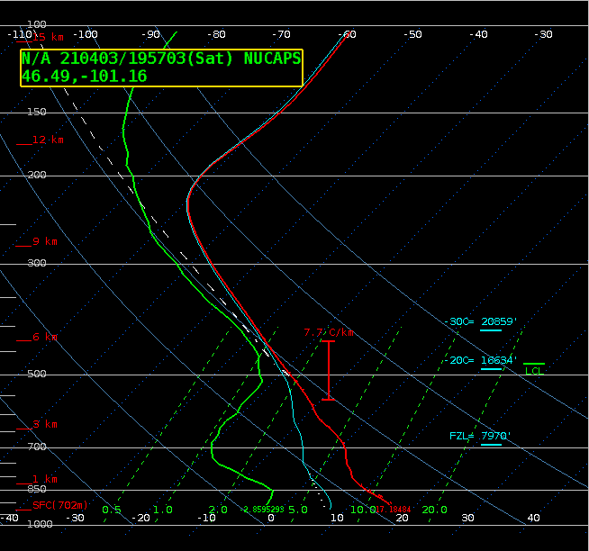
Example of using temperature/moisture data to determine environment
Is this an elevated mixed layer?
What does the Imager show?
Retrieved Soundings from near a fire location ( )

Slide 20
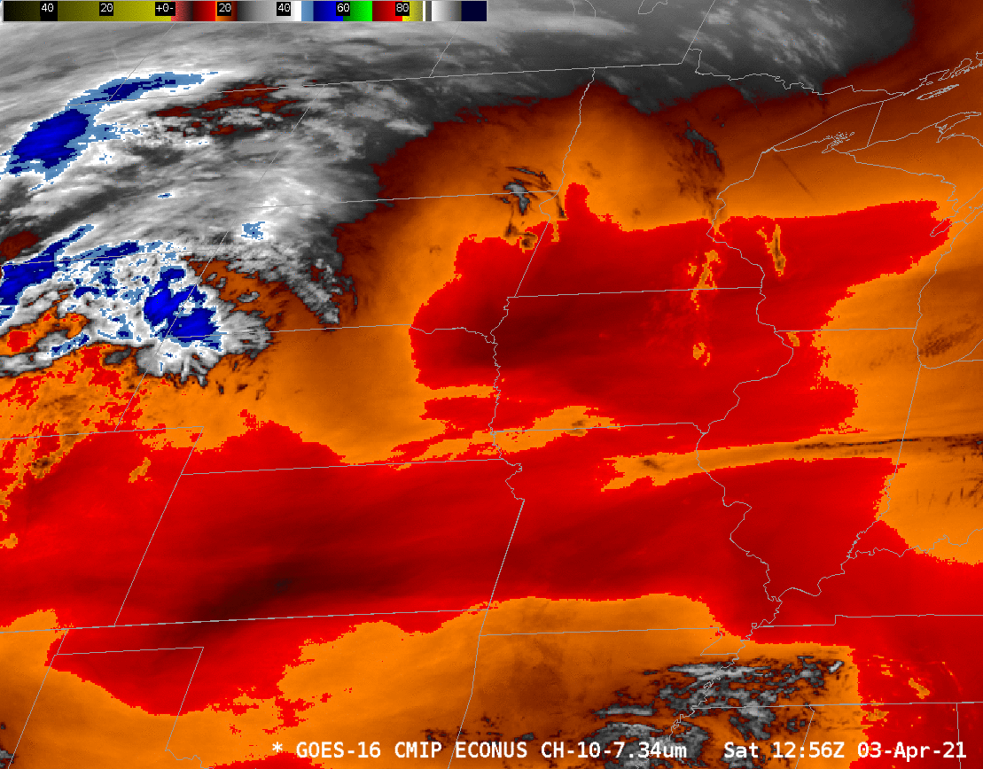

Slide 21
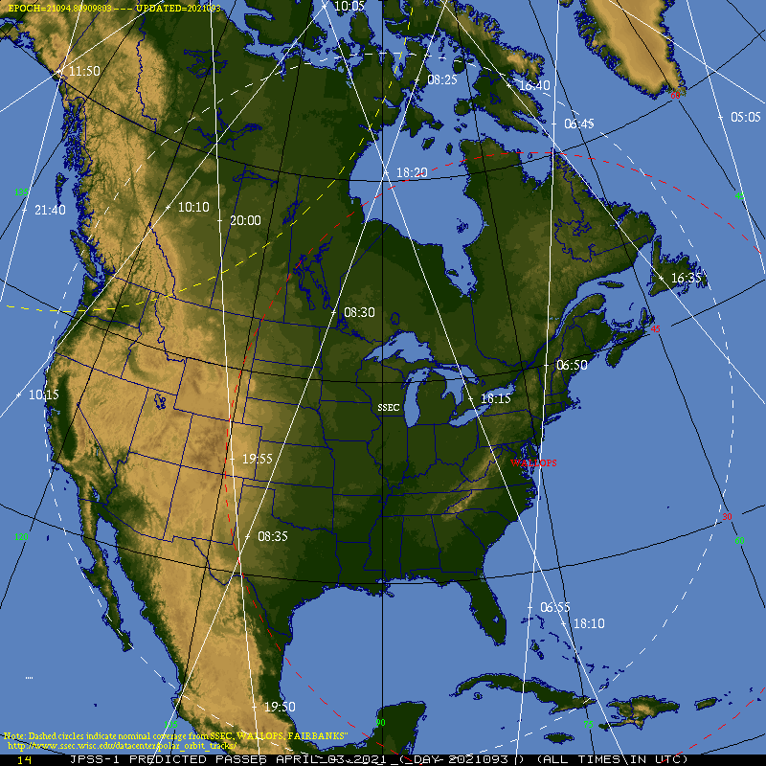
Where can you find maps like this?
https://www.ssec.wisc.edu/datacenter/polar_orbit_tracks/#satellite:NOAA20;region:North%20America;

Slide 22
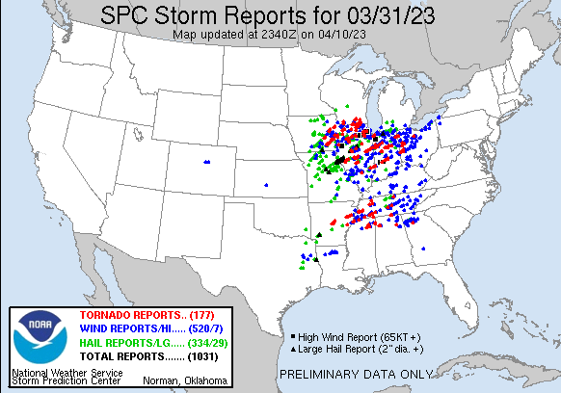
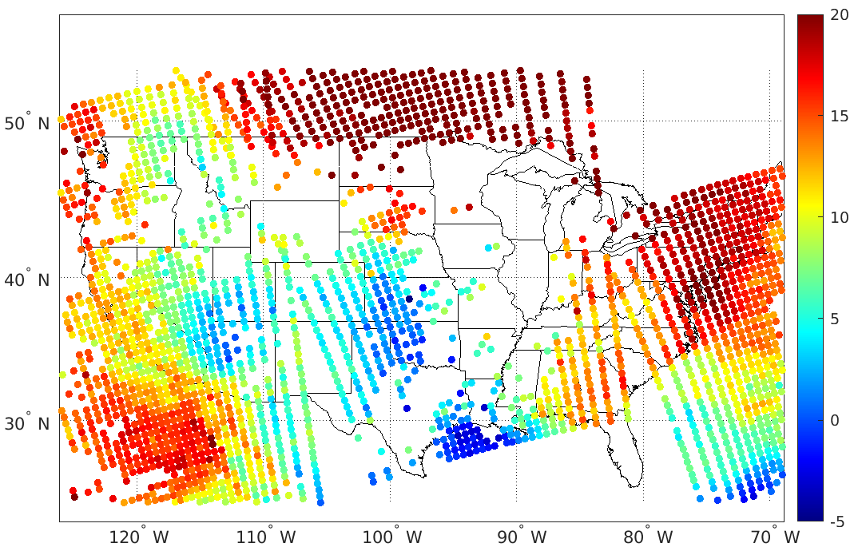
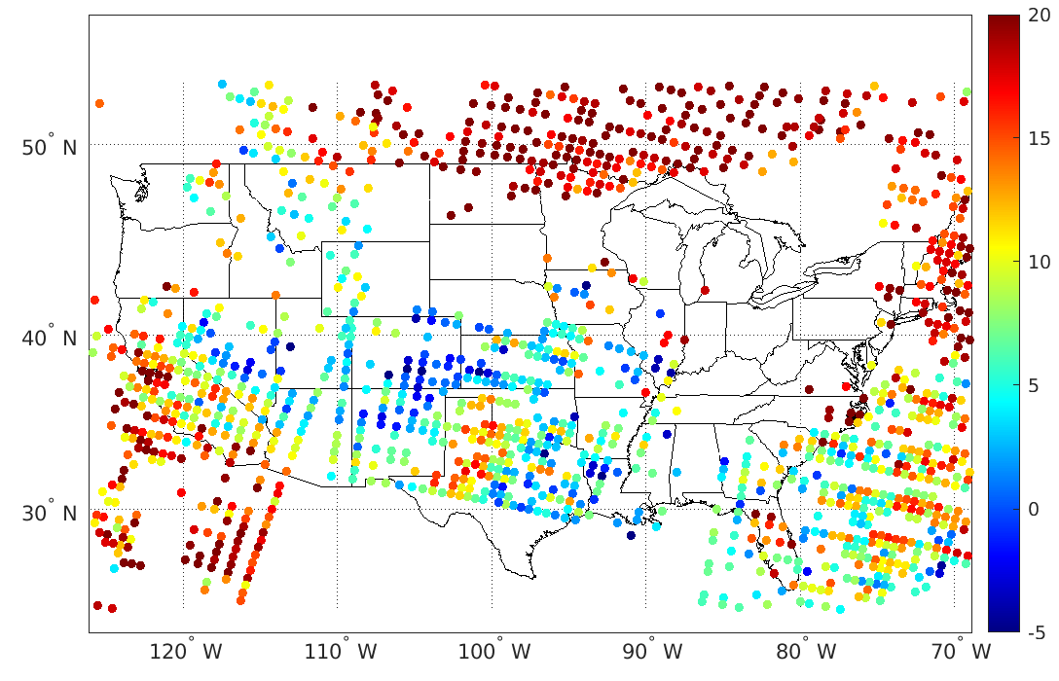
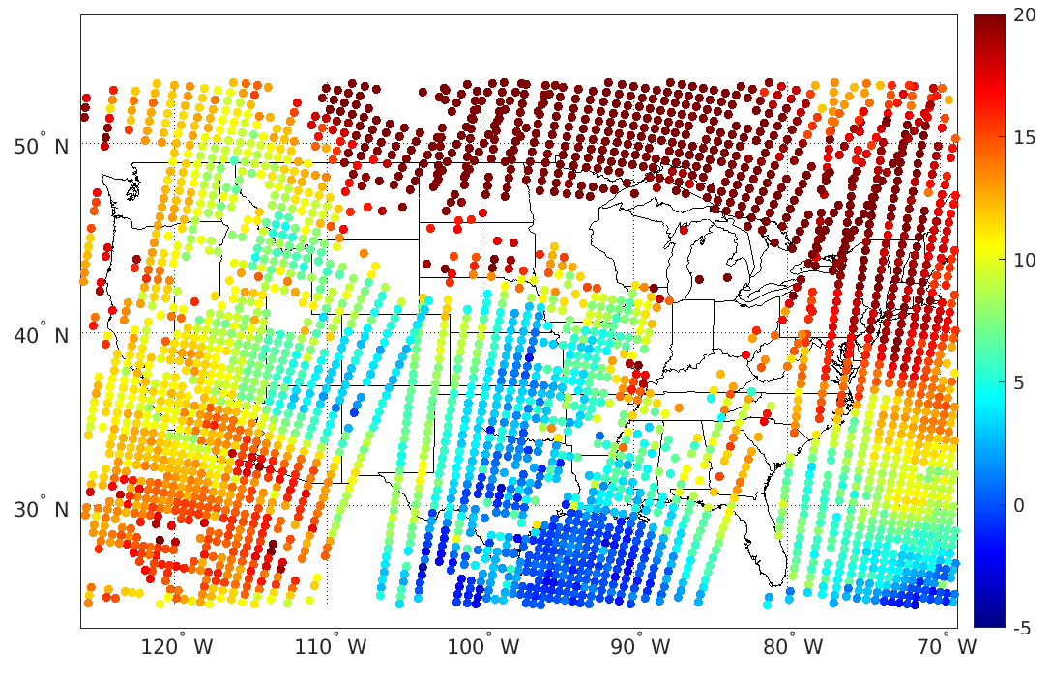
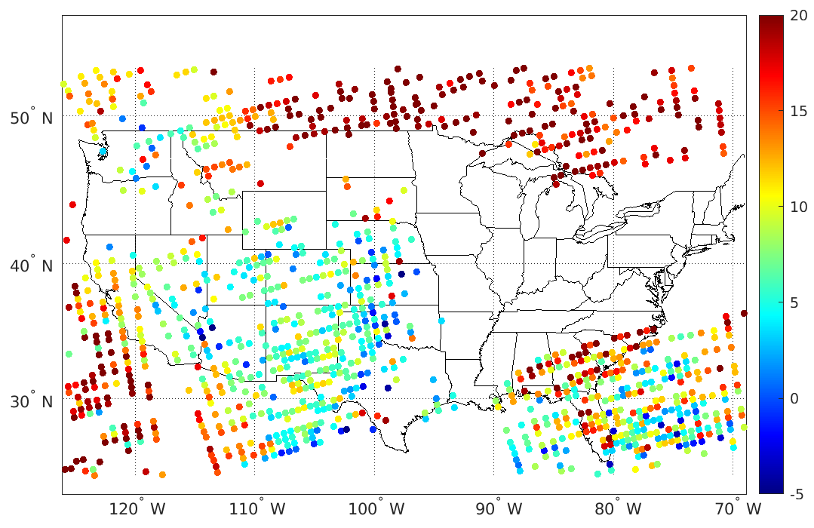
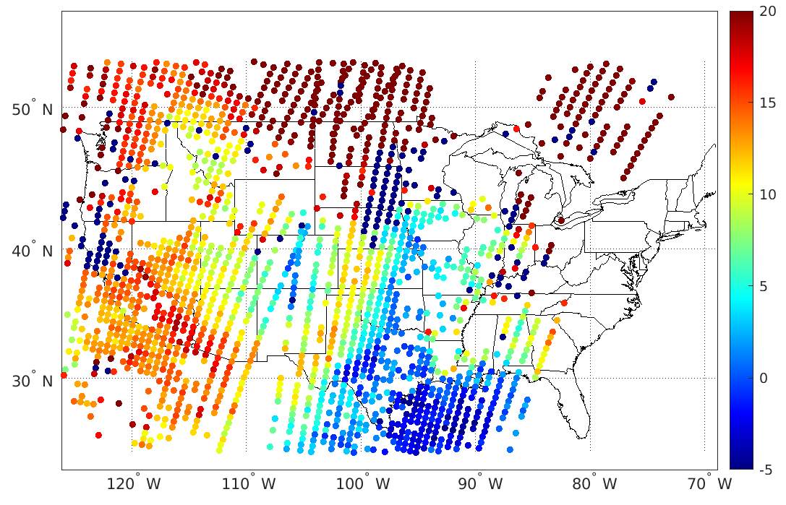
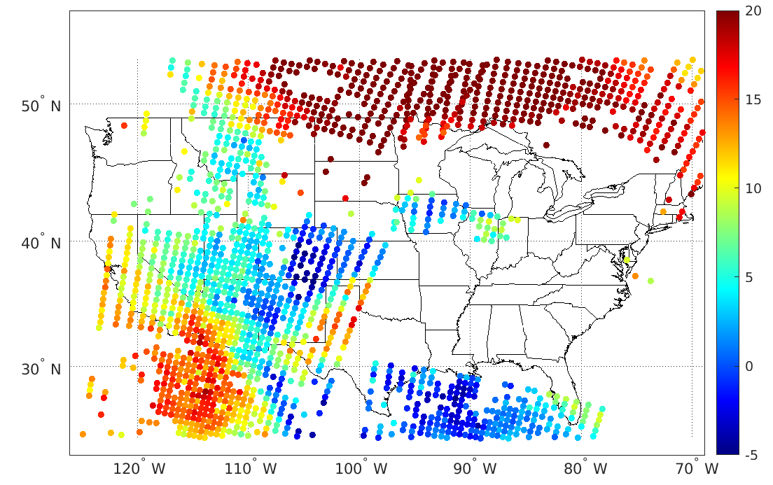
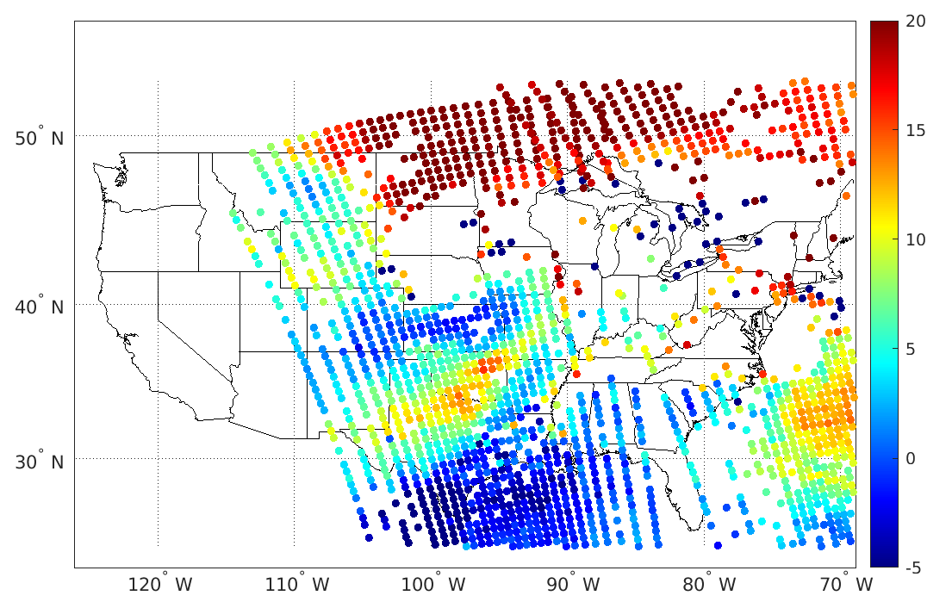
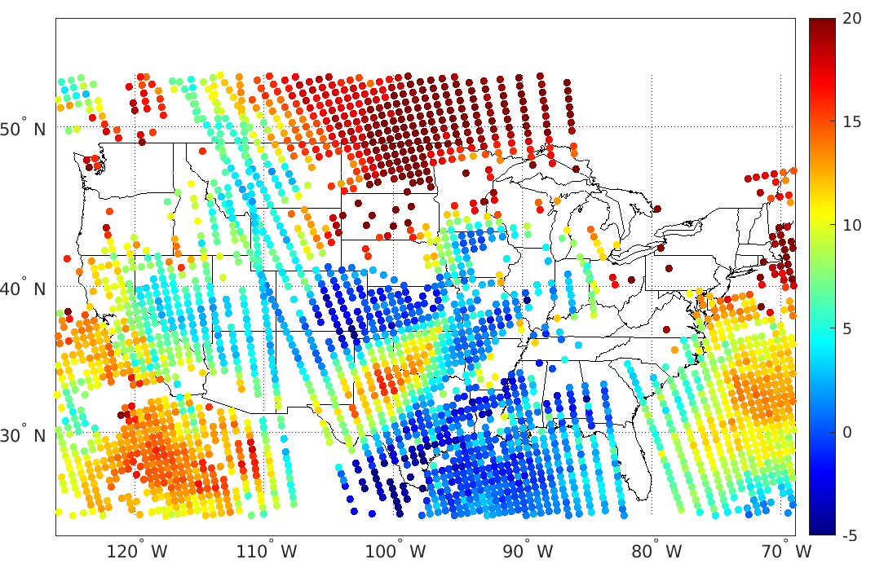
Satellite overpass time over CONUS on 31 March 2023
Early morning FY-3E sounding profiles to fill in the temporal gap!
METOP-C
METOP-B
NOAA-20
FY-3E
METOP-C
METOP-B
NOAA-20
FY-3E
00
02
04
06
08
10
12
14
16
18
20
22
00
00
02
04
06
08
10
12
14
16
18
20
22
00

Slide 23
Metop-C 15-18 UTC
Metop-B 14-19 UTC
Lifted index
NOAA-20 17-22 UTC
FY-3E 21-00 UTC

Slide 24
All that data on the previous page: Observed from satellite
No need to worry about model biases or bad initialization
However, infrared sounder data doesn’t give great information where clouds are in the way

Slide 25
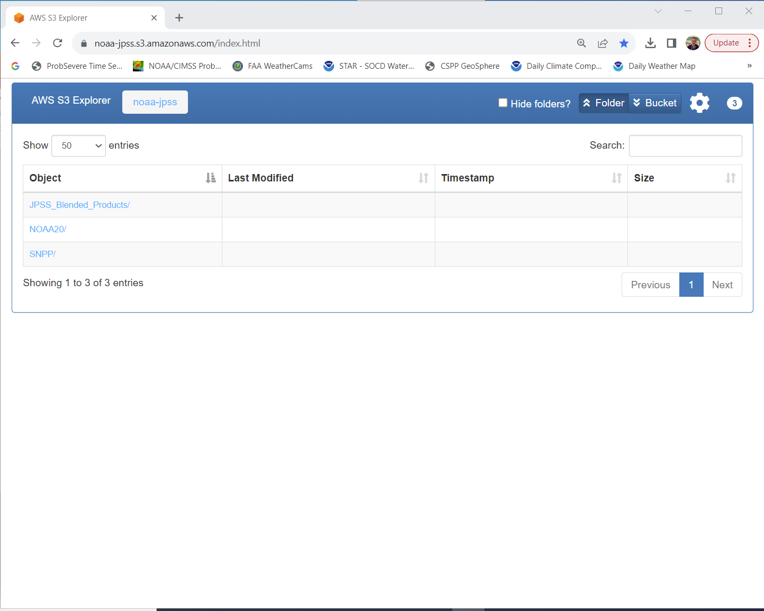
NOAA-20 (and Suomi NPP) sounding data are available online https://noaa-jpss.s3.amazonaws.com/index.html
https://noaa-jpss.s3.amazonaws.com/index.html

Slide 26
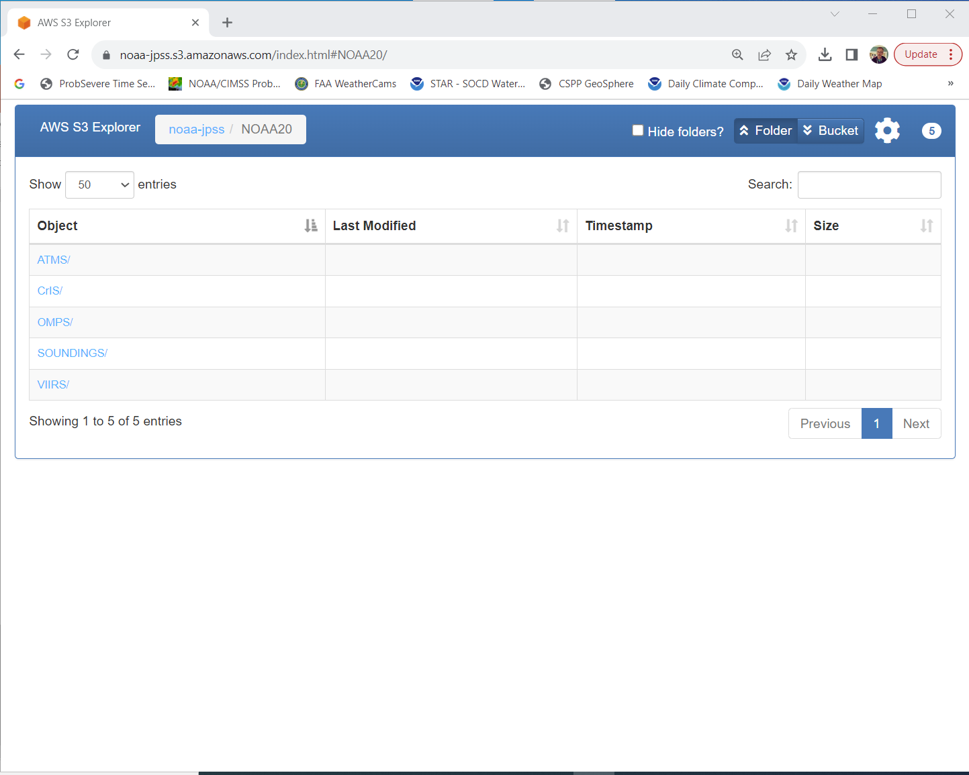
NOAA-20 (and Suomi NPP) sounding data are available online https://noaa-jpss.s3.amazonaws.com/index.html
https://noaa-jpss.s3.amazonaws.com/index.html

Slide 27
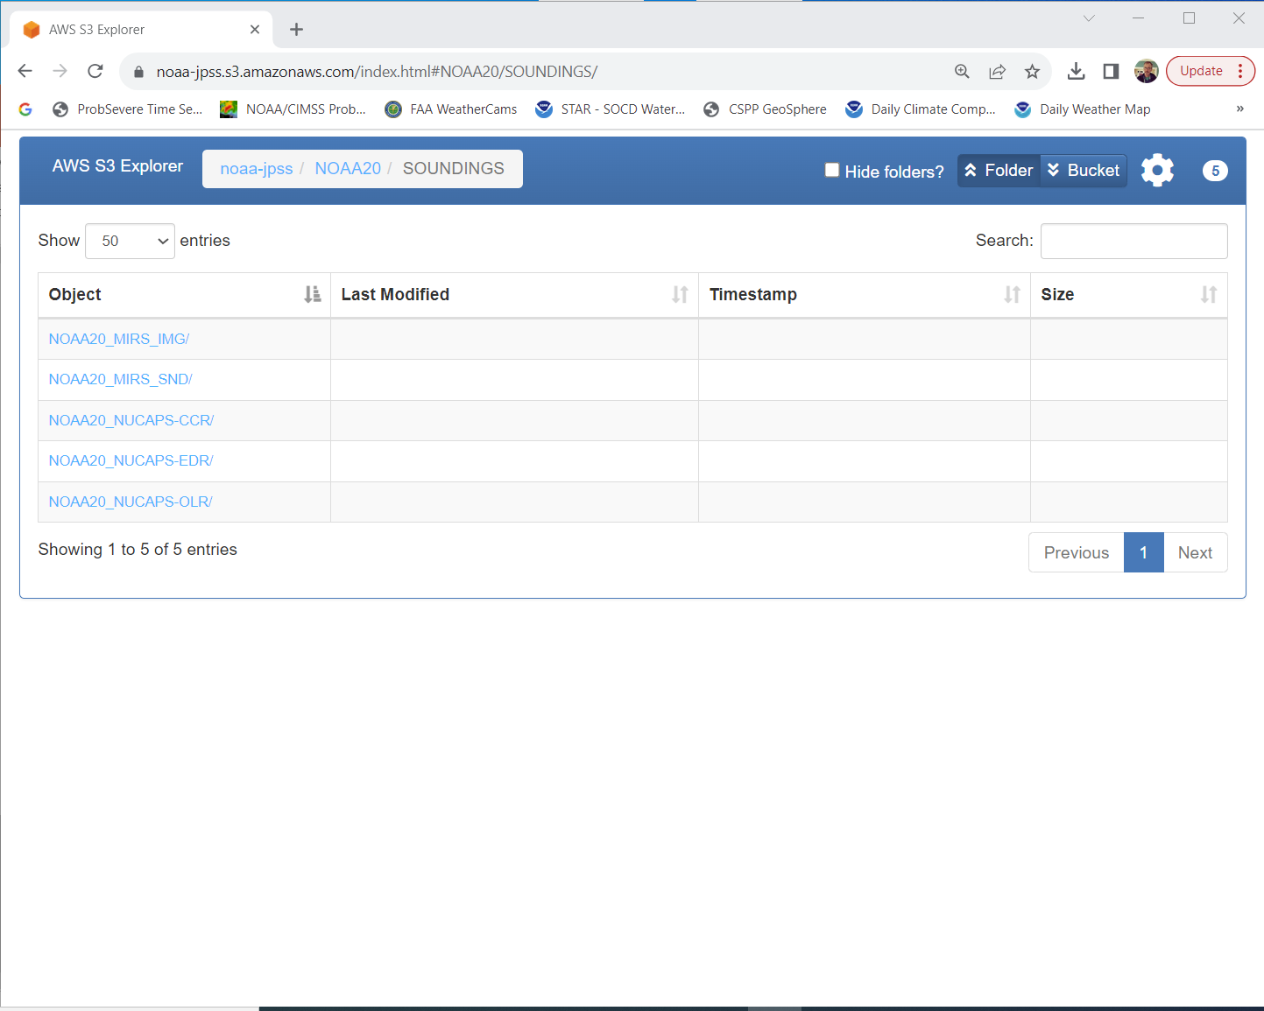
NOAA-20 (and Suomi NPP) sounding data are available online https://noaa-jpss.s3.amazonaws.com/index.html
https://noaa-jpss.s3.amazonaws.com/index.html

Slide 28
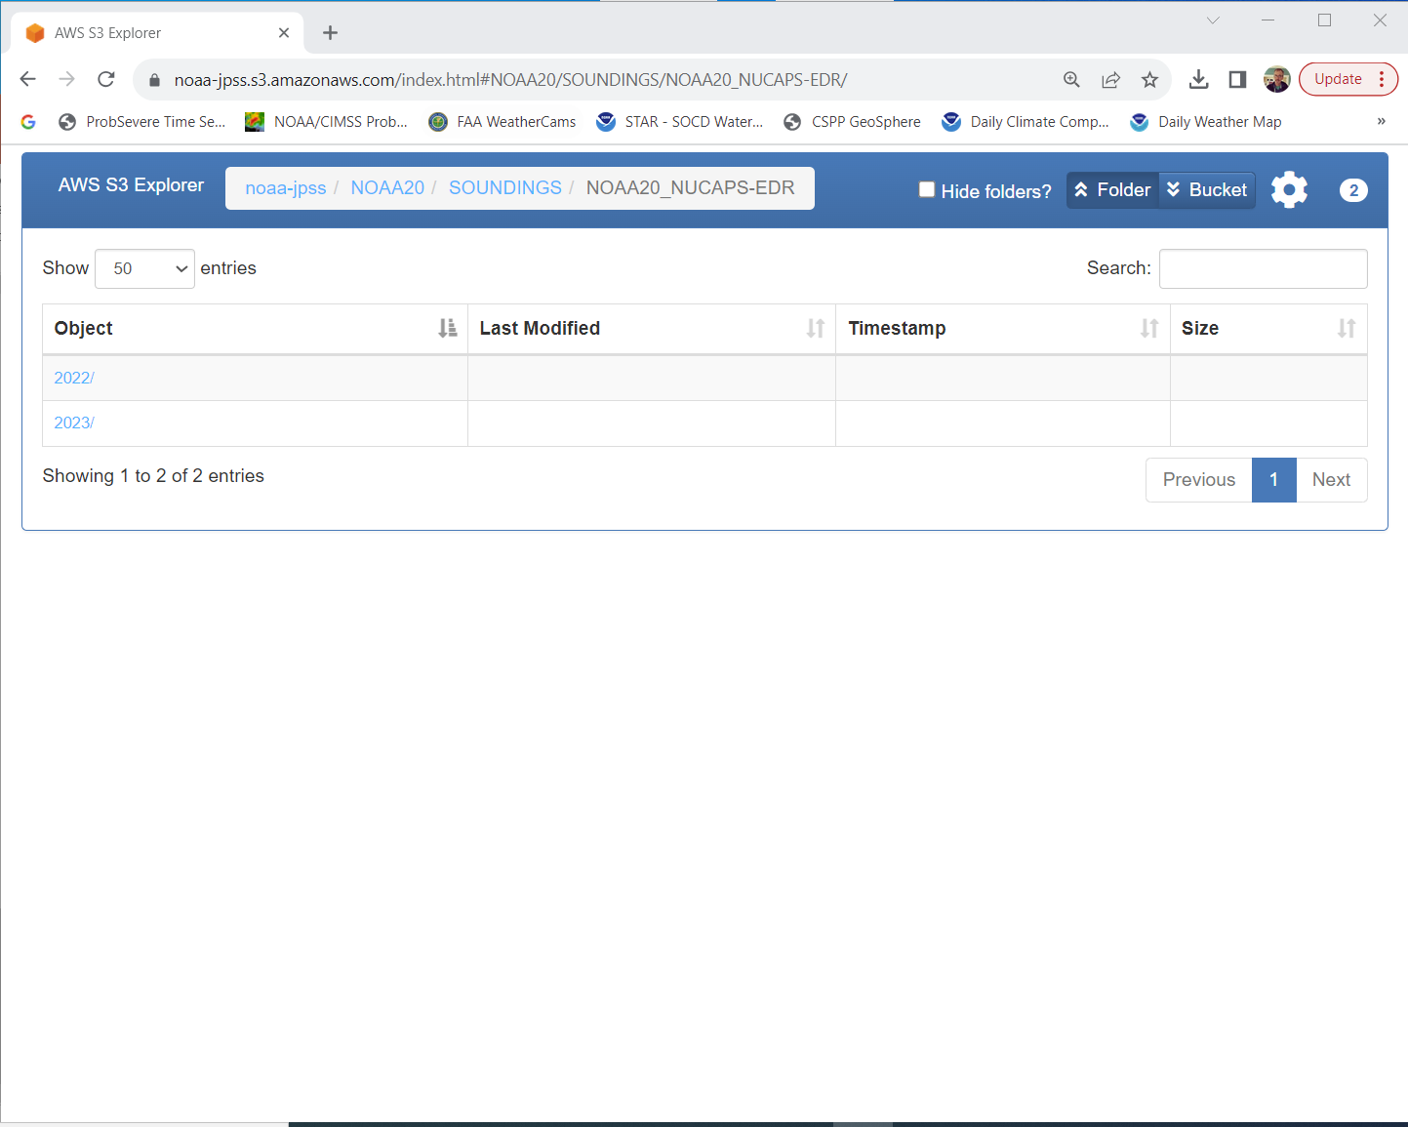
NOAA-20 (and Suomi NPP) sounding data are available online https://noaa-jpss.s3.amazonaws.com/index.html
https://noaa-jpss.s3.amazonaws.com/index.html

Slide 29
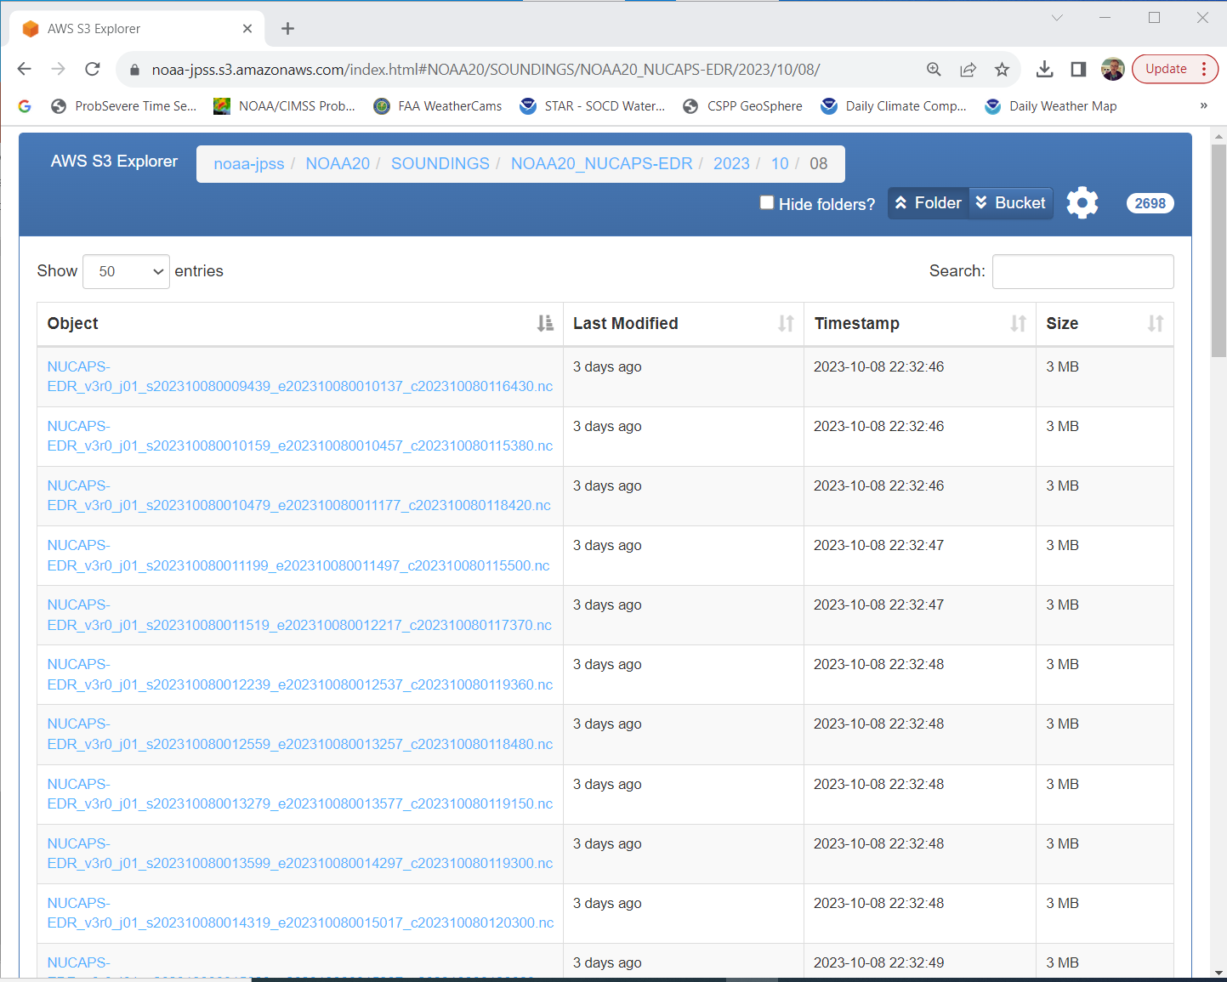
NOAA-20 (and Suomi NPP) sounding data are available online https://noaa-jpss.s3.amazonaws.com/index.html
https://noaa-jpss.s3.amazonaws.com/index.html
Where is NOAA-20 at these times?

Slide 30
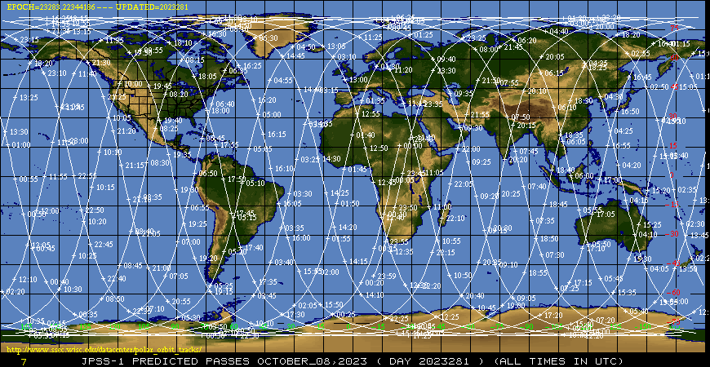
Find orbit paths online
https://www.ssec.wisc.edu/datacenter/polar_orbit_tracks/

Slide 31
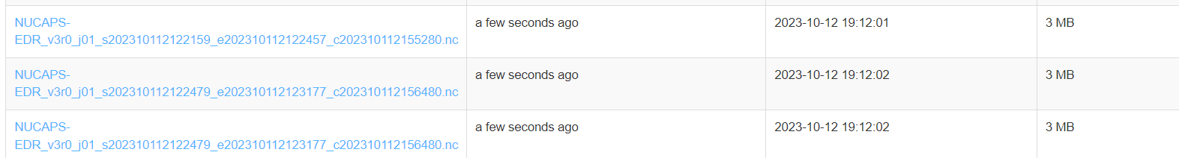
How timely are the data at that website?
Data from 2122 UTC on 11 October!
Written at 19:12 on 12 October
(or – 0012 UTC on 13 October)
Conclusion: Data aren’t useful for real-time, but are useful for post-storm analysis

Slide 32
Geostationary Sounders
Constantly view one region (typically not full disk)
  GIIRS (FY-4B) views
    a 5000x5000 km China domain in 45 minutes
    a 1000x1000 km meso domain in 15 minutes
Direct link to website to view products: https://satellite.nsmc.org.cn/PortalSite/Data/DataView.aspx?SatelliteCode=FY4B&SatelliteType=1&InstrumentTypeCode=GIIRS&currentculture=en-US

Slide 33
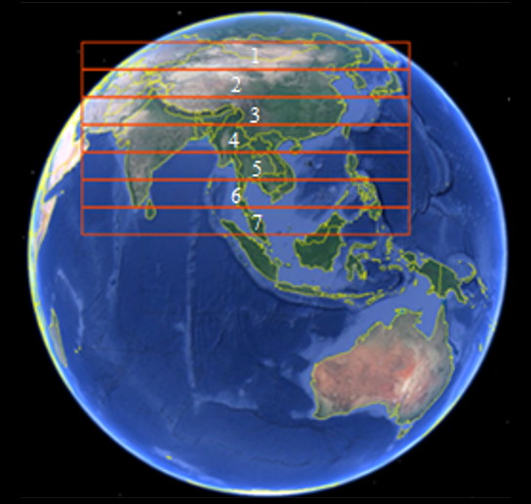
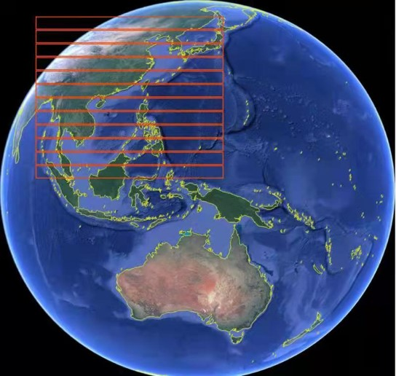
Where does GIIRS view?
FY4A GIIRS domain
FY4B GIIRS domain
Image Source

Slide 34
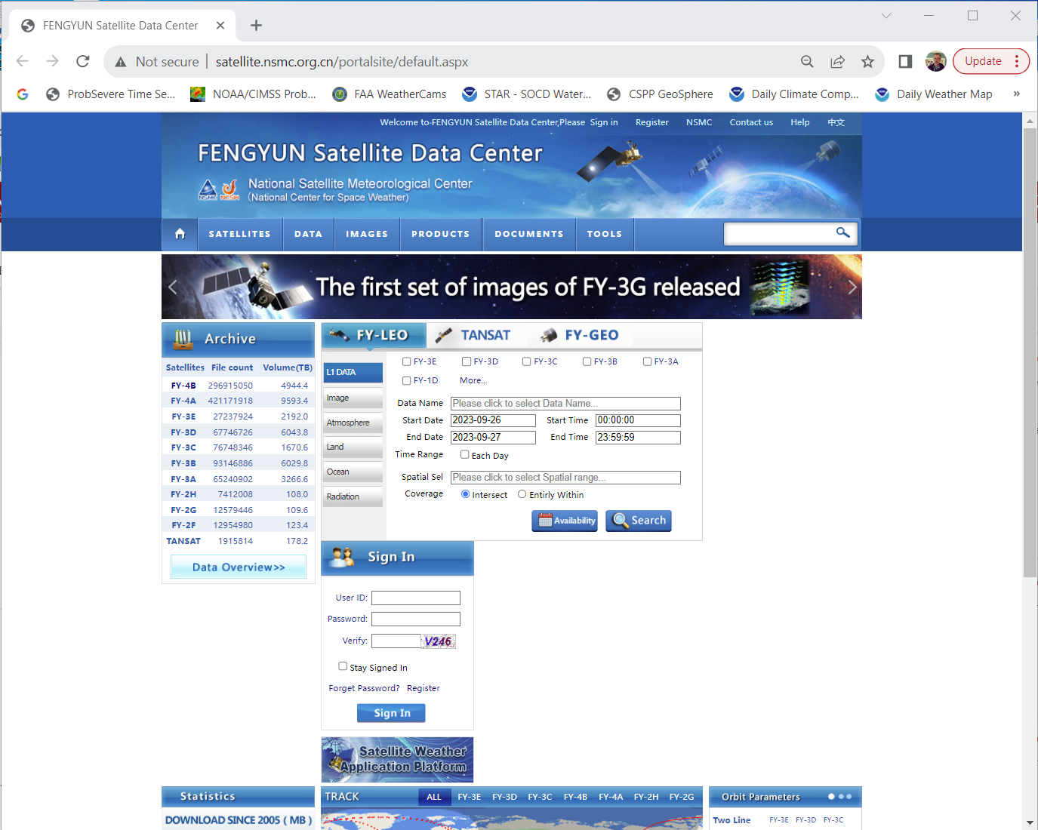
How to get GIIRS data
Create a User
Presence
(or log in!)
We want to access GEO

Slide 35
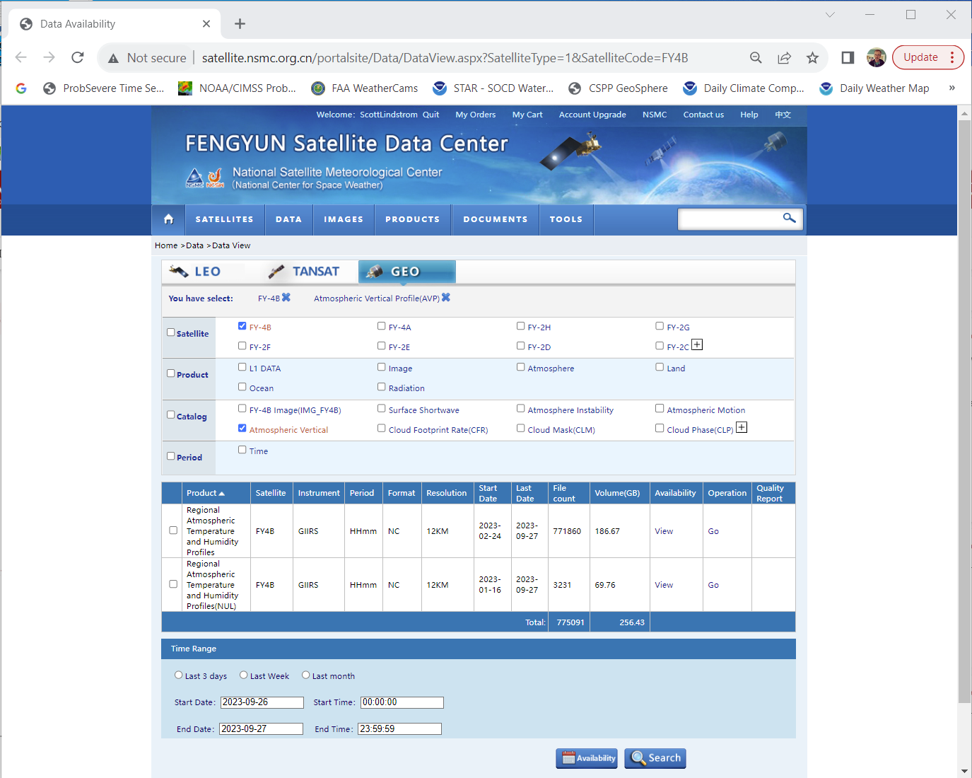
How to get GIIRS data
Choose what you want
Satellite
Data

Slide 36

How to get GIIRS data
Choose what you want
Satellite
Data
Start/end Data
as shown

Slide 37
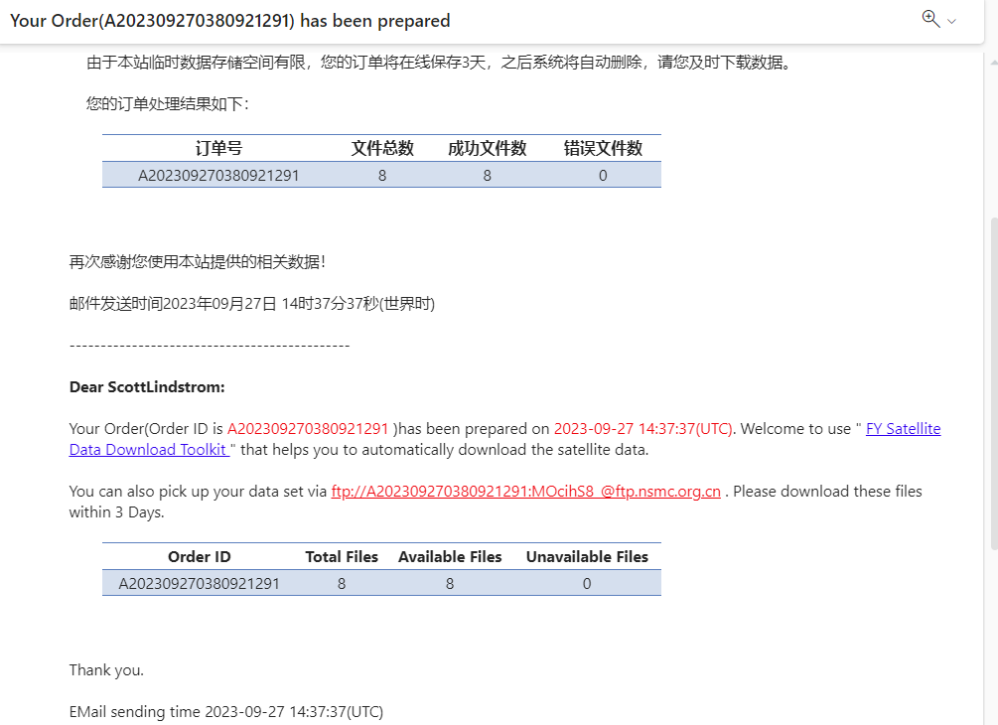
How to get GIIRS data
Email tells you where the data are
Email tells you where the data are
ftp server at ftp.nmsc.org.cn
User name: A202309270380921291
Password: MOcihS8_
(this changes with every order!!)

Slide 38
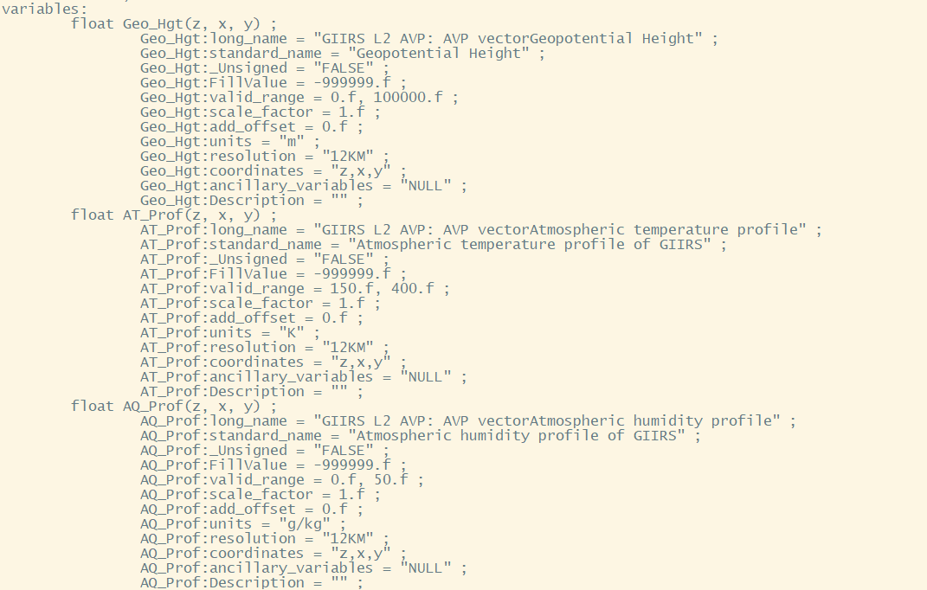
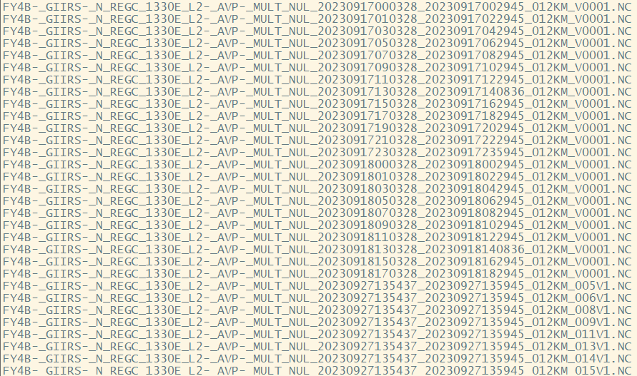
List of netCDF files (downloading takes a while)
z Dimension: Levels in RTM ; x: cross-track ; y: along-track
There’s also a Quality Flag variable

Slide 39
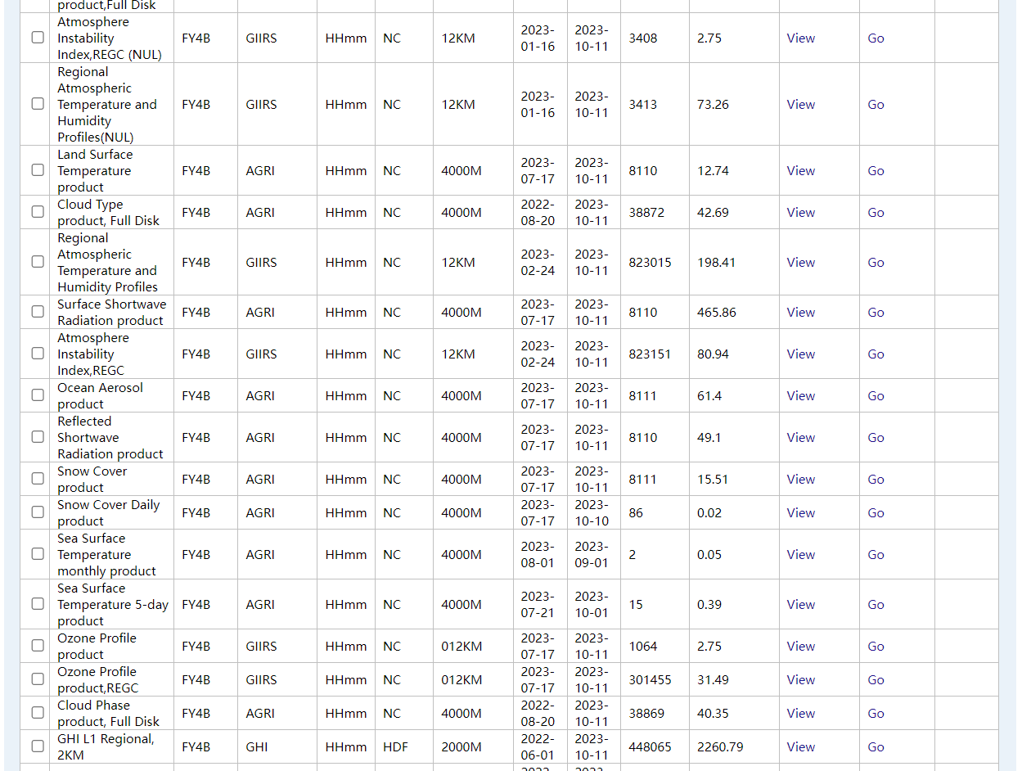
GIIRS and AGRI and GHI possibilities

Slide 40
What’s the problem with the above?
You cannot automate this
  Access requires you to go to the website, and order the data, and then go get it!
  Maybe there are inter-governmental agreements out there that I don’t know about that allow a quick transfer of data if it is taken over your region of interest
Ask your bosses to streamline data access for Geo Sounder data, or from polar orbiting sounder data

Slide 41
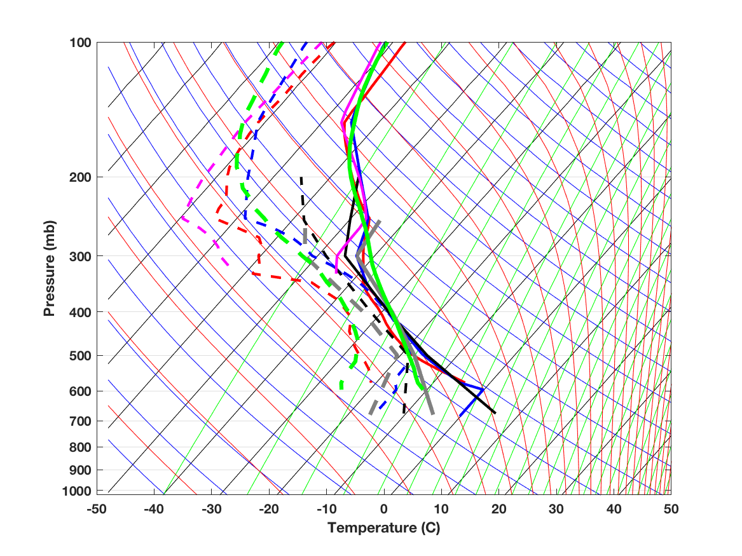
GIIRS Sounding
Black = Radiosonde 12z (8 pm)
Grey = Radiosonde 00z (8 am)
Blue = GDAS (same location as GIIRS) 6z (2 pm)
Red = GIIRS 6z (2 pm)
Green = NUCAPS (same location as CrIS) 21z (5 am)
Magenta = CrIS Dual Regression 6z (2 pm)

Slide 42
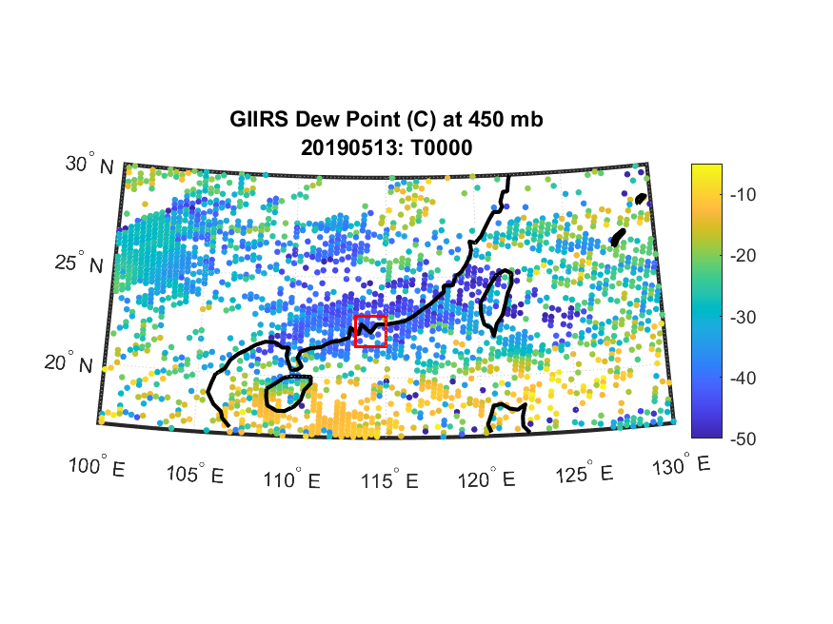
Derived GIIRS dewpoint at 450 mb

Slide 43
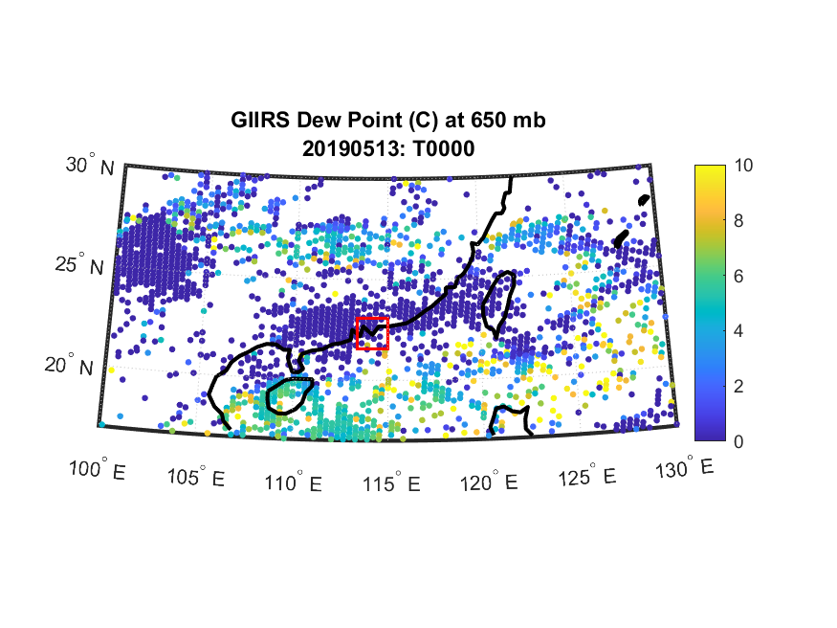
Derived GIIRS dewpoint at 650 mb

Slide 44
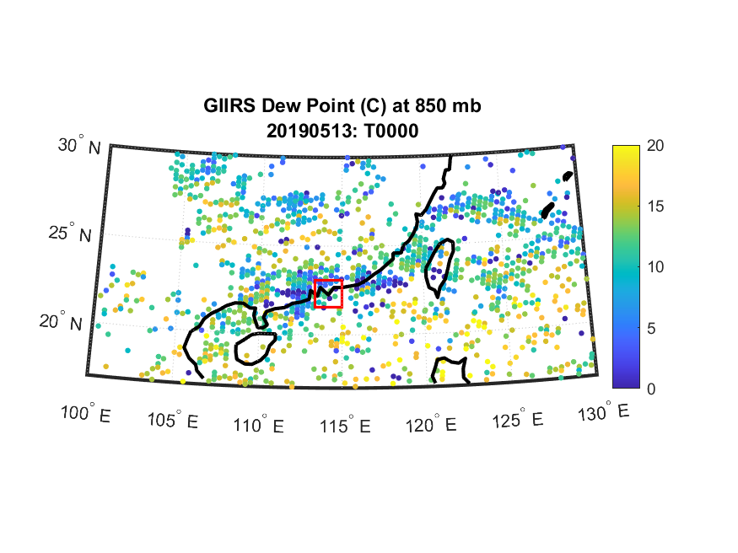
Derived GIIRS dewpoint at 850 mb

Slide 45
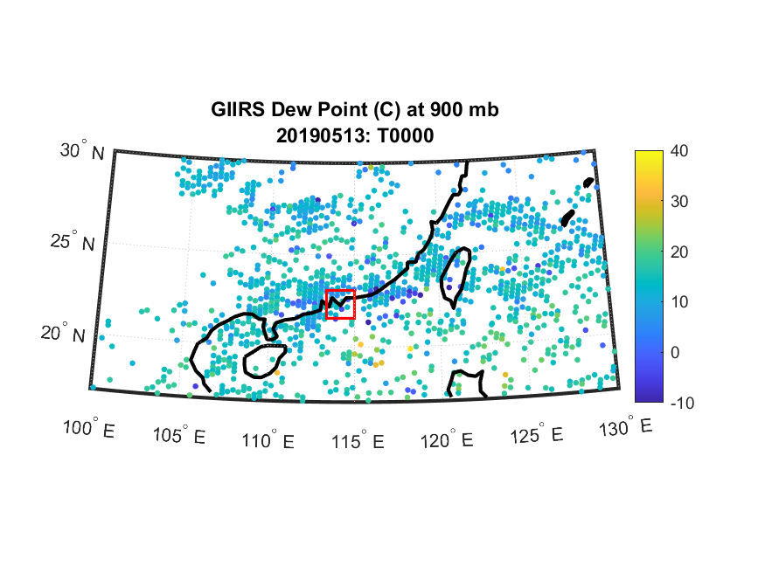
Derived GIIRS dewpoint at 900 mb

Slide 46
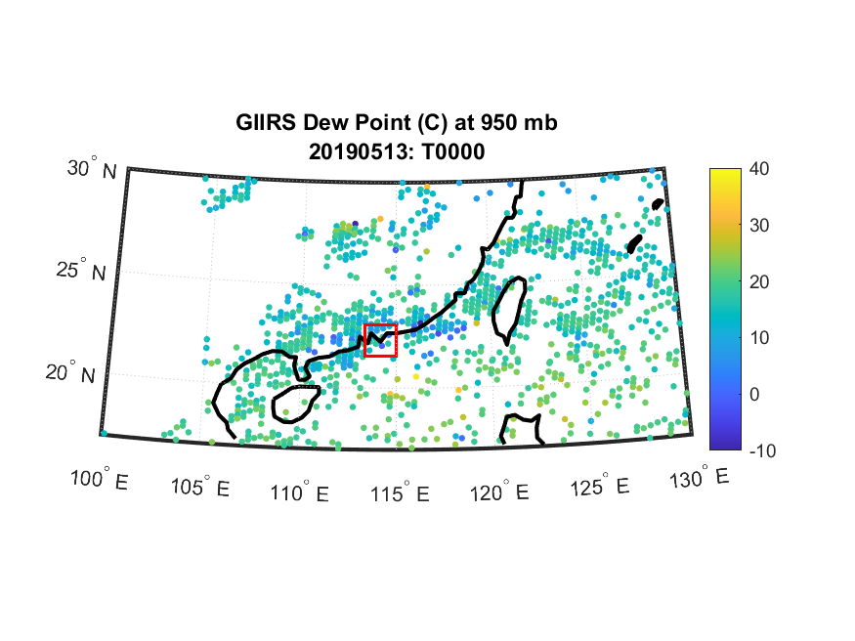
Derived GIIRS dewpoint at 950 mb

Slide 47
Satellite Observations
These are current observations
They give you information that is different from a model simulation/forecast
Can help you fine-tune what you want to investigate
Can help you better define what is happening right now, and what to expect

Slide 48
Geo Sounders are coming: Get used to using/understanding their data
MTG-S1 will be launched in 2024:
  IRS: 4.44-6.25 μm; 8.26 – 14.70 μm
  Sentinel-4: UV sounder
Himawari-10 will have GHMS: Geostationary HiMawari Sounder (launch: 2029)
GeoXO (USA follow-on to GOES-R): mid 2030s

Slide 49
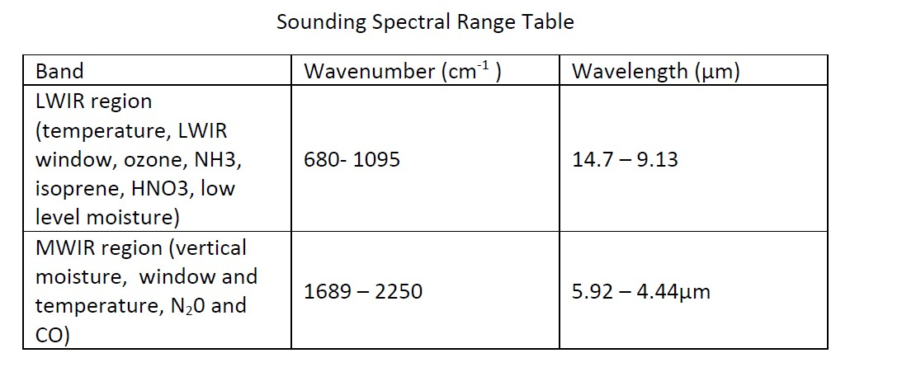
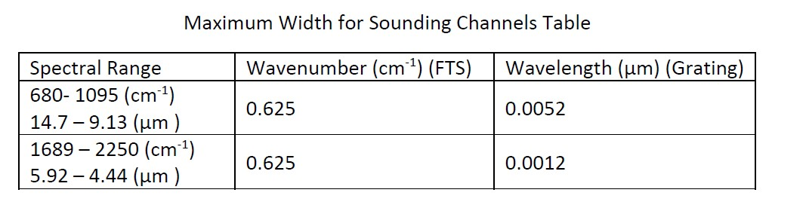
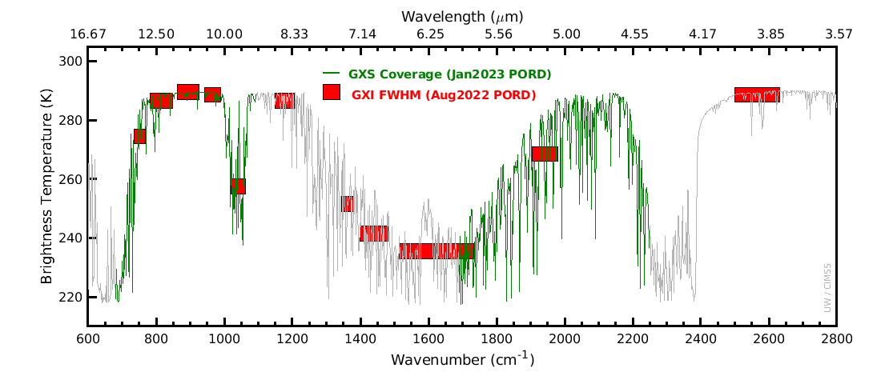
Coming in the 2030s: GXS (Sounder on US Geo Satellite)

Slide 50
IR Sounder Presentations at AOMSUC-13
S2-14, 7 Nov: 13:45-14:00, Estimate of atmospheric vertical information using FY-4B/GIIRS ; Byung-il Lee ; NMSC/KMA
S2-25, 7 Nov: 17:00-17:15, Equivalent cloud property retrievals algorithm based on the FengYun-4 GIIRS ; You Zhao ; Nanjing University

Slide 51
Thank you!
Contact Information:
scott.lindstrom@ssec.wisc.edu
scott.lindstrom@noaa.gov
scottlindstrom1@gmail.com
608 263 4425 (USA Phone number)

