Slide 1
NOAA/CIMSS ProbTor Model
– Training Module –
Spring 2017
Notes:
This is a short training module for users of the NOAA/CIMSS ProbTor Model.
ProbTor is an extension of the NOAA/CIMSS ProbSevere model. This training module is designed for users that are already familiar with the NOAA/CIMSS ProbSevere model and provides only information very specific to the ProbTor model—including data used, examples, validation statistics, and best practices for ProbTor usage by operational forecasters.
If you are not familiar with ProbSevere it is recommended you first complete the 2016 ProbSevere training module available at: http://cimss.ssec.wisc.edu/severe_conv/training/training.html

Slide 2
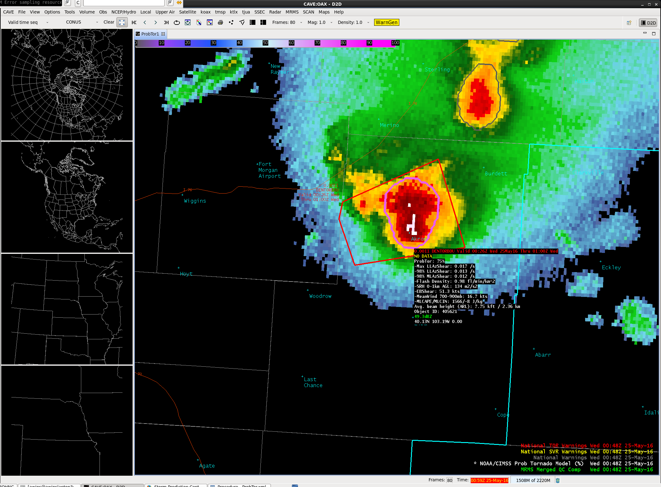
NOAA/CIMSS ProbTor Model Goals
ProbTor is a statistical model designed to increase forecaster confidence and/or increase lead-time in tornado warning issuance.
This statistical model predicts the probability that a storm will produce a tornado in the near-term (in the next 0-60 min).
ProbTor can be used as a ‘pre-polygon’ product as well as an aid for warning reissuance.
Notes:
ProbTor follows the same radar object-based naïve Bayesian statistical framework as NOAA/CIMSS ProbSevere model and also follows the same display concepts (both in AWIPS-II and PHI visualization).
ProbTor is a statistical model designed to increase forecaster confidence and/or increase lead-time in tornado warning issuance.

Slide 3
NOAA/CIMSS ProbTor Model
Probability derived from: climatology environment observations
1% of severe storms are tornadic
RAP NWP:
0-1 km Storm Relative Helicity
Effective Bulk Shear
Mean Wind 900-700 mb layer
mlCAPE and mlCIN
OBSERVATIONAL PREDICTORS:
0-2 km AzShear (MRMS)
3-6 km AzShear (MRMS)
Maximum Flash Density (ENTL)
The statistical model is driven by observations and environmental fields from NWP. As in ProbSevere, ProbTor probabilities are derived for existing storm cells in NEXRAD.
Notes:
This is a high-level summary of the predictors used in the ProbTor statistical model.
The climatology or apriori is 1%--which is the fraction of severe storms that produce tornadoes in our training database (training database spans the CONUS over the annual cycle; containing over 123,000 thunderstorms).
The environmental data used is from the RAP model and relies most on kinematic fields (e.g., storm relative helicity, effective bulk shear and 900-700 mb mean wind).
The observational predictors are the MRMS low-level (0-2 km) and mid-level (3-6 km) AzShear, which depict storm updraft rotation intensity and the Earth Networks maximum flash density (total lightning), which is an observation of updraft intensity.
To reiterate, like ProbSevere, ProbTor is a statistical model and does not predict future storm development or initiation—a storm must be observed on radar to calculate probabilities.

Slide 4
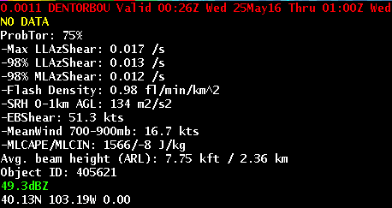
ProbTor Model AWIPS-II Display
Model output are shapefiles contoured around radar storm cells.
Enhancement designed for overlay atop radar reflectivity—but can be overlaid on any field (satellite, radar velocity, etc.).
Sampling offers readout of model probability as well as each model predictor.
Notes:
The ProbTor visualization in AWIPS-2 is shown. The ProbTor visualization utilizes the same concept as ProbSevere, a contour around an identified radar object is color-coded based on the ProbTor value. The component ingredients of the ProbTor model are also provided and are explained in the following slides.

Slide 5
ProbTor Model AWIPS-II Display
ProbTor: Probability of Tornado; 0-100%
Notes:
ProbTor is the statistical model output probability the storm will produce a tornado in the future and ranges between 0-100%.

Slide 6
ProbTor Model AWIPS-II Display
Max LLAzShear: Maximum 0-2 km MRMS AzShear. Low-level rotation intensity.
Notes:
The storm cell’s maximum MRMS low-level (0-2km) AzShear is a measure of low-level storm rotation. This value is used as predictor in the ProbTor model.

Slide 7
ProbTor Model AWIPS-II Display
98% LLAzShear; 98th percentile value of 0-2 km MRMS AzShear (within radar object). Low-level rotation intensity.
Notes:
The storm cell’s 98th percentile value MRMS low-level (0-2km) AzShear is a measure of low-level storm rotation. This value, combined with 0-1km storm relative helicity is used as predictor in the ProbTor model.

Slide 8
ProbTor Model AWIPS-II Display
98% MLAzShear; 98th percentile value of 3-6km MRMS AzShear (within radar object). Mid-level rotation intensity.
Notes:
The storm cell’s 98th percentile value MRMS mid-level (3-6km) AzShear is a measure of mid-level storm rotation. This value, combined with the maximum flash density is used as predictor in the ProbTor model.

Slide 9
ProbTor Model AWIPS-II Display
Flash Density; Maximum of total lightning flashes per minute per km². A measure of updraft intensity.
Notes:
The storm cell’s maximum flash density is a measure of the updraft strength. This value, combined with the 98th percentile value MRMS mid-level (3-6km) AzShear is used as predictor in the ProbTor model.

Slide 10
ProbTor Model AWIPS-II Display
NWP (RAP) parameters:
SRH 0-1km AGL: Storm Relative Helicity 0-1 km above ground level (m²/s²)
EBShear: Effective Bulk Shear (kts)
MeanWind 700-900 mb: Mean wind in the 700-900 mb layer (kts).
MLCAPE/MLCIN: Mixed-layer CAPE and CIN (J/kg)
Notes:
These NWP (RAP) models fields are used as predictors in the ProbTor model.

Slide 11
ProbTor Model AWIPS-II Display
Avg. beam height (ARL): Average beam height above radar level (kft and km). (Assuming a standard atmosphere.)
Notes:
The average beam height above radar level is provided within the ProbTor read-out. Since ProbTor relies on radar rotation intensity observations, regions where the lowest level radar beam height is largely above the 0-2km layer may result in degraded performance. The forecaster is encouraged to use the same beam height/blockage considerations as when using single site radar observations.

Slide 12
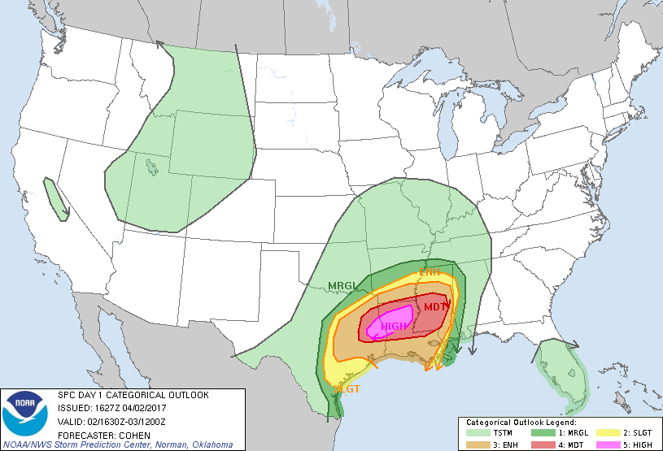
02 April 2017
Notes:
We will show an example of ProbTor before moving to validation and best practices for using ProbTor.
This example focuses on Louisiana on April 2, 2017 in a very favorable kinematic environment for tornadoes as evidenced by the SPC outlook.

Slide 13
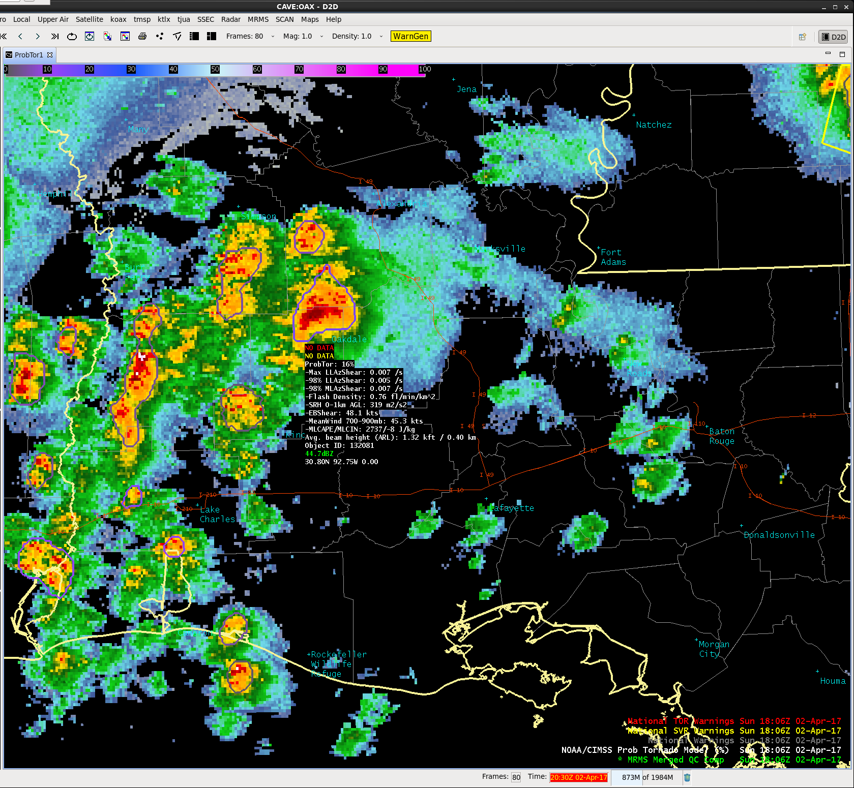
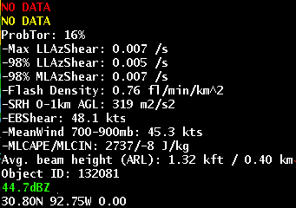
02 April 2017 – 1806 UTC
ProbTor = 16%
Very favorable kinematics
Moderate low and mid-level rotation
Notes:
The highlighted storm over south central LA has ProbTor value of 16% at 1806 UTC. The neighboring storms, in a similar kinematic environment have ProbTor values less than 10%.

Slide 14
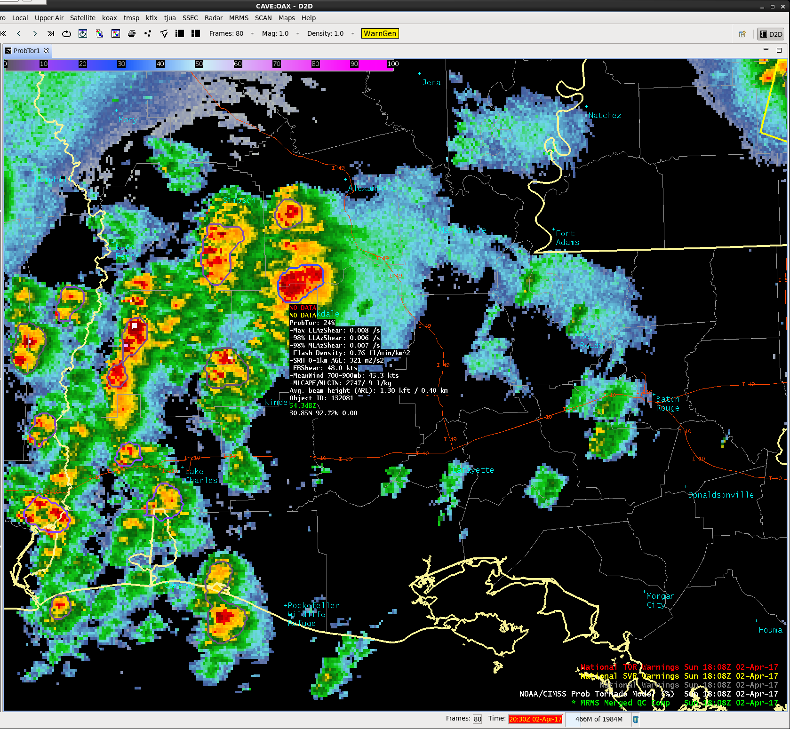
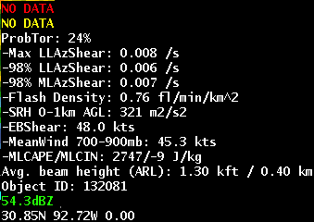
02 April 2017 – 1808 UTC
ProbTor = 24%
Very favorable kinematics
Moderate low and mid-level rotation increased in past 2 minutes
Notes:
The storm of interest ProbTor value increased from 16% in 24% in the past 2 minutes owing to increased observed storm rotation. Meanwhile the neighboring storms maintain < 10% ProbTor values.

Slide 15
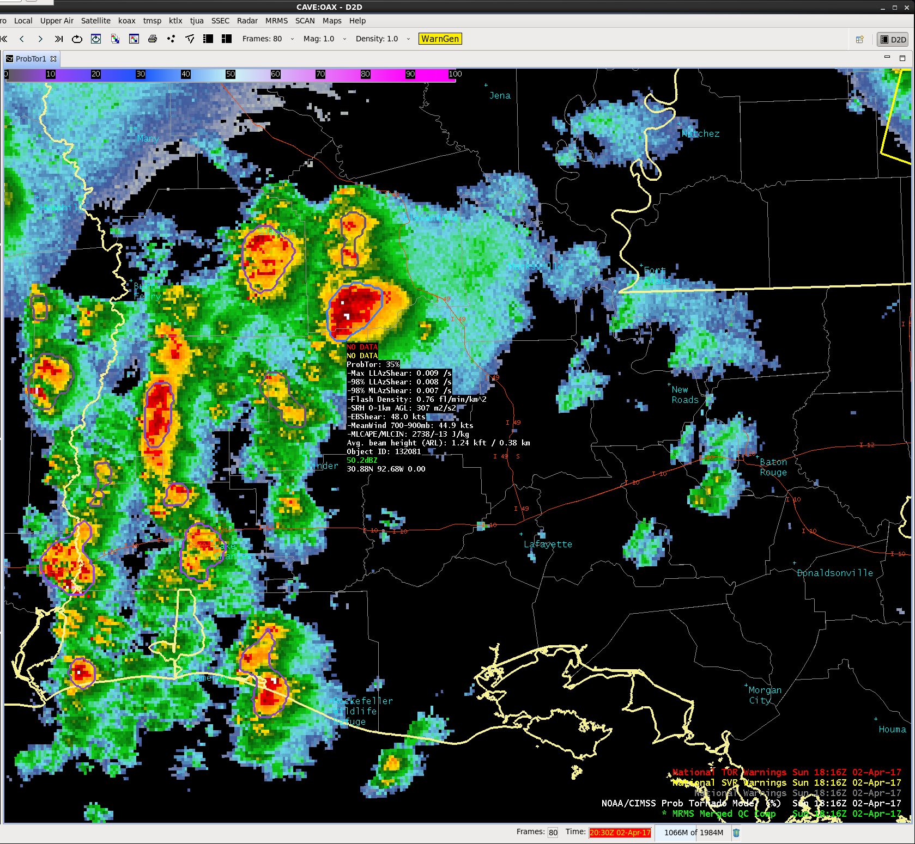

02 April 2017 – 1816 UTC
ProbTor = 35%
Very favorable kinematics
Low-level rotation increased in past 8 minutes
Notes:
The storm of interest ProbTor value increased from 24% to 35% in the past 8 minutes owing to increased observed low-level storm rotation. Given ProbTor is well-calibrated, the 35% equates to a 1 in 3 chance this storm will produce a tornado. The neighboring storms continue to exhibit low ProbTor values (< 10%).

Slide 16
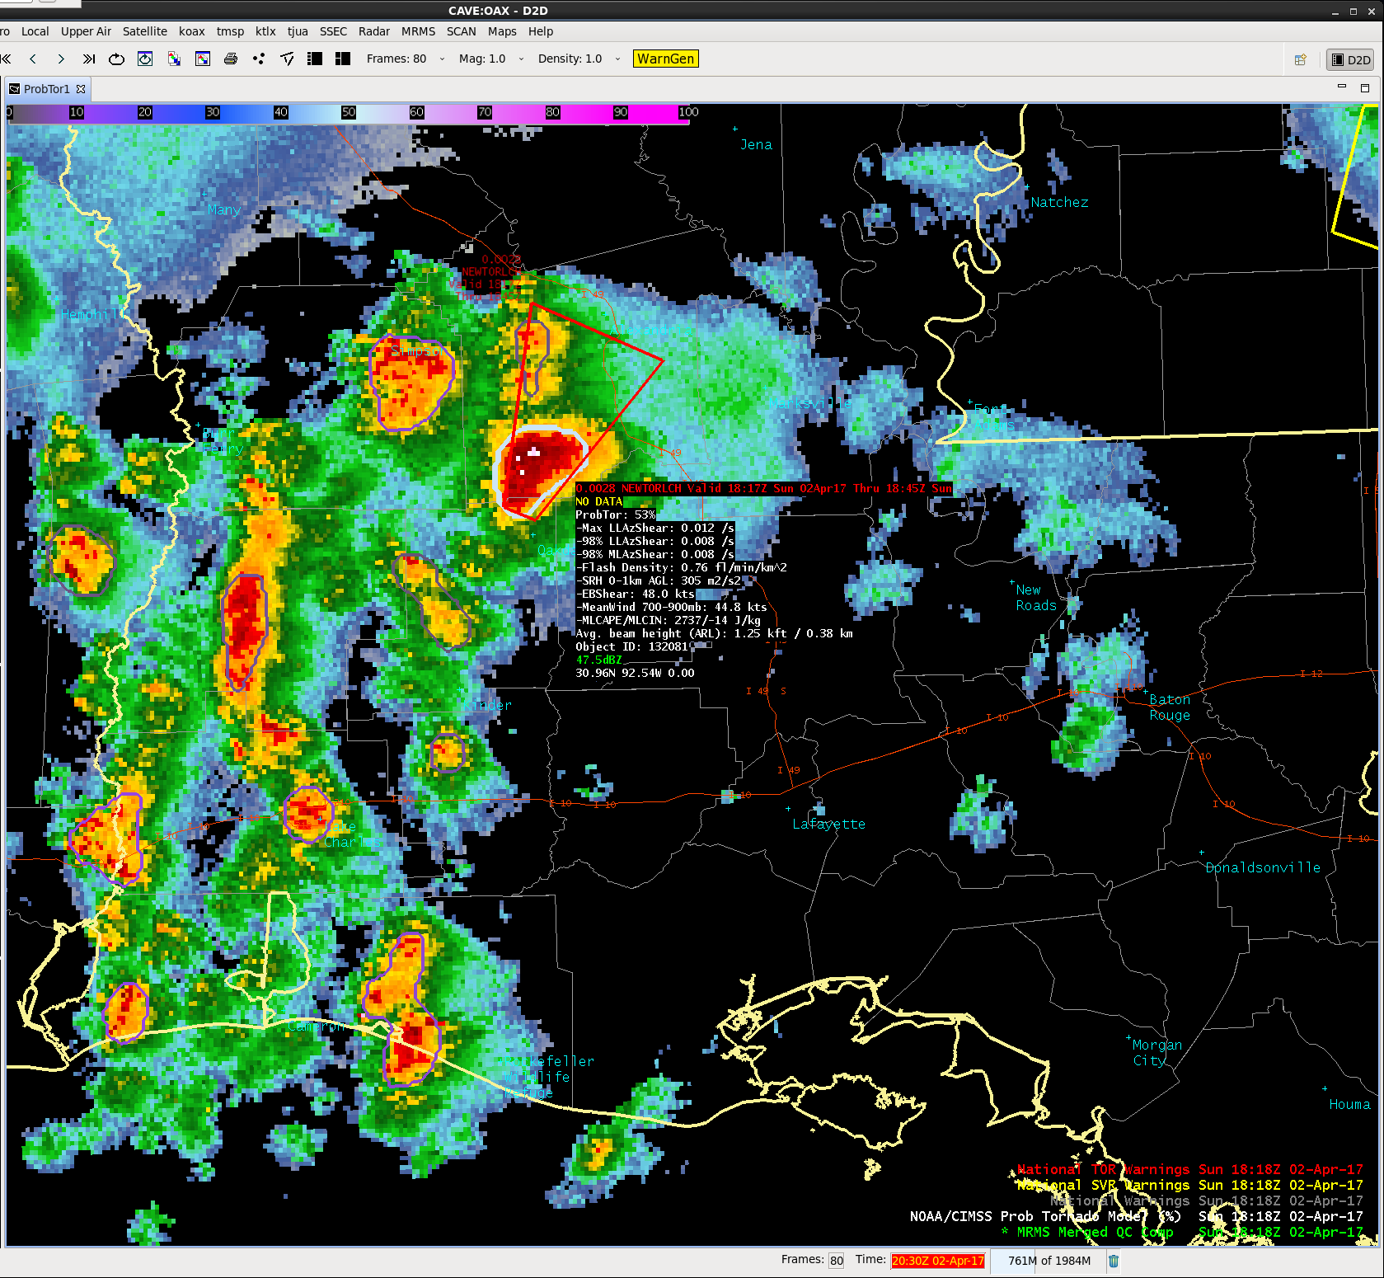
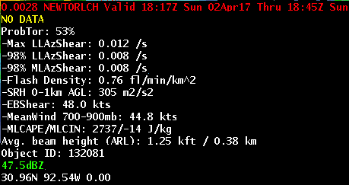
02 April 2017 – 1818 UTC
ProbTor = 53%
Very favorable kinematics
Low-level rotation increased in past 8 minutes
Notes:
At 1818 UTC the ProbTor value increased to 53%, coincident with the Lake Charles office issuing a tornado warning. In this example ProbTor can assist the warning forecaster by 1) demonstrating an increased tornado threat with this storm as evidenced by increasing ProbTor values from 16% at 1806 UTC to 53% at 1818 UTC and 2) highlighting this storm as the storm with the largest threat relative to the remaining storms (ProbTor values < 10%).

Slide 17
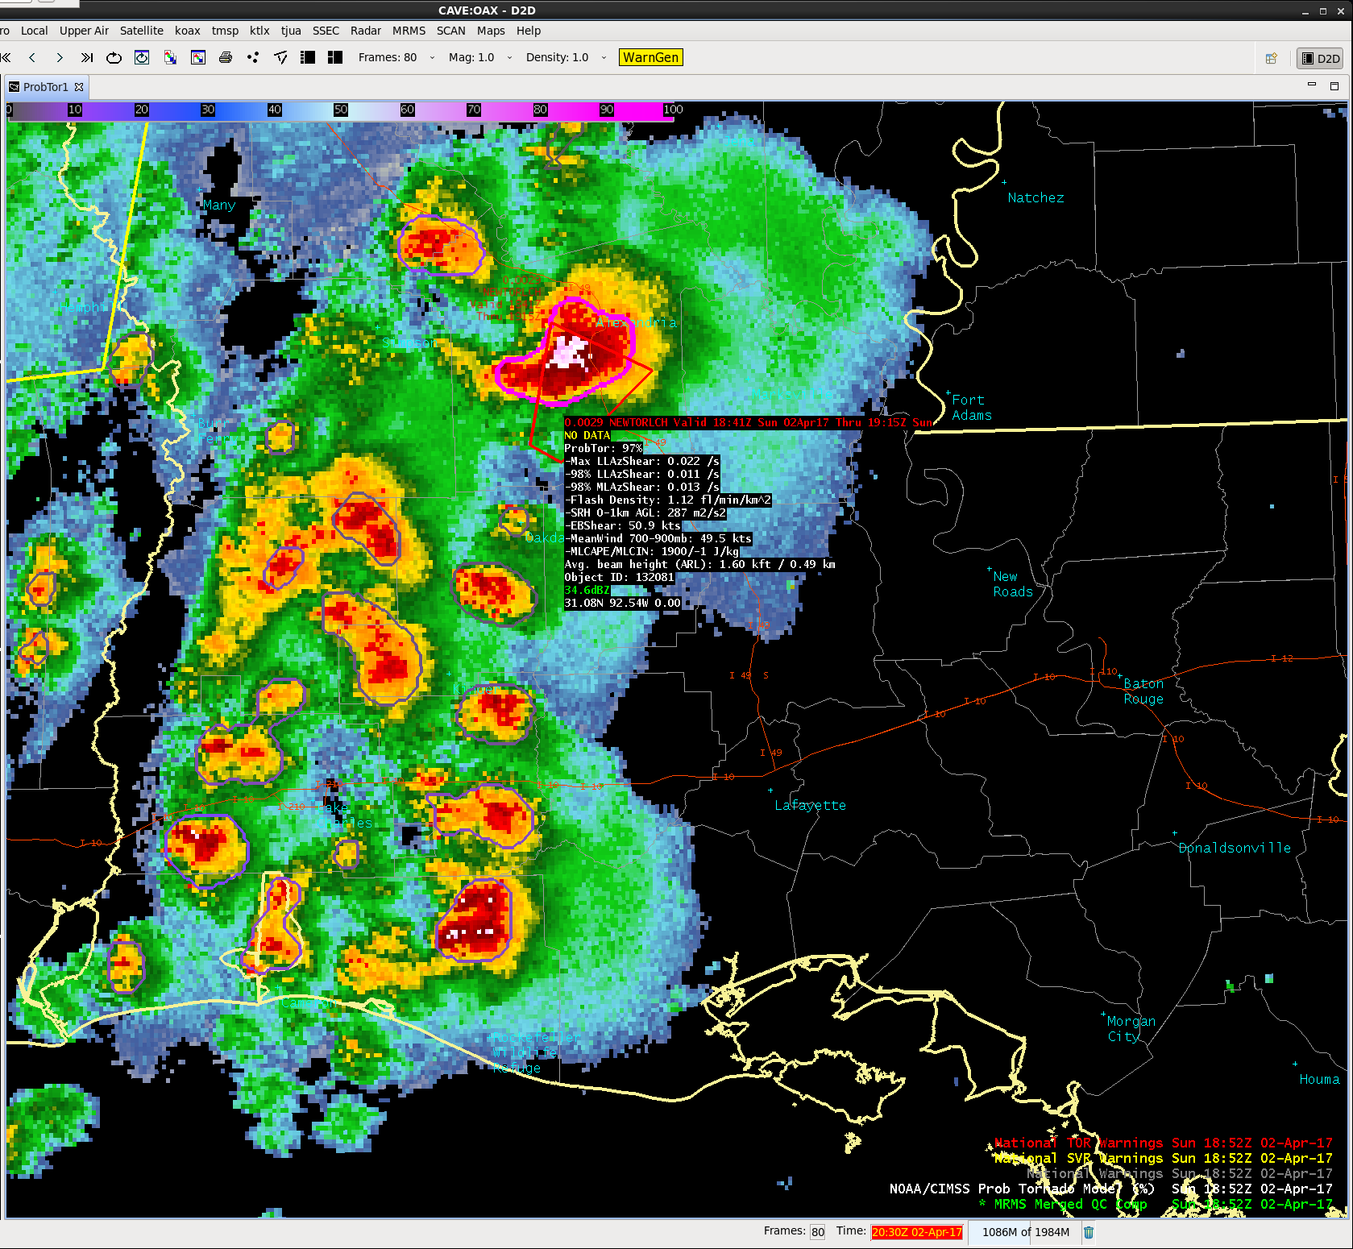
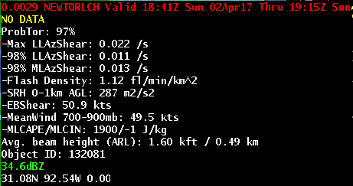
02 April 2017 – 1852 UTC
ProbTor = 97%
Very favorable kinematics
First tornado report
Intense storm rotation
Notes:
The first tornado report with this storm occurred at 1852 UTC and produced subsequent reports as well as a tornado emergency declaration for Alexandria, LA.

Slide 18
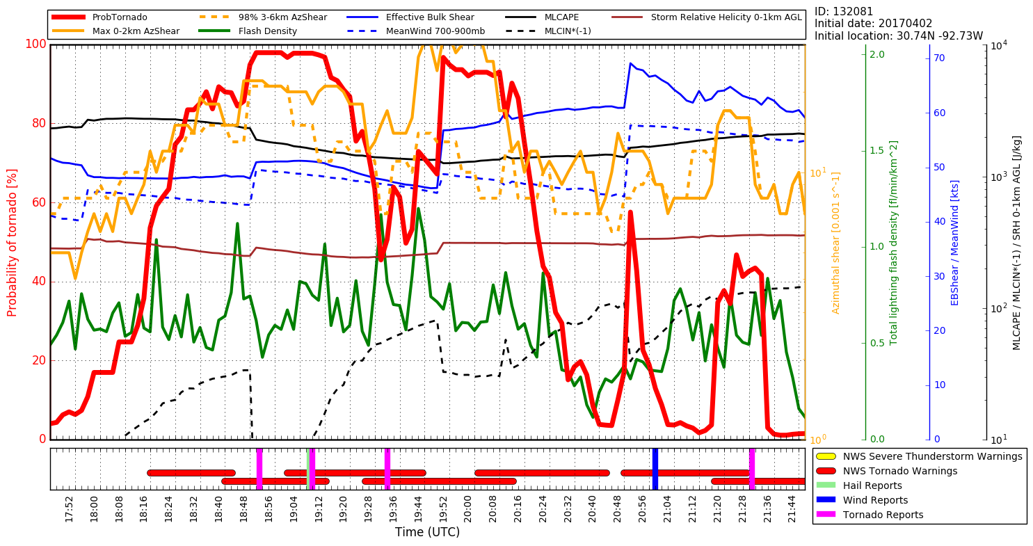
02 April 2017 – Time Series
Notes:
This slide shows a time series of many fields for the tornadic storm we’ve just covered.
There are many curves, but focus on the solid red line (ProbTor) with the axis label on the left.
At the bottom of the plot you will see time as well as NWS warnings and severe weather reports.
To PHI users, real-time time-series capabilities will be available within the PHI tool.
To HWT users, we do not yet have a time-series capability in AWIPS-2, but recognize the value and are working toward this capability.
The highlights of this time-series include:
Rapidly increasing ProbTor values prior to the first tornado warning and well in advance of the first tornado report, which can increase confidence in issuing a tornado warning and potentially increase lead-time.
ProbTor values can fluctuate considerably in response to changing observations of low and mid level storm rotation and total lightning density. A drop in ProbTor values should NOT necessarily be interpreted as an end to the tornadic threat, but may simply be storm cycling. Continued monitoring of the storm remains essential.

Slide 19
ProbTor Model Performance
POD/FAR/CSI
Reliability
Verification against LSR’s shows that ProbTor is less skillful than experienced forecasters (as expected), but offers increased lead-time
Reliability analysis shows ProbTor tends to slightly under forecast when probability is ≤ 60% and slightly over forecast when the probability is ≥ 70%
Overall, ProbTor is well-calibrated
Notes:
POD/FAR/CSI/reliability statistics are for ALL tornadoes in validation database. (60 days in 2016; 325 tornadic storms; 45,586 non-tornadic storms)
The lead-time statistics are measured to the FIRST tornado report associated with tornadic storms.
ProbTor skill (as expected) is poorer than experienced NWS forecasters, yet still comparable (CSI: ProbTor: 0.18 vs NWS: 0.23). However, ProbTor, in the median, provides 10-minutes greater lead-time than traditional techniques (ProbTor: 35 min vs NWS: 25 min)**.
ProbTor users should utilize the good reliability of the probabilities, for example a storm with 33% ProbTor will produce a tornado a bit more than 1 in 3 times; a storm with 50% ProbTor will produce a tornado a bit more than 1 in 2 times.
**Note the NWS lead-time values are larger than published statistics. This is due to the validation methodology, since ProbTor can count as a hit up to 90 minutes in the future, we do not penalize the NWS for the first TOR report occurring AFTER (spatially ‘down wind’ of) the initial warning, which acts to inflate total lead-time. The difference between the two lead-times is what is significant.

Slide 20
ProbTor: Helping in the ‘uncertain’ zone
Tornadic
TorWarn
Tornadic Certainty
Uncertain
Tornadic Zone of Uncertainty
Non-tornadic
Time
Notes:
ProbTor will be most useful to forecasters in the uncertain zone between definitely not tornadic and definitely tornadic (or warranting a tornado warning). The zone of uncertainty—when a forecaster ponders do I warn or not warn this storm, do I wait for another volume scan, etc. is when the ProbTor value (relative to its neighbors) and very short-term trends (e.g., past 4-8 minutes) COMBINED with base/SRM velocity interrogation can help to increase tornado warning lead-time and/or confidence.
ProbTor is most useful to the warning forecaster to increase confidence that a storm will (will not) produce a tornado, both for the first tornado and subsequent tornadoes. While validation has not focused on tornado dissipation, qualitative assessment suggests ProbTor can also highlight when a tornado threat has diminished (although beware of storm cycling and subsequent ProbTor increases)

Slide 21
ProbTor: Kinematic Environment Matters!
3%
10%
Vs.
30%
60%
0%
6%
Marginal Kinematics (e.g.)
0-1 km SRH: 100 m² s⁻²
Eff. Bulk Shear: 30 kts
700-900 mb MW: 20 kts
Favorable Kinematics (e.g.)
0-1 km SRH: 200 m² s⁻²
Eff. Bulk Shear: 50 kts
700-900 mb MW: 40 kts
Do not expect the same ProbTor probability value to give the same results from event to event—the kinematic fields impact ProbTor!
It is best to use ProbTor in a relative fashion—like in the example above.
Notes:
It is best to use ProbTor in a relative sense—how does a storm’s ProbTor value compare to its neighbors opposed to using a fixed ProbTor threshold.
ProbTor is well-calibrated and responds to storm observations (total lightning and MRMS AzShear), but the kinematic environment also plays a significant role in formulating the probabilities. A day with more marginal kinematics will in general have lower probabilities than a day with more favorable kinematics—however the storms that pose the highest threat will still stand-out relative to its neighbors. Therefore forecasters are encouraged not to use a fixed ProbTor threshold, but must also consider the kinematic environment and temporal trends.

Slide 22
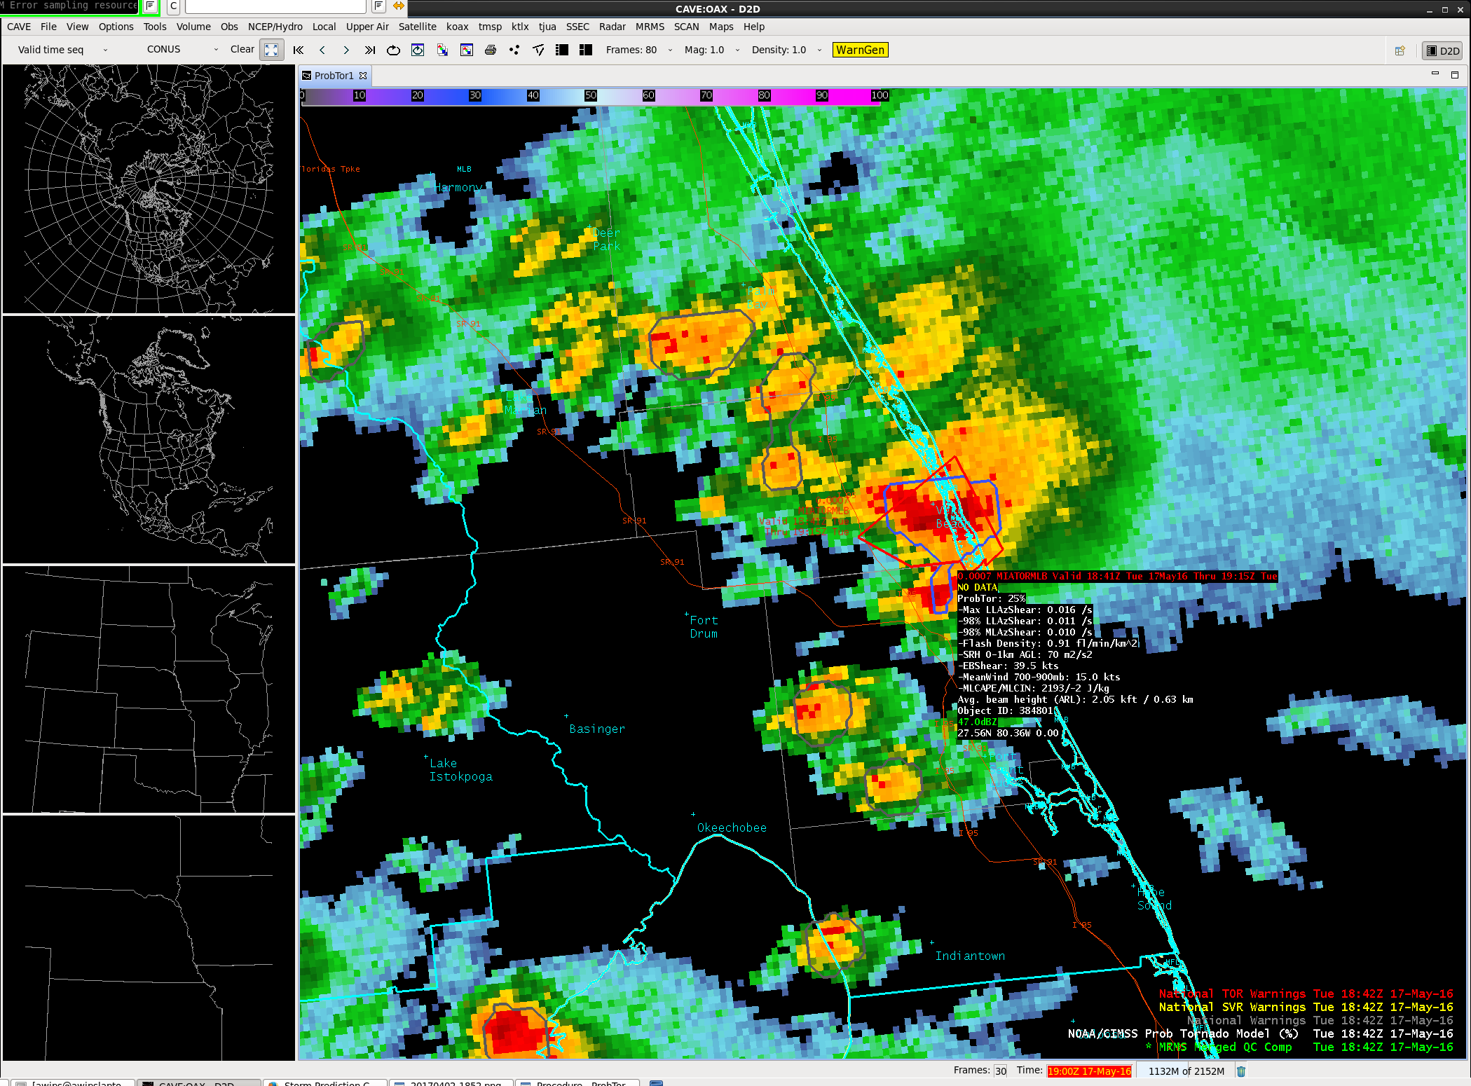
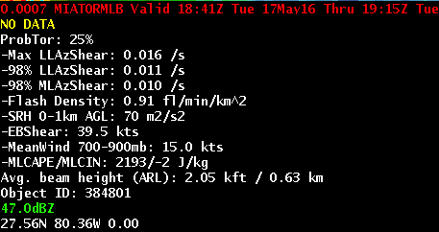
ProbTor: Highlights storm of highest threat
Notes:
This is a real-world example of the previous cartoon. Here ProbTor highlights a storm with the highest tornado threat over eastern Florida on 17 May 2016.
The ProbTor value for the storm, coincident the NWS tornado warning issuance was 25%. All neighboring storms (gray contours) are 0 or 1%.
The kinematic environment in this example was marginal for tornadoes.

Slide 23
ProbTor: Known Caveats
ProbTor requires an identifiable object in radar reflectivity
  Most often in linear modes, object identification can become more difficult—the absence of an object (and hence ProbTor value) does not mean there is no tornadic threat
ProbTor is impacted by radar beam blockage and increasing beam height away from radar just as base/SRM velocity interrogation
ProbTor interpretation can be more difficult in long convective lines
  Pinpointing the portion of a long convective line posing the highest tornadic threats can become difficult since the entire line is identified as single object (we are working toward improving this)
  ProbTor can over forecast in strong convective lines in favorable kinematic environments
ProbTor will typically have very low probabilities with ‘land spout’ tornadoes
Use ProbTor with caution near the radar (within ~10 mi), as AzShear values may be artificially high due t0 non-meteorological targets.
ProbTor will only be as good as its inputs—occasionally the RAP environment (especially 0-1 km SRH) can deviate (toward lower values) from the SPC mesoanalysis, which can cause underforecast ProbTor values

Slide 24
ProbTor: Summary
ProbTor is a statistical model that incorporates NWP fields, radar observations, and total lightning observations to predict the probability a storm will produce a tornado in the next 0-60 minutes.
ProbTor should be used in combination with existing radar interrogation techniques and is designed to increase forecaster confidence and increase lead-time
ProbTor is best used in a relative sense—how a storm’s values compare to neighbors since the kinematic environment will impact probabilities in addition to observations (the ‘best’ probability threshold will change based on the environment).
ProbTor is fairly well-calibrated; so a storm with a 33% probability will produce a tornado about 1 in 3 times and so on.
ProbTor values will fluctuate in response to changes in strength of storm rotation and storm updraft.

Slide 25
Contact
Mike Pavolonis (michael.pavolonis@noaa.gov)
John Cintineo (john.cintineo@ssec.wisc.edu)
Justin Sieglaff (justin.sieglaff@ssec.wisc.edu)
Dan Lindsey (dan.lindsey@noaa.gov)
To access this training online and access supplement training please see:
http://cimss.ssec.wisc.edu/severe_conv/training/training.html
ProbTor is also available on the web in real-time:
http://cimss.ssec.wisc.edu/severe_conv/probtor.html
Notes:
Please contact the statistical model researchers with questions, suggestions, etc. at the email addresses provided.

