Slide 1
NOAA/CIMSS ProbSevere Model (All Hazards)
– Training Module –
Spring 2017
Notes:
This is a short training module for users of the NOAA/CIMSS ProbSevere ‘All Hazards’ Model.
ProbSevere All Hazards is an improvement to the NOAA/CIMSS ProbSevere model. ProbSevere All Hazards generates probabilities for the 3 severe storm hazards--severe hail, severe straight-line winds, and tornadoes. This training module is designed for users that are already familiar with the legacy NOAA/CIMSS ProbSevere model and provides only information very specific to the ProbSevere All Hazards model—including data used, examples, validation statistics, and best practices for ProbSevere All Hazards usage by operational forecasters.
If you are not familiar with ProbSevere it is recommended you first complete the 2016 ProbSevere training module available at: http://cimss.ssec.wisc.edu/severe_conv/training/training.html Additionally this training will not focus on the tornado aspect of ProbSevere All Hazards since a specific ProbTor training module has been created. This training module will focus on the hail and wind hazards and how ProbSevere All Hazards improves upon the previous version of ProbSevere, especially for wind hazards.
For simplicity, we will refer to ProbSevere All Hazards as ProbSevere. If we are making a comparison to the previous version/legacy ProbSevere, we will explicitly state that as such.

Slide 2
NOAA/CIMSS ProbSevere Timeline
2015:
ProbSevere Improved
Derived from:
NWP
GOES-13/15
NEXRAD (MRMS)
2017:
“All Hazards” ProbSevere
Including:
ProbHail, ProbWind, ProbTor
More physically relevant NWP and observational predictors for each hazard
2014:
ProbSevere Introduced
Derived from:
NWP
GOES-13/15
NEXRAD (MRMS)
2016:
Earth Networks Total
Lightning incorporated into ProbSevere
Notes:
The timeline above shows the development history of ProbSevere and its evaluation within the Hazardous Weather Testbed, including the transition from “legacy” ProbSevere to “All Hazards” ProbSevere in 2017.

Slide 3
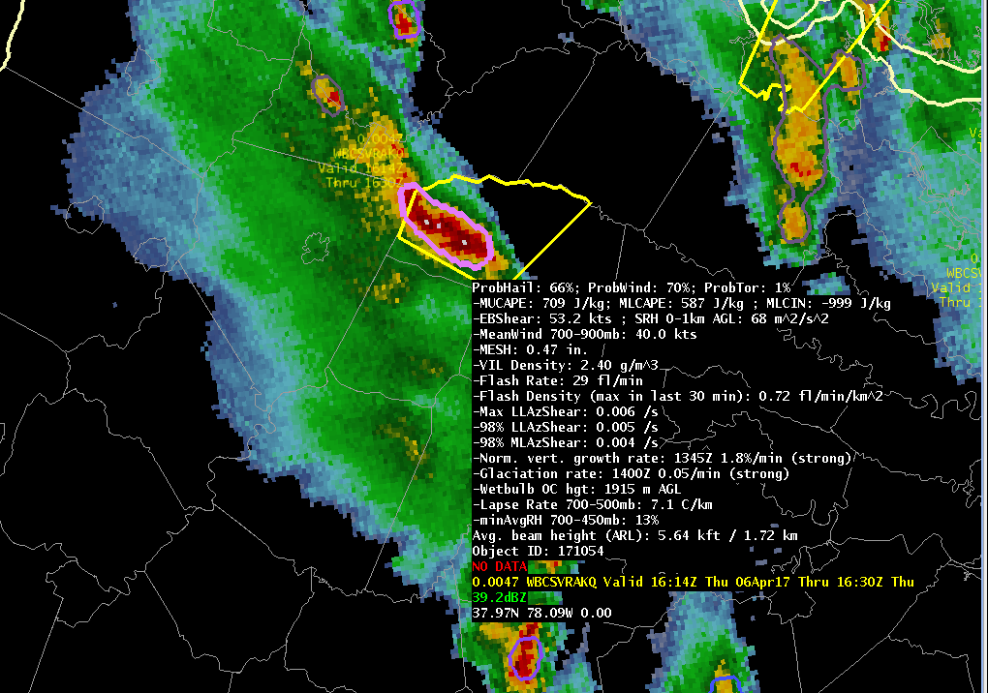
NOAA/CIMSS ProbSevere Model Goals
ProbSevere is a statistical model designed to increase forecaster confidence and/or increase lead-time in severe thunderstorm/tornado warning issuance.
The “all hazards” version of ProbSevere provides the probability of severe wind (ProbWind), the probability of severe hail (ProbHail), and the probability of tornado (ProbTor). The overall probability of severe is given by the maximum of ProbWind, ProbHail, and ProbTor.
ProbSevere can be used as a ‘pre-polygon’ product as well as an aid for warning reissuance.
Notes:
ProbSevere follows the same radar object-based naïve Bayesian statistical framework as the legacy NOAA/CIMSS ProbSevere model and also follows the same display concepts (both in AWIPS-II and PHI visualization). ProbSevere is the probability a storm will produce severe weather in the next 60 minutes. The displayed probability is the maximum of the three hazard predictions—severe hail, severe wind, and tornado.
ProbSevere is a statistical model designed to increase forecaster confidence and/or increase lead-time in severe thunderstorm/tornado warning issuance.

Slide 4
NOAA/CIMSS ProbSevere Model
Storm objects are identified and tracked from radar reflectivity—identically to the legacy version of ProbSevere
Each storm object has a probability for:
  Severe Hail (ProbHail)
  Severe Straight-line Winds (ProbWind)
  Tornado (ProbTor) [covered in more detail by a separate training module]
The predictors used for each hazard are shown in the next slide
The most significant improvements between legacy ProbSevere and “all hazards” ProbSevere is for storms that produce severe straight-line winds and/or tornado.
Notes:
ProbSevere employs the same object tracking and statistical model as the previous version/legacy ProbSevere, except more physically relevant NWP and radar observations are used to predict each specific hazard.
ProbSevere most significantly improved for wind and tornado hazards, with more modest improvement for hail hazards (the previous version of ProbSevere already demonstrated excellent skill with respect to the hail hazard).

Slide 5
NOAA/CIMSS ProbSevere Model
Probabilities are a function of the dynamic and thermodynamic environment and observations
ProbHail:
a priori: f(MUCAPE/EBS)
MESH vs. Wet Bulb 0°^{C} Height
Flash Rate vs. EBS
Lapse Rate (700-500 mb ) vs. min average RH (700-450 mb)
Satellite Growth Rate
Satellite Glaciation Rate
ProbWind:
a priori: f(Mean wind (900-700 mb)/ MLCAPE)
VIL Density
Flash Rate vs 3-6 km AzShear
Mean wind (900-700 mb) vs. 0-2 km AzShear
Satellite Growth Rate
Satellite Glaciation Rate
ProbTor: see separate training module
Key
MESH: Maximum Expected Size of Hail
EBS: Effective Bulk Shear
AzShear: Azimuthal Shear
**Like legacy ProbSevere, all radar fields are from the MRMS (multi-radar, multi-sensor)
Notes:
For ProbSevere the most pertinent environmental and observational datasets are utilized for the targeted hazard. ProbHail and ProbWind predictors are outlined on this slide, recall an entire training module is available for ProbTor, so ProbTor predictors are not included in this training module.
For ProbHail:
a priori: MUCAPE/EBS—measure of potential updraft intensity for most unstable parcel and potential storm organization
Maximum Expected Size of Hail (MESH) vs the height of the wet bulb 0C--inclusion of the wet bulb 0C paired with MESH better accounts for lack of melting in low-topped hail storms and increased melting in many southeastern US summertime storms.
Flash Rate (Earth Networks Total Lightning) vs Effective Bulk Shear—measure of updraft strength and potential storm organization
Lapse rate (700-500 mb) vs minimum average RH in 700-450 mb layer—Combination of steeper mid-level lapse rates and drier mid-level air are more favorable for severe hail
Satellite growth and glaciation rates—Measures of initial updraft intensity
For ProbWind:
a priori: Mean wind (900-700 mb)/MLCAPE—measure of environmental momentum to potentially transfer to the surface and potential updraft intensity for mixed-layer parcels (mixed-layer parcels are better for wind, while most unstable parcels are better for hail).
VIL Density—Measure of precipitation core intensity
Flash Rate vs 3-6 km AzShear—measure of updraft intensity and proxy for strength of mid-level storm winds
Mean wind (900-700 mb) vs 0-2 km AzShear—measure of environmental momentum to potentially transfer to the surface and proxy for strength of low-level storm winds
Satellite growth and glaciation rates—Measures of initial updraft intensity

Slide 6
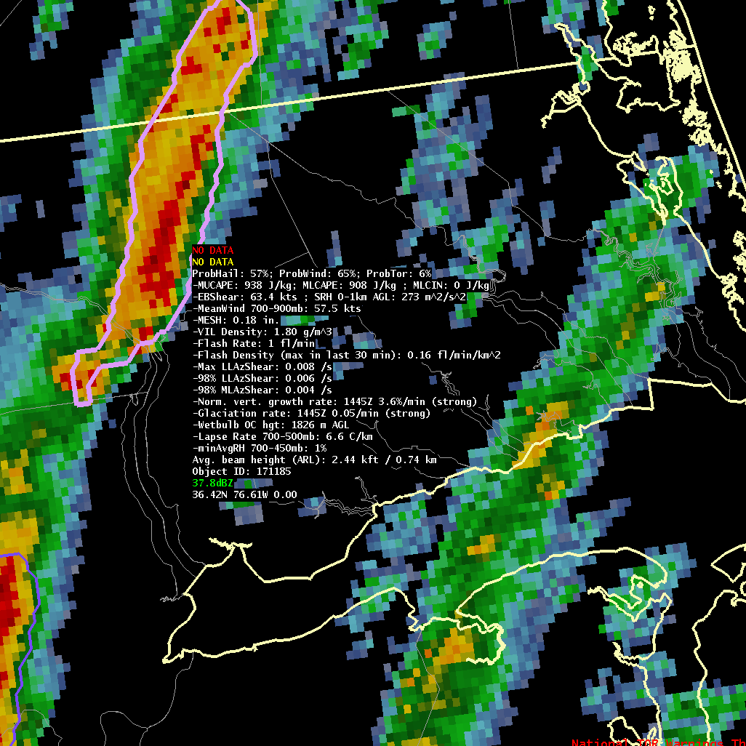
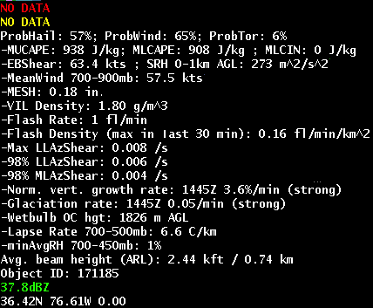
ProbSevere Model AWIPS-II Display
Model output are shapefiles contoured around radar storm cells.
Enhancement designed for overlay atop radar reflectivity—but can be overlaid on any field (satellite, radar velocity, etc.).
Sampling offers readout of model probability as well as each model predictor.
Notes:
The ProbSevere visualization in AWIPS-2 is shown. The ProbSevere visualization utilizes the same concept as legacy ProbSevere, a contour around an identified radar object is color-coded based on the ProbSevere value. Since some predictors are used by more than 1 individual hazard prediction, the predictors listed in the read-out are not grouped by individual hazard prediction, but all the predictors used to compute ProbHail, ProbWind, and ProbTor are listed.
It should be noted for 2017 HWT we are providing 2 versions of ProbSevere in the AWIPS-2 menu—ProbSevere Full and ProbSevere Light. The “Full” version is what is shown here. The “Light” version offers the forecaster the same probabilities, but with fewer predictors shown for a smaller read-out footprint.

Slide 7
ProbSevere Model AWIPS-II Display
ProbSevere = Maximum of:
ProbHail: Probability of Hail; 0-100%
ProbWind: Probability of Wind; 0-100%
ProbTor: Probability of Tornado; 0-100%
Notes:
The contours shaded on the AWIPS-2 terminal is the ProbSevere probability—which is the maximum of the 3 component probabilities (ProbHail, ProbWind, ProbTor).

Slide 8
ProbSevere Model AWIPS-II Display
MUCAPE: Most Unstable parcel CAPE (J/kg)
MLCAPE: Mixed-layer parcel CAPE (J/kg)
MLCIN: Mixed-layer parcel CIN (J/kg)
Notes:
These NWP-based (RAP model) predictors are used to measure the potential atmospheric instability and inhibition.

Slide 9
ProbSevere Model AWIPS-II Display
EBS: Effective Bulk Shear (kts)
SRH 0-1km AGL: Storm relative helicity in 0-1 km layer above ground level (m²/s²)
MeanWind 700-900 mb: Mean wind in the 700-900 mb layer (kts)
Notes:
These are the NWP-based kinematic fields used within ProbSevere.

Slide 10
ProbSevere Model AWIPS-II Display
MESH: Storm maximum MRMS MESH (inches)
VIL Density: Storm maximum MRMS VIL Density (g/m³)
Notes:
The storm cell’s maximum MRMS MESH and MRMS VIL Density are radar measurements of the storm’s precipitation core.

Slide 11
ProbSevere Model AWIPS-II Display
Flash Rate: Total lightning flash rate within radar object (flashes / min)
Flash Density (max in last 30 min): Maximum flash density within object in past 30 minutes
Notes:
The storm cell’s maximum total lightning flash rate and flash density are used by ProbSevere and offer an additional measure of the storm’s updraft intensity.

Slide 12
ProbSevere Model AWIPS-II Display
Max LLAzShear: Maximum MRMS 0-2 km AzShear within radar object
98% LLAzShear: 98th percentile MRMS 0-2 km AzShear within radar object
98% MLAzShear: 98th percentile MRMS 3-6 km AzShear within radar object
Notes:
These predictors are MRMS observations of the storm wind field intensity/rotation.

Slide 13
ProbSevere Model AWIPS-II Display
Norm Vert Growth Rate: Maximum storm cell satellite vertical growth rate (%)
Glaciation rate: Maximum storm cell satellite glaciation rate (%)
Time occurred; classified as weak, moderate, or strong.
Notes:
These predictors are derived from the GOES-EAST and GOES-WEST satellites and measure the storm’s initial updraft intensity. It should be noted that during 2017, we will continue to use GOES-13 and GOES-15—GOES-16(R) measurements are not yet employed during 2017. We cannot yet use GOES-16 measurements because the statistical model needs a sufficient period of training data—2017 will serve as the GOES-16 training dataset—we anticipate using GOES-16 measurements in 2018.

Slide 14
ProbSevere Model AWIPS-II Display
Wetbulb 0°^{C} hgt: Height of wetbulb 0°^{C} (m, above ground level)
Lapse Rate 700-500 mb: Lapse rate in the 700-500 mb layer (C/km)
minAvgRH 700-450 mb: Minimum mean RH in 700-450 mb layer (%)
Notes:
These are additional NWP-based predictors used by the ProbSevere model—specifically in the ProbHail computation.

Slide 15
ProbSevere Model AWIPS-II Display
Avg. beam height (ARL): Average beam height above radar level (kft and km). (Assuming a standard atmosphere.)
Notes:
The average center beam height above radar level is provided within the ProbSevere read-out. Since ProbSevere relies on radar observations, the forecaster is encouraged to use the same beam height/blockage considerations as when using single site radar observations.

Slide 16
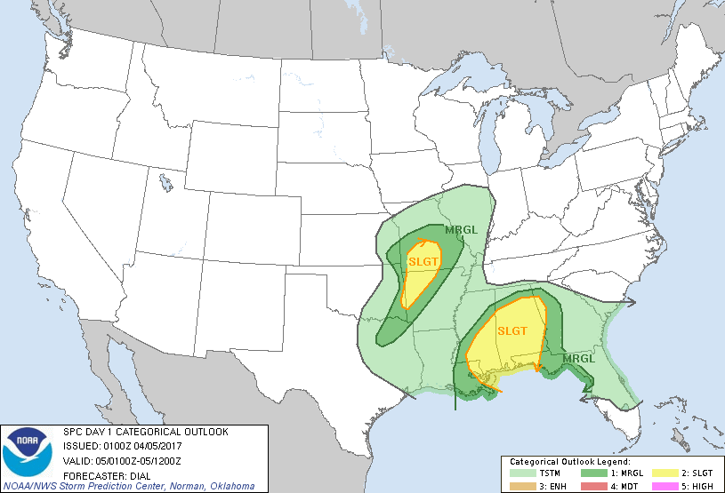
05April 2017
Notes:
We will show an example of ProbSevere before moving to validation and best practices.
This example focuses on northeastern Alabama during the early morning hours of April 5, 2017.

Slide 17
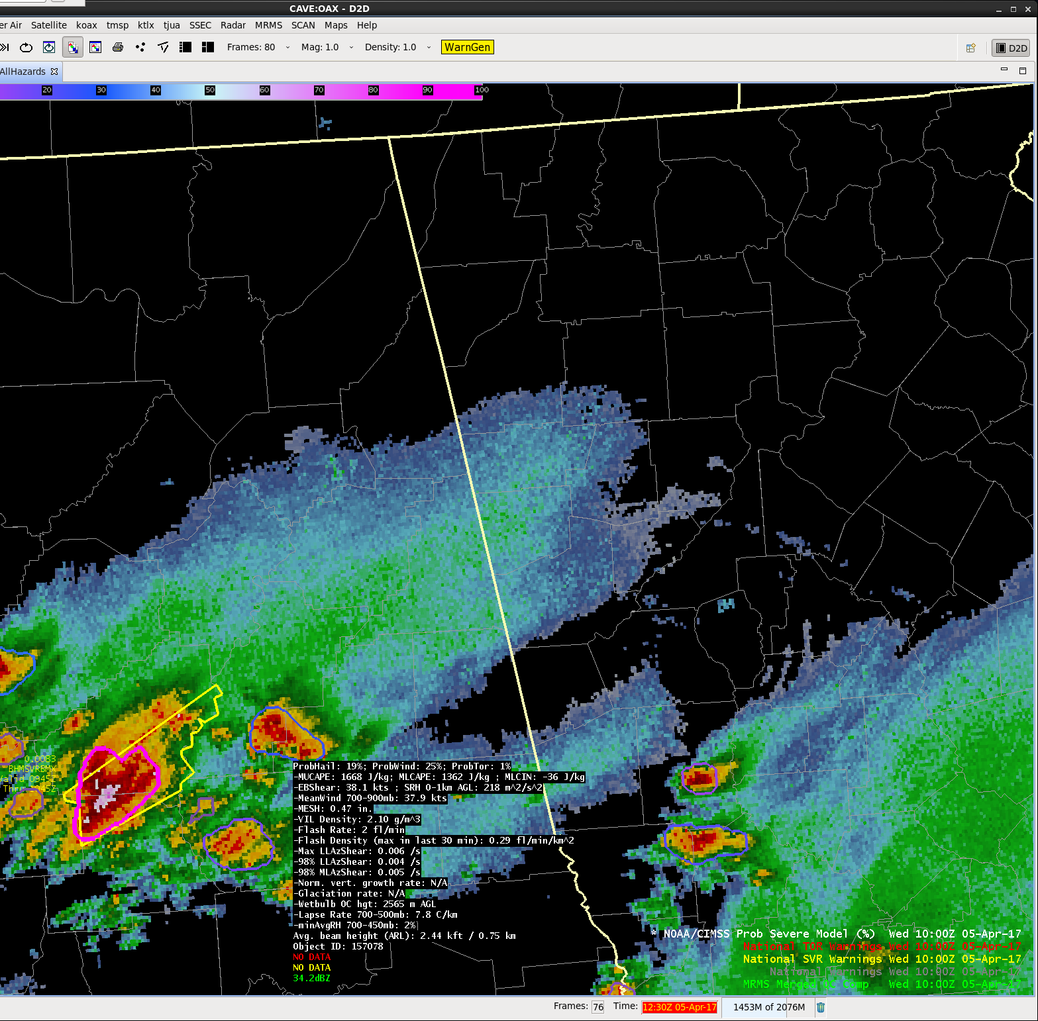
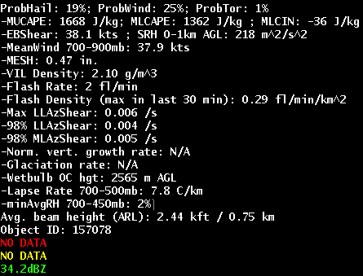
05 April 2017 – 1000 UTC
ProbSevere = 25%
Sufficient instability and moderate effective bulk shear
Notes:
A storm near Talladega, Alabama was developing at 1000 UTC on 05 April 2017.
The environment was favorable for severe weather and at 1000 UTC ProbSevere was 25% (ProbHail: 19%, ProbWind: 25%).

Slide 18
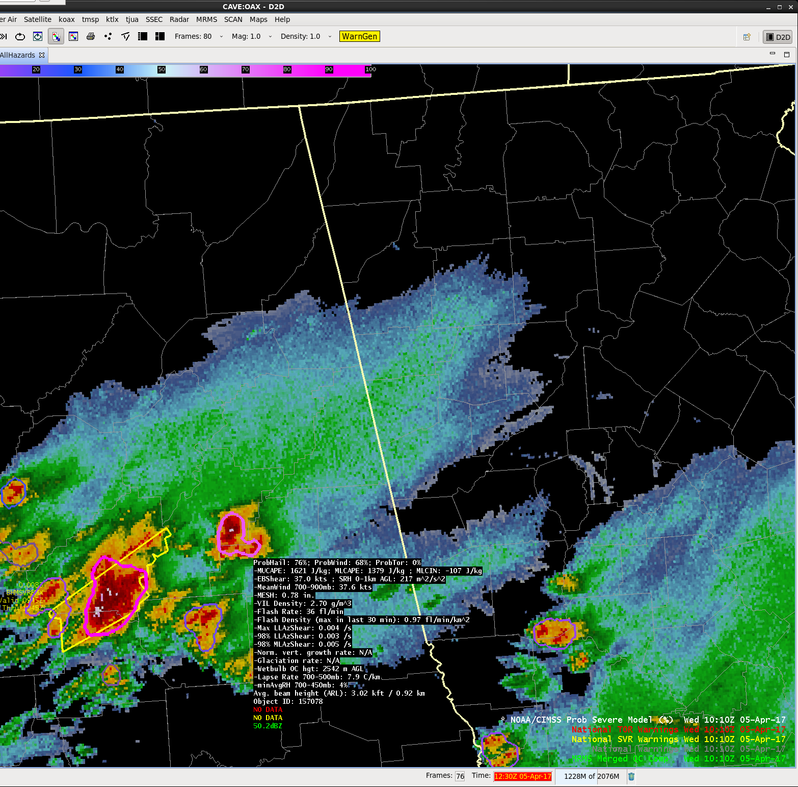
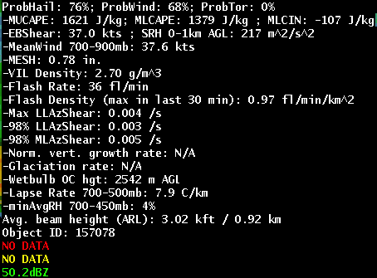
05 April 2017 – 1010 UTC
ProbSevere = 76%
Significant ProbSevere increase over past 10 minutes due to increasing radar and lightning intensity
Notes:
Ten minutes later, ProbSevere jumped to 76% (ProbHail: 76%; Probwind: 68%)
The ProbSevere values jumped due to increases in MRMS MESH/VIL Density as well as storm flash rate.

Slide 19
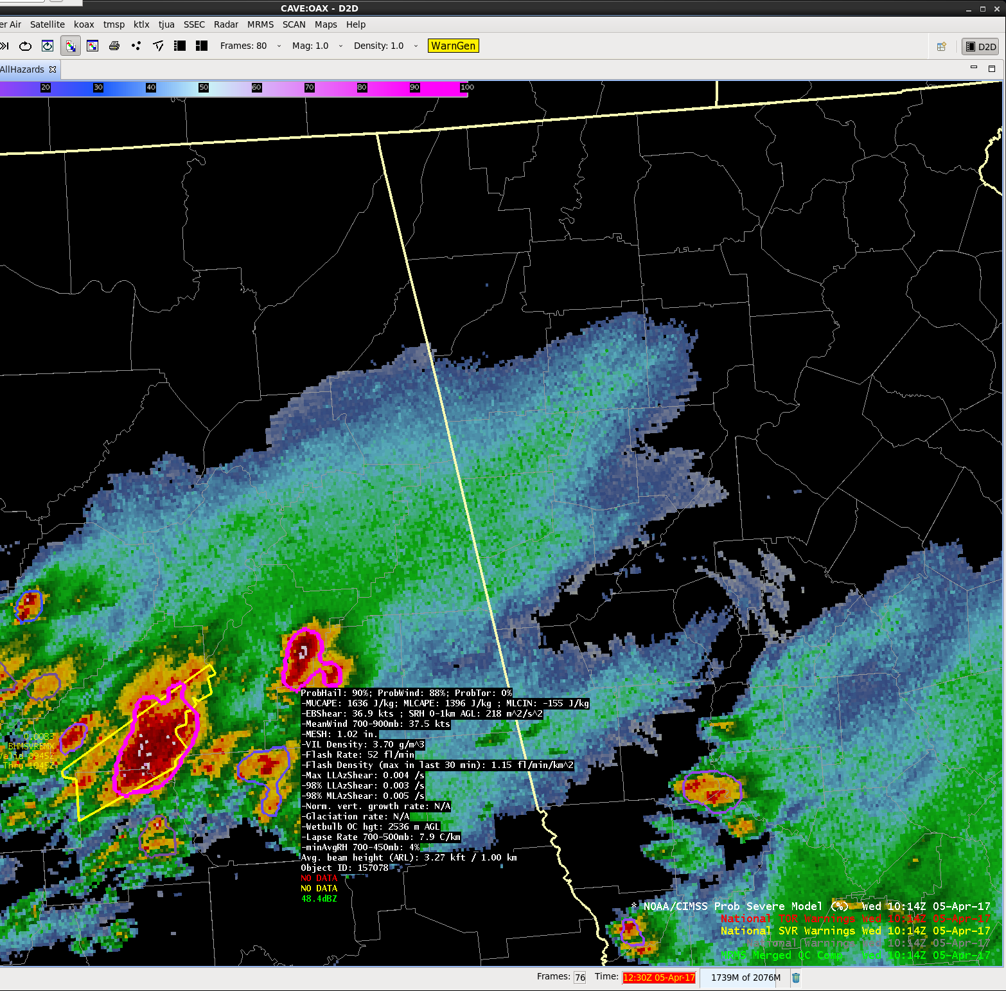
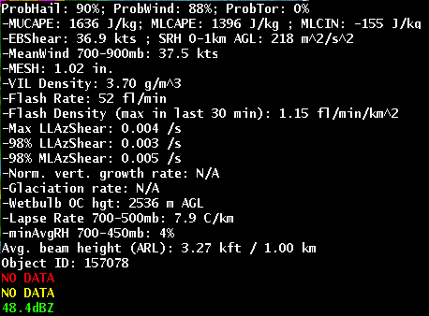
05 April 2017 – 1014 UTC
ProbSevere = 90%
Only 4 minutes later, ProbSevere value is now very high due further storm strengthening
Notes:
Only 4 minutes later, at 1014 UTC, ProbSevere jumped to 90% (ProbHail: 90%; ProbWind: 88%)

Slide 20
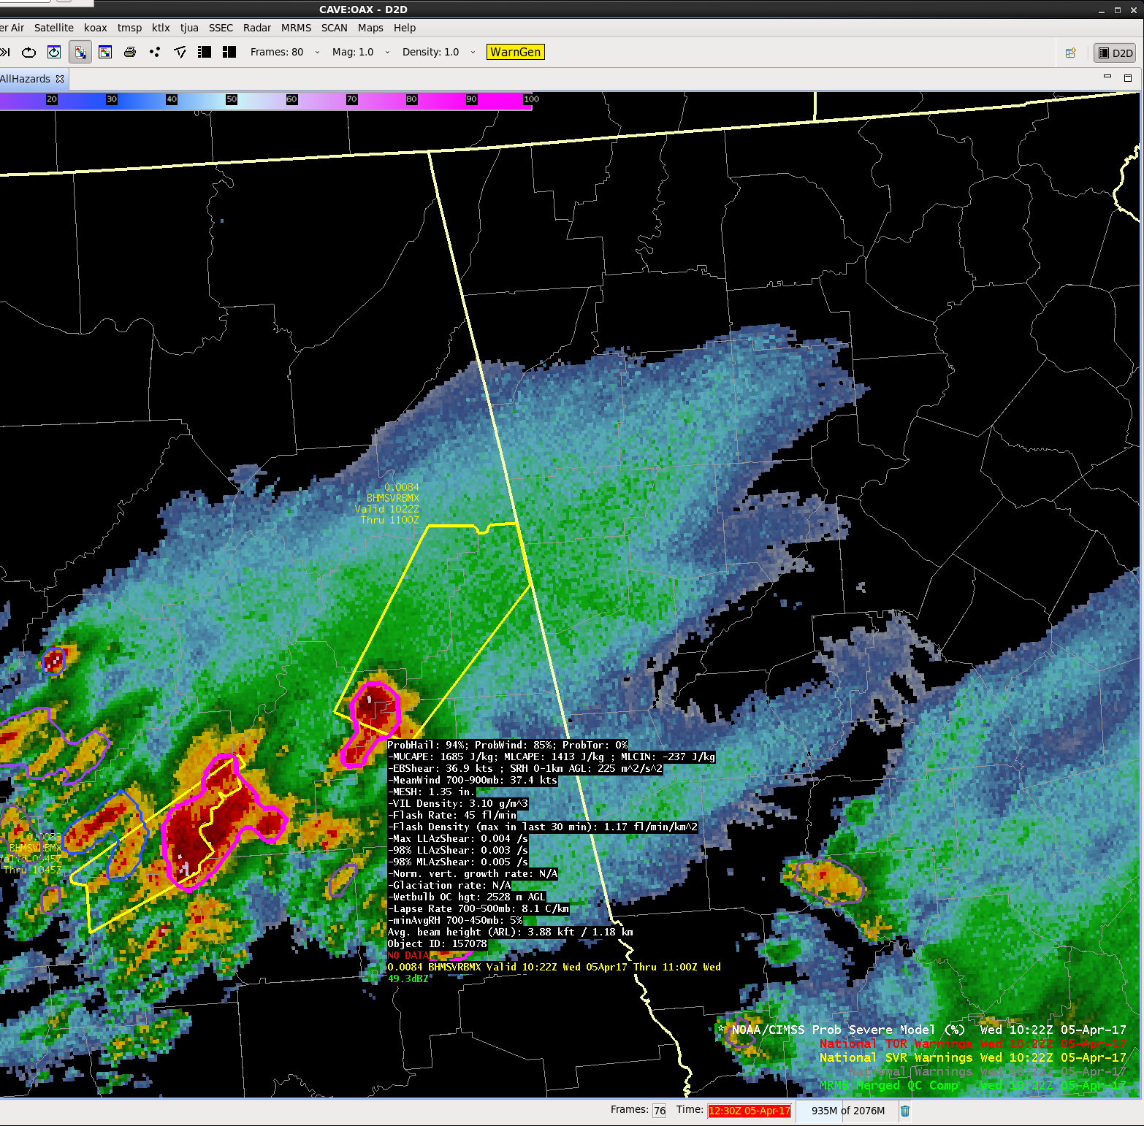
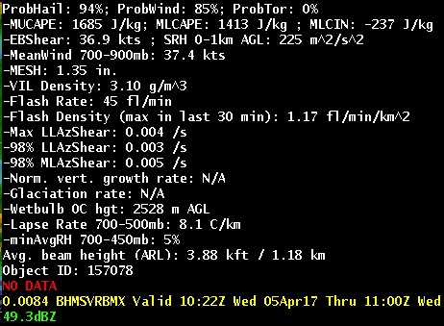
05 April 2017 – 1022 UTC
ProbSevere = 94%
At 1022 UTC NWS issues severe thunderstorm warning
1027 UTC: First wind report
1030 UTC: First hail report
Notes:
At 1022 UTC the NWS in Birmingham issued a severe thunderstorm warning.
The first wind report was at 1027 UTC and first hail report was at 1030 UTC (1.00”), with subsequent golf ball sized hail reports.
This example illustrates the potential utility of ProbSevere to the warning forecaster:
As a potential to increase lead-time—the ProbSevere values jumped above 70% 12 minutes prior to the warning and 17 minutes prior to the first wind report.
As a potential to increase confidence–the warning forecaster may not need to “wait for 1 or 2 more volume scan(s)” when adding ProbSevere to their toolkit.

Slide 21
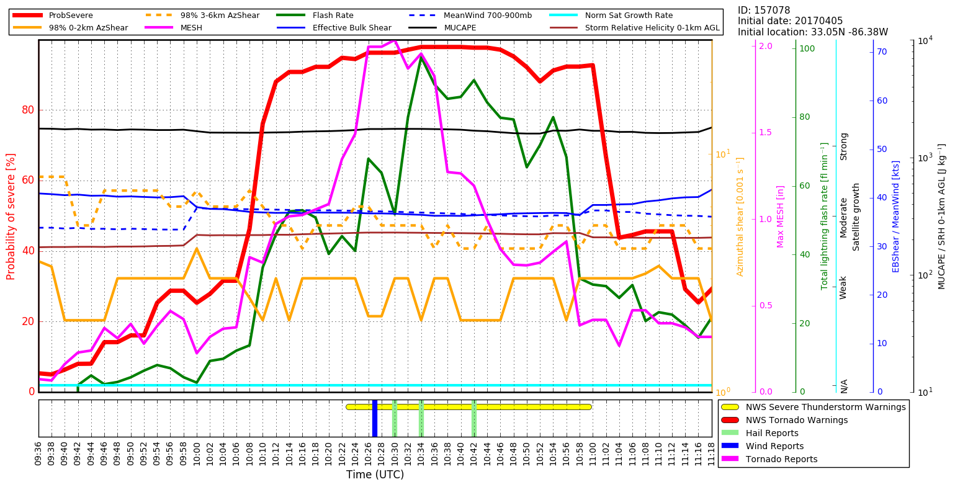
05 April 2017 – Time Series
Notes:
This slide shows a time series of many fields for the severe thunderstorm we’ve just covered.
There are many curves, but focus on the solid red line (ProbSevere) with the axis label on the left.
At the bottom of the plot you will see time as well as NWS warnings and severe weather reports.
To PHI users, real-time time-series capabilities will be available within the PHI tool.
To HWT users, we do not yet have a time-series capability in AWIPS-2, but recognize the value and are working toward this capability.
The highlights of this time-series include:
Rapidly increasing ProbSevere values prior to the first severe thunderstorm warning and well in advance of the first wind report, which can increase confidence in issuing a severe thunderstorm warning and as well as increase lead-time.

Slide 22
ProbSevere Model Performance
POD/FAR/CSI
Reliability
Skill plots show ProbSevere is less skillful than experienced forecasters (as expected) , but is comparable and offers increased lead-time
Reliability diagram shows slight over forecast bias for most probability thresholds, but “all hazards” ProbSevere is well calibrated overall
Notes:
The ProbSevere preliminary verification shown on this slide includes 2,250 severe storms and 42,000 non-severe storms during 2016.
ProbSevere is fairly well calibrated and users should expect verification at the approximate rate as the probability (e.g., a storm achieving a 40% probability will produce severe weather 4 in 10 times, a storm achieving a 80% probability will produce severe weather about 8 in 10 times, and so on).
The skill and lead-time analysis demonstrates that ProbSevere is not as skilled experienced NWS forecasters, yet is comparable. The increased lead-time and well-calibrated probabilities can offer the forecaster 1) increased confidence in their decision making and 2) increased lead-time in making warning decisions.

Slide 23
ProbSevere – Wind Improvement
Wind LSR’s Only Legacy ProbSevere
Wind LSR’s Only ProbWind from “all hazards” ProbSevere
Skill plots show that the ProbWind component of “all hazards” ProbSevere significantly improves upon the severe probability from the legacy version of ProbSevere.
Notes:
The ProbWind preliminary verification for wind events shown on this slide includes 1,650 severe storms and 42,000 non-severe storms during 2016.
ProbSevere—ProbWind incorporates more physically relevant NWP predictors and more direct measurements of thunderstorm wind velocity than the original version of ProbSevere. As such this figure shows the ProbSevere--ProbWind (right) has significantly higher POD, lower FAR and higher CSI for most probability thresholds when scoring for wind events (and is also better calibrated (more reliable), not shown).

Slide 24
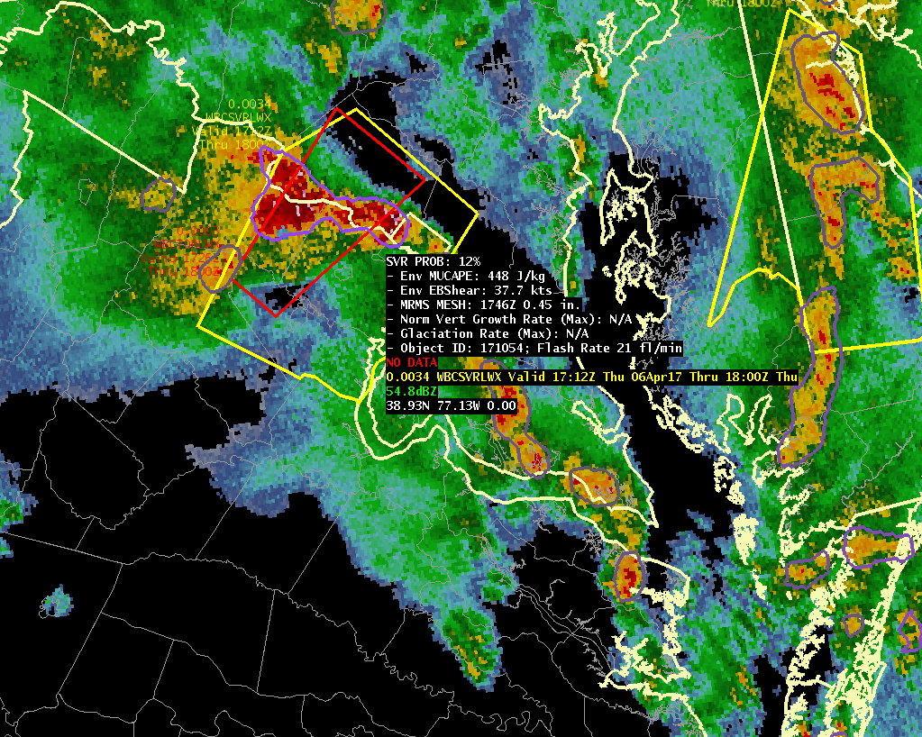
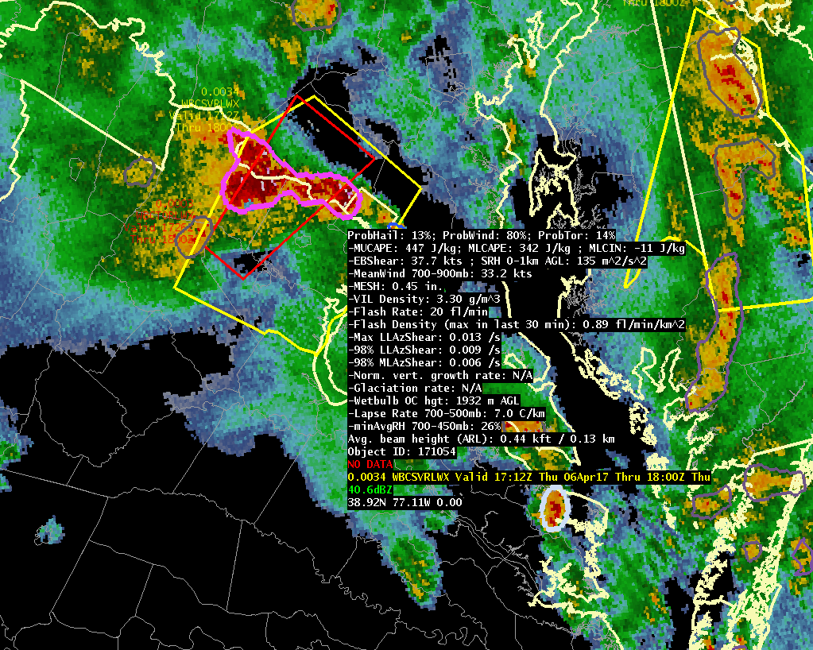
ProbSevere – Wind Improvement
06 April 2017 – 1748 UTC near Washington DC
Legacy ProbSevere: 12%
ProbHail: 13%, ProbWind: 80%, ProbTor: 14%
Notes:
This is a specific example of of the improvement of ProbSevere for a wind event near Washington DC at 1748 UTC on 06 April 2017.
ProbSevere is 80% (from ProbWind prediction) compared to legacy ProbSevere being only 12%.
This storm had a history of producing wind damage and continued to produce wind damage reports for the following ~2 hours through the Baltimore area.

Slide 25
ProbSevere: Known Caveats
ProbSevere will not provide lead time to every storm
ProbSevere requires an identifiable object in radar reflectivity
  Most often in linear modes, object identification can become more difficult—the absence of an object (and hence ProbSevere value) does not mean there is no severe weather threat
ProbSevere is impacted by radar beam blockage and increasing beam height away from radar just as base NEXRAD data are
Use ProbSevere with caution within 10 mi of the radar for wind/tornado prediction, as AzShear values may be artificially high due t0 non-meteorological targets.
Lead-time will be greatest when the satellite can observe the development of the storm from immature cumulus to cumulonimbus

Slide 26
ProbSevere: Summary
ProbSevere is a statistical model that incorporates NWP fields, radar observations, and total lightning observations to predict the probability a storm will produce severe weather in the next 0-60 minutes. Additionally, ProbSevere now provides probabilistic guidance to each hazard—severe hail, severe straight-line winds, and tornado.
ProbSevere should be used in combination with existing radar interrogation techniques and is designed to increase forecaster confidence and increase lead-time

Slide 27
Contact
Mike Pavolonis (michael.pavolonis@noaa.gov)
John Cintineo (john.cintineo@ssec.wisc.edu)
Justin Sieglaff (justin.sieglaff@ssec.wisc.edu)
Dan Lindsey (dan.lindsey@noaa.gov)
To access this training online and access supplement training (including ProbTor training) please see:
http://cimss.ssec.wisc.edu/severe_conv/training/training.html
All Hazards ProbSevere is also available on the web in real-time:
http://cimss.ssec.wisc.edu/severe_conv/probsevtest.html
Notes:
Please contact the statistical model researchers with questions, suggestions, etc. at the email addresses provided.

