Slide 1
NOAA/CIMSS ProbSevere Model
– Training Module –
Spring 2014
Notes:
This training module describes the NOAA/CIMSS Prob Severe statistical model, provides examples of the model output in AWIPS-II, and briefly discusses model validation and model limitations. Why do we need a statistical model to nowcast severe weather?
The uses of statistical models are becoming more and more important and common place as data volumes explode in all aspects of our lives. Statistical models are used with great success to predict things like presidential elections and outcomes of the NCAA basketball tournament. Meteorology is no different; as bigger and more frequent data becomes available to forecasters it becomes more important to distill gigabytes of data into kilobytes of useful information. And that is what the NOAA/CIMSS Prob Severe model does.

Slide 2
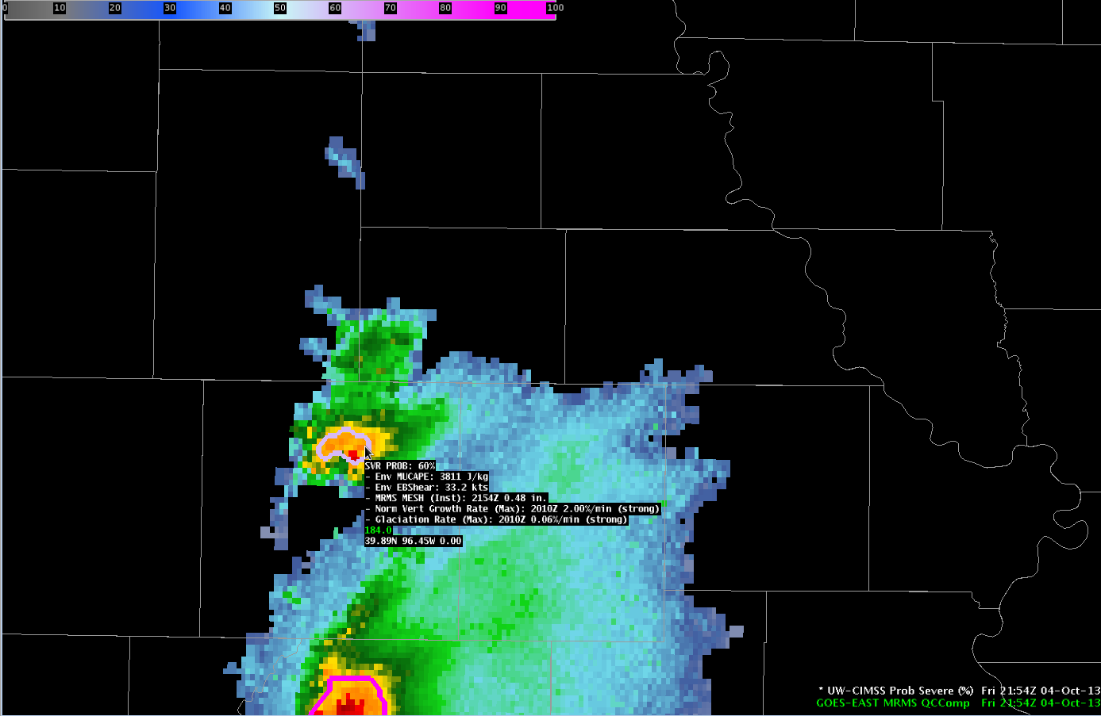
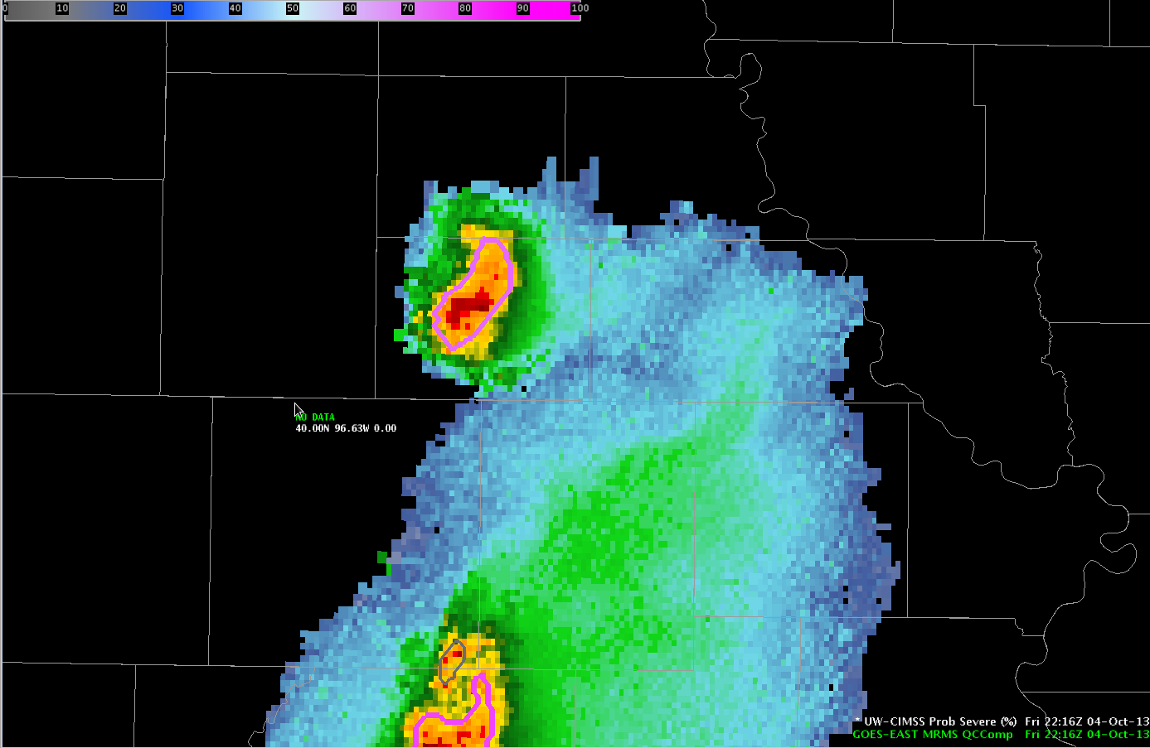
NOAA/CIMSS ProbSevere Model Goals
This statistical model predicts the probability that a storm will first produce severe weather in the near-term (in the next 60 min).
The statistical model does not predict if a storm will continue to pose a severe threat or if the storm will decay.
A “pre-polygon” product.
Notes:
The Prob Severe model is a statistical model that employs NWP environmental information, satellite observations, and radar observations. Before a brief discussion of the statistical model and data used, it is critical to define the objectives of the model.
In this image you can see a developing strong thunderstorm. The statistical model is designed to predict (in a probabilistic manner) that a given developing storm will FIRST produce severe weather in the next 60 minutes.
In the example shown, the developing storm has a 60% probability of FIRST producing severe weather in the next 60 minutes.
The model is NOT designed to predict if a given storm will continue to pose a severe threat once it has been warned and/or is producing severe weather. And is NOT designed to forecast storm decay.
It is important to use the model output as a “pre-polygon” product.
There may be utility in using the model probabilities past issuance of the first severe warning, but the model was not designed for this purpose and has not been validated in such a manner.

Slide 3
NOAA/CIMSS ProbSevere Model
Probability = f ( [instability, shear] X observational predictors )
Storm environment from NWP (RAP)
OBSERVATIONAL PREDICTORS:
2 satellite growth rates
1 instantaneous radar field
The statistical model is driven by observational predictors. The model does not predict cloud growth, but rather measures the rate of cloud growth using satellite observations and measures precipitation core intensity using radar.
Supplemental Training Link
Notes:
Every detail of the statistical model is not important for understanding the model on a high-level. The following equation describes the model on a high level. Simply, the model probability for a given storm is a function of storm environment, specifically instability and shear, and three observational predictors.
In the model, the storm environment is characterized, to a first order, as a combination of instability and shear computed from the Rapid Refresh model.
The observational predictors are comprised of two satellite growth rates and one instantaneous radar field.
Because observational predictors drive the model—model output does not exist until clouds begin to develop. The model does not predict cloud growth nor predict where a storm will move—but gives a probability a given storm will first produce severe weather in the next 60 minutes, wherever it may move.
On the bottom right corner of certain slides you will see a “Supplemental Training Link”. This link opens a web page with a bit more detail about the slide topic.

Slide 4
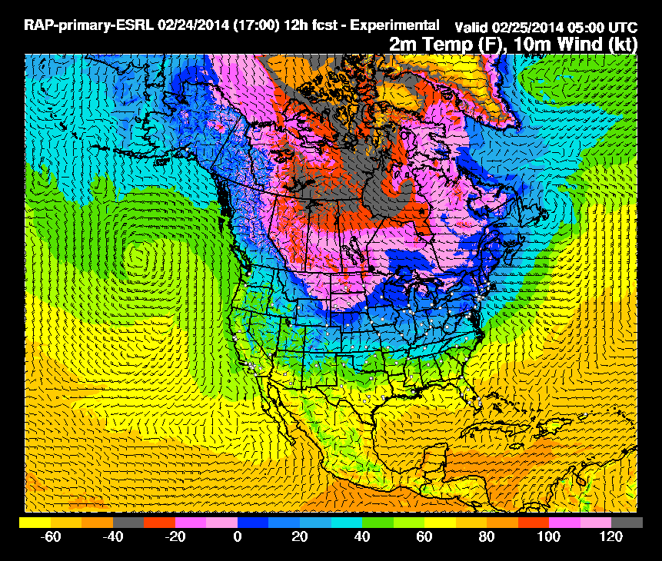
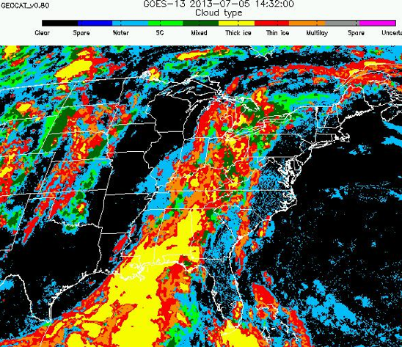
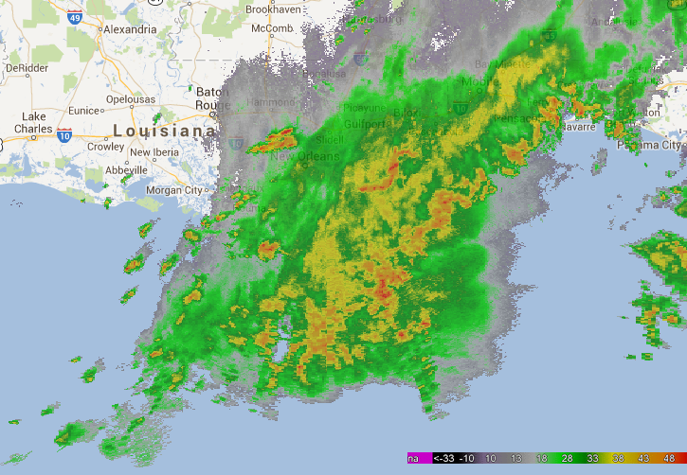
What data does the model use?
High-resolution NWP data
Satellite Imagery and Derived Products
Radar Imagery and Derived Products
Storm Environment
Cloud Tracking and Cloud Growth Rates
Radar Tracking and Storm Intensity
Notes:
A few more details about the input data into the statistical model are beneficial. The high-resolution NWP data (currently the Rapid Refresh) are used to characterize the instability and shear of the environment a storm develops.
The satellite imagery is used in two ways; to track clouds across space and time—in the same way a human views satellite imagery loops and to quantify the cloud growth rates, which are used as predictors in the model.
The radar data are used in a similar manner as the satellite data. The radar data are used to track storm cells in reflectivity imagery—again like how a meteorologist looks at a loop of radar imagery. And to quantify the intensity of the precipitation core of a developing thunderstorm, which is used as a predictor in the model. Before discussing a few more details about the input datasets, a schematic of how the statistical model works is presented in the following slide.
.

Slide 5
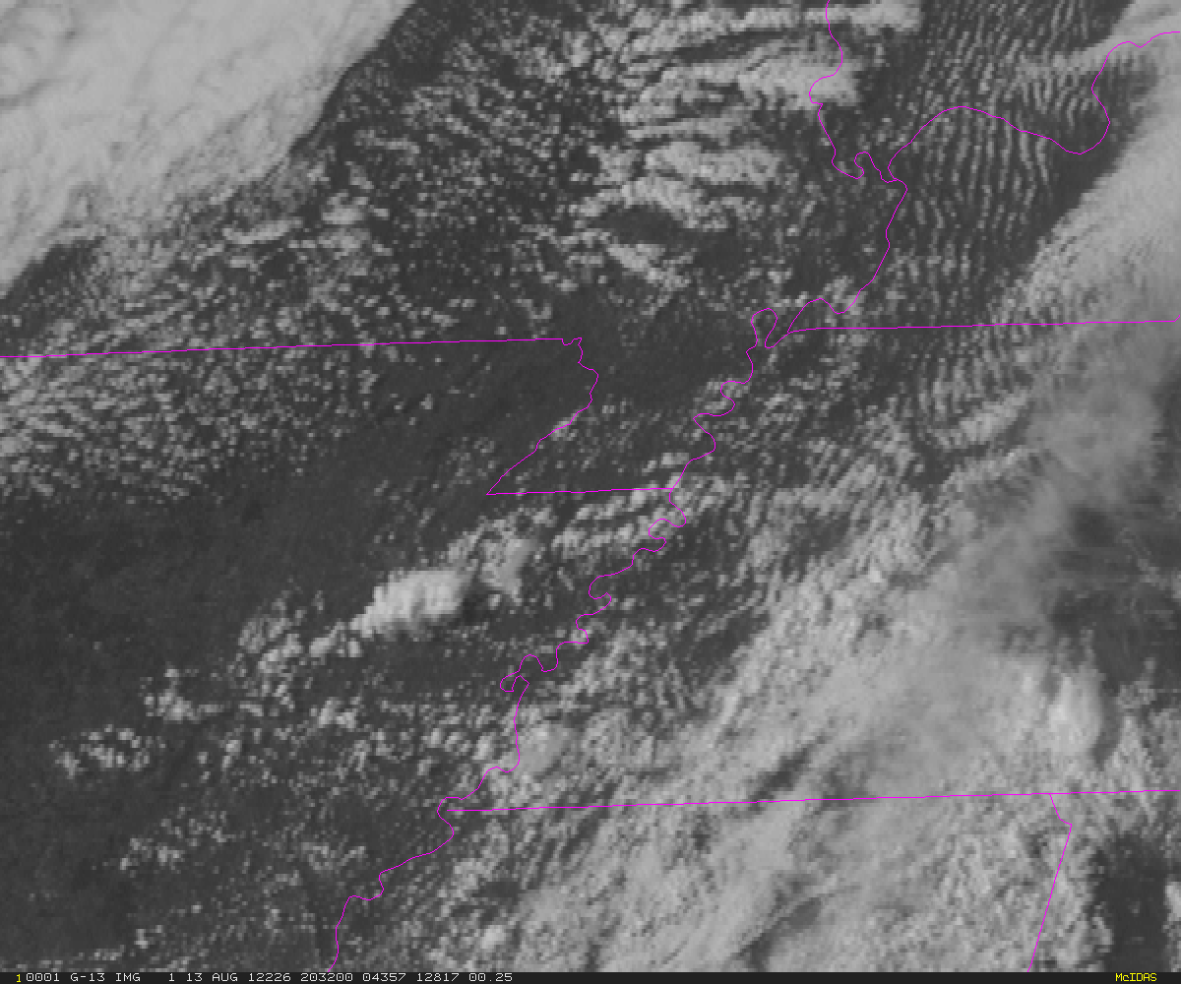
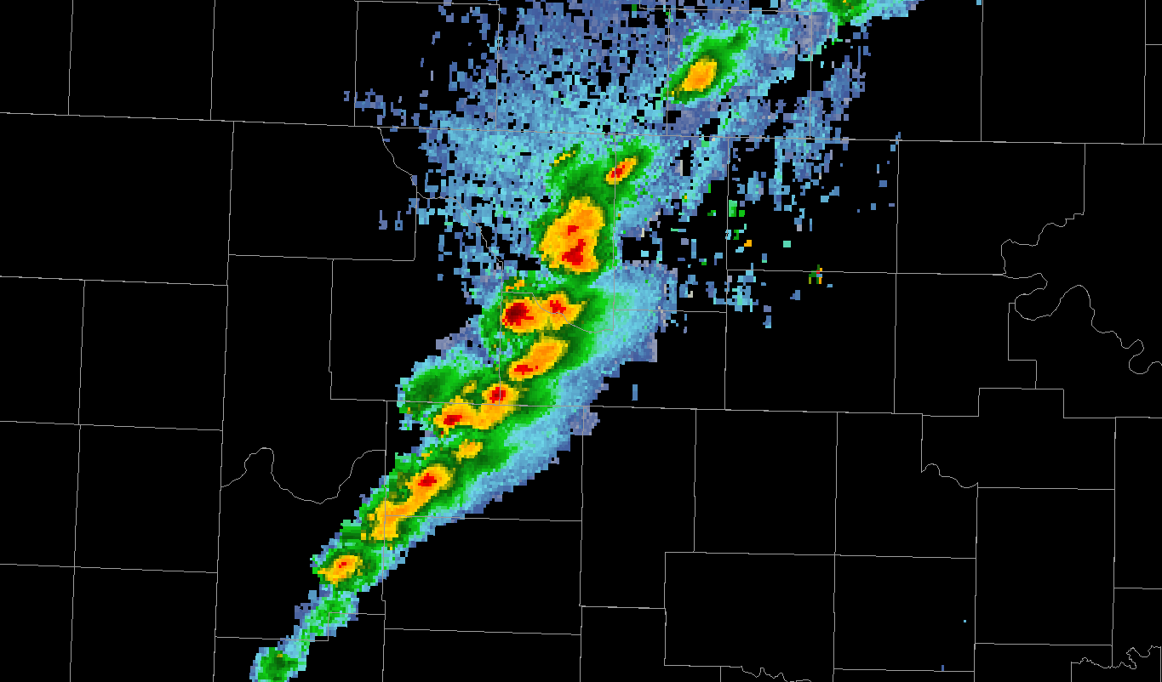
Automated integration of information
Time
Notes:
The following schematic illustrates how satellite and radar data are tracked by the computer and how this all feeds data into the statistical model—without dwelling on the complicated details of satellite and radar tracking. First we have a visible satellite image. A meteorologist doesn’t look at this image and see pixels—
A meteorologist sees cloud clusters, developing thunderstorms, etc.
So it is necessary to train the computer to think like a meteorologist. The computer needs to identify cloud boundaries and track those cloud clusters and their evolution over time.
The same concepts apply to radar data. Again the computer needs to “think” like a human and identify storms or cells.
And like with satellite data, the computer needs to track these storm cells and their evolution over time.
So how does this all come together? This animation is a 2-d schematic representing a storm growing with time.
The computer tracks clouds as storms or clusters like a human, while computing the satellite growth trends.
Once a developing storm exhibits moderate reflectivity, the computer identifies and tracks cells in radar imagery. Once storms are tracked on radar, they inherit the parent cloud’s satellite growth information, which generally occurred earlier in the storm life cycle. Both the satellite growth rate information and radar storm intensity information are input into the statistical model to derive the probability of severe weather.
The computer continues to track storms in both satellite and radar imagery. The model continually updates probabilities, as new observations are available.

Slide 6
Automated integration of information
Schematic of increasing model probability of a severe thunderstorm
Time
Low Prob
Moderate Prob
High Prob
Warnings and Reports

Slide 7
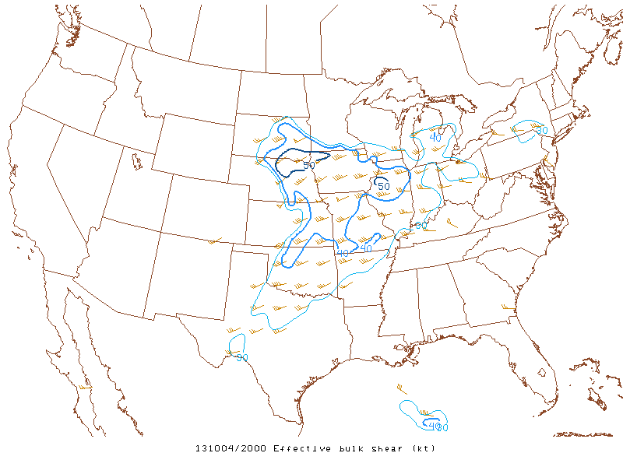
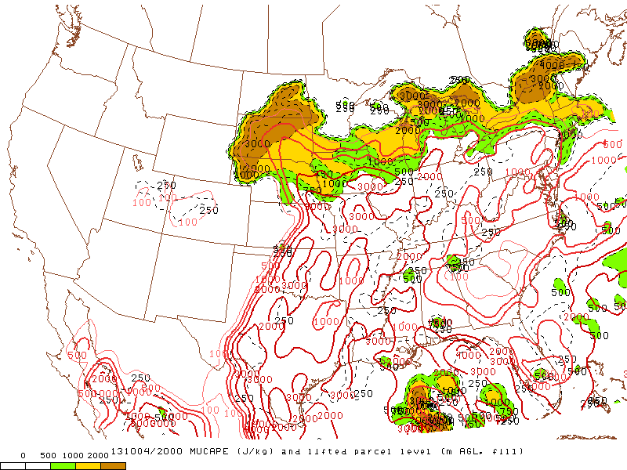
Data sources – Rapid Refresh (RAP)
Effective bulk shear (EBS):
  Discriminates well between supercell and non-supercell convection
  Normalizes shear between storms with deep and shallow inflow layers
Most-unstable CAPE (MUCAPE):
  Rough estimate of maximum updraft potential, even for elevated convection.
Supplemental Training Link
Notes:
The storm environment information currently comes from the Rapid Refresh model. Recall we use model information to make a first order approximation of the storm environment—namely instability and shear.
The environmental shear parameter used is the effective bulk shear. The EBS normalizes shear between storms with deep and shallow inflow layers and is more accurate when considering elevated convection.
The environmental instability parameter used is the most unstable CAPE. The MUCAPE provides a generous estimate of instability. MUCAPE is useful for both surface based convection as well as elevated convection.
One important note about the NWP data used within the model is we do not use a single forecast or single analysis. We create a temporal composite and spatially smooth that temporal composite. The temporal compositing and spatial smoothing acts to mitigate NWP phase and placement errors in convective development. The last outcome we want is a poor NWP solution to squash model probabilities incorrectly—surely if strong convection is developing there must be sufficient CAPE.

Slide 8
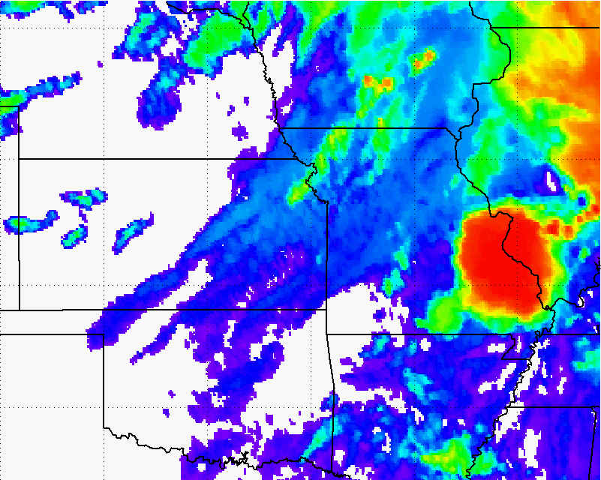
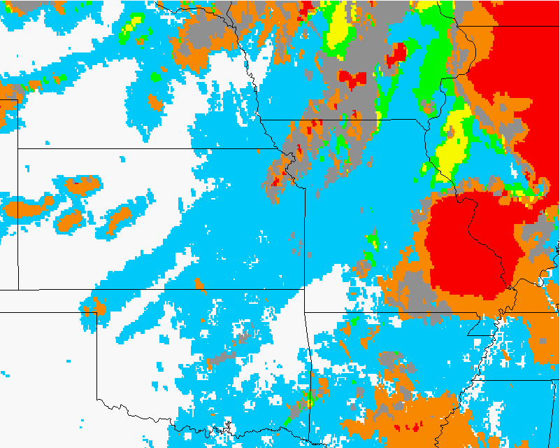
Data sources – GOES-derived Cloud Properties
How much does a developing storm-top cool over a period of time?
  Infers vertical growth of convective clouds (and updraft strength)
Rate-of-change in ice-cloud fraction:
  At cloud-top
  Infers vertical growth and glaciation rate (i.e., how fast is the cloud-top changing from mostly liquid water to ice).
How quickly a developing storm transitions from water cloud (blue) to ice (orange, red, and gray) is automatically quantified.
How quickly a developing storm cools is automatically quantified.
Supplemental Training Link
Notes:
The two satellite cloud growth predictors used in the statistical model are a normalized vertical cloud growth rate and a glaciation rate.
How quickly a developing storm cools in infrared brightness temperatures is an indicator of severe potential. In the example over eastern Kansas, we can see rapid cooling in the imagery and the computer quantifies this cooling rate, which is used as input into the statistical model. The cooling rate we use is normalized—such that seasonal and latitudinal differences in the cooling rates are automatically accounted for.
The other satellite predictor used is the glaciation rate or how quickly the cloud-top is transitioning from liquid water cloud droplets (blue in the imagery) to ice crystals (orange, red, and gray in the imagery). Like the normalized vertical growth rates, the computer quantifies this information and how quickly a developing storm-top transitions from water tops to ice tops is an indicator of severe potential.

Slide 9
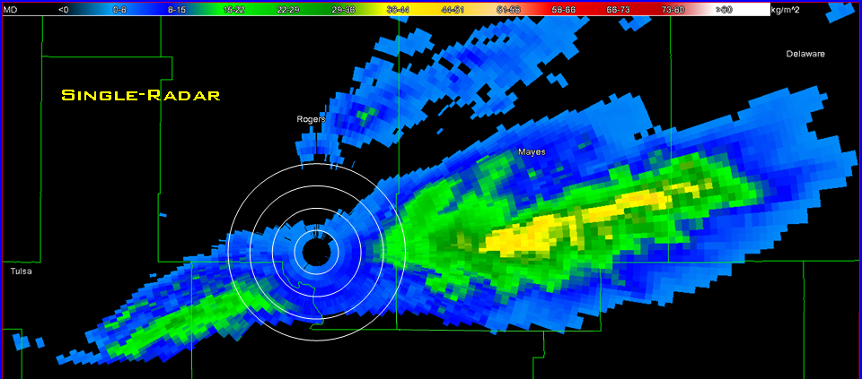
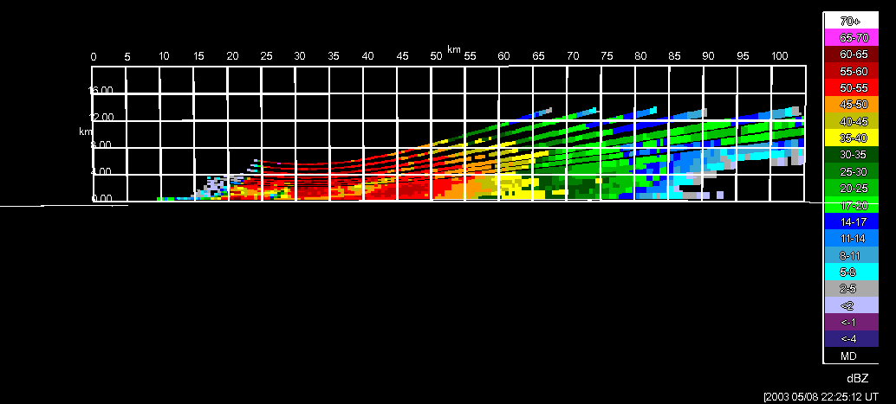
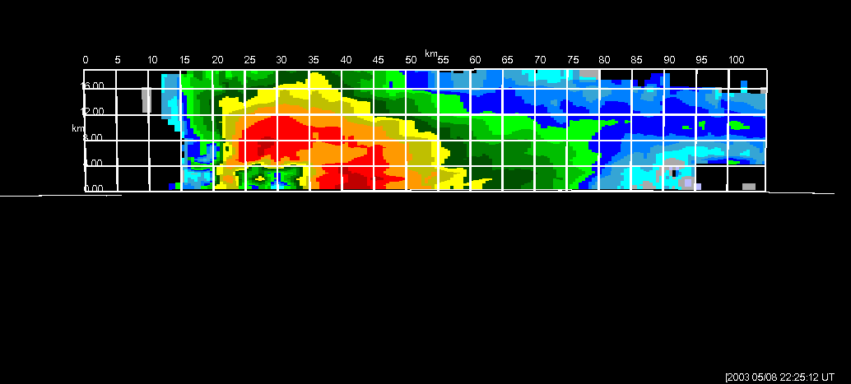
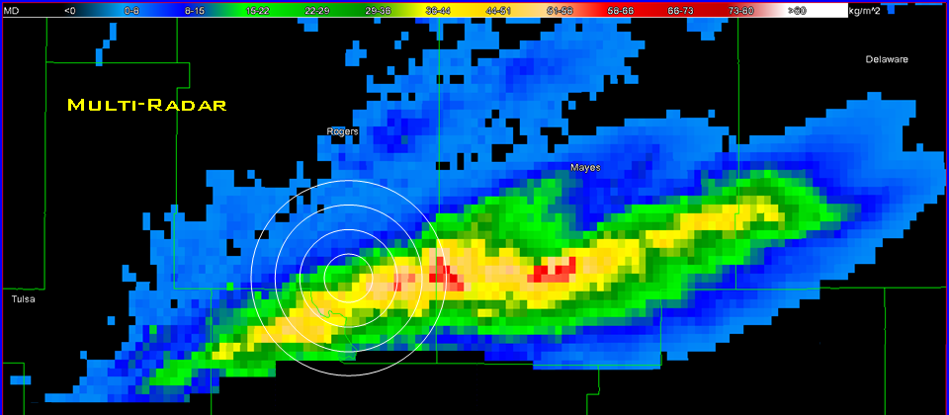
Data sources – Multi-Radar Multi-Sensor products
Developed at OU-CIMMS/NOAA-NSSL
Provide better estimates of radar-derived products
  Overlapping coverage
  Fill gaps caused be cone of silence and terrain blockage
  Increased sampling frequency
Vertical Cross-Section
VIL Tracks
(Figures from OU-CIMMS)
Notes:
The radar dataset used is the Multi-Radar Multi-Sensor radar products from the National Severe Storms Laboratory and the University of Oklahoma. The MRMS radar fields are a CONUS-wide composite of all individual NEXRAD radars—which is an ideal format for doing radar storm cell tracking. The MRMS data also fills gaps in single site coverage, including cone of silence and offers increased sampling frequency when a storm is sampled by more than one radar.

Slide 10
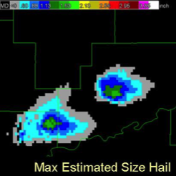
Data sources – MRMS products
Maximum Expected Size of Hail (MESH):
  Empirically derived from the Severe Hail Index (SHI)
  SHI is a thermally-weighted vertical integration of reflectivity above the melting level
MESH
(Figure from OU-CIMMS)
Supplemental Training Link
Notes:
The radar storm cell tracking utilizes the MRMS composite reflectivity. The radar data used as a predictor in the statistical model is the MRMS maximum expected size of hail or MESH. The MESH is derived from the Severe Hail Index algorithm, which is essentially a vertical integration of reflectivity above the melting level.

Slide 11
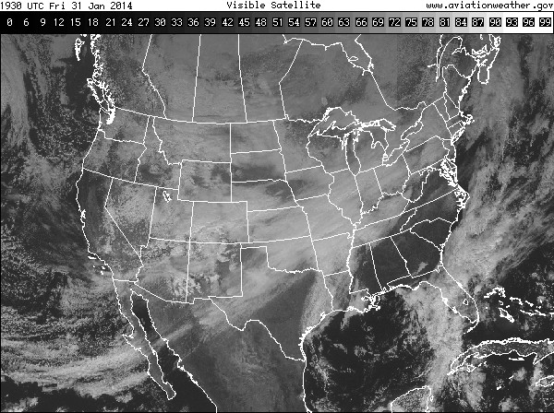
ProbSevere Model Real-Time Operations
t = 0
2
4
6
8
10
12
14
16
18
20
22
24
26
28
30
32
34
36
38
40
42
44
min
Notes:
So how is all this information combined in real-time processing? Unlike most GOES-R related projects that update with each satellite scan—the statistical model is different. The model updates at the frequency of the MRMS radar data—about every 2 minutes.
When a storm develops and is tracked within satellite imagery, it has information about the storm environment from the RAP composite—which updates every hour. The probabilities are computed for every set of MRMS radar data—about every 2 minutes. In this schematic you see the satellite data popup every 15 minutes—which is the approximate update frequency of the current GOES satellite in routine scan mode (or approximately 7 minutes in rapid-scan mode).
The critical point is:
The model does not wait on a satellite scan—it uses the most recent information available from satellite—whether the satellite is in routine scan mode or rapid scan mode. So users should expect updates in AWIPS-II about every 2 minutes.

Slide 12
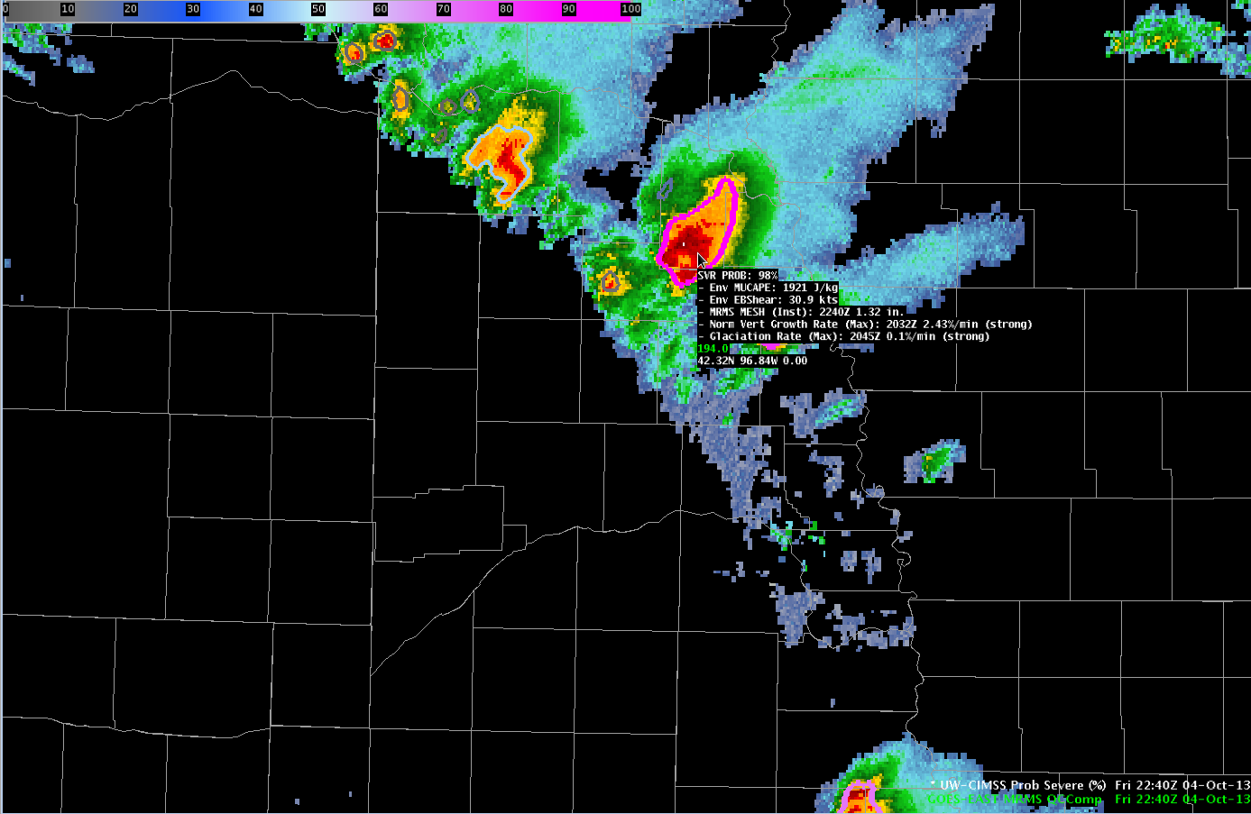
ProbSevere Model AWIPS-II Display
Model output are shapefiles contoured around radar storm cells.
Enhancement designed for overlay atop radar reflectivity—but can be overlaid on any field (satellite, radar velocity, etc.).
Sampling offers readout of model probability as well as each model predictor.
SVR PROB: Probability from statistical model 0-100%.
Env MUCAPE: RAP composite MUCAPE for storm environment.
Norm Vert Growth Rate (Max): Maximum storm cell satellite vertical growth rate.
Time occurred, normalized vertical cloud growth rate per minute.
Classified as weak, moderate, or strong.
Env EBShear: RAP composite effective bulk shear for storm environment.
Glaciation rate (Max): Maximum storm cell satellite glaciation rate.
Time occurred, percentage of conversion from water to ice cloud-tops per minute. Classified as weak, moderate, or strong.
MESH (Inst): Instantenous maximum expected size of hail from MRMS radar data. Time (current) and size (inches).
Notes:
We will now transition from discussing how the statistical model works and learning about the input datasets to showing examples of how the model performed in some severe weather events.
The examples will feature screenshots of the model output in AWIPS-II. The model output is, by default, displayed in two ways. One is a probability contour with a color enhancement designed for overlay on top of typical radar reflectivity color tables. The shapefile nature of the output makes the display very flexible—the contours can be overlaid on any field within AWIPS-II (for example satellite imagery or radar velocity imagery). Additionally, the model probability and each model predictor is displayed as text when sampling is turned on. The following bullets briefly describe the text read-out.
This field is the statistical model probability and ranges between 0 and 100% for a given storm cell.
This field is the most unstable CAPE from our RAP composite for the storm cell.
This field is the effective bulk shear from our RAP composite for the storm cell.
This field is the instantaneous MRMS MESH value—the time and value are provided. Note the MRMS may not match a single site MESH algorithm—both time and value.
This field is the normalized vertical growth rate of the storm. It is the maximum value attained during the growth stage of the storm and the time that maximum value occurred. The units are percentage of the troposphere depth the cloud grew per minute. So a value of 3%/min would mean the cloud grew 3% of the tropospheric depth every minute—or 45% of the tropospheric depth over the course of 15 minutes. The exact values are not terribly important—we append a statistical measure of intensity with the terms “weak”, “moderate”, or “strong”.
This field is the glaciation rate or the rate at which the storm-top transitioned from liquid water droplets to ice crystals. It is the maximum value attained during the growth stage of the storm and the time that maximum value occurred. The units are percentage of water to ice conversion per minute. So a value of 0.05/min would mean the cloud transitioned 5% of the water droplets to ice crystals every minute—or 75% of the liquid droplets converted to ice crystals over the course of 15 minutes. Again, the exact values are not terribly important—we append a statistical measure of intensity with the terms “weak”, “moderate”, or “strong”.
While each model predictor is provided in the text read-out, it is important to emphasize—the sum of the information--the probability--is more valuable than any individual piece of information.

Slide 13
HWT Questions
The following examples illustrate our take on how a forecaster may want to use the ProbSevere model output--but we do not have all the answers and need forecaster feedback.
Especially:
How can a forecaster interpret/use the probability when it fluctuates over short periods (< 10 min)?
Do rapid jumps in probability over short periods (< 10 min) to high probability values signify something unique about a storm?
In some cases high probability can exhibit as much as 60 minutes of lead-time ahead of reported severe weather, how can forecasters use information when lead-time is potentially large?
Notes:
The examples on the following slides provide our take on how a forecaster may want to use the Prob Severe model output—but we don’t have all the answers and need your feedback. Especially with the following questions:
[
How can a forecaster interpret or use probability when it fluctuates over short periods (< 10 min)?
Do rapid jumps in probability over short periods (< 10 mins) to high probability values signify something unique about a storm?
In some cases high probability can exhibit has much as 60 minutes of lead-time ahead of reported severe weather, how can forecasters use information when lead-time is large?

Slide 14
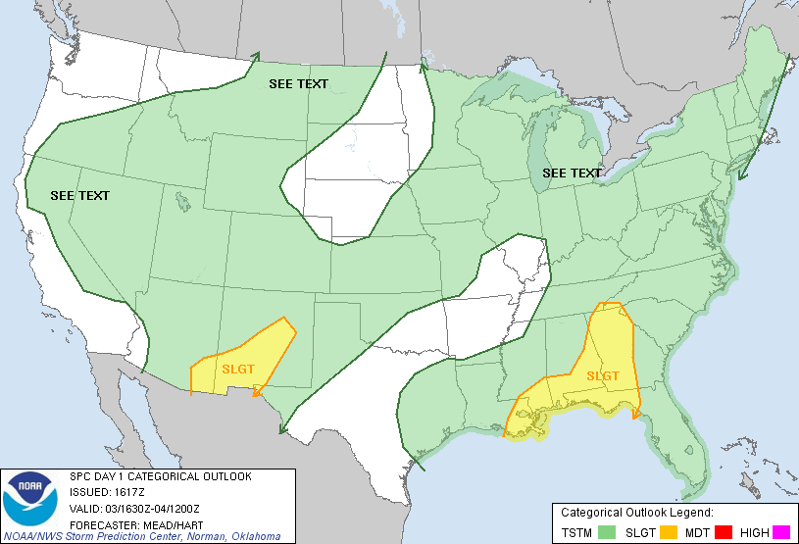
3 July 2013
Notes:
The first example is over upstate New York in a region of marginal severe threat as depicted by the Storm Prediction Center outlook.

Slide 15
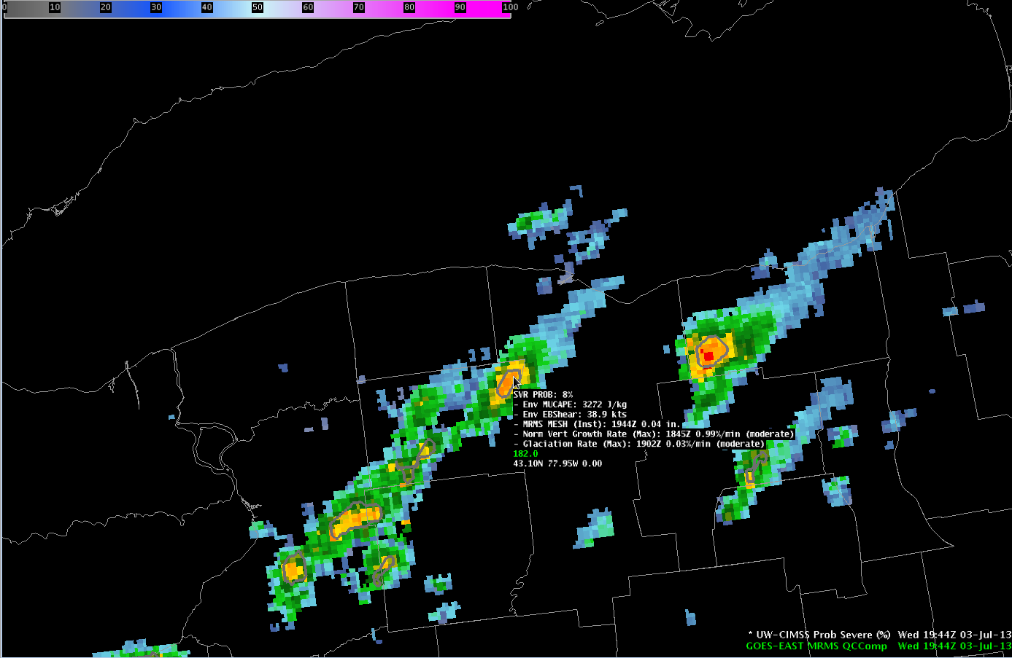
1944 UTC Jul-03-2013
MUCAPE ~ 3000 J kg⁻¹
Eff. shear ~ 35 kts
Prob = 8%
Moderate satellite growth
Lake Ontario
NY
Notes:
Staring at 1944 UTC we are over upstate New York. MRMS composite reflectivity is shaded and the statistical model contours are overlaid on the reflectivity data with the text read-out provided for the storm of interest. At 1944UTC a developing storm had moderate instability and sufficient shear to organize. The probability at this time was low—only 8% as the satellite growth wasn’t overly strong—in the moderate range.

Slide 16
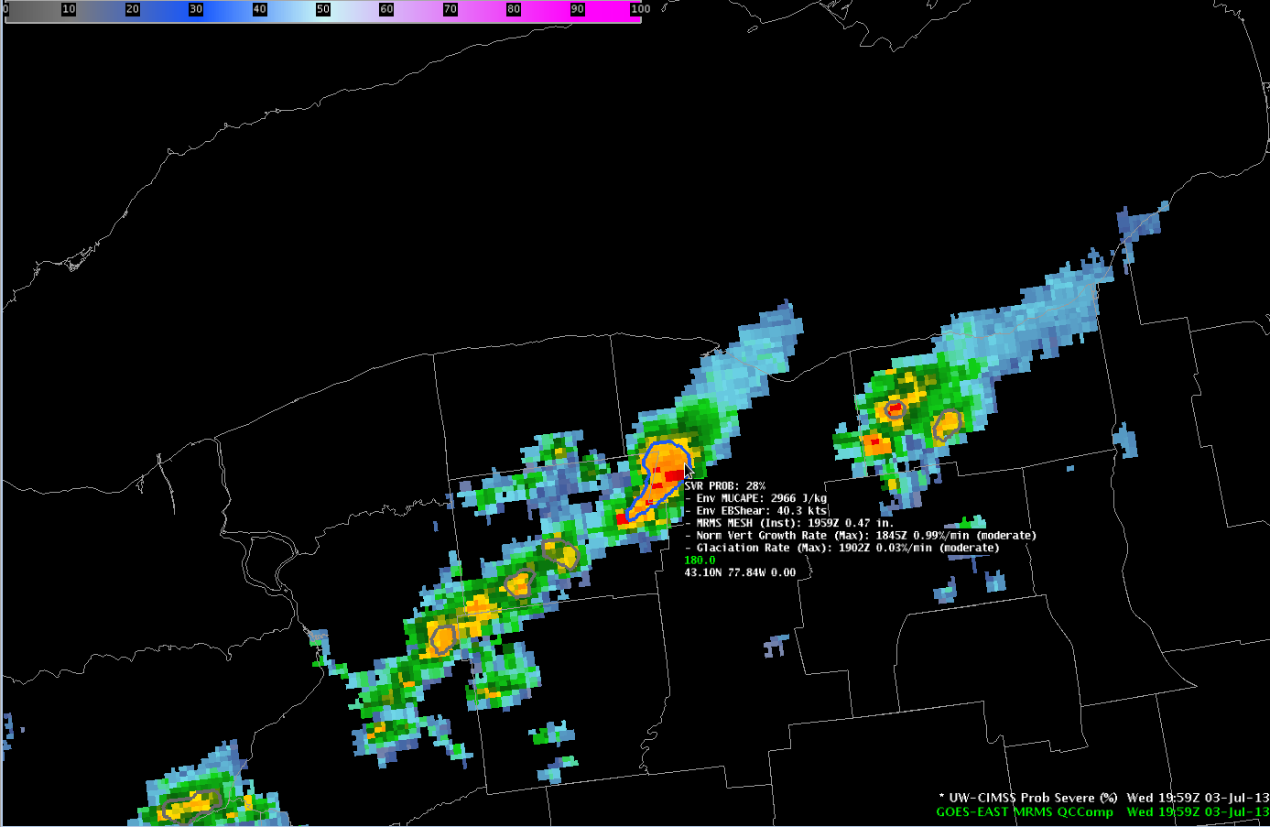
1959 UTC Jul-03-2013
MUCAPE ~ 3000 J kg⁻¹
Eff. shear ~ 40 kts
Prob = 28%
Moderate satellite growth
Lake Ontario
NY
Notes:
By 1959 UTC the radar intensity of the storm began to increase and the model probability increased to 28%.

Slide 17
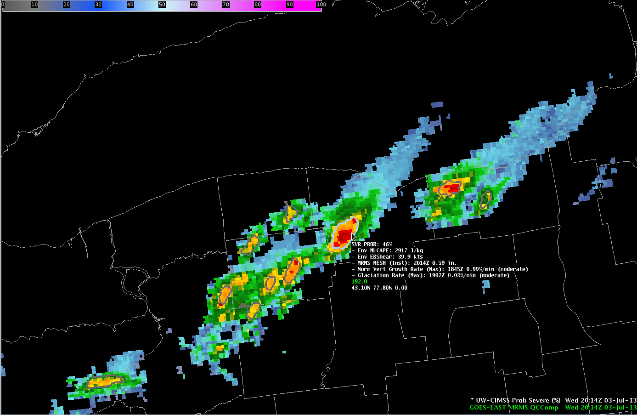
2014 UTC Jul-03-2013
MUCAPE ~ 3000 J kg⁻¹
Eff. shear ~ 40 kts
Prob = 46%
Moderate satellite growth
Lake Ontario
NY
Notes:
At 2014 UTC the radar intensity continued to increase—and so did the model probability—now up to 46%.

Slide 18
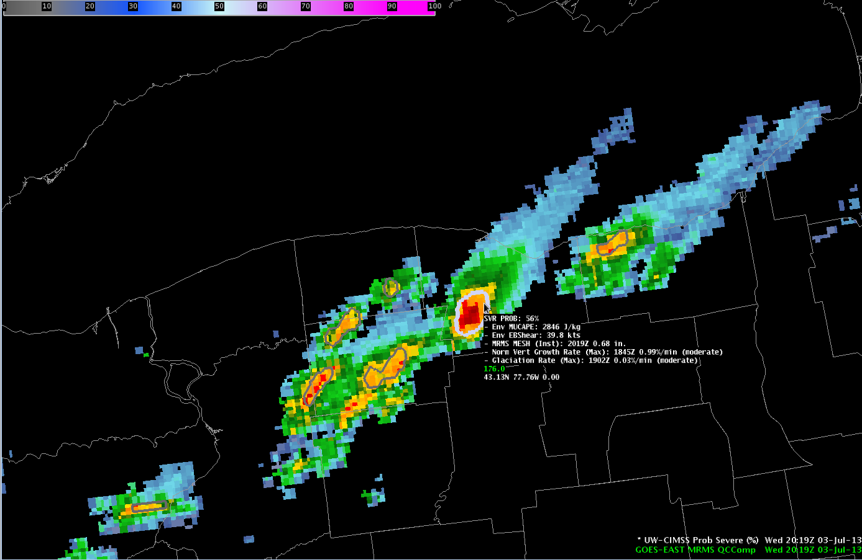
2019 UTC Jul-03-2013
MUCAPE ~ 3000 J kg⁻¹
Eff. shear ~ 40 kts
Prob = 56%
Consider warning?
Lake Ontario
NY
Notes:
At 2019 UTC the model probability first crossed the 50% threshold—which means the storm is more likely to produce severe weather than not. Perhaps looking through the radar tilts of the storm puts you on the fence to take action or not? The probabilistic information can be used to increase confidence and increase lead-time of issuing a warning.

Slide 19
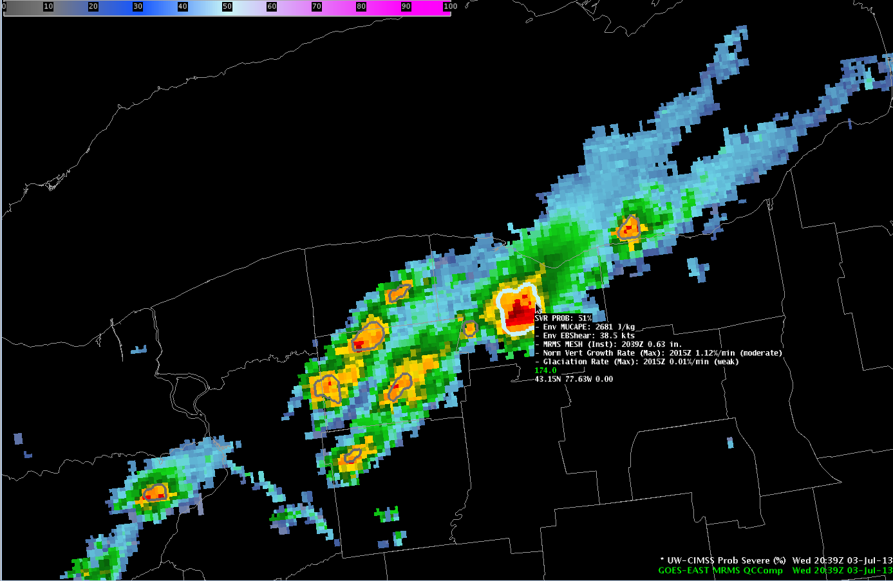
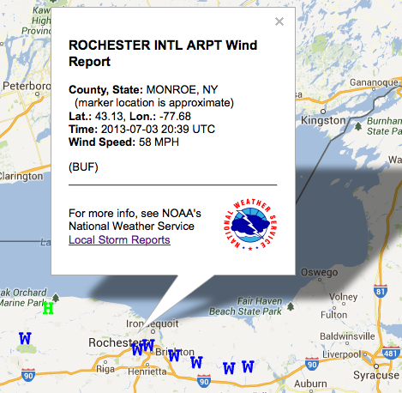
2039 UTC Jul-03-2013
MUCAPE ~ 3000 J kg⁻¹
Eff. shear ~ 40 kts
Prob = 51%
Probability fluctuates as radar intensity fluctuates.
First wind report @ 2039 UTC
58 mph @ KROC
20 min after Prob > 50%
Lake Ontario
NY
Notes:
Now at 2039 UTC a 58 MPH wind gust was reported at the Rochester International Airport—20 minutes after the model probability first exceeded 50%.

Slide 20
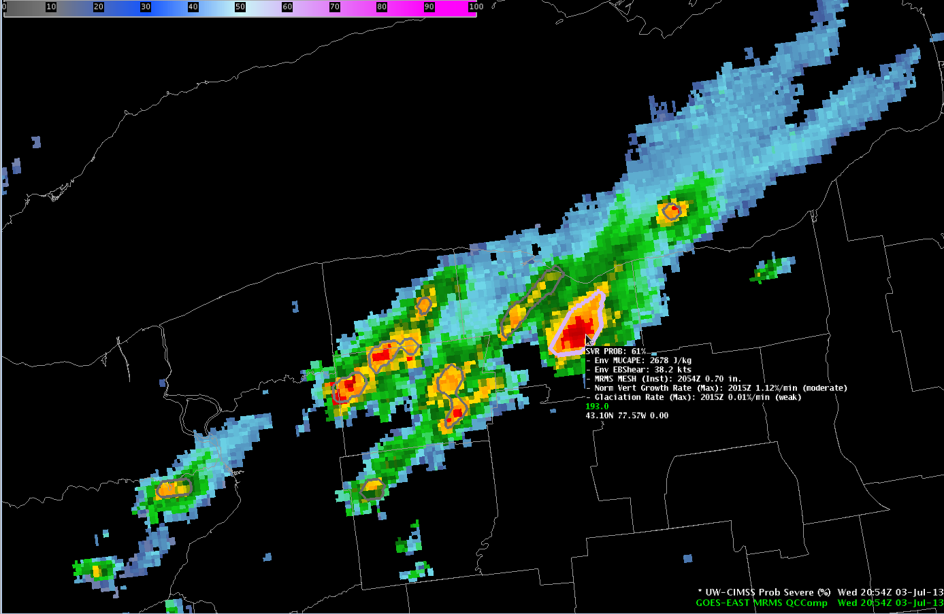
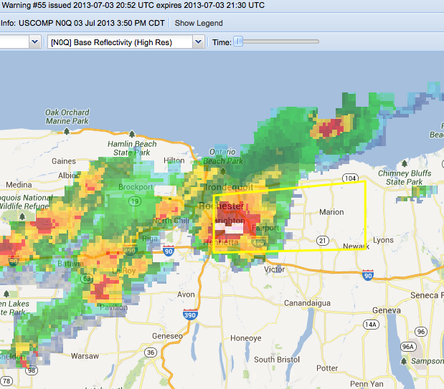
2054 UTC Jul-03-2013
First warning @ 2052 UTC
33 min after Prob > 50%
Prob = 61%
Lake Ontario
NY
Notes:
The first severe thunderstorm warning was issued at 2052 UTC—33 minutes after the first model probability greater than 50%. This was the only storm to produce severe weather in this time frame. (Storms further west did eventually generate higher probabilities and also produced severe weather.) So in this example, the probabilistic information could have been used to raise awareness and increase confidence that this storm would produce severe weather on a day when the severe threat was marginal.

Slide 21
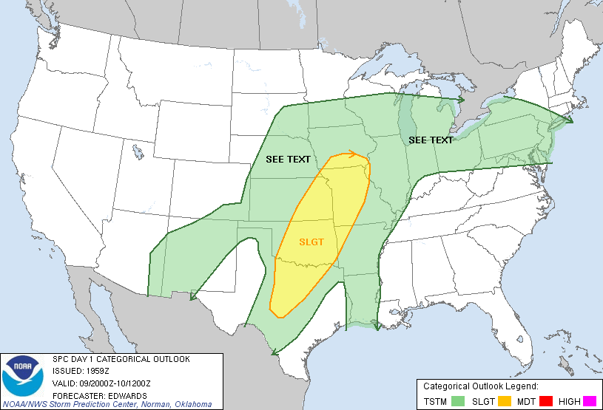
09-10 April 2013
Notes:
The next example takes us to the Kansas City metro area on the evening of April 9. This example occurs at night and within a slight risk region in the Storm Prediction Center outlook.

Slide 22
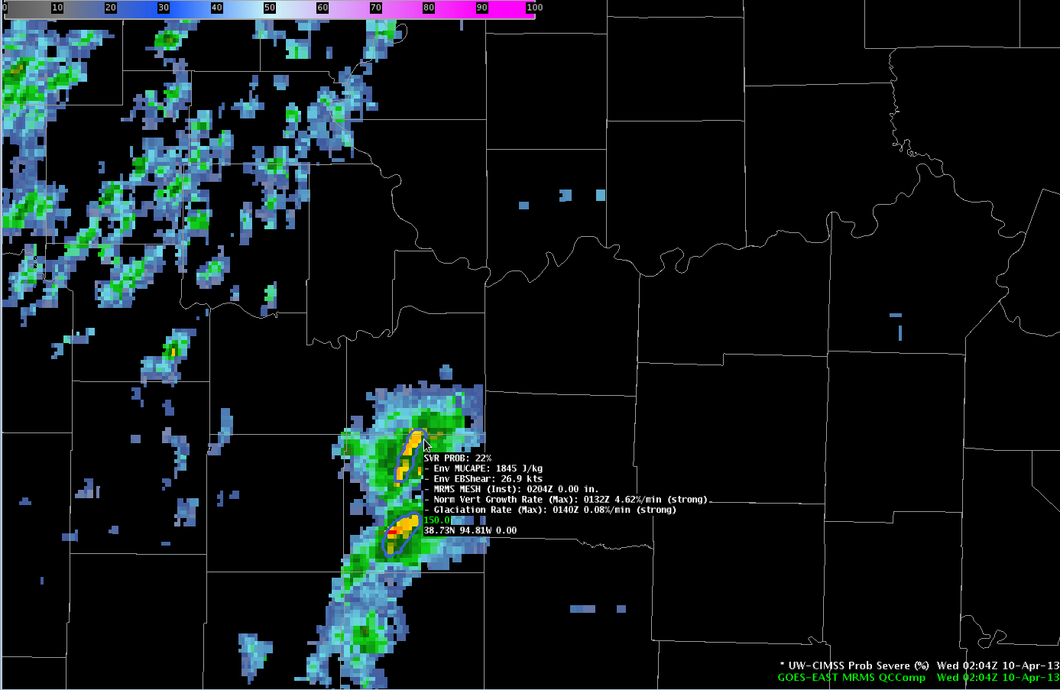
0204 UTC Apr-10-2013
MUCAPE ~ 1850 J kg⁻¹
Eff. shear ~ 25 kts
Prob = 22%
Strong satellite growth
MO
KS
Notes:
Starting at 0204 UTC a storm was developing to the south-southwest of the Kansas City metro area with strong satellite growth signals, moderate instability and shear. The probability at this time was 22%.

Slide 23
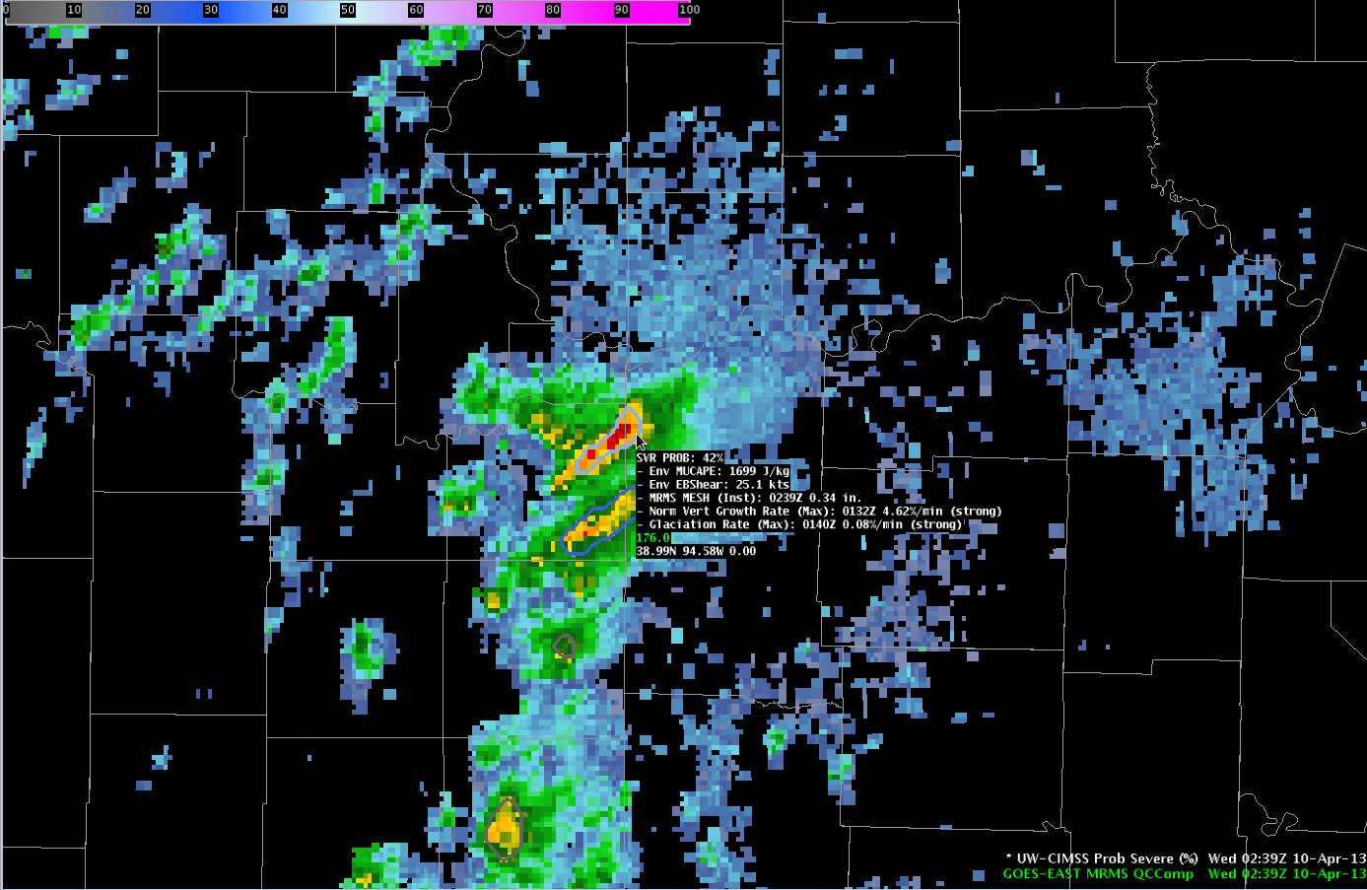
0239 UTC Apr-10-2013
Prob = 42%
Radar intensity increasing
MO
KS
Notes:
A bit more than 30 minutes later, at 0239 UTC, the probability increased to 42% as the radar intensity increased.

Slide 24
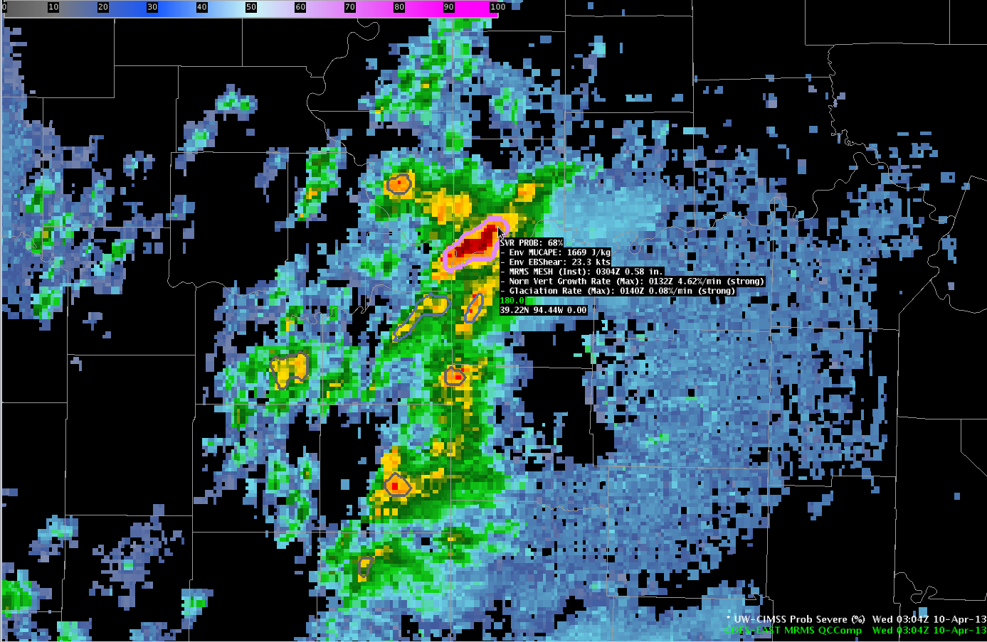
0304 UTC Apr-10-2013
Prob = 68%
Radar intensity increasing
Consider warning?
MO
KS
Notes:
At 0304 UTC the model probability exceeded 50%--coming at in 68%. Can a forecaster take their existing warning procedure and incorporate the probability to potentially issue a warning sooner?

Slide 25
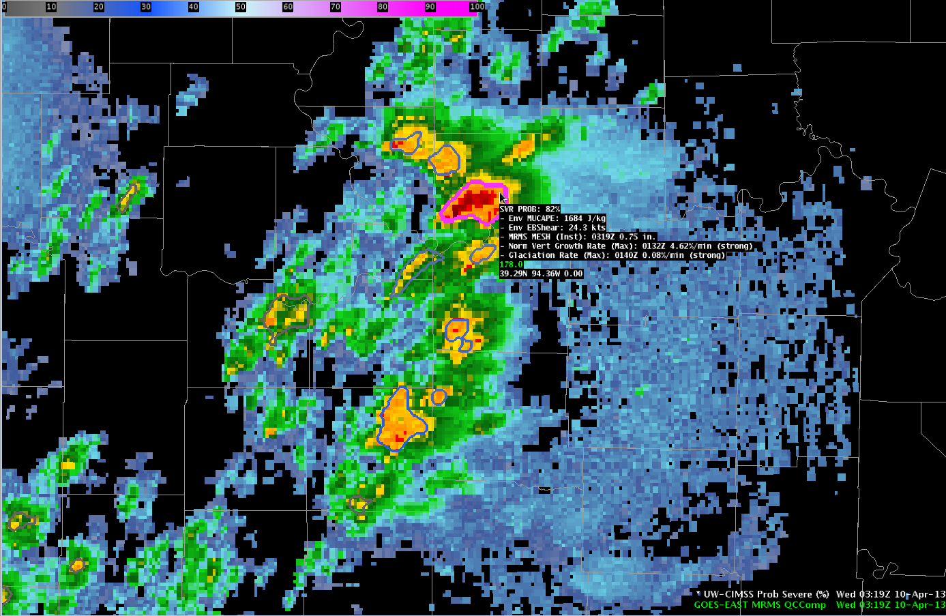
0319 UTC Apr-10-2013
Prob = 82%
Radar intensity increasing
Consider warning?
1.00” hail report @ 0322 UTC
18 min after Prob > 50%
No warnings issued
MO
KS
Notes:
By 0319 UTC the model probability was in excess of 80%. Three minutes later the first severe hail report was received, 18 minutes after the first model probability exceeded 50%. No warnings were issued on this storm. This was the only storm within the small arc of storms seen in radar imagery that produced a severe weather report and the only storm to have probabilities exceed 50%.

Slide 26
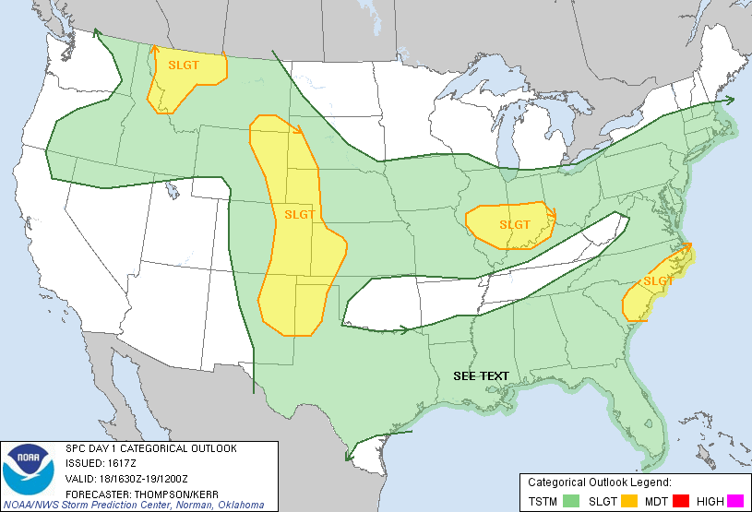
18 June 2013
Notes:
We have another example in a region with a marginal severe weather threat over south central Iowa.

Slide 27
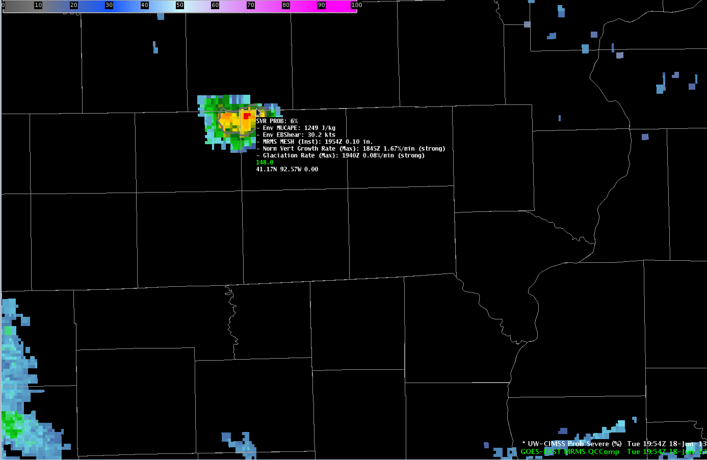
1954 UTC Jun-18-2013
IA
MUCAPE ~ 1250J kg⁻¹
Eff. shear ~ 30 kts
Prob = 6%
Strong satellite growth
IL
MO
Notes:
At 1954 UTC a storm developed over south-central Iowa with strong satellite growth rates, marginal CAPE and sufficient shear. The probability was initially low—around 6%.

Slide 28
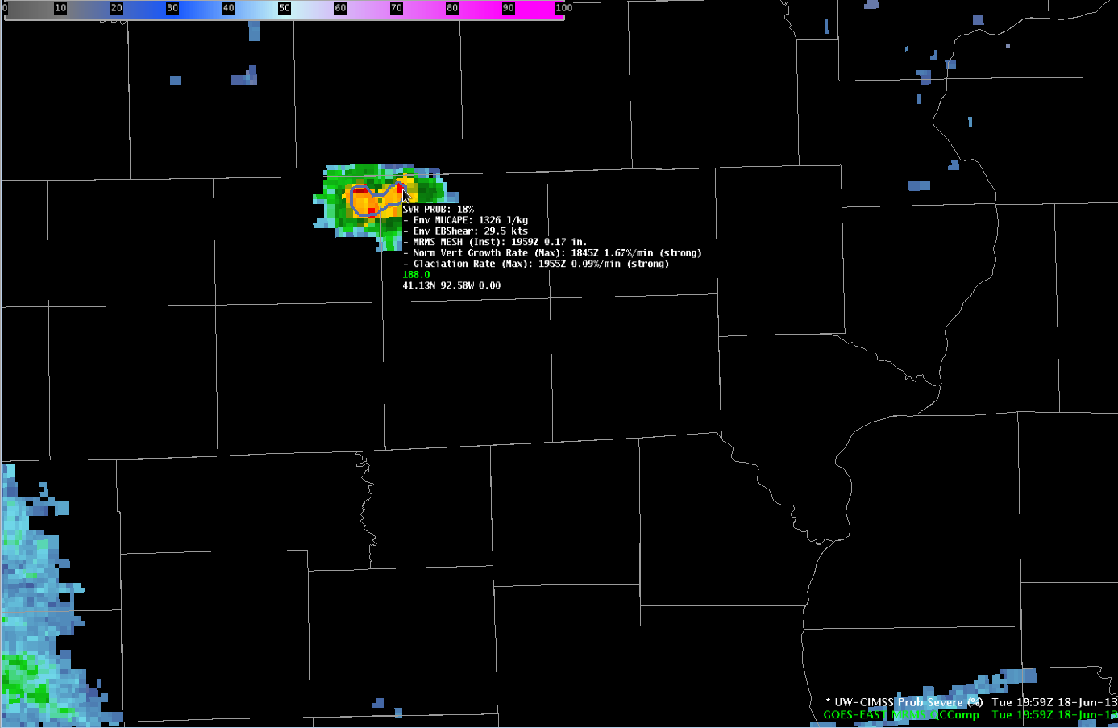
1959 UTC Jun-18-2013
IA
MUCAPE ~ 1250J kg⁻¹
Eff. shear ~ 30 kts
Prob = 18%
Strong satellite growth
IL
MO
Notes:
At 1959 UTC the probability increased slightly to 18% as radar intensity increased.

Slide 29
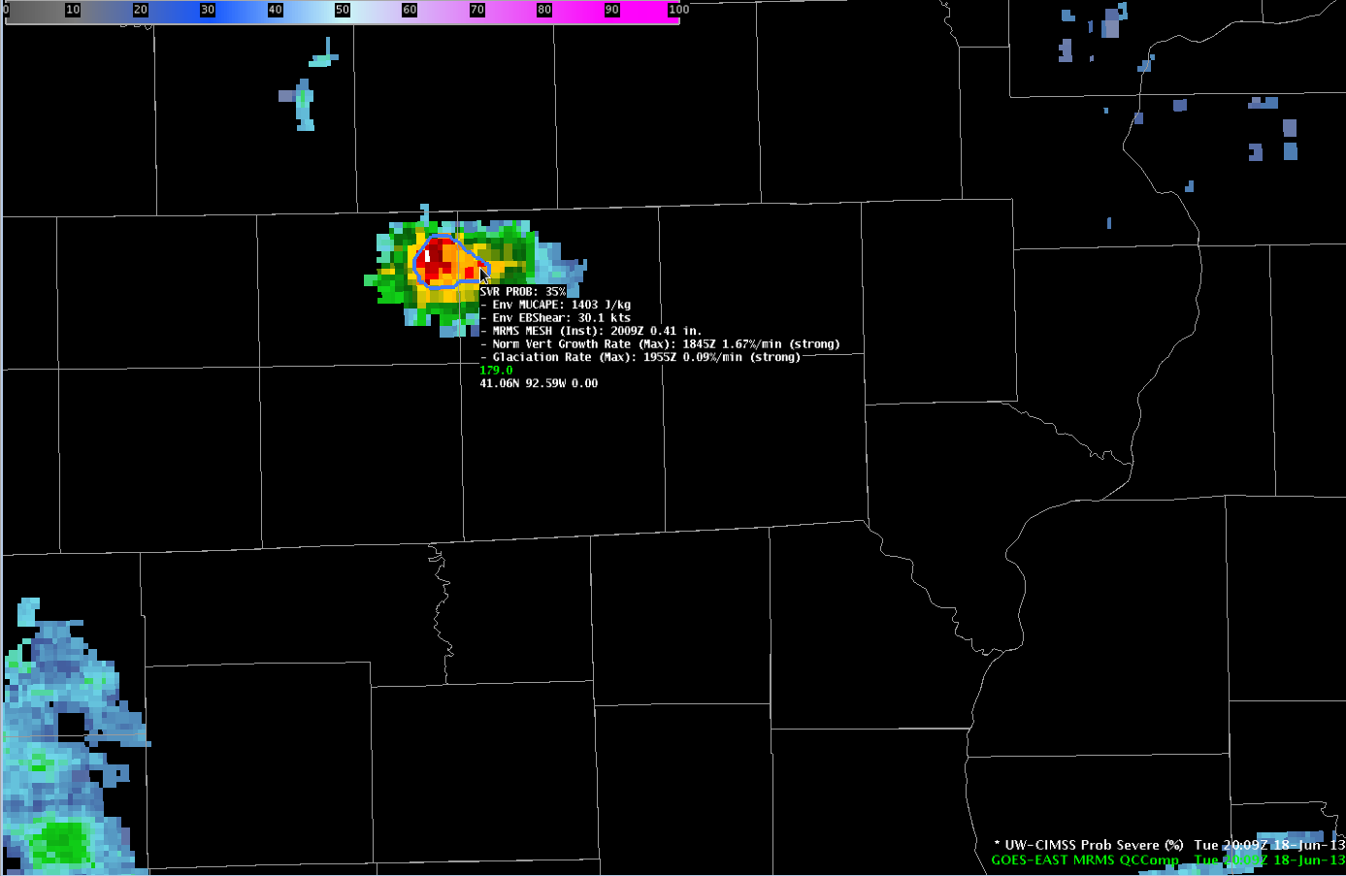
2009 UTC Jun-18-2013
IA
MUCAPE ~ 1250J kg⁻¹
Eff. shear ~ 30 kts
Prob = 35%
Radar intensity increasing
IL
MO
Notes:
10 minutes later; at 2009 UTC the probability was now 35%.

Slide 30
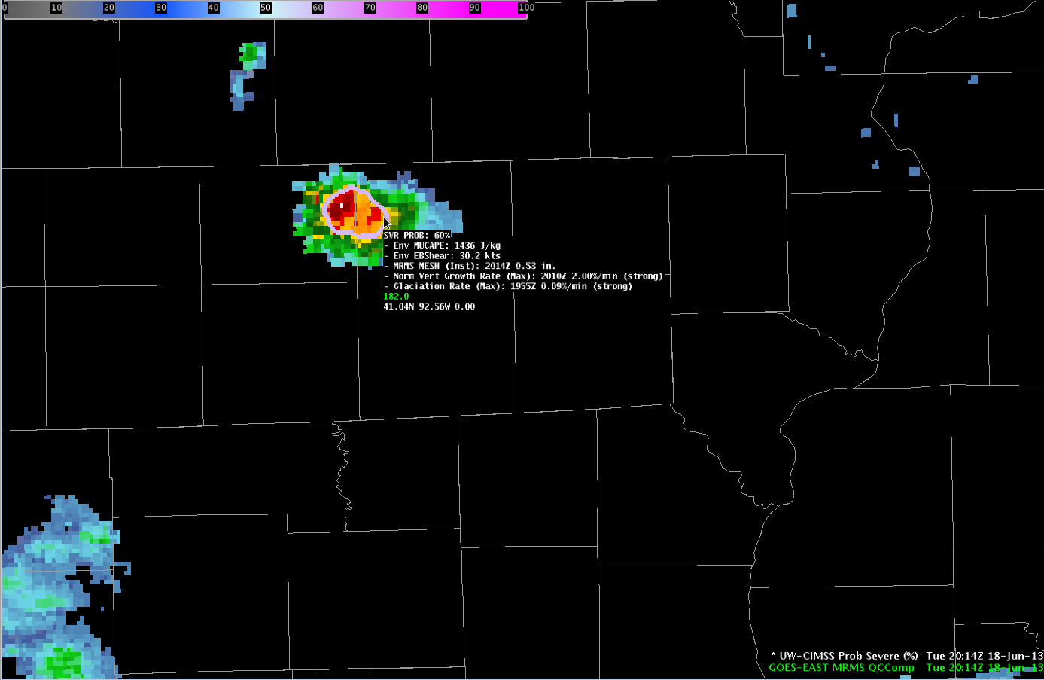
2014 UTC Jun-18-2013
IA
MUCAPE ~ 1250J kg⁻¹
Eff. shear ~ 30 kts
Prob = 60%
Consider warning?
IL
MO
Notes:
5 minutes later the probability is now 60% as radar is observing an intensifying precipitation core.

Slide 31
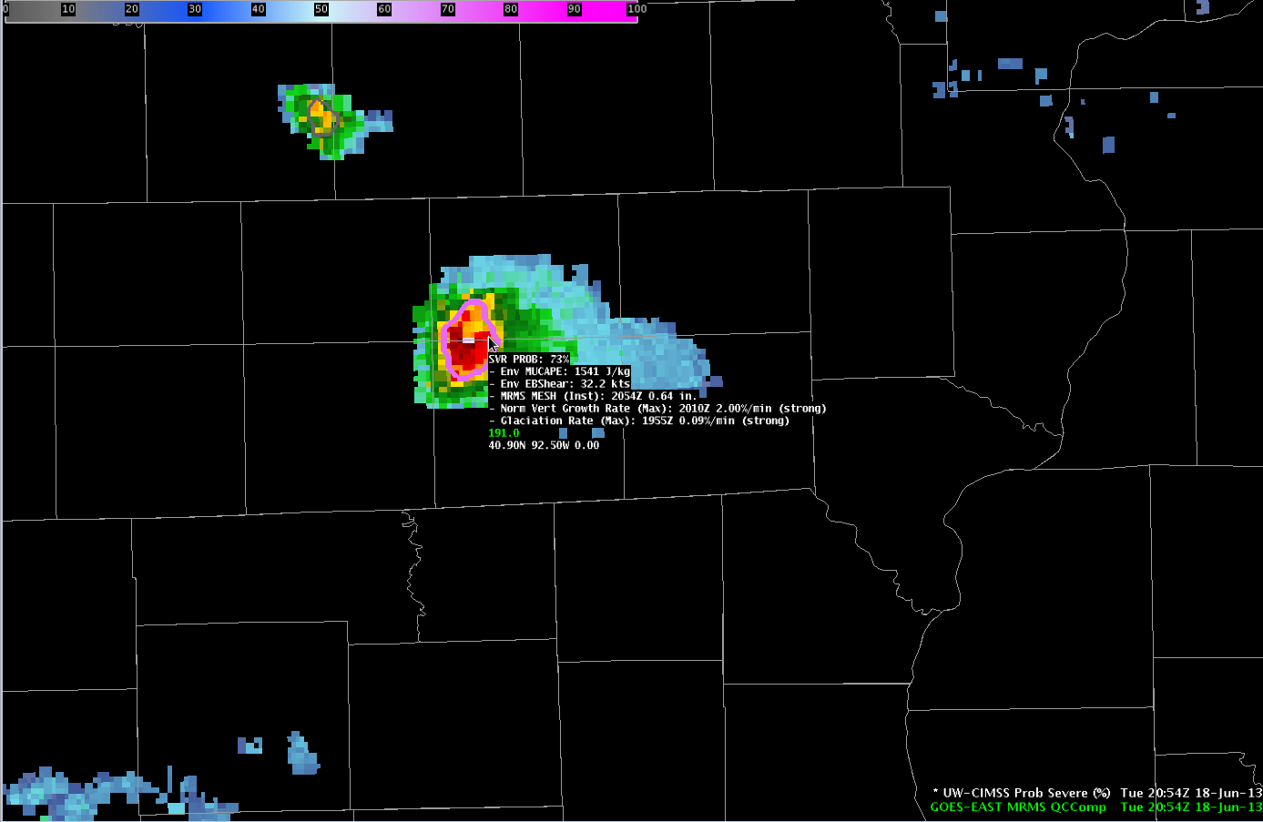
2054 UTC Jun-18-2013
IA
MUCAPE ~ 1250J kg⁻¹
Eff. shear ~ 30 kts
Prob = 73%
Consider warning?
IL
MO
Notes:
We now jump 40 minutes ahead to 2054 UTC. The model probability up to this point fluctuated between 50 and 65% and now was 73%. Again using existing storm interrogation methods, a forecaster on the fence between issuing a warning and not can utilize the probability to increase confidence to issue a warning earlier.

Slide 32
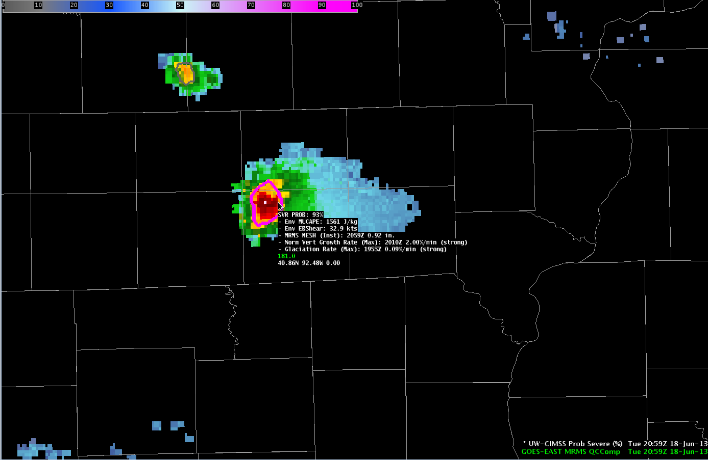
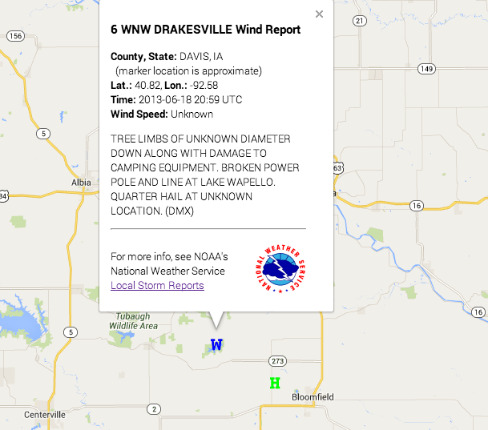
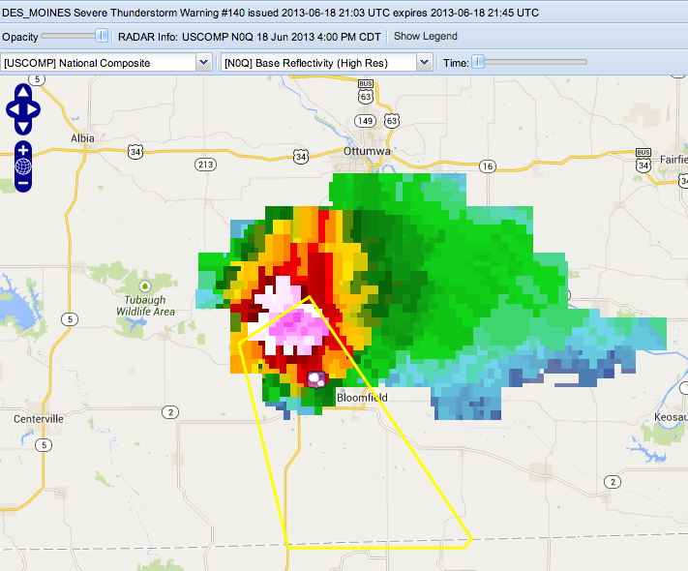
2059 UTC Jun-18-2013
IA
MUCAPE ~ 1250J kg⁻¹
Eff. shear ~ 30 kts
Prob = 93%
First wind/hail @ 2059 UTC
45 min after Prob > 50%
First warning @ 2103 UTC
49 min after Prob > 50%
IL
MO
Notes:
At 2059 UTC the probability was over 90% and the first severe wind and hail reports were received at this time—45 minutes after the first probability over 50%. The first warning was issued at 2103 UTC—49 minutes after the first probability exceeding 50%.

Slide 33

What information does the satellite provide?
2059 UTC Jun-18-2013
IA
IA
Prob = 93%
Prob = 40%
IL
IL
MO
MO
NWP + Satellite + Radar
NWP + Satellite + Radar
Time (UTC) | With Satellite | Without Satellite
1954 | 6% | 3%
1959 | 18% | 3%
2009 | 35% | 7%
2014 | 60% | 12%
2054 | 73% | 18%
2059 | 93% | 40%
Notes:
One question we received was what would the model look like if we just used the NWP environmental information and the MRMS MESH information? Using the Iowa example, we ran the model with and without the satellite predictors. This slide demonstrates the satellite information is absolutely critical. The probability at 2059 UTC is considerably higher with the satellite data, 93%, than without the satellite data, 40%. But even more important is the lead-time and increase of probability earlier in the storm life cycle. The model run with the satellite data generates probability over 50% at 2014 UTC, which certainly would grab someone’s attention that this storm needs careful watching. The model run without satellite data is only at 12% at the same time and would imply little threat from this storm.

Slide 34
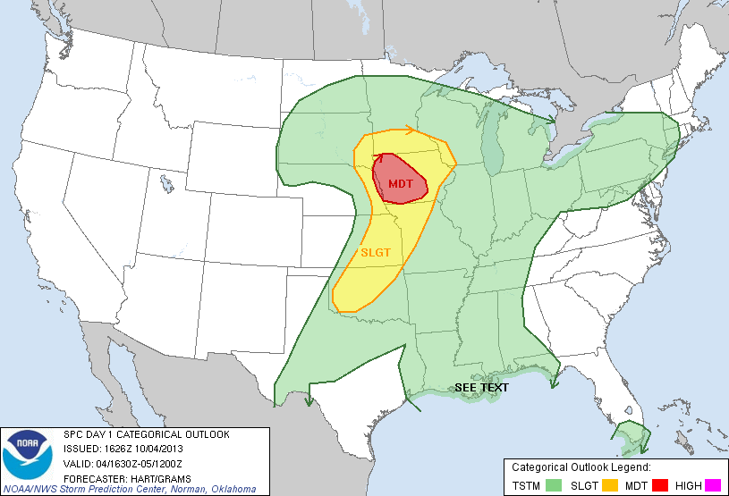
4 October 2013
Notes:
The final example in this training is over Nebraska and Oklahoma—on a day where a significant outbreak of severe weather was expected. Up to this point, the examples have focused on more marginal events because we believe the probability information might provide the most value in those cases. However the probability information is still very useful on the more “slam-dunk” moderate and high risk days.

Slide 35
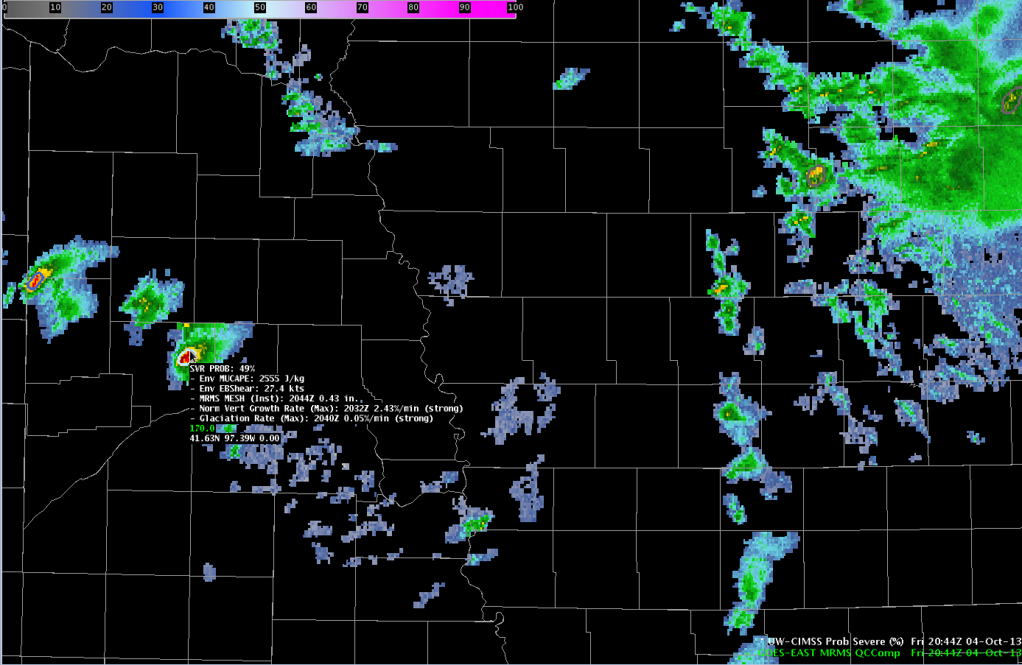
2044 UTC Oct-04-2013
IA
MUCAPE ~ 2800J kg⁻¹
Eff. shear ~ 30 kts
Prob = 49%
Strong satellite growth
NE
MO
Notes:
There are a number of storms on this day—but for brevity we’ll focus on a couple over Nebraska. At 2044 UTC storms developed in an environment supportive of severe weather and exhibiting strong satellite growth rates. The probability on the highlighted storm was 49%.

Slide 36
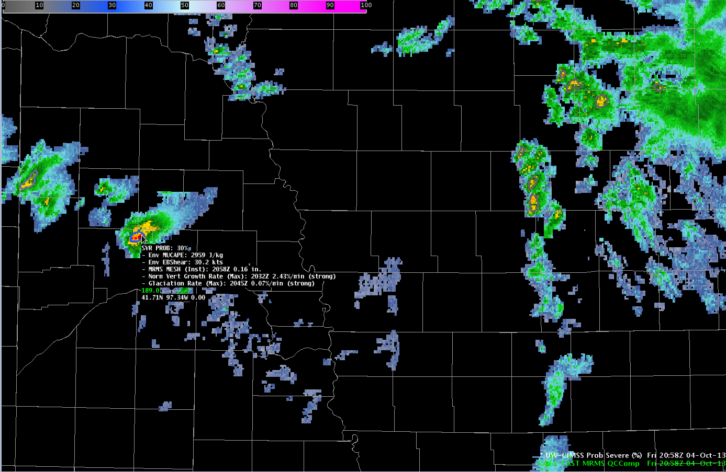
2058 UTC Oct-04-2013
IA
MUCAPE ~ 2800J kg⁻¹
Eff. shear ~ 30 kts
Prob = 30%
Probability fluctuates as radar intensity fluctuates.
More noticeable with 2 min updates.
NE
MO
Notes:
At 2058 UTC the probability fluctuated downward to 30% as the radar intensity diminished—these fluctuations are more obvious when viewing the full time updates—every 2 minutes.

Slide 37
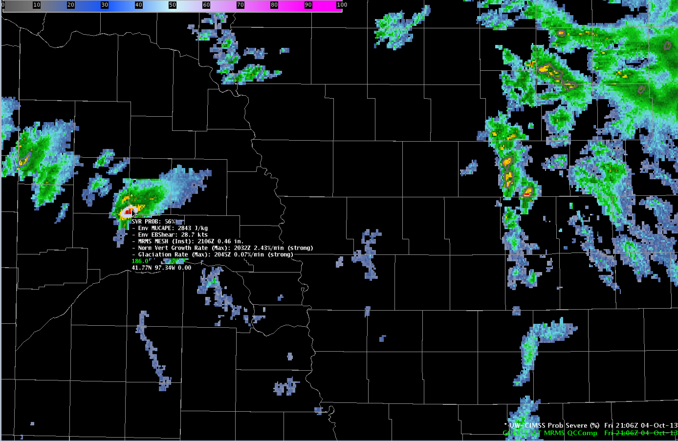
2106 UTC Oct-04-2013
IA
MUCAPE ~ 2800J kg⁻¹
Eff. shear ~ 30 kts
Prob = 56%
Probability fluctuates as radar intensity fluctuates.
More noticeable with 2 min updates.
NE
MO
Notes:
By 2106 UTC the model probability increased again, now over 50% for the first time—coming in at 56%.

Slide 38
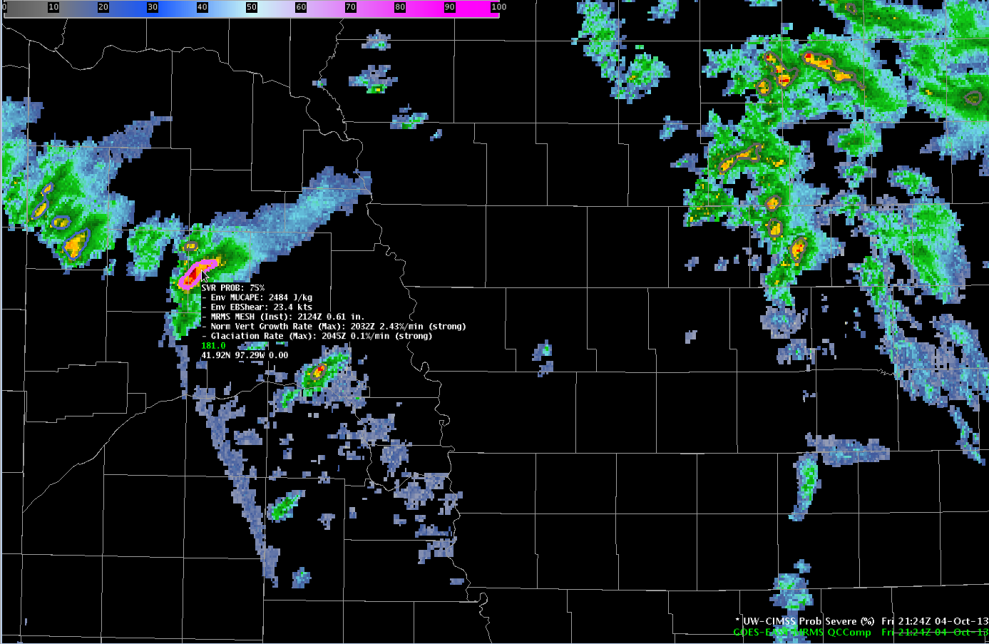
2124 UTC Oct-04-2013
IA
MUCAPE ~ 2800J kg⁻¹
Eff. shear ~ 30 kts
Prob = 75%
Consider warning?
NE
MO
Notes:
18 minutes later at 2124 UTC the model probability for this storm was now 75%. Using existing warning procedures combined with the model probability can allow a forecaster to consider a warning earlier.

Slide 39
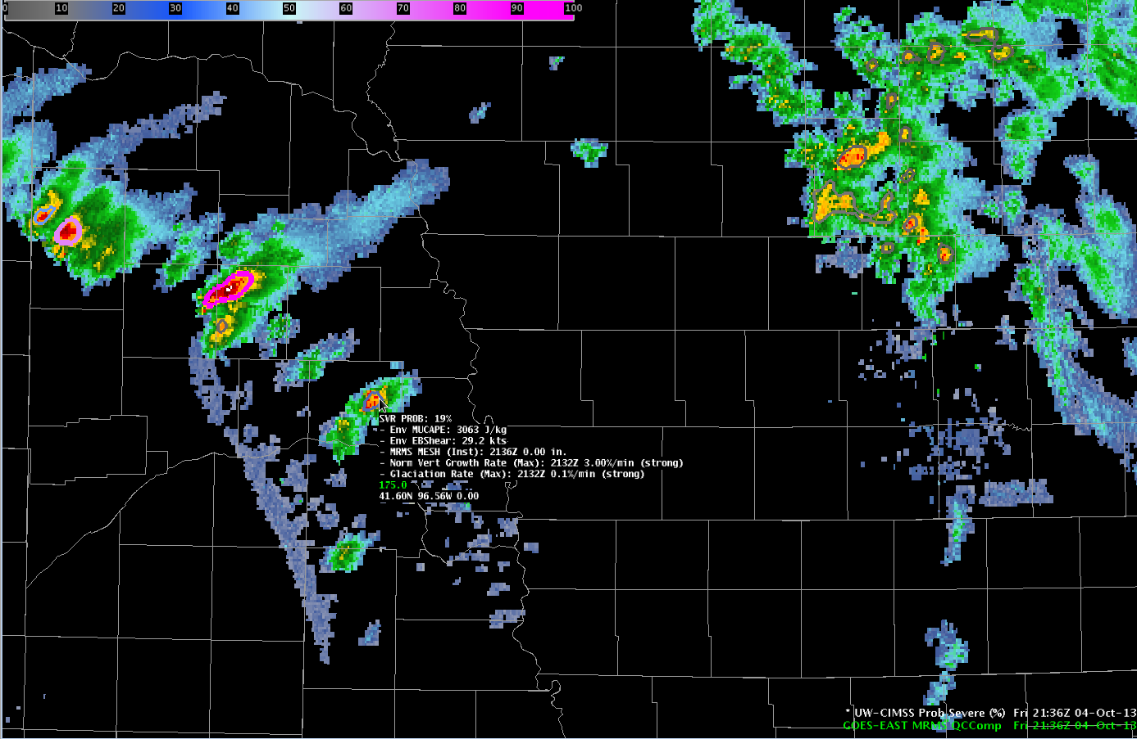
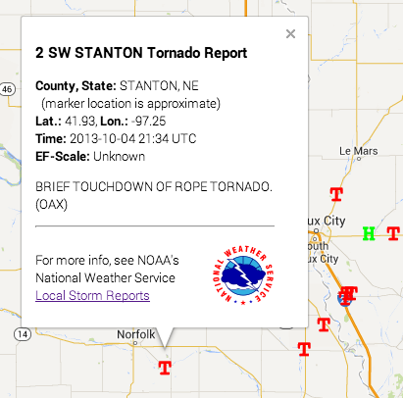
2136 UTC Oct-04-2013
IA
MUCAPE ~ 2800J kg⁻¹
Eff. shear ~ 30 kts
Prob = 90%
Tornado report @ 2134 UTC
28 min after Prob > 50%
Tornado warning @ 2143 UTC
37 min after Prob > 50%
New cell to the southeast
MUCAPE ~ 3000J kg⁻¹
Eff. shear ~ 30 kts
Strong satellite growth
Prob = 19%
NE
MO
Notes:
At 2136 UTC the probability now exceeded 90%. A tornado was reported at 2134 UTC and the first warning was issued at 2143 UTC, 28 and 37 minutes, respectively after the statistical model generated probability in excess of 50%.
Further southeast another storm was developing at 2136 UTC with a favorable environment and strong satellite growth rates.

Slide 40
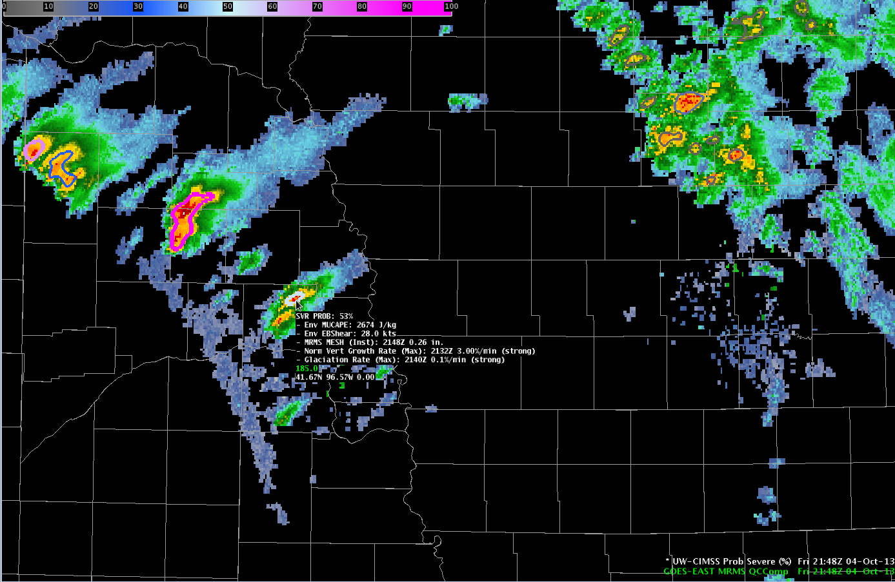
2148 UTC Oct-04-2013
IA
MUCAPE ~ 3000J kg⁻¹
Eff. shear ~ 30 kts
Prob = 53%
NE
MO
Notes:
At 2148 UTC the model probability for the new storm was 53%.

Slide 41
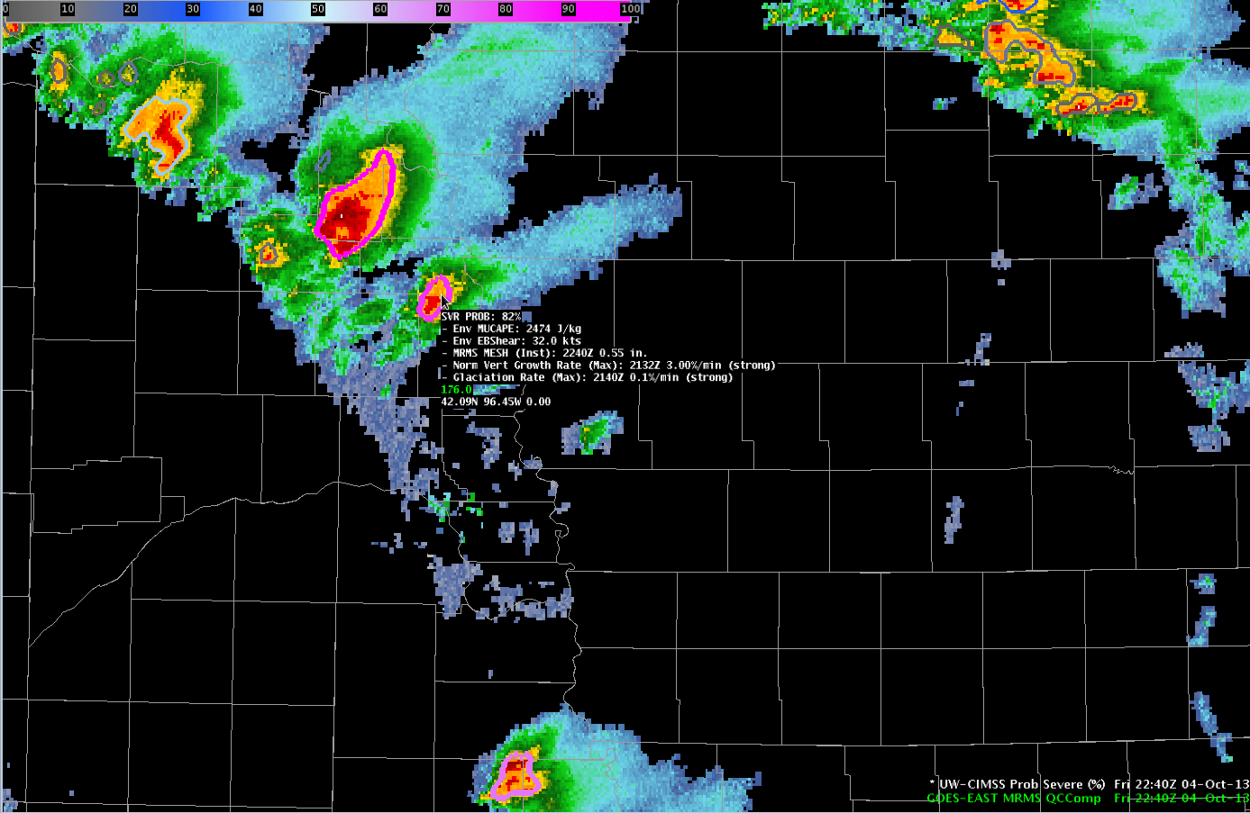
2240 UTC Oct-04-2013
IA
MUCAPE ~ 3000J kg⁻¹
Eff. shear ~ 30 kts
Prob = 82%
Consider warning?
Tornado report @ 2245 UTC
43 min after Prob > 50%
Tornado warning @ 2245 UTC
43 min after Prob > 50%
Major damage and injuries.
NE
MO
Notes:
Jumping ahead nearly an hour, at 2240 UTC the model probability was 82%. During the past 52 minutes, the probability fluctuated between 45-65% and then increased into the 80% range near 2240 UTC. This storm was tornado warned and produced a tornado with damage and injuries at 2245 UTC—43 minutes after the initial probability over 50%. Again a forecaster can include the probability into the existing storm interrogation techniques to increase confidence for issuing warnings earlier.

Slide 42

2144 UTC Oct-04-2013
MUCAPE ~ 2000J kg⁻¹
Eff. shear ~ 35 kts
Prob = 16%
TX
OK
Notes:
Jumping to the southwest over northwestern Oklahoma at 2144 UTC storms were developing along the cold front. At 2144 UTC a developing storm exhibited low probability.

Slide 43

2148 UTC Oct-04-2013
MUCAPE ~ 2000J kg⁻¹
Eff. shear ~ 35 kts
Prob = 54%
Big probability jump in 4 min.
TX
OK
Notes:
Only 4 minutes later, at 2148 UTC the probability jumped to 54% as the MRMS MESH and satellite growth rates intensified.

Slide 44

2204 UTC Oct-04-2013
MUCAPE ~ 2000J kg⁻¹
Eff. shear ~ 35 kts
Prob = 90%
First wind report @ 2152 UTC
2154 UTC power lines snapped
4 min after first Prob > 50%
First warning @ 2225 UTC
35 min after first Prob > 50%
First severe hail @ 2302 UTC
60+ min after first Prob > 50%
TX
OK
Notes:
By 2204 UTC the model probability was 90%. This storm snapped power lines at 2154 UTC and was first warned at 2225 UTC. The lead-time for probability over 50% was only 4 minutes—but 35 minutes before the first warning. This example also illustrates one of the earlier questions—does a rapid jump in probability over short periods of time to high values signify something unique about those storms?

Slide 45
Preliminary Model Performance
Supplemental Training Link
Notes:
The specific storm examples are useful—both for gaining confidence in the statistical model and seeing how the data looks within AWIPS-II. The following figure illustrates a quantitative validation of the model probabilities. A validation for about 9000 storms on 19 convectively active days during 2014 was performed.
This figure shows the probability of detection, false alarm rate, and critical success index for both the most skillful model probability level (which was the 80% threshold in this case) and the NWS warnings using local storm reports as truth. The probability of detection is 60% for the model and 68% for the NWS. The false alarm rate is about 58% for the model and 44% for the NWS warnings. Combined with the misses—the CSI scores are 33% for the model and 44% for the NWS warnings. To no one’s surprise; trained, experienced human forecasters are more skillful than the statistical model. However in looking at the median lead-time the model provides 29 minutes of lead-time to the first storm report, while the NWS warnings provides 19 minutes of lead-time to the first storm report.
So the model, has less (but comparable) skill AND provides an additional 10-minutes of median lead-time on the NWS warnings!

Slide 46
Observed model limitations
“Washed-out” satellite trends during 30-min scan gaps (full disk scans every 3 hrs) → underforecast
Thick cirrus shields → underforecast (model operates with NWP + radar)
Linear convective modes → underforecast
Single-radar coverage → underforecast / overforecast
Notes:
While the model performance is quite good—there are known biases and these biases should be considered when using the model output. This figure shows for many environments the model is well calibrated—but the model is known to underforecast in low CAPE/high shear environments and overforecast in high CAPE/low shear environments.
Additionally, the current GOES contains 30-minute observation gaps every 3 hours and storms that develop during those gaps will be underforecast as the growth rates are essentially ‘washed out’ by the poor temporal resolution.
Storms developing beneath thick cirrus shields or anvils are generally underforecast. The reason being the model is essentially running with only NWP and radar information since the satellite could not observe the growth of the storm.
Once developing convection transitions to linear modes the probabilities will be underforecast. Again recall the goal and design of the statistical model—it is the initial severe threat the model is designed for and often, linear convective events are a result of upscale growth of initially more discrete convection.
Storms that are only sampled by one radar may by underforecast or overforecast since the benefits of the MRMS data are not gained.

Slide 47
Keep in mind…
This model will not give forecasters guidance on the type of severe hazard
This model will not provide lead time to every storm
Forecasters must still bear in mind environmental factors (in addition to instability and shear)
The model is designed and trained to provide the probability a storm will first produce severe weather within the next 60 minutes
The model is NOT designed to provide the probability a storm will continue to produce severe weather nor forecast storm decay
The model is most skillful and provides most lead-time when the satellite can observe the development of the storm from immature cumulus to mature cumulonimbus
Currently only GOES-EAST is processed
Notes:
A few points to keep in mind when using the model probabilities:
This model will not give forecasters guidance on the type of severe hazard
This model will not provide lead time to every storm
Forecasters must still bear in mind environmental factors in addition to instability and shear
The model is designed and trained to provide probability a storm will first produce severe weather within the next 60 minutes
The model is NOT designed to provide probability a storm will continue to produce severe weather nor forecast storm decay
The model is most skillful and provides most lead-time when the satellite can observe the development of the storm from immature cumulus to mature cumulonimbus
Underforecast bias in low CAPE/moderate-high shear environments
Overforecast bias in high CAPE/low shear environments
Currently only GOES-EAST is processed.

Slide 48

Forecasting severe storms is not easy…
Notes:
Forecasting severe storms is not easy. The statistical model is intended to distill gigabytes of data into kilobytes of useful information regarding the severe potential of developing storms in a clear, concise manner. It is important to re-emphasize the model will be most useful when incorporated into your current warning procedures and can help increase confidence in issuing warnings, on average 1-4 NEXRAD volume scans earlier, than would be done without the probability information.

Slide 49
References
Cintineo, J. L., M. J. Pavolonis, J. M. Sieglaff, and D.T. Lindsey, 2014: An empirical model for assessing the severe weather potential of developing convection. Weather and Forecasting., accepted.
Cintineo, J. L., M. J. Pavolonis, J. M. Siegalff, and A. K. Heidinger, 2013: Evolution of severe and non-severe convection inferred from GOES-derived cloud properies. J. Appl. Meteorol. Climatol., 52, 2009-2023.
Lakshmanan, V., T. Smith, G. Stumpf, and K. Hondl, 2007: The Warning Decision Support System-Integrated Information. Weather and Forecasting, 22, doi:10.1175/WAF1009.1
Pavolonis, M. J., 2010: Advances in Extracting Cloud Composition Information from Spaceborne Infrared Radiances-A Robust Alternative to Brightness Temperatures. Part I: Theory. Journal of Applied Meteorology and Climatology, 49, doi:10.1175/2010JAMC2433.1.
Pavolonis, M.J., 2010: ABI Cloud Type/Phase Algorithm Theoretical Basis Document. NOAA NESDIS Center for Satellite Applications and Research (STAR), 60 pp.
Sieglaff, Justin M., D. C. Hartung, W. F. Feltz, L. M. Cronce, V. Lakshmanan, 2013: A satellite-based convective cloud object tracking and multipurpose data fusion tool with application to developing convection. J. Atmos. Oceanic Technol., 30, 510–525.
Witt, A., M. D. Eilts, G. J. Stumpf, J. T. Johnson, E. D. W. Mitchell, K. W. Thomas, 1998: An Enhanced Hail Detection Algorithm for the WSR-88D. Wea. Forecasting, 13, 286–303.
Notes:
The details of the underlying statistical model, input datasets, and cloud and radar tracking have been omitted from this training but can be found in the following references. The first reference specifically provides statistical model details and a more comprehensive analysis of the validation statistics.

Slide 50
Contact
Mike Pavolonis (michael.pavolonis@noaa.gov)
John Cintineo (john.cintineo@ssec.wisc.edu)
Justin Sieglaff (justin.sieglaff@ssec.wisc.edu)
Dan Lindsey (dan.lindsey@noaa.gov)
To access this training online and access supplemental training material links from this presentation please see:
http://cimss.ssec.wisc.edu/severe_conv/training/training.html
Notes:
Please contact the statistical model researchers with questions, suggestions, etc. at the email addresses provided. To access this training online and access supplemental training material links from this presentation please follow the URL provided. This concludes the probabilistic nowcasting of severe convection training module.

