Slide 1
ProbSevere LightningCast
John Cintineo (NOAA/OAR/NSSL)
Mike Pavolonis (NOAA/NESDIS/STAR)
Lena Heuscher (UW-CIMSS)
Justin Sieglaff (UW-CIMSS)
Scott Lindstrom (UW-CIMSS, training)
With support from GOES-R Science Program

Slide 2
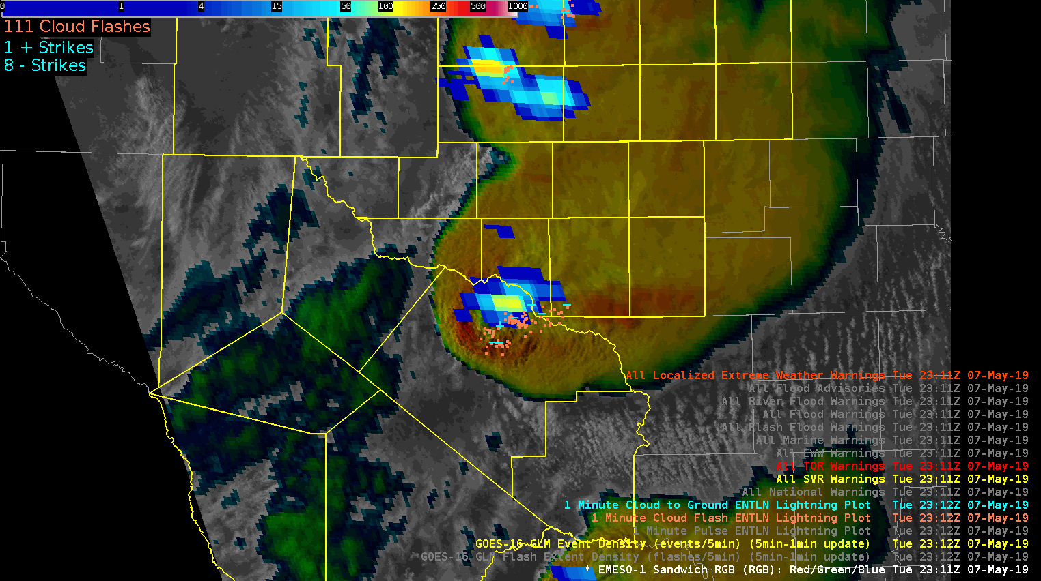
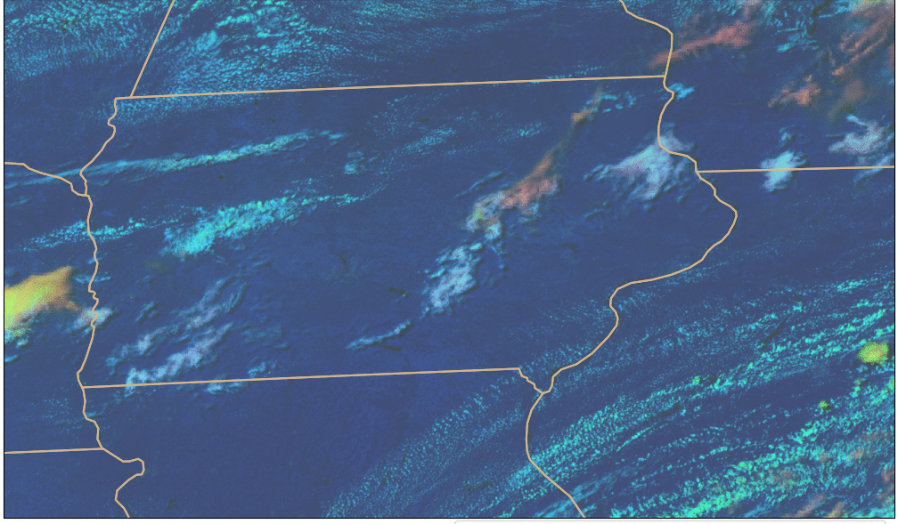
What is ProbSevere LightningCast?
GLM: where lightning is currently present
ABI: multi-spectral images of convective clouds
Day Cloud Phase Distinction is discussed in depth in Elsenheimer and Gravelle 2019
ProbSevere LightningCast is an ABI-based machine-learning model that predicts where the (gridded) GLM will observe lightning up to 60 minutes in the future – based on the evolution of ABI cloud imagery. Human eyes/brains already do this – the model attempts to mimic this capability objectively.
Notes:
-GLM observes lightning
-Human interpretation of ABI imagery has been shown to be important for nowcasting lightning, especially lightning initiation
-In short, we used a portion of the historical ABI and GLM data record (2019) to train a machine learning algorithm to analyze multispectral ABI imagery with the goal of nowcasting lightning as observed by GLM

Slide 3
Lightning Probability: How?
Take image observations of the ABI Bands, including those used operationally in Convective situations (Day Cloud Phase Distinction, for example, during daytime)
Take future image observations of lightning from GLM
Use both of these to train a model based on ABI data on when lightning will occur
A request for this product came from OPC/WPC – for predictive information over the ocean

Slide 4
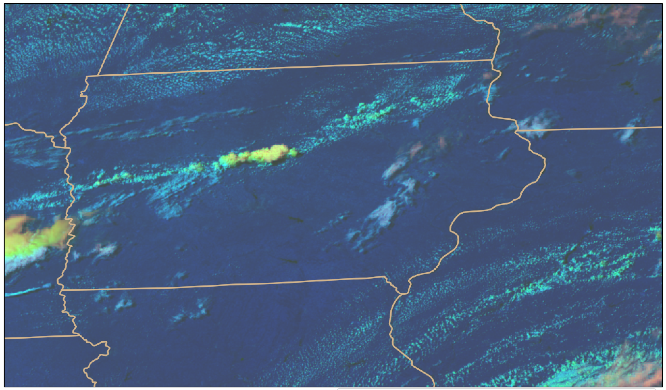
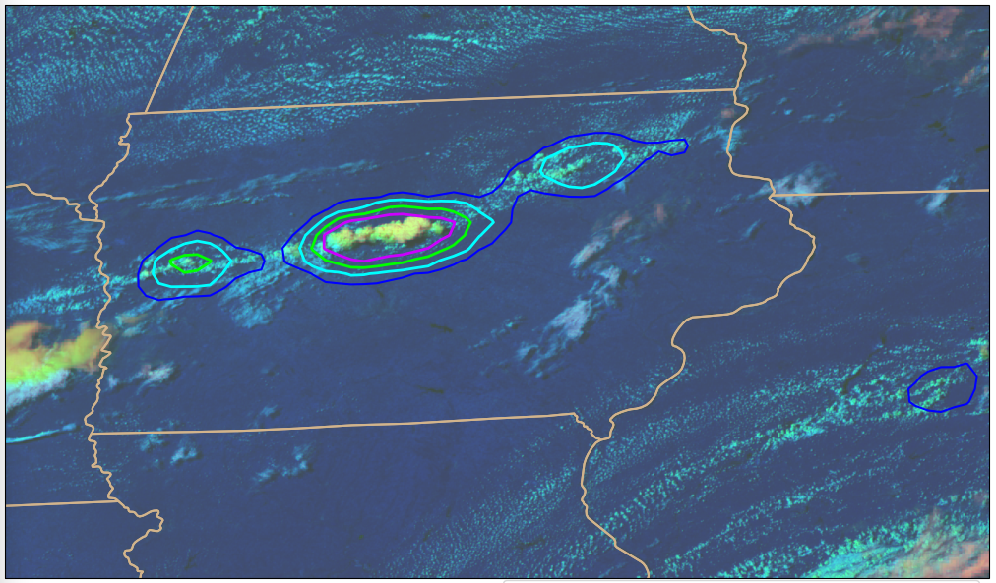
How does LightningCast work?
Input:
0.64 µm reflectance (band 2)
1.6 µm reflectance (band 5)
10.3 µm brightness temperature (band 13)
12.3 µm brightness temperature (band 15)
Output:
probability that GLM will observe lightning in the next 60 minutes
Natively 2-km res. on the ABI grid
Remapped to ~10-km res. on equal lat-lon grid
Works day and night; Applicable to any scan domain (meso, CONUS, or FD); Applicable to GOES-East (GOES-19) and GOES-West (GOES-18)
Notes:
-Same family of computer vision machine learning that is used in self driving cars
-Learns the relationship between ABI image patterns (spatial and spectral) and the location of where GLM observed any lightning in the 60 minutes that follow the ABI image time – millions of ABI images with GLM derived labels were used
-Unlike with PSv2 and PSv3, there is no feature detection or tracking; it is a pure computer vision approach (mimics how a human interprets imagery)
-Input: All channel input is at 0.5 km via oversampling
-The contribution from the reflective bands gracefully ramps down to zero at night, with no noticeable discontinuity
-Output: A 0.5 km map of probabilities is the result. The probability map is subsequently subsampled and converted into probability contours.

Slide 5
How does LightningCast work?
Input:
0.64 µm reflectance (band 2)
1.6 µm reflectance (band 5)
10.3 µm brightness temperature (band 13)
12.3 µm brightness temperature (band 15)
MRMS Reflectivity -10C (new for HWT 2025)
Output:
probability that GLM will observe lightning in the next 60 minutes
Natively 2-km res. on the ABI grid
Remapped to ~10-km res. on equal lat-lon grid
Works day and night; Applicable to any scan domain (meso, CONUS, or FD); Applicable to GOES-East (GOES-19) and GOES-West (GOES-18)
Notes:
-Same family of computer vision machine learning that is used in self driving cars
-Learns the relationship between ABI image patterns (spatial and spectral) and the location of where GLM observed any lightning in the 60 minutes that follow the ABI image time – millions of ABI images with GLM derived labels were used
-Unlike with PSv2 and PSv3, there is no feature detection or tracking; it is a pure computer vision approach (mimics how a human interprets imagery)
-Input: All channel input is at 0.5 km via oversampling
-The contribution from the reflective bands gracefully ramps down to zero at night, with no noticeable discontinuity
-Output: A 0.5 km map of probabilities is the result. The probability map is subsequently subsampled and converted into probability contours.

Slide 6
How is LightningCast used?
Impact-based Decision Support Services (IDSS) for outdoor events
Maritime nowcasting
Airport and air traffic operations
Wildfire incident response
General convective initiation/maintenance guidance
Personal decision making

Slide 7
5 (75%) – 25 (25%) minutes of lead-time prior to first GLM flash
15 (75%) – 25 (25%) minutes of lead-time prior to first GLM flash
15 (75%) – 30 (25%) minutes of lead-time prior to first GLM flash
30 (75%) – 70 (25%) minutes of lead-time prior to first GLM flash
Notes:
-Clean example with variable lead-time in the midwest
-The lead-time is a function of how rapidly the storm develops

Slide 8
Note : LightningCast is frequently shown on animations; however, time tendency (how ABI Band information is changing) is not used in the algorithm.

Slide 9
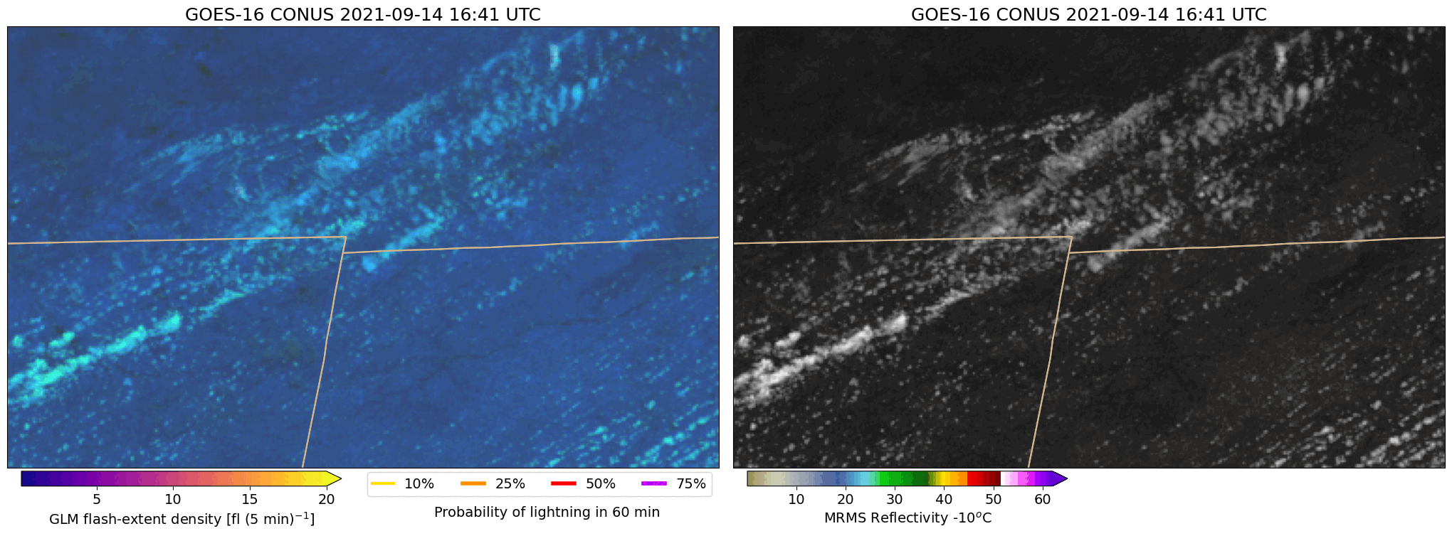
Comparison to NEXRAD radar
Michigan
Michigan
Ohio
Ohio
Day-cloud-phase distinction RGB + LightningCast contours
Visible imagery + Refl. @ -10ºC
Spatially coherent LightningCast signals often precede early radar indicators of convective and lightning initiation
Notes:
-Storms in N. Indiana with composite reflectivity
-Not an extreme example

Slide 10
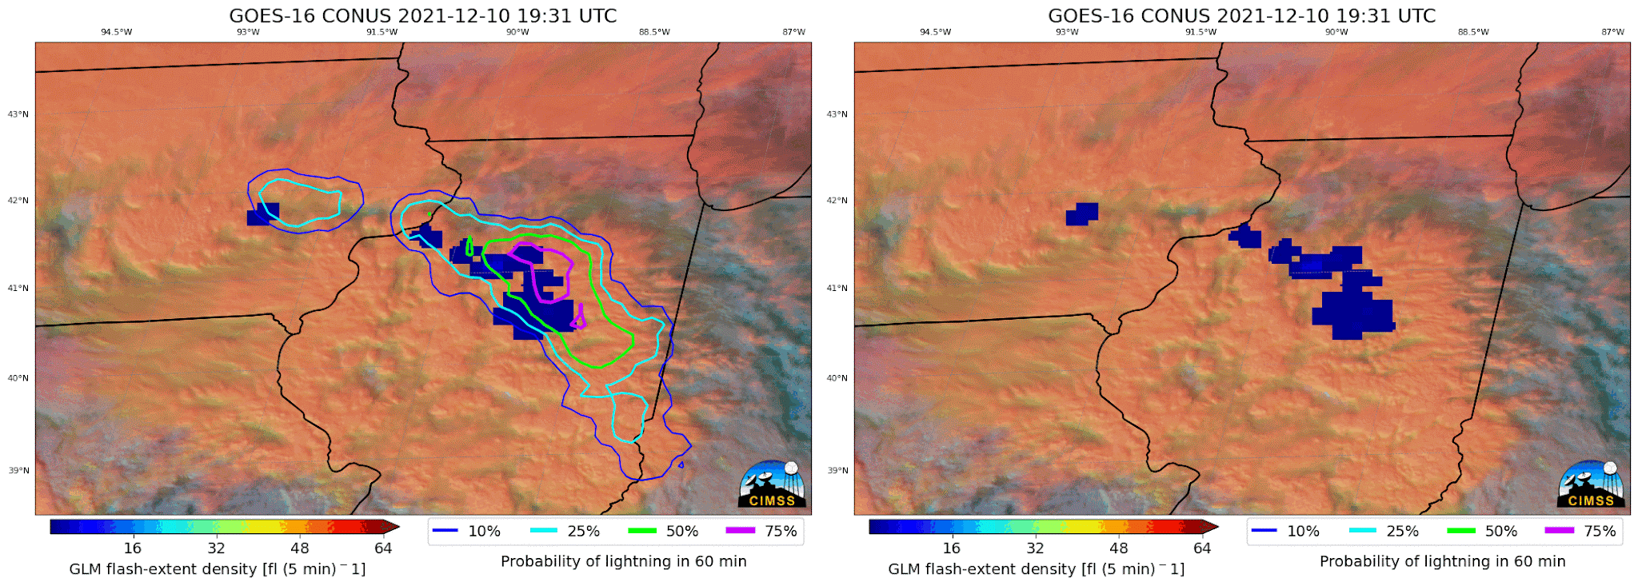
Key Focus: Comparison between LightningCast with and without MRMS
Features at HWT 2025
Web-based lightning dashboards
Including on-demand location request
GOES-East model including MRMS Reflectivity -10°C as a predictor
Higher skill over CONUS
Increases lead time to lightning initiation
In what situations does radar help the most?
Development under thick ice
“Marginal” convection
Lightning cessation
Nighttime convection
Notes:
Elevated but shallow warm-frontal convection

Slide 11
Developing convection under thick cirrus
ABI+MRMS
ABI-only
Notes:
The message is here is that thick cirrus can obscure growing convection. LightningCast that includes MRMS picks up on it earlier than ABI only.

Slide 12
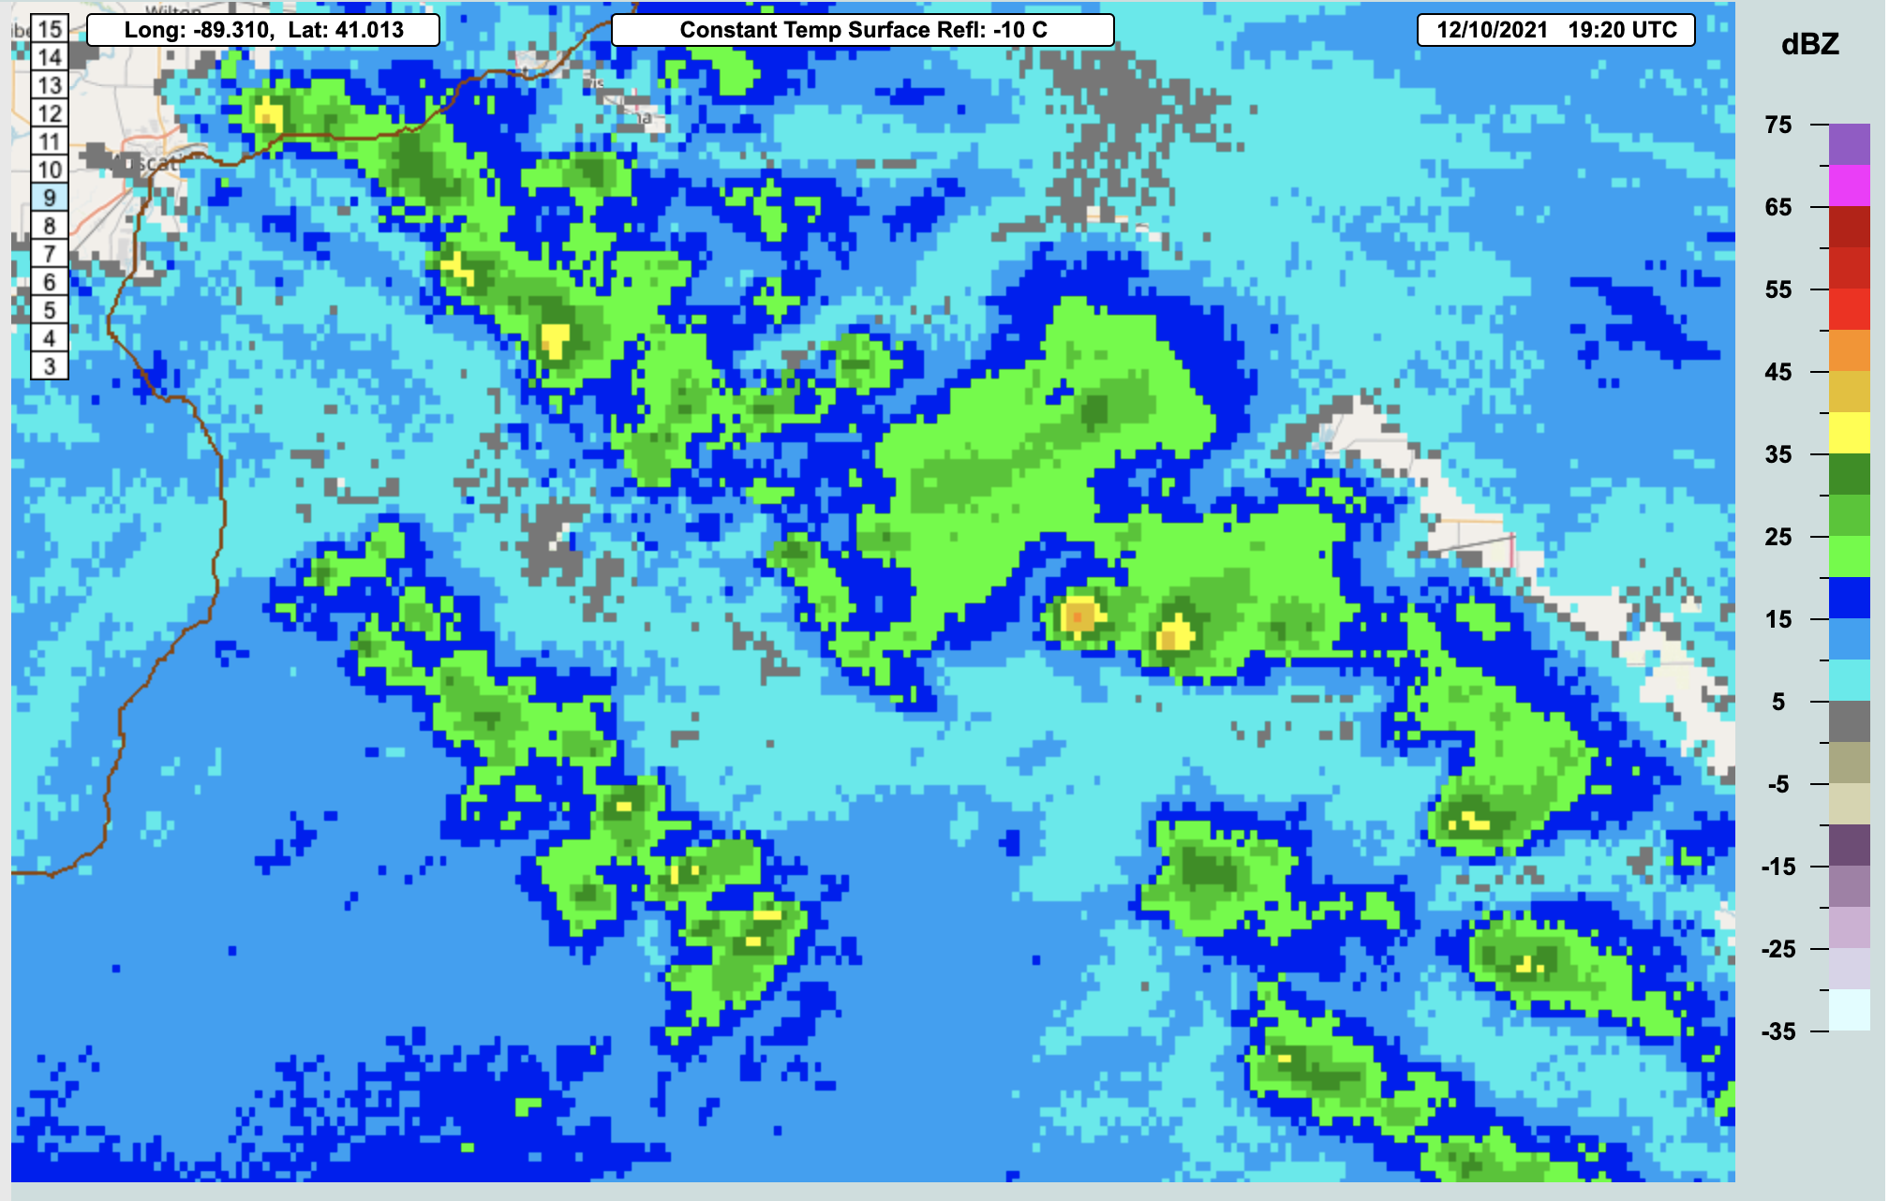
“Marginal” Convection
Ref -10ºC
35-45 dBZ
cores
ABI+MRMS
ABI-only
Notes:
Elevated but shallow warm-frontal convection

Slide 13
Lightning cessation
ABI+MRMS
ABI-only
Notes:
LightningCast that includes MRMS picks up on the lightning cessation over the NY/VT border earlier than ABI only.

Slide 14
Nighttime convection
ABI+MRMS
ABI-only
Notes:
LightningCast that includes MRMS has better/more coherent predictions than the ABI-only when the reflective bands aren’t available.

Slide 15
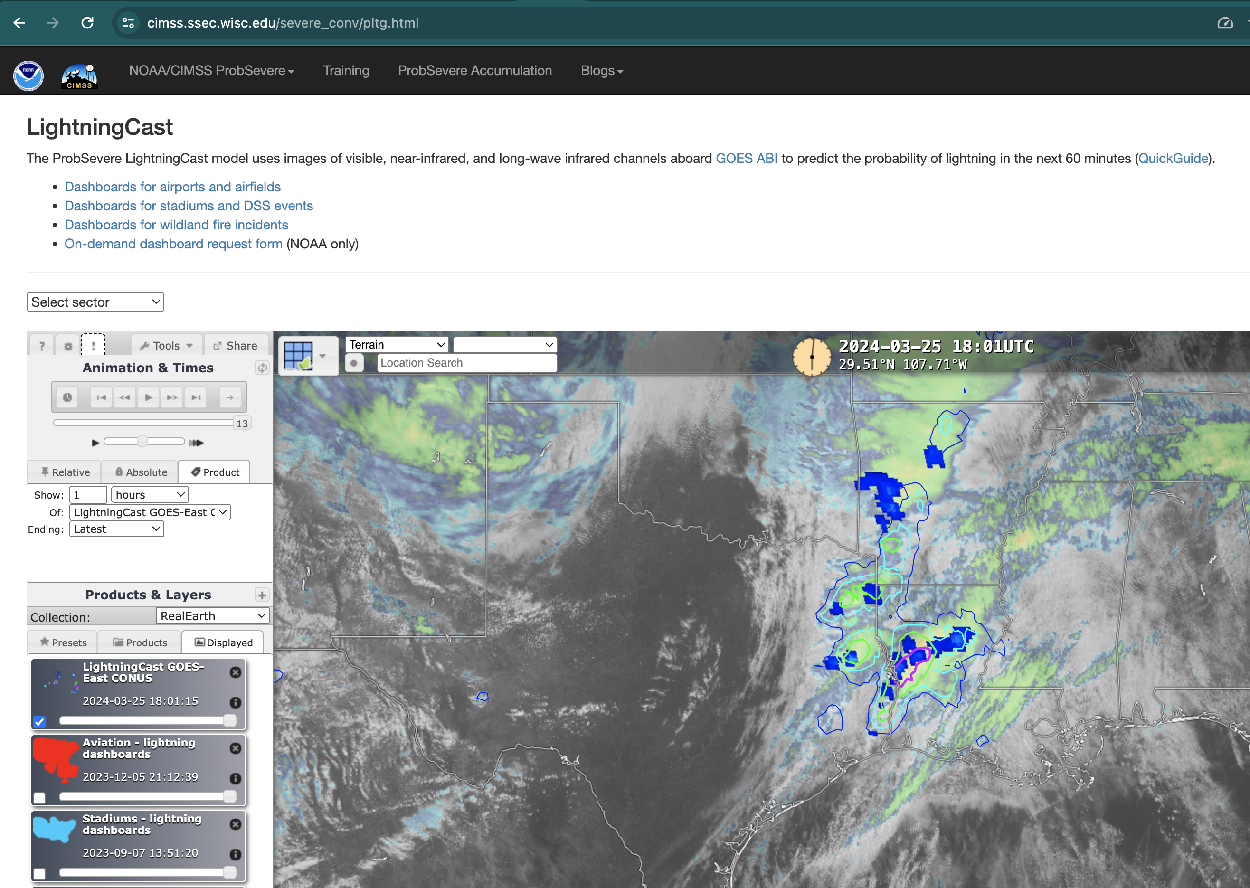
Navigate to webpage:
cimss.ssec.wisc.edu/severe_conv/pltg.html

Slide 16
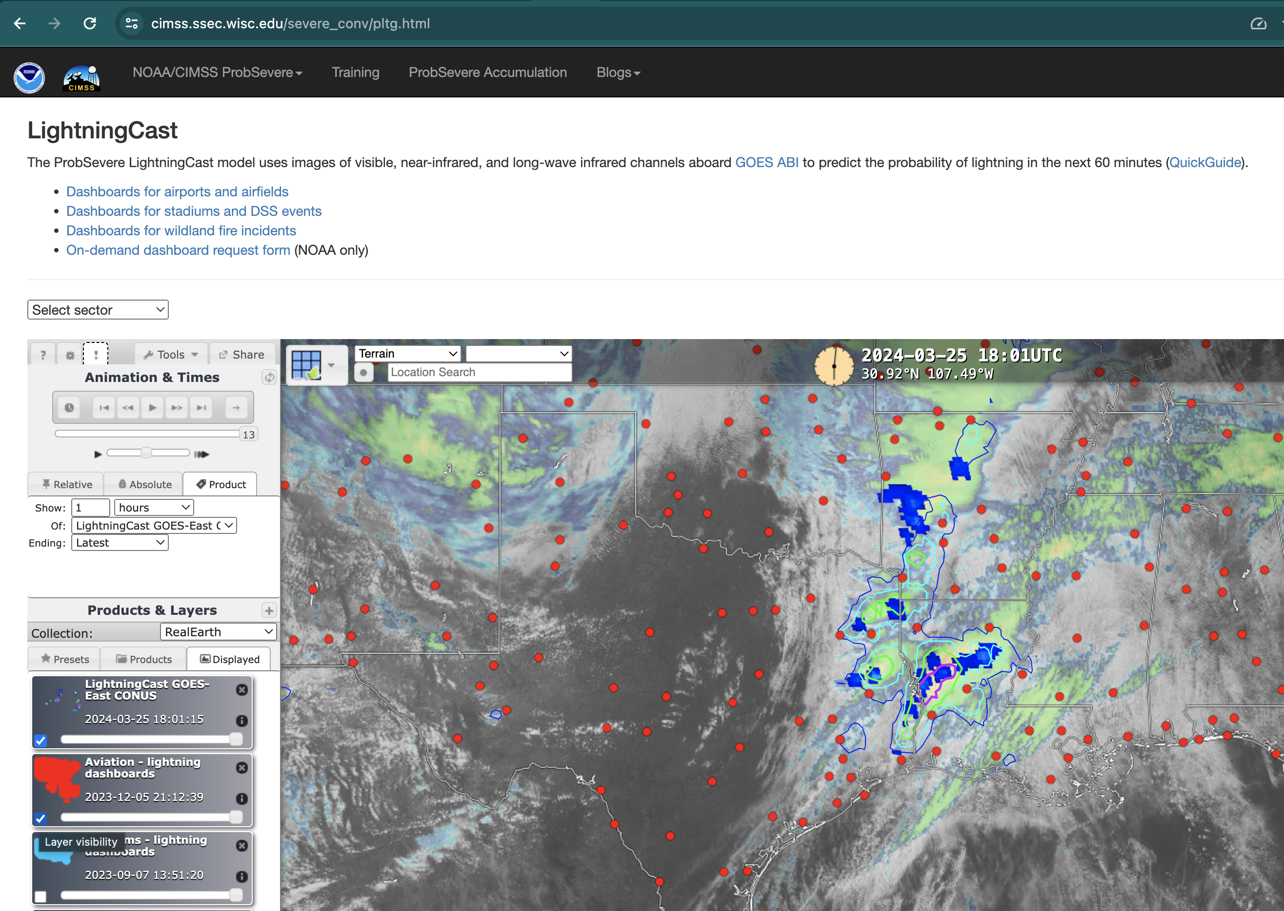
Toggle on dashboard layer

Slide 17
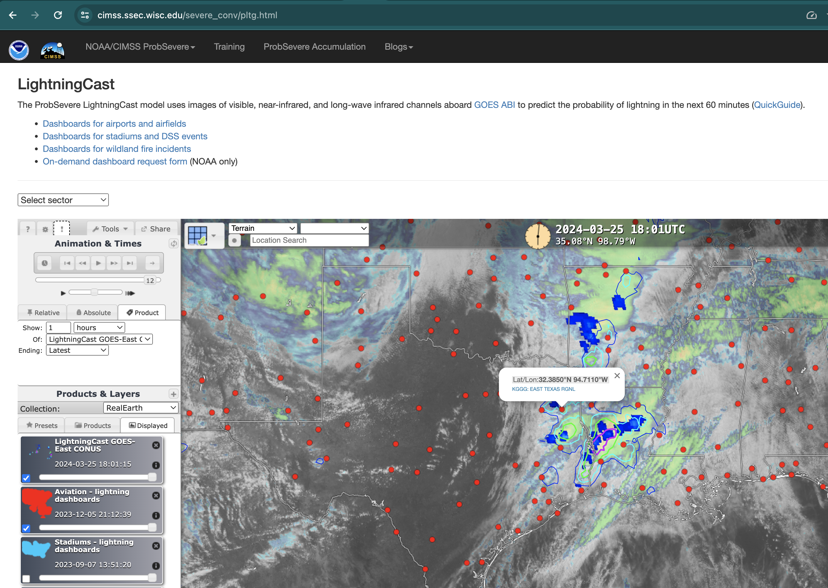
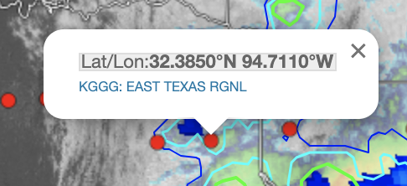
Click on airport (or stadium)
Click link

Slide 18
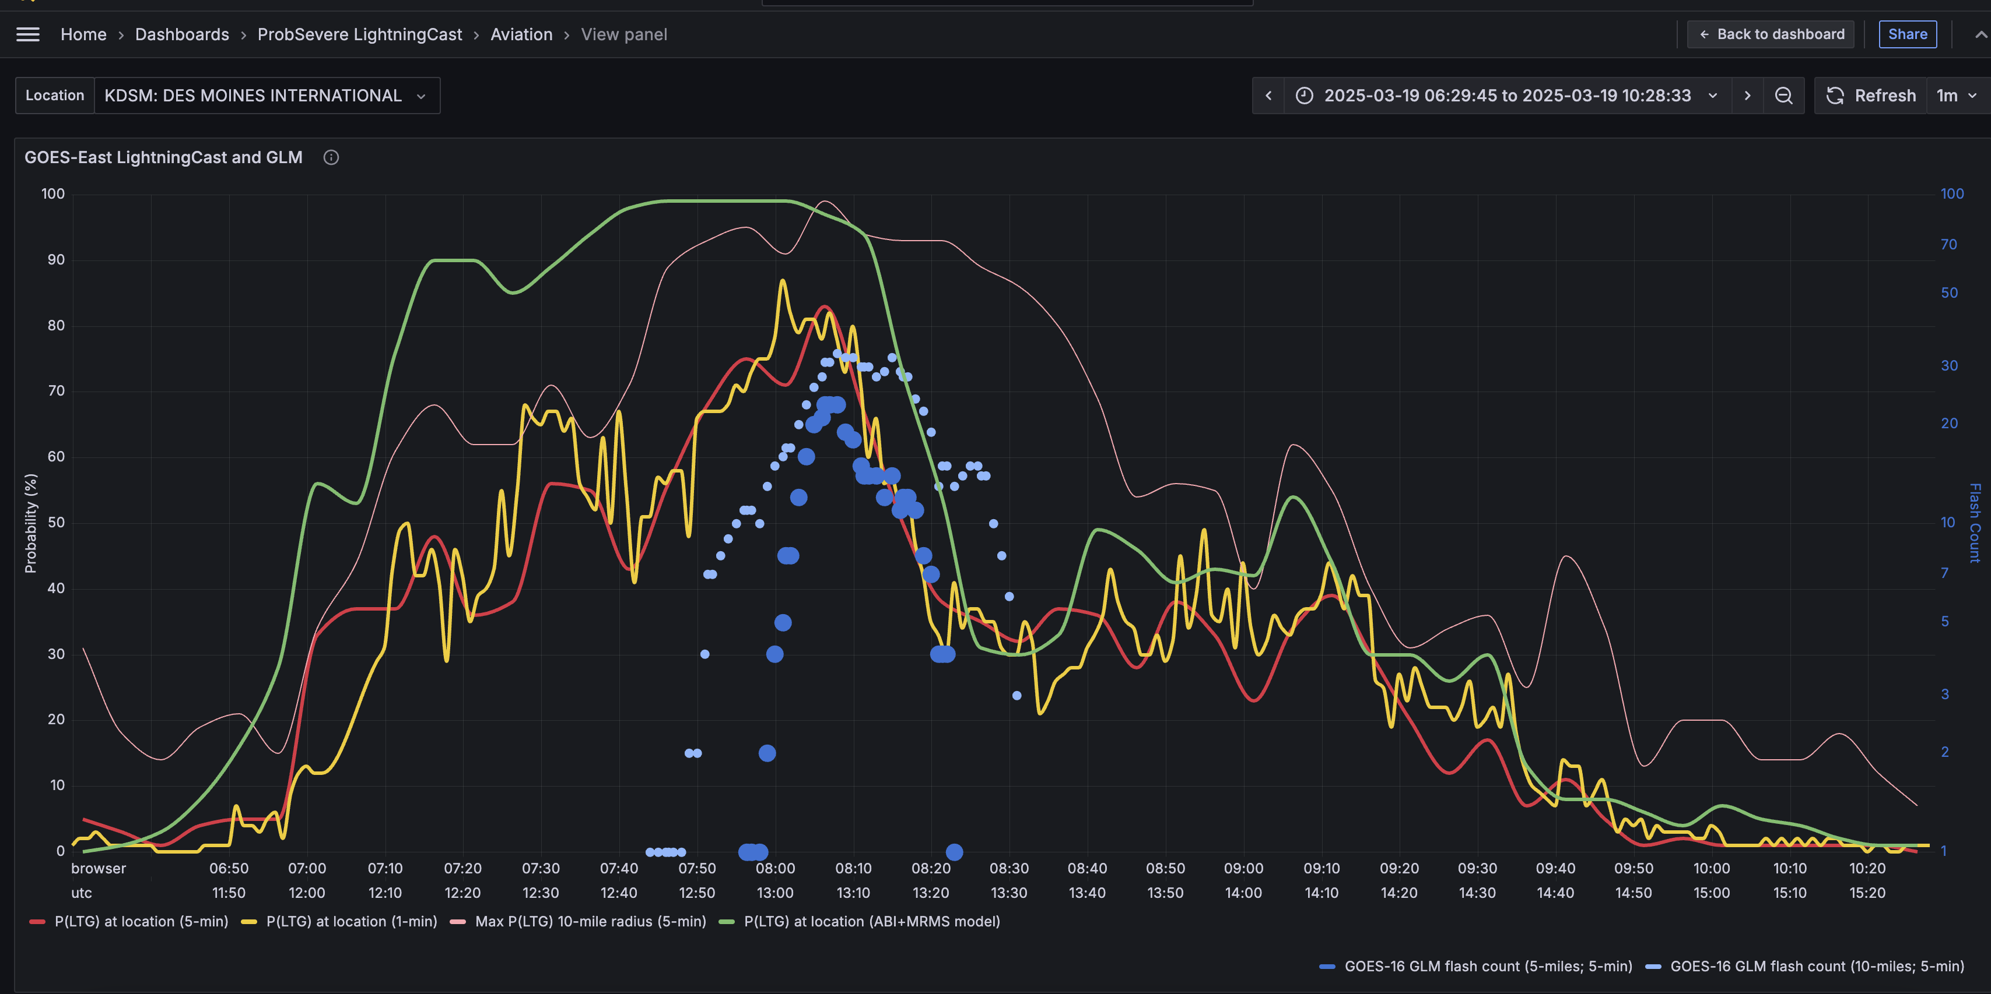
Dashboards open in new browser window
Change airport (or stadium)
Change time frame and time zone
CONUS LightningCast V2 (ABI+MRMS) probs (5 min)
GLM flash centroids w/in 10 miles and 5 min before
CONUS Max probability of lightning (ABI only) w/in 10 miles and 5 min before
CONUS LightningCast V1 (ABI only) probs (5 min)
Meso. LightningCast probs
(1 min, when applicable)
GLM flash centroids w/in 5 miles and 5 min before
Toggle on/off meteograms

Slide 19
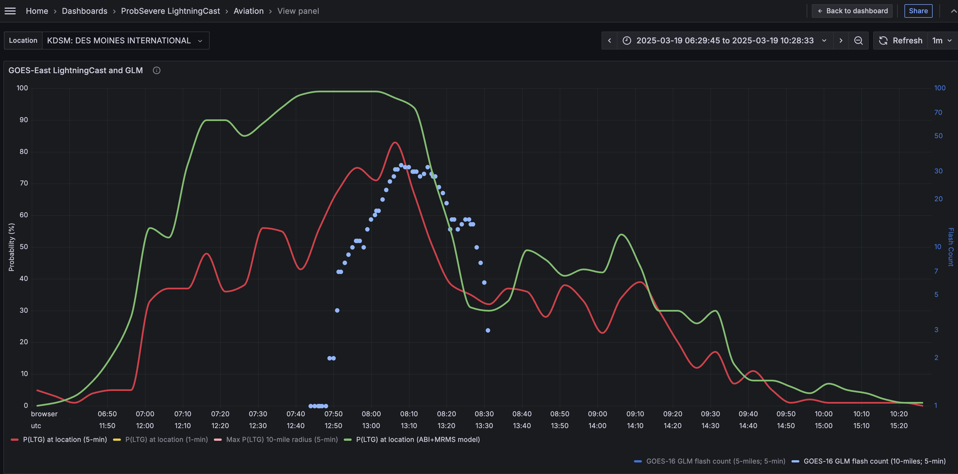
Dashboards with meteograms toggled off
CONUS LightningCast V2 (ABI+MRMS) probs (5 min)
GLM flash centroids w/in 10 miles and 5 min before
CONUS LightningCast V1 (ABI only) probs (5 min)

Slide 20
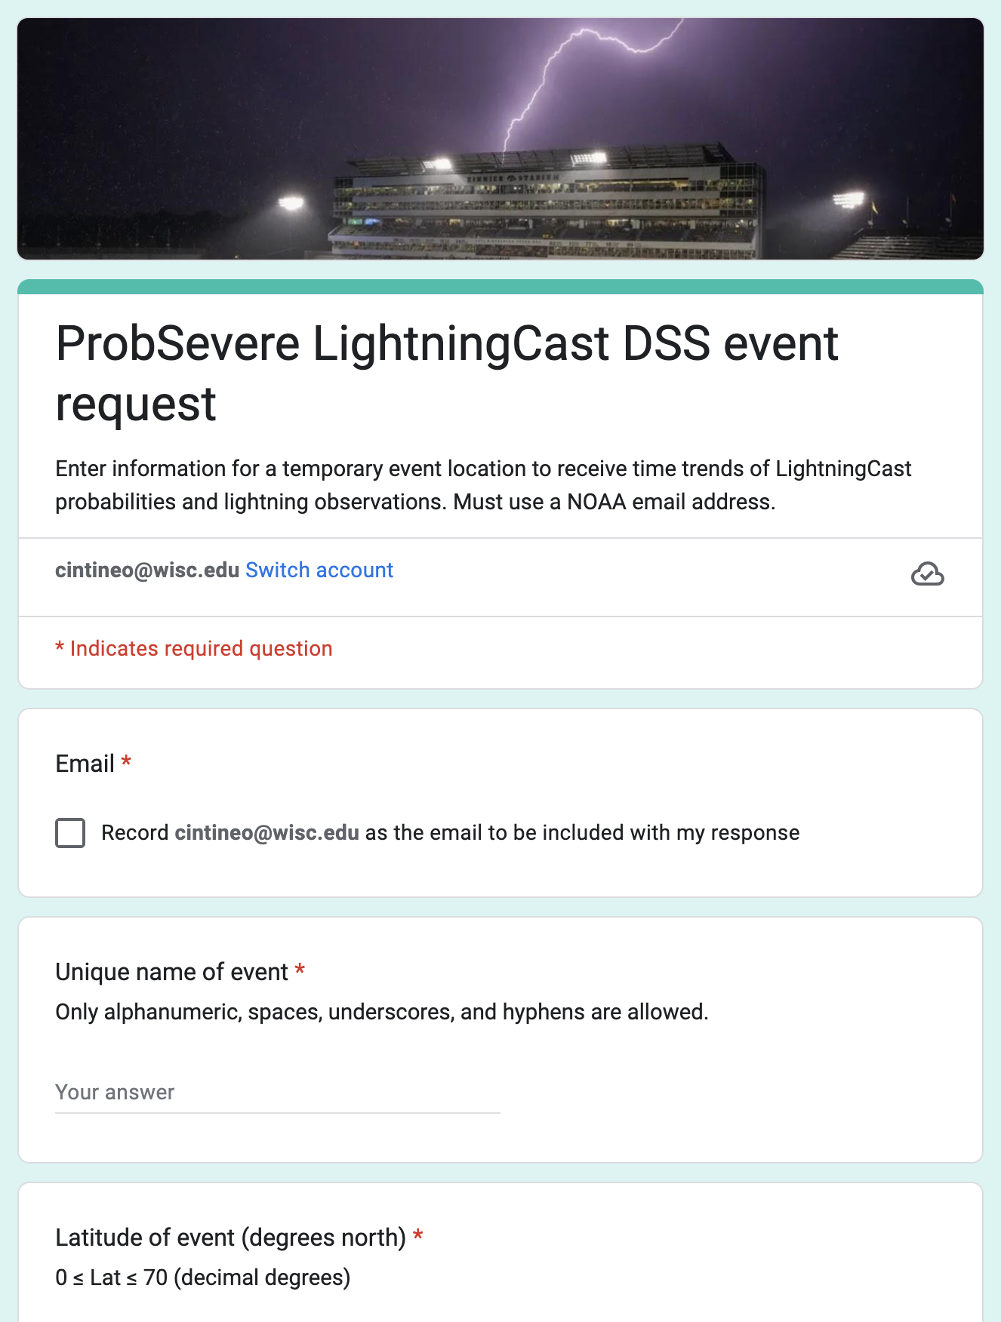
2025 DSS On-demand location request
Simple google form: https://go.wisc.edu/x16m56
Email address (@noaa.gov)
Name of event
Location (lat / lon)
Start and end time of event
Email sent with link to dashboard
valid during event
Try it out for DSS events this week!
Your feedback on the static and on-demand dashboards is crucial for if and how these features get transitioned to operations!

Slide 21
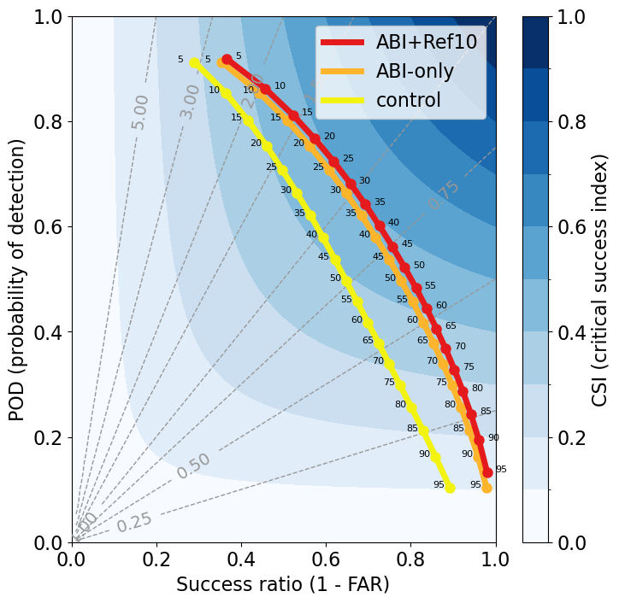
ABI+MRMS
ABI-only
WAF22
Big improvement in using more data
WAF22 model (yellow line) trained/validated on 2019
ABI-only (orange line) trained/validated on 2019-2022
Improved POD/Decreasing FAR
ABI only
ABI+MRMS (red line) trained/validated on 2019-2022
Point labels are probability thresholds

Slide 22
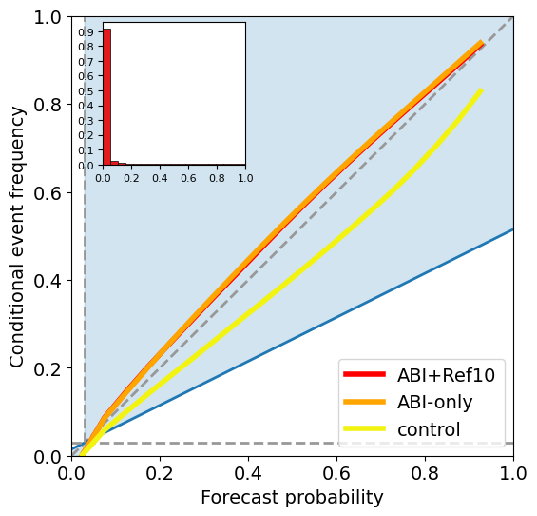
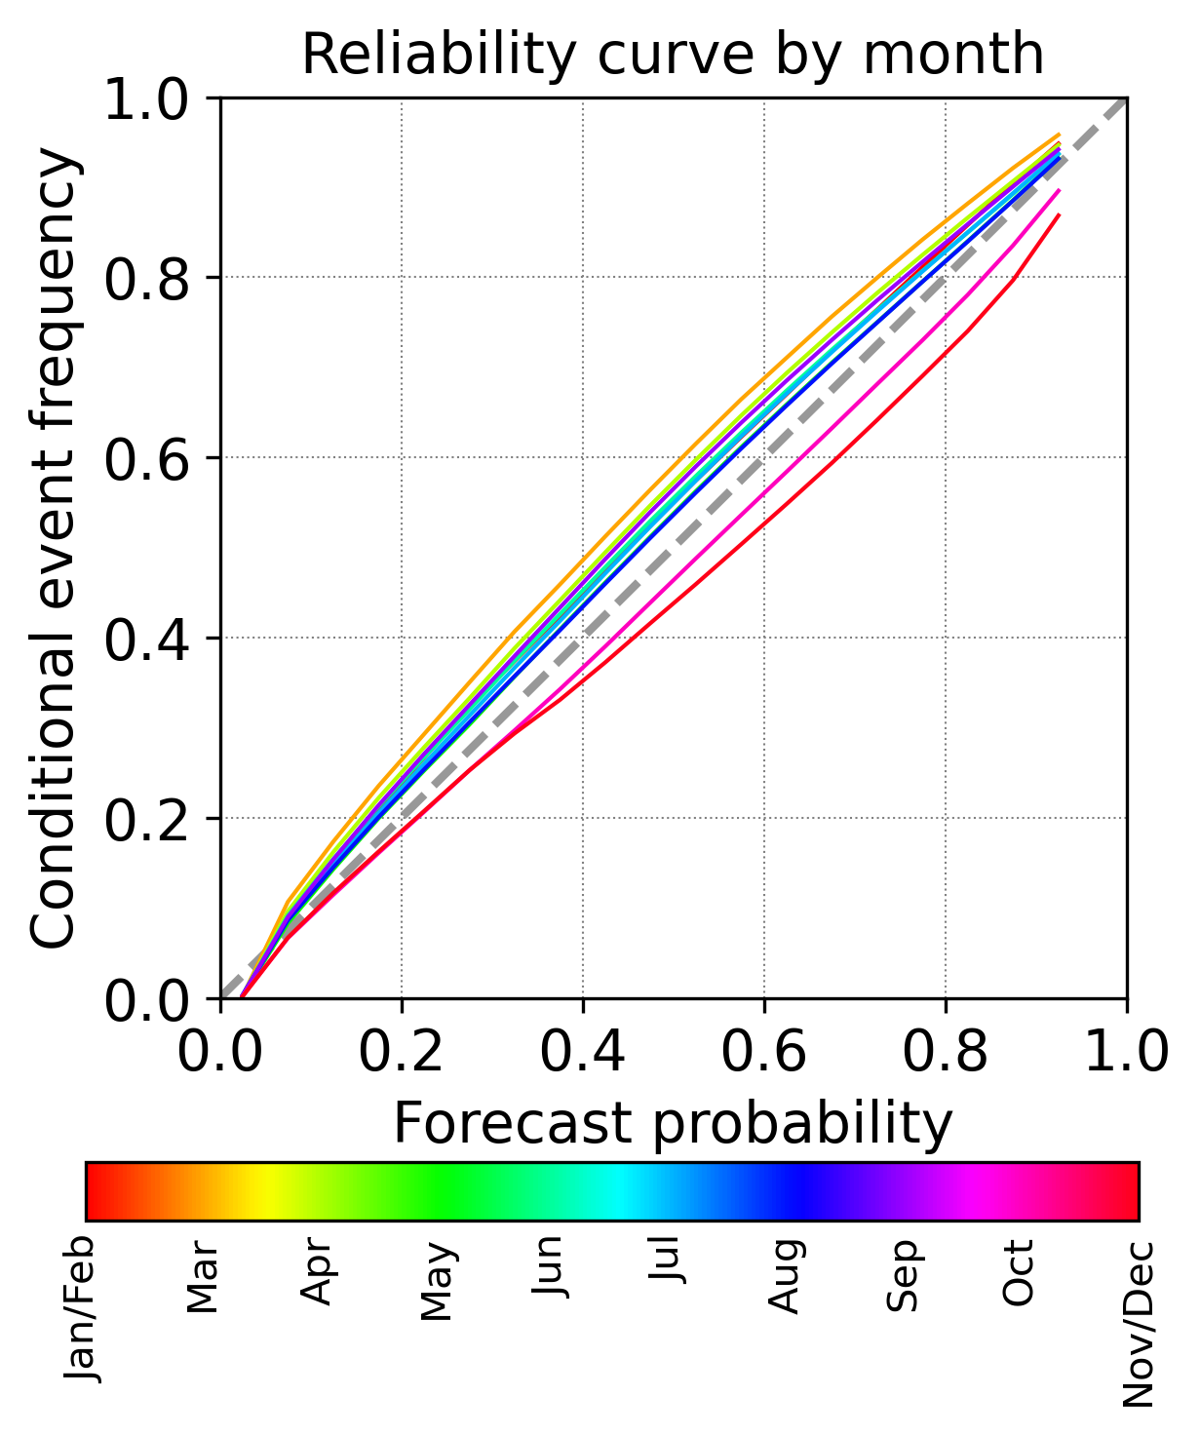
Better probability calibration
ABI+MRMS
ABI-only
WAF22
ABI+MRMS by month
Notes:
Very good calibration. This is for ALL predictions (lightning initiation and persistence/advection)

Slide 23
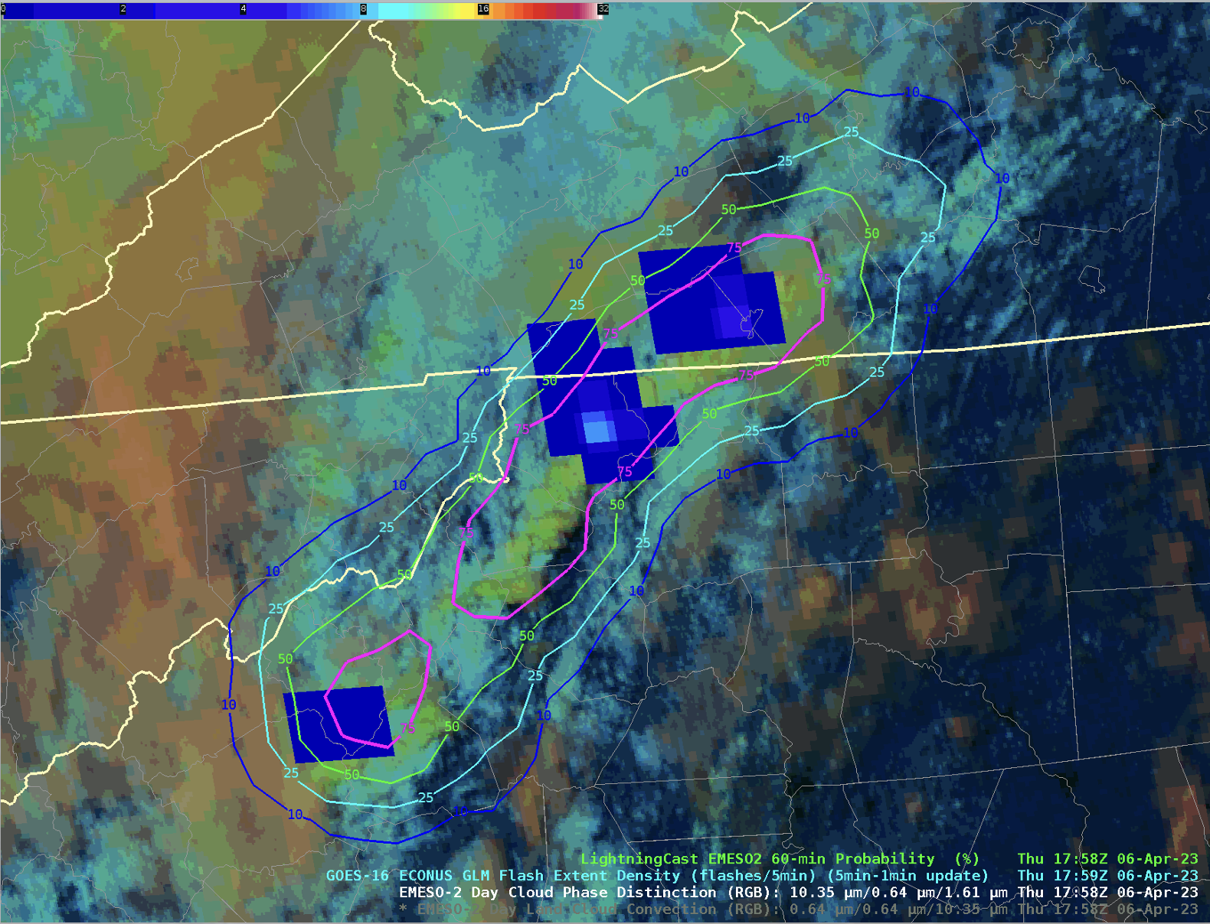
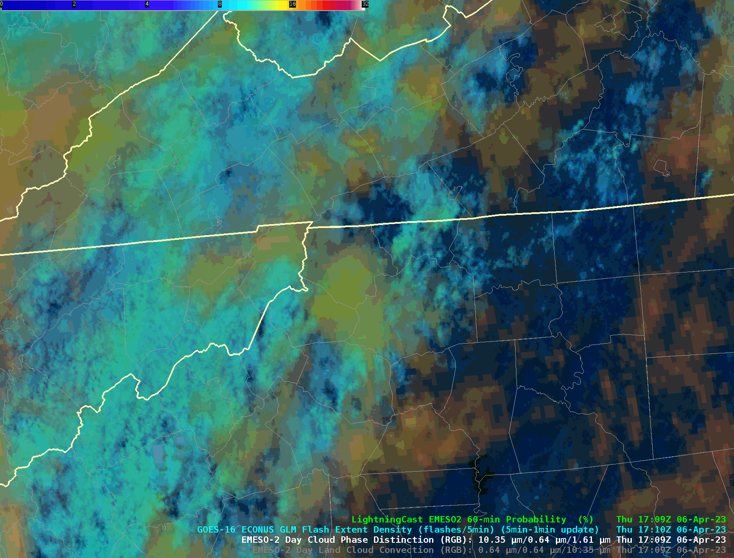
GLM Flash-extent density
4
10
Default contour colormaps
P(≥ 1 flash)
10%
25%
50%
75%

Slide 24
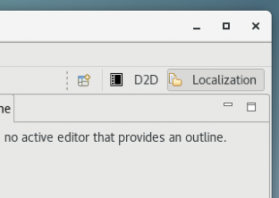
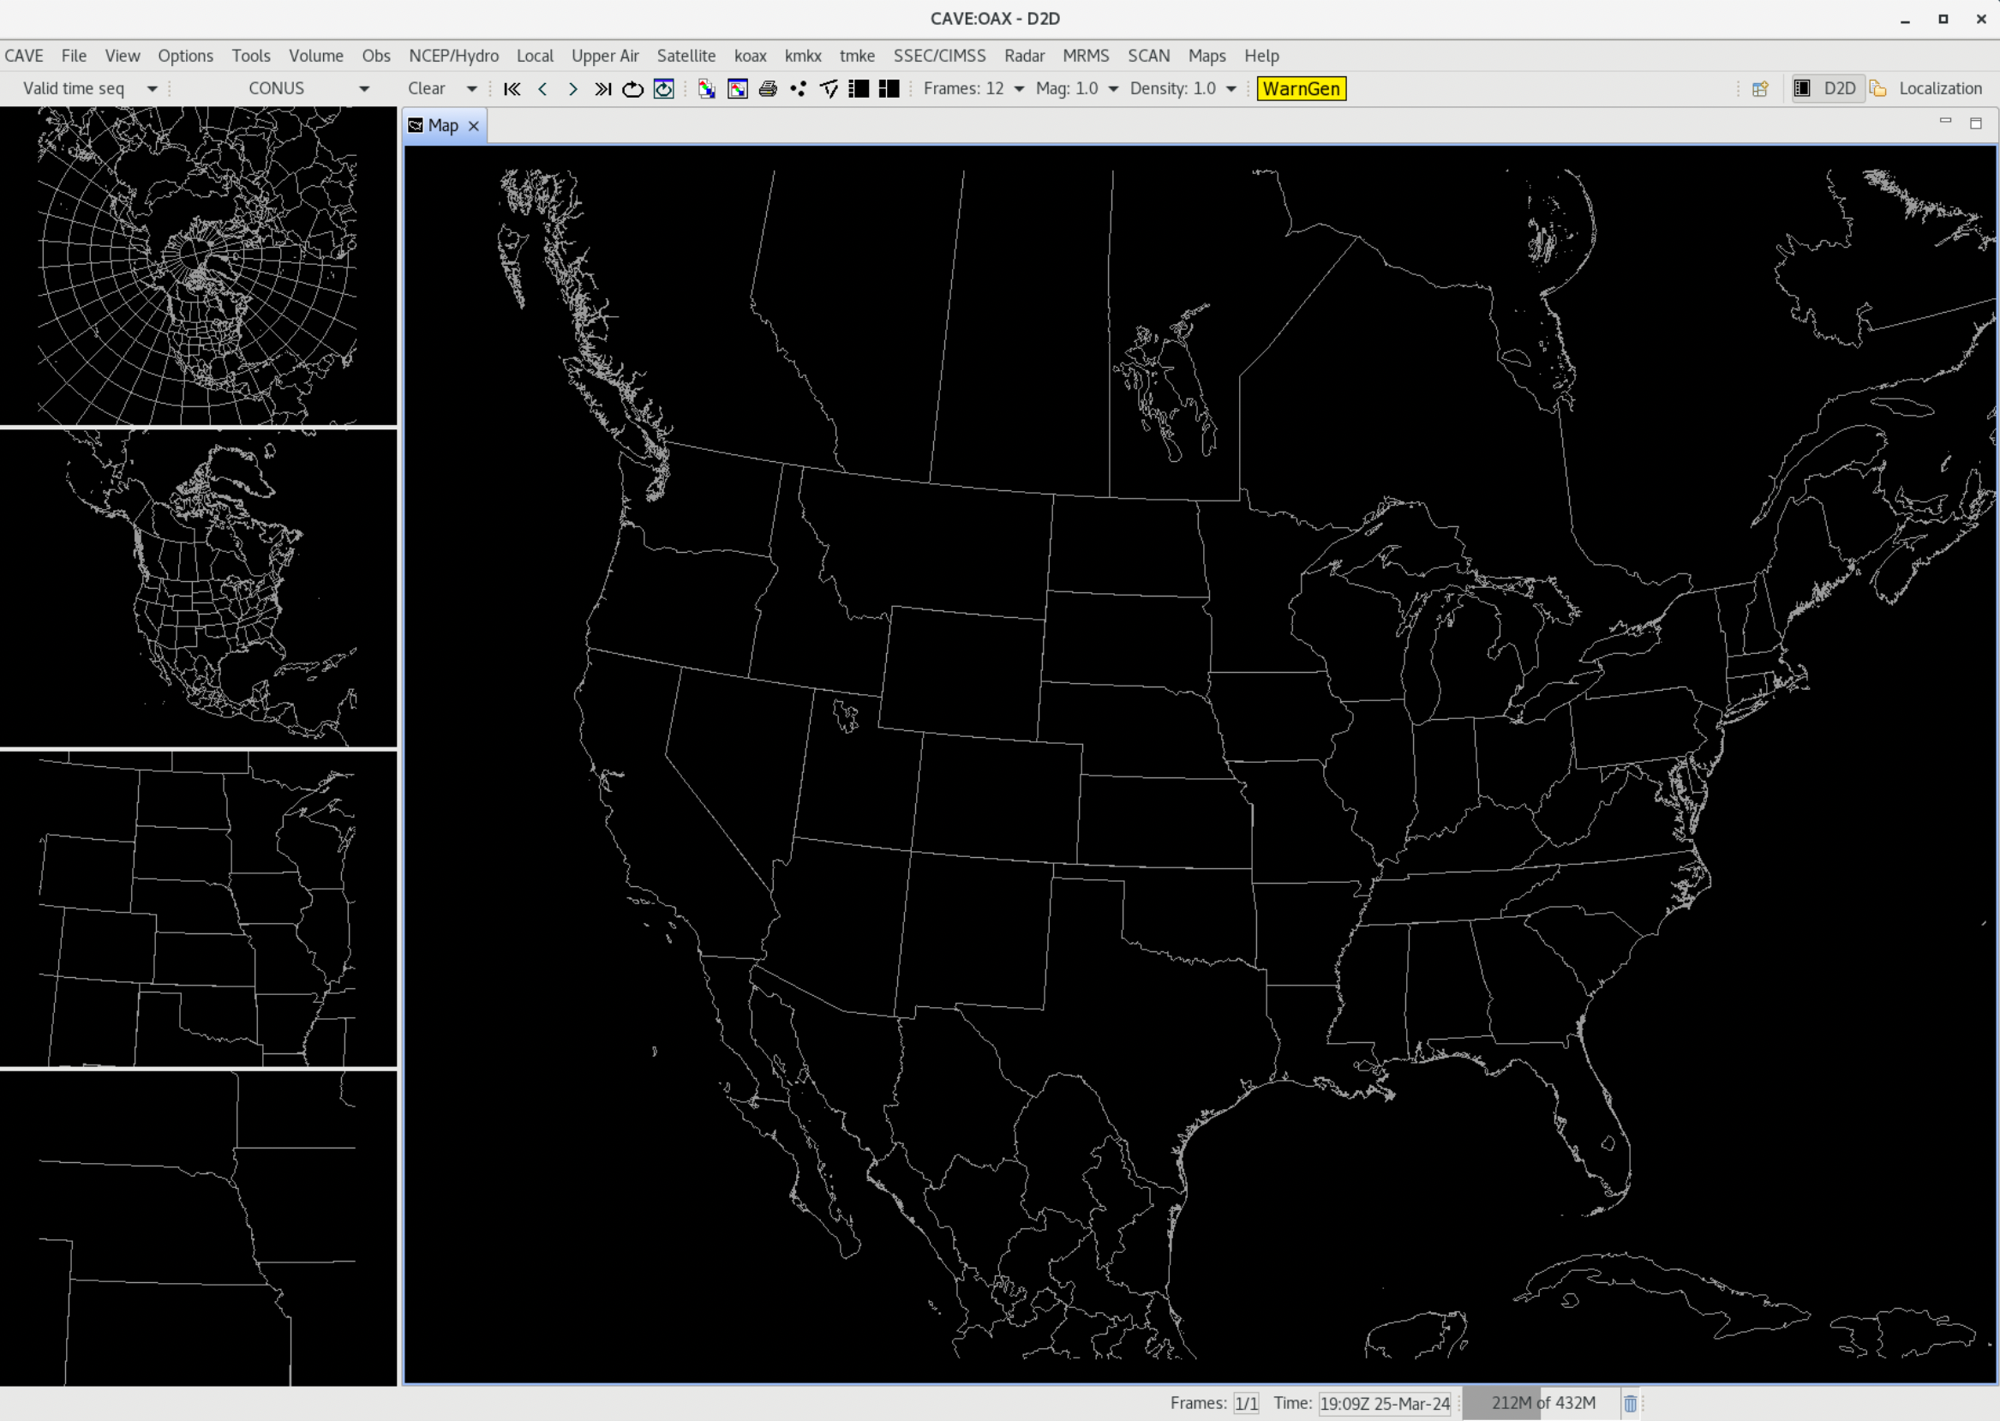
LightningCast contours are easily configurable…
Click on “Localization” pane
This info also available at:: https://tinyurl.com/lightningcast-in-awips

Slide 25
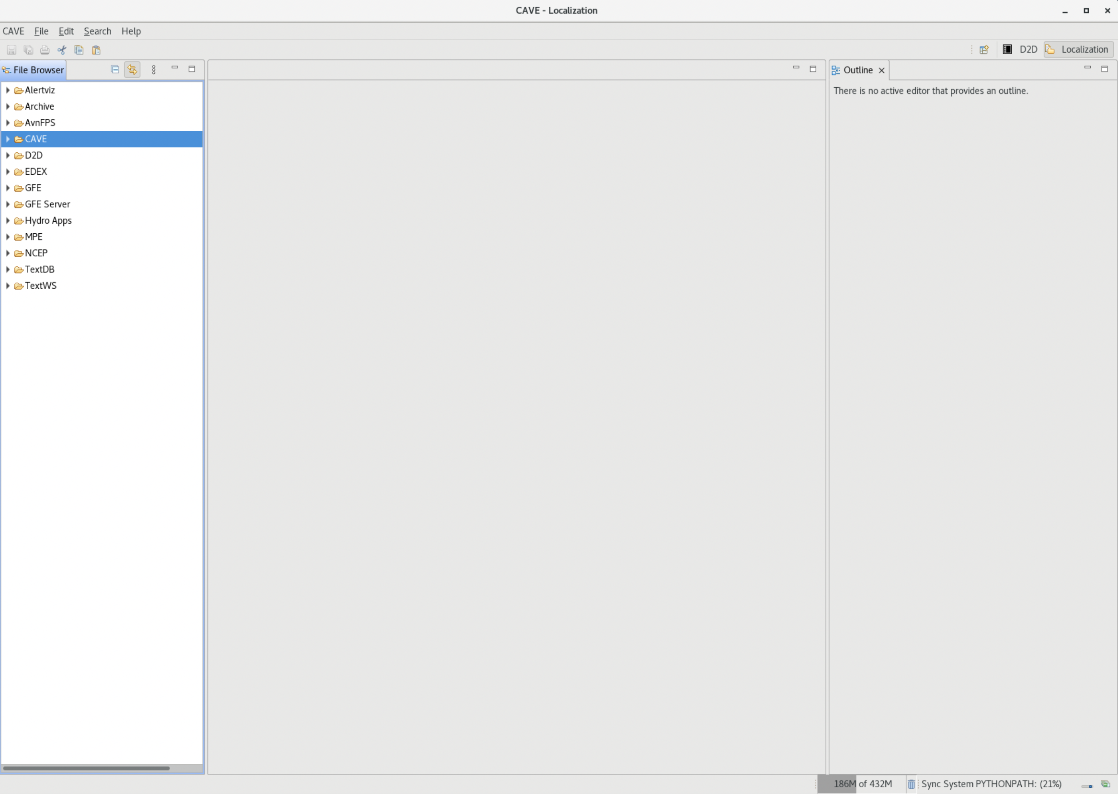
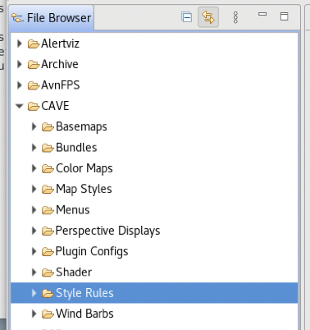
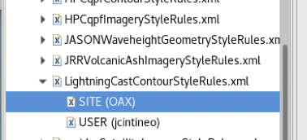
LightningCast contours are easily configurable…
Expand this menu, then find and open the LightningCastContourStyleRules.xml menu. Select the USER file. If it doesn’t exist, right click on the SITE file and select “Copy To → User”. Then open the USER file.
Navigate to CAVE → Style Rules
This info also available at:: https://tinyurl.com/lightningcast-in-awips

Slide 26
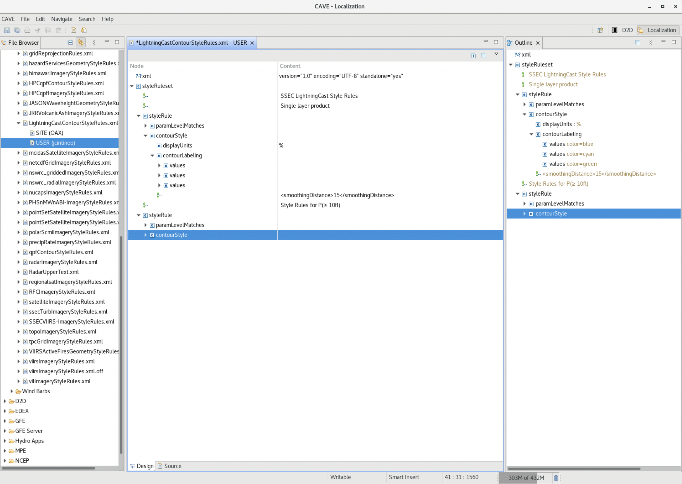
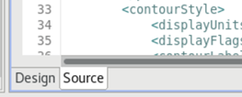
If not already selected, switch views to the Source tab located on the bottom of the window.

Slide 27
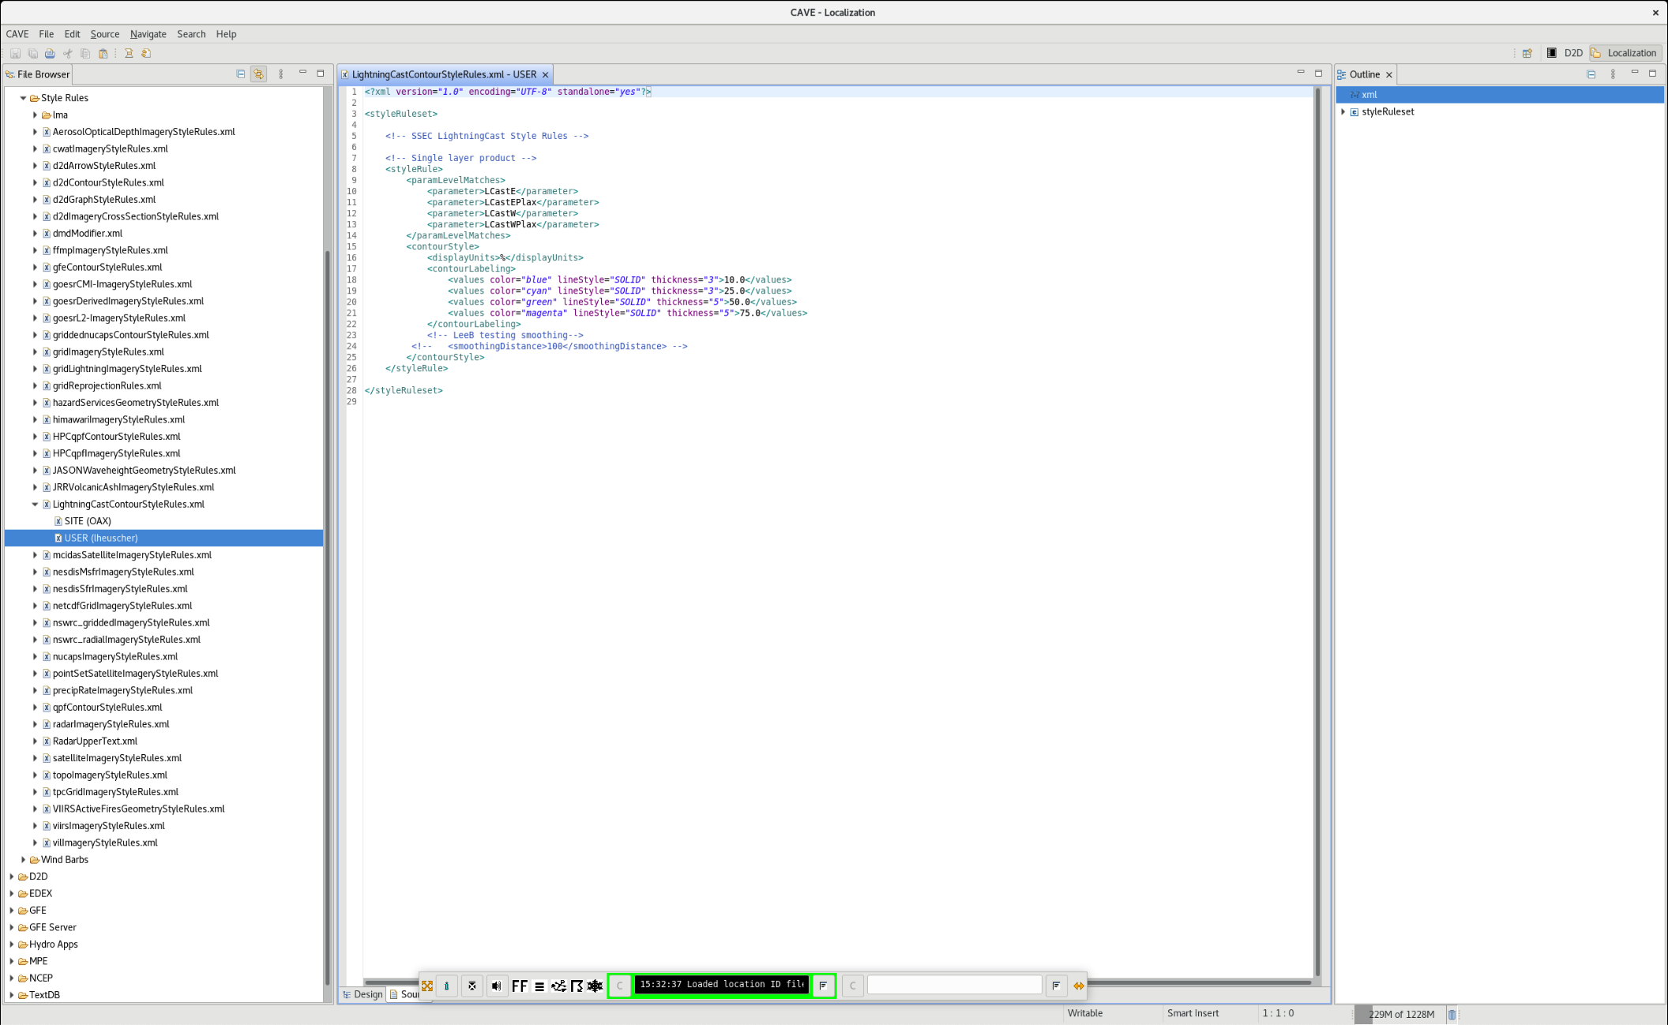
Block is for both V1 and V2 products
This info also available at:: https://tinyurl.com/lightningcast-in-awips

Slide 28
You can change contour….
Color
Style
Thickness
Probability level
Make changes, save the file, then reload the LightningCast product(s) for changes to take effect.
This info also available at:: https://tinyurl.com/lightningcast-in-awips

Slide 29
ProbSevere LightningCast: Summary/Next Steps
Unique quantitative exploitation of GOES-R data: ~20-30 minutes of lead-time relative to first occurrence of GLM-detected lightning.
AI tools are not a replacement for human expert analysis, but they enable consistent, efficient, and timely decision-making.
LightningCast v1 (ABI only) is scheduled to be transitioned-to-operations at NESDIS in 2025.
We want to hear ideas from the field regarding how to prioritize R+D and improve LightningCast products.
We’re interested in forecaster utility of the LightningCast dashboards
Notes:
-Unique exploitation of GOES-R that provides 10-50 minutes of lead-time ahead of the first occurrence of lightning (~20-30 minutes is a typical lead-time); systematic and objective
-Does not replace human expert analysis for IDSS, but it may improve efficiency, lead-time, and enable a great focus on hazard communication (uniquely human)
-Now that a sufficiently mature and proven model has been deployed, user feedback will dictate further development of the model, user interfaces, and dissemination mechanisms

Slide 30
Questions?
john.cintineo@noaa.gov
michael.pavolonis@noaa.gov
heuscherstew@wisc.edu
justin.sieglaff@ssec.wisc.edu
scott.lindstrom@noaa.gov

