Slide 1
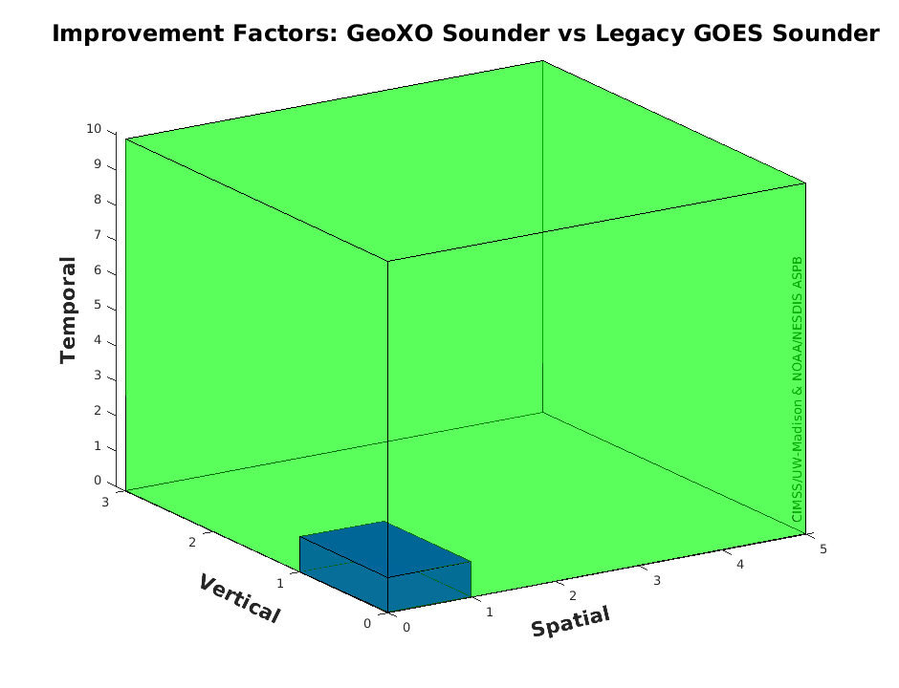
Program Science
More on the GXS to Predict Thunderstorms, etc.
GEO Senior Scientist: Andrew Heidinger
GeoXO Program Science Support: Steve Goodman
GeoXO Science Working Group for GXS Tim Schmit, etc.
"For weather surveillance a geostationary hyperspectral infrared sounder would dramatically increase confidence in forecasts of hurricanes and other storms that originate over the ocean and head towards U.S. interests."
- Ken Graham, NWS Director (former NHC Director)

Slide 2
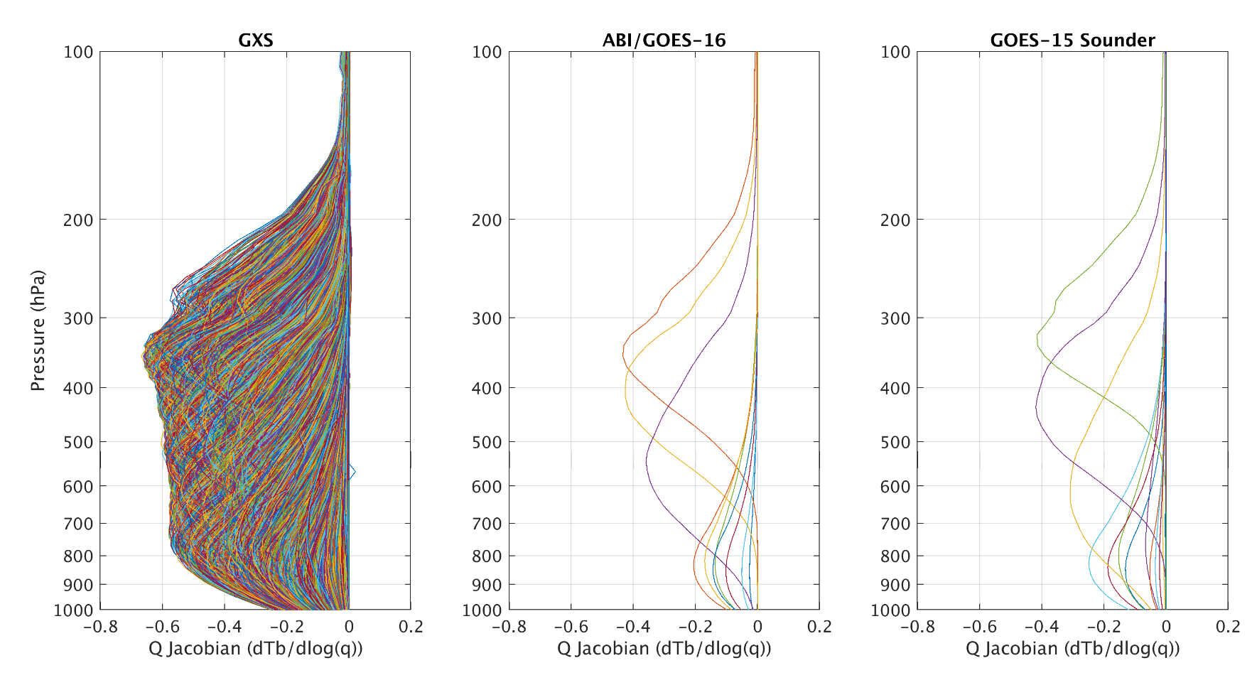
GeoXO GXS Moisture Weighting Functions
GeoXO IR-Sounder (GXS) Science Working Group has computed the Weighting functions for the nominal specifications of GXS.
Weighting functions (aka Jacobians) show where in the atmosphere information comes from.
These plots show the weighting functions for moisture.
These are also important for picking channels for data assimilation, although as many as possible should be used..
They show how much more vertical information GXS will provide compared to ABI or the previous GOES Sounders, this is in part to the many more overlapping spectral bands.
UW/CIMSS
Notes:
Farther from the zero line is more vertical resolution. More bands reduces the noise. 1976 US standard atmosphere

Slide 3
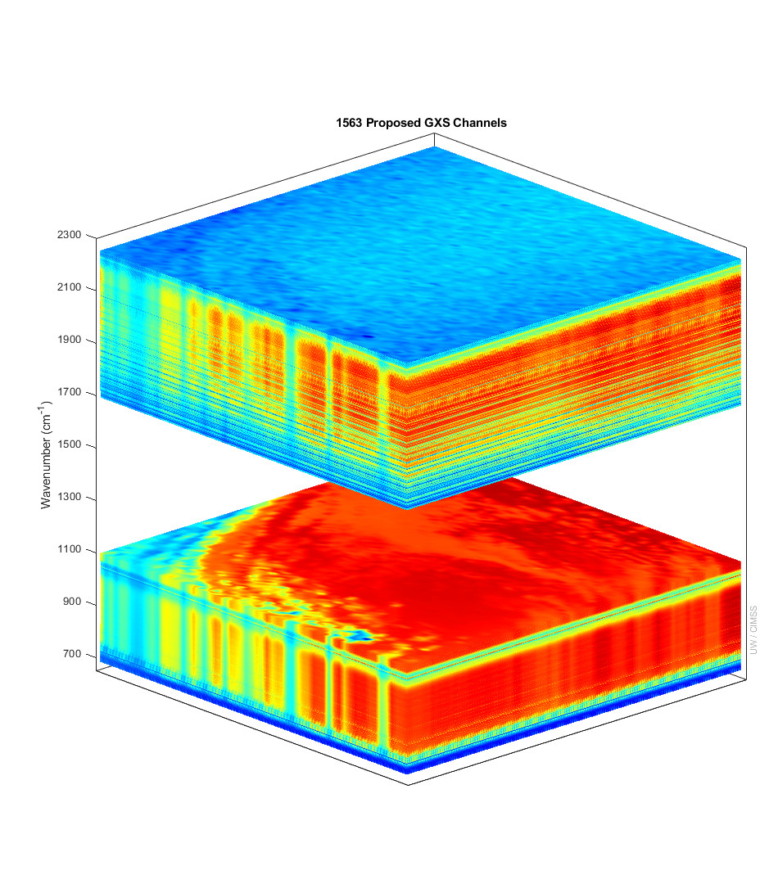
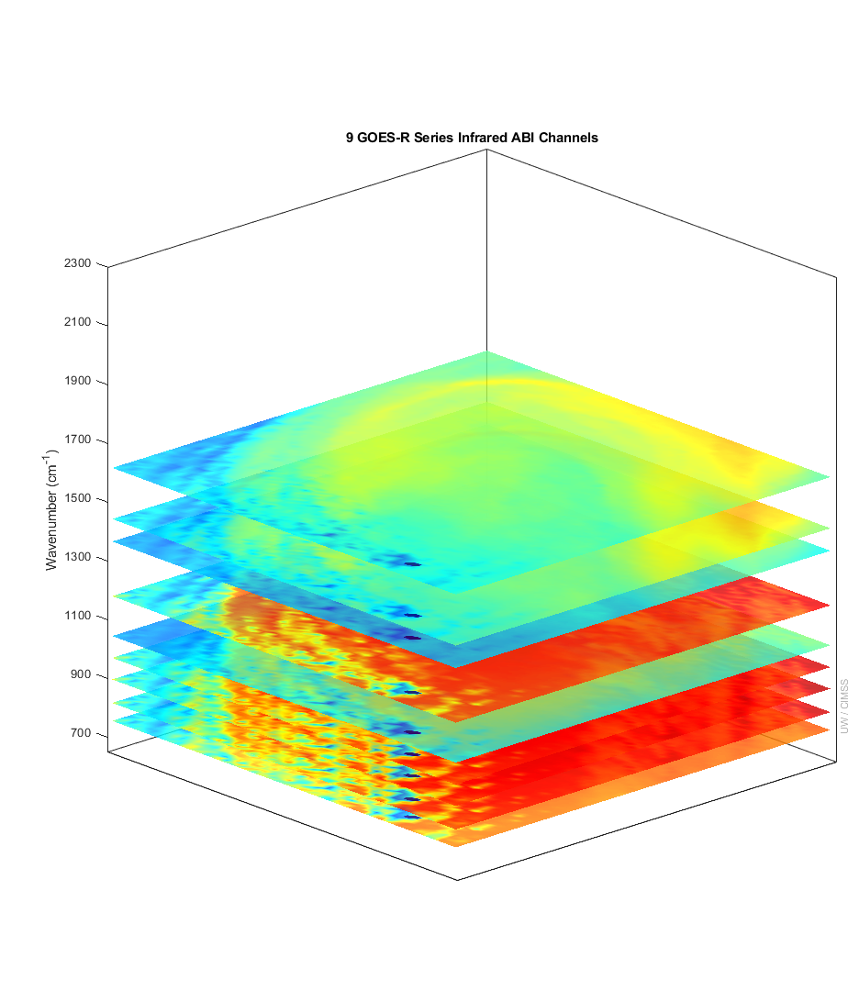
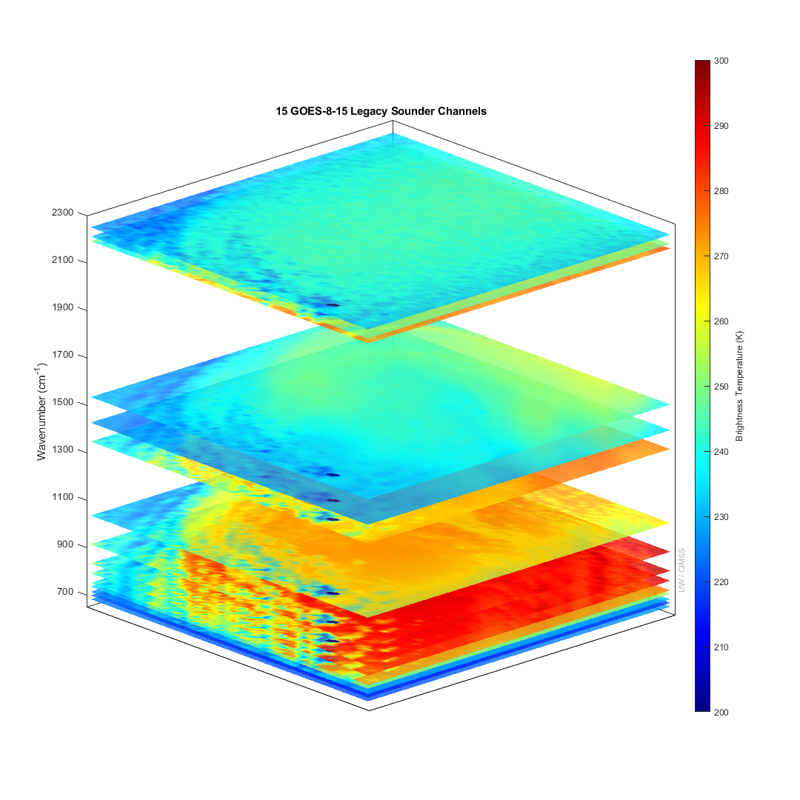
More spectral bands means more vertical information for temperature and moisture
GXS ABI GOES Legacy Sounder
IASI granule used to show the great improvement of the GXS over previous geostationary capabilities
Notes:
Y axis is wavenumber. ABI and GOES Sounder bands within the GXS range are shown. Credit: UW/CIMSS

Slide 4
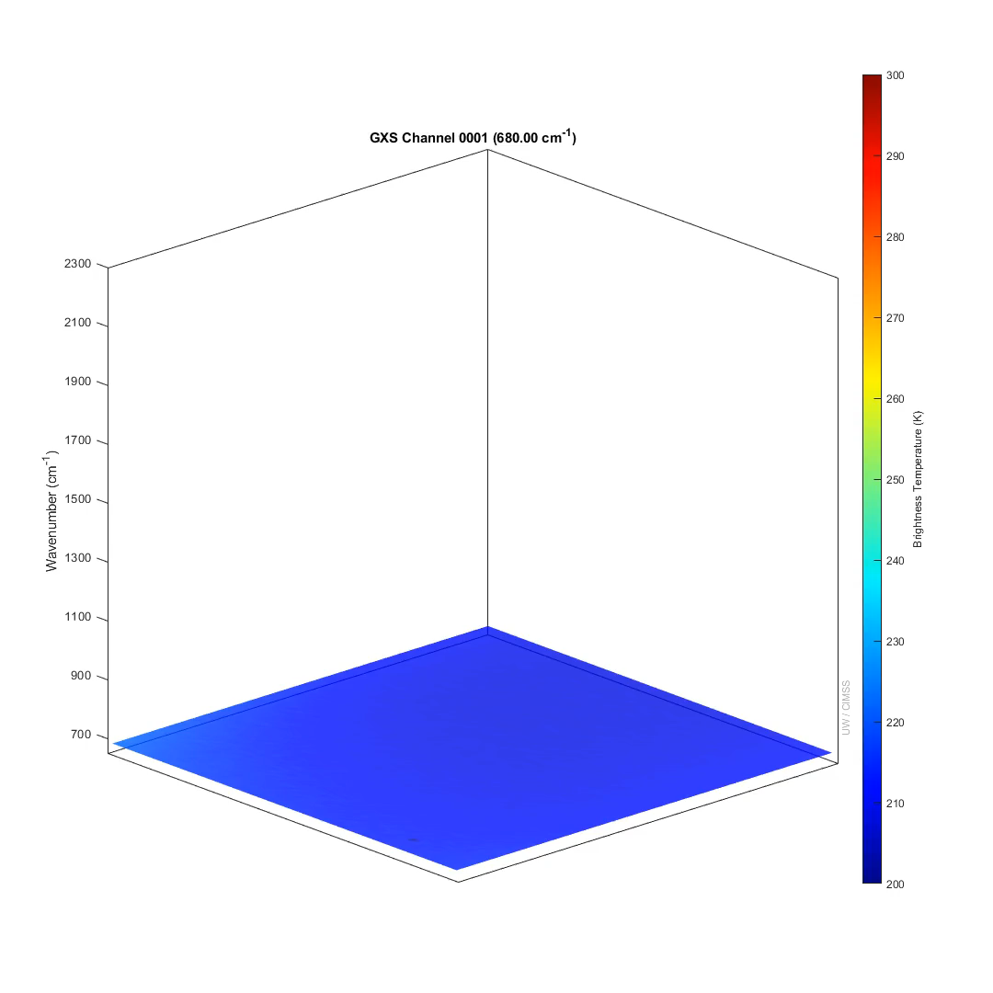
More spectral bands means more vertical information for temperature and moisture
IASI granule (movie) used to show how the GXS provides vertical information on both moisture and temperatures, keys to forecasting convection.

Slide 5
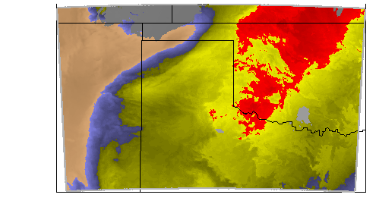
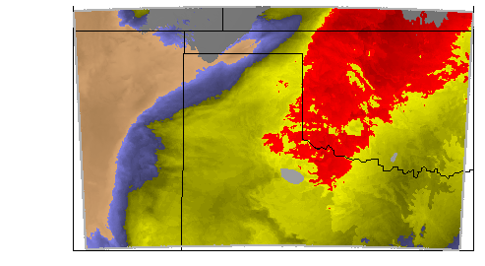
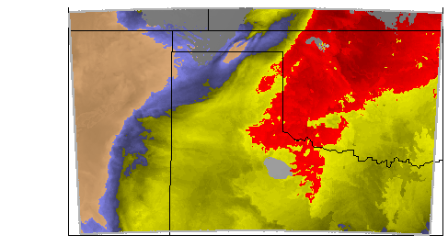
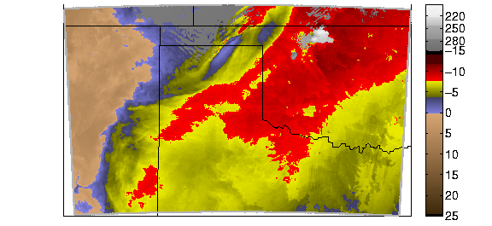
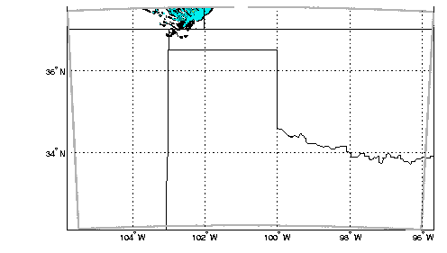
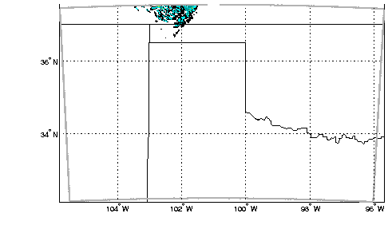
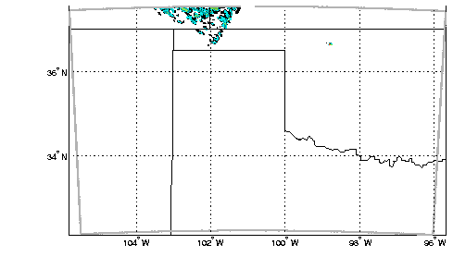
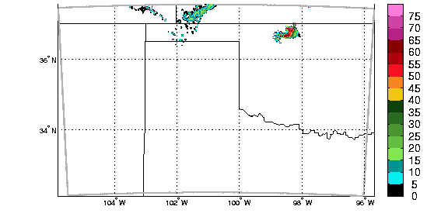
GeoXO GXS Can Monitor Conditions ripe for Thunderstorms; increasing lead times
The GXS - sounder can provide hours more lead time of atmospheric instability compared to waiting for the radar echoes. The GXS does this via uniquely monitoring upper-level drying; low-level moisture pooling; and atmospheric flow before the clouds form. These are important vertical moisture changes; as they are key to the prediction of convection. The GXI will not provide the detailed vertical moisture or temperature information (not shown).
- 3 hours before convection - 2 hours - 1 hour Convection
time
GXS Atmospheric Instability
Radar
Notes:
- 3 hours is 13Z in the published IHOP case … This is an OSSE, so radar is simulated. Ovals added for reference. Images are grouped.
1 hour is when the imager can be used, since the clouds have to have formed
The 0 hr is when there’s lightning and hence the LMX can see it.
PS: ACX also useful for modeling convection: Ntelekos, A.A., Smith, J.A., Donner, L., Fast, J.D., Gustafson, W.I., Jr, Chapman, E.G. and Krajewski, W.F. (2009), The effects of aerosols on intense convective precipitation in the northeastern United States. Q.J.R. Meteorol. Soc., 135: 1367-1391. https://doi.org/10.1002/qj.476

Slide 6
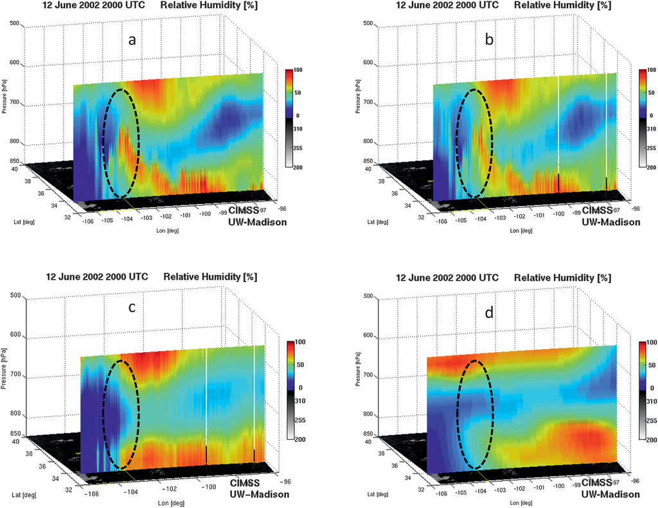
Truth
GXS-like
GXS can monitor important vertical moisture changes; these are the key to the prediction of convection
12-June-2002 20 UTC
Relative Humidity [%]
ABI-like
Regional NWP
Imagers nor NWP capture the vertical moisture changes
Notes:
Relative humidity cross section at 2000 UTC 12 Jun 2002 from (a) true, (b) the geostationary advanced IR sounder, (c) ABI, and (d) RUC.
Citation: Journal of Applied Meteorology and Climatology 50, 3; 10.1175/2010JAMC2441.1
Image and labels are grouped.

Slide 7
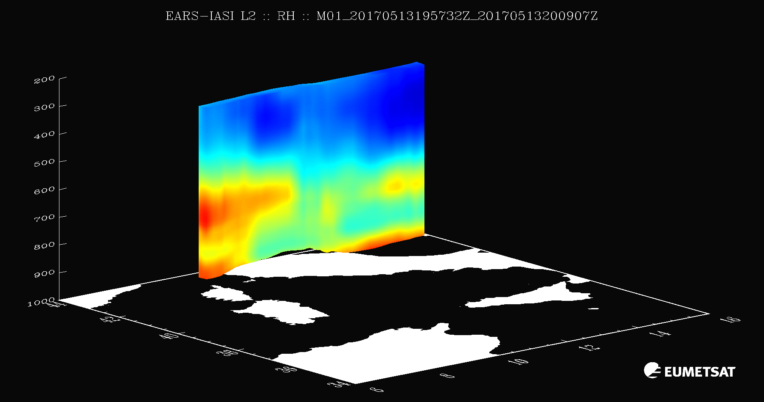

GeoXO GXS is the only sensor to monitor vertical moisture on high time and space scales
Relative Humidity (movie) note the elevated moisture plumes.
GXS will add the important time component.
Notes:
https://www.eumetsat.int/IASI-PWLR
Example of relative humidity fields generated from EARS-IASI L2 over Italy on 13 May 2017

Slide 8
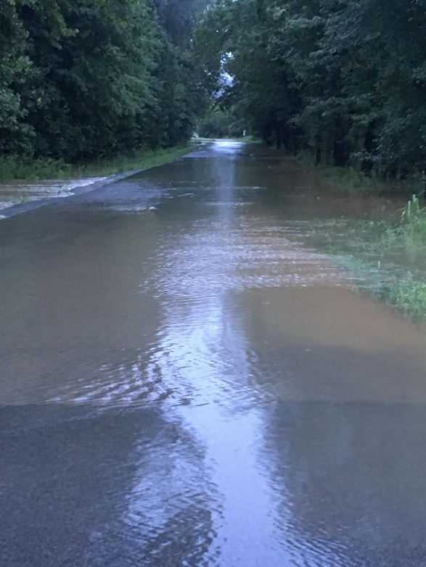
Forecasts with high spectral and time resolution satellite data greatly improve precipitation forecasts
NWS
KY flooding: 9-hour forecasts of hourly accumulated precipitation for the period 01:00 to 02:00 CDT, on August 5, 2022. The control forecast is obtained from the same model and conventional observations used for the ‘Satellite’ forecast but without the assimilation of the satellite moisture profile data. Without the satellite profiles, the heavy rain was not forecast by the model.
Notes:
https://www.weather.gov/pah/2022Aug4-5_Flooding

Slide 9
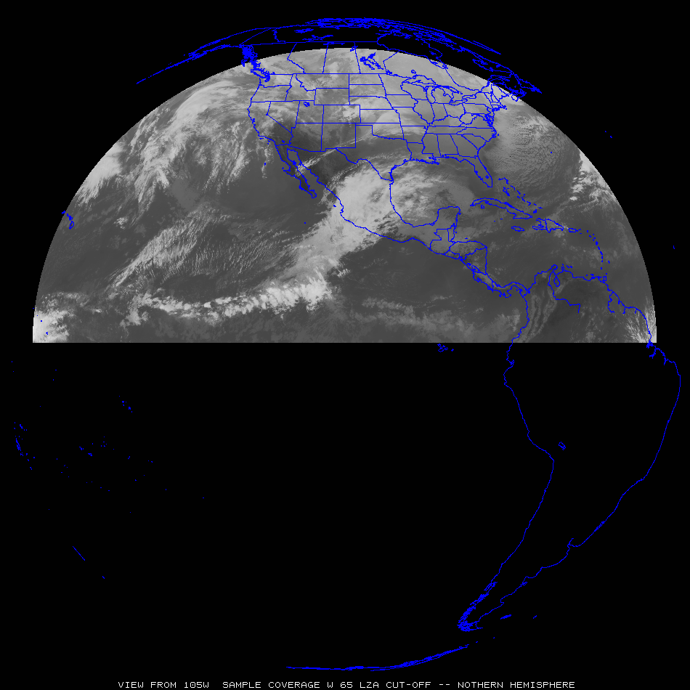
GeoXO Sounder Uses
Select GXS uses for both nowcasting and NWP applications
“clippers”
Most everywhere:
Pre-convection, stability, winds, moisture, high clouds, help AQ, etc.
“atmospheric
rivers”
“Nor-easters”
“dryline”
Sub-tropical jet
“return flow”
“Atlantic
Tropical
Cyclones”
“EastPac Tropical Cyclones”
Tropical winds for NWP
Tropical winds for NWP
Tropical winds for NWP

Slide 10
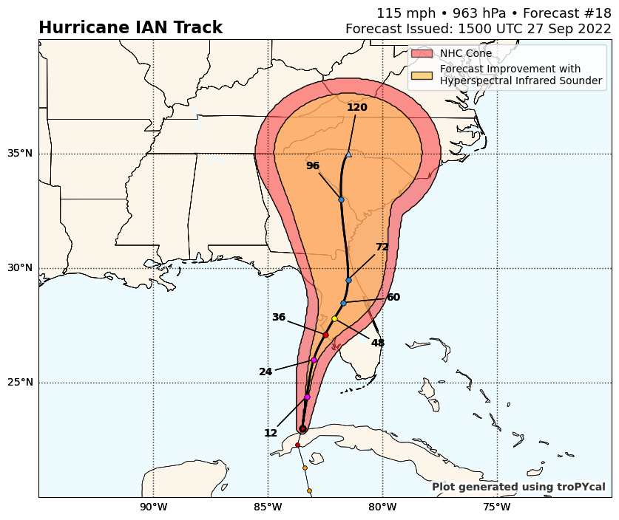
Demonstration of Possible Hurricane Track Improvements with GXS
Hurricane Intensity improvements, similar to as seen with another geo advanced sounder. Also expected, but not included on this graphic, are hurricane intensity forecast improvements.

Slide 11
Need for high spectral & temporal observations
High-spectral-resolution observations provide much more information
  Imagers average out important vertical information.
  LEO has shown the many benefits, especially on the global scale, lacks time resolution
Forecasting Applications – fill in critical gaps wrt vertical moisture, wind and temperature
  Nowcasting and Numerical weather prediction, especially on the regional/mesoscales
Additional applications
  High-spectral-resolution sounder observations would also improve derived products with only advanced imager data (and or with polar-orbiter and other data)
    volcanic ash, cloud detection, cloud-top properties, atmospheric motion vectors, dust detection, land and sea surface temperatures.
  New areas
    Moisture flux, capping inversion, surface emissivity, trace gases and climate
Economic impacts (“billions”…) More with the benefits of 4dvar analysis …
Critical Component of the Global Constellation

Slide 12
Back-up

Slide 13
Information Content
(GXS-like)
(legacy)
The relative vertical number of independent pieces of information is shown. The moisture content is similar between the ABI and the legacy GOES Sounder. The legacy GOES Sounder does show more temperature information than the ABI. The ABI is not close to the information content of a high-spectral IR sensor.
Notes:
https://journals.ametsoc.org/view/journals/atot/26/11/2009jtecha1248_1.xml

Slide 14
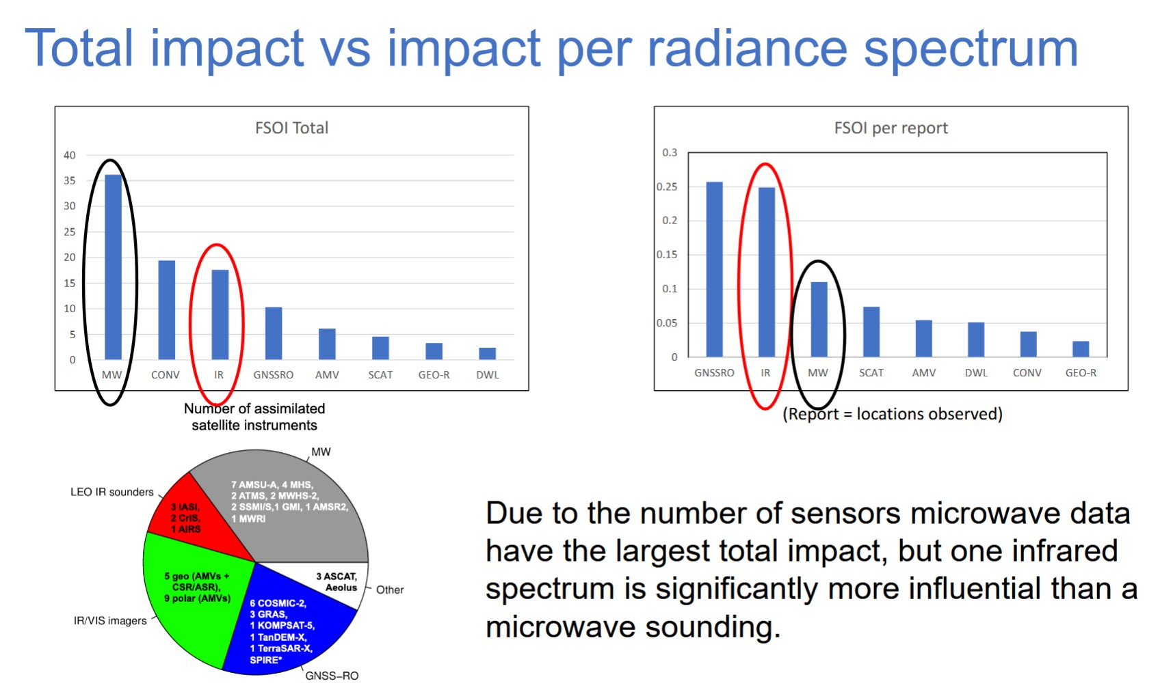
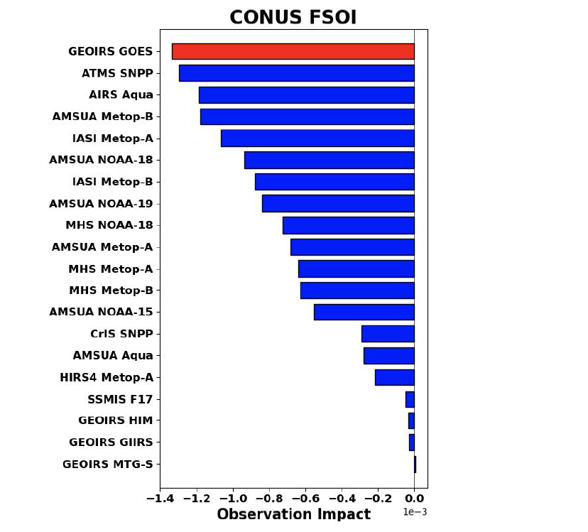
Benefits
Computer simulation of 24-hr Forecast Sensitivity Observation Impact ... for CONUS, for the four cycles (NASA GMAO):
Based on early CrIS implementation strategy
Data Assimilation considerations for future
infrared sounder deployment
Tony McNally, Principal Scientist, ECMWF
Notes:
https://www.nesdis.noaa.gov/s3/2022-03/TonyMcNally_20211206-noaa-virtual-infrared-sounder-workshop.pdf
https://www.nesdis.noaa.gov/s3/2022-03/JohnEyre_20211206-noaa-virtual-infrared-sounder-workshop.pdf

Slide 15
Leverage existing studies to showcase what GeoXO Instruments are needed to best Predict and Observe Thunderstorms
Based in part on:
Li, J., Jinlong. Li, J. Otkin, T. J. Schmit, and C. Liu, 2011: Warning information in a preconvection environment from the geostationary advanced infrared sounding system – A simulation study using IHOP case, Journal of Applied Meteorology and Climatology, 50, 776 – 783.
Cintineo, J. L., Pavolonis, M. J., Sieglaff, J. M., Cronce, L., & Brunner, J. (2020). NOAA ProbSevere v2.0—ProbHail, ProbWind, and ProbTor, Weather and Forecasting, 35(4), 1523-1543. Retrieved Oct 12, 2022, from https://journals.ametsoc.org/view/journals/wefo/35/4/wafD190242.xml
Rudlosky, S. D., Goodman, S. J., Virts, K. S., & Bruning, E. C. (2019). Initial geostationary lightning mapper observations. Geophysical Research Letters, 46, 1097– 1104. https://doi.org/10.1029/2018GL081052

