Slide 1
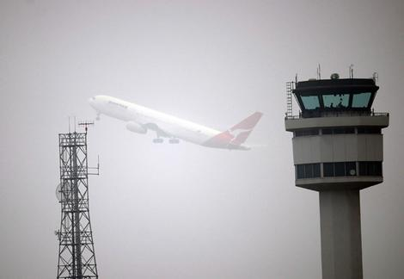
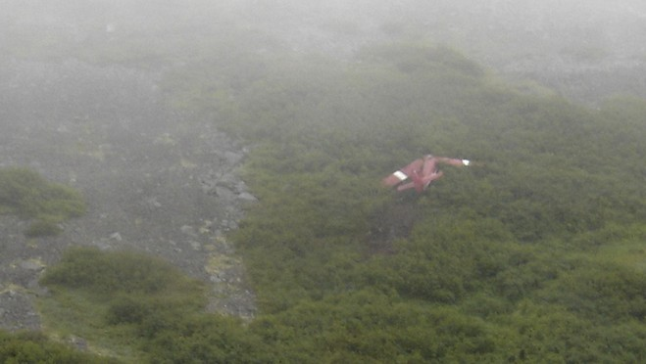
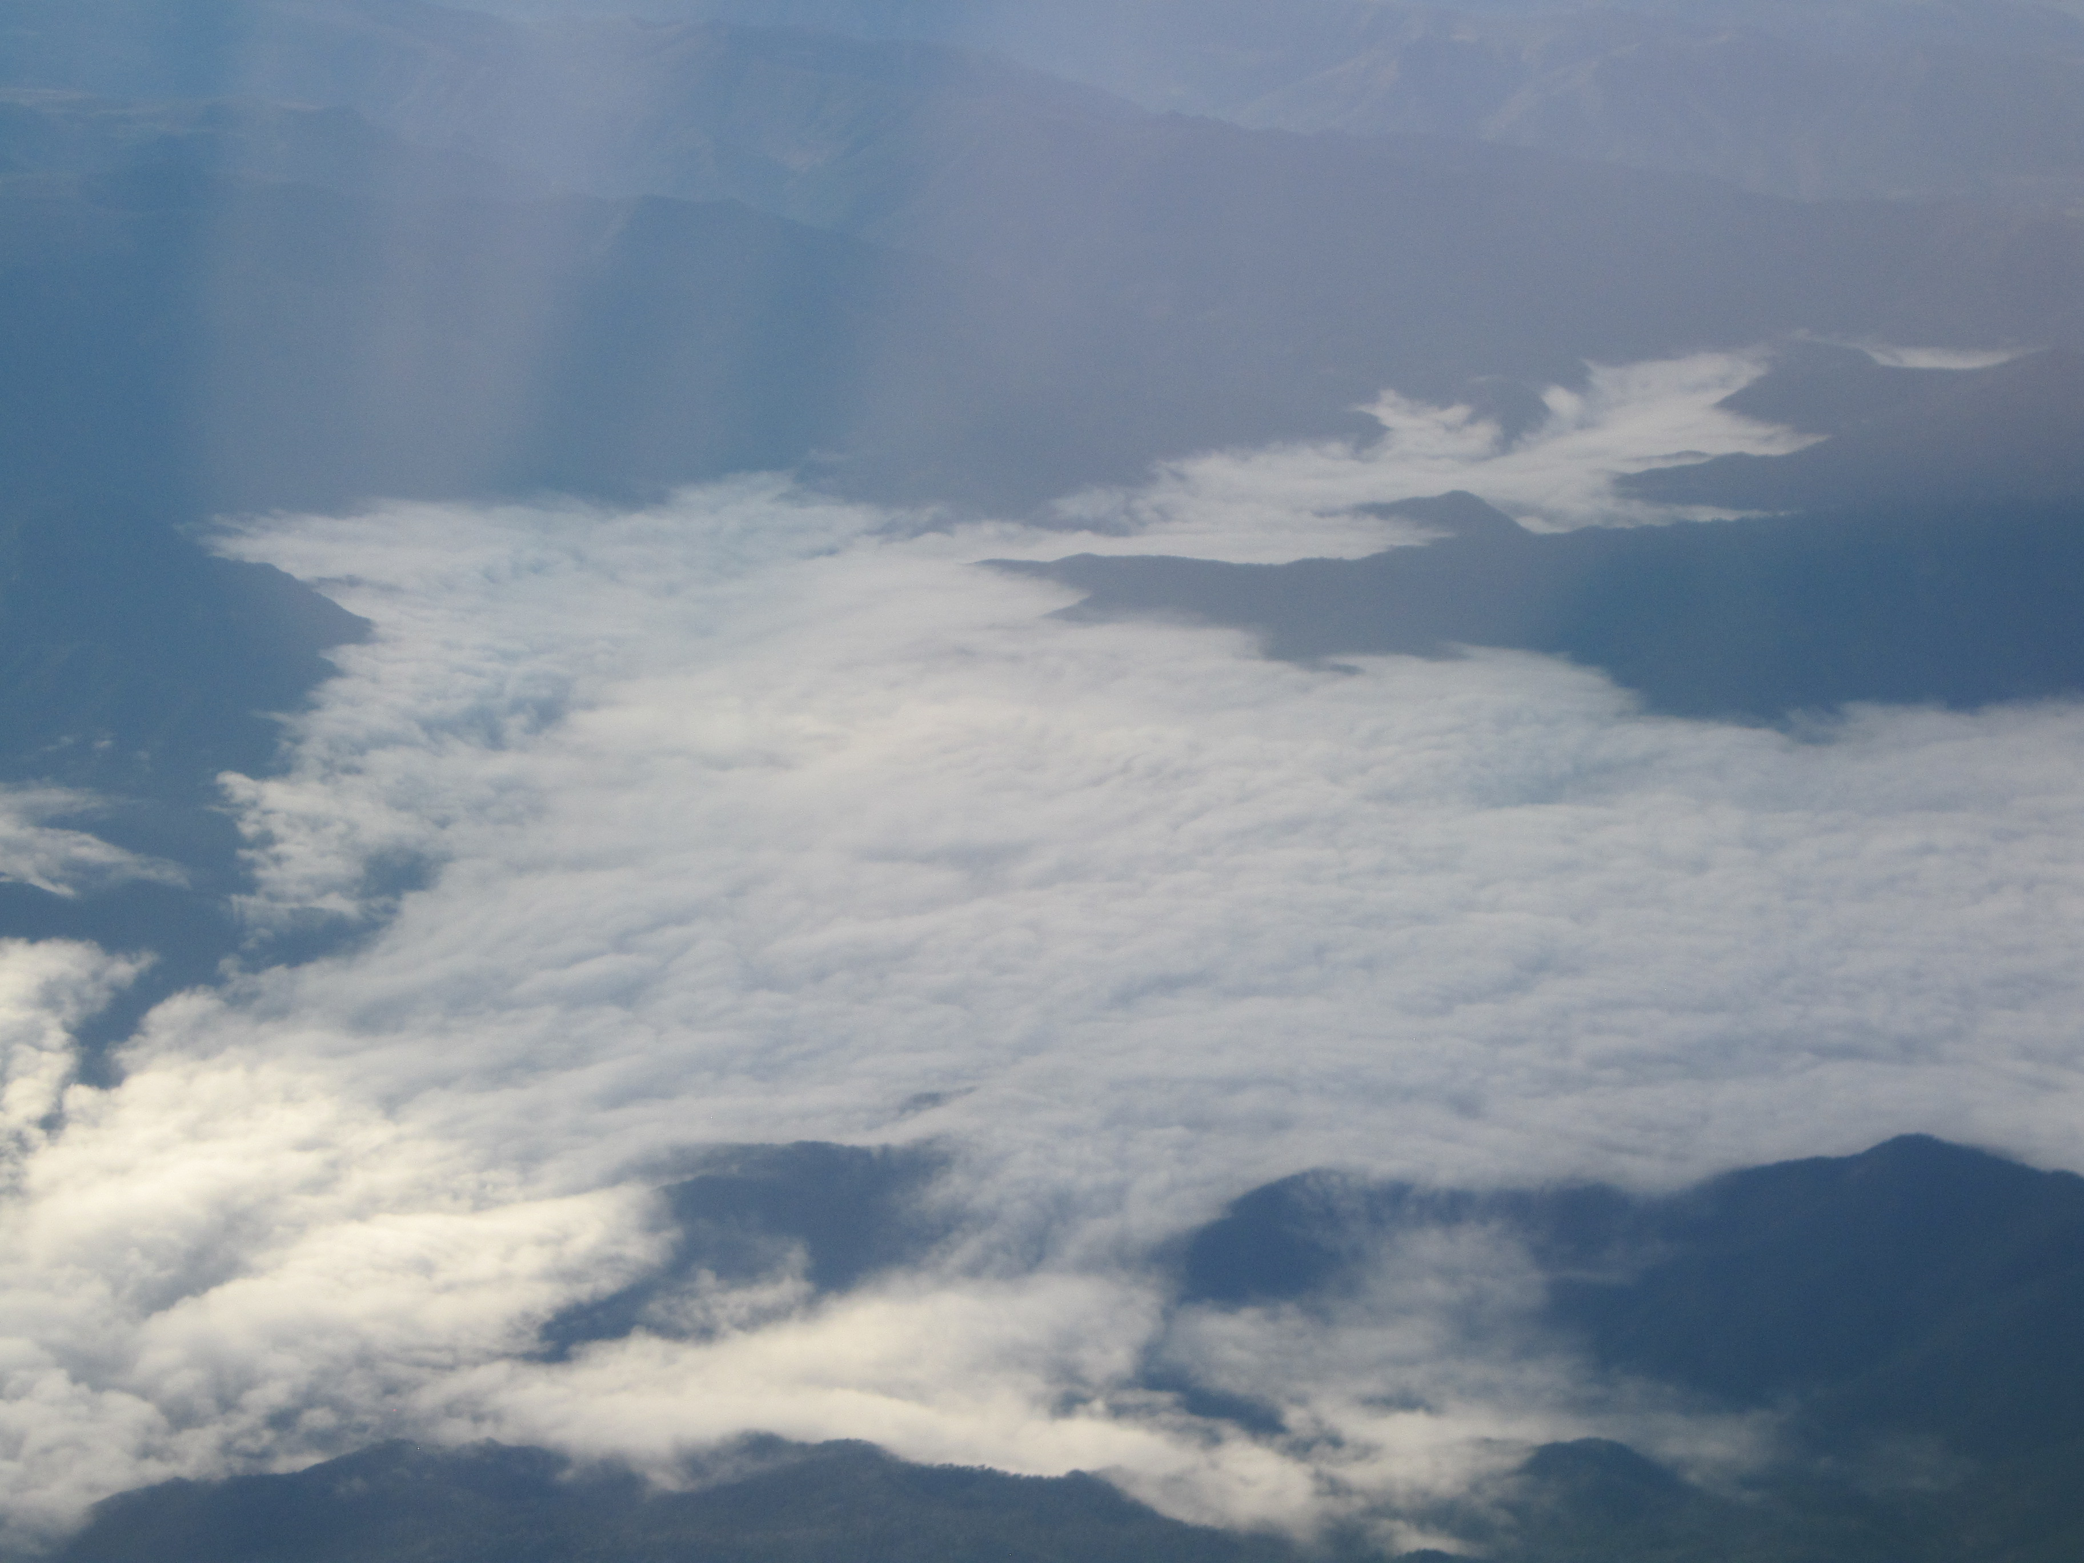
The GOES-R AWG Fog/Low Cloud Product
Joe Armao
Mike Pavolonis (NOAA/NESDIS)
Corey Calvert (UW-CIMSS)

Slide 2
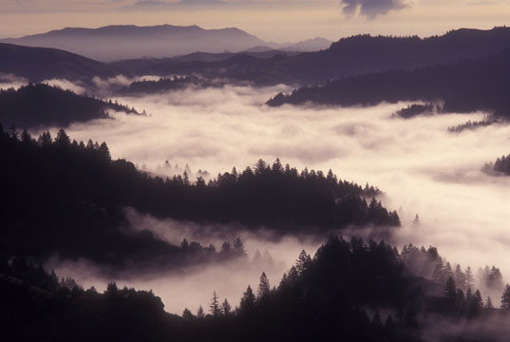
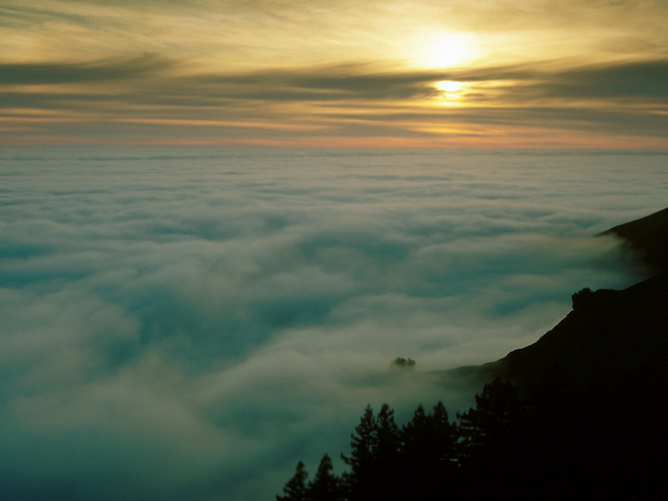
What You Should Know by the End of Training
Which GOES-R fog/low cloud algorithms are available within AWIPS
Product interpretation through examples of interest in Alaska
Strengths and limitations of the fog/low cloud product
Future improvements for the fog/low cloud algorithm

Slide 3
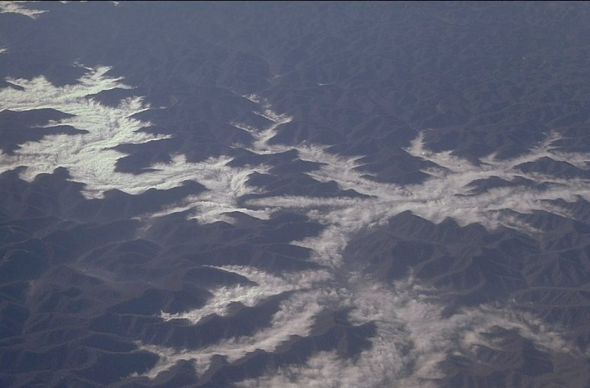
Introduction
End user products viewable in AWIPS
Fog probability (%)
Fog depth (m)
Fog mask (yes/no)
These products are retrieved using satellite imager observations at 0.65, 3.9 and 11 μm as well as surface temperature data from an NWP model such as the GFS
The GOES-R products are being made available by using MODIS as a proxy data source for the GOES-R ABI (similar spectral channels)

Slide 4
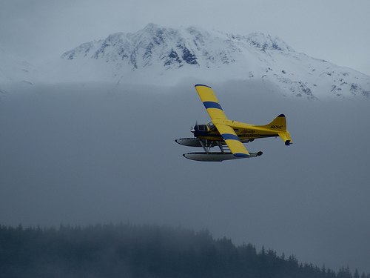
What Is Fog?
Aviation-based fog/low stratus cloud definition
VFR - Visual flight rules
ceiling > 3000 ft (914 m)
MVFR - Marginal visual flight rules
1000 ft (305 m) < ceiling < 3000 ft (914 m)
IFR - Instrument flight rules
500 ft (152 m) < ceiling < 1000 ft (305 m)
LIFR - Low instrument flight rules
ceiling < 500 ft (152 m)
The aviation flight rules above also include a visibility requirement, however, surface visibility is difficult to infer from satellites. Therefore, cloud ceiling is solely used to define fog and low stratus clouds.
Given the above definition, the goal is to identify clouds that have a ceiling below 3000 ft (MVFR conditions), which may impact aviation.

Slide 5
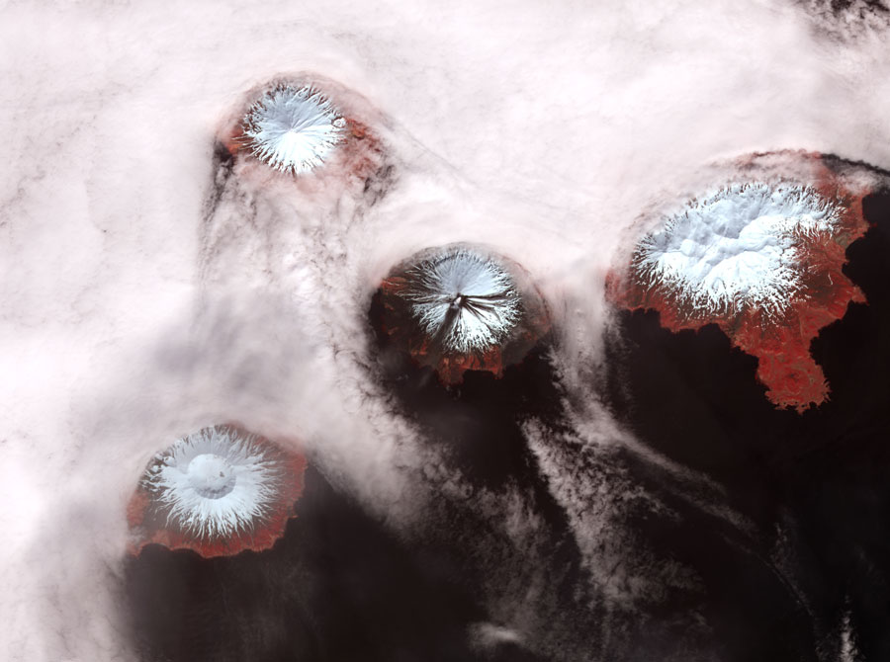
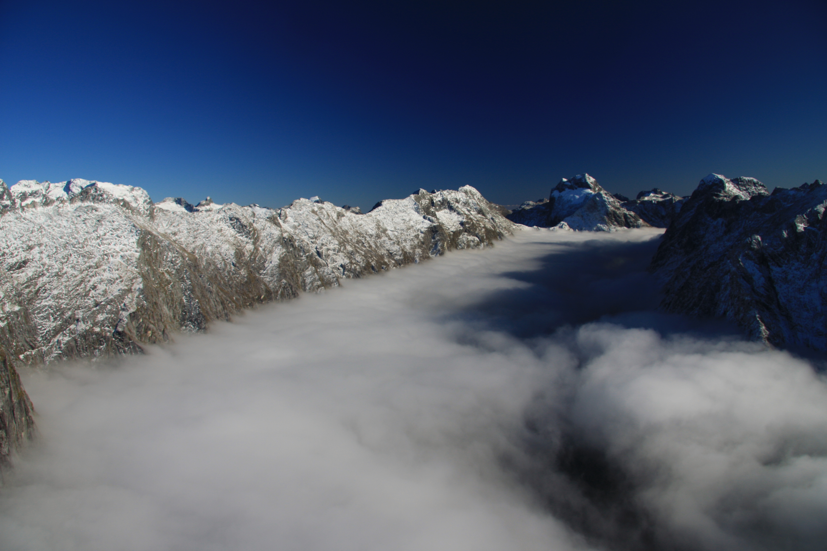
GOES-R Fog/Low Cloud Product
The fog detection algorithm, developed by the GOES-R algorithm working group, uses spectral and textural information to determine fog probability during both day and night.
This is a quantitative approach that returns the probability that MVFR ceilings or lower (e.g., IFR or LIFR) are present.

Slide 6
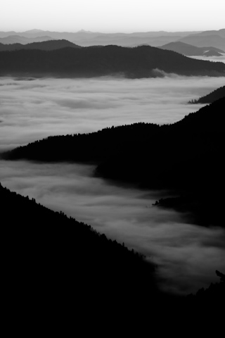
Fog Detection Methodology
What characteristics define fog or low stratus clouds?
Fog/low stratus clouds are close to the surface so the difference between the cloud temperature and the surface temperature should be small
From a satellite perspective these clouds are spatially uniform in both temperature and reflectivity
These clouds are composed of small liquid water particles
The GOES-R fog algorithm is currently not applied to pixels flagged as ice clouds by the GOES-R cloud type algorithm
The GOES-R fog/low stratus detection algorithm uses these characteristics to find areas of fog/low stratus clouds

Slide 7
Fog Detection Methodology
Fog probabilities come from a Bayesian probability model based on satellite comparisons with surface observations of cloud ceiling along with modeled relative humidity (RH).
The variables used to determine fog probability during the daytime differ slightly from those used at night, since reflection of sunlight must also be accounted for during the day.
Daytime fog probability is a function of the spatial uniformity of the 11 μm brightness temperature of the clouds, the temperature difference between the cloud and the surface and the modeled RH
Nighttime fog probability is a function of cloud emissivity at 3.9 μm, the temperature difference between the cloud and the surface and the modeled RH
For more information on the specifics of how the fog probabilities were calculated consult the contacts listed at the end of this presentation

Slide 8
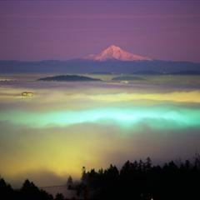
GOES-R Fog Mask
The GOES-R fog mask (yes or no) product was
created to satisfy a requirement for the GOES-R
Algorithm Working Group
The overall satellite-based fog probabilities should have more relevance for forecasters because:
Forecasters are not forced to believe a yes/no answer provided by the fog mask (fog probability gives information on uncertainty)
When combined with their experience and knowledge of the local environment, the fog probabilities should be more useful for helping the forecaster decide where fog/low stratus is likely located
Again, we feel the fog probability product provides more useful information for forecasters than the fog mask

Slide 9
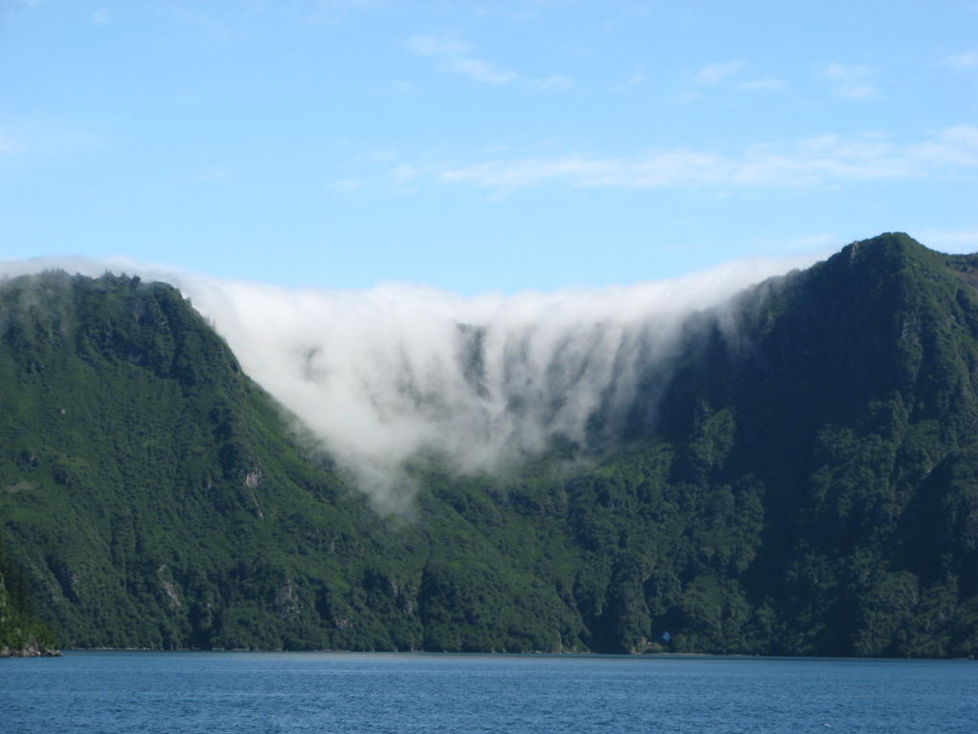
GOES-R Fog Depth
The GOES-R fog depth product was developed for both day and night, however, the daytime methodology requires the liquid water path (LWP) from the GOES-R optical properties code which is not currently available for MODIS
Until the optical properties are made available to MODIS the fog depth will only be available during the night.
The nighttime GOES-R fog depth is determined using an empirical linear relationship between the satellite-derived 3.9 μm cloud emissivity and independent fog thickness measurements
Generally, as the 3.9 μm emissivity decreases the fog thickness increases
As long as a valid 3.9 μm emissivity can be retrieved from the satellite a fog depth can be estimated

Slide 10
Fog Products:
What Is Currently Available

Slide 11
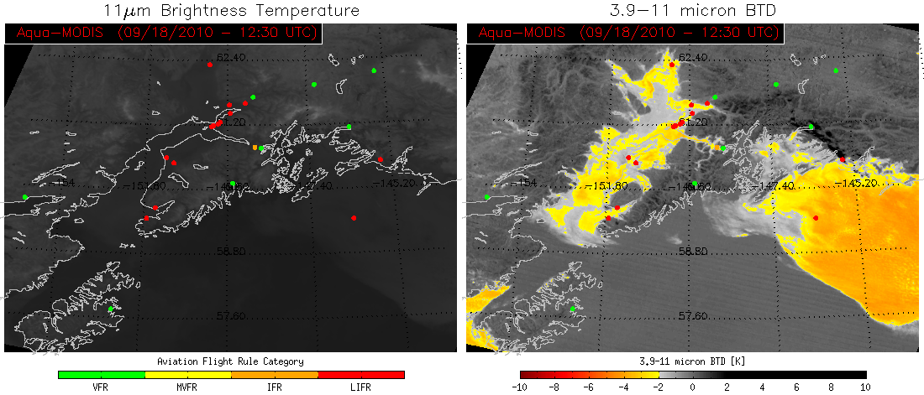
What Is Currently Available
Nighttime
Surface observations
Infrared satellite imagery
3.9–11 micron brightness temperature difference (BTD)
¹Ellrod (1995) determined that areas of fog/low stratus cloud coincided with 3.9-11 micron BTDs below -2 K
Anchorage
¹Ellrod, G. P., 1995: Advances in the detection and analysis of fog at night using GOES multispectral infrared imagery.
Wea. Forecasting, 10, 6006-619.

Slide 12
What Is Currently Available
Anchorage
All surface observations are color-coded to the aviation instrument flight rules category by measured ceiling height (see color bar under 11 μm BT image – left image)
Because fog is usually similar in temperature to the surrounding area, it is frequently hard to see using single channel infrared imagery alone (left image)
The standard -2 K BTD threshold does not always capture the entire area of fog/low stratus. In the right image image above, BTDs less than -2 K are colored in yellow to red. In order to capture all the fog the user would have to to tweak the threshold for each scene, which may then introduce a larger number of false alarms

Slide 13
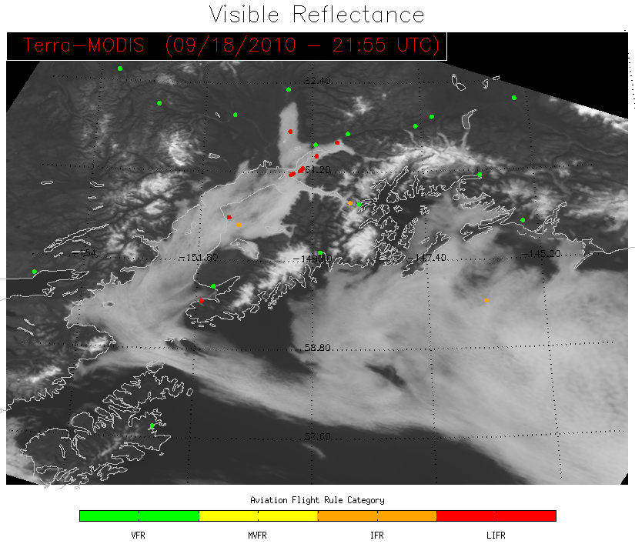
What Is Currently Available
Daytime
Surface Observations
Visible satellite imagery
Anchorage
All surface observations are color-coded to the aviation instrument flight rules category by measured ceiling height (see color bar under visible reflectance image)
The 3.9-11 micron BTD can not be used effectively during the day due to solar contamination in the 3.9 micron channel
There currently is no operational daytime fog/low stratus product available

Slide 14
GOES-R Fog/Low Stratus Product:
What is Provided

Slide 15
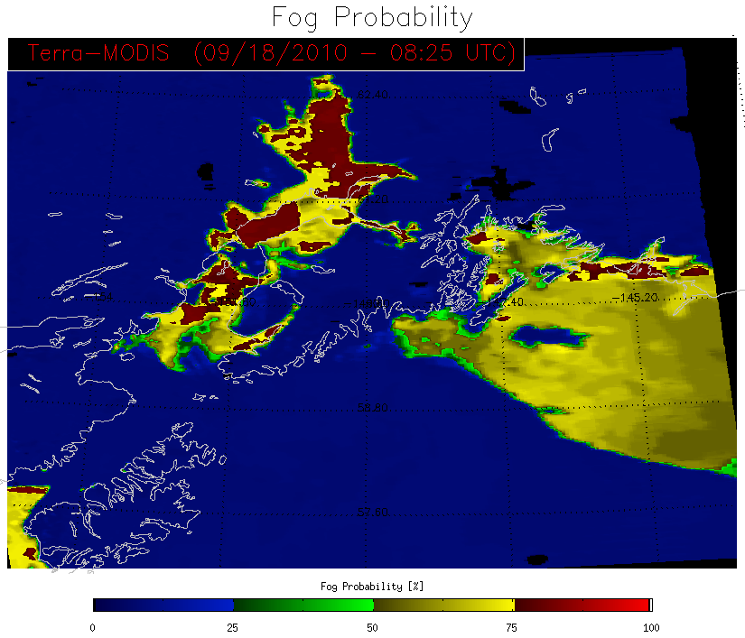
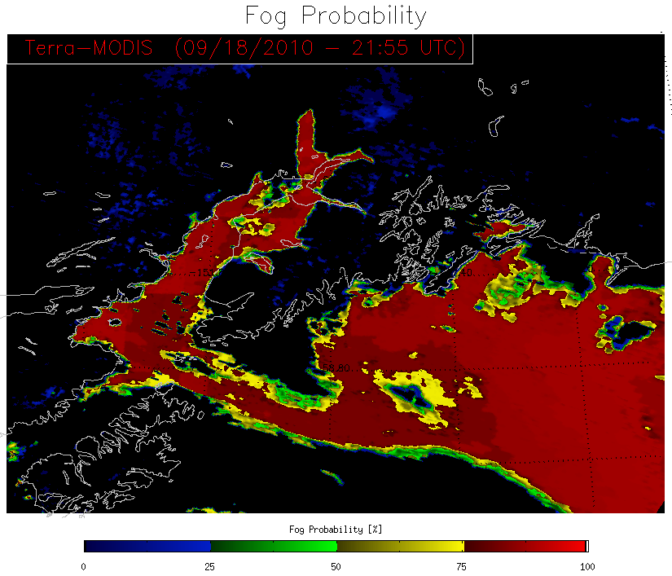
GOES-R Fog/Low Stratus Product
The GOES-R product is not threshold-based like the 3.9-11 micron BTD, but a quantitative probability that fog/low stratus is present
Fog/low stratus detection is available both day and night
Nighttime
Daytime
Anchorage
Anchorage
Kodiak Island
Kodiak Island

Slide 16
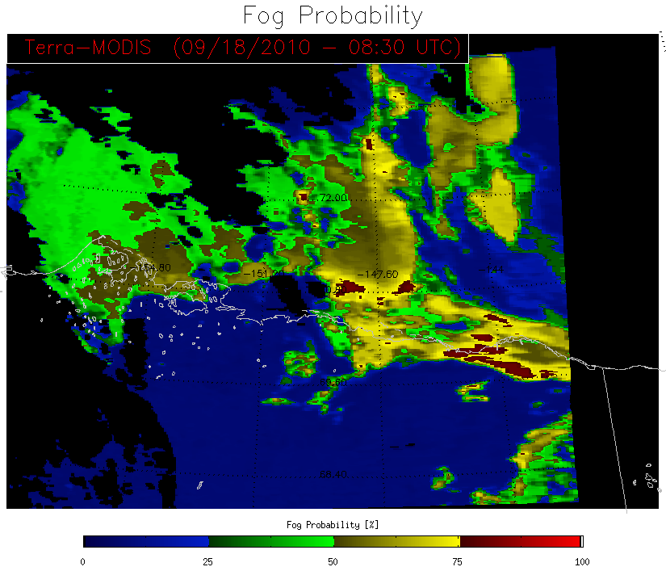
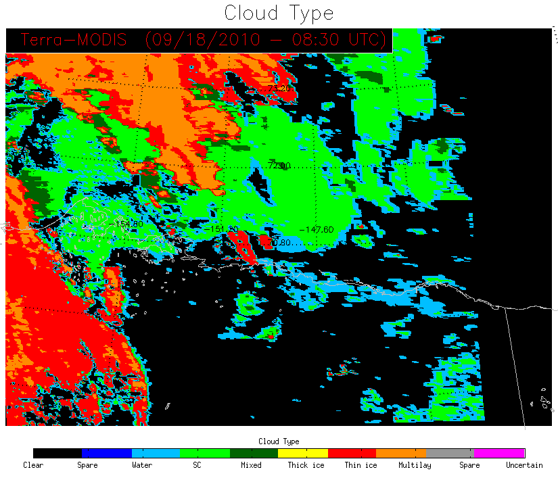
GOES-R Fog/Low Stratus Product
The nighttime GOES-R fog product should always be viewed along with the GOES-R cloud type product. Why is that?
Nighttime fog probability will not be available where ice/overlaying clouds are detected
Note: Without the availability of visible channels at night, the nighttime cloud mask sometimes has trouble detecting all areas of fog/low stratus. For this reason the nighttime fog algorithm is run on all pixels determined to be liquid water, supercooled (SC), mixed phase or clear sky by the GOES-R cloud mask and type algorithms

Slide 17
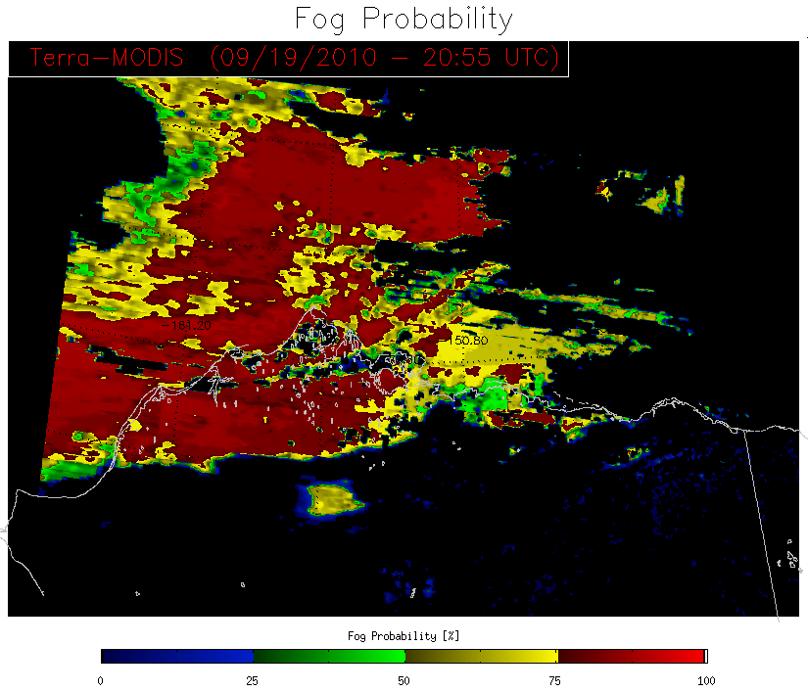
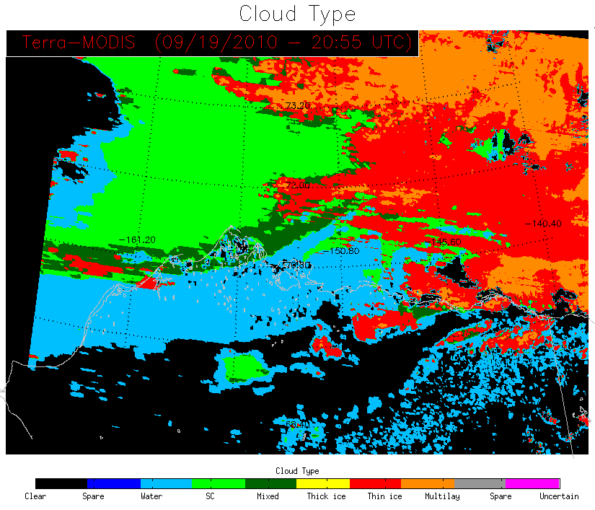
GOES-R Fog/Low Stratus Product
The daytime GOES-R fog product should also always be viewed along with the GOES-R cloud type product. Why is that?
Daytime fog probability is only available where liquid water, supercooled (SC) or mixed phase clouds are determined by the GOES-R cloud type product.
Some fog layers may not fully consist of liquid water, but also contain ice nuclei. For this reason day/night fog probabilities are calculated for mixed-phase clouds.
ICE CLOUD
MIXED PHASE
CLEAR SKY
Note: With the ability to use visible channels during the day, the daytime cloud mask does a good job of detecting areas of fog/low stratus. For this reason the daytime fog algorithm is not run on pixels determined to be clear sky by the GOES-R cloud mask algorithm

Slide 18
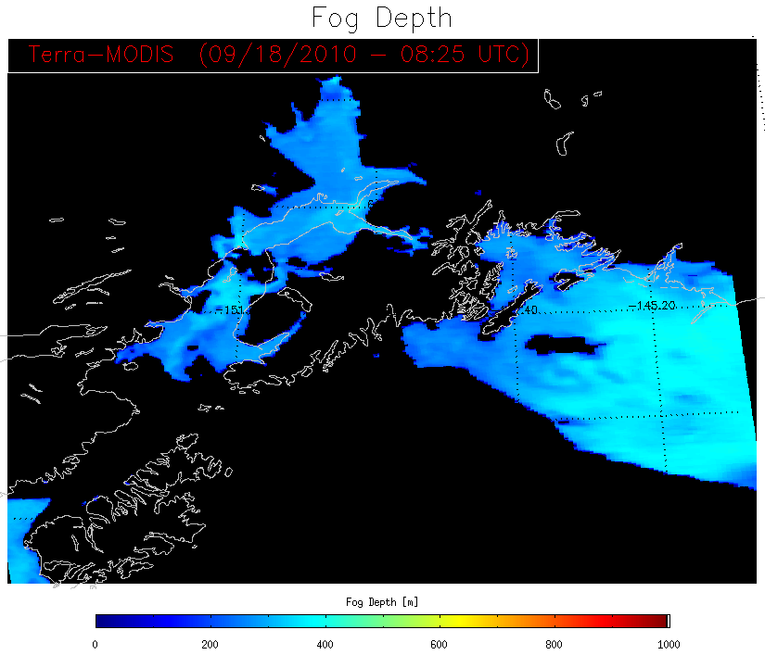
GOES-R Fog/Low Stratus Depth Product
The GOES-R fog/low stratus depth product is currently only available at night.
Once the GOES-R cloud optical properties algorithm is available for MODIS daytime fog depth will also become available
Fog depth is calculated for every nighttime pixel that contains a valid fog probability
For imaging purposes fog depths are only shown when the fog probability is greater than 25%.
Anchorage
Kodiak Island

Slide 19
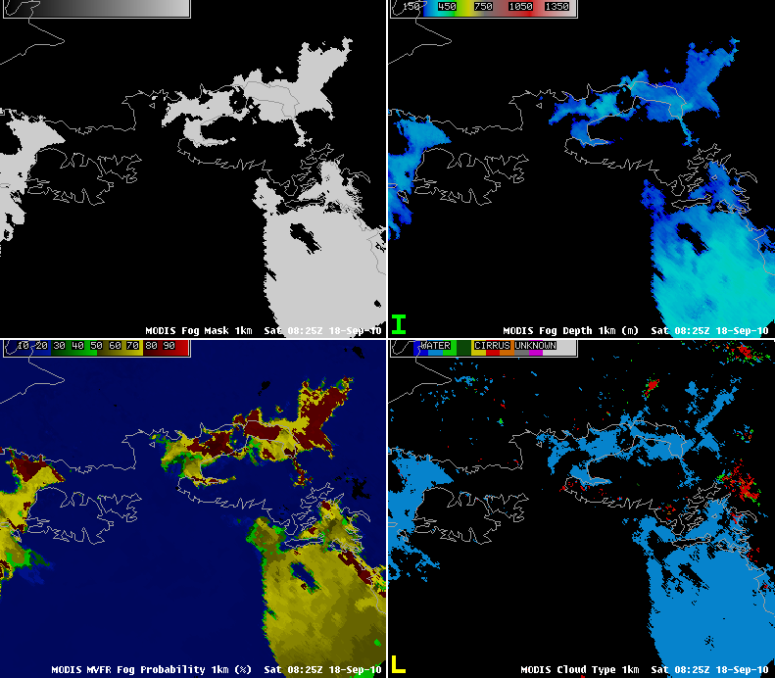
GOES-R Fog/Low Stratus Product In AWIPS
The fog/low stratus probability and depth products are both available via AWIPS as shown in the image to the right.
However, our AWIPS at the Univ. of Wisc. is centered on Madison, WI so imaging Alaska cases sometimes results in oddly rotated images.
For convenience we will replicate what is seen in AWIPS using IDL to reduce confusion when viewing the examples.
Note that color bars shown in the IDL images are the same ones a forecaster will see when using AWIPS (see image).
Anchorage
Anchorage
Kodiak Island
Kodiak Island
Anchorage
Anchorage
Kodiak Island
Kodiak Island
All GOES-R fog/low stratus products as seen in AWIPS
The next several slides will show 4-panel images followed by a series of the same, enlarged single images that can be toggled through for easy comparison

Slide 20
GOES-R Fog/Low Stratus Algorithm:
Nighttime Examples

Slide 21
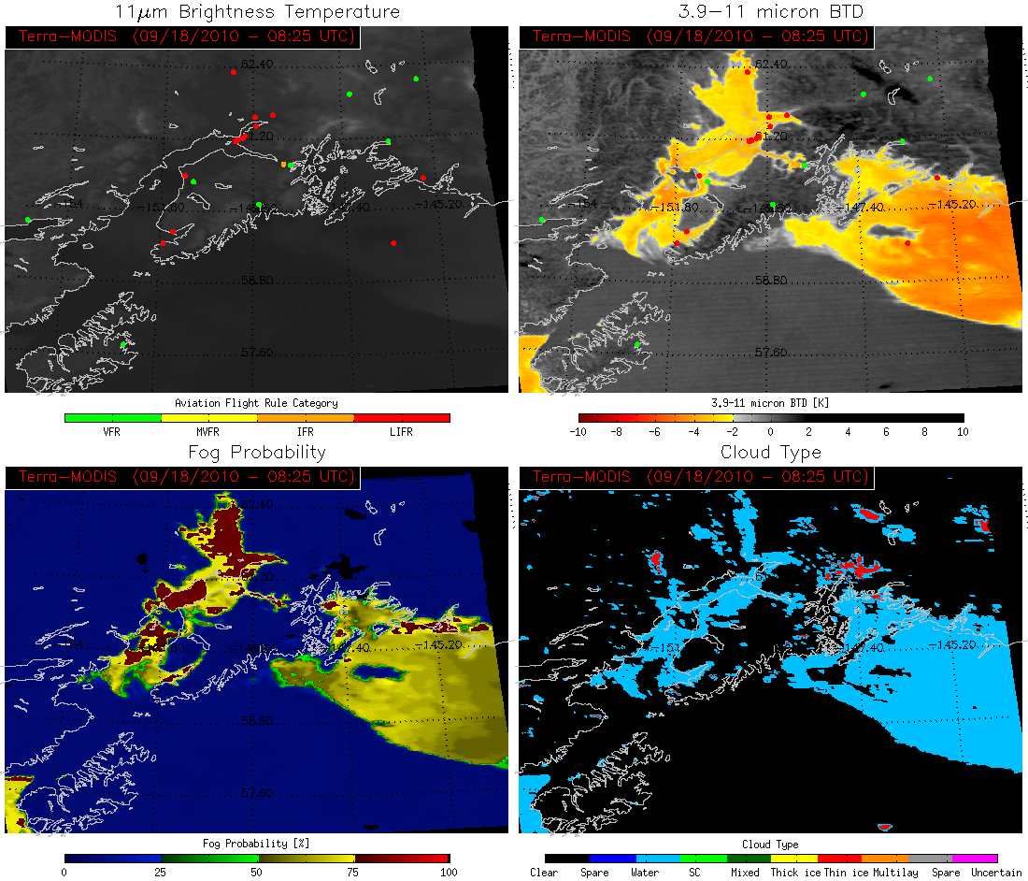
Anchorage
Kodiak Island

Slide 22
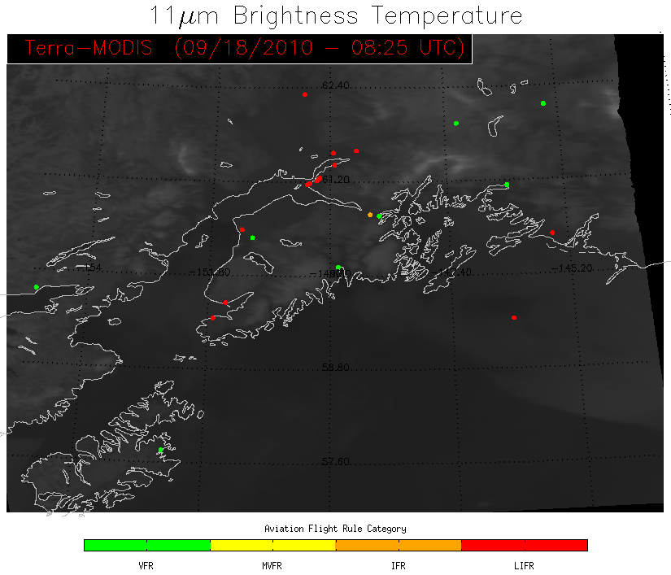
Anchorage
Prince William Sound
Using thermal imagery alone it is very difficult to find areas of fog/low stratus clouds accurately
Kodiak Island

Slide 23
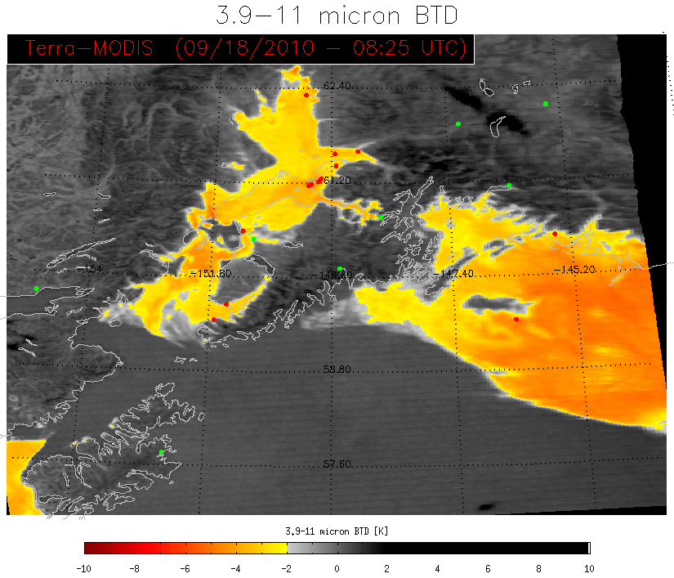
Anchorage
Prince William Sound
The GOES-R fog product is in general agreement with BTD threshold. Both show a low false alarm rate in absence of clouds and good agreement with surface observations
Kodiak Island

Slide 24
Anchorage
Prince William Sound
The GOES-R fog product is in general agreement with BTD threshold. Both show a low false alarm rate in absence of clouds and good agreement with surface observations
Kodiak Island

Slide 25
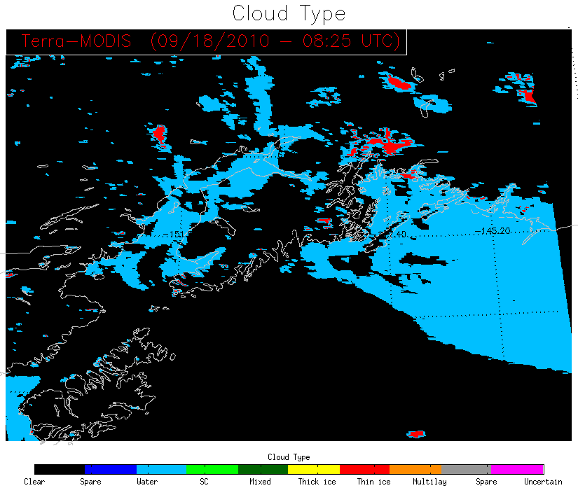
Anchorage
Prince William Sound
The GOES-R fog product is in general agreement with BTD threshold. Both show a low false alarm rate in absence of clouds and good agreement with surface observations
Kodiak Island

Slide 26
Anchorage
Prince William Sound
Once again, fog depth product only shown when the probability is greater than 25%
Kodiak Island

Slide 27
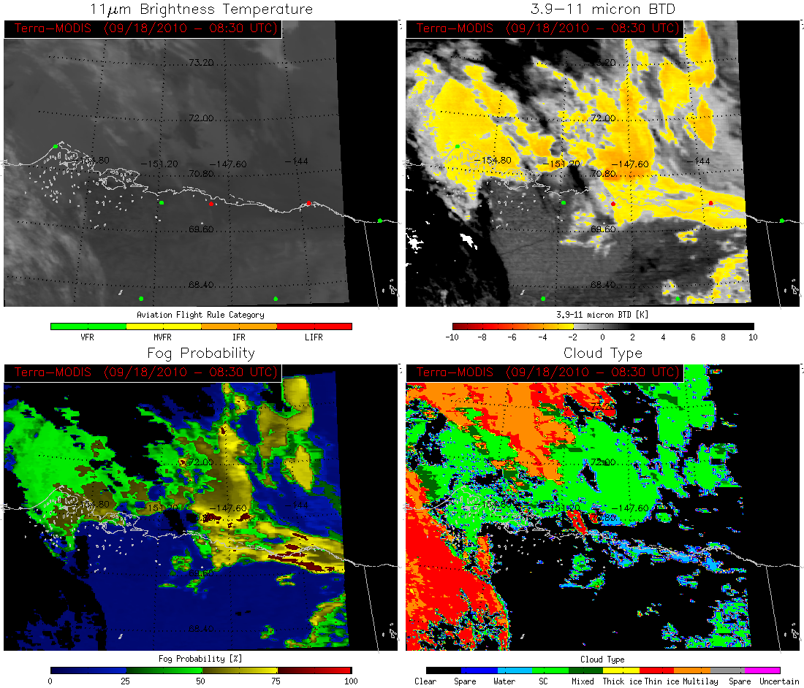
Arctic Ocean
Area of interest
Barrow
Deadhorse

Slide 28
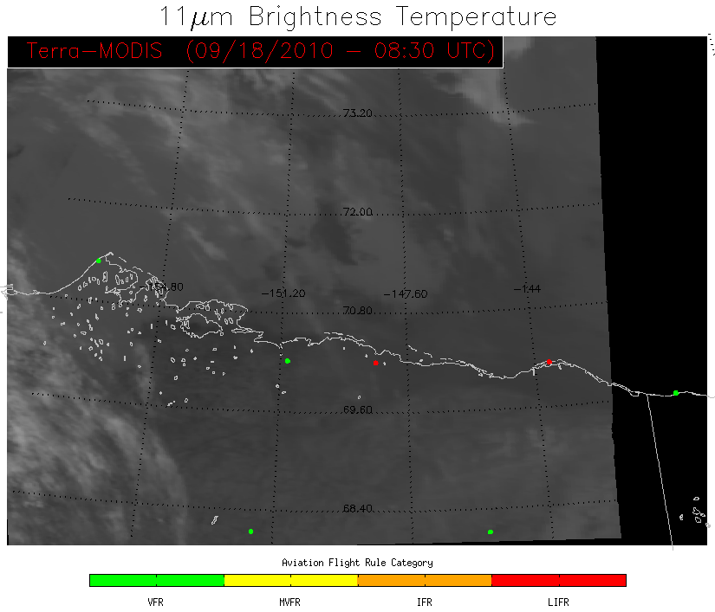
Arctic Ocean
Barrow
Surface observation at Barrow (in middle of apparent fog/low stratus deck) shows VFR conditions
Deadhorse

Slide 29
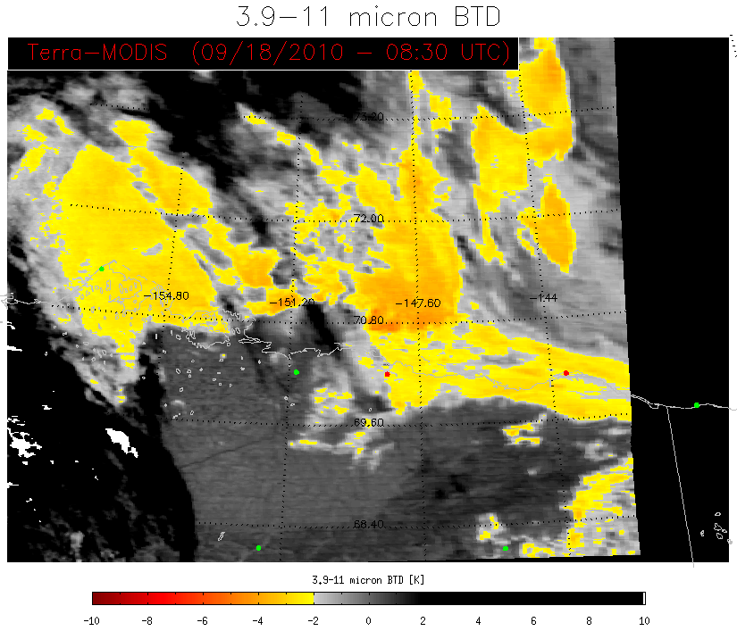
Barrow
BTD fog product would indicate fog/low stratus clouds are present inside the circled area
Deadhorse

Slide 30
Barrow
GOES-R fog product also picks up on fog/low stratus signal, however, the lower probability indicates less confidence that this area meets MVFR criteria. A forecaster looking for hazardous low stratus clouds could use this information to infer that only part, if any, of this area poses a hazard
Deadhorse

Slide 31
Barrow
Deadhorse

Slide 32
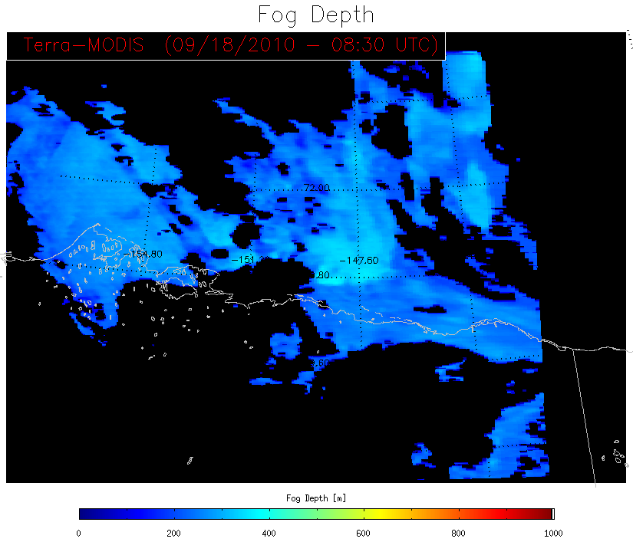
Barrow
Deadhorse

Slide 33
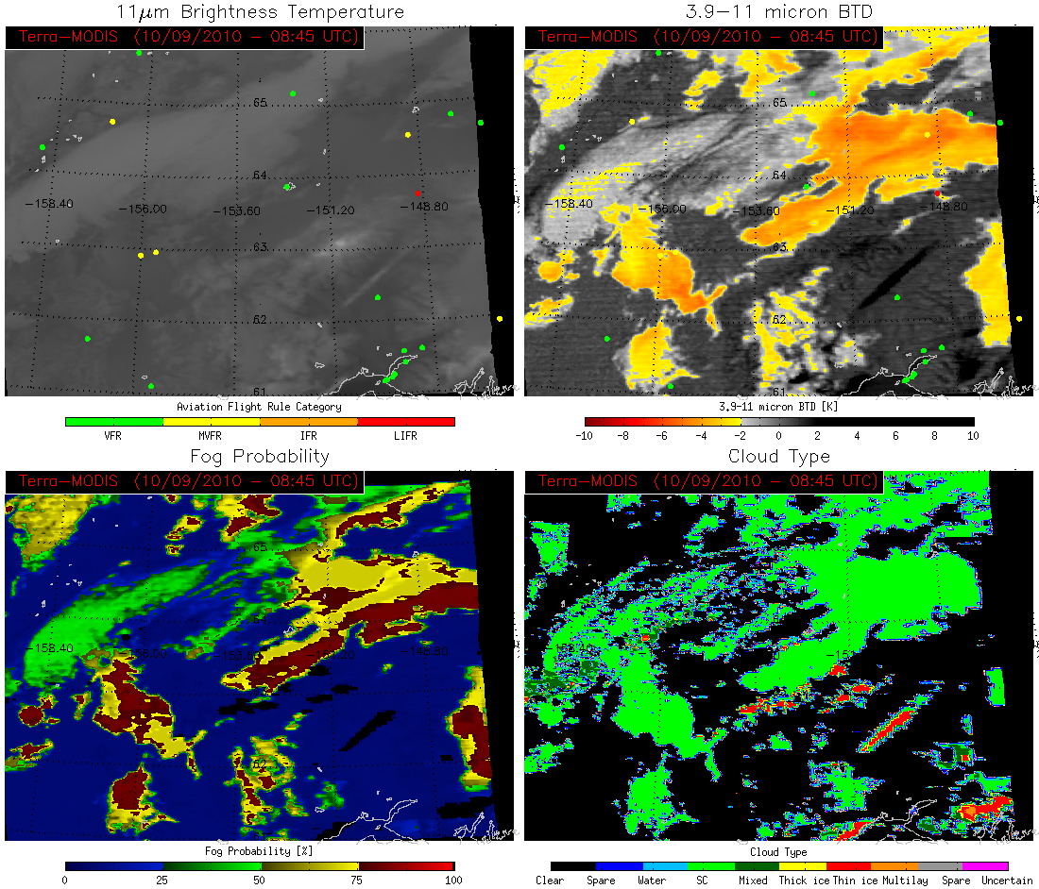
Galena
Fairbanks
Anchorage

Slide 34
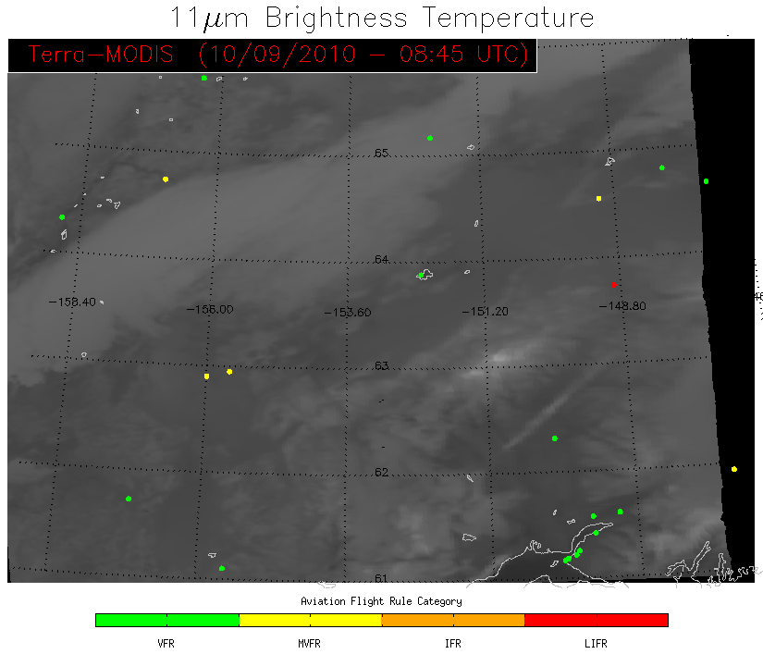
Galena
Fairbanks
Surface observations are not always located in areas with fog/low stratus clouds
Anchorage

Slide 35
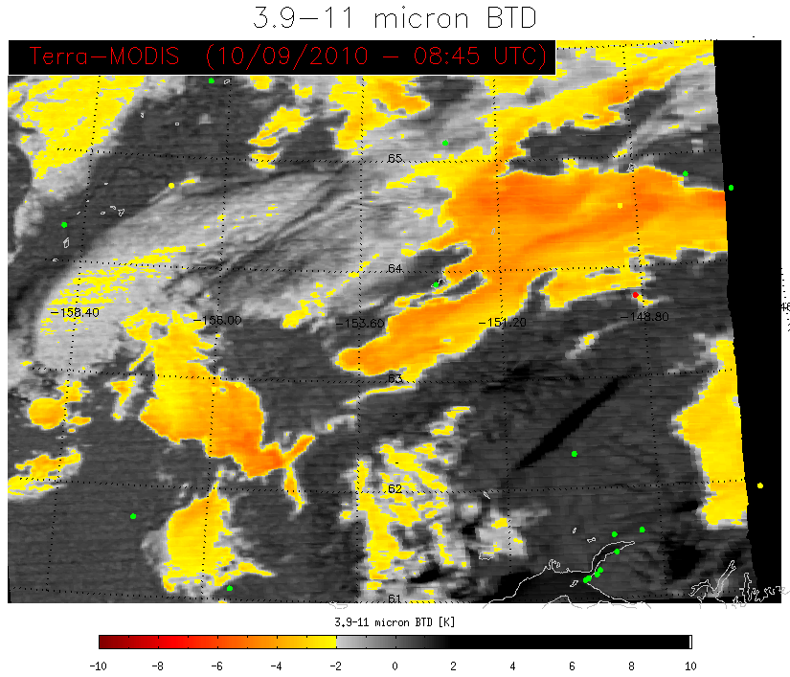
Galena
Fairbanks
In this case the BTD and GOES-R products are similar, but the GOES-R fog probability again provides a forecaster with a confidence level rather then just a threshold
Anchorage

Slide 36
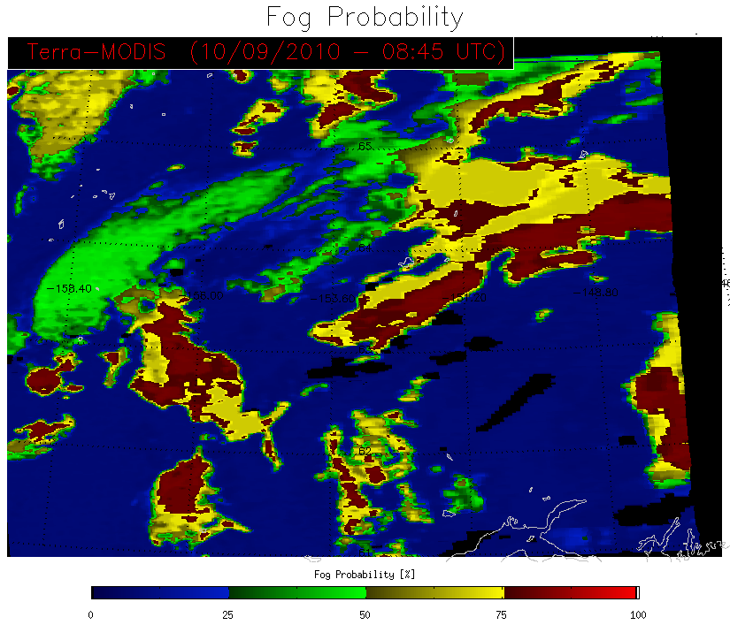
Galena
Fairbanks
In this case the BTD and GOES-R products are similar, but the GOES-R fog probability again provides a forecaster with a confidence level rather then just a threshold
Anchorage

Slide 37
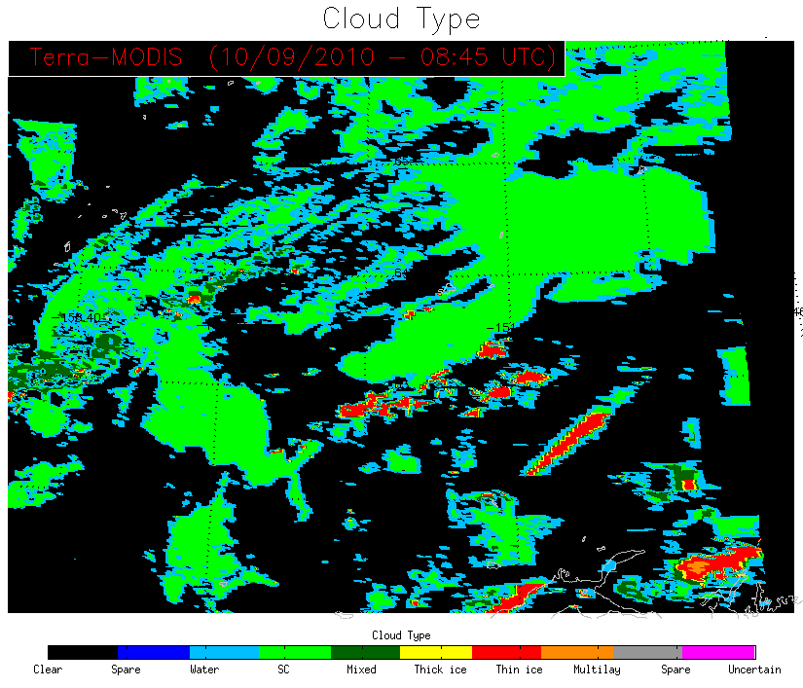
Galena
Fairbanks
In this case the GOES-R cloud type algorithm indicates most of the clouds in the area consist of supercooled water, possibly indicating an icing hazard for aviation
Anchorage

Slide 38
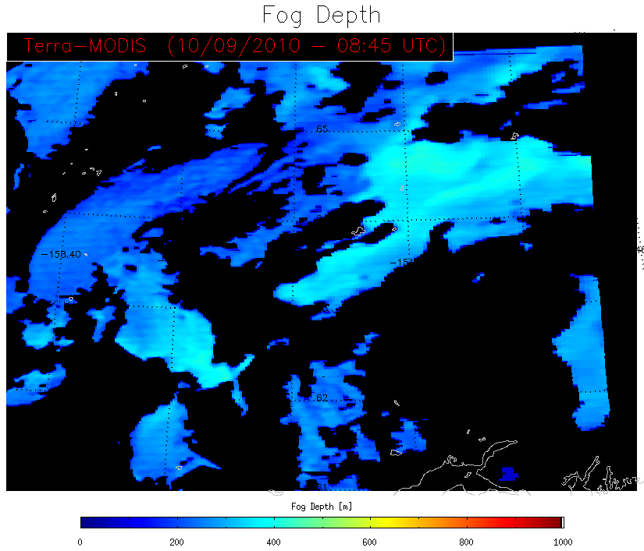
Galena
Fairbanks
Anchorage

Slide 39
GOES-R Fog/Low Stratus Algorithm:
Daytime Examples

Slide 40
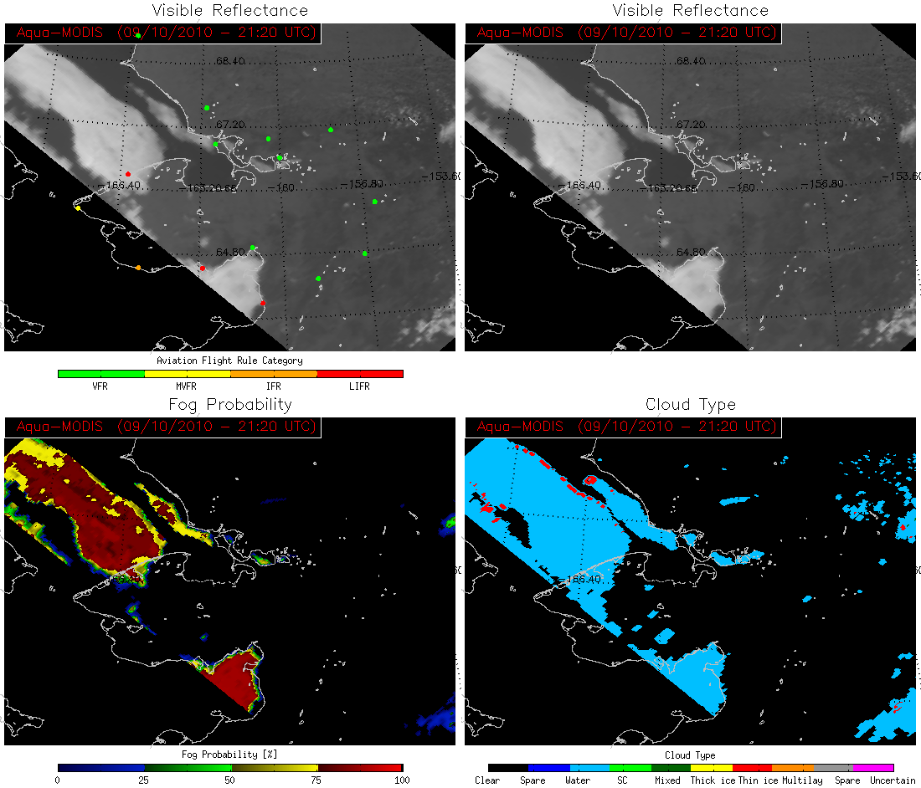
Point Hope
Ambler
Nome

Slide 41
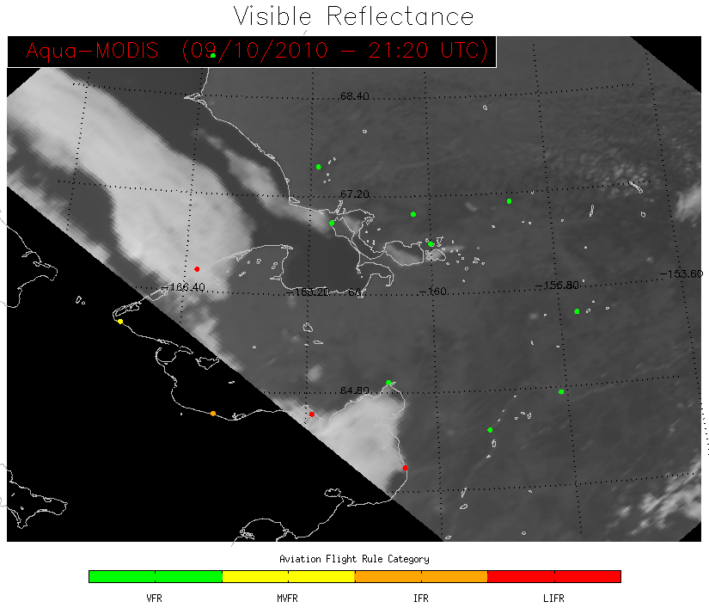
Point Hope
Surface observations of LIFR conditions show areas of fog/low stratus cloud
Ambler
Nome

Slide 42
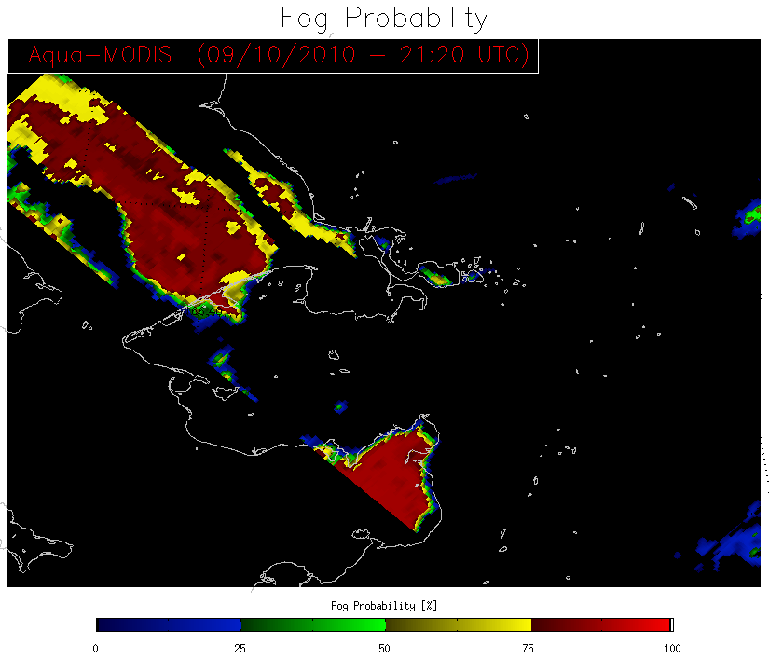
Point Hope
GOES-R fog product accurately detects these areas providing a forecaster with high confidence that fog/low stratus is present and where the boundaries are located
Ambler
Nome

Slide 43
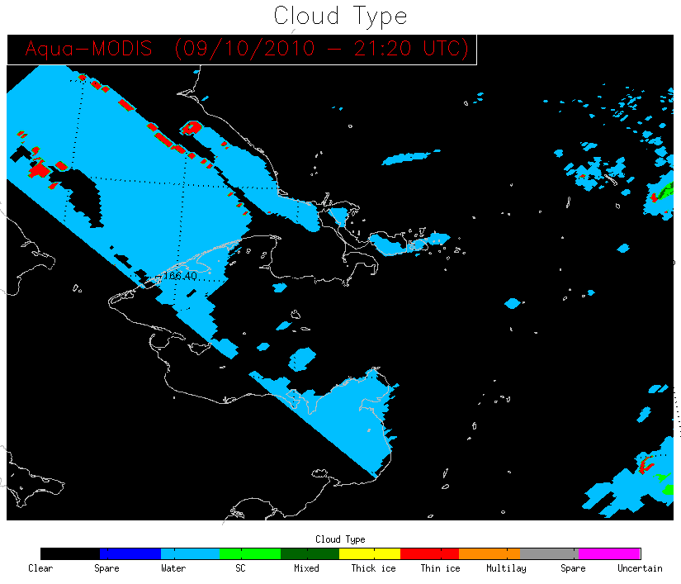
Point Hope
GOES-R cloud type algorithm indicates that the fog/low stratus clouds in this scene are composed of liquid water
Ambler
Nome

Slide 44
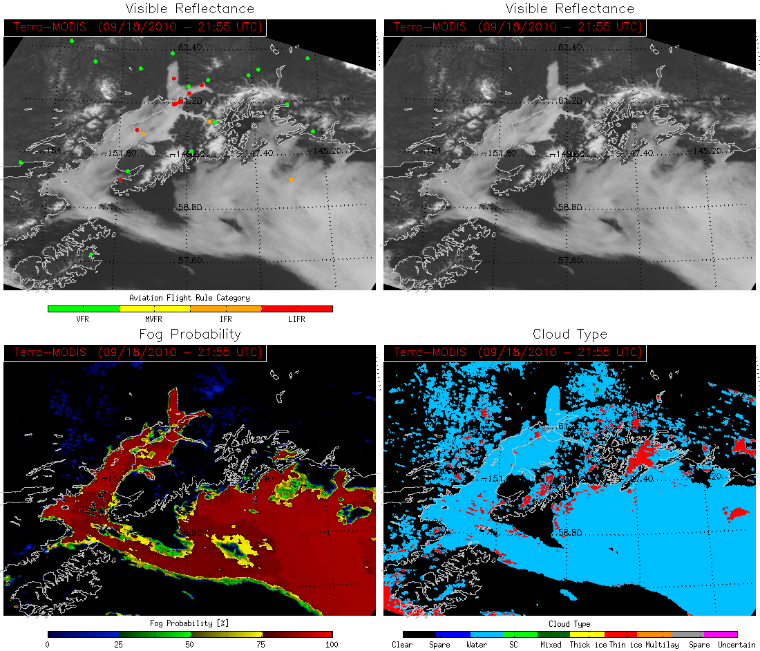
Anchorage

Slide 45
Anchorage
Circled areas contain snow with no clouds
Surface observations confirm this cloud deck is fog/low stratus

Slide 46
Anchorage
GOES-R fog product accurately detects these areas with high confidence that fog/low stratus is present while minimizing false alarms in areas of snow or clear sky

Slide 47
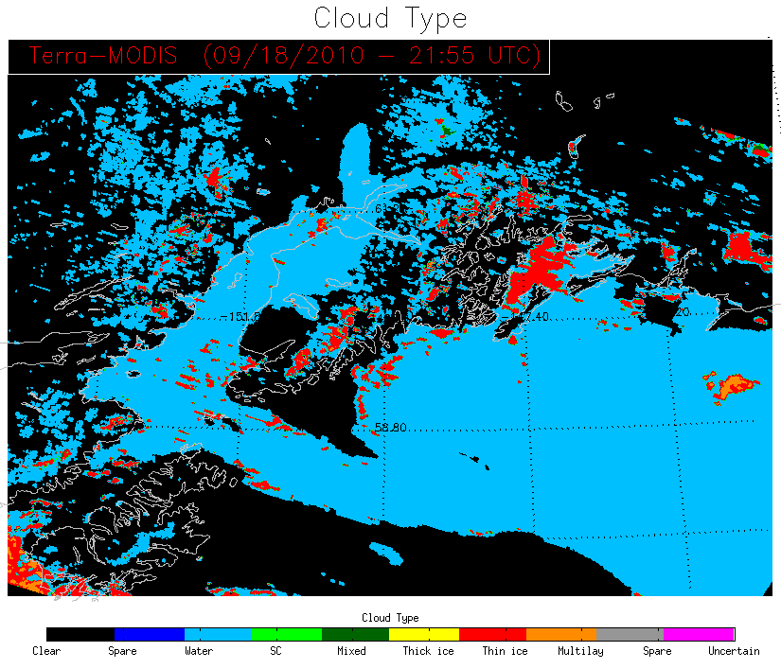
Anchorage
Where the GOES-R cloud mask algorithm (and therefore cloud type algorithm) detects clouds falsely, the GOES-R fog product returns low probabilities that tell a forecaster fog/low stratus is not likely present

Slide 48
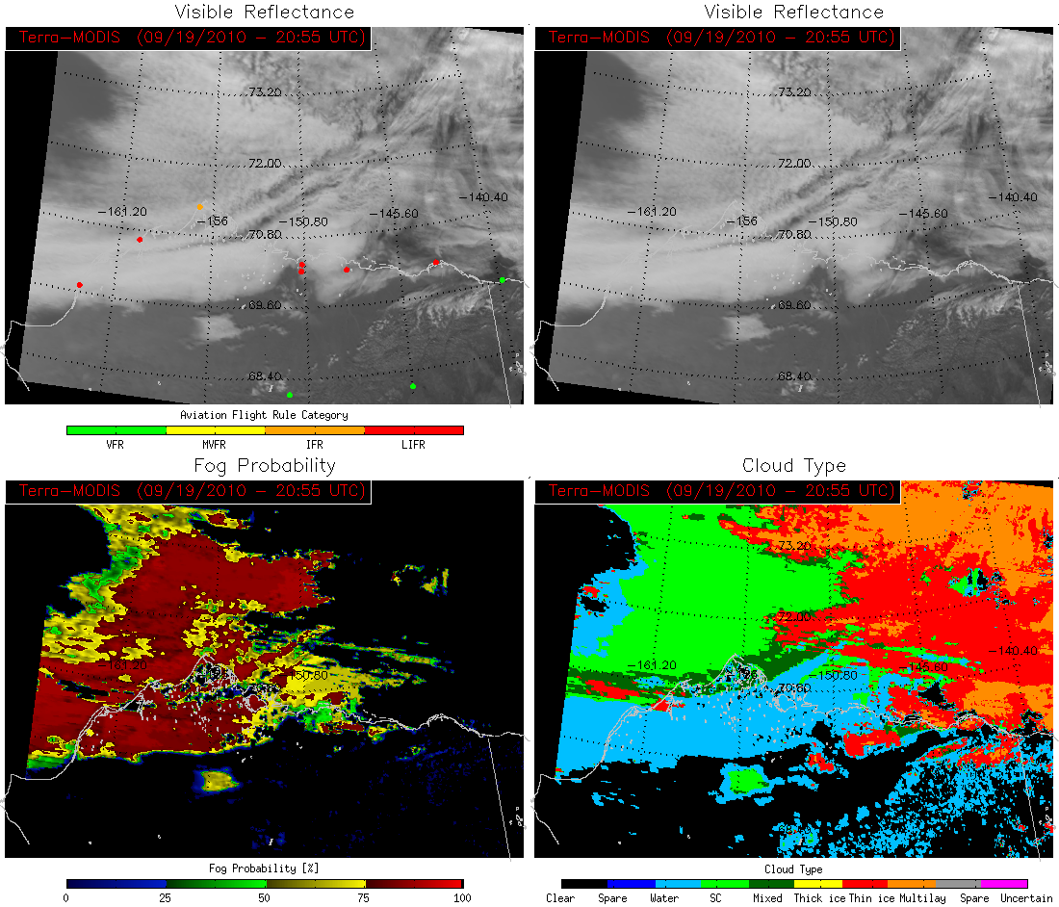
Barrow

Slide 49
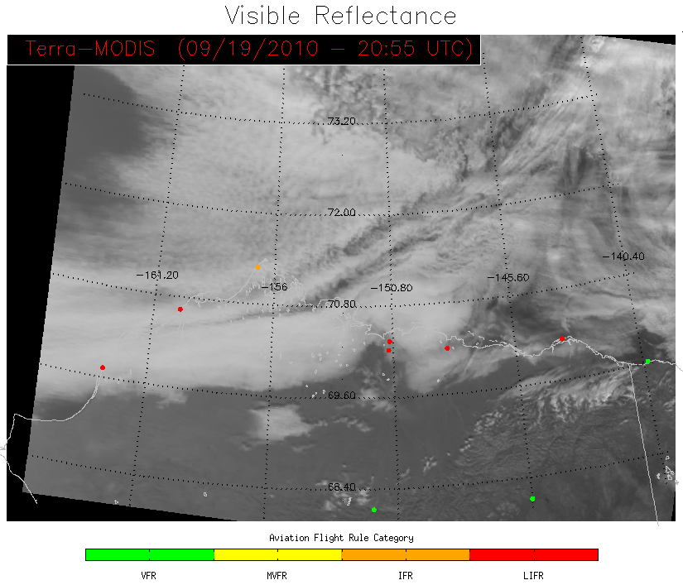
Cirrus
Large area of thin cirrus cloud appears over right side of this scene with fog/low stratus deck (indicated by surface observations) along the northern coast of Alaska
Barrow

Slide 50
Barrow
GOES-R fog product accurately detects the fog/low stratus clouds with high confidence where cirrus clouds are not present

Slide 51
GOES-R cloud type algorithm indicates a large portion of the fog/low stratus deck detected consists of supercooled water which may pose an icing hazard
Barrow

Slide 52
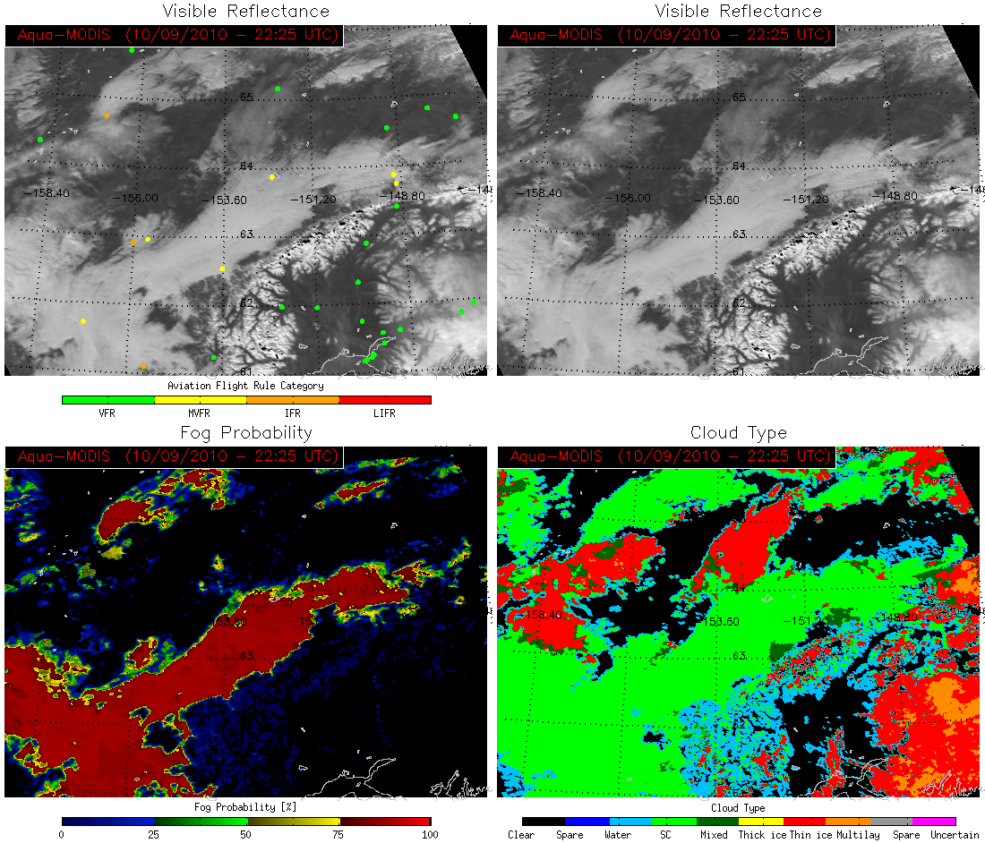
Fairbanks
Tatalina AFS
Anchorage

Slide 53
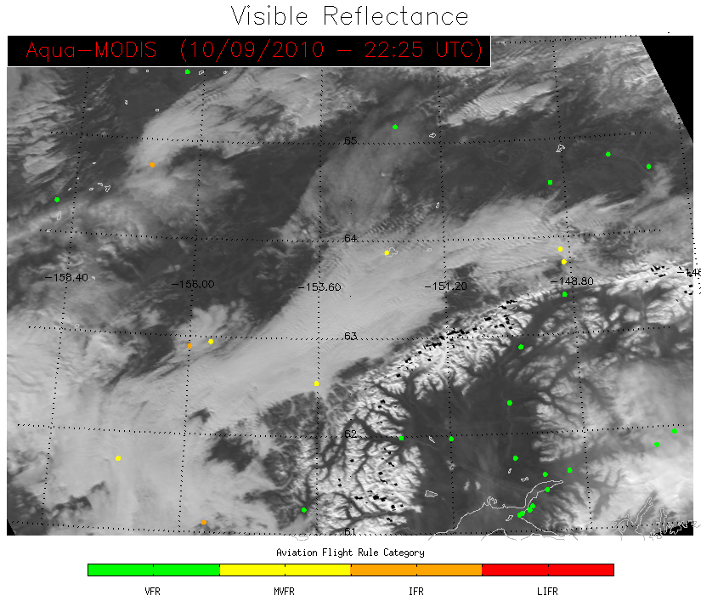
Large area of stratus clouds that, according to surface observations, contain MVFR conditions
Fairbanks
Tatalina AFS
Anchorage

Slide 54
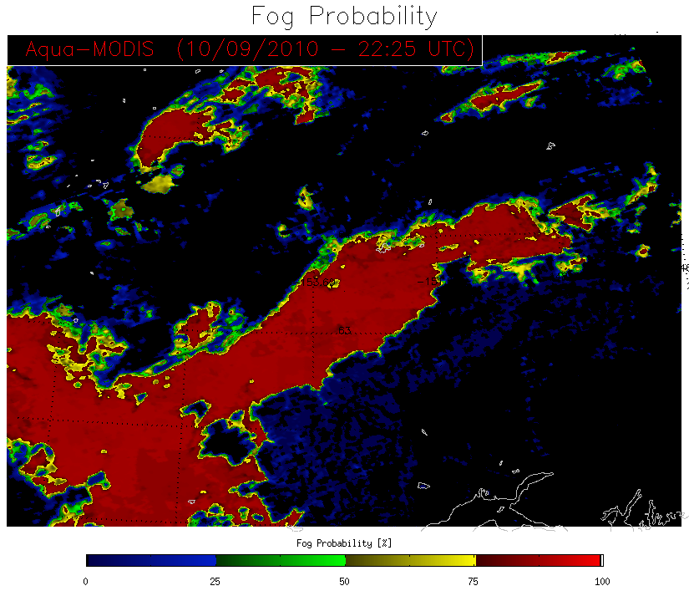
Fairbanks
Tatalina AFS
GOES-R fog product detects the stratus deck where surface obs indicate MVFR or lower conditions while showing little to no confidence of there being fog/low stratus where surface obs indicate VFR conditions
Anchorage

Slide 55
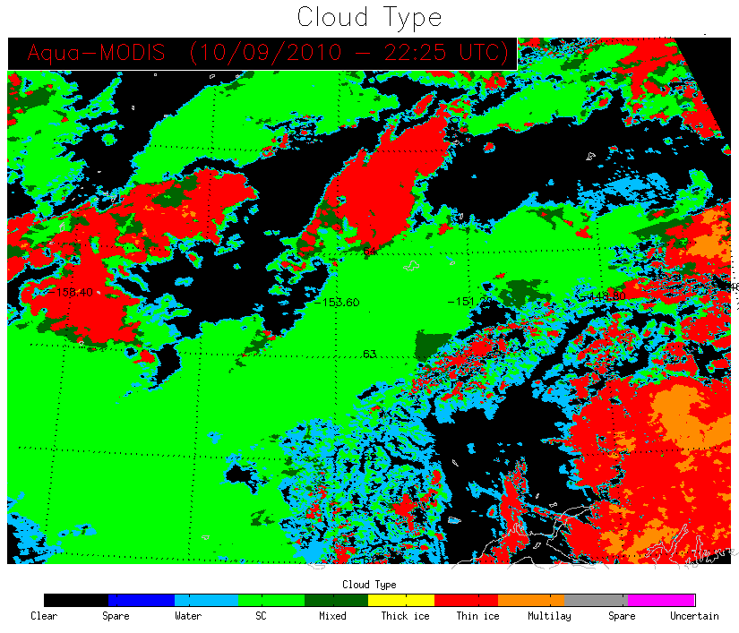
GOES-R cloud type algorithm indicates a large portion of the low stratus deck consists of supercooled water which may pose an icing hazard
Fairbanks
Tatalina AFS
Anchorage

Slide 56
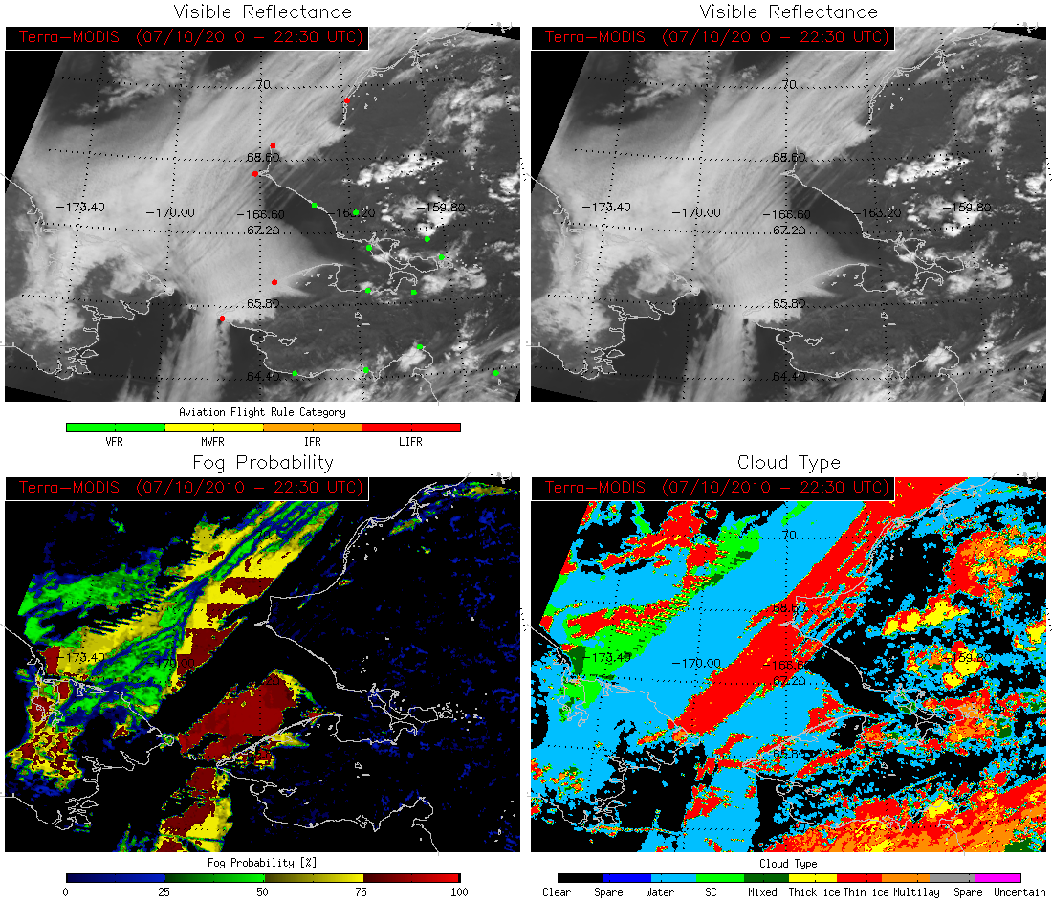
Point Lay
Russia
Nome

Slide 57
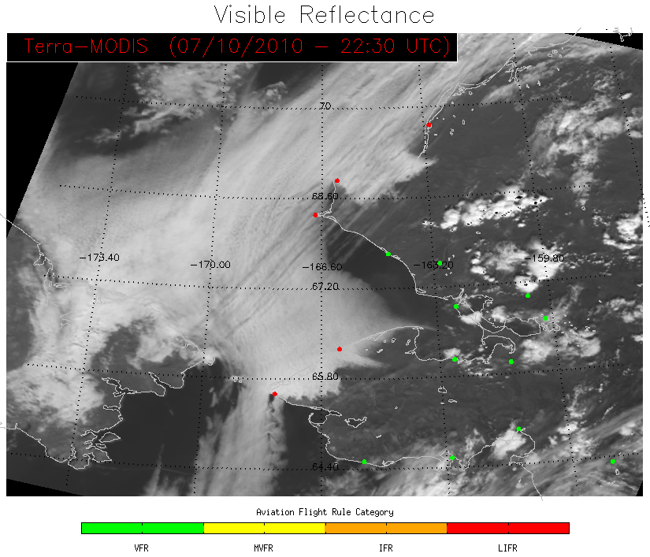
This scene contains a large area of fog/low stratus with overlaying cirrus clouds. The GOES-R fog/low stratus product will only work when the fog/stratus clouds are the highest cloud layer.
Point Lay
Russia
Nome

Slide 58
Point Lay
Although surface obs indicate that LIFR conditions are present the GOES-R fog/low stratus algorithm will not return a probability because the cloud type algorithm detected ice cloud. In this case it would be in a forecaster’s better interest to look at the visible image and see that the fog is visible through the thin cirrus clouds and assume the fog probability under this cirrus layer is similar to the areas on either side
Russia
Nome

Slide 59
The GOES-R cloud type algorithm shows the cirrus streak starting over Eastern Russia and running along the NW Alaska coastline
Point Lay
Russia
Nome

Slide 60
Primary Limitations
The methodology used to detect fog in the day/night terminator is still under development.
Passive sensor based algorithms can only detect fog when fog is the highest cloud layer.
Although there is a method for retrieving daytime fog depth that uses cloud liquid water path, daytime fog depth calculations for MODIS are currently not available due to the unavailability of MODIS daytime optical properties.

Slide 61
Known
Strengths
Replaces the commonly-used qualitative 3.9-11 μm brightness temperature difference method for detecting fog/low stratus that can only be used during the night.
Provides a quantitative probability that each non-ice pixel contains fog/low stratus clouds (MVFR criteria of cloud ceiling < 3000 ft)
The GOES-R fog/low cloud algorithm is available during both day and night (except in the small terminator region where the day/night transition occurs)
Products are generated within minutes of receiving satellite data

Slide 62
Near-Term Improvements
Currently a single fog probability is providing the probability that MVFR conditions (ceiling < 3000 ft) are present for each pixel. A second fog probability will soon also be available that will give the probability that IFR (including LIFR) conditions (ceiling < 1000 ft) are present.
A high resolution (1 km) terrain map will be used to help detect areas where terrain rises into elevated liquid cloud layers thus creating localized MVFR/IFR conditions
Once daytime cloud optical properties are available for MODIS the daytime fog depth product will also be incorporated
End user feedback is essential and will be used to guide future improvements

Slide 63
What You Should Know by the End of Training
Which GOES-R fog/low cloud algorithms are available within AWIPS
Product interpretation through examples of interest in Alaska
Strengths and limitations of the fog/low cloud product
Future improvements for the fog/low cloud algorithm

Slide 64
Contact
Questions? Suggestions?
Contact:
Michael Pavolonis (Mike.Pavolonis@noaa.gov)
Corey Calvert (Corey.Calvert@ssec.wisc.edu)

