Slide 1
NOAA GOES-R Air Quality Proving Ground (AQPG) Advisory Group Workshop September 14, 2010 University of Maryland, Baltimore County (UMBC)
Raymond M. Hoff, UMBC
Shobha Kondragunta, NOAA NESDIS
Sundar Christopher, University of Alabama - Huntsville
Amy K. Huff, Battelle

Slide 2
Purpose of the Workshop
The AQPG has assembled an Advisory Group of air quality forecasters and analysts to provide input on GOES-R air quality products.
The workshop was a forum for the AQPG technical team and Advisory Group to meet and discuss the latest work on the project.
The Advisory Group also had the opportunity to review AQPG case studies and examples of simulated GOES-R ABI data.
The Advisory Group provided feedback on simulated ABI data and discussed options for an internet delivery system for GOES-R air quality products.

Slide 3
Workshop Participants
39 air quality experts participated in the workshop:
15 state/local air quality forecasters from across the country
2 air quality modelers
3 EPA staff, representing OAQPS, Region 3, and the National Exposure Research Laboratory
3 NOAA National Weather Service staff
10 AQPG team members
6 additional NOAA NESDIS staff

Slide 4
Morning: Overview of GOES-R and AQPG
To give the participants background on the AQPG project, the workshop opened with talks on the GOES-R satellite, ABI, and simulated ABI data:
NOAA’s GOES-R Proving Ground (Steve Goodman, NOAA NESDIS)
Overview of the GOES-R Satellite and ABI (Mitch Goldberg, NOAA NESDIS)
Air Quality Products from the ABI (Shobha Kondragunta, NOAA NESDIS)
Development of Proxy ABI Data for the AQPG (Brad Pierce, NOAA NESDIS)
Case Studies of Simulated ABI Data (Ray Hoff, UMBC)

Slide 5
Special Presentations by AQ Forecasters
To help the AQPG team understand user needs, air quality forecasters gave a series of presentations about air quality forecasting and analysis across the country. The talks highlighted how satellite observations fit into the forecasting process:
Overview of Air Quality Forecasting (Bill Ryan, Penn State University - Philadelphia, PA forecaster)
East Coast Forecasting Considerations (Duc Nguyen, Maryland Department of the Environment)
Lake Michigan/Midwest Forecasting Issues (Bill Adamski, Wisconsin Department of Natural Resources)
Satellite Data for Forecasting – a West Coast Perspective (Kevin Durkee, South Coast Air Quality Management District)
A Recent PM_{2.5} Episode over Georgia (Bill Murphey, Georgia Department of Natural Resources)

Slide 6
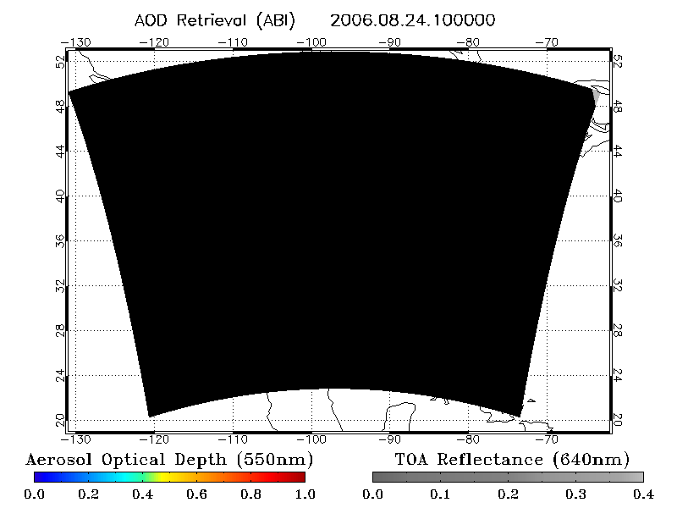
Breakout Session: Review of Case Study Data
Participants broke into groups of 2-3 and reviewed a Power Point file that contained simulated ABI AOD data and supplemental information about an air quality event on 8/24/06.
Participants answered questions on a worksheet about the temporal and spatial resolution, latency, geographic coverage, visualization, and formatting of ABI data.

Slide 7
Afternoon: Group Discussions
After participants reviewed simulated ABI data, the AQPG team led a group discussion about users’ needs and the ABI data. User requests include:
15-30 min temporal resolution
2 km spatial resolution
30 min - 1 hr data latency
loops and still images of data
geographic coverage of the CONUS, Canada, Mexico and Central America; ability to zoom-in on areas of interest
access to ABI data validation information (accuracy, bias)
easy access to archived ABI data/images

Slide 8
Feedback from Workshop Participants
The participants really enjoyed the workshop! They praised the content, organization, and meeting facilities.
What was your favorite part of the workshop?
NOAA and EPA participants thought that the presentations by the AQ forecasters were most useful.
The AQ forecasters/modelers liked the review of simulated ABI data and the group discussions the best.
What was your least favorite part of the workshop?
Many participants had no “least favorite” part – they liked everything.
Some participants felt the presentations on GOES-R and the ABI were too technical, while others thought they were too simplistic.

Slide 9
Feedback from Workshop Participants
Based on your experience at this year’s workshop, will you attend next year?
Almost all of the participants indicated that they will attend the follow-up workshop in September 2011.
Participants stressed the importance of travel funding from NOAA – without funding, most could not attend the workshop.
Please list any suggestions for improving the workshop.
The majority of participants had no suggestions.
Several participants asked for more case studies of ABI data.
One participant requested a presentation on IT considerations (data rates, gigabytes per day, storage requirements, archive requirements, file size).
One participant requested more information about the technical principles of reflectance in each ABI band and the applications for each band.

Slide 10
Next Steps for the GOES-R AQPG
We expect to hold at least one training on simulated ABI data for end users at a major conference (possibly the 2011 National Air Quality Conference).
We will conduct the second annual AQPG Advisory Group workshop in September 2011, likely at UMBC, to discuss advances in the project.
In summer 2011, we plan to have an AQPG testbed running for a 1-2 week intensive period. The testbed will provide simulated ABI data in near real-time, which we will provide to select members of the Advisory Group for their feedback.

Slide 11
Acknowledgements
Steve Goodman
Mitch Goldberg
Brad Pierce
Mark Ruminski and Matt Seybold
Chuanyu Xu and Pubu Ciren
Funding provided by NOAA grants:
NA09NES4400022 (2009-2010)
NA10NES4280016 (2010-2011)

