Slide 1
JCSDA-HFIP and -ECMWF Workshop Recommendations
Lars Peter Riishojgaard
and
Sid Boukabara
Joint Center for Satellite Data Assimilation

Slide 2
Overview
JCSDA Introduction
JCSDA-ECMWF Workshop on Clouds and Precipitation
JCSDA-HFIP Workshop on Satellite Data Assimilation and Hurricane Forecasting
Summary and Conclusions

Slide 3
JCSDA Partners, Vision, Mission
NOAA/NESDIS
NOAA/NWS
NASA/Earth Science Division
NOAA/OAR
US Navy/Oceanographer and
Navigator of the Navy and NRL
US Air Force/Director of Weather
Vision:
An interagency partnership working to become a world leader in applying satellite data and research to operational goals in environmental analysis and prediction
Mission:
…to accelerate and improve the quantitative use of research and operational satellite data in weather, ocean, climate and environmental analysis and prediction models.

Slide 4
JCSDA Mode of operation
Directed research
Carried out by the partners
Mixture of new and leveraged funding
JCSDA plays a coordinating role
External research
Grants or contracts awarded following proposals submitted to one of the JCSDA partners (administrative responsibility rotates between agencies)
Funding typically pooled from more than one agency and/or program
Open to the broader research community
Funding awarded competitively, peer review process
Visiting Scientist program

Slide 5
JCSDA Science Priorities
Overarching goal: Help the operational services improve the quality of their prediction products via improved and accelerated use of satellite data and related research
Radiative Transfer Modeling (CRTM)
Preparation for assimilation of data from new instruments
Clouds and precipitation
Assimilation of land surface observations
Assimilation of ocean surface observations
Atmospheric composition; chemistry and aerosol
Driving the activities of the Joint Center since 2001, reviewed by the Science Steering Committee

Slide 6
ECMWF-JCSDA Workshop on Assimilating Satellite Observations of Clouds and Precipitation into NWP Models
Workshop held at ECMWF in Reading (UK) June 15-17 2010
Follow-on to JCSDA Workshop in 2006
~60 participants (~20 from the US) representing a broad section of researchers active in these topics
Why a workshop on clouds and precip?
Important to NWP users
Important to satellite data assimilation as either signal or noise
Major scientific challenge

Slide 7
ECMWF-JCSDA Workshop; Major Issues
Modeling
Capabilities are lacking for variables involving hydrological cycle
Model bias
Data assimilation
Non-linearity of physics poses a severe test of data assimilation algorithm (“what if an observation tells us that it rains over a given area if the background model does not even have clouds there ?”)
The severity of this increases with more sophisticated model physics
Poor retention of information ingested into analysis
Verification
Link from observational information to forecast skill is weak
Both methodology and metrics better suited for dry dynamics than for clouds/precip

Slide 8
Selected recommendations from ECMWF-JCSDA Workshop
(there were many, and many of them cannot be implemented by JCSDA alone!)
Improve model parameterizations
Transform control variables to obtain Gaussian statistics
Smooth out background and observational data to allow use of linear analysis methods
Experiment with non-linear analysis methods (e.g. particle filters)
Adapt verification methods to hydrological cycle variables
This is not an easy problem; no quick fixes identified; no specific lack of observational data cited

Slide 9
JCSDA-HFIP Workshop on Satellite Data Assimilation for Hurricane Forecasting
AOML, Miami, Dec 2-3 2010
53 Scientists representing various operational and research organizations
Three sessions, featuring presentations on
Current data assimilation systems used for hurricane prediction
Various types of satellite data used for hurricane prediction
Future directions
Plenty of discussion, both in plenary and in working groups

Slide 10
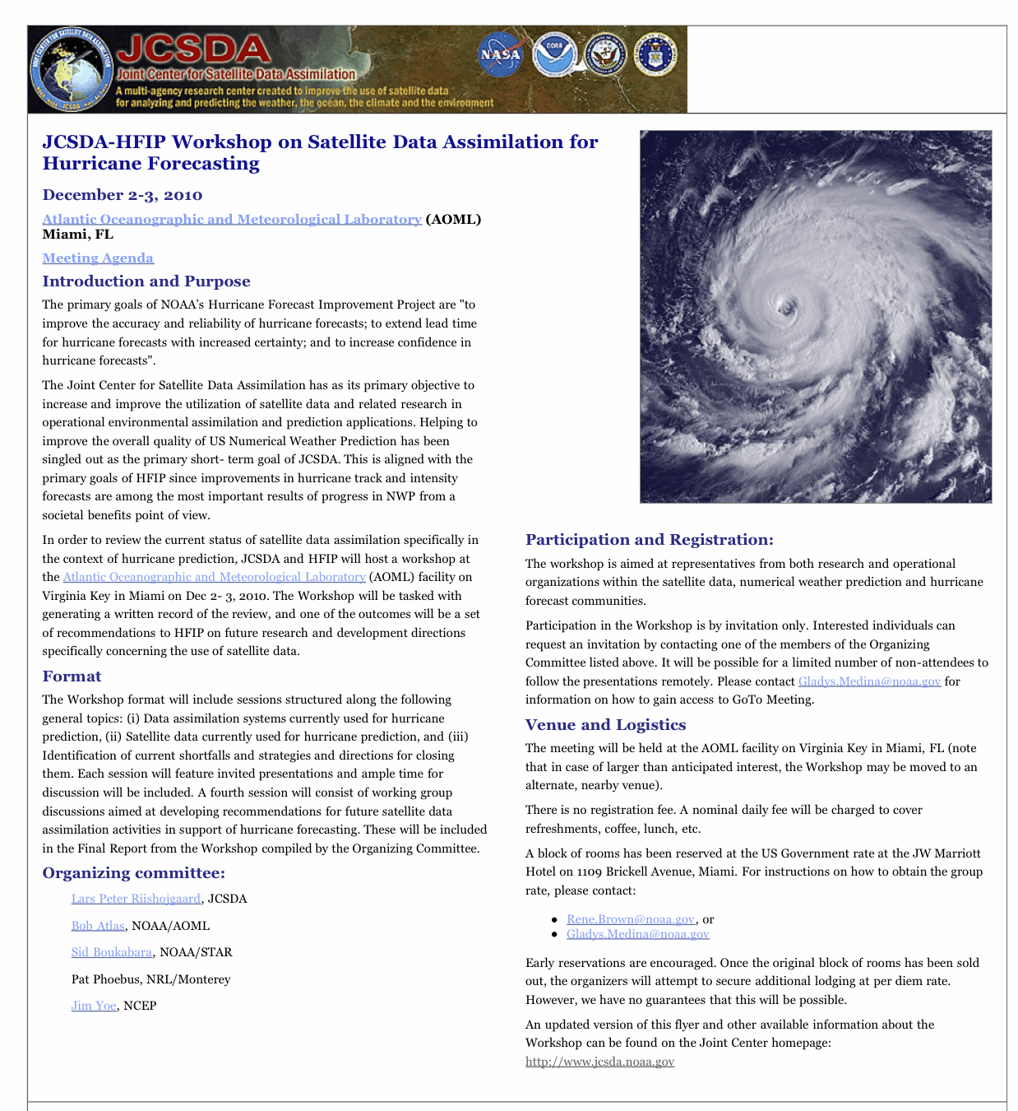

Slide 11
Key findings and recommendations
Three-dimensional data assimilation methodology has come close to exhausting its potential for hurricane forecasting. 4D-VAR or ensemble methods are needed.
Hyperspectral IR sensors (e.g. AIRS, IASI) are underutilized, especially near hurricanes.
Satellite winds are generally underutilized; especially rapid-scan geostationary winds contain information about the circulation that is not currently exploited.
Direct use (assimilation) of imagery data should also be pursued
The microwave sensors are underutilized over cloudy and (especially) precipitating areas.
Ocean surface winds from scatterometers contain information about the hurricane circulation, and yet these data have had minimal impact on forecast skill in 3D-VAR systems. This will change with the next generation of data assimilation systems, and new investigations into the use of these data are needed.
Full Workshop Report available at: http://www.jcsda.noaa.gov/meetings_JCSDA-HFIPWorkshop2010.php

Slide 13
Summary and Conclusions
Two workshops have provided community guidance to JCSDA efforts on different, both closely related topics
Clouds and precipitation
Hurricane forecasting
The latter provided several implementable recommendations, and JCSDA is working with its partners on funding these

