Slide 1
GOES-R Activities at CIRA
Louie Grasso,
Renate Brummer, and Robert DeMaria CIRA, Fort Collins, CO
Dan Lindsey, Don Hillger, NOAA/NESDIS/RAMMB, Fort Collins, CO
High Impact Weather Workshop
24 February 2011, Norman, Oklahoma
grasso@cira.colostate.edu

Slide 2
CIRA Proving Ground Product Name | Satellite | Category | Status
GeoColor Imagery | GOES/MODIS/DMSP |  | Spring 2009
True Color Imagery | MODIS |  | Spring 2010
Low-Cloud/Fog Imagery | GOES |  | Fall 2009
Cirrus Enhancement Imagery | MODIS |  | Spring 2010
Orographic Rain Index | GOES/Radar/GFS |  | Winter 2009
Marine Stratus Cloud Climatology | GOES |  | Summer 2010
Blowing Dust Detection (split-window) | GOES |  | Fall 2009
Blowing Dust (blue-light-absorption) | MODIS |  | Spring 2010
Cloud/Snow Discriminator (binary) | MODIS |  | Fall 2009
Cloud Layers & Snow Cover (multi-layer) | MODIS |  | Fall 2009
Cloud / Snow Discriminator (3-color) | GOES |  | Fall 2010
Volcanic Ash (PCI) | GOES |  | Summer 2010
Volcanic Ash (blue-light-absorption) | MODIS |  | Spring 2010
Land Surface Temperature | GOES |  | Summer 2010
Vegetation (NDVI) | MODIS |  | Spring 2010
SPC Hail Probability | GOES/RUC |  | Spring 2010
Synthetic NSSL WRF Imagery | NSSL WRF-ARW |  | Spring 2010
NHC Lightning-based TC Intensification | Grnd-based lightning network/ GFS/GOES |  | Summer 2010
MSG-based Air Mass Product | MSG |  | Summer 2010
MSG-based Dust Product | MSG |  | Summer 2010
Super Rapid Scan Imagery | GOES |  | Summer 2010
Notes:
2

Slide 3
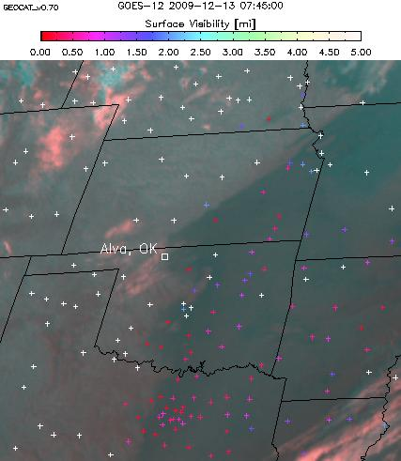
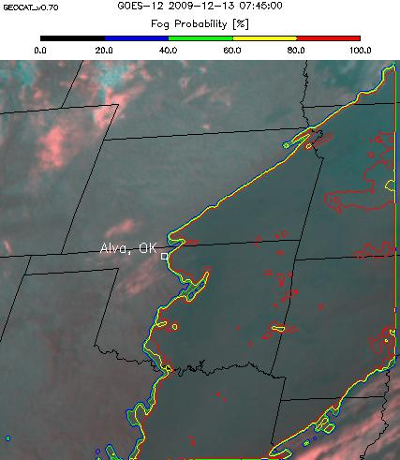
GOES-R Fog Detection Algorithm (night) CIMSS
3

Slide 4
California 10/23/2007 Canopy Wildfire
Notes:
4

Slide 5
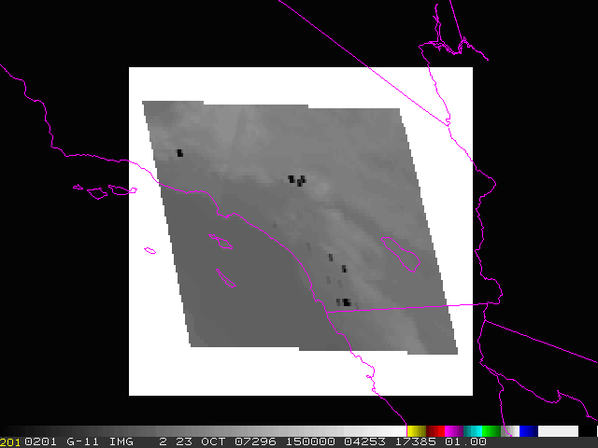
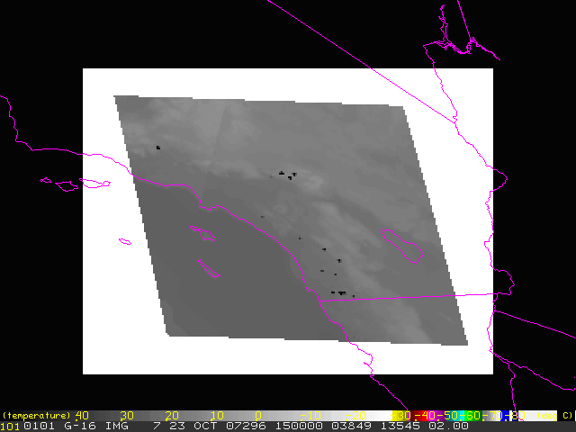
Synthetic California fire imagery for 23 October 2007
Six hour loop, images every five minutes.
CIRA
CIRA
GOES-11 (GOES-west) Imager band-2 (3.9 μm)
GOES-R (at GOES-west location) ABI band-7 (3.9 μm)

Slide 6
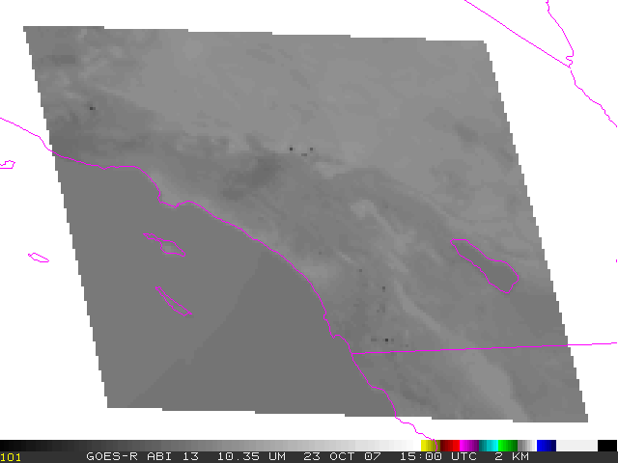
Synthetic California fire imagery for 23 October 2007
Six hour loop, images every five minutes.
CIRA
CIRA
GOES-R ABI 10.35 μm
GOES-R ABI 11.2 μm

Slide 7
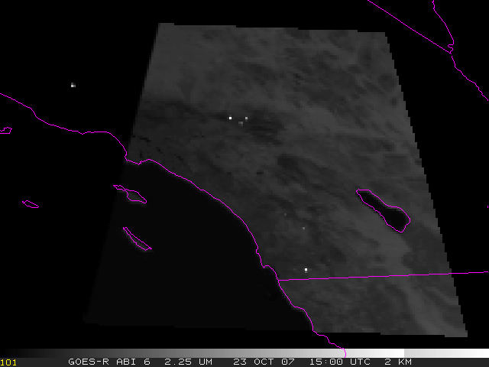
Synthetic California fire imagery for 23 October 2007
Six hour loop, images every five minutes
CIRA
GOES-R ABI 2.25 μm
Notes:
7

Slide 8
Arkansas 11/05/2008 Agricultural Burning

Slide 9
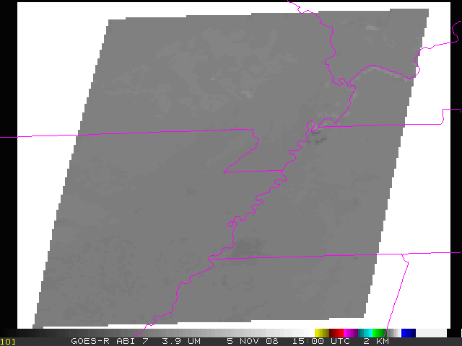
Synthetic Arkansas fire imagery for 5 November 2008
Six hour loop, images every five minutes
CIRA
GOES-R ABI 3.9 μm

Slide 10
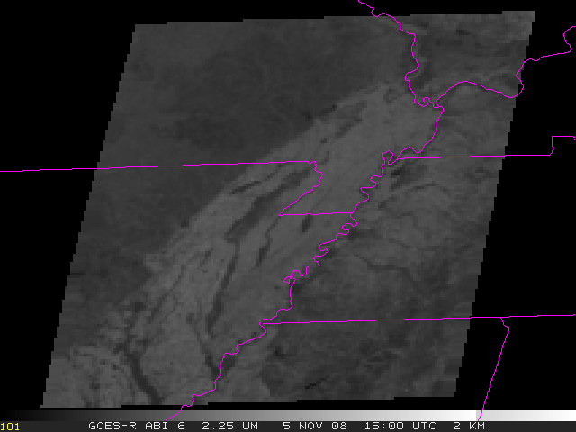
Synthetic Arkansas fire imagery for 5 November 2008
Six hour loop, images every five minutes
CIRA
GOES-R ABI 2.25 μm
Notes:
10

Slide 11
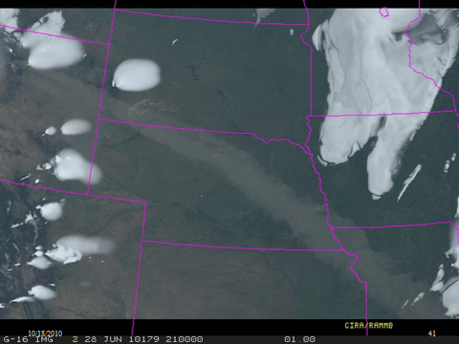
Synthetic GOES-R ABI true-color image of an idealized volcanic ash plume

Slide 12
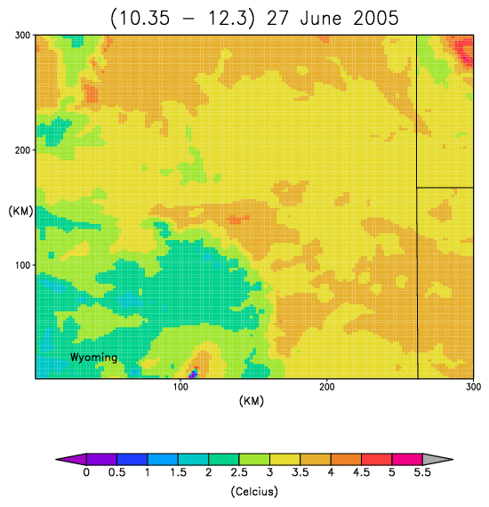
Model Simulations – 27 June 2005
Synthetic Tb(10.35 µm) - Tb(12.3 µm).
Notes:
12

Slide 13
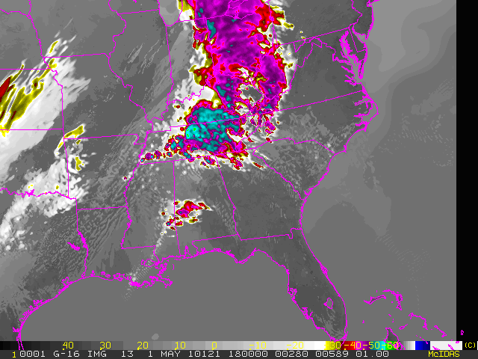
Synthetic ABI Imagery Synthetic ABI Imagery from NSSL 4 km WRF-ARW
Daily forecasts from NSSL’s 4 km WRF-ARW used to simulate ABI imagery at 6.95, 7.34, 8.5, 10.35, and 12.3 µm.
The bands are simulated hourly from the 12 hr to the 36 hr forecast.
Output is provided to the Storm Prediction Center in NAWIPS format, as well as several NWS offices, including Boulder, Riverton and Pueblo in AWIPS format
Channel differencing: 8.5 – 10.35, 8.5 – 12.3, and 10.35 – 12.3.
CIRA
Synthetic 10.35 µm band valid at 1800 UTC on 1 May 2010, based on an 18-hour forecast from NSSL’s WRF-ARW. The active convection forecast in Tennessee produced devastating flash flooding

Slide 14
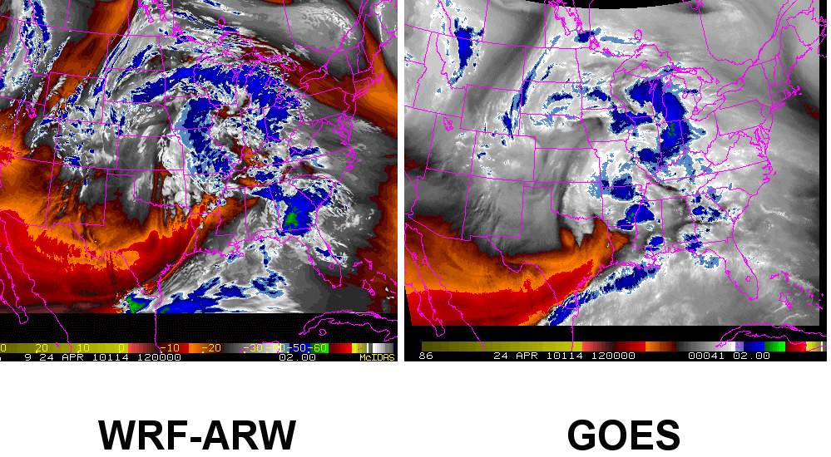
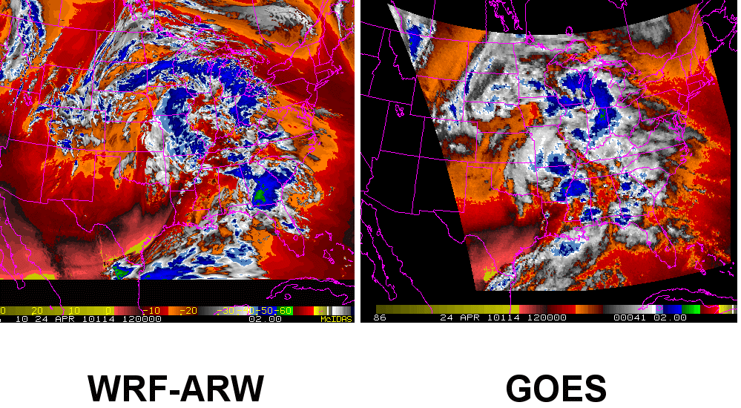
Synthetic ABI Imagery Synthetic ABI Imagery from NSSL 4 km WRF-ARW
Synthetic (left) and GOES-13 observed (right) imagery for the 24 April 2010 tornado outbreak.
With an upgraded cluster, we can now provide one WV and one IR band by 10 UTC every morning, in time for the NWS morning zone forecast packages
Synthetic imagery ideal for evaluating the timing of shortwaves in the model, and for low and high cloud forecasts
6.95 µm
6.7 µm
CIRA
7.34 µm
Sounder 7.5 µm
Notes:
14

Slide 15
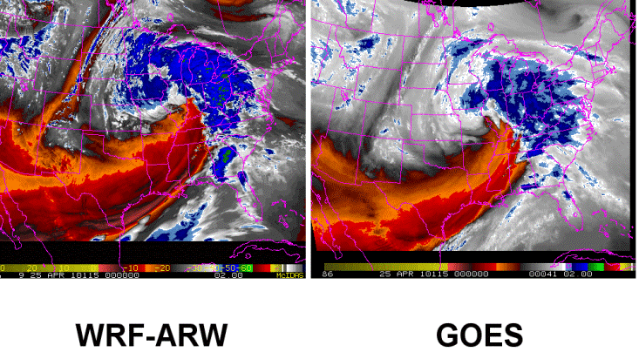
Synthetic NSSL 4km WRF-ARW Imagery on the Web
http://rammb.cira.colostate.edu/ramsdis/online/goes-r_proving_ground.asp

Slide 16
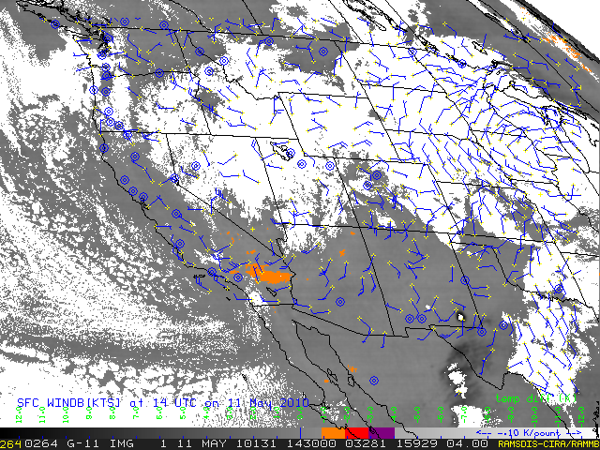
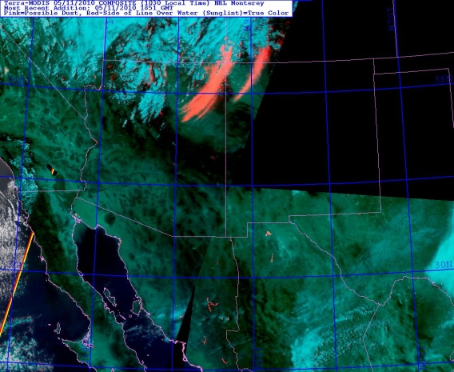
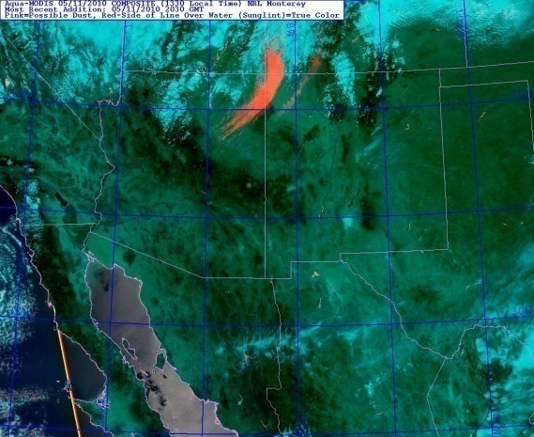
Dust Detection GOES Split-Window
Uses the split-window (12.0-10.7 micron) brightness temperature difference (will not be available from U.S. geostationary again until ABI).
Scaling and progressive color enhancement tuned to dust.
Day/night cloud mask applied, no non-satellite ancillary data.
←Useful in providing temporal context to the additional ABI capabilities for dust detection, demonstrated with MODIS.
Terra/MODIS 1850Z
Aqua/MODIS 2030Z

Slide 17
Summary
GOES-R ABI 3.9 µm and 2.25 µm can be used for fire detection and retrieval.
CIRA is producing synthetic GOES-R ABI imagery from the 4 km WRF-ARW
real-time runs at NSSL.
Several Proving Ground products are being investigated at CIMSS/CIRA.
Collaboration
Collaborations are always welcome: grasso@cira.colostate.edu

