Slide 1
How can GOES-R Contribute to Weather Forecast Improvement?
Proposed Contributions, Studies….
.
.
.
Steven Goodman
GOES-R Program Senior Scientist
NOAA/NESDIS
http://www.goes-r.gov
NOAA High Impact Weather Workshop
Norman, OK
24 February, 2011

Slide 2
GOES Product Heritage
(Yellow = current GOES and GOES-R, Blue = GOES-R only)
+ indicates Option 2 products (option 1 refers to reduced latency)

Slide 3
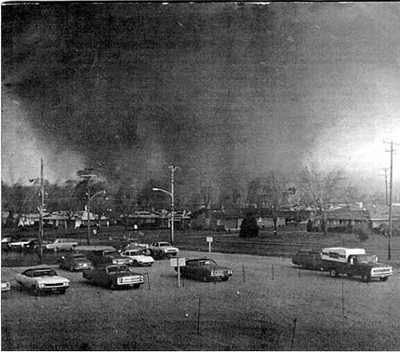
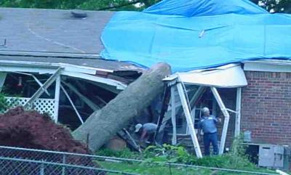
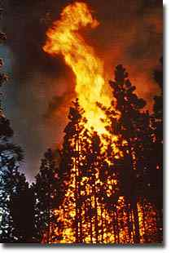
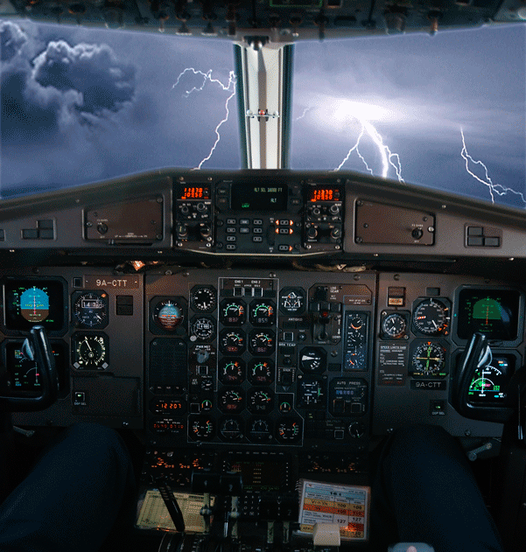
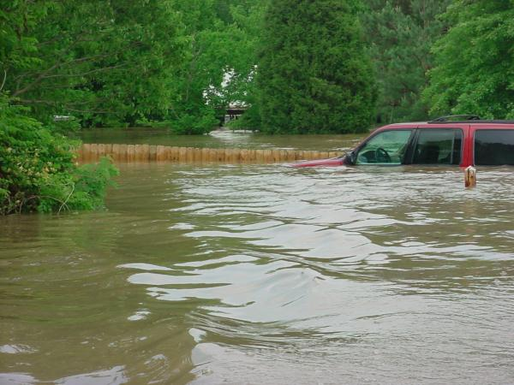
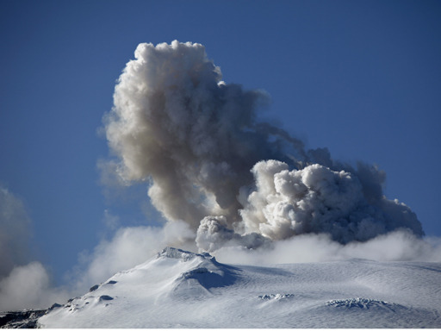
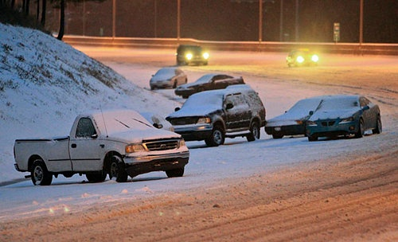
GOES-R Warning Product Set
The following products offer opportunity for near-real time Warning Related utility.
Products:
Cloud and Moisture Imagery
Hurricane Intensity
Lightning Detection: Events, Groups & Flashes
Rainfall Rate / QPE
Total Precipitable Water
Fire/Hot Spot Characterization
Aircraft Icing Threat
Trop. Fold Turbulence Prediction
Volcanic Ash: detection & Height
Convective Initiation
Enhanced “V” / Overshooting Top Detection
Low Cloud and Fog
SO₂ Detection

Slide 4
Nowcasts leads to a “call to action”
Met. Information
VSRF (Anal+NWP) >caution
Nowcast (Anal) >warning
SRF(NWP) >Outlook
Cancel warning
Local Government
Action for disaster prevention
Action for recovery
Ready to take action
Stand by
Citizen
Back to normal (recovery)
Keep in mind
preparation
evacuation
1-2 days before
3-6 hours before
1 hour before
Is the skill of our forecast fulfilling their needs?
disaster (Flood/Landslide)
Precip. Intensity
Courtesy, Shingo Yamada JMA

Slide 5
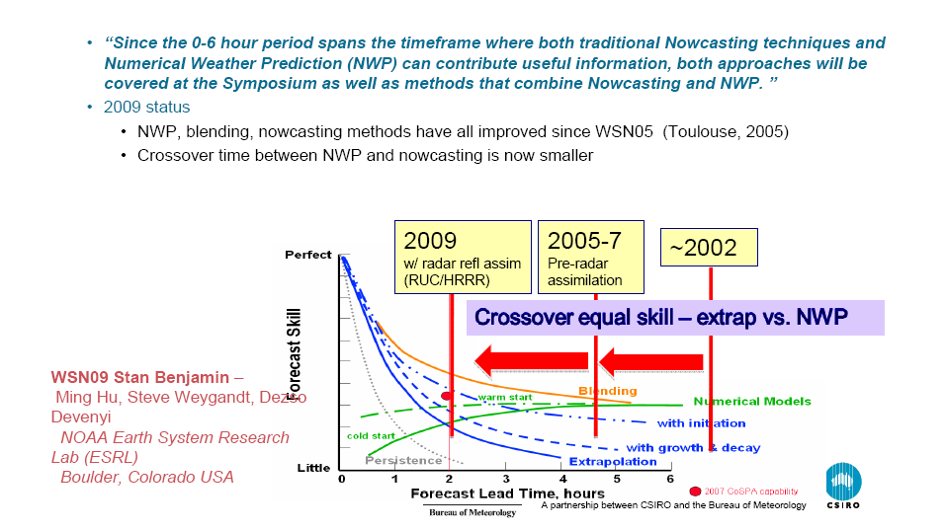
Bridging (and Shrinking) the Gap Between Extrapolation/Expert Systems and NWP
(From the WSN09 WMO Nowcasting Symposium, Whistler, BC Canada)
Courtesy, Tom Keenan BoM

Slide 6
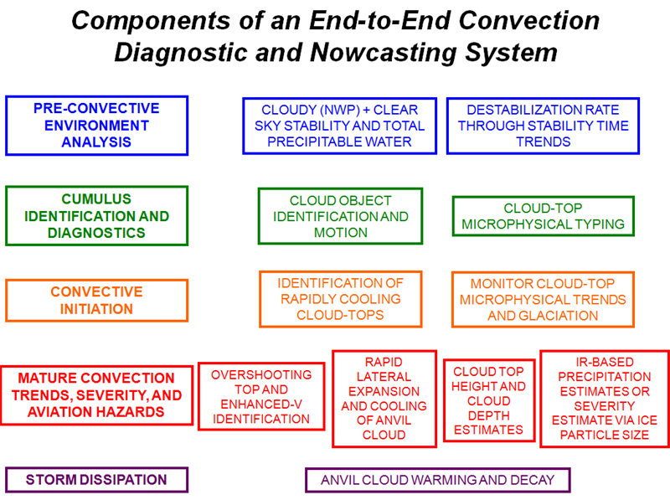
(courtesy of Kris Bedka, Marianne Koenig and the EUMETSAT Convection WG)

Slide 7
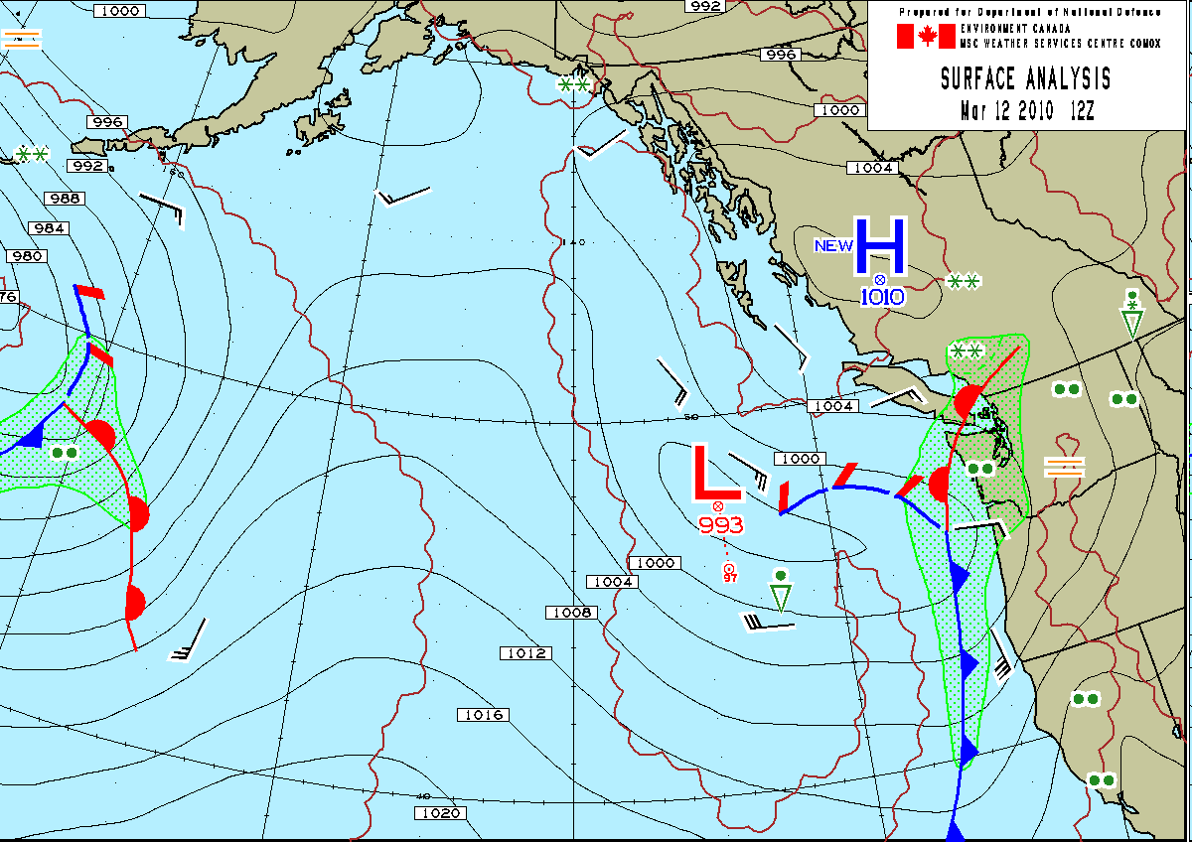
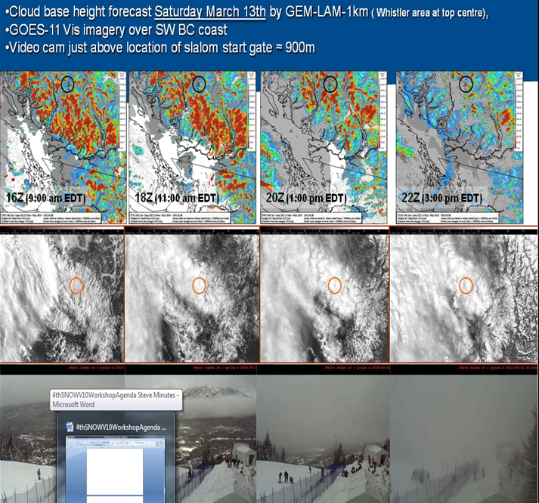
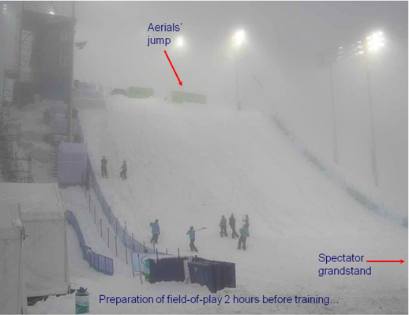
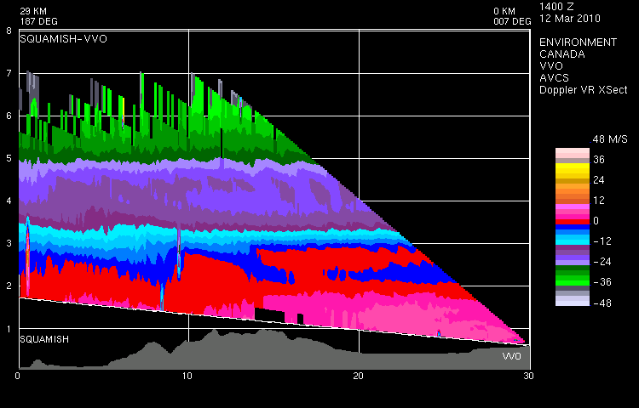
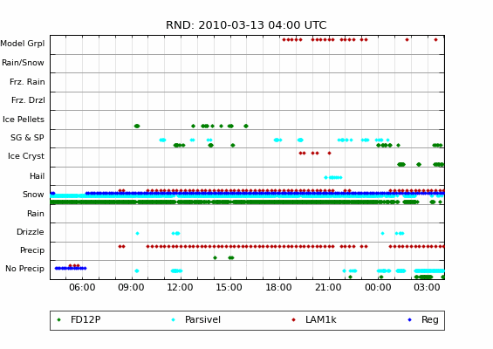
WMO SNOW-V10 Forecast Demonstration Project
Integrated Observations-NWP For the Vancouver Olympic Games
12 March
21 cm
snow event
KH(?) Waves
Courtesy, Env Canada and SNOW V-10

Slide 8
Vancouver Olympic Games Summary
Geo Satellite Applications
Verify models- primary use of the Geo data
Change of precipitation type (e.g., rain-snow)
  Winds- Can miss Low off-shore- rapidly developing front affects surface wind speeds
Visibility- not too useful in winter months
Parallax issues at high latitudes
Need for higher spatial resolution (complex terrain, point forecasts at venues)
  GOES-R will have twice the spatial resolution of current GOES
  High resolution polar satellite products, blended GEO-LEO

Slide 9
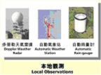
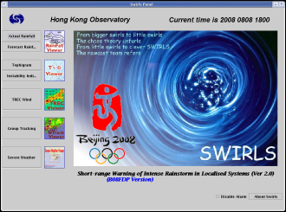
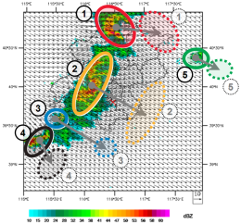
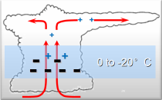




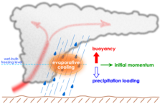


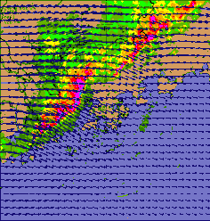
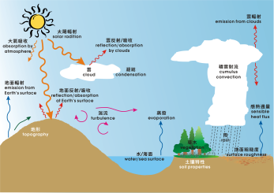
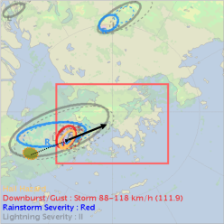


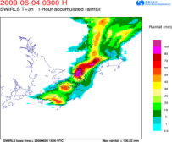

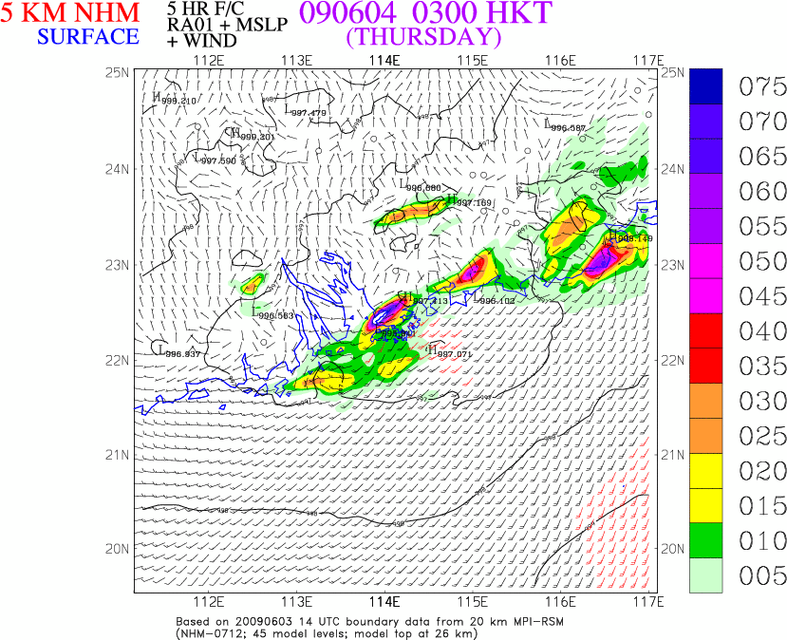
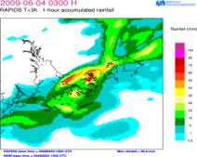


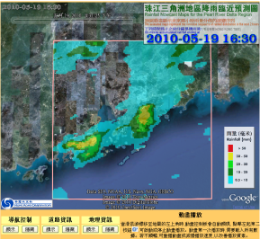

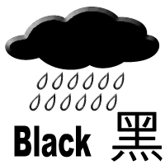

SWIRLS & RAPIDS Nowcasting Overview
電腦模擬大氣物理過程
Computer Simulation of Physical Processes in the Atmosphere
雷達追蹤、分析及預測
Radar Tracking, Analysis and Forecast
臨近預報產品及服務
Nowcast Products & Services
「小渦旋」特別版 Special Editions of SWIRLS
支援國際盛事
In support of Important International Events
「小渦旋」
臨近預報系統
SWIRLS Nowcasting System
遙感及常規天氣觀測資料
Remote-sensing and conventional weather observation data
利用雷達自動追蹤及估計雨帶的移動路徑
Automatic tracking and prediction of rainband movement from radar
利用密集的雨量站數據，實時訂正雷達探測降雨率
Real-time calibration of radar-detected rainfall rate using the dense raingauge network
強風暴單體識別及雷達特徵分析
Cell identification and radar signature analysis for severe storms
支援雷暴警告系統
In support of Thunderstorm Warning System
高分辨率風暴模式，直接模擬未來15小時雨雲的演變過程
High-resolution storm model to directly simulate the evolution of precipitating clouds up to 15 hours ahead
電腦製作未來1至6小時的雷達降雨預測圖
Computer-generated forecast rainfall maps up to 6 hours ahead based on radar
電腦製作狂風、閃電、冰雹及大雨預測圖
Computer-generated forecast map of squalls, lightning, hail and heavy rain
NHM
支援暴雨及相關警告系統
In support of Rainstorm and Related Warning Systems
「珠三角」降雨臨近預測圖在天文台網站公開發放
Public dissemination of nowcast rainfall maps for the Pearl River Delta region via HKO Internet website
降雨預測資料透過四維立體地圖展示
Forecast rainfall information visualized with 4-dimensional map of the globe
融合雷達臨近預報及電腦模擬結果的未來1至6小時雨量預測圖
Forecast rainfall maps up to 6 hours ahead blended from radar nowcast and computer simulation results
電腦製作未來15小時的模擬降雨預測圖
Computer-generated forecast rainfall maps for the next 15 hours based on simulation
Courtesy, Peter Li HKO

Slide 10
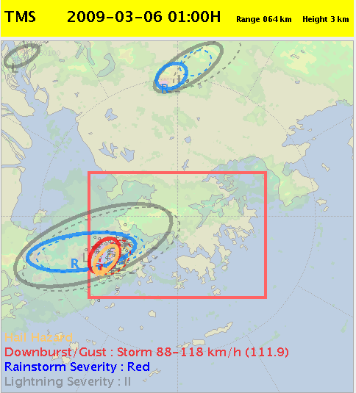
SWIRLS2 severe weather forecast panel
Legend
area with hail potential
30-min forecast location of hail
area with severe gust potential
30-min forecast location of severe gust
area with rainstorm potential
30-min forecast location of rainstorm
area with lightning potential
30-min forecast location of lightning
=/+
detected –ve/+ve CG lightning location
o
Hail Hazard
detected CC lightning location
Warning area
Courtesy, Peter Li HKO

Slide 11
Challenges and Opportunities for GOES-R
  Major data assimilation issues for storm scale (1-5 inputs from Steve Lord):
  1) How to capture high time resolution data (such as from GOES)
  2) How to assimilate cloud information from imagery
  3) How to merge above information with complementary information from radar
  4) Development of model systems that simulate storm behavior at 1-2 km resolution
  5) Reanalysis of historical cases to calibrate skill and support forecaster use
  JCSDA-HFIP Workshop Recommendations:
    Hyperspectral IR sensors (e.g. AIRS, IASI) are underutilized, especially near hurricanes.
    Satellite winds are generally underutilized; especially rapid-scan geostationary winds contain information about the circulation that is not currently exploited.
      Learn from the Navy experience (super-obing, QC)
      Better height assignment
      Nested tracking winds
With input from Tim Schmit, Steve Lord, Lars Peter Riishojgaard

Slide 12
Challenges and Opportunities for GOES-R
  How do we truly exploit the high time resolution of GOES/GOES-R, EnKF, 4D-VAR? etc.
  Research on direct assimilation of imagery data, building on and expanding the current experience with model-simulated satellite images
  Research on data assimilation use of non-traditional data (e.g. lightning, precipitation)
  How do we best use cloudy radiances?
  How to assimilate GOES-R products and data into the Hybrid Variational ensemble model at 1 km and 10 km?
  How do we best use GOES images/products to VALIDATE (or tune the models)?
  What model impact studies are of highest priority to determine GOES- R benefit?
  What metrics are most appropriate and useful ?
    Storm track and timing of intensity/severity
  What verification methodologies are most appropriate and useful ?
    Refer to WMO Joint WWRP/WGNE Working Group on Forecast Verification Research
  What are the attributes of a High Impact Weather OSSE for a geostationary sounder

Slide 13
Forthcoming 2011 WMO Workshop on
Use of NWP in Support of Nowcasting
Scientific questions
    use and potential of existing techniques and observation types for nowcasting
    major physical processes that influence the forecast accuracy for the very short term
    requirements from nowcasting for mesoscale NWP systems, in terms of products, quality, timeliness, etc. , from the perspective of several typical nowcasting applications
    conversely, requirements from mesoscale models on observations, and typical problems and limitations experienced by them on this account
    experiences to date in, and plans for, application of mesoscale NWP for nowcasting in rapid update cycling systems: experiences so far, challenges, (comparison of) potential of various assimilation techniques
    challenges for NWP posed by the nowcasting applications, i.e, different operational setups for nowcasting and longer range, how to handle issues related to specific location and phenomenon
    data types that have the most impact for nowcasting purpose from both the typical nowcasting and NWP approaches
    identification of topics where stronger interactions between the nowcasting and NWP communities should be fostered
    ways to assess and evaluate the potential of mesoscale NWP models for nowcasting purposes
    discussion on possible follow-up actions and experiments
Keenan, Sun, Onvlee

