Slide 1
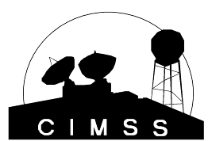



High impact weather nowcasting and short-range forecasting with advanced IR soundings
Jun Li@, Tim Schmit&, Hui Liu#, Jinlong Li@, Jing Zheng@, and Elisabeth Weisz@
&Center for Satellite Applications and Research, NESDIS
@CIMSS/SSEC, University of Wisconsin-Madison
#National Center for Atmospheric Research
High Impact Weather Workshop
Norman, Oklahoma
24 February 2011
Supported by GOES-R projects and JCSDA FFO

Slide 2
Objective
High impact weather studies with soundings
  To study the combined LEO advanced IR soundings and high spatial/temporal resolution ABI profiles in pre-convection environment for mesoscale high impact weather (severe storms over CONUS, tropical cyclones, etc.) nowcasting
  To study the impact of combined LEO advanced IR soundings and ABI profiles on high impact weather short-rang forecasts through data assimilation techniques
JCSDA FFO – Utilization of GOES-R data for hurricane
  Collaborate with CIRA on using advanced IR soundings in operational equivalent system – HWRF/GSI for hurricane study

Slide 3
Methodologies/technical approaches
Direct application of LEO advanced IR soundings and high spatial/temporal resolution ABI profiles in the pre-convection environment for storm warning
Assimilating LEO advanced IR soundings and high spatial/temporal resolution ABI profiles in regional NWP for improving the instability products (LI, CAPE, KI, SI etc.) in pre-convection environment for storm warning
Assimilating LEO advanced IR soundings and high spatial/temporal resolution ABI profiles for improving short-range forecasts (hurricane track, intensity, storm precipitation, location etc.)

Slide 4
Progress on HIW studies
Analysis of warning information from advanced IR soundings in pre-convection environment
Using advanced IR soundings (AIRS, next IASI and in future CrIS) in hurricane forecast through WRF/DART (implemented at CIMSS) forecast/assimilation system.
  2-day assimilation followed by 4-day forecast for Hurricane Ike (2008)
  1-day assimilation followed by 2-day forecast for Typhoon Sinlaku (2008)
Using advanced IR soundings in hurricane forecast through WRF/3DVAR (implemented at CIMSS) forecast/assimilation system
  48 hour forecast for Hurricane Ike (2008)
Assimilating advanced IR soundings in regional NWP models for storm forecast through GRAPES/4DVAR (collaboration with IAP/CAS)
  24 hour precipitation forecast

Slide 5
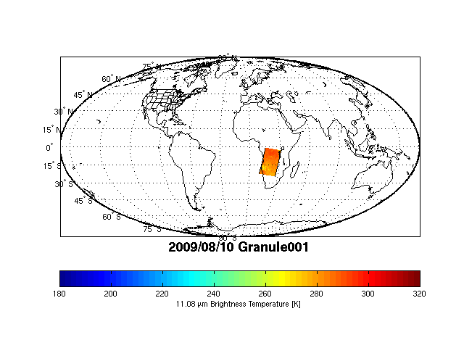
LEO advanced IR sounder spatial coverage (e.g., AIRS)

Slide 6
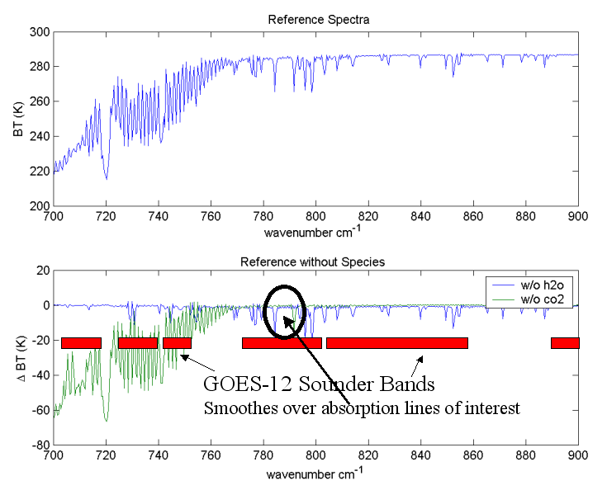
Comparing Current GOES to High Spectral Measurements

Slide 7
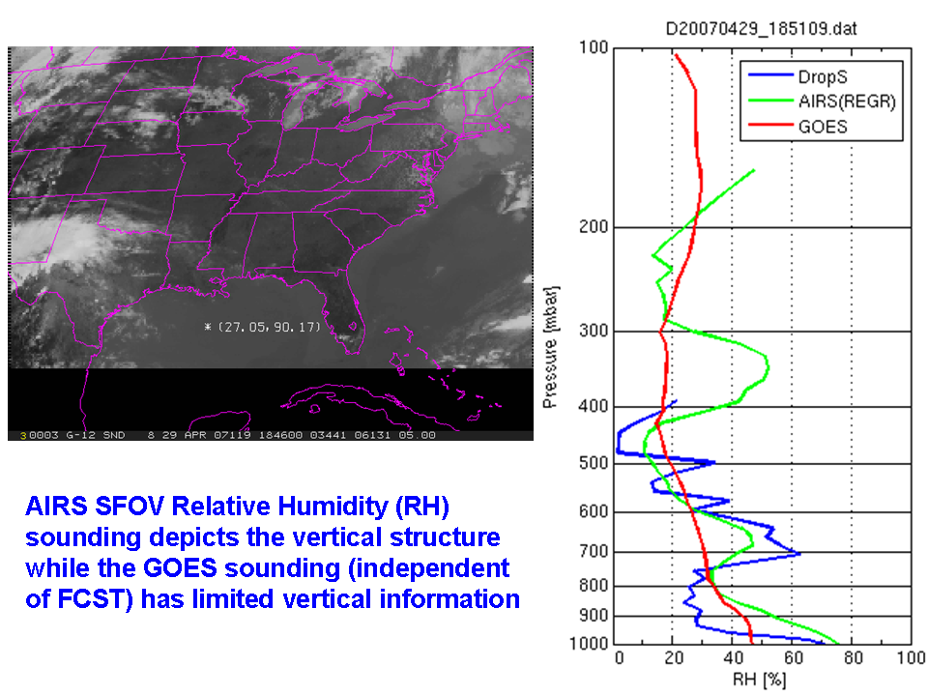

Slide 8
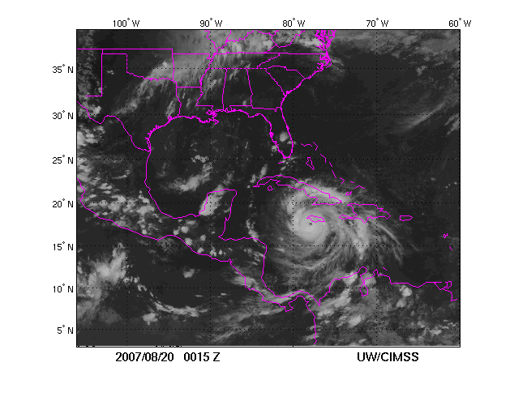
AIRS measurements overlay on GOES IR image (Hurricane Dean 2007)
LEO advanced IR sounder data have limitation on coverage due to orbital gap and low temporal resolution.
High temporal/spatial resolution is unique aspect of GOES-R ABI measurements
Combination of GEO/LEO measurements for high impact weather applications
A geostationary hyperspectral sounder could provide full hourly disk coverage rather than the partial coverage available with polar orbiting sounders.

Slide 9
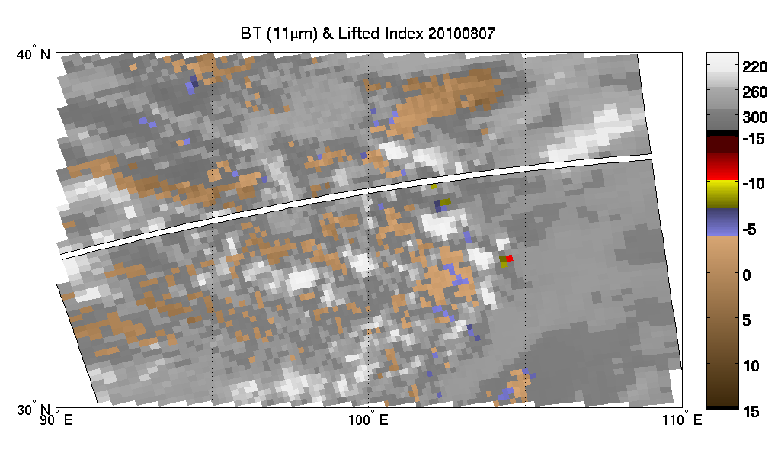
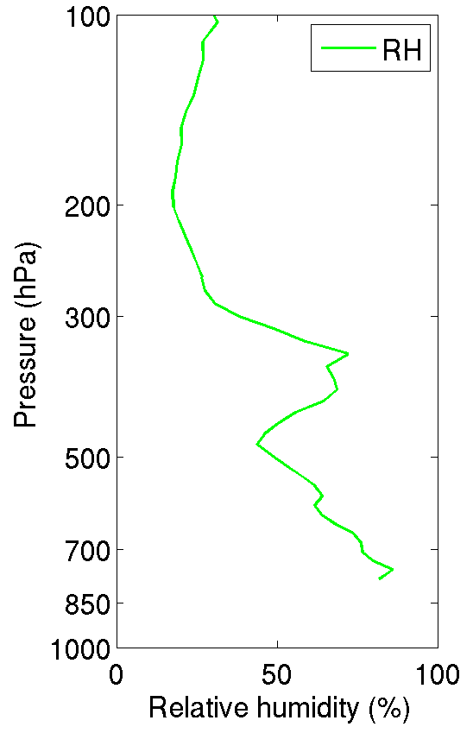
LI = T500 – Taa
  0< LI → stable
  -3< LI <0 → marginally unstable
  -6< LI <-3 → moderately unstable
  -9< LI <-6 → very unstable
  LI <-9 → extreme instability
AIRS (SFOV soundings) detected atmospheric instability for Zhou Qu storm 5.5 hours pre-convection
Lat=34.19; Lon=104.41
0635UTC on 07 August 2010 (storm starts 12 UTC on 07 August 2010)

Slide 10
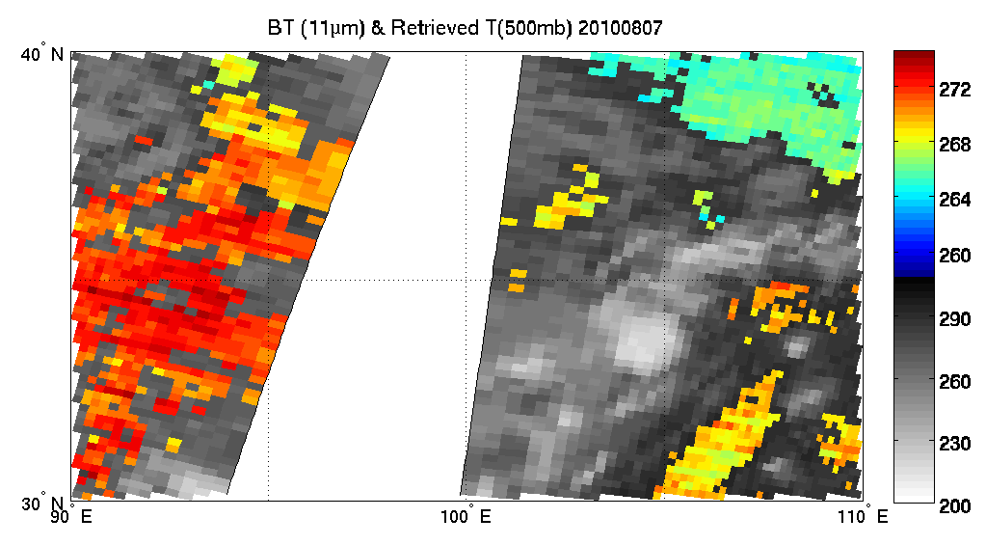
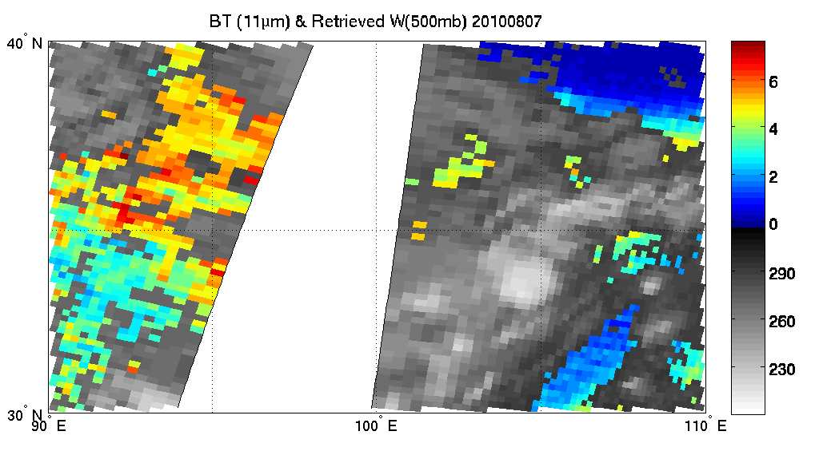
(K)
Cold and dry air
Zhou Qu Storm
Warm and moist air
AIRS SFOV 500 hPa temperature (K)
1840 UTC
07 August
2010
2015 UTC
07 August
2010
(g/kg)
AIRS SFOV 500 hPa water vapor mixing ratio (g/kg)
Southwest wind
(K)

Slide 11
Assimilating advanced IR soundings with WRF/DART – hurricane/typhoon forecast experiments
~10 AIRS granules over the regional WRF domain
Full spatial resolution AIRS soundings (13.5 km at nadir) are derived using CIMSS hyperspectral infrared sounding retrieval (CHISR) algorithm
Clear sky only soundings are used
Ensemble assimilation of AIRS soundings followed by ensemble forecast (36 km resolution)
  CTL run: Assimilate radiosonde, satellite cloud winds, QuikSCAT winds, aircraft data, COSMIC GPS refractivity, ship, and land surface data.
  AIRS run: Same as CTL run plus AIRS full spatial resolution T and Q soundings

Slide 12
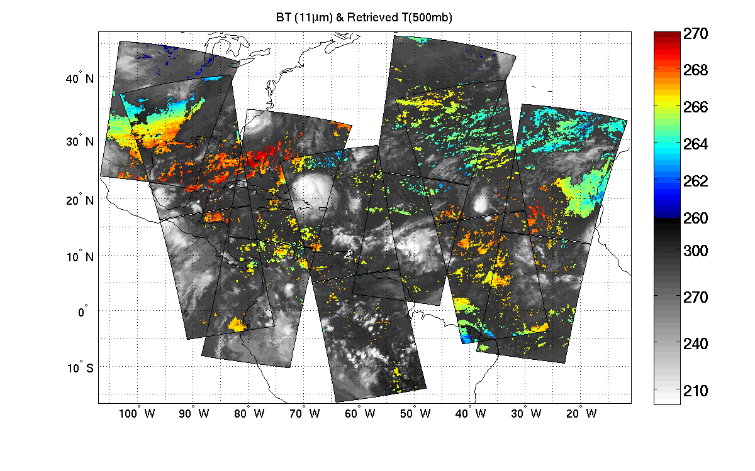
Hurricane Ike (2008): Retrieved 500 hPa temperature 2008.09.06 – Used in assimilation)
(K)
CIMSS/UW
Clear sky AIRS single field-of-view temperature retrievals at 500 hPa on 06 September 2008, each pixel provides vertical temperature and moisture soundings.

Slide 13
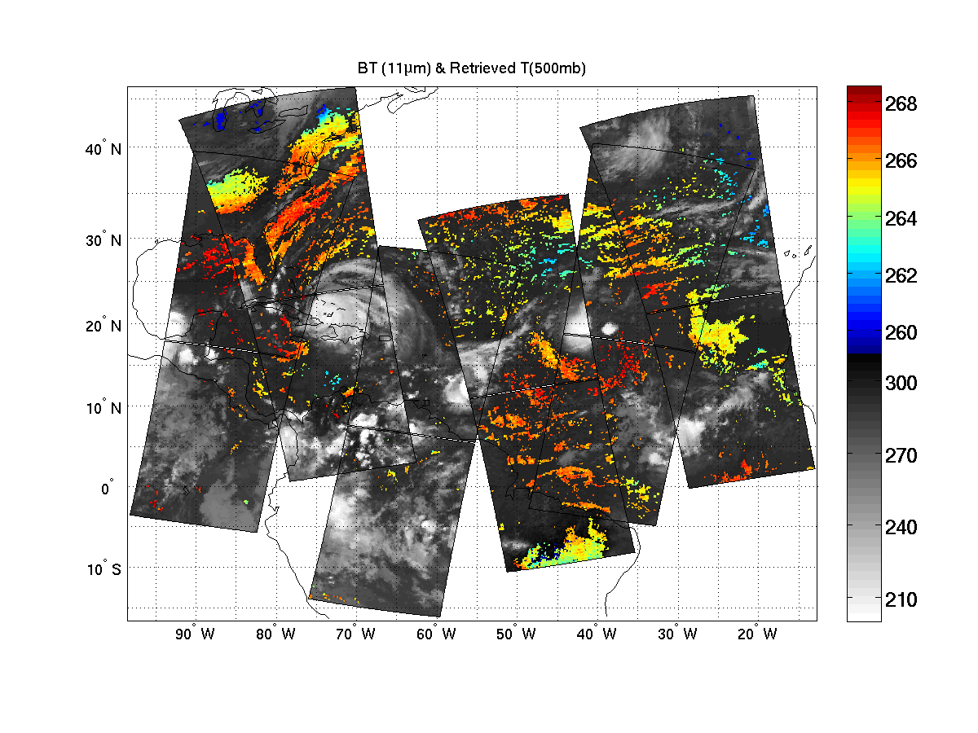
Hurricane Ike (2008): Retrieved 500 hPa temperature 2008.09.07 – Used in assimilation)
(K)
CIMSS/UW
Clear sky AIRS single field-of-view temperature retrievals at 500 hPa on 07 September 2008, each pixel provides vertical temperature and moisture soundings.

Slide 14
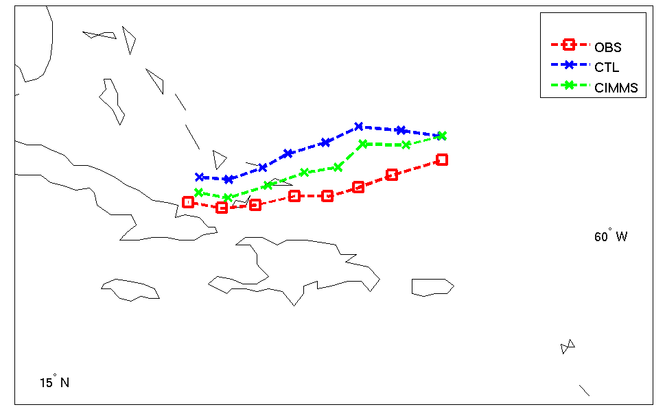
Tracks of ensemble mean analysis on Hurricane IKE
CTL run: Assimilate radiosonde, satellite cloud winds, aircraft data, and surface data.
AIRS
Analysis from 06 UTC 6 to 00UTC 8 September 2008

Slide 15
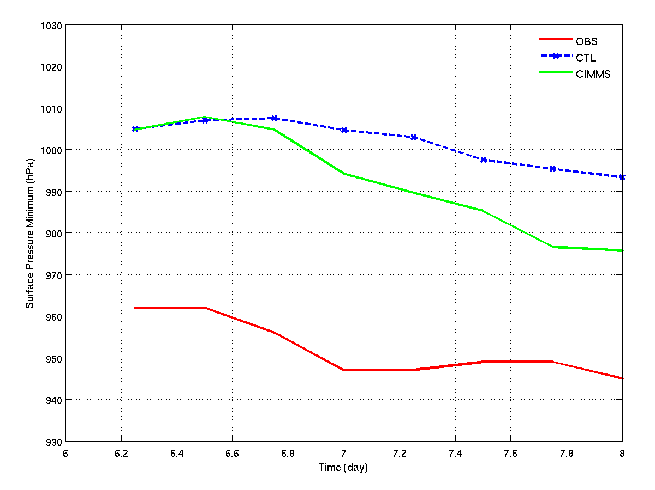
SLP of ensemble mean analysis on Hurricane IKE
AIRS
Analysis from 06 UTC 6 to 00UTC 8 September 2008

Slide 16
Forecast Experiments on Ike (2008)
4-day ensemble forecasts (16 members) from the analyses on 00UTC 8 September 2008.
Track trajectory and hurricane surface central pressure are compared (every 6-hourly in the plots).

Slide 17
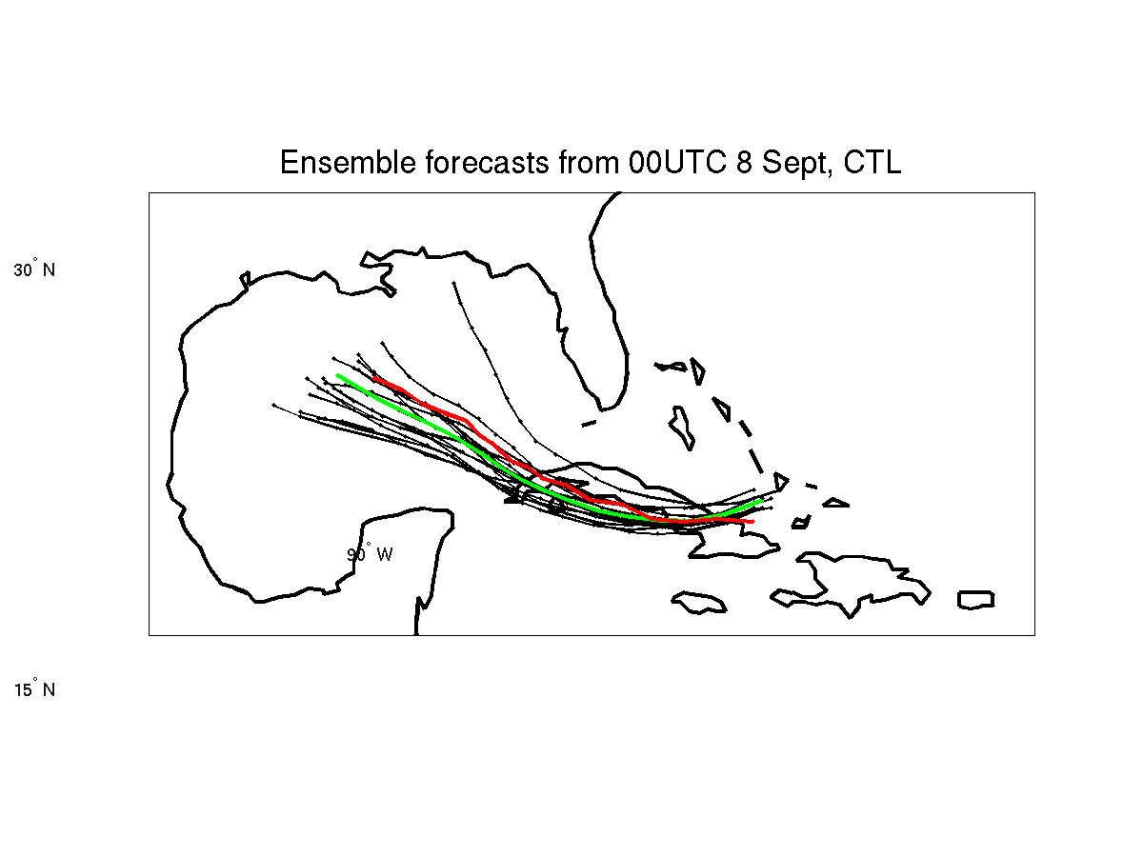
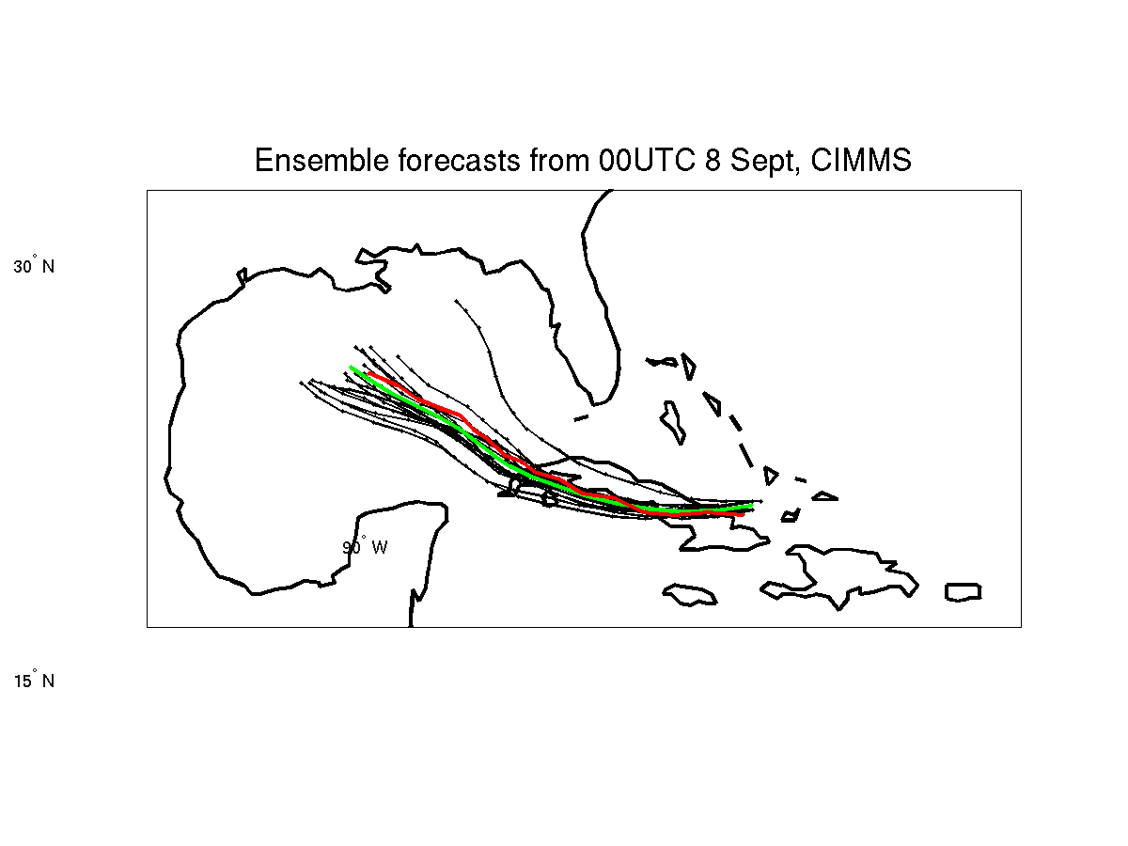
Tracks of 96h forecasts on Hurricane IKE
AIRS
CTRL run: Assimilate radiosonde, satellite cloud winds, aircraft data, and surface data.
No AIRS
With AIRS
Red is observation, green is forecast
Forecasts start at 00 UTC 8 September 2008

Slide 18
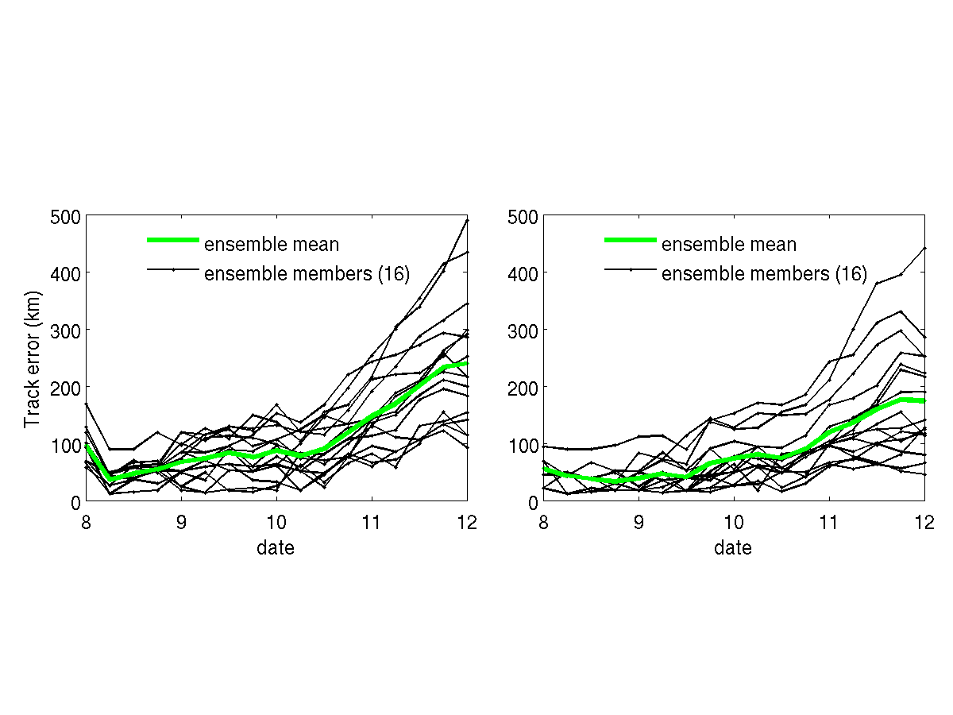
Without AIRS
With AIRS
Without AIRS
With AIRS
Track error (upper two panels) and sea level pressure from 96 hour forecasts (start at 00 UTC 8 September 2008)
Notes:
Track error (upper two panels) and sea level pressure (lower two panels) for 96 hour ensemble forecast.

Slide 19
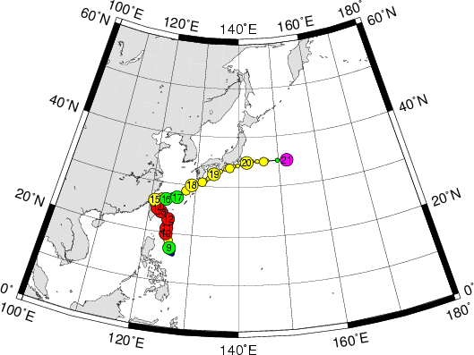
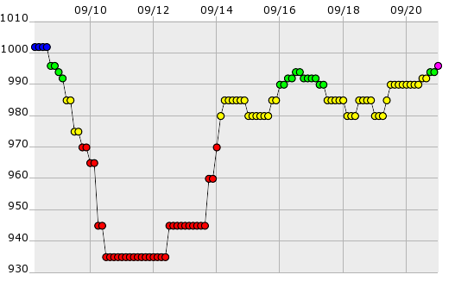
Typhoon Sinlaku (2008) Fact
Sinlaku Path
Sinlaku rapid intensification observed

Slide 20
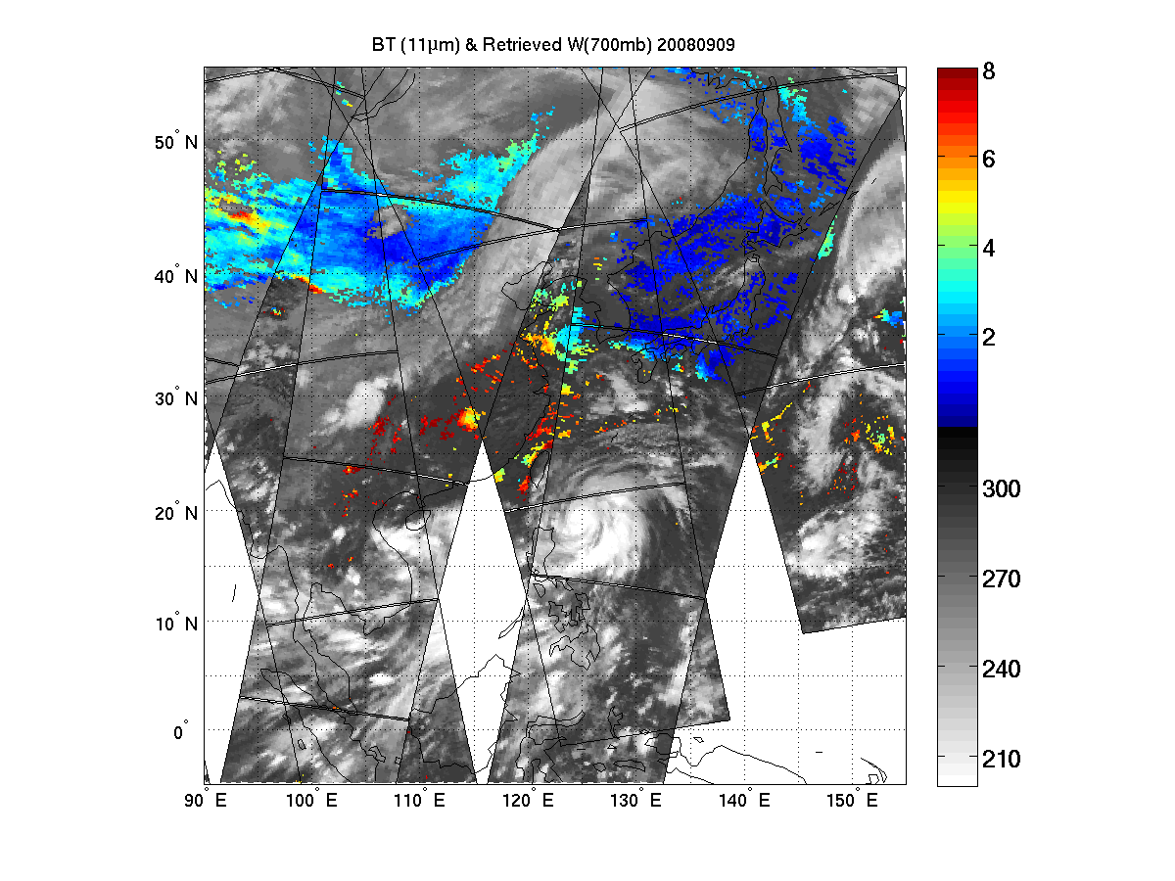
Typhoon Sinlaku (2008): Retrieved 700 hPa water vapor mixing ratio 2008.09.09 – Used in assimilation)
(g/kg)
(K)
700 hPa water vapor mixing ratio (g/kg) in clear skies (Sinlaku – 09 September 2008)

Slide 21
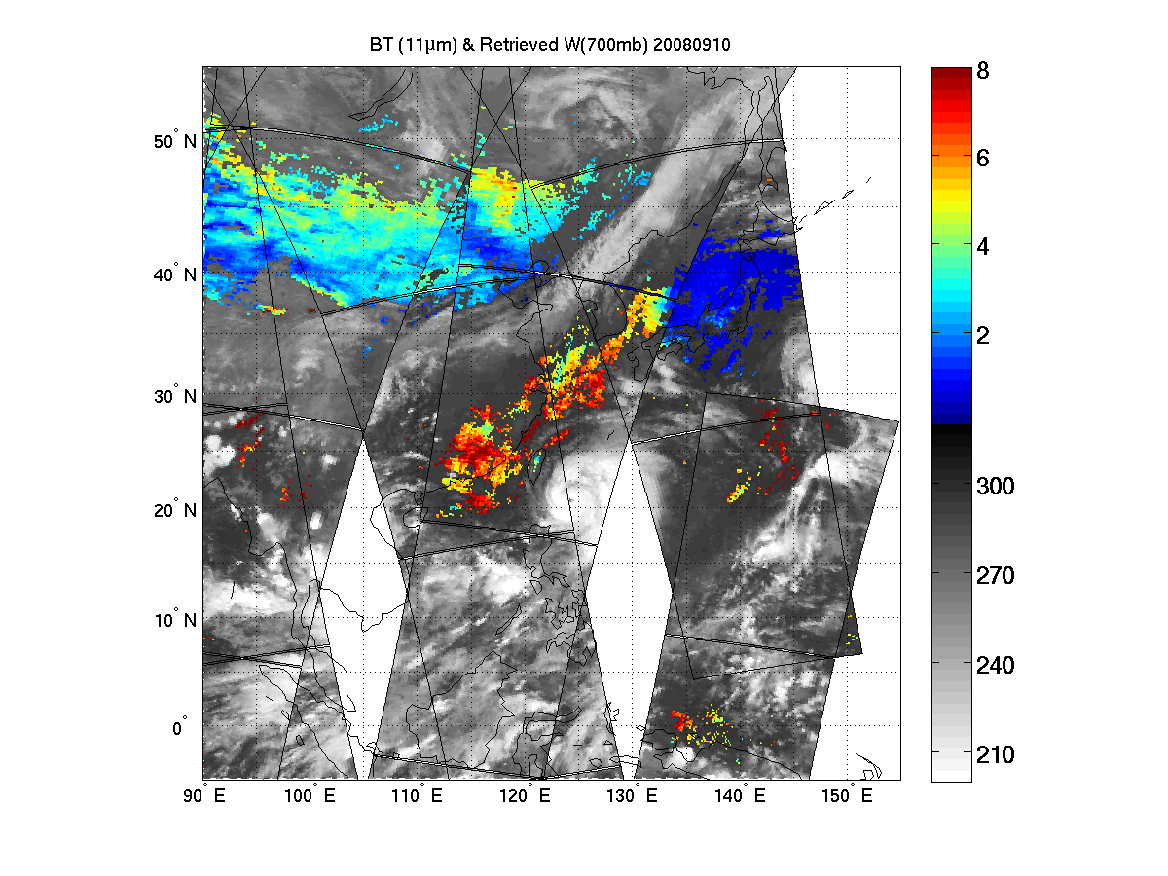
Typhoon Sinlaku (2008): Retrieved 700 hPa water vapor mixing ratio 2008.09.10 – Used in assimilation)
(g/kg)
(K)
700 hPa water vapor mixing ratio (g/kg) in clear skies (Sinlaku – 10 September 2008)

Slide 22
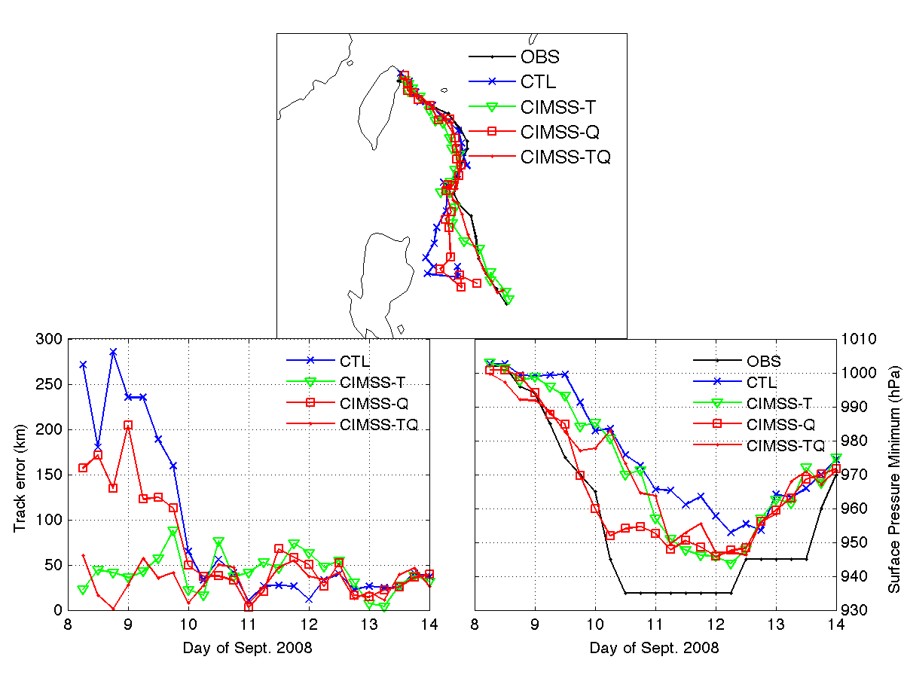
Track and Intensity Analyses for Sinlaku (2008)
Rapid intensification from 9 – 10 September 2011 – water vapor soundings are important!
CIMSS-T: AIRS SFOV temperature
CIMSS-Q: AIRS SFOV water vapor
CIMSS-TQ: AIRS SFOV temperature and water vapor

Slide 23
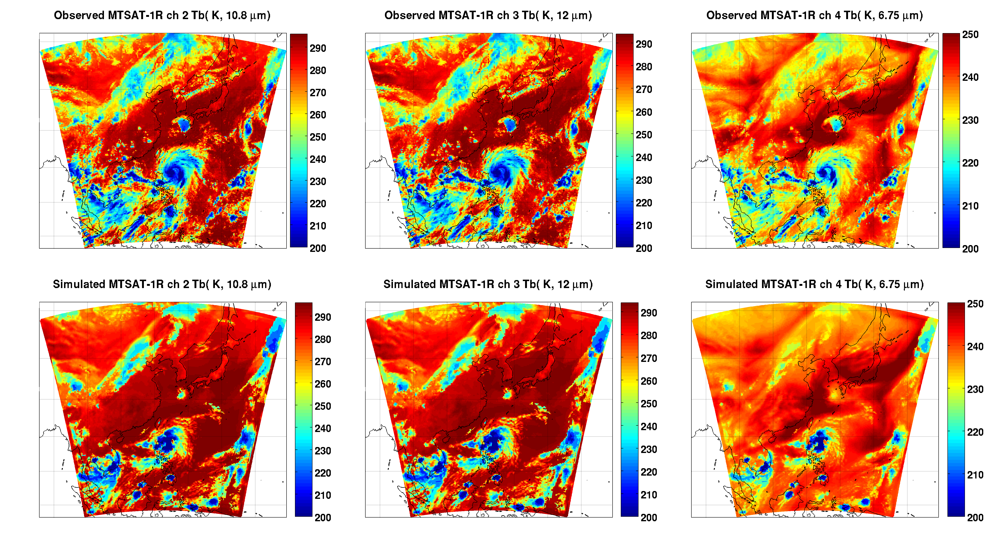
Verify forecast/analysis with geostationary IR images
Observed MTSAT IR Images
10.8 μm
6.75 μm
Simulated MTSAT IR Images

Slide 24
Assimilating advanced IR soundings with WRF/3DVAR - Hurricane forecast experiments
2008090606_WRF/3DVAR
CTRL run: use NCEP 6-hour final operational global analysis (1.0 x 1.0 degree grids; http://dss.ucar.edu/datasets/ds083.2/), including radiosondes, satellite winds, pilot report, GPS, ship, profiler, surface observations etc., starting at 06 UTC 06 September 2008
AIRS (Control + AIRS) run: use clear-skies from granules g066/067/068, but only assimilate 13 levels of AIRS SFOV temperature profiles between 500 and 800 hPa
Comparisons of Hurricane track for the next 48 hour forecast

Slide 25
AIRS 2008090606_g066, g067, g068

Slide 26
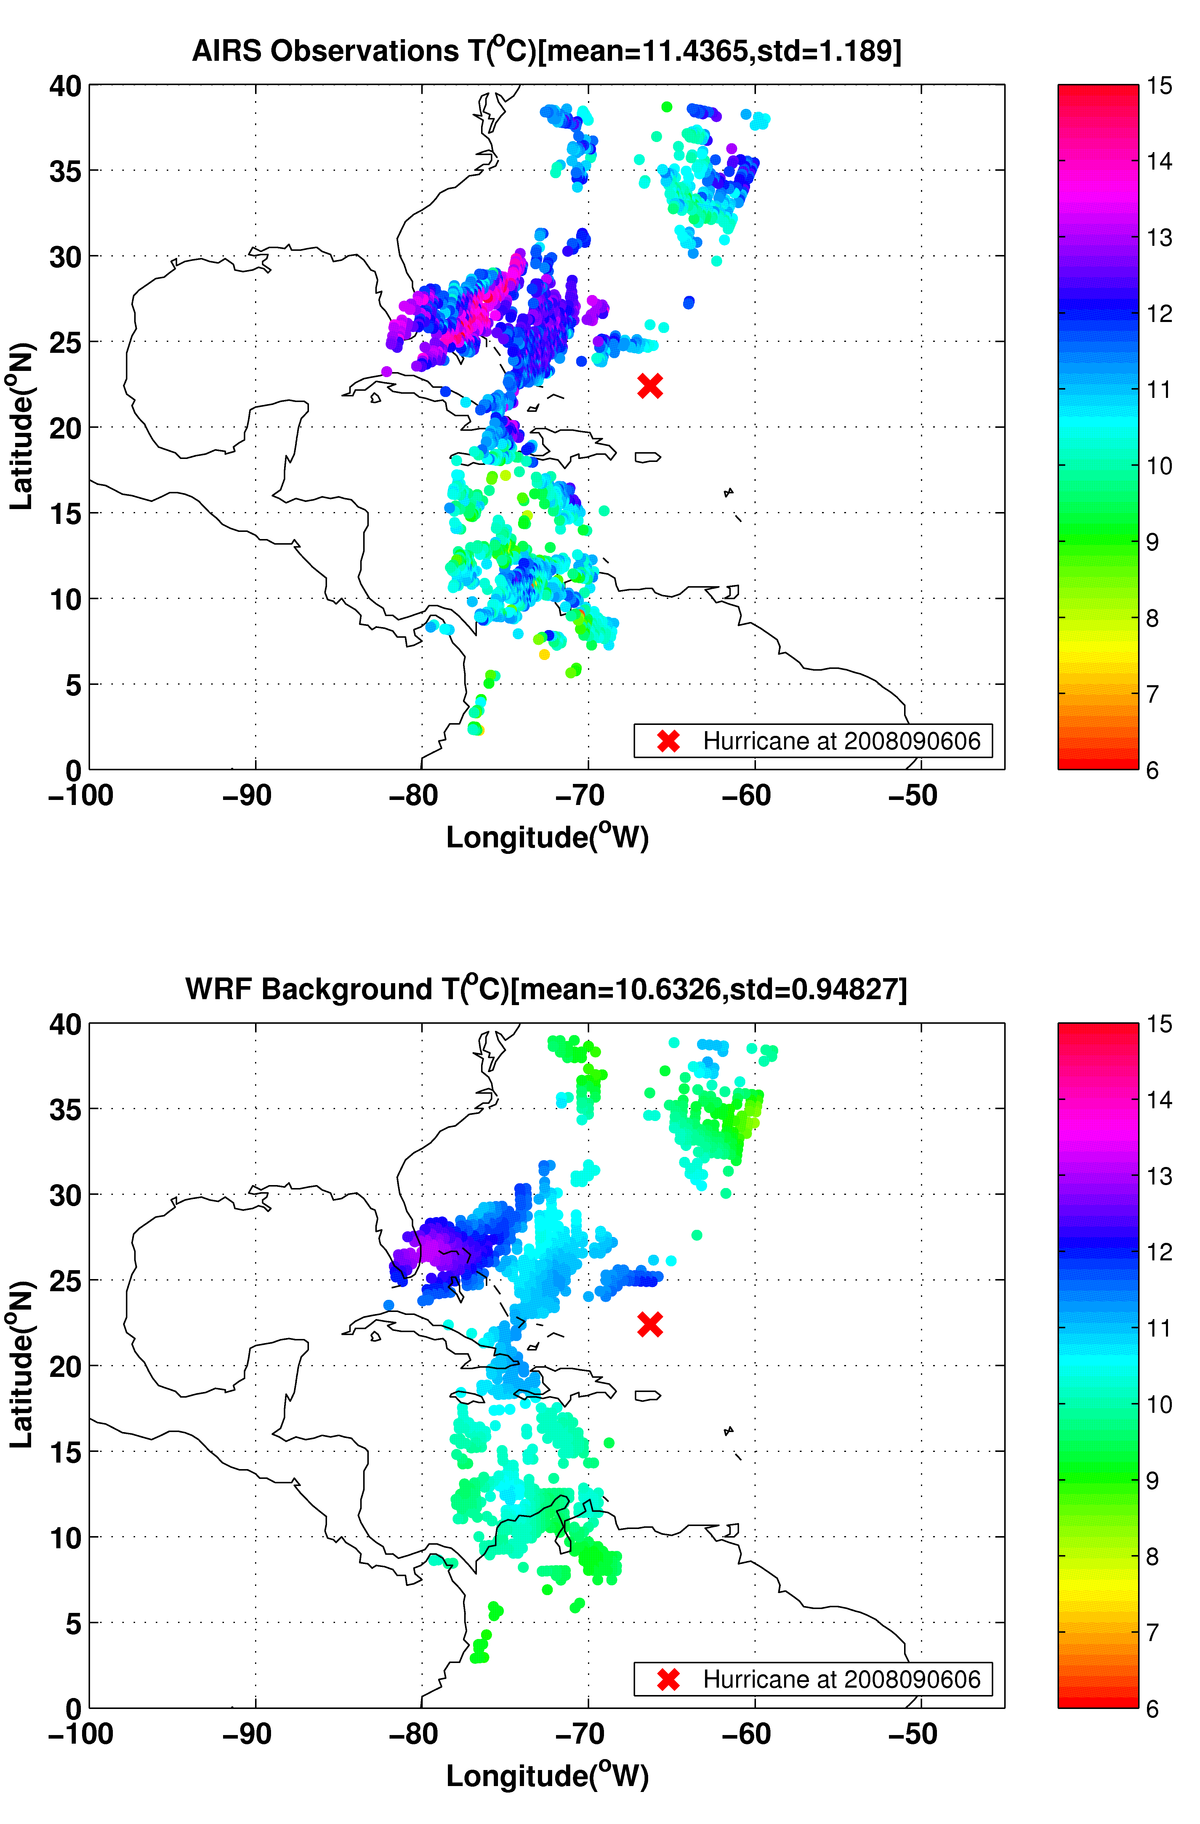
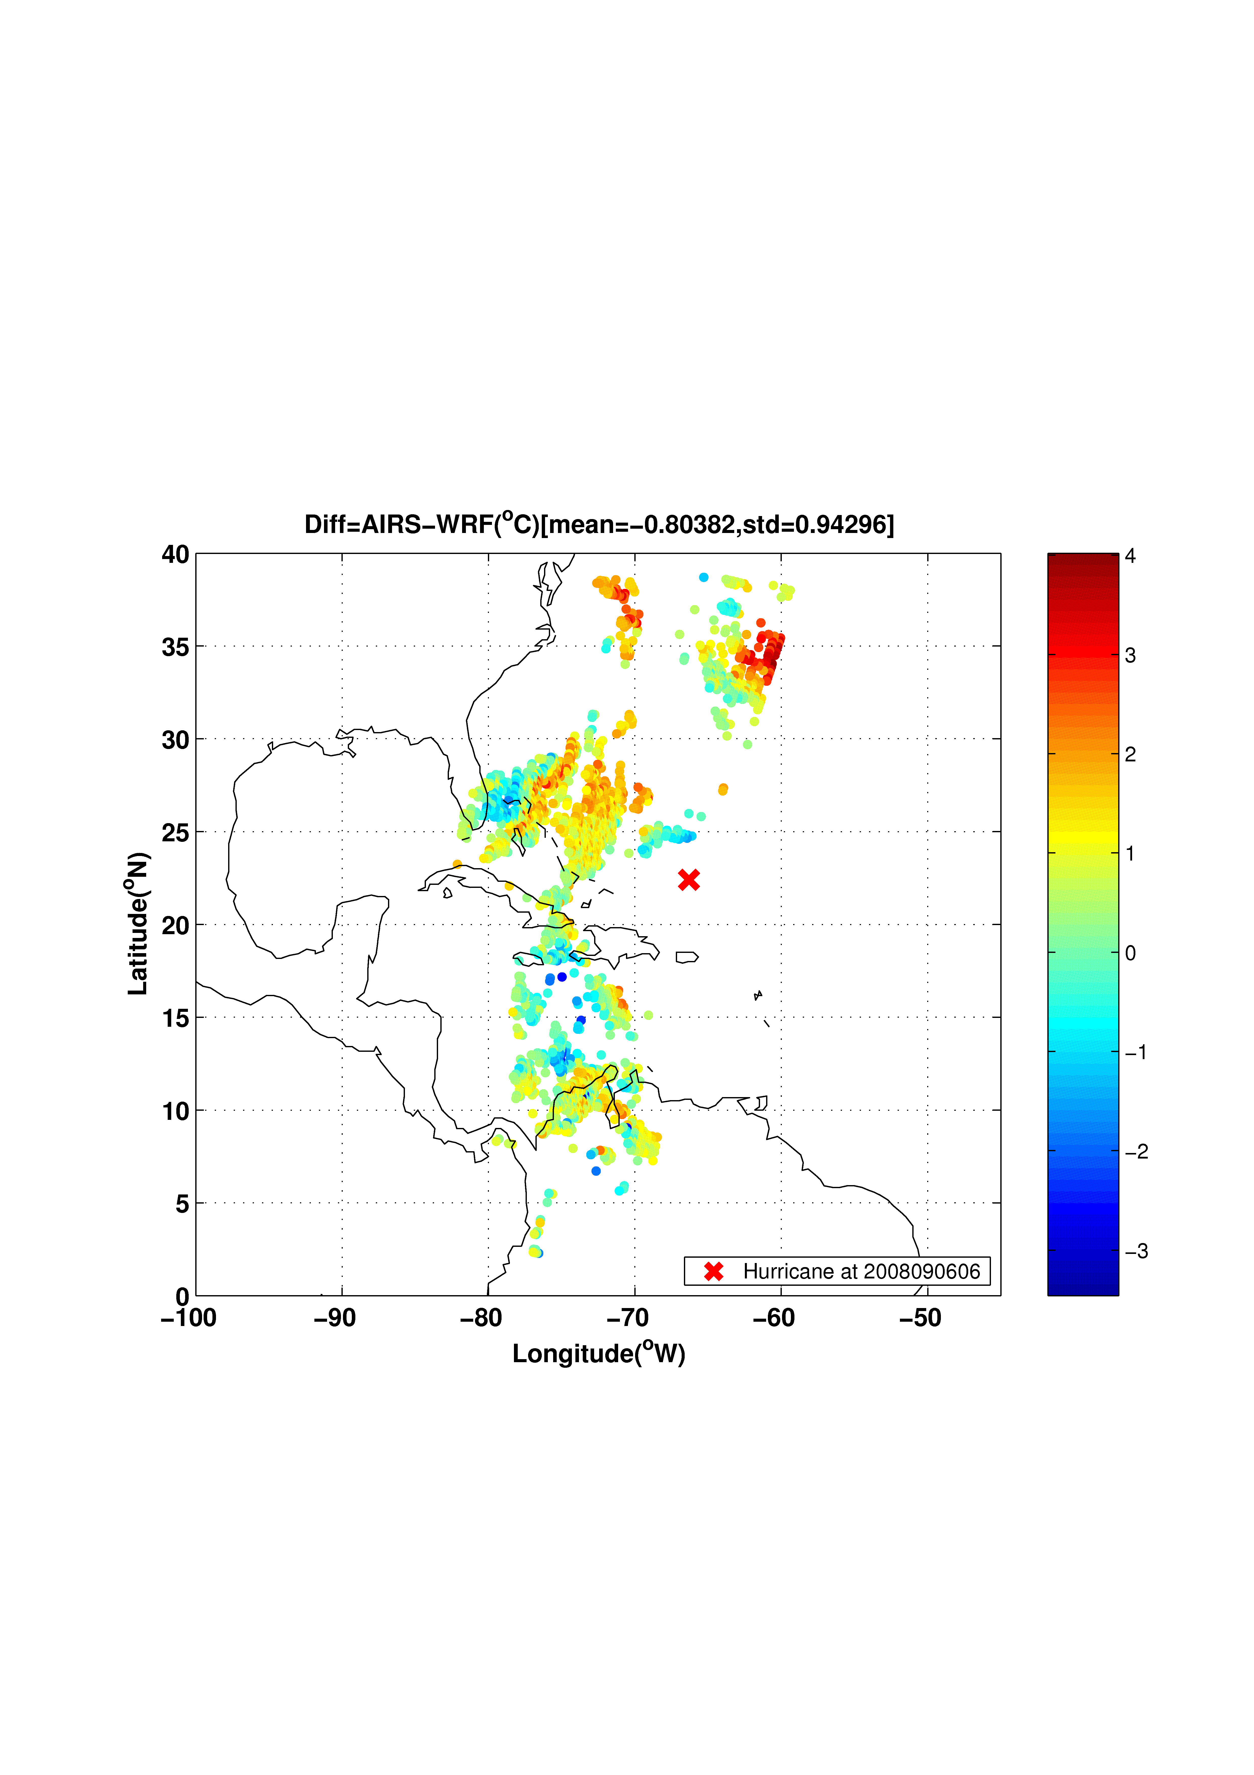
AIRS 2008090606_g066, g067, g068
AIRS 700 hPa temperature (upper left), WRF 700 hPa background temperature (lower left panel), and the temperature difference between the AIRS and WRF background (lower right panel) at 06 UTC 0n 06 September 2008.

Slide 27
48 hour forecast starting at 06 UTC 06 September 2008
Exp CTRL vs. OBS
Control run with NCEP, including radiosondes, satellite winds, pilot report, GPS, ship, profiler, surface observation, etc.
Exp AIRS vs. OBS
Control + assimilating 13 levels of AIRS single FOV temperature profiles between 500 and 800 hPa

Slide 28
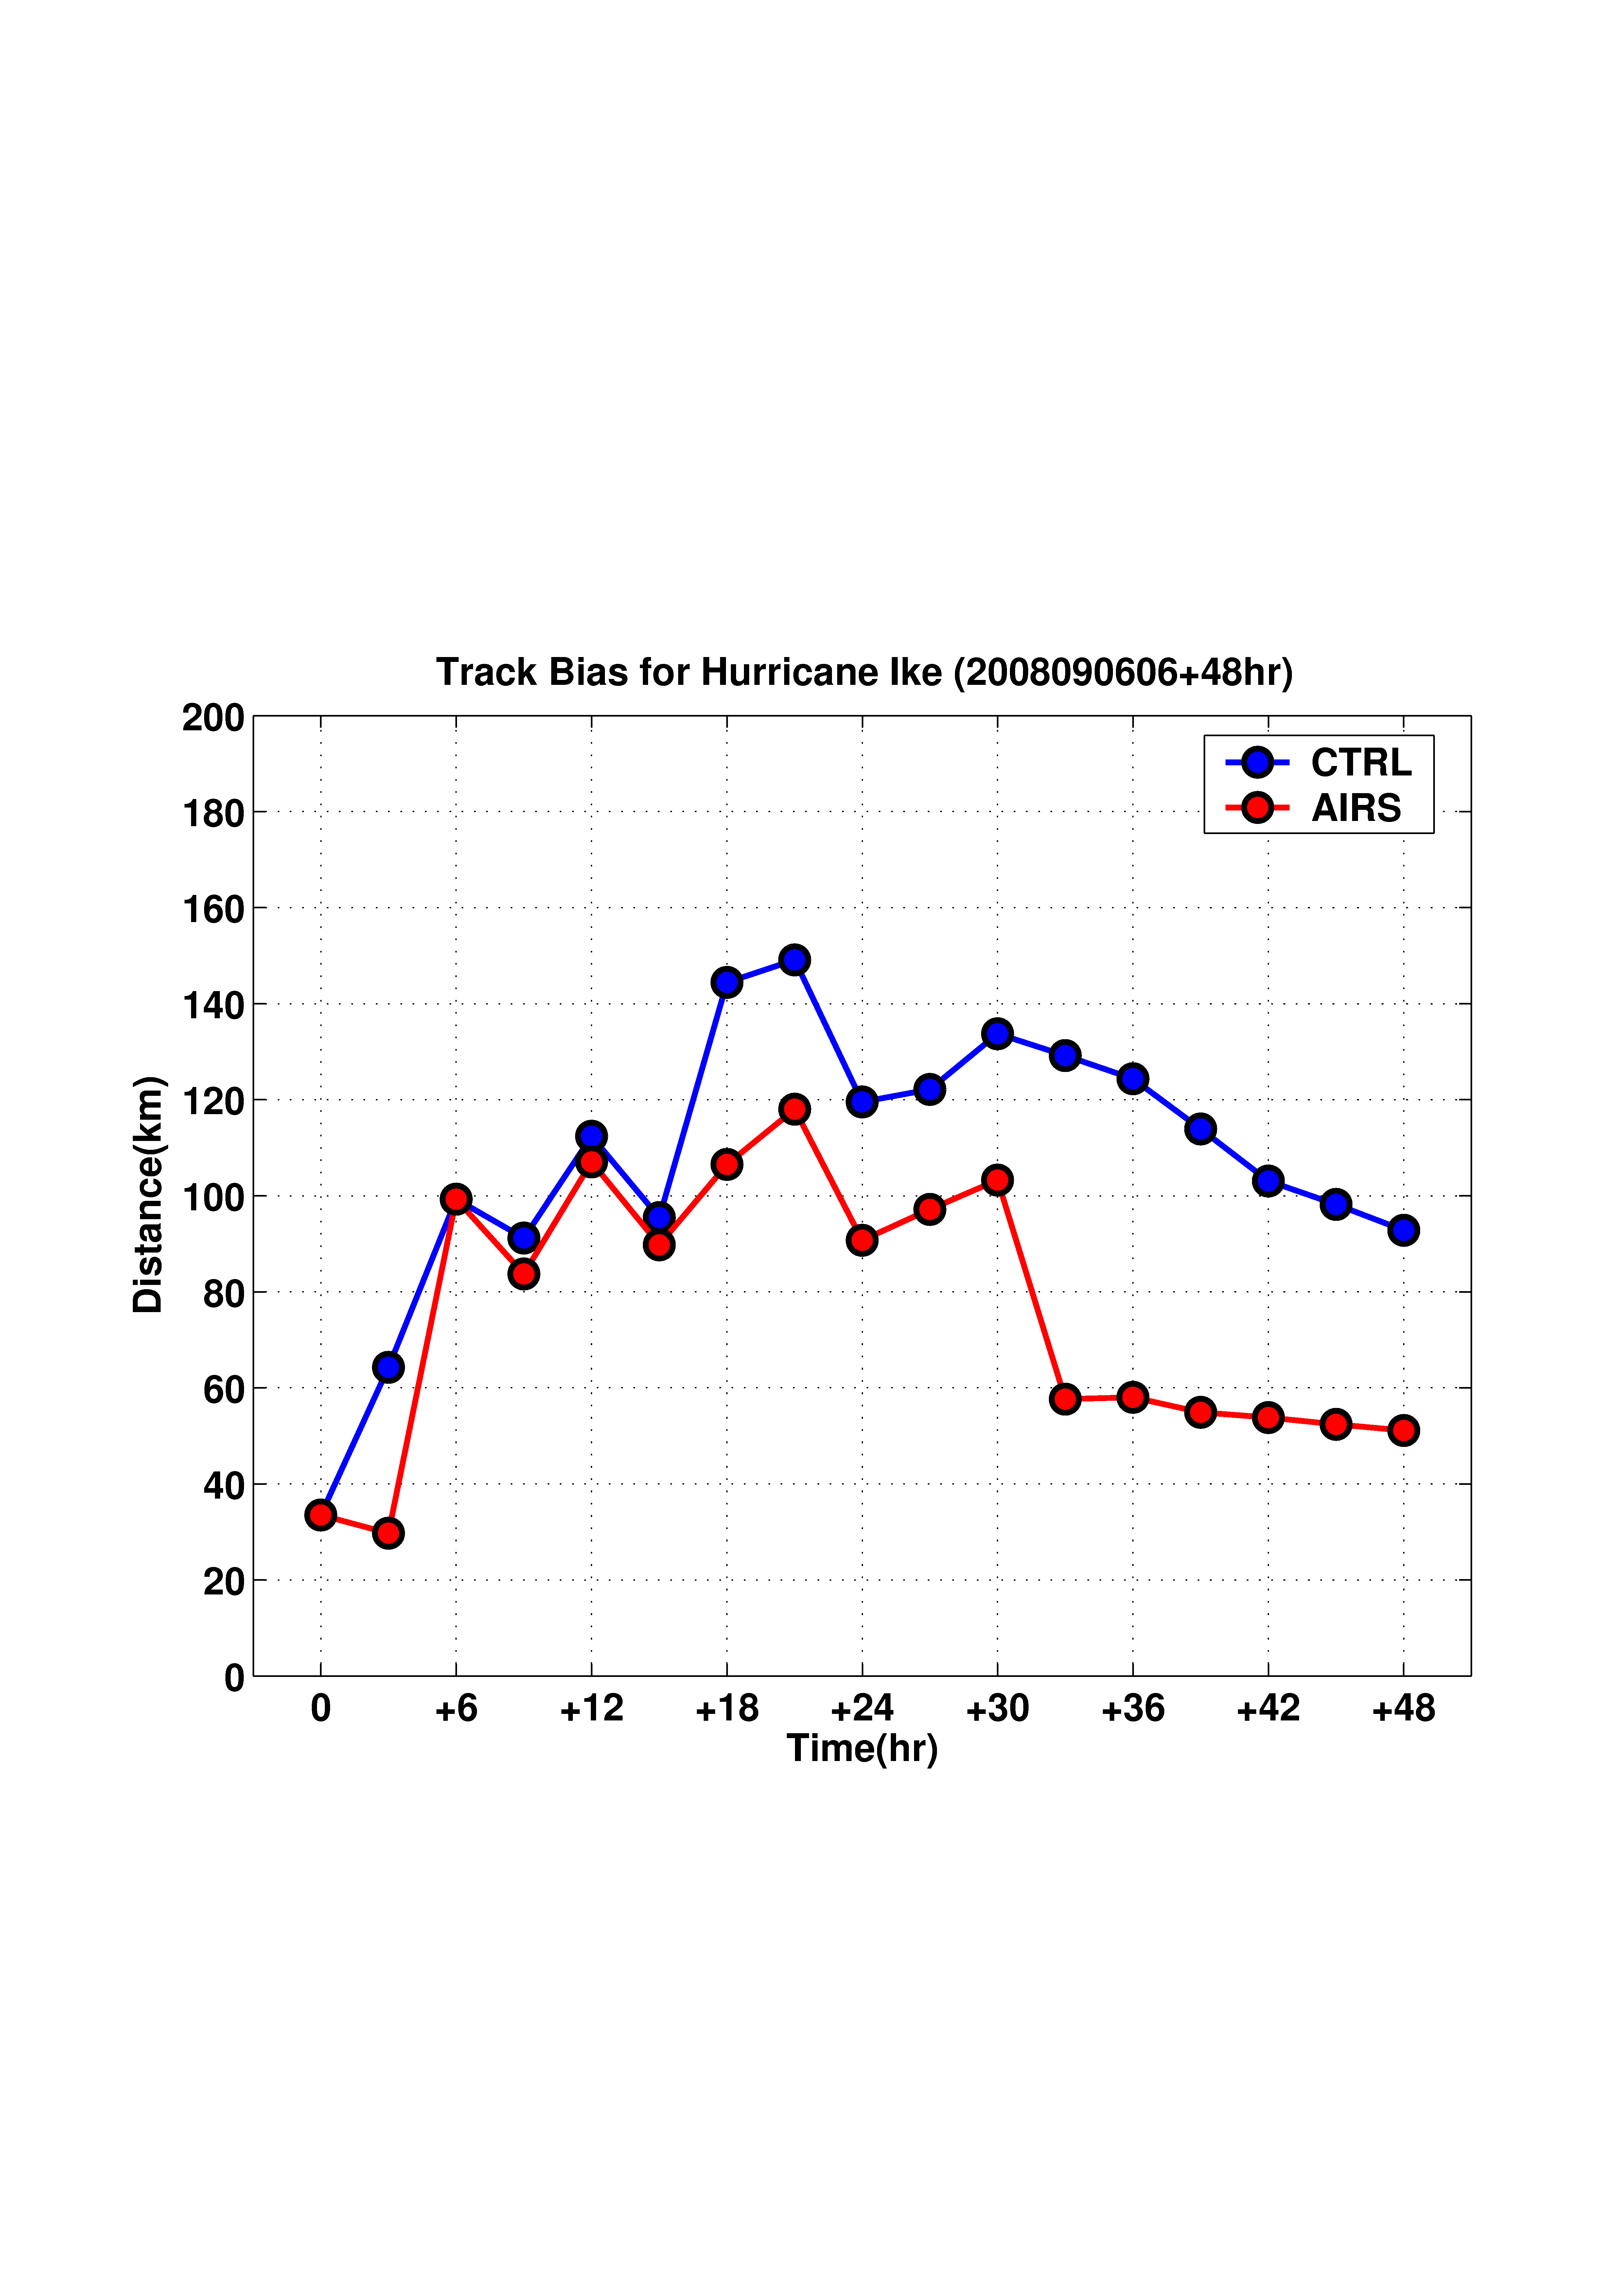
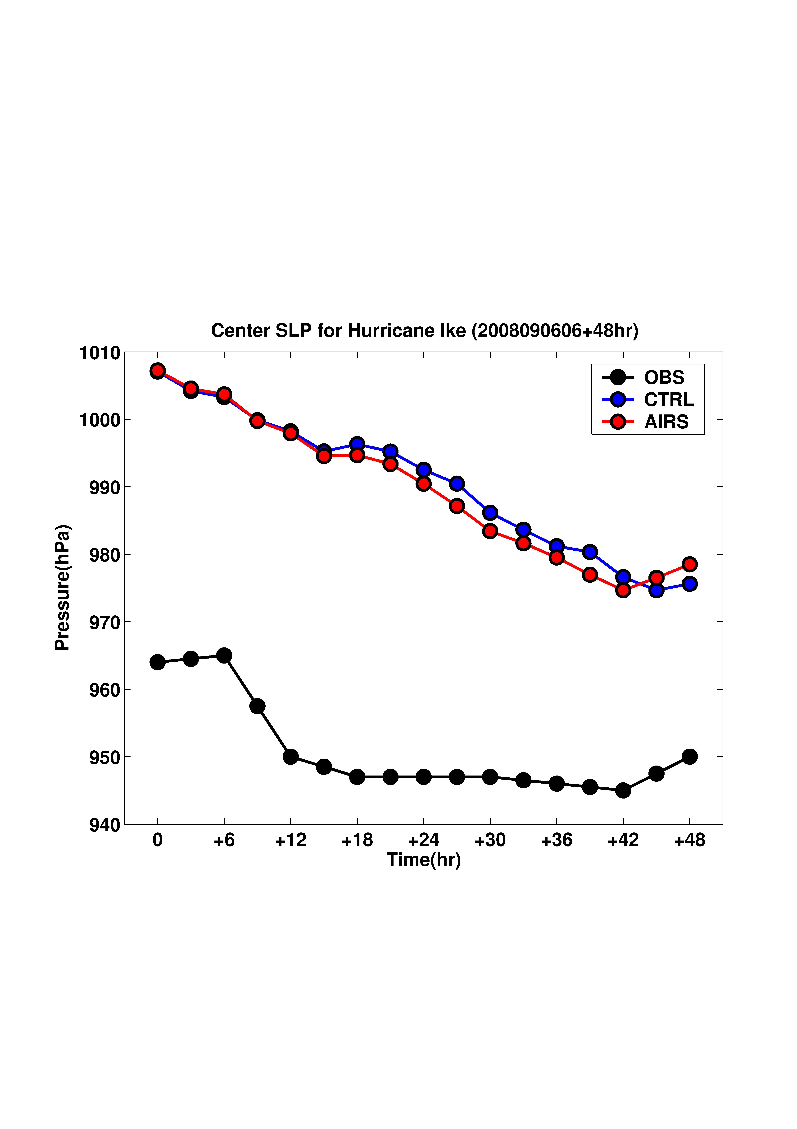
48 hour forecast track bias
(assimilate 500 – 800 hPa AIRS_T)
48 hour forecast SLP
(assimilate 500-800 hPa AIRS_T)
strongest

Slide 29
700 hPa Spatial Pattern: wind & wind speed
t=0
t=48 hr
CTRL
t=0
t=48 hr
AIRS

Slide 30
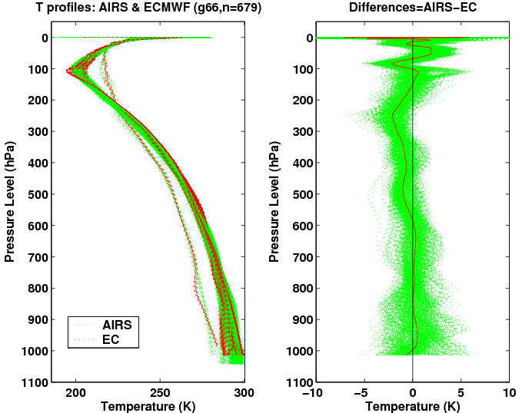

Slide 31
Assimilating advanced IR soundings with GRAPES/4DVAR – Storm precipitation forecast experiment
NWP and assimilation system: GRAPES/4DVAR
Assimilation time window: 18 UTC 21 July 2009, one AIRS granule is used, full spatial resolution water vapor soundings are used in the initial experiment
Forecast period: 18 UTC 21 – 00 UTC 23 July 2009
Comparisons: 24-hour precipitation (00 UTC 22 – 00 UTC 23 July 2009), the forecasts versus ground observations

Slide 32
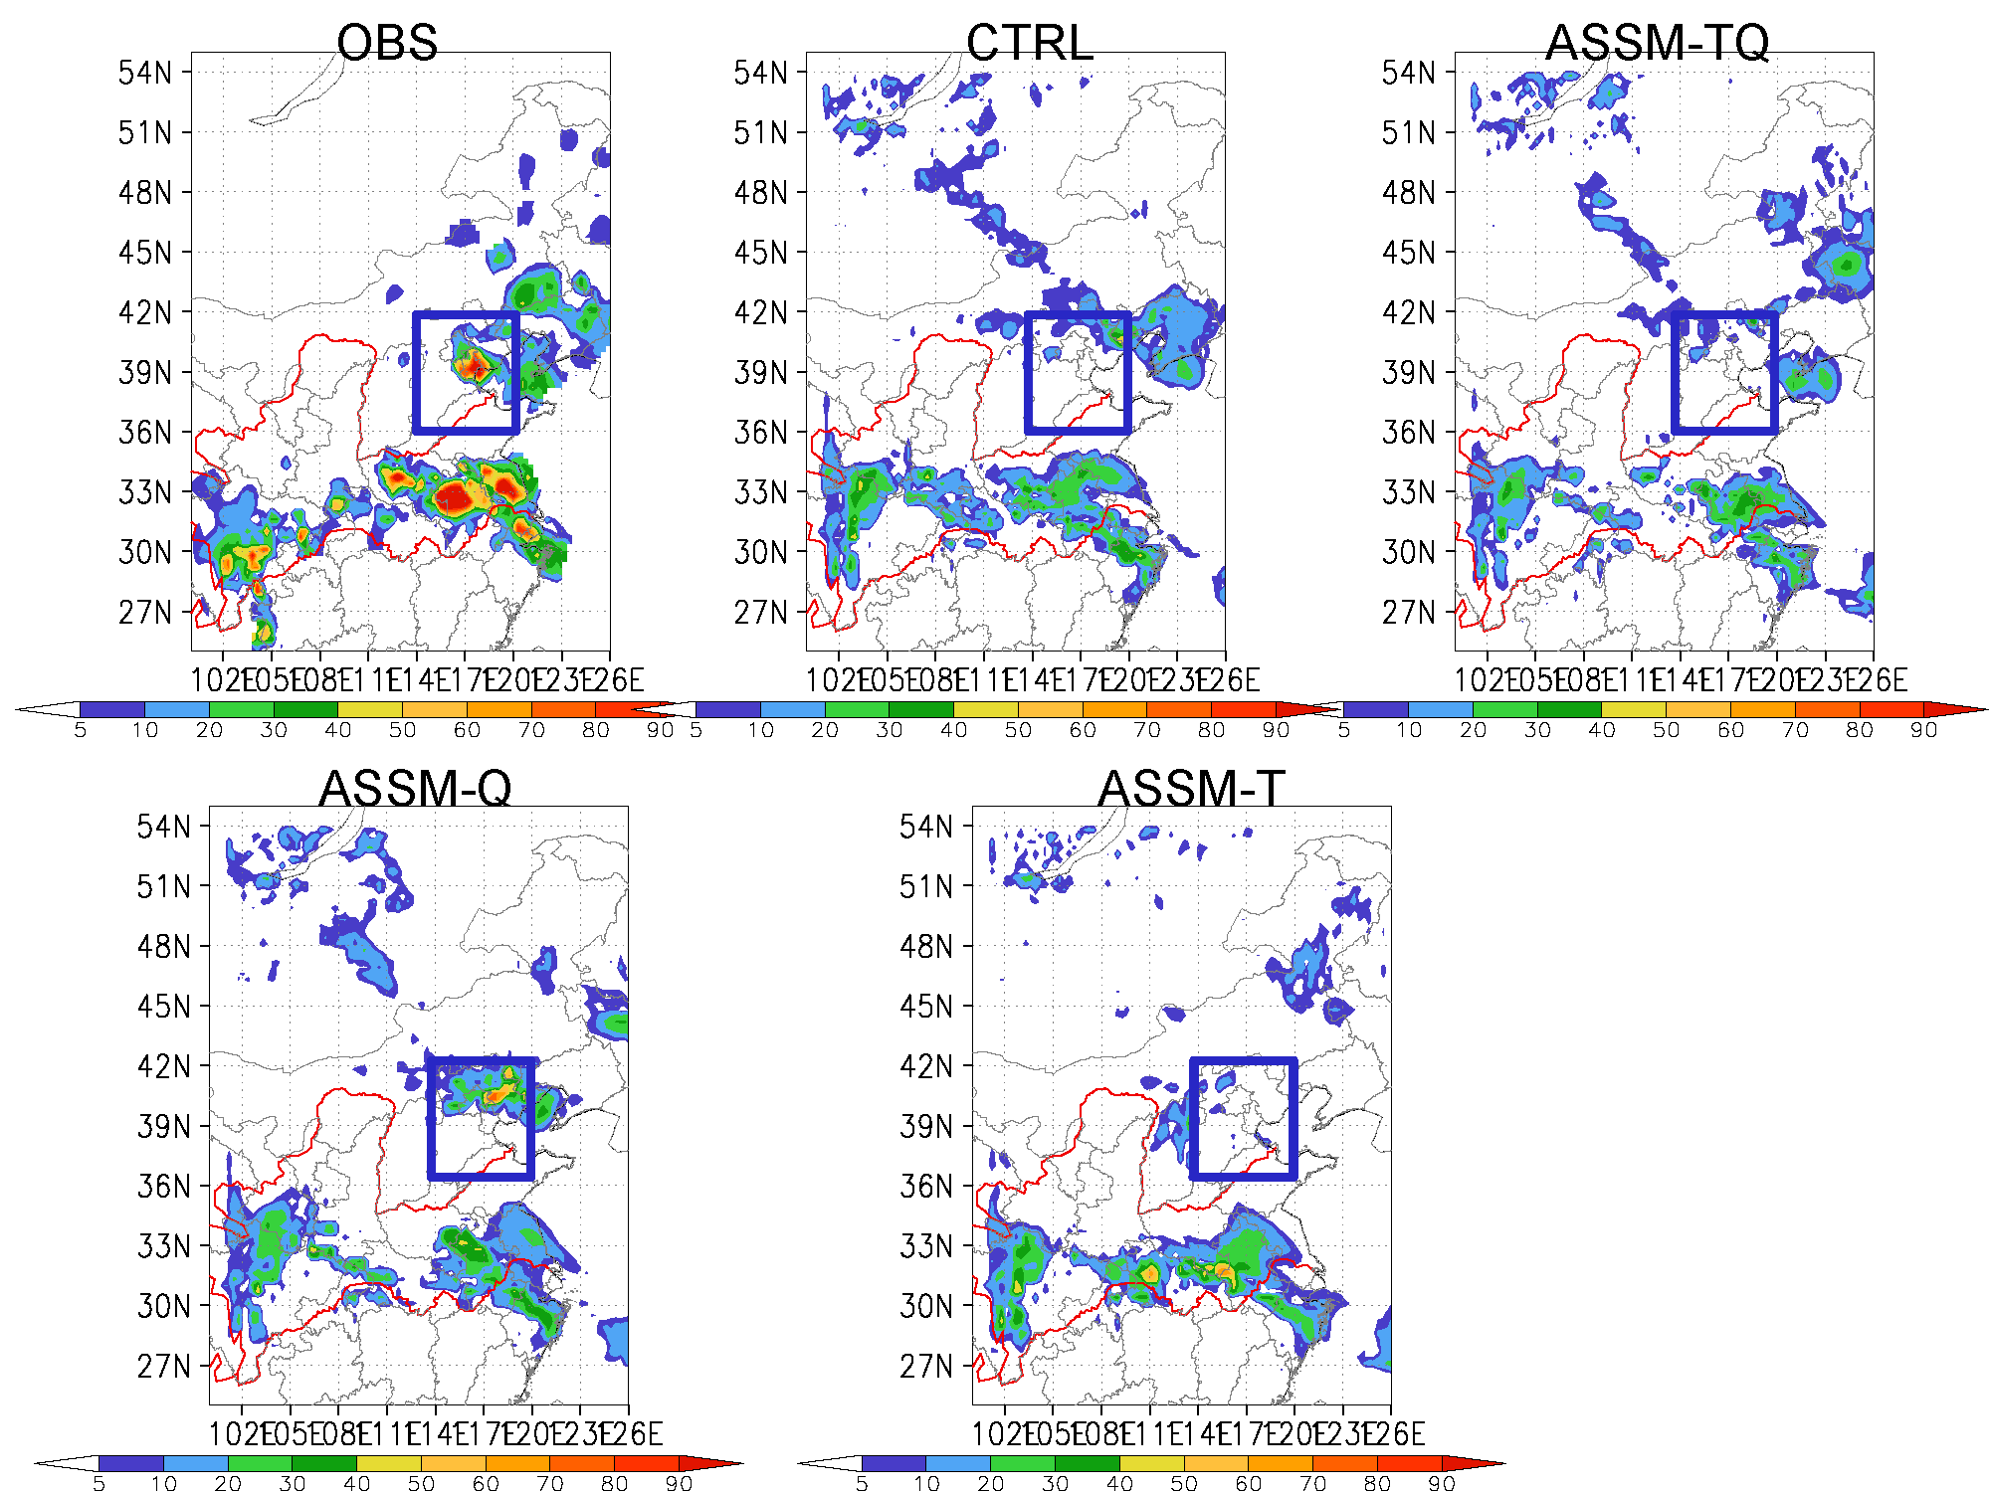
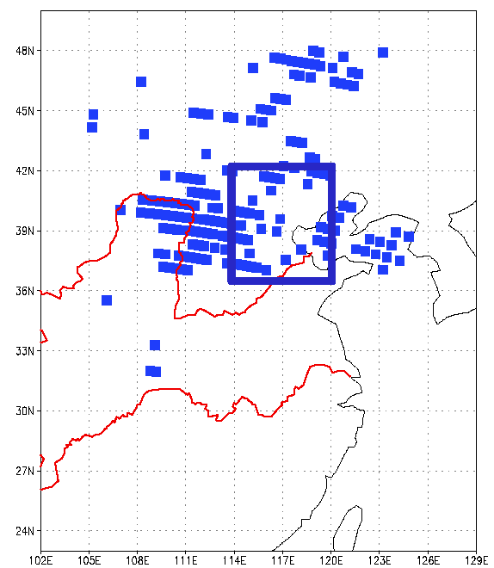
One out of 2 X 4 AIRS FOVs is selected, only 1/8 clear sky pixels are used in the assimilation. AIRS overpass time: 18:23 – 18:29 UTC 21 July 2009. CTRL run uses the NCEP analysis as initial. The regional NWP model is GRAPES_Meso2.0.
AIRS overpass time: 18:23 – 18:29 UTC 21 July 2009
24 hour precipitation forecast is improved when the AIRS single field-of-view water vapor profiles are assimilated.

Slide 33
Summary
The advanced IR soundings provide useful warning information in pre-convection environment
AIRS SFOV temperature and water vapor soundings improve both the track and intensity forecast for Hurricane Ike (2008) and Typhoon Sinlaku (2008) with both WRF/DART and WRF/3DVAR simulation and forecast systems.
AIRS SFOV moisture soundings significantly improve the definition of the typhoon vortex in the analysis and the forecast of the rapid intensification for Typhoon Sinlaku.
AIRS SFOV water vapor soundings improve 24 hour precipitation forecast with GRAPES/4DVAR

Slide 34
Plans on 2011
Study the value-added full spatial resolution advanced IR sounding data from polar-orbiting satellites for GOES-R in high impact weather nowcasting and short-range forecasting.
  GOES-R ABI water vapor
  GOES-R ABI water vapor + AIRS/IASI
Continue to study the unique applications of advanced IR sounder data for severe storm warning in the pre-convection environment
  Extracting and application of warning information in pre-convection environment from advanced IR soundings and GOES-R profiles
  Improving warning information by assimilating advanced IR soundings in regional NWP model
Study the impact of full spatial resolution advanced IR soundings on HIW forecasts through data assimilation techniques (DART, 3DVAR, 4DVAR, GSI).
Collaborate with ESRL on the better use of the advanced IR sounding data in the Rapid Refresh model.
Full spatial resolution advanced IR sounding algorithm update/improvement.

Slide 35
References
Li, J., H. Liu, 2009: Improved hurricane track and intensity forecast using single field-of-view advanced IR sounding measurements, Geophysical Research Letters, 36, L11813, doi:10.1029/2009GL038285.
Liu, H., and J. Li, 2010: An improvement in forecast of rapid intensification of typhoon Sinlaku (2008) using clear sky full spatial resolution advanced IR soundings, Journal of Applied Meteorology and Climate, 49, 821 – 827.
Li, J., H. Liu, and T. Schmit, 2010: Advanced infrared water vapor measurements improve hurricane forecasts. SPIE, 012337/FAE9473B/000053. (http://spie.org/x42479.xml?highlight=x2420&ArticleID=x42479)
Wang, B., J. Liu, S. Wang, W. Cheng, J. Liu, C. Liu, Q. Xiao, and Y. Kuo, 2010: An Economical Approach to Four-dimensional Variational Data Assimilation. Adv. Atmos. Sci., 27, 715 - 727.

