Slide 1


Geostationary Lightning Mapper (GLM)
Steven Goodman
GOES-R Program Senior Scientist
NOAA/NESDIS
http://www.goes-r.gov
(with contributions from our many partners)
NOAA igh Impact Weather Workshop
Norman, OK
24 February, 2011

Slide 2
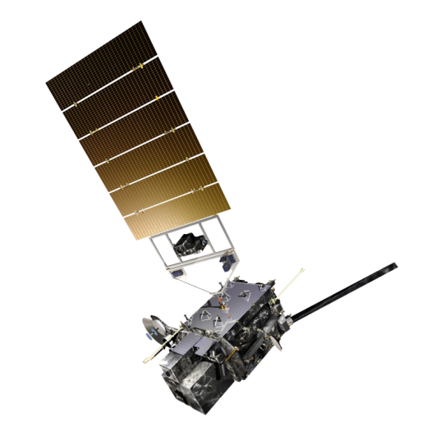
GOES-R Spacecraft
Specifications
Size ~5.5 meters (from launch vehicle interface to top of ABI)
Mass Satellite (spacecraft and payloads) dry mass <2800kg
Power Capacity >4000W at end-of-life (includes accounting for limited array degradation)
Lockheed-Martin Space Systems Co (LMSSC) of Newtown, PA is primary contractor
Extreme UV/X-ray Irradiance Sensor (EXIS)
Solar UV Imager (SUVI)
Magnetometer
Space Environment
In-situ Suite (SEISS)
Current Status
Design activities progressing well
Spacecraft System Definition Review (SDR)
completed March 9-10, 2010
Spacecraft baseline established in April 2010
Preliminary Design Review (PDR) held
January 18-20, 2011
Geostationary Lightning Mapper (GLM)
Advanced Baseline Imager (ABI)
Unique Payload Services:
High Rate Information Transmission/Emergency Managers Weather
Information Network (HRIT/EMWIN)
Data Collection System (DCS)
Search and Rescue Satellite-aided Tracking (SARSAT) Repeater
GOES-R Rebroadcast (GRB)

Slide 3
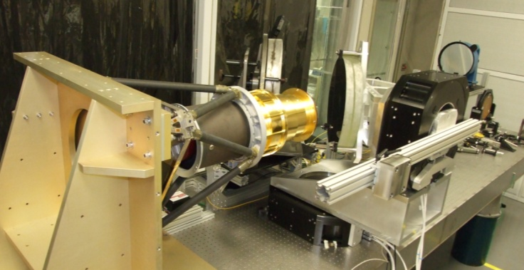
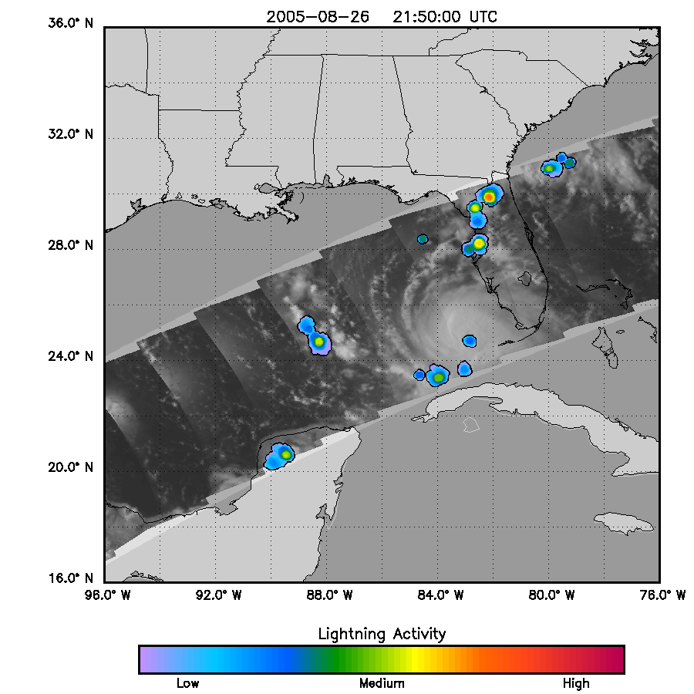
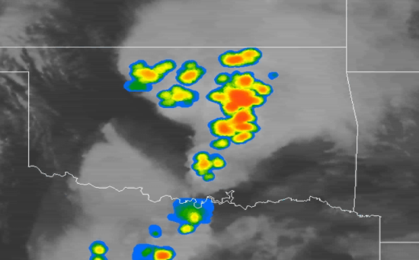
Geostationary Lightning Mapper (GLM)
Sensor Unit Mechanical Support Structure
Metering tube
Optical Assembly
Detects total lightning: in cloud, cloud to cloud, and cloud to ground
  Aids in forecasting severe storms and tornado activity, and convective weather impacts on aviation safety and efficiency.
  Currently no ocean coverage, and limited land coverage in dead zones
Lightning with Hurricane Katrina and Tornadic Storms over Oklahoma
Notes:
The Geostationary Lighting Mapper (GLM) will map total lightning activity (in-cloud and cloud-to-ground lighting flashes) continuously day and night with near-uniform spatial resolution of 8 km with a product refresh rate of less than 20 sec over the Americas and adjacent oceanic regions.
This will aid in forecasting severe storms and tornado activity, and convective weather impacts on aviation safety and efficiency.
n parallel with the instrument development (a prototype and 4 flight models), a GOES-R Risk Reduction Team and Algorithm Working Group Lightning Applications Team have begun to develop the Level 2 algorithms, cal/val performance monitoring tools, and new applications.
Proxy total lightning data from the NASA Lightning Imaging Sensor on the Tropical Rainfall Measuring Mission (TRMM) satellite and regional test beds are being used to develop the pre-launch algorithms and applications, and also improve our knowledge of thunderstorm initiation and evolution.

Slide 4
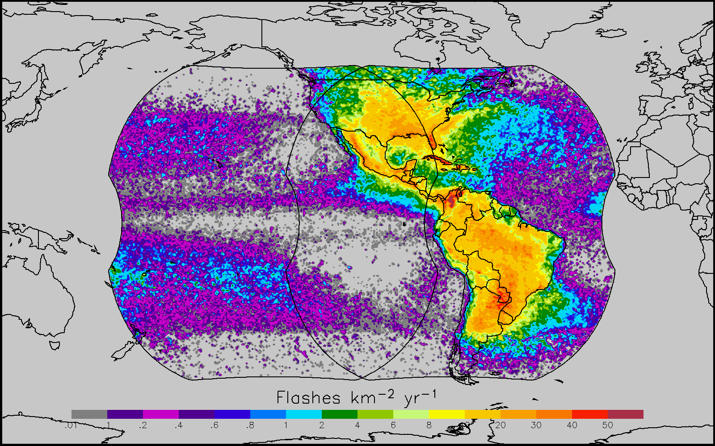
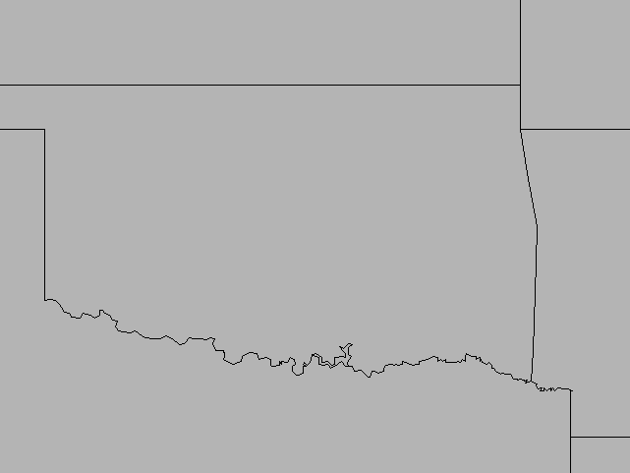
GOES-R GLM Coverage
LIS/OTD Combined Lightning 1997-2005
GLM Characteristics
Staring CCD imager (1372x1300 pixels)
Near uniform spatial resolution/ coverage up to 52 deg lat
  - 8 km nadir
  14 km edge fov
70-90% flash detection
Single band 777.4 nm
2 ms frame rate
7.7 Mbps downlink data rate
< 20 sec product latency
1-minute of observations from TRMM/LIS

Slide 5
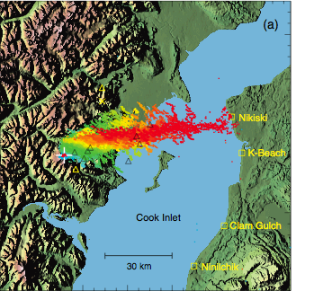
Volcanic Lightning: Eruption of Redoubt Volcano
NM Tech

Slide 6
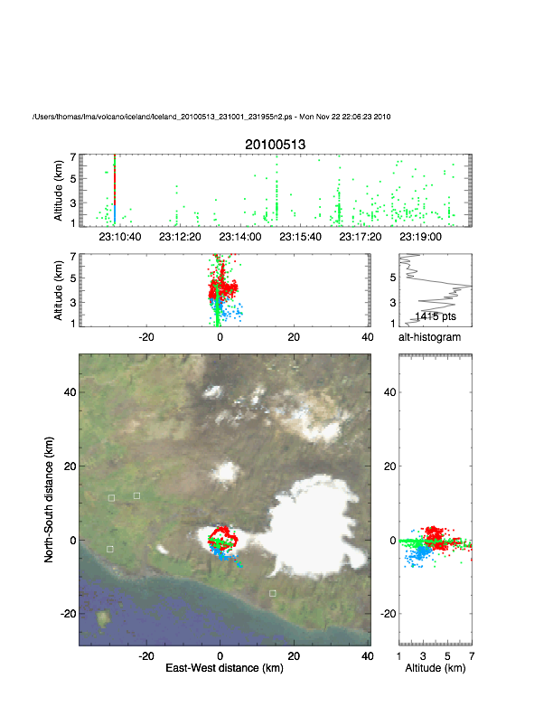
Volcanic Lightning:
Eyjafjallajökull Eruption, Iceland 2010
Reykjavik
NM Tech

Slide 7
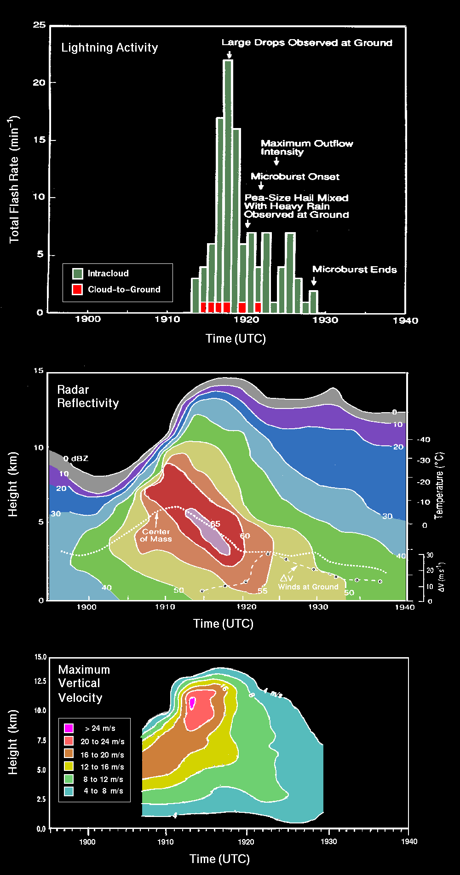
Physical Basis:
Lightning Connection to Thunderstorm Updraft, Storm Growth and Decay
Air Mass Storm
20 July 1986
Total Lightning —responds to updraft velocity and concentration, phase, type of hydrometeors, integrated flux of particles
WX Radar — responds to concentration, size, phase, and type of hydrometeors- integrated over small volumes
Microwave Radiometer — responds to concentration, size, phase, and type of hydrometeors — integrated over depth of storm (85 GHz ice scattering)
VIS / IR — cloud top height/temperature, texture, optical depth
Figure from Gatlin and Goodman, JTECH, Jan. 2010- adapted from Goodman et al, 1988; Kingsmill and Wakimoto, 1991

Slide 8
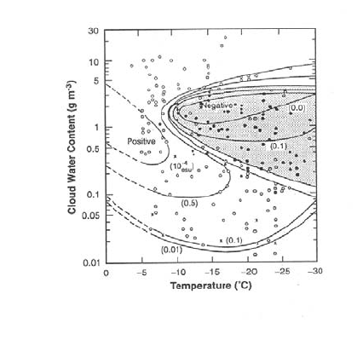
Laboratory Cloud Charging Results
Large ice particles charge negatively
Laboratory charging results for temperature as a function of cloud water content (Takahashi et al., 1978)

Slide 9
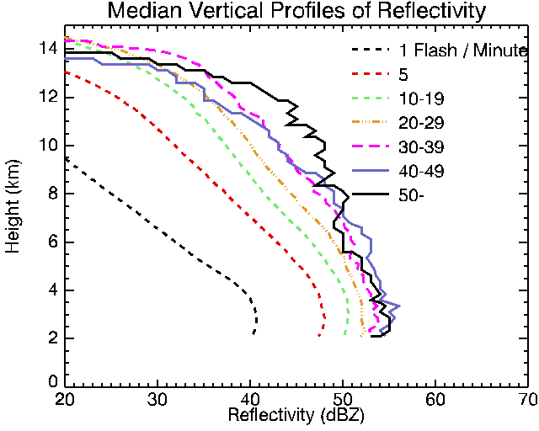
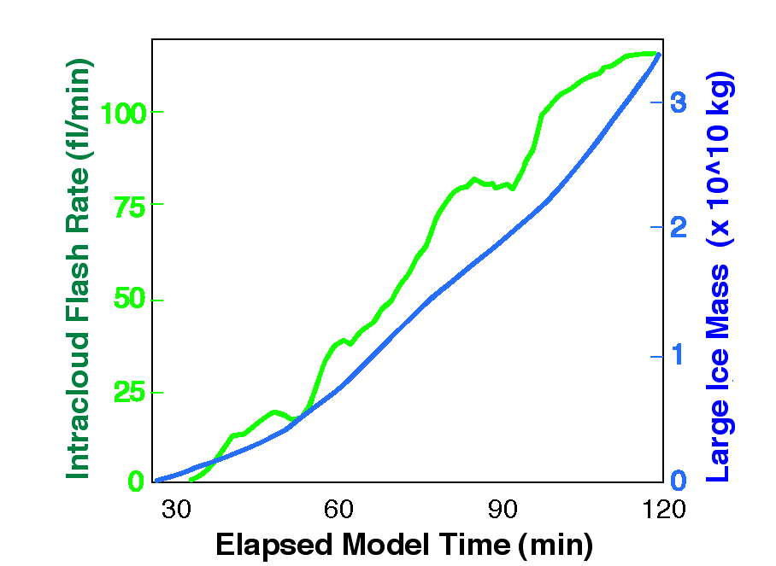
Physical Basis: Flash Rate Coupled to Mass in the Mixed Phase Region
TRMM PR and LIS
Process physics understood
(Cecil et al., Mon. Wea. Rev. 2005)
Storm-scale model with explicit microphysics and electrification (Mansell)
Ice flux drives lightning
Physical basis for improved forecasts
0 ºC
IC flash rate controlled by graupel (ice mass) production (and vertical velocity)

Slide 10




NOAA’s Hazardous Weather Testbed
EFP
EWP
Experimental
Forecast
Program
Experimental
Warning
Program
GOES-R PG
Prediction of hazardous weather events from a few hours to a week in advance
Detection and prediction of hazardous weather events up to several hours in advance

Slide 11
GOES-R Proving Ground
  What is the GOES-R Proving Ground?
    Collaborative effort between the GOES-R Program Office, selected NOAA Cooperative Institutes, NASA SPoRT, NWS forecast offices, NCEP National Centers, JCSDA, and NOAA Testbeds.
    Where proxy and simulated GOES-R products are tested, evaluated and integrated into operations before the GOES-R launch
    A key element of GOES-R User Readiness (Risk Mitigation)

Slide 12
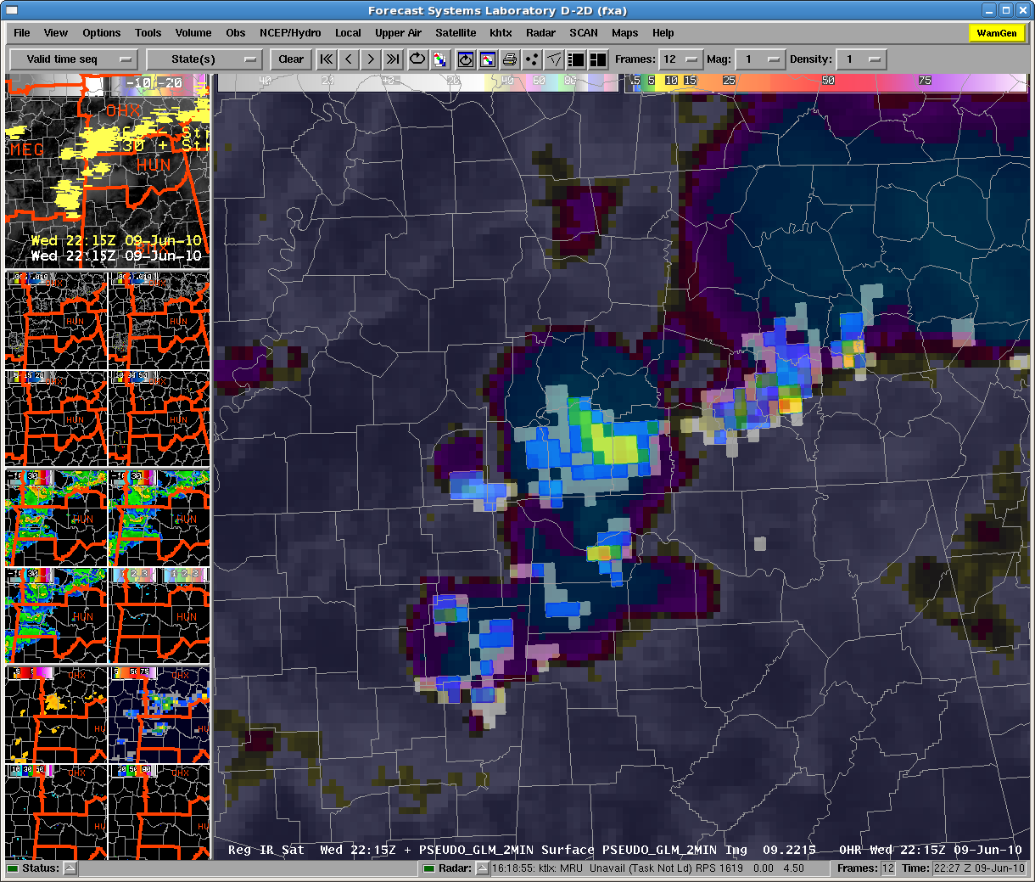
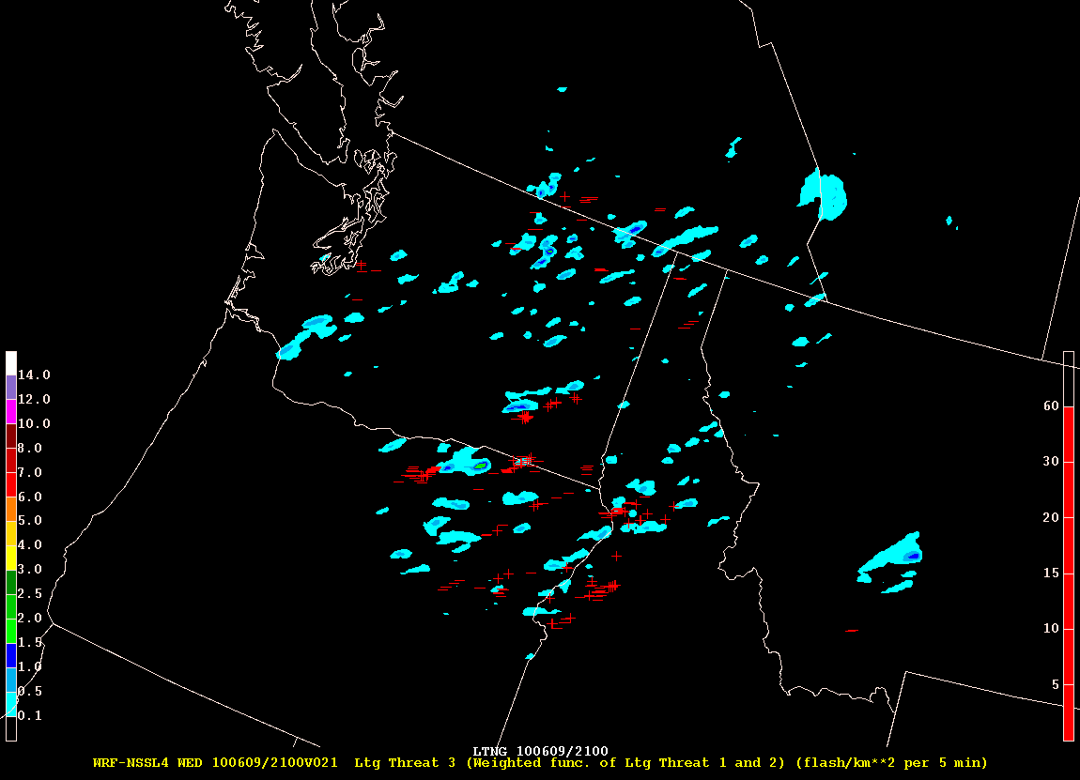
Total Lightning Detection
Pseudo-GLM
  Data from ground-based total lightning detection networks
    Huntsville, AL; Washington, DC; Melbourne, FL; and Norman, OK
  Raw data sorted into flashes and interpolated to an 8km grid
  Running 2-minute average
Simulated lightning threat
  Based on NSSL-WRF 0Z 4km data
  Estimates total lightning from vertical ice content and flux within cloud objects (see McCaul et al., 2009)

Slide 13
Pseudo-Geostationary Lightning Mapper (PGLM)
The real-time lightning data was available in 1 or 2-minute intervals and sorted into flashes using algorithms available through Warning Decision Support System – Integrated Information (WDSS-II). Following flash sorting, a Flash Extent Density product was created at 8-km resolution to match that expected by the GOES-R GLM.
NWS forecasters evaluated the PGLM product during both real-time operations and for an archive event. The PGLM product was available as a running 2-minute average at 1-minute updates within AWIPS.
The PGLM products provided a strong support tool for the forecasters and helped increase forecaster confidence to warn or not warn on a storm. The lightning data was often noted as perhaps being more important with pulse storms or near-severe situations where lightning would be more clearly indicative of important updraft fluctuations. Forecasters viewed future GLM data as a “great tool” or a possible “mainstream product” for “situational awareness” in “making sure no dangerous cells are being missed.”
Forecaster AWIPS display of PGLM flash extent density product and IR image over Central Tennessee and Northern Alabama at 2215 UTC on 9 June 2010. The overlay of PGLM on IR allowed the forecaster to focus on the most active convective cores.

Slide 14
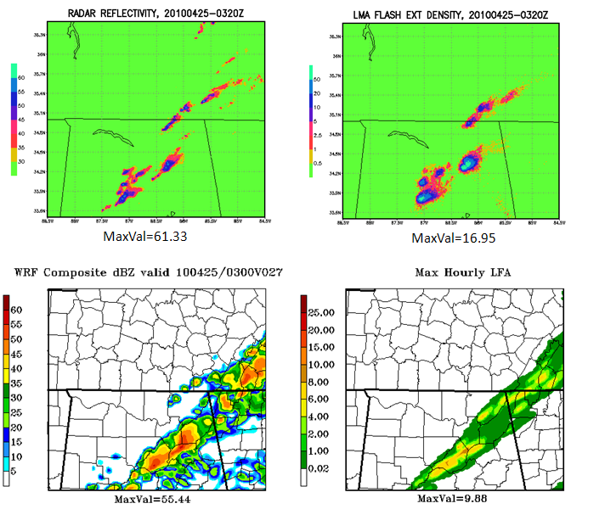
WRF Lightning Threat Comparison with NEXRAD and LMA Observations
Direct comparison of the NSSL WRF 27 h forecast at 03Z on 25 April 2010 with the 0300 UTC radar and Lightning Mapping Array (LMA, top row) and model composite reflectivity and max-hourly LFA flash extensity density (bottom row). The LFA in the lower-right shows the tracks of storms in the previous forecast hour. The radar data are a merged composite of HTX,OHX,GWX,BMX and FFC, with the plotted values being the largest of the 5 radars at each pixel.

Slide 15
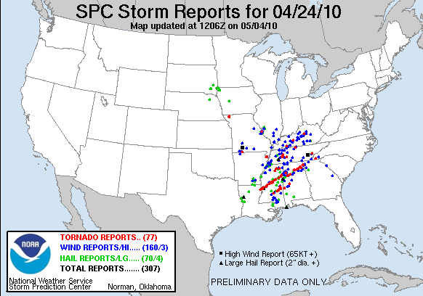

Slide 16
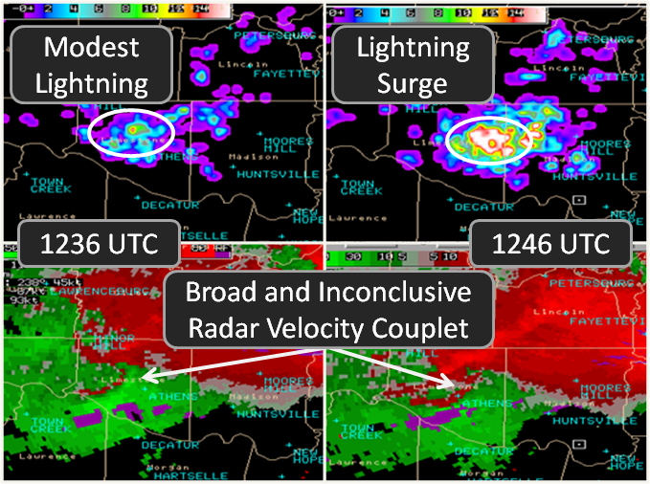
Total Lightning Increases with Storm Growth and Updraft Intensification

Slide 17
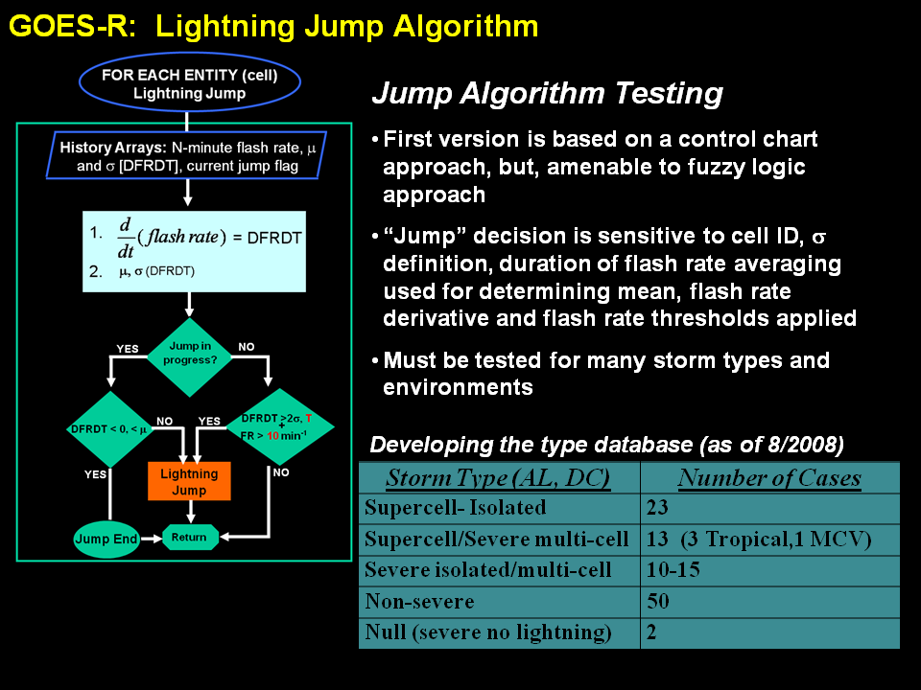
Lightning Jump Algorithm Status
Six separate lightning jump configurations tested
Case study expansion:
  107 T-storms analyzed
    38 severe
    69 non-severe
The “2σ” configuration yielded best results
  POD beats NWS performance statistics (80-90%);
  FAR even better i.e.,15% lower (Barnes et al. 2007)
    Caveat: Large difference in sample sizes, more cases are needed to finalize result.
M.S. Thesis completed and study accepted to JAMC (Schultz, Petersen, Carey 2009); forms the conceptual basis of the lightning jump ATBD
Thunderstorm breakdown:
North Alabama – 83 storms
Washington D.C. – 2 storms
Houston TX – 13 storms
Dallas – 9 storms
Algorithm | POD | FAR | CSI | HSS
Gatlin and Goodman | 90% | 66% | 33% | 0.49
Gatlin 45 | 97% | 64% | 35% | 0.52
2σ | 87% | 33% | 61% | 0.75
3σ | 56% | 29% | 45% | 0.65
Threshold 10 | 72% | 40% | 49% | 0.66
Threshold 8 | 83% | 42% | 50% | 0.67

Slide 18
LJA Case Expansion
Since, we’ve expanded to 638 thunderstorms
  Primarily from N. Alabama (537)
  Also included
    Washington D.C. (49 and counting)
    Oklahoma (30 and counting)
    STEPS (22)
Regional expansion has proven robust
  POD: 82%, FAR 35%, avg. lead time: 22 mins.
Courtesy Chris Schultz, UAH

Slide 19
HWT Blog
EWP ready to go... 5/19/2010
Some notes from the briefing...
The NSSL-WRF lightning threat forecast was shown to the forecasters for this evening and it helped us identify which storms may have stronger updrafts because of their increased lightning output, which we couldn't necessarily determine from the synthetic satellite or radar output.
Thursday, May 20, 2010
At 1:30 PM, the North Alabama Lightning Mapping Array (NALMA) showed lightning activity along the northern Mississippi-Alabama border. The 00Z 20 May NSSL-WRF run in support of the NSSL/SPC EFP shows continued evolution of this convection toward central Alabama by 00-02Z this evening.
The lightning threat field in the NSSL-WRF using the McCaul blended vertically integrated ice / graupel flux method shows lightning activity extending north-south through Alabama at 1Z. The predicted flash rates are somewhat less over the far northern part of the domain.

Slide 20
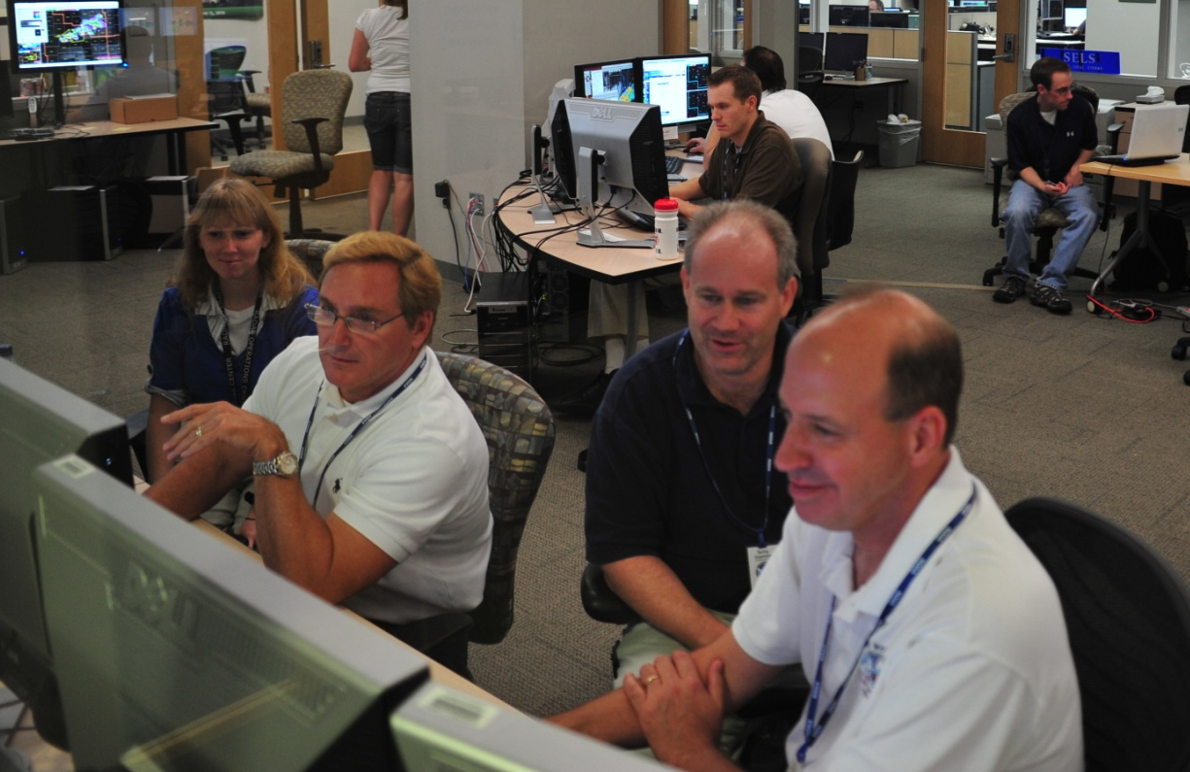
HWT: Forecaster Feedback from 2010
“We saw several instances where the total lightning was picking up on storms before the AWIPS lightning [NLDN] program picked up on them. One could see the utility of this in the future, bringing with it a potential for lighting statements and potentially lightning based warnings.”
  -Pat Spoden (SOO, NWSFO Paducah, KY)
http://ewp.nssl.noaa.gov/
http://goesrhwt.blogspot.com/
K. Kuhlman

Slide 21
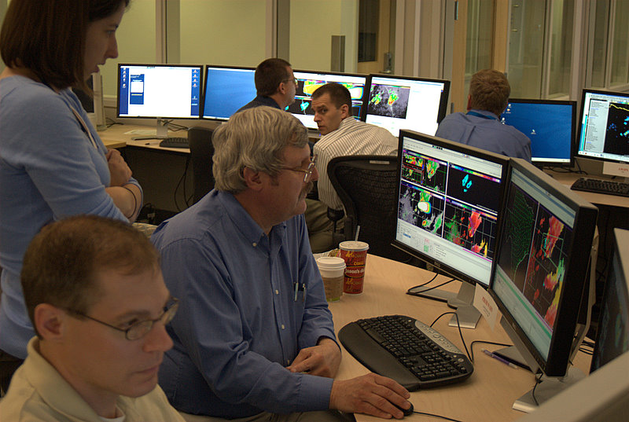
HWT: Forecaster Feedback from 2010
“lightning data provide a reassurance that I can see leading me to make a warning decision a little earlier due to having more confidence in imminent severe weather.”
“would be of great benefit to aviation forecasting in those situations where there is a developing shower or embedded thunderstorms in stratiform rain.”
“[GLM] will also prove very beneficial as we get more into decision support services, especially to support the safety of responders to incidents who are exposed to lightning hazards.”
  -- Frank Alsheimer (SOO, NWSFO Charleston, SC)
K. Kuhlman

Slide 22
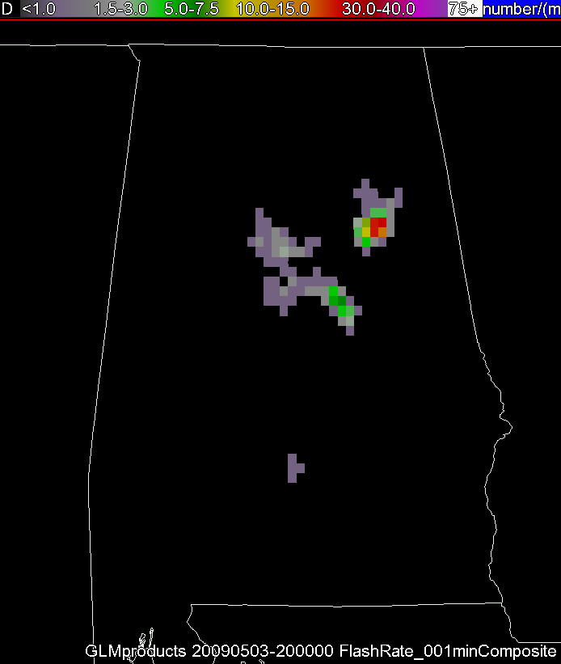
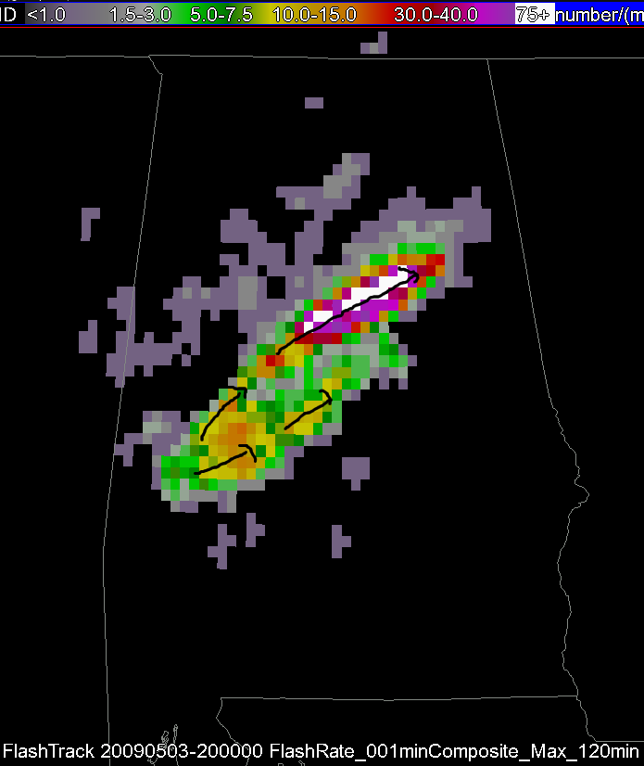
Suggestions for Future Testing:
Additional Products:
  Rate of change of flash rate (as a gridded product, not a line graph)
More Events:
  Winter Weather (convective snow bands)
  Landfalling tropical cyclones
  Fire & Aviation Applications
Increased guidance from research
  Flash rates expected with different convective modes and associated severe weather occurrence
  Relationship of flash density with radar signatures typical of severe weather
K. Kuhlman

Slide 23
Aviation-Convective Weather Hazards
Since there are few surface-based radar and/or other meteorological observations covering most of the oceans, convective intensity and associated aviation hazard potential (i.e., turbulence, icing, lightning, volcanic ash) are evaluated using satellites
Ultimately, the goal is a combined GOES-R GLM/ABI algorithm for the detection of aviation hazards associated with convection. Such an algorithm should improve aviation routing and safety in the vicinity of thunderstorms, thus reducing the number of related incident reports and suspected storm-related accidents

Slide 24
GLM Proxy over Remote Regions
Within the lightning science and applications community, there is a need for lightning data over the oceans and other remote regions (i.e., global).
  E.g., enroute aviation applications, hurricane studies, GLM proxy
LIS (OTD) is an ideal proxy for GLM but there is no temporal continuity (snapshots).
What are the potential options for global (or very large remote region)?
  World Wide Lightning Location Network (WWLLN)
  Vaisala Global Lightning Dataset (GLD360)
  Earth Networks (AWS) WeatherBug (WTLN)
  Other ground-based VLF-based long-range networks (WSI TOA, UK ATDnet)
WWLLN is more mature and better characterized
  30% cloud-to-ground (CG) flash detection efficiency (DE) for peak current > 30 kA
  CG Flash Location Accuracy (LA) ~ 15 – 30 km

Slide 25
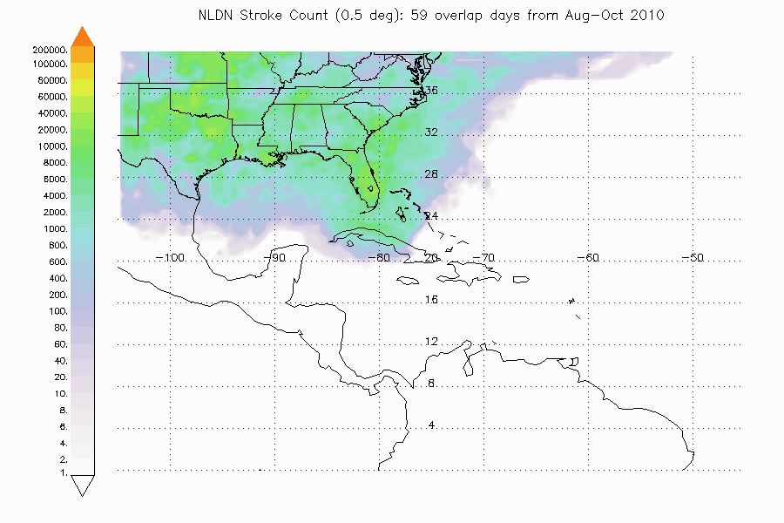
NLDN Lightning: August-September-October 2010
* Overlap days: 8/17/2010, 8/24/2010 – 9/15/2010, 9/21/2010 – 10/5/2010, 10/12/2010 – 10/31/2010

Slide 26
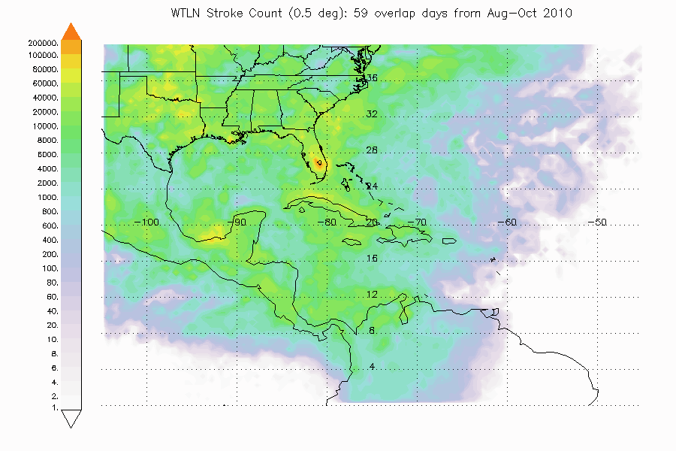
WTLN Lightning: August-September-October 2010
* Overlap days: 8/17/2010, 8/24/2010 – 9/15/2010, 9/21/2010 – 10/5/2010, 10/12/2010 – 10/31/2010

Slide 27
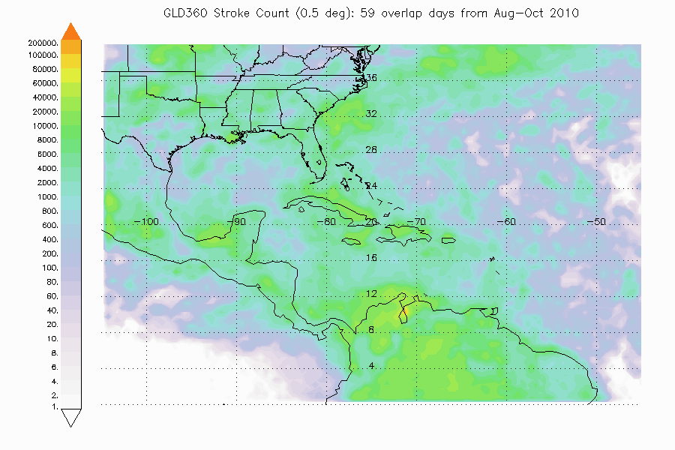
GLD360 Lightning: August-September-October 2010
* Overlap days: 8/17/2010, 8/24/2010 – 9/15/2010, 9/21/2010 – 10/5/2010, 10/12/2010 – 10/31/2010

Slide 28
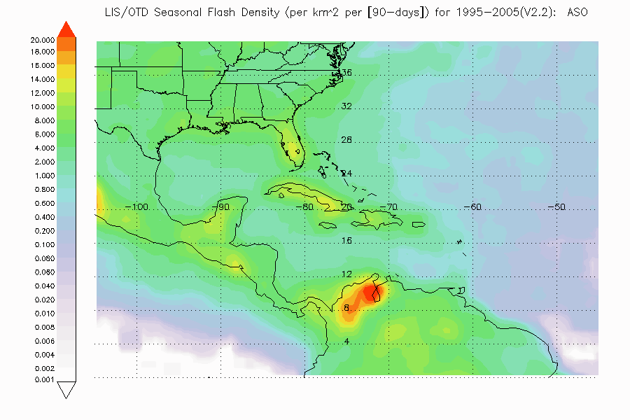
LIS/OTD Total Lightning Climatology: August-September-October
Of critical importance- need to understand commercial ground-based lightning detection systems for 1) GLM proxy data set development, and 3) potential use in GLM on-orbit cal/val, and 3) potential applications using integrated observing systems

Slide 29
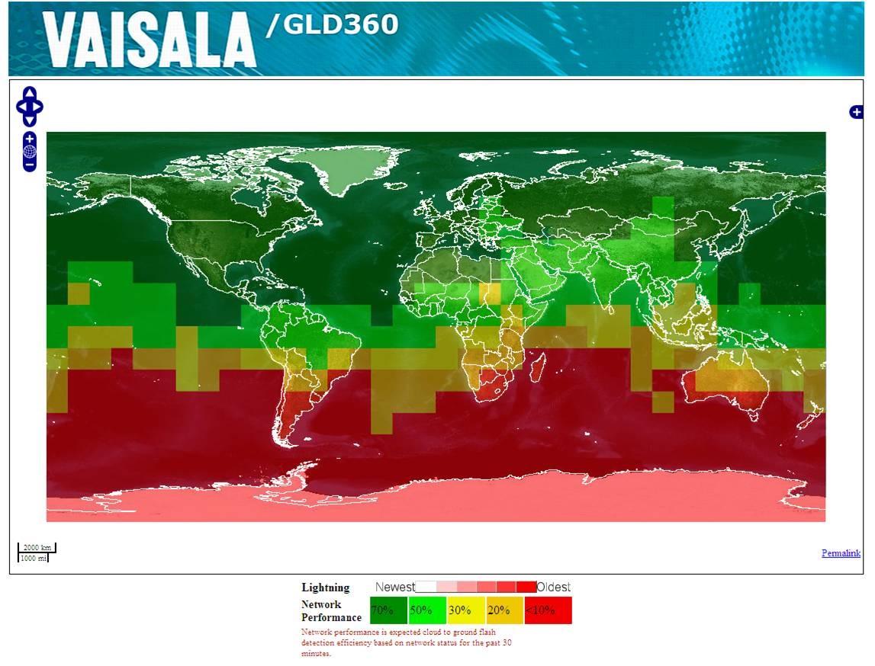
Courtesy, Nikki Hembury

Slide 30
Lightning Data Assimilation into NWP Models
Previous lightning data assimilation work:
  Alexander et al., 1999; Chang et al. 2001 (latent heating)
  Papadopoulos et al., 2005 (moisture profiles)
  Mansell et al., 2006, 2007 (BL moisture and updraft speed; NLDN/LMA convective trigger switch for Kain-Fritsch)
  Weygandt et al., 2006, 2008 (cloud and moisture fields-lightning-reflectivity relationship to create a latent heating-based temperature tendency field, applied to RUC /HRRR during a pre-forecast diabatic digital filter initialization)
  Pessi and Businger, 2009 (Vaisala Pacnet long-range lightning data over the open ocean- tropical cyclones, oceanic storms)
Workshop on Lightning Modeling and Data Assimilation (2010)
  http://www.nssl.noaa.gov/research/forewarn/lt_workshop/

Slide 31
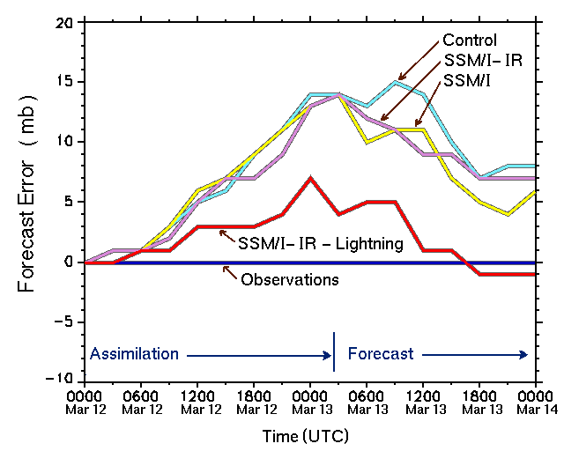
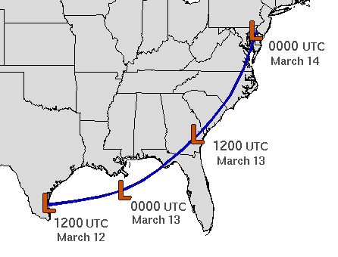
Lightning Data Assimilation:
Reduces Forecast Error
March 13, 1993 Superstorm (Alexander et al., 1999 MWR)
Lightning assimilated via latent heat transfer functional relationship

Slide 32
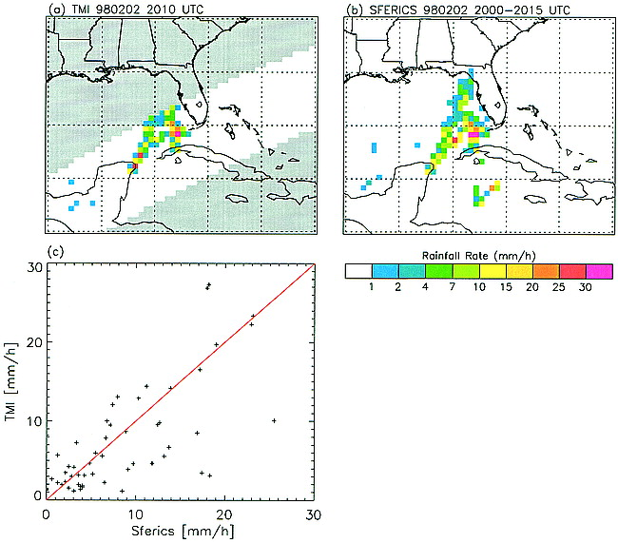
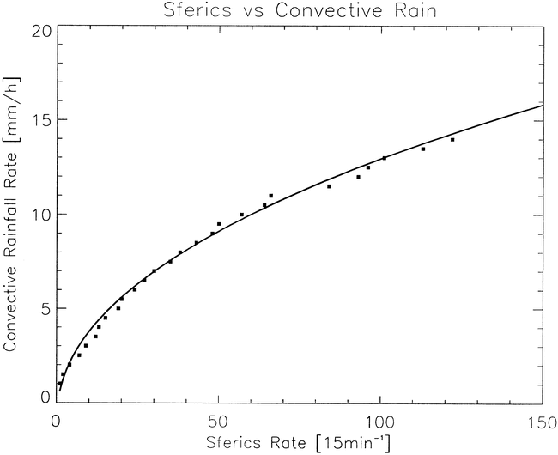
Establish a Lightning – Rain Rate Transfer Function
TMI
GPROF
Rain Rate
Sferics
Rain Rate
Rain rate transfer function
LTG-RR converted into parabolic Latent Heat profile centered at 500 mb

Slide 33
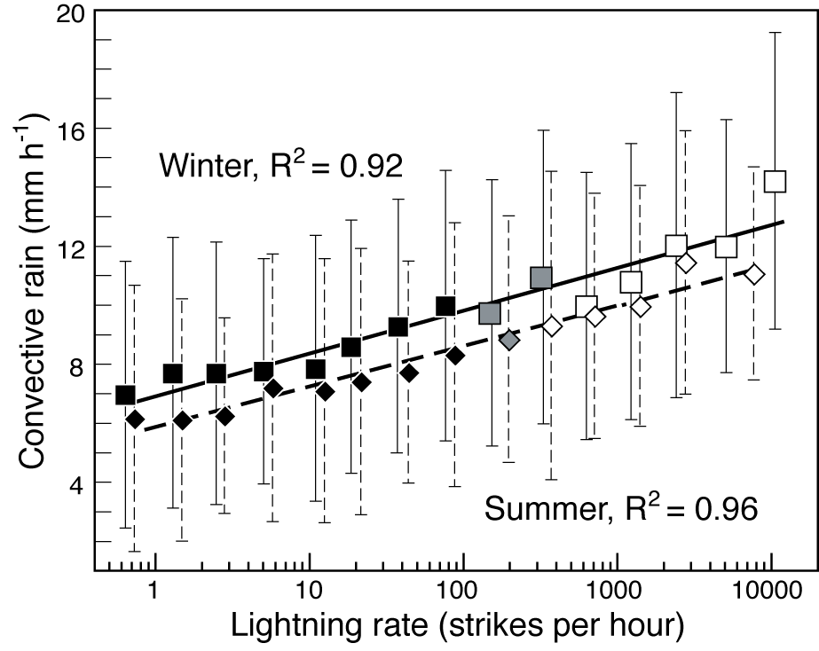
Lightning vs. Convective Rainfall
The log-normal relationship between lightning rate and rainfall intensity derived from TRMM and PacNet data is the key to use of lightning data in numerical weather prediction models (Pessi and Businger).
  Pessi, A. T. et al., 2008: J. Atmos. and Ocean. Tech., 26, 145–166.
  Pessi, A. T., and S. Businger, 2009: J. Appl. Meteor., 48, 833–848.
  Squires, K. and S. Businger, 2008: Mon. Wea. Rev., 136, 1706–172.
  Pessi, A. T., and S. Businger, 2009: Mon. Wea. Rev., 137, 3177-3195.

Slide 34
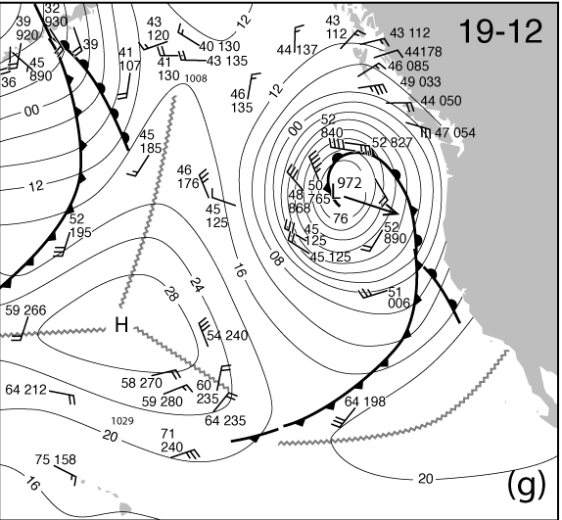
12-Hour Forecast of Sea-Level Pressure and 3-h Rainfall
Control
L
982
Lightning
Assimilation
L
972
Surface analysis
Valid 1200 UTC
19 December 2002
Steve Businger

Slide 35
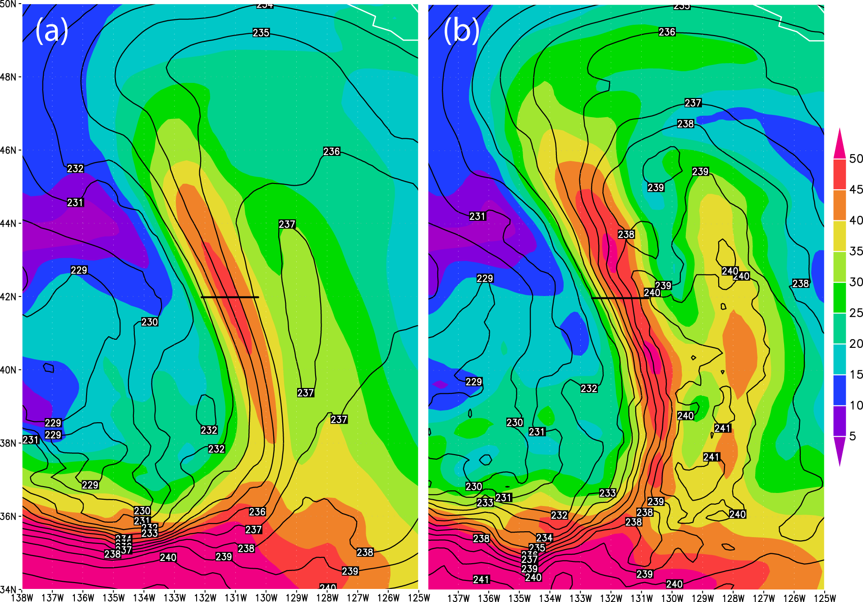
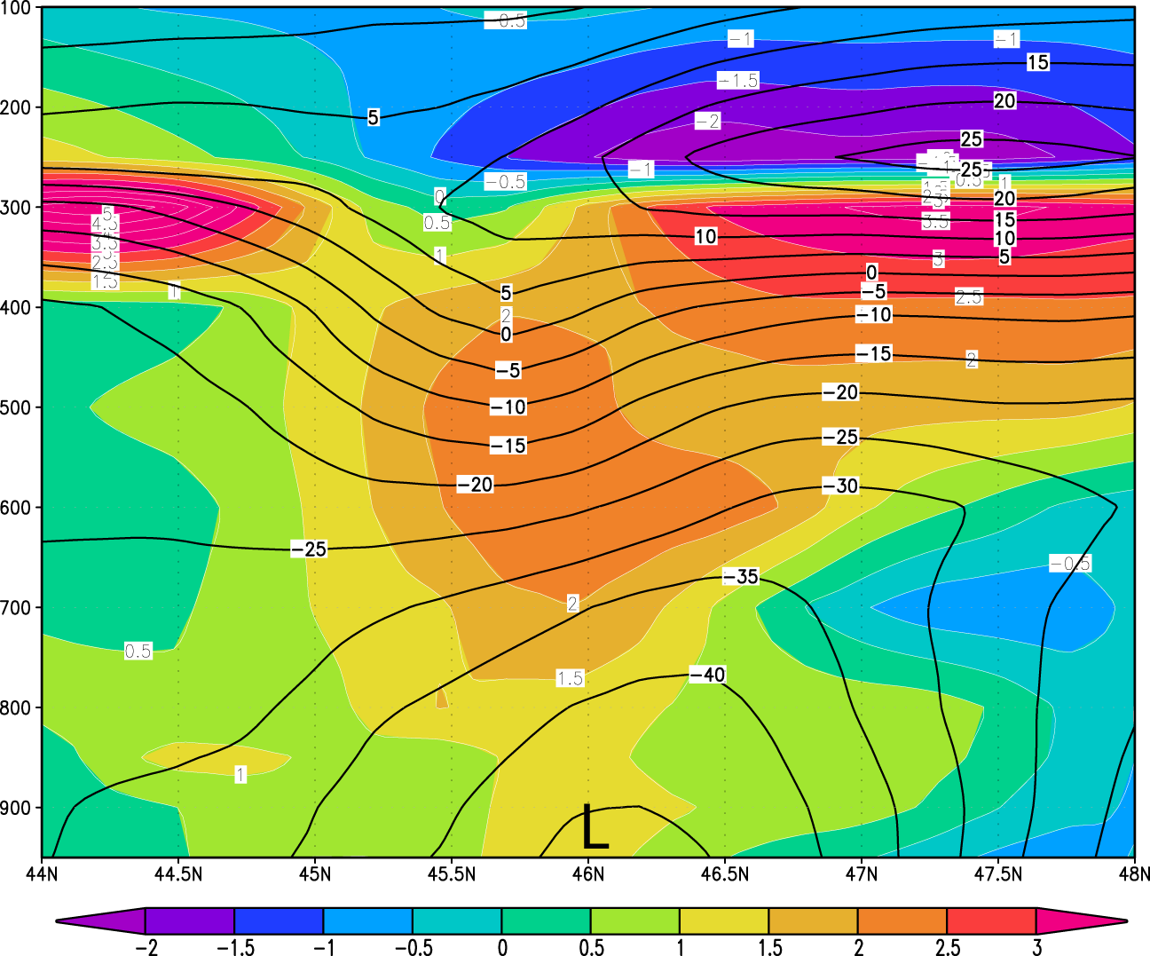
Advection of High Theta-e Air into the Storm Center
Upper figure:
(a) CTRL, (b) LDA
Wind speed at 400 hPa (m/s, shaded)
Temperature at 400 hPa (K, contours)
Latent heating, as informed by the high lightning rates, increased temperature and ∇T across the front. This resulted in increased along-front winds, consistent with thermal wind balance.
Lower figure:
Difference between LDA and CTRL in:
Virtual temperature (K, shaded)
Geopotential height (m, contours)
Enhanced advection of warm air over the storm center dropped the surface pressure hydrostatically.
Steve Businger

Slide 36
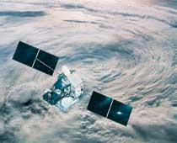
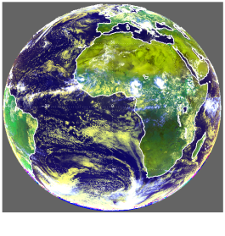
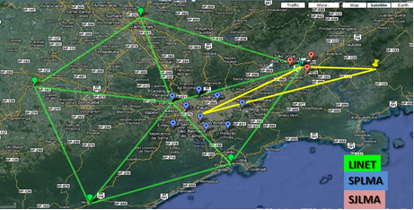
CHUVA Ground Validation IOP
Sao Paulo, Brazil 2011-2012
TRMM/LIS
MSG/SEVERI
Field Campaign
  Leverage observing assets associated with CHUVA with U.S. supplied portable LMA network (and European supplied LINET) to generate proxy data sets for GLM and ABI that include total lightning (LIS and ground-based) and SEVIRI.
  Allow GLM and Combined AWG/Science teams to better address and assess several areas of on-going research
Science Objectives:
    Algorithm and Proxy Data Validation
    Validation Systems Performance Assessment
    Storm Electrification/Physics
    Applications for GLM+ABI+…
  Key scientific measurements: VHF 3-D Lightning Mapping Array (LMA), LINET, TRMM/LIS, MSG SEVERI (ABI proxy data), high speed digital video, VLF lightning networks, dual-pol radar, electric field change, airplane in-situ microphysics, and ancillary meteorological data

Slide 37
Partners and Collaborators
GLM Science Team
  Richard Blakeslee, NASA (LMA lead)
  Larry Carey, Jeff Bailey, UAH (NOAA funded to deploy LMA)
  John Hall, UAH (Web support for real time network operations)
  Monte Bateman, USRA (proxy data, other analyses)
  Many others (and other GOES-R teams) (algorithm and proxy val)
InPE (CPTEC, ELAT) and USP
  Luiz Machado, InPE/CPTEC (overall CHUVA lead)
  Rachel Albrecht, InPE/CPTEC
  Carlos Morales, USP (Electrification processes lead)
  Osmar Pinto Jr., InPE/ELAT Research Group
EUMETSAT MTG Lighting Imager Science Team
  Hartmut Hoeller, DLR (LINET lead) (Collaborator)
Commercial Data Providers
  Vaisala LS8000, WeatherBug WTLN (Collaborator)

Slide 38
Summary
The GOES-R GLM offers information on high impact weather phenomena-storm growth, decay and intensity
The GOES-R Proving Ground provides mechanism to:
  Involve CIs, AWG, National Centers, NOAA Testbeds and WFOs in user readiness
  Get prototype GOES-R products in hands of forecasters
  Keep lines of communication open between developers and forecasters
  Allow end user to have say in final product, how it is displayed and integrated into operations
Opportunities for FDP/RDP demonstrations of experimental satellite and lightning products

