Slide 1
Alaska Satellite Activities
Dr Gary Hufford

Slide 2
POLAR ORBITING SATELLITES
QUICK SCAT
METOPS
RADARSAT
SAR
NOAA
POES
FENG
YUN
DMSP
MODIS
NATIONAL WEATHER
SERVICE
ALASKA REGION
SEA ICE/SST
MARINE
PROGRAM
FIRE
WEATHER
PUBLIC
PROGRAM
CLIMATE
MONITORING
AVIATION
PROGRAM
HYDROLOGY
PROGRAM

Slide 3
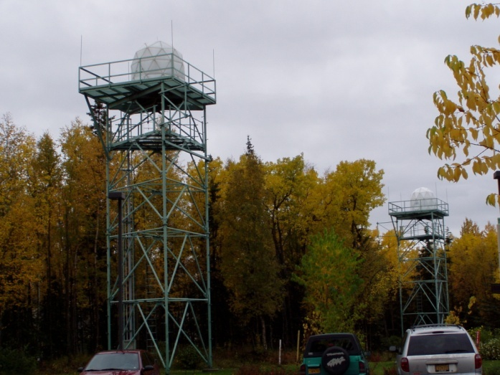
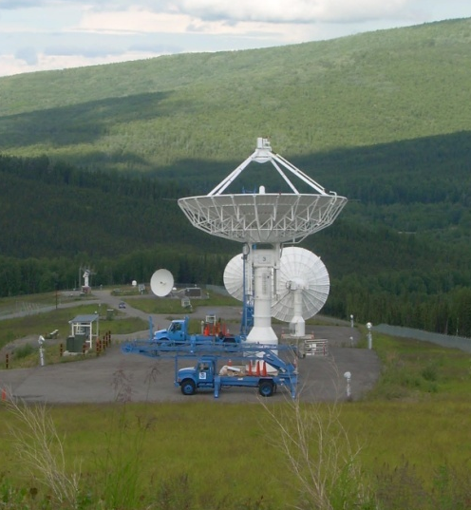
Current NWS ARH Global Imaging System is not a preferred long term solution
NWS ARH desires to centralize their satellite downlink capabilities at NOAA NESDIS Fairbanks Command and Data Acquisitions Site (FCDAS)
  ∙ FCDAS able to allocate available downlink time on two 13m tracking antennas – redundant capability
  ∙ The capability also exists to use their northern site at Barrow to distribute the load and receive additional passes
Global Imaging
FCDAS

Slide 4
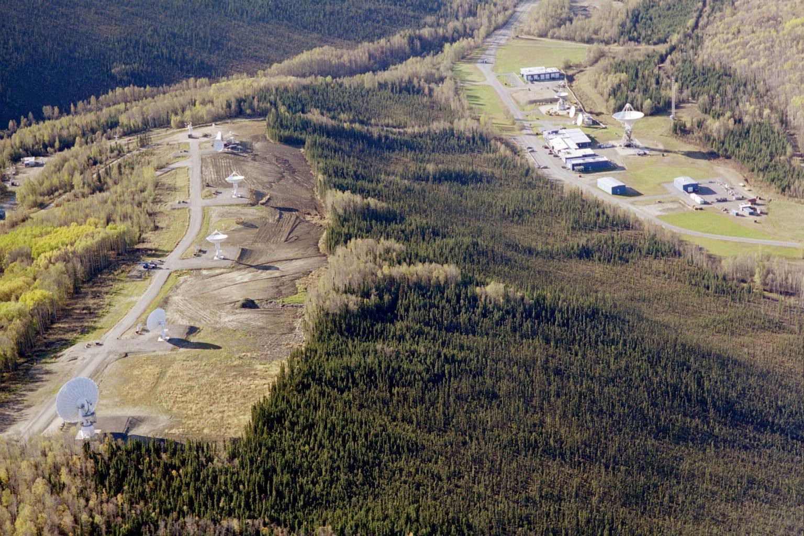
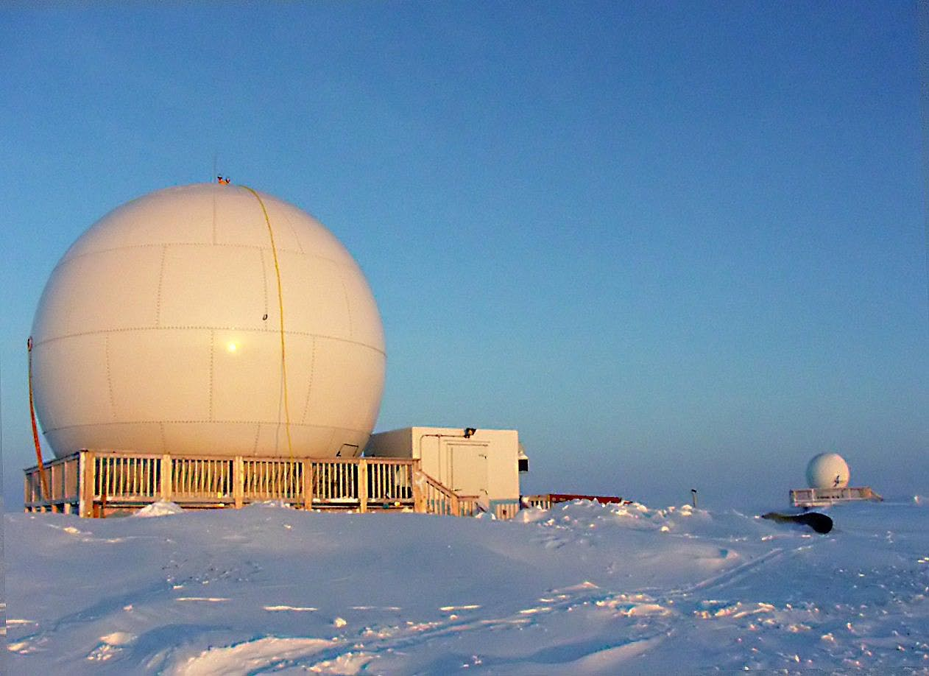
Barrow Downlink Site
Fairbanks Command and Data Acquisition Site

Slide 5
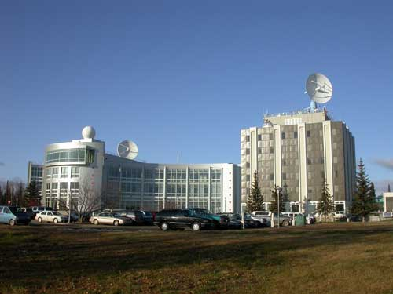
attachment

Slide 6
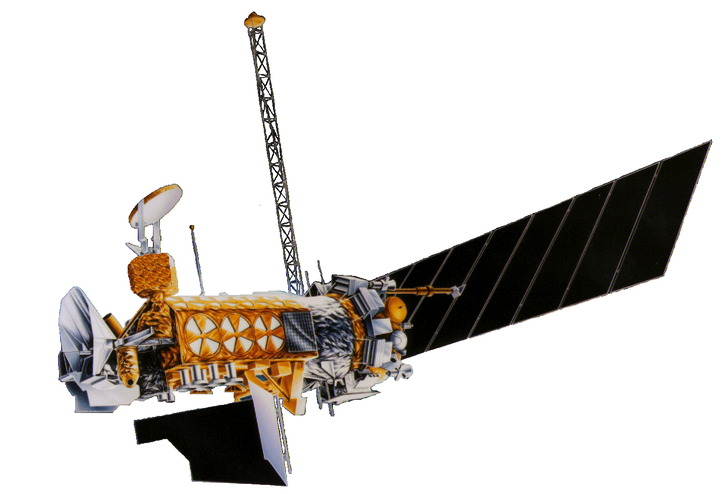
RTD
U of A Fairbanks
DMSP RTD Processing
FAIR CDA
And Barrow
Dedicated
Comm
DISA
.mil Demarc
NWS
Alaska Regional HQ
The long term solution will optimize the communication path between sites and provide secure, supportable, reliable transfer of data
  NWS ARH indicates an intent to pursue this type of connectivity
The .mil connectivity should consider a dedicated solution to provide data during elevated INFOCON
11OWS
LEADS
NWS
Alaska WFOs
17OWS
LEADS

Slide 7

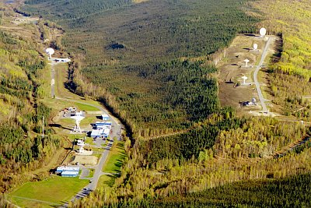
Alaska Environmental Satellite Workshop
July 29-31, 2008
Fairbanks, Alaska

Slide 8
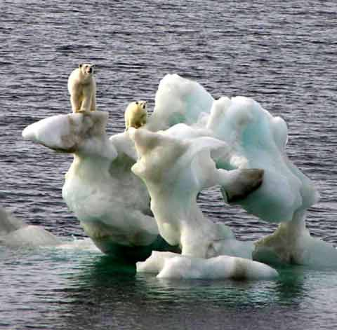
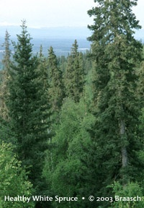
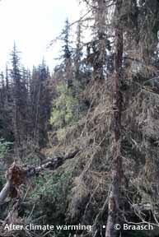
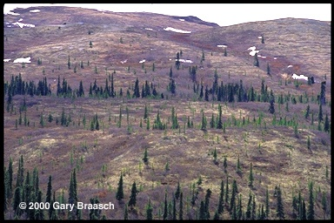
Alaska’s Landscape is Changing
Wildlife
Forests
Ecosystems

Slide 9
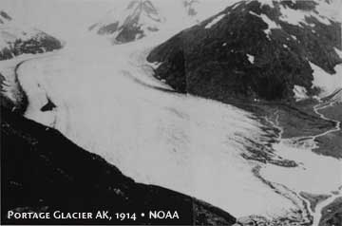
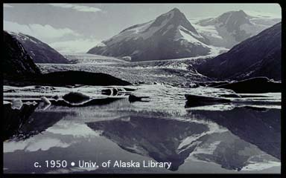
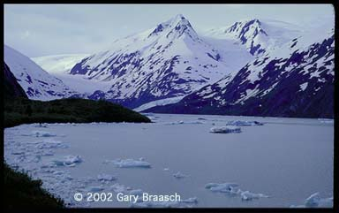
Alaska’s Landscape is Changing
Glaciers

Slide 10
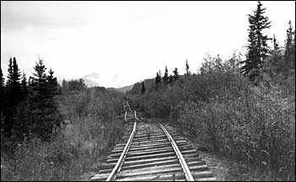
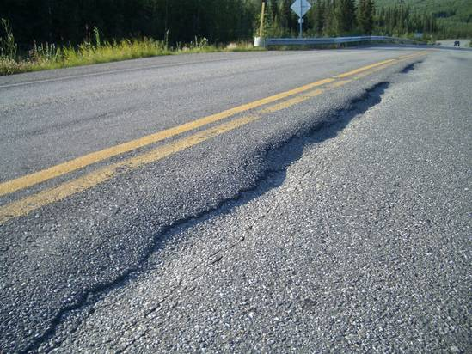
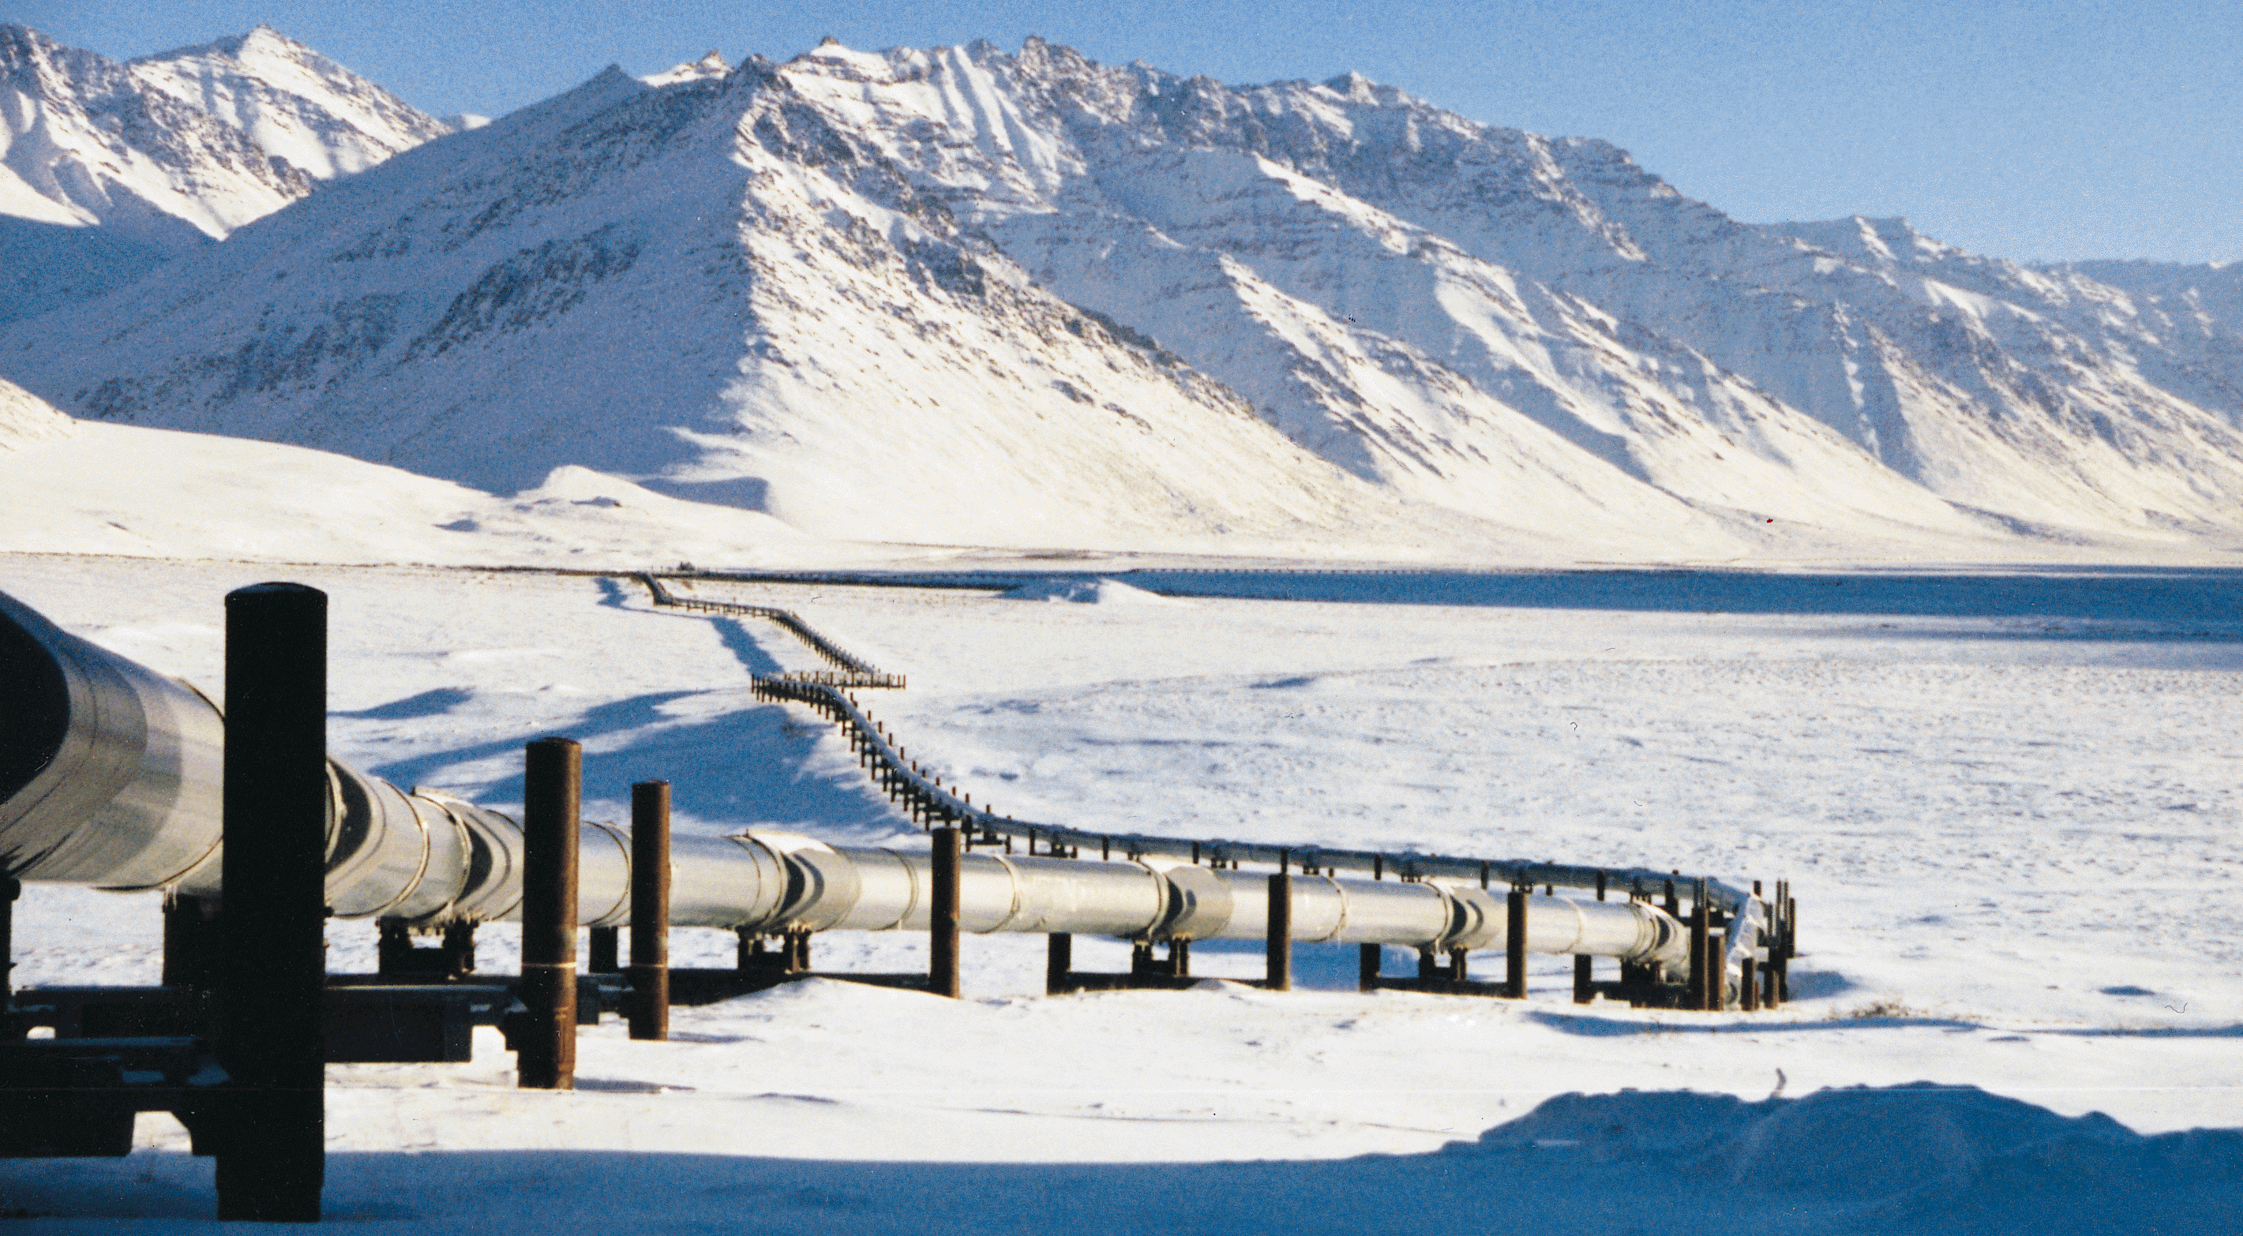
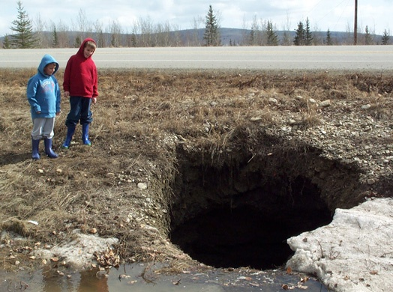
Alaska’s Landscape is Changing
Infrastructure

Slide 11
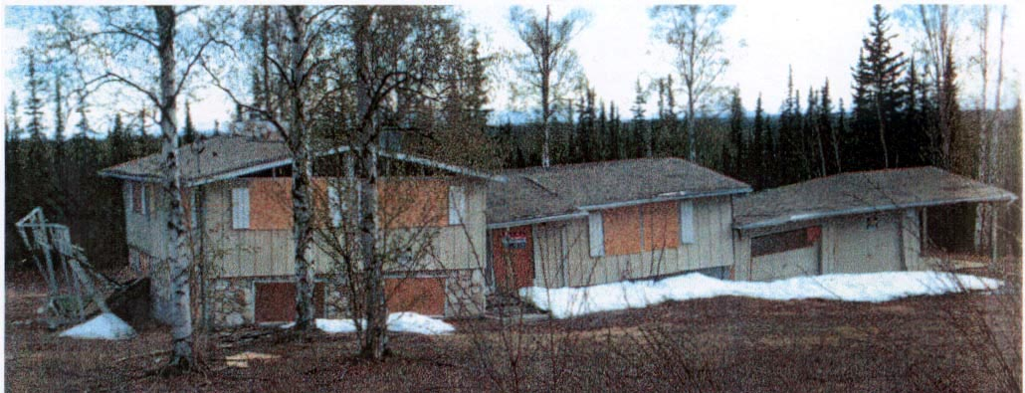
PERMAFROST THAW
90,000 PEOPLE IN ALASKA LIVE ON PERMAFROST

Slide 12
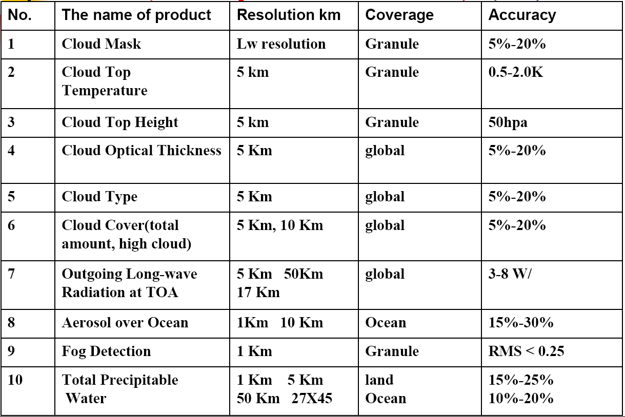

Slide 13
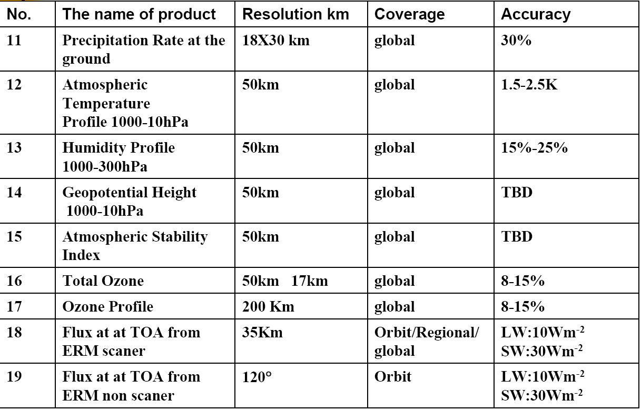

Slide 14
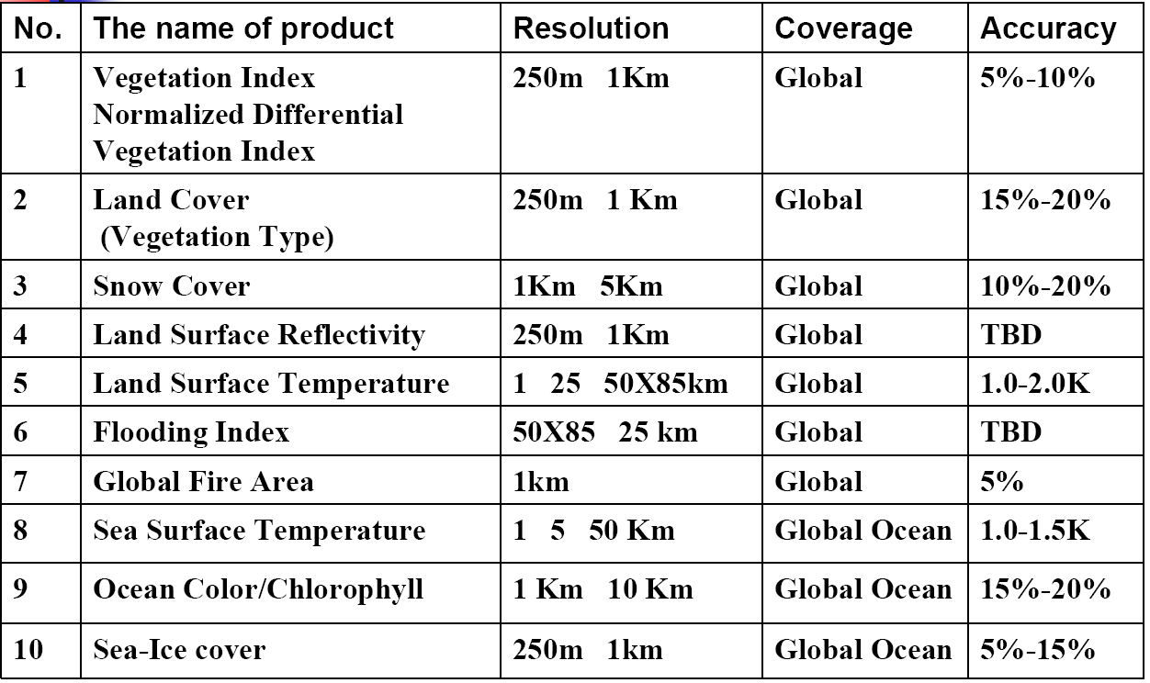

Slide 15
REACT OR PLAN?

