Slide 1
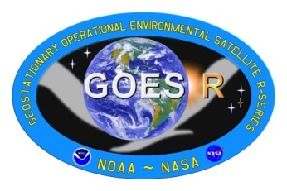
GOES-R User Readiness
Steven Goodman
GOES-R Program Senior Scientist
NOAA/NESDIS/GOES-R Program Office
Greenbelt, MD 20771 USA
(steve.goodman@noaa.gov)
Fuzhong Weng, Shobha Kondragunta, Jun Li, James Gurka, Timothy Schmit, Mark DeMaria, Daniel Lindsey, Wayne Feltz, Scott Bachmeier, Kris Bedka, Wayne Feltz, Steven Miller, Eric Bruning, Gary Jedlovec, Richard Blakeslee, Russell Schneider, Chris Siewert, Robert Rabin
ECMWF Seminar
Reading, UK
24 September 2009

Slide 2
Outline
GOES-R Proving Ground
Purpose, Goals, and Components
Examples from the HWT Spring Experiment
Convective Initiation
Lightning Detection, Trending
Future Plans
GOES-R Risk Reduction
Innovative Ideas for Multi-instrument Blended Satellite Products
Visiting Scientist Program
JCSDA 2010 Data Assimilation Initiative
Recent Results
Summary
http://www.goes-r.gov
http://cimss.ssec.wisc.edu/goes_r/proving-ground.html

Slide 3
GOES-R Improvements vs Current GOES
Performance Capability | GOES I-M | GOES N-P | GOES R
Imaging
Visible Resolution | 1 km | 1 km | 0.5 km
IR Resolution | 4-8 km | 4-8 km N 4 km O/P | 1-2 km
Full Disk Coverage Rate | 30 min | 30 min | 5 min
Rapid Scan Imaging Mode | 7.5 min | 7.5 min | 30 sec
# of Channels | 5 | 5 | 16
Solar Monitoring | GOES-M only | Yes | Yes
Lightning Detection | No | No | Yes 8km <20 sec latency
Operate through Eclipse | No | Yes | Yes
Ground System Backup | Limited | Limited | Limited
Archive and Access | Limited | Limited | Yes
S/C Raw Data Volume | 2.6 Mbps | 2.6 Mbps | 75 Mbps

Slide 4
GOES-R Imager Coverage

Slide 5
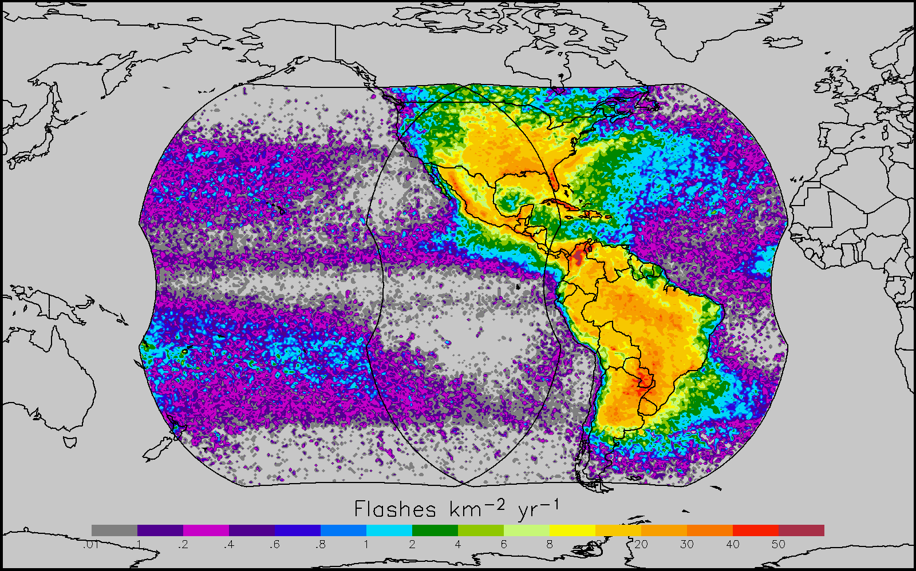
GOES-R GLM Coverage
LIS/OTD Combined Lightning 1997-2005
GLM Characteristics
Staring CCD imager (1372x1300 pixels)
Near uniform spatial resolution up to 52 deg lat
- 8 km nadir
- 12 km edge fov
Single band 777.4 nm
2 ms frame rate
7.7 Mbps downlink data rate
< 20 sec product latency
1-minute of observations from TRMM/LIS

Slide 6
GOES-R Algorithm/Product Readiness
Underpinning Research & Development (new applications & Day 2 Products) Risk Reduction | Pre & Post Launch Sensor Calibration and validation Calibration Working Group | Operational Algorithm Readiness Development and Transition to Operations Algorithm Working Group | Sustained Post Launch Validation and Reactive Science Maintenance Algorithm Working Group | User Readiness Proving Ground, Risk Reduction, Training
6
Notes:
6

Slide 7
GOES-R OPERATIONAL PRODUCTS
OPTION 2 (Enhanced Capability)
BASELINE (Continuity)
Cloud Layer/Heights
Cloud Ice Water Path
Cloud Liquid Water
Cloud Type
Convective Initiation
Turbulence
Low Cloud and Fog
Visibility
Surface Albedo
Upward and Downward Longwave Radiation
Upward and Absorbed Shortwave Radiation
Total Ozone
SO2 Detections (Volcanoes)
Surface Emissivity
Aerosol Particle Size
Vegetation Index
Vegetation Fraction
Snow Depth
Flood Standing Water
Rainfall probability and potential
Enhanced “V”/Overshooting Top
Aircraft Icing Threat
Ice Cover
Sea & Lake Ice Concentration, Age, Extent, Motion
Ocean Currents.
Clouds and Moisture Imagery
Clear Sky Masks
Temperature and Moisture Profiles
Total Precipitable Water
Stability Parameters (Lifted Index)
Cloud Top Pressure and Height
Cloud Top Phase
Cloud Particle Size Distribution
Cloud Optical Path
Rainfall Rate
Aerosols Optical Depth
Atmospheric Motion Vectors (AMVs)
Hurricane Intensity
Volcanic Ash
Fire/Hot Spot Characterization
Land and Sea Surface Temperature
Snow Cover
Downward Surface Insolation
Lightning Detection

Slide 8
Proving Ground/ Testbed Concept
• Proving Ground is a valuable tool to ensure user
readiness for GOES-R products on Day-1
Use proxy and simulated data sets to:
Validate new or improved products
Test and validate processing and distribution systems
Validate/ optimize decision aids
Optimize product display techniques
Develop content for training
• Venue for direct user input
• Proven successful in NEXRAD program
Intended outcomes are Day-1 readiness and maximum utilization for both the developers and users of GOES-R products, and an effective transition to operations

Slide 9
Proxy Data for GOES-R
No current GEO satellite has the spatial, spectral and temporal resolution of GOES-R
Use proxy and simulated data sets to develop, test and validate products, decision aids, data processing and distribution systems
• MODIS
• AIRS
• IASI
• SEVIRI
• NAST-I (airborne simulator)
Unmanned Aircraft Systems-Global Hawk
• NPP/ VIIRS/ CrIS
Ground-based Total Lightning Networks
• Computer Simulated Atmospheres- WRF radiances

Slide 10
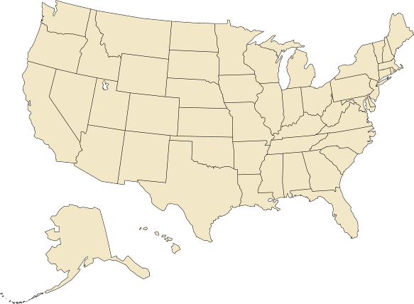
GOES-R Proving Ground Partners
Green Bay, WI WFO
Sullivan, WI WFO
Cooperative Institute for Meteorological Satellite Studies
Madison, Wisconsin
Sterling, VA WFO
Cheyenne, WY WFO
Cooperative Remote Sensing Science and Technology Center
New York, NY
Cooperative Institute for Research in the Atmosphere
Fort Collins, Colorado
La Crosse, WI WFO
NWS Headquarters; Cooperative Institute for Satellite Climate Studies; Center for Satellite Applications and Research; Office of Satellite Data Processing and Distribution; GOES-R Program Office;
University of Maryland Baltimore County
Maryland
Boulder, CO WFO
Eureka, CA WFO
NWS Central Region
Kansas City, MO
EPA
Research Triangle Park, NC
NWS Alaska Region
Anchorage, Alaska
Melbourne, FL WFO
NASA Kennedy Space Center
NWS Pacific Region
Honolulu, Hawaii
NCEP Tropical Prediction Center Joint Hurricane Testbed
Miami, Florida (Planned for FY2010)
NCEP: National Centers for Environmental Prediction
NWS: National Weather Service
WFO: Weather Forecast Office
NCEP Storm Prediction Center;
Norman, OK WFO;
National Severe Storms Laboratory;
University of Oklahoma;
Cooperative Institute for Mesoscale Meteorological Studies
Norman, Oklahoma
Hazardous Weather Testbed- Experimental Forecast and Warning Programs
Huntsville, AL WFO
University of Alabama Huntsville
NASA Short-term Prediction Research and Transition Center
Huntsville, AL

Slide 11
GOES-R User Readiness
Proving Ground Examples

Slide 12
NOAA Hazardous Weather Testbed
Two Main Program Areas…
Experimental
Forecast
Program
Experimental
Warning
Program
EFP
EWP
Prediction of hazardous weather events from a few hours to a week in advance
Detection and prediction of hazardous weather events up to several hours in advance

Slide 13
During Product Demonstration Always Be Mindful of Forecaster Needs
Incorporating new products into a forecaster’s routine difficult
Must use constantly to gain comfort
Must address problem, aid decision-making
May even replace something currently used that they already have confidence in
Must have knowledge on product limitations
Products must provide information already not available

Slide 14
GOES-R Proving Ground Spring Experiment Activities
In concert with EWP, EFP and VORTEX-II during April-June 2009 severe weather season
2-3 visitors per day
Interaction with EWP/EFP/VORTEX-II forecasters on a constant basis
Provide local expertise on satellite products/techniques
Expose non-satellite community to satellite capabilities
Hourly convective forecast activities during convectively active periods
Constant interaction with products in real-time forecast environment
Daily morning post-mortem analysis of product performance

Slide 15
Initial Products & Examples
Four GOES-R Proving Ground products available at the SPC for 2009 Spring Experiment
15-minute Cloud-top Cooling (CTC) Rate (UW-CIMSS)
Monitors cloud-top IR brightness temperature based on an operational cloud mask using a box-averaging method
Convective Initiation (CI) Nowcast (UW-CIMSS)
Based on CTC product with more stringent requirements for cloud-top microphysical properties
10-km Total Lightning Source Density (SPoRT/NSSL)
Re-sampled from three LMA networks (Huntsville, AL, Washington DC and Norman, OK)
0-1 Hour Probability of Severe Hail (CIRA)
Based on RUC objective analysis fields and cloud-top temperature

Slide 16
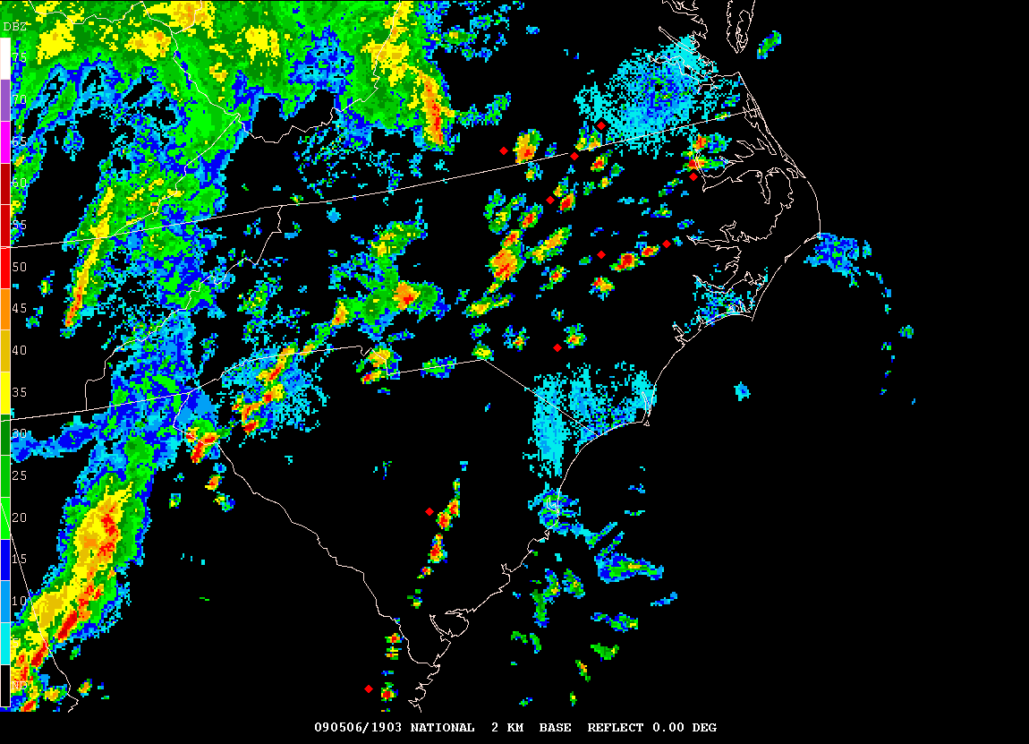
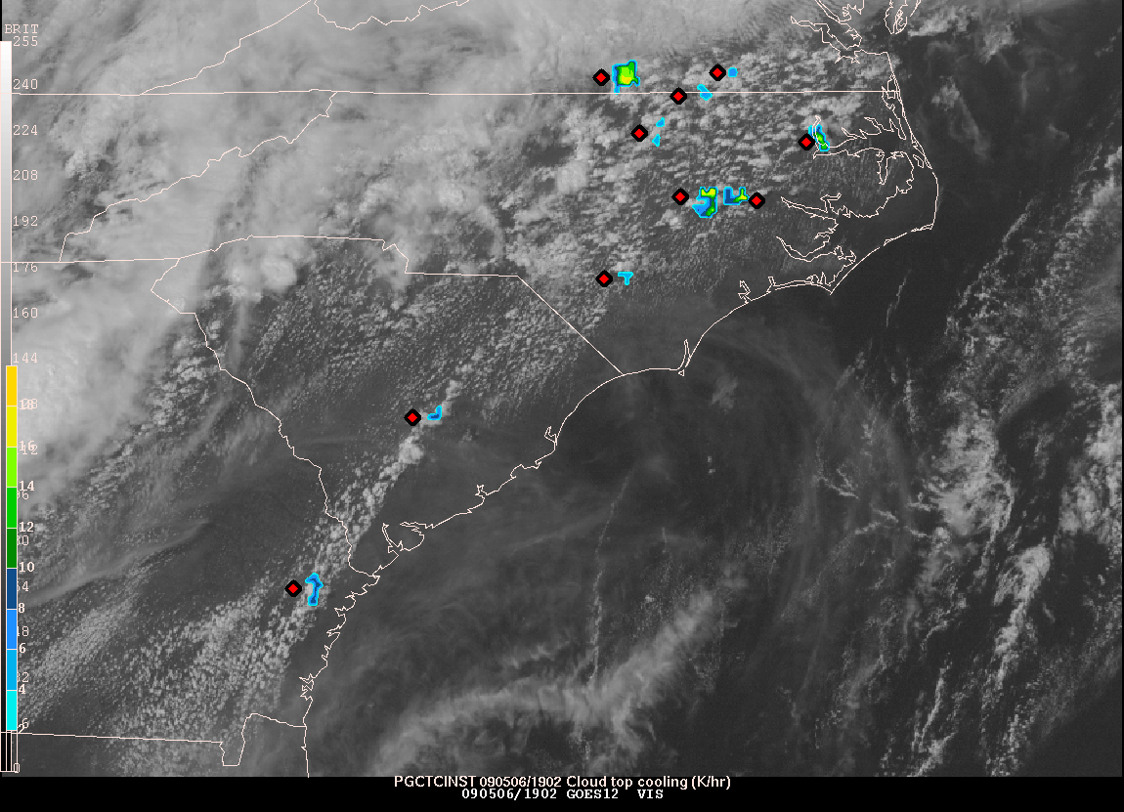
Convective Initiation (CI) Product:
Identifies regions of new/rapidly intensifying convection
2 components
cloud typing
cloud top cooling rate

Slide 17
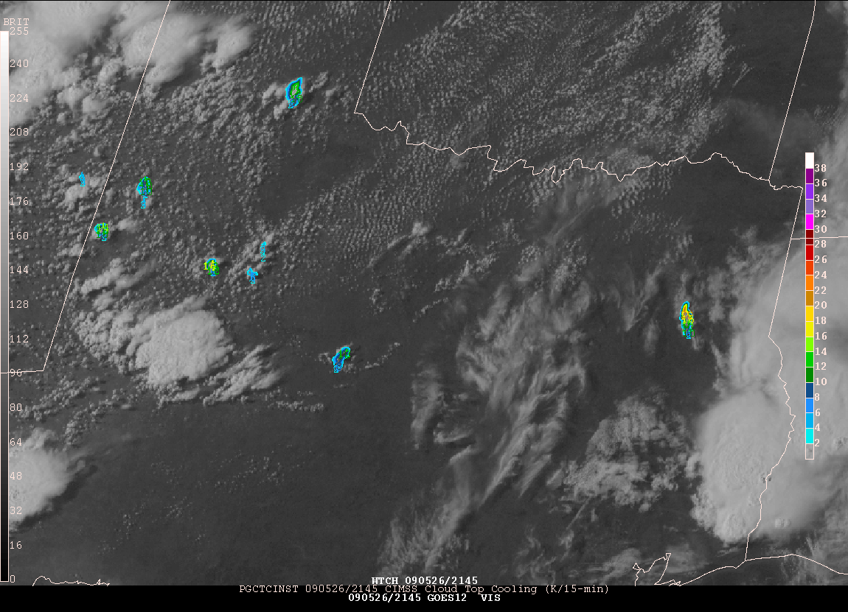
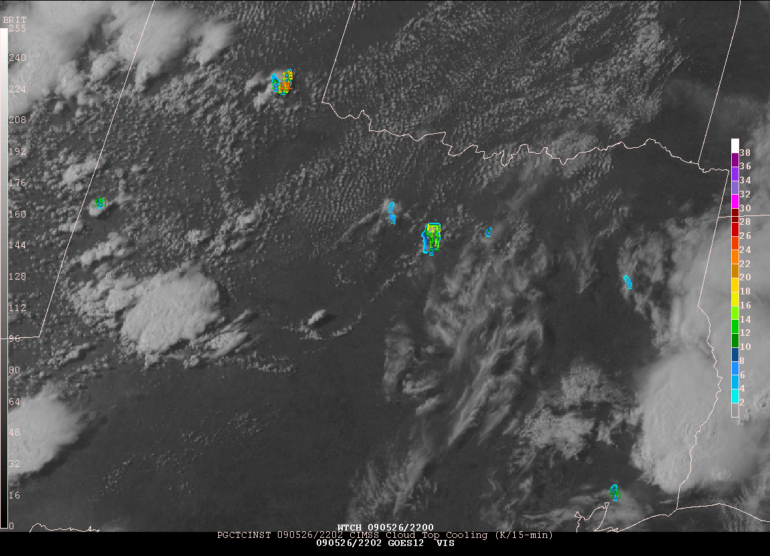
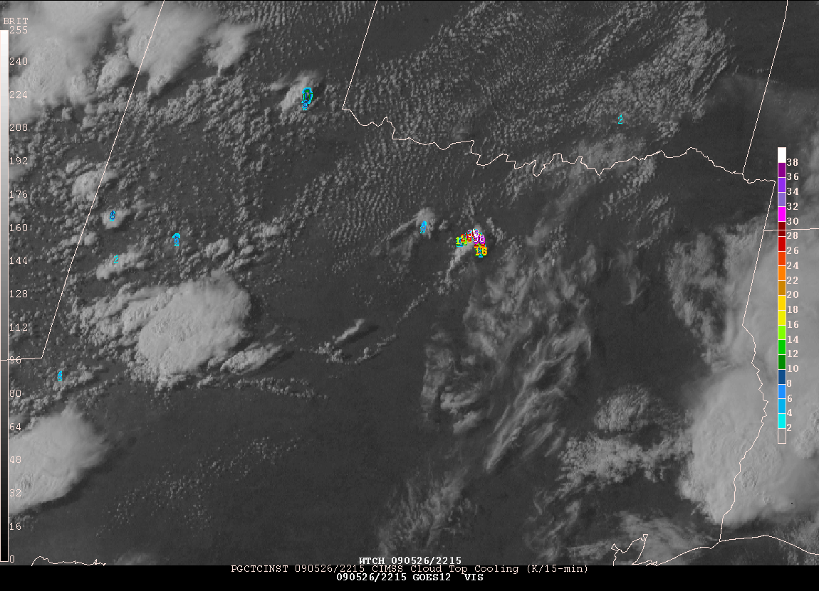
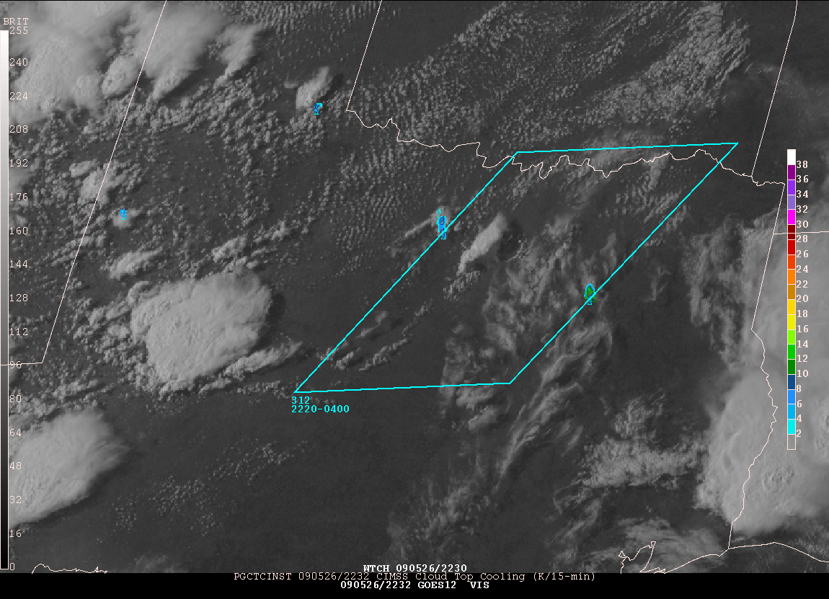
CI: Cloud Top Growth During Successive 15 min observations
2145
2202
2215
2232

Slide 18
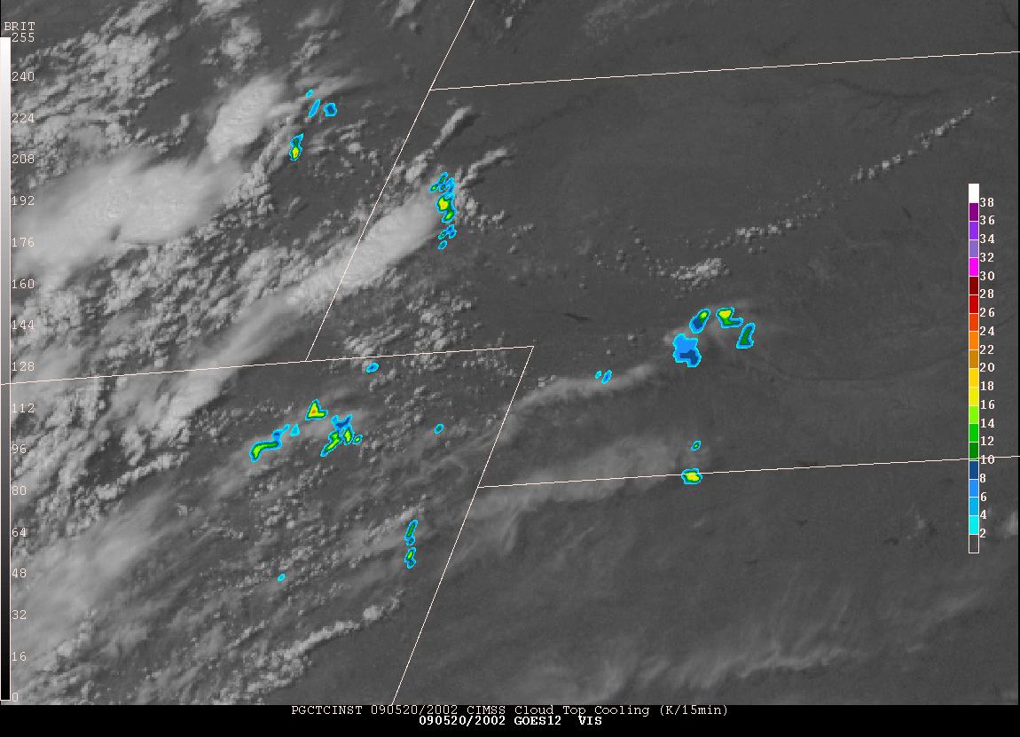
CI: False Cooling Rates Due to Anvil Expansion and Overriding Cirrus
Expanding Cloud Edges
Thin Cirrus

Slide 19
Lessons Learned at SPC
Convective Initiation/Cloud Top Cooling (CI/CTC)
CTC is valuable product in itself- forecaster wants to see intermediate products- no black box
Poor over SE warm sector environments
Masked where thick cirrus present
Thin cirrus over land/water/water clouds and expanding edge false alarms
Avg. lead time ~15 minutes over radar (for successful nowcasts)
Full disk 30 min. scan limitations (false alarms/missed nowcasts)
Cloud detection limitations due to poor spatial/spectral resolution
Instantaneous fields more useful to forecasters than accumulated fields
Overlay on visible/IR essential to forecasters
Continue CTC after CI occurs (storm severity) interest from forecasters
Effective for terrain/dryline convection
CI misses some CTC signals
Works well in rapid scan operations

Slide 20
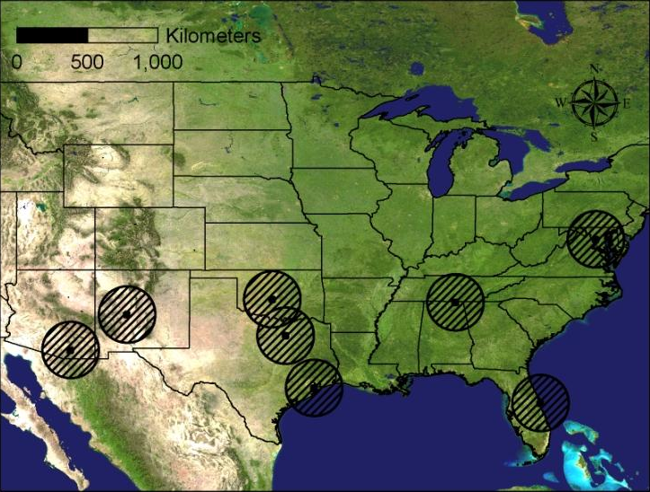
Regional Operational and Research VHF Total Lightning Networks in USA

Slide 21
DCLMA Area Lightning Discharge
2.2 sec hybrid flash
50 km horiz extent
Initiation at 5.2 km
VHF Sources 2187
CG strike at 2 s
GLM will map initiation and propagation of each flash, detect in-cloud and CG lightning, but unable to distinguish between them based on the optical properties alone
http://branch.nsstc.nasa.gov/PUBLIC/DCLMA
Animated gif

Slide 22
GLM Proxy Data: Sterling WFO DC Regional Storms November 16, 2006 Resampled 5-min source density at 1 km and 10 km
LMA 1 km resolution
LMA @ GLM 10 km resolution
GLM Testbeds at Huntsville, AL; Norman, OK; Sterling, VA; KSC, FL

Slide 23
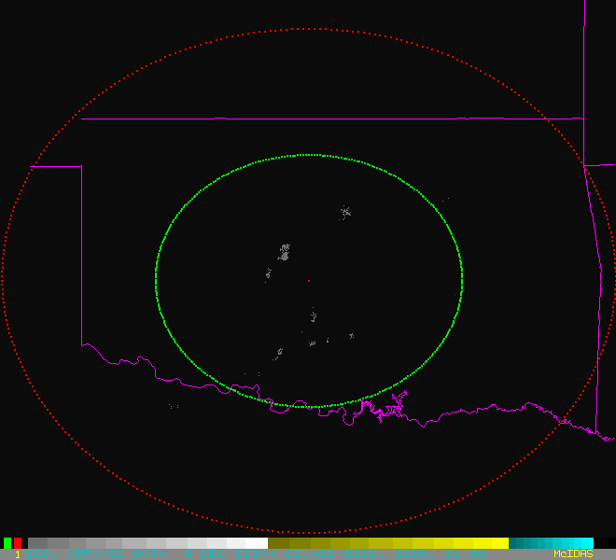
GLM Proxy Data from OKLMA

Slide 24
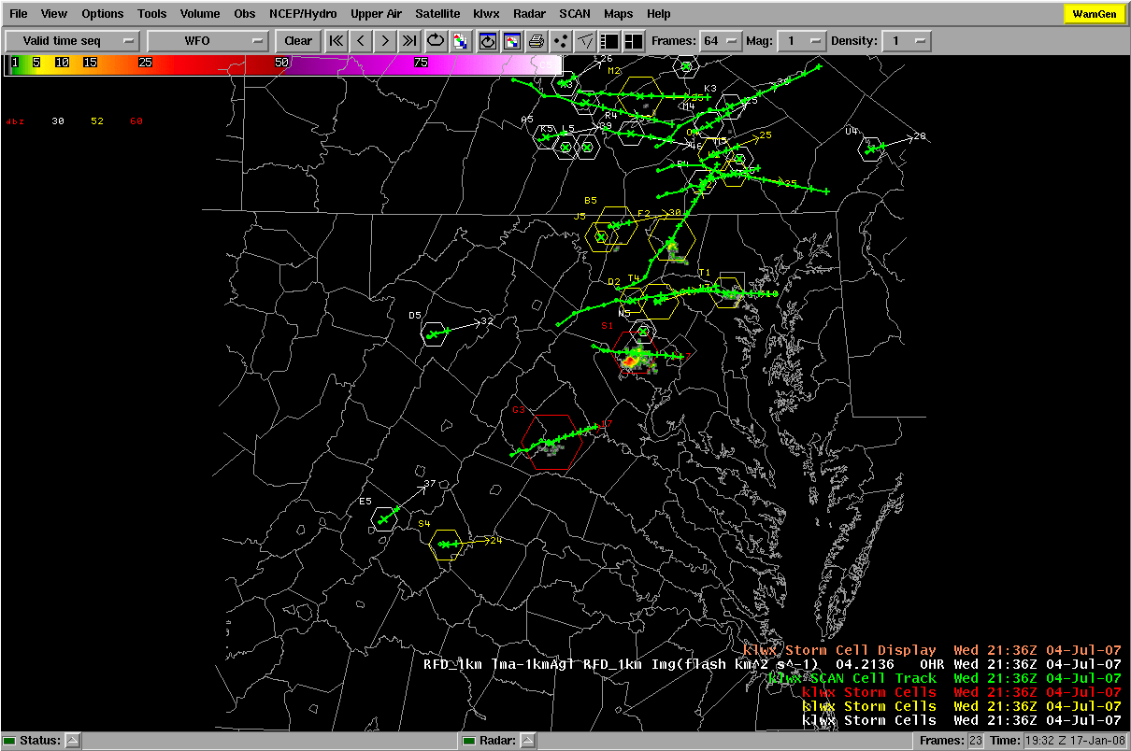
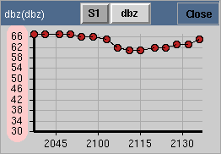
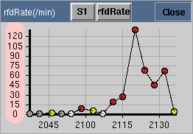
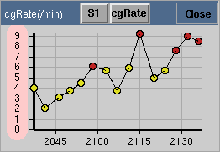
GLM Lightning Jump Algorithm:
(Gatlin and Goodman, JTECH, 2009; Schultz et al., JAMC, 2009) Experimental Trending Implementation in AWIPS/SCAN
Red > 60
Red > 6
Yellow: 2-6
White : 1-2
Gray < 1
SCAN Cell Table
Cell S1
DC LMA total lightning
Red > 6
Yellow: 2-6
(July 04, 2007 at 21:36Z)
Courtesy Momoudou Ba

Slide 25
2010 PG Plans and Opportunities
Provide select products for real-time testing within SPC operations
Invitations and announcements for 2010 Spring Experiment in January/February… experiment likely begins in late April
Expanded product suite possibilities
TPW/LI/CAPE
Continuous CTC
Enhanced-V/overshooting tops
GLM proxy-LMA 10-km flashes, density and pixel-based trends
Ingest LMA data from Cape Canaveral network
0-6 hour severe hail, wind and tornado forecast
Others…
Additional Experiments (spread out during the year)
Fire weather/heavy rain experiment (August)
Winter weather experiment (December/January)
NWP- Short-Range Ensemble Forecasts (warn on forecast)

Slide 26
Capacity Building and Outreach
GOES Users Conferences, Meetings, Symposia
Training modules (COMET, VISITView)
2 staff at NWS HQS to support Proving Ground planning and implementation
1 satellite champion at the NOAA Hazardous Weather Testbed in Norman, OK
1 Data Assimilation scientist at GSD/ESRL in Boulder, CO
3 Data Assimilation scientists at EMC to develop 4D-VAR/EnKF capability

Slide 27
Proving Ground Summary
Proving Ground Program Plan under development
Phase I spin-up at CIMSS, CIRA (2008)
Phase II added SPoRT, AQ, Alaska, Pacific
HWT IOP with VORTEX-2 (2009, 2010)
JHT IOP with GRIP (NASA), PREDICT (NSF) 2010
Need real time and archived events (AWIPS2, WES)
PG is the ultimate tool for user interaction
Must maintain focus on clear path to operations
Ensuring pathway into operations by developing GOES-R proxy products for the AWIPS2 environment
Existing and Planned collaborations with NOAA Testbeds- HWT, JHT, DTC, HMT, JCSDA, others (Aviation Testbed)

Slide 28
GOES-R User Readiness
Risk Reduction (Mitigation)

Slide 29
Innovative Ideas for Multi-instrument Blended Satellite Products
New topical areas (phenology, energy applications)
New investigators/team members are encouraged
Projects that “bridge the gap” between current single-instrument or single-satellite projects (such as making connections between currently funded SSMIS and GLM projects focused on precipitation)
Projects that result in portable applications with software following industry coding standards are encouraged
Selections include:
Combining GOES-R (ABI+GLM) and GPM to improve GOES-R rainrate product
Using Hyperspectral POES Products to Improve GOES-R ABI Temperature/Moisture Profiles
Combined Geo/Leo High Latitude Atmospheric Motion Vectors (to fill gap between 60 and 70 deg latitude)

Slide 30
Visiting Scientist Program Initiative
To exchange ideas and formulate cross-cutting proposals to explore innovative multi-sensor blended satellite products that will be possible in the GOES-R era
Ideas can be explored in detail during visits of 1-4 weeks duration.
10 proposals selected for 2010 including:
5 researcher visits of 1-2 weeks to Hazardous Weather Testbed/NCEP Storm Prediction Center (Aviation, Fire Weather, NWP)
CalNEX Air Quality/Trace Gas Field Validation Campaign participation
River flood product collaboration with NWS Office of Hydrology
ABI+GLM advanced products for aviation weather hazards (oceanic)
Martin Setvak (CMHI, NC-SAF) visit to CIRA- severe convection/clouds
Attendance at Nowcasting SAF 2010 User’s Workshop
Cloud Algorithm Collaboration with NC-SAF, Swedish Hydrological and Meteorological Institute (SMHI) and CM-SAF Royal Dutch Meteorological Institute (KNMI)

Slide 31
JCSDA 2010 Data Assimilation Initiative
Funding Opportunity Title: Research in Satellite Data Assimilation for Numerical Weather, Climate and Environmental Forecast Systems
Funding Opportunity: NOAA-NESDIS-NESDISPO-2010-2001902 (Proposals Due October 13, 2009)
The JCSDA’s goal is to accelerate the abilities of NOAA, DOD, and NASA to ingest and effectively use large volumes of data from current and future satellite-based instruments (over the next 10 years). Maximizing the impact of these observations on numerical weather prediction and data assimilation systems is a high priority of the JCSDA.
New for 2010:
Advanced Instruments (e.g. IASI, ASCAT, SSMIS, Jason-2/3, SMOS, Aquarius, ADM, CrIS, ATMS, ABI, GLM, GPM, and other planned research missions) are or will become available over the course of the next decade.
- Impact studies of assimilating future instruments data and products on the forecast of severe weather events (hurricanes, flash flooding, etc) at both global and regional scales.
Full announcement at JCSDA web site:http://www.jcsda.noaa.gov/ or through Grants-On-Line (www.grants.gov)
Please contact Sid-Ahmed Boukabara with any questions (sid.boukabara@noaa.gov).

Slide 32
Motivation/Justification
Operational data assimilation systems have not been able to take advantage of GOES high temporal refresh and high resolution spatial data because of a lack of advanced data assimilation capability (4D-VAR, EnKF)
For GOES-R ABI simulation and assimilation, JCSDA Community Radiative Transfer Model (CRTM) needs more accurate components such as BRDF and IR emissivity models, accurate and fast gaseous, aerosol and cloud optical models

Slide 33
Improvement Using New IR Emissivity in CRTM
New emissivity
shows improved
bias across seasons
GOES 3.9 um
GOES 10.7 um
F. Weng

Slide 34
Tests SEVIRI- Clear Sky Radiance Data
CSR Ch-5 6.25 µm 11:45 UTC 05/22/ 2008
CSR Ch-6 7.35 µm 11:45 UTC 05/22/ 2008
Hourly SEVIRI Clear sky Radiances (CSR) and All Sky Radiances (ASR) data for May 22-28, and November 22-28, 2008. The data has been converted to NCEP BUFR data format.
We have developed new GSI subroutines for reading ASR/CSR data and modified many old subroutines and parameters to ingest this new sensor into GSI system.
We are working on bias correction for the simulated radiance in GSI, and develop QC scheme for SEVIRI observations.
F. Weng

Slide 35
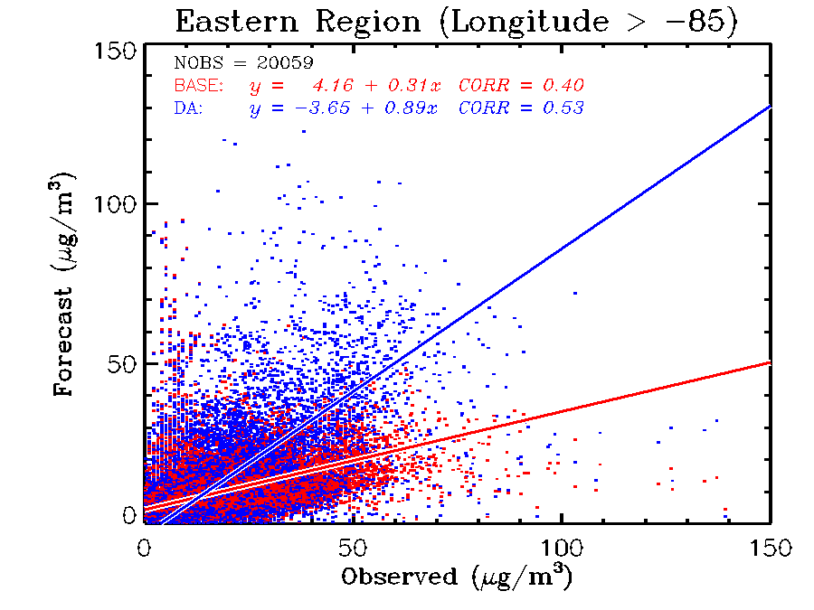
Improved Aerosol Predictions with Satellite Data Assimilation
Assimilation (Cressman analysis) of GOES Aerosol Optical Depth (AOD) in a NOAA-EPA Weather and Research (WRF)/Community Multiscale Air Quality (CMAQ) model shows improved aerosol predictions for an east coast pollution episode
Observed vs Predicted Surface PM2.5 (µg/m³) Concentrations
Assimilation
No Assimilation
AOD
S. Kondragunta
Notes:
The movie loops show WRF-CMAQ simulations for one day beginning at 00z. This was a regional-scale industrial haze/pollution episode. Top left panel shows 24-hr forecast without assimilation and the bottom left panel shows 24-hr forecast with GOES AOD (aerosol optical depth) assimilation. AOD can be viewed as a proxy to particulate matter (PM2.5) pollution. PM2.5 stands for particulate matter in ug/m3 for particles smaller than 2.5 microns. These particles are the most harmful because they can make it through your respiratory system and cause health problems. As evident by the scatterplot of predicted PM2.5 concentrations and observed concentrations, simulations with assimilation correlate better with observations than the forecast runs without assimilation.

Slide 36
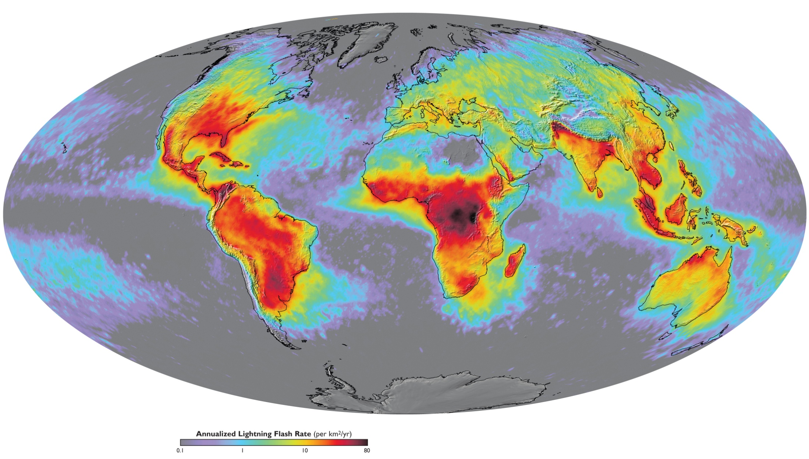
Global Distribution of Lightning Activity
Goodman et al., 2007. Our Changing Planet: The View from Space, M. King, ed., Cambridge University Press
Mean annual global lightning flash rate (flashes km⁻² yr⁻¹) derived from a combined 8 years from April 1995 to February 2003. (Data from the NASA OTD instrument on the OrbView-1 satellite and the LIS instrument on the TRMM satellite.)

Slide 37
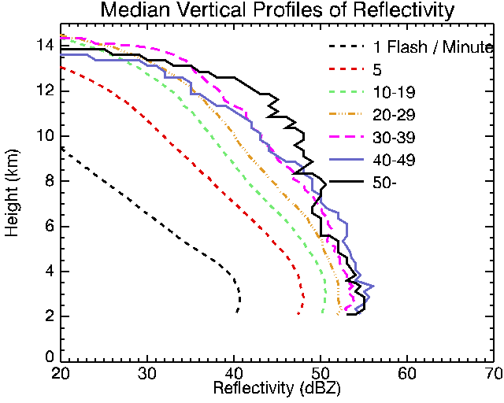
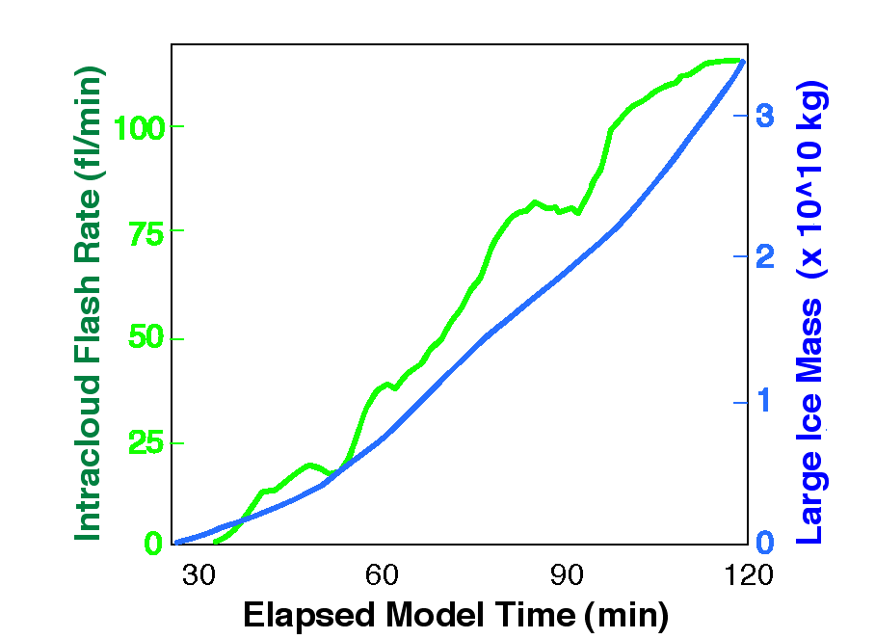
Flash Rate Coupled to Mass in the Mixed Phase Region
TRMM PR and LIS
Process physics understood
(Cecil et al., Mon. Wea. Rev. 2005)
Storm-scale model with explicit microphysics and electrification (Mansel)
Ice flux drives lightning
0 ºC
Physical basis for improved forecasts
IC flash rate controlled by graupel (ice mass) production (and vertical velocity)

Slide 38
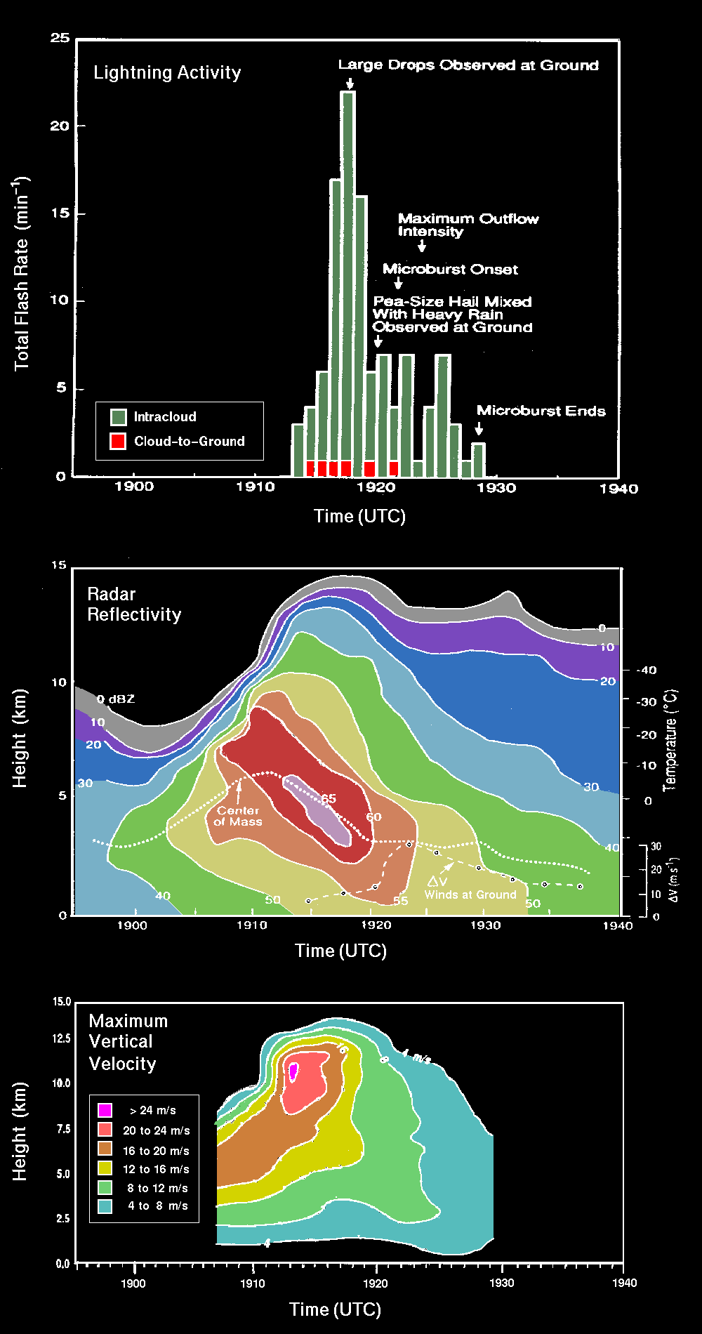
Lightning Connection to Thunderstorm Updraft, Storm Growth and Decay
Air Mass Storm
20 July 1986
Total Lightning —responds to updraft velocity and concentration, phase, type of hydrometeors, integrated flux of particles
WX Radar — responds to concentration, size, phase, and type of hydrometeors- integrated over small volumes
Microwave Radiometer — responds to concentration, size, phase, and type of hydrometeors — integrated over depth of storm (85 GHz ice scattering)
VIS / IR — cloud top height/temperature, texture, optical depth

Slide 39
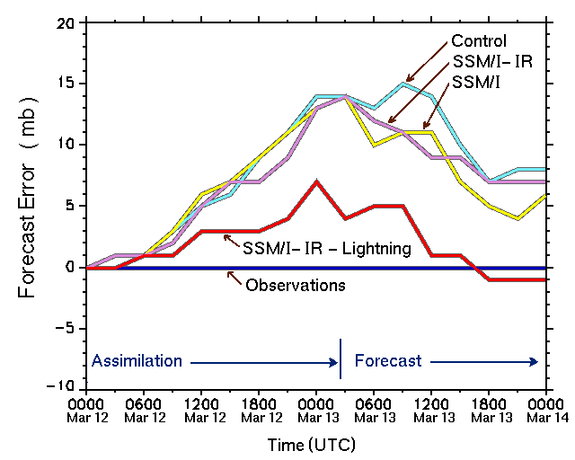
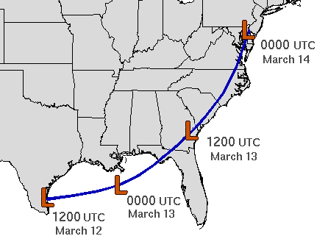
Lightning Data Assimilation: Reduces Forecast Error
March 13, 1993 Superstorm (Alexander et al., 1999 MWR)
Lightning assimilated via latent heat transfer functional relationship

Slide 40
Background on the Current GOES Sounder
19 channels (18 Infrared; 1 Visible)
Spatial resolution: ~ 10km
Hourly scanning over CONUS and adjacent waters
Products include standard imagery and derived, Level-2 products

Slide 41
Current Sounder Operational Uses
GOES Sounder Product | Operational Use within the NWS
Clear-sky Radiances | Assimilation into NCEP operational regional & global NWP models over water
Layer & Total Precipitable Water | Assimilation into NCEP operational regional & global NWP models; display and animation within NWS AWIPS for use by forecasters at NWS WFOs & National Centers in forecasting precipitation and severe weather
Cloud-top retrievals (pressure, temperature, cloud amount) | Assimilation into NCEP operational regional NWP models; display and animation within NWS AWIPS for use by forecasters at NWS WFOs; supplement to NWS/ASOS cloud measurements for generation of total cloud cover product at NWS/ASOS sites
Surface skin temperature | Image display and animation within NWS AWIPS for use by forecasters at NWS WFOs
Profiles of temperature & moisture | Display (SKEW-Ts) within NWS AWIPS for use by forecasters at NWS WFOs in forecasting precipitation and severe weather
Atmospheric stability indices | Image display and animation within NWS AWIPS for use by forecasters at NWS WFOs in forecasting precipitation and severe weather
Water Vapor Winds | Image display and animation within NWS AWIPS for use by forecasters at NWS WFOs
Notes:
Note the many operational uses of today’s sounder, even with its limited spatial and spectral attributes.

Slide 42
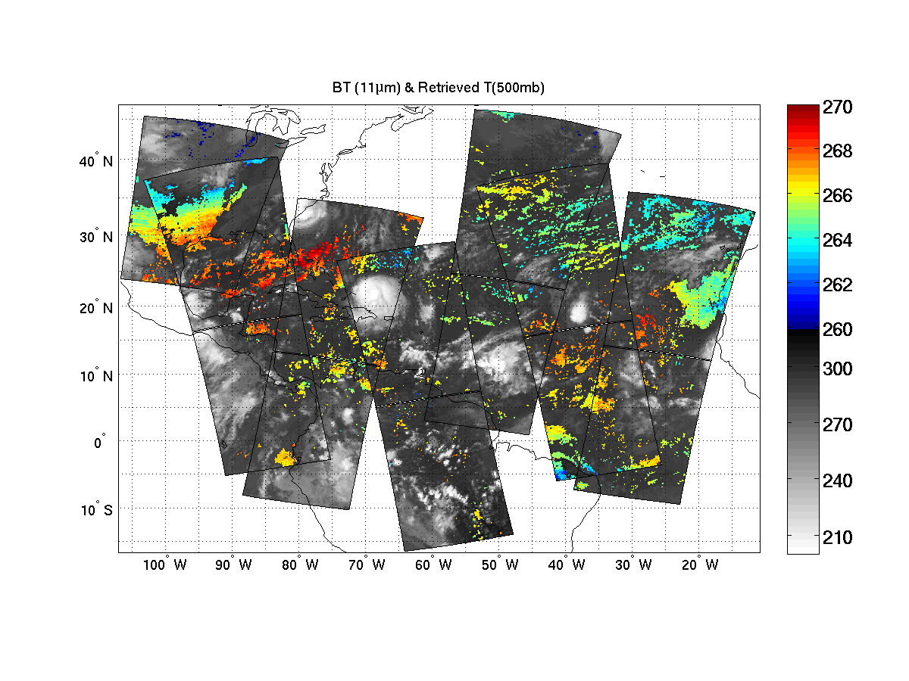
Hurricane IKE- Retrieved 500 mb Temperature (2008.09.06 – Used in assimilation)
(K)
(K)
CIMSS/UW
Clear sky AIRS SFOV temperature retrievals at 500 hPa on 06 September 2008, each pixel provides vertical temperature and moisture soundings.

Slide 43
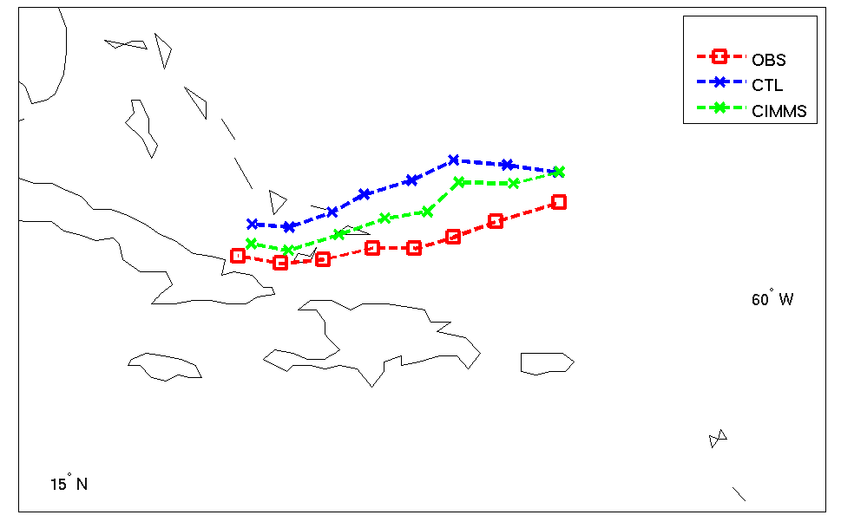
Tracks of Ensemble Mean Analysis - Hurricane IKE
CTL Run: Assimilate radiosonde, satellite cloud winds, aircraft data, and surface data.
AIRS
Li and Liu 2009 (GRL)
Analysis from 06 UTC 6 to 00UTC 8 September 2008

Slide 44
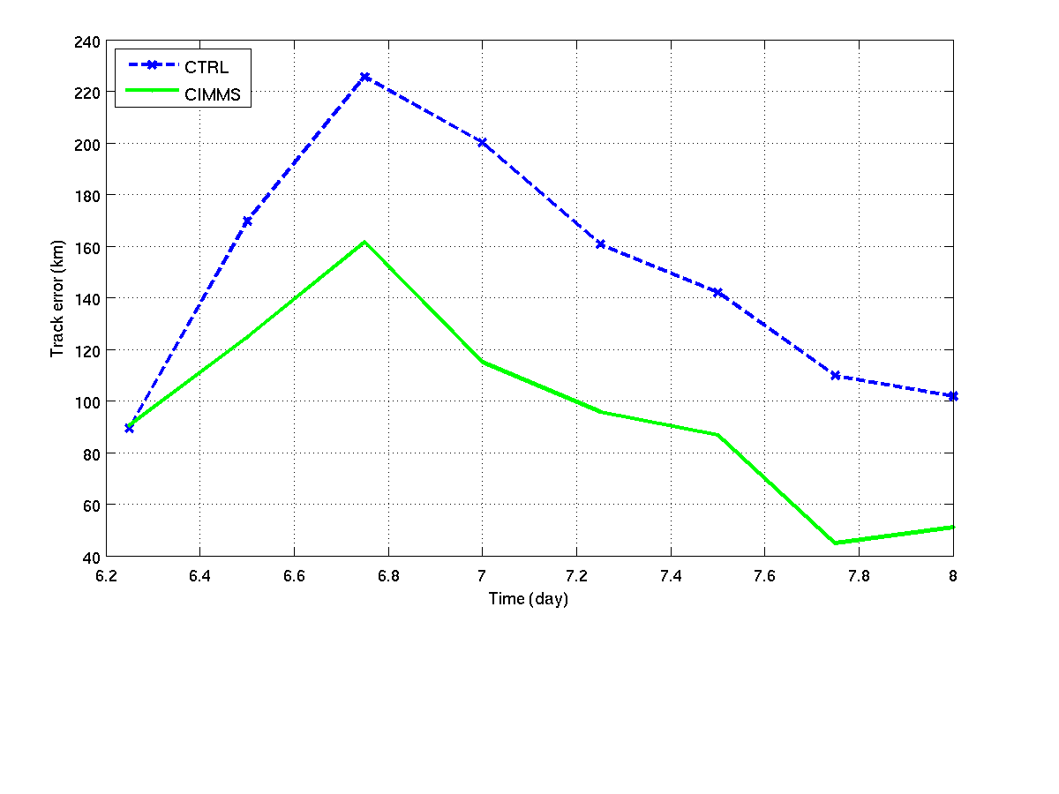
Track Errors - Hurricane IKE
AIRS
Li and Liu 2009 (GRL)
Analysis from 06 UTC 6 to 00UTC 8 September 2008

Slide 45
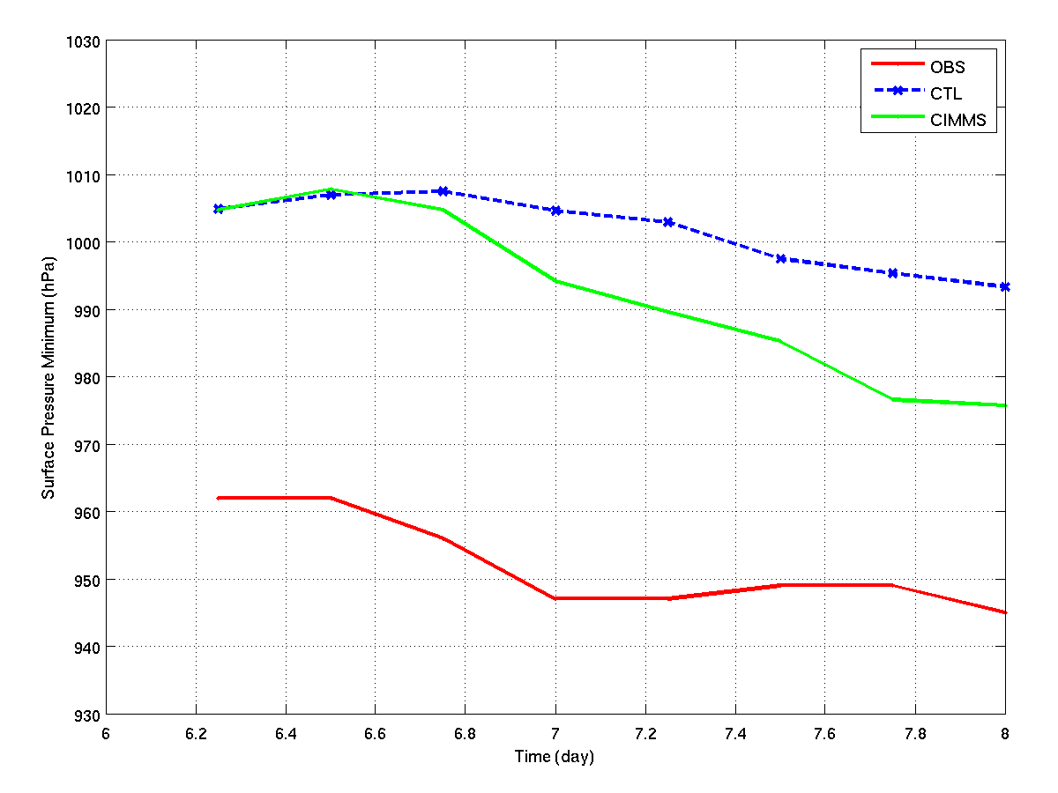
Sea Level Pressure (SLP) Intensity - Hurricane IKE
AIRS
Li and Liu 2009 (GRL)
Analysis from 06 UTC 6 to 00UTC 8 September 2008

Slide 46
GEO Advanced Sounder Simulation Application to severe storm warning
IHOP (12 June 2002) case has been used to simulate the GEO advanced IR sounding system as well as radar observations.
High spatial and temporal resolution 3-km WRF model output is used as truth in the simulation.
Retrieval method is applied to convert the radiances into temperature and moisture profiles
Derived product (e.g., Lifted Index) from true (WRF) and Advanced GEO Sounder are demonstrated along with the simulated Radar imagery
The GEO advanced IR sounder represents a dramatic new capability for earlier warnings of severe weather, 4 – 8 hours earlier than the radar observation or the regional forecast model

Slide 47
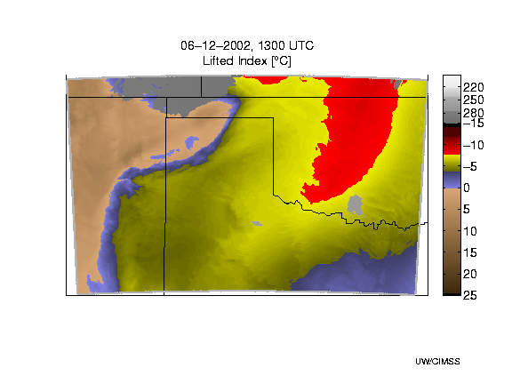
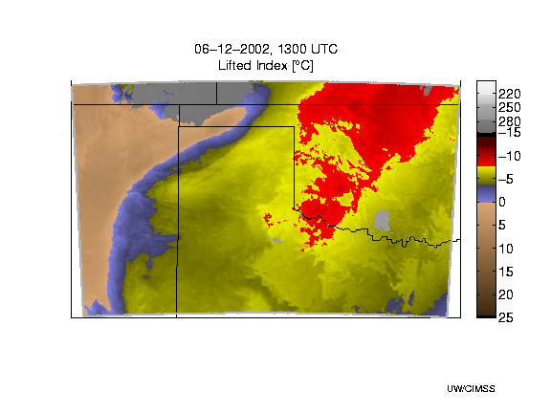
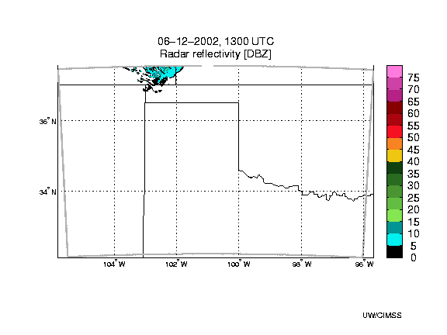
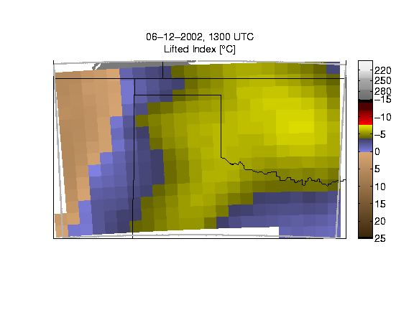
WRF Model LI
GEO Advanced Sounder-Derived LI
Extreme instability indicated
Simulated Radar
RUC Forecast
1300 UTC

Slide 48
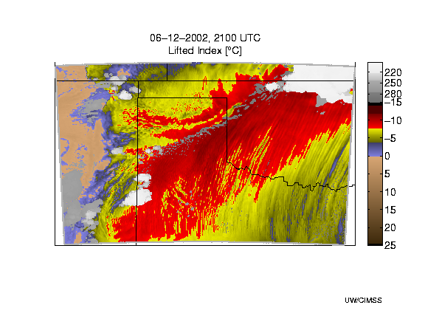
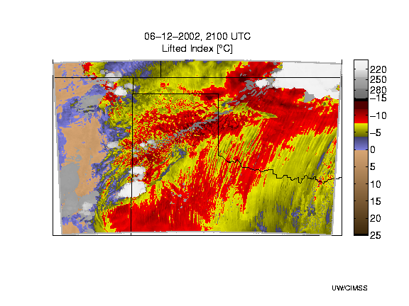
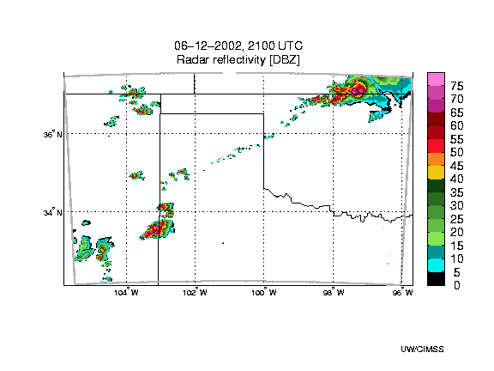
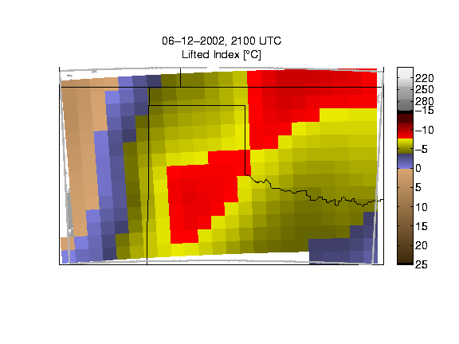
WRF Model LI
GEO Advanced Sounder-Derived LI
Simulated Radar
RUC Forecast
Rain line shows in radar 8 hours later
2100 UTC

Slide 49
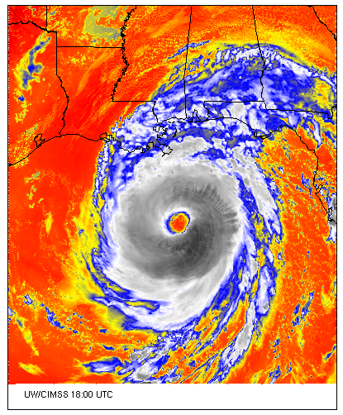
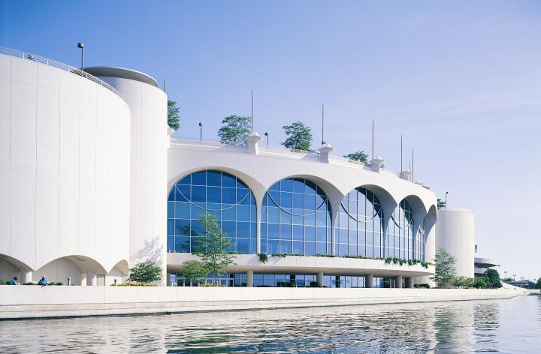
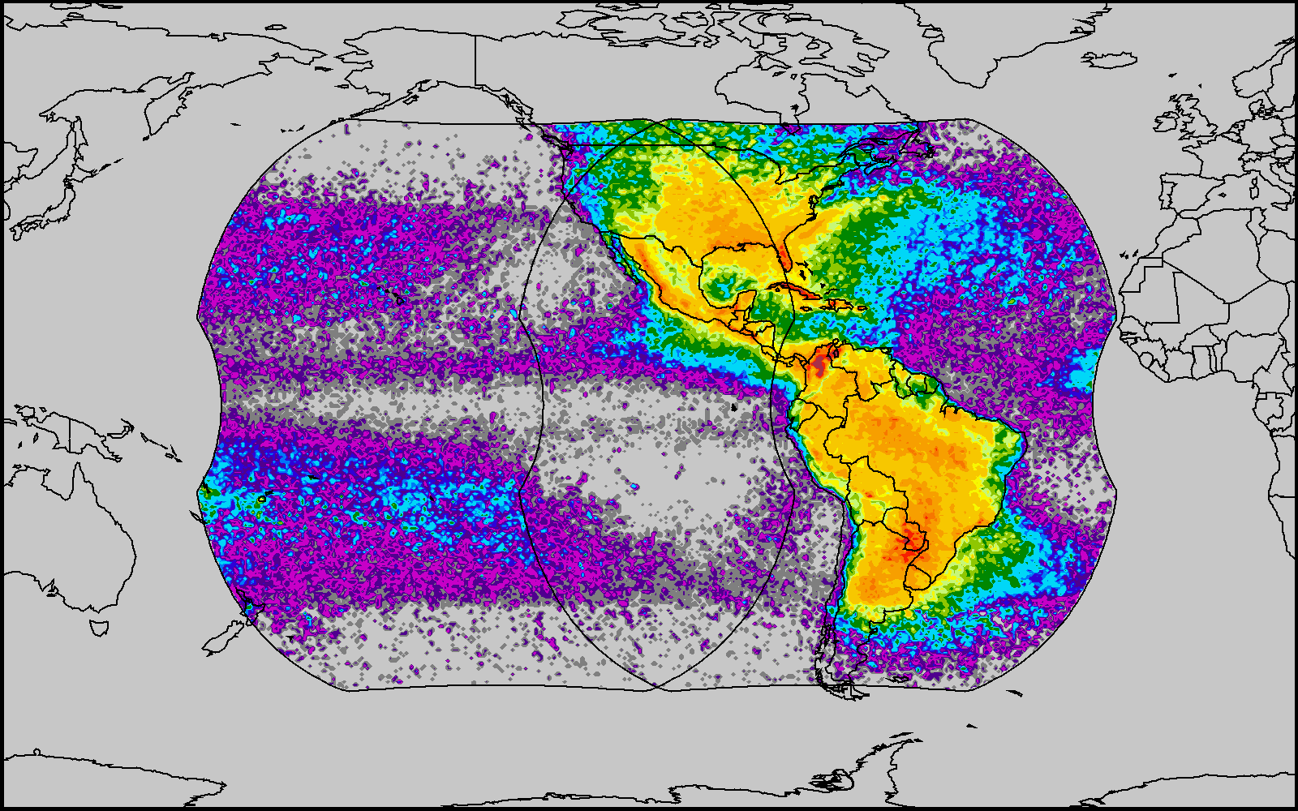
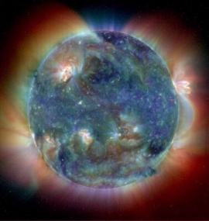
6th GOES Users’ Conference
http://cimss.ssec.wisc.edu/goes_r/meetings/guc2009/
3-5 November 2009
Monona Terrace Convention Center
Madison, Wisconsin
Geostationary Operational Environmental Satellites: http://www.goes-r.gov
Special Event on 2 November: 50th Anniversary of the 1st Meteorological Satellite Experiment

