Slide 1
The GOES-R Proving Ground and User Readiness
Steven Goodman¹, James Gurka¹, Timothy Schmit², Mark DeMaria³
¹NOAA/NESDIS/GOES-R Program Office, Greenbelt, MD 20771 USA
²NOAA/NESDIS/Center for Satellite Applications and Research, Madison, WI
³NOAA/NESDIS/Center for Satellite Applications and Research, Fort Collins, CO
http://www.goes-r.gov
http://cimss.ssec.wisc.edu/goes_r/proving-ground.html
IGARSS 2009
Cape Town, South Africa

Slide 2
Contributors
Daniel Lindsey
NOAA/NESDIS/Center for Satellite Applications and Research, Fort Collins, CO
Wayne Feltz, Scott Bachmeier and Kris Bedka
Cooperative Institute for Meteorological Satellite Studies, University of Wisconsin, Madison, WI
Steven Miller
Cooperative Institute for Research in the Atmosphere, Colorado State University, Fort Collins, CO
Eric Bruning
Cooperative Institute for Satellite Climate Studies, University of Maryland, College Park, MD
Gary Jedlovec and Richard Blakeslee
NASA Short-term Prediction Research and Transition (SPoRT) Center, Huntsville, AL
Russell Schneider and Chris Siewert
Cooperative Institute for Mesoscale Meteorological Studies, NOAA/NWS/Storm Prediction Center, Norman, OK
Robert Rabin
NOAA/National Severe Storms Laboratory

Slide 3
Outline
GOES-R Proving Ground Overview
Mission, Components, Framework, Partners
Progress and Status
Some Examples
Advanced Baseline Imager
Geostationary Lightning Mapper
Summary

Slide 4
Proving Ground/ Testbed Concept
• Proving Ground is a valuable tool to ensure user
readiness on Day-1
Use proxy and simulated data sets to:
Validate new or improved products
Test and validate processing and distribution systems
Validate/ optimize decision aids
Optimize product display techniques
Develop content for training
• Venue for direct user input
• Proven successful in NEXRAD program
Intended outcomes are Day-1 readiness and maximum utilization for both the developers and users of GOES-R products, and an effective transition to operations

Slide 5
Proving Ground Framework
Place where technologies and ideas are tested and proven before being fielded in operations
Evaluates how infusion of technology or process in forecast environment impacts operations
Integrates technology or process with other available tools
User readiness risk mitigation
Key component: operational testing by those independent of the development process
Key Benefit: users more accepting of fielded technology
They have had a say in the design
Design better fits an identified need

Slide 6
Key Components of Proving Ground
Ability to fully test individual components
Ability to fully test integrated components
Testing which simulates routine low-end events
Testing which simulates high-end non-routine events
Testing using archived events and simulation
Testing using live events
Test team independence
Test team membership made up of test experts, trainers, and operational users
Ability to make recommendations to the decision maker based on impacts noted in test findings

Slide 7
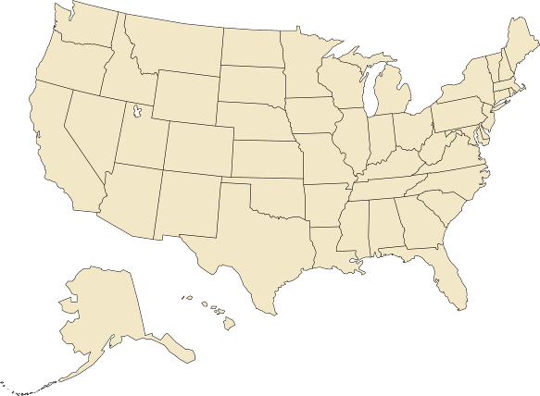
GOES-R Proving Ground Partners
Green Bay, WI WFO
Sullivan, WI WFO
Cooperative Institute for Meteorological Satellite Studies
Madison, Wisconsin
Sterling, VA WFO
Cheyenne, WY WFO
Cooperative Remote Sensing Science and Technology Center
New York, NY
Cooperative Institute for Research in the Atmosphere
Fort Collins, Colorado
La Crosse, WI WFO
NWS Headquarters; Cooperative Institute for Satellite Climate Studies; Center for Satellite Applications and Research; Office of Satellite Data Processing and Distribution; GOES-R Program Office;
University of Maryland Baltimore County
Maryland
Boulder, CO WFO
Eureka, CA WFO
NWS Central Region
Kansas City, MO
EPA
Research Triangle Park, NC
NWS Alaska Region
Anchorage, Alaska
Melbourne, FL WFO
NASA Kennedy Space Center
NWS Pacific Region
Honolulu, Hawaii
NCEP Tropical Prediction Center Joint Hurricane Testbed
Miami, Florida (Planned for FY2010)
NCEP: National Centers for Environmental Prediction
NWS: National Weather Service
WFO: Weather Forecast Office
NCEP Storm Prediction Center;
Norman, OK WFO;
National Severe Storms Laboratory;
University of Oklahoma;
Cooperative Institute for Mesoscale Meteorological Studies
Norman, Oklahoma
Hazardous Weather Testbed- Experimental Forecast and Warning Programs
Huntsville, AL WFO
University of Alabama Huntsville
NASA Short-term Prediction Research and Transition Center
Huntsville, AL

Slide 8
GOES-R Improvements vs Current GOES
Performance Capability | GOES I-M | GOES N-P | GOES R
Imaging
Visible Resolution | 1 km | 1 km | 0.5 km
IR Resolution | 4-8 km | 4-8 km N 4 km O/P | 1-2 km
Full Disk Coverage Rate | 30 min | 30 min | 5 min
Rapid Scan Imaging Mode | 7.5 min | 7.5 min | 30 sec
# of Channels | 5 | 5 | 16
Solar Monitoring | GOES-M only | Yes | Yes
Lightning Detection | No | No | Yes (8km)
Operate through Eclipse | No | Yes | Yes
Ground System Backup | Limited | Limited | Limited
Archive and Access | Limited | Limited | Yes
S/C Raw Data Volume | 2.6 Mbps | 2.6 Mbps | 75 Mbps

Slide 9
GOES-R 34 Baseline Products
GOES-R 34 Additional Products (Option 2)
Aerosol Detection (incl Smoke & Dust)
Aerosol Particle Size
Suspended Matter / Optical Depth
Aircraft Icing Threat
Volcanic Ash: Detection & Height
Cloud Ice Water Path
Cloud & Moisture Imagery
Cloud Imagery: Coastal
Cloud Optical Depth
Cloud Layers / Heights and Thickness
Cloud Particle Size Distribution
Cloud Liquid Water
Cloud Top Phase
Cloud Type
Cloud Top Height
Convective Initiation
Cloud Top Pressure
Enhanced “V” / Overshooting Top Detection
Cloud Top Temperature
Low Cloud and Fog
Hurricane Intensity
Turbulence
Lightning Detection: Events, Groups & Flashes
Visibility
Rainfall Rate / QPE
Probability of Rainfall
Legacy Vertical Moisture Profile
Rainfall Potential
Legacy Vertical Temperature Profile
Total Water Content
Derived Stability Indices
Absorbed Shortwave Radiation: Surface
Total Precipitable Water
Downward Longwave Radiation: Surface
GOES-R Product Set- 68
Clear Sky Masks
Upward Longwave Radiation: Surface
Radiances
Upward Longwave Radiation: TOA
Downward Solar Insolation: Surface
Ozone Total
Reflected Solar Insolation: TOA
SO2 Detection
Derived Motion Winds
Flood/Standing Water
Fire / Hot Spot Characterization
Ice Cover/Landlocked
Land Surface (Skin) Temperature
Snow Depth
Snow Cover
Surface Albedo
Sea Surface Temperature
Surface Emissivity
Energetic Heavy Ions
Vegetation Fraction: Green
Magnetospheric Electrons and Protons: Low Energy
Vegetation Index
Magnetospheric Electrons and Protons: Medium & High Energy
Currents
Solar and Galactic Protons
Currents: Offshore
Geomagnetic Field
Sea & Lake Ice: Age
Solar Flux: EUV
Sea & Lake Ice: Concentration
Solar Flux: X-Ray
Sea & Lake Ice: Extent
Solar Imagery: X-Ray
Sea & Lake Ice: Motion
ABI
SUVI
EXIS
GLM
SEISS
Magnetometer

Slide 10
Proxy Data for GOES-R
No current GEO satellite has the spatial, spectral and temporal resolution of GOES-R
Use proxy and simulated data sets to develop, test and validate products, decision aids, data processing and distribution systems
• MODIS
• AIRS
• IASI
• SEVIRI
• NAST-I (airborne simulator)
Unmanned Aircraft Systems-Global Hawk
• NPP/ VIIRS/ CrIS
Ground-based Total Lightning Networks
• Computer Simulated Atmospheres- WRF radiances

Slide 11
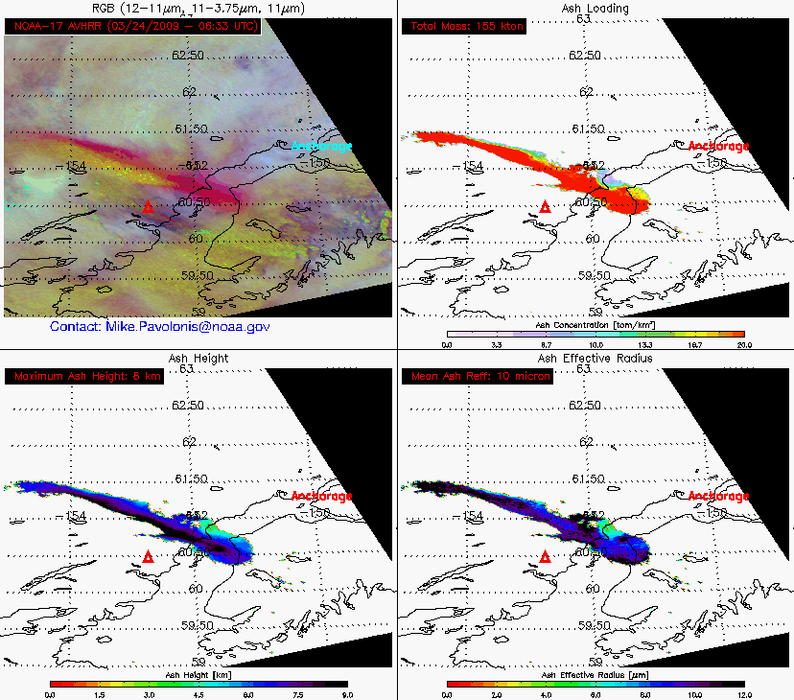
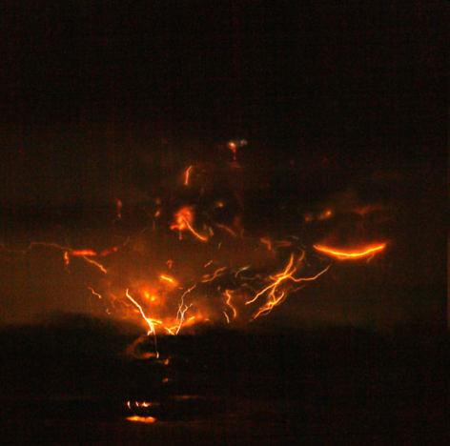
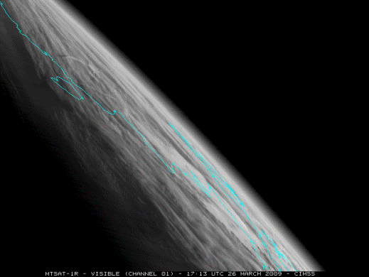
Examples of Proving Ground Products
Mt. Redoubt has had more than 20 major eruptions since Sunday morning March 22, 2009. The eruptions have created a continuous major ash plume that has disrupted aviation across the State of Alaska. Rapid scan products of GOES imagery provided new insight on the eruptive activity of the mountain. NWS forecasters were able to use this insight to provide better information for warnings and advisories issued to the public and aviation communities.
False-color RGB image along with 3 other volcanic retrieval products: Ash loading, Ash height, and Ash effective radius. (produced by Mike Pavolonis, CIMSS/ASPB)
http://cimss.ssec.wisc.edu/goes/blog/archives/2228

Slide 12
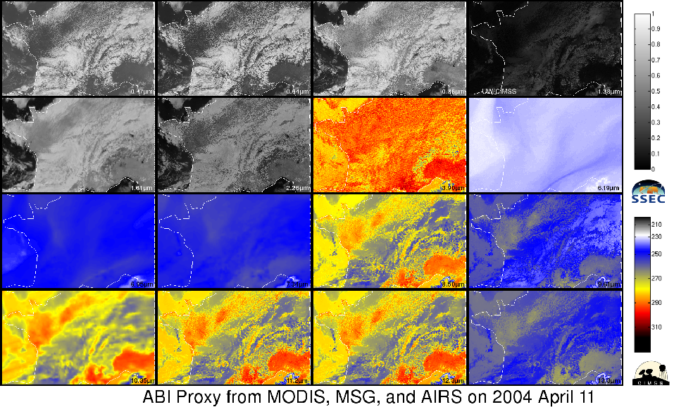
“ABI” Proxy Data from Current Satellites
Heritage,
clouds, etc
Cirrus
Clouds
Aerosols
Vegetation
Snow, Cloud phase
Fog, Fires,
clouds, etc
Water Vapor
Particle size
WV, Upper-level SO2
Vol. Ash,
Cloud phase
Water Vapor
Total Ozone
Surface
features, clouds
Heritage,
clouds, etc
Low-level
Moisture
Clouds

Slide 13
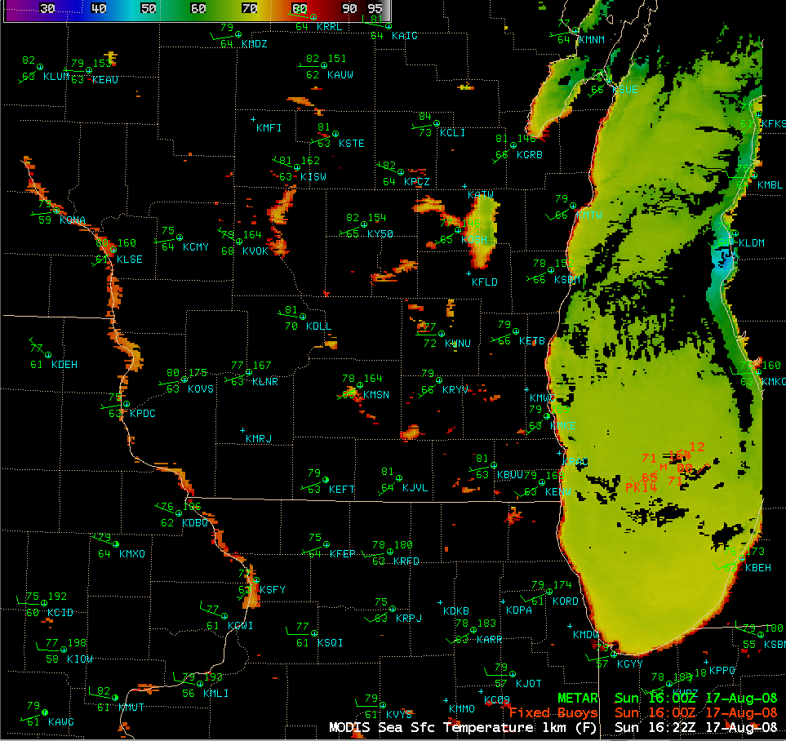
AREA FORECAST DISCUSSION NATIONAL WEATHER SERVICE MILWAUKEE/SULLIVAN WI 159 PM CDT SUN AUG 17 2008 EVEN WITH THE WEST SURFACE WINDS 1622Z MODIS SHOWS WARM UPPER 60 DEGREE LAKE MICHIGAN TEMPS NEAR SHORE...WITH NO COOLER UPWELLING SEEN. WOULD HAVE THOUGHT TEMPS WOULD HAVE BEEN COOLER...BUT WINDS ARE WEAK.

Slide 14
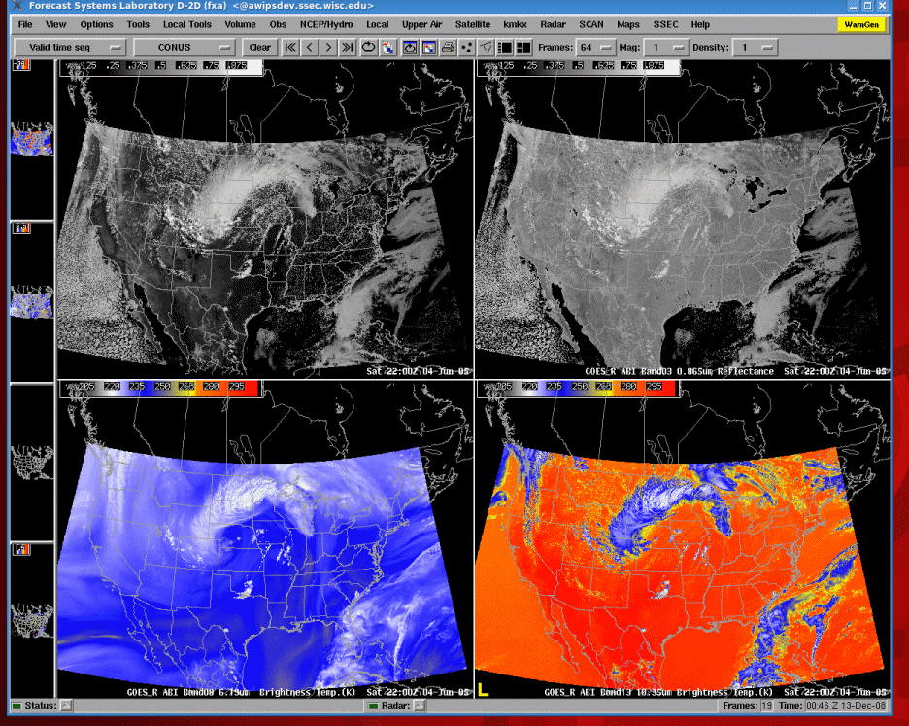
Animation of sample ABI visible and near-IR bands in AWIPS

Slide 15
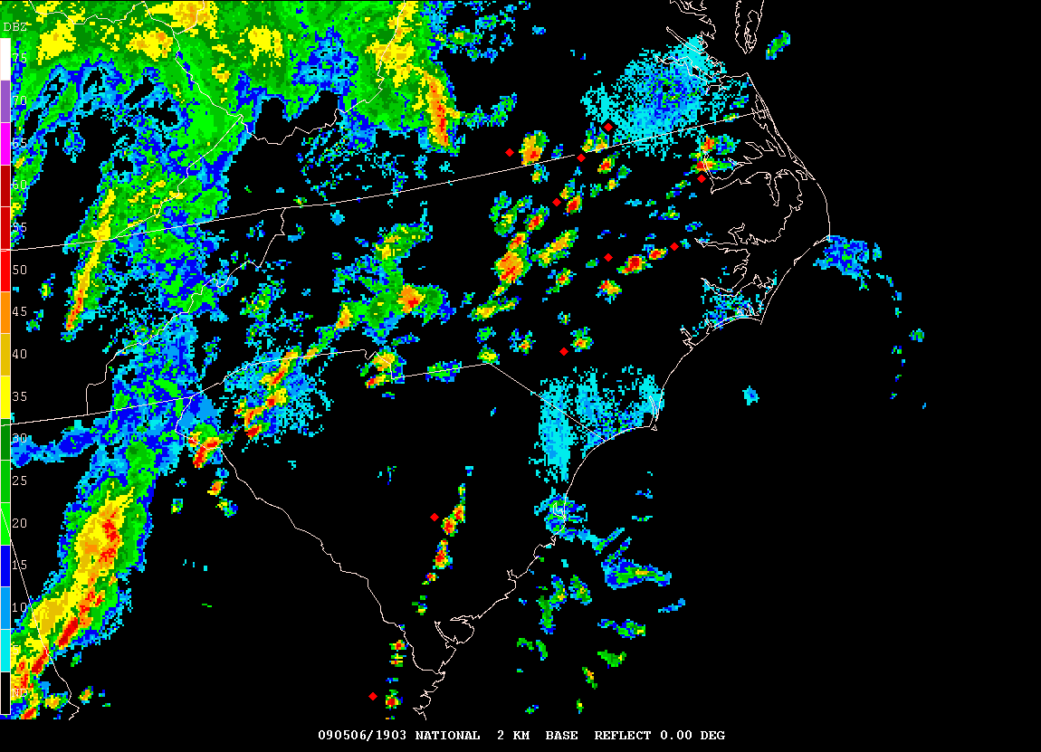
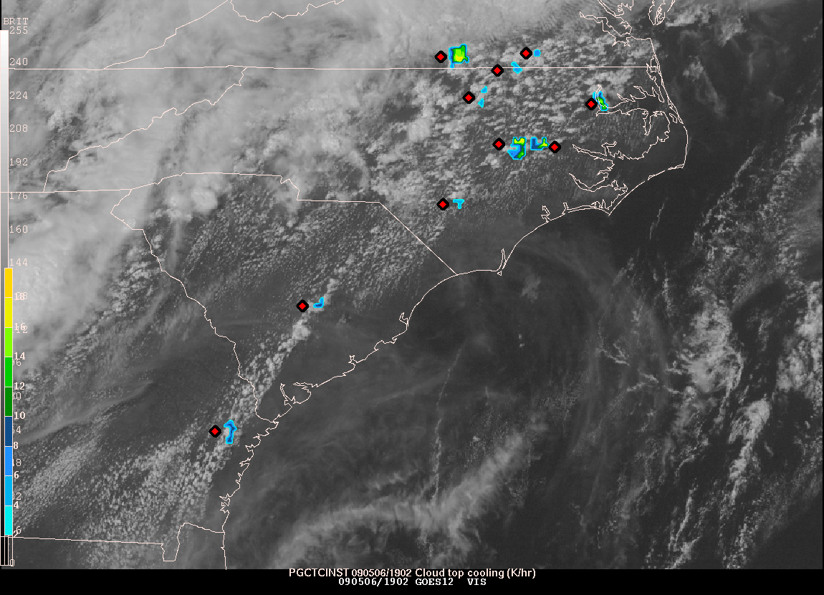
Convective Initiation (CI) Product:
Identifies regions of new/rapidly intensifying convection
2 components
cloud typing
cloud top cooling rate

Slide 16
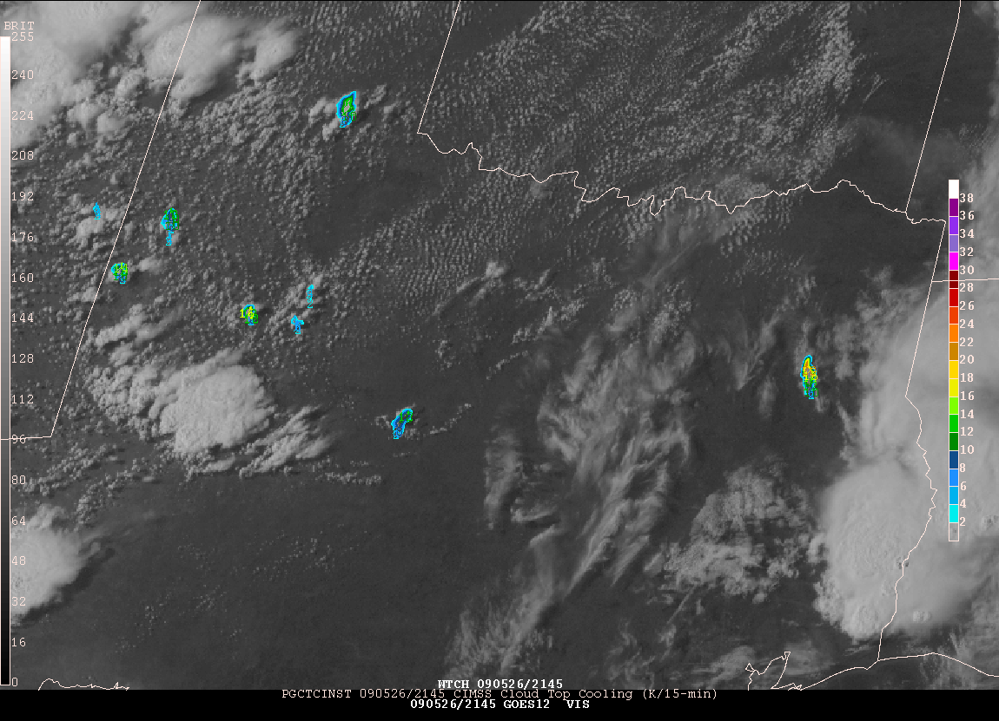
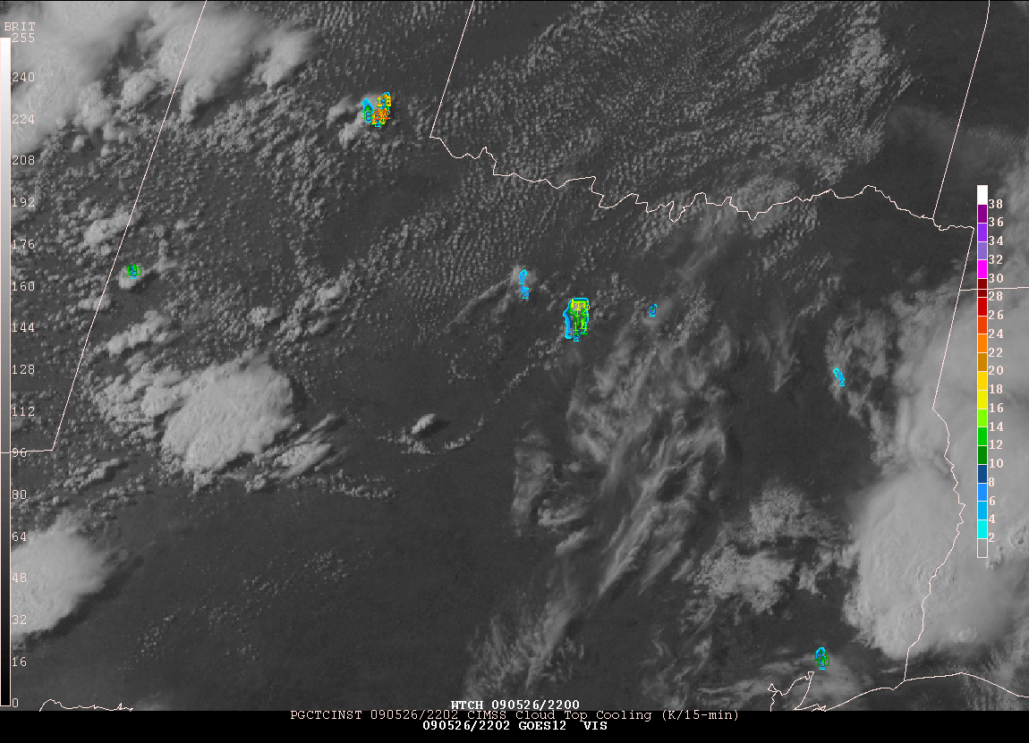
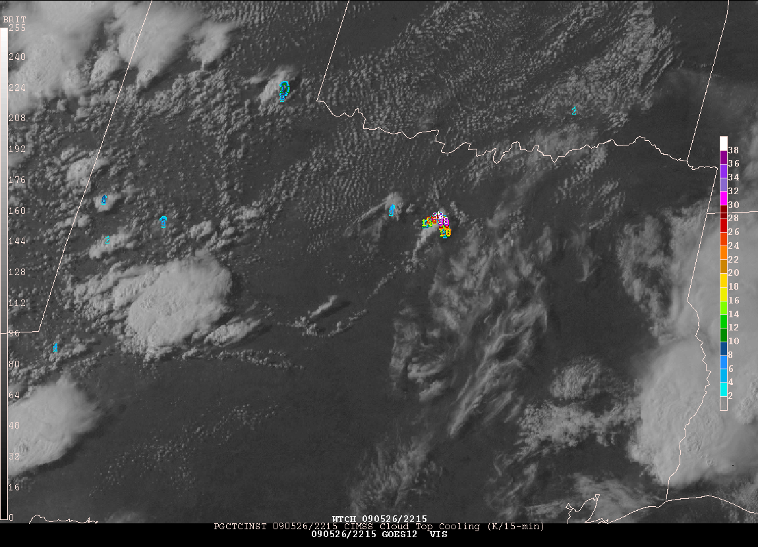
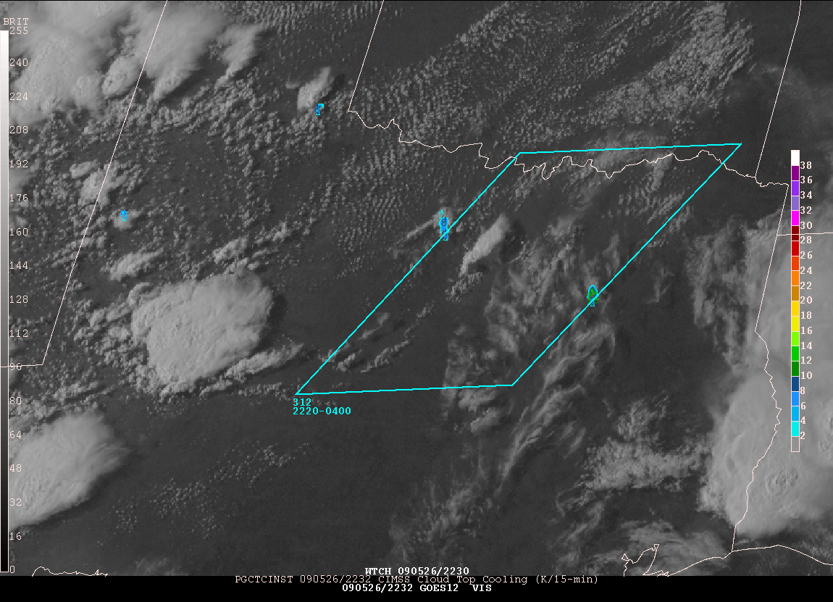
CI: Cloud Top Growth During Successive 15 min observations
2145
2202
2215
2232

Slide 17
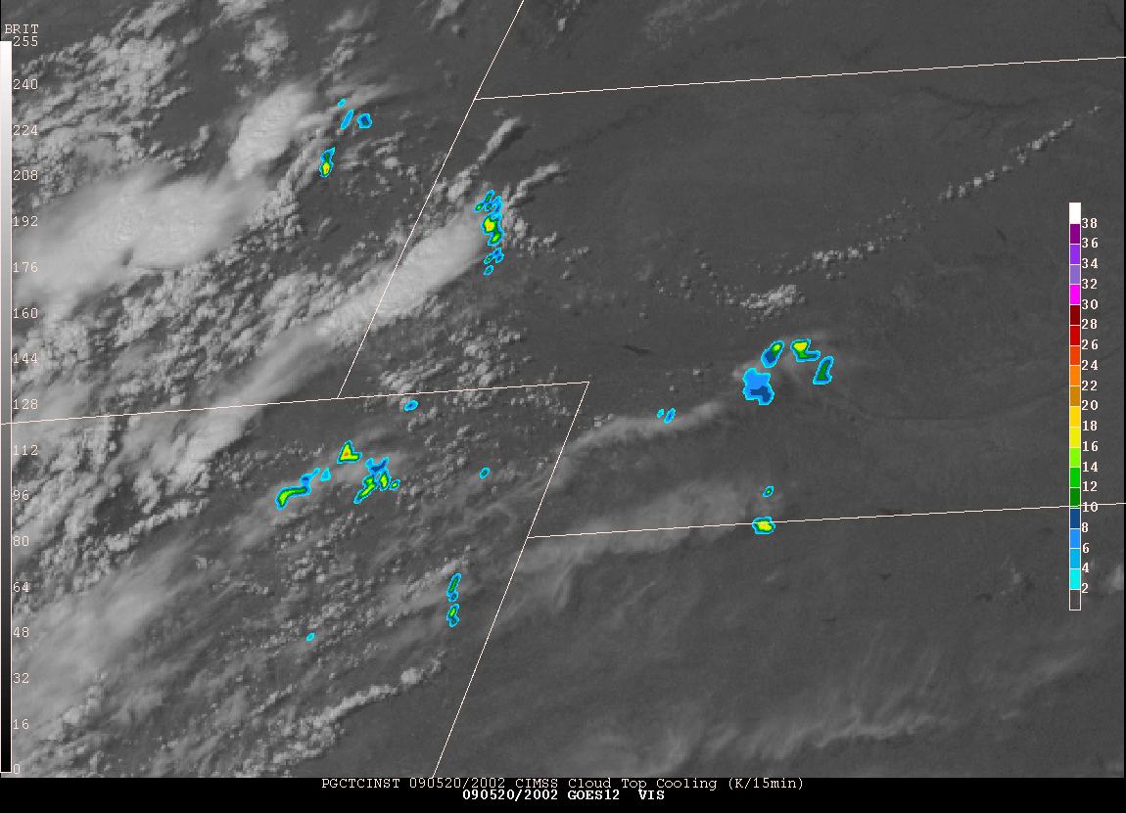
CI: False Cooling Rates Due to Anvil Expansion and Overriding Cirrus
Expanding Cloud Edges
Thin Cirrus

Slide 18
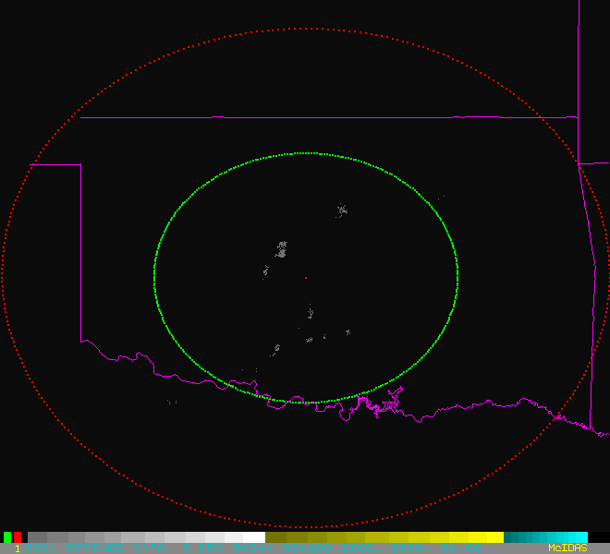
GLM Proxy Data from OKLMA

Slide 19
GLM Proxy Data DC Regional Storms November 16, 2006 Resampled 5-min source density at 1 km and 10 km
LMA 1 km resolution
LMA @ GLM 10 km resolution
GLM Testbeds at Huntsville, AL; Norman, OK; Sterling, VA; KSC, FL

Slide 20
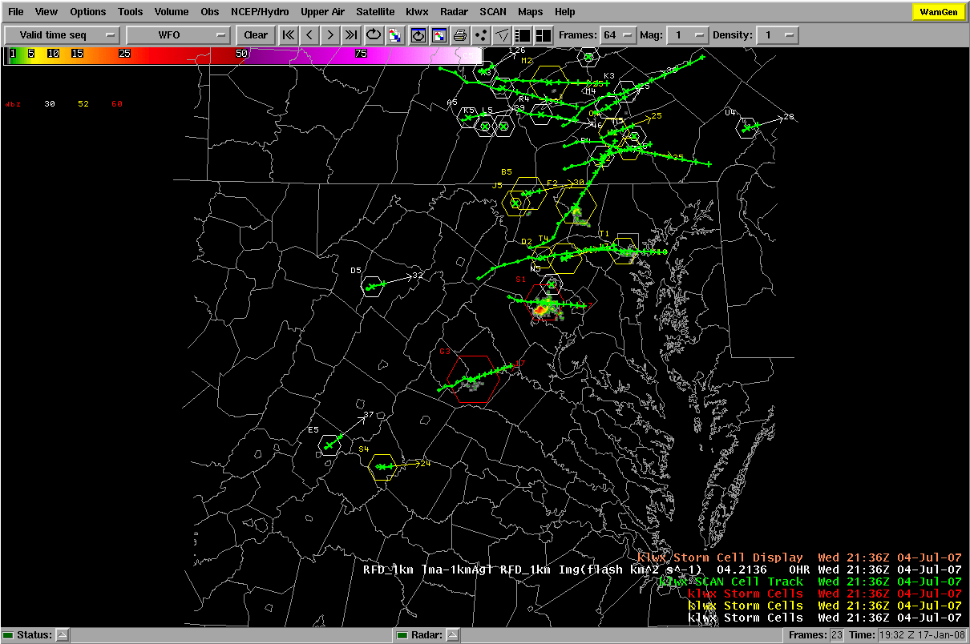
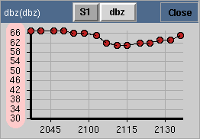
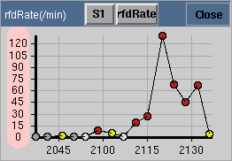
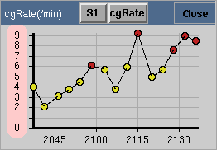
GLM Lightning Jump Algorithm: Experimental Trending Implementation in AWIPS/SCAN
Red > 60
Red > 6
Yellow: 2-6
White : 1-2
Gray < 1
SCAN Cell Table
Cell S1
DC LMA total lightning
Red > 6
Yellow: 2-6
(July 04, 2007 at 21:36Z)
Courtesy Momoudou Ba

Slide 21
Proving Ground Summary
Must be able to test individual and integrated components with independence from developers
Need pathway for user assessment and feedback to have impact on algorithm refinement
Ensuring pathway into operations by developing GOES-R proxy products for the AWIPS2 environment
Need real time and archived events (AWIPS2, WES)
Must maintain focus on clear path to operations

Slide 22
Pathways to User Readiness for GOES-R
GOES-R Proving Ground
User Education and Outreach
COMET modules; VISIT; SHyMet; ESRC
GOES-R Web Page, Fact Sheets, Social Media
GOES Users Conferences
Special Sessions at AMS (GOES/POES, IIPS, Satellite Conferences)
NOAA Direct Readout Conferences
User Readiness Plan

Slide 23
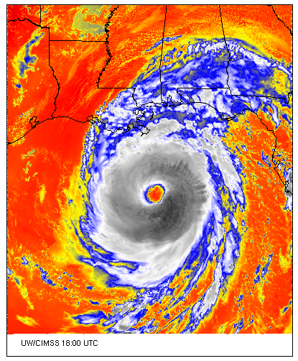
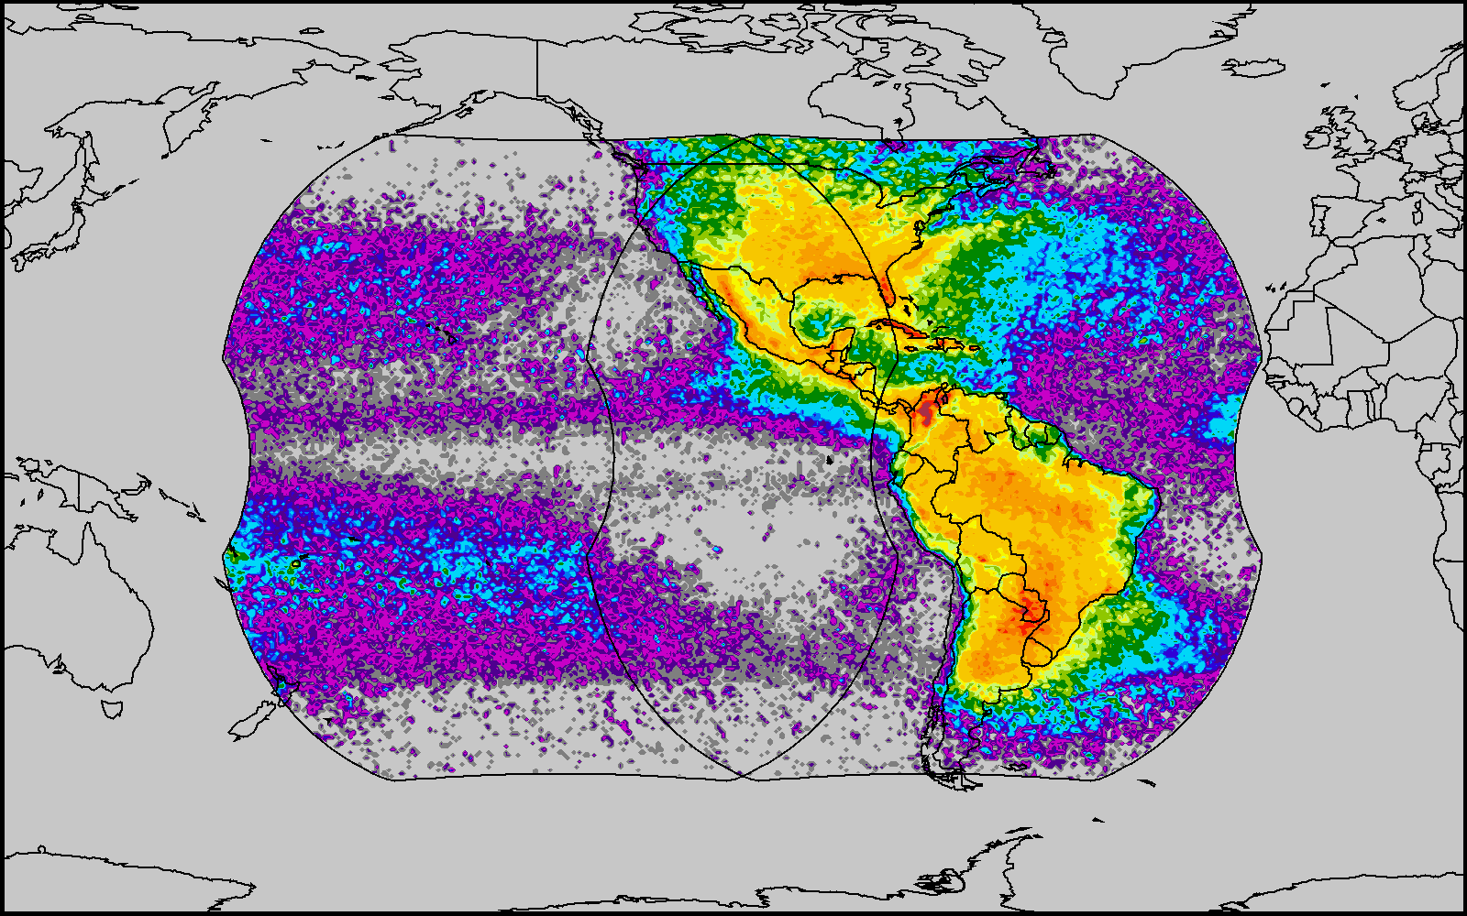
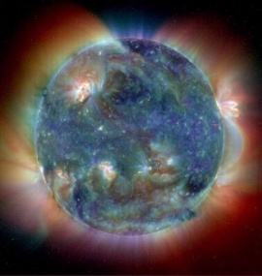
6th GOES Users’ Conference
http://cimss.ssec.wisc.edu/goes_r/meetings/guc2009/
3-5 November 2009
Monona Terrace Convention Center
Madison, Wisconsin
Geostationary Operational Environmental Satellites: http://www.goes-r.gov
Special Event on 2 November: 50th Anniversary of the 1st Meteorological Satellite Experiment

