Slide 1
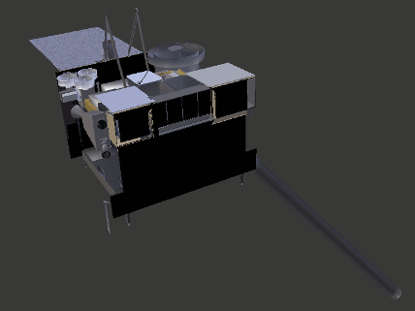
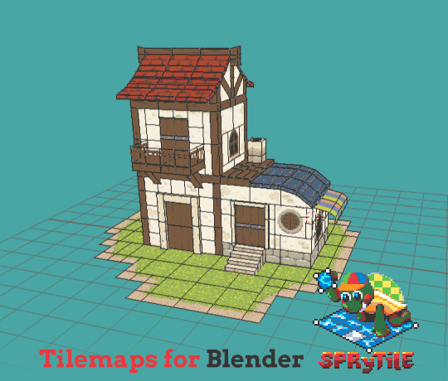
The Importance of 3D Computer Graphics Software in the STEM field
Andres Perez James Madison Memorial High School
Wonders of 3D Computer Graphics Software:
What are 3D Computer Graphics Softwares?
3D Computer Graphics Software refers to, a or multiple, programs that uses a three-dimensional representation of geometric data. This data, later stored into the device, can be used to perform calculations, rendering of 2D images, and animations. Not only that, but these images, calculations, and animations can be viewed later or displayed in real-time once saved. All IN A COMPUTER!!!
History of 3D Computer Graphics:
3D Computer Graphics Softwares began appearing around the late 1970s for home computers. Which then later began evolving and developing over the years go by.
Advantages of 3D Computer Graphics Softwares:
Helps designers and engineers to visualize space requirements
Improves drawing efficiency and accuracy
Allows designers and engineers to physically see the object to scale with all its details
Time Saver
So Much More…
Disadvantages of 3D Computer Graphics Softwares:
In Conclusion:
Top tier Softwares cost $$$$
Storage Consumption (that’s to be expected)
The first couple of tries can be overwhelming (but practice make perfection)
You tell me….
There’s just no words to really explain how such-of-a-tool 3D Computer Graphics Software has become to everyday life in the STEM field. But not only for STEM but for home projects as well.
Sources:
Images:
Animated ISS.gif GOES Satellite NASA.gif Tile house.gif
Lightning tornado.gif hSuperCellThunderStorm.gif
Websites:
https://www.google.com/search Blender https://en.m.wikipedia.org/wiki/3D_computer_graphics
https://nasa3d.arc.nasa.gov/detail/GOES https://plusgroups.com/the-advantages-of-3d-design/
https://medium.com/imeshup/blender-pros-cons-quirks-and-links-3a9bf803826f
https://www.google.com/search?q=different+3d+computer+graphics+software&oq=different+3d+computer+gr&aqs=chrome.2.69i57j33l5.13343j1j7&sourceid=chrome&ie=UTF-8
Some 3D Computer Graphics Softwares:
Blender
Autodesk Maya
Cinema 4D
Autodesk 3ds Max
LightWave 3D
etc…

