Slide 1
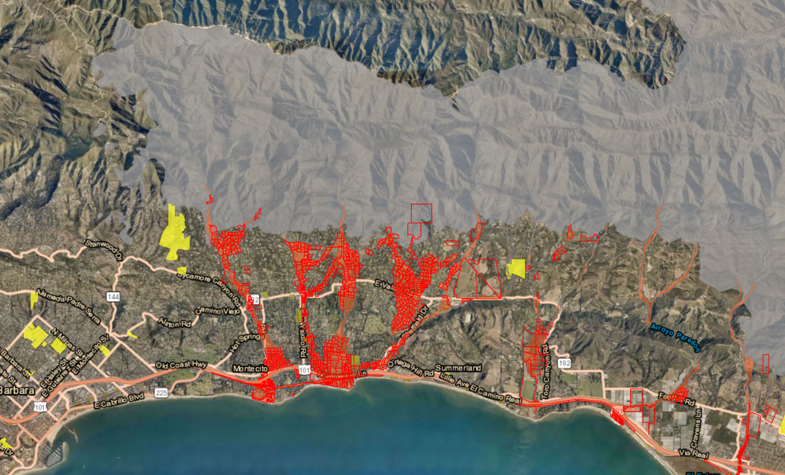
Web-based Tool for Rapid Burn Intensity Estimates Using VIIRS NDVI PI: Sam Batzli
Motivation: Wildfires destabilize the soil by converting trees and vegetation to ash and debris. In areas with hilly or mountainous terrain, ensuing rainstorms can generate flash floods, debris flows, and mudslides. Current sources of burn intensity estimates often arrive too late to help. VIIRS can accelerate the process.
Objectives: To provide wildfire burn intensity estimates to the NWS-WFOs as a rapid preliminary input for forecasting and issuing warnings for life-threatening post-fire debris and mud flows.
Burn Scar Input “BRIDGE” Map
Approach: To semi-automate production of VIIRS delta NDVI BRIDGE (Burn Intensity Delta Greenness Estimate) maps to cut latency.
Evacuation Orders
Example evacuation order map from 5 March 2019. Source: County of Santa Barbara, Emergency Operation Center and Santa Barbara County Sheriff
Project funding source: NOAA JPSS
Highlights and Outcomes
Initial workflow testing and web interface development is underway.
Co-I’s: Katherine Rowden (NWS/Spokane-WFO), Ivan Csiszar (NOAA/NESDIS-STAR)
April, 2019
Notes:
Major Result to go in lower left side: Figures should not be too complex or busy – this example is probably the limit of acceptable complexity.

Slide 2
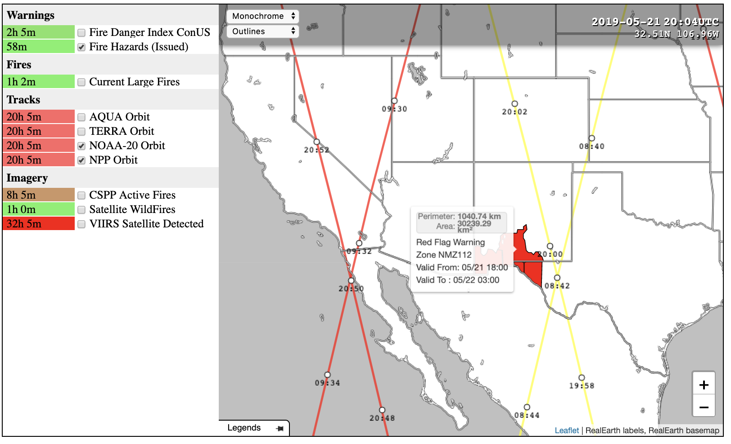
Web-based Tool for Rapid Burn Intensity Estimates Using VIIRS NDVI PI: Sam Batzli
Burn Scar Input “BRIDGE” Map
[BRIDGE Map generation upload/download tools will go here]
Evacuation Orders
Prototype BRIDGE Map dashboard in development, showing S-NPP (yellow) and NOAA-20 (red) satellite tracks with UTC times, coincident with a Red Flag Warning. Future elements will include before and after NDVI visualization with BRIDGE Map generation tools.
April, 2019
Notes:
Major Result to go in lower left side: Figures should not be too complex or busy – this example is probably the limit of acceptable complexity.

