Slide 1
Considering alternatives for
GOES-R ABI scan modes:
“Continuous FD”, “Flex”, and “Hybrid”
Timothy J. Schmit (tim.j.schmit@noaa.gov)
NOAA/NESDIS/Satellite Applications and Research
Advanced Satellite Products Branch (ASPB)
Chris Velden (ChrisV@ssec.wisc.edu)
UWisc. - CIMSS
Madison, WI

Slide 2
Possible ABI Modes of Operation (assuming GOES-West positioning)
Continuous Full Disk : Provides uninterrupted scans of the full disk every 5 minutes.
Flex : Provides a FD scan every 15 minutes, a CONUS every 5 minutes, and a Mesoscale every 30 seconds (or two Mesoscale areas with 1-min. scans)
Mesoscale: Provides coverage over a selectable 1000x1000km box with a
temporal resolution of 30 seconds. Option: Two Meso areas with
1-min. scans, with one “fixed” over Hawaii.
CONUS: Provides coverage that includes southern Alaska, the western
continental US, and northeastern Pacific Ocean regions (but not
Hawaii) every 5 minutes. Referred to as “PACUS” (note quotes)
Hybrid : Provides “PACUS” coverage every 5 minutes, a FD scan every 15 minutes (accept every 5 minutes near the top of every hour), and Mesoscale coverage every 30 seconds (except for a 15-min. period near the top of every hour, when it becomes 5-min.)
ITT scan mode video: http://www.youtube.com/watch?v=p8SgXJSMOfc&feature=player_embedded
Notes:
http://www.goes-r.gov/spacesegment/abi.html

Slide 3
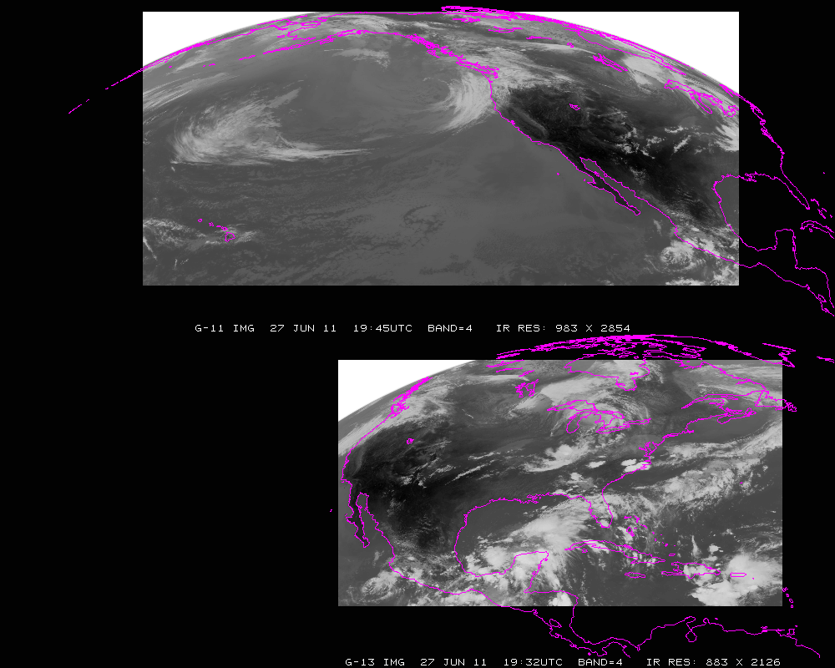
Current GOES Imager scans: GOES-W PACUS (upper) and GOES-E CONUS (right). Note that PACUS is one-third larger. These regions are sub-selected for AWIPS.

Slide 4
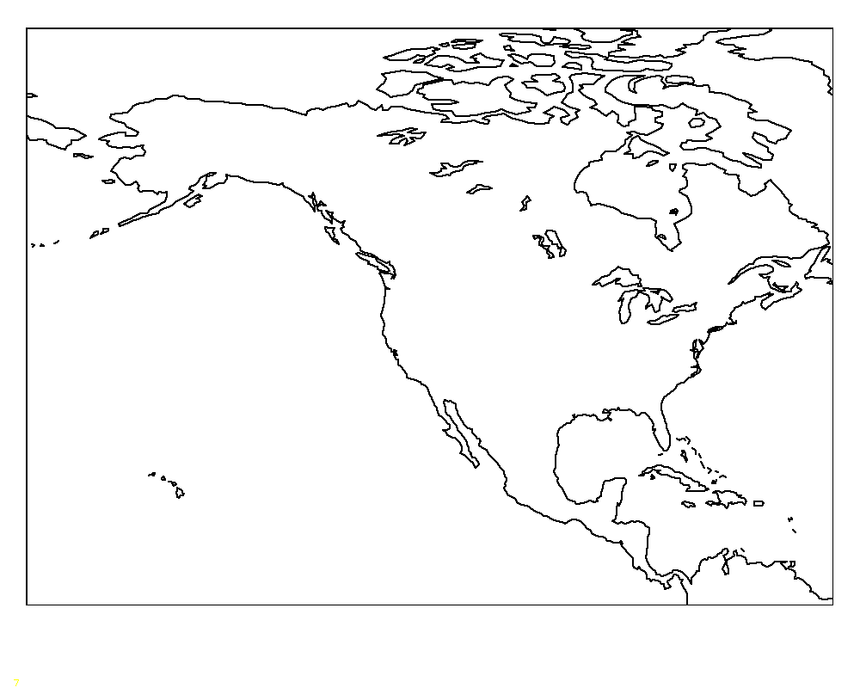
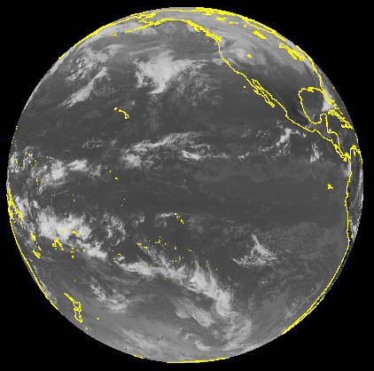
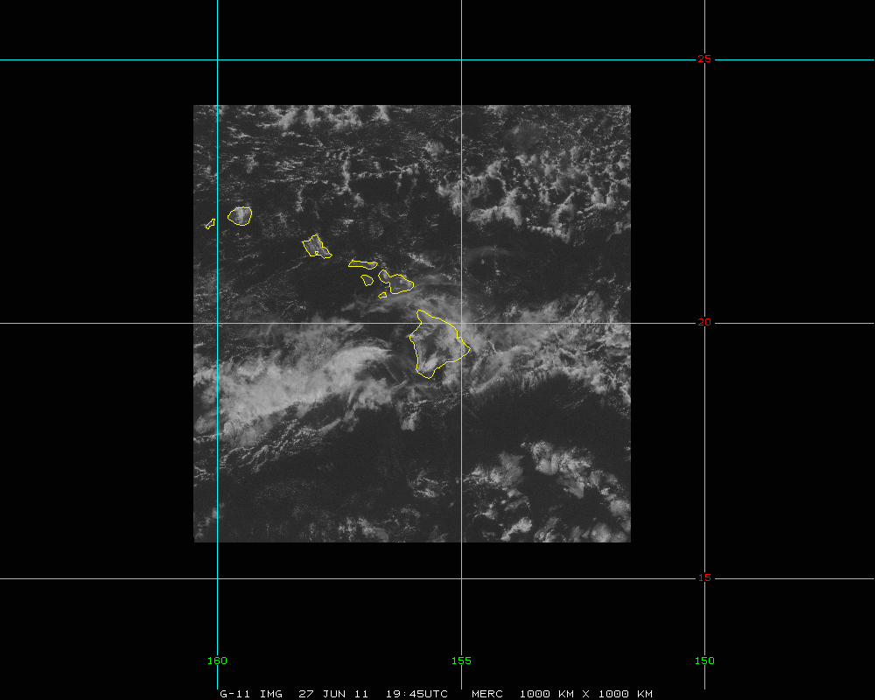
GOES-West
“5 min PACUS”
Full Disk
meso
Mesoscale
Possible scan modes for the west ABI (per hour):
Continuous FD--Full disk scan every 5 minutes, OR
FLEX--Full disk scan every 15 mins + continuous 5-min “PACUS” images + two
selectable Mesoscale areas with continuous 1-min scans, OR…

Slide 5
GOES-West
“5 min PACUS”
Full Disk
meso
Possible scan modes for the west ABI (per hour):
Hybrid - For ¾ of the hour: FLEX mode (Full disk scan every 15 mins + 5 min
“PACUS” images + two 1-min. mesoscales); for ¼ of the hour: FD mode
(5-min. FD scans for AMV production)
Mesoscale

Slide 6
~ mode 3 (mp4)
http://cimss.ssec.wisc.edu/goes/srsor2013/900x900_GOES_B1_WI_MODE3_animated_2013233_170000_182_2013233_230000_182_X.mp4

Slide 7
~ mode 3
(mpeg)
Notes:
mpeg

Slide 8
~ mode 3.25
(mp4)
http://cimss.ssec.wisc.edu/goes/srsor2013/900x900_GOES_B1_WI_MODE325_animated_2013233_170000_182_2013233_224500_182_X.mp4

Slide 9
~ mode 3.25
(mpeg)
Notes:
mpeg

Slide 10
~ mode 3
(mp4)
http://cimss.ssec.wisc.edu/goes/srsor2013/900x900_GOES_B1_NV_MODE3_animated_2013231_140000_182_2013231_210000_182_X.mp4

Slide 11
~ mode 3
(mpeg)
Notes:
mpeg

Slide 12
~ mode 3.25
(mp4)
http://cimss.ssec.wisc.edu/goes/srsor2013/900x900_GOES_B1_NV_MODE325_animated_2013231_140000_182_2013231_204500_182_X.mp4

Slide 13
~ mode 3.25
(mpeg)
Notes:
mpeg

Slide 14
“Continuous FD” Mode of Operations Pros Cons
Uninterrupted scans of the entire ABI viewing footprint at 5-min. intervals
Improved operational cloud-tracked winds vs. 15-min sampling
No need for NWS to request special scanning operations
Give up the mesoscale sampling and products
Will miss rapidly changing/evolving events
No ‘targeted’ observations, e.g. event-driven scanning

Slide 15
“Flex” Mode of Operations Pros Cons
Syncs FD sampling (15-min) with other future geo satellites
Provides for 5-min scans over western US, southern Alaska and northeast Pacific
Allows for selectable and uninterrupted mesoscale sampling (e.g. Hawaii and rapidly changing events, etc.)
Operational cloud-tracked winds (outside of “PACUS” domain) limited to 15-min. imagery (sub-optimal)
Other cloud products less frequently available for aviation and global NWP applications outside of the “PACUS”

Slide 16
“Hybrid” Mode of Operations Pros Cons
All of Flex mode pros, except the mesoscale views will be interrupted for one-fourth of the hour
Allows FD cloud-tracked winds to be produced from 5-min. images once per hour
1-min. or 30-sec mesoscale sampling will be interrupted every hour (replaced by 5-min. scans for a duration of 15 min.)
Introduces a discontinuity in the animations once per hour (for 15 min).

Slide 17
Summary of ABI Operational Scan Mode Alternatives
Continuous FD mode of operations would be great for large-scale animations and improved cloud-track wind derivation, but no ‘super-rapid-scan’ (SRS) imaging for mesoscale events.
Flex mode of operations would provide unique opportunities for mesoscale imaging (SRS), but would be sub-optimal for cloud-tracked winds over most of the viewing region (important for global NWP).
Hybrid mode of operations would allow improved cloud-tracked winds and mesoscale sampling, but with small interruptions to the SRS animations (and any derived products)

Slide 18
References
Schmit, T. J., and co-authors, 2013: GOES-14 Super Rapid Scan Operations to Prepare for GOES-R, Accepted to J. Applied Remote Sensing.
or
Rapid Refresh Information of Significant Events: Preparing users for the next generation of geostationary operational satellites, submited to JARS.

Slide 19
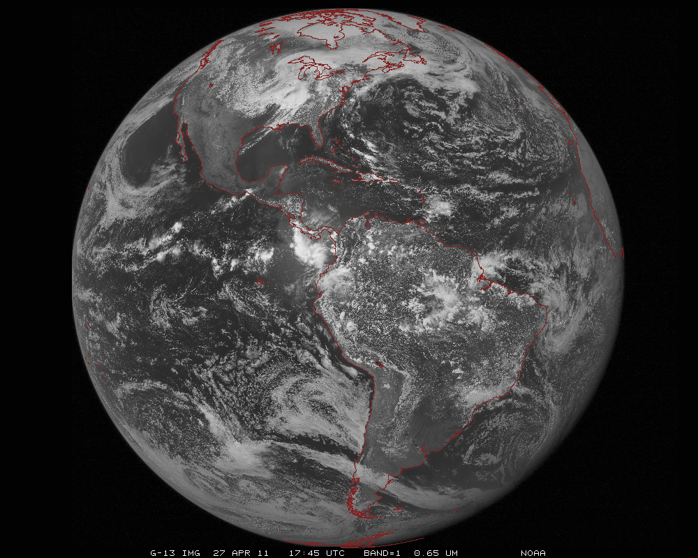
ABI scans about 5 times faster
than the current GOES imager
Anticipated scan mode for the ABI:
- Full disk images every 15 minutes + 5 min CONUS images + mesoscale.

Slide 20
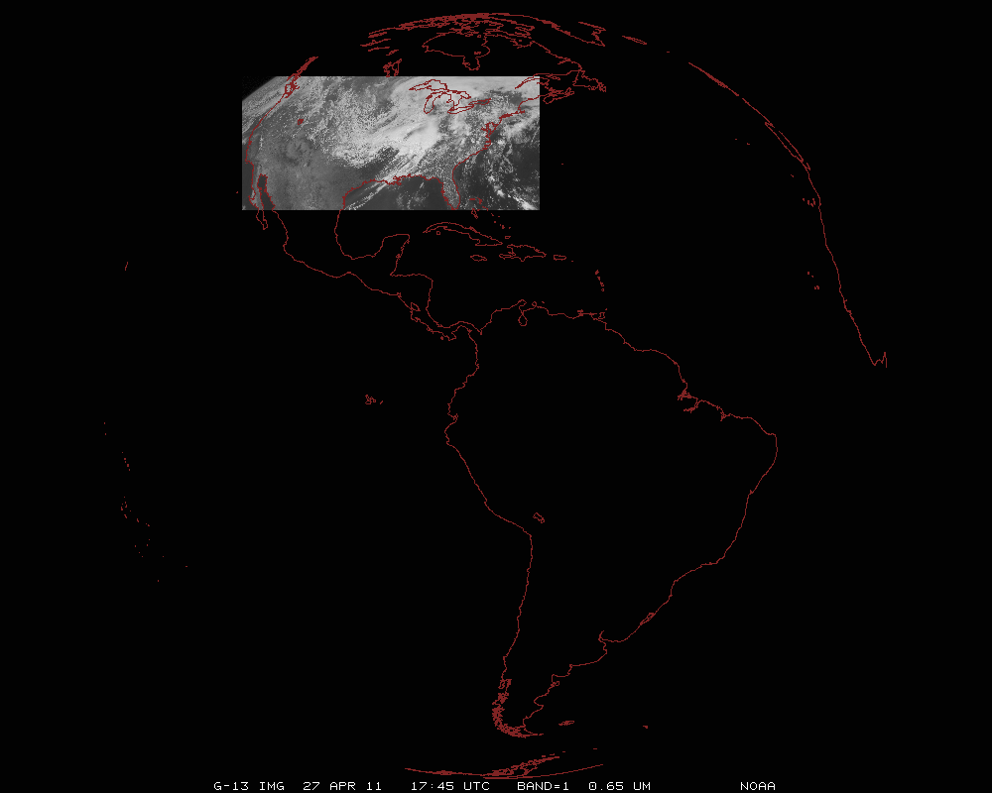
ABI can offer Continental US images every 5 minutes for routine monitoring of a wide range of events (storms, dust, clouds, fires, winds, etc).
This is every 15 or 30 minutes with the current GOES in routine mode.
Notes:
Approx. size of CONUS

Slide 21
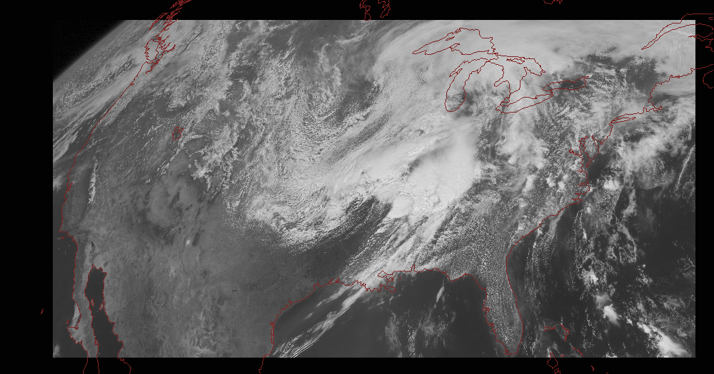
Notes:
Approx. size of CONUS

Slide 22
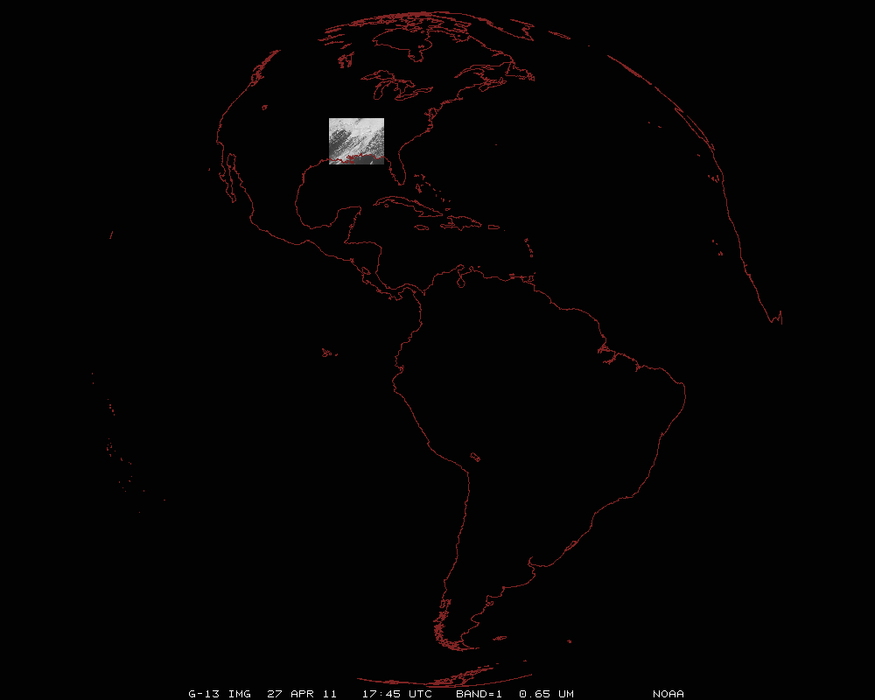
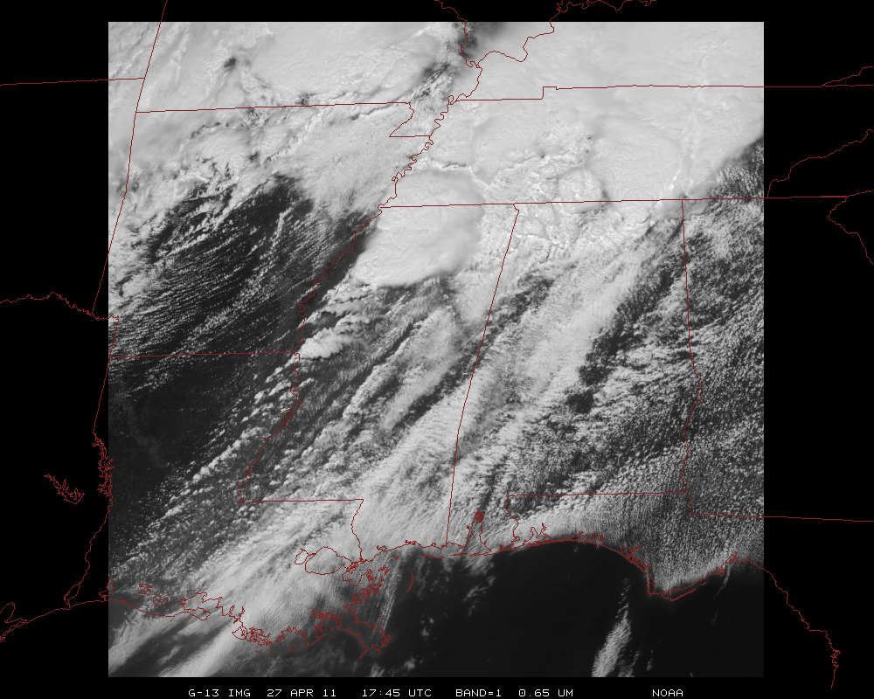
Mesoscale images every 30 seconds for rapidly changing phenomena
(thunderstorms, hurricanes, fires, etc). Or two regions every 60 seconds.
Notes:
Approx. size of meso-scale showing “Franklin”.

