Slide 1
National Centers for Environmental Information (NCEI)
AMS Short Course GOES-R Preview for Users Space Weather
W.F. Denig
National Centers for Environmental Information (NCEI)
NOAA/NESDIS
Boulder, Colorado
22 January 2017
Notes:
1

Slide 2
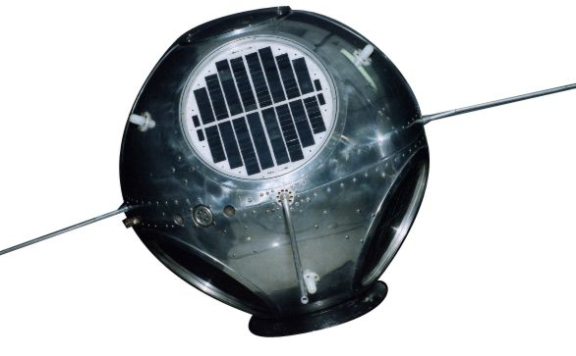
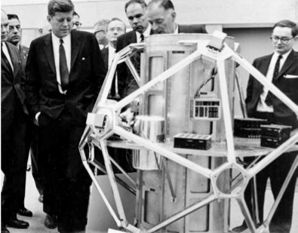
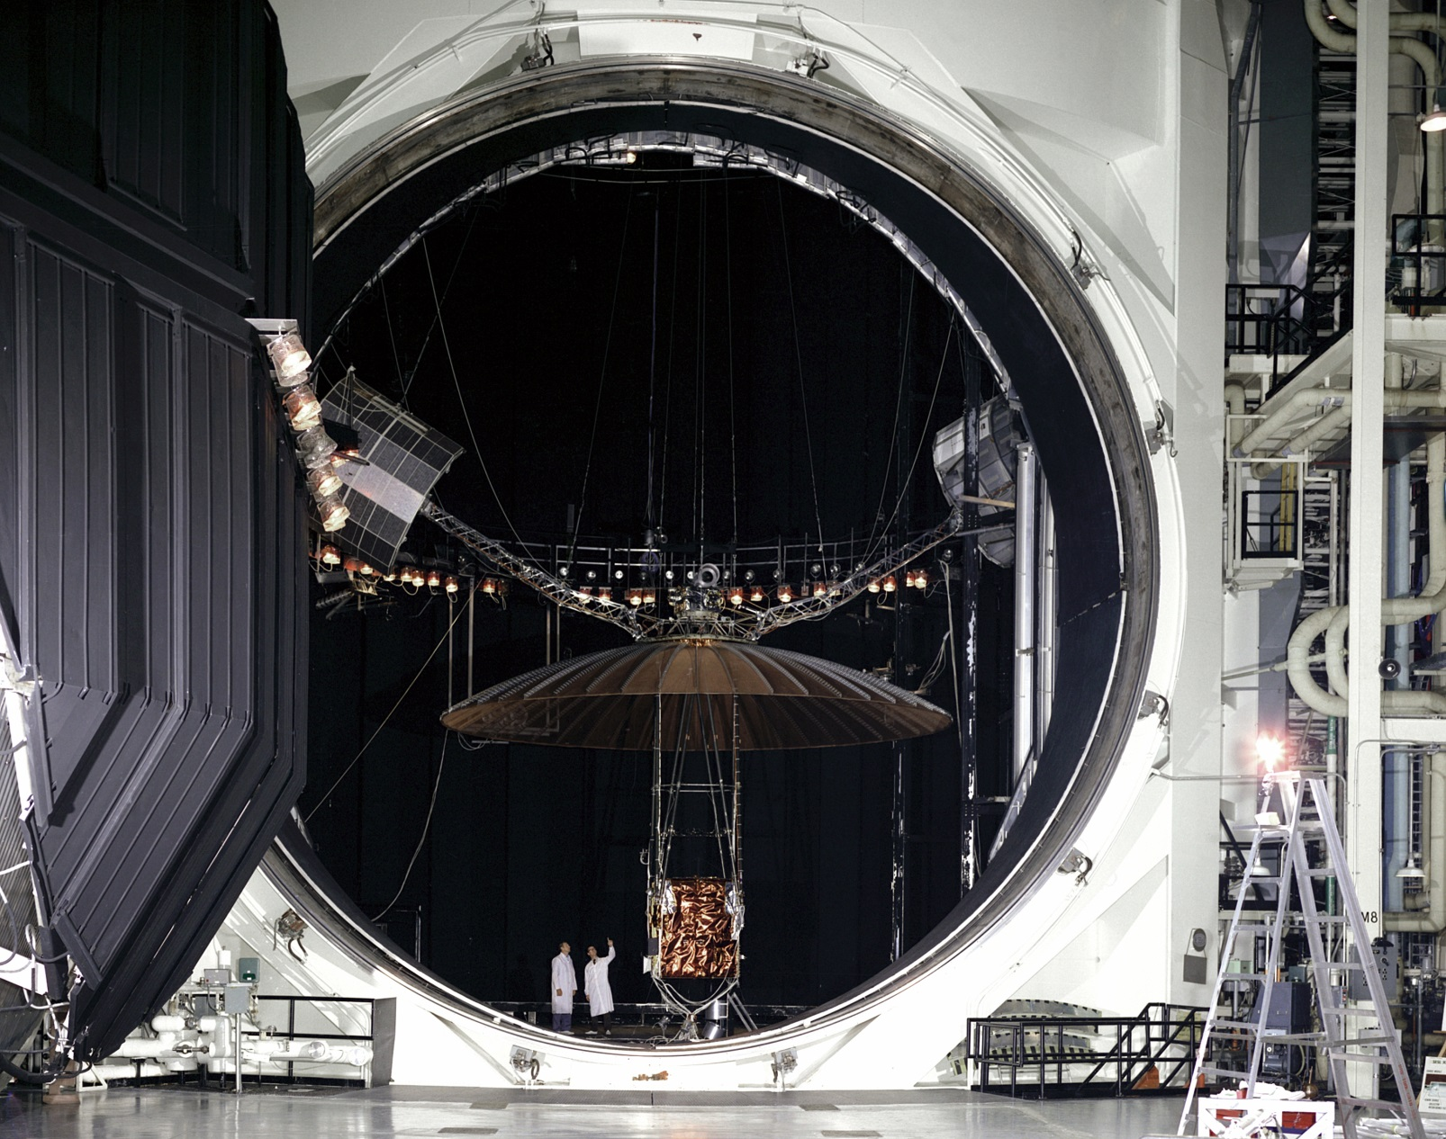
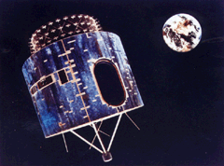
Before GOES – Early Satellites
SOLar RADiation (SOLRAD, 1960-1976) – Determined relationship between solar x-rays and radio-wave fadeouts. Non operational.
Memorandum to David Johnson from George Benton (04 Mar 1969)
NRL
“I am pleased to submit to you in outline our firm requirements for operational space disturbance monitoring from the first GOES satellite. These are for operational monitoring of energetic protons, alpha particles and solar x-rays in the 1 – 8 and 0.5 – 3 Angstrom bands.”
Vela Hotel (She Watches Over, 1963-1971) – 1963 Partial Test Ban Treaty compliance but detected solar events.
Sandia
Advanced Technology Satellites (ATS, 1966-1977) – Demonstrated utility of geosynchronous orbit for meteorological monitoring.
Synchronous Meteorological Satellites (1974-1979) – Immediate predecessor to GOES; Identical to GOES 1-3
Dr. George Benton
ESSA Research
Laboratories (ERL)
David Johnson
National Environmental
Satellite Center (NESC)
(unsigned file copy, courtesy Dick Grubb)

Slide 3
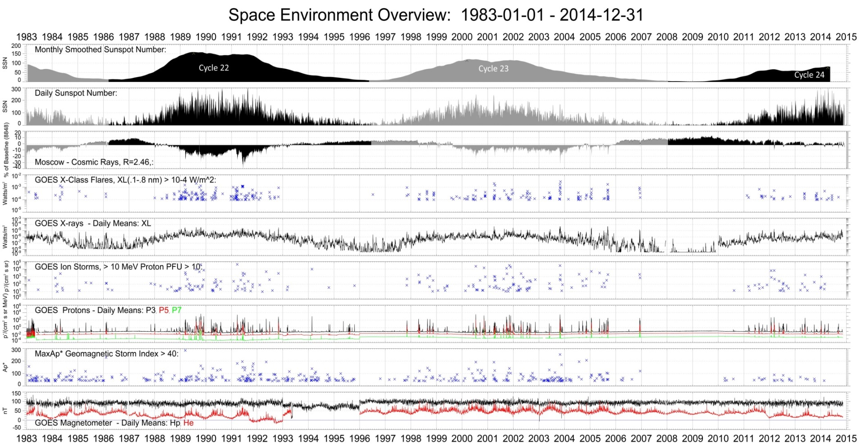
GOES-R – 40+ Years of SWx

Slide 4
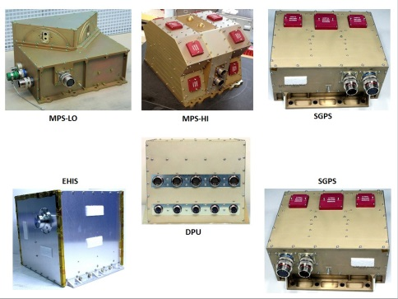
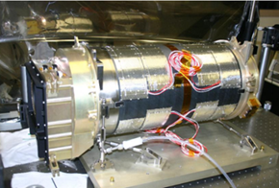
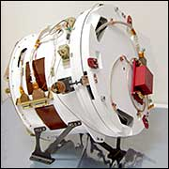
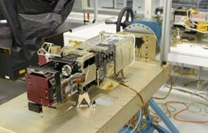
Space Weather Sensors
GOES-16
Space Environmental In-Situ Suite
(SEISS)
Solar Ultra-Violet Imager
(SUVI)
Magnetometer
MAG
EUV and X-ray Irradiance Sensors
(EXIS)

Slide 5
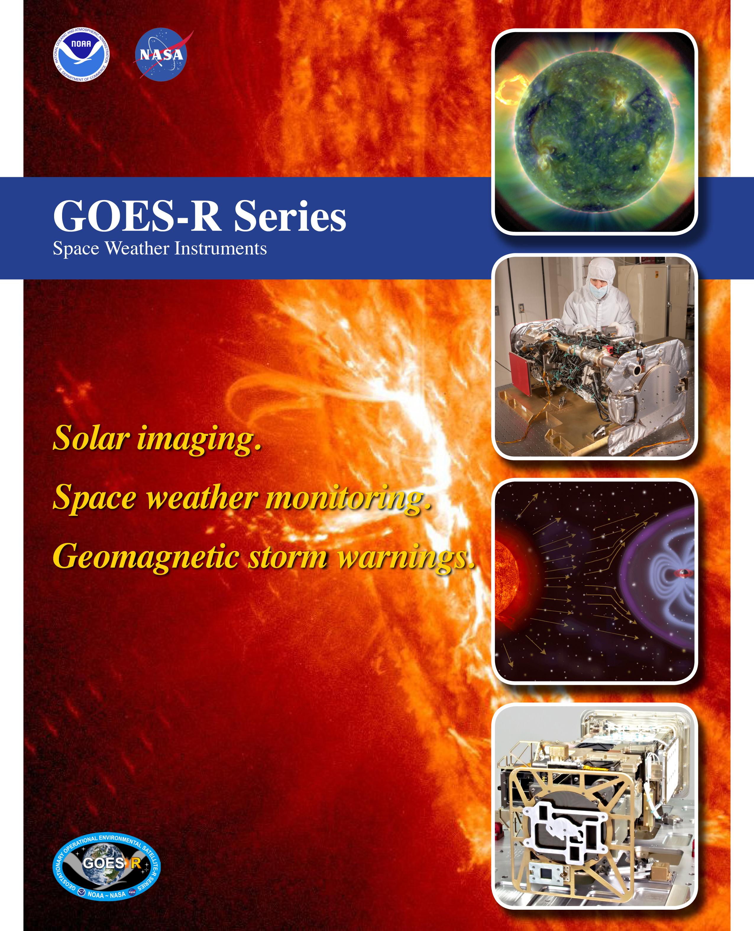
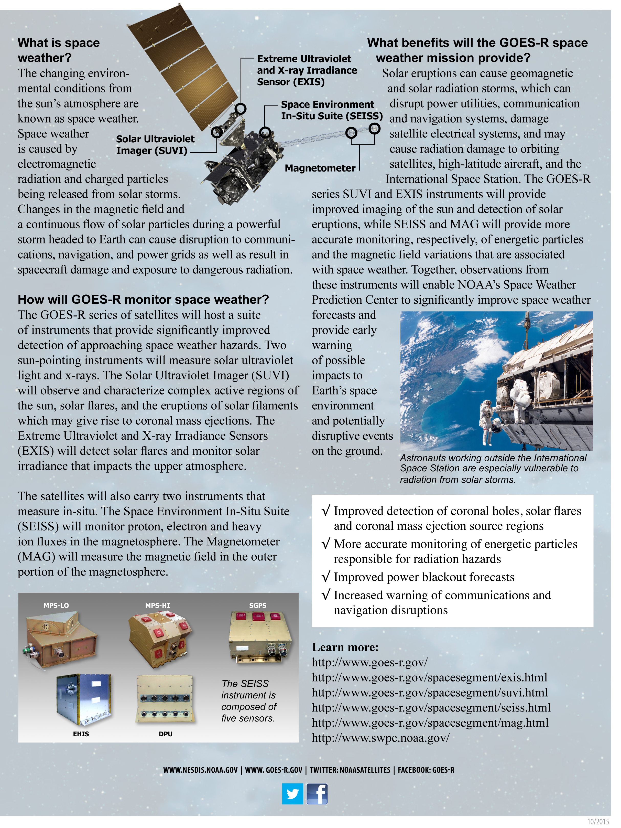
GOES-16 SWx Handout

Slide 6
Why EXIS?
EUV and X-ray Irradiance Sensors (EXIS/EUVS & EXIS/XRS)
X-Ray irradiance /// solar flare monitoring
EXIS/XRS measures the background x-ray solar irradiance and detects solar flares that disrupt communications, reduce navigational accuracy, affecting satellites, high altitude airlines and power grids on Earth.
Extreme UltraViolet (EUV) solar irradiance
NOAA requires the real-time monitoring of the solar irradiance variability that controls the variability of the terrestrial upper atmosphere (ionosphere and thermosphere). This requirement supports NOAA’s space weather operations and is implemented with XRS and EUVS.

Slide 7
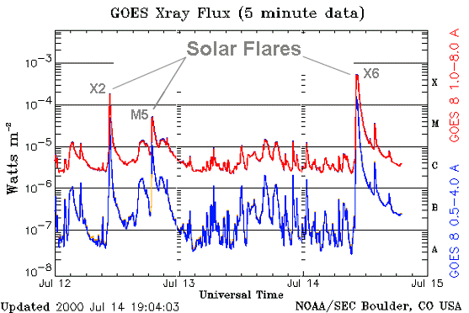
EXIS/XRS Product
X45 (Carrington)
X
M
Classification
C
B
A
Note: Solar x-ray flares observed above the background solar irradiance. Letters to the right of the image are the classifications

Slide 8
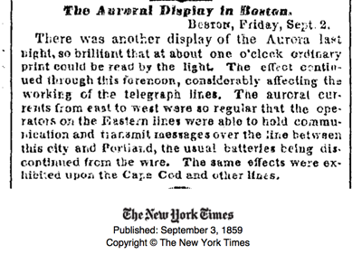
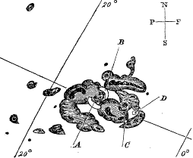
The Carrington Event (1859)
Carrington Event
The Carrington event was an extreme geomagnetic storm that was both awe inspiring and impactful on the technology system of the day; that is, the telegraph. The event was trigger by a massive solar flare on 01-Sep of estimated X45 intensity. A high-speed Coronal Mass Ejection (CME) slammed into the earth some 19 hours later resulting in an extreme geomagnetic storm. A storm of similar intensity would have a debilitating impact on today’s high technology systems.
Notes:
http://www.swsc-journal.org/articles/swsc/pdf/2013/01/swsc130015.pdf

Slide 9
White House Action
“White House is preparing for catastrophic solar flares which could wipe out power around the world for months
Massive electromagnetic pulse caused by solar flares could bring an end to modern civilization as we know it
Extreme space weather event could wipe out power for months and render cellphones and internet useless
One study estimates that in the U.S. alone it could cost the fragile economy up to $2.6 trillion
Now the White House are preparing for the threat after a major solar flare narrowly missed the Earth in 2012
Strategy includes improving prediction abilities as forecasters only have 15-60 minutes warning to protect energy grids”

Slide 10
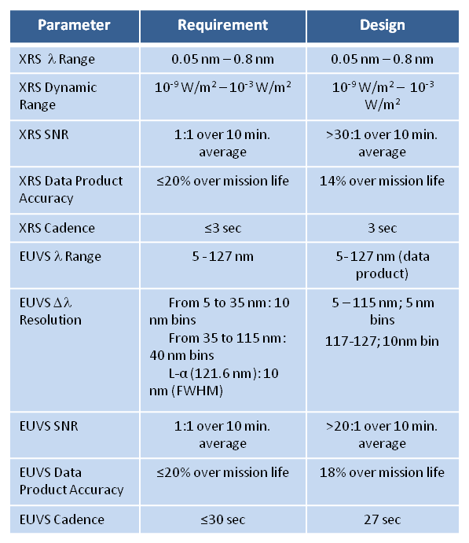
EXIS Key Requirements
X-Rays
EUV

Slide 11
NOAA Space Weather Scales
Radio Blackouts
The NOAA Radio Blackout Scale is directly driven by EXIS/XRS measurements. Scale varies from Minor R1 (<M5) to Extreme (>X20)

Slide 12
Why SEISS?
Energetic Charged Particles
The information provided by SEISS is critical for assessing the electrostatic discharge (ESD) risk and radiation hazard to astronauts and satellites
MPS-LO – Magnetospheric Particle Sensor Low
e⁻ & p⁺; 30 eV – 30 keV
MPS-HI – Magnetospheric Particle Sensor High
e⁻; 50 keV – 4 MeV; >2 MeV integral
p⁺; 80 keV – 10 MeV
SGPS – Solar & Galactic Particle Sensor
p⁺; 1 MeV – 500 MeV; >500 MeV integral
EHIS – Energetic Heavy Ion Sensor (10 – 100 MeV/nucleon)

Slide 13
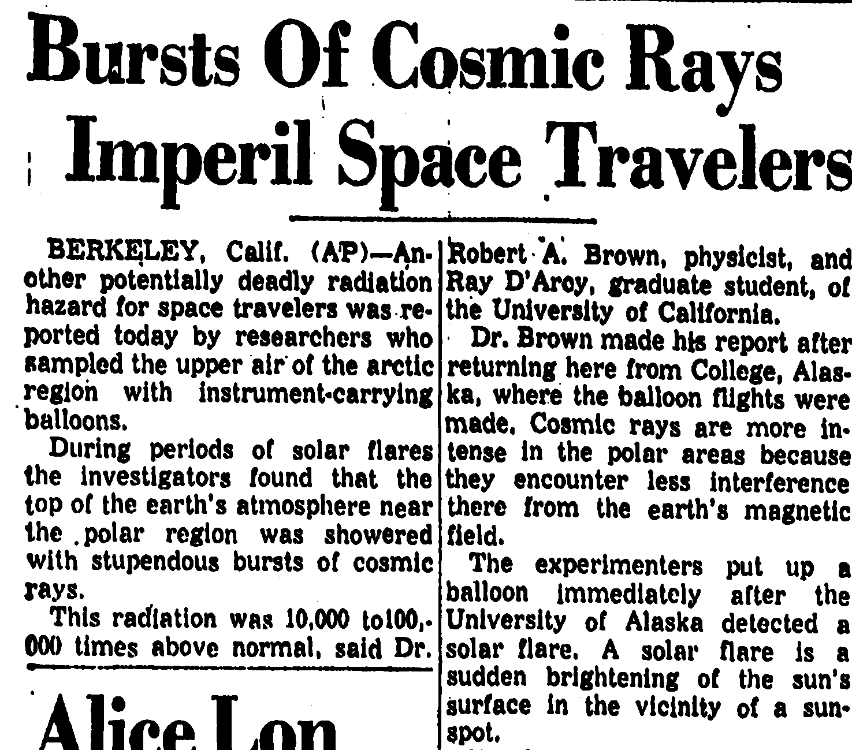
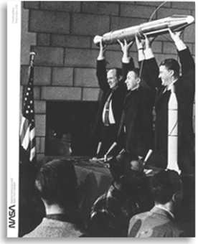
My God – Space is Radioactive¹
¹Credited to Van Allen (or team)

Slide 14
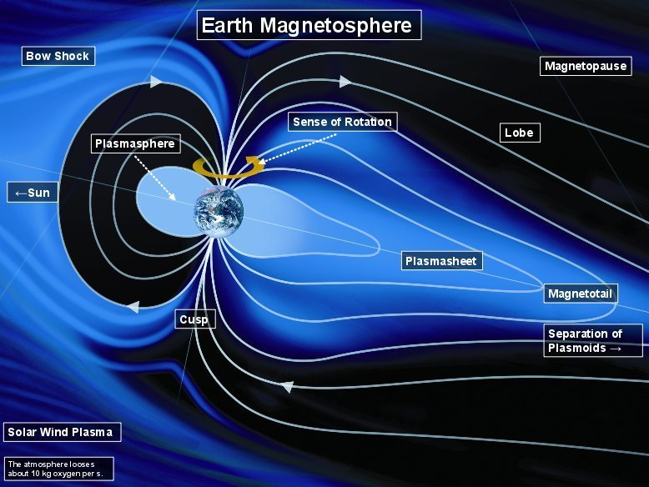
Charged Particles in the Geospace
Notes:
http://www.mps.mpg.de/4117745/standard_sans_both-1441639298.jpg

Slide 15
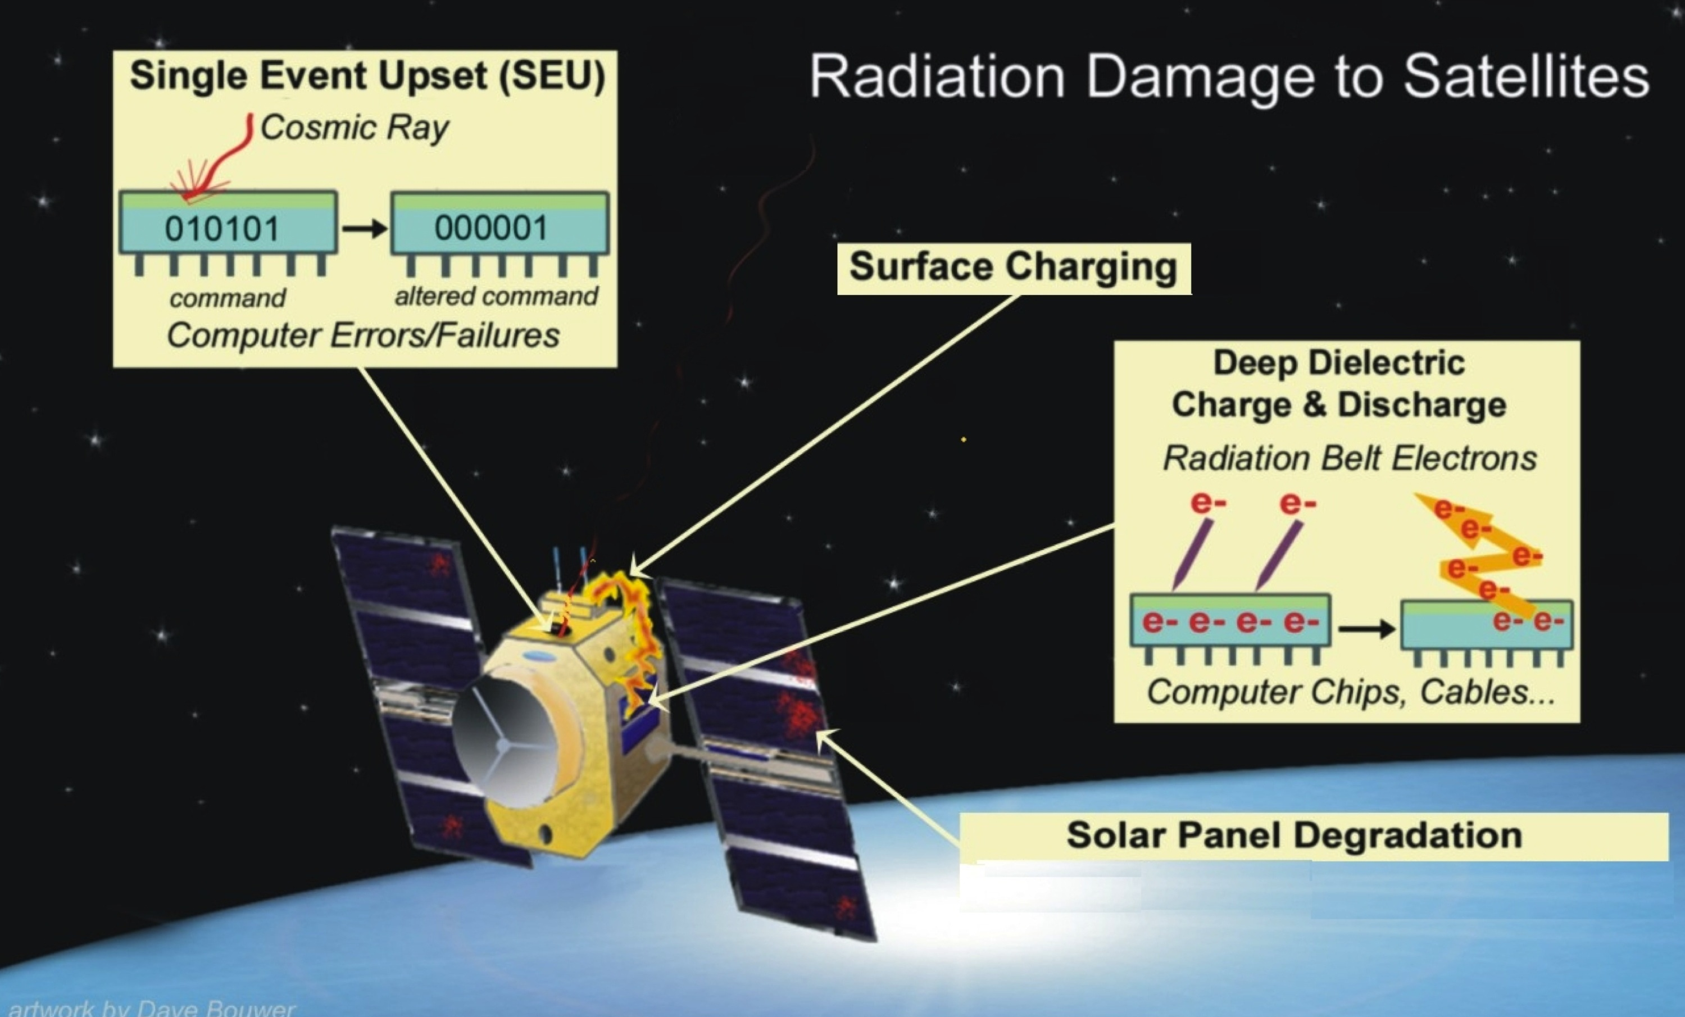
Spacecraft Charging

Slide 16
NOAA Space Weather Scales
Radiation Storms
The NOAA Radiation Storm Scale is directly driven by SEISS/MPS-HI measurements. Scale varies from Minor (S1) to Extreme (S5)

Slide 17
Why MAG?
Geomagnetic storm alerts/warnings
Geomagnetic field measurements are important for providing alerts and warnings to many customers, including satellite operators and power utilities.
Research
GOES Magnetometer data are also important in research, being among the most widely used spacecraft data by the national and international research community.
Note: MAG data also vital for correct interpretation of SEISS charged particle data.

Slide 18
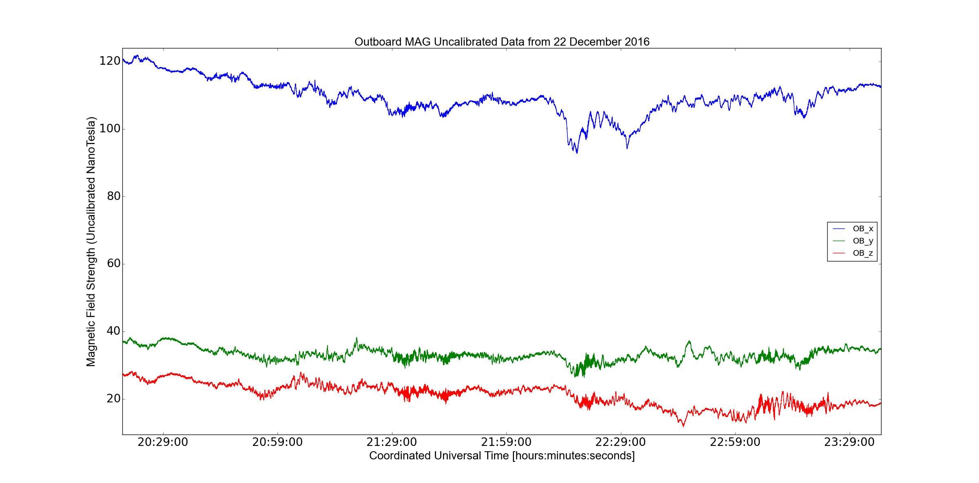
GOES-16 MAG – Initial Data Release
LINK
Text: Earth’s geomagnetic field acts as a shield, protecting us from hazardous incoming solar radiation. Geomagnetic storms, caused by eruptions on the surface of the sun, can interfere with communications and navigation systems, cause damage to satellites, cause health risks to astronauts, and threaten power utilities. When a solar flare occurs, GOES-16 will tell space weather forecasters where it happened on the sun and how strong it was. Using that information, forecasters can determine if the explosion of energy is coming towards Earth or not.
See: Loto'aniu et al, “The GOES-R Spacecraft Mission Series Magnetometer” (Monday AM)

Slide 19
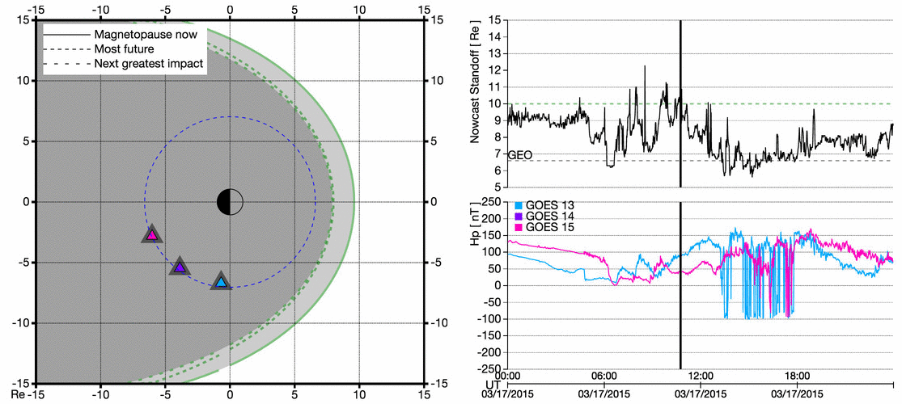
Magnetopause Crossing
GOES-16 MAG measurements combined with a DSCOVR-driven model of the magnetopause location are used to determine when GEO satellites are exposed to the interplanetary space environment.

Slide 20
Why SUVI?
Solar region characterization
SUVI will observe and characterize complex active regions of the sun, solar flares, and the eruptions of solar filaments which may give rise to coronal mass ejections.
Solar flares and eruptive events
SUVI observations of solar flares and solar eruptions will provide an early warning of possible impacts to Earth’s space environment and enable better forecasting of potentially disruptive events on the ground.

Slide 21
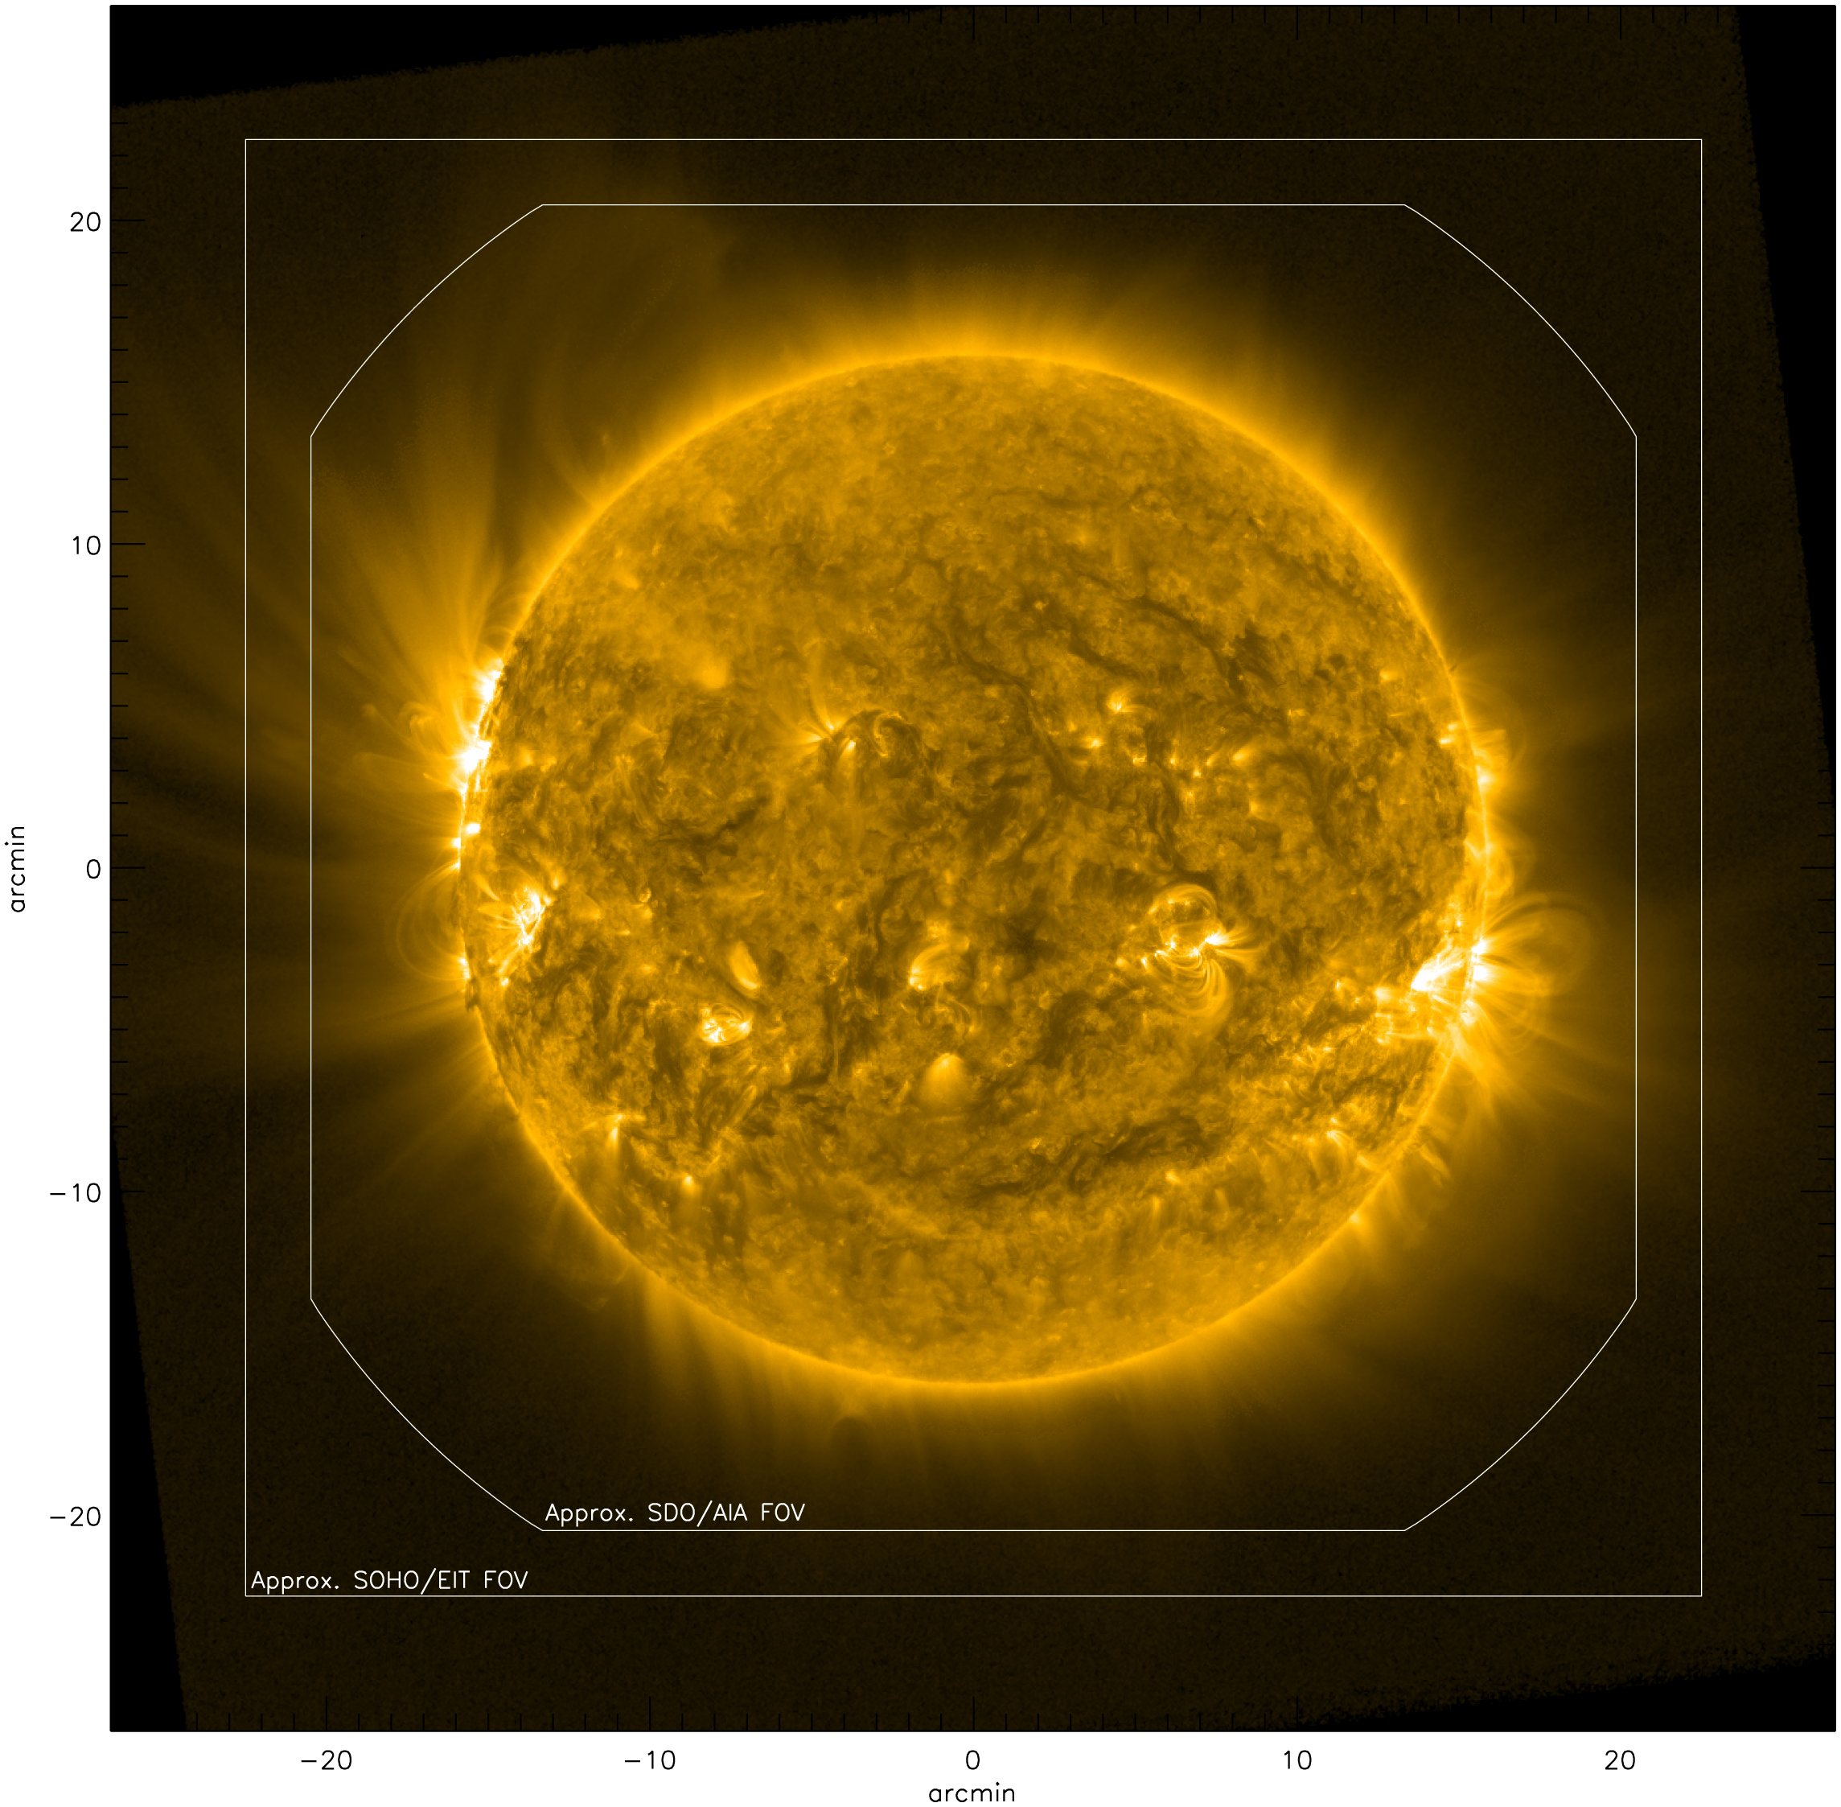
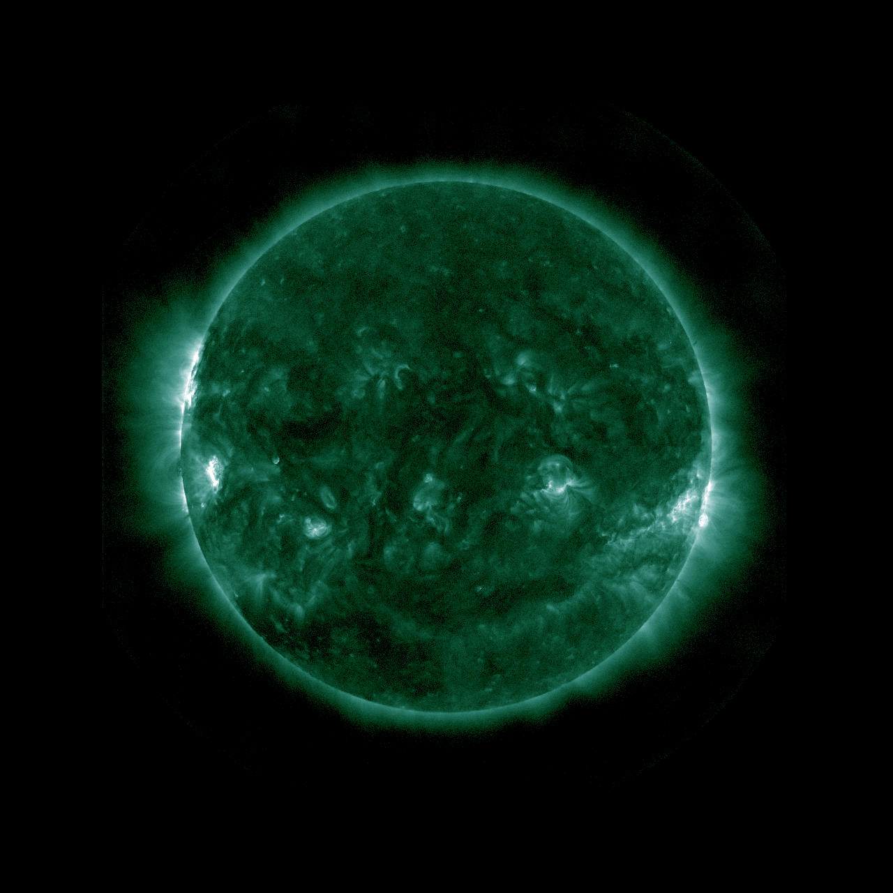
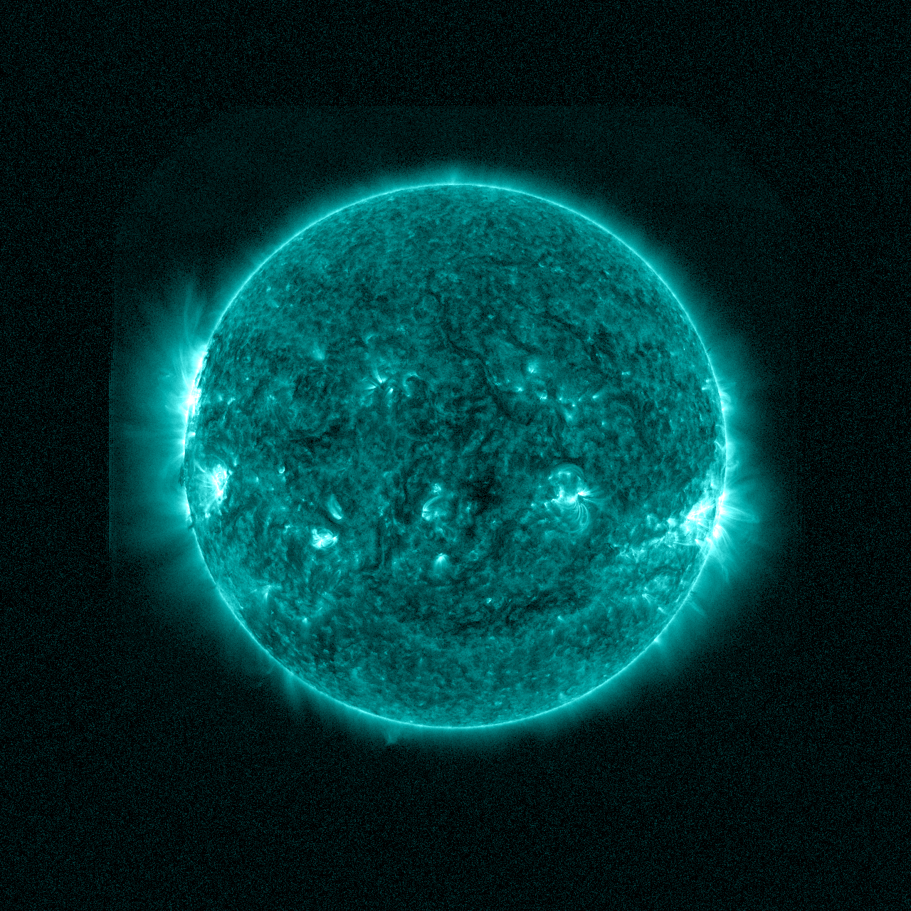
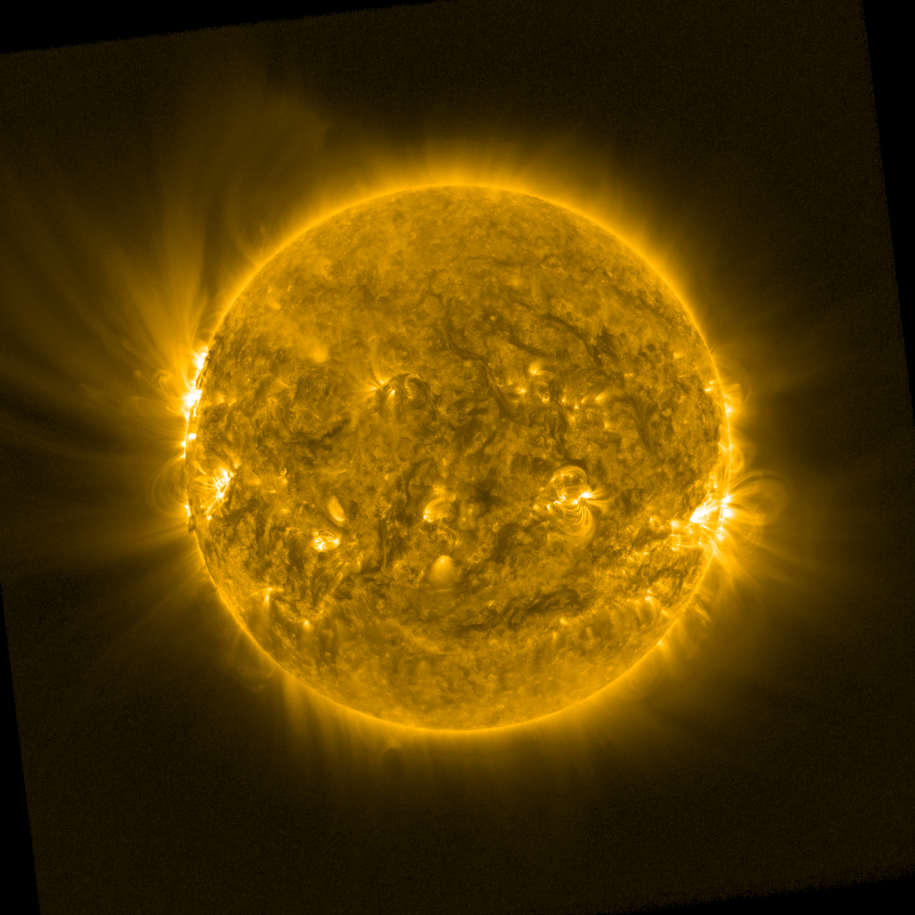
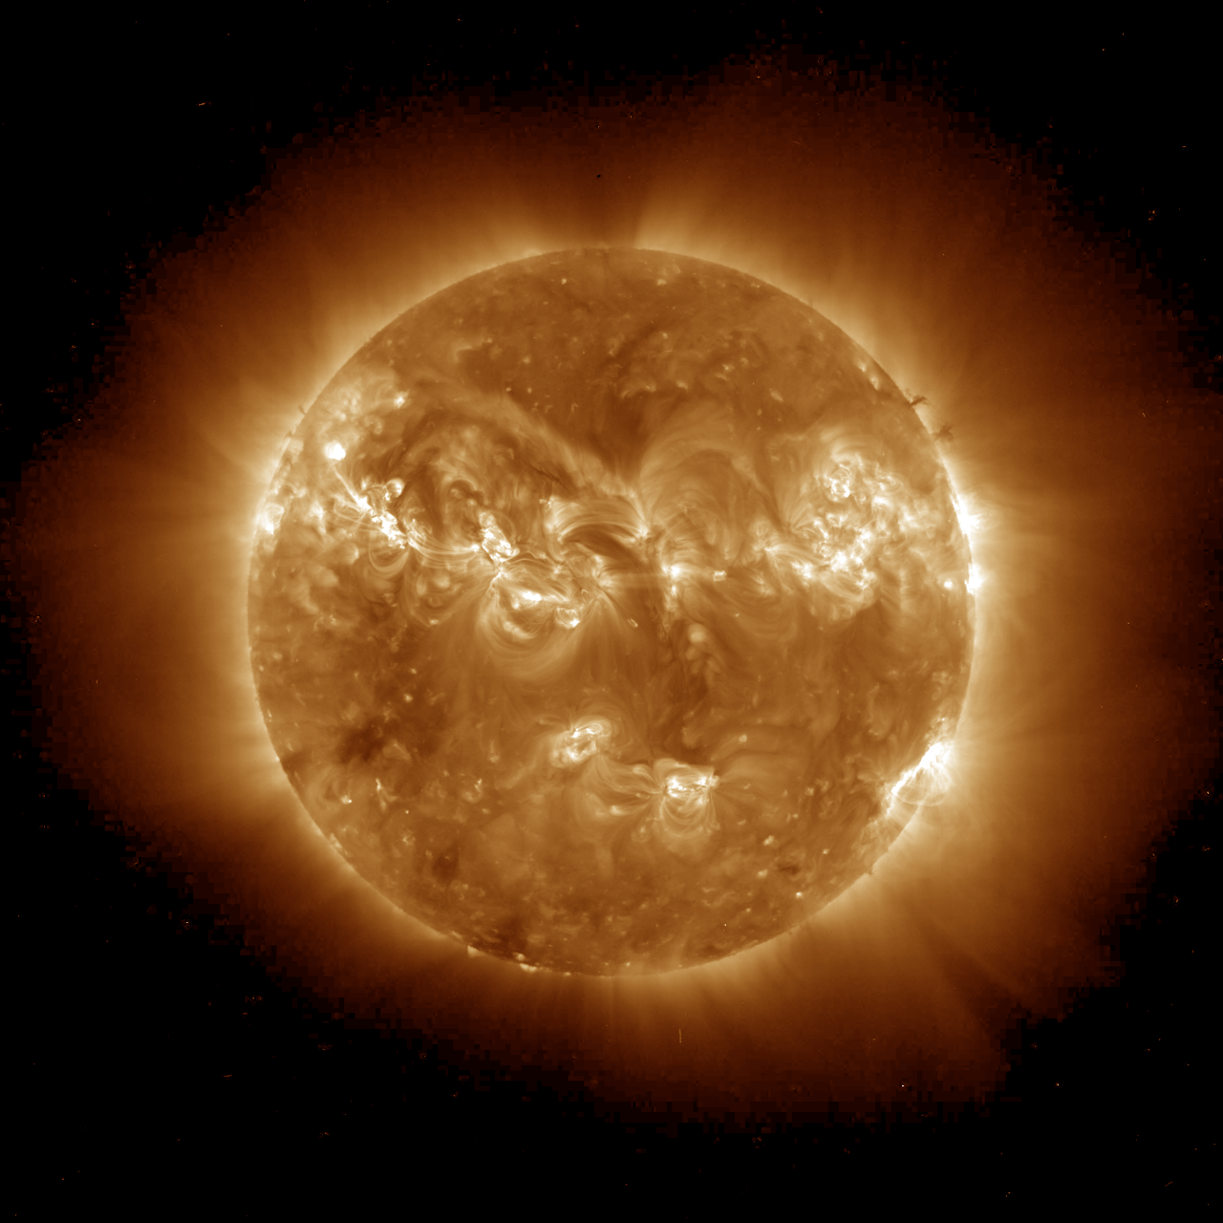
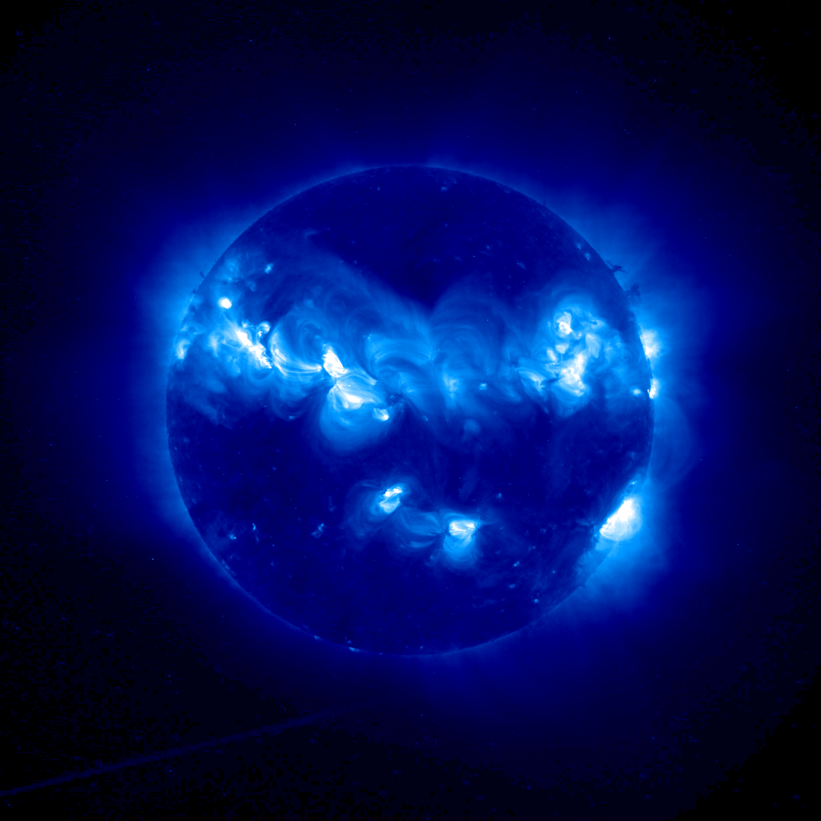
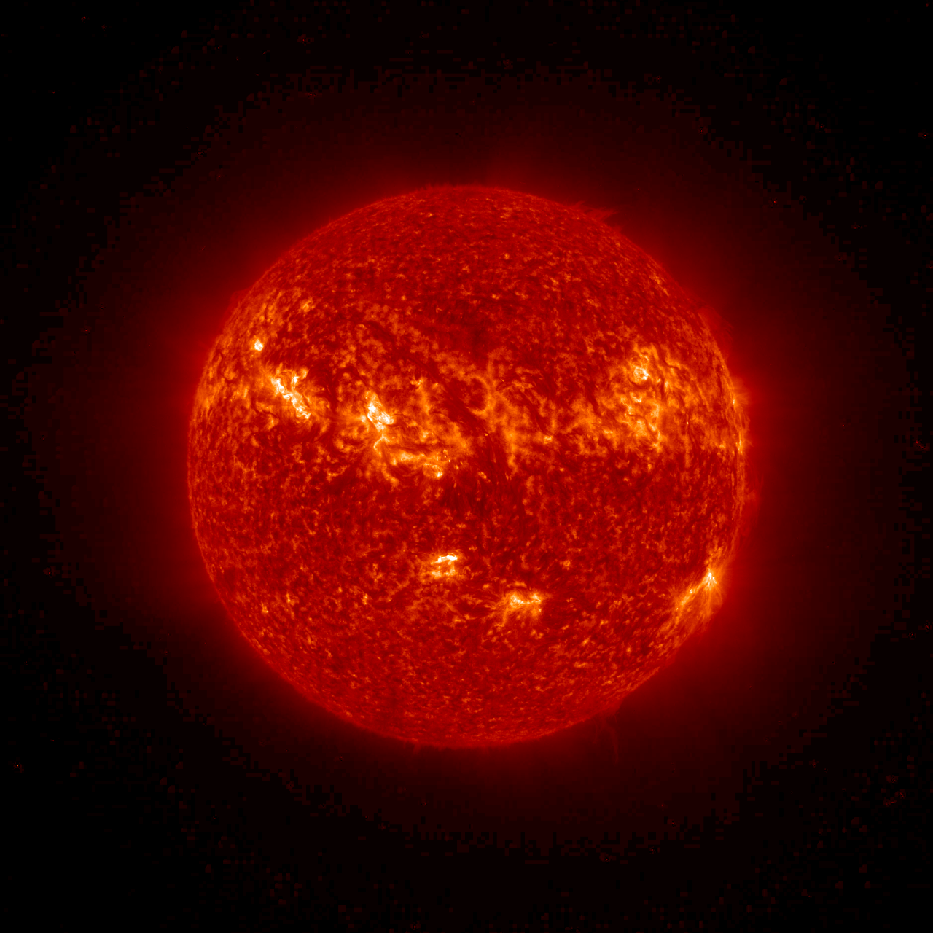
SUVI Overview
GOES-16 shifts current x-ray imagery to the ultraviolet for improved solar feature characterization. Wavelength bands are comparable to SDO/AIA.
Overlapping Fields of View
93 Å
131 Å
171 Å
Flaring Regions
(Fe XVIII)
Flaring Regions
(Fe VIII / XX / XXIII)
Transition Region
(Fe IX)
195 Å
284 Å
304 Å
Corona
(Fe XII / XXIV)
Flaring Regions
(Fe XV)
Chromosphere
(He II)
Simulated SUVI image at 171 Angstroms (Fe IX)
Transition Region (chromosphere-corona)
Notes:
SDO – Solar Dynamics Observatory “http://sdo.gsfc.nasa.gov/”
AIA - Atmospheric Imaging Assembly “http://aia.lmsal.com/”
SOHO – Solar & Heliospheric Observatory “https://www.nasa.gov/mission_pages/soho/index.html”
EIT - Extreme ultraviolet Imaging Telescope “http://umbra.nascom.nasa.gov/eit/’
Fe – Iron
A – Angstrom
He - Helium

Slide 22
SUVI Operational Requirements
Locate coronal holes for geometric storm forecasts
Detect and locate solar flares for forecasts of solar energetic particle events related to flares
Monitor changes in the corona that indicate coronal mass ejections (CMEs)
Analyze active region complexity for flare forecasts

Slide 23
Training: Helioviewer.org
Training: Helioviewer
Hosted by NASA/ESA
Satellites
SDO/AIA
SOHO
STEREO A/B
PROBA2
Yohkoh
Hinode
TRACE
Services
Images
Movies
Features

Slide 24
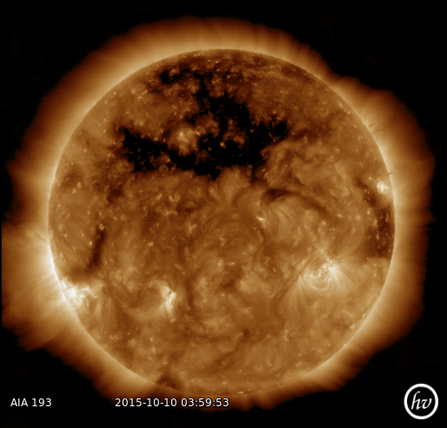
Coronal Hole (image)
The dark area across the top of the sun in this image is a coronal hole, a region on the sun where the magnetic field is open to interplanetary space, sending coronal material speeding out in what is called a high-speed solar wind stream. The high-speed solar wind originating from this coronal hole, created a geomagnetic storm near earth that resulted in several nights of auroras.
Training: Sensor: SDO/AIA
Type: Image
Date: 2015/10/10
Time: 03:59:53
Wavelength: 193 Å
https://helioviewer.org/
Notes:
https://www.nasa.gov/image-feature/goddard/coronal-hole-front-and-center

Slide 25
Solar Flare (movie)
A solar flare is defined as a sudden, rapid, and intense variation in brightness. A solar flare occurs when magnetic energy that has built up in the solar atmosphere is suddenly released. Radiation is emitted across virtually the entire electromagnetic spectrum
Training: Sensor: SDO/AIA
Type: Movie
Date: 2015/10/16
Start: 12:45:06
End: 13:44:54
Wavelength: 304 Å
https://helioviewer.org/
Notes:
https://www.nasa.gov/image-feature/goddard/coronal-hole-front-and-center

Slide 26
Coronal Mass Ejection (Movie)
A coronal mass ejection (or CME) is a giant cloud of solar plasma drenched with magnetic field lines that is blown away from the sun during strong, long-duration solar flares and filament eruptions.
Training: Sensor: SDO/AIA
Type: Movie
Date: 2013/05/01
Start: 02:30:31
End: 03:29:55
Wavelength: 304 Å
https://helioviewer.org/
Notes:
https://www.youtube.com/watch?v=C7XYSRhlfNM

Slide 27
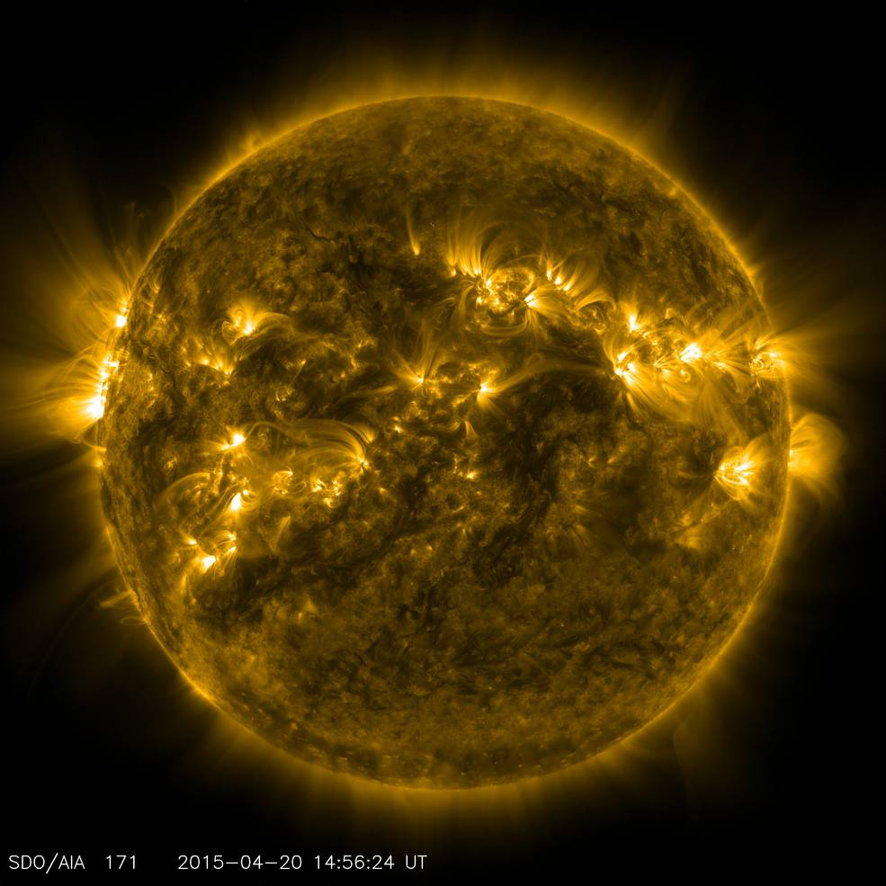
Active Regions (Image)
Active regions on the Sun are places where the Sun's magnetic field is disturbed. These regions frequently spawn various types of solar activity, including explosive "solar storms" such as solar flares and coronal mass ejections (CME). Dark sunspots are visual indicators of active regions.
Training: Sensor: SDO/AIA
Type: Image
Date: 2015/04/20
Time: 14:56:24 UT
Wavelength: 171 Å
https://helioviewer.org/

Slide 28
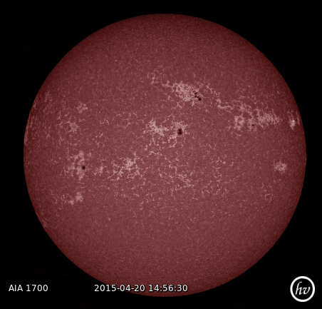
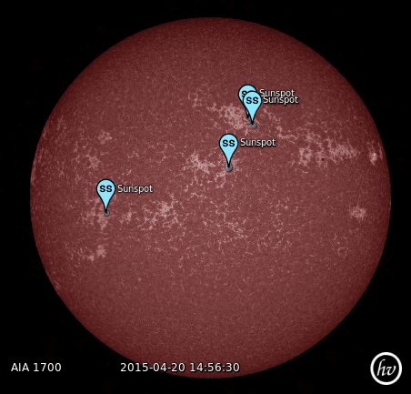
Heliophysics Events Knowledge
The Heliophysics Events Knowledgebase (HEK) is a source-agnostic catalog of solar features. HEK will be used within Helioviewer for GOES-16 solar imagery. HEK is not real time – see SUVI L2+ thematic maps.
Active Regions // Coronal Holes // Emerging Fluxes // Sunspots

Slide 29
Validation Schedule (L1b Products)
Initial Data Release
08 Jan
02 Feb
10 Feb
22 May
PLT End + 12 Mo
SEISS L1b
SUVI L1b
EXIS L1b
MAG L1b
Instrument Perf
Product Performance
Full Validation Phase
PLT
PLT End
PLPT End
09 Jan
21 Feb
06 Mar
22 May
PLT End + 12 Mo
Instrument Perf
Product Performance
Full Validation Phase
PLT
PLT End
PLPT End
11 Dec
01 Feb
15 Feb
22 May
PLT End + 12 Mo
Instrument Performance
Product Performance
Full Validation Phase
PLT
PLT End
PLPT End
07 Dec
04 Jan
09 Mar
22 May
PLT End + 12 Mo
Instrument Performance
Product Performance
Full Validation Phase
PLT
PLT End
PLPT End

Slide 30
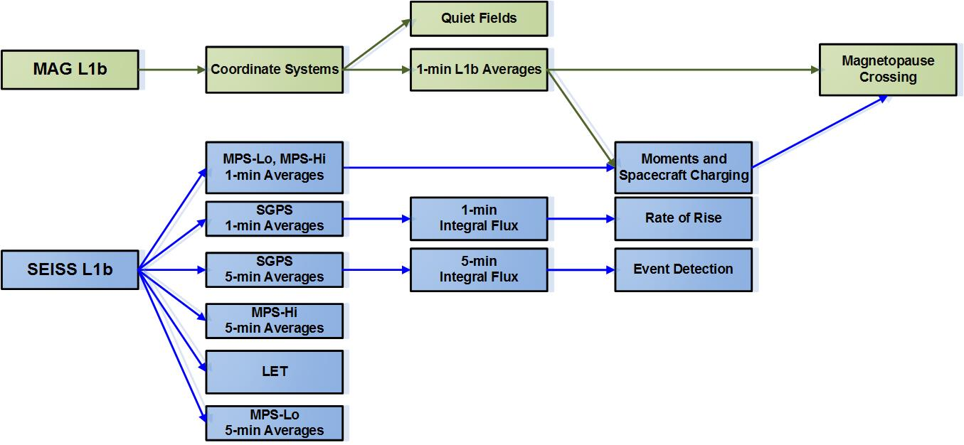
L1b and L2+ SWx Products
+ SWx products are used operationally by the NWS Space Weather Prediction Center
L2+ Products for EXIS and SUVI not shown

Slide 31
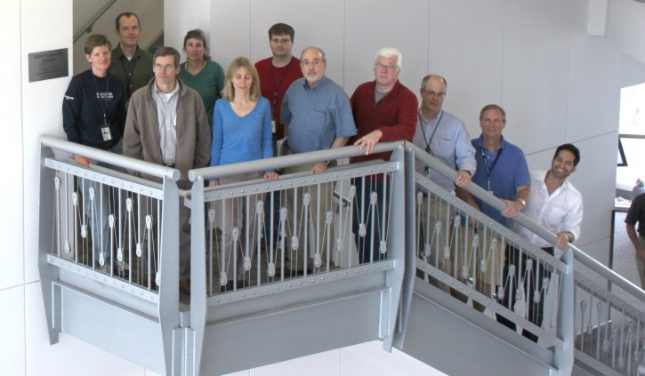
Summary
GOES-R Space Weather Team

