Slide 1
A More Challenging Second Case
Timeframe: 2140-2310 UTC
SPC slight risk
18Z: CAPE = 486 Jkg⁻¹
SRH (sfc-1km) = 315m²/s²
More of a high shear, weak CAPE case
Things to note
Using the 5 min accumulation (1 min update)
Monitor changes between radar, ABI, and the GLM
When do you believe severe weather, if any, occurred?
Did GLM offer any support?
Lightning safety concerns?
How did GLM in this case compare to the GLM in the Central Florida case?

Slide 2
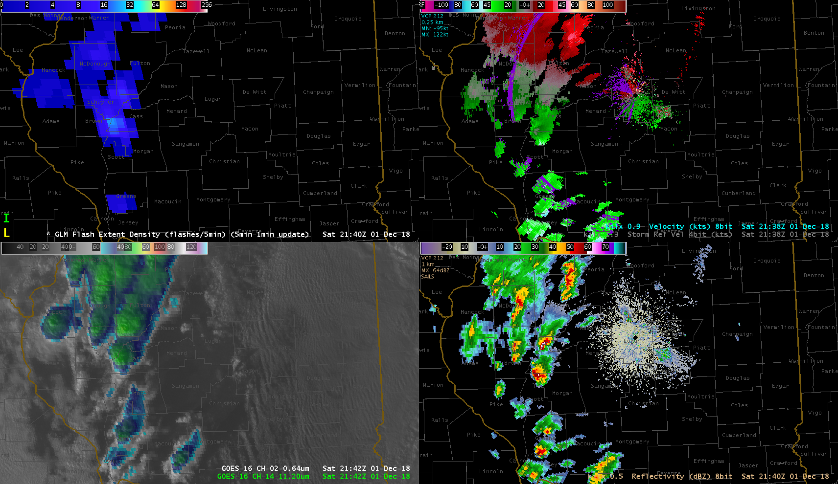
Flash Extent Density
(5 min accumulation)
Radar Velocity
ABI “sandwich”
0.64 and 11.2
Radar Reflectivity

Slide 3
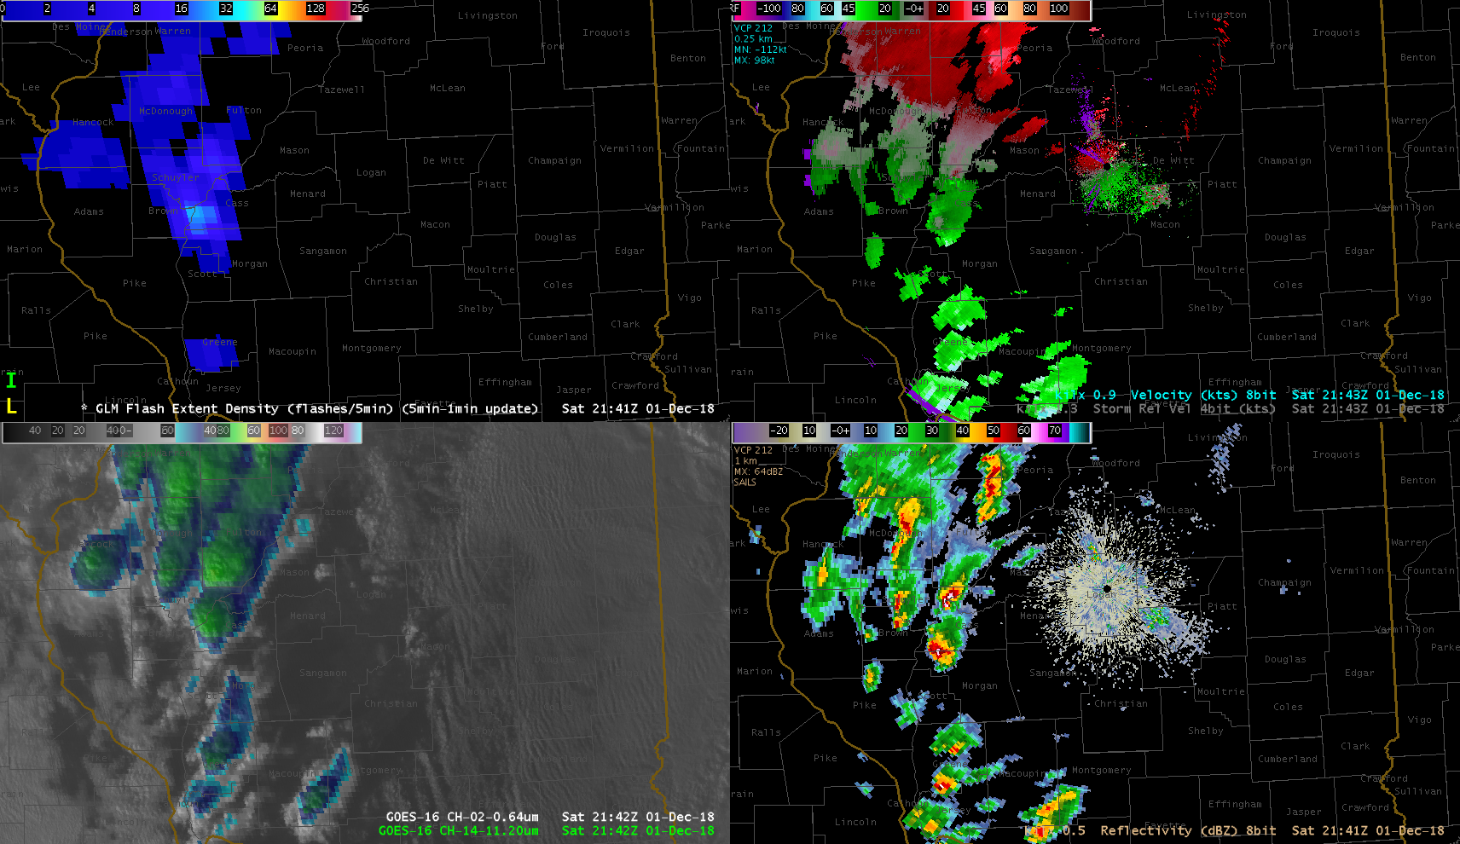
Flash Extent Density
(5 min accumulation)
Radar Velocity
ABI “sandwich”
0.64 and 11.2
Radar Reflectivity

Slide 4
Flash Extent Density
(5 min accumulation)
Radar Velocity
ABI “sandwich”
0.64 and 11.2
Radar Reflectivity

Slide 5
Flash Extent Density
(5 min accumulation)
Radar Velocity
ABI “sandwich”
0.64 and 11.2
Radar Reflectivity

Slide 6
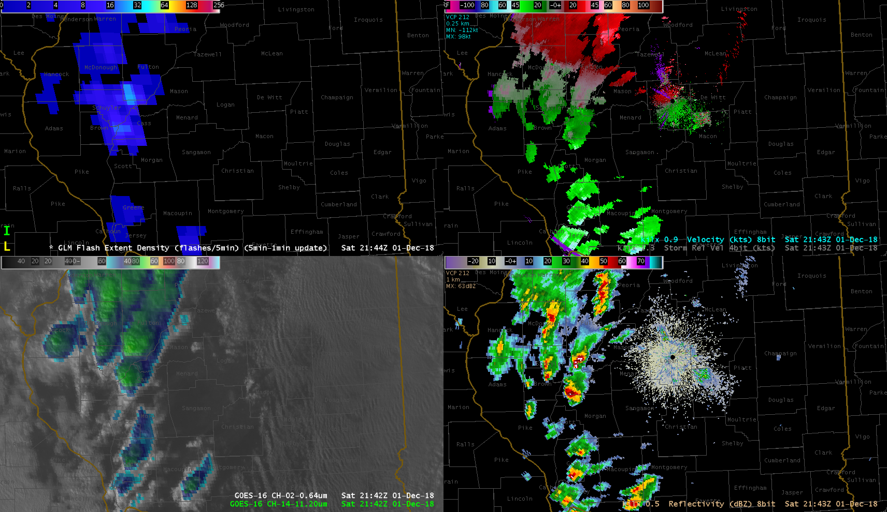
Flash Extent Density
(5 min accumulation)
Radar Velocity
ABI “sandwich”
0.64 and 11.2
Radar Reflectivity

Slide 7
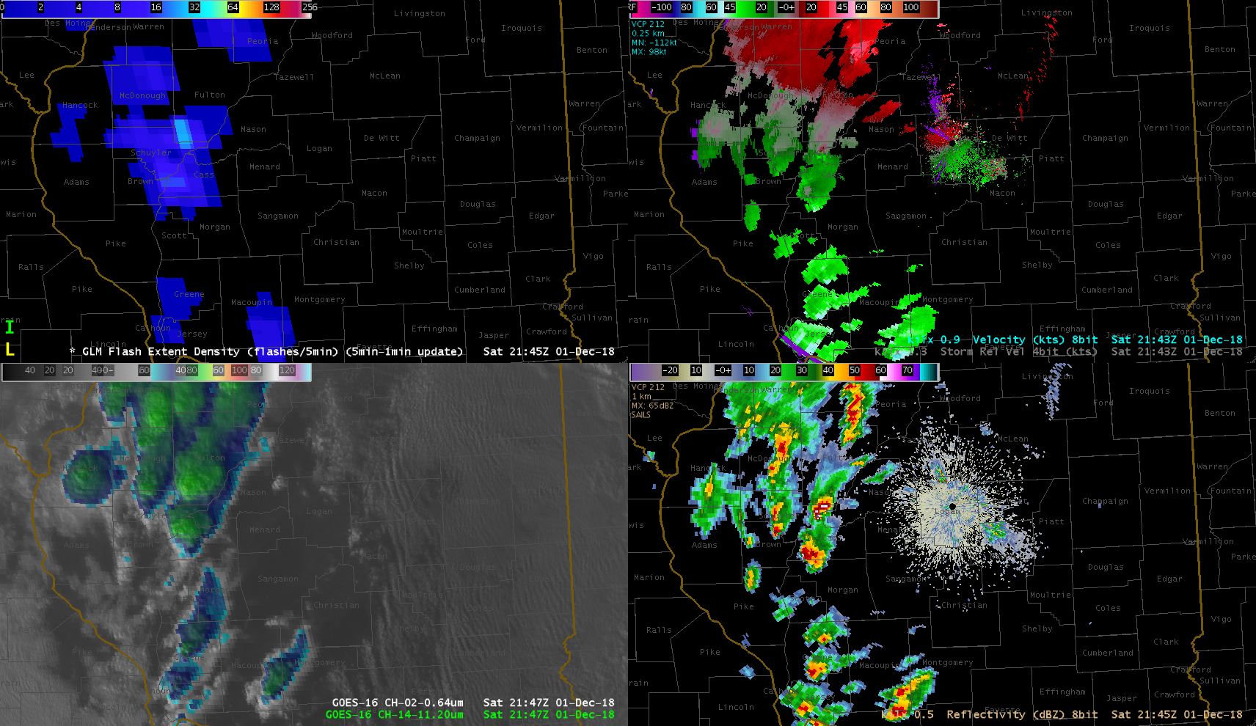
Flash Extent Density
(5 min accumulation)
Radar Velocity
ABI “sandwich”
0.64 and 11.2
Radar Reflectivity

Slide 8
Flash Extent Density
(5 min accumulation)
Radar Velocity
ABI “sandwich”
0.64 and 11.2
Radar Reflectivity

Slide 9
Flash Extent Density
(5 min accumulation)
Radar Velocity
ABI “sandwich”
0.64 and 11.2
Radar Reflectivity

Slide 10
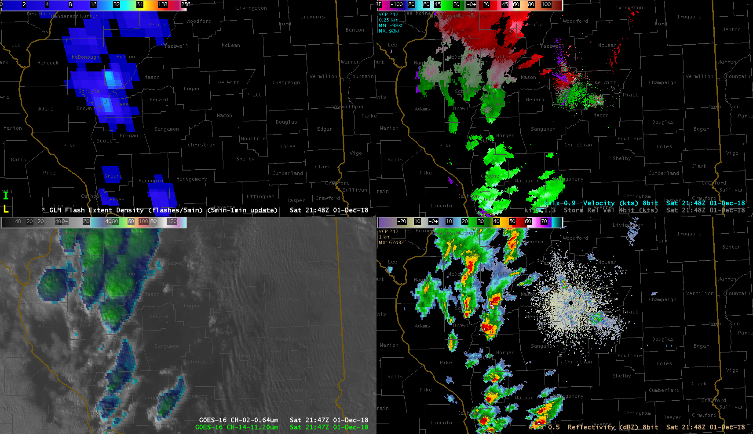
Flash Extent Density
(5 min accumulation)
Radar Velocity
ABI “sandwich”
0.64 and 11.2
Radar Reflectivity

Slide 11
Flash Extent Density
(5 min accumulation)
Radar Velocity
ABI “sandwich”
0.64 and 11.2
Radar Reflectivity

Slide 12
Flash Extent Density
(5 min accumulation)
Radar Velocity
ABI “sandwich”
0.64 and 11.2
Radar Reflectivity

Slide 13
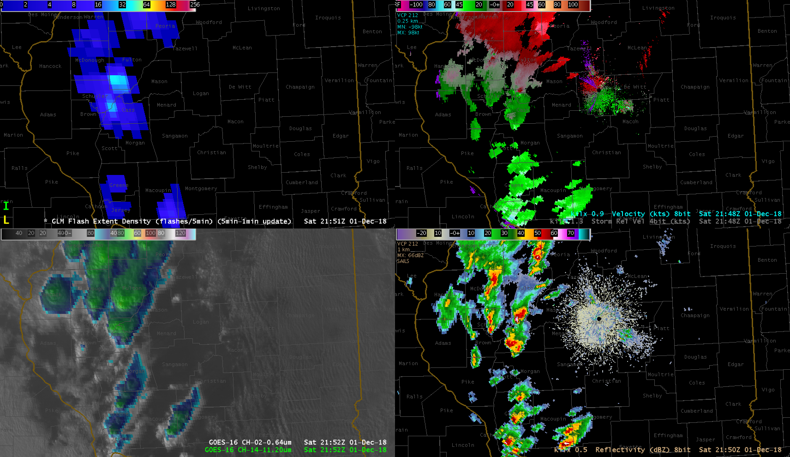
Flash Extent Density
(5 min accumulation)
Radar Velocity
ABI “sandwich”
0.64 and 11.2
Radar Reflectivity

Slide 14
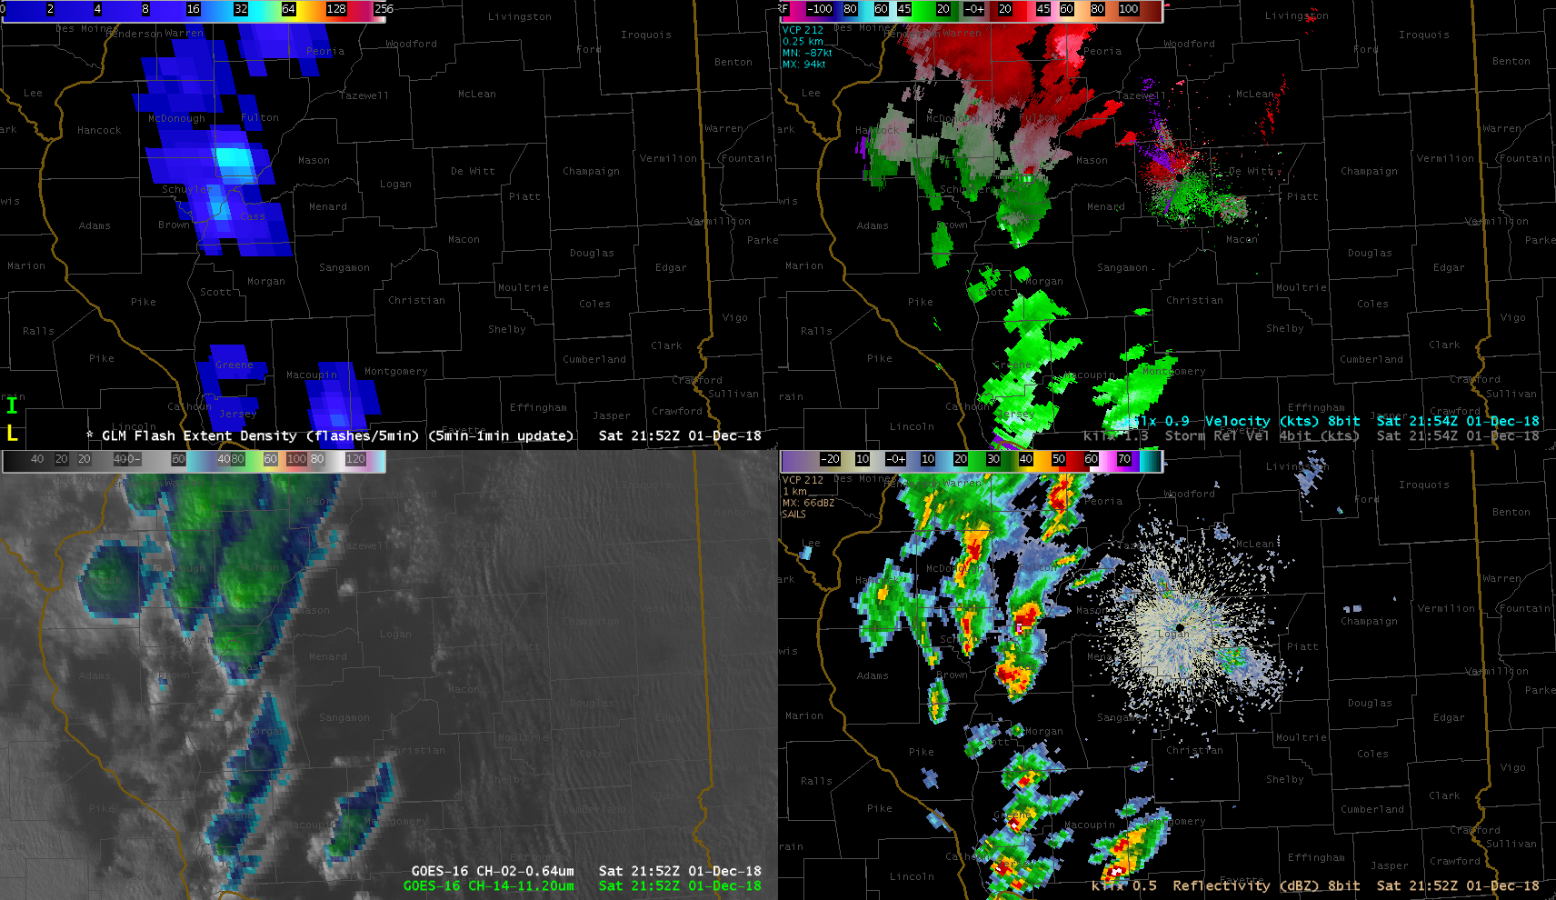
Flash Extent Density
(5 min accumulation)
Radar Velocity
ABI “sandwich”
0.64 and 11.2
Radar Reflectivity

Slide 15
Flash Extent Density
(5 min accumulation)
Radar Velocity
ABI “sandwich”
0.64 and 11.2
Radar Reflectivity

Slide 16
Flash Extent Density
(5 min accumulation)
Radar Velocity
ABI “sandwich”
0.64 and 11.2
Radar Reflectivity

Slide 17
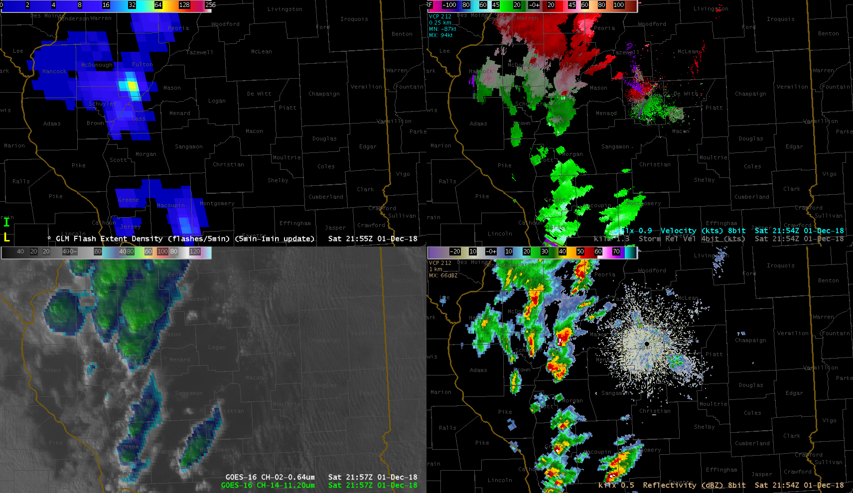
Flash Extent Density
(5 min accumulation)
Radar Velocity
ABI “sandwich”
0.64 and 11.2
Radar Reflectivity

Slide 18
Flash Extent Density
(5 min accumulation)
Radar Velocity
ABI “sandwich”
0.64 and 11.2
Radar Reflectivity

Slide 19
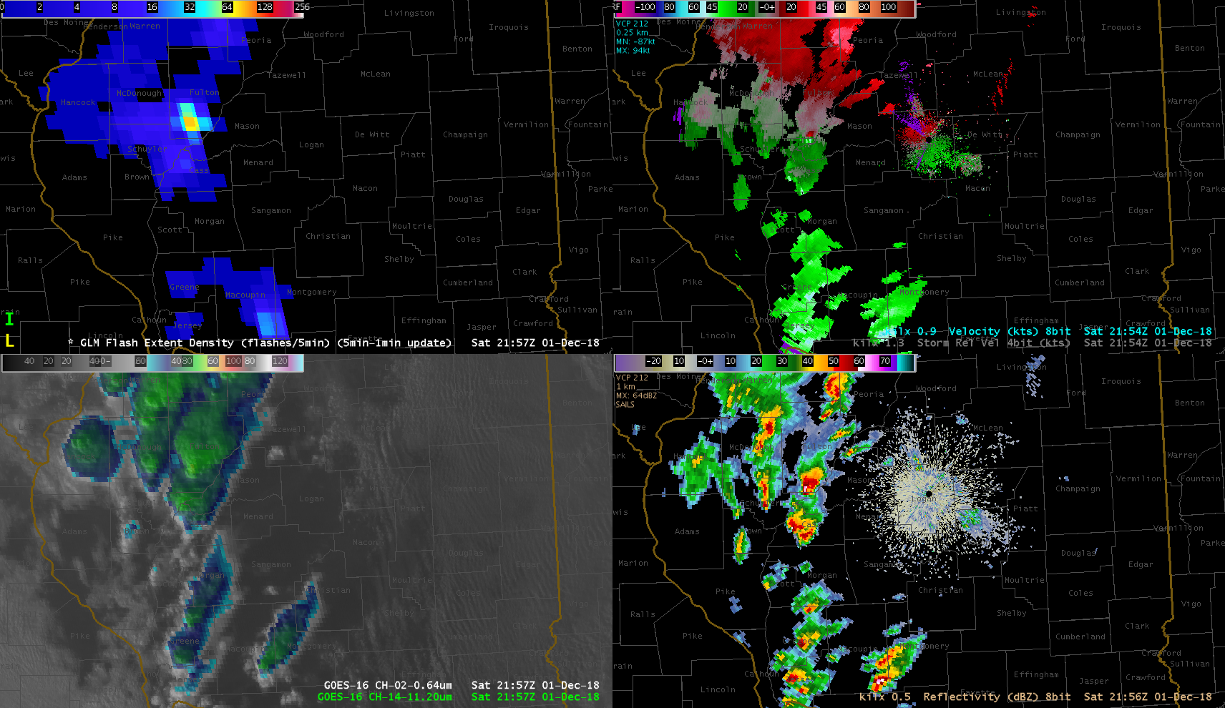
Flash Extent Density
(5 min accumulation)
Radar Velocity
ABI “sandwich”
0.64 and 11.2
Radar Reflectivity

Slide 20
Flash Extent Density
(5 min accumulation)
Radar Velocity
ABI “sandwich”
0.64 and 11.2
Radar Reflectivity

Slide 21
Flash Extent Density
(5 min accumulation)
Radar Velocity
ABI “sandwich”
0.64 and 11.2
Radar Reflectivity

Slide 22
Flash Extent Density
(5 min accumulation)
Radar Velocity
ABI “sandwich”
0.64 and 11.2
Radar Reflectivity

Slide 23
Flash Extent Density
(5 min accumulation)
Radar Velocity
ABI “sandwich”
0.64 and 11.2
Radar Reflectivity

Slide 24
Flash Extent Density
(5 min accumulation)
Radar Velocity
ABI “sandwich”
0.64 and 11.2
Radar Reflectivity

Slide 25
Flash Extent Density
(5 min accumulation)
Radar Velocity
ABI “sandwich”
0.64 and 11.2
Radar Reflectivity

Slide 26
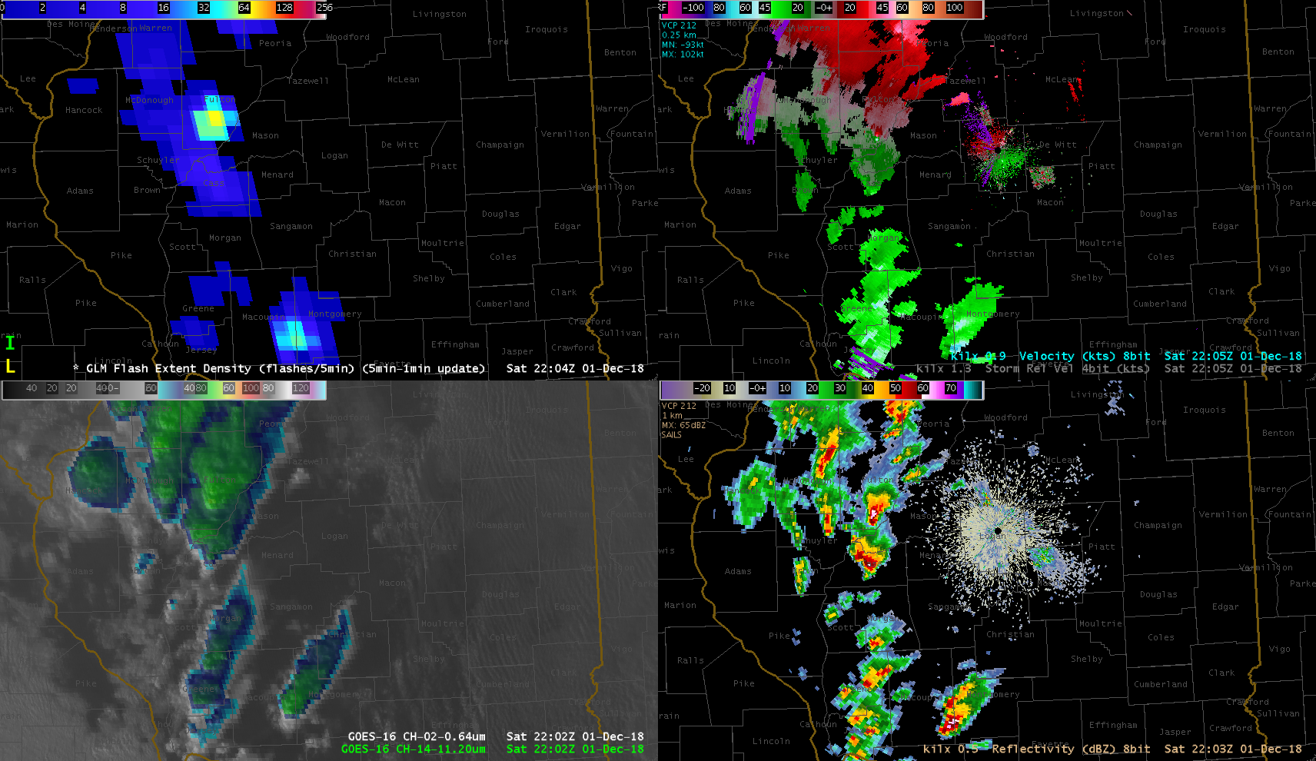
Flash Extent Density
(5 min accumulation)
Radar Velocity
ABI “sandwich”
0.64 and 11.2
Radar Reflectivity

Slide 27
Flash Extent Density
(5 min accumulation)
Radar Velocity
ABI “sandwich”
0.64 and 11.2
Radar Reflectivity

Slide 28
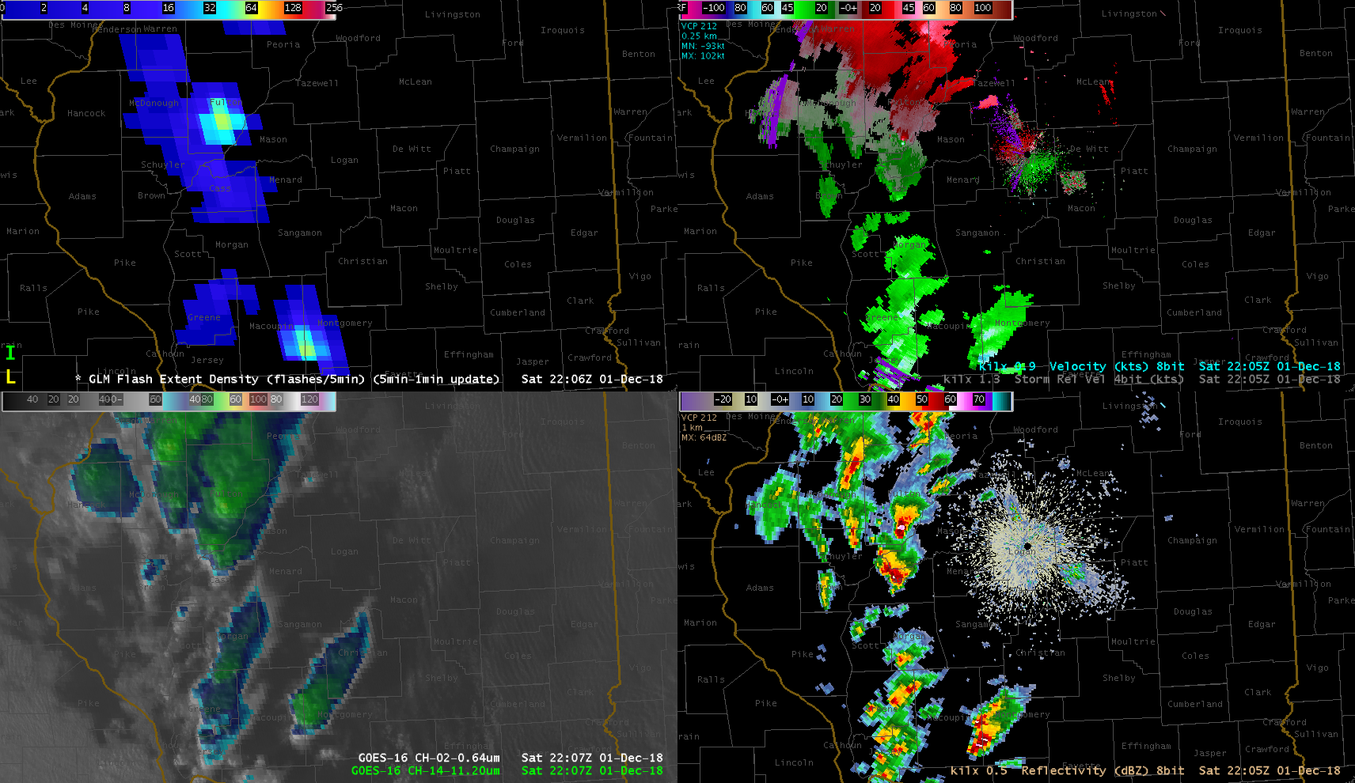
Flash Extent Density
(5 min accumulation)
Radar Velocity
ABI “sandwich”
0.64 and 11.2
Radar Reflectivity

Slide 29
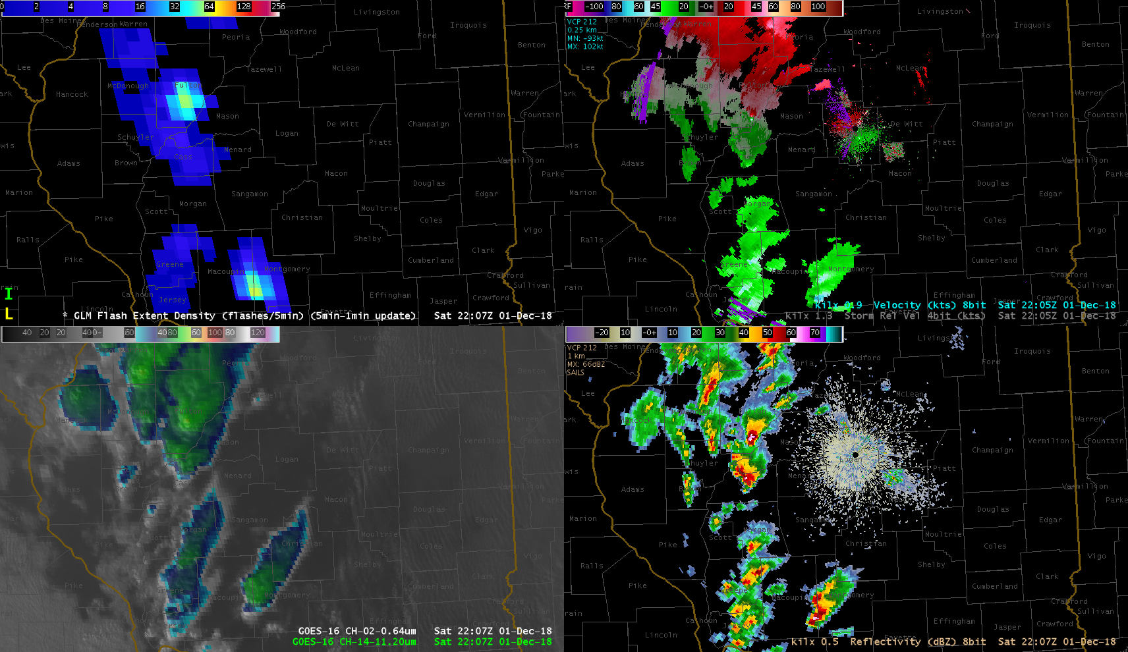
Flash Extent Density
(5 min accumulation)
Radar Velocity
ABI “sandwich”
0.64 and 11.2
Radar Reflectivity

Slide 30
Flash Extent Density
(5 min accumulation)
Radar Velocity
ABI “sandwich”
0.64 and 11.2
Radar Reflectivity

Slide 31
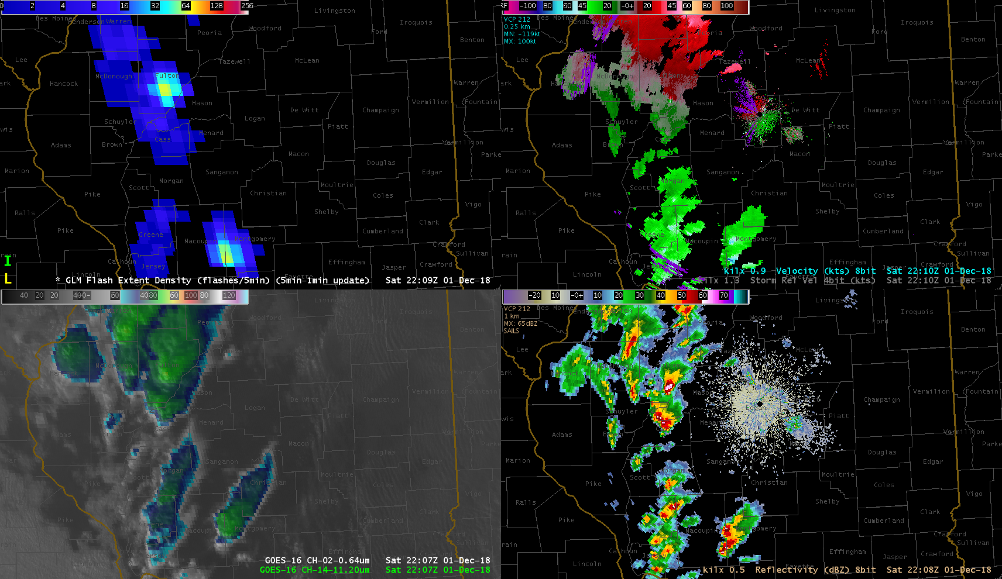
Flash Extent Density
(5 min accumulation)
Radar Velocity
ABI “sandwich”
0.64 and 11.2
Radar Reflectivity

Slide 32
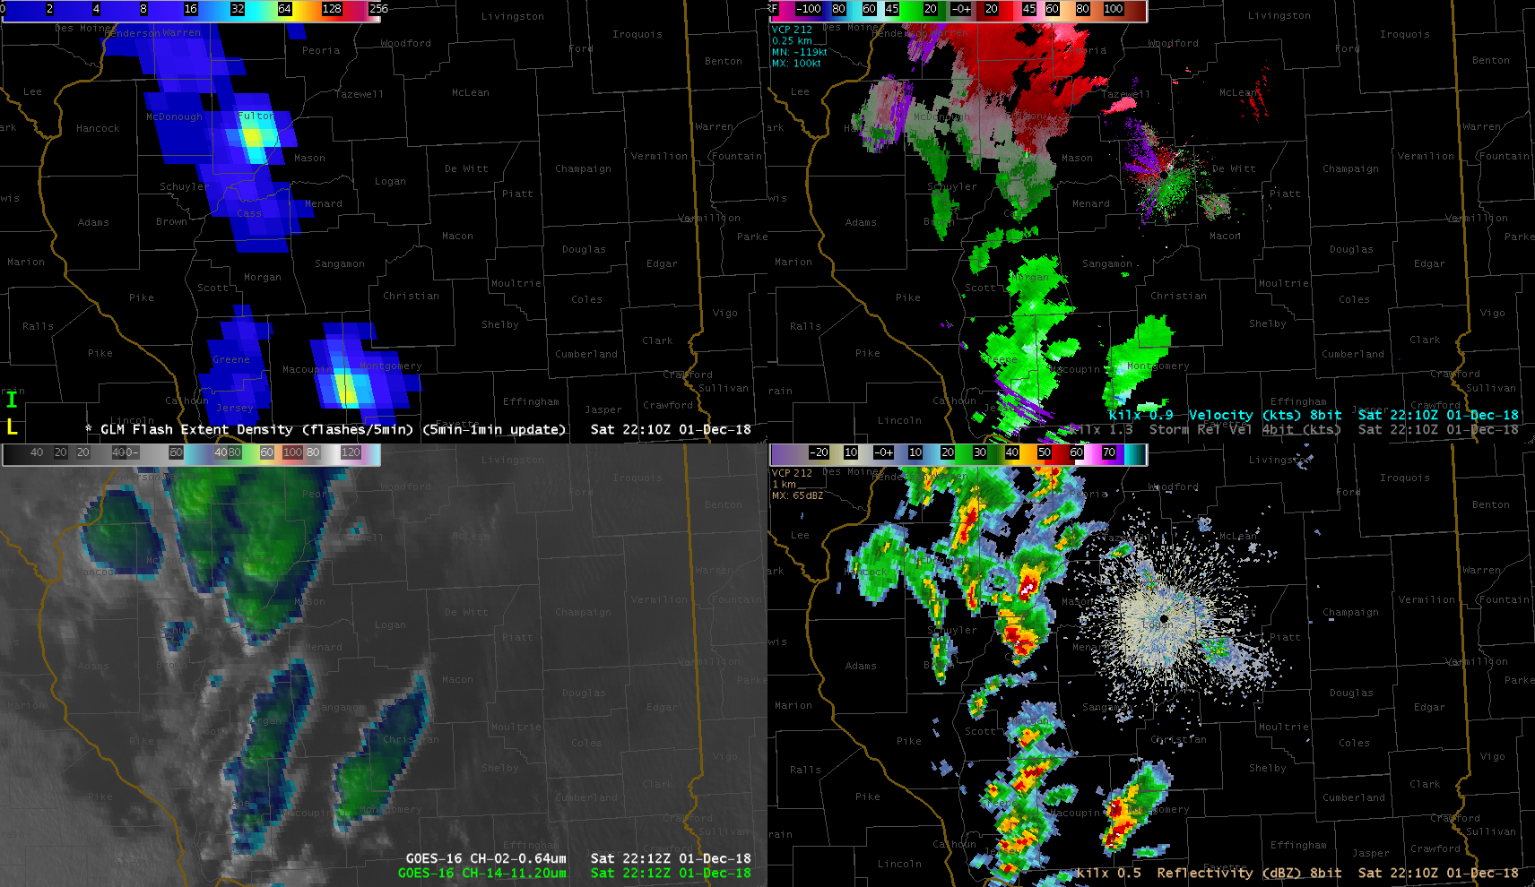
Flash Extent Density
(5 min accumulation)
Radar Velocity
ABI “sandwich”
0.64 and 11.2
Radar Reflectivity

Slide 33
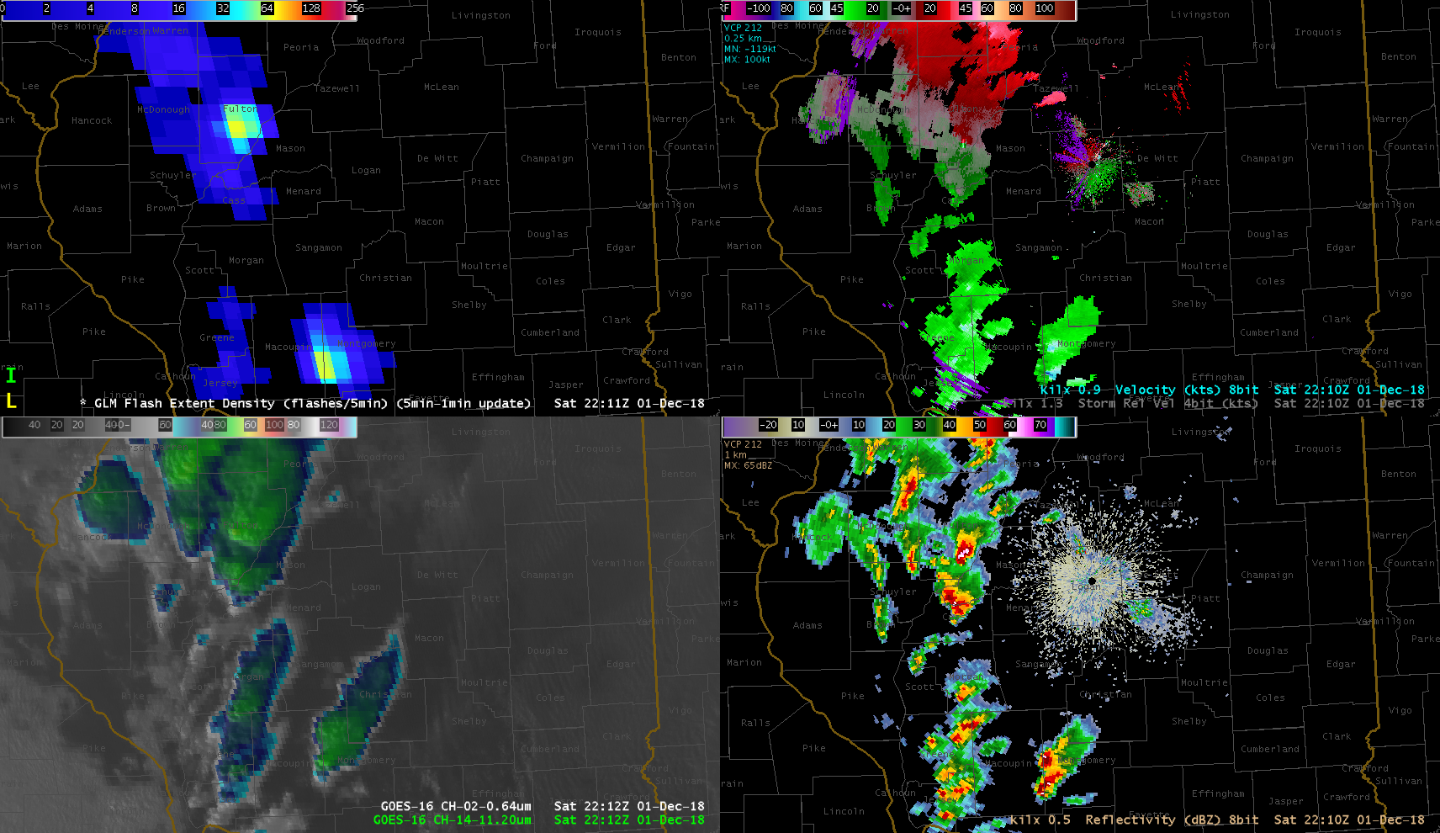
Flash Extent Density
(5 min accumulation)
Radar Velocity
ABI “sandwich”
0.64 and 11.2
Radar Reflectivity

Slide 34
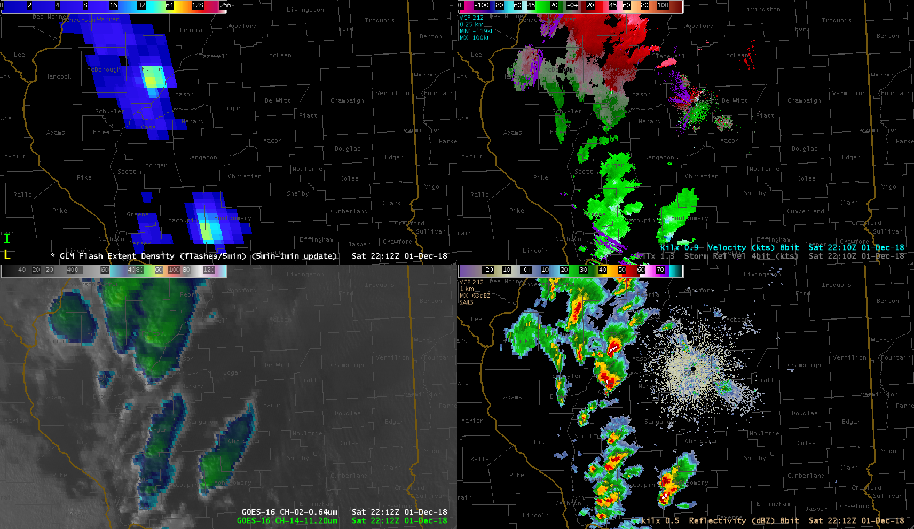
Flash Extent Density
(5 min accumulation)
Radar Velocity
ABI “sandwich”
0.64 and 11.2
Radar Reflectivity

Slide 35
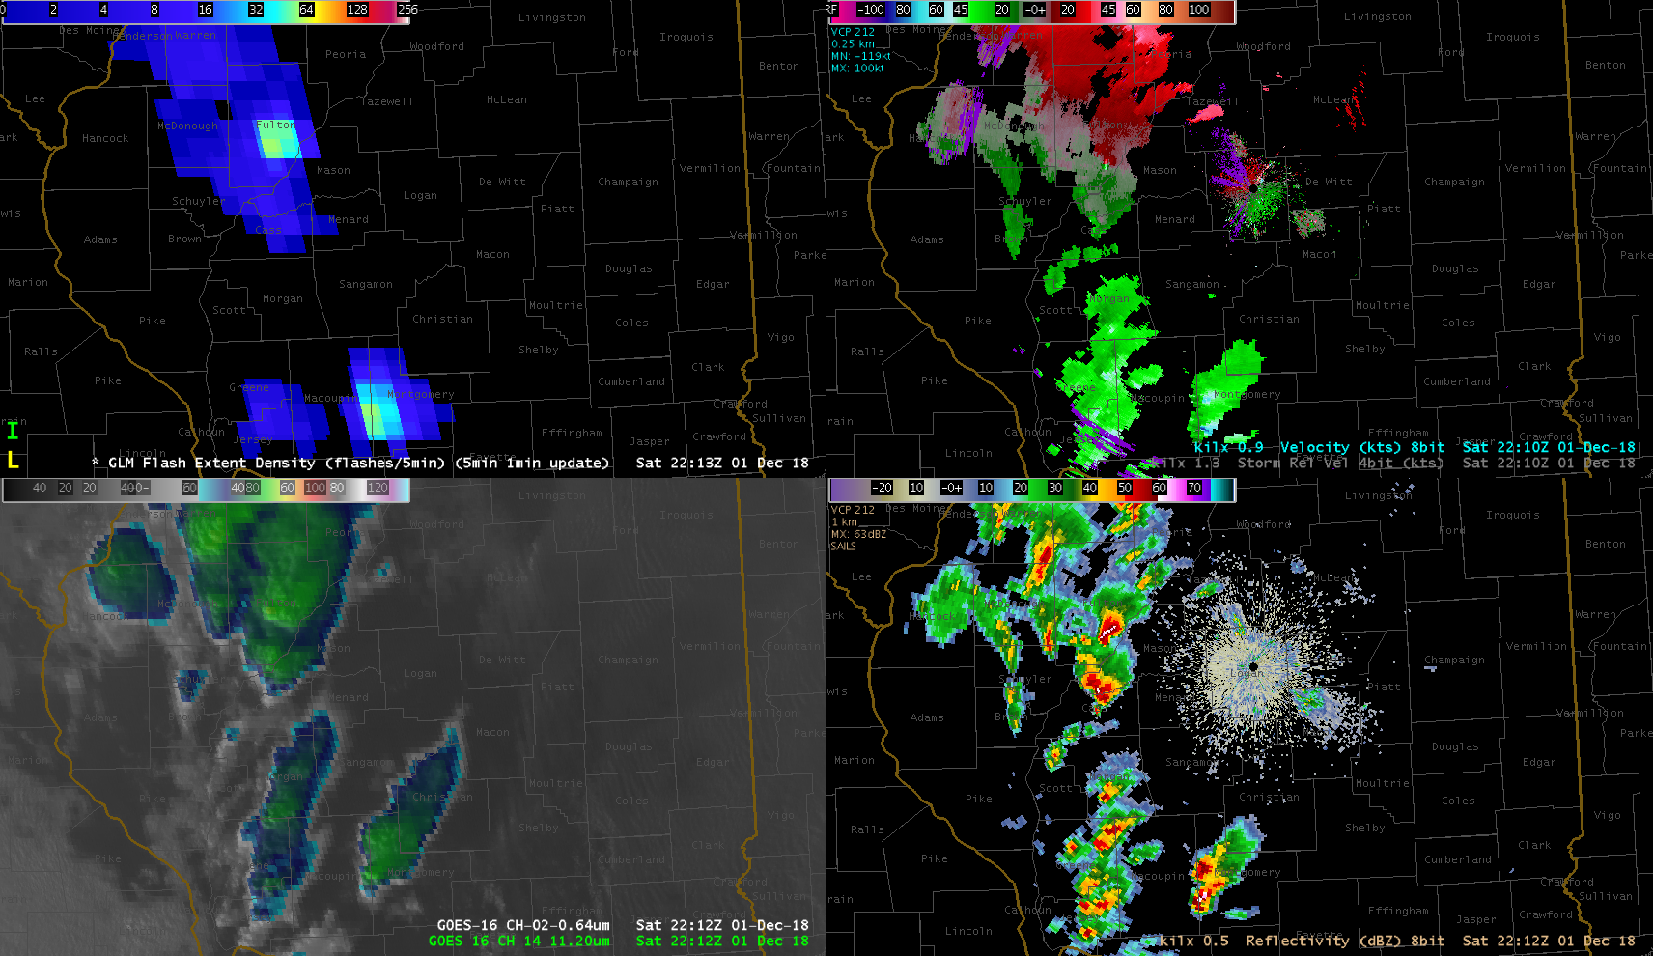
Flash Extent Density
(5 min accumulation)
Radar Velocity
ABI “sandwich”
0.64 and 11.2
Radar Reflectivity

Slide 36
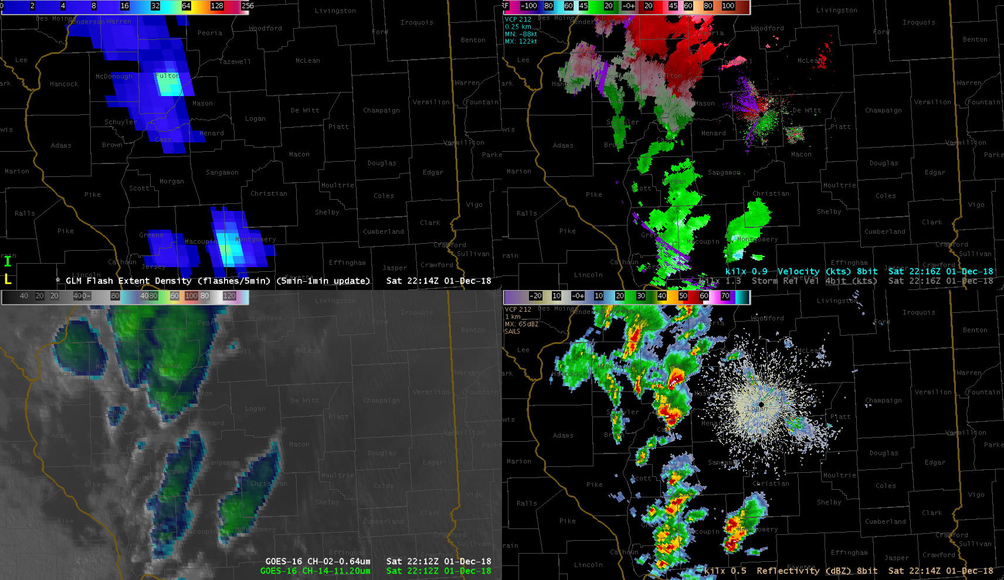
Flash Extent Density
(5 min accumulation)
Radar Velocity
ABI “sandwich”
0.64 and 11.2
Radar Reflectivity

Slide 37
Flash Extent Density
(5 min accumulation)
Radar Velocity
ABI “sandwich”
0.64 and 11.2
Radar Reflectivity

Slide 38
Flash Extent Density
(5 min accumulation)
Radar Velocity
ABI “sandwich”
0.64 and 11.2
Radar Reflectivity

Slide 39
Flash Extent Density
(5 min accumulation)
Radar Velocity
ABI “sandwich”
0.64 and 11.2
Radar Reflectivity

Slide 40
Flash Extent Density
(5 min accumulation)
Radar Velocity
ABI “sandwich”
0.64 and 11.2
Radar Reflectivity

Slide 41
Flash Extent Density
(5 min accumulation)
Radar Velocity
ABI “sandwich”
0.64 and 11.2
Radar Reflectivity

Slide 42
Flash Extent Density
(5 min accumulation)
Radar Velocity
ABI “sandwich”
0.64 and 11.2
Radar Reflectivity

Slide 43
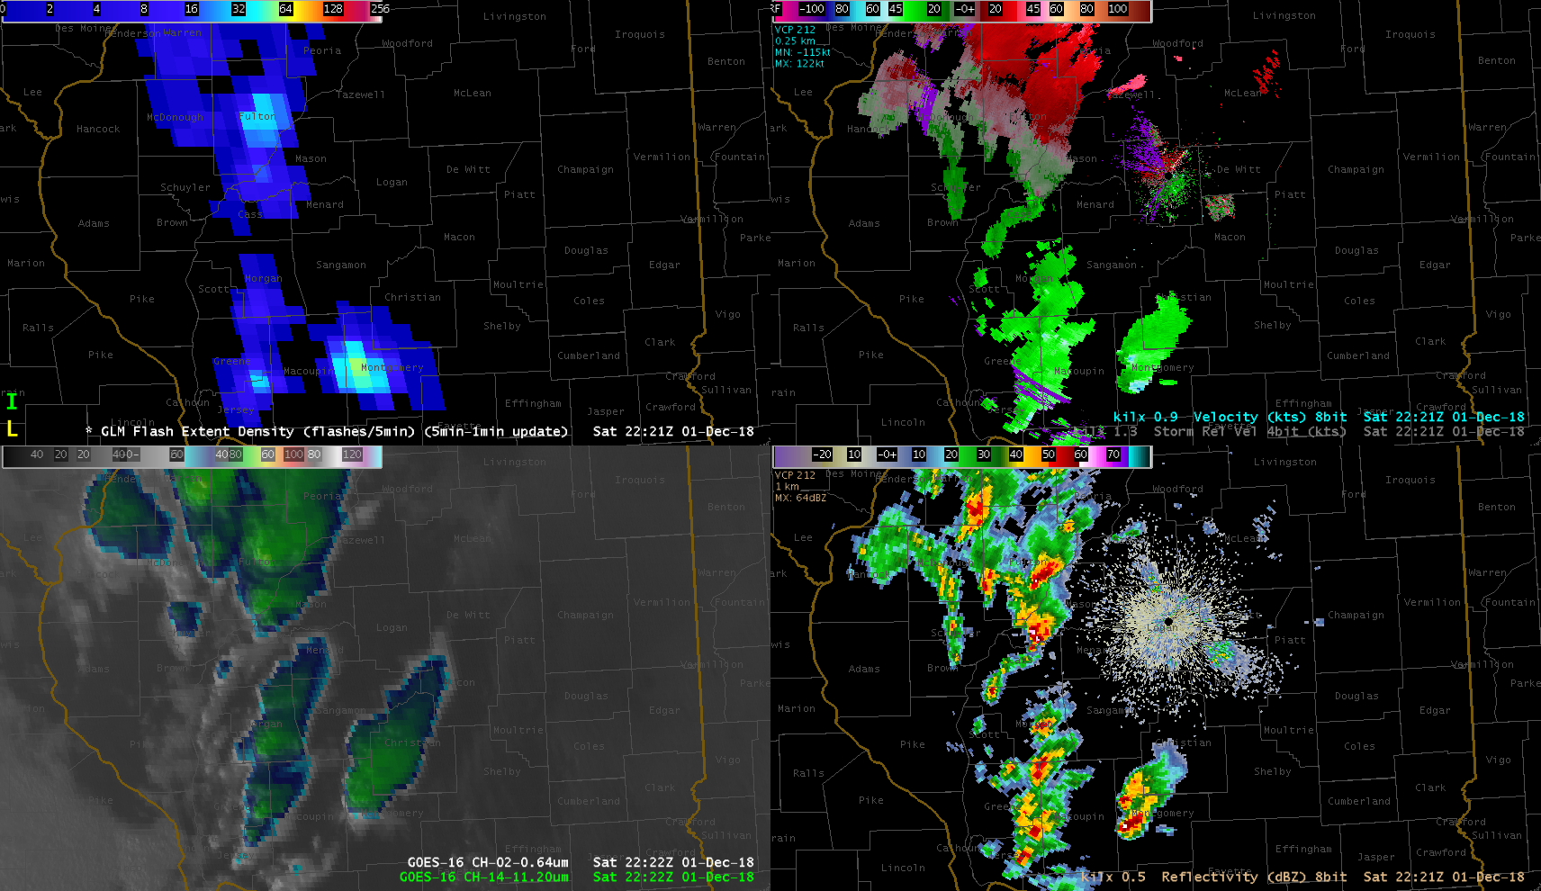
Flash Extent Density
(5 min accumulation)
Radar Velocity
ABI “sandwich”
0.64 and 11.2
Radar Reflectivity

Slide 44
Flash Extent Density
(5 min accumulation)
Radar Velocity
ABI “sandwich”
0.64 and 11.2
Radar Reflectivity

Slide 45
Flash Extent Density
(5 min accumulation)
Radar Velocity
ABI “sandwich”
0.64 and 11.2
Radar Reflectivity

Slide 46
Flash Extent Density
(5 min accumulation)
Radar Velocity
ABI “sandwich”
0.64 and 11.2
Radar Reflectivity

Slide 47
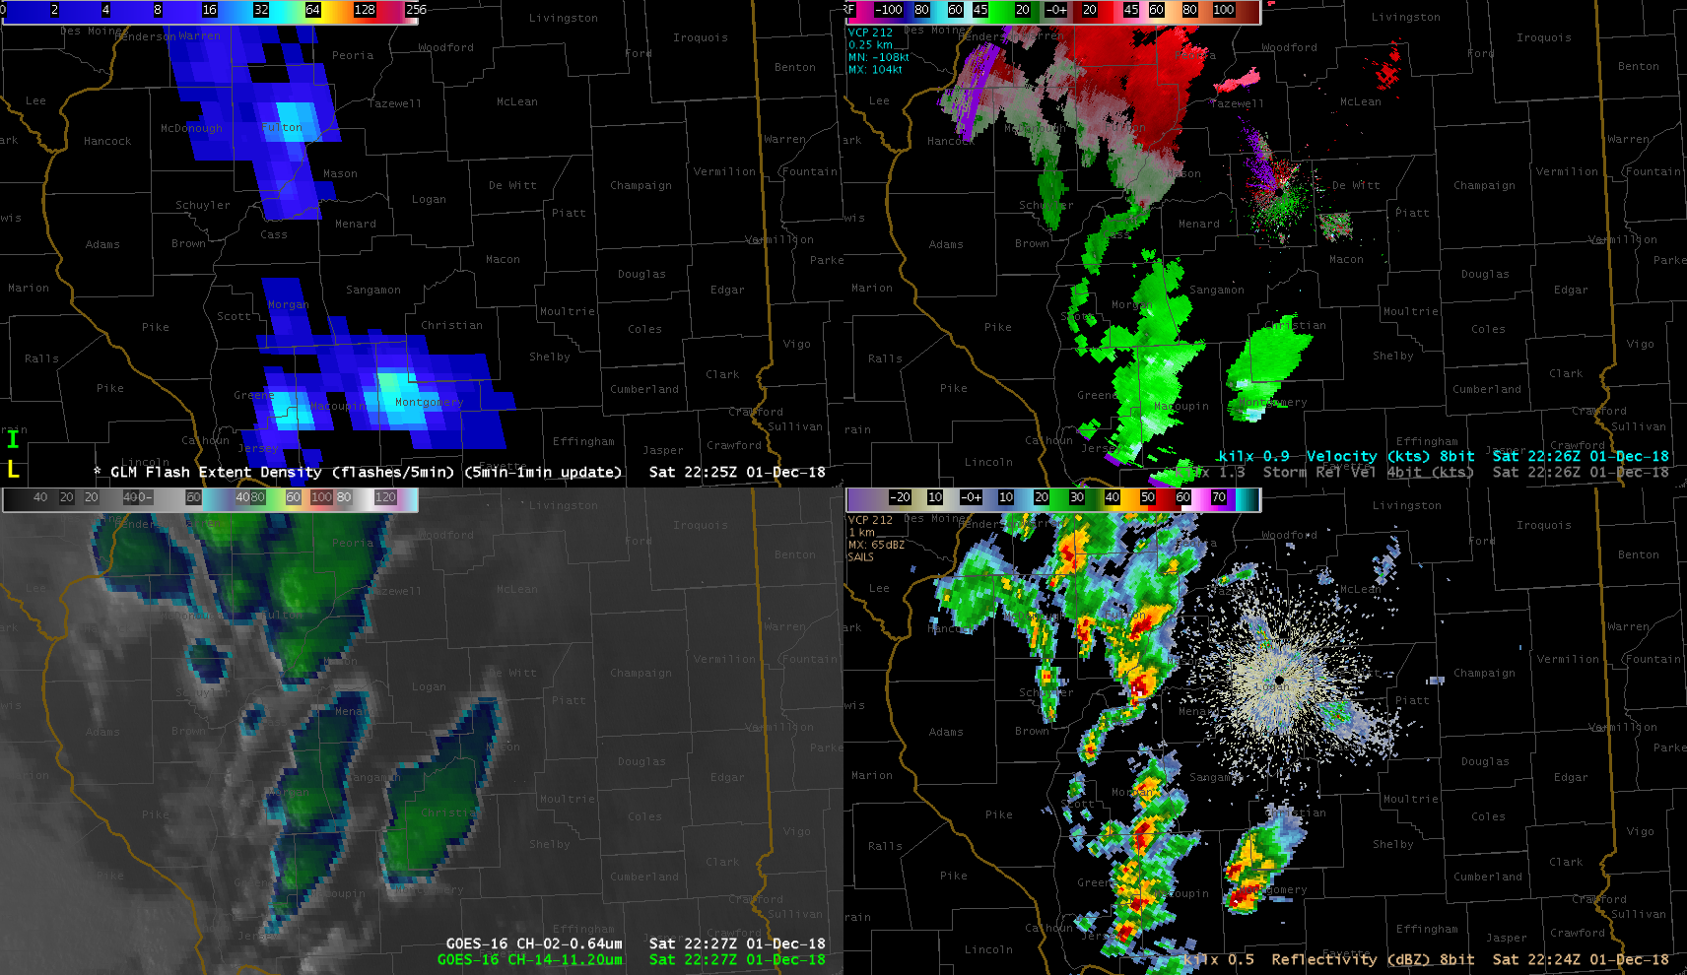
Flash Extent Density
(5 min accumulation)
Radar Velocity
ABI “sandwich”
0.64 and 11.2
Radar Reflectivity

Slide 48
Flash Extent Density
(5 min accumulation)
Radar Velocity
ABI “sandwich”
0.64 and 11.2
Radar Reflectivity

Slide 49
Flash Extent Density
(5 min accumulation)
Radar Velocity
ABI “sandwich”
0.64 and 11.2
Radar Reflectivity

Slide 50
Flash Extent Density
(5 min accumulation)
Radar Velocity
ABI “sandwich”
0.64 and 11.2
Radar Reflectivity

Slide 51
Flash Extent Density
(5 min accumulation)
Radar Velocity
ABI “sandwich”
0.64 and 11.2
Radar Reflectivity

Slide 52
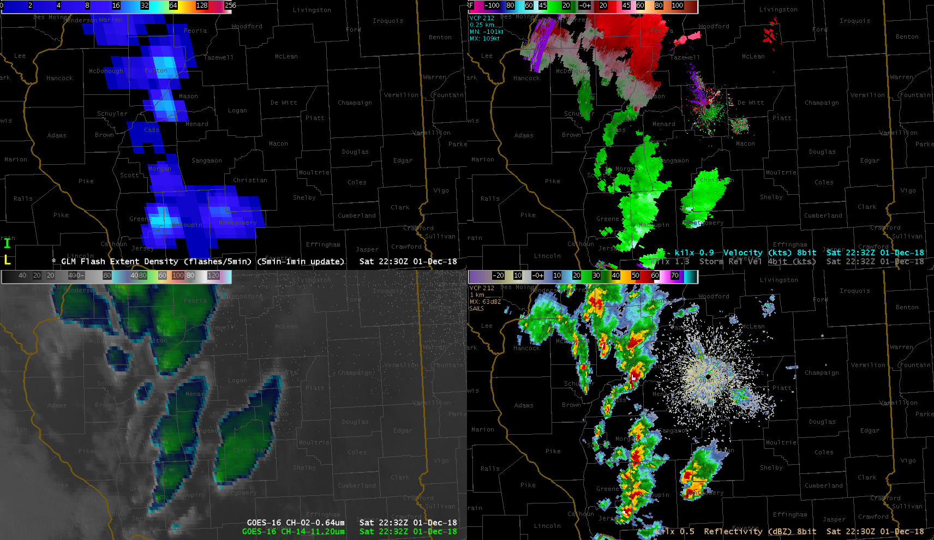
Flash Extent Density
(5 min accumulation)
Radar Velocity
ABI “sandwich”
0.64 and 11.2
Radar Reflectivity

Slide 53
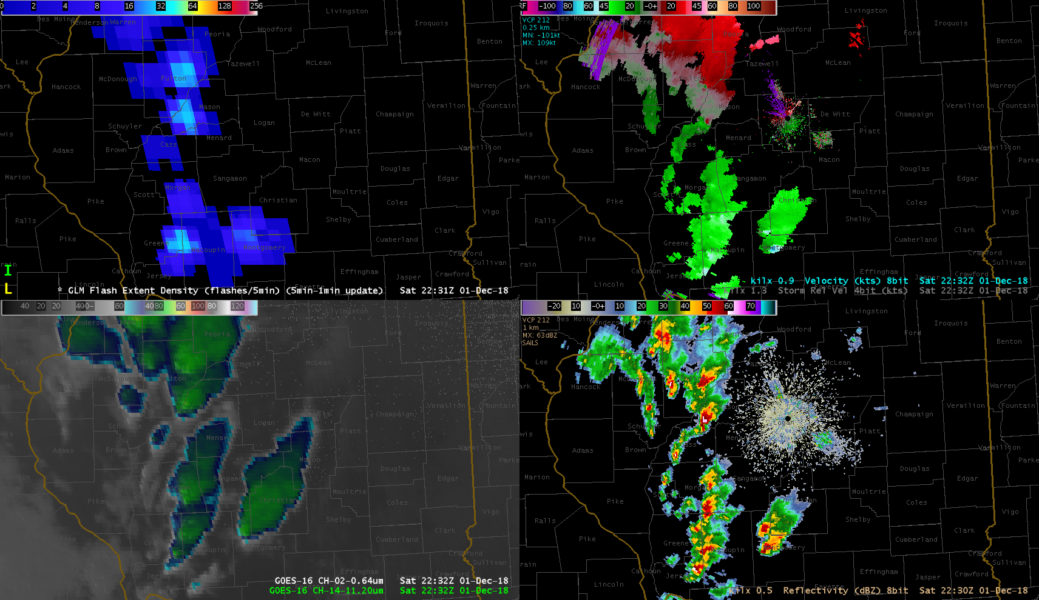
Flash Extent Density
(5 min accumulation)
Radar Velocity
ABI “sandwich”
0.64 and 11.2
Radar Reflectivity

Slide 54
Flash Extent Density
(5 min accumulation)
Radar Velocity
ABI “sandwich”
0.64 and 11.2
Radar Reflectivity

Slide 55
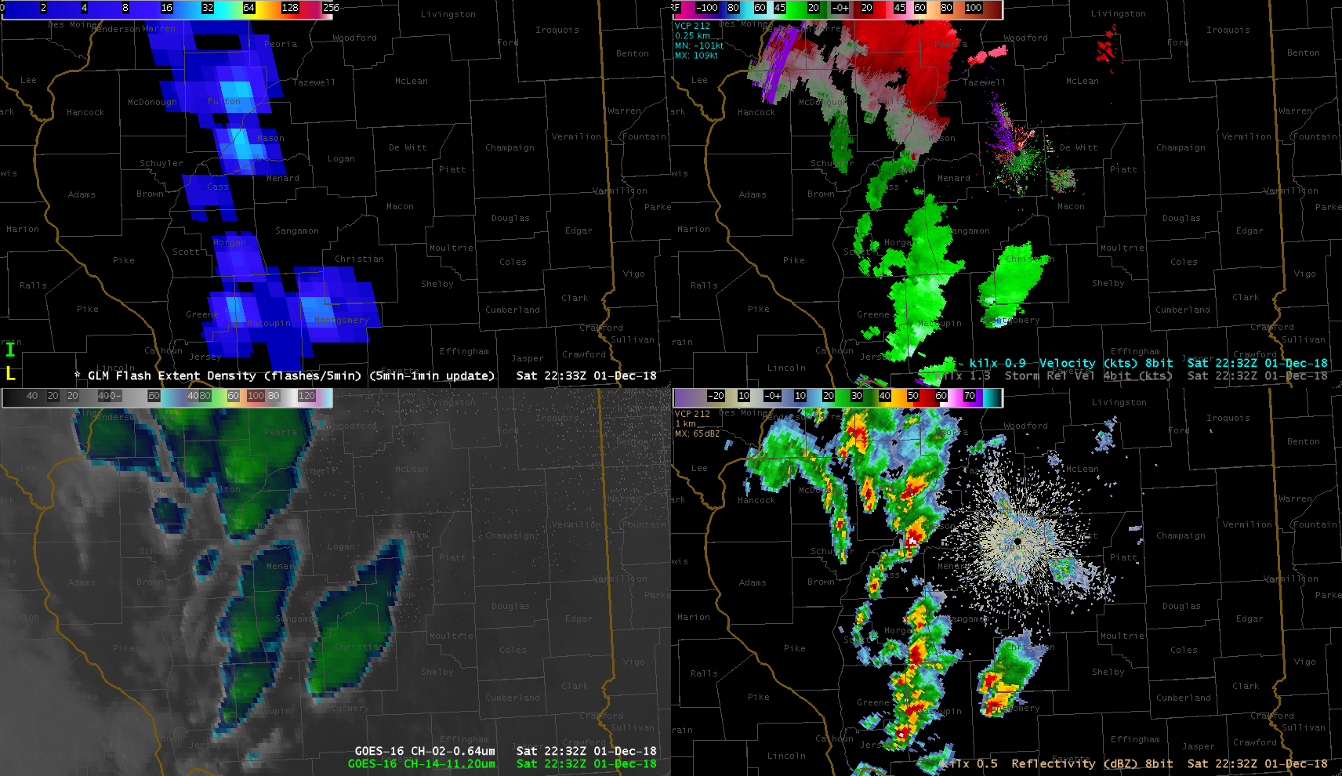
Flash Extent Density
(5 min accumulation)
Radar Velocity
ABI “sandwich”
0.64 and 11.2
Radar Reflectivity

Slide 56
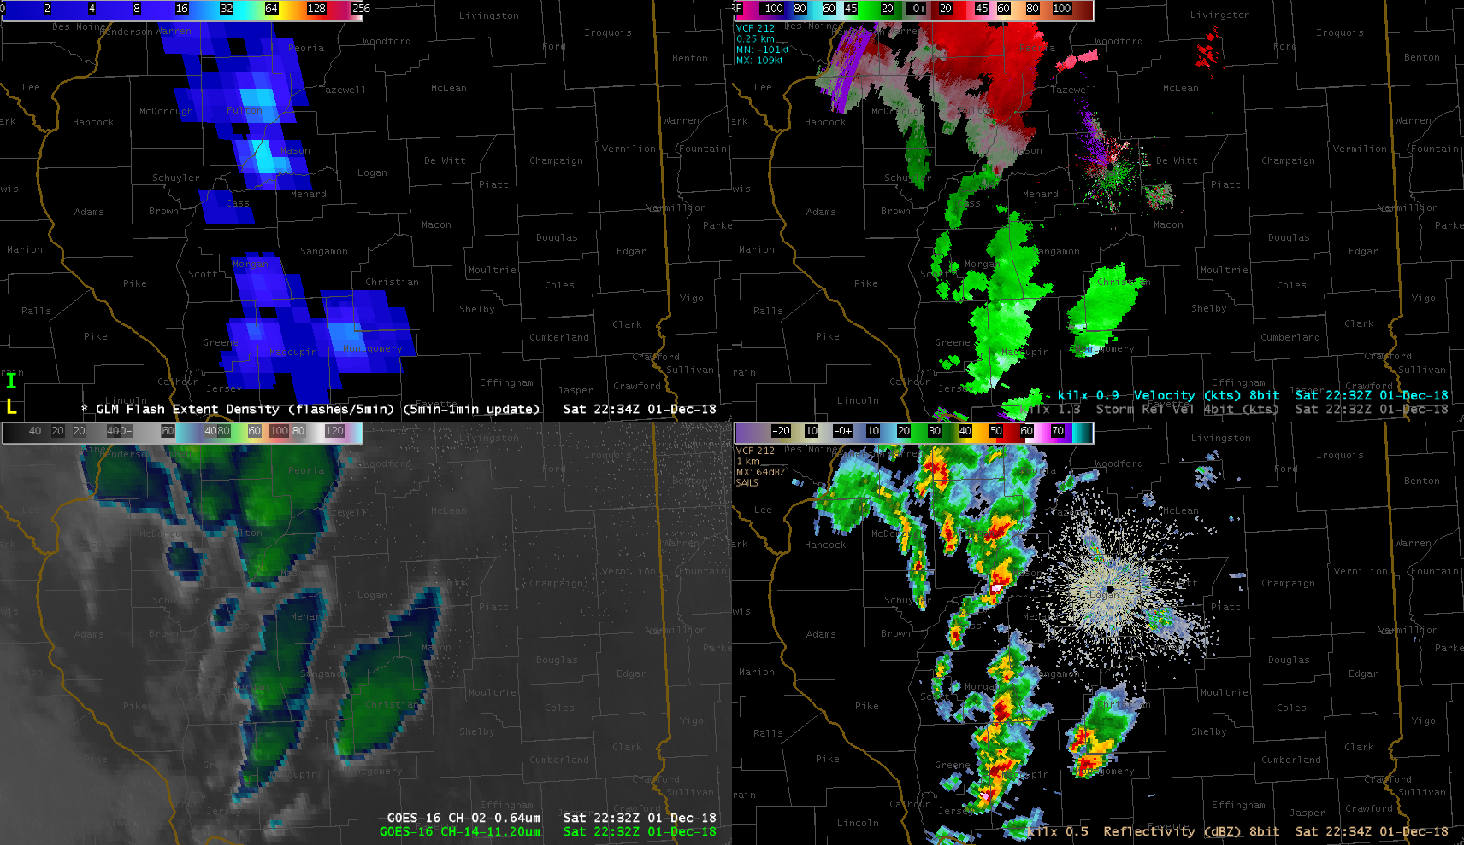
Flash Extent Density
(5 min accumulation)
Radar Velocity
ABI “sandwich”
0.64 and 11.2
Radar Reflectivity

Slide 57
Flash Extent Density
(5 min accumulation)
Radar Velocity
ABI “sandwich”
0.64 and 11.2
Radar Reflectivity

Slide 58
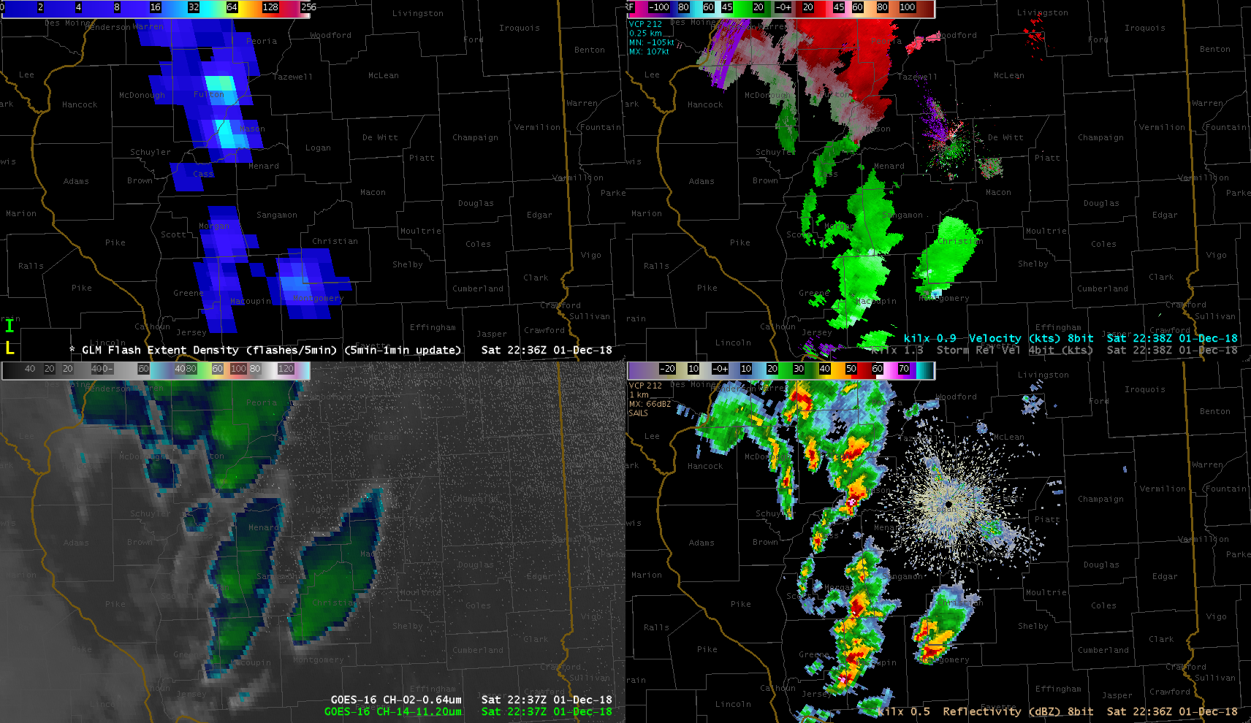
Flash Extent Density
(5 min accumulation)
Radar Velocity
ABI “sandwich”
0.64 and 11.2
Radar Reflectivity

Slide 59
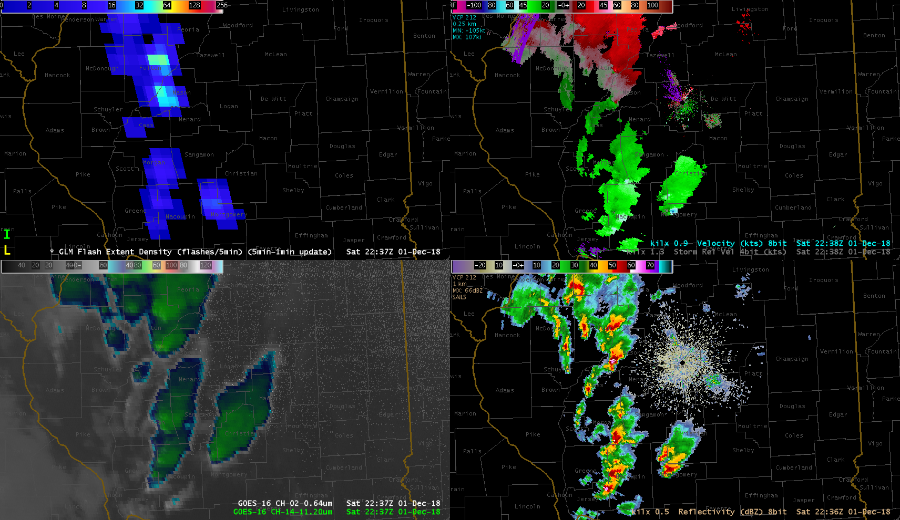
Flash Extent Density
(5 min accumulation)
Radar Velocity
ABI “sandwich”
0.64 and 11.2
Radar Reflectivity

Slide 60
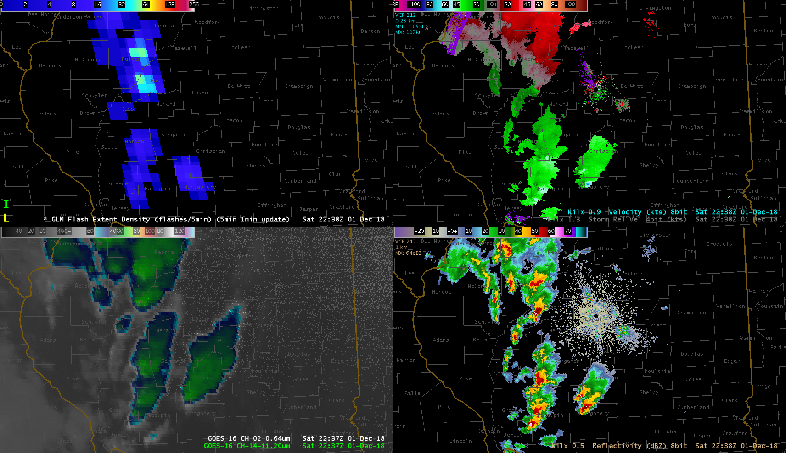
Flash Extent Density
(5 min accumulation)
Radar Velocity
ABI “sandwich”
0.64 and 11.2
Radar Reflectivity

Slide 61
Flash Extent Density
(5 min accumulation)
Radar Velocity
ABI “sandwich”
0.64 and 11.2
Radar Reflectivity

Slide 62
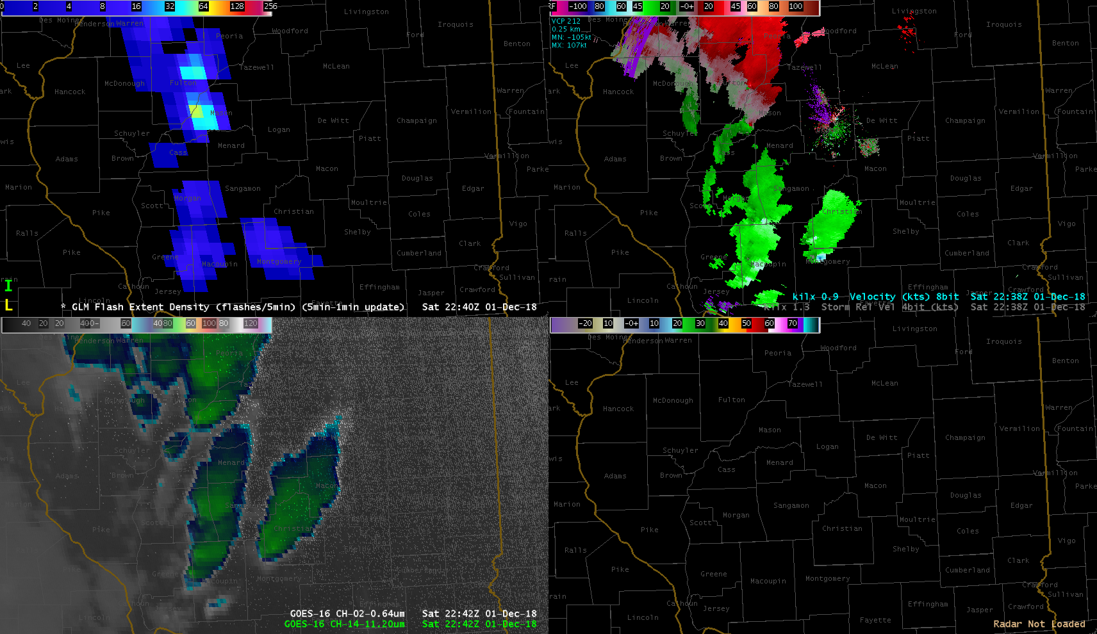
Flash Extent Density
(5 min accumulation)
Radar Velocity
ABI “sandwich”
0.64 and 11.2
Radar Reflectivity

Slide 63
Flash Extent Density
(5 min accumulation)
Radar Velocity
ABI “sandwich”
0.64 and 11.2
Radar Reflectivity

Slide 64
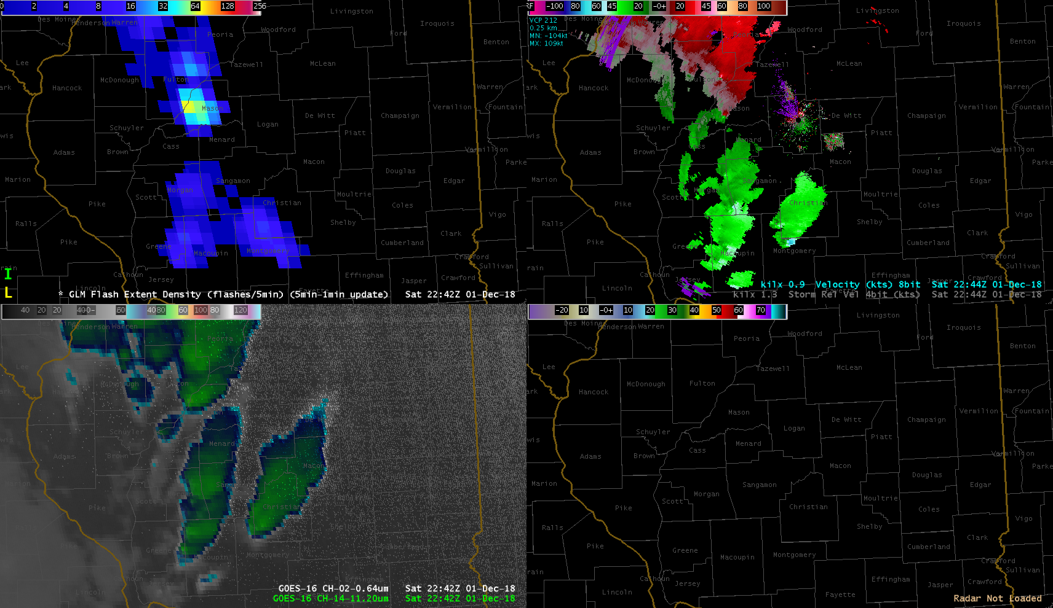
Flash Extent Density
(5 min accumulation)
Radar Velocity
ABI “sandwich”
0.64 and 11.2
Radar Reflectivity

Slide 65
Flash Extent Density
(5 min accumulation)
Radar Velocity
ABI “sandwich”
0.64 and 11.2
Radar Reflectivity

Slide 66
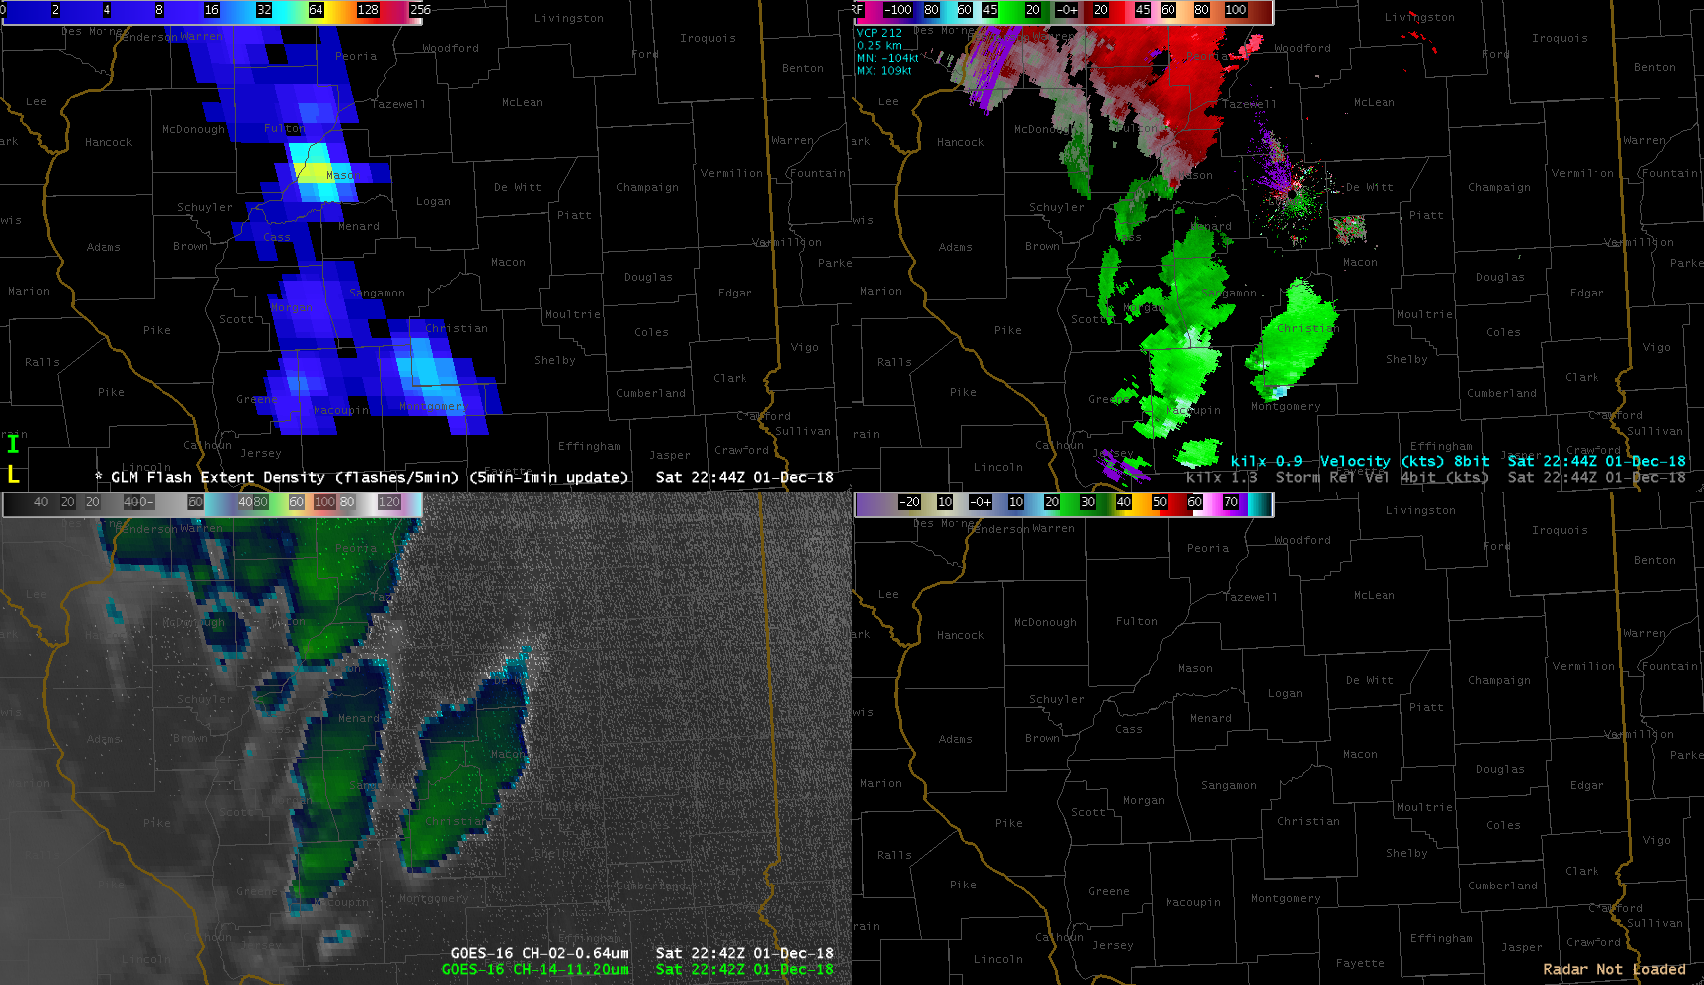
Flash Extent Density
(5 min accumulation)
Radar Velocity
ABI “sandwich”
0.64 and 11.2
Radar Reflectivity

Slide 67
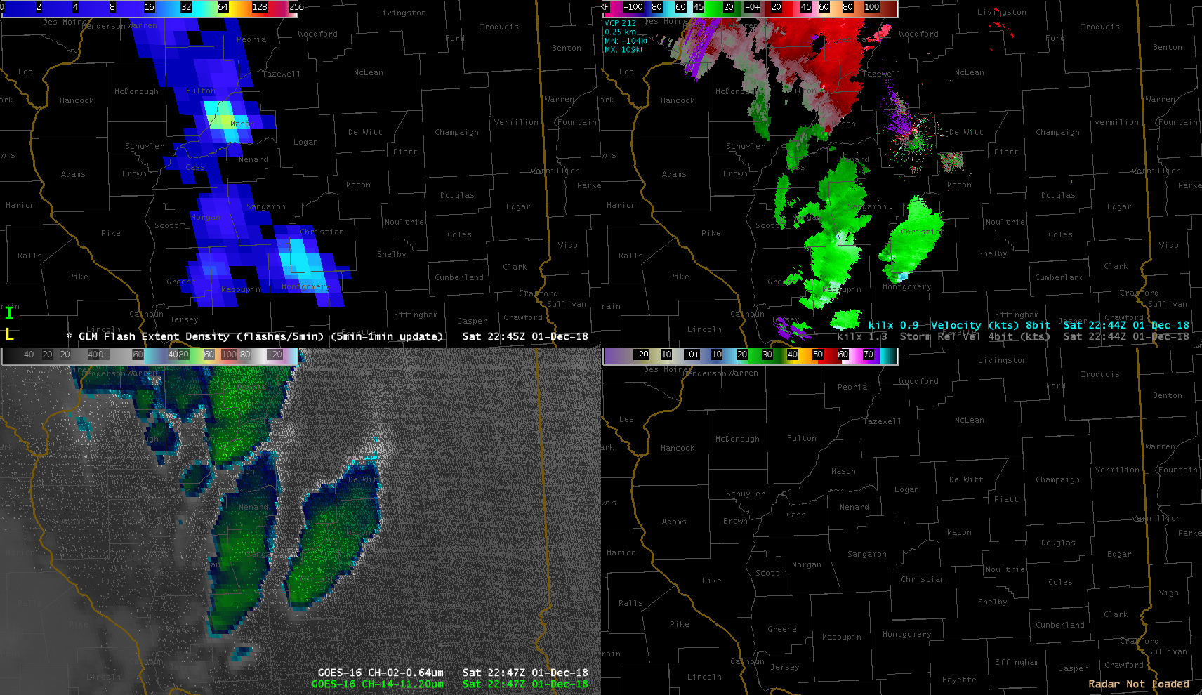
Flash Extent Density
(5 min accumulation)
Radar Velocity
ABI “sandwich”
0.64 and 11.2
Radar Reflectivity

Slide 68
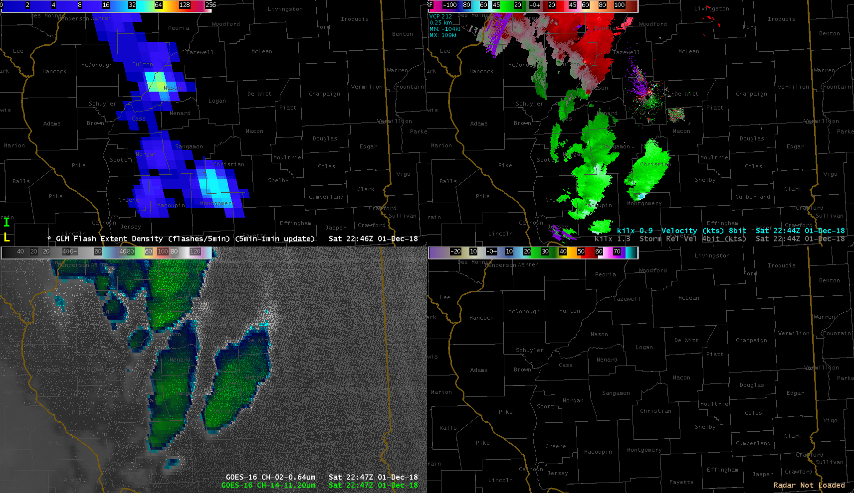
Flash Extent Density
(5 min accumulation)
Radar Velocity
ABI “sandwich”
0.64 and 11.2
Radar Reflectivity

Slide 69
Flash Extent Density
(5 min accumulation)
Radar Velocity
ABI “sandwich”
0.64 and 11.2
Radar Reflectivity

Slide 70
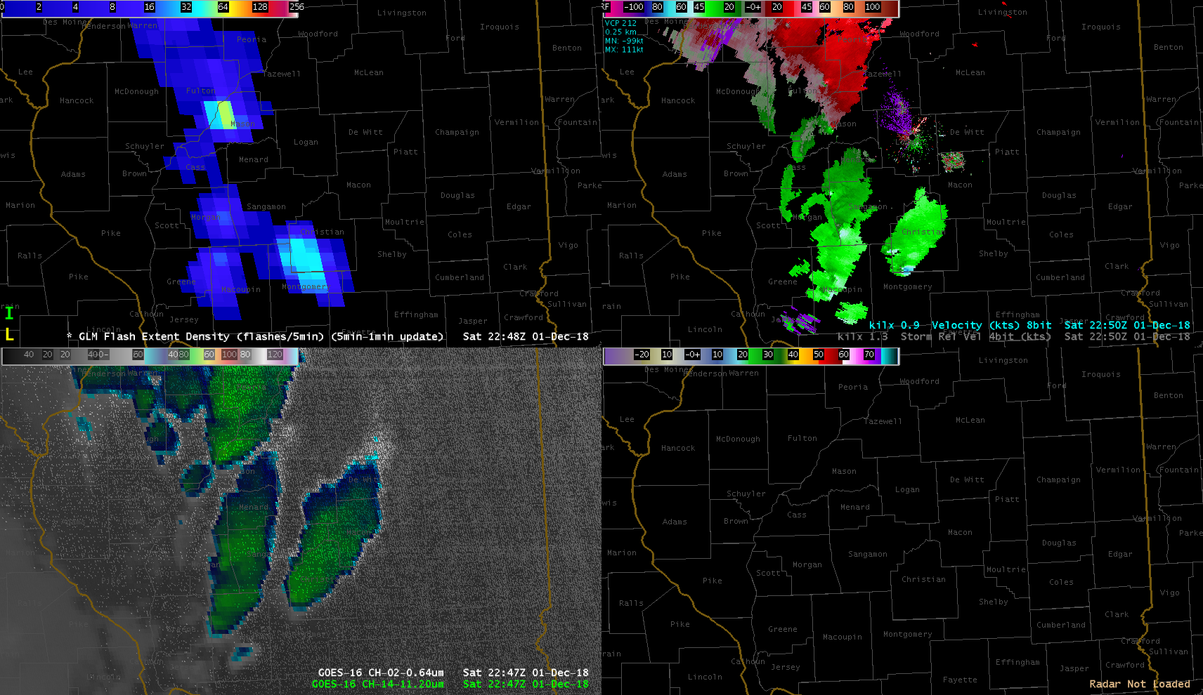
Flash Extent Density
(5 min accumulation)
Radar Velocity
ABI “sandwich”
0.64 and 11.2
Radar Reflectivity

Slide 71
Flash Extent Density
(5 min accumulation)
Radar Velocity
ABI “sandwich”
0.64 and 11.2
Radar Reflectivity

Slide 72
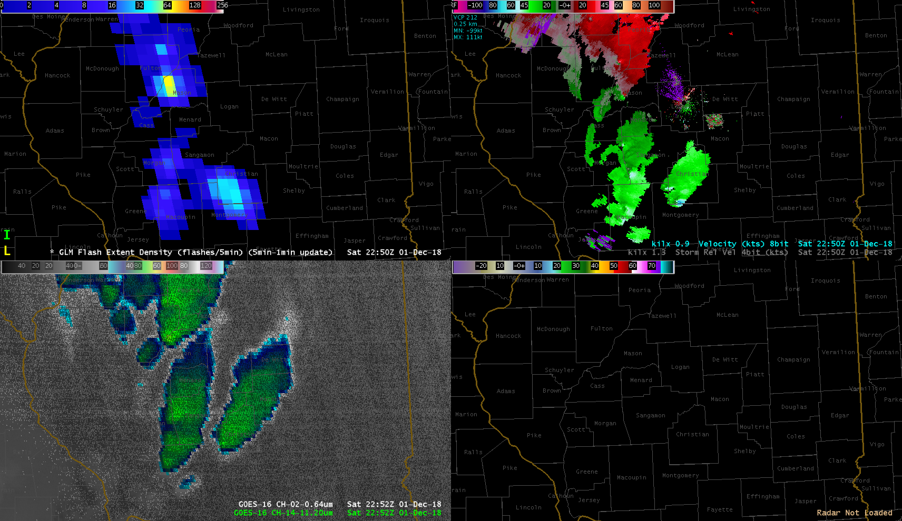
Flash Extent Density
(5 min accumulation)
Radar Velocity
ABI “sandwich”
0.64 and 11.2
Radar Reflectivity

Slide 73
Flash Extent Density
(5 min accumulation)
Radar Velocity
ABI “sandwich”
0.64 and 11.2
Radar Reflectivity

Slide 74
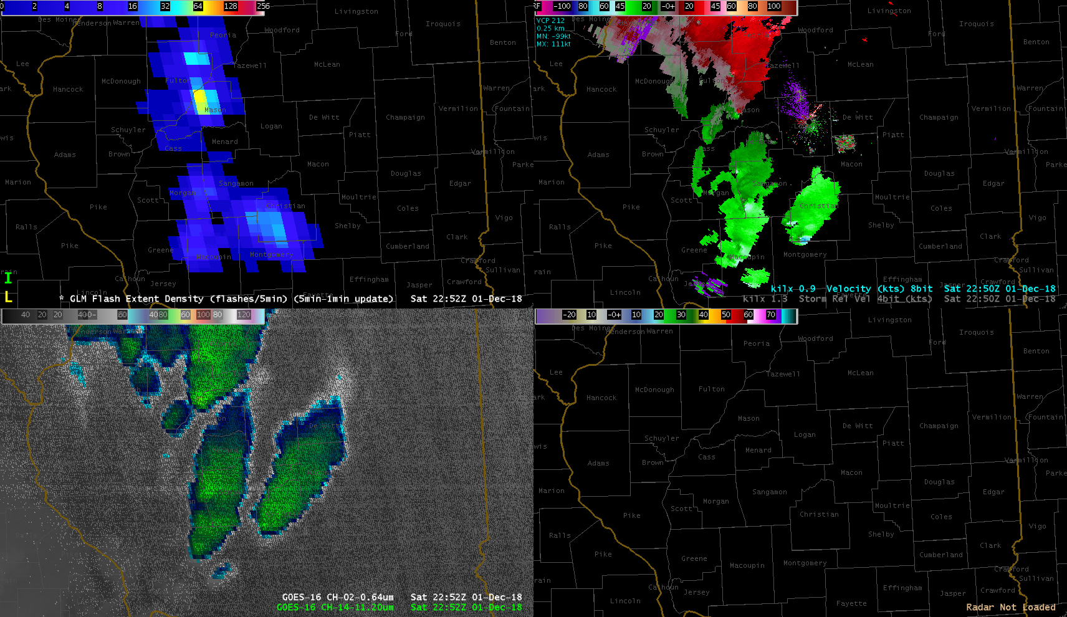
Flash Extent Density
(5 min accumulation)
Radar Velocity
ABI “sandwich”
0.64 and 11.2
Radar Reflectivity

Slide 75
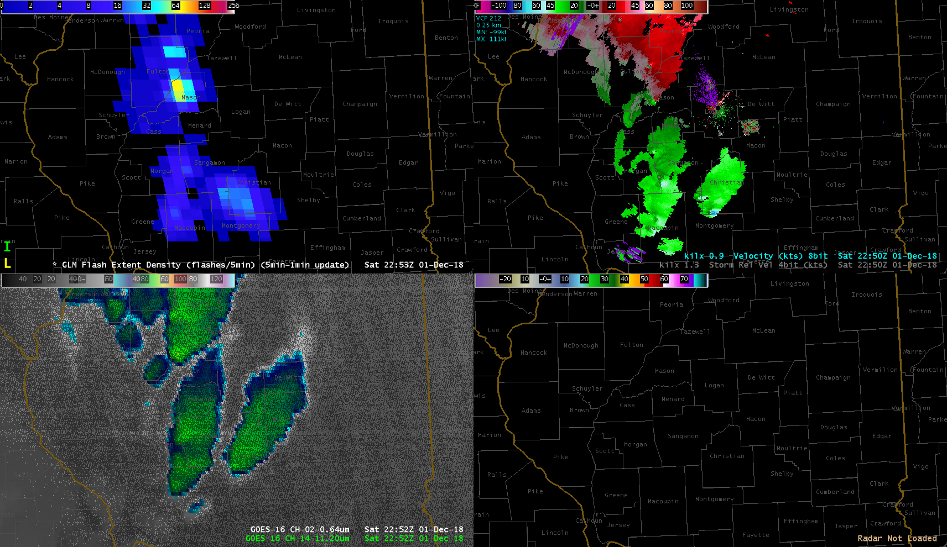
Flash Extent Density
(5 min accumulation)
Radar Velocity
ABI “sandwich”
0.64 and 11.2
Radar Reflectivity

Slide 76
Flash Extent Density
(5 min accumulation)
Radar Velocity
ABI “sandwich”
0.64 and 11.2
Radar Reflectivity

Slide 77
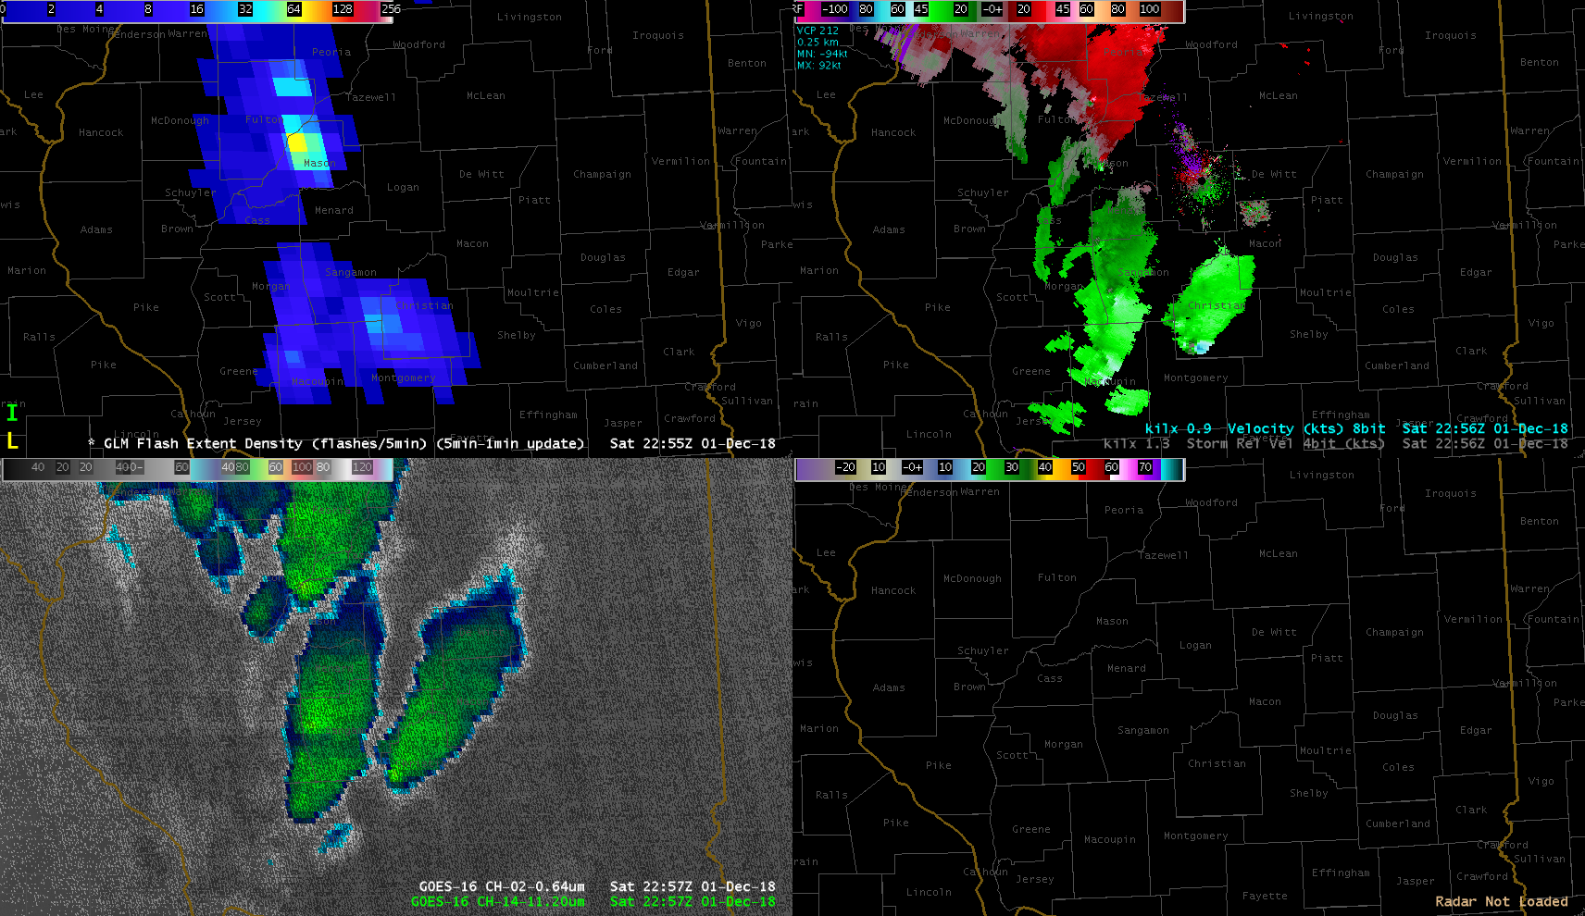
Flash Extent Density
(5 min accumulation)
Radar Velocity
ABI “sandwich”
0.64 and 11.2
Radar Reflectivity

Slide 78
Flash Extent Density
(5 min accumulation)
Radar Velocity
ABI “sandwich”
0.64 and 11.2
Radar Reflectivity

Slide 79
Flash Extent Density
(5 min accumulation)
Radar Velocity
ABI “sandwich”
0.64 and 11.2
Radar Reflectivity

Slide 80
Flash Extent Density
(5 min accumulation)
Radar Velocity
ABI “sandwich”
0.64 and 11.2
Radar Reflectivity

Slide 81
Flash Extent Density
(5 min accumulation)
Radar Velocity
ABI “sandwich”
0.64 and 11.2
Radar Reflectivity

Slide 82
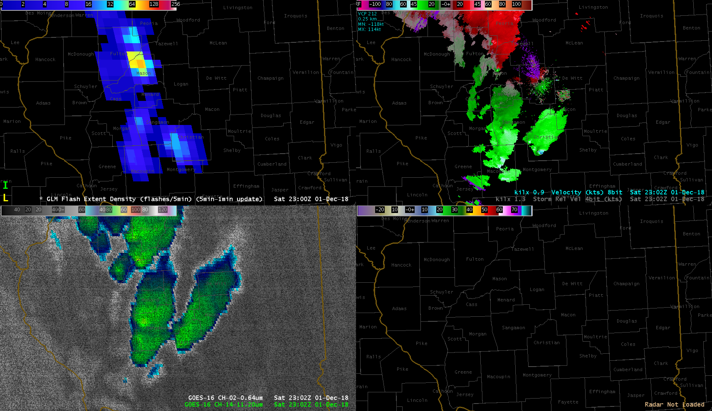
Flash Extent Density
(5 min accumulation)
Radar Velocity
ABI “sandwich”
0.64 and 11.2
Radar Reflectivity

Slide 83
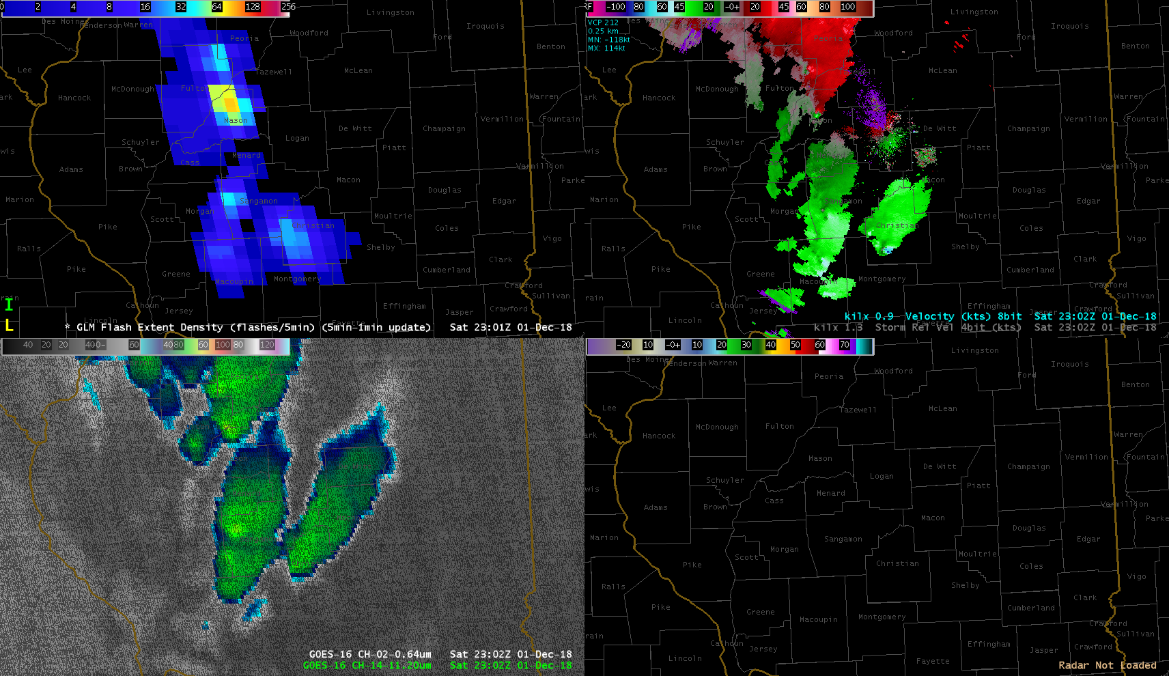
Flash Extent Density
(5 min accumulation)
Radar Velocity
ABI “sandwich”
0.64 and 11.2
Radar Reflectivity

Slide 84
Flash Extent Density
(5 min accumulation)
Radar Velocity
ABI “sandwich”
0.64 and 11.2
Radar Reflectivity

Slide 85
Flash Extent Density
(5 min accumulation)
Radar Velocity
ABI “sandwich”
0.64 and 11.2
Radar Reflectivity

Slide 86
Flash Extent Density
(5 min accumulation)
Radar Velocity
ABI “sandwich”
0.64 and 11.2
Radar Reflectivity

Slide 87
Flash Extent Density
(5 min accumulation)
Radar Velocity
ABI “sandwich”
0.64 and 11.2
Radar Reflectivity

Slide 88
Flash Extent Density
(5 min accumulation)
Radar Velocity
ABI “sandwich”
0.64 and 11.2
Radar Reflectivity

Slide 89
Flash Extent Density
(5 min accumulation)
Radar Velocity
ABI “sandwich”
0.64 and 11.2
Radar Reflectivity

Slide 90
Flash Extent Density
(5 min accumulation)
Radar Velocity
ABI “sandwich”
0.64 and 11.2
Radar Reflectivity

Slide 91
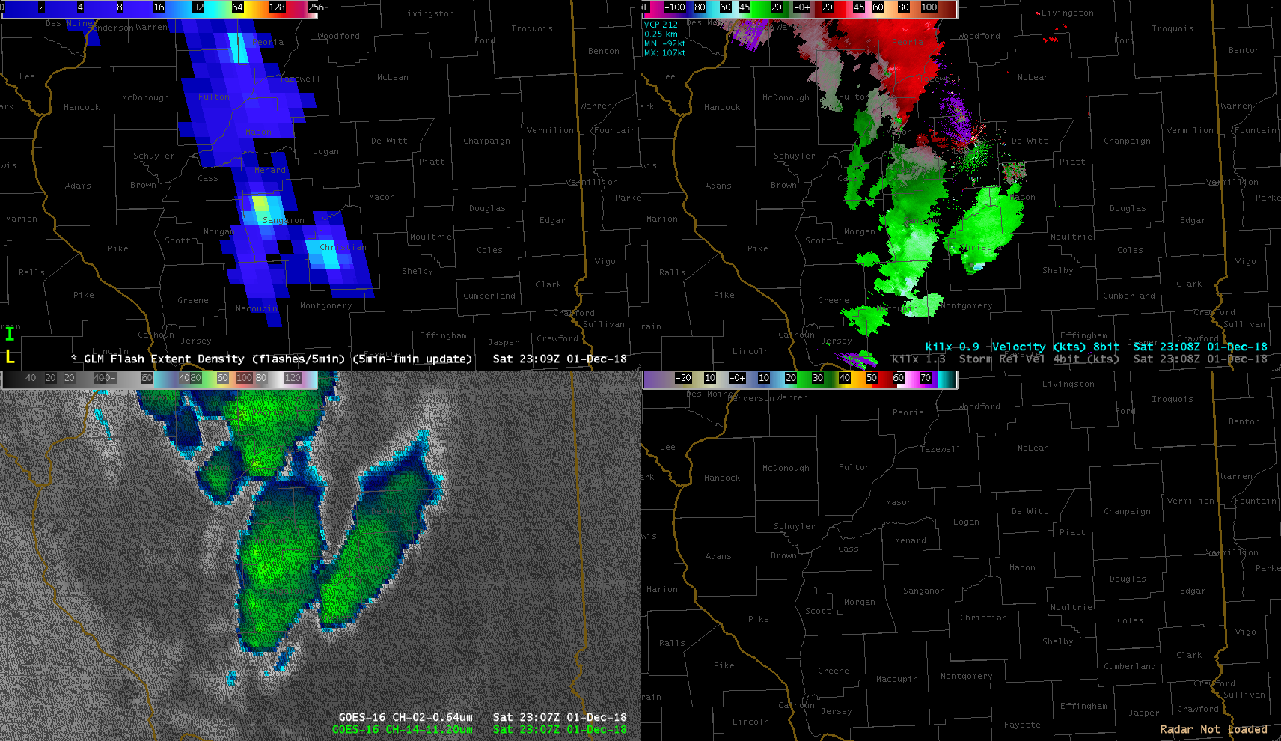
Flash Extent Density
(5 min accumulation)
Radar Velocity
ABI “sandwich”
0.64 and 11.2
Radar Reflectivity

Slide 92
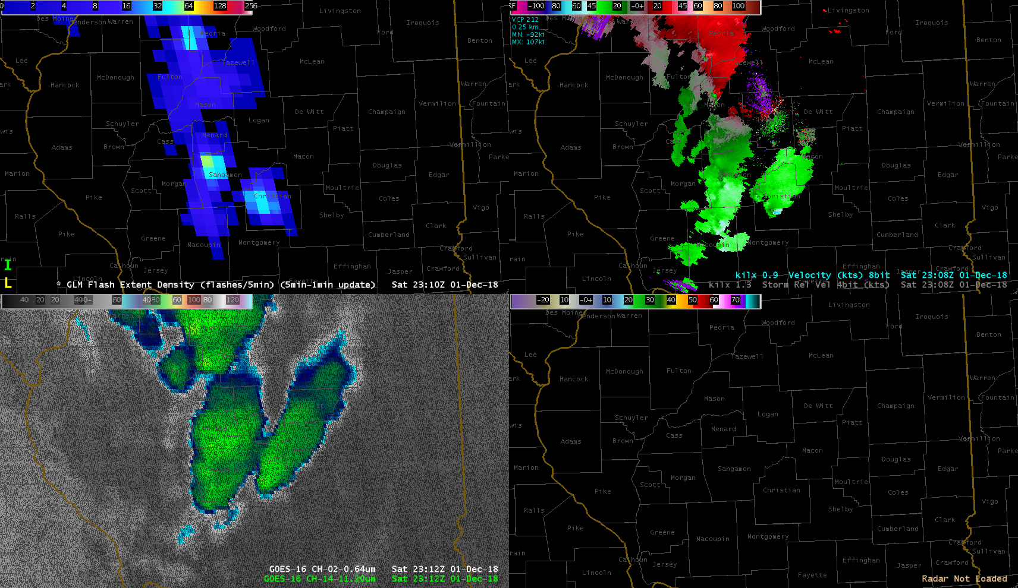

Slide 93
Animation (2140-2310)

Slide 94
Flash Extent Density
(5 min accumulation)
Radar Velocity
ABI “sandwich”
0.64 and 11.2
Radar Reflectivity

Slide 95
Review
Notes:
2045-2130, with severe weather at 2125

