Slide 1
Initial Case
Timeframe: 2045-2130 UTC
SPC general thunderstorm only
Things to note
Watch total optical energy versus flash area and flash extent density
Note Slide 76 (large flash with large optical energy)
Watch parallax (i.e., displacement between radar and GLM locations)
Thoughts on safety concerns?
When do you believe severe weather, if any, occurred?
Did GLM offer any support?
Notes:
2045-2130, with severe weather at 2125

Slide 2
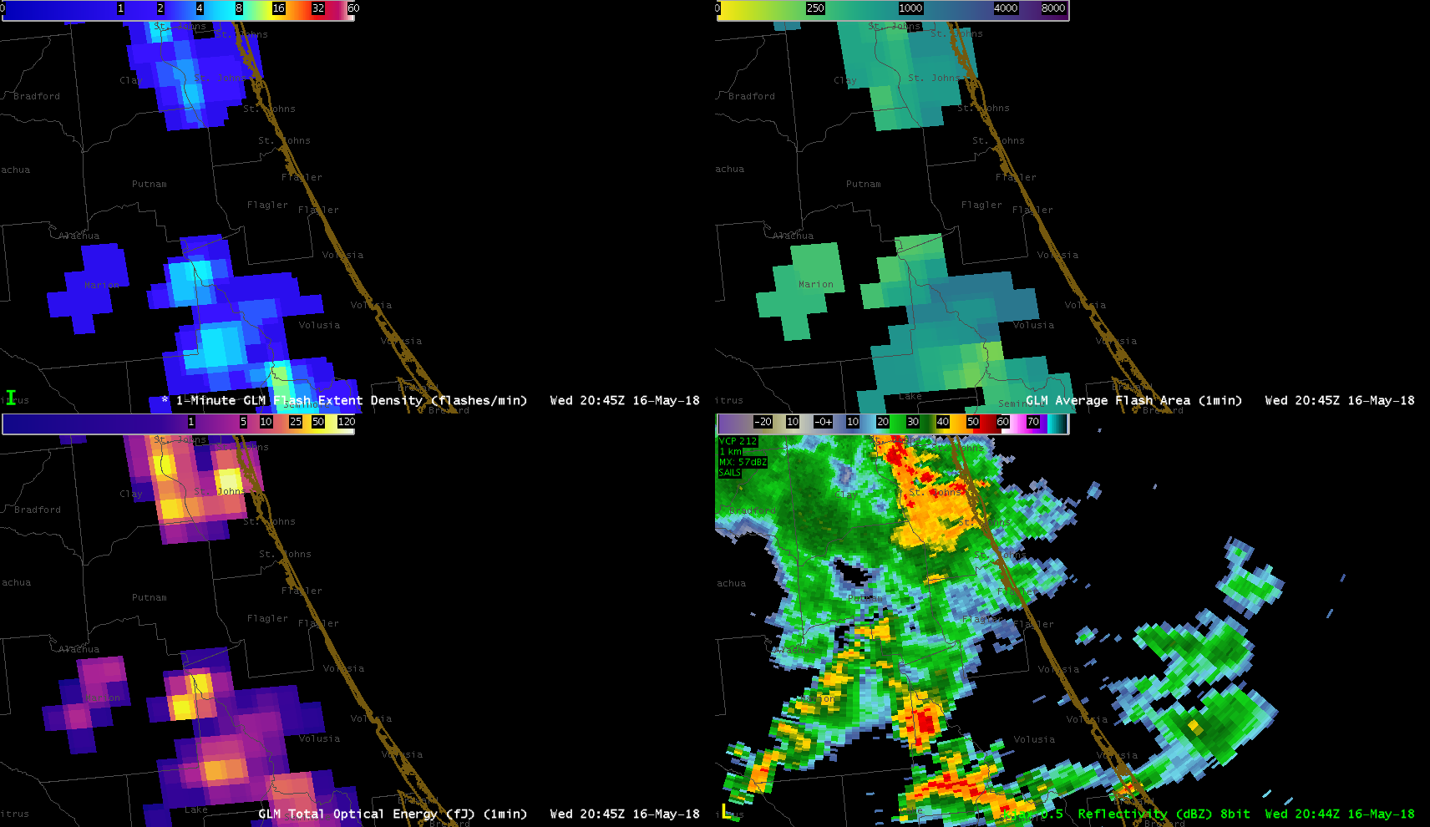
Flash Extent Density
Average Flash Area
Total Optical Energy
Radar Reflectivity

Slide 3
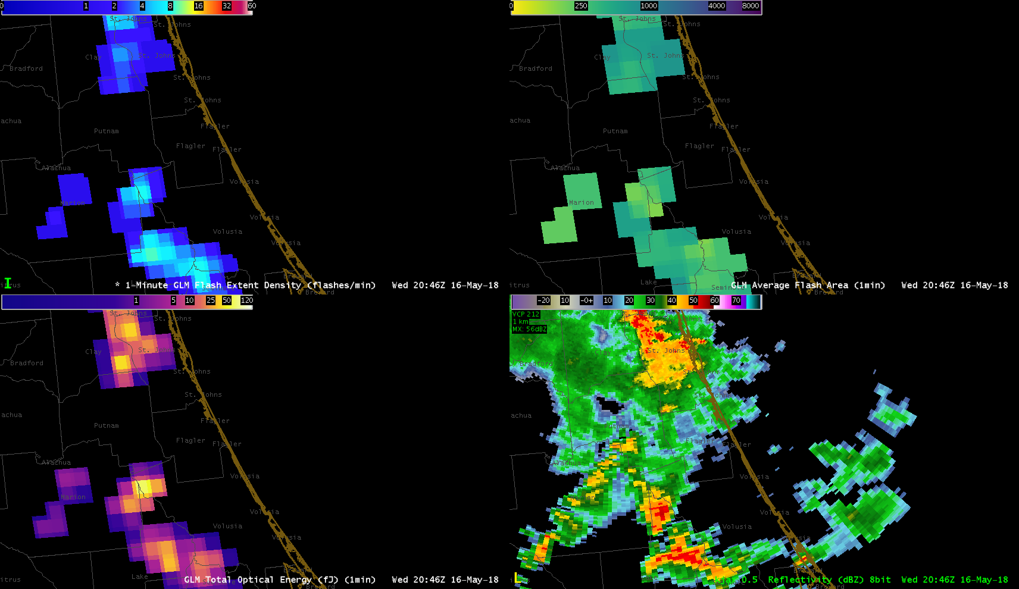
Flash Extent Density
Average Flash Area
Total Optical Energy
Radar Reflectivity

Slide 4
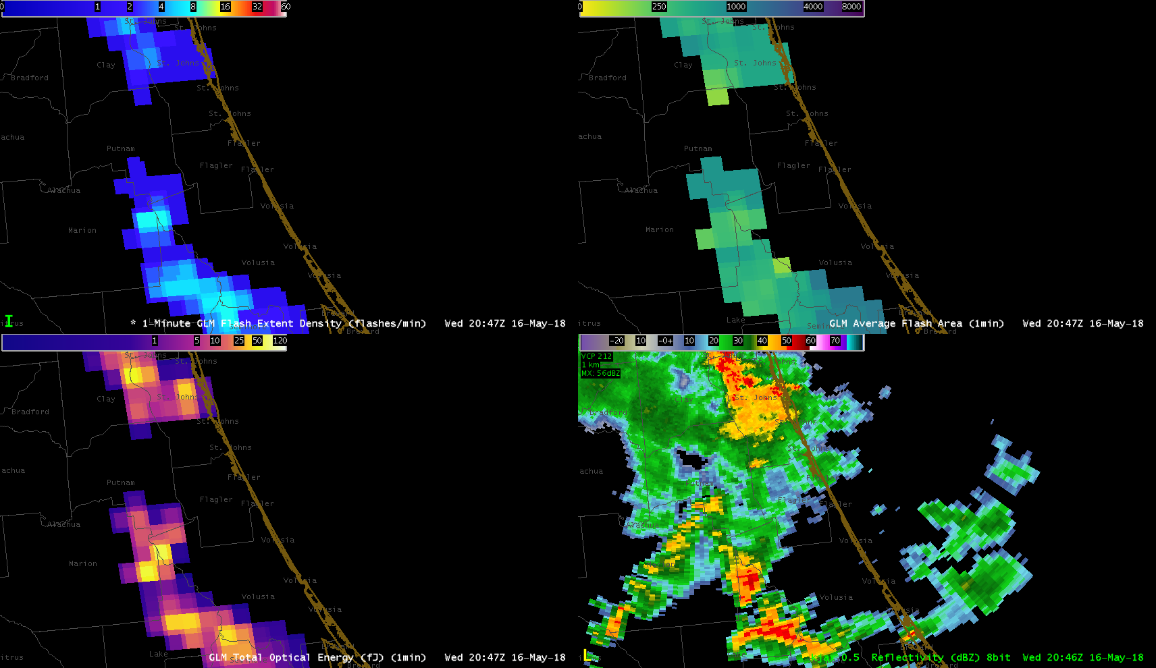
Flash Extent Density
Average Flash Area
Total Optical Energy
Radar Reflectivity

Slide 5
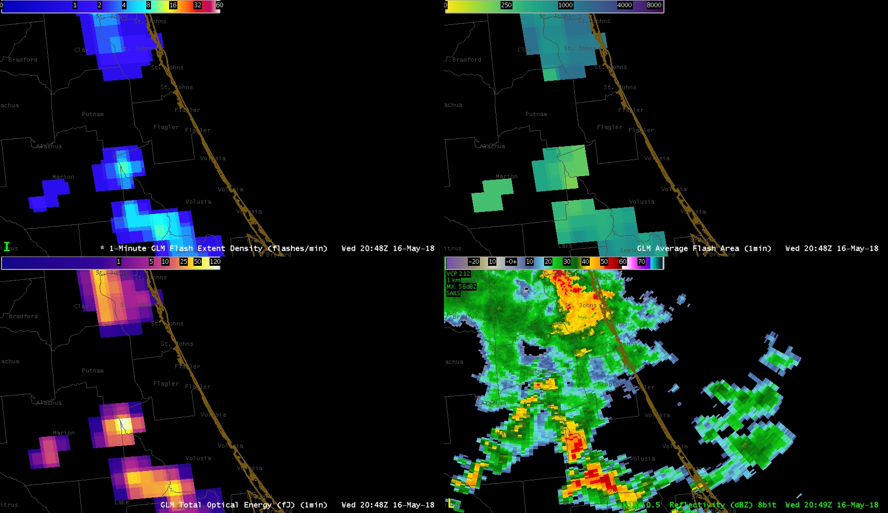
Flash Extent Density
Average Flash Area
Total Optical Energy
Radar Reflectivity

Slide 6
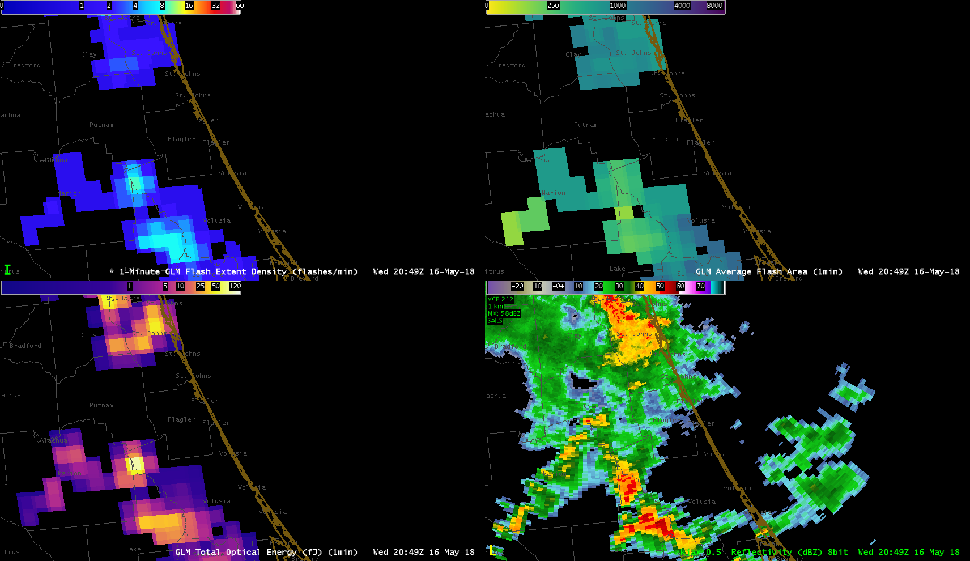
Flash Extent Density
Average Flash Area
Total Optical Energy
Radar Reflectivity

Slide 7
Flash Extent Density
Average Flash Area
Total Optical Energy
Radar Reflectivity

Slide 8
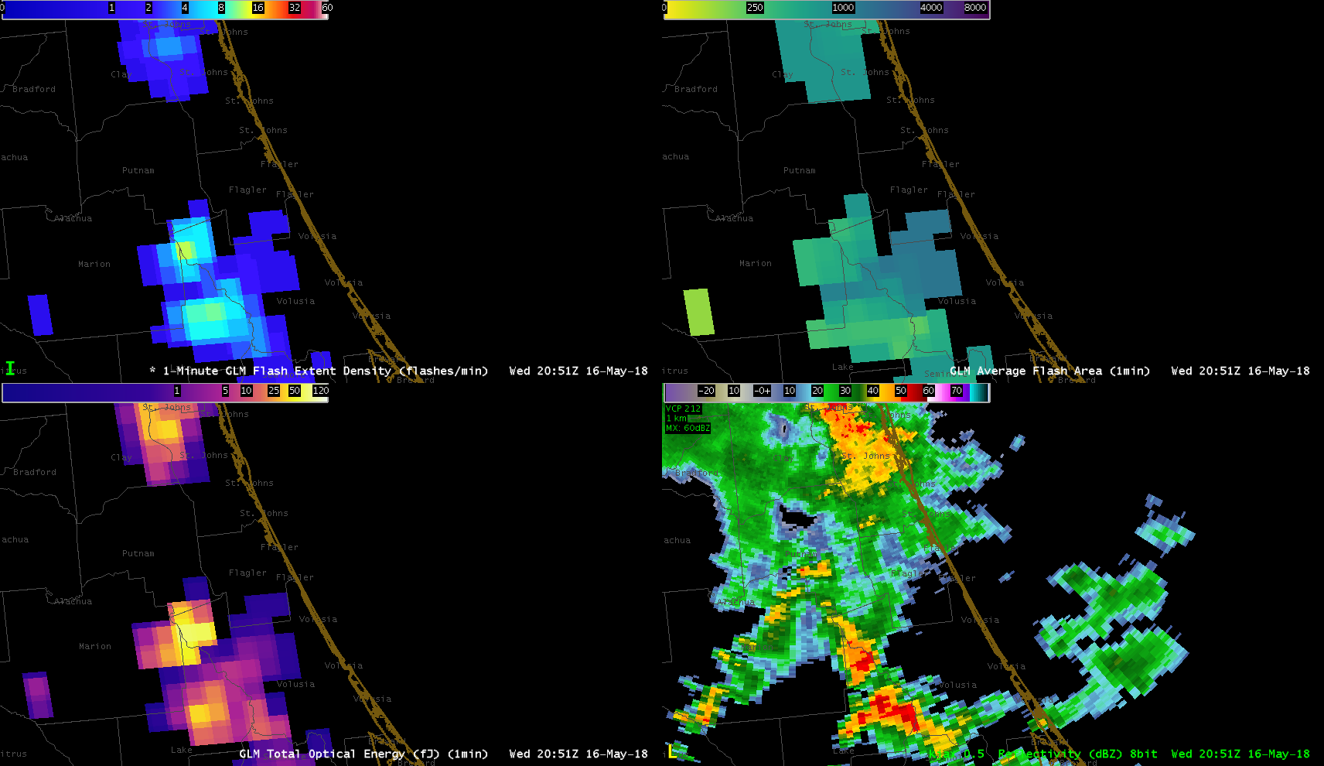
Flash Extent Density
Average Flash Area
Total Optical Energy
Radar Reflectivity

Slide 9
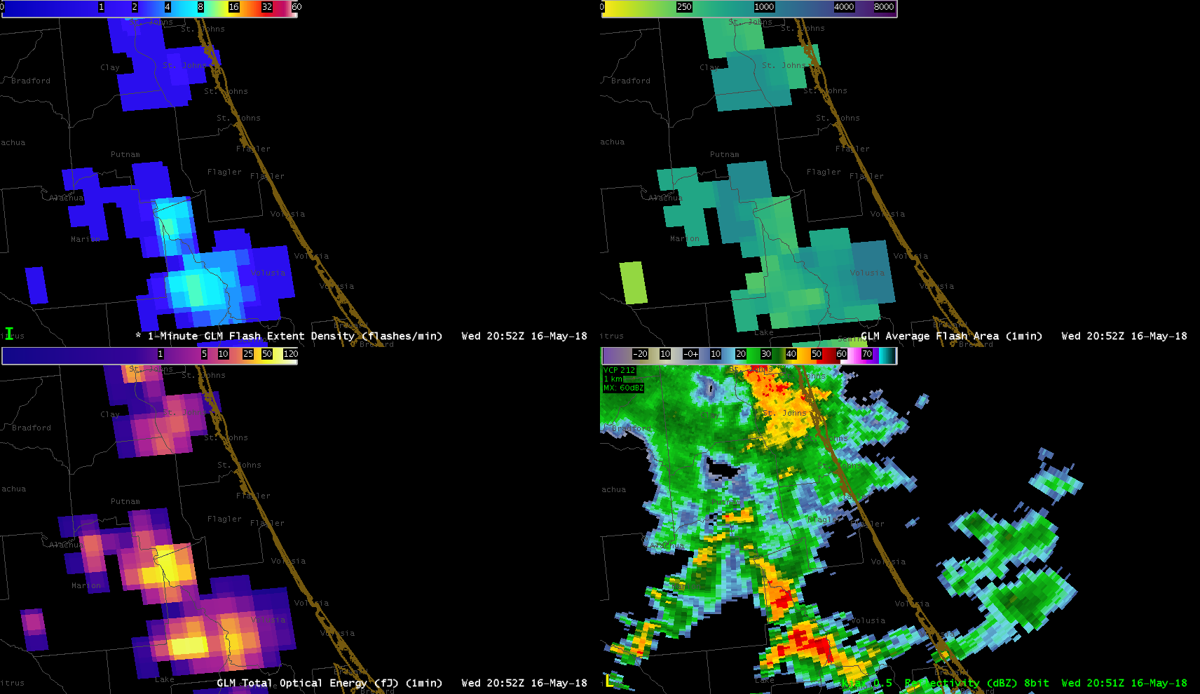
Flash Extent Density
Average Flash Area
Total Optical Energy
Radar Reflectivity

Slide 10
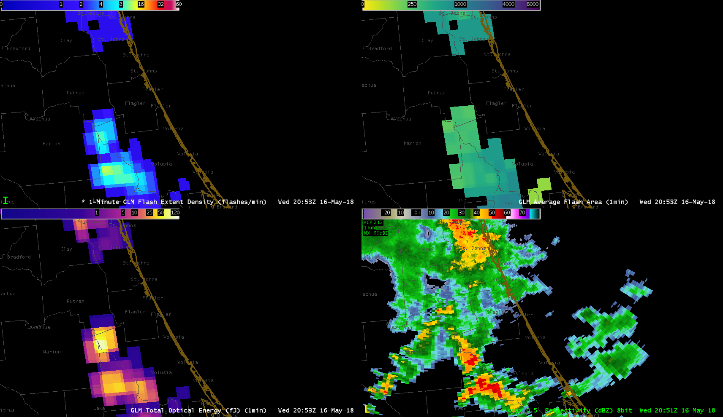
Flash Extent Density
Average Flash Area
Total Optical Energy
Radar Reflectivity

Slide 11
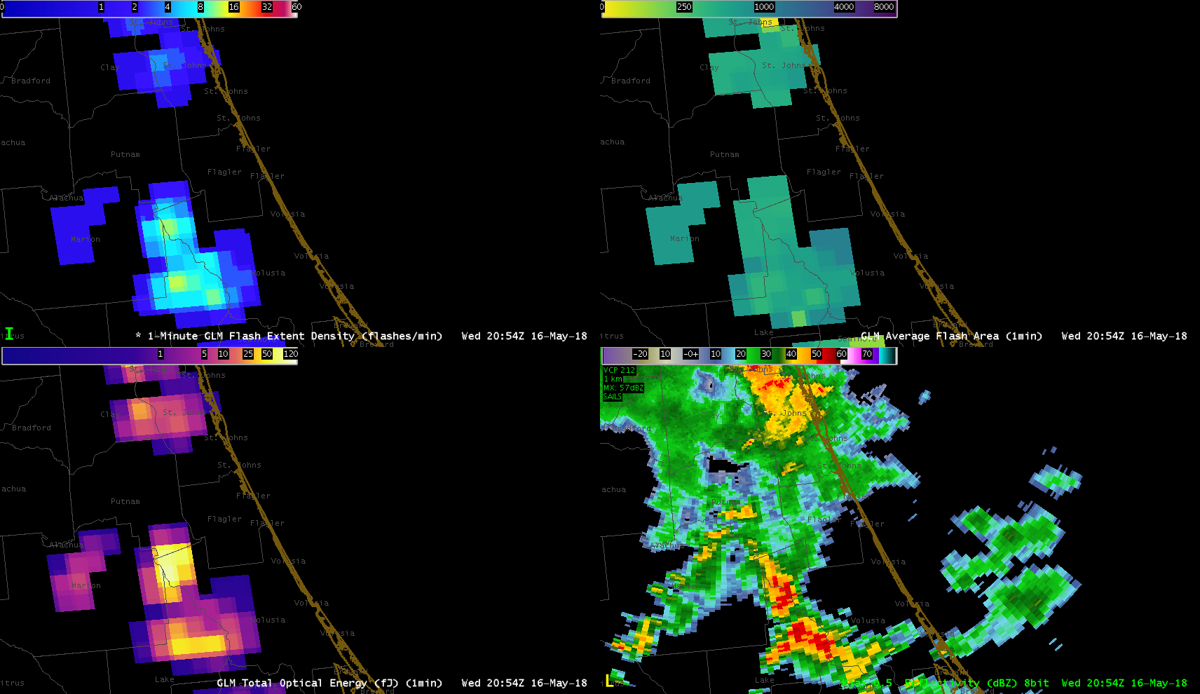
Flash Extent Density
Average Flash Area
Total Optical Energy
Radar Reflectivity

Slide 12
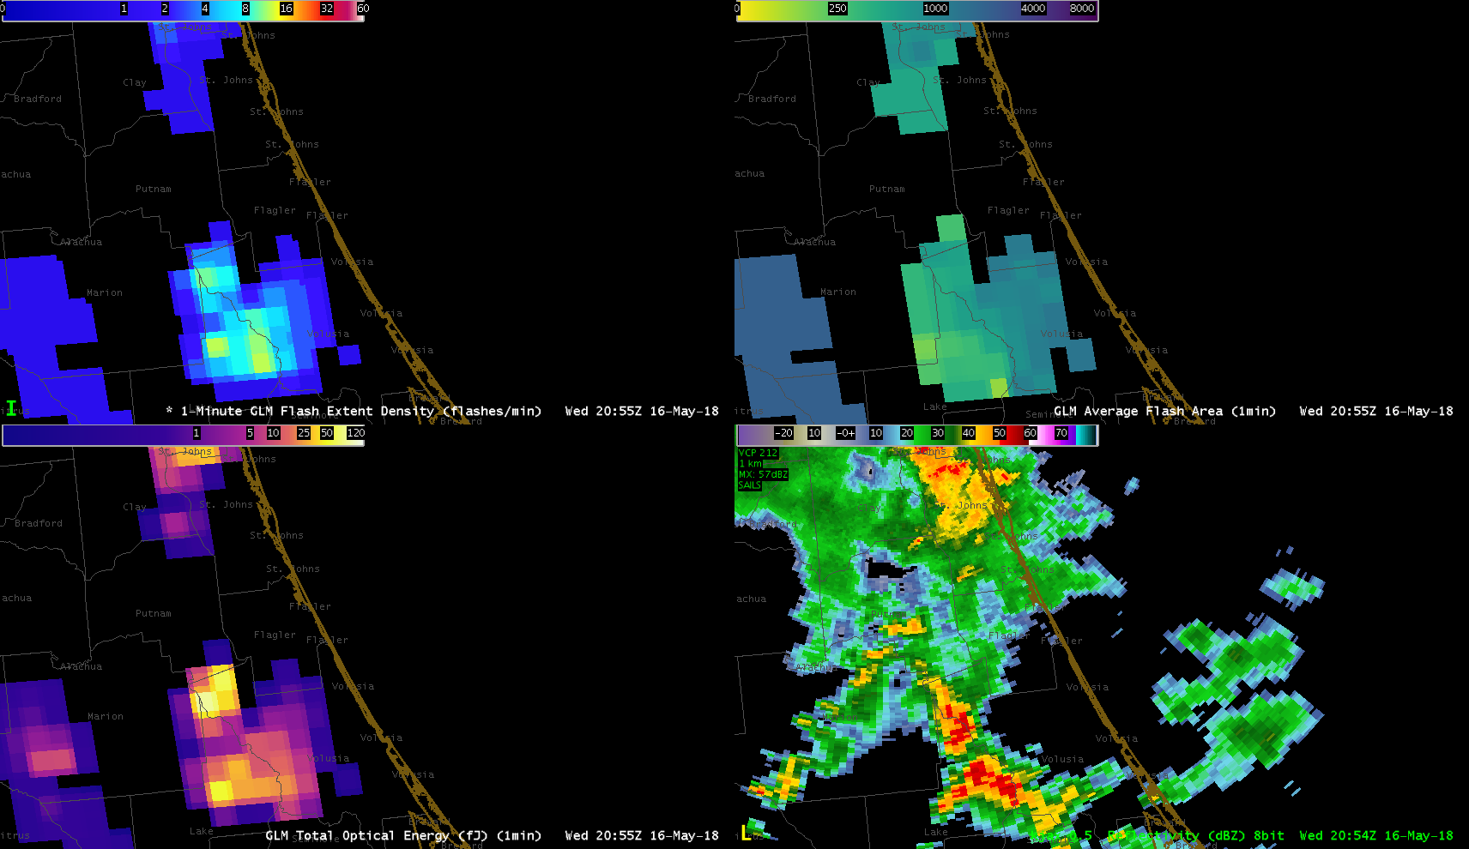
Flash Extent Density
Average Flash Area
Total Optical Energy
Radar Reflectivity

Slide 13
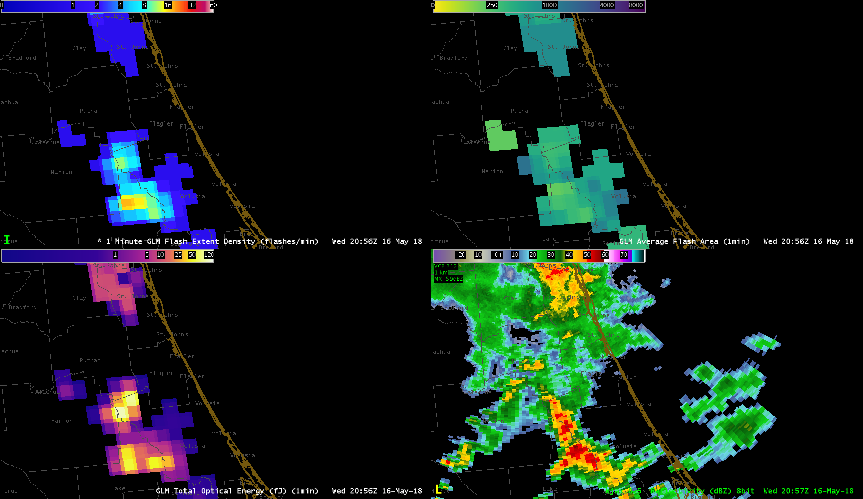
Flash Extent Density
Average Flash Area
Total Optical Energy
Radar Reflectivity

Slide 14
Flash Extent Density
Average Flash Area
Total Optical Energy
Radar Reflectivity

Slide 15
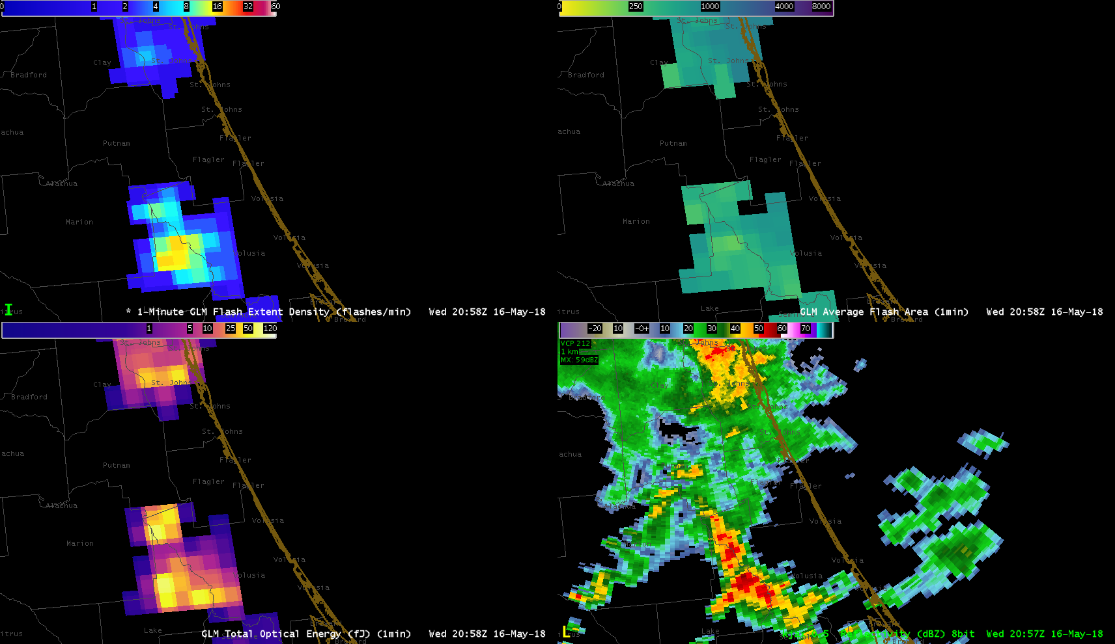
Flash Extent Density
Average Flash Area
Total Optical Energy
Radar Reflectivity

Slide 16
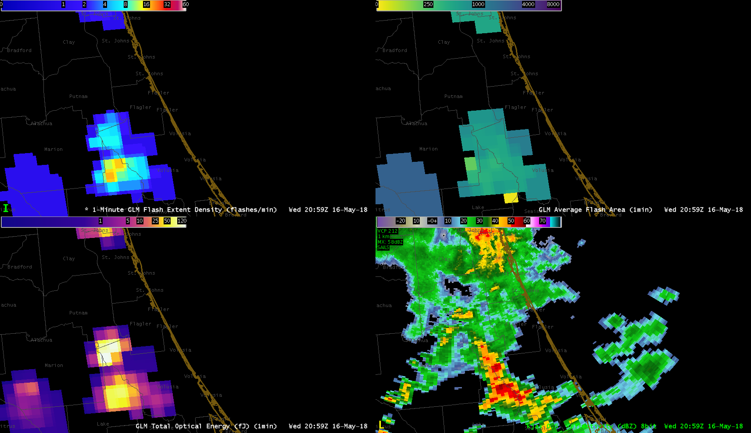
Flash Extent Density
Average Flash Area
Total Optical Energy
Radar Reflectivity

Slide 17
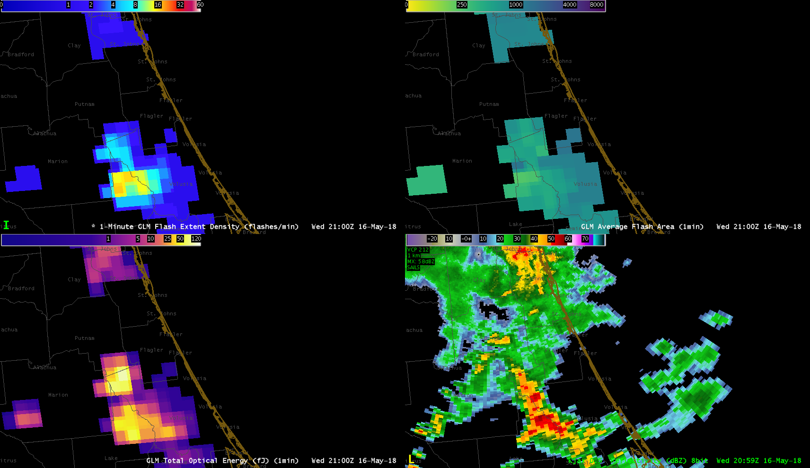
Flash Extent Density
Average Flash Area
Total Optical Energy
Radar Reflectivity

Slide 18
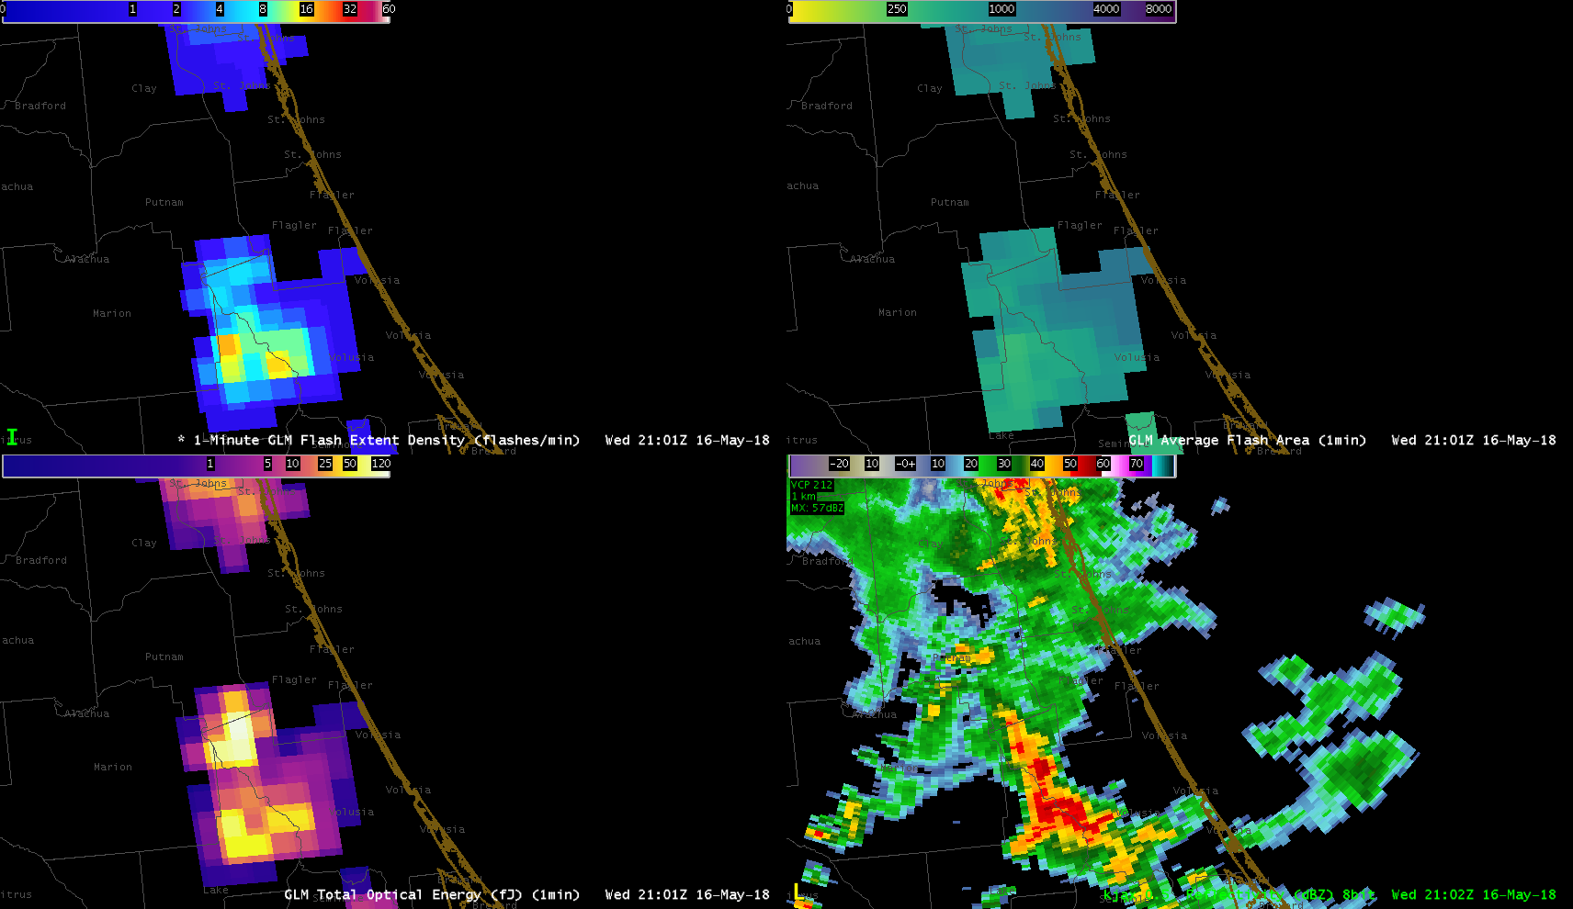
Flash Extent Density
Average Flash Area
Total Optical Energy
Radar Reflectivity

Slide 19
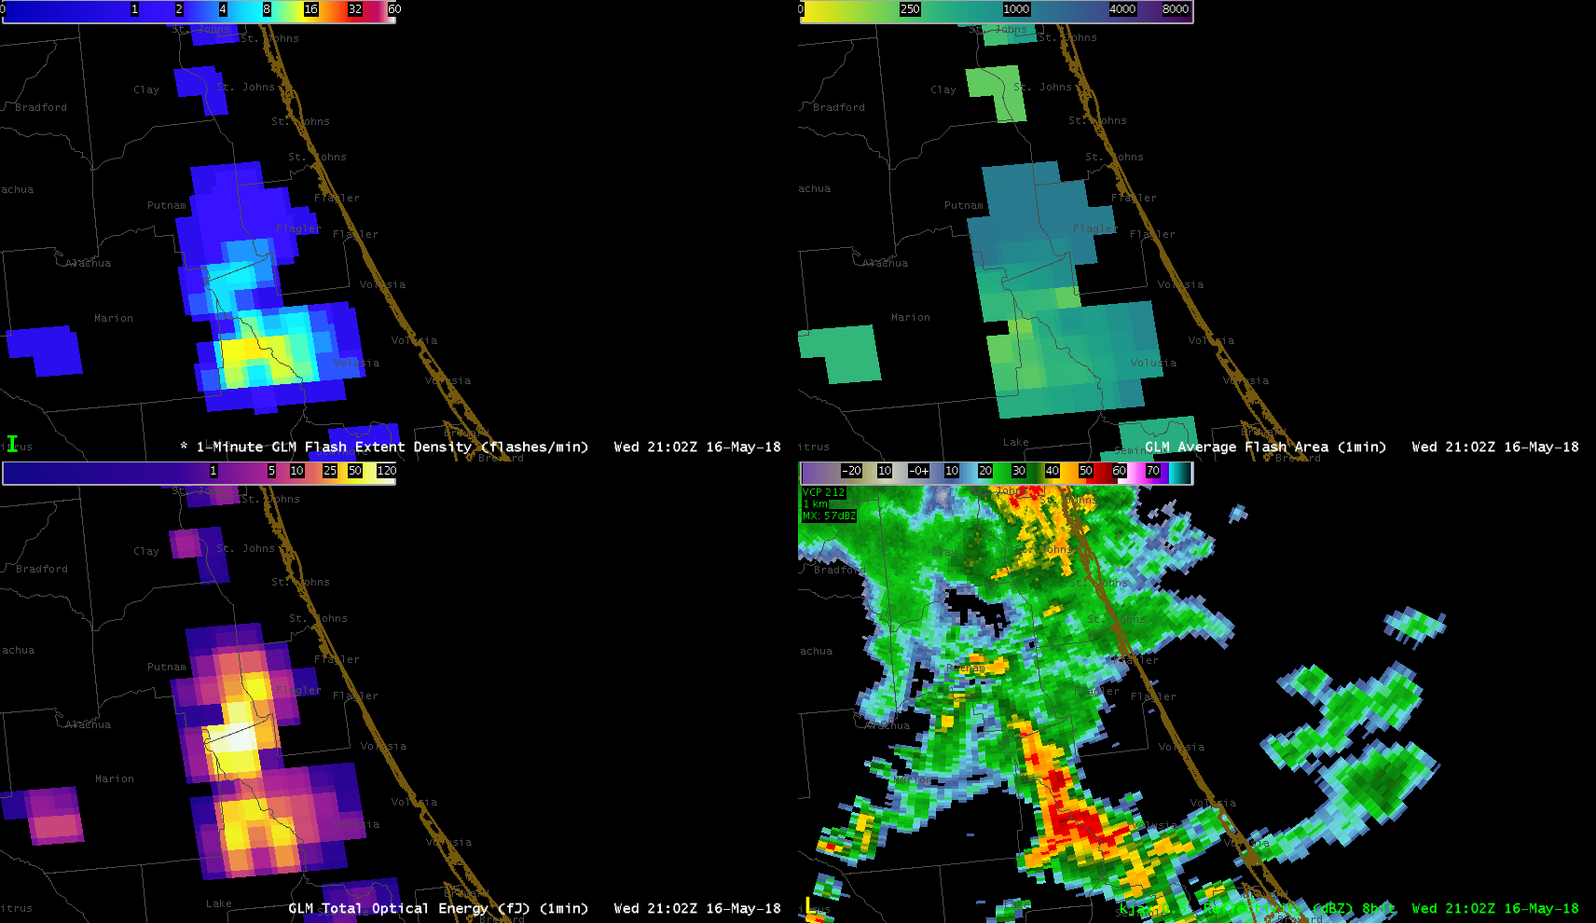
Flash Extent Density
Average Flash Area
Total Optical Energy
Radar Reflectivity

Slide 20
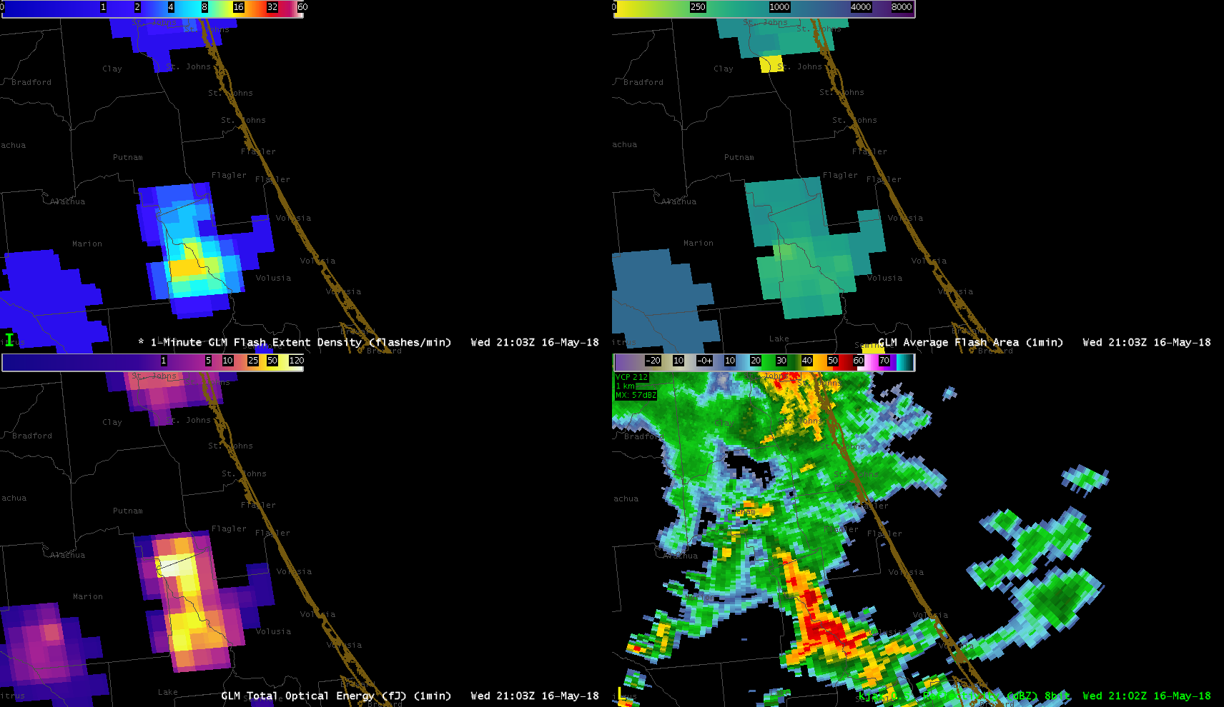
Flash Extent Density
Average Flash Area
Total Optical Energy
Radar Reflectivity

Slide 21
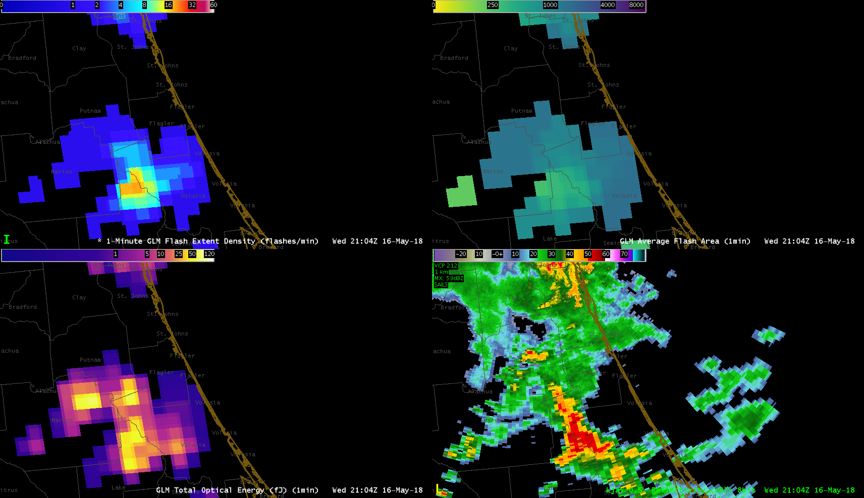
Flash Extent Density
Average Flash Area
Total Optical Energy
Radar Reflectivity

Slide 22
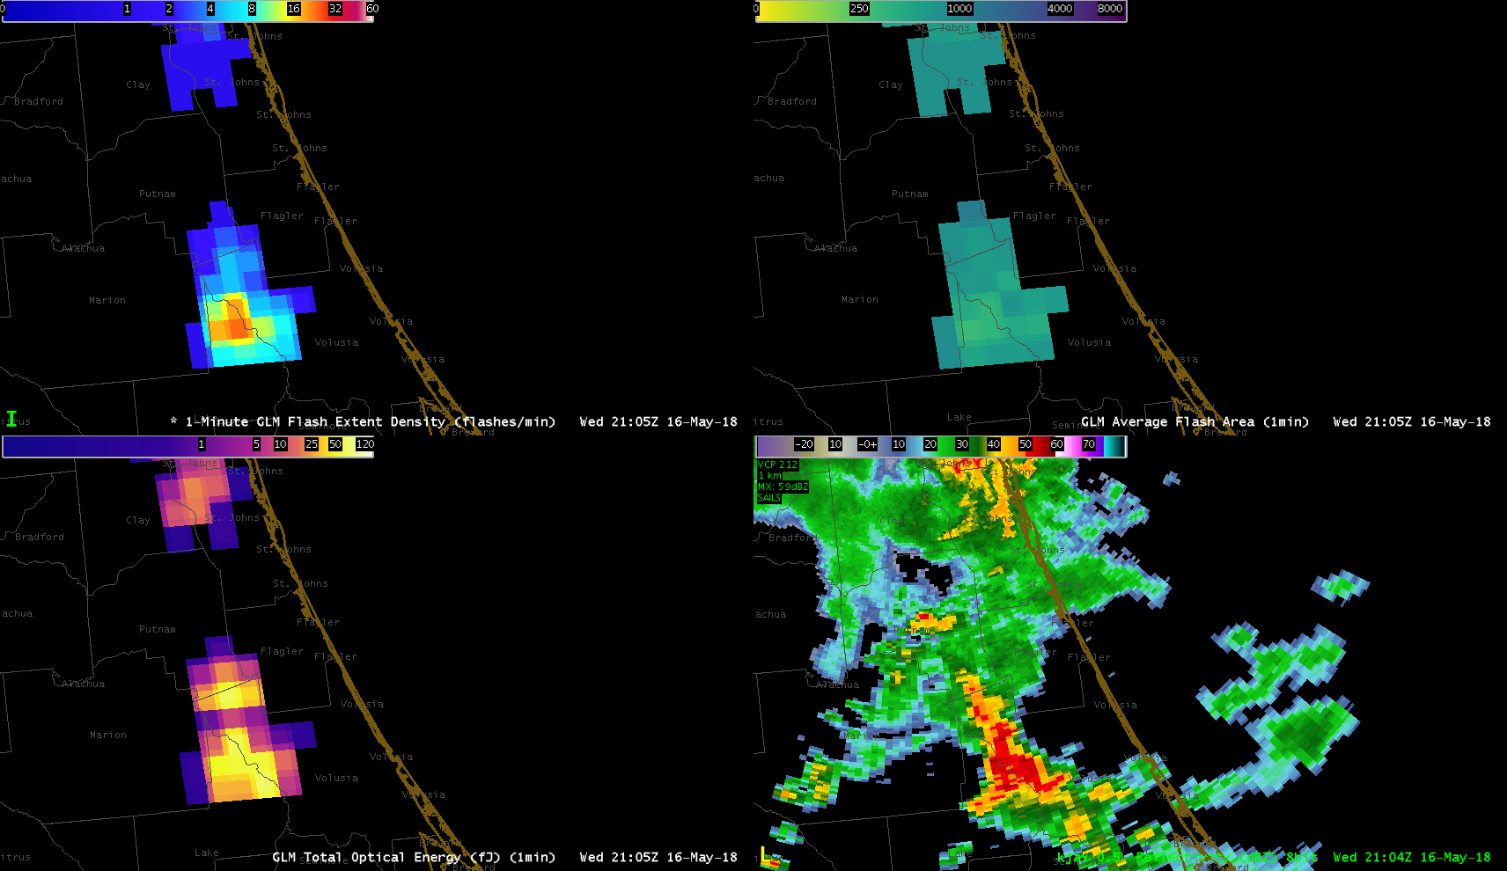
Flash Extent Density
Average Flash Area
Total Optical Energy
Radar Reflectivity

Slide 23
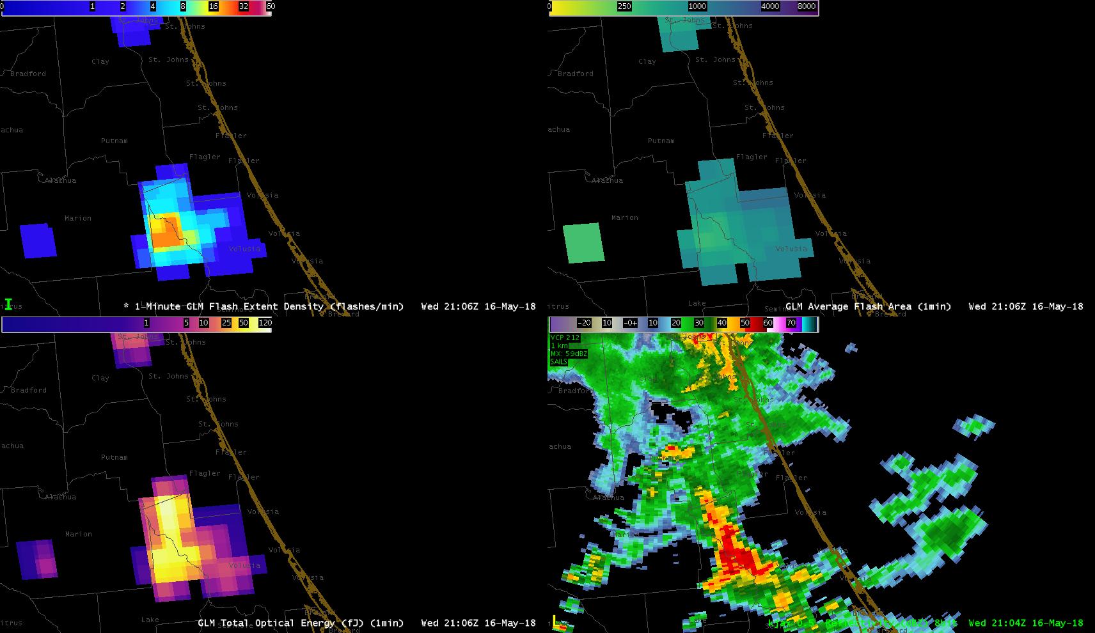
Flash Extent Density
Average Flash Area
Total Optical Energy
Radar Reflectivity

Slide 24
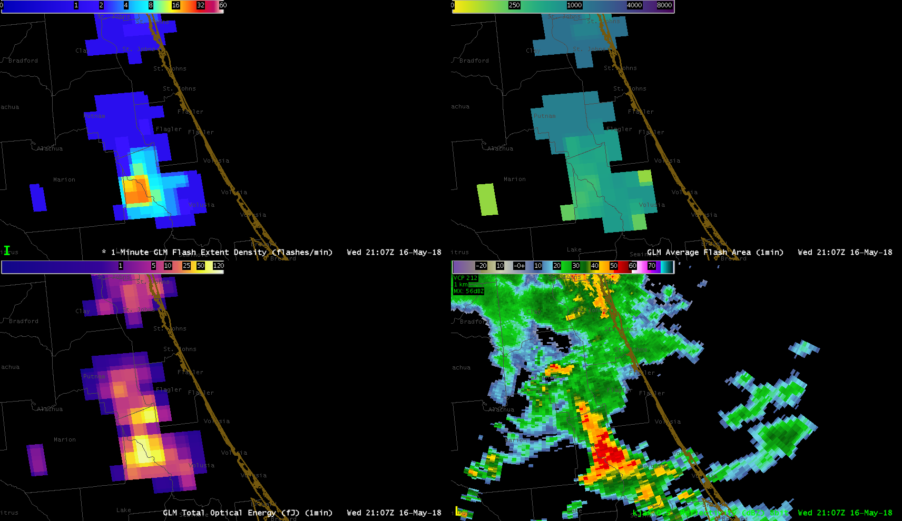
Flash Extent Density
Average Flash Area
Total Optical Energy
Radar Reflectivity

Slide 25
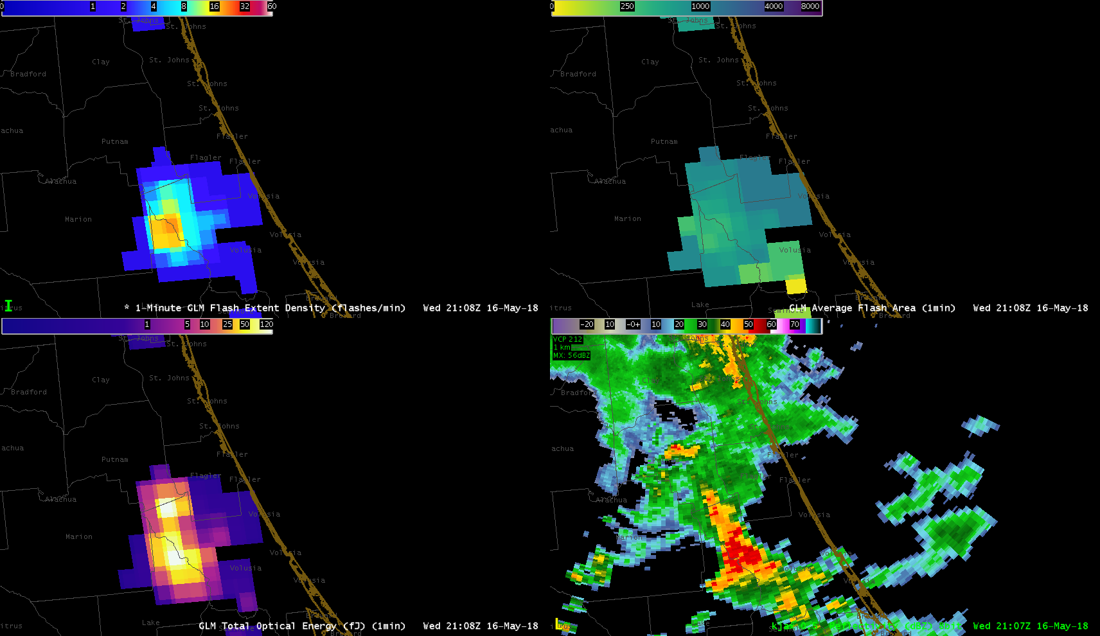
Flash Extent Density
Average Flash Area
Total Optical Energy
Radar Reflectivity

Slide 26
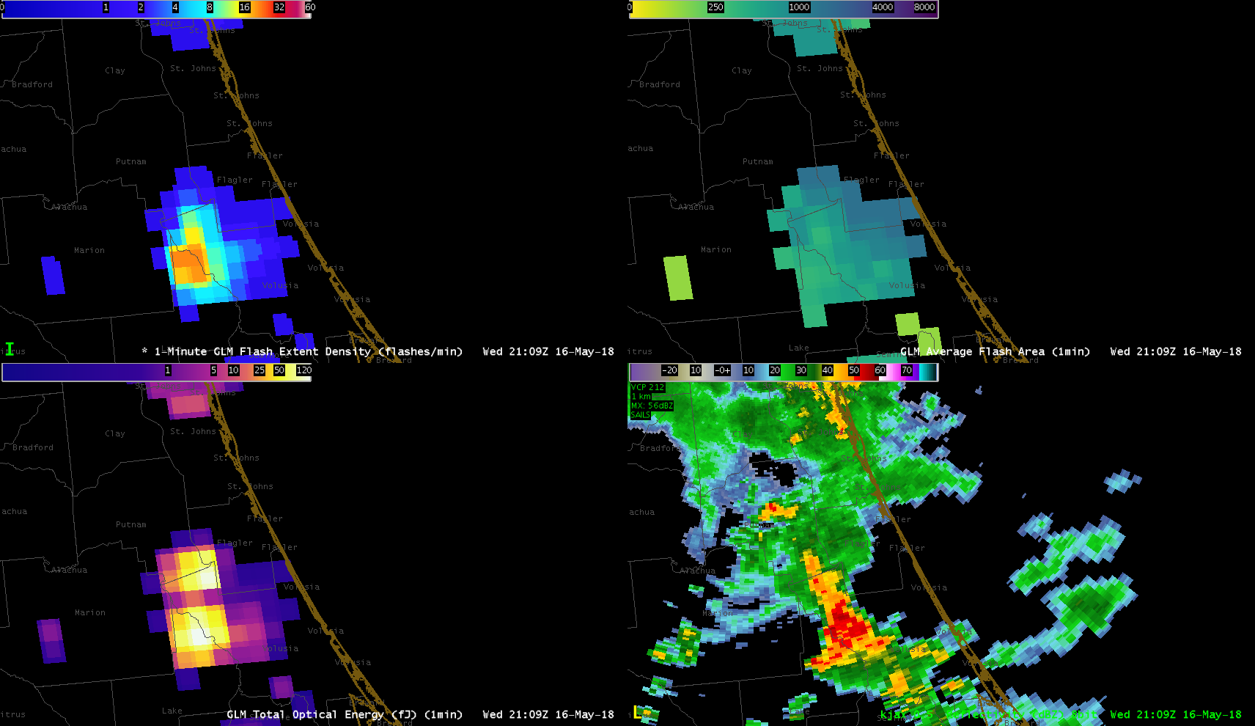
Flash Extent Density
Average Flash Area
Total Optical Energy
Radar Reflectivity

Slide 27
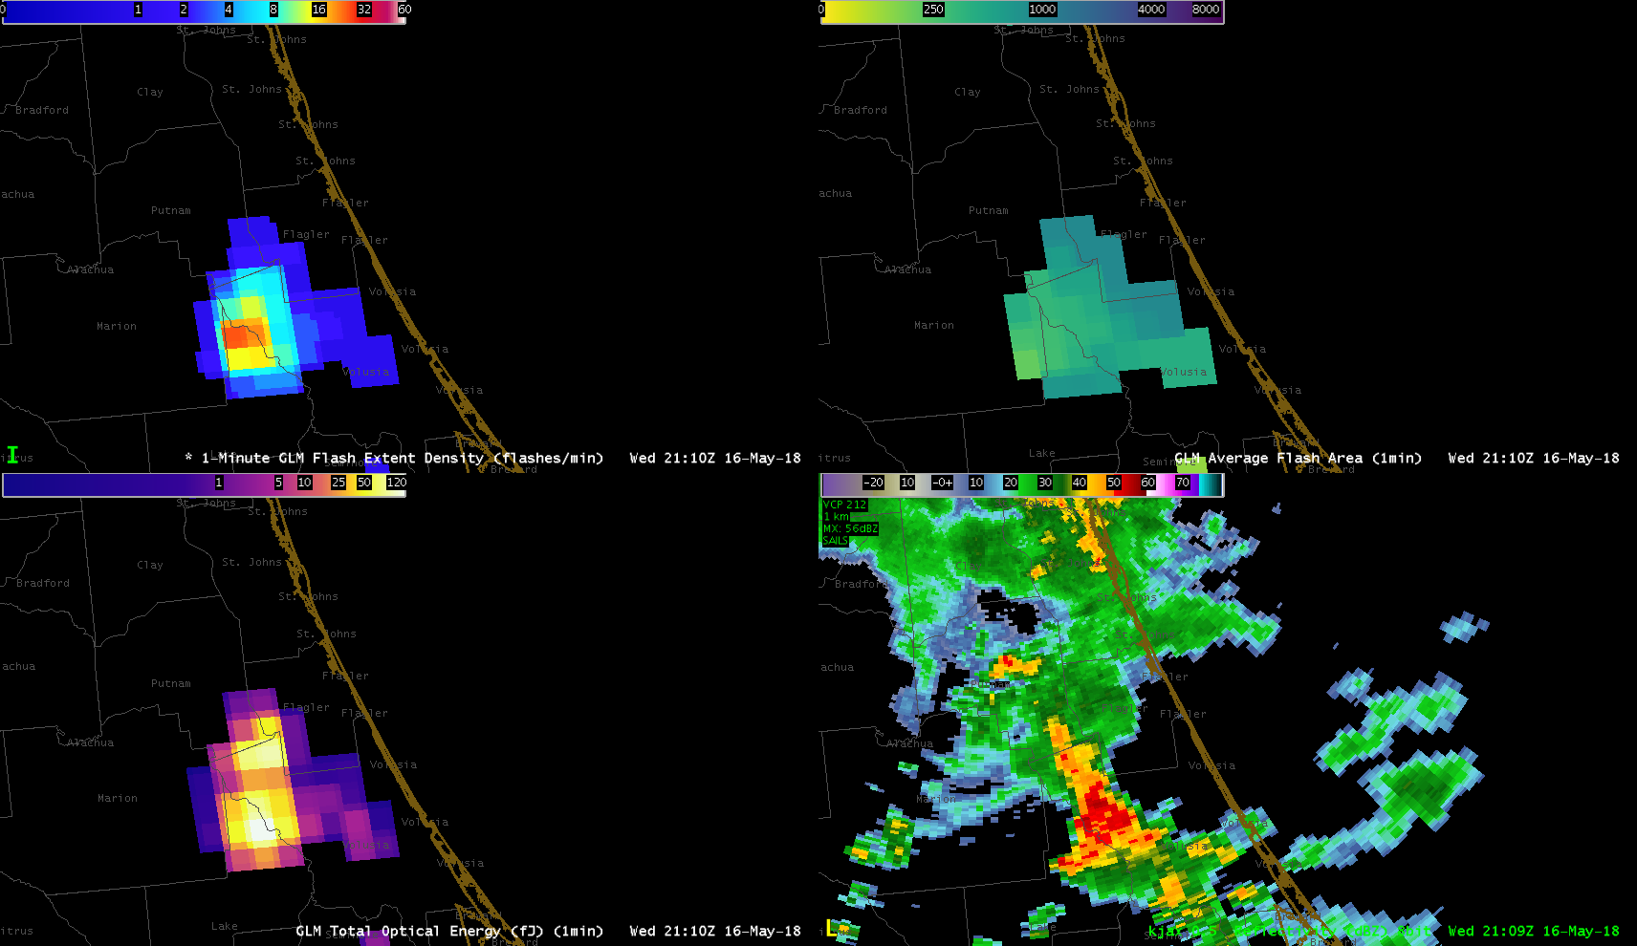
Flash Extent Density
Average Flash Area
Total Optical Energy
Radar Reflectivity

Slide 28
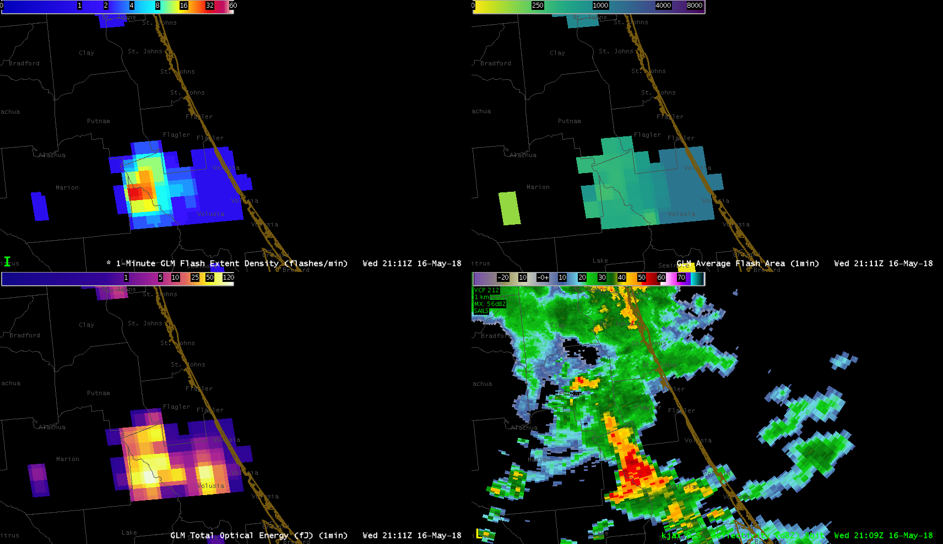
Flash Extent Density
Average Flash Area
Total Optical Energy
Radar Reflectivity

Slide 29
Flash Extent Density
Average Flash Area
Total Optical Energy
Radar Reflectivity

Slide 30
Flash Extent Density
Average Flash Area
Total Optical Energy
Radar Reflectivity

Slide 31
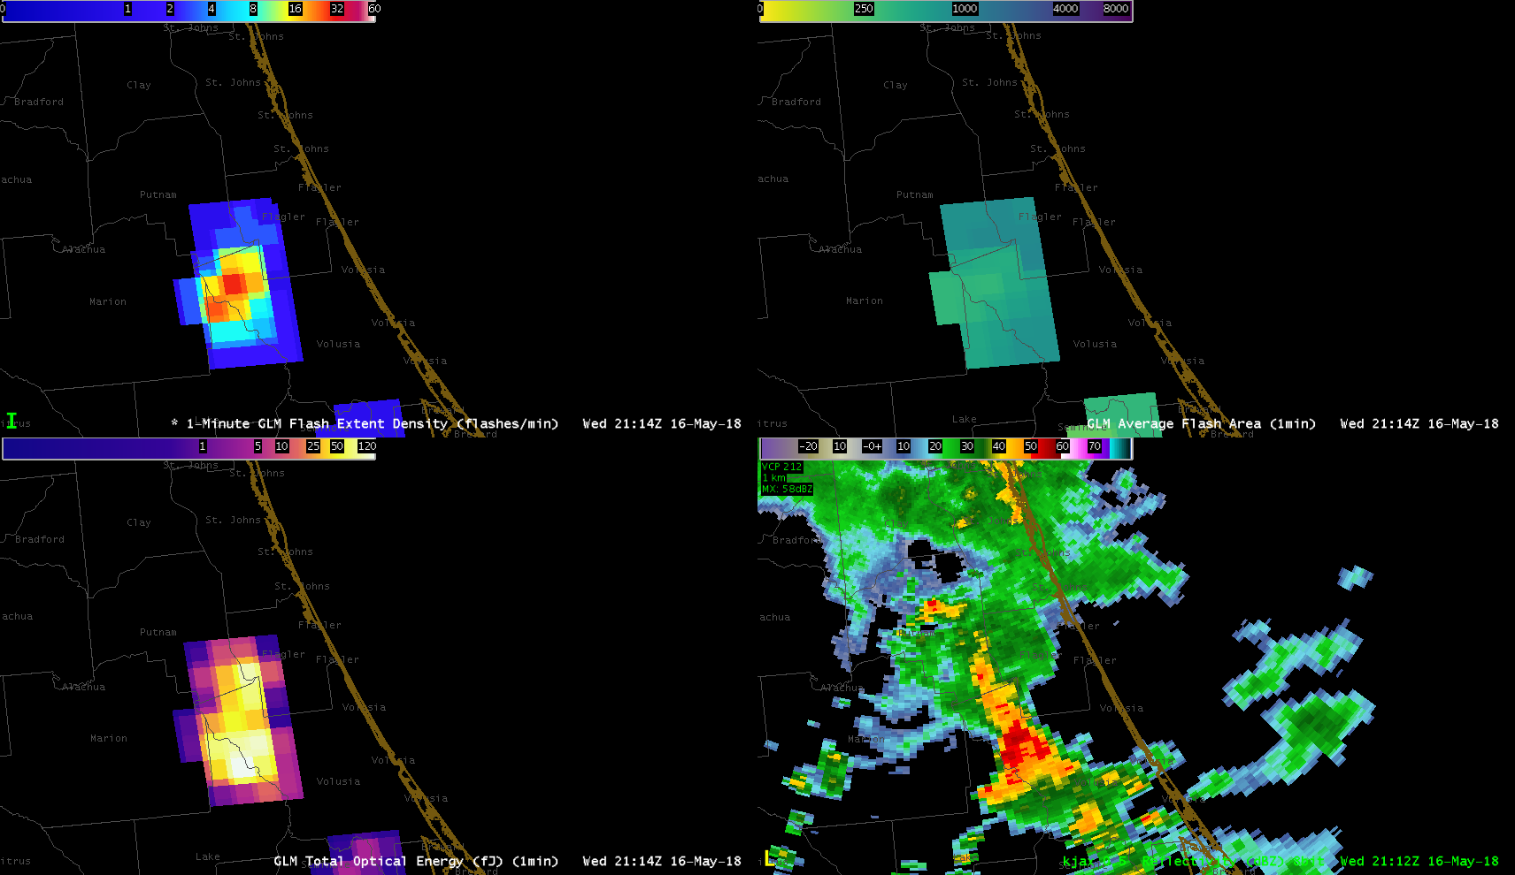
Flash Extent Density
Average Flash Area
Total Optical Energy
Radar Reflectivity

Slide 32
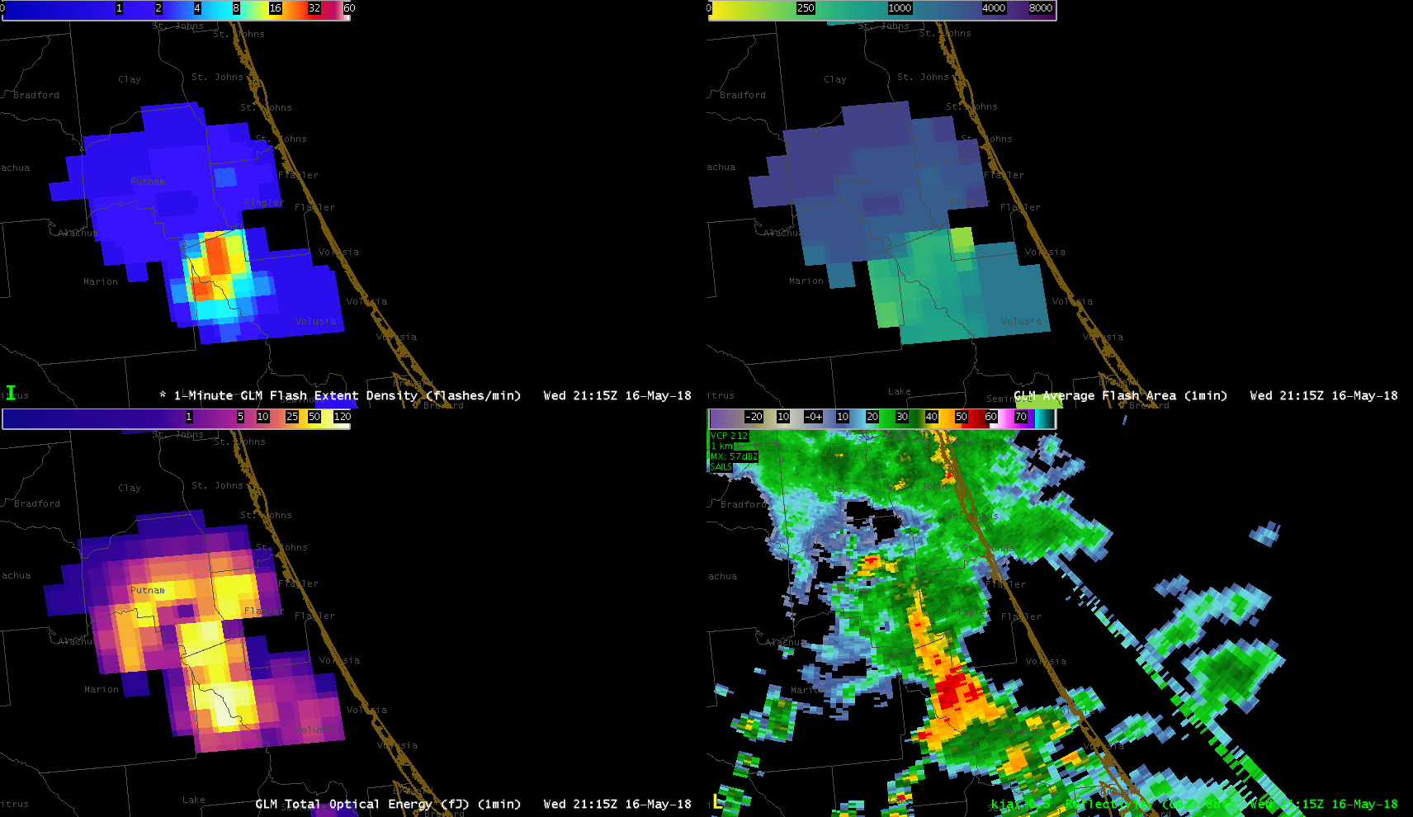
Flash Extent Density
Average Flash Area
Total Optical Energy
Radar Reflectivity

Slide 33
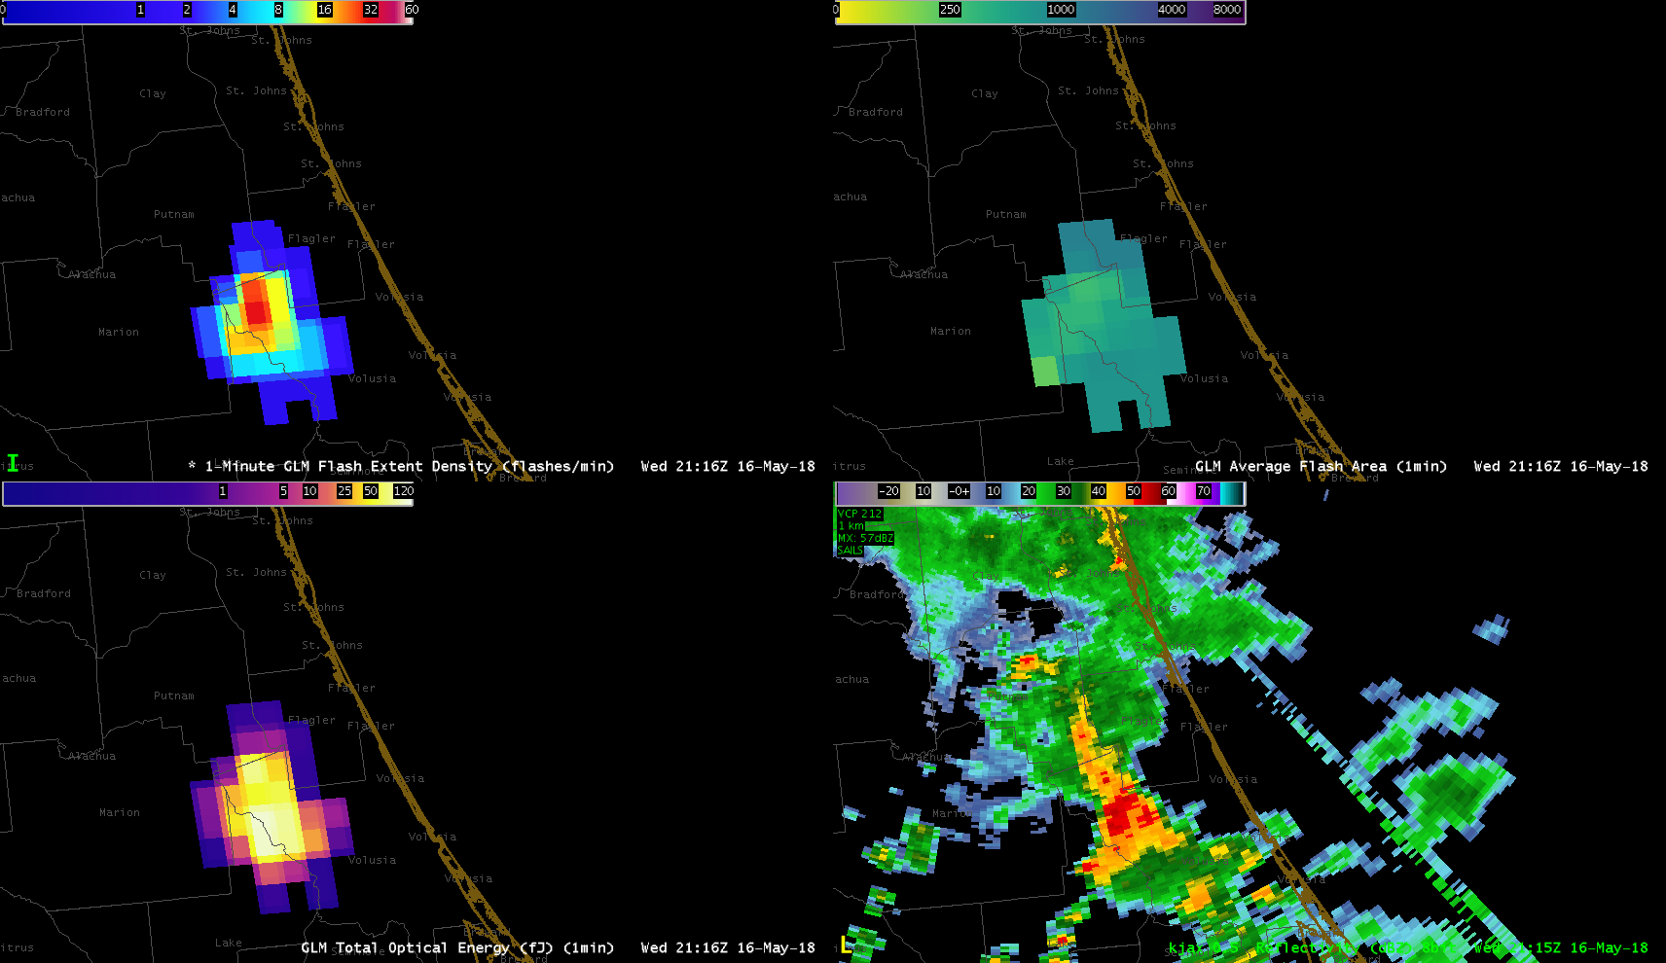
Flash Extent Density
Average Flash Area
Total Optical Energy
Radar Reflectivity

Slide 34
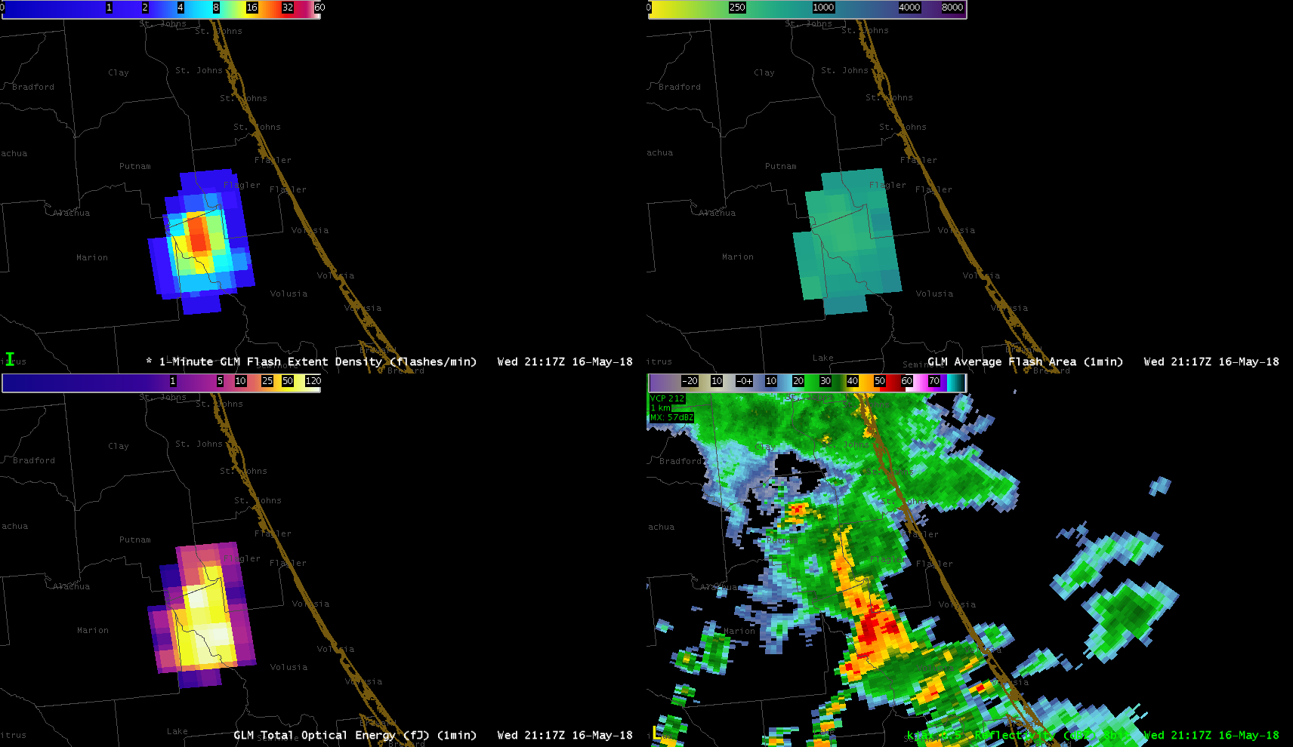
Flash Extent Density
Average Flash Area
Total Optical Energy
Radar Reflectivity

Slide 35
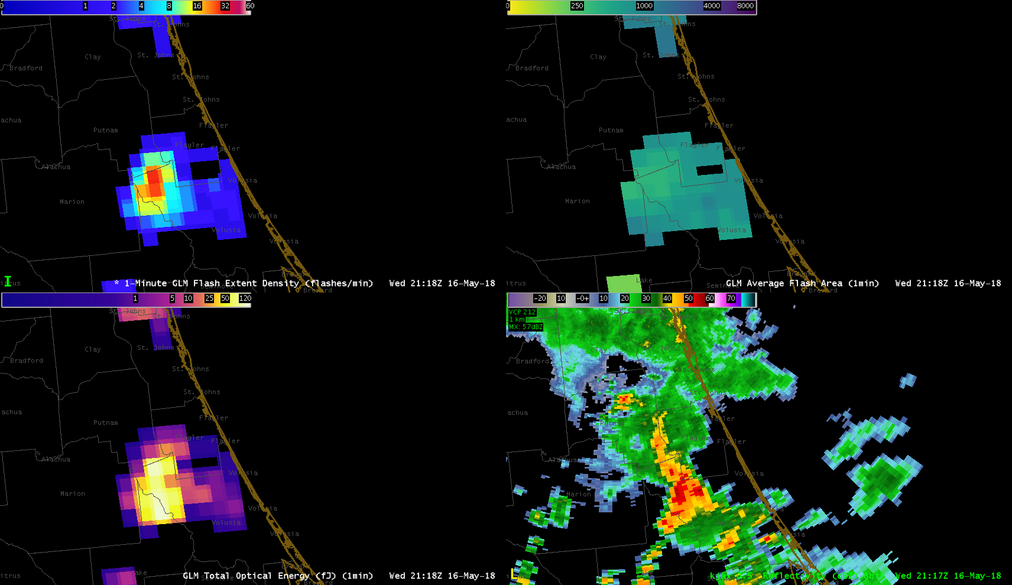
Flash Extent Density
Average Flash Area
Total Optical Energy
Radar Reflectivity

Slide 36
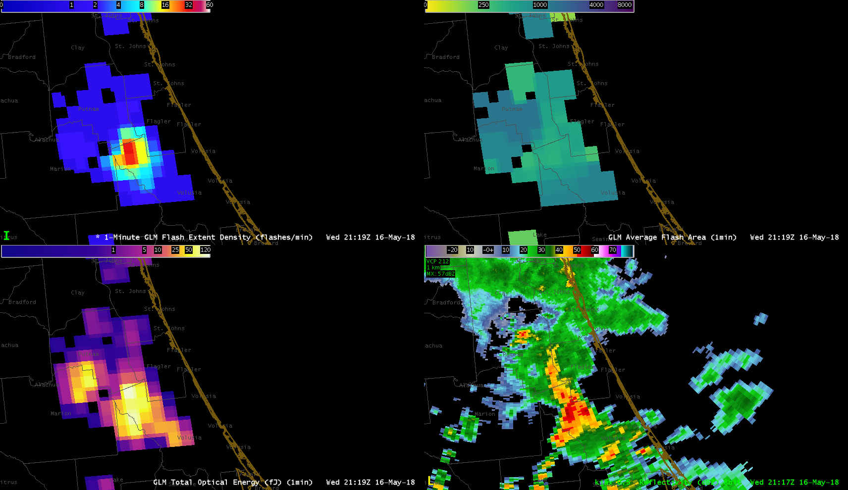
Flash Extent Density
Average Flash Area
Total Optical Energy
Radar Reflectivity

Slide 37
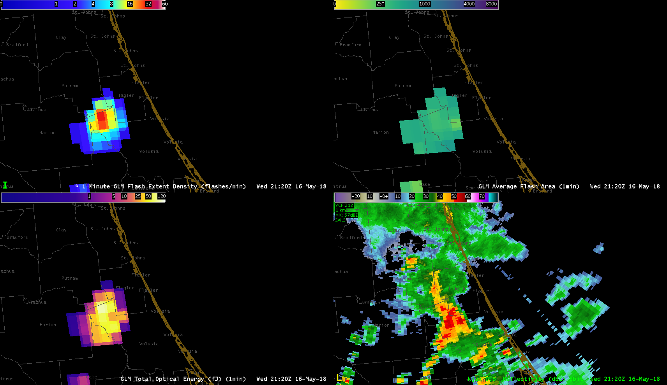
Flash Extent Density
Average Flash Area
Total Optical Energy
Radar Reflectivity

Slide 38
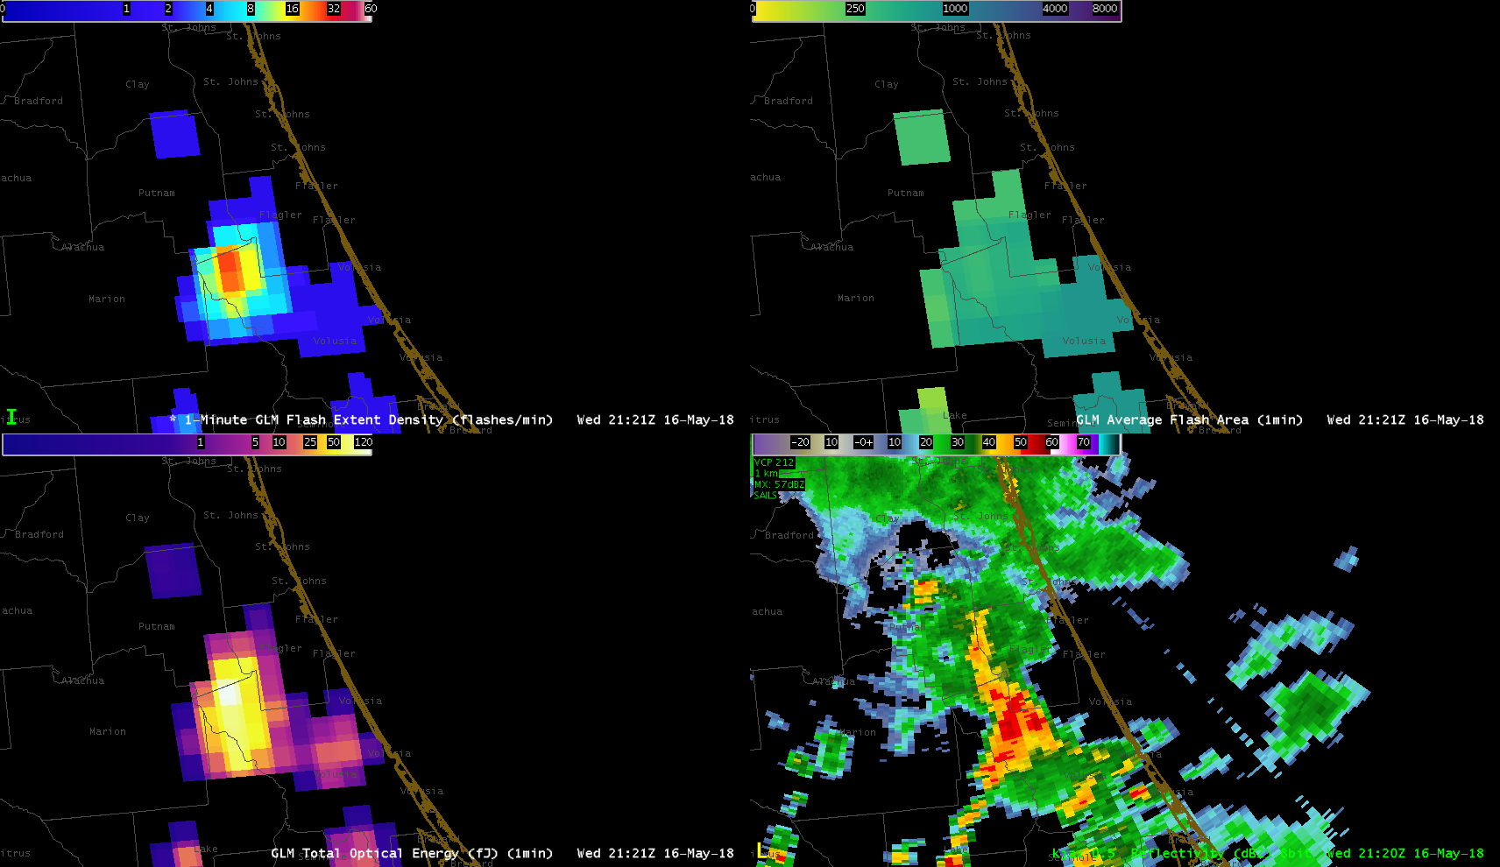
Flash Extent Density
Average Flash Area
Total Optical Energy
Radar Reflectivity

Slide 39
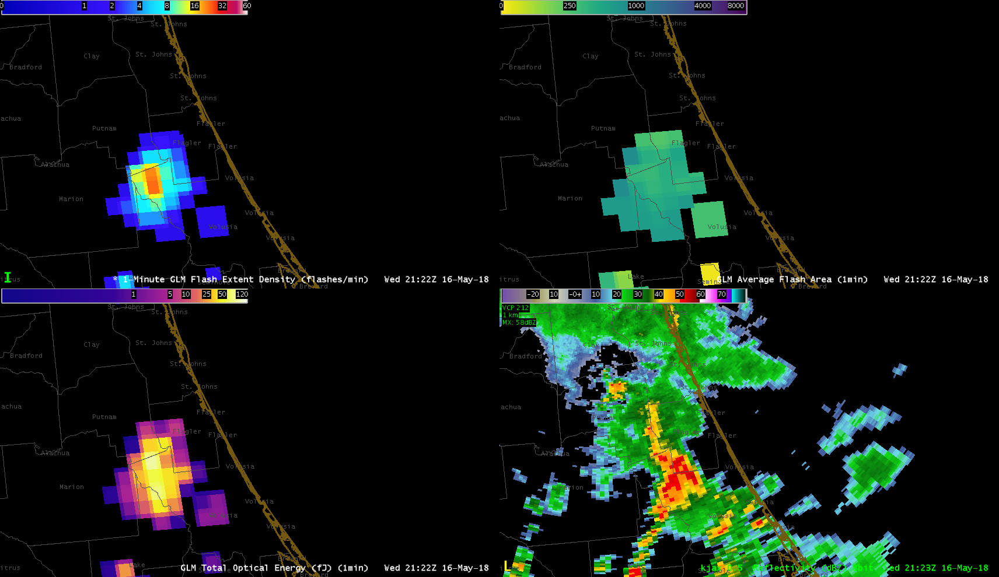
Flash Extent Density
Average Flash Area
Total Optical Energy
Radar Reflectivity

Slide 40
Flash Extent Density
Average Flash Area
Total Optical Energy
Radar Reflectivity

Slide 41
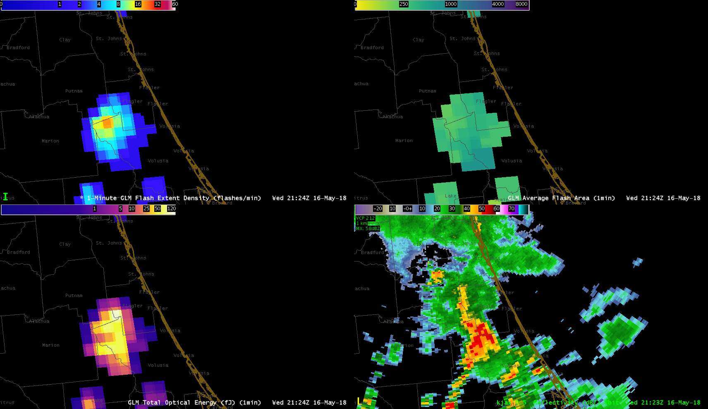
Flash Extent Density
Average Flash Area
Total Optical Energy
Radar Reflectivity

Slide 42
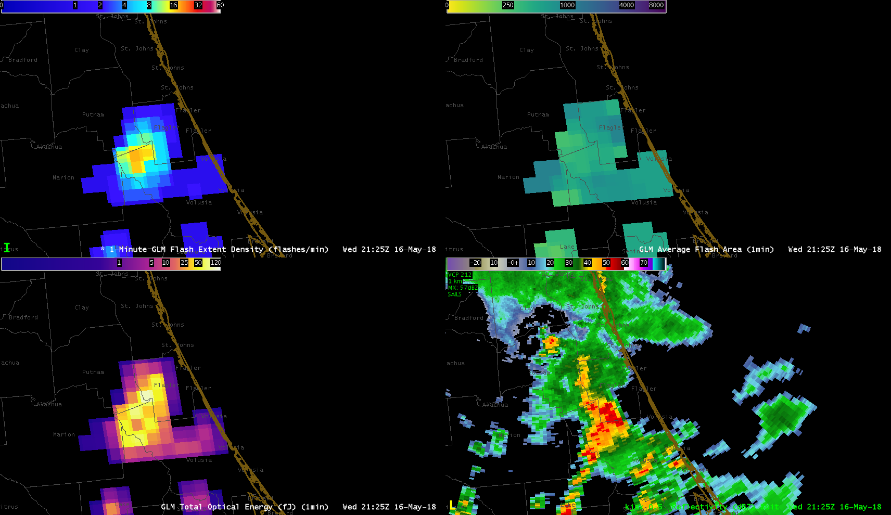
Flash Extent Density
Average Flash Area
Total Optical Energy
Radar Reflectivity

Slide 43
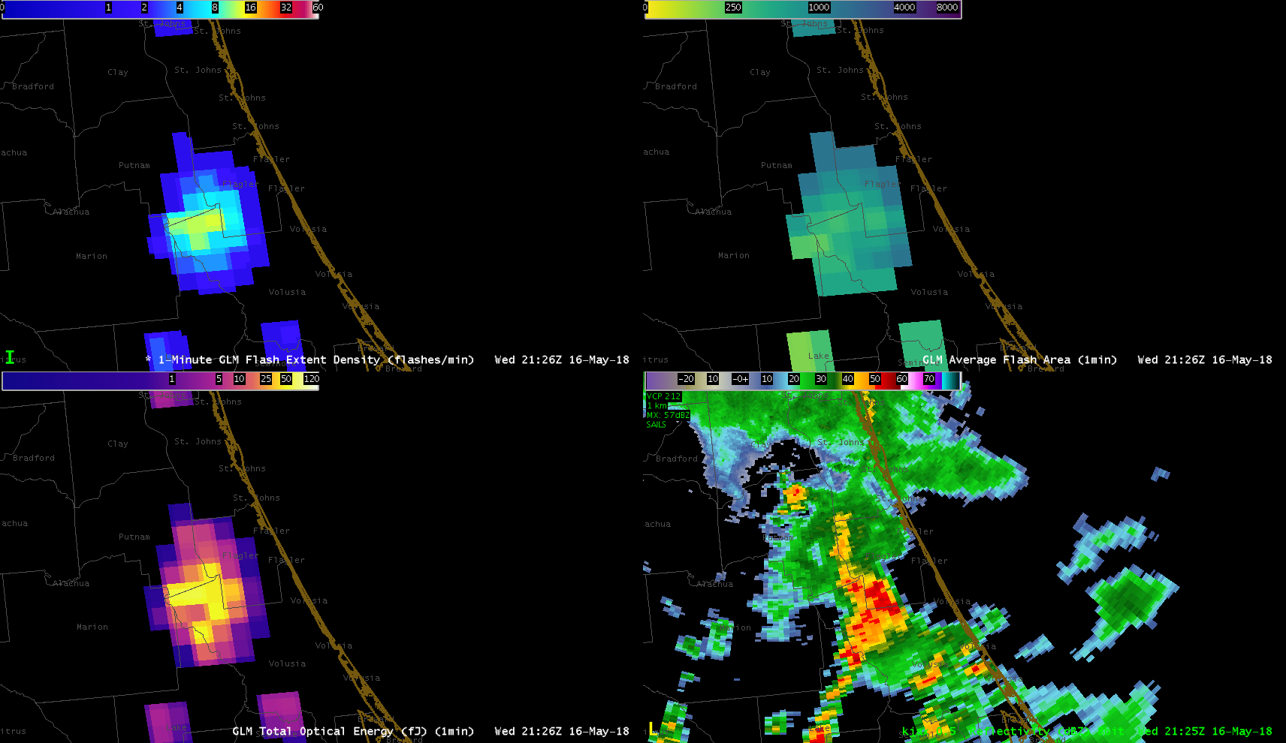
Flash Extent Density
Average Flash Area
Total Optical Energy
Radar Reflectivity

Slide 44
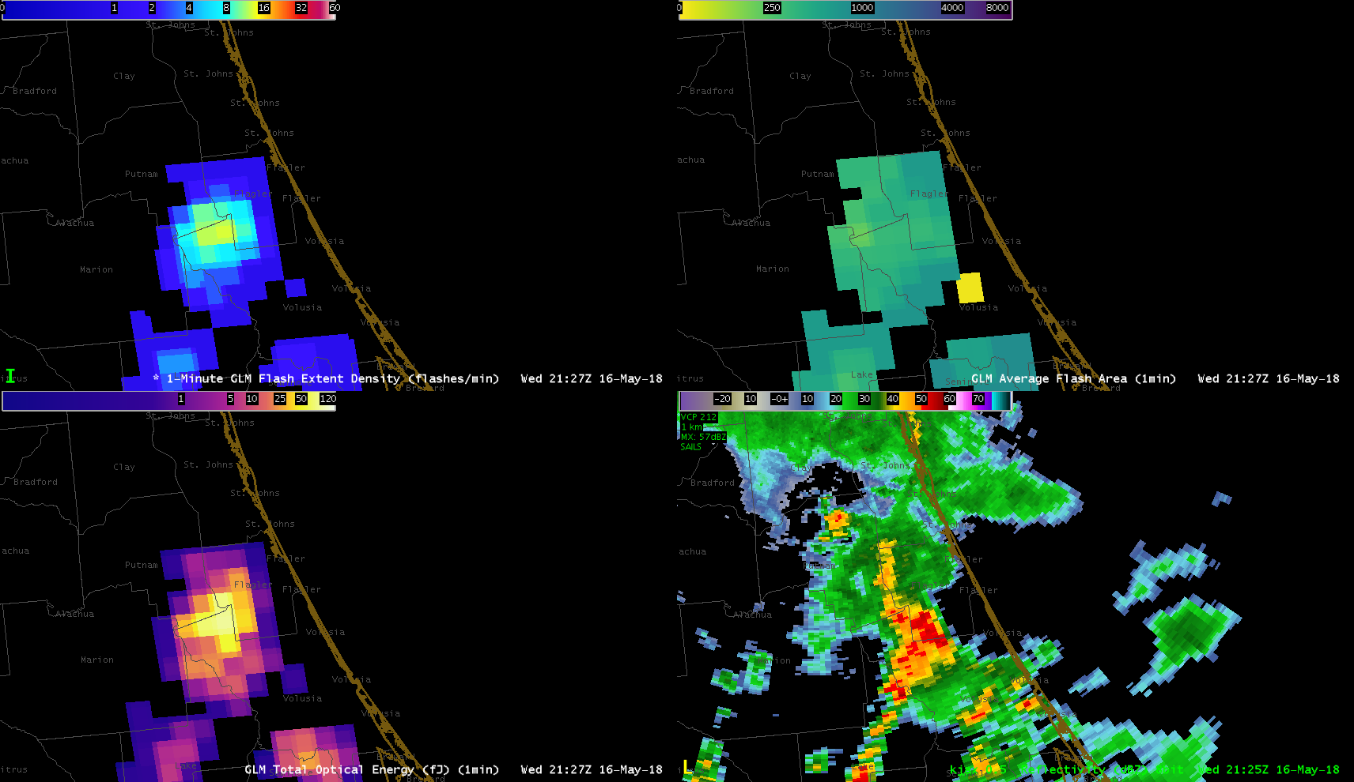
Flash Extent Density
Average Flash Area
Total Optical Energy
Radar Reflectivity

Slide 45
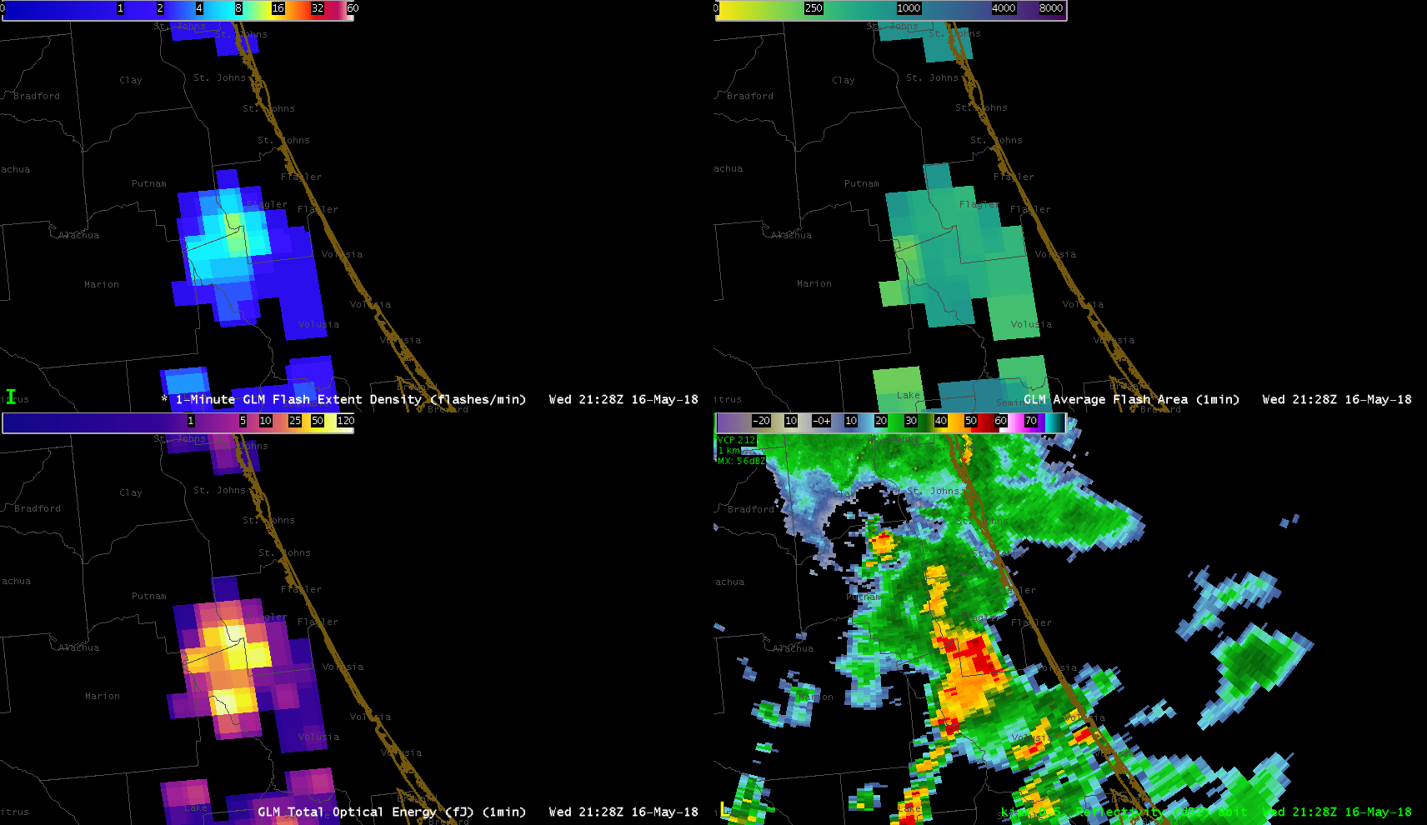
Flash Extent Density
Average Flash Area
Total Optical Energy
Radar Reflectivity

Slide 46
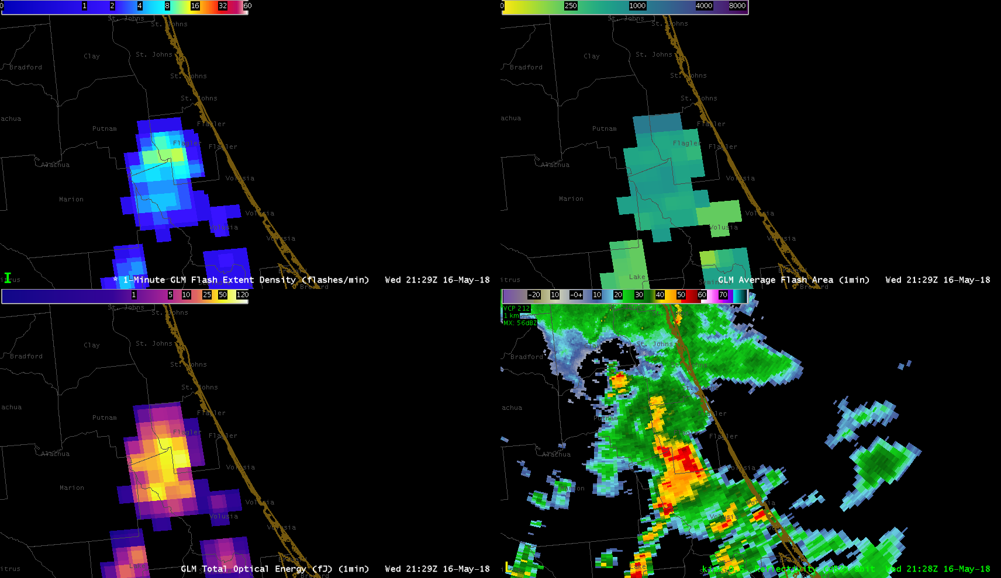
Flash Extent Density
Average Flash Area
Total Optical Energy
Radar Reflectivity

Slide 47
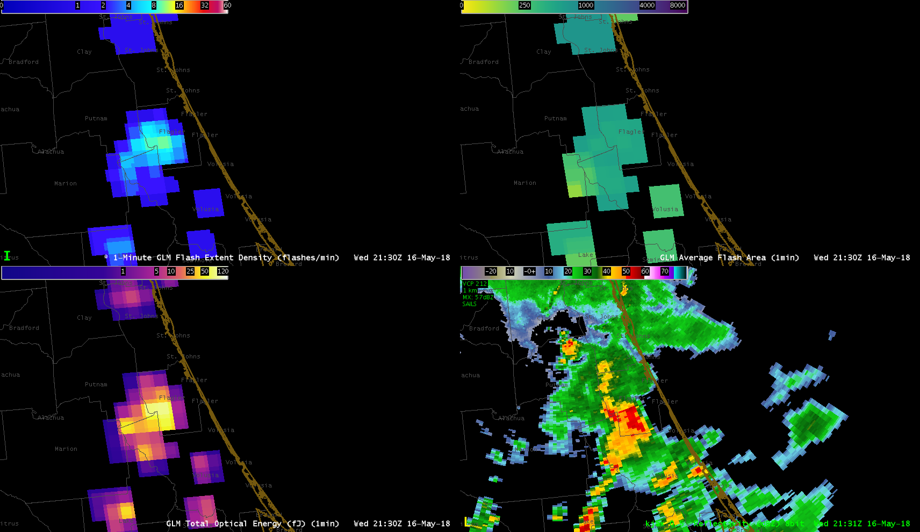
Flash Extent Density
Average Flash Area
Total Optical Energy
Radar Reflectivity

Slide 48
Animation (2045-2130 UTC)

Slide 49
Flash Extent Density
Average Flash Area
Total Optical Energy
Radar Reflectivity

Slide 50
Review
Notes:
2045-2130, with severe weather at 2125

