Slide 1
ABI on The GOES-R Series
Tim Schmit
Madison, WI
American Meteorological Society 99th Annual Meeting
Phoenix, AZ • January 5-10, 2019
Thanks to Mat Gunshor, CIMSS and many others

Slide 2
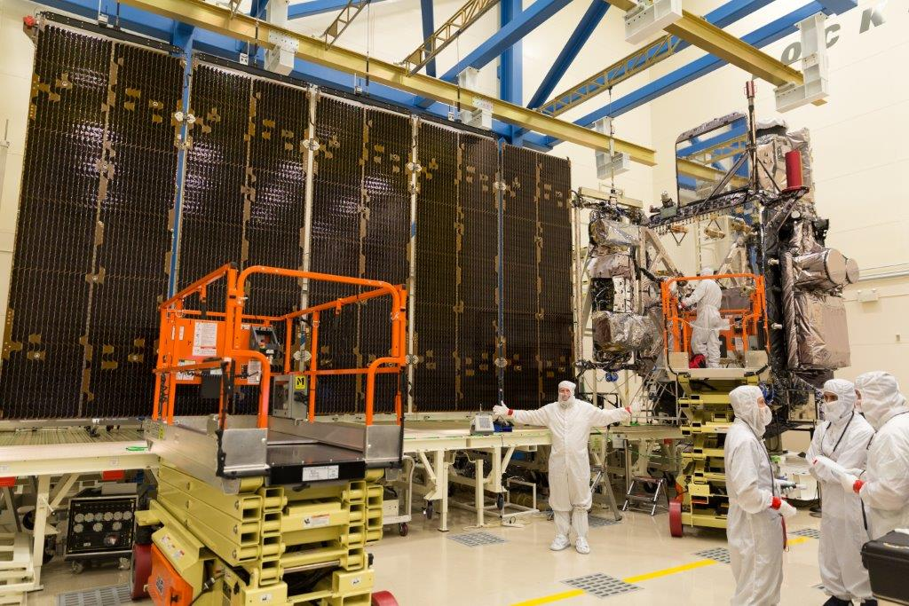
GOES-R Advanced Baseline Imager (ABI)
  Spectral
    Improved!
  Spatial
    Improved!
  Temporal
    Improved!
  Calibration
    Improved!
Lockheed Martin

Slide 3
Question
How many total images (for a given band) per hour from one ABI in “flex” mode (or mode 3)?
a) 4
b) 12
c) 120
d) 136
e) 138

Slide 4
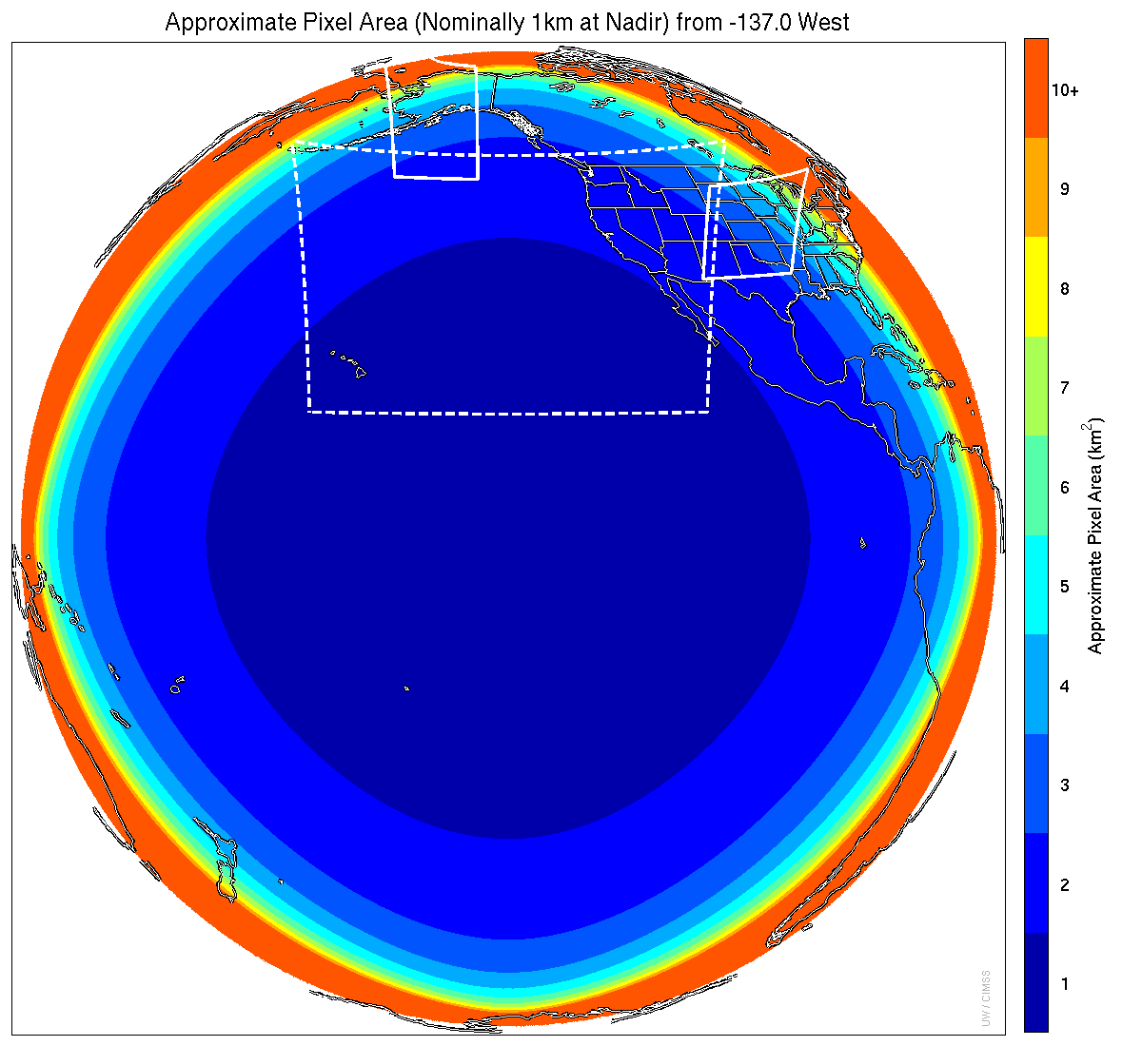
Meso-scale box locations are movable
1 min
1 min
5 min
15 min (or 10 min in mode 6)
Scan mode (3) or ‘flex mode’ for the ABI:
Full disk every 15 min
+ 5 min CONUS
+ 1-min mesoscale (2 locations).
Mat Gunshor, CIMSS
Notes:
1-km² spatial resolution at satellite nadir. Pixel Areas are approximate. Each bin is rounded to the nearest 1km² until we get to 9.5km² and then all are binned into the red 10+ area. So the first, dark blue, ring covers pixel areas from 1 to 1.49km² and is labeled “1”, above 1.5 to below 2.5km² goes into the next ring and is called “2”, etc. GOES-West location. Proposed CONUS sector, approved by the NWS NOAT. Two meso-scale image sectors shown; these are selectable. The same central lat/lon used for these mesoscales produces a different sized and shaped area for different satellite locations.

Slide 5
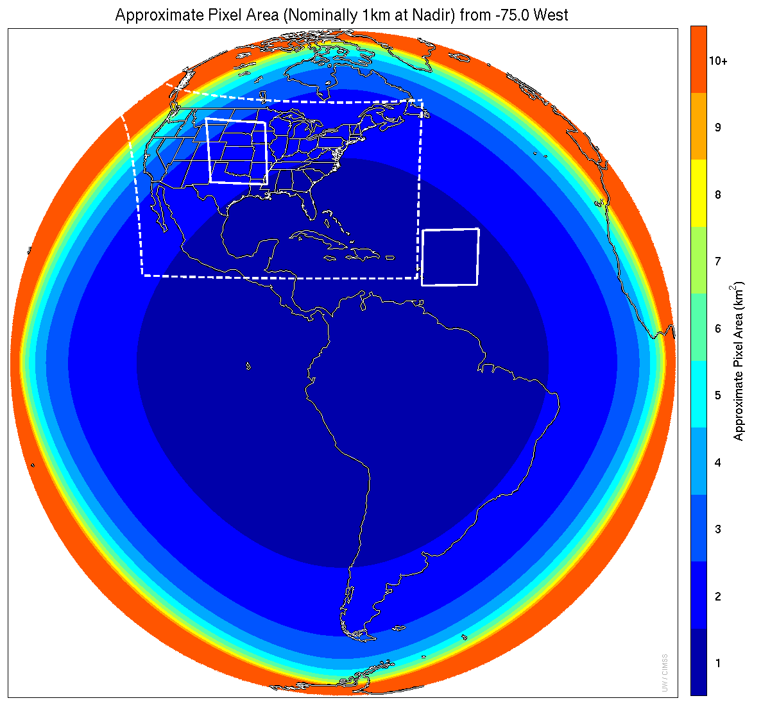
Meso-scale box locations are movable
1 min
5 min
1 min
15 min or 10 min in mode 6
Scan mode (3) or ‘flex mode’ for the ABI:
Full disk every 15 min
+ 5 min CONUS
+ 1-min mesoscale (2 locations).
Mat Gunshor, CIMSS
Notes:
1-km² spatial resolution at satellite nadir. Pixel Areas are approximate. Each bin is rounded to the nearest 1km² until we get to 9.5km² and then all are binned into the red 10+ area. So the first, dark blue, ring covers pixel areas from 1 to 1.49km² and is labeled “1”, above 1.5 to below 2.5km² goes into the next ring and is called “2”, etc. GOES-East location. Proposed CONUS sector, approved by the NWS NOAT. Two meso-scale image sectors shown; these are selectable. The same central lat/lon used for these mesoscales produces a different sized and shaped area for different satellite locations.

Slide 6
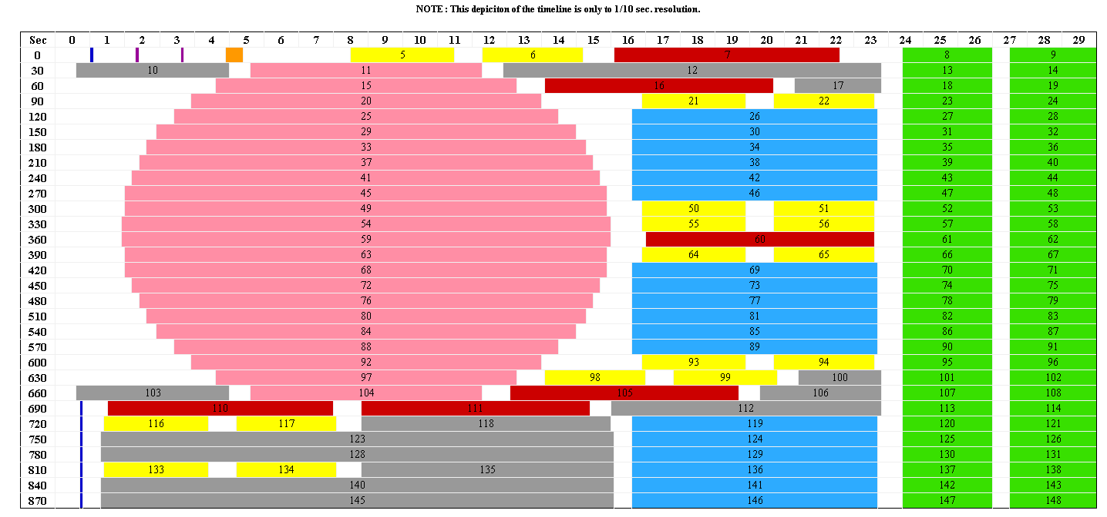
Scan Mode 3 Timeline (Flex Mode) Delivers Storm Watch Every 30 Seconds
30 seconds
Blackbody
IR Star
Meso
(north
swath)
Spacelook
Vis Star
CONUS
Full
Disk
Meso
(south
swath)
Nadir
Note: Autonomous spacelook collected with each Full Disk swath
MISTiC
Meso: one every 30 seconds or two at 1 minute intervals each
Scene locations can be changed on the fly (no interruption of timeline)

Slide 7
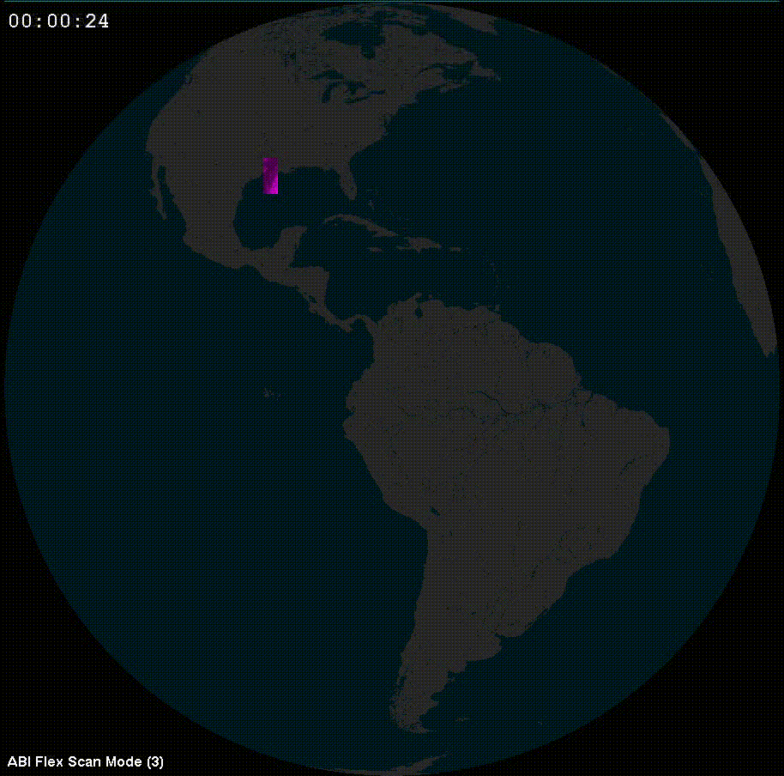
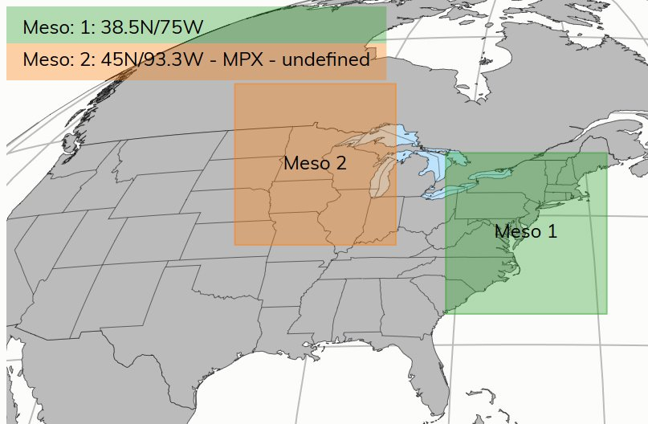
ABI - 5 times faster coverage
GOES-16: Previous:
Flex Mode Routine
Full Disk: 15 min 3-hr
CONUS: 5 min 15-min
Mesoscale: 1-min n/a
or 30-sec
PLUS – Flex mode scanning!
Credit: Rick Kohrs and Margaret Mooney, CIMSS

Slide 8
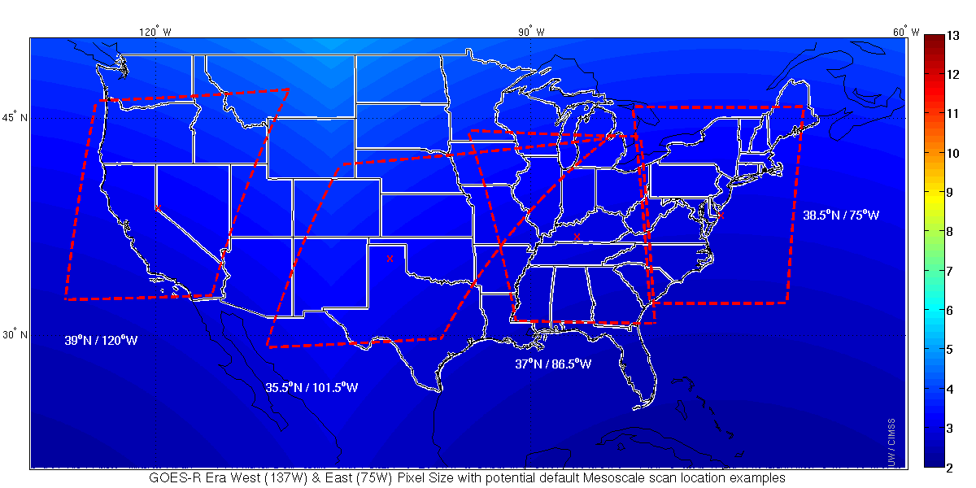
Default Meso Locations
Two meso from GOES-West and two from GOES-East
Mat Gunshor, CIMSS

Slide 9
ABI: Bands 1-6 (Visible / NearIR)
ABI Band | Wavelength (µm) | Wavelength range (µm) | Sub-point pixel spacing (km) | Descriptive Name
1 | 0.47 | 0.45 - 0.49 | 1 | “Blue”
2 | 0.64 | 0.60 - 0.68 | 0.5 | “Red”
3 | 0.864 | 0.847 - 0.882 | 1 | “Veggie”
4 | 1.373 | 1.366 - 1.380 | 2 | “Cirrus”
5 | 1.61 | 1.59 - 1.63 | 1 | “Snow/Ice”
6 | 2.24 | 2.22 -2.27 | 2 | “Cloud Particle Size”
Six visible or near visible bands on ABI, one on heritage imager
Notes:
Based on Schmit et al, 2017. stars = today’s imager band.

Slide 10
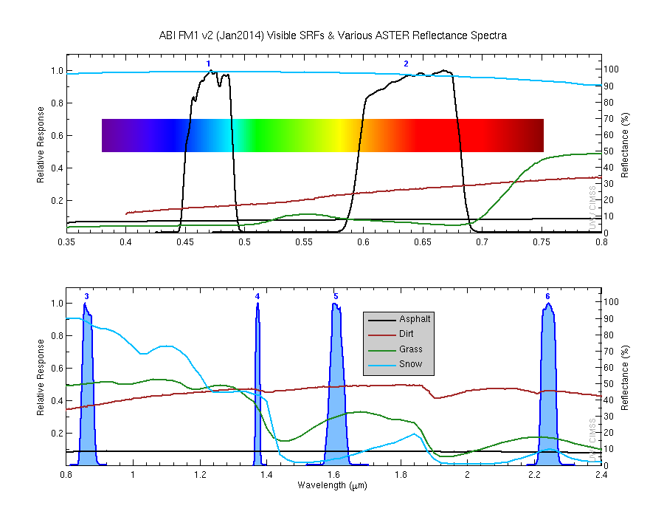

Slide 11
ABI Visible / Near IR Bands
Current (legacy) GOES imagers: One visible band
GOES-R ABI:
  Two visible bands (1 km and 0.5 km)
  Four Near IR bands 1 or 2 km resolution
Benefits:
  Depiction of clouds
  Depiction of smoke
  Depiction of fog
  Used for AMV generation
  Used in snow cover estimates
Many thanks to Jordan Gerth, CIMSS

Slide 12
ABI Near-Infrared Bands
Current (legacy) GOES imagers: No near-infrared bands
GOES-R ABI: Four near-infrared bands, two at 1 km resolution, two at 2 km resolution
Benefits:
Depiction of vegetation health/coverage
Sharper coastlines and easier detection of inland river flooding
Easier cirrus cloud
Cloud-phase discrimination
Nocturnal fire detection

Slide 13
ABI: Bands 7-16 (Infrared)
ABI Band | Wavelength (µm) | Wavelength range (µm) | Sub-point pixel spacing (km) | Descriptive Name
7 | 3.90 | 3.80 - 3.99 | 2 | “Shortwave window”
8 | 6.19 | 5.79 - 6.59 | 2 | “Upper-level Water Vapor”
9 | 6.93 | 6.72 - 7.14 | 2 | “Mid-Level Water Vapor”
10 | 7.34 | 7.24 - 7.43 | 2 | “Lower/Mid-level Water Vapor”
11 | 8.44 | 8.23 - 8.66 | 2 | “Cloud-top Phase”
12 | 9.61 | 9.42 - 9.80 | 2 | “Ozone”
13 | 10.33 | 10.18 - 10.48 | 2 | “Clean longwave window”
14 | 11.21 | 10.82 - 11.60 | 2 | “Longwave window”
15 | 12.29 | 11.83 - 12.75 | 2 | “Dirty longwave window”
17 | 13.28 | 12.99 - 13.56 | 2 | “CO₂”
10 infrared bands on the ABI, four on heritage imager
Notes:
Based on Schmit et al, 2017. stars = today’s imager band.

Slide 14
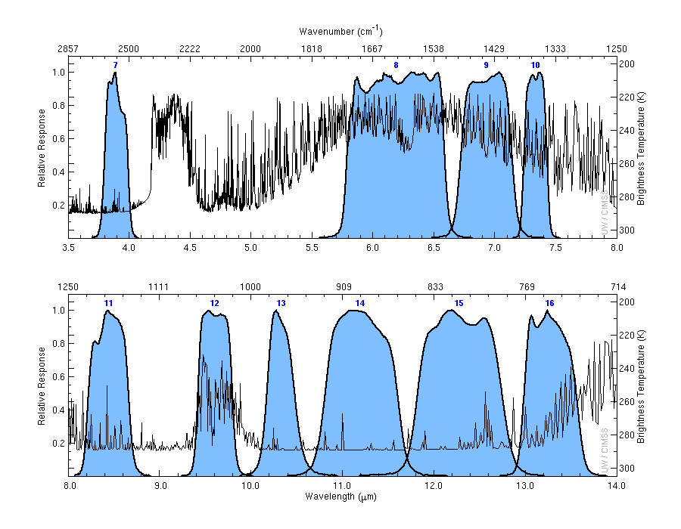
ABI Spectral (IR) Bands
Credit: Mat Gunshor

Slide 15
ABI Infrared Bands
Current GOES imagers: Four infrared bands
GOES-R ABI: 10 infrared bands, all at 2 km resolution
Benefits:
  Fire detection with better thermal signal
  Resolution of middle and upper tropospheric water vapor features
  Detection of sulfur dioxide and upper-atmosphere ozone
  Several window channels for discerning low-level water vapor gradients
  Clouds and Clouds phase
  Convection
  Atmospheric Motion and Atmospheric Moisture
  Volcanic plumes
  Ozone (and related PV)

Slide 16
Question
How many spectral bands on the ABI?
a) 5
b) 16
c) 160
d) 1600

Slide 17
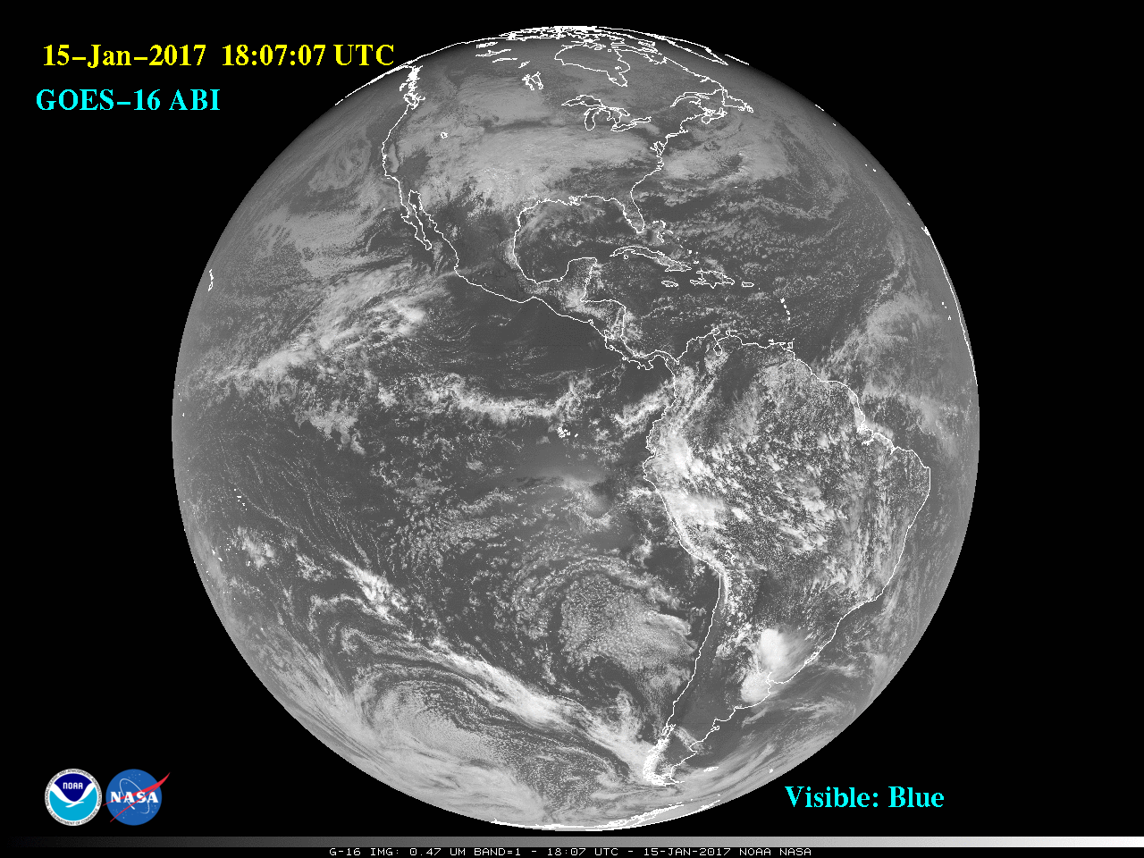
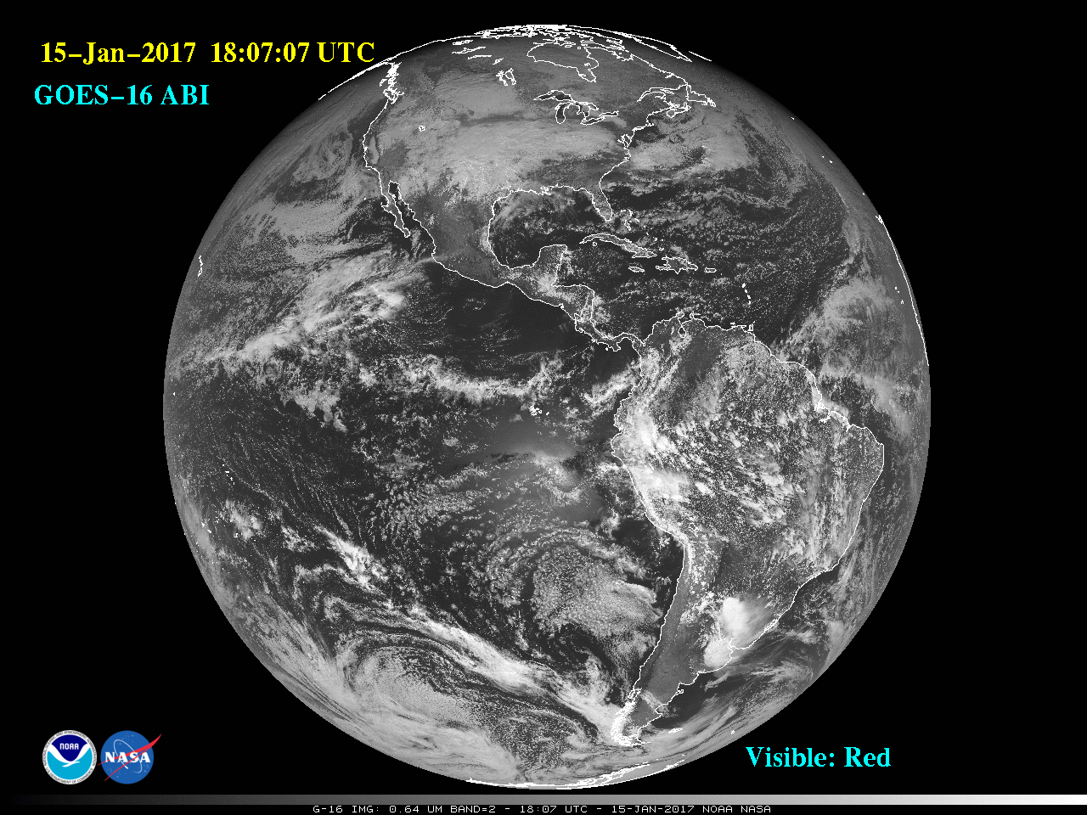
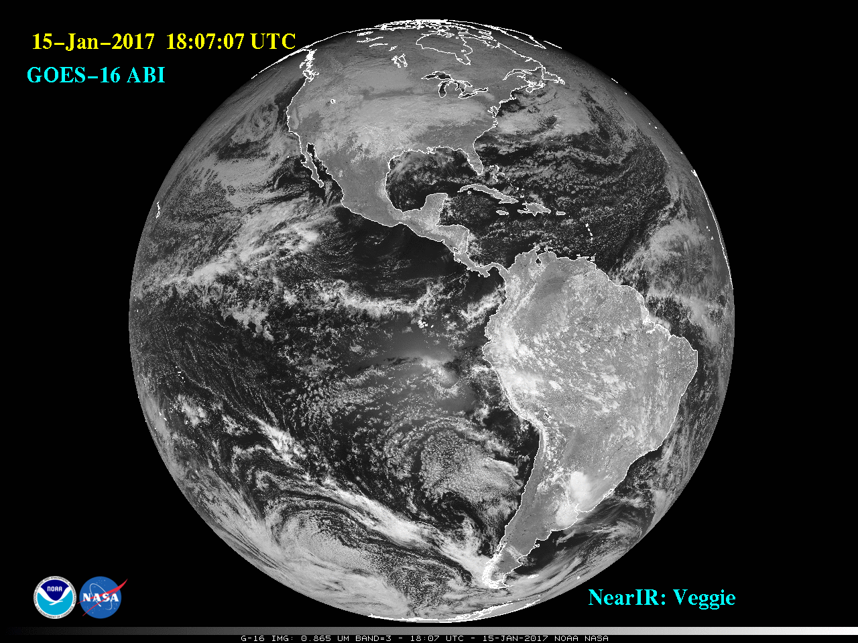
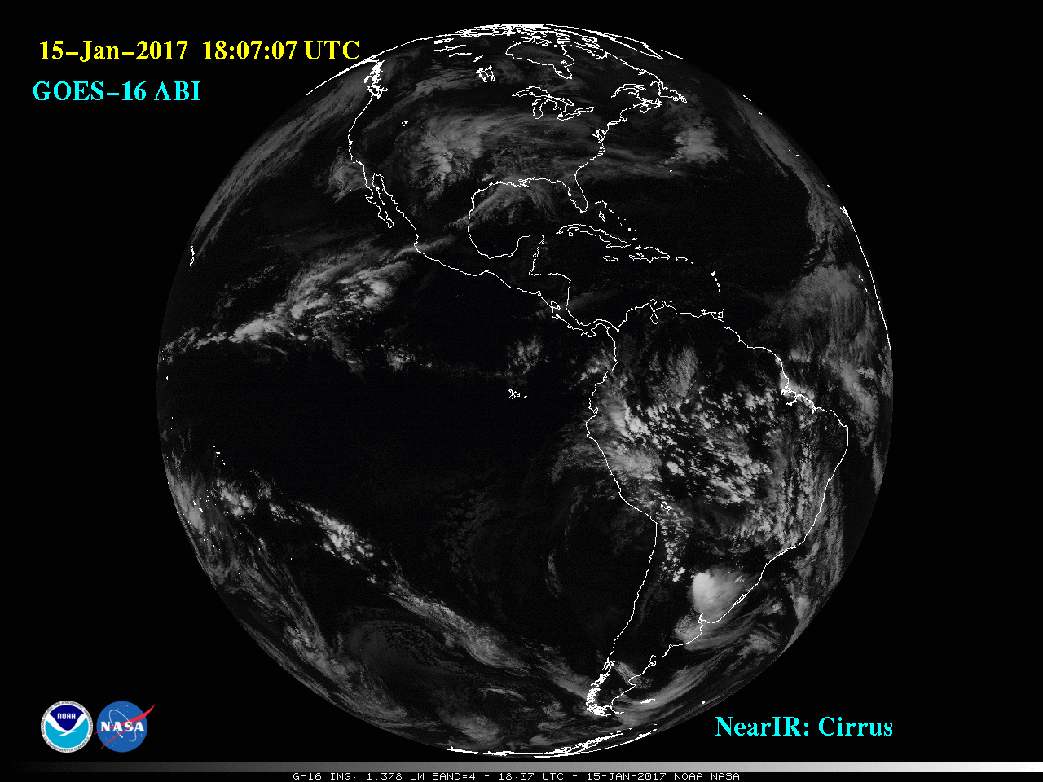
0.47 μm
0.64 μm
0.86 μm
1.37 μm

Slide 18
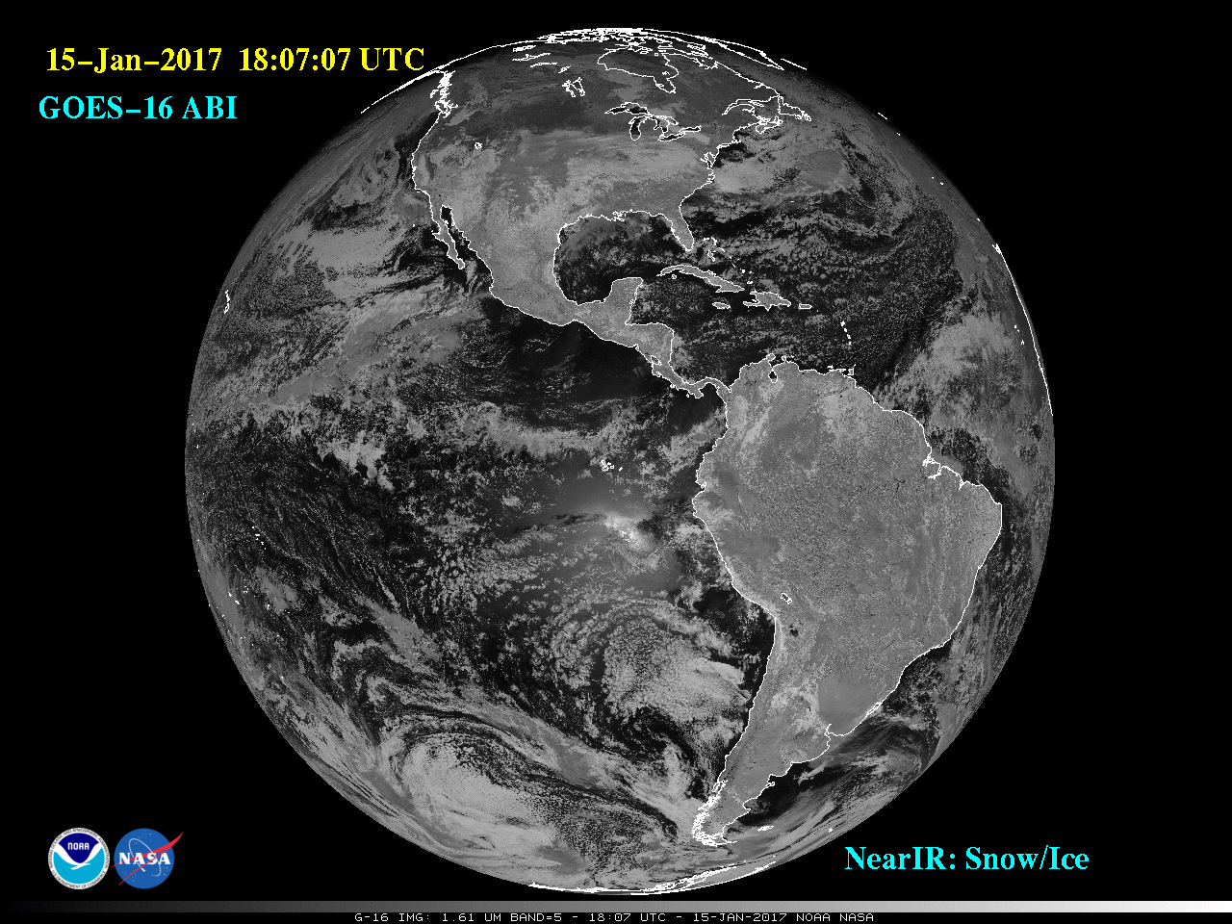
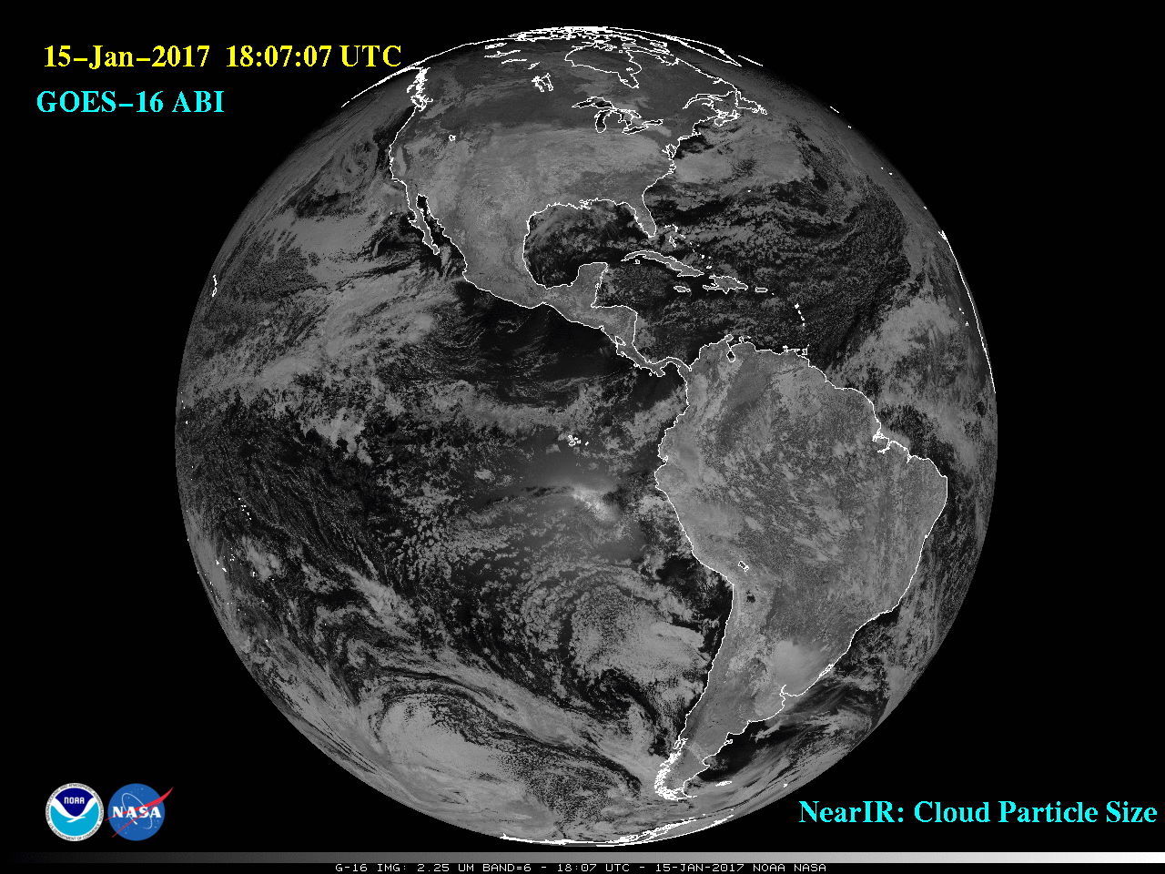
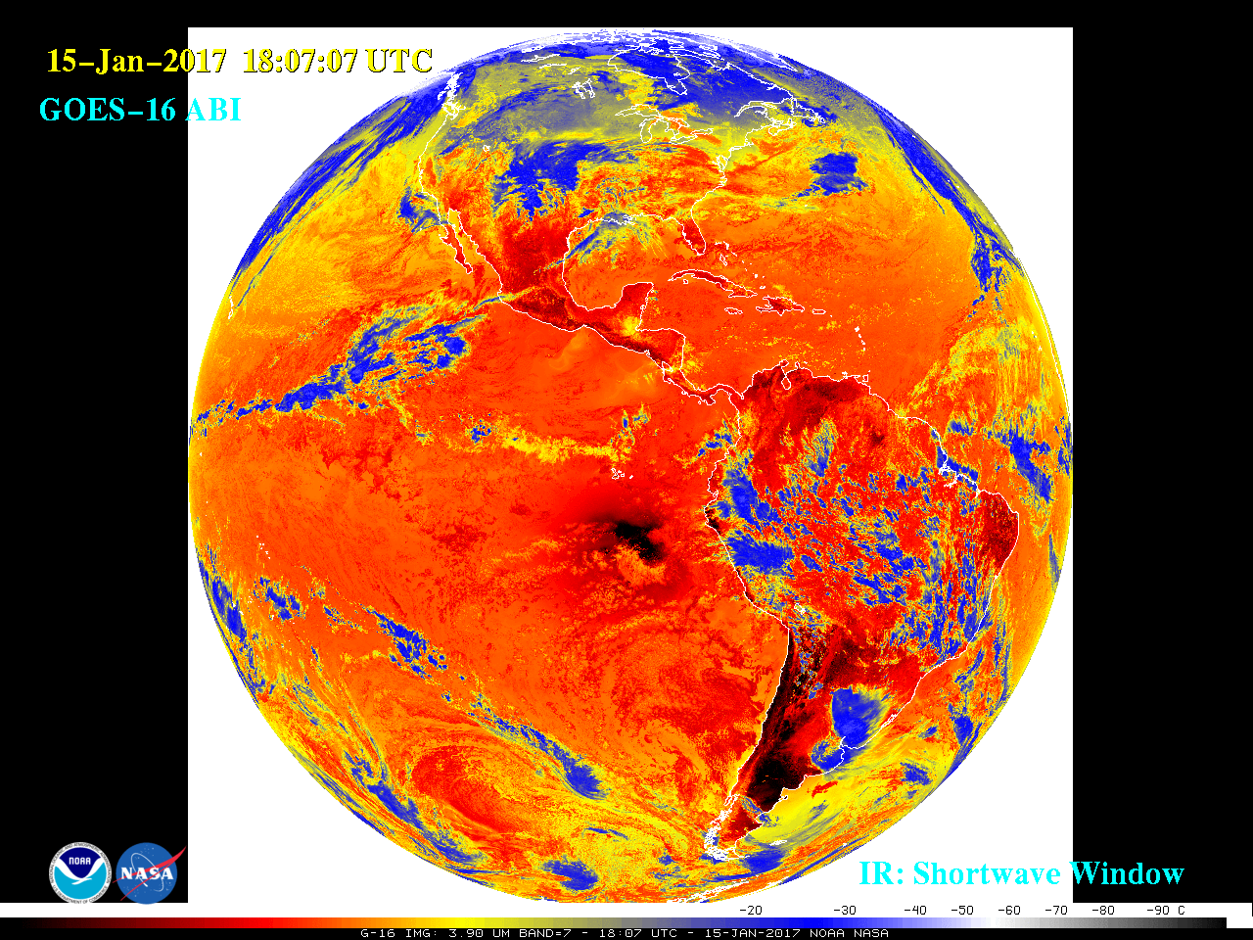
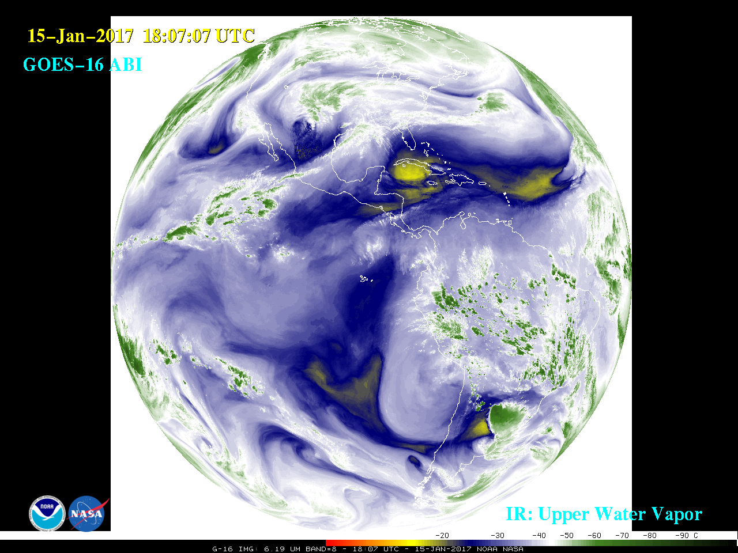
1.6 μm
2.2 μm
3.9 μm
6.2 μm

Slide 19
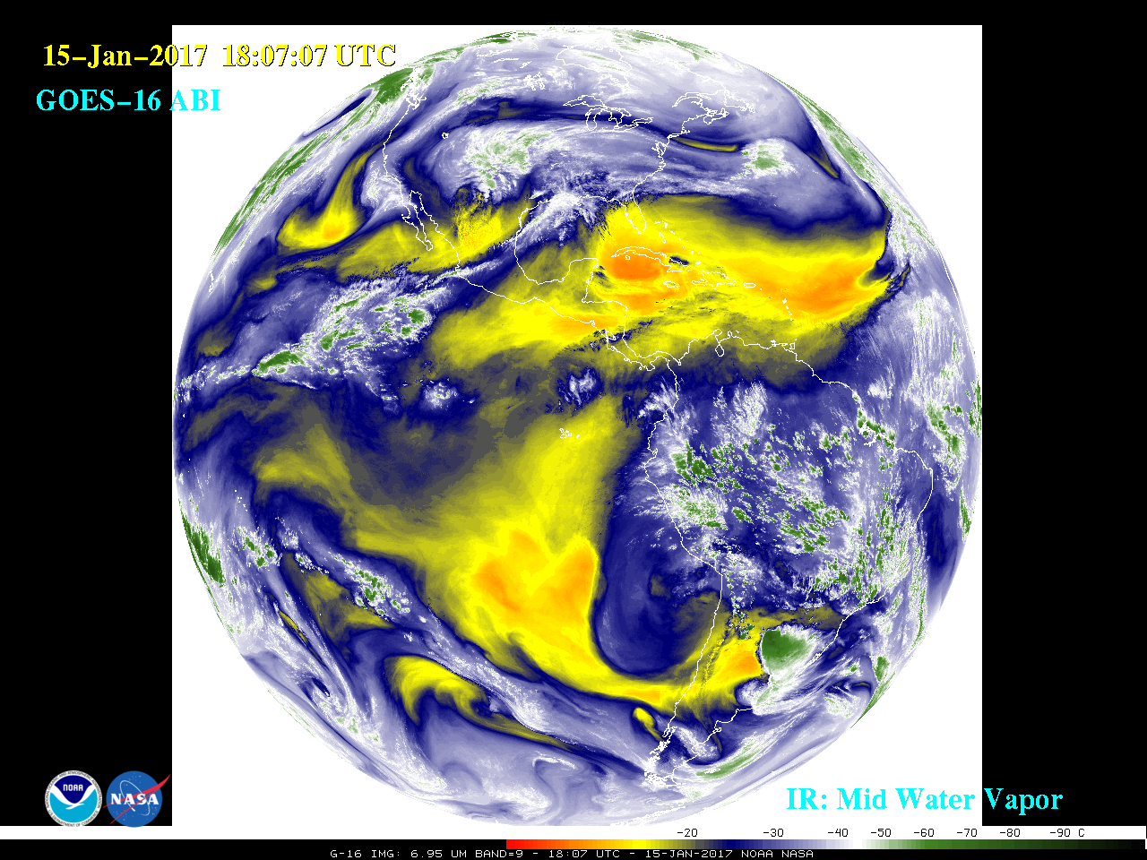
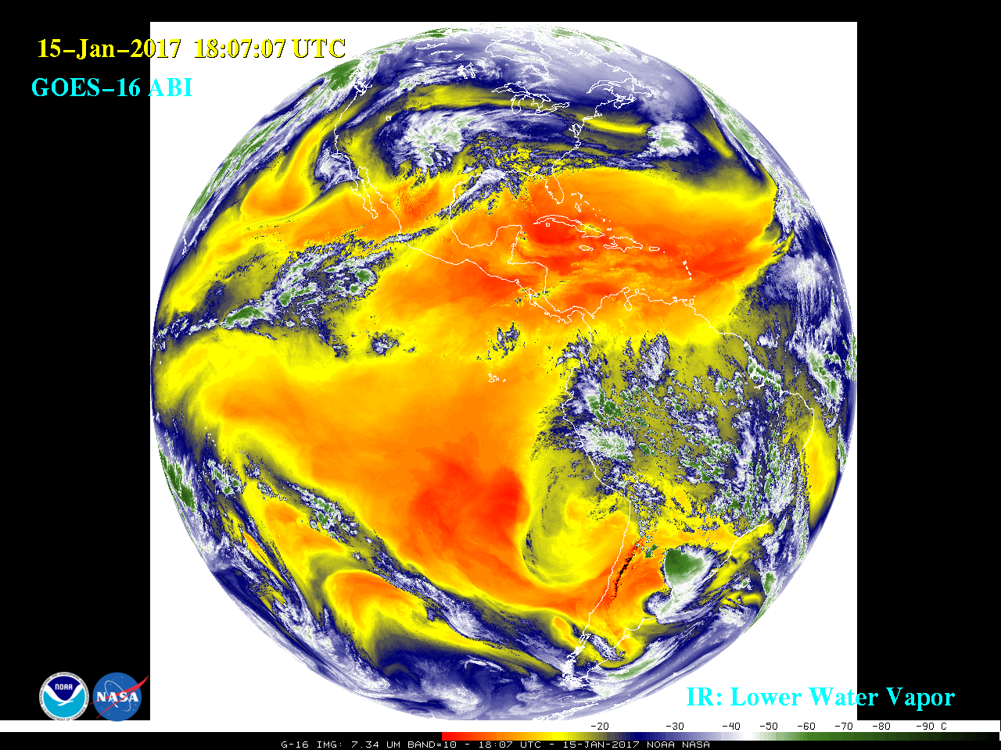
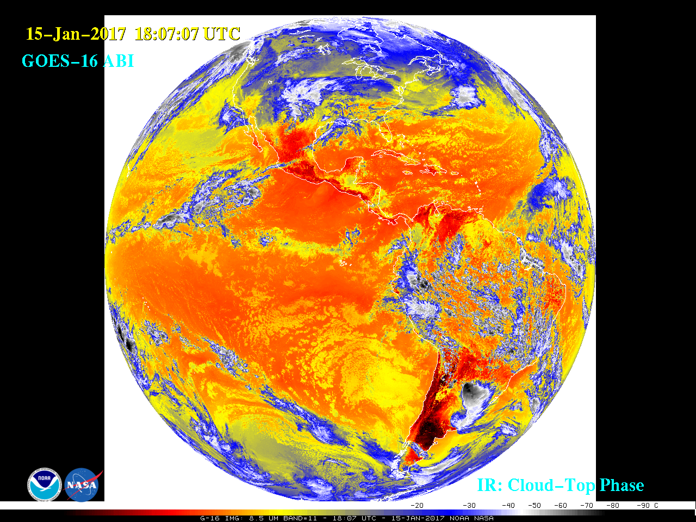
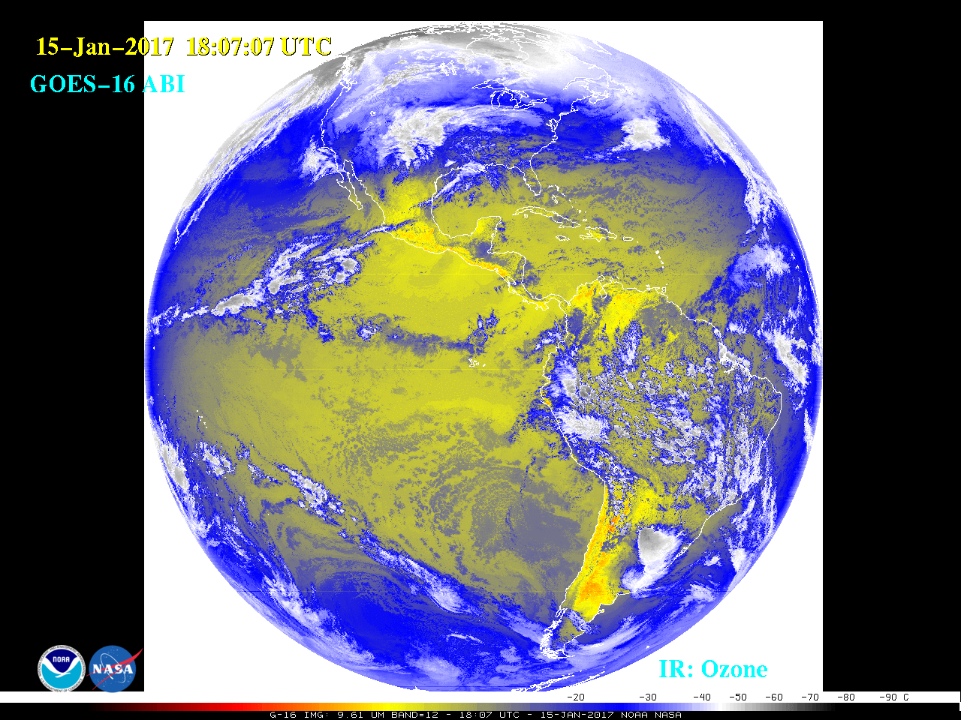
6.9 μm
7.3 μm
8.4 μm
9.6 μm

Slide 20
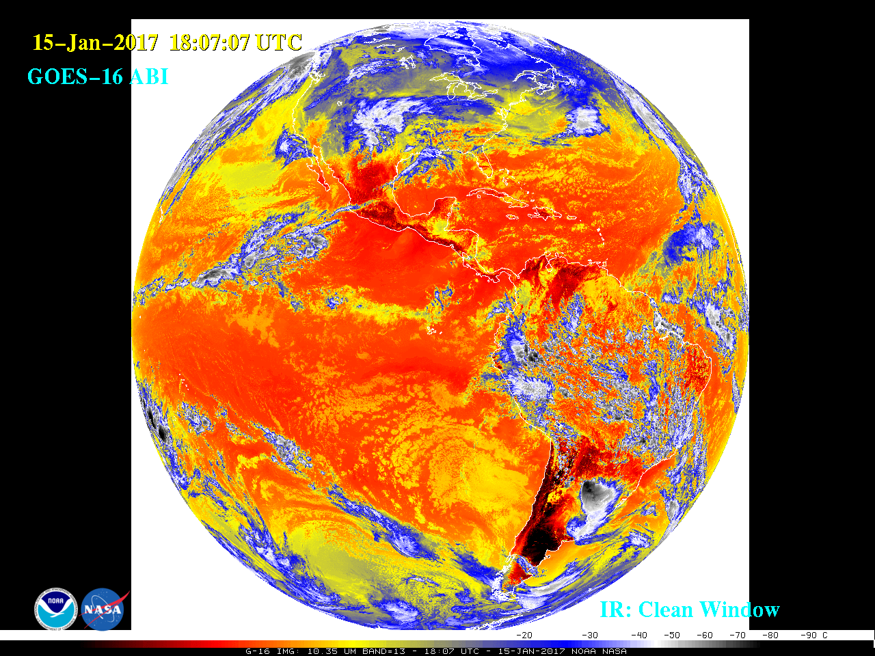

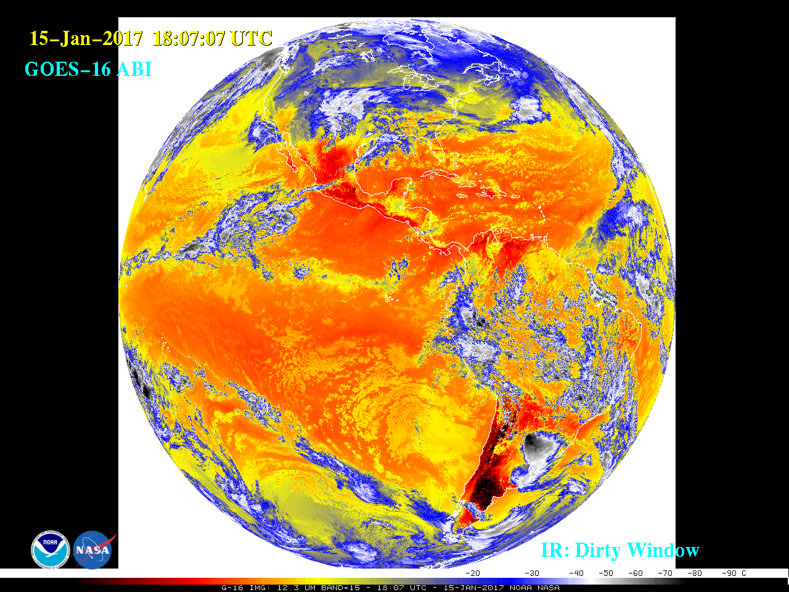
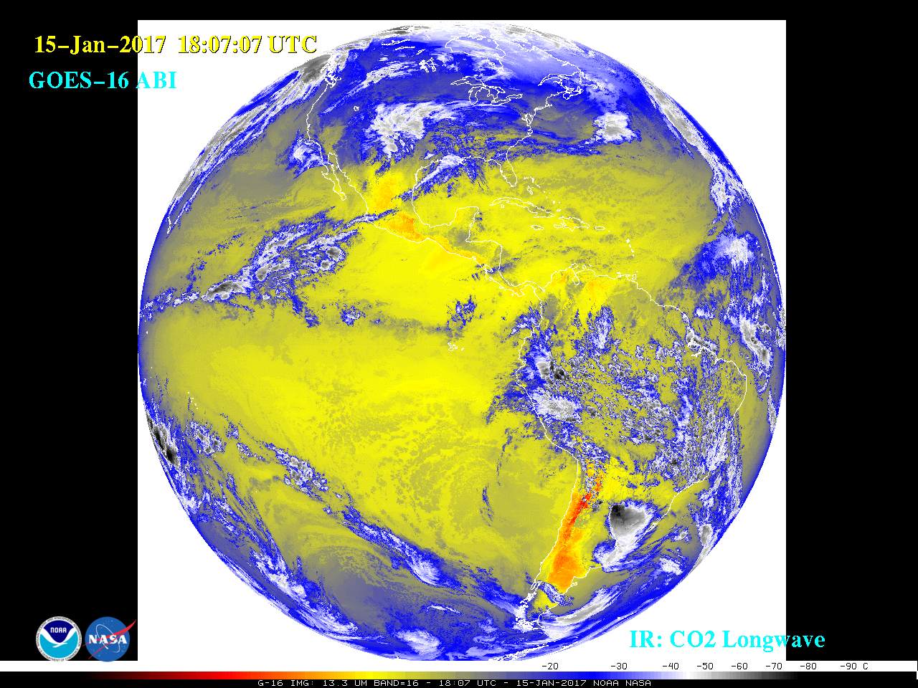
10.3 μm
11.2 μm
12.3 μm
13.3 μm

Slide 21
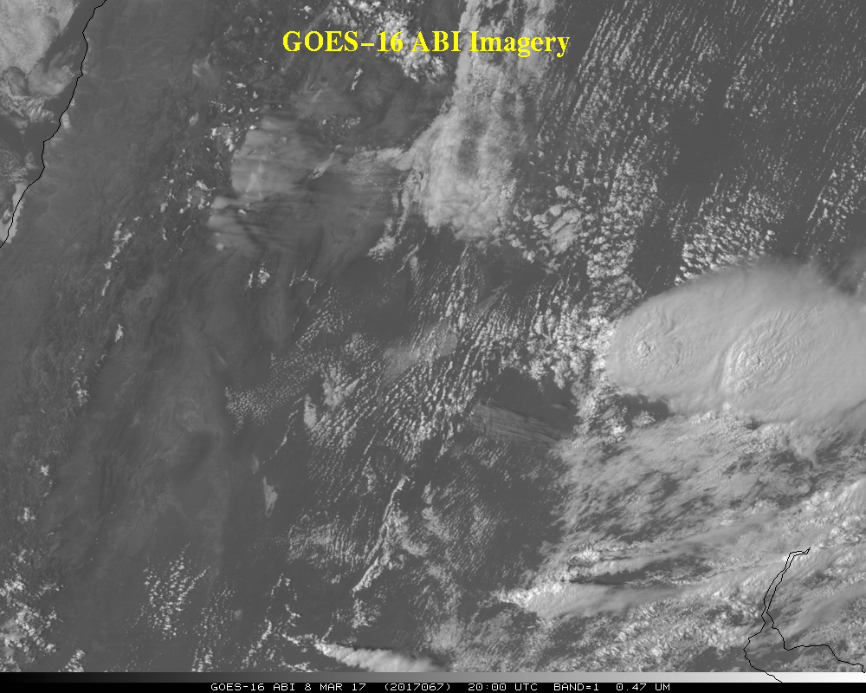

Slide 22
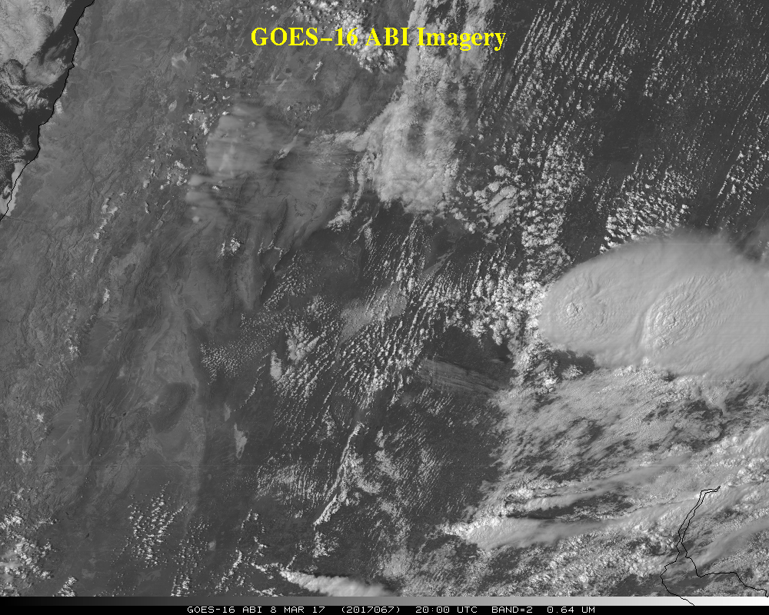

Slide 23
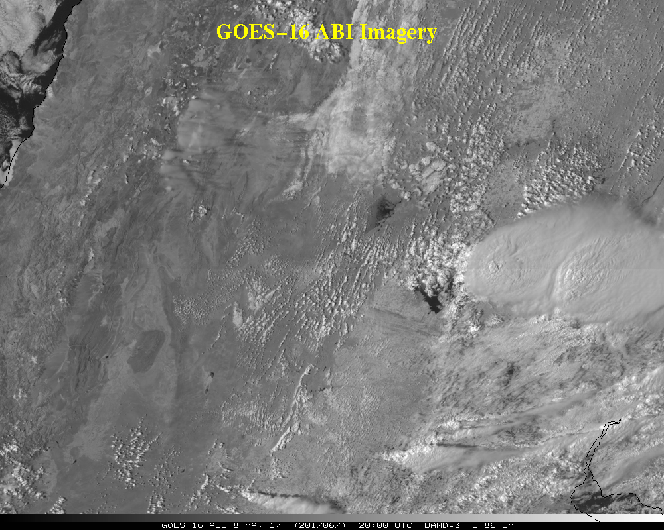

Slide 24
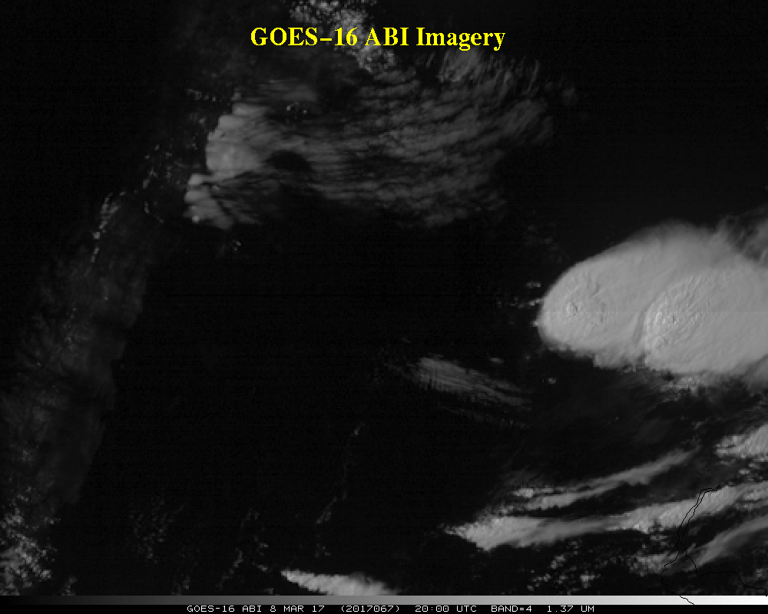

Slide 25
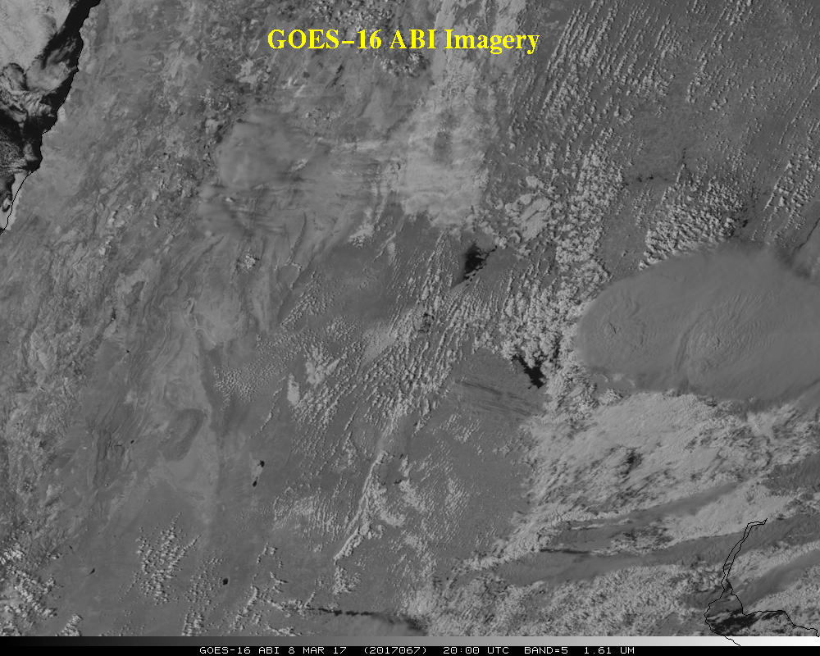

Slide 26
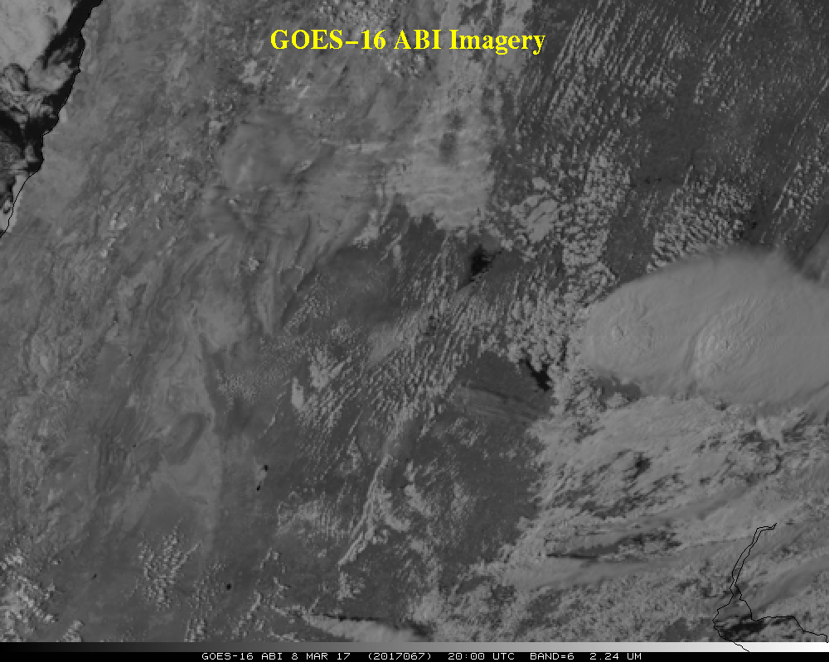

Slide 27
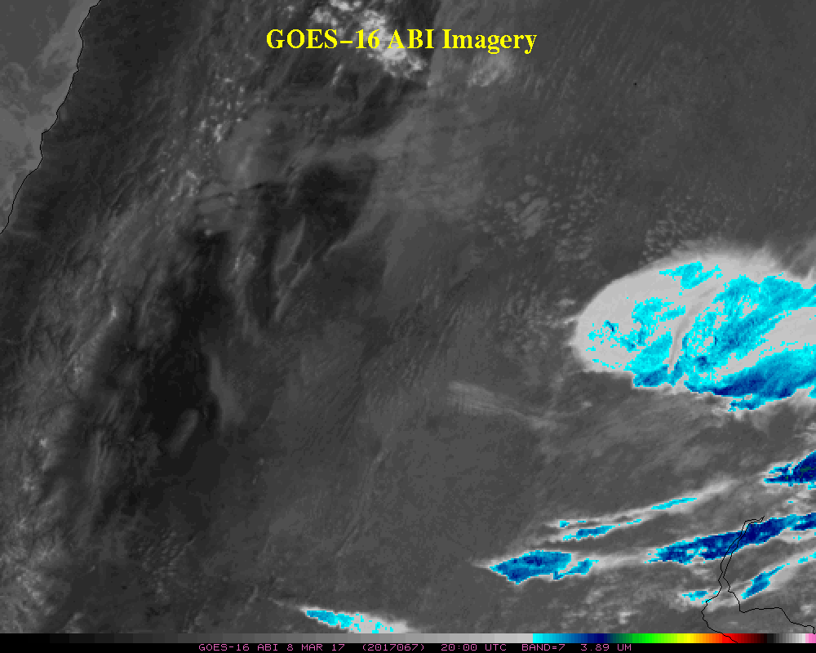

Slide 28
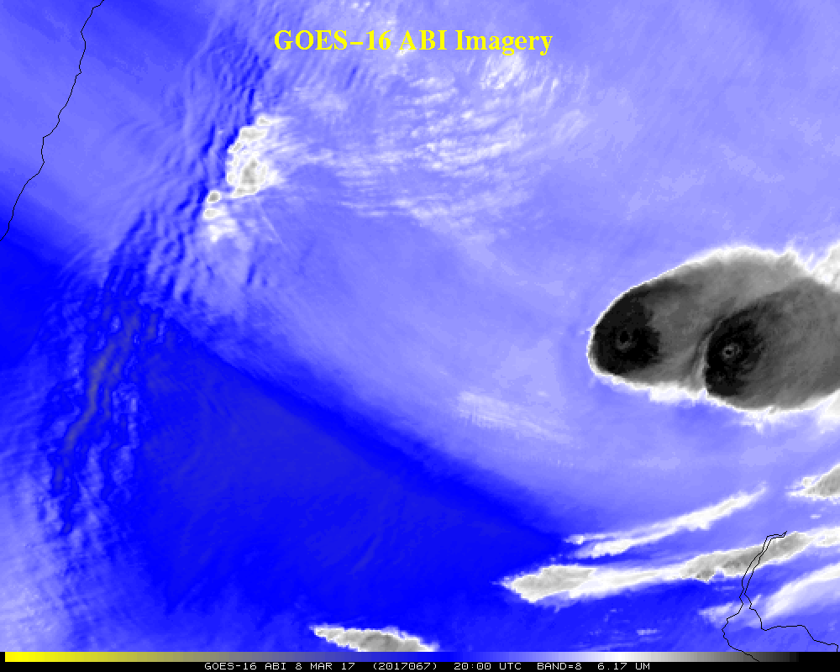

Slide 29
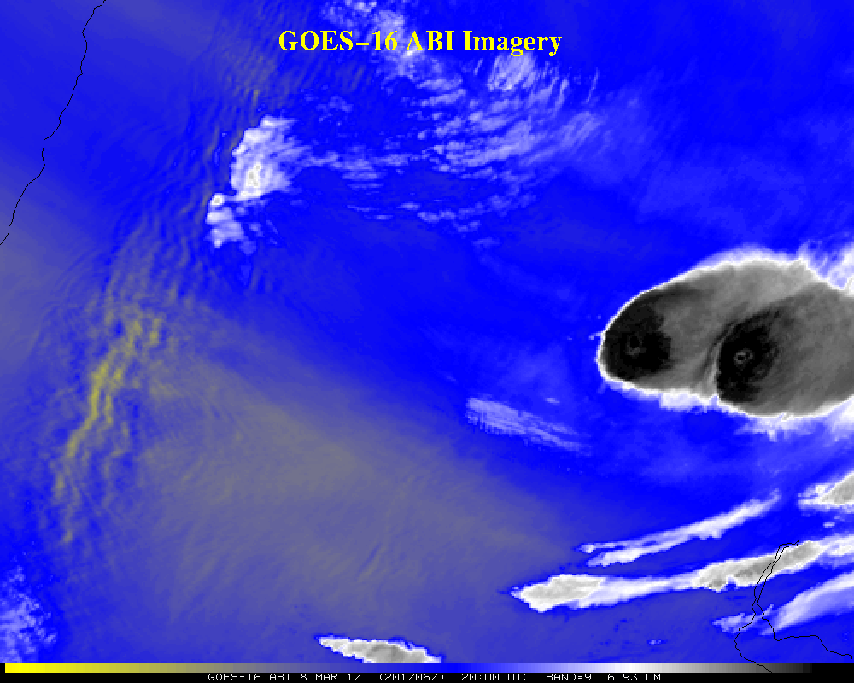

Slide 30
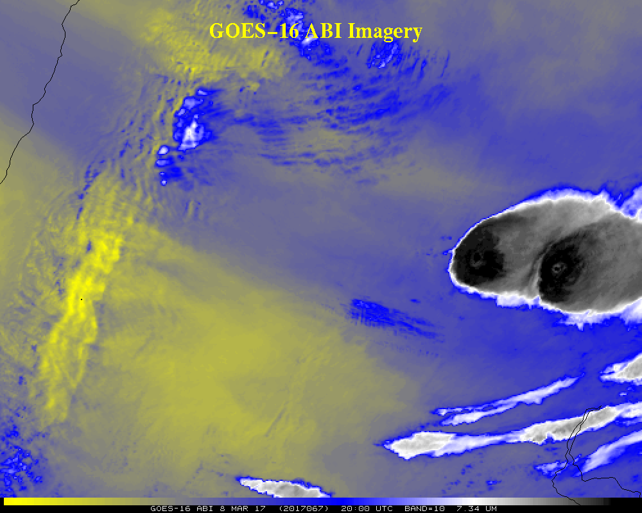

Slide 31
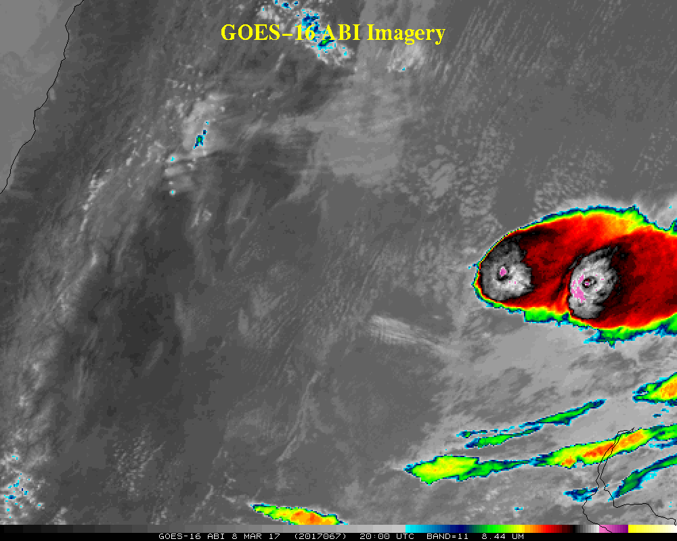

Slide 32
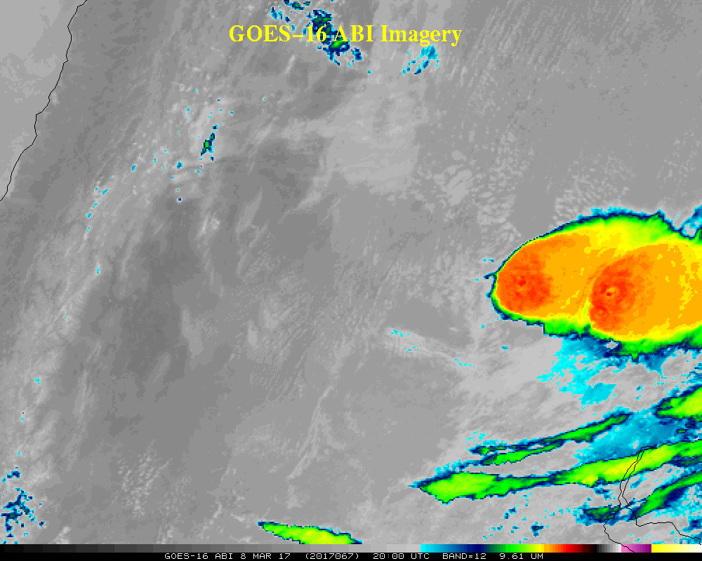

Slide 33
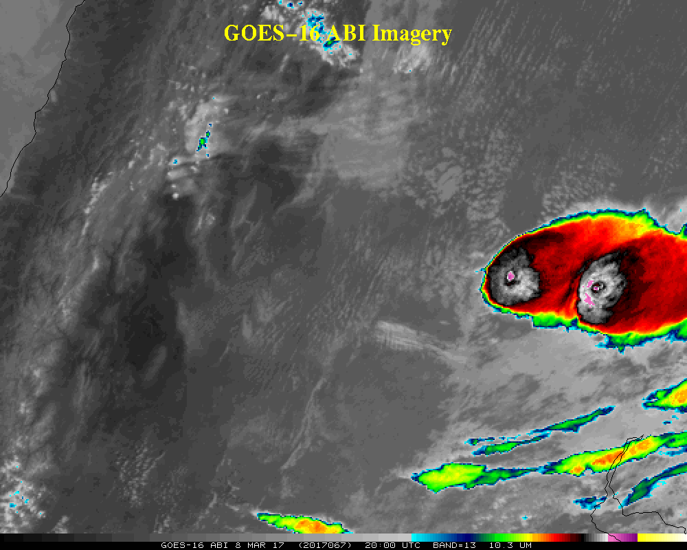

Slide 34
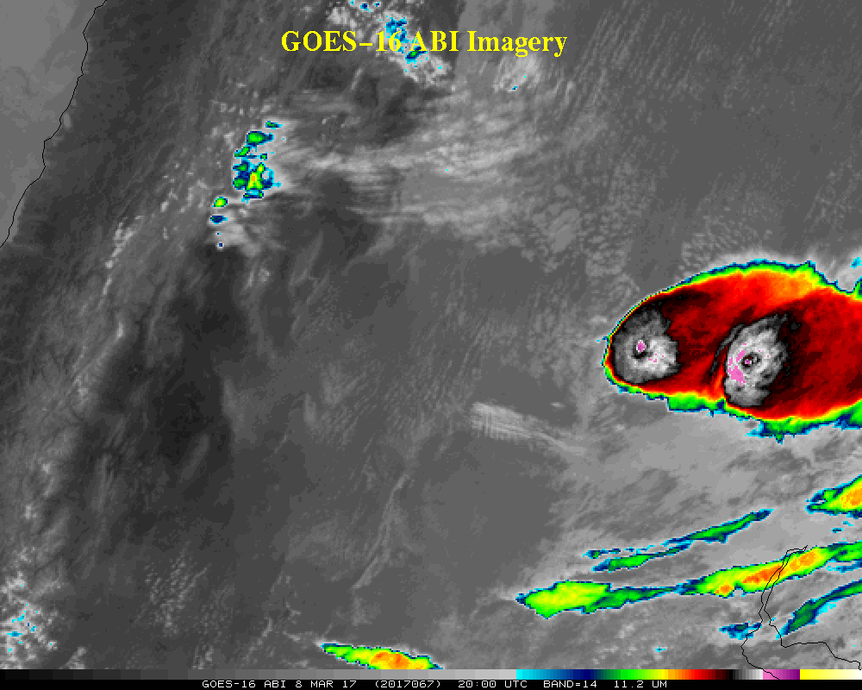

Slide 35
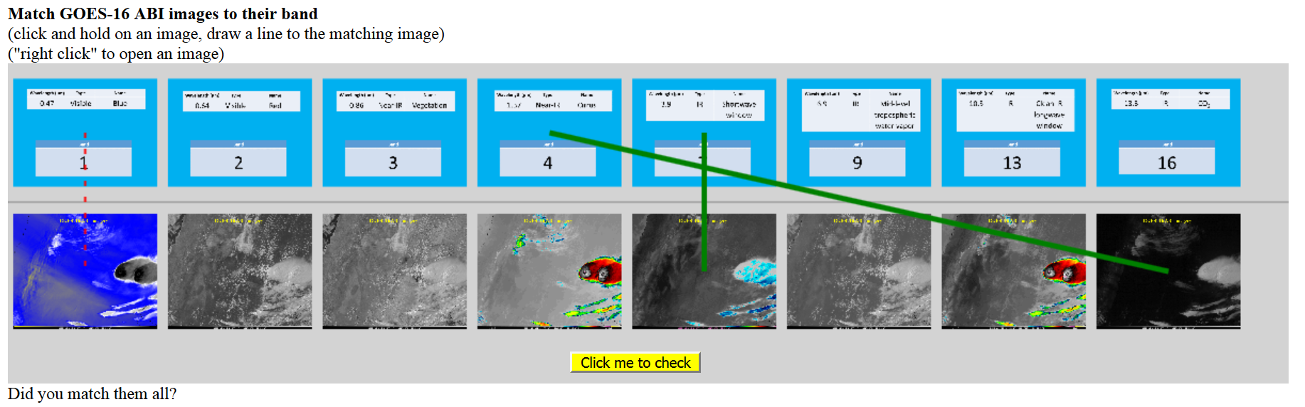
Matching Action
https://cimss.ssec.wisc.edu/goes/webapps/matching/satmatch_abi_AZ1.html
Or other Band Matching links on the web page

Slide 36
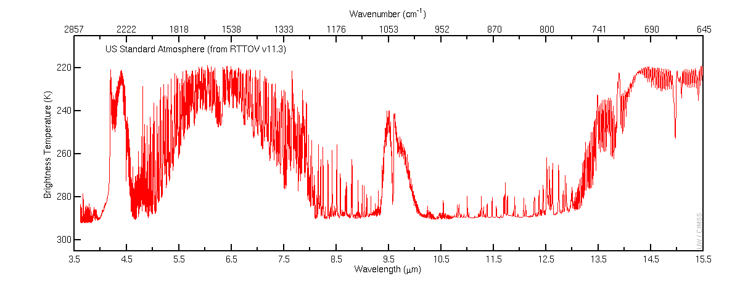
US Standard Atmosphere (1976)
Forward Model Used: RTTOV v11.3

Slide 37
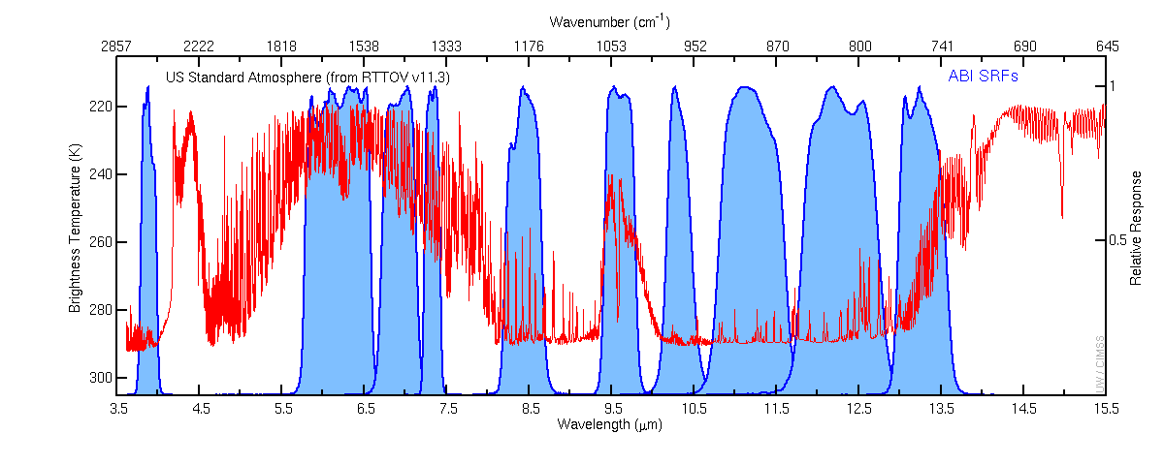
US Standard Atmosphere (1976)
Forward Model Used: RTTOV v11.3
GOES-16 ABI SRFs

Slide 38
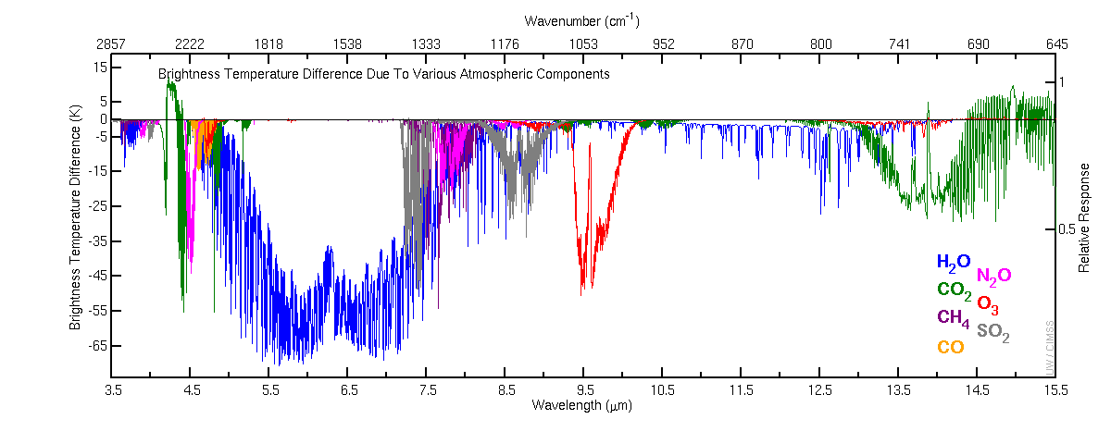
US Standard Atmosphere (1976) Brightness Temperature Difference
Caused By Removing Atmospheric Components
Forward Model Used: RTTOV v11.3
(Except 1000 DU of SO₂ with PFAAST)
Notes:
The SO2 plot

Slide 39
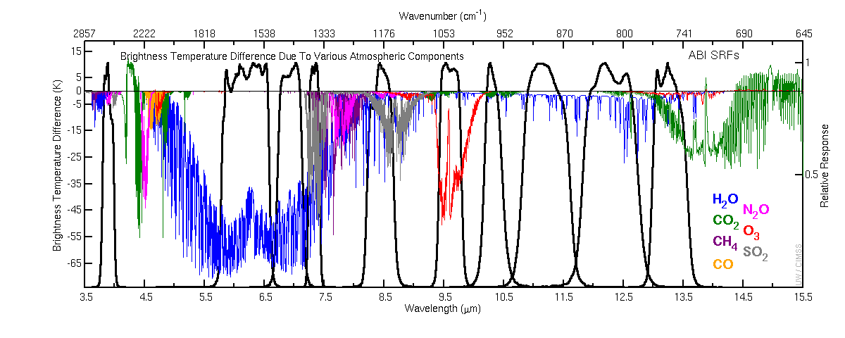
US Standard Atmosphere (1976) Brightness Temperature Difference
Caused By Removing Atmospheric Components
Forward Model Used: RTTOV v11.3
(Except 1000 DU of SO₂ with PFAAST)
GOES-16 ABI SRFs

Slide 40
Question
Approximately how many ABI detectors are downloaded?
a) 16
b) 160
c) 1600
d) 8000
e) too many to count

Slide 41
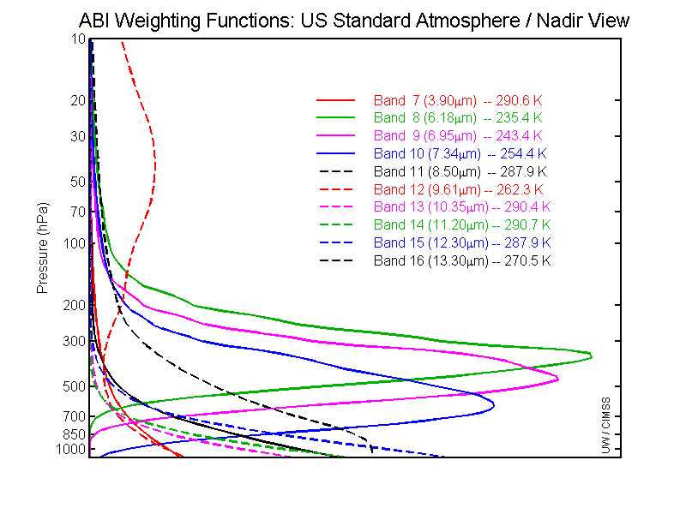
GOES-R ABI Weighting Functions
ABI has only 1 CO₂ band, so upper-level temperature will be degraded compared to the current sounder

Slide 42
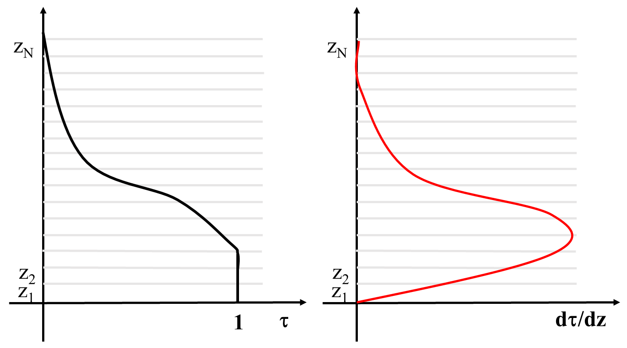
Transmittance vs. Weighting Function

Slide 43
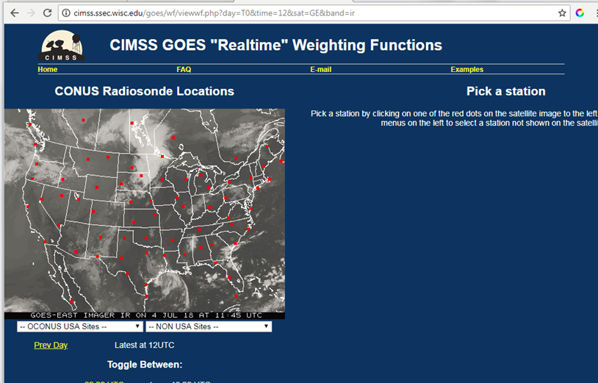

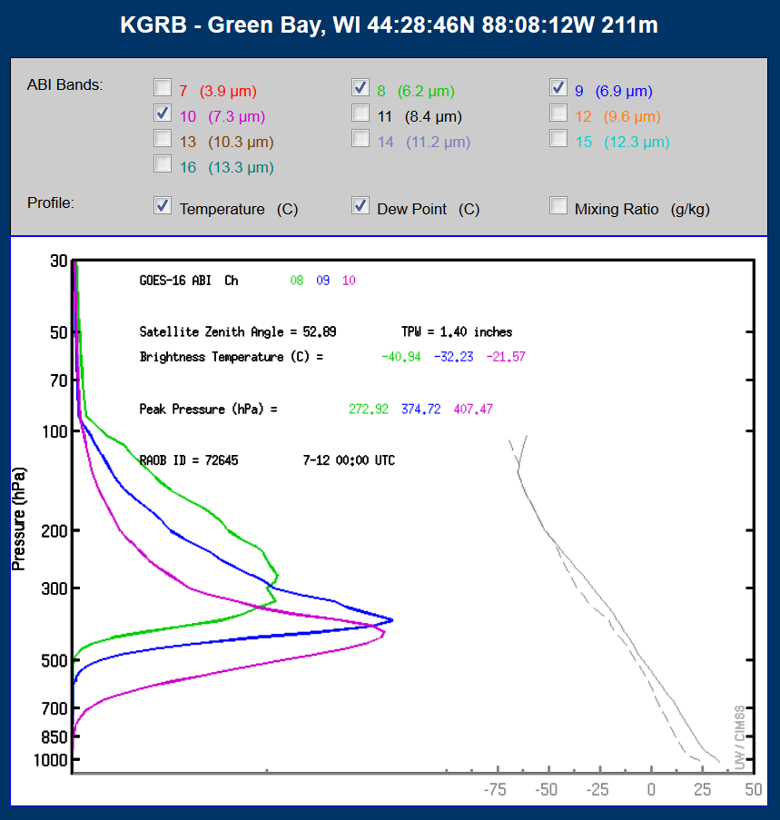
Real Time Weighting Functions
http://cimss.ssec.wisc.edu/goes/wf
Notes:
You can compute real-time weighting functions using actual radiosondes too (again, you’re assuming clear skies – which may not be true in reality). Including, if you click on the Non-USA Sites, radiosondes over central/South America (and Canada). Recently changed to inches for PW and C for the calculated temps.

Slide 44
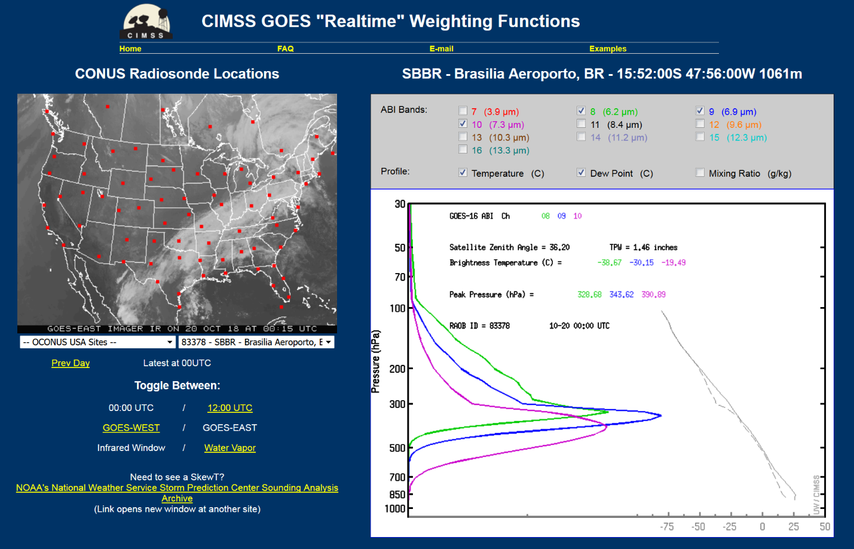
WF Action 1
http://cimss.ssec.wisc.edu/goes/wf/
Bring up the water vapor weighting functions from today and report the warmest water vapor band brightness temperature for a GOES ABI.

Slide 45
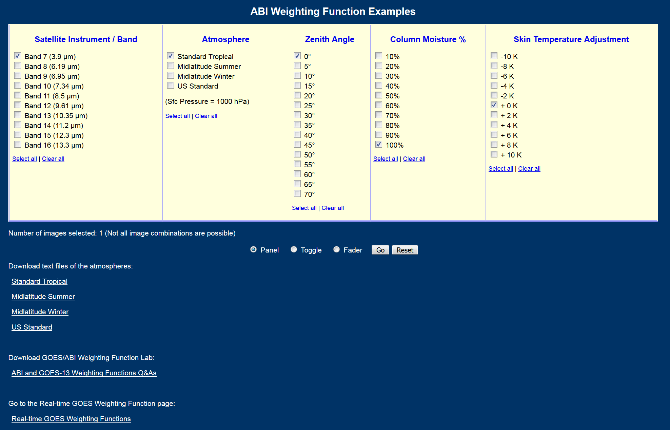
WF Action 2
http://cimss.ssec.wisc.edu/goes/wf/examples/ABI/
Download and work on the ABI WF lab.

Slide 46
Question
Approximately how large (in km) is the parallax from GOES for a 15 km high thunderstorm over Phoenix, AZ?
a) 0
b) 16
c) 22
d) 86
e) unknowable
Parallax is the apparent shift in an object's position (away from the sub-satellite point) as a result of viewing angle.

Slide 47
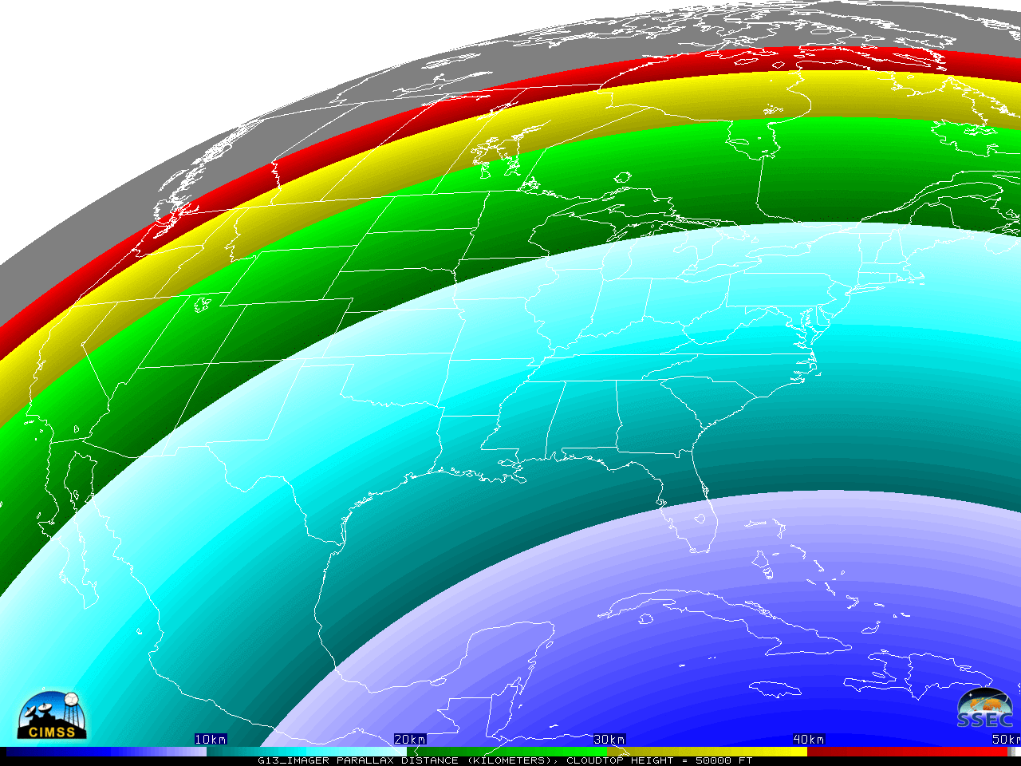
Parallax
50,000 ft
(~15 km)
Cloud
The view of a high thunderstorm near Phoenix from an East GOES would have an apparent offset of approximately 22 km away from the satellite sub-point.
Thanks to Jim Nelson, CIMSS
Notes:
Source: Jim Nelson

Slide 48

Parallax
50,000 ft
(~15 km)
Cloud
The view of a high thunderstorm near Phoenix from a West GOES would have an apparent offset of approximately 16 km away from the satellite sub-point.
Thanks to Jim Nelson, CIMSS

Slide 49
Temporal Spatial Action
http://cimss.ssec.wisc.edu/goes/webapps/temporal/
Pick a case, what time resolution do you prefer?

Slide 50


 CIMSS Natural True Color
CIRA Enhanced True Color 
Notes:
The CIRA variant is corrected for Rayleigh scattering with green produced from a look-up table.

Slide 51
Red-Green-Blue (RGB)
Composites
Red-Green-Blue (RGB) composites are a way to visualize multiple bands in one image.
In order to interpret an RGB composite image, you must understand the contribution of the individual bands.
There are practically an infinite number of possible RGBs.
  It is possible to display any phenomena in any color.
  Don’t be tempted to correlate a feature with a color in your memory.
Many thanks to Jordan Gerth and Scott Lindstrom, CIMSS

Slide 52
The Birth of an RGB Composite
Scale a range of values for a single band from 0 to 1
Create a triplet at each pixel, where each of the three bands contributes a value to the triplet
The triplet is in the order of the additive primary colors for display purposes
  (Red, Green, Blue)
The triplet (1, 0, 0) is red, (0, 1, 0) is green, (0, 0, 1) is blue, (0, 0, 0) is black, and (1, 1, 1) is white

Slide 53

RGB Color Space as a Cube
Source: https://en.wikipedia.org/wiki/RGB_color_space

Slide 54




Educational RGB Webapp
Sample interactive “RGB” educational webapp using ABI images:
http://cimss.ssec.wisc.edu/education/apps/satrgb/FirstLightRGB.html
Webapp to combine 3 ABI bands into one image.
Notes:
Tim Schmit, ASPB
https://ams.confex.com/ams/95Annual/webprogram/Paper265203.html ABI = Advanced Baseline Imager
Other new webapps: one to change both the spatial and temporal sampling and the other only the pixel sampling

Slide 55
RGB Action
http://cimss.ssec.wisc.edu/goes/webapps/satrgb/overview_abi_goes16.html
Use GOES-16 ABI first light imagery to make a RGB to highlight cloud phase
Or
http://cimss.ssec.wisc.edu/goes/webapps/satrgb/satrgb_ABI_fd_realtime.html
Use GOES-16 ABI near realtime FD imagery to make a RGB to highlight cloud heights

Slide 56
Question
The ABI can monitor:
a) fires
b) cloud top phase
c) the cryosphere
d) volcanic ash plumes
e) all of the above

Slide 57

Many critical derived quantities
http://www.goes-r.gov

Slide 58
GOES-16 Products
ABI L1b Product
Radiances
ABI L2+ Products (con’t)
Downward S/W Radiation: Surface
Fire/Hot Spot Characterization
Hurricane Intensity Estimation
Land Surface Temperature
Legacy Vertical Moisture Profile
Legacy Vertical Temperature Profile
Rainfall Rate/QPE
Reflected S/W Radiation: TOA
Sea Surface Temperature
Snow Cover
Total Perceptible Water
Volcanic Ash: Detection and Height
GLM L2 Product
Lightning: Events, Groups, Flashes
SEISS L1b Products
Energetic Heavy Ions
Magnetospheric e⁻/p⁺: Low Energy
Magnetospheric e⁻/p⁺: High Energy
Solar & Galactic Protons
EXIS L1b Product
Solar Flux: EUV
Solar Flux: X-ray Irradiance
SUVI L1b Product
Solar EUV Imagery
MAG L1b Product
Geomagnetic Field
ABI L2+ Products
Cloud and Moisture Imagery (KPP)
Aerosol Detection (Smoke & Dust)
Aerosol Optical Depth (AOD)
Clear Sky Mask
Cloud Particle Size Distribution
Cloud Top Height
Cloud Top Phase
Cloud Top Pressure
Cloud Top Temperature
Derived Motion Winds
Derived Stability Indices
Plus from the ABI (Pathfinders)
Aerosol Particle Size Cloud Layers/Heights Ice Thickness Low Cloud and Fog Ice: Concentration Ice: Motion

Slide 59


TPW + Cloud Heights

Slide 60

Conclusions
The next generation advanced geostationary imager continues the critical continuity of geostationary imagers
Large positive societal impacts, given its improved temporal, spatial, spectral and radiometric attributes; part of a global constellation
The ABI is improved, improved, improved and improved! Many quantitive derived products.
No other spacecraft observes over such a wide range of time and space scales

Slide 61


Slide 62


GOES-17 Approximate Predicted Max FPM Temperature
Yaw flip
Yaw flip
Courtesy of: John Van Naarden (HARRIS Corporation)

Slide 63


GOES-17 1 Minute Imagery
POC: Tim Schmit, NESDIS Center for Satellite Applications and Research (Tim.J.Schmit@noaa.gov)

Slide 64





Acknowledgements
The authors would like to thank the entire GOES and GOES-R teams; both within the government, industry and academia.
The views, opinions, and findings contained in this presentation are those of the authors and should not be construed as an official National Oceanic and Atmospheric Administration or U.S. Government position, policy, or decision.
GOES-16 / 17 data shown may be preliminary, experimental, during on-orbit testing.

