Slide 1
GOES-R Series Data Access
GOES-R Series Training
AMS Short Course
January 2019
Notes:
Changes:
Added CIRA Central America site http://rammb.cira.colostate.edu/ramsdis/online/rmtc.asp

Slide 2
Contributors
Jim McNitt ¹, Matt Seybold ², Kathryn Mozer ², Seth Clevenstine¹, Natalia Donoho¹, Hongming Qi¹, Richard Antoine¹, Donna McNamara ³, Alan Hall ³, and Ed Kearns⁴
Office of Satellite and Product Operations (OSPO),
National Environmental Satellite, Data, and Information Service (NESDIS)
National Oceanic and Atmospheric Administration (NOAA)
Affiliations: 1 Satellite Products and Services Division; 2 GOES-R Product Readiness and Operations Team, 3 Mission Operations Division; 4 NOAA Big Data Project
Additional Acknowledgements: University of Wisconsin – Madison, SSEC/CIMSS

Slide 3
Agenda
Objectives of Lesson
Overview of the Office of Satellite and Product Operations
Overview of GOES-R Series Data Access
GOES Rebroadcast (GRB)
High Rate Information Transmission/ Emergency Managers Weather Information Network (HRIT/EMWIN)
Production Distribution and Access (PDA)
Comprehensive Large Array-data Stewardship System (CLASS)
GOES Data Collection System (DCS)
GEONETCast Americas (GNC-A)
NOAA Big Data Project – Cloud Access
Internet Access - Websites

Slide 4
Objectives of the Lesson
By the end of the lesson the participant should:
Understand the GOES-R Series data sources and which products are available from each source
Gain a basic understanding of the GOES Rebroadcast (GRB), High Rate Information Transmission/ Emergency Managers Weather Information Network (HRIT/EMWIN), and GEONETCast Americas (GNC-A)
Understand what function the Production Distribution and Access (PDA) provides and its relationship to the other sources of GOES-R Series data products
Understand how to retrieve data from the Comprehensive Large Array-data Stewardship System (CLASS)
The participants will be provided information on User Groups
The participants will be provided links to Websites, Unidata/UCAR, and the Big Data Project that can be used to retrieve products

Slide 5
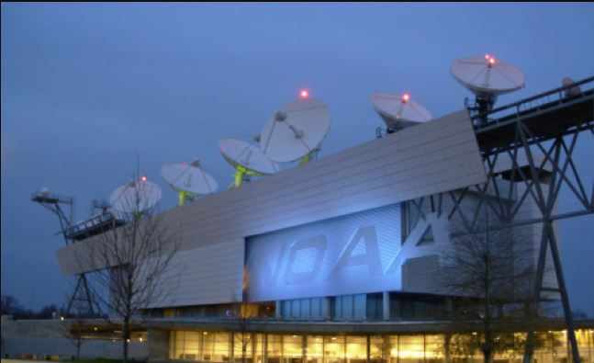
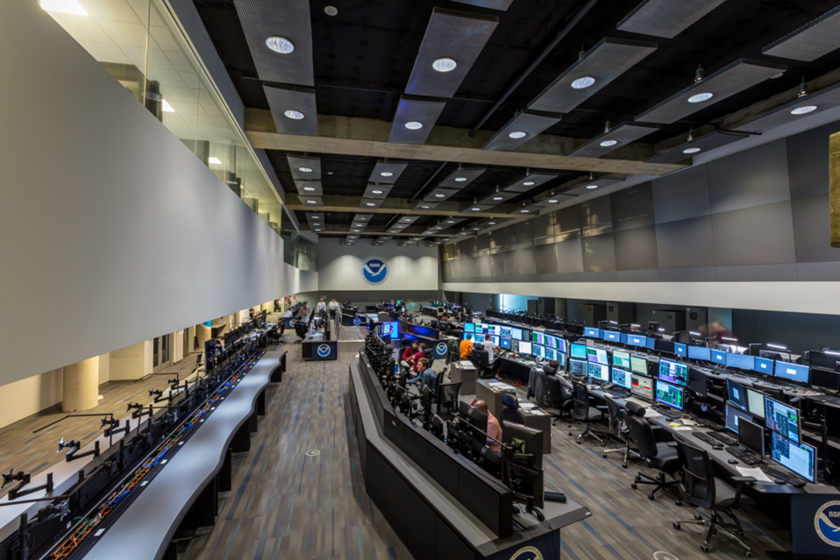
Satellite and Product Operations
NOAA NESDIS Office of Satellite and Product Operations
Performs command and control of United States operational weather satellites
Operates ground sites for command and control; and for data acquisition and retransmission
Produces derived products from satellite observations and distributes those products to authorized users in near real-time or to the archive for use by the scientific community

Slide 6
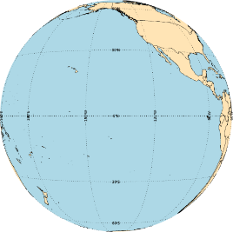
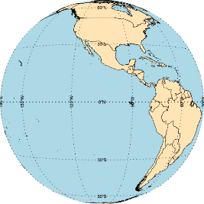
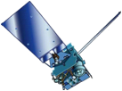
GOES Constellation
Preparing for GOES-West Ops
GOES-17
137.2° West
GOES-West
GOES-15
128° West
Standby
GOES-14
105° West
GOES-East
GOES-16
75.2° West
Storage
GOES-13
60° West
Current as of
Dec 20, 2018
GOES-West
GOES-17
137.2° West
Supplemental Operations
GOES-15
128° West
Standby
GOES-14
105° West
GOES-East
GOES-16
75.2° West
Storage
GOES-13
60° West
Plan for
January 2019
GOES-West
GOES-17
137.2° West
Storage
GOES-15
128° West
Standby
GOES-14
105° West
GOES-East
GOES-16
75.2° West
Storage
GOES-13
60° West
6 months
after GOES-17
assigned to
GOES-West

Slide 7
Overview of GOES-R Series Data Access
Acronym | System Name | Description
GRB | GOES Rebroadcast | The primary relay of full resolution, calibrated, near-real-time broadcast of GOES-R for Level 1b data products (Advanced Baseline Imager L1b, Space Weather L1b, and Geostationary Lightning Mapper L2). These data are available to all users with GRB receivers in view of a GOES-R series satellite at the East or West operational longitudes.
HRIT/ EMWIN | High Rate Information Transmission/ Emergency Managers Weather Information Network | The HRIT/EMWIN service is a new high data rate (400 Kbps) broadcast for GOES-R satellite imagery and selected products to remotely-located user terminals. Combines LRIT and the EMWIN direct broadcast service that provides users with weather forecasts, warnings, graphics and other information directly from the NWS in near real-time. Also included is a copy of GOES-DCS.
PDA | Product Distribution and Access | The Environmental Satellite Processing and Distribution System is responsible for receiving and storing real-time environmental satellite data and products and making them available to authorized users. It is located in the Environmental Satellite Processing Center at the NOAA Satellite Operations Facility in Suitland, Maryland. The Product Distribution and Access (PDA) component of ESPDS provides real-time distribution and access services for GOES-R users through a terrestrial network.
CLASS | Comprehensive Large Array-data Stewardship System | Web-based data archive and distribution system for NOAA’s environmental data. CLASS will provide retrospective data access and distribution services of GOES-R data to all users.

Slide 8
Overview of GOES-R Series Data Access
Acronym | System Name | Description
GNC-A | GEONETCast Americas | GEONETCast Americas is the Western Hemisphere component of GEONETCast, a near real time, global network of satellite-based data dissemination systems designed to distribute space-based, air-borne and in situ data, metadata and products to diverse communities.
Websites | Websites on the Internet | NOAA, NASA, NOAA Cooperative Institutes, and Universities distribute GOES-16 imagery on their websites. Many universities receive data from Unidata. Unidata has GRB and NOAPort receive stations
BDP | Big Data Project | Demonstration Project. The BDP, through Cooperative Research and Development Agreements (CRADAs), currently works with five infrastructure-as-a-service (IaaS) providers to broaden access to NOAA’s data resources.
NOAAPort | NWS Satellite Broadcast Network | GOES-R will provide selected products to the NWS Advanced Weather Interactive Processing System (AWIPS) Satellite Broadcast Network and NOAAPort. Sectorized Cloud and Moisture Imagery (SCMI) will be delivered via SBN/NOAAPort

Slide 9
GOES-R Series GOES Rebroadcast
The GOES Rebroadcast (GRB) provides the primary relay of GOES-R Series full resolution, calibrated, near-real-time direct broadcast Level 1b data from the Advanced Baseline Imager and the Space Weather instruments and Level 2 data from the Geostationary Lightning Mapper
The GRB downlink is standards-based and documented in the Product Definition and Users’ Guide and Downlink Specifications
DVB-S2
CCSDS
Product Definition and
Users’ Guide
GRB
Downlink Specifications for
Users
Digital Video Broadcasting
Consultative Committee for Space Data Systems
Notes:
The GOES Rebroadcast (GRB) provides the primary relay of full resolution, calibrated, near-real-time direct broadcast space relay of Level 1b data from each instrument and Level 2 data from the Geostationary Lightning Mapper (GLM)
The GRB downlink is standards-based, making use of the following protocols:
Digital Video Broadcasting (DVB-S2)
Consultative Committee for Space Data Systems (CCSDS) Advanced Orbiting Systems (AOS)
Space Data Link Protocol
CCSDS Space Packet Protocol

Slide 10
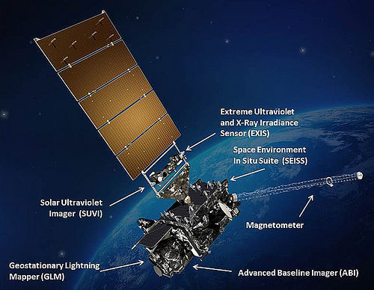
GOES-16 Products on GRB
Level 1b Products:
Radiances from the Advanced Baseline Imager: 16 Bands; Full Disk, CONUS, and Mesoscale
Solar imagery from the Solar Ultraviolet Imager
Solar flux from the Extreme Ultraviolet and X-ray Irradiance Sensors
Energetic heavy ions from the Space Environment In-Situ Suite
Space environment magnetic field from the Magnetometer
Level 2 products:
Geostationary Lightning Mapper
Space Weather Products
Notes:
Level 1b products:
Radiances from Advanced Baseline Imager: 16 Bands; Full Disk, CONUS, and Mesoscale
Solar Imagery from Solar Ultraviolet Imager
Solar Flux from the Extreme Ultraviolet and X-ray Irradiance Sensors
Energetic Heavy Ions from the Space Environment In-Situ Suite
Level 2 products:
Geostationary Lightning Mapper

Slide 11
GRB Specifications
 | GOES Rebroadcast (GRB)
Full Disk Image | 5 mins (Mode 4), 15 mins (Mode 3), and 10 mins (Mode 6)
Other Modes | 3000 km X 5000 km (CONUS: 5 minute) 1000 km X 1000 km (Mesoscale: 30 seconds)
Polarization | Dual Circular Polarized
Receiver Center Frequency | 1686.6 MHz (L-Band)
Data Rate | 31 Mbps
Antenna Coverage | Earth Coverage to 5⁰
Data Sources | ABI (16 bands), GLM, SEISS, EXIS, SUVI, MAG
Space Weather | ~2 Mbps
Lightning Data | 0.5 Mbps
Notes:
GRB replaces the GOES VARiable (GVAR) service
GRB provides improved products. ABI provides three times more spectral information, four times the spatial resolution, and more than five times faster temporal coverage than the previous system

Slide 12
GOES Rebroadcast Reception
Reception of the GOES Rebroadcast (GRB) data is accomplished by means of a fixed dish antenna with a dual left and right hand circular feed horn connected to two Low Noise Amplifiers
The Low Noise Amplifiers outputs are connected to Radio Frequency/ Intermediate Frequency down-converters
The Radio Frequency/ Intermediate Frequency down-converters are connected to Digital Video Broadcasting-S2 (DVB-S2) capable receivers
The GRB downlink signal from the satellite is at a center frequency of 1686.600 MHz and requires an Antenna gain-to-noise-temperature (G/T) of 15.2 dB/K for worst-case locations

Slide 13
GRB Reception
GOES Rebroadcast Reception
Modulation is either
8PSK with a symbol rate of 7.825768 Million symbols per second (Msps) with a rate 2/3 Forward Error Correction coding
QPSK with a symbol rate of 8.665938 Million symbols per second (Msps) with a rate 9/10 Forward Error Correction coding*
Nominal antenna size: 4.5 meter dish with a system noise temperature of 120° K
A dual circular polarization is used to accommodate the 31 Mbps data rate
See the next slide for product allocation on Right Hand Circular Polarized (RHCP) and Left Hand Circular Polarized (LHCP)
Note: The default modulation mode for GOES-16 is QPSK
GOES-R Documents are available at: https://www.goes-r.gov/resources/docs.html
GOES Rebroadcast (GRB) Downlink Specifications for Users, August 6, 2012
https://www.goes-r.gov/users/docs/GRB_downlink.pdf

Slide 14
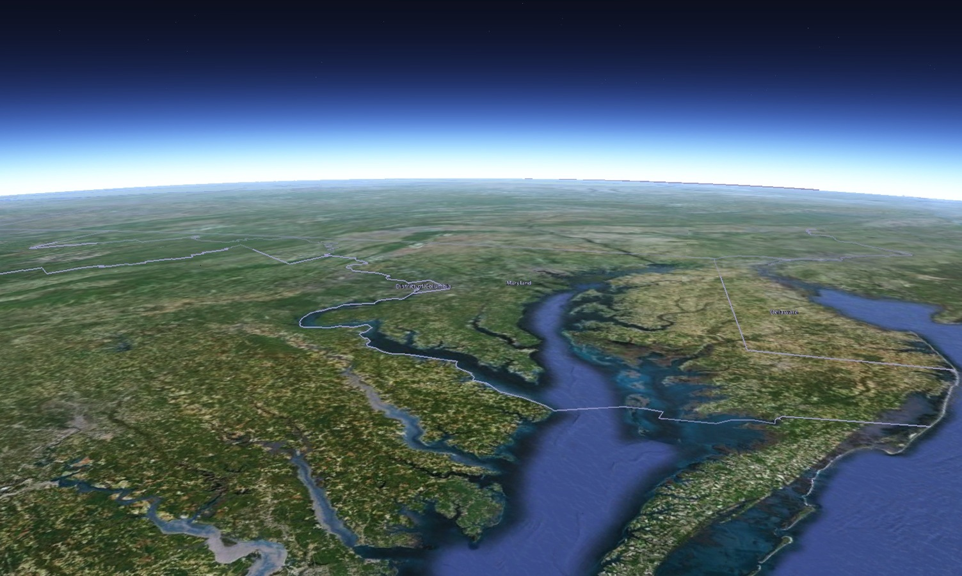
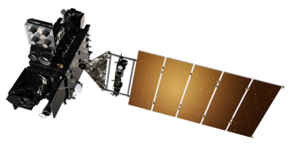
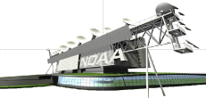
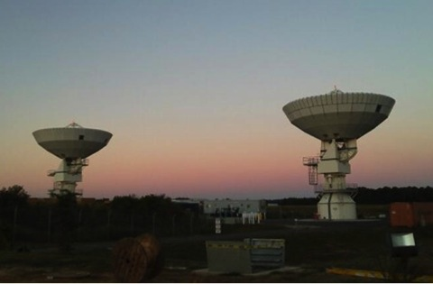
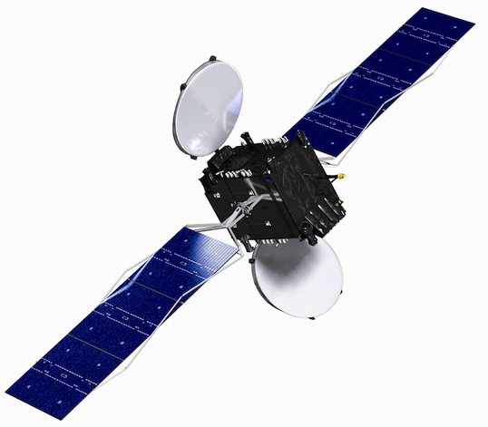
GRB Data Flow
GOES-17
137.2° West
GOES-East
75.2° West
GOES Storage
105° West
Consolidated Backup (CBU) Fairmont, WV
Command & Control, Mission Data, GRB, and HRIT/EMWIN
GRB and HRIT/EMWIN
Direct Broadcast Community
GRB
GRB
Instrument and Telemtry Data
SARSAT
DCS
SARSAT
DCS
NOAA Satellite Operations Facility (NSOF)
Suitland, MD
Instrument and Telemtry Data
Command & Control, Mission Data, GRB
L1B and L2+ Derived Products
DCS, HRIT/EMWIN
L1B, L2+
PDA
Sectorized Cloud and
Moisture Imagery
AWIPS
NCFs
Climate Research and Academia
Authorized Operational Users
Wallops Command and
Data Acquisition Station (WCDAS)
Wallops, VA
SBN/NOAAPort
NOAA Port Community

Slide 15
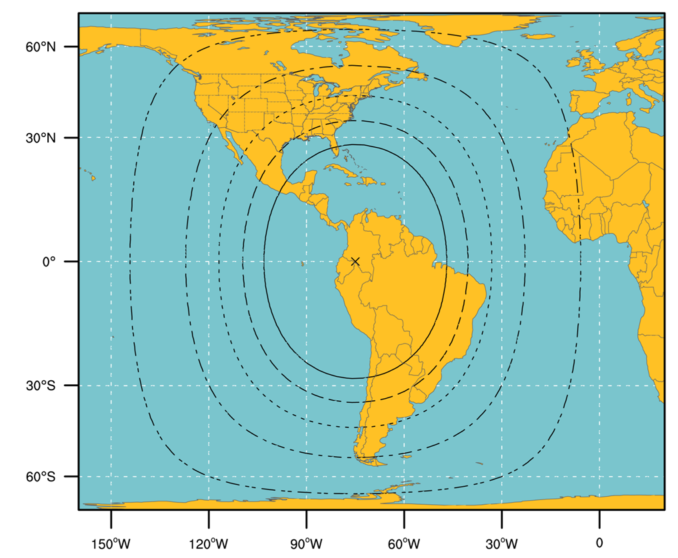
GOES-R Series GRB Ground Antenna Sizes
GOES West
GOES East
NOTES:
Calculations based on available data as of May 2011.
Each antenna size is usable within the indicated contour.
Rain attenuations included are: 1.3/1.6/2.0/2.2/2.5 dB (3.8 to 6 m)
4. An operating margin of 2.5 dB was included in the calculations, but users are warned that may not be enough in parts of North America where cellular and mobile internet service providers may provide strong interference and therefore additional antenna gain may be needed.

Slide 16
Community Satellite Processing Package for Geostationary (CSPP Geo)
Himawari AHI Composite RGBs
Funded by NOAA GOES-R Program to create and distribute software to process direct broadcast data from geostationary satellites, generating products in real-time
All software is free to download and use
GOES-16 product software is available to:
Process the GRB data stream, reconstructing the products that were generated on the ground system
Further process ABI data to generate Level 2 products
In addition, software is available to process direct broadcast data from GOES-13, GOES-15 and Himawari-8.
ABI quicklooks (GRB package)
SUVI Imagery (GRB Package)
ABI true color
Himawari-8 AHI Imagery and Cloud products (GEOCAT package)

Slide 17
CSPP Geo Level 2 Processing
ABI Level 2 products are generated by research implementations of the operational algorithms, running in the “AIT Framework” which was developed at NOAA
Level 2 products were initially made available in CSPP Geo AIT Framework Beta, and are now in Version 1 (December 2018):
Aerosol Detection: Smoke and Dust
Cloud Top Height
Aerosol Optical Depth
Cloud Top Phase
Clear Sky Mask
Cloud Top Pressure
Cloud and Moisture Imagery
Cloud Top Temperature
Cloud Optical Depth (day/night)
Land Surface Temperature (skin)
Cloud Particle Size Distribution (day/night)
GOES-16 Land Surface Temp.
GOES-16 Cloud Top Height

Slide 18
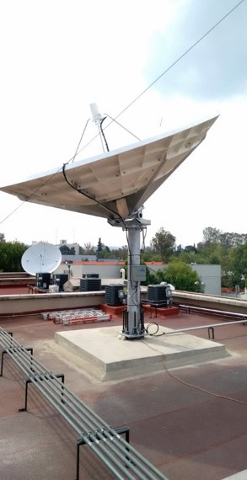
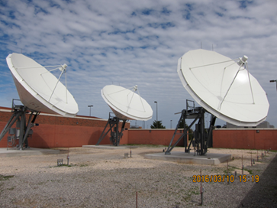
GRB User Readiness
100 GRB receive stations are accounted for (planned and installed)
83 GRB receive stations are installed
56 are receiving GOES-16 GRB (including spares)
21 are receiving GOES-17 GRB
2 plan to receive GOES-17 when it is declared GOES West
1 SKYWARN
19
International
32
Government
10
Military
7
Academic
14
Commercial
GRB Receive Station = 1 antenna and 1 receiver
18

Slide 19
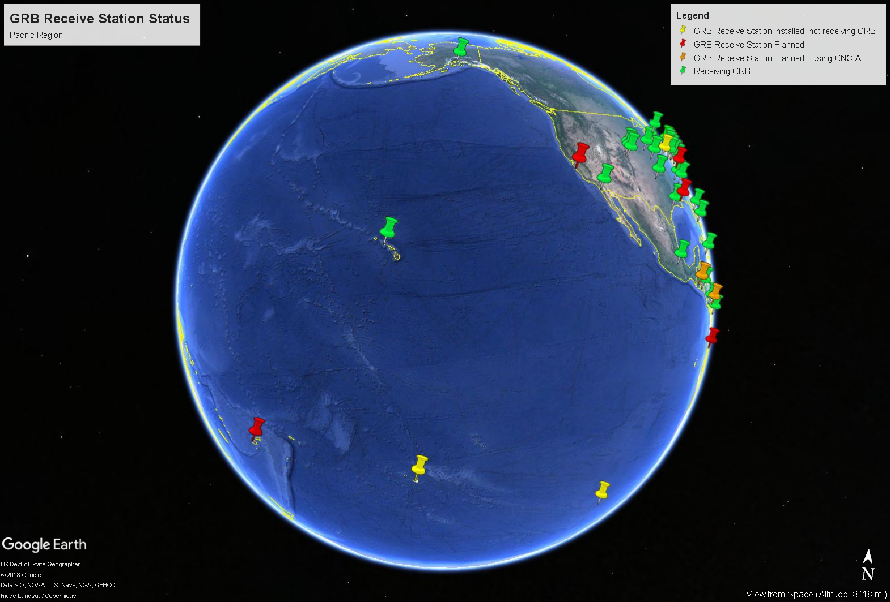
GRB Site Status
Updated on March 13, 2018

Slide 20
HRIT/EMWIN
The High Rate Information Transmission (HRIT) / Emergency Managers Weather Information Service (EMWIN) broadcast is operational on GOES-16 with a data relay capacity of 400Kbps
However, the EMWIN content on HRIT/EMWIN, virtual channels 20 – 22, is in test mode and is expected to be operational in May 2019
The initial HRIT/EMWIN product offering includes:
EMWIN products includes National Weather Service watches, warnings, forecasts and graphics
Copy of the GOES-DCS observations
Environmental maritime products from National Hurricane Center
Additional 4 km resolution GOES-15 & Himawari-8 IR/WV/Visual Imagery (GOES-17 only)
GOES-16 & 17 Imagery – ABI Cloud and Moisture Imagery (CMI) converted to the 2013 CGMS Global LRIT/HRIT standard
2 kilometer spatial resolution ABI Full Disk Bands 2, 7, 8, 9, 13, 14 and 15 available every 30 minutes
ABI mesoscale imagery in Bands 2, 7 and 13 available every 15 minutes (Band 2 is .5 km while Bands 7 and 13 are 2 km resolution)

Slide 21
HRIT/EMWIN
EMWIN
EMWIN products will be transmitted as a contiguous file on the HRIT/EMWIN broadcast, a departure from the Quick Block Transfer (QBT) protocol packet transmission from GOES NOP series broadcasts
Retransmissions of EMWIN Priority 1 products are enabled 5 seconds apart if an data dissemination outage or noisy radio frequency environments are observed
File Names. The EMWIN file naming convention has been revised to follow the WMO format identified in WMO Pub 386.
More information can be found at http://www.nws.noaa.gov/emwin/index.htm
Quarterly HRIT/EMWIN User Group Meetings
The latest HRIT/EMWIN Stakeholder/User Group meeting was held on December 6th, 2018, next user group meeting is planned for sometime in March 2019 (held quarterly)
Contact seth.clevenstine@noaa.gov to participate in HRIT/EMWIN User Group meetings and added to the email distribution list for HRIT outages/notifications

Slide 22
HRIT/EMWIN Processing Chain
GOES-16
75.2° West
GOES-17
137.2° West
Wallops Acquisition Station
Consolidated Backup
FEP-0
FEP-1
FEP-2
FEP-3
FEP-4
FEP-2
FEP-1
FEP-0
G16 Backup
G16 Backup
G16 Primary
G17 Primary
G17 Backup
G16
G17 Backup
G17
NSOF HRIT Broadcast Stream Services
CBU HRIT Broadcast Stream Services
NSOF Product Distribution and Access (PDA)
CBU Product Distribution and Access (PDA)
NSOF HRIT Broadcast Subscriptions
CBU HRIT Broadcast Subscriptions
GOES-16/17 CMI
(NSOF/CBU)
DADDS DCS Data (NSOF/WCDAS)
EWMIN (College Park/Boulder)
Internet Data (NHC & NWS)
Legacy GOES
(NSOF/CBU)

Slide 23
HRIT/EMWIN Users By Numbers
Users are defined as a having a complete receiving station capable of obtaining the HRIT/EMWIN broadcast downlink

Slide 24
HRIT/EMWIN Reception
To receive HRIT/EMWIN, a user can purchase the necessary equipment (antenna, cabling, receiver, computer, and software) from commercial companies for unlimited access to the GOES-R Series HRIT/EMWIN. A manufacturer’s list is available at: http://www.noaasis.noaa.gov/NOAASIS/ml/manulst.html
Previous compatible 1.0+ meter LRIT antennas, cabling and majority of LNB downconverters can be reused for HRIT/EMWIN
All LRIT 1691.0 MHz receivers will not work without modification or new 1694.1 MHz HRIT/EMWIN compatible receivers will need to be obtained
The transmission format; “The Coordination Group for Meteorological Satellites LRIT/HRIT Global Specification” can be downloaded from: https://www.cgms-info.org/documents/cgms-lrit-hrit-global-specification-(v2-8-of-30-oct-2013).pdf
The GOES-R Web Site provides program and technical information at: https://www.goes-r.gov/users/hrit.html
A software-based solution is described at the HRIT/EMWIN prototype receiver links and specifications webpage: https://www.goes-r.gov/users/hrit-links.html
There is no fee or license requirement required by NOAA to receive the products on HRIT/EMWIN
For any HRIT/EMWIN broadcast inquiries, please send an email to seth.clevenstine@noaa.gov for further information.

Slide 25
GRB Reception
HRIT/EMWIN Reception Details
Component | HRIT/EMWIN Broadcast Specifications | Additional Information
Platform | Operational East and West GOES-R Series Satellites | GOES-16 at 75.2° West GOES-17 at 137.2° West
Broadcast | Operating Downlink Frequency Range | L-band
 | Center Frequency | 1694.1 MHz
 | Data Rate | 400 Kbps
 | Symbol Rate | 927,000 symbols per second (sps)
 | Modulation - BPSK | Convolutional rate ½ code with constraint length 7 concatenated with Reed Solomon (255,223) with Interleave = 4 Square Root Raised Cosine filtering using an Alpha factor of 0.3 The resulting “Necessary Bandwidth” for this signal will be 1.205 MHz
 | Polarization - Linear | Vertical Offset
Antenna System | VSAT | At 5 degree elevation, the minimum antenna is 1.2 meter. At 10 degrees or more elevation the minimum size is 1.0 meter
Low-Noise Block-Down Converter | L-band | Example: Input 1691 MHz Output 137.5 Mhz
Satellite Receiver | L-band | BPSK 1691 MHz to 137.5 MHz
Software | N/A | De-encapsulates HRIT/LRIT files Visualization and Manipulation of Files Optional Applications (examples) EMWIN visualization application GOES-DCS database software or application

Slide 26
GOES Data Collection System
The GOES DCS is a relay system used to collect information from a large number of Earth-based platforms that transmit in-situ environment sensor data on predefined frequencies and schedules
In the GOES-R era, the number of user-platform channels has expanded from 266 to 433. There is also a frequency change from 1695 MHz to 1679 MHz, for the Direct Readout Ground Stations (DRGS)
Data transmission rates are 300 bps and 1200 bps
There are approximately 30,000 active DCPS (of 40,000 deployed)
Most transmit every hour. There are some platforms that transmit data every half hour and a number of platforms that transmit every 15 minutes
Tide Gages monitoring for tsunamis report every 5 or 6 minutes.
DCS relays 800,000 messages per day
An estimated 8,000,000 (million) observations per day are distributed through the global observing system
There 800 user agencies/organizations
There are 1,200 individual users registered for system access

Slide 27
Baseline Products
ADVANCED BASELINE IMAGER (ABI)
Aerosol Detection (Including Smoke and Dust)
Aerosol Optical Depth (AOD)
Clear Sky Masks
Cloud and Moisture Imagery*
Cloud Optical Depth
Cloud Particle Size Distribution
Cloud Top Height
Cloud Top Phase
Cloud Top Pressure
Cloud Top Temperature
Derived Motion Winds
Derived Stability Indices
Downward Shortwave Radiation: Surface
Fire/Hot Spot Characterization
Hurricane Intensity Estimation
Land Surface Temperature (Skin)
Legacy Vertical Moisture Profile
Legacy Vertical Temperature Profile
Radiances
Rainfall Rate / QPE
Reflected Shortwave Radiation: TOA
Sea Surface Temperature (Skin)
Snow Cover
Total Precipitable Water
Volcanic Ash: Detection and Height
Note: *Key Performance Parameter (KPP)
Notes:
GOES-R SERIES PRODUCT DEFINITION AND
USERS’ GUIDE
(PUG)
VOLUME 1: MAIN
VOLUME 2: L0 PRODUCTS
VOLUME 3: LEVEL 1B PRODUCTS
VOLUME 4: GOES-R REBROADCAST (GRB)
VOLUME 5: LEVEL 2+ PRODUCTS
APPENDIX X: ISO SERIES METADATA

Slide 28
Baseline Products
GEOSTATIONARY LIGHTNING MAPPER (GLM)
Lightning Detection: Events, Groups & Flashes
SPACE ENVIRONMENT IN-SITU SUITE (SEISS)
Energetic Heavy Ions
Magnetospheric Electrons & Protons: Low Energy
Magnetospheric Electrons & Protons: Med & High Energy
Solar & Galactic Protons
MAGNETOMETER (MAG)
Geomagnetic Field
EXTREME ULTRAVIOLET AND X-RAY IRRADIANCE SENSORS (EXIS)
Solar Flux: EUV
Solar Flux: X-ray Irradiance
SOLAR ULTRAVIOLET IMAGER (SUVI)
Solar EUV Imagery

Slide 29
Environmental Satellite Processing and Distribution System
The Environmental Satellite Processing and Distribution System (ESPDS) is an enterprise system for ingesting, producing delivering near real-time data to our core, time critical users. It is located in the Environmental Satellite Processing Center (ESPC) and includes the following major segments:
Product Generation - NOAA Data Exploitation (NDE)
Product Distribution – Production Distribution and Access (PDA)
Re-broadcast HRIT/EMWIN and GNC-A
High-speed network and services – Enterprise Infrastructure (EI)
PDA capabilities:
Peers with high speed wide area network (N-WAVE)
Greater security (secure transfer protocols, baseline monitoring, high performance threat scanning, etc.)
Configurable production with custom tailoring capability

Slide 30
GOES Data Operations in the ESPC
GOES-16/17
GRB
GOES-16/17
PPZ
PDA
Users
AWIPS
GEOPROD
Misc PG (SFS)
Users
Consolidated Backup
(CBU)
GOES-14/15
GEODIST
Legend
Environmental Satellite Processing Center (ESPC)
Nominal Operations
GOES-16/17
GRB
GOES-14/15
Backup Operations
Flow activated during Backup
Wallops CDA
GEOPROD
CIP
Misc PG
GEODIST
CIP
Users
Hot Backup
Cold Backup
Wallops Critical Infrastructure Protection (Backup)

Slide 31
Production Distribution and Access
PDA service is dedicated for authorized near real-time users. Other near real-time distribution services are being explored as PDA is a finite resource
The PUSH services are available only to users with a 24x7 support desk
New user onboarding is currently suspended while the organization assesses time critical user needs and evaluates available capacity on the system
Data access information is available at:
http://www.ospo.noaa.gov/Organization/About/access.html
Must be signed by the Government official responsible for the data flow on the subscriber’s end
For existing users who contact ESPC about a problem:
Make sure to say that you are a PDA user and provide our PDA user group name
Provide PDA product names or exact files names for the data you are missing. The filename of the last data you received is most useful to help us pinpoint your problem quickly

Slide 32
Comprehensive Large Array-data Stewardship System
CLASS is NOAA's Archive and delayed-mode distribution system for distribution of NOAA and US Department of Defense (DoD) Polar-orbiting Operational Environmental Satellite (POES) data, NOAA's Geostationary Operational Environmental Satellite (GOES) data, and derived data.
CLASS stores an average of 130 TB/month of data. The total amount of data at CLASS is almost 11 PB
A number of GOES-16/17 ABI Level 2 products are now available to the public through CLASS (GOES-17 data products have been available since November 28, 2018)
All available ABI products , as well as the L1B radiance data, are found under the GRABIPRD data family. For complete details on data maturity start dates and access dates please go to: https://www.ncdc.noaa.gov/data-access/satellite-data/goes-r-series-satellites
The GLM Level-2 products can now be ordered from CLASS under the Family name GOES-R Series GLM L2+ Data Product (GRGLMPROD)
Users need to be aware of any data caveats (warning) documented during the PS-PVR by clicking on the appropriate readme links provided
Note that CLASS is not a near real-time system and data availability is not guaranteed

Slide 33
Levels of Access Services
CLASS order types: | Average completion time | Average File Limit | Contact the CLASS Help Desk?
Ad hoc orders (Use Search button to obtain inventory) | Usually within 12 to 24 hours | Up to 500 files | No
Large orders (use Quick Search button to skip inventory ) | 24 to 48 hours | 1000 to 3000 | No
Block orders (use Quick Search button) | > 48 hours | 3000 to 6000 | Yes
Subscription (standing orders) | < 6-7 hours | No limit | Yes

Slide 34
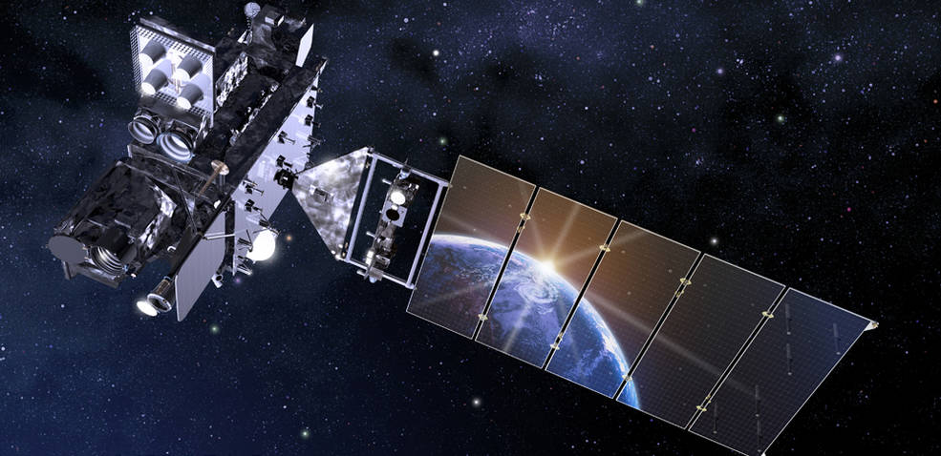
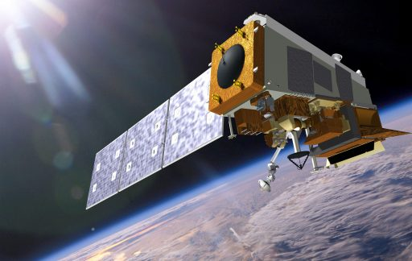
Data Availability Times
4 to 5 hrs
4 hrs
3 to 4 hrs
3 to 4 hrs
3 to 4 hrs
The data availability in CLASS for S-NPP and JPSS-1 (NOAA-20) is about 4 hours. IDPS has a built in delay in order to ensure repaired granules make it to CLASS. CLASS changed the SNPP availability from 6 hours to 4 during 2018
GOES-N GOES-R POES JASON S-NPP JPSS
Notes:
CLASS changed the S-NPP from 6 hours to 4 this year. After working JPSS, CLASS was able to reduce the time to get the repaired granuals quicker.

Slide 35
GOES-16/17 Data Products from CLASS
How to request GOES-16 data products from CLASS
Start at the following link:
https://www.class.ncdc.noaa.gov/saa/products/welcome
Then register
Set up your user preferences
Select data family to search
Search for data
Select files
Review shopping cart
Review your order status
A demonstration is available at:
https://www.class.noaa.gov/notification/demo.htm

Slide 36
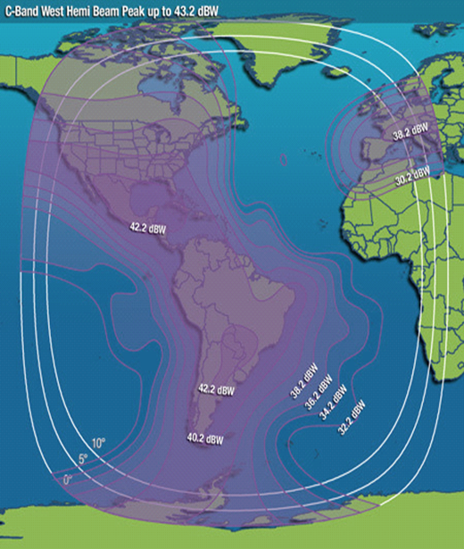
GEONETCast Americas (GNC-A)
GNC-A is the Western Hemisphere component of GEONETCast, a near real time, global network of satellite-based data dissemination systems designed to distribute space-based, air-borne and in situ data, metadata and products to diverse communities
12 Megabits per second data rate with Multiplexed C-Band DVB-S
Intelsat-21 Geostationary satellite at 58 degrees West
Footprint covers most of the Americas and Caribbean
GNC-A is providing GOES-16 Full Disk Cloud Moisture Imagery (CMI) Bands 2, 7, 8, 9, 13, 14, 15 (band 2 at 1 km and others at 2 km) every 15 minutes and Level-2 baseline products
GOES-17 Full Disk CMI on the above 7 bands and Level-2 baseline products will be provided once they reach the provisional maturity level
Selected JPSS imagery and products are available on GNC-A
Currently 81 GNC-A user stations from 19 countries in the Americas and Caribbean
More details about GNC-A on the presentation in Session 9B “National and International Education, Training, and user Readiness Activities for the New Generation Operational Environmental Satellite Systems”
Email for the point of contact for GNC-A: gnc.americas@noaa.gov

Slide 37
GNC-A Broadcast
GEONETCast Americas Broadcast Parameter | Parameter Value
Satellite | IS-21 (Intelsat)
Location | 58 ° West or 302° East
PID | 4201
Transponder | 7C
Radio Frequency Band | C-band
Frequency | 3840 MHz
Frequency Range | 3700 – 4200 MHz
Symbol Rate: | 27.69 Msym
Polarization | Linear – Vertical (Horizontal or Vertical)
Typical Edge of Coverage e.i.r.p. (Effective Isotropic Radiated Power) | > 31.3 dBW
Datacasting Client Software (Required) | Kencast FAZZT Professional Client
FEC (Forward Error Correction – Kencast FAZZT) | 7/8
Peak G/T (antenna gain-to-noise-temperature) | Up to 2.5 dB/K

Slide 38
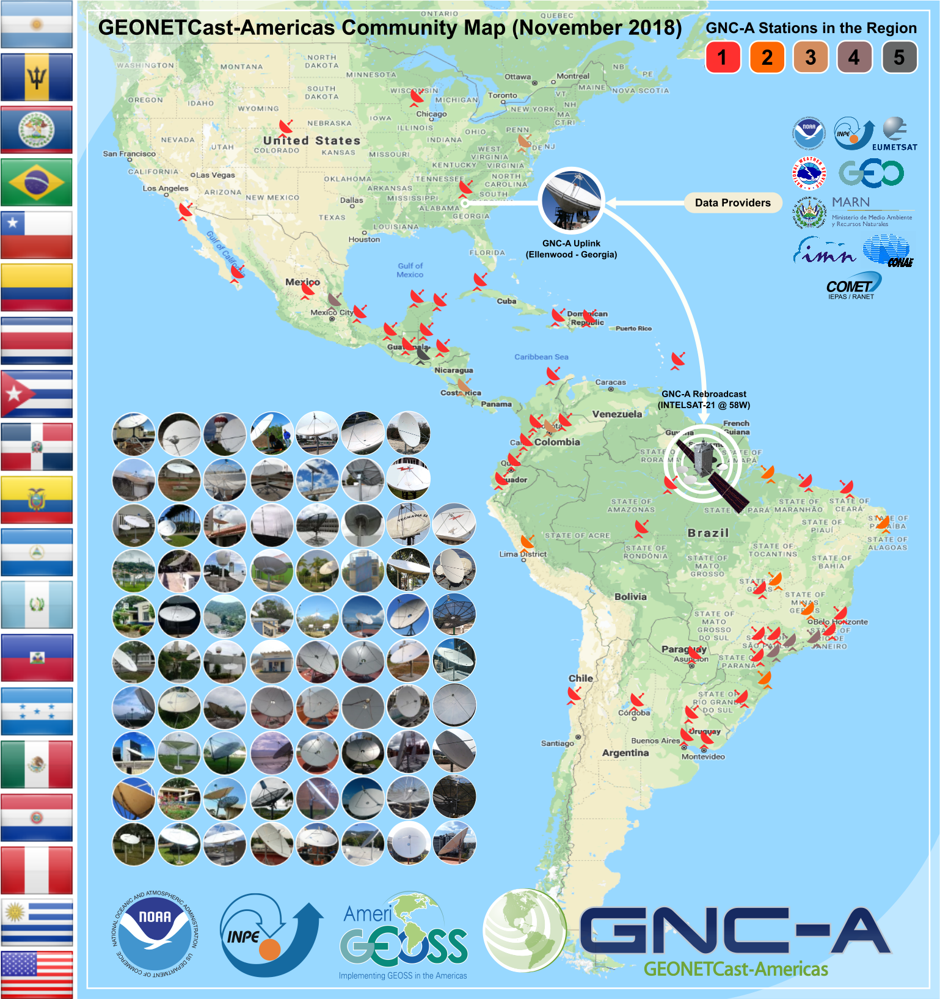
GNC-A Community Map

Slide 39
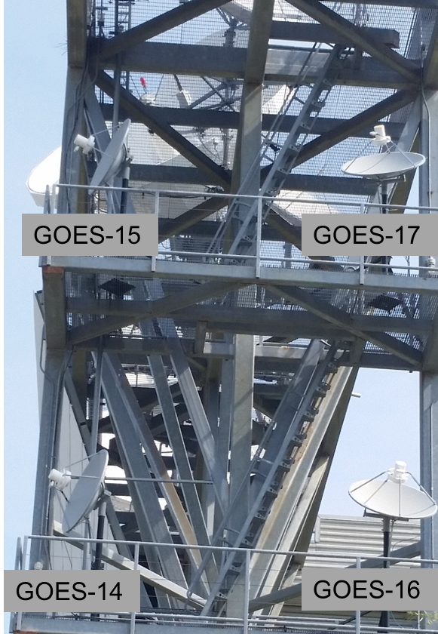
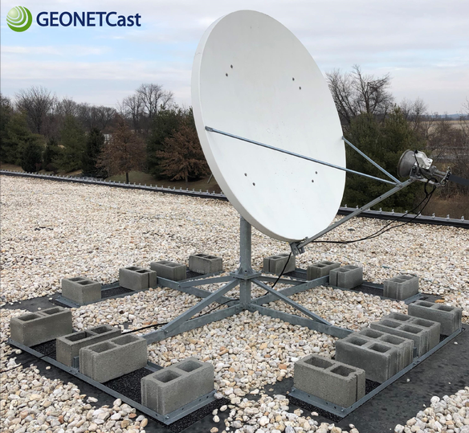
Data Access Options
14 Minutes
12 Minutes
Data Latency
(From L1b generation to receipt by receive station)
10 Minutes
8 Minutes
GNC-A
6 Minutes
HRIT/
EMWIN
4 Minutes
2 Minutes
GRB
5MBps 10 MBps 15 MBps 20 MBps 25 MBps 30 MBps
Bandwidth

Slide 40
Big Data Project
NOAA’s Big Data Project (BDP) is designed to facilitate public use of key environmental datasets by providing copies of NOAA’s information in the Cloud, allowing users to do analyses of data and extract information without having to transfer and store these massive datasets themselves
http://www.noaa.gov/big-data-project
CICS-NC is a partner in the BDP and acts as a broker between NOAA and the public cloud providers
Links to Public Cloud Information and Datasets
GOES-16/17 Data:
Amazon Web Services
Google Cloud Platform
Open Commons Consortium
Notes:
BDP Homepage:
http://www.noaa.gov/big-data-project
CICS-NC is a partner in the BDP and acts as a broker between NOAA and the public cloud providers
https://ncics.org/data/noaa-big-data-project/
Links to Public Cloud Information and Datasets
GOES-16 Data:
Amazon Web Services
Open%20Commons%20Consortium
IBM NOAA Data Portal
https://noaa-crada.mybluemix.net/node/33
Google Cloud Platform
https://console.cloud.google.com/launcher/details/noaa-public/goes-16?pli=1
Open Commons Consortium
http://edc.occ-data.org/goes16/getdata/

Slide 41
Unidata/UCAR
Unidata/UCAR is currently making all GOES-16 and GOES-17 data available
Receiving GOES-16 GRB and GOES-17 GRB
Receiving GOES-16 products on NOAAPort
Methods of distribution include:
McIDAS Abstract Data Distribution Environment (ADDE). ADDE is a Client/server data access model developed for McIDAS. Provides access for McIDAS-X, McIDAS-V, IDV, etc.) for NOAAPort and GRB-delivered content
THREDDS Data Server (TDS) provides access for a variety of applications for NOAAPort and GRB-delivered content thredds-test.unidata.ucar.edu
Website for NOAAPort and GRB delivered content
Internet Data Distribution (IDD) is a real-time data "push" technology for NOAAPort and GRB-delivered content
Projects -> Internet Data Distribution
https://www.unidata.ucar.edu/projects/index.html#idd

Slide 42
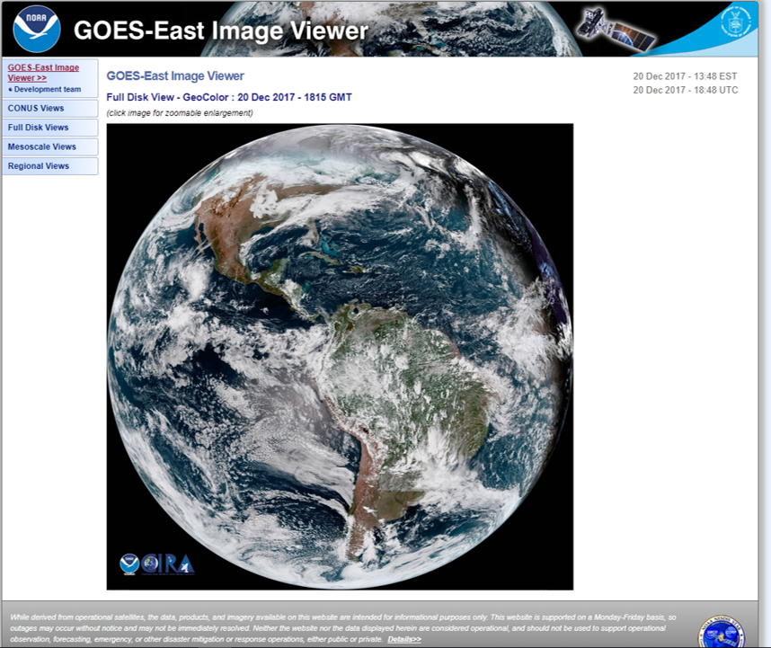
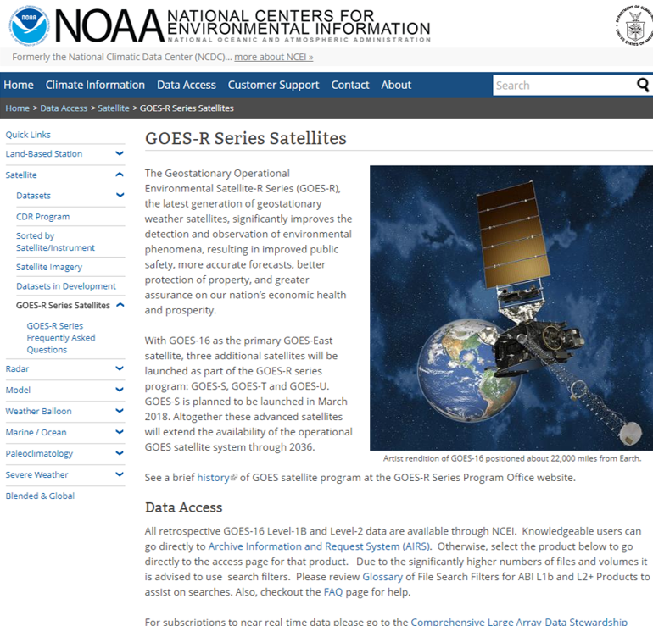
Websites
https://www.star.nesdis.noaa.gov/GOES/
https://www.ncdc.noaa.gov/data-access/satellite-data/goes-r-series-satellites

Slide 43
Links to Websites
NOAA STAR GOES-16 Image Viewer
NOAA/NESDIS Geostationary Satellite Server
SSEC Geo Browser Color hybrid with GOES-16/17 and Suomi NPP
SSEC Geo Browser All bands, Meso1 Meso2 and CONUS and Full Disk, plus a "spectral" (all channels) loop geo imagery (SSEC Real Earth TM) All bands, CONUS and Full Disk and both meso-scale sectors
UW – Madison SSEC/CIMSS List of GOES-16 Websites
UW-Madison AOS Many sectors (including Southern Wisconsin) and several enhancements
RAMMB Slider GeoColor, all bands and all sectors
CIRA Central and South America and the Caribbean
ABI GOES-16/17 imagery (SPORT) 16 bands, RGBs, Full Disk and CONUS and Meso-scale sectors weather.us US view, several options
Meteo-Chile 16 bands and RGB images over Chile and 1-page band fact sheets
Brazil's CPTEC All ABI bands in animation over South America.
UNAM
Fuerza Aérea Colombiana
Notes:
NOAA STAR GOES-16 Image Viewer https://www.star.nesdis.noaa.gov/GOES/GOES16_CONUS.php
NOAA/NESDIS Geostationary Satellite Server http://www.goes.noaa.gov/index.html
SSEC Geo Browser Color hybrid with GOES-16 and Suomi NPP http://www.ssec.wisc.edu/data/geo/#/animation?satellite=goes-16&end_datetime=latest&n_images=4&coverage=conus&channel=rgbstr&image_quality=gif&anim_method=javascript
SSEC Geo Browser All bands, Meso1 Meso2 and CONUS and Full Disk, plus a "spectral" (all channels) loop geo imagery (SSEC Real Earth TM) All bands, CONUS and Full Disk and both meso-scale sectors
https://www.ssec.wisc.edu/data/geo/#/animation?satellite=goes-16
UW-Madison AOS Many sectors (including Southern Wisconsin) and several enhancements
http://www.aos.wisc.edu/weather/wx_obs/GOES16.html
RAMMB Slider GeoColor, all bands and all sectors http://rammb-slider.cira.colostate.edu/
ABI GOES-16 imagery (SPORT) 16 bands, RGBs, Full Disk and CONUS and Meso-scale sectors weather.us US view, several options
https://weather.msfc.nasa.gov/sport/
Meteo-Chile 16 bands and RGB images over Chile and 1-page band fact sheets
http://www.meteochile.cl/PortalDMC-web/index.xhtml
Brazil's CPTEC All ABI bands in animation over South America.
http://pyata.cptec.inpe.br/acervowebv2/loop.show.logic
UNAM http://www.lanot.unam.mx/
Fuerza Aérea Colombiana https://www.simfac.mil.co/news.php

Slide 44
Links to Websites
Embry Riddle Aeronautical University (Daytona Beach, FL campus)
GLM NASA SPoRT
GLM Univ of Maryland
Notes:
Embry Riddle Aeronautical University (Daytona Beach, FL campus)
http://wx.erau.edu/erau_sat/
GLM NASA SPoRT
https://weather.msfc.nasa.gov/cgi-bin/sportPublishData.pl?dataset=goeseastglm&product=group&loc=conus
GLM Univ of Maryland
hhttp://lightning.umd.edu/Apps/GoesCesium/

Slide 45
Other Data Access Links
NOAA satellite direct broadcast systems (GRB, HRIT, EMWIN, HRD, GNC-A)
http://www.noaasis.noaa.gov/NOAASIS/ml/satservices.html
NOAA Centers for Environmental Information (NCEI) portal NOAA/NESDIS CLASS
http://www.class.ngdc.noaa.gov/saa/products/welcome
Cloud services (experimental)
AWS: https://aws.amazon.com/public-datasets/goes/
Google: https://console.cloud.google.com/launcher/details/noaa-public/goes-16?pli=1
OCC: http://edc.occ-data.org/goes16/getdata/
NESDIS websites:
NOAA/NESDIS Geostationary Satellite Server http://www.goes.noaa.gov/index.html
NOAA/NESDIS GOES-East Image Viewer https://www.star.nesdis.noaa.gov/GOES/index.php

Slide 46
Notifications, Status, and Contacts
24/7 Help Desk | ESPCOperations@noaa.gov
ESPC Messages | https://www.ospo.noaa.gov/Operations/messages.html
User Services | SPSD.UserServices@noaa.gov
Data Access | NESDIS.Data.Access@noaa.gov
Facebook | https://www.facebook.com/NOAASatellites/
Twitter | https://twitter.com/NOAASatellites
GOES Status | https://www.ospo.noaa.gov/Operations/GOES/status.html
GOES User Information and Documents | https://www.ospo.noaa.gov/Operations/GOES/documents.html
Direct Services | https://noaasis.noaa.gov/NOAASIS/
GRB User Group | James.mcnitt@noaa.gov
Notes:
24/7 Help Desk
ESPCOperations@noaa.gov
ESPC Messages
http://www.ssd.noaa.gov/PS/SATS/messages.html
User Services
SPSD.UserServices@noaa.gov
Data Access
NESDIS.Data.Access@noaa.gov
Facebook
www.facebook.com/NOAANESDIS
Twitter
www.twitter.com/noaasatellites
Press releases
http://www.nesdis.noaa.gov/news_archives/
GOES Status
http://www.ospo.noaa.gov/Operations/GOES/status.html
GOES User Information and Documents
http://www.ospo.noaa.gov/Operations/GOES/documents.html
Direct Services
http://noaasis.noaa.gov/NOAASIS/
Other Links:
NOAASIS Website
http://noaasis.noaa.gov/NOAASIS/
List of GRB Vendors and Manufacturers at:
http://www.noaasis.noaa.gov/NOAASIS/ml/manulst.html
GOES-R Website
https://www.goes-r.gov/
GOES-R Product Definition and Users' Guide (PUG) Volume 4 http://www.goes-r.gov/users/docs/PUG-GRB-vol4.pdf
GRB Downlink Specification
http://www.goes-r.gov/users/docs/GRB_downlink.pdf

Slide 47
Summary
There are a number of alternatives for obtaining GOES-R Series data products:
GOES Rebroadcast (GRB) is the fastest and most reliable way. It is also the most expensive for the user
High Rate Information Transmission/ Emergency Managers Weather Information Network (HRIT/EMWIN) provides low-resolution imagery. Cost to user is less than GRB. There is a delay due to processing at ESPC
GEONETCast Americas (GNC-A) provides a subset of products. Cost to user is less than GRB. There is a delay due to processing at ESPC and distribution to NOAA’s contractor
Production Distribution and Access (PDA). PDA service is dedicated for authorized near real-time users. New user onboarding is currently suspended while the organization assesses time critical user needs and evaluates available capacity on the system
Comprehensive Large Array-data Stewardship System (CLASS). Level 1b and Level 2 products available with a delay
Internet Access
Point of Contact: Jim McNitt, Email: james.mcnitt@noaa.gov

Slide 48
Acronyms
ABI | Advanced Baseline Imager
AIT | Algorithm Integration Team
AOS | Advanced Orbiting Systems
AWIPS | Advanced Weather Interactive Processing System
BDP | Big Data Project
CBU | Consolidated Backup
CCSDS | Consultative Committee for Space Data Systems
CMI | Cloud Moisture Imagery
DADDS | DCS Administration and Data Distribution System
CFDP | CCSDS File Delivery Protocol
CICS-NC | NOAA Cooperative Institute for Climate and Satellites – North Carolina
CIMSS | Cooperative Institute for Meteorological Satellite Studies

Slide 49
Acronyms
CIP | Critical Infrastructure Protection
CLASS | Comprehensive Large Array-data Stewardship System
DRO | Direct Readout
DVB-S2 | Digital Video Broadcasting
DCS | Data Collection System
DoD | Department of Defense
EIRP | Equivalent Isotropically Radiated Power
EOC | Edge of Coverage
ESPC | Environmental Satellite Processing Center
ESPDS | Environmental Satellite Processing and Distribution System

Slide 50
Acronyms
EXIS | Extreme Ultraviolet and X-ray Irradiance Sensors
FEC | Forward Error Correction
FEP | Front End Processor
GLM | Geostationary Lightning Mapper
GNC-A | GEONETCast Americas
GOES | Geostationary Operational Environmental Satellites
GRB | GOES Rebroadcast
GVAR | GOES Variable
G/T | Antenna gain-to-noise-temperature
GTS | Global Telecommunication System (GTS)
HRR | Handover Readiness Review
JPSS | Joint Polar Satellite System
KPP | Key Performance Parameter

Slide 51
Acronyms
HRIT/EMWIN | High Rate Information Transmission/ Emergency Managers Weather Information Network
LNA | Low Noise Amplifier
LZSS | Level Zero Storage System
NESDIS | National Environmental Satellite, Data, and Information Service
NHC | National Hurricane Center
NOAA | National Oceanic and Atmospheric Administration
NSOF | NOAA Satellite Operations Facility
NWS | National weather Service
OSPO | Office of Satellite and Product Operations
PDA | Production Distribution and Access
PLT | Post Launch Test
PUG | Product Definition and Users’ Guide
PS-PVR | Peer Stakeholder – Product Validation. Reviews

Slide 52
Acronyms
NDE | NPP Data Exploitation
PLPT | Post Launch Product Testing
QC | Quality Control
SCMI | Sectorized Cloud and Moisture Imagery
SEISS | Space Environment In-Situ Suite
S-NPP | Suomi National Polar-orbiting Partnership
SSEC | Space Science and Engineering Center
SUVI | Solar Ultraviolet Imager i
WCDAS | Wallops Command and Data Acquisition Station
XPI | Cross-Polarization Interference

