Slide 1
Hands-on exercise showcasing ABI’s 16 channels with improved spatial resolution and temporal refresh rate (plus RGB ABI examples) Mat Gunshor¹, Tim Schmit², Scott Lindstrom¹, Chris Schmidt¹, and Jordan Gerth¹ (and others) 1. Cooperative Institute for Meteorological Satellite Studies (CIMSS) – UW-Madison 2. NOAA/NESDIS/STAR/ASPB
http://cimss.ssec.wisc.edu/goes/shortcourse/seattle2017.html
http://tinyurl.com/goesrsea17

Slide 2
Educational
WebApps:
Front Page
http://cimss.ssec.wisc.edu/education/goesr

Slide 3
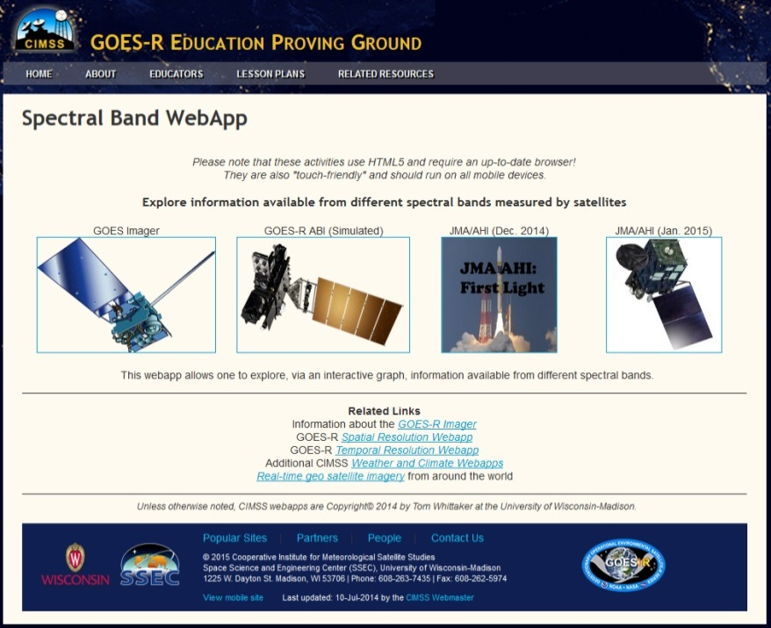
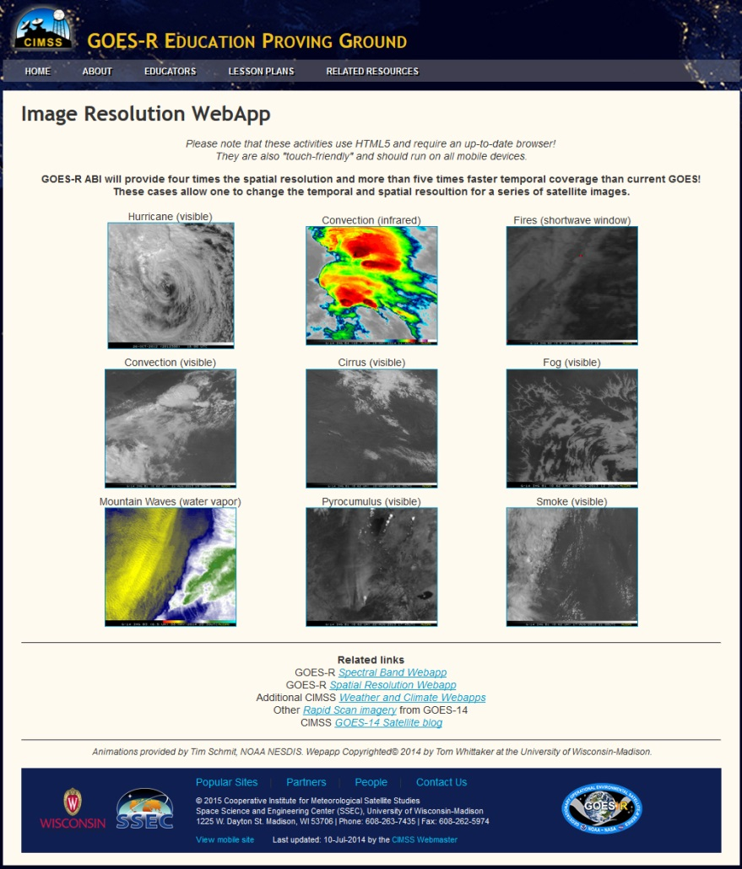
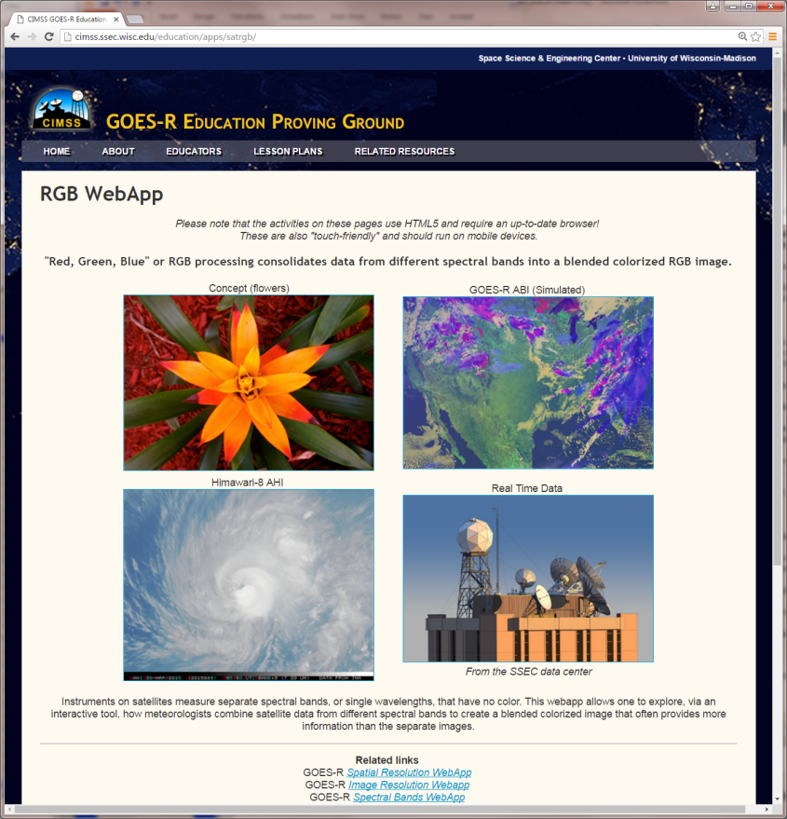
Educational WebApps
http://cimss.ssec.wisc.edu/education/goesr/

Slide 4
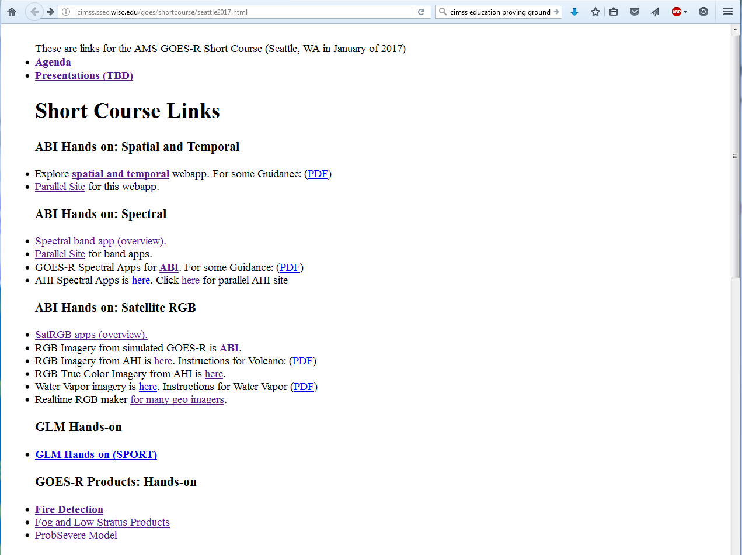
http://cimss.ssec.wisc.edu/goes/shortcourse/seattle2017.html
OR
http://tinyurl.com/goesrsea17
Explore an example, what might advantages of high time observations be?
Pick another case, what do you see?
Note: The main purpose is to introduce the tools, they can be further explored later.

Slide 5
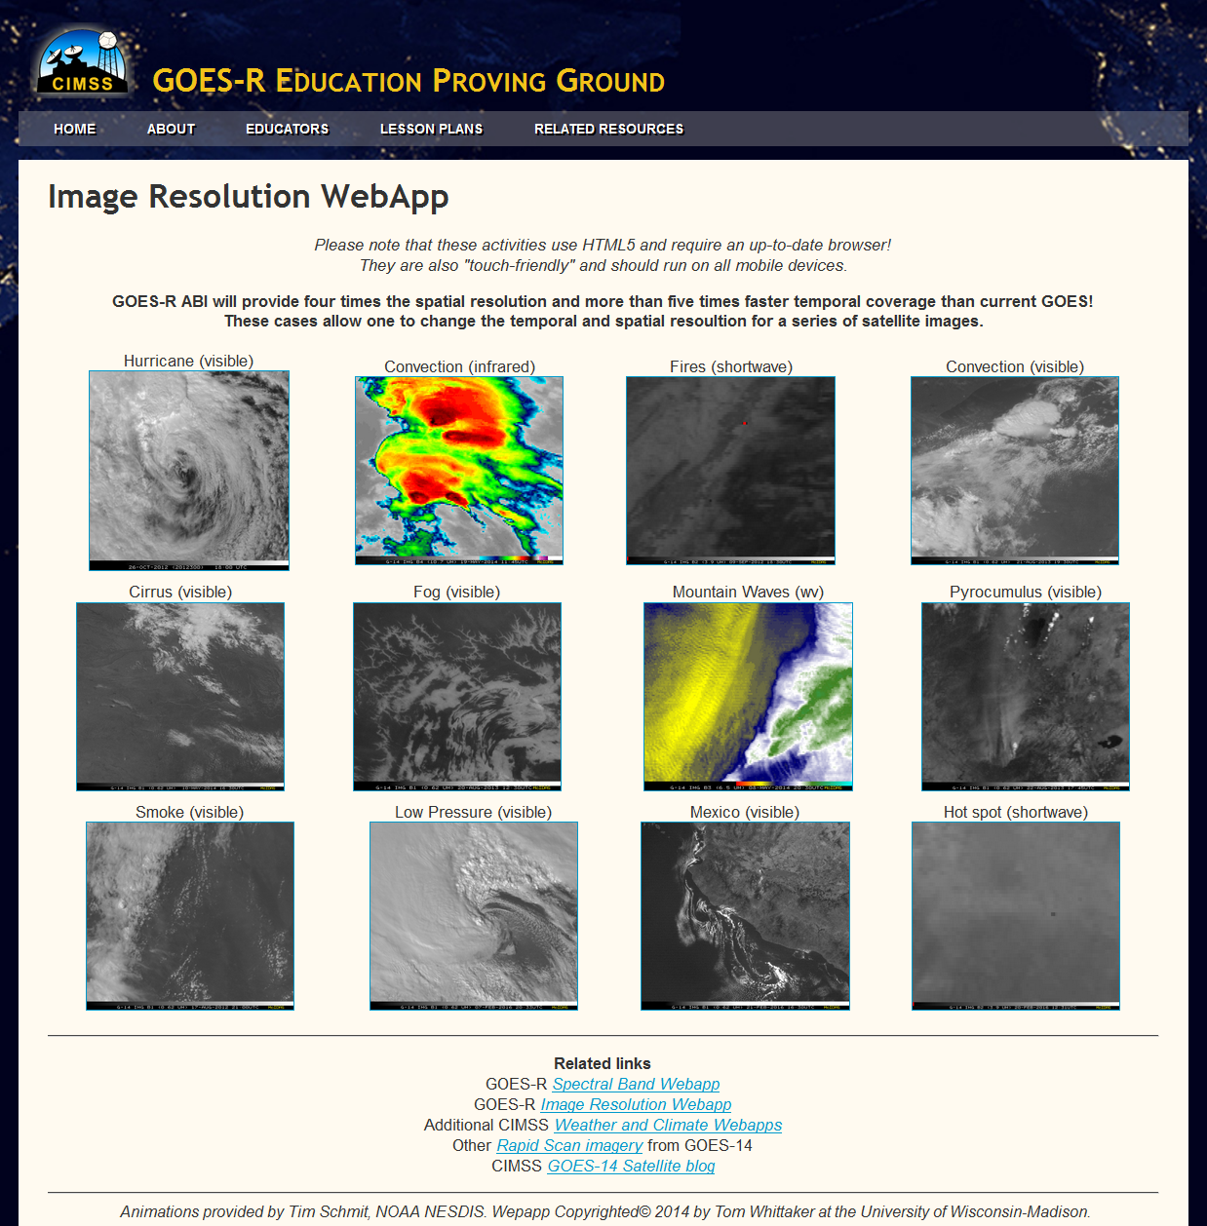
http://cimss.ssec.wisc.edu/goes/applets/overview.html

Slide 6
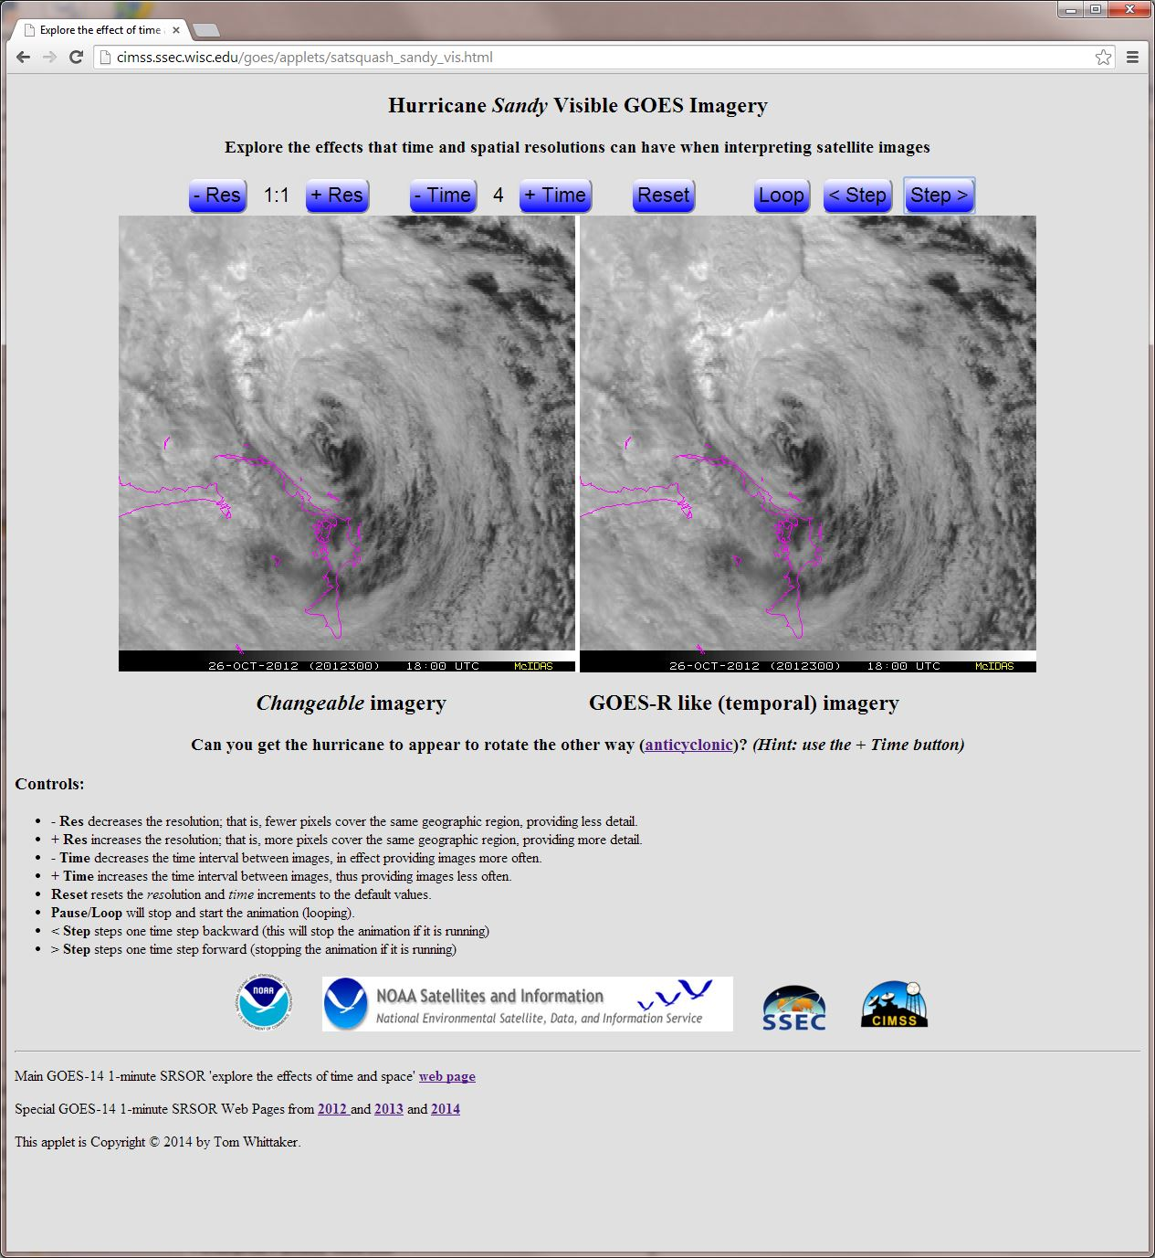

Slide 7
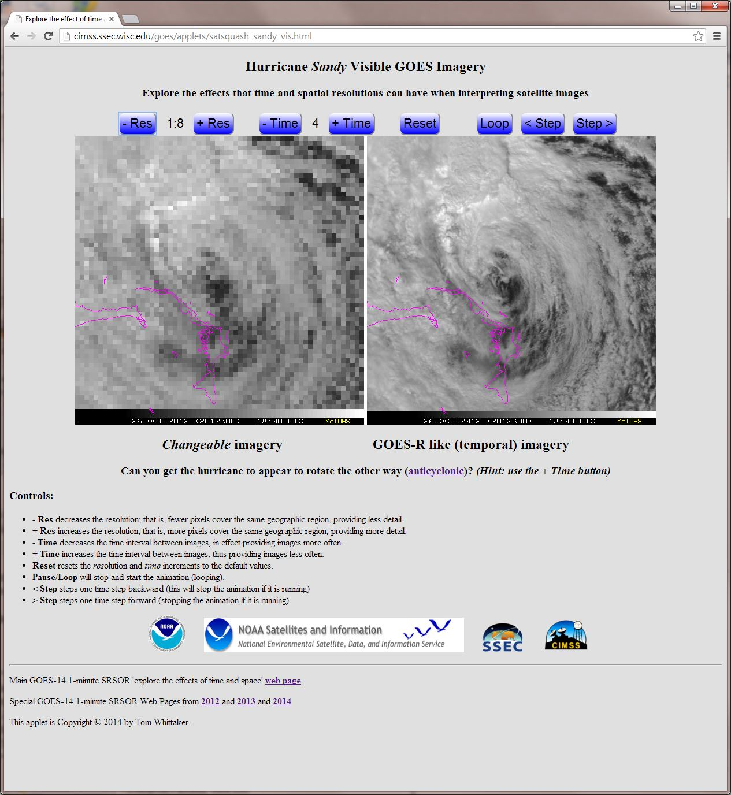

Slide 8
http://cimss.ssec.wisc.edu/goes/shortcourse/seattle2017.html
OR
http://tinyurl.com/goesrsea17
Explore an example, pick a case.
Turn on the “interactive chart”
What’s the general relationship between the visible and IR bands?
Note: The main purpose is to introduce the tools, they can be further explored later.

Slide 9
Then pick a case…

Slide 10
Spectral Band Webapp
NOAA NESDIS ASPB teamed up with CIMSS researchers to develop several educational WebApps to explore space, time and spectral resolutions of satellite imagery.
Part of the GOES-R Educational Proving Ground at CIMSS:
http://cimss.ssec.wisc.edu/education/goesr
Teacher feedback: “…. Wow!! This is awesome!! This is impressive. Thank you for sharing. This is great. Thanks for all your hard work and help!!!! We are honored and will use it next week … Earth SySTEM Teacher Academy”
Sample interactive “Bandapp” educational webapp using simulated ABI images:
http://cimss.ssec.wisc.edu/education/apps/bandapp/
Notes:
Tim Schmit, ASPB
https://ams.confex.com/ams/95Annual/webprogram/Paper265203.html ABI = Advanced Baseline Imager
Other new webapps: one to change both the spatial and temporal sampling and the other only the pixel sampling

Slide 11
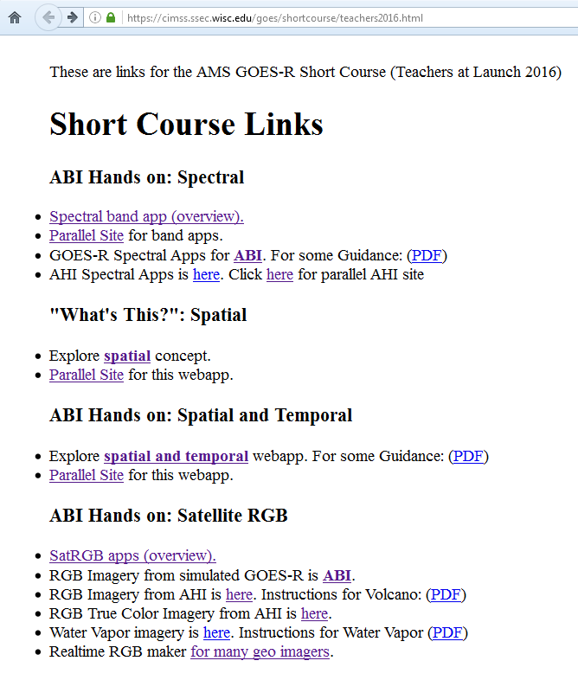
http://cimss.ssec.wisc.edu/goes/shortcourse/seattle2017.html
OR
http://tinyurl.com/goesrsea17

Slide 12
The Birth of an RGB Composite
Scale a range of values for a single band from 0 to 1
Create a triplet at each pixel, where each of the three bands contributes a value to the triplet
The triplet is in the order of the additive primary colors for display purposes
(Red, Green, Blue)
The triplet (1, 0, 0) is red, (0, 1, 0) is green, (0, 0, 1) is blue, (0, 0, 0) is black, and (1, 1, 1) is white

Slide 13
RGB Color Space as a Cube
Source: https://en.wikipedia.org/wiki/RGB_color_space

Slide 14
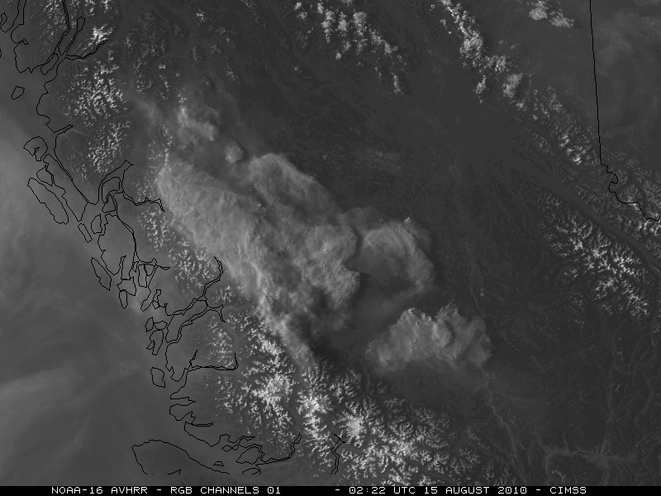
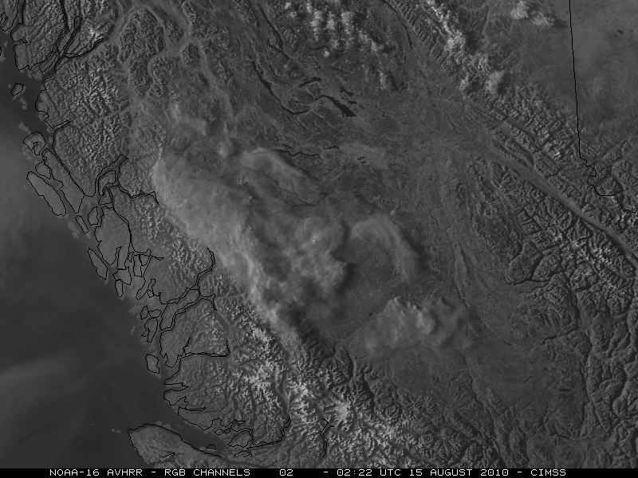
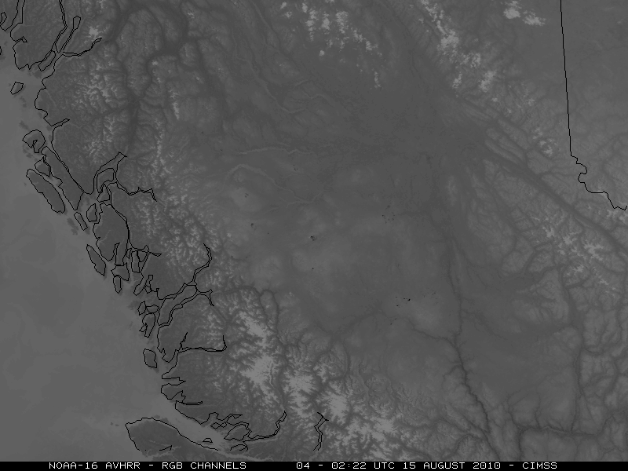
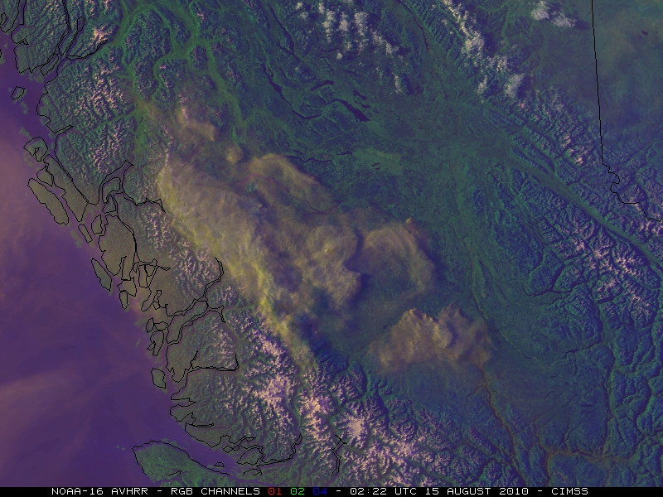
AVHRR example courtesy of Scott Bachmeier, CIMSS
R G
B C

Slide 15
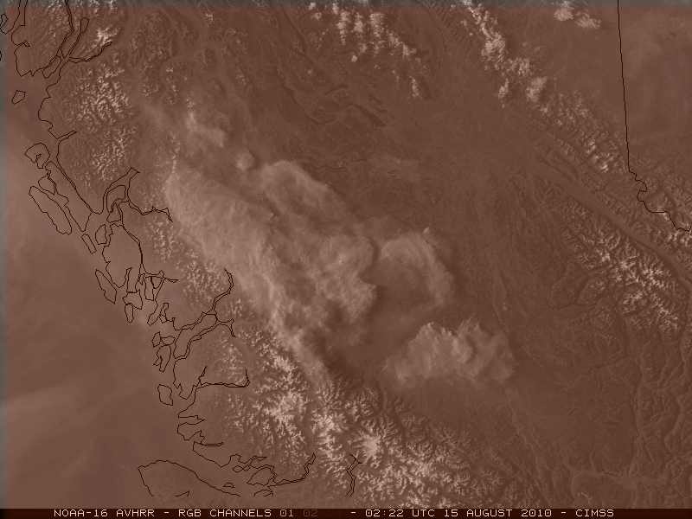
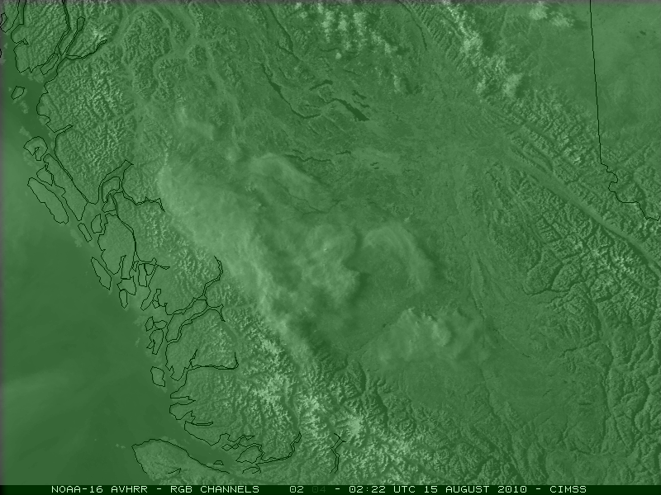
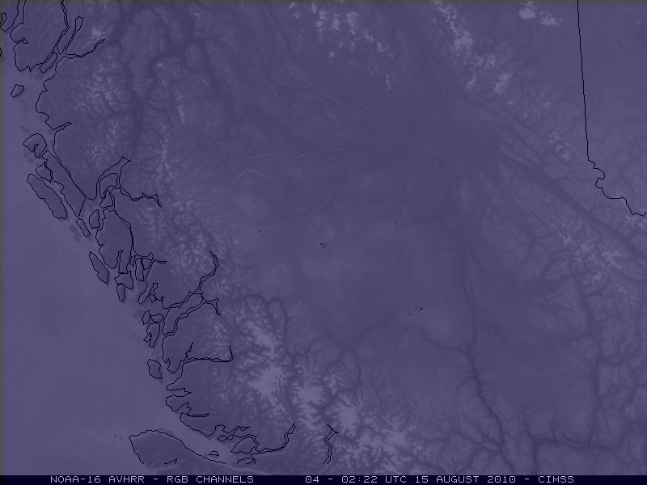
AVHRR example courtesy of Scott Bachmeier, CIMSS
R G
B C

Slide 16
http://cimss.ssec.wisc.edu/goes/shortcourse/seattle2017.html
OR
http://tinyurl.com/goesrsea17
Explore an example. Can you get the ice clouds to stand out?
Or the vegetation?
Can you make a really ‘vivid’ image?
Note: The main purpose is to introduce the tools, they can be further explored later.

Slide 17
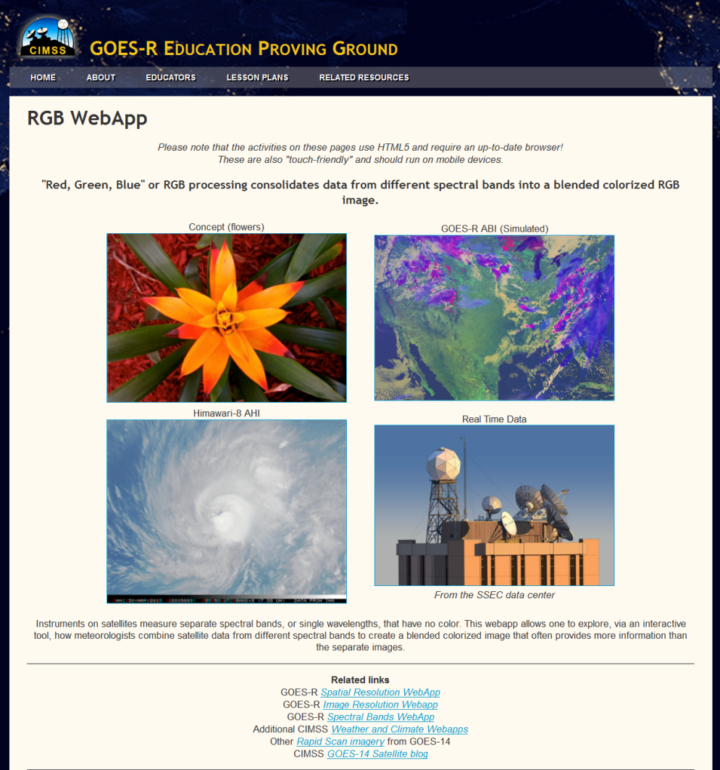
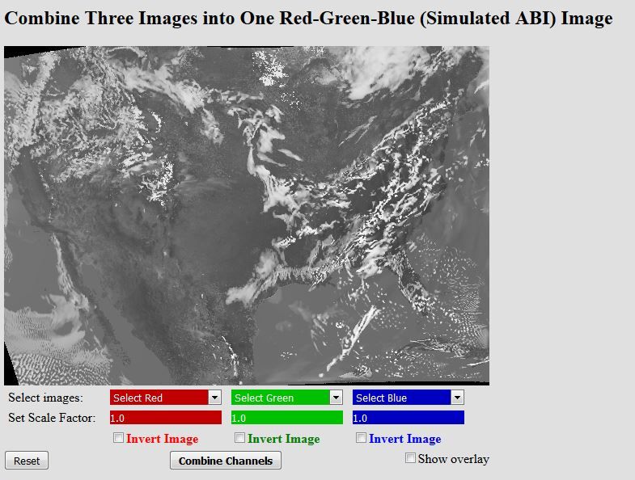
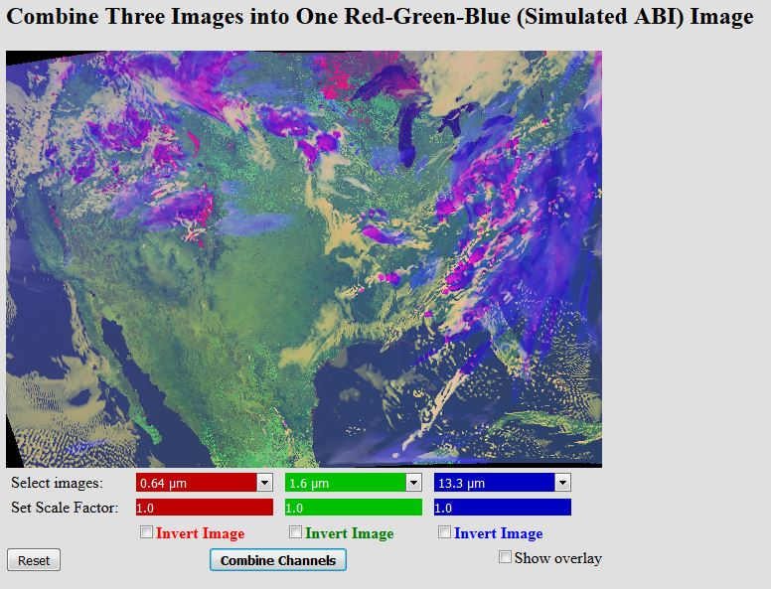
Educational RGB Webapp
Sample interactive “RGB” educational webapp using simulated ABI images:
http://cimss.ssec.wisc.edu/education/apps/satrgb/
Webapp to combine simulated ABI images into one image.
Notes:
Tim Schmit, ASPB
https://ams.confex.com/ams/95Annual/webprogram/Paper265203.html ABI = Advanced Baseline Imager
Other new webapps: one to change both the spatial and temporal sampling and the other only the pixel sampling

Slide 18
Educational
WebApps:
Front Page
http://cimss.ssec.wisc.edu/education/goesr/
Simulated ABI Spectral Bands:
Notes:
Bottom image is simulated 16 bands of the ABI

