Slide 1
Single Band Lab
Fog/Stratus-Cloud-Ice

Slide 2
Aim
Feature identification through a comparison of the output from four ABI bands (2, 3, 4 and 5)
Exercise:
  Compare the images shown on the next four slides
  Suggest possible feature types at locations A, B and C
  Justify your suggestions based on your knowledge of the characteristics of these bands

Slide 3
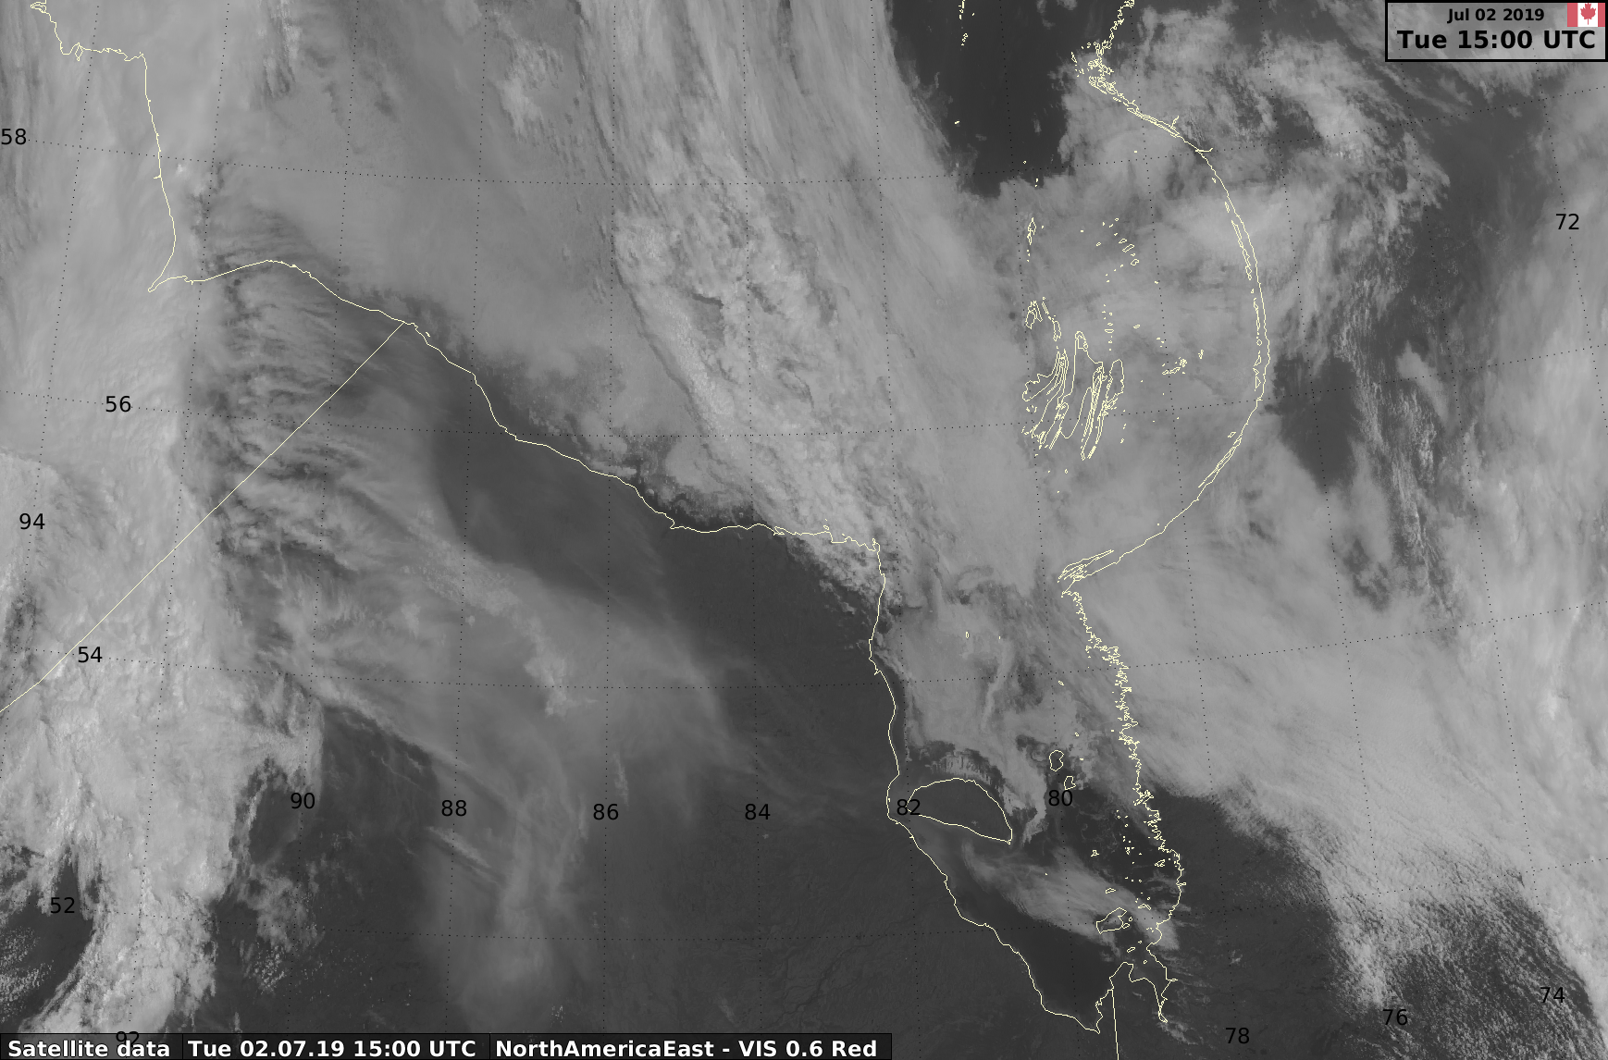
Band 2 – VIS (red) – 0.6 micron
A
B
C

Slide 4
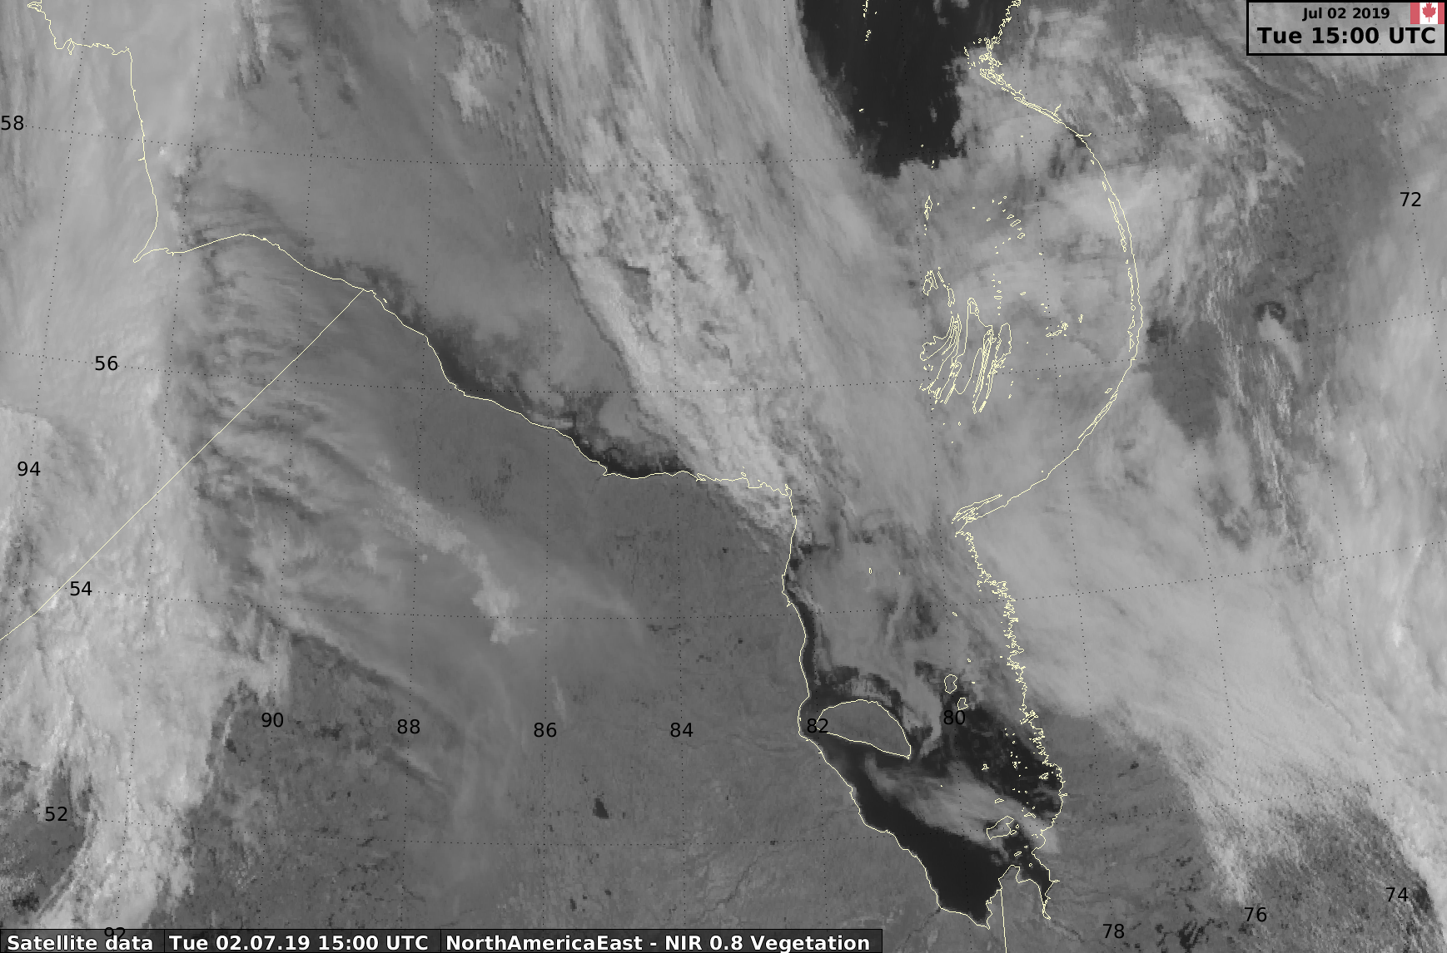
Band 3 – Veggie – 0.8 micron
A
B
C

Slide 5
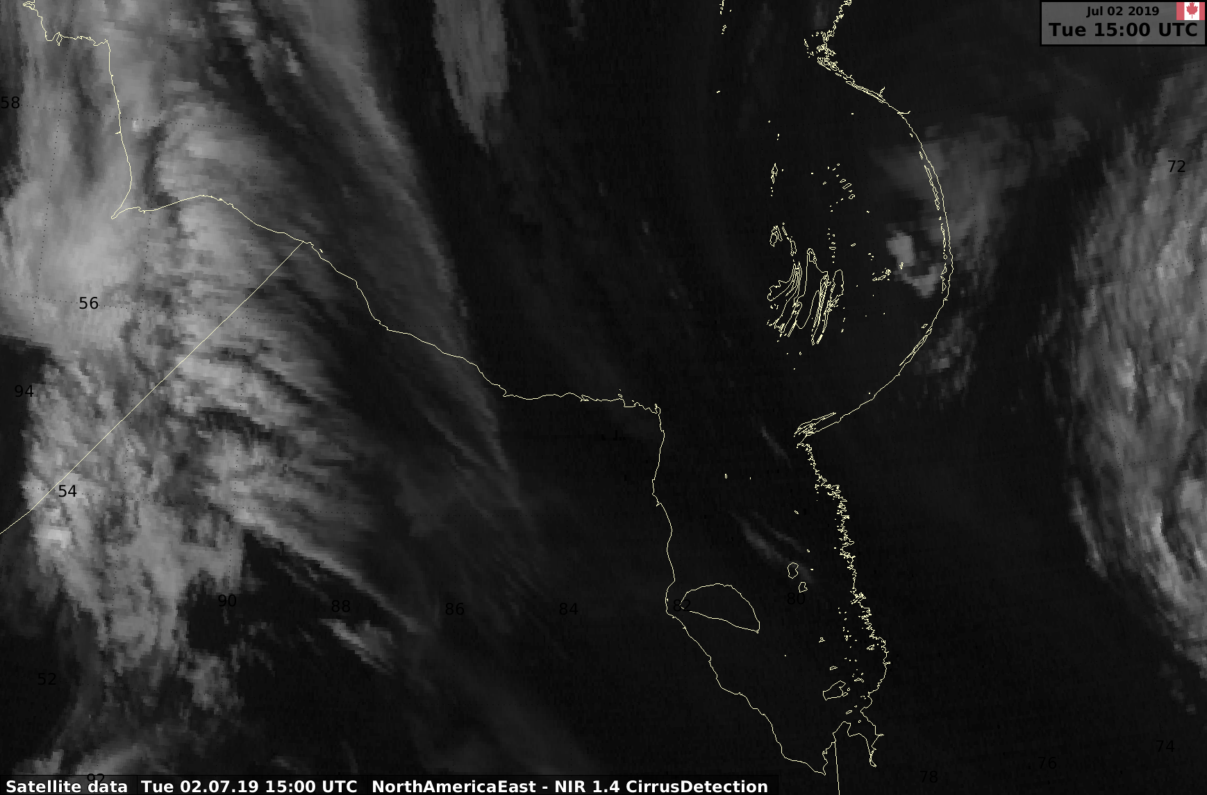
Band 4 – Cirrus – 1.4 microns
A
B
C

Slide 6
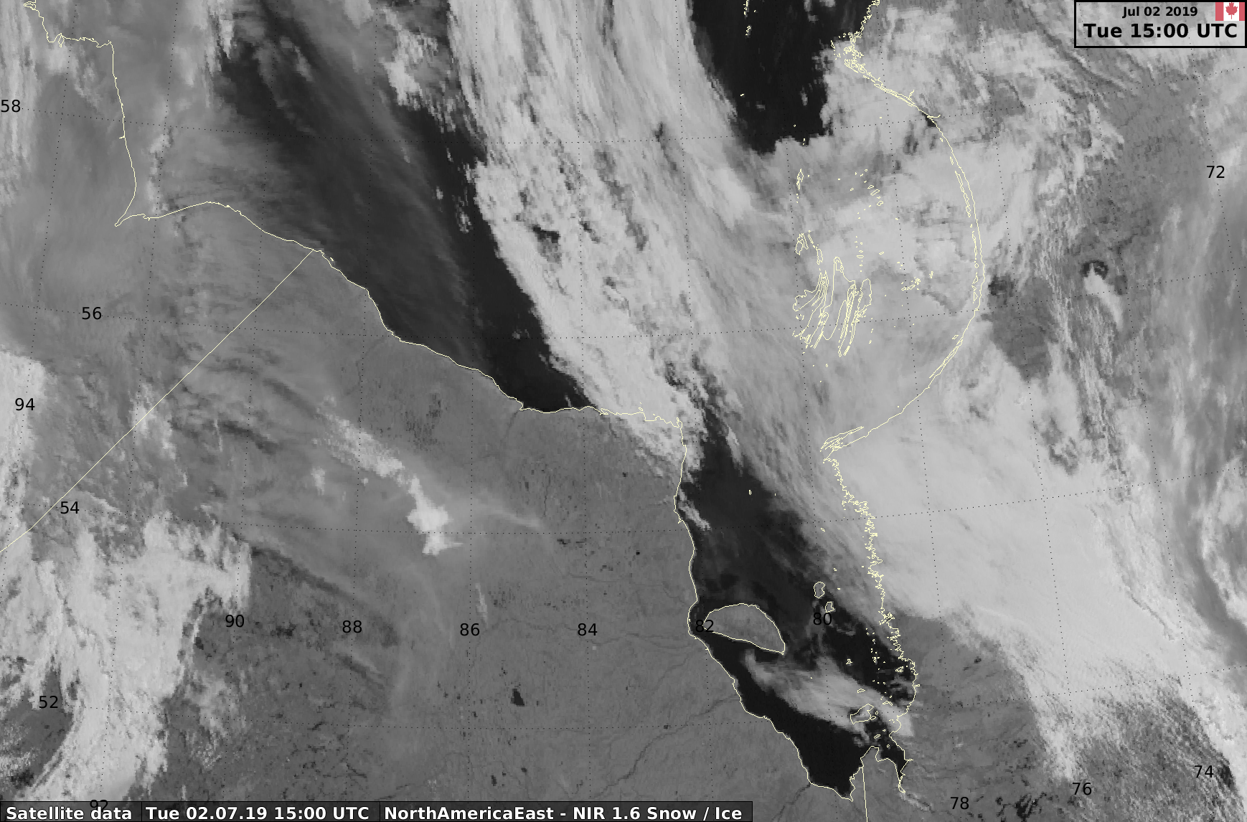
Band 5 – Snow/Ice 1.6 micron
A
B
C

Slide 8
Worksheet
Location | Comparison | Identification
A | Band 2 Band 3 Band 4 Band 5
B | Band 2 Band 3 Band 4 Band 5
C | Band 2 Band 3 Band 4 Band 5

Slide 9
Take up
Location | Comparison | Identification
A | Band 2 bright grey, so reflective Band 3 individual elements more evident since water is darker in this band Band 4 dark grey streaks – detecting some Cirrus? Band 5 black – ice and snow strongly absorb radiation at this wavelength | Sea ice with some thin cirrus
B | Band 2 textured, reflective targets Band 3 same but with better contrast Band 4 almost black – no cirrus Band 5 highly reflective – so not seeing ice/snow | Thicker cloud, but no cirrus
C | Band 2 smoother, reflective but a darker grey than A Band 3 similar to band 2 Band 4 black – no cirrus Band 5 grey | Stratus / fog

Slide 10
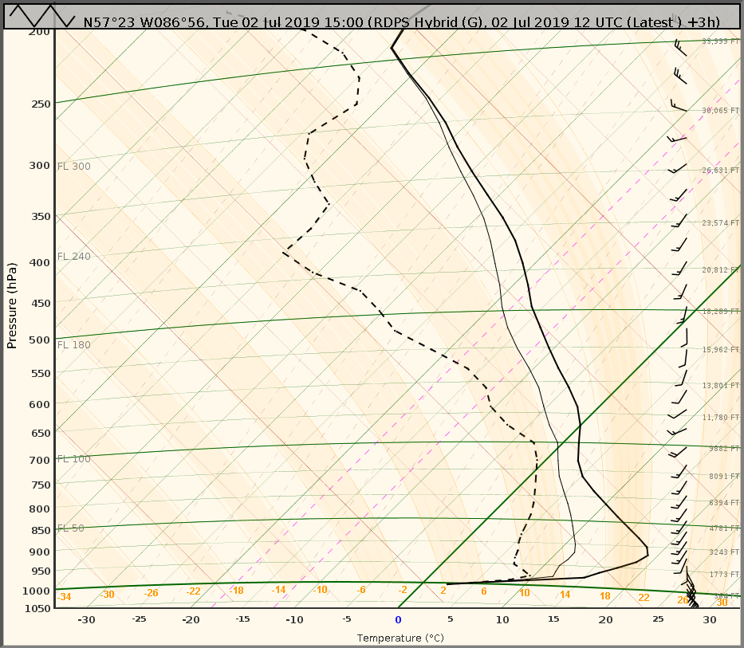
Model sounding at A

Slide 11
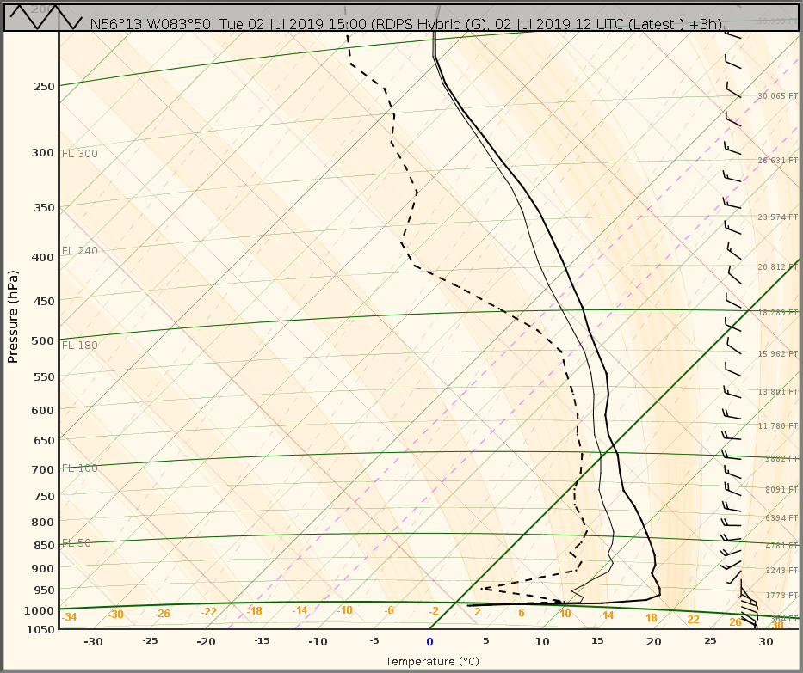
Model sounding at B

Slide 12
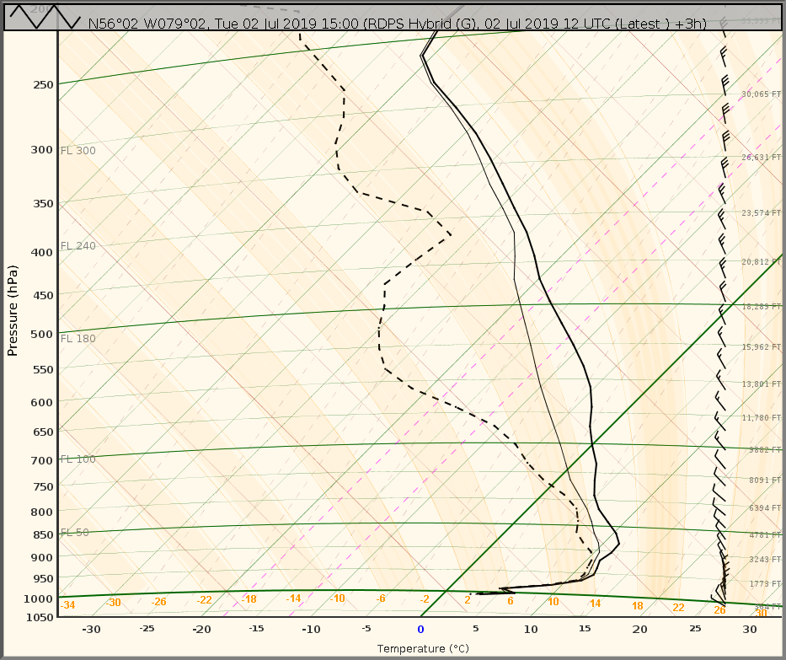
Model sounding at C

Slide 13
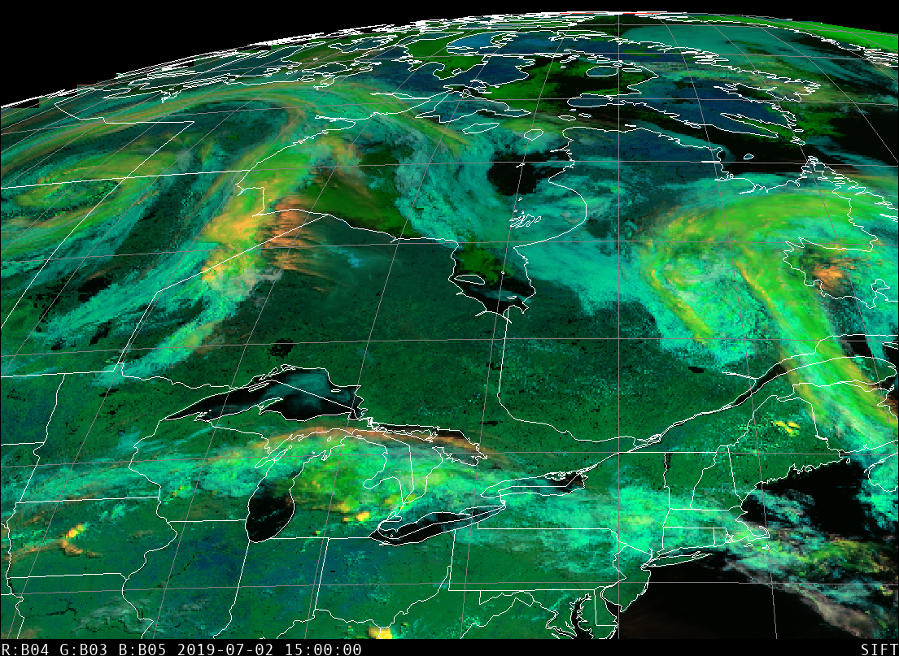
Cirrus Veggie Snow-Ice RGB

Slide 14
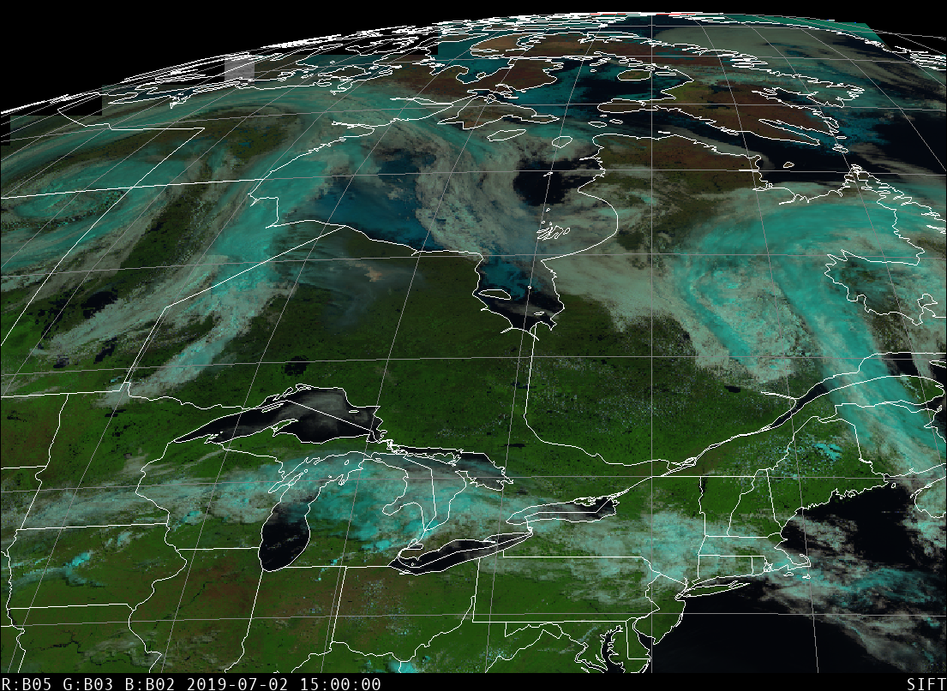
Day Land Cloud RGB

Slide 15
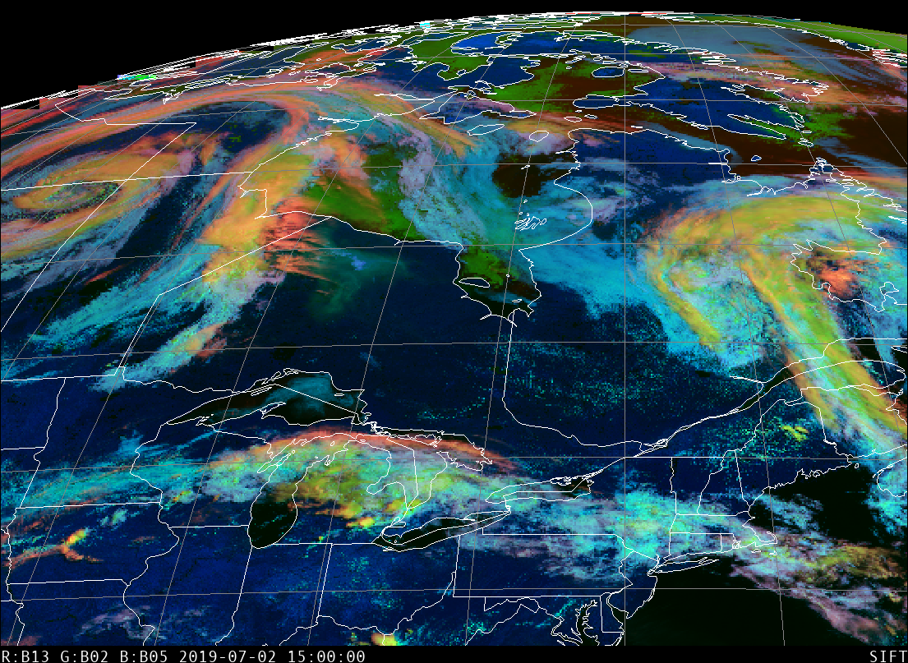
Day Cloud Phase RGB

