Slide 1
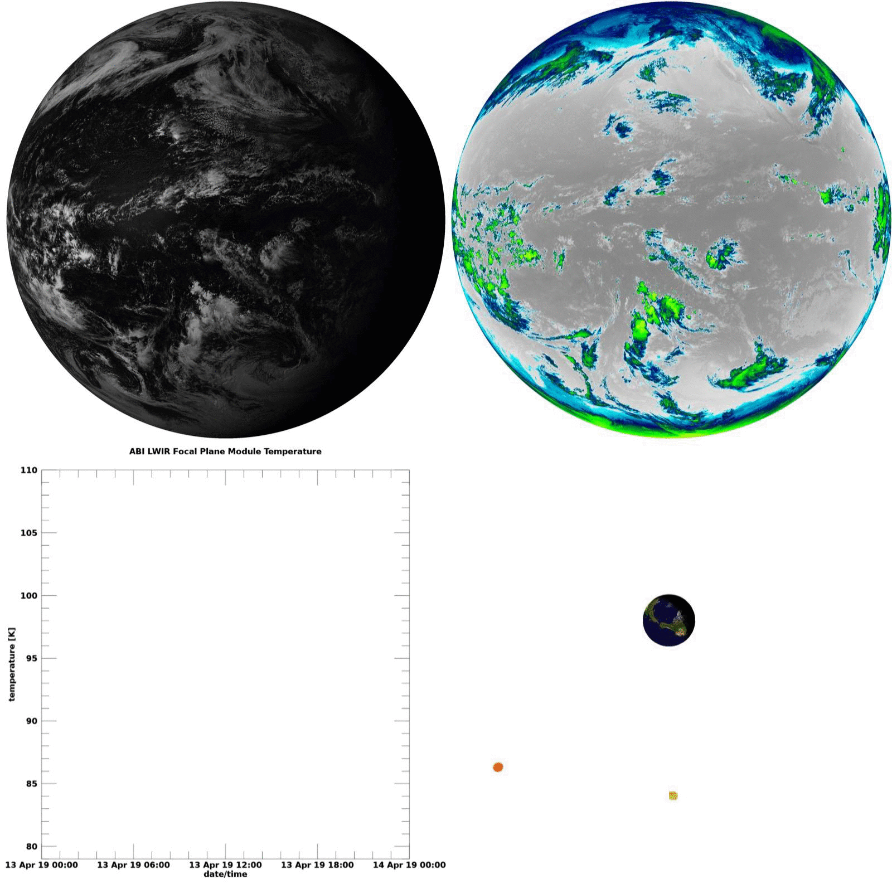
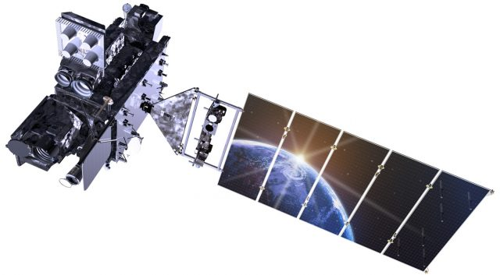
Cool animation here, maybe replace last 3 slides?
Band 2
0.64 µm
Band 12
9.61 µm
IR FPM Temperature

