Slide 1
GOES-R Series Data Access
GOES-R Series Workshop
International Union of Geodesy and Geophysics (IUGG) General Assembly
July 2019
Notes:
Changes:
Added CIRA Central America site http://rammb.cira.colostate.edu/ramsdis/online/rmtc.asp

Slide 2
Contributors
Jim McNitt ¹, Matt Seybold ², Elizabeth Kline², Thomas Feroli², Seth Clevenstine¹, Natalia Donoho¹, Richard Antoine¹, Donna McNamara ³, Alan Hall ³, Jon O'Neil⁴, and Matt Arkett⁵
Office of Satellite and Product Operations (OSPO),
National Environmental Satellite, Data, and Information Service (NESDIS)
National Oceanic and Atmospheric Administration (NOAA)
Affiliations: 1 Satellite Products and Services Division; 2 GOES-R Product Readiness and Operations Team, 3 Mission Operations Division; 4 NOAA Big Data Project
Additional Acknowledgements: University of Wisconsin – Madison, SSEC/CIMSS, 5 Earth Observation and Geomatics, Meteorological Service of Canada, Environment and Climate Change Canada

Slide 3
Agenda
Objectives of Lesson
Overview of the Office of Satellite and Product Operations
Overview of GOES-R Series Data Access
GOES Rebroadcast (GRB)
High Rate Information Transmission/ Emergency Managers Weather Information Network (HRIT/EMWIN)
Production Distribution and Access (PDA)
Comprehensive Large Array-data Stewardship System (CLASS)
GOES Data Collection System (DCS)
GEONETCast Americas (GNC-A)
NOAA Big Data Project – Cloud Access
Internet Access - Websites

Slide 4
Objectives of the Lesson
By the end of the lesson the participant should:
  Understand the GOES-R Series data sources and which products are available from each source
  Gain a basic understanding of the GOES Rebroadcast (GRB), High Rate Information Transmission/ Emergency Managers Weather Information Network (HRIT/EMWIN), GOES DCS, and GEONETCast Americas (GNC-A)
  Understand what function the Production Distribution and Access (PDA) provides and its relationship to the other sources of GOES-R Series data products
  Understand how to retrieve data from the Comprehensive Large Array-data Stewardship System (CLASS)
The participants will be provided information on User Groups
The participants will be provided links to Websites, Unidata/UCAR, and the Big Data Project that can be used to retrieve products

Slide 5
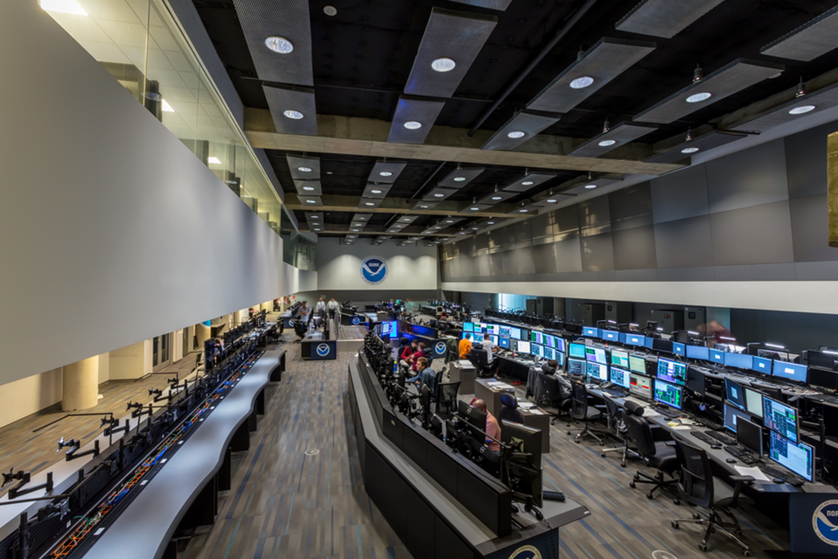
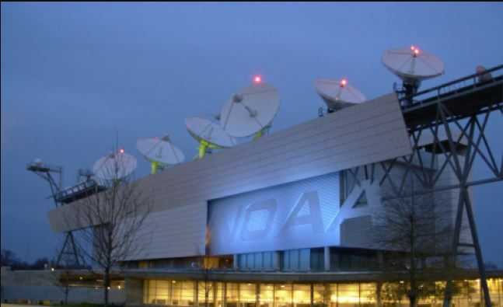
Satellite and Product Operations
NOAA NESDIS Office of Satellite and Product Operations
  Performs command and control of United States operational weather satellites
  Operates ground sites for command and control; and for data acquisition and retransmission
  Produces derived products from satellite observations and distributes those products to authorized users in near real-time or to the archive for use by the scientific community

Slide 6
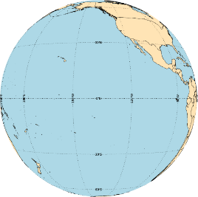
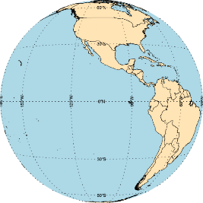
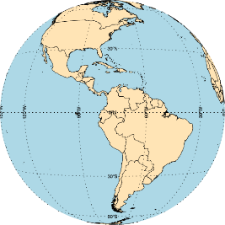

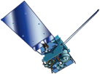
GOES Constellation
Current Constellation (July 2019)
GOES-West
GOES-17
137.2° West
Supplemental Operations
GOES-15
128° West
Standby
GOES-14
105° West
GOES-East
GOES-16
75.2° West
January 2020
GOES-West
GOES-17
137.2° West
Storage
GOES-15
128° West
Standby
GOES-14
105° West
GOES-East
GOES-16
75.2° West
Notes:
GOES-15 will continue to operate alongside GOES-17 through December 2019 to allow users more time to transition to the new space weather data products available from GOES-16 and GOES-17 and continue to corelate GOES-17 ABI thermal data during short periods of thermal data outage.

Slide 7
Overview of GOES-R Series Data Access
Acronym | System Name | Description
GRB | GOES Rebroadcast | The primary relay of full resolution, calibrated, near-real-time broadcast of GOES-R for Level 1b data products (Advanced Baseline Imager L1b, Space Weather L1b, and Geostationary Lightning Mapper L2). These data are available to all users with GRB receivers in view of a GOES-R series satellite at the East or West operational longitudes.
HRIT/ EMWIN | High Rate Information Transmission/ Emergency Managers Weather Information Network | The HRIT/EMWIN service is a new high data rate (400 Kbps) broadcast for GOES-R satellite imagery and selected products to remotely-located user terminals. Combines LRIT and the EMWIN direct broadcast service that provides users with weather forecasts, warnings, graphics and other information directly from the NWS in near real-time. Also included is a copy of GOES-DCS.
PDA | Product Distribution and Access | The Environmental Satellite Processing and Distribution System is responsible for receiving and storing real-time environmental satellite data and products and making them available to authorized users. It is located in the Environmental Satellite Processing Center at the NOAA Satellite Operations Facility in Suitland, Maryland. The Product Distribution and Access (PDA) component of ESPDS provides real-time distribution and access services for GOES-R users through a terrestrial network.
CLASS | Comprehensive Large Array-data Stewardship System | Web-based data archive and distribution system for NOAA’s environmental data. CLASS will provide retrospective data access and distribution services of GOES-R data to all users.

Slide 8
Overview of GOES-R Series Data Access
Acronym | System Name | Description
GNC-A | GEONETCast Americas | GEONETCast Americas is the Western Hemisphere component of GEONETCast, a near real time, global network of satellite-based data dissemination systems designed to distribute space-based, air-borne and in situ data, metadata and products to diverse communities.
Websites | Websites on the Internet | NOAA, NASA, NOAA Cooperative Institutes, and Universities distribute GOES-16 imagery on their websites. Many universities receive data from Unidata. Unidata has GRB and NOAPort receive stations
BDP | Big Data Project | Demonstration Project. The BDP, through Cooperative Research and Development Agreements (CRADAs), currently works with five infrastructure-as-a-service (IaaS) providers to broaden access to NOAA’s data resources.
NOAAPort | NWS Satellite Broadcast Network | GOES-R will provide selected products to the NWS Advanced Weather Interactive Processing System (AWIPS) Satellite Broadcast Network and NOAAPort. Sectorized Cloud and Moisture Imagery (SCMI) will be delivered via SBN/NOAAPort

Slide 9
GOES-R Series GOES Rebroadcast
The GOES Rebroadcast (GRB) provides the primary relay of GOES-R Series full resolution, calibrated, near-real-time direct broadcast Level 1b data from the Advanced Baseline Imager and the Space Weather instruments and Level 2 data from the Geostationary Lightning Mapper
The GRB downlink is standards-based and documented in the Product Definition and Users’ Guide and Downlink Specifications
DVB-S2
Product Definition and
Users’ Guide
GRB
Downlink Specifications for
Users
CCSDS
Digital Video Broadcasting
Consultative Committee for Space Data Systems
Notes:
The GOES Rebroadcast (GRB) provides the primary relay of full resolution, calibrated, near-real-time direct broadcast space relay of Level 1b data from each instrument and Level 2 data from the Geostationary Lightning Mapper (GLM)
The GRB downlink is standards-based, making use of the following protocols:
Digital Video Broadcasting (DVB-S2)
Consultative Committee for Space Data Systems (CCSDS) Advanced Orbiting Systems (AOS)
Space Data Link Protocol
CCSDS Space Packet Protocol

Slide 10
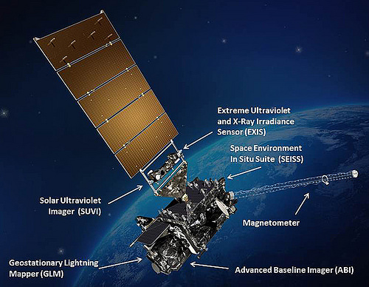
GOES-16 Products on GRB
    Level 1b Products:
    Radiances from the Advanced Baseline Imager: 16 Bands; Full Disk, CONUS, and Mesoscale
    Solar imagery from the Solar Ultraviolet Imager
    Solar flux from the Extreme Ultraviolet and X-ray Irradiance Sensors
    Energetic heavy ions from the Space Environment In-Situ Suite
    Space environment magnetic field from the Magnetometer
Space Weather Products
Level 2 products:
  Geostationary Lightning Mapper
Notes:
Level 1b products:
Radiances from Advanced Baseline Imager: 16 Bands; Full Disk, CONUS, and Mesoscale
Solar Imagery from Solar Ultraviolet Imager
Solar Flux from the Extreme Ultraviolet and X-ray Irradiance Sensors
Energetic Heavy Ions from the Space Environment In-Situ Suite
Level 2 products:
Geostationary Lightning Mapper

Slide 11
GRB Specifications
 | GOES Rebroadcast (GRB)
Full Disk Image | 5 mins (Mode 4) and 10 mins (Mode 6)
Other Modes | 3000 km X 5000 km (CONUS: 5 minute) 1000 km X 1000 km (Mesoscale: 30 seconds)
Polarization | Dual Circular Polarized
Receiver Center Frequency | 1686.6 MHz (L-Band)
Data Rate | 31 Mbps
Antenna Coverage | Earth Coverage to 5⁰
Data Sources | ABI (16 bands), GLM, SEISS, EXIS, SUVI, MAG
Space Weather | ~2 Mbps
Lightning Data | 0.5 Mbps
Notes:
GRB replaces the GOES VARiable (GVAR) service
GRB provides improved products. ABI provides three times more spectral information, four times the spatial resolution, and more than five times faster temporal coverage than the previous system

Slide 12
GOES Rebroadcast Reception
Reception of the GOES Rebroadcast (GRB) data is accomplished by means of a fixed dish antenna with a dual left and right hand circular feed horn connected to two Low Noise Amplifiers
The Low Noise Amplifiers outputs are connected to Radio Frequency/ Intermediate Frequency down-converters
The Radio Frequency/ Intermediate Frequency down-converters are connected to Digital Video Broadcasting-S2 (DVB-S2) capable receivers
The GRB downlink signal from the satellite is at a center frequency of 1686.600 MHz and requires an Antenna gain-to-noise-temperature (G/T) of 15.2 dB/K for worst-case locations
Nominal antenna size: 4.5 meter dish with a system noise temperature of 120 K

Slide 13
GOES Rebroadcast Reception
Modulation is either:
  8PSK with a symbol rate of 7.825768 Million symbols per second (Msps) with a rate 2/3 Forward Error Correction coding
  QPSK with a symbol rate of 8.665938 Million symbols per second (Msps) with a rate 9/10 Forward Error Correction coding*
A dual circular polarization is used to accommodate the 31 Mbps data rate
See the next slide for product allocation on Right Hand Circular Polarized (RHCP) and Left Hand Circular Polarized (LHCP)
*Note: The default modulation mode for GOES-16 is QPSK
GOES-R Documents are available at: https://www.goes-r.gov/resources/docs.html
GOES Rebroadcast (GRB) Downlink Specifications for Users, August 6, 2012
https://www.goes-r.gov/users/docs/GRB_downlink.pdf

Slide 14
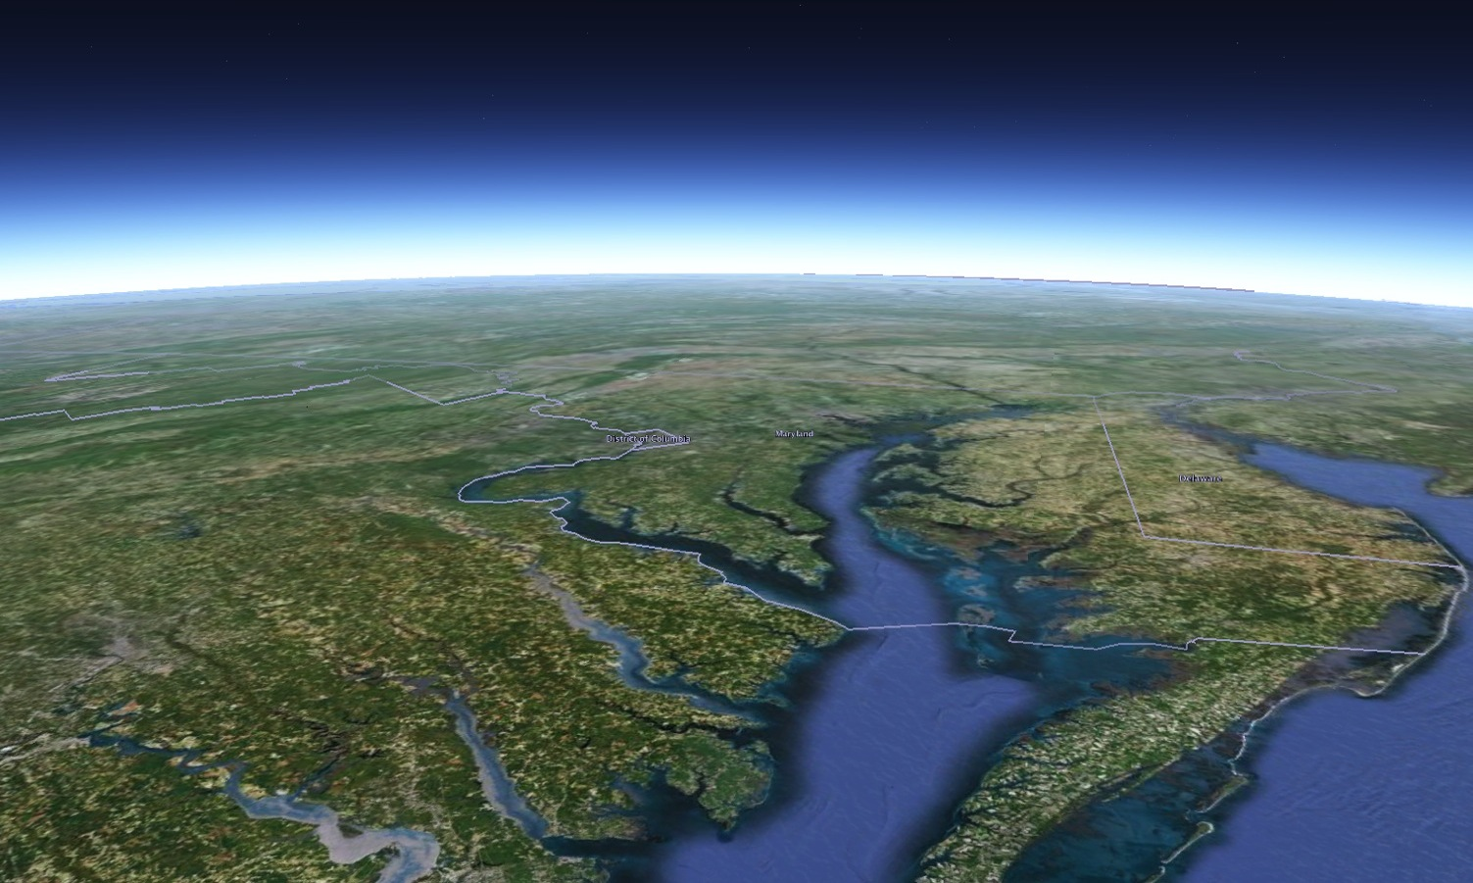

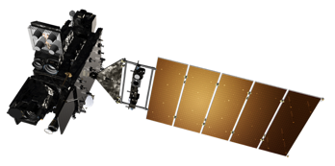
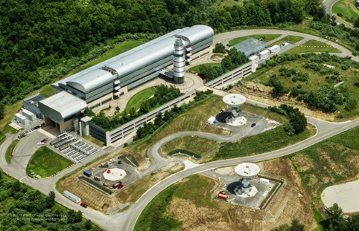
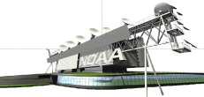


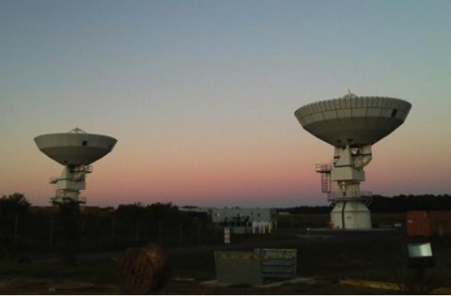




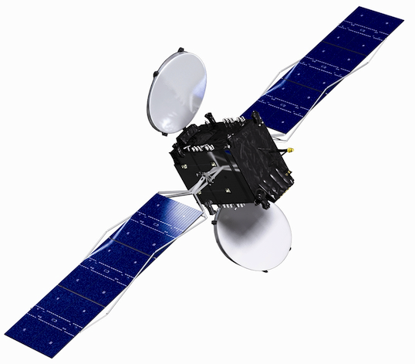
GRB Data Flow
GOES-R Series Ground Systems Architecture
GOES-17
137.2° West
GOES Storage
105° West
GOES-East
75.2° West
Consolidated Backup (CBU) Fairmont, WV
Command & Control, Mission Data, GRB, and HRIT/EMWIN
GRB and HRIT/EMWIN
GRB
Direct Broadcast Community
Instrument and Telemtry Data
GRB
SARSAT
DCS
SARSAT
DCS
Instrument and Telemtry Data
NOAA Satellite Operations Facility (NSOF)
Suitland, MD
GRB, DCS, HRIT/EMWIN
Command & Control, Mission Data,
L1B and L2+ Derived Products
L1B, L2+
PDA
Sectorized Cloud and
Moisture Imagery
AWIPS
NCFs
Climate Research and Academia
Authorized Operational Users
Wallops Command and
Data Acquisition Station (WCDAS)
Wallops, VA
SBN/NOAAPort
NOAA Port Community
Notes:
The NOAA GOES-R series spacecraft, instruments, ground, and data distribution systems work together within an integrated operational systems architecture.
The spacecraft’s scientific instruments sense the environment and distribute data to the onboard computer for processing and distribution to the X-Band antenna for transmission to Earth as a digital data stream.
The antennas at the Wallops Command and Data Acquisition Station (WCDAS) receives the data stream. The ground system software at WCDAS processes the Level 0 raw data and creates Level 1b scientific data products. For example, the measurements from the ABI are converted to units of radiance and calibrated, navigated, and remapped to a fixed grid. The antenna at WCDAS then transmits the products to the GOES-R series satellite for relay through the satellite’s GOES Rebroadcast (GRB) transponder and L-Band antenna to the GRB receive stations, including GRB receive stations at the NOAA Satellite Operations Facility (NSOF). In addition to the NOAA NESDIS GRB receive stations at the WCDAS, NSOF, and CBU, about 70 other sites have installed or plan to install GRB receive stations. WCDAS generates the Sectorized Cloud and Moisture Imagery (SCMI) product for the NWS.
NOAA’s National Environmental Satellite, Data, and Information Service (NESDIS) disseminates GOES-R Series satellite-derived data products to users through a variety of means including the GRB and High Rate Information Transmission (HRIT)/ Emergency Managers Weather Information Network (EMWIN). Although they are both Direct Broadcast (DB) services, the HRIT/EMWIN receive station costs much less than a GRB receive station and contains a subset of the GOES-R products and the products are formatted to fit on the 400 Kbps link. The HRIT/EMWIN service disseminates low-resolution geostationary satellite products and weather forecasts, warnings, graphics, and other information directly from NWS in near-real time.
CBU functions as a completely independent backup for the Mission Management and selected Product Generation and Product Distribution functions. It can operate concurrently with NSOF and WCDAS. Its X-Band antenna receives the Level 0 data and the Product Generation function produces the GRB products, information packets, and metadata that are uplinked to the satellite for relay through the GRB. CBU can also generate the Sectorized Cloud and Moisture Imagery (SCMI) product for NWS.
NSOF hosts the primary MM and selected PG and PD functions and is responsible for maintaining the calibration database, monitoring radiometric performance, monitoring Image Navigation and Registration (INR) performance, generating Level 2+ products, and disseminating Level 1b and Level 2+ products.
The ESPC, which is located at NSOF, is NOAA's primary data-processing system for the nation's environmental satellite data. Through a large variety of hardware, software, networks, telecommunication lines, and software tools, ESPC ingests, processes, and distributes environmental data and information received from all of NOAA's satellites, several foreign countries' satellites and the Department of Defense's satellites. PDA is the product distribution node in the ESPC that distributes Level 1b products, Level 2+ products, and associated mission data to authorized operational users.
CLASS is the Comprehensive Large Array-data Stewardship System and it is a web-based data archive and distribution system for NOAA’s environmental data. CLASS provide non-real time data access and distribution services of GOES-R data to users.
NESDIS provides products to the NWS AWIPS Network Control Facility for distribution through the NWS Satellite Broadcast Network and NOAAPort. The SBN distributes products to the NWS Advanced Weather Interactive Processing System (AWIPS) located at NWS offices.

Slide 15
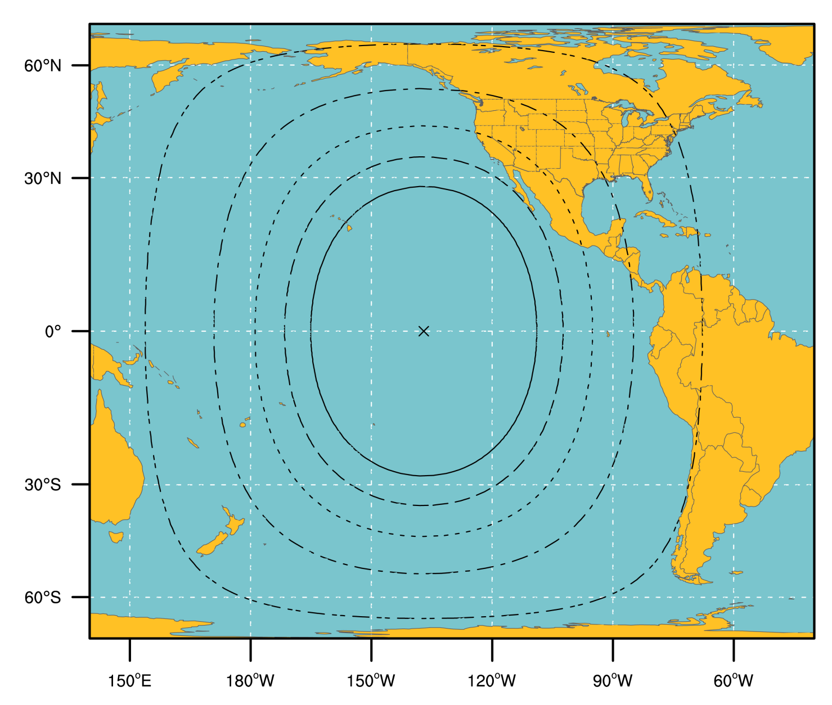
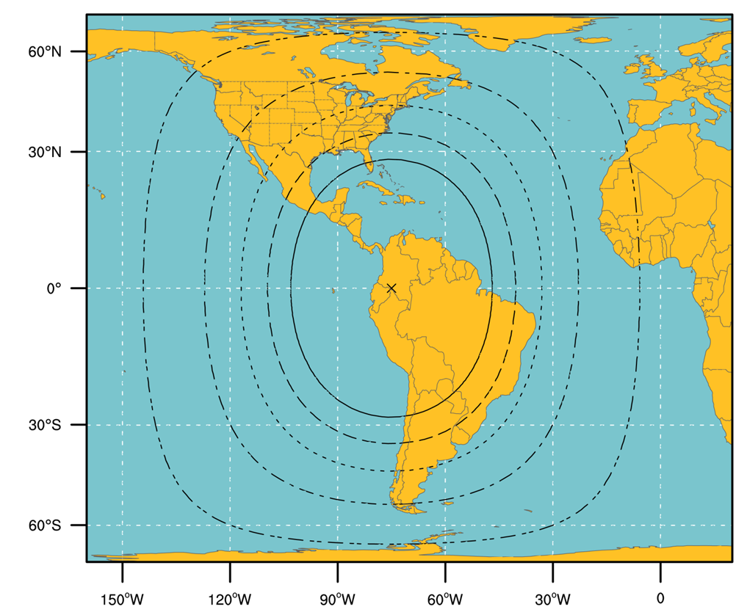
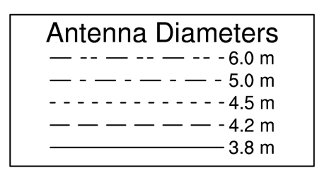
GOES-R Series GRB Ground Antenna Sizes
GOES West
GOES East
NOTES:
Calculations based on available data as of May 2011.
Each antenna size is usable within the indicated contour.
Rain attenuations included are: 1.3/1.6/2.0/2.2/2.5 dB (3.8 to 6 m)
4. An operating margin of 2.5 dB was included in the calculations, but users are warned that may not be enough in parts of North America where cellular and mobile internet service providers may provide strong interference and therefore additional antenna gain may be needed.
Notes:
Calculations based on available data as of May 2011.
Each antenna size is usable within the indicated contour.
Rain attenuations included are: 1.3/1.6/2.0/2.2/2.5 dB (3.8 to 6 m)
An operating margin of 2.5 dB was included in the calculations, but users are warned that may not be enough in parts of North America where cellular and mobile internet service providers may provide strong interference and therefore additional antenna gain may be needed

Slide 16


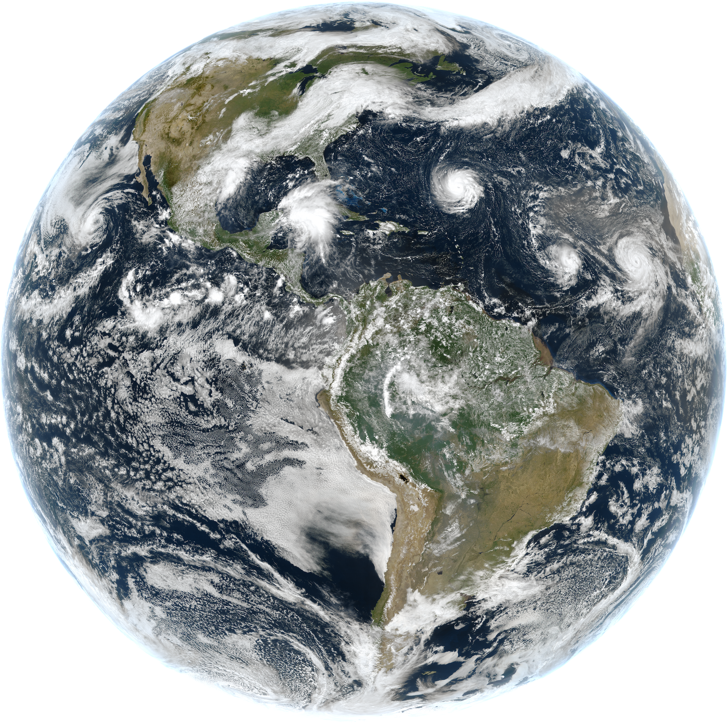
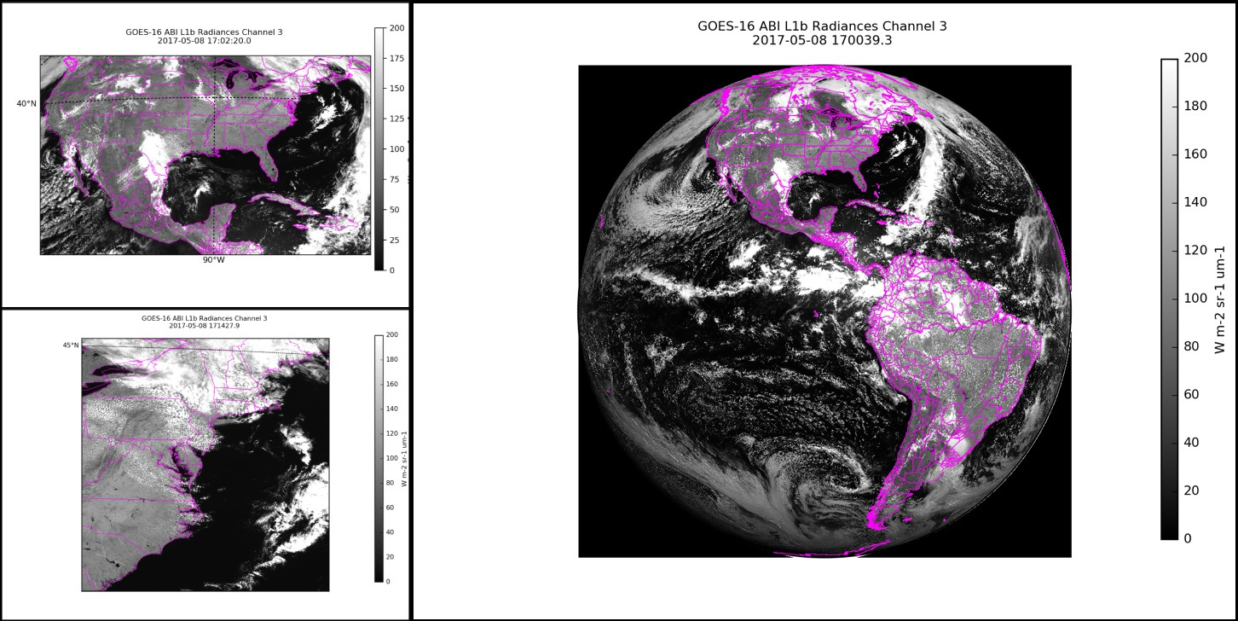
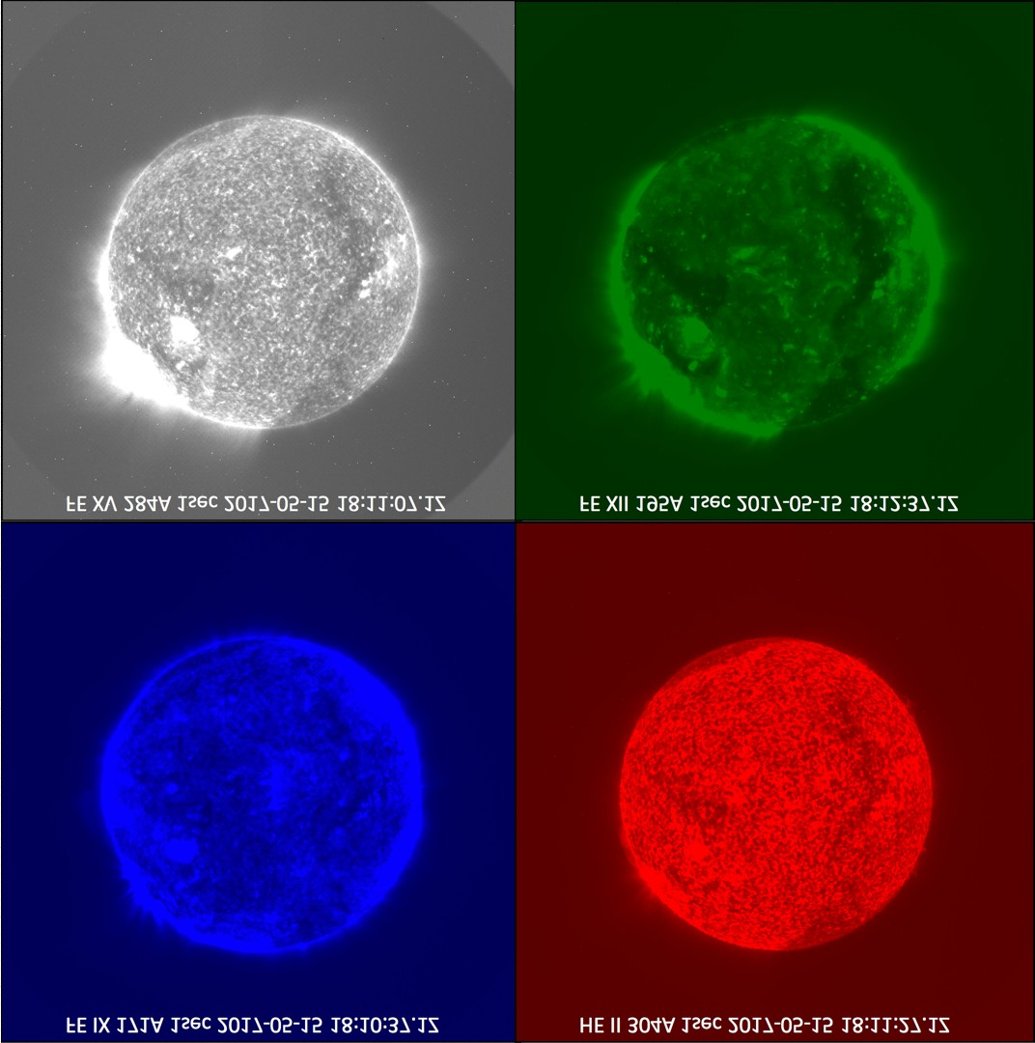
Community Satellite Processing Package
for Geostationary Data
Funded by NOAA GOES-R Program to create and distribute software to process direct broadcast data from geostationary satellites, generating products in real-time. Software is available at: http://cimss.ssec.wisc.edu/csppgeo/
All software is free to download and use. Capabilities include:
  Process the GOES-16 and GOES-17 GRB data streams, reconstructing the products that were generated on the ground system
  Further process GOES-16 ABI data to generate Level 2 products
  Process direct broadcast data from GOES-15 and Himawari-8
  Create high quality RGB and single band images in GeoTiff format
ABI true color
ABI L1 Quicklooks
SUVI Imagery

Slide 17
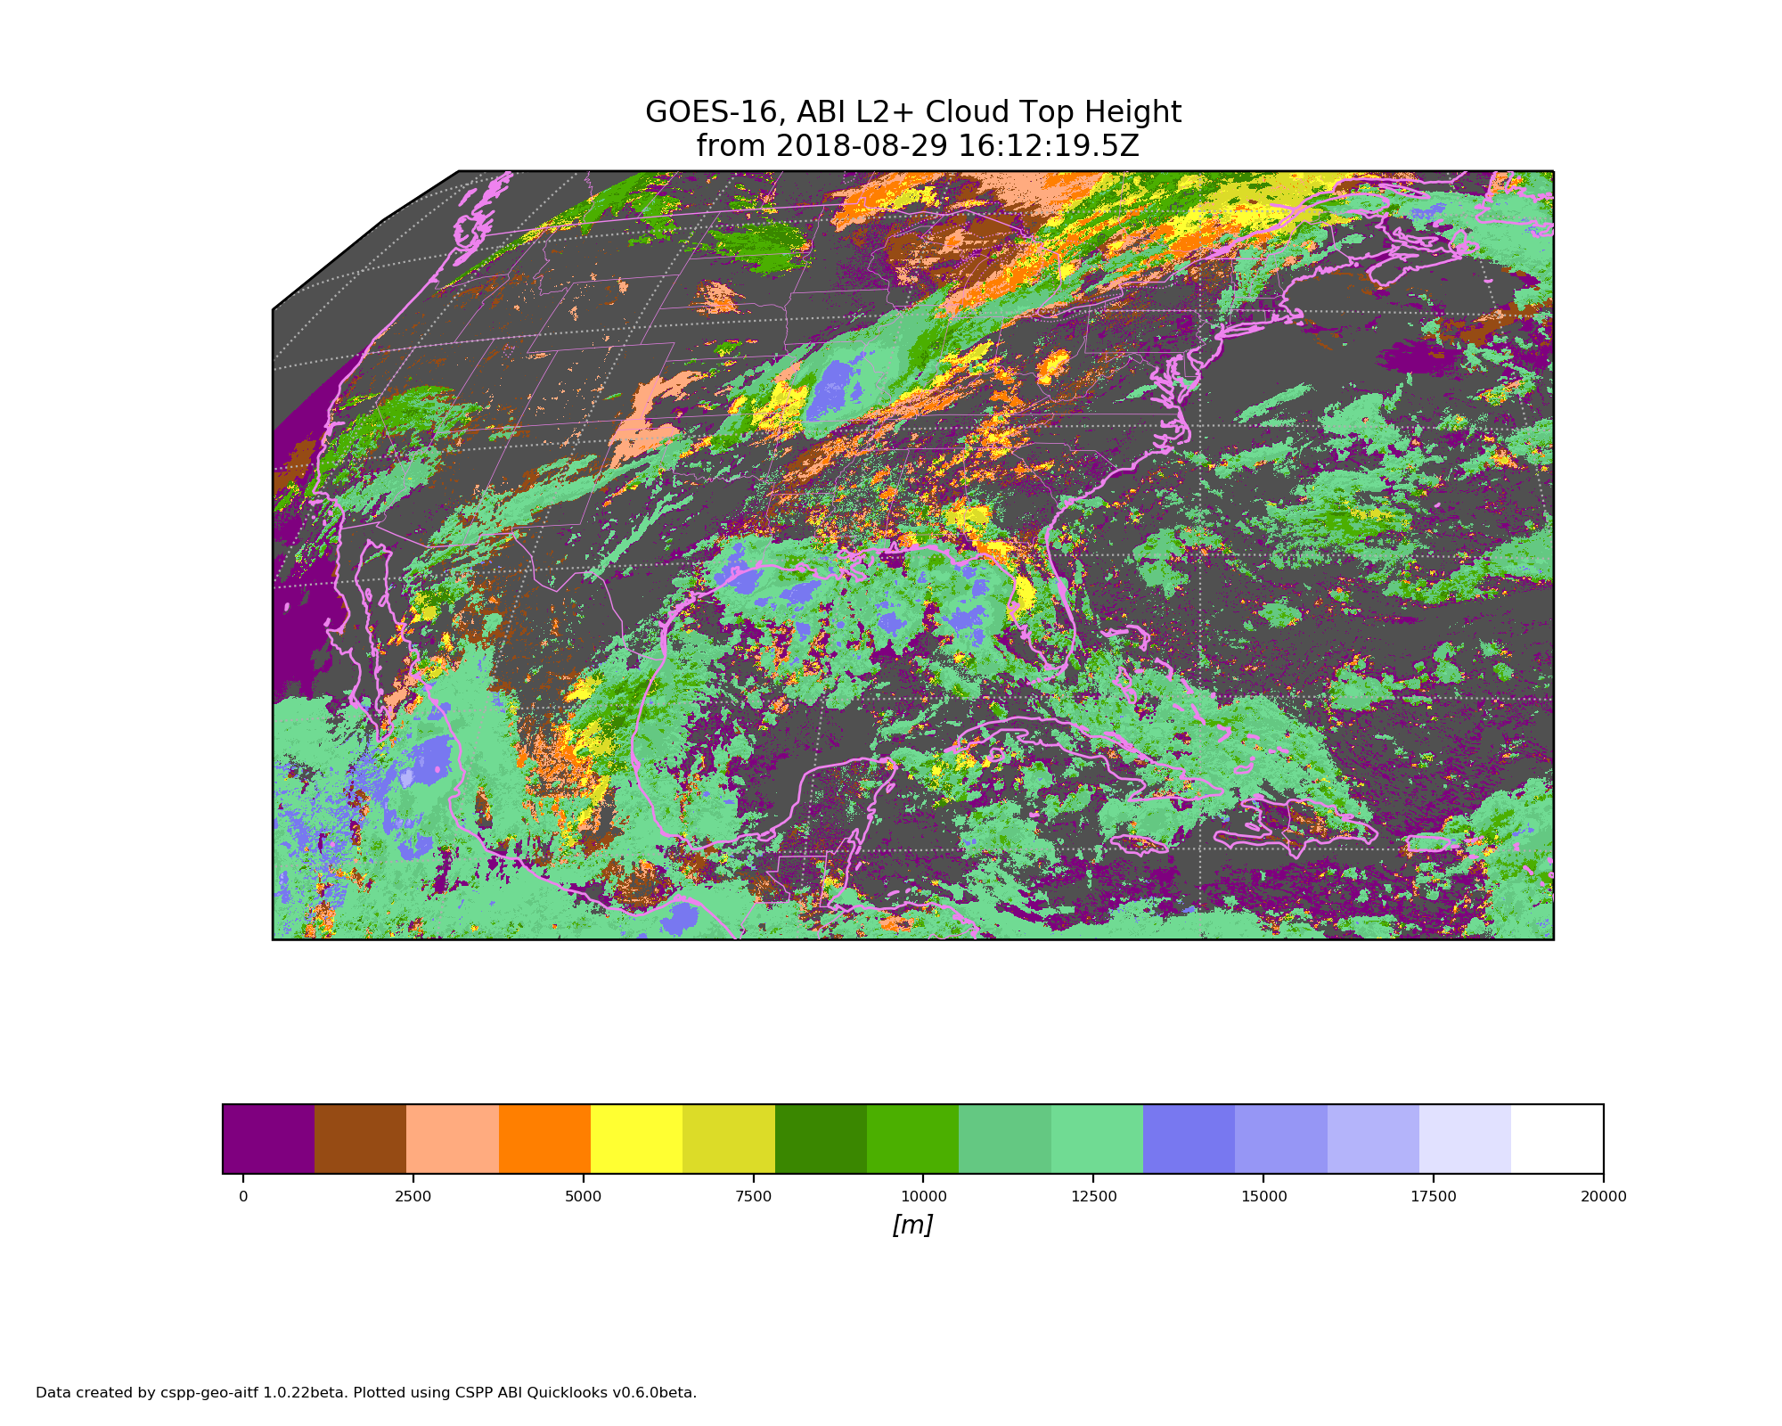
CSPP Geo Level 2 Processing
ABI Level 2 products are generated by research implementations of the operational algorithms, running in the “AIT Framework” which was developed at NOAA
Level 2 products are available in CSPP Geo AIT Framework Version 1 beta:
  Aerosol Detection: Smoke and Dust
  Cloud Top Height
  Aerosol Optical Depth
  Cloud Top Phase
  Clear Sky Mask
  Cloud Top Pressure
  Cloud and Moisture Imagery
  Cloud Top Temperature
  Cloud Optical Depth (day/night)
  Land Surface Temperature (skin)
  Cloud Particle Size Distribution (day/night)
GOES-16 Cloud Top Height

Slide 18
Recent Changes to GRB
DO.07.02.00 patch includes a new Data Quality Flag value (DQF = 4) and additional metadata to identify pixels and products impacted by high focal plane temperature. New data quality indicators are provided at both the pixel and product level:
  At the pixel level, DQF range is extended to include the new flag value 4
  At the product level, additional metadata convey the configuration parameters, focal plane temperatures, and TDQF metrics
Build DO.07.02.00 went operational on April 8, 2018. Installation, Test, and Check-Out (ITCO) completed on May 6, 2019
Transition of GOES-16 and GOES-17 ABI to Mode 6 on April 2, 2019, as the default mode (replaced Mode 3 as Flex Mode). Continuous Full Disk Mode (mode 4) will continue to be a secondary operational mode
DO.08.00.00 planned for operations in mid-July, 2018. Includes an algorithm fix to improve the ABI performance during the hotter times of year

Slide 19
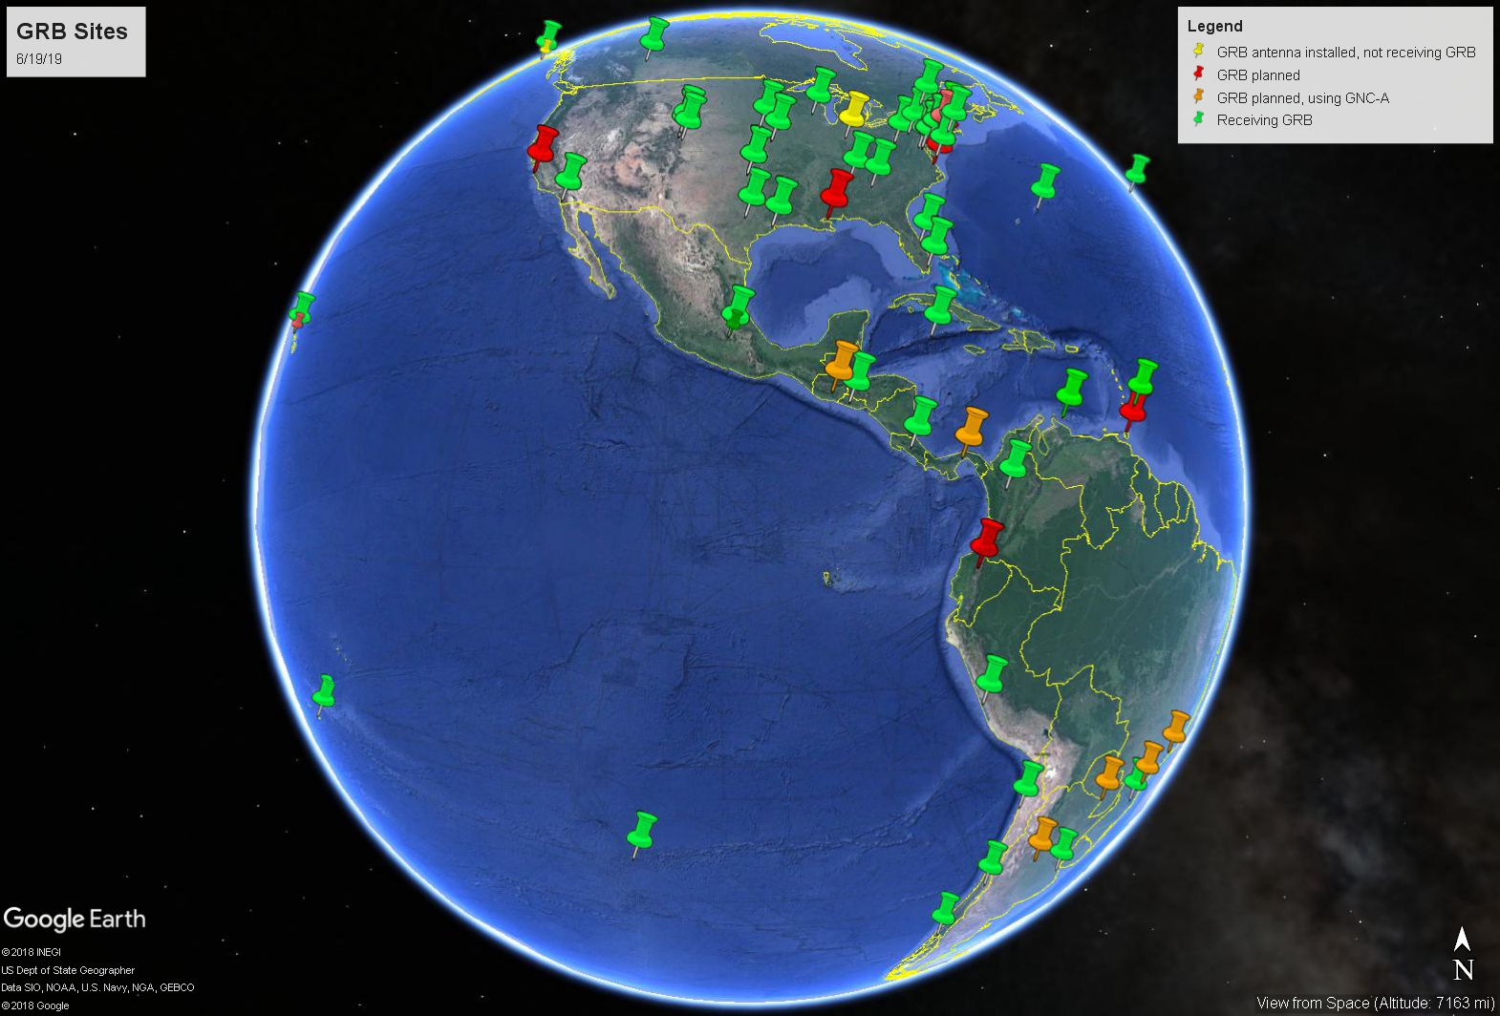
GRB Sites
60 GRB sites accounted for that are receiving GOES-R series GRB.
Total of 89 antennas (some sites have more than 1 antenna).

Slide 20
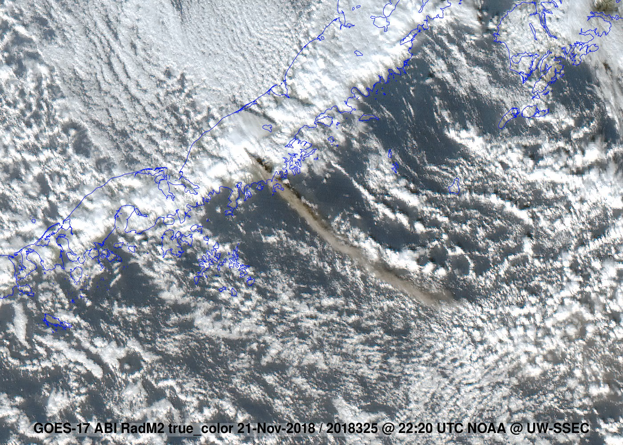
Example of a GRB Site that Distributes Products
University of Wisconsin – Madison Space Science and Engineering Center (SSEC) Cooperative Institute for Meteorological Satellite Studies (CIMSS)
Satellite Data Services (SDS) ingests GOES-16 and GOES-17 GRB using CSPP Geo and the SDI GRB Appliance. In addition to local direct access, real-time and archive GOES ABI and L2 ABI products are provided via ADDE, LDM, HTTP, and FTP.
Data are also provided to external users as a GRB CADU stream through a fanout mixer server using multiple antenna inputs to mitigate local RFI. The primary users of GRB data from SSEC are scientists (including NOAA and NASA), educational and commercial users worldwide, which include those in the solar power and sports fishing industries, broadcast media, and the aviation community.
Real-time GOES visualization packages available from SSEC:
  McIDAS-X and McIDAS-V
  RealEarth VM, web-based and mobile app
  Geostationary Satellite Image Browser
  SSEC-GOES mobile app
  WxSat mobile app
  Geo2Grid
Notes:
University of Wisconsin SSEC / CIMSS: Satellite Data Services (SDS) ingests GOES-16 and GOES-17 GRB using CSPP Geo and the SDI GRB Appliance. In addition to local direct access, real-time and archive GOES ABI and L2 ABI products are provided via ADDE, LDM, HTTP, and FTP. Data are also provided to external users as a GRB CADU stream through a fanout mixer server using multiple antenna inputs to mitigate local RFI. The primary users of GRB data from SSEC are scientists (including NOAA and NASA), educational and commercial users worldwide, which include those in the solar power and sports fishing industries, broadcast media, and the aviation community. Real-time GOES visualization packages available from SSEC are:
McIDAS-X and McIDAS-V
RealEarth VM, web-based and mobile app
Geostationary Satellite Image Browser
SSEC-GOES mobile app
WxSat mobile app
Geo2Grid

Slide 21
HRIT/EMWIN
The High Rate Information Transmission (HRIT) / Emergency Managers Weather Information Service (EMWIN) broadcast is operational on GOES-16 and GOES-17 with a data relay capacity of 400 kilobits per second.
However, the EMWIN content on HRIT/EMWIN, virtual channels 20 – 22, is in test mode and is expected to be operational in late July 2019
The HRIT/EMWIN product offering includes:
  EMWIN products includes National Weather Service watches, warnings, forecasts and graphics
  Copy of the GOES-DCS observations
  Environmental maritime products from National Hurricane Center
  Additional 4 km resolution GOES-15 & Himawari-8 IR/WV/Visual Imagery (GOES-17 only)
  GOES-16 & 17 Imagery – ABI Cloud and Moisture Imagery (CMI) converted to the 2013 CGMS Global LRIT/HRIT standard
    2 kilometer spatial resolution ABI Full Disk Bands 2, 7, 8, 9, 13, 14 and 15 available every 30 minutes
    ABI mesoscale imagery in Bands 2, 7 and 13 available every 15 minutes (Band 2 is 0.5 km while Bands 7 and 13 are 2 km resolution)

Slide 22
HRIT/EMWIN Virtual Channel Listing
VCID # | Product Name | GOES-16 Availability | GOES-17 Availability | Period -Min | Format | Resolution | Product Status
0 | Admin Text | X | X | 60 | Text Messages | N/A
1 | Mesoscale Imagery | X | X | 15 | HRIT/LRIT | 0.5km Band 2, 2km for bands 7 and 13 | Active and available
2 | CMI Band 2 | X | X | 30 | HRIT/LRIT | 2 km | Active and available
5 | GOES-15 WV Imagery |  | X | 30 - 180 | LRIT | 4 km | Active and available
6 | GOES-15 IR Imagery |  | X | 30 -180 | LRIT | 4 km | Active and available
7 | CMI Band 7 | X | X | 30 | HRIT/LRIT | 2 km | Active and available
8 | CMI Band 8 | X | X | 30 | HRIT/LRIT | 2 km | Active and available
9 | CMI Band 9 | X | X | 30 | HRIT/LRIT | 2 km | Active and available
13 | CMI Band 13 | X | X | 30 | HRIT/LRIT | 2 km | Active and available
14 | CMI Band 14 | X | X | 30 | HRIT/LRIT | 2 km | Active and available
15 | CMI Band 15 | X | X | 30 | HRIT/LRIT | 2 km | Active and available
16 | G16 CMI Band 13 |  | X | 60 | HRIT/LRIT | 4 km | Active and available
17 | G17 CMI Band 13 | X |  | 60 | HRIT/LRIT | 4 km | Active and available
20 | EMWIN - Priority | X | X | Variable | Text | N/A | Active and available, non-operational
21 | EMWIN - Graphics | X | X | Variable | Graphic (e.g. GIF, JPEG) | N/A | Active and available, non-operational
22 | EMWIN - Other | X | X | Variable | Text and Graphic | N/A | Active and available, non-operational
23 | NWS Products | X | X | Variable | Graphic | N/A | Active and available
24 | NHC Maritime Graphics Products | X | X | Variable | Graphic (e.g. GIF, JPEG) | N/A | Active and available
25 | GOES-R/S Additional Level II Products |  |  | Variable | HRIT/LRIT | 2 - 10 km | Available, Not active
30 | DCS Admin | X | X | Continuous | Text | N/A | Active and available
31 | DCS Data Old Format | X | X | Continuous | Formatted Text | N/A | Removed on May 22nd, 2019
32 | DCS Data New Format | X | X | Continuous | Formatted Text | N/A | Active and available
60 | Himawari-8 |  | X | 60 | LRIT | 4 km | Active and available

Slide 23
HRIT/EMWIN
EMWIN
EMWIN products will be transmitted as a contiguous file on the HRIT/EMWIN broadcast, a departure from the Quick Block Transfer (QBT) protocol packet transmission from GOES NOP series broadcasts
Retransmissions of EMWIN Priority 1 products are enabled 5 seconds apart if an data dissemination outage or noisy radio frequency environments are observed
File Names. The EMWIN file naming convention has been revised to follow the WMO format identified in WMO Pub 386.
  More information can be found at http://www.nws.noaa.gov/emwin/index.htm
Quarterly HRIT/EMWIN User Group Meetings
The latest HRIT/EMWIN Stakeholder/User Group meeting was held on April 4th, 2018, next user group meeting is planned for mid-July 2019 (held quarterly)
  Contact seth.clevenstine@noaa.gov to participate in HRIT/EMWIN User Group meetings and added to the email distribution list for HRIT outages/notifications

Slide 24
HRIT/EMWIN Reception
To receive HRIT/EMWIN, a user can purchase the necessary equipment (antenna, cabling, receiver, computer, and software) from commercial companies for unlimited access to the GOES-R Series HRIT/EMWIN. A manufacturer’s list is available at: http://www.noaasis.noaa.gov/NOAASIS/ml/manulst.html
  Previous compatible 1.0+ meter LRIT antennas, cabling and majority of LNB downconverters can be reused for HRIT/EMWIN
  All LRIT 1691.0 MHz receivers will not work without modification or new 1694.1 MHz HRIT/EMWIN compatible receivers will need to be obtained
The transmission format; “The Coordination Group for Meteorological Satellites LRIT/HRIT Global Specification” can be downloaded from: https://www.cgms-info.org/documents/cgms-lrit-hrit-global-specification-(v2-8-of-30-oct-2013).pdf
The GOES-R Web Site provides program and technical information at: https://www.goes-r.gov/users/hrit.html
A software-based solution is described at the HRIT/EMWIN prototype receiver links and specifications webpage: https://www.goes-r.gov/users/hrit-links.html
There is no fee or license requirement required by NOAA to receive the products on HRIT/EMWIN
For any HRIT/EMWIN broadcast inquiries, please send an email to seth.clevenstine@noaa.gov for further information.

Slide 25
GRB Reception
HRIT/EMWIN Reception Details
Component | HRIT/EMWIN Broadcast Specifications | Additional Information
Platform | Operational East and West GOES-R Series Satellites | GOES-16 at 75.2° West GOES-17 at 137.2° West
Broadcast | Operating Downlink Frequency Range | L-band
 | Center Frequency | 1694.1 MHz
 | Data Rate | 400 Kbps
 | Symbol Rate | 927,000 symbols per second (sps)
 | Modulation - BPSK | Convolutional rate ½ code with constraint length 7 concatenated with Reed Solomon (255,223) with Interleave = 4 Square Root Raised Cosine filtering w/ Alpha factor of 0.3 The resulting “Necessary Bandwidth” for this signal will be 1.205 MHz
 | Polarization - Linear | Vertical Offset
Antenna System | VSAT | At 5 degree elevation, the minimum antenna is 1.2 meter. At 10 degrees or more elevation the minimum size is 1.0 meter
Low-Noise Block-Down Converter | L-band | Example: Input 1691 MHz Output 137.5 Mhz
Satellite Receiver | L-band | BPSK 1691 MHz to 137.5 MHz
Software | N/A | De-encapsulates HRIT/LRIT files Visualization and Manipulation of Files Optional Applications (examples): EMWIN visualization application and GOES-DCS database software or application

Slide 26
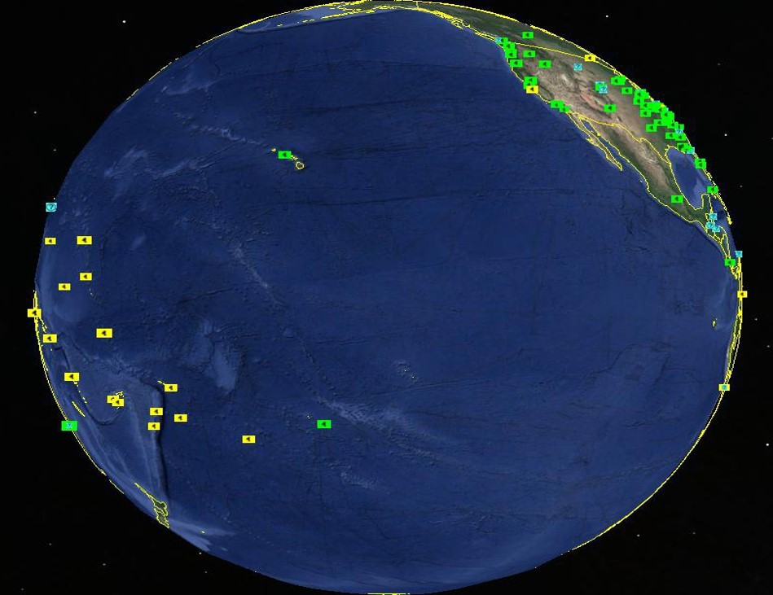
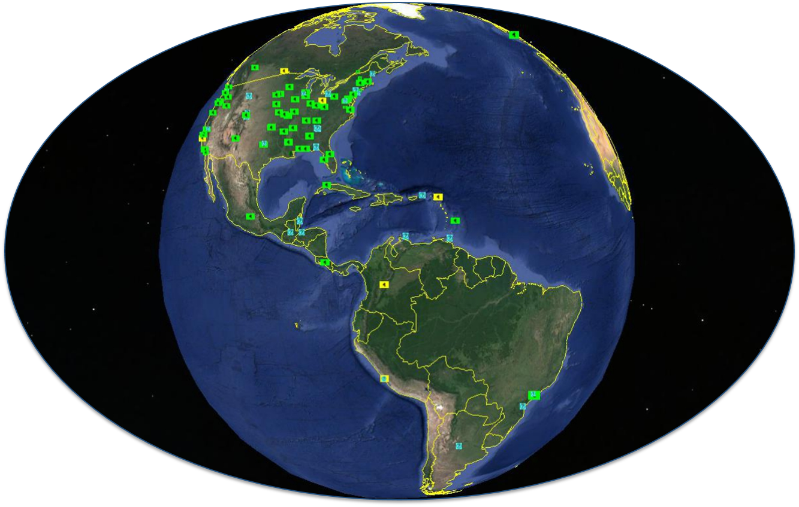
HRIT/EMWIN Users By Numbers
Users are defined as a having a complete receiving station capable of obtaining the HRIT/EMWIN broadcast downlink

Slide 27
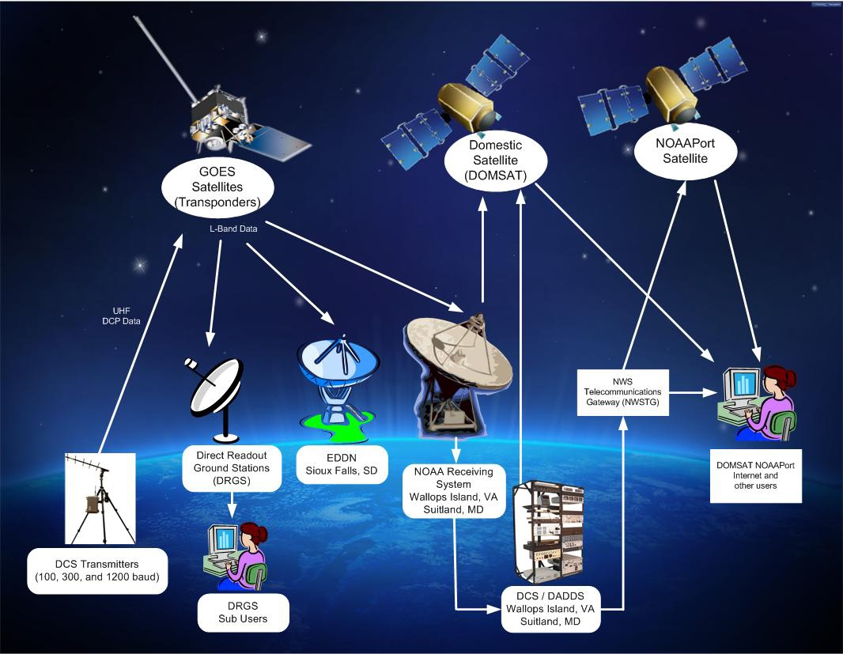
GOES Data Collection System
Notes:
A GOES data relay service used for the collection and distribution in real-time of environmental data from remote data collection platforms located throughout the Western Hemisphere.
Started in 1974 as an experimental system for collecting real-time data that has evolved into a National Critical operational system used by many Federal, State and Local agencies.
Has evolved into the backbone of real-time data collection programs for many environmental agencies.
Many Emergency warning systems in the U.S. and neighboring countries rely on data delivered through GOES DCS.
Restricted by federal regulation to environmental, government or government sponsored users.
ECCC accesses the Data Collection Platform Reports (DCPR) via the US NWS gateway between the NOAA Satellite Operations Facility (NSOF) in Suitland, MD and the Canadian Meteorological Centre in Dorval, QC, and also via DCS toolkit to Wallops and the Emergency Data Distribution Network (EDDN) of the U.S. Geological Survey (USGS) in Sioux Falls, SD.

Slide 28
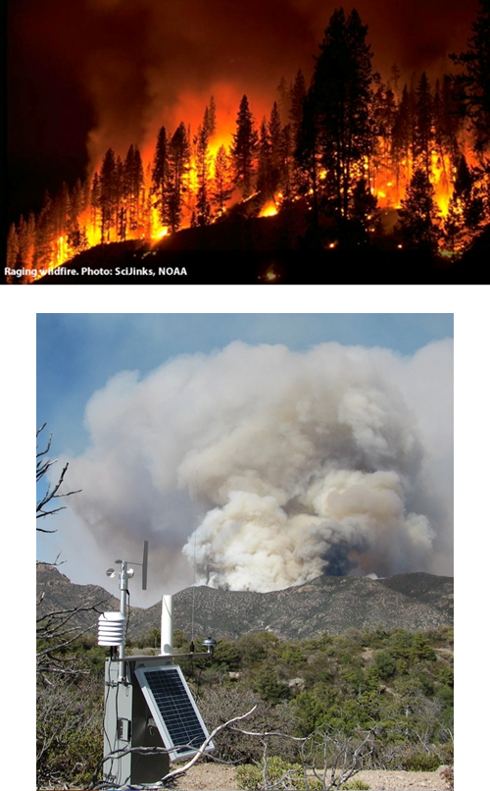
GOES DCS Today
Users enjoys 99.99% availability and 30 second latency after transmission
All users have open access to all data collected within the DCS network
User data is available through downlink 1679 to 1695 MHz frequency range w/ no outside interference
User sends observations through uplink via 401 - 403 MHz frequency range w/ no outside interference
Users can access DCS data through the DCS Administrative & Data Distribution System (DADDS), NWS Telecommunication Gateway, HRIT and the Local Readout Ground Station (LRGS)
Notes:
BLUF:
States two concerns:
NSOSA reviewing opportunities to use commercial systems to host the DCS capability
Potential spectrum sharing impacts with respect to future FCC decision not to mention sharing with small sats as well
Spectrum Enhancement Act of 2004 (CSEA),¹¹ and Title X of the Bipartisan Budget Act of 2015 (Spectrum Pipeline Act),¹² all included provisions designed to make more spectrum available for non-federal or shared use. Notably, the CSEA created the Spectrum Relocation Fund to streamline the process by which federal incumbents can recover the costs associated with relocating their spectrum-dependent systems from spectrum bands authorized to be licensed under the Commission’s competitive bidding authority.¹³
(1) current federal earth stations in, and adjacent to, the band could be protected from harmful interference; (2) future federal earth stations could be added to the band
while minimizing disruptions to commercial service; and (3) non-federal earth stations that rely on the data transmitted in the band by NOAA satellites could continue to have access to this data.
In addition, NTIA has assigned several frequencies in different portions of the 1675-1695 MHz band to NOAA for Geostationary Operational Environmental Satellites-N Series (GOES-N) downlinks, with the 1673.4-1678.6 MHz portion of the band being used for Sensor Data Links24 at four locations (Wallops Island, VA; Greenbelt, MD; Omaha, NE; and Fairbanks, AK).25 The National Weather Service also uses GOES-N downlinks from 1680.5 to 1694.5 MHz at several locations (Miami, FL; Kansas City, MO; Suitland, MD; Silver Spring, MD; College Park, MD; Norman, OK; Boulder, CO; Honolulu, HI; and Anchorage, AK). NOAA also receives GOES-N series data at Asheville,
Paper only reference Radiosondes. Also some CDAs and ground stations (14 sites) Not all DRGS customer sites are mentioned…

Slide 29
DCS By The Numbers……….
More than 40,000 transmitters deployed with more than 30,000 transmitters sending data through GOES.
Most transmit every hour, but some are transmitting every half hour, some every 15 minutes. EVERYONE is pushing for more.
Tide Gages monitoring for tsunamis report every 5 or 6 minutes.
Over 800,000 messages per day.
Estimated 8,000,000 (million) observations per day into the global observing system.
Nearly 500 user agencies
Approximately 1500 individual users registered for system access.
Real time access to relevant environmental data: 30 seconds on average
Notes:
40,000 transmitters with over 30,000 actively transmitting
What is the difference between observations and actual messages?
So, TRANSMISSIONs can contain a number of OBSERVATIONS
Hence, 850,000 transmissions vs. 8 Million per day

Slide 30
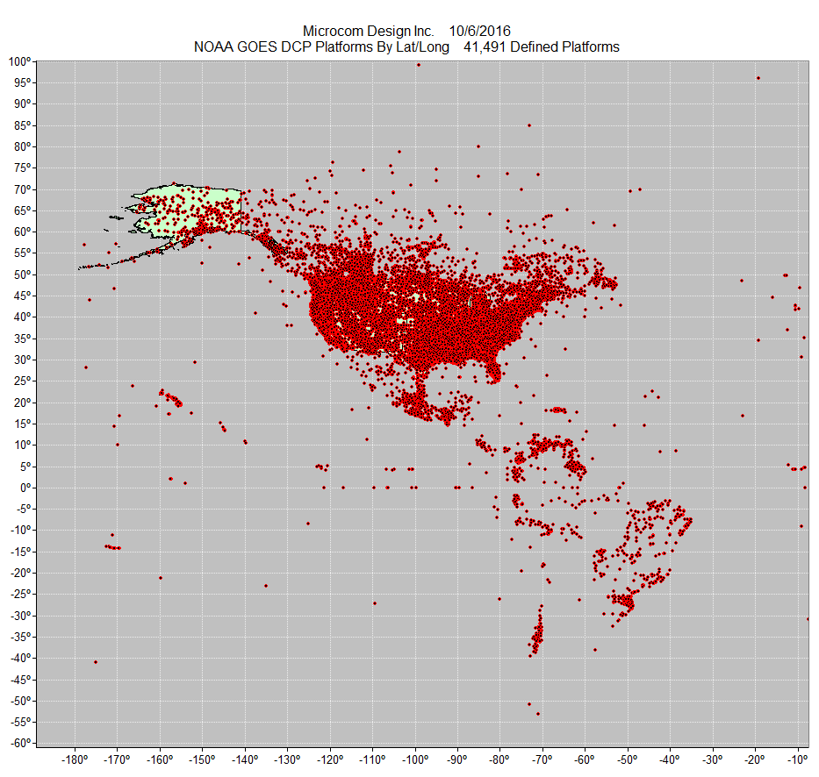
Distribution of GOES DCS Platforms
Notes:
North and South America, Pacific Islands, the Caribbean islands
So, this chart gives use a good perspective on the Scope of the GOES DCS program
There are approximately 40,000 Data Collection Platforms are deployed
Approximately, 30,000 are actively transmitting data
There are nearly 700 agencies (Federal, State and Local)
With just under 2000 individual users
We are literally moving over 850,000 messages per day…..

Slide 31
Major DCS Users
United States Geological Survey (USGS)
  12,031 DCPs
United States Army Corps of Engineers (USACE)
  2936 DCPs
NOAA National Weather Service
  502 DCPs
USDA United States Forest Service
  1,009 DCPs
Bureau of Land Management
  800 DCPs
NOAA National Ocean Service
  634 DCPs
United States Bureau of Reclamation
  640 DCPs
National Climatic Data Center
  507 DCPs
Venezuela Institute of Meteorology & Hydrology
  1,730 DCPs
  National Water Commission in Mexico
    807 DCPs
  Brazil National Water Agency
    579 DCPs
  Institute de Hidrologia, Meteorologia y Estudios, Colombia
    429 DCPs
  CANADA Overall (approx. 81 organizations)
    4578 DCPs
      Alberta Environment, Canada
        354 DCPs
      Hydro Quebec
        437 DCPs
      Water Survey of Canada
        1561 DCPs

Slide 32
Environmental Satellite Processing
and Distribution System
The Environmental Satellite Processing and Distribution System (ESPDS) is an enterprise system for ingesting, producing delivering near real-time data to our core, time critical users. It is located in the Environmental Satellite Processing Center (ESPC) and includes the following major segments:
  Product Generation - NOAA Data Exploitation (NDE)
  Product Distribution – Production Distribution and Access (PDA)
  Re-broadcast HRIT/EMWIN and GNC-A
  High-speed network and services – Enterprise Infrastructure (EI)
PDA capabilities:
  Peers with high speed wide area network (N-WAVE)
  Greater security (secure transfer protocols, baseline monitoring, high performance threat scanning, etc.)
  Configurable production with custom tailoring capability

Slide 33

GOES Data Operations in the ESPC
GRB
GOES-16/17
PDA
Users
GOES-16/17
PPZ
AWIPS
GEOPROD
Misc PG (SFS)
Users
Consolidated Backup
(CBU)
GOES-14/15
GEODIST
Legend
Environmental Satellite Processing Center (ESPC)
Nominal Operations
GRB
GOES-14/15
GOES-16/17
Backup Operations
Flow activated during Backup
Wallops CDA
GEOPROD
CIP
Misc PG
GEODIST
CIP
Users
Hot Backup
Cold Backup
Wallops Critical Infrastructure Protection (Backup)

Slide 34
GOES-R Baseline Products
ADVANCED BASELINE IMAGER (ABI)
    Aerosol Detection (Including Smoke and Dust)
            Aerosol Optical Depth (AOD)
            Clear Sky Masks
            Cloud and Moisture Imagery*
            Cloud Optical Depth
            Cloud Particle Size Distribution
            Cloud Top Height
            Cloud Top Phase
            Cloud Top Pressure
            Cloud Top Temperature
            Derived Motion Winds
            Derived Stability Indices
            Downward Shortwave Radiation: Surface
Fire/Hot Spot Characterization
Hurricane Intensity Estimation (retired)
Land Surface Temperature (Skin)
Legacy Vertical Moisture Profile
Legacy Vertical Temperature Profile
Radiances
Rainfall Rate / QPE
Reflected Shortwave Radiation: TOA
Sea Surface Temperature (Skin)
Snow Cover
Total Precipitable Water
Volcanic Ash: Detection and Height
Note: *Key Performance Parameter (KPP)
Notes:
GOES-R SERIES PRODUCT DEFINITION AND
USERS’ GUIDE
(PUG)
VOLUME 1: MAIN
VOLUME 2: L0 PRODUCTS
VOLUME 3: LEVEL 1B PRODUCTS
VOLUME 4: GOES-R REBROADCAST (GRB)
VOLUME 5: LEVEL 2+ PRODUCTS
APPENDIX X: ISO SERIES METADATA

Slide 35
Baseline Products
GEOSTATIONARY LIGHTNING MAPPER (GLM)
Lightning Detection: Events, Groups & Flashes
SPACE ENVIRONMENT IN-SITU SUITE (SEISS)
Energetic Heavy Ions
Magnetospheric Electrons & Protons: Low Energy
Magnetospheric Electrons & Protons: Med & High Energy
Solar & Galactic Protons
MAGNETOMETER (MAG)
Geomagnetic Field
EXTREME ULTRAVIOLET AND X-RAY IRRADIANCE SENSORS (EXIS)
Solar Flux: EUV
Solar Flux: X-ray Irradiance
SOLAR ULTRAVIOLET IMAGER (SUVI)
Solar EUV Imagery

Slide 36
Production Distribution and Access
PDA service is dedicated for authorized near real-time users. Other near real-time distribution services are being explored as PDA is a finite resource
The PUSH services are available only to users with a 24x7 support desk
New user onboarding is currently suspended while the organization assesses time critical user needs and evaluates available capacity on the system
Data access information is available at:
http://www.ospo.noaa.gov/Organization/About/access.html
Must be signed by the Government official responsible for the data flow on the subscriber’s end
For existing users who contact ESPC about a problem:
  Make sure to say that you are a PDA user and provide our PDA user group name
  Provide PDA product names or exact files names for the data you are missing. The filename of the last data you received is most useful to help us pinpoint your problem quickly

Slide 37
Comprehensive Large Array-data Stewardship
System (CLASS)
CLASS is NOAA's Archive and delayed-mode distribution system for distribution of NOAA and US Department of Defense (DoD) Polar-orbiting Operational Environmental Satellite (POES) data, NOAA's Geostationary Operational Environmental Satellite (GOES) data, and derived data.
CLASS stores an average of 180 TB/month of data. The total amount of data at CLASS is almost 14 PB
A number of GOES-16/17 ABI Level 2 products are now available to the public through CLASS (GOES-17 data products have been available since November 28, 2018)
All available ABI products , as well as the L1B radiance data, are found under the GRABIPRD data family. For complete details on data maturity start dates and access dates please go to: https://www.ncdc.noaa.gov/data-access/satellite-data/goes-r-series-satellites
The GLM Level-2 products can now be ordered from CLASS under the Family name GOES-R Series GLM L2+ Data Product (GRGLMPROD)
Users need to be aware of any data caveats (warning) documented during the PS-PVR by clicking on the appropriate readme links provided
Note that CLASS is not a near real-time system and data availability is not guaranteed

Slide 38
Levels of Access Services
CLASS order types: | Average completion time | Average File Limit | Contact the CLASS Help Desk?
Ad hoc orders (Use Search button to obtain inventory) | Usually within 12 to 24 hours | Up to 500 files | No
Large orders (use Quick Search button to skip inventory ) | 24 to 48 hours | 1000 to 3000 | No
Bulk orders (use Quick Search button) | > 48 hours | 3000 to 6000 | Yes
Subscription (standing orders) | < 6-7 hours | No limit | Yes

Slide 39
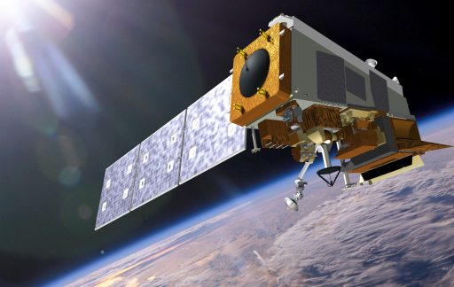
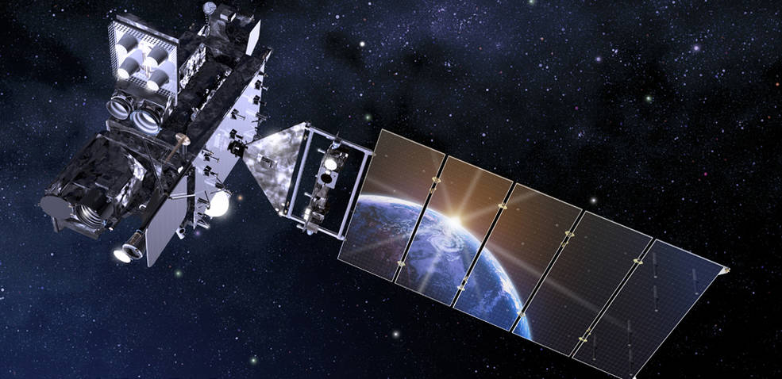
Data Availability Times
4 to 5 hrs
4 hrs
3 to 4 hrs
3 to 4 hrs
3 to 4 hrs
The data availability in CLASS for S-NPP and JPSS-1 (NOAA-20) is about 4 hours. IDPS has a built in delay in order to ensure repaired granules make it to CLASS. CLASS changed the S-NPP/JPSS availability from 6 hours to 4 during 2018
GOES-N GOES-R POES JASON JPSS
Notes:
CLASS changed the S-NPP from 6 hours to 4 this year. After working JPSS, CLASS was able to reduce the time to get the repaired granuals quicker.

Slide 40

GOES-16/17 Data Products from CLASS
How to request GOES-16 data products from CLASS
Start at the following link:
https://www.bou.class.noaa.gov/saa/products/user_profile
Then register
  Set up your user preferences
  Select data family to search
  Search for data
  Select files
  Review shopping cart
  Review your order status
A demonstration is available at:
https://www.class.noaa.gov/notification/demo.htm
A tutorial is available at:
https://www.avl.class.noaa.gov/notification/pdfs/CLASS%20Data%20Access%20Tutorial_042015.pdf

Slide 41
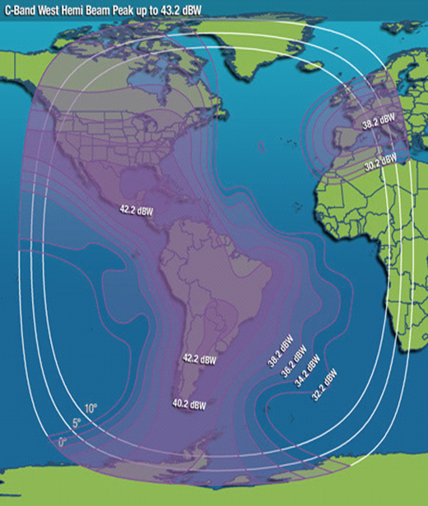
GEONETCast Americas (GNC-A)
GNC-A is the Western Hemisphere component of GEONETCast, a near real time, global network of satellite-based data dissemination systems designed to distribute space-based, air-borne and in situ data, metadata and products to diverse communities
12 Megabits per second data rate with Multiplexed C-Band
Intelsat-21 Geostationary satellite at 58 degrees West
> 99.5% availability
Footprint covers most of the Americas and Caribbean
Currently 86 GNC-A user stations in 19 countries
GOES-16 & GOES-17 Full Disk Cloud Moisture Imagery (CMI) Bands 2, 7, 8, 9, 13, 14, 15 (band 2 at 1 km and others at 2 km) every 15 minutes
GOES-16 Level-2 baseline products
Selected JPSS imagery and products
Products from NWS, USEPA, US Drought monitor (NADM)
Full product list: https://geonetcast.wordpress.com/gnc-a-product-catalog/
Email for the GNC-A point of contact: gnc.americas@noaa.gov

Slide 42
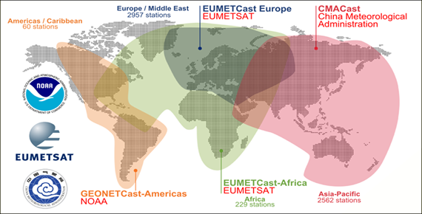
GEONETCast Americas

Slide 43
GNC-A Broadcast
GEONETCast Americas Broadcast Parameter | Parameter Value
Satellite | IS-21 (Intelsat)
Location | 58 ° West or 302° East
PID | 4201
Transponder | 7C
Radio Frequency Band | C-band
Frequency | 3840 MHz
Frequency Range | 3700 – 4200 MHz
Symbol Rate: | 27.69 Msym
Polarization | Linear – Vertical (Horizontal or Vertical)
Typical Edge of Coverage Effective Isotropic Radiated Power | > 31.3 dBW
Datacasting Client Software (Required) | Kencast FAZZT Professional Client
FEC (Forward Error Correction – Kencast FAZZT) | 7/8
Peak G/T (antenna gain-to-noise-temperature) | Up to 2.5 dB/K

Slide 44
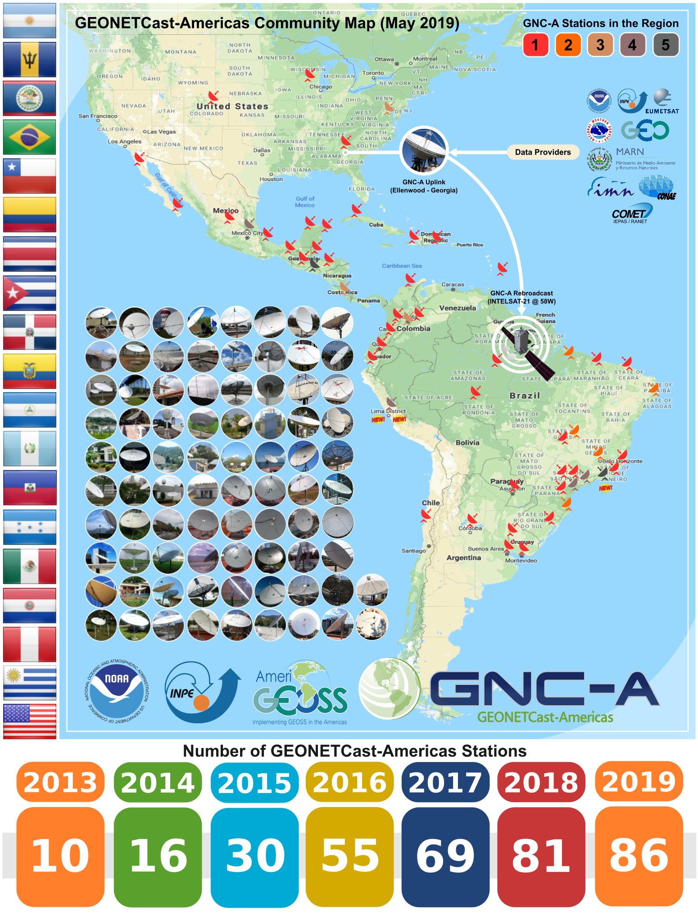
GNC-A Community Map

Slide 45
Big Data Project
NOAA’s Big Data Project (BDP) is designed to facilitate public use of key environmental datasets by providing copies of NOAA’s information in the Cloud, allowing users to do analyses of data and extract information without having to transfer and store these massive datasets themselves
http://www.noaa.gov/big-data-project
CICS-NC is a partner in the BDP and acts as a broker between NOAA and the public cloud providers
Links to Public Cloud Information and Datasets
  GOES-16/17 Data:
    Amazon Web Services
    Google Cloud Platform
    Open Commons Consortium
Notes:
BDP Homepage:
http://www.noaa.gov/big-data-project
CICS-NC is a partner in the BDP and acts as a broker between NOAA and the public cloud providers
https://ncics.org/data/noaa-big-data-project/
Links to Public Cloud Information and Datasets
GOES-16 Data:
Amazon Web Services
Open%20Commons%20Consortium
IBM NOAA Data Portal
https://noaa-crada.mybluemix.net/node/33
Google Cloud Platform
https://console.cloud.google.com/launcher/details/noaa-public/goes-16?pli=1
Open Commons Consortium
http://edc.occ-data.org/goes16/getdata/

Slide 46
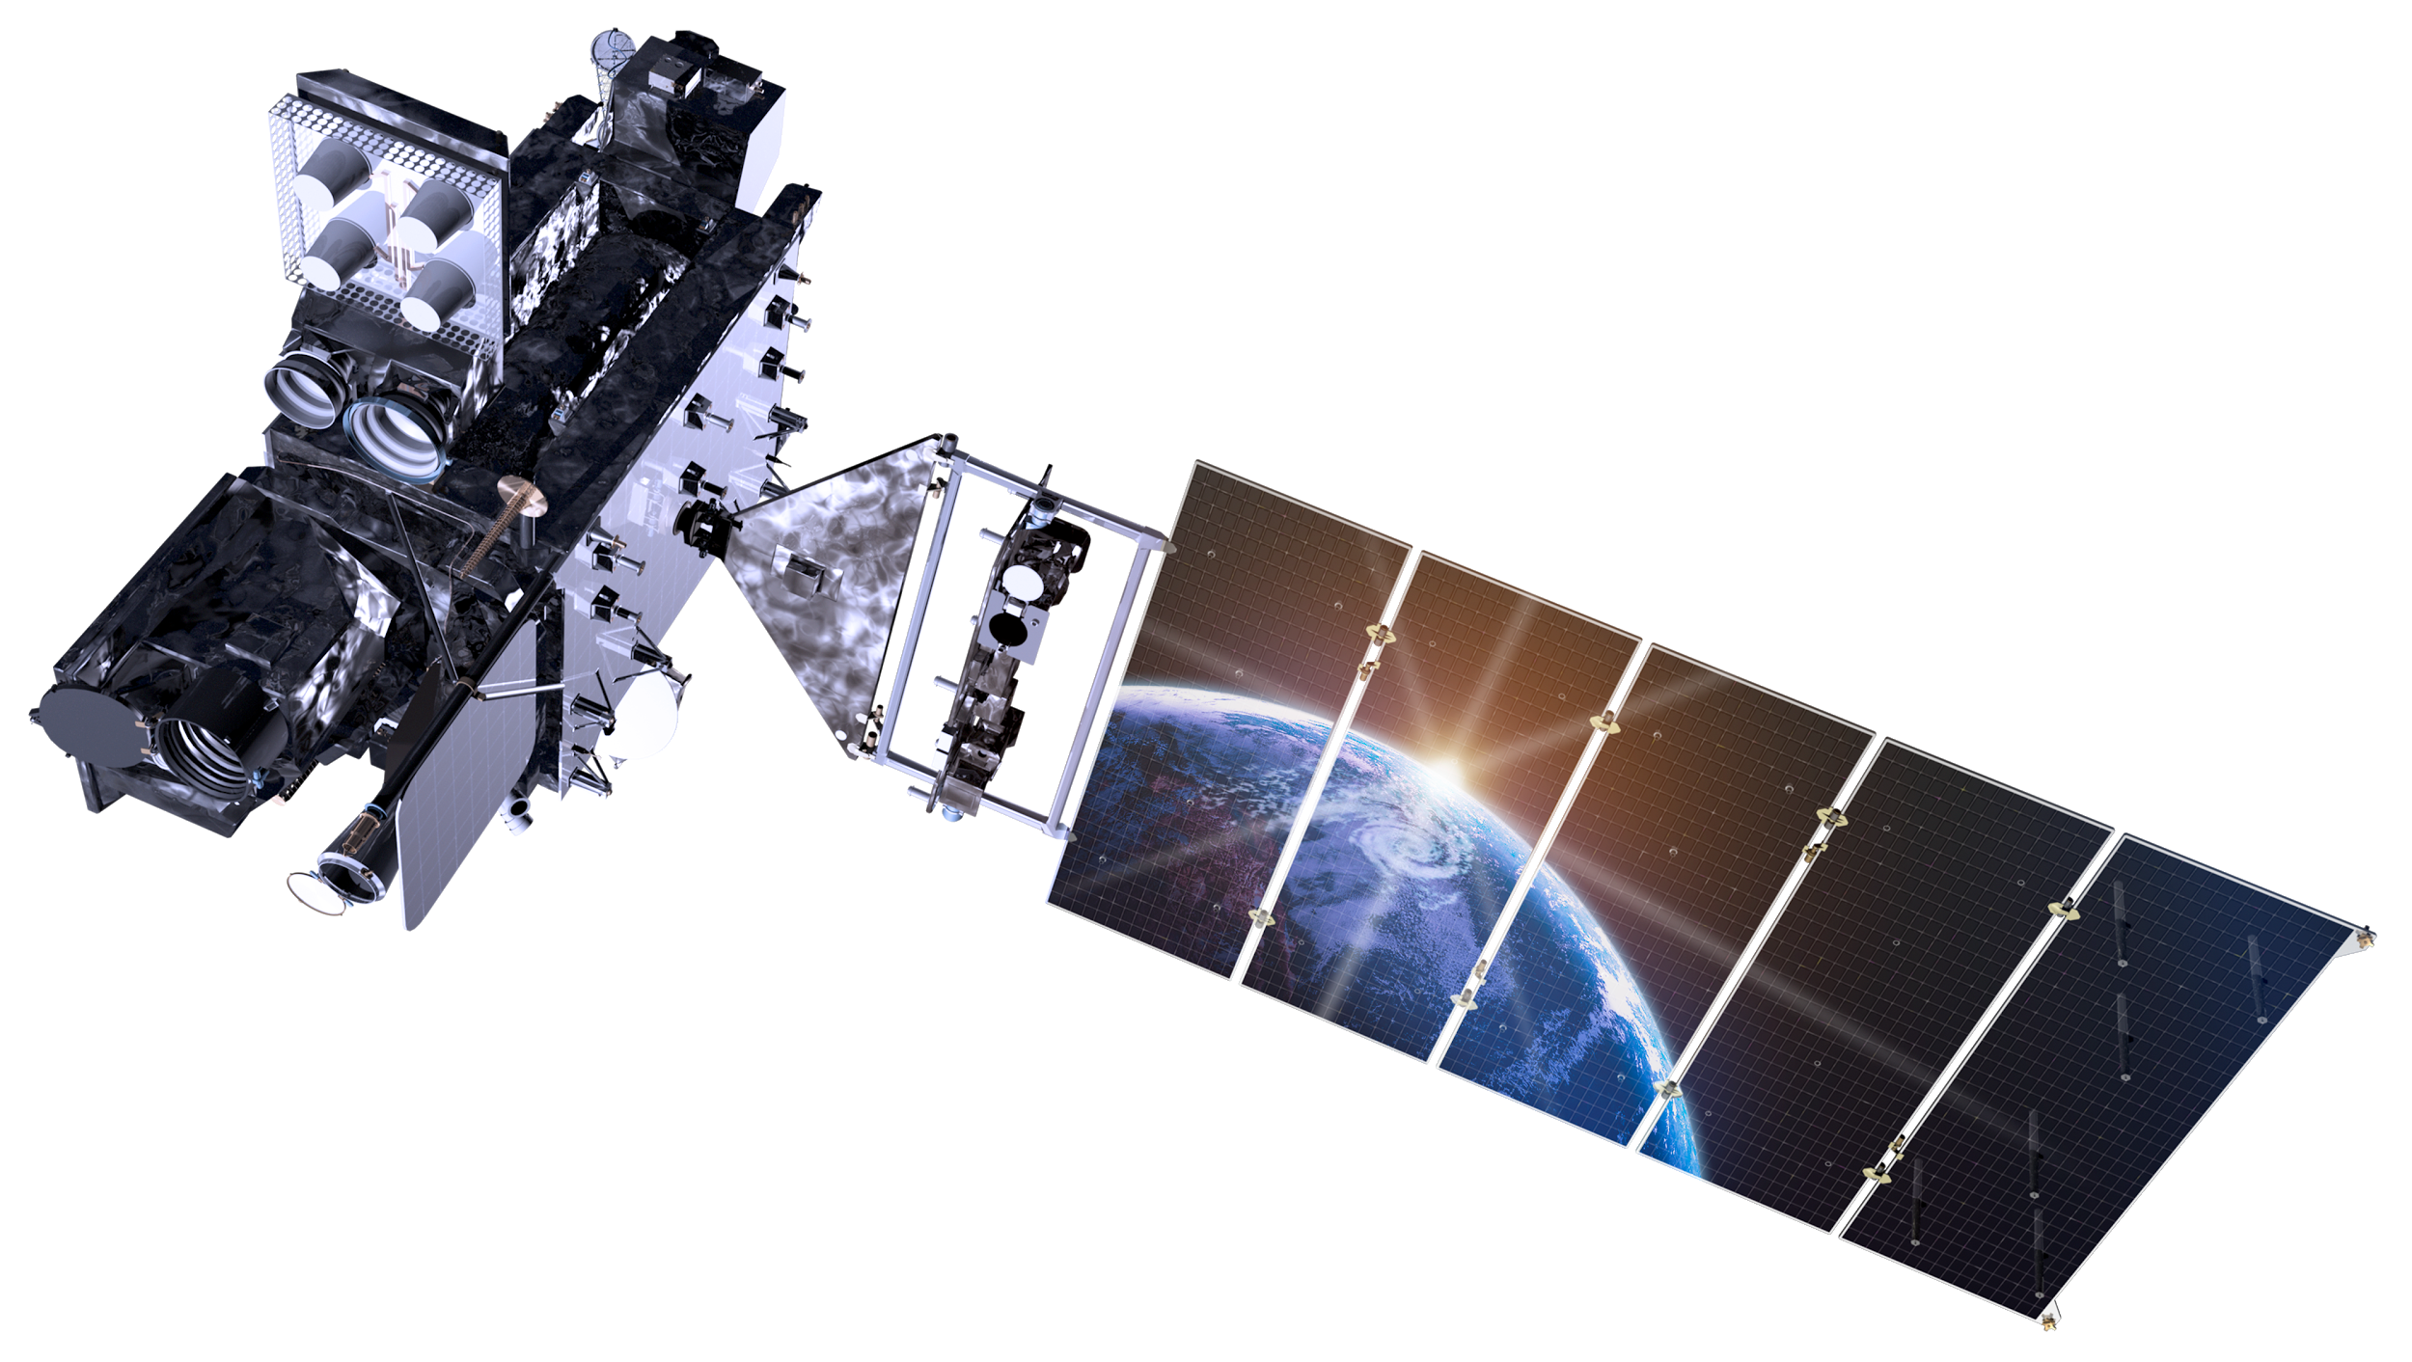
Traditional NOAA Satellite Data Internet Access Strategy
Consumer Must Download Data to Use
Consumer
Ground System Data Distribution
Consumer
Consumer
Consumer
Consumer

Slide 47
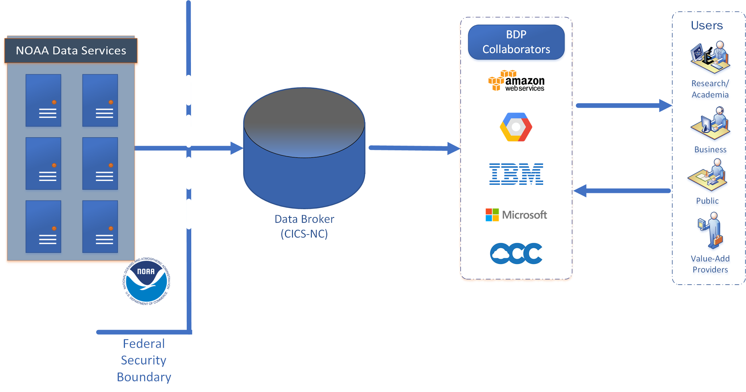
BDP Data Access
Single Copy Services Many -- Use Data in Place
Data access and egress from cloud platforms are free
One-way transfer out of federal systems. Only a trusted user inside security boundary
Distributing a single copy of data can support all users.

Slide 48



GOES-R Products Available through the BDP
  https://aws.amazon.com/noaa-big-data/
  https://console.cloud.google.com/storage/browser/
  http://edc.occ-data.org/
Advanced Baseline Imager--Level 1b--Radiances, CONUS
Advanced Baseline Imager--Level 1b--Radiances, Full Disk
Advanced Baseline Imager--Level 1b--Radiances, Mesoscale
Advanced Baseline Imager--Level 2--Cloud and Moisture Imagery, CONUS
Advanced Baseline Imager--Level 2--Cloud and Moisture Imagery, Full Disk
Advanced Baseline Imager--Level 2--Cloud and Moisture Imagery, Mesoscale
Advanced Baseline Imager--Level 2--Fire Detection and Characterization, CONUS
Advanced Baseline Imager--Level 2--Fire Detection and Characterization, Full Disk
Advanced Baseline Imager--Level 2--Multiband Cloud and Moisture Imagery, CONUS
Advanced Baseline Imager--Level 2--Multiband Cloud and Moisture Imagery, Full Disk
Advanced Baseline Imager--Level 2--Multiband Cloud and Moisture Imagery, Mesoscale
Global Lightning Mapper-Level 2--Lightning Cluster-Filter Algorithm

Slide 49
UCAR/Unidata
UCAR/Unidata is currently receiving GOES-16 and GOES-17 data products on GRB and NOAAPort and is making all GOES-16 and GOES-17 products available to its customers. Methods of distribution include:
  McIDAS Abstract Data Distribution Environment (ADDE). ADDE is a Client/server data access model developed for McIDAS. Provides access for McIDAS-X, McIDAS-V, IDV, etc.) for NOAAPort and GRB-delivered content
  THREDDS Data Server (TDS) provides access for a variety of applications for NOAAPort and GRB-delivered content thredds-test.unidata.ucar.edu
  TDS-provided web access for NOAAPort and GRB delivered content: thredds-test.unidata.ucar.edu
  Internet Data Distribution (IDD). The IDD provides real-time data "push" technology for a wide variety of data including NOAAPort and GRB-delivered GOES-16 and GOES-17 data and products: https://www.unidata.ucar.edu/projects/index.html#idd
  Website for NOAAPort and GRB delivered content http://atm.ucar.edu/

Slide 50
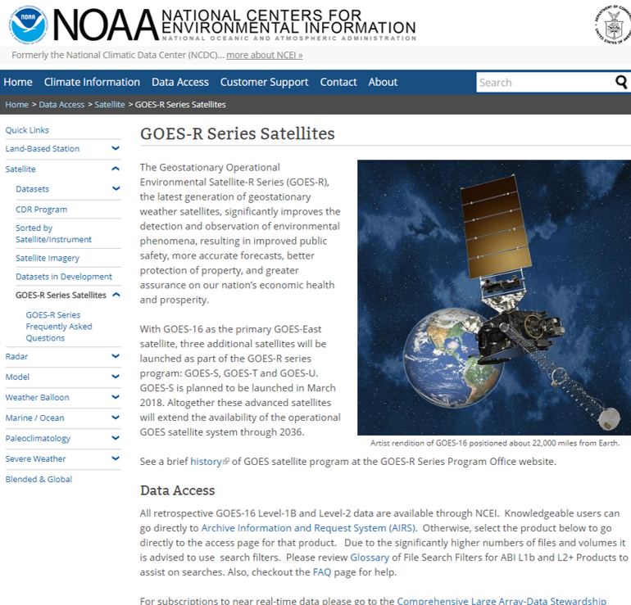
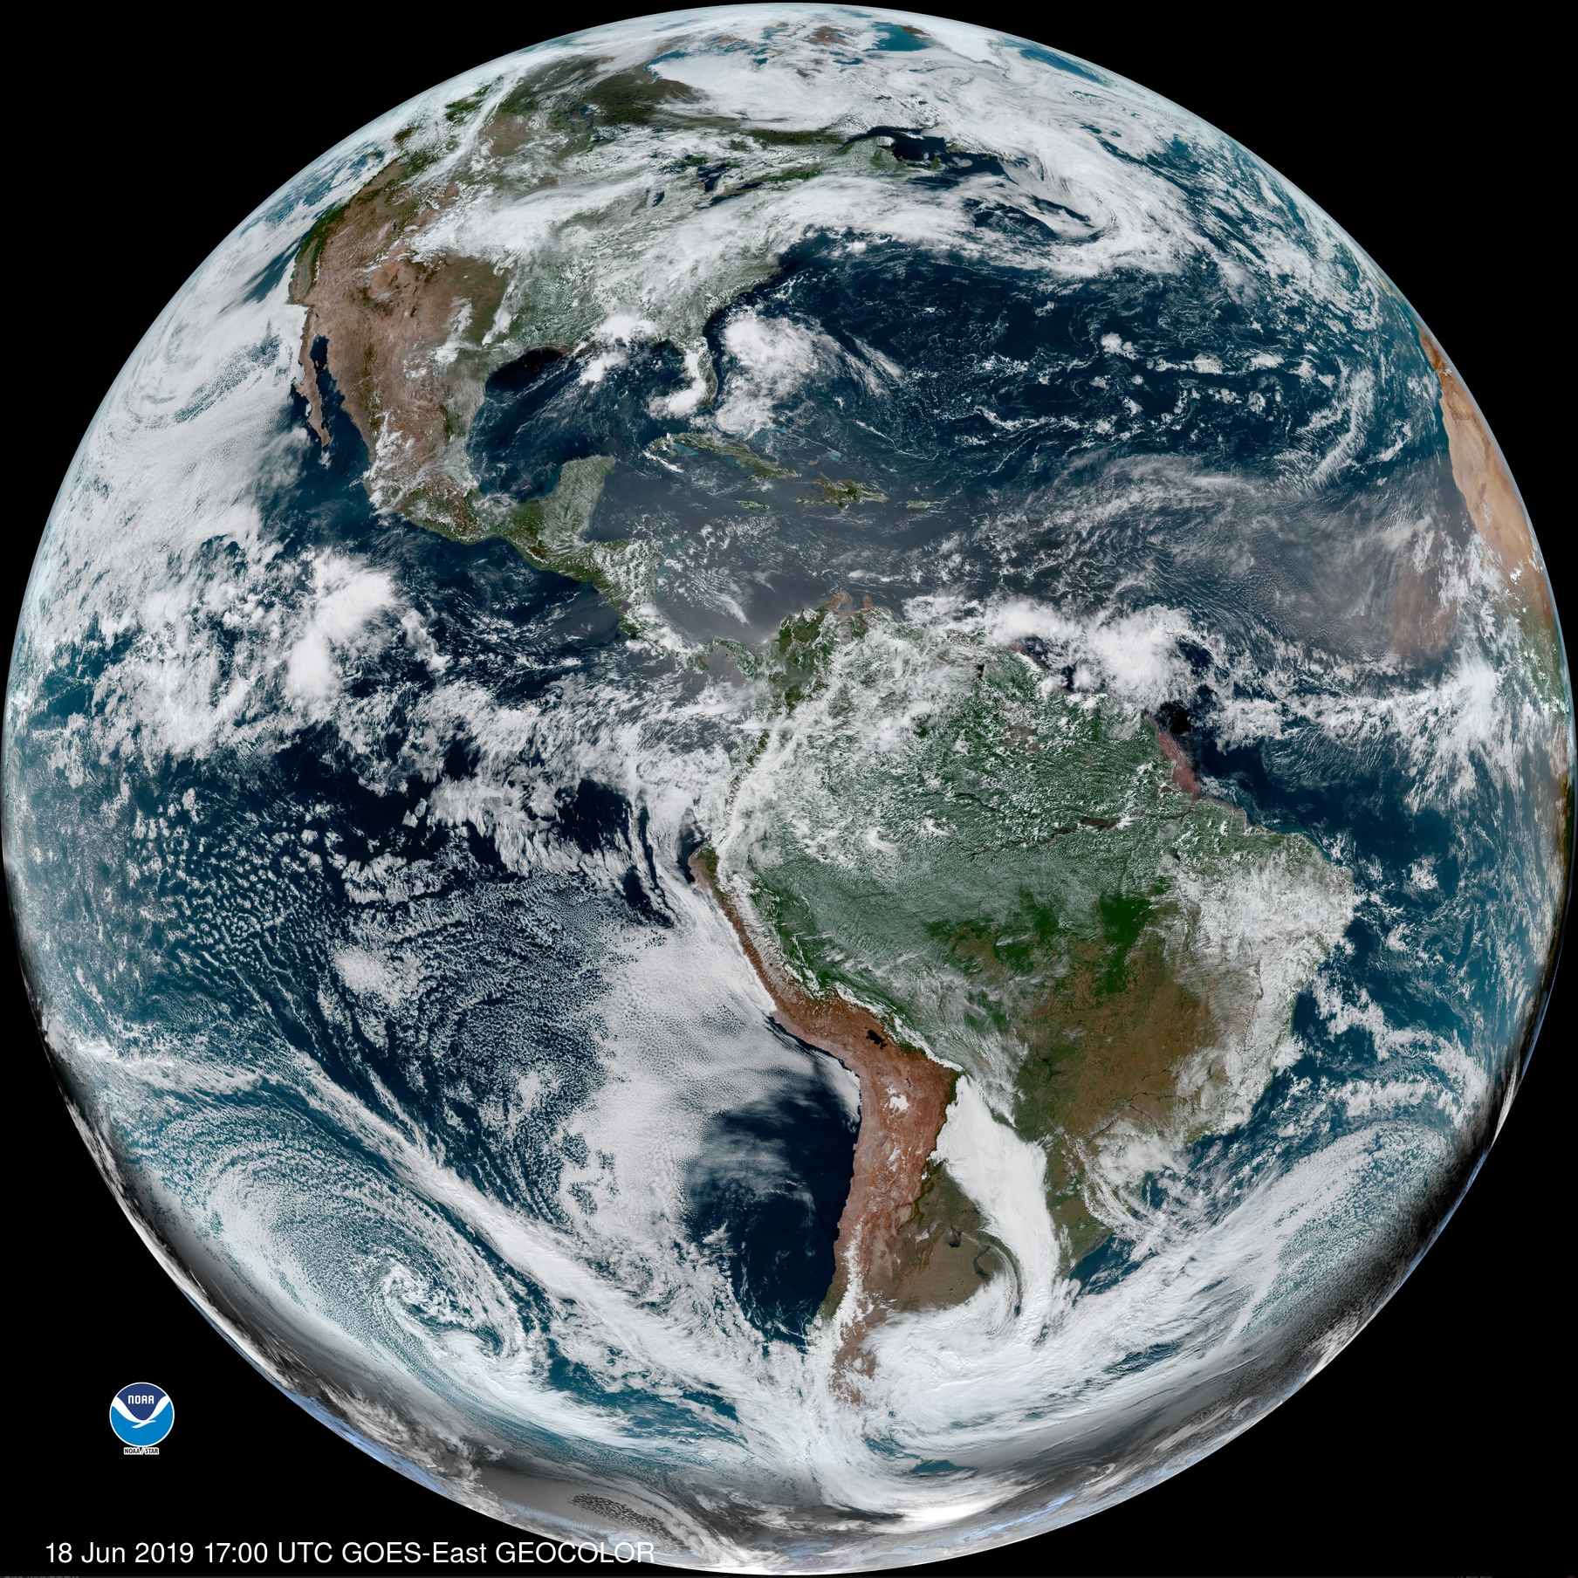
Websites
https://www.star.nesdis.noaa.gov/GOES/
https://www.nesdis.noaa.gov/content/our-satellites
NOAA does not control or guarantee the accuracy, relevance, timeliness, or completeness of information contained in the non-NOAA sites. NOAA does not endorse the organizations or individuals maintaining these sites, any views they express, or any products/services they offer

Slide 51
Links to Websites
NOAA STAR GOES Image Viewer https://www.star.nesdis.noaa.gov/GOES/
NOAA/NESDIS Geostationary Satellite Server https://www.goes.noaa.gov/
NOAA satellite direct broadcast systems (GRB, HRIT, EMWIN, HRD, GNC-A)
http://www.noaasis.noaa.gov/NOAASIS/ml/satservices.html
NOAA Centers for Environmental Information (NCEI) portal NOAA/NESDIS CLASS
http://www.class.ngdc.noaa.gov/saa/products/welcome
Cloud services (experimental)
  AWS: https://aws.amazon.com/public-datasets/goes/
  Google: https://console.cloud.google.com/launcher/details/noaa-public/goes-16?pli=1
  OCC: http://edc.occ-data.org/goes16/getdata/
  Environment and Climate Change Canada (ECCC)
  Satellite Images and Animation
  https://weather.gc.ca/satellite/index_e.html

Slide 52
Links to Websites
University of Wisconsin – Madison Space Science and Engineering Center (SSEC) Cooperative Institute for Meteorological Satellite Studies (CIMSS).
RealEarth: https://realearth.ssec.wisc.edu/
Geostationary Satellite Image Browser: SSEC Geo Browser Color hybrid with GOES-16/17 and Suomi NPP https://www.ssec.wisc.edu/data/geo
  All bands, Meso1 Meso2 and CONUS and Full Disk, plus a "spectral" (all channels) loop geo imagery (SSEC Real Earth) All bands, CONUS and Full Disk and both meso-scale sectors
UW – Madison SSEC/CIMSS List of GOES-16 Websites http://cimss.ssec.wisc.edu/goes/goesdata.html
UW-Madison AOS Many sectors (including Southern Wisconsin) and several enhancements
    http://aos.wisc.edu/weather/wx_obs/Satellite.html
Notes:
NOAA STAR GOES-16 Image Viewer https://www.star.nesdis.noaa.gov/GOES/GOES16_CONUS.php
NOAA/NESDIS Geostationary Satellite Server http://www.goes.noaa.gov/index.html
SSEC Geo Browser Color hybrid with GOES-16 and Suomi NPP http://www.ssec.wisc.edu/data/geo/#/animation?satellite=goes-16&end_datetime=latest&n_images=4&coverage=conus&channel=rgbstr&image_quality=gif&anim_method=javascript
SSEC Geo Browser All bands, Meso1 Meso2 and CONUS and Full Disk, plus a "spectral" (all channels) loop geo imagery (SSEC Real Earth TM) All bands, CONUS and Full Disk and both meso-scale sectors
https://www.ssec.wisc.edu/data/geo/#/animation?satellite=goes-16
UW-Madison AOS Many sectors (including Southern Wisconsin) and several enhancements
http://www.aos.wisc.edu/weather/wx_obs/GOES16.html
RAMMB Slider GeoColor, all bands and all sectors http://rammb-slider.cira.colostate.edu/
ABI GOES-16 imagery (SPORT) 16 bands, RGBs, Full Disk and CONUS and Meso-scale sectors weather.us US view, several options
https://weather.msfc.nasa.gov/sport/
Meteo-Chile 16 bands and RGB images over Chile and 1-page band fact sheets
http://www.meteochile.cl/PortalDMC-web/index.xhtml
Brazil's CPTEC All ABI bands in animation over South America.
http://pyata.cptec.inpe.br/acervowebv2/loop.show.logic
UNAM http://www.lanot.unam.mx/
Fuerza Aérea Colombiana https://www.simfac.mil.co/news.php

Slide 53
Links to Websites
CIRA Colorado State University receives GOES-16 and GOEs-17 GRB and generates and distributes products. CIRA provides access to a variety of advanced experimental satellite products via LDM, RAMSDIS Online web access http://rammb.cira.colostate.edu/ramsdis/online/, the RAMMB-SLIDER http://rammb-slider.cira.colostate.edu visualization tool and ftp. These products include specialized CIRA derived products such as:
  DEBRA dust detection https://ams.confex.com/ams/92Annual/webprogram/Paper199249.html
  GeoColor http://rammb.cira.colostate.edu/training/visit/quick_guides/QuickGuide_CIRA_Geocolor_20171019.pdf
  Advected Layered Precipitable Water http://rammb.cira.colostate.edu/training/visit/quick_guides/QuickGuide_LPW_Advected_20180223.pdf
  Proxy Visible https://ams.confex.com/ams/98Annual/webprogram/Paper334276.html
  Snow/Cloud Layer discrimination http://rammb.cira.colostate.edu/research/goes-r/proving_ground/cira_product_list/cloud_layers_and_snow_cover_discriminator_detailed.asp
Products are developed from locally ingest data available on GOES-16, GOES-17, Himawari-8 and SNPP/JPSS1 satellites. Product format includes AWIPS2 netCDF4 and NAWIPS McIDAS AREA file, GIF, JPG, and HDF. CIRA’s global client base includes the US weather research community, the National Weather Service, the Joint Typhoon Warning Center, commercial users such as the aviation and fishing communities, satellite researchers in the South Pacific and Asia, educators and media developers such as National Geographic, Public Broadcasting Service, television networks
Notes:
NOAA STAR GOES-16 Image Viewer https://www.star.nesdis.noaa.gov/GOES/GOES16_CONUS.php
NOAA/NESDIS Geostationary Satellite Server http://www.goes.noaa.gov/index.html
SSEC Geo Browser Color hybrid with GOES-16 and Suomi NPP http://www.ssec.wisc.edu/data/geo/#/animation?satellite=goes-16&end_datetime=latest&n_images=4&coverage=conus&channel=rgbstr&image_quality=gif&anim_method=javascript
SSEC Geo Browser All bands, Meso1 Meso2 and CONUS and Full Disk, plus a "spectral" (all channels) loop geo imagery (SSEC Real Earth TM) All bands, CONUS and Full Disk and both meso-scale sectors
https://www.ssec.wisc.edu/data/geo/#/animation?satellite=goes-16
UW-Madison AOS Many sectors (including Southern Wisconsin) and several enhancements
http://www.aos.wisc.edu/weather/wx_obs/GOES16.html
RAMMB Slider GeoColor, all bands and all sectors http://rammb-slider.cira.colostate.edu/
ABI GOES-16 imagery (SPORT) 16 bands, RGBs, Full Disk and CONUS and Meso-scale sectors weather.us US view, several options
https://weather.msfc.nasa.gov/sport/
Meteo-Chile 16 bands and RGB images over Chile and 1-page band fact sheets
http://www.meteochile.cl/PortalDMC-web/index.xhtml
Brazil's CPTEC All ABI bands in animation over South America.
http://pyata.cptec.inpe.br/acervowebv2/loop.show.logic
UNAM http://www.lanot.unam.mx/
Fuerza Aérea Colombiana https://www.simfac.mil.co/news.php

Slide 54
Links to Websites
NASA Marshall Space Flight Center, Huntsville, AL
Short-term Prediction Research and Transition Center (SPORT). ABI GOES-16/17 imagery: 16 bands, RGBs, Full Disk and CONUS and Meso-scale sectors weather.us US view, several options. GLM product ABI GOES-16/17 imagery (SPORT) 16 bands, RGBs, Full Disk and CONUS and Meso-scale sectors weather.us US view, several options https://weather.msfc.nasa.gov/sport/
College of DuPage
  https://weather.cod.edu/satrad/
Pennsylvania State University Department of Meteorology
  http://mp1.met.psu.edu/~fxg1/PSUGOES_US/index.html
Notes:
Embry Riddle Aeronautical University (Daytona Beach, FL campus)
http://wx.erau.edu/erau_sat/
GLM NASA SPoRT
https://weather.msfc.nasa.gov/cgi-bin/sportPublishData.pl?dataset=goeseastglm&product=group&loc=conus
GLM Univ of Maryland
hhttp://lightning.umd.edu/Apps/GoesCesium/

Slide 55
Links to Websites
The National Earth Observation Lab (LANOT) at the Geography Institute, National Autonomous University of Mexico (UNAM) receives images through GOES-16 GRB with Terascan software (SeaSpace ). LANOT processes ABI Full Disk, CONUS, and mesoscale (when available over Mexico). LANOT uses CSPP Geo. Examples of products generated by LANOT:UNAM
Aerosol (Aerosol, Dust, and Smoke)
Cloud (Cloud_Top_Height, Cloud_Top_Temp, Cloud_Top_Phase, Clear_Sky_Mask, Cloud_Optical_Depth, Cloud_Particle_Size, Cloud_Top_Pressure, Low cloud, Rainrate, Water vapor height, and Water vapor pressure)
LST, NDVI, and SST
LANOT distributes the information to different government and academic institutions as National Meteorological Service, National Disaster Prevention Center, University of the State of Mexico and another 12 institutions. LANOT is also developing different algorithms, including: Floating algae index FAI (to spot Sargasso), volcanic ash, total precipitable water, and fire
Brazil Centro de Previsão do Tempo e Estudos Climáticos, INPE
http://satelite.cptec.inpe.br/home/index.jsp
Notes:
NOAA STAR GOES-16 Image Viewer https://www.star.nesdis.noaa.gov/GOES/GOES16_CONUS.php
NOAA/NESDIS Geostationary Satellite Server http://www.goes.noaa.gov/index.html
SSEC Geo Browser Color hybrid with GOES-16 and Suomi NPP http://www.ssec.wisc.edu/data/geo/#/animation?satellite=goes-16&end_datetime=latest&n_images=4&coverage=conus&channel=rgbstr&image_quality=gif&anim_method=javascript
SSEC Geo Browser All bands, Meso1 Meso2 and CONUS and Full Disk, plus a "spectral" (all channels) loop geo imagery (SSEC Real Earth TM) All bands, CONUS and Full Disk and both meso-scale sectors
https://www.ssec.wisc.edu/data/geo/#/animation?satellite=goes-16
UW-Madison AOS Many sectors (including Southern Wisconsin) and several enhancements
http://www.aos.wisc.edu/weather/wx_obs/GOES16.html
RAMMB Slider GeoColor, all bands and all sectors http://rammb-slider.cira.colostate.edu/
ABI GOES-16 imagery (SPORT) 16 bands, RGBs, Full Disk and CONUS and Meso-scale sectors weather.us US view, several options
https://weather.msfc.nasa.gov/sport/
Meteo-Chile 16 bands and RGB images over Chile and 1-page band fact sheets
http://www.meteochile.cl/PortalDMC-web/index.xhtml
Brazil's CPTEC All ABI bands in animation over South America.
http://pyata.cptec.inpe.br/acervowebv2/loop.show.logic
UNAM http://www.lanot.unam.mx/
Fuerza Aérea Colombiana https://www.simfac.mil.co/news.php

Slide 56
Links to Websites
Dirección Meteorológica de Chile
    http://www.meteochile.cl/PortalDMC-web/index.xhtml
Chilean Weather Service uses the satellite data products from the GRB reception system to generate products, including:
  RGB
  Level-2 and enhanced images which are made automatically
The GRB receive stations were installed by Enterprise Electronics Corporation (EEC).
Chilean Weather Service has four workstations where reception, processing and visualizing GOES-16 data is done, Antofagasta, Isla de Pascua, Santiago and Puerto Montt.
Customers are mainly meteorologists who work in the Dirección Meteorológica de Chile (Chilean Weather Service). They use the satellite data and products to make analysis and forecasts for Chile, in a short and very short term for public and aeronautical purposes.
Chilean Weather Service makes public some images and products for the general public and they have seen that there is a wide application of the satellite data, for example:
  TV meteorologists
  Agrometeorology
  Academic studies
  Environmental uses
A secondary use of the products are directed to research meteorology when it is needed.

Slide 57
Notifications, Status, and Contacts
24/7 Help Desk | ESPCOperations@noaa.gov
ESPC Messages | https://www.ospo.noaa.gov/Operations/messages.html
User Services | SPSD.UserServices@noaa.gov
Data Access | NESDIS.Data.Access@noaa.gov
Facebook | https://www.facebook.com/NOAASatellites/
Twitter | https://twitter.com/NOAASatellites
GOES Status | https://www.ospo.noaa.gov/Operations/GOES/status.html
GOES User Information and Documents | https://www.ospo.noaa.gov/Operations/GOES/documents.html
Direct Services | https://noaasis.noaa.gov/NOAASIS/
GRB User Group | James.mcnitt@noaa.gov
GOES-R Series Data Book:
https://www.goes-r.gov/downloads/resources/documents/GOES-RSeriesDataBook.pdf
Notes:
24/7 Help Desk
ESPCOperations@noaa.gov
ESPC Messages
http://www.ssd.noaa.gov/PS/SATS/messages.html
User Services
SPSD.UserServices@noaa.gov
Data Access
NESDIS.Data.Access@noaa.gov
Facebook
www.facebook.com/NOAANESDIS
Twitter
www.twitter.com/noaasatellites
Press releases
http://www.nesdis.noaa.gov/news_archives/
GOES Status
http://www.ospo.noaa.gov/Operations/GOES/status.html
GOES User Information and Documents
http://www.ospo.noaa.gov/Operations/GOES/documents.html
Direct Services
http://noaasis.noaa.gov/NOAASIS/
Other Links:
NOAASIS Website
http://noaasis.noaa.gov/NOAASIS/
List of GRB Vendors and Manufacturers at:
http://www.noaasis.noaa.gov/NOAASIS/ml/manulst.html
GOES-R Website
https://www.goes-r.gov/
GOES-R Product Definition and Users' Guide (PUG) Volume 4 http://www.goes-r.gov/users/docs/PUG-GRB-vol4.pdf
GRB Downlink Specification
http://www.goes-r.gov/users/docs/GRB_downlink.pdf

Slide 58
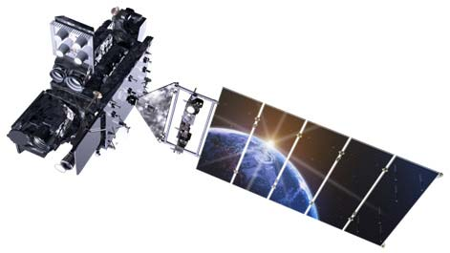

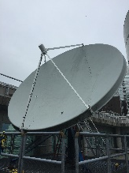
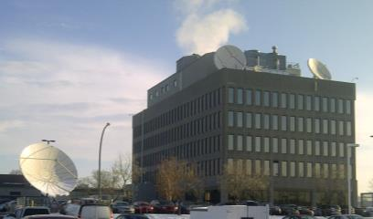
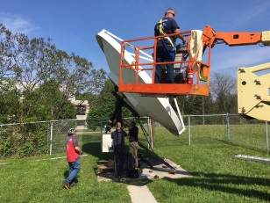


MSC’s GOES Network Transformation
GOES-17
GOES-16
Primary
Data Access
GRB
Vancouver
CMC-Dorval
Downsview
Secondary
Data Access
NOAA Product, Distribution, and Access System (PDA)
Archive
Data Access
Comprehensive Large Array-data Stewardship System (CLASS)
End Users
Ninjo (SPCs)
CCMEP
ADS/DWS
NavCAN
Haiti Wxo
ECCC Wxo

Slide 59
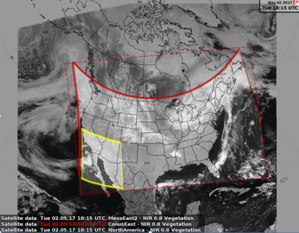
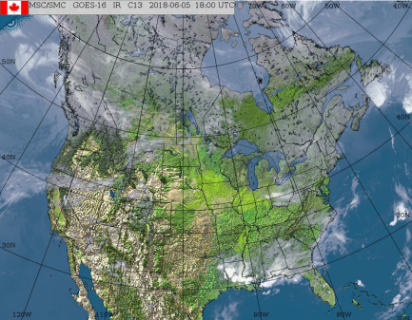
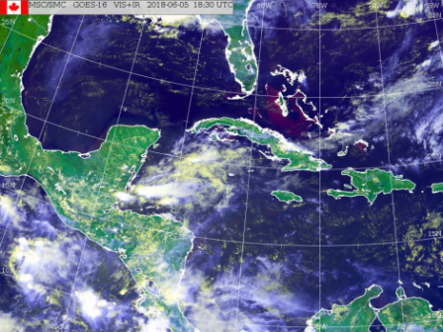
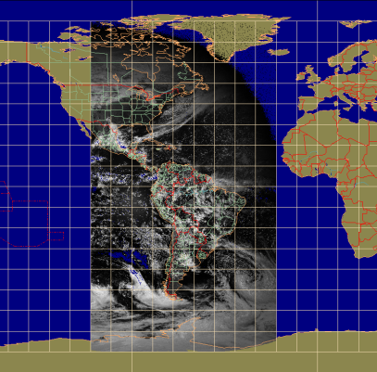
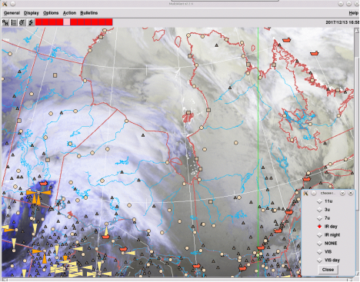
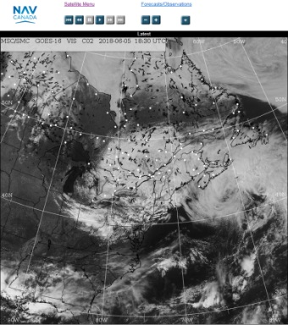

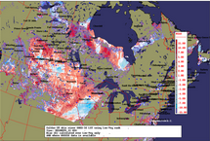
GOES-R – Clients
MSC Forecasting (Ninjo)
ECCC Weatheroffice
Haiti Weatheroffice
Legacy Applications
Aviation & Defence Services
Research & Development
NavCanada
CCMEP
Notes:
Continuity for the existing satellite product clients

Slide 60
Summary
There are a number of alternatives for obtaining GOES-R Series data products:
  GOES Rebroadcast (GRB) is the fastest and most reliable way. It is also the most expensive for the user
  High Rate Information Transmission/ Emergency Managers Weather Information Network (HRIT/EMWIN) provides low-resolution imagery. Cost to user is less than GRB. There is a delay due to processing at ESPC
  GEONETCast Americas (GNC-A) provides a subset of products. Cost to user is less than GRB. There is a delay due to processing at ESPC and distribution to NOAA’s contractor
  Production Distribution and Access (PDA). PDA service is dedicated for authorized near real-time users. New user onboarding is currently suspended while the organization assesses time critical user needs and evaluates available capacity on the system
  Comprehensive Large Array-data Stewardship System (CLASS). Level 1b and Level 2 products available with a delay
  Internet Access

Slide 61
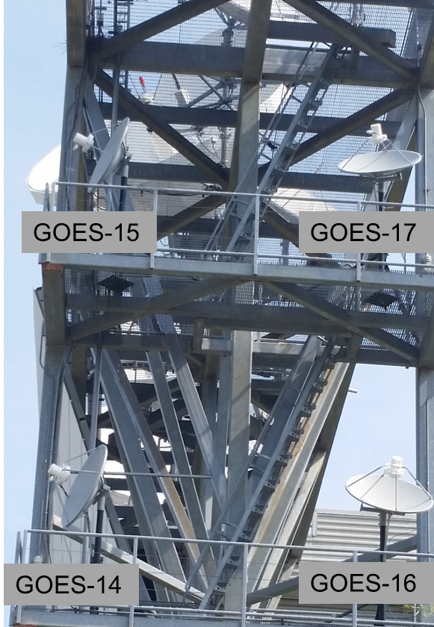
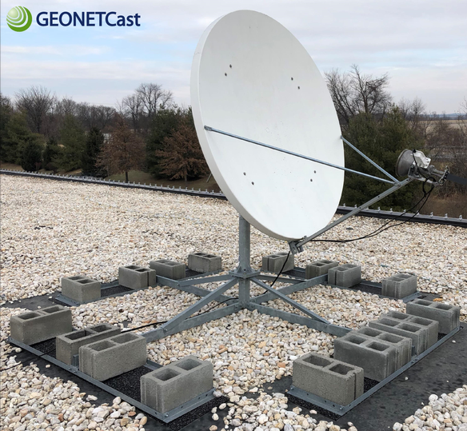
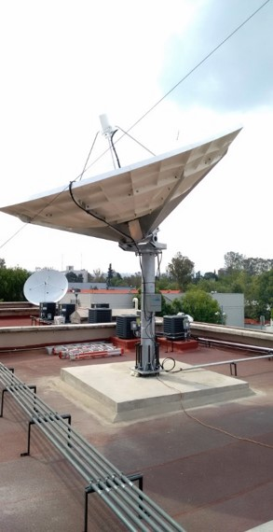
Data Access Options
14 Minutes
12 Minutes
Data Latency
(From L1b generation to receipt by receive station)
10 Minutes
8 Minutes
6 Minutes
GNC-A
4 Minutes
HRIT/
EMWIN
2 Minutes
GRB
5MBps 15 MBps 25 MBps
10 MBps 20 MBps 30 MBps
Bandwidth

Slide 62
Points of Contact
Jim McNitt
Direct Services Branch
Satellite Products and Services Division
Office of Satellite and Product Operations
NOAA NESDIS
Email: james.mcnitt@noaa.gov
Matt Arkett
Earth Observation and Geomatics
Meteorological Service of Canada
Environment and Climate Change Canada
Email: matt.arkett@canada.ca

Slide 63
Acronyms
ABI | Advanced Baseline Imager
AIT | Algorithm Integration Team
AOS | Advanced Orbiting Systems
AWIPS | Advanced Weather Interactive Processing System
BDP | Big Data Project
CBU | Consolidated Backup
CCSDS | Consultative Committee for Space Data Systems
CMI | Cloud Moisture Imagery
CFDP | CCSDS File Delivery Protocol
CICS-NC | NOAA Cooperative Institute for Climate and Satellites – North Carolina
CIMSS | Cooperative Institute for Meteorological Satellite Studies

Slide 64
Acronyms
CIP | Critical Infrastructure Protection
CLASS | Comprehensive Large Array-data Stewardship System
DCP | Data Collection Platform
DCPR | Data Collection Platform Report
DCS | Data Collection System
DoD | Department of Defense
DRGS | Direct Readout Ground Station
DRO | Direct Readout
DVB-S2 | Digital Video Broadcasting
EIRP | Equivalent Isotropically Radiated Power
EOC | Edge of Coverage
ESPC | Environmental Satellite Processing Center
ESPDS | Environmental Satellite Processing and Distribution System

Slide 65
Acronyms
EXIS | Extreme Ultraviolet and X-ray Irradiance Sensors
FEC | Forward Error Correction
FEP | Front End Processor
GLM | Geostationary Lightning Mapper
GNC-A | GEONETCast Americas
GOES | Geostationary Operational Environmental Satellites
GRB | GOES Rebroadcast
GVAR | GOES Variable
G/T | Antenna gain-to-noise-temperature
GTS | Global Telecommunication System (GTS)
HRR | Handover Readiness Review
JPSS | Joint Polar Satellite System
KPP | Key Performance Parameter

Slide 66
Acronyms
HRIT/EMWIN | High Rate Information Transmission/ Emergency Managers Weather Information Network
LNA | Low Noise Amplifier
LZSS | Level Zero Storage System
NESDIS | National Environmental Satellite, Data, and Information Service
NHC | National Hurricane Center
NOAA | National Oceanic and Atmospheric Administration
NSOF | NOAA Satellite Operations Facility
NWS | National weather Service
OSPO | Office of Satellite and Product Operations
PDA | Production Distribution and Access
PLT | Post Launch Test
PUG | Product Definition and Users’ Guide
PS-PVR | Peer Stakeholder – Product Validation. Reviews

Slide 67
Acronyms
NDE | NPP Data Exploitation
PLPT | Post Launch Product Testing
QC | Quality Control
SCMI | Sectorized Cloud and Moisture Imagery
SEISS | Space Environment In-Situ Suite
S-NPP | Suomi National Polar-orbiting Partnership
SSEC | Space Science and Engineering Center
SUVI | Solar Ultraviolet Imager i
WCDAS | Wallops Command and Data Acquisition Station
XPI | Cross-Polarization Interference

