Slide 1
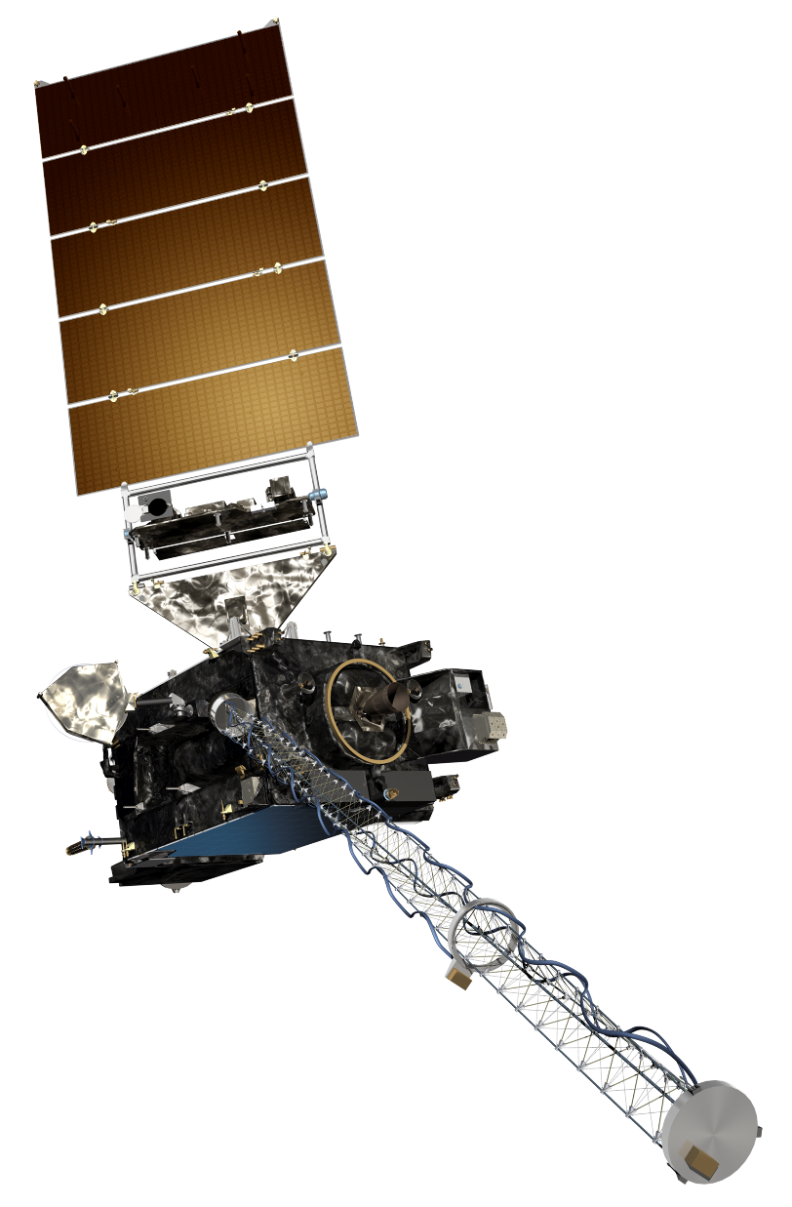
GOES-R Short Course
Convective Weather Lab
Chris Schmidt
Researcher, CIMSS/SSEC/UW-Madison
IUGG 2019
8 July 2019

Slide 2
The Bands of ABI
The ABI band “cheat sheet”, aka primary uses (but not the only uses):
Band # | Central Wavelength, resolution | Nickname | Uses
1 | 0.47 μm, 1 km | Blue Band | Smoke/Aerosol Detection, Visible Imagery
2 | 0.64 μm, 0.5 km | Red Band | Visible Imagery, highest resolution
3 | 0.86 μm, 1 km | Veggie Band | Vegetation health, Land/Water contrast
4 | 1.38 μm, 2 km | Cirrus Band | Cirrus Detection
5 | 1.61 μm, 1 km | Snow/Ice Band | Differentiate between Liquid/Ice clouds; Identify snow on ground; Hottest fire detection
6 | 2.24 μm, 2 km | Cloud Particle Size Band | Hot fire detection
7 | 3.9 μm, 2 km | Shortwave Infrared | Fire and Fog detection
8 | 6.19 μm, 2 km | Upper-level Water Vapor | Upper level flow, Potential Vorticity Analysis, CAT detection
9 | 6.95 μm, 2 km | Mid-level Water Vapor | Upper level flow, Potential Vorticity Analysis, CAT detection
10 | 7.34 μm, 2 km | Low-Level Water Vapor | Upper level flow, Potential Vorticity Analysis, CAT detection, Elevated Mixed Layer detection
11 | 8.44 μm, 2 km | IR Clouds Phase, SO2 | Volcanic Ash detection, Cloud Phase
12 | 9.61 μm, 2 km | Ozone | Air Mass identification
13 | 10.3 μm, 2 km | Clean Window | Fog Detection, Convective Applications
14 | 11.2 μm, 2 km | Longwave Infrared | Fire Detection, Convective Applications
15 | 12.3 μm, 2 km | Dirty Window | Moisture distributions
16 | 13.3 μm, 2 km | CO₂ | Cloud Top Features

Slide 3
Convection in Oklahoma
I know, it isn’t Canada, but it illustrates the concepts discussed with the Ottawa tornadoes example.
It's March 23, 2019, and you have to give a forecast for that afternoon and evening for the Oklahoma City area. The radar is down, the model data is missing, but you do have some short loops ABI data from 18-20:37 UTC that day, CAPE, and an experimental daytime cloud phase distinction RGB (you can find a description of it here: http://rammb.cira.colostate.edu/training/visit/quick_guides/Day_Cloud_Phase_Distinction.pdf).
What is the short term convective weather forecast for Oklahoma City?

Slide 7
Daytime Cloud Phase RGB
Red: Longwave IR (more red = colder)
Green: Band 2 (0.64 μm) (more green = high reflectance)
Blue: Band 5 (1.6 μm) (more blue = high reflectance)
This is useful for monitoring the cumulus cloud field leading up to and including convective initiation. Pure liquid cumulus clouds appear as cyan (high reflectance in the 0.64 μm and 1.6 μm bands, warm in the IR). As convection begins to initiate and ice develops in the cloud top, the blue component decreases as ice does not reflect as well in the 1.6 μm band, but the green component (0.64 μm) stays the same or increases. Red begins to increase as the temperature of the clouds decreases.

Slide 8
What Happened in OKC?

